Slide 1
FEA Summary Report_1
For APA Shipping Frame
Ang Lee
July 28, 2020

Slide 2
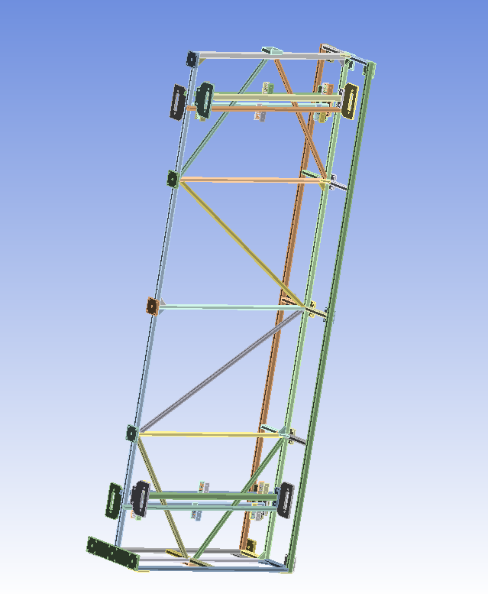
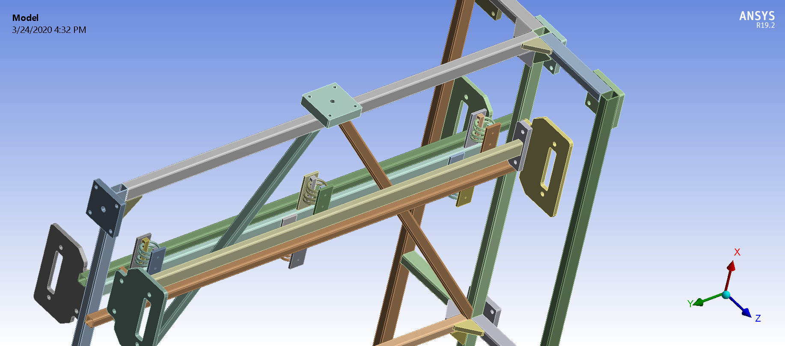
Summary of FEA Analysis for APA Shipping Frame
APA Shipping Frame mainly Consists of :
- S355 steel Tubing with S (yield)=355 MPa ; Su=470 MPa.
- Carbon steel plate.
- Shock Absorber _Wire Rope Isolator (WRI)

Slide 3
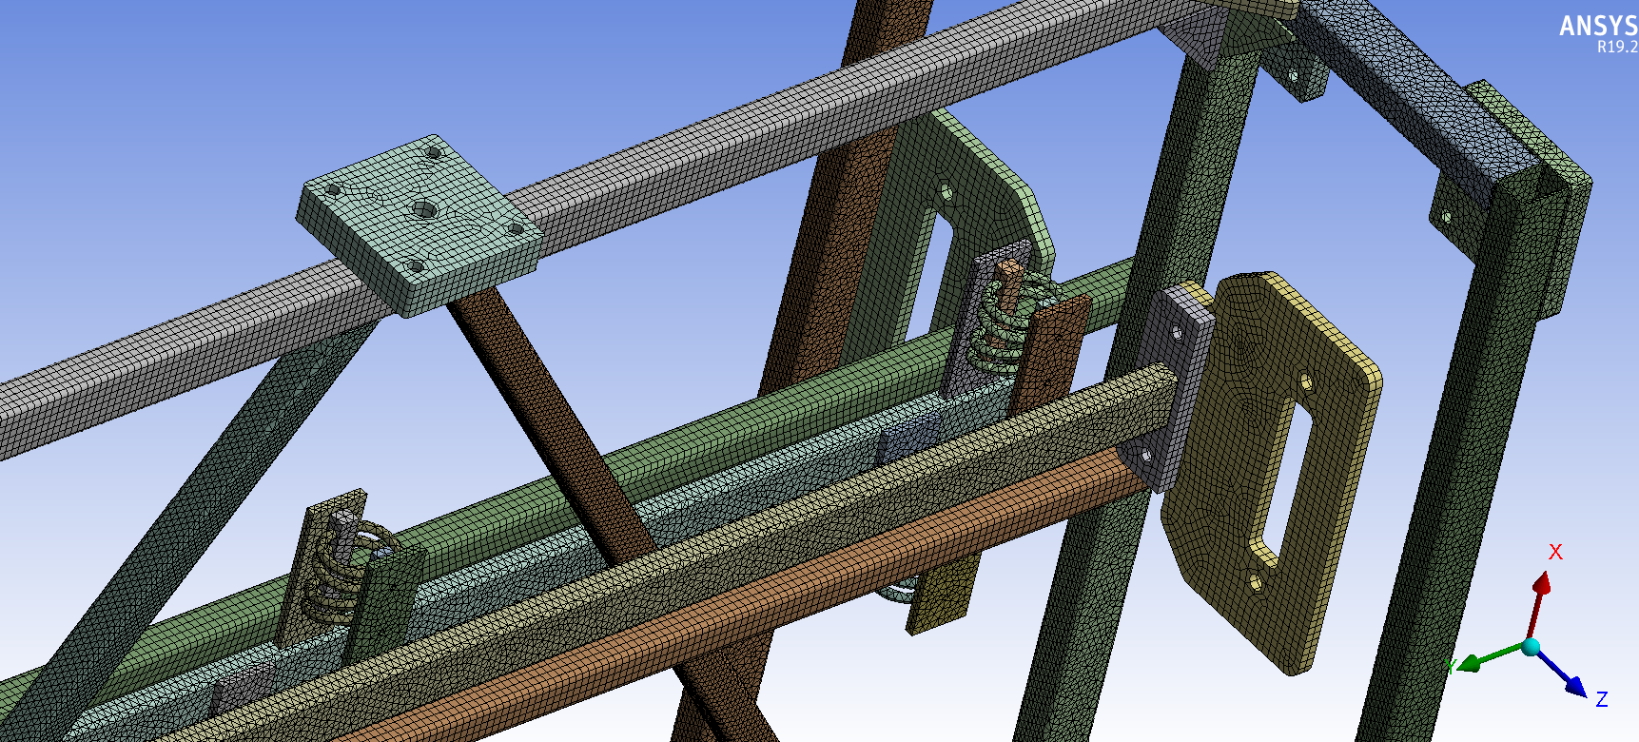
Summery of FEA Analysis for APA Shipping Frame
Steel Plate
Steel Tubing
3”x2”x1/8”
2”x2”x1/8”
AVM Wire Shock Absorber
The solid Model is provided by George Stavrakis in STEP file format.
It is base on Version 1 of the drawing package https://edms.cern.ch/document/2368942/1
The ANSYS WB 19.2 is used for FEA analysis as shown above.
.

Slide 4
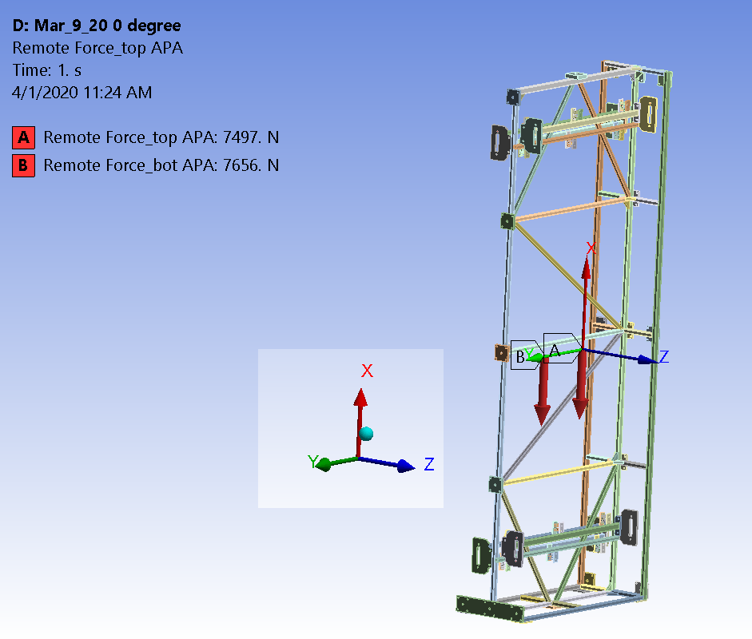
FEA Model: Loading and boundary condition
STP file was imported into ANSYS WB 19.2. It is based on Version 1 of the drawing package https://edms.cern.ch/document/2368942/1. This EDMS folder includes the model, the technical drawings, and the center of mass calculations.
The model is meshed with the solid element containing the middle node. The mesh size is ~10 mm which results a model of ~3.26 million nodes or ~10 million degree of freedom.
The connection is treated as “bonded” with an exception of the “pin” connection area which is modeled as “slip joint”. The gigantic model requires some iterations to solve.
The integrated APA mass is 562 kg (5.5 KN) for the upper one and 516 kg (5.1 KN) for the lower one respectively (EDMS #2281422). The FEA model uses 7497 (N) for the upper one and 7656 (N) for the lower one, as shown at right. It is modeled as the remote force scoped to the attachment plate where the APA is attached. It is a very conservative approach as it is analyzed without considering the stiffness of APA detector frame itself.
The density of the steel frame has been modified to include the weight of frame itself and other components ( for example, the protection panel and etc). The total weight of the structure is 31,840 (N), 3249 kg including both APAs and the shipping frame. This number has a ~25% or more contingency for further design iterations. It is an upper limit for the load.

Slide 5
Applicable Code used for FEA Analysis
ASME BTH-1 Codes is used for the lifting device. It agrees with the Compliance Office preliminary requirements_ Memorandum dated 2/11/2020 EDMS No.:2093094 for service class A.

Slide 6
Required (Safety factor) SF
  ASME BTH-1 required
  SF ≥ 2 for the structure member.
  SF≥ 2.4 for the connections.
  Above SF is respected to the yield stress of the material in use.
  The shipping frame is made of S355 carbon steel, which has a yield stress of 355 MPa (~51.5 Ksi) and 470 MPa for its ultimate stress.
  7 (or more) possible configurations have been analysed.

Slide 7
Load case study
Transport frame Load Case | FEA Configuration | Status
1 _ Sitting on the factory floor | See case 3 | Done
2 _ Lifting at the factory | See case 3 | Done
3 _ Lifting in front of the Ross Shaft | Case 3a ,3b and 3c | Done
4 _ Lifting down the Ross Shaft | Case 4 (1 G and 2 G) | Done
5 _Lifting at the bottom of Ross shaft | Case 5a,5b,and 5c | Done
6_ On the underground trolley | The floor requirement from CF shows very smooth. | Done
7_ Lifting the frame vertical on a trolley | Similar to case 4 ( Trolley weight is ~750 kg, it is still within 25% contingency). | Done
8_ Transport frame sitting in the vertical position | No worse than case 4 | Done
9_ Additional case study for the attachment plate | Done | Done
10_ Additional case study for the attachment plate | Done | Done
The load case 3,4 and 5 (total 7 configurations ) are considered as the critical case to drive the design.
We will go case by case in following pages

Slide 8
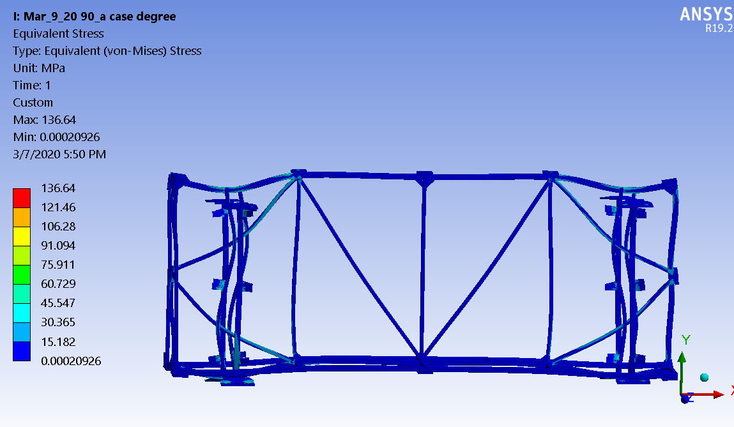
FEA RESULT (Case 3a and case 2)
Case 3a (covers case 2)
Above illustration is from Justin Freitag, January 24, 2020 report
Case 3a_ Stress (MPa)
SF=355/136.6=2.59>2

Slide 9
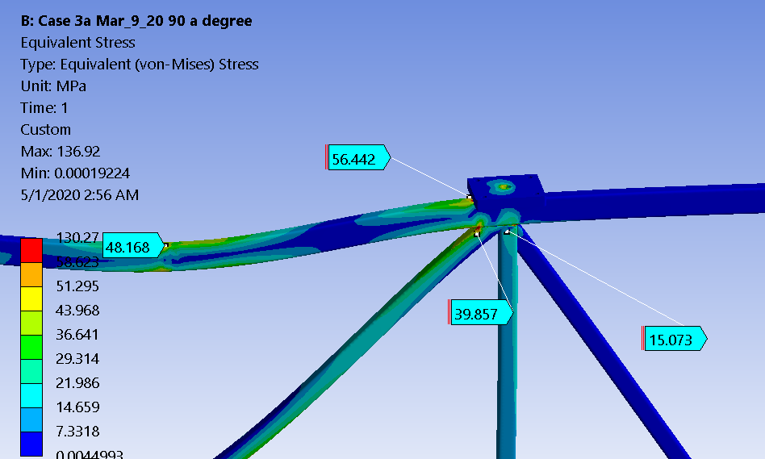
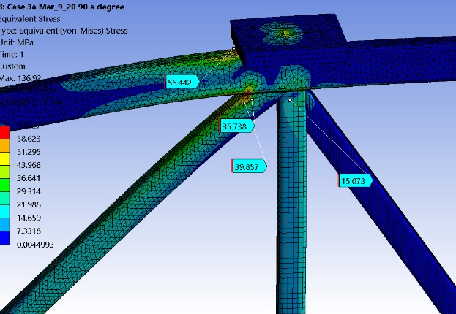
FEA RESULT (Case 3a and case 2)
The stress around the lifting point is around 70 MPa
without considering stress concentration.

Slide 10
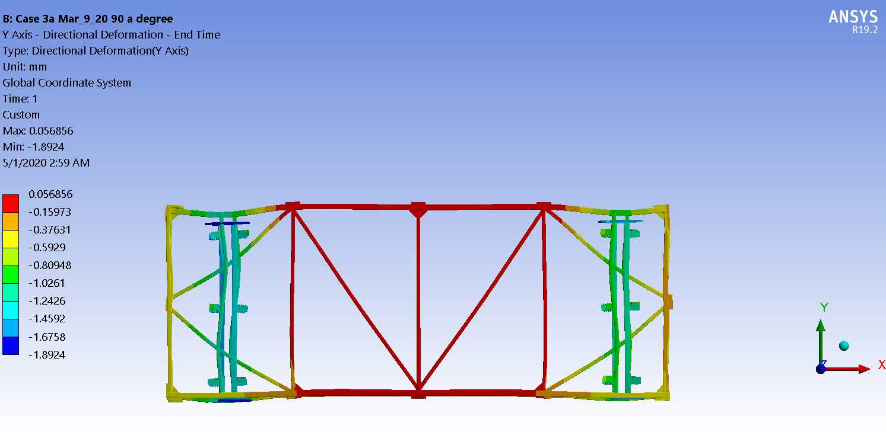
FEA RESULT (Case 3a and case 2)

Slide 11
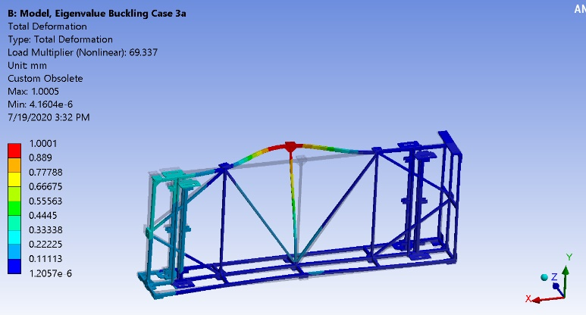
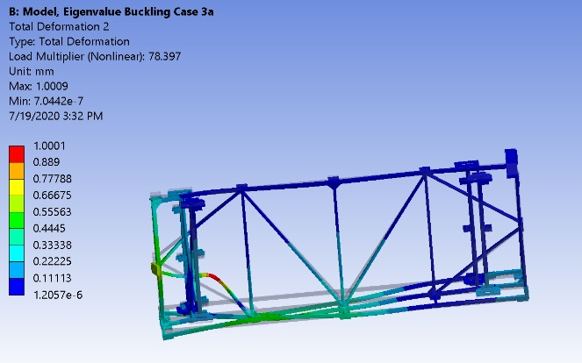
FEA RESULT (Case 3a )_ Buckling result SF min=69.
It is done without considering the stiffness contribution from the APA tubing
SF=69.3 (first buckling mode)
SF=78.4 (2nd buckling mode)

Slide 12
From Case 3a to Case 3b (just before the rotation start)
Case 3b
Case 3b

Slide 13
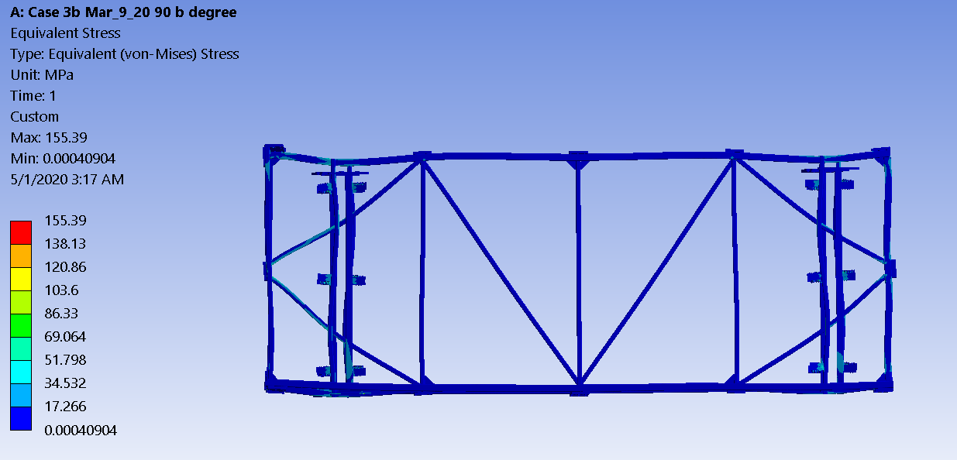
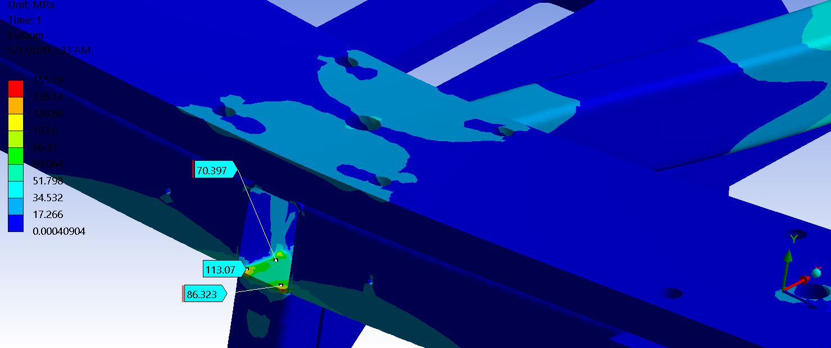
Case 3b
Just before to rotate
The stress (MPa) for case 3b.
Case 3b Stress MPa
SF=355/155.39=2.29

Slide 14
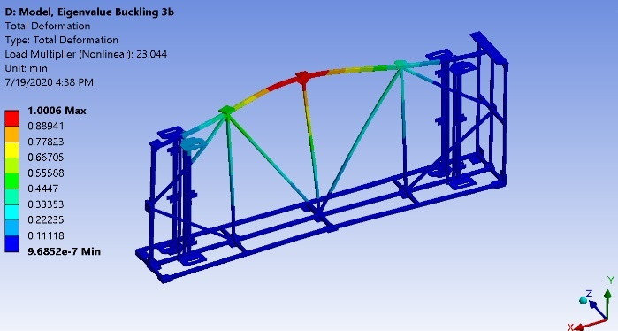
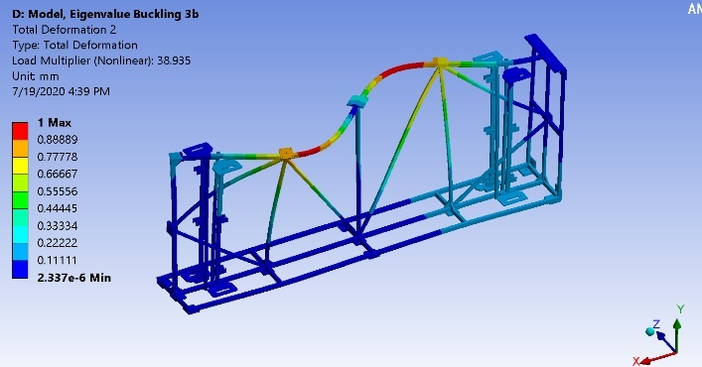
The buckling SF (min)=23 for case 3b
SF=23 (first buckling mode)
SF=38.9 ( 2nd buckling mode)

Slide 15
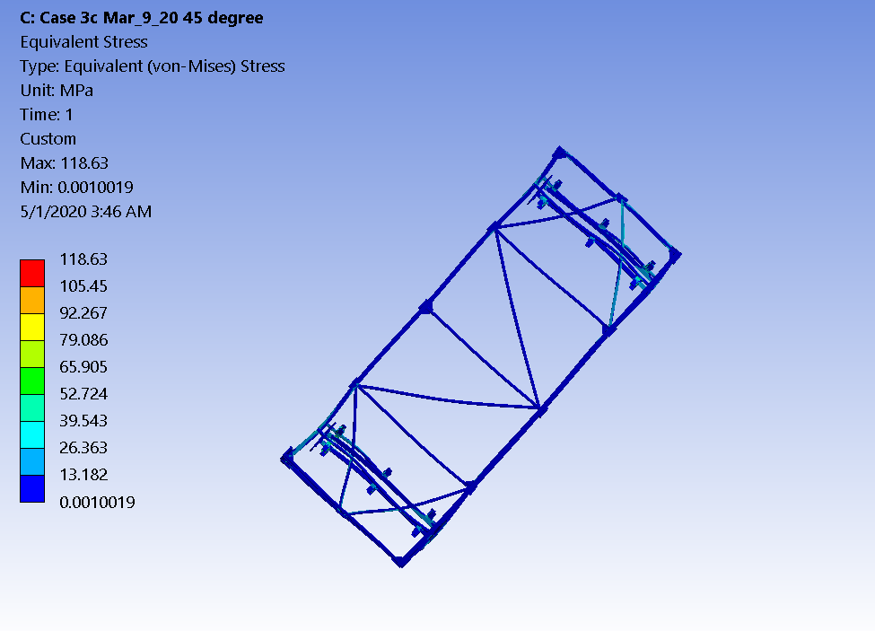
Case 3c Stress (MPa)
SF=355/118.63=2.99
One point
Two corner points
Case 3c

Slide 16
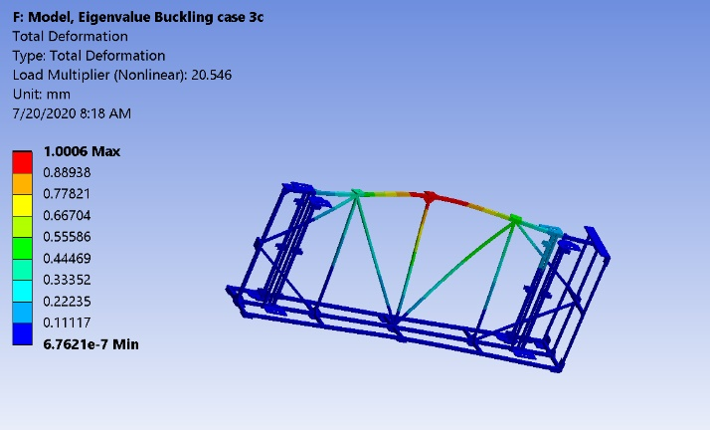
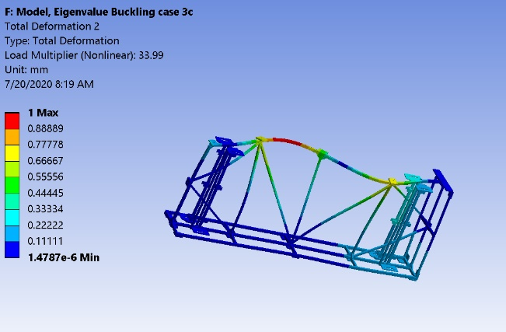
The buckling SF (min)=20.5 for case 3c
SF=20.5 (first buckling mode)
SF=33.99 ( 2nd buckling mode)

Slide 17
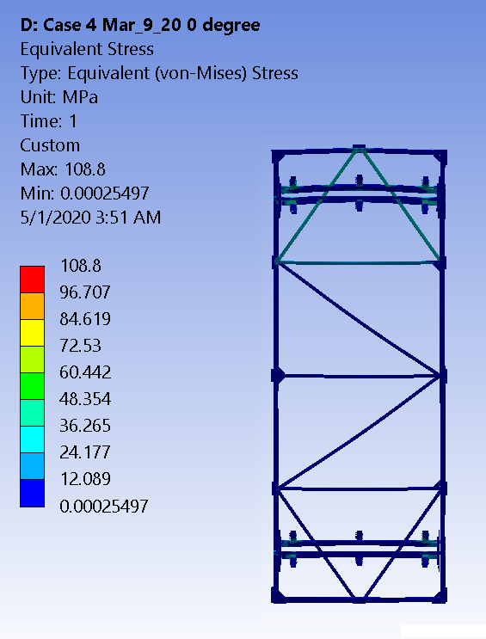
Case 4 Vertical position
F=31840 N=3249 Kg
Case 4 Vertical stress (MPa); SF=355/108.90=3.26
Finished 1st rotation (from Horizontal to Vertical)

Slide 18
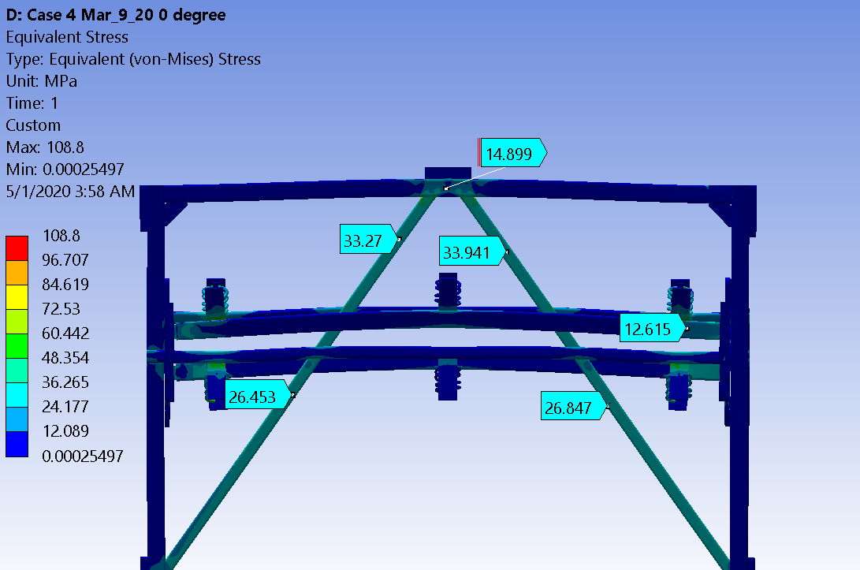
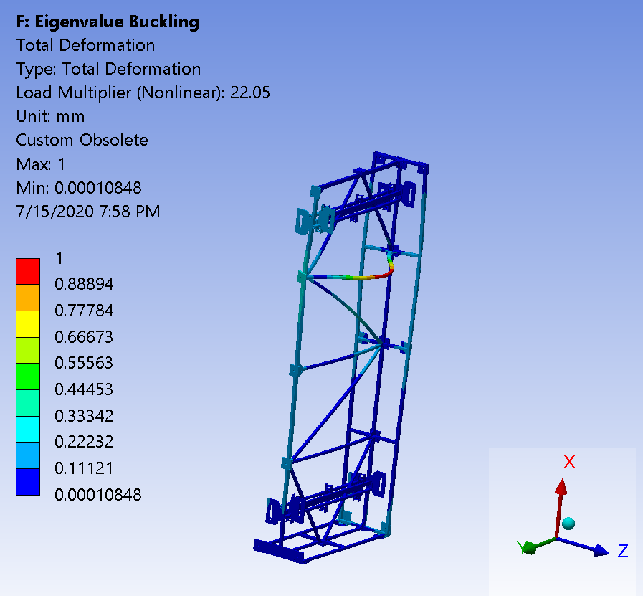
Buckling SF for Case 4
F=31840 N=3249 Kg
Stress (MPa) at the top section
The buckling SF (min)=22 for case 4

Slide 19
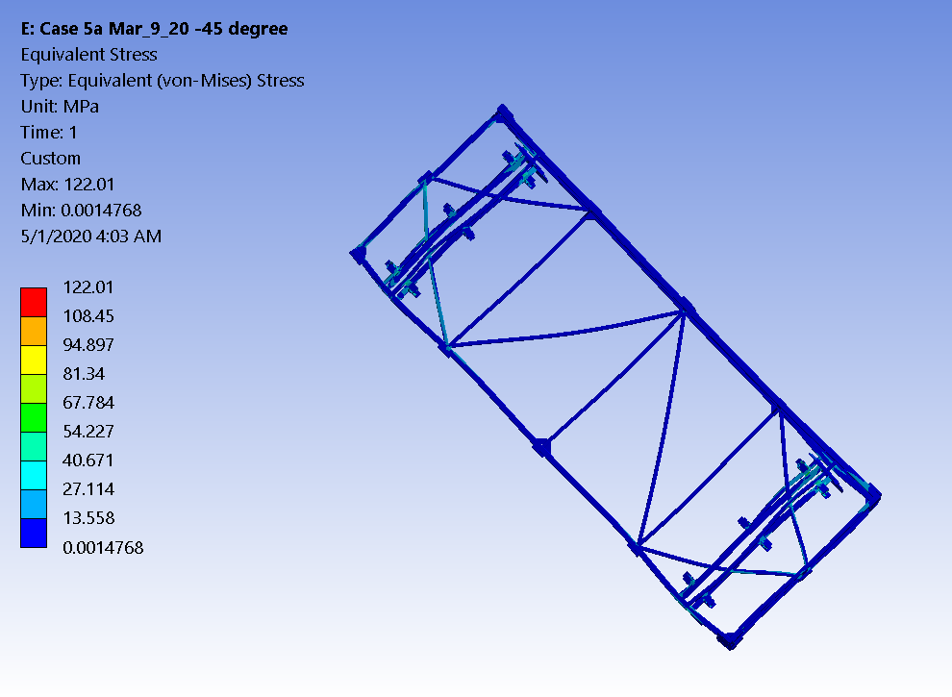
Case 5a _ Second rotation
Case 5a The Second rotation (45 degree) Stress MPa; SF=355/122.01=2.91 (Second rotation)

Slide 20
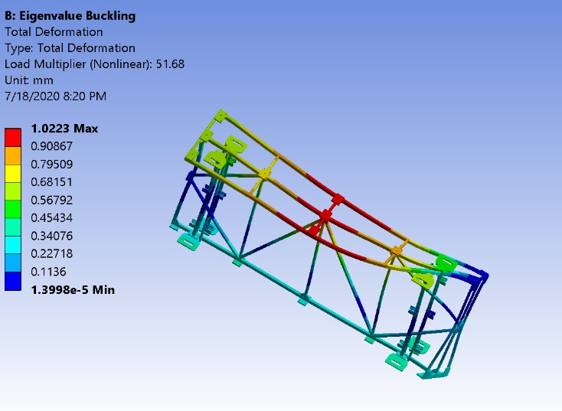
The buckling SF (min)=51.68 for case 5a

Slide 21
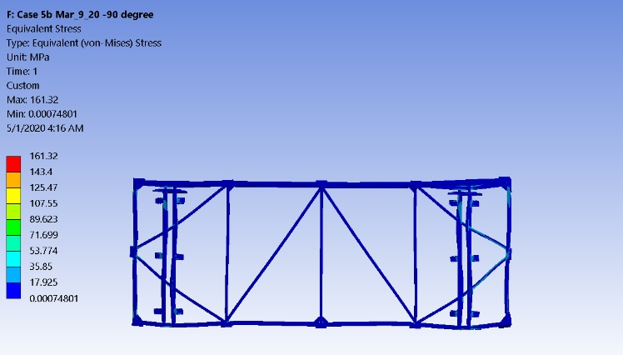
Case 5b Stress (MPa); SF (min) = 355/161.32 = 2.20.
(Just before the yellow sling to picked up the frame )
Case 5b

Slide 22
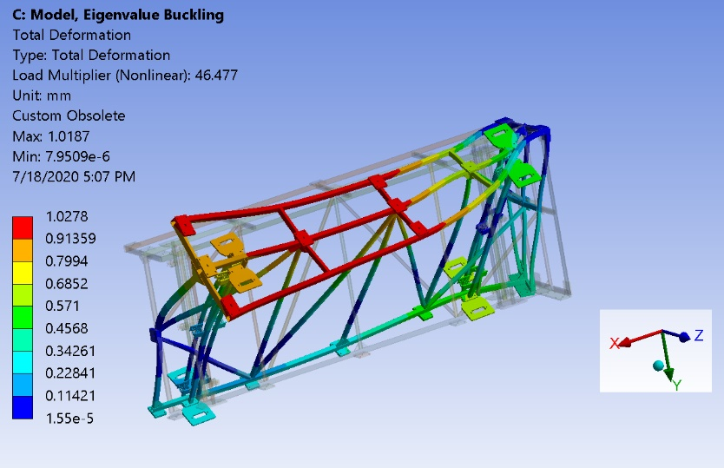
The buckling SF (min)=46.7 for case 5b

Slide 23
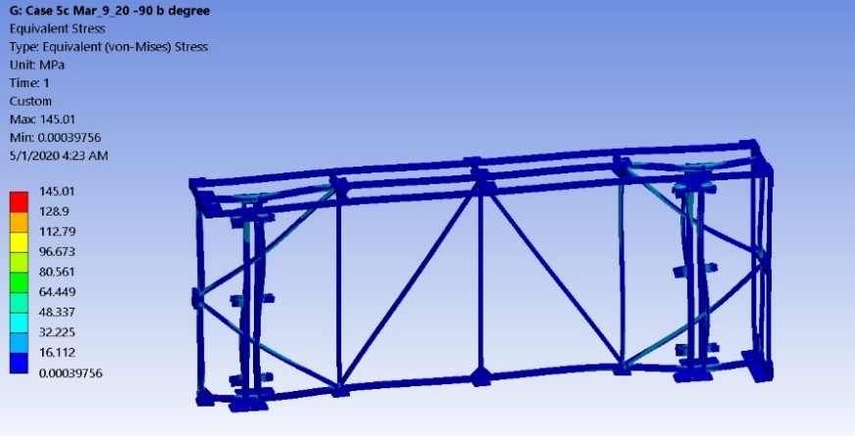
Case 5c Stress (MPa); SF=355/145.01=2.45
case 5c

Slide 24
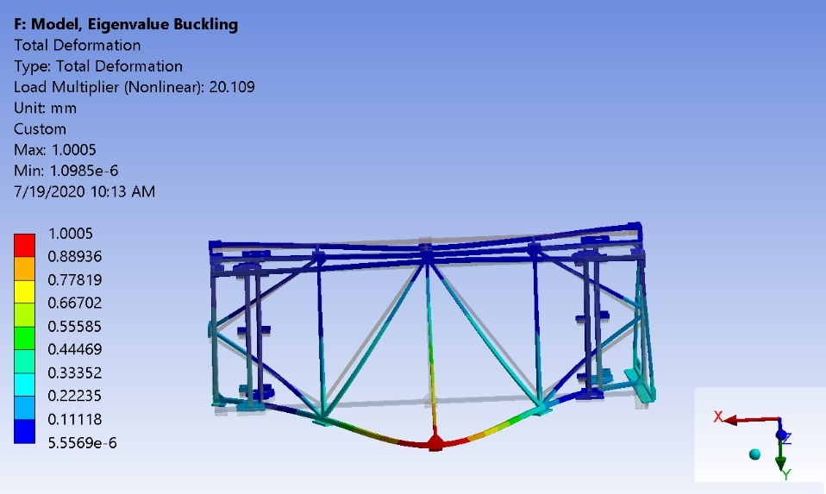
The buckling SF (min)=20.1 for case 5c

Slide 25
Table 2 - Summary of the results of the lift case analysis
Case | 7 Configurations (Critical conditions) | Pick up points | Peak Stress (MPa) | SF (min) For the frame | BTH-1 req satisfaction | SF Buckling
3a = 2 | Landscape Mode | 2 | 136.92 | 2.59 | Y | 69.3
3b | Landscape Mode | 3 | 155.39 | 2.28 | Y | 23
3c | 45 degree _1st rotation | 3 | 118.63 | 2.99 | Y | 20.5
4 | Vertical position | 3 | 108.80 | 3.26 | Y | 22.05
5a | 45 degree _2nd rotation | 3 | 122.01 | 2.90 | Y | 51.6
5b | Landscape Mode upside down | 3 | 161.32 | 2.20 | Y | 46.5
5c | Landscape Mode upside down | 2 | 145.01 | 2.45 | Y | 20.1

Slide 26
Case study conclusions
Analysis of all 7 lifting configurations at SURF is summarized in Table 2.
The shipping frame structure is more than adequate to satisfy the ASME BTH-1 requirement of SF (min) ≥ 2 based on the yield strength.
For the case of the accident (2G load), the stress of the frame structure will remain below the yield stress of 355 MPa by (resultant stress x 2 < 355 MPa).
SF of the buckling is more than adequate to resist the frame instability.
The analysis is done without considering the stiffness of the APA frame (stainless steel tubing 4”x4”x1/8”). The actual stress will be lower than analyzed. The buckling SF will be much higher than calculated above as well.
Weld stress needs to be checked. It is difficult task. So many welds and so many cases. The connection force and moment are extracted from FEA model. The weld stress is calculated according BTH code requirement for Nd=2.4 minimum.

Slide 27
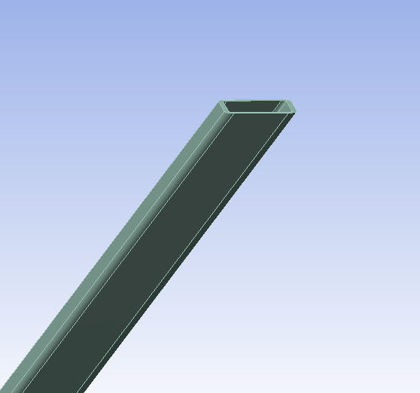
Weld Stress Study
Weld stress needs to be checked. It is a difficult task. So many welds and so many cases. The connection force and moment are extracted from FEA model. The weld stress is calculated according BTH code requirement for Nd=2.4 minimum.
Connection area
Fx, Fy, Fz
Mx, My, Mz
The resultant force is extracted at the connection,
where Fy=355 MPa (parent material yield strength) and Nd=2.4 in above equation 3-37

Slide 28
Weld stress study
Connection area
Extracting the force (Fx, Fy and Fz) and moment (Mx, My and Mz) at each connection as illustrated. Both normal and shear stress are calculated based on the given weld size (3.2 mm).
The combined stress is obtained based on BTH-1 code Eq (3-37). A complete detailed list for all 7 load cases is included in Appendix. All weld connections exceed the code requirement of SF(Nd)>2.4.
It is noteworthy to mention that the connection between the 30 mm/50 mm plates and 3.2 mm wall thickness tubing requires a transition weld to satisfy BTH-1 section of 3-3.4.3 and table 3-3.4.3-1 requirement. A cheek plate design has been proposed. This solution is being validated by a BTH-qualified vender. However, the current analysis uses a minimum weld thickness of 3.2 mm. There is no further calculation is needed at this moment.
Fx, Fy, Fz
Mx. My, Mz

Slide 29
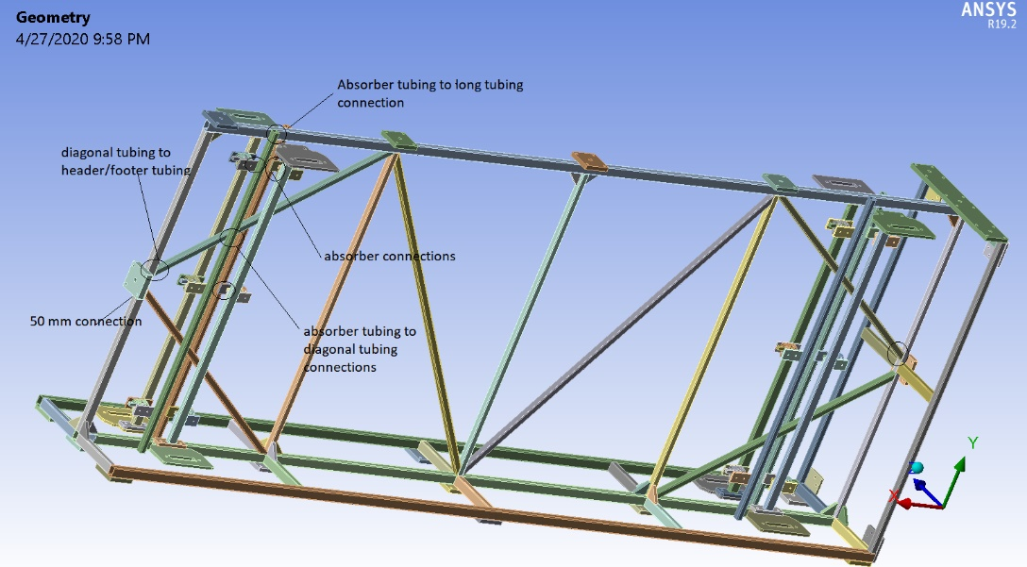
Examples of some critical weld along the load path

Slide 30
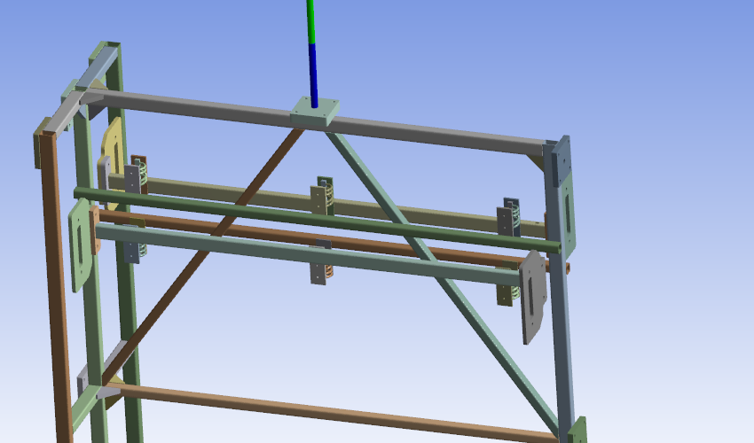
BTH equation (3-37)
Absorber has 12 weld connections
> 2.4 (per ASME BTH -1 requirement)
Weld stress at the vertical position

Slide 31
Diagnal beam connection
> 2.4 (per ASME BTH -1 requirement)
Weld stress at the vertical position

Slide 32
Connection at the top
SF>>2.4 required by ASME BTH-1
top section _diagnal beam
Weld SIZE |  | width |  | effective width | DY1 | DZ1 | DY2 | DZ2 | AREA | IZZ | IYY | IXX | Rmax
diagnal tubing |  | 3.2 |  | 2.2624 | 62.285 | 50.8 | 66.8098 | 55.3248 | 532.1608 | 351962.7618 | 262352.1121 | 614314.8739 | 43.3716
 | Fx | Fy | Fz | Mx | My | Mz | (MPa) | Sx_n | Sy+Sz_s | Smz_n | Smy_n | Smx_s | Sn_sub | S_shear | Scombined | SF
1 | -15153.3 | 10912.82 | 25.82 | -1701.53 | 7836.49 | 2968.18 |  | 28.48 | 20.51 | 0.28 | 0.83 | 0.12 | 29.58 | 20.63 | 46.38 | 7.65
2 | -15613.7 | -11258.2 | 27.94 | -4008.88 | 10840.6 | -105.62 |  | 29.34 | 21.16 | 0.01 | 1.14 | 0.28 | 30.49 | 21.44 | 48.05 | 7.39
3 | 491.17 | 369.36 | 32.75 | 1676.09 | -2153.1 | 6663.57 |  | 0.92 | 0.70 | 0.63 | 0.23 | 0.12 | 1.78 | 0.82 | 2.27 | 156.12
4 | -18.82 | 31.96 | 23.11 | -3299.53 | -1140.07 | 10112.17 |  | 0.04 | 0.07 | 0.96 | 0.12 | 0.23 | 1.12 | 0.31 | 1.24 | 287.30
 |  |  |  |  |  |  |  |  |  |  |  |  |  |  | SF (min) | 7.39
50 mm plate
Weld SIZE |  | width |  | effective width | DZ1 | DY1 | DZ2 | DY2 | AREA | IYY | IZZ | IXX | Rmax
 |  | 3.20 |  | 2.26 | 38.10 | 190.00 | 42.62 | 194.52 | 1052.58 | 379712.42 | 4368722.19 | 4748434.61 | 99.57
 | Fx | Fy | Fz | Mx | My | Mz | (MPa) | Sx_n | Sz+Sy_s | Smy_n | Smz_n | Smx_s | Sn_sub | S_shear | Scombined | SF
1 | 30525.26 | 377.41 | 1.78 | -532.44 | 42921.23 | 30335.6 |  | 29.00 | 0.36 | 2.41 | 0.68 | 0.01 | 32.08 | 0.37 | 32.09 | 11.06
Weld stress at the vertical position

Slide 33
Sample of Weld stress at the vertical position
The full list is attached in Appendix B

Slide 34
Table 3 - Summary of SF for some of the critical connection
Case | Lifting configuration | Absorber plate connection (SF) | Diagonal tubing and absorber tubing connection (SF) | Diagonal tubing and header/footer tubing connection (SF) | Long tubing and absorber tubing connection (SF) | 50 mm plate | Tubing connected to attachment
3a=2 | 1_landscape mode | 13.42 | 10.71 | 14.89 | 9.42 | N/A | 9.97
3b | 2_ landscape mode | 13.62 | 5.43 | 7.68 | 6.77 | 11.84 | 9.25
3c | 3_ 45 degree | 18.25 | 5.99 | 8.34 | 7.28 | 10.44 | 4.45
4 | 4_ Vertical | 19.44 | 7.12 | 7.39 | 12.03 | 11.06 | 5.12
5a | 5_ 45 degree | 15.17 | 5.86 | 8.83 | 6.56 | 10.88 | 5.12
5b | 6_ landscape mode | 13.45 | 5.28 | 7.02 | 7.95 | 11.78 | 9.04
5c | 7_ landscape mode | 13.10 | 11.50 | 15.16 | 9.62 | N/A | 7.76
where Fy=355 MPa ( the yield strength of the parent material) and Nd=2.4 in equation 3-37
All the SF>>2.4 BTH-1 requirement

Slide 35
Additional case study
Case 9 and 10

Slide 36
Attachment Plate and Connection Study (case 9 & case 10)
In the previous case study, the APA detector weight was treated as force remotely applied to the attachment plate from its gravity center. it is a conservative approach without considering the stiffness of APA frame.
However, it does not address how the actual APA detector is connected to the transport frame in great detail, which requires a separate FEA model.
The APA frame is connected to shipping frame using 8 stainless steel M16 to M20 adaptors attached to a steel plate. During the installation, the APA detectors will be loaded into the shipping frame from the top.
Total weight of the APA will be sitting on the lower attachment plate. Instead of 8 stainless steel adaptors, only 4 of them will participate in the load bearing, as it is considered as the worst case. To understand the resulting stress, a separate FEA model is created as case 9/10.

Slide 37
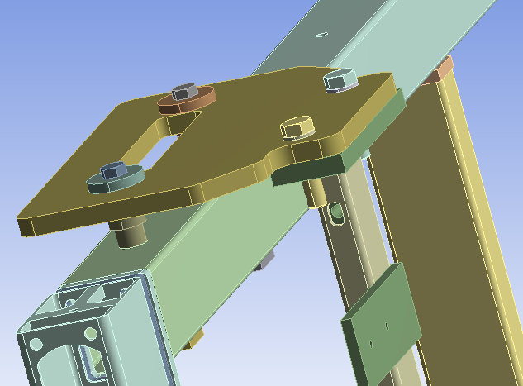
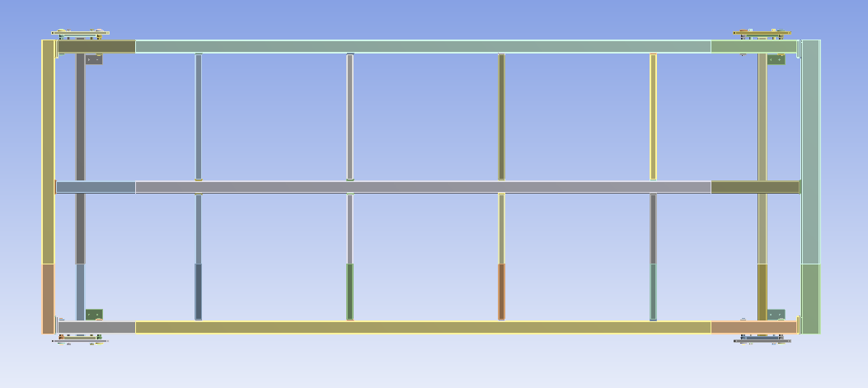
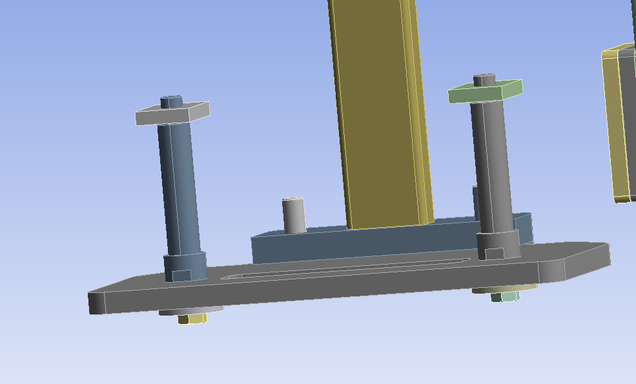
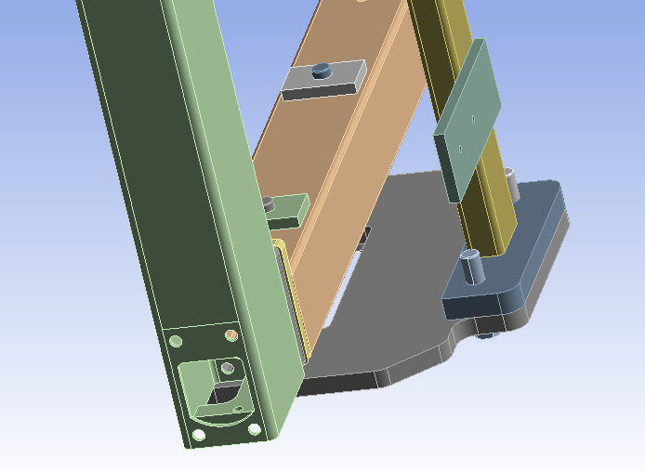
Top bracket is a “SLIP JOINT_SLIDING
1 G load =7659 N
79.6x50.8x12.7 mm SS 304 plate welded to APA tubing
GRAVITY LOAD IS HOLD BY THESE TWO PLATE_ LOWER SECTION
6 absorber plates:
Each of them is connected by THREEE springs with Kx, Ky and Kz , provided by Jake and Dan (PSL). THANK YOU!
The spring stiffness is as follows:
X = 726 kN/m
Y = 726 kN/m
Z = 2.742 MN/m
M16 bolt SS 304
M16 to M20 adaptor SS 304

Slide 38
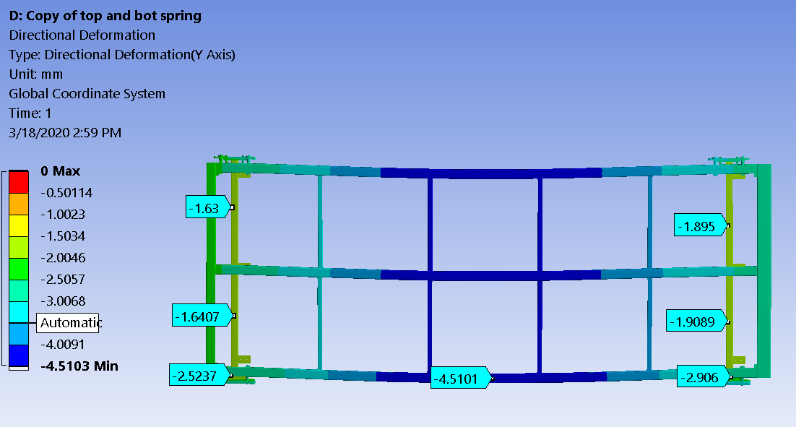
The deflection of APA frame is about 4.5-2.5=~2 mm
The vertical tubing has moved downward 1.66~1.9 mm (more like translation due to the spring attachment).
It is consistent with X=7659 N/(726e3*6)=~1.75 mm (Good agreement !)

Slide 39
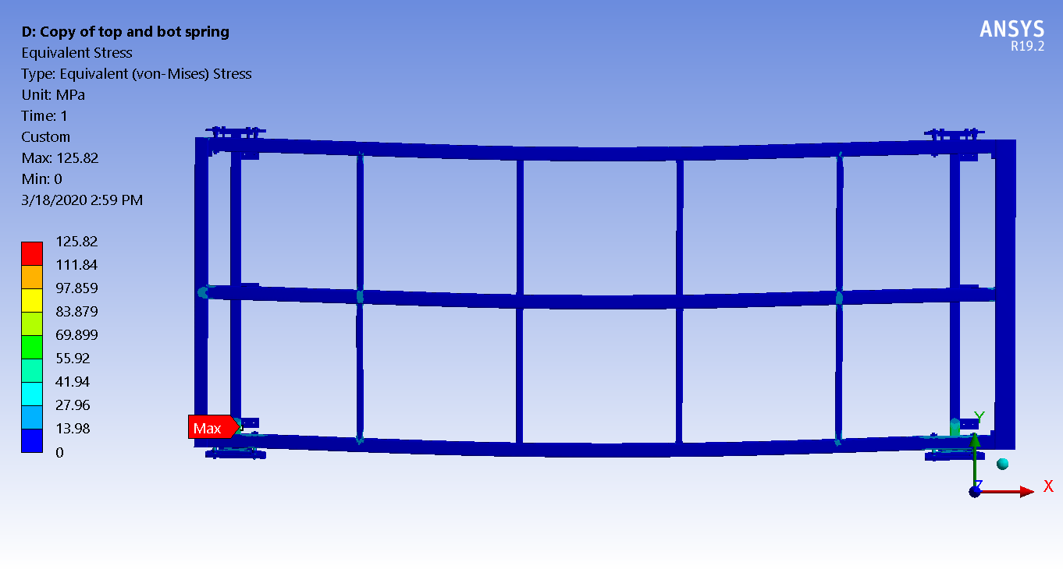
The FEA model indicates the stress is below ~125 Mpa << 355 MPa; SF=355/125=2.84

Slide 40
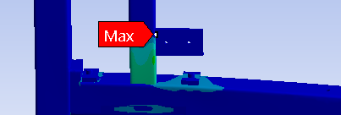
Weld stress check
Weld SIZE |  | width |  | effective width | DX1 | DZ1 | DX2 | DZ2 | AREA | IZZ | IXX | IYY | Rmax
 |  | 3.20 |  | 2.26 | 62.29 | 38.10 | 66.81 | 42.62 | 474.70 | 292083.22 | 144104.52 | 436187.74 | 39.62
 | Fx | Fy | Fz | Mx | My | Mz | (MPa) | SY_n | Sx+Sz_s | Smz_n | Smy_S | Smx_N | Sn_sub | S_shear | Scombined | SF
1.00 | -2.53 | -4130.60 | -77.65 | 532030.00 | -1347.90 | 53473.00 |  | 8.70 | 0.16 | 6.12 | 0.12 | 78.68 | 93.50 | 0.29 | 93.50 | 3.80
2.00 | -10.71 | -3554.30 | -68.19 | 468380.00 | 6140.90 | -99012.00 |  | 7.49 | 0.15 | 11.32 | 0.56 | 69.27 | 88.08 | 0.70 | 88.09 | 4.03
Check the weld stress

Slide 41
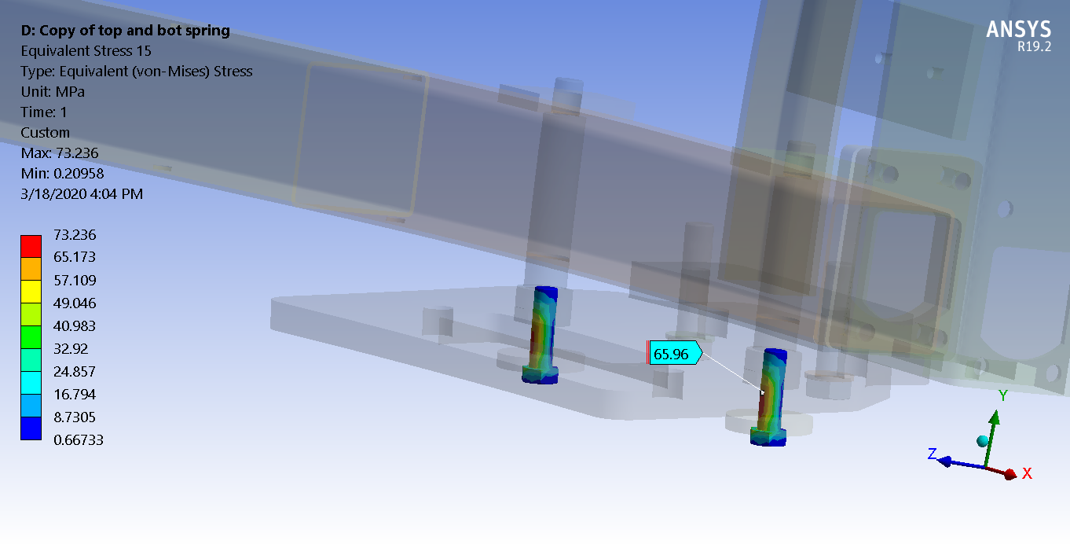
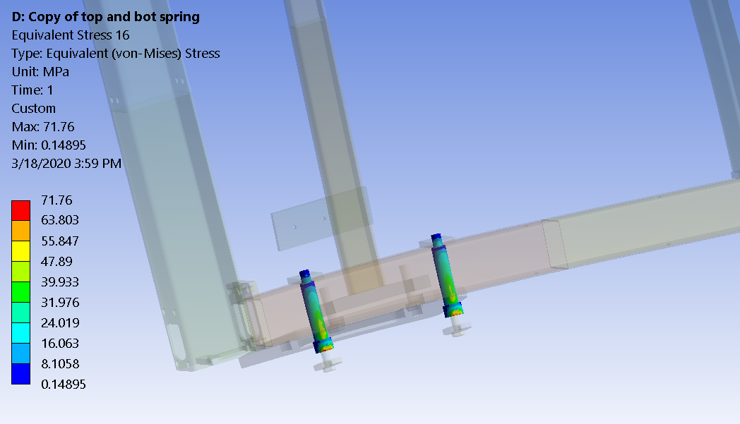
SS 304
Syield=205 MPa min
Su=515 MPa min
SS 304Adaptor (MPa) SF=205/72=2.85
M16X2 SS bolt (grade 304); SF=205/73=2.82

Slide 42
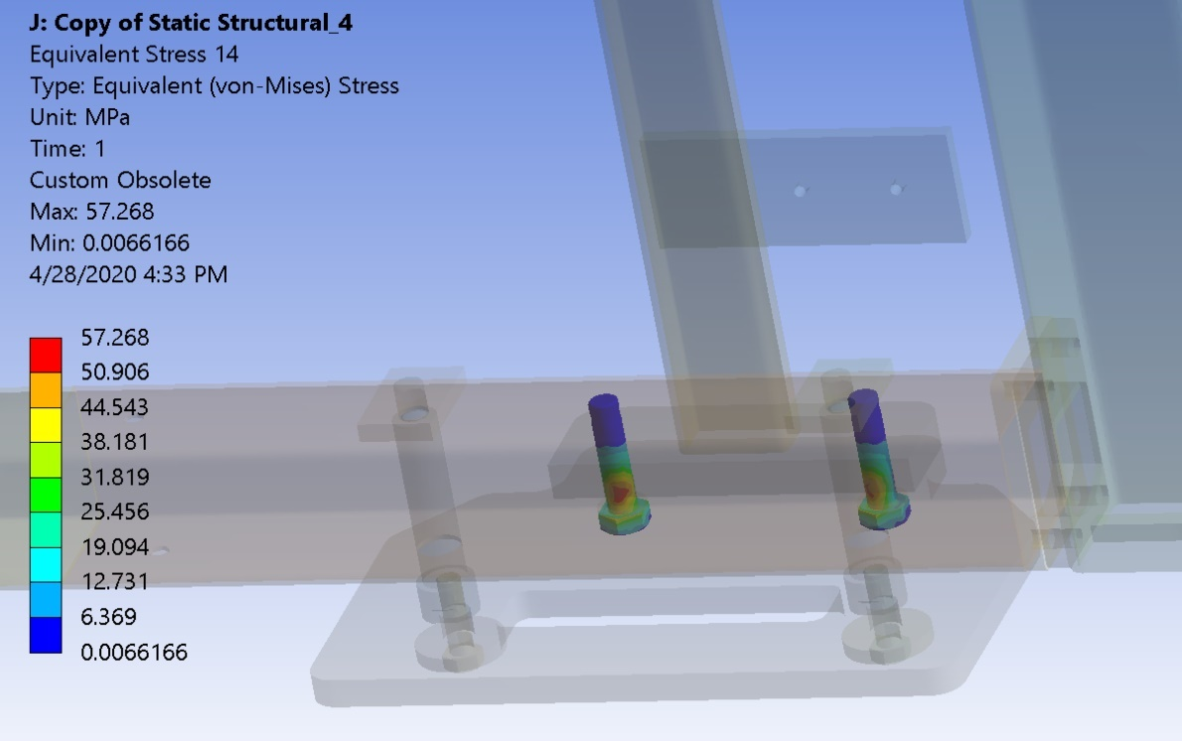
M20 steel bolt –stress (MPa)
M20 steel bolt is class 8.8
With minimum yield of 660 MPa and 830 MPa ultimate strength.
SF=660/57.268=11.5
This bolt connection has been changed to the bolt/nut (instead of tap hole)

Slide 43
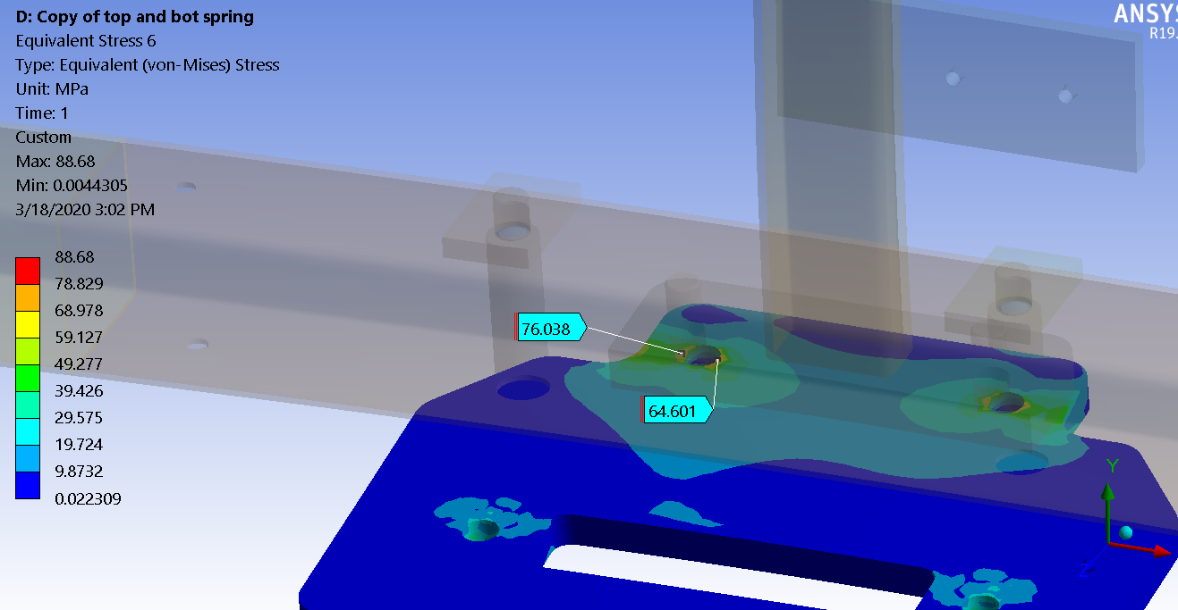
S355 carbon steel
Syield=355 MPa min
Attachment plate S355; SF=355/88.68=4

Slide 44
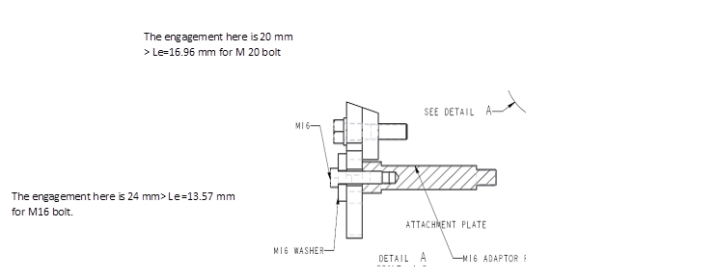

Thread Engagement Check
 | D | p | Ds | At | Dp | Le min (mm) | L (design) (mm)
M16X2 | 16.00 | 2.00 | 14.12 | 156.67 | 14.70 | 13.57 | 24.00
M20X2.5 | 20.00 | 2.50 | 17.65 | 244.79 | 18.38 | 16.96 | 20.00

Slide 45
Summary of the attachment plate analysis (Case 9)
 | Stress (MPa) | SF | Meet BTH-1 requirement?
Steel plate | 87.2 | 355/87.2 = 4.1 | Y
M20 Steel bolt (class 8.8) | 57.3 | 660/57.3 = 11.5 | Y
M16-M20 SS 304 adapter | 76 | 205/76 = 2.7 | Y
M16 SS 304 bolt | 78 | 205/78 = 2.6 | Y
Weld | 92.41 | 355/92.41 = 3.84 | Y
The result shows that the attachment plate assembly satisfies ASME BTH-1 SF (min) ≥ 2.4 for the connections and SF (min) ≥ 2 for the rest of the structure.
This case 10 should be applicable to case 9 since which is just a flip of the gravity vector. The case 10 is the worst case which places the M20 bolt in the tension. The other rotation positions will be analyzed for completeness in the future (we do not anticipate any problems since the other side of the joints will start to pick up the load when it is rotated from the landscape to the vertical position).

Slide 46
Conclusions
Based on the preliminary static structural analysis result, the current design of the shipping frame is adequate to satisfy the requirements of ASME BTH-1 2017.
The dynamic analysis will be continued to understand the dynamic response during the shipping environment with a proper shock absorber. We will present the result tomorrow.
As the design progressed, the FEA analysis will be updated accordingly.
Lastly, in a design improvement the two APAs within the shipping frame will be translated by 15 mm along their long direction to improve clearances (on the bottom ends) with no net change in the center of gravity. This is called Version 2 of the technical drawing package. Compared with the ~6,700 mm overall dimension, this shift has a negligible impact on these results. However, the analysis will be updated to reflect this and all updates to the final shipping frame design.

Slide 47
Reference
1) “Design of Below-the Hook Lifting Devices”, ASME BTH-1-2017, March 15, 2017.
2) “Compliance Office Preliminary Requirements Memorandum”, dated 2/11/2020 EDMS No.:2093094.
3) “Design recommendations for APA transport frame and detector” by M. Zimbru, J-L. Grenard, O. Beltramello (CERN).

