Slide 1
Considerations on the APA frame
The effect on wire tension due to APA frame distortions during transport and handling.
Strength of M20 adaptor connection
Stress in the APA frame due to higher g-loads
Installing the conduits
Lessons learned from protoDUNE transport box

Slide 2
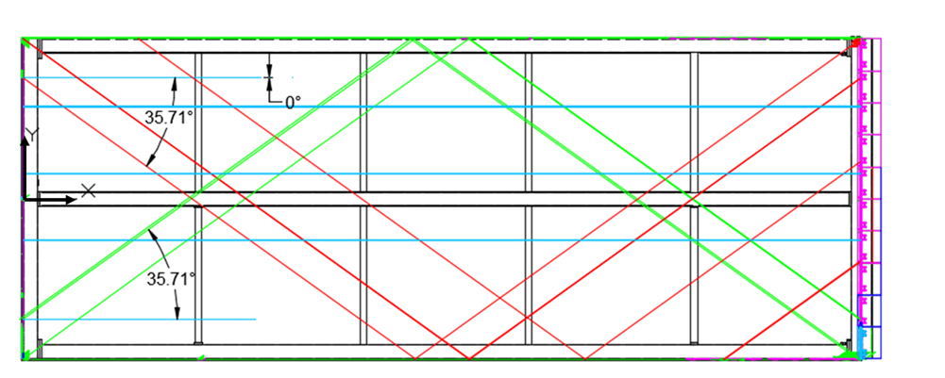
Effect on wire tension during transport and handling
Each APA is wrapped with 23.4km of 152 micron wire.
It is important to not to break wires during transportation and handling.
Note: Some wires are sloped down at 35.71, some up and some are horizontal.

Slide 3
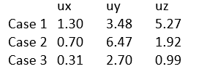
Approach
The APA is supported in it’s shipping frame on isolators, but will still be subjected to forces that distort the APA and stretch some of its wires.
Frame displacement data was extracted from the 3 transportation cases that will have the largest effect on wire tension.
Quasi-static sea transport (analyzed by Jake Nesbit)
Road transportation with vibration (analyzed by Ang Lee)
Road transportation with shock (analyzed by Ang Lee)
The effects on wires for both “in-plane” and “out-of-plane” distortions were considered.
Frame “displacements” from FEA
Displacements as defined by the difference between the maximum and minimum displacements (See image on page 2 for coordinate system.)

Slide 4
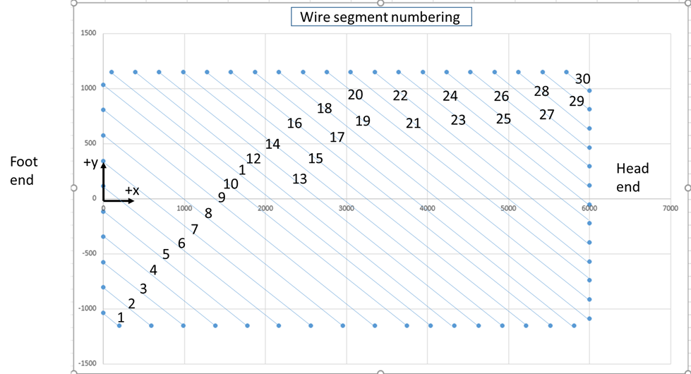
Analysis of “In-plane” effects
30 wire segments were checked on the wires sloped at -35.71 degrees
Determined the change in length in the x-y plane between two nodes on each end of the wire.
Wires sloped at +35.71 will see similar strains
Wires with no slope will not see as much stress.

Slide 5
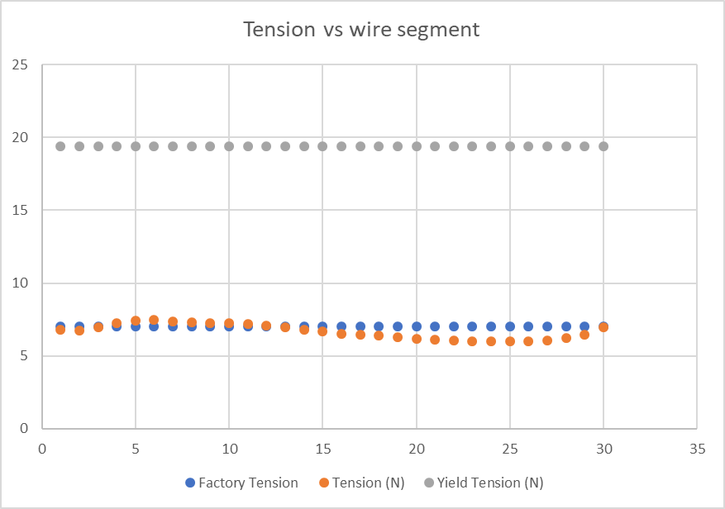
Results: Case 1 “in-plane”
Max Tension increases from 7* to 7.5N
*Note: Factory tension tolerance is 6+/-1N. For purposes of this analysis, it is assumed all wires will start out at the maximum tension

Slide 6
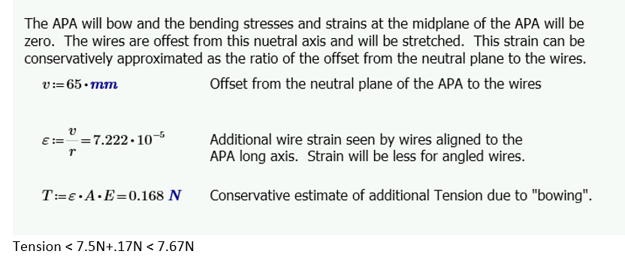
Results: Case 1 “out-of-plane”
APA will bow out ~5mm > ~radius of curvature > 900m

Slide 7
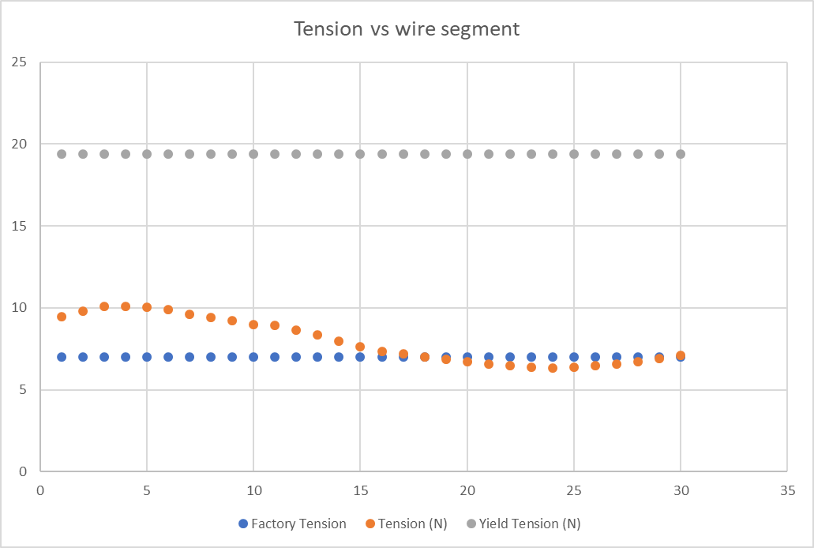
Results: Case 2 “ in plane”
Tension increases from 7 to 10.1N.
Note: Transverse deflection is less than 2mm and can be ignored

Slide 8
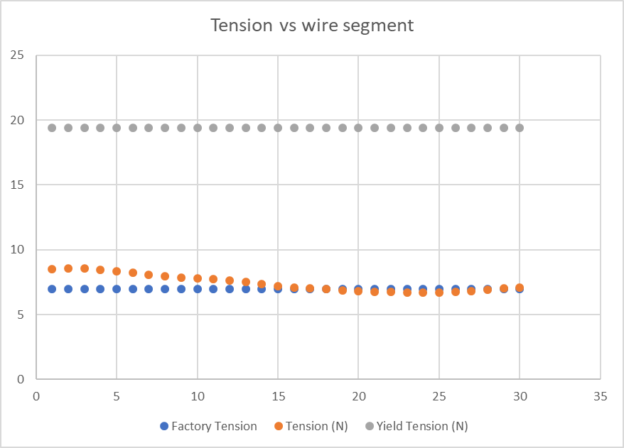
Results: Case 3 “ in plane”
Tension increases from 7 to 8.59N.
Note: Transverse deflection is less than 1mm and can be ignored.

Slide 9
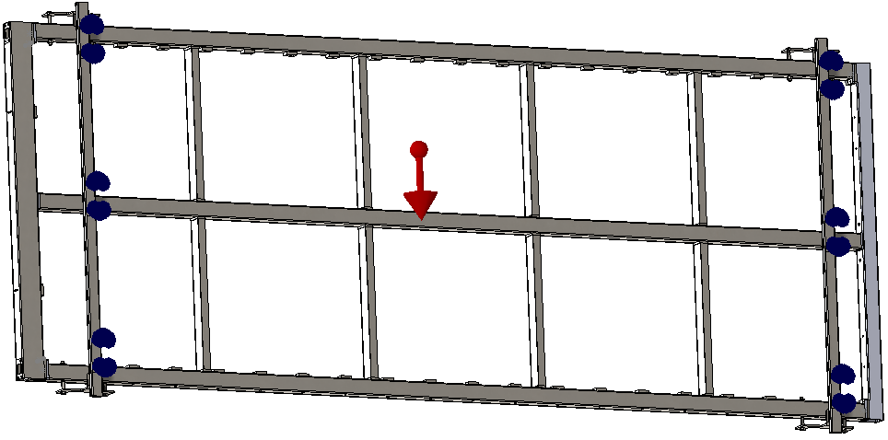
Strength of M20 adaptor connection - Constraints
Frame and support bracket included in the model
The frame and bracket assembly are constrained in FEA model using soft supports with spring constants approximating the vibration isolators
Soft supports

Slide 10
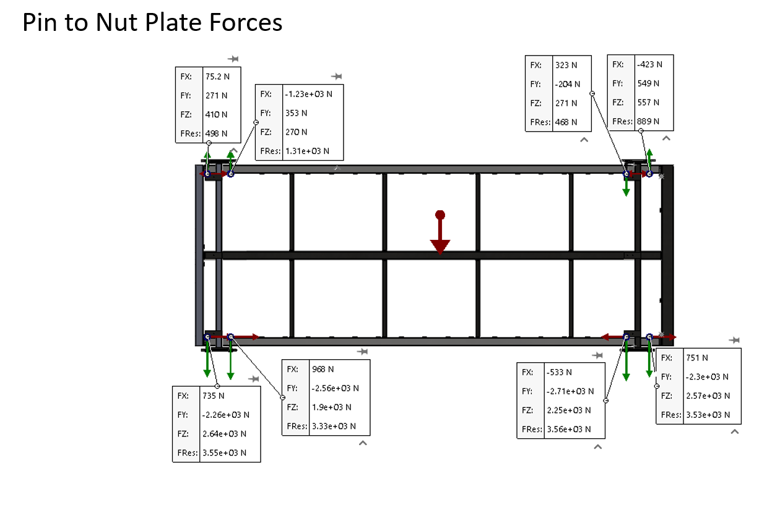
Strength of M20 bolt and threads - inputs
Inputs Mass of APA with protection, contingency and a 1.4 load factor is 868kg
loads –determined by FEA
y
x
Maximum FY on pins. See note.
Slide courtesy of Jake Nesbit
Note: Polarity shown represents forces acting on the pins. The forces of the pin acting on the nut plate are equal and opposite.

Slide 11
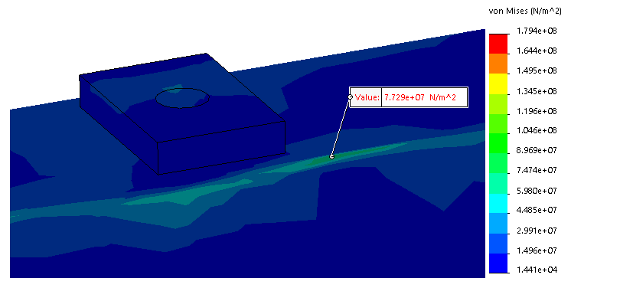
Tube wall stress
Stress by nut plate with vertical load of 2710N is 72 MPA. Available stress is 186MPa

Slide 12
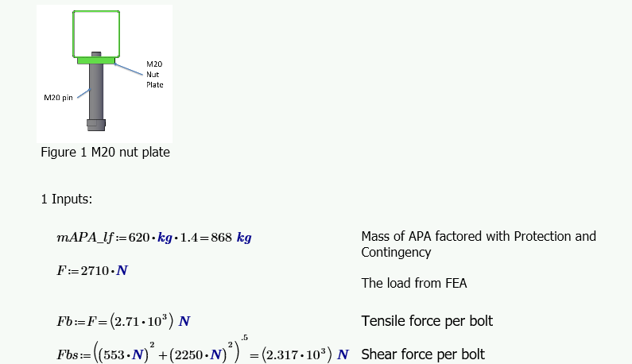
Inputs continued

Slide 13
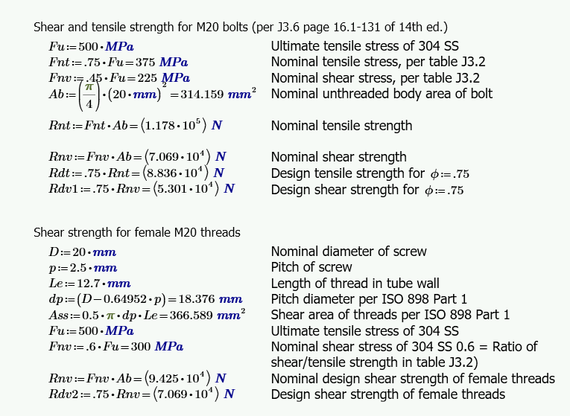
Strength of M20 bolts and threads per code

Slide 14
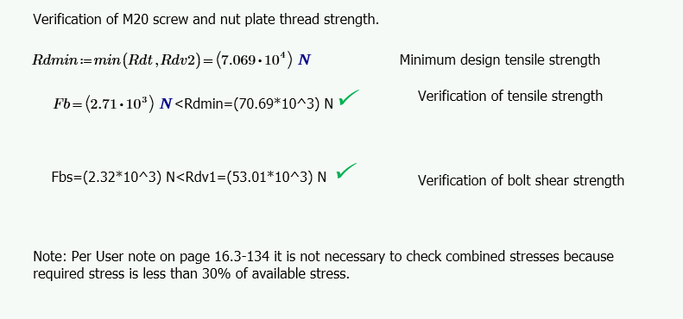
Results

Slide 15
High G load analysis on APA frame - inputs
Three load cases were analyzed with extra g-load on the APA frame
Case 8 - The APA and transport box lying flat. This case represented possible orientation in the South Dakota warehouse and this orientation is no longer foreseen. (g-load applied perpendicular to the plane of the APA)
Case 9 - The APA and transport box in landscape mode. This is the typical orientation during transportation. (g-load aligned to minor axis of the APA)
Case 13 - The APA vertical with the head end down. This is orientation the upside down APA will see when transported down the shaft. (g-load aligned to major axis of the APA)
Load factor of 1.4 applied to loads on the APA frame
Proper resistance factors applied to material and connections

Slide 16
High G load analysis on APA frame - results
G-load increased until a limiting factor was reached
Limiting factor > Weld strength by AISC code
Case 8 > 4g
Case 9 > 4g
Case 13 > 6g
Max g-load from vibration or shock that can transferred to the APA. (Analysis was done in the vertical direction for the various orientations. The vertical direction is typically the direction of maximum g-loads.)
Ang Lee’s analysis dynamic analysis estimates g-loads much lower than 4 g’s.

Slide 17
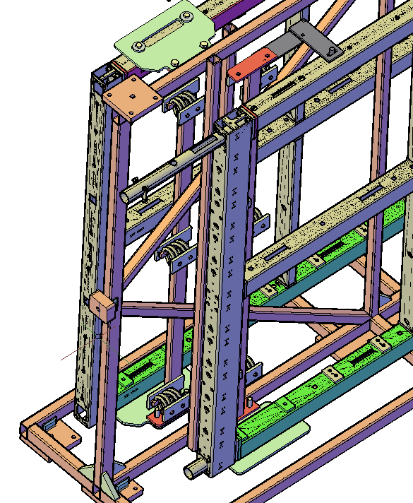
Conduit installation – Steps 1 to 4
Stabilizing strap
APA is transferred using the edge lift kit to the transport box. Adaptor pins are preinstalled in the bottom side tube.
Bottom plates are mounted to the adaptor pins.
Stabilizing straps are mounted on each end to keep APA from tipping
Top conduit is installed (Tapered nose cone added to help guide conduit.)
Conduit
Note: Protection is not shown for clarity
Bottom Plate

Slide 18
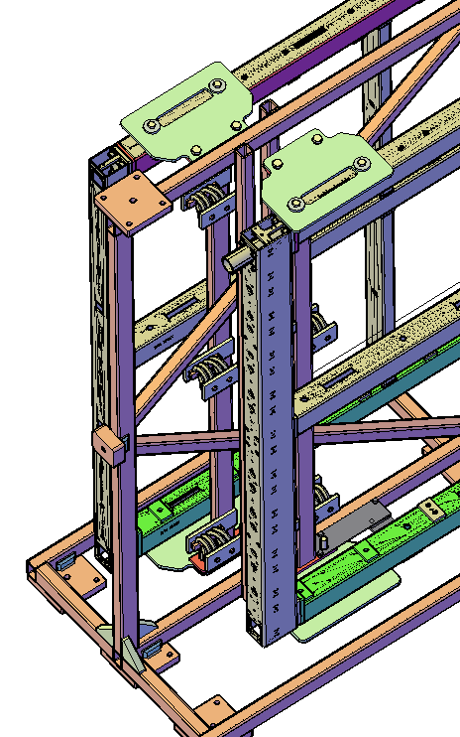
Conduit installation – Step 5-8
Install adaptor pins in the top side tube
Mount the top support plates
Remove the top stabilizing strap
Add the bottom stabilizing strap
Note: Protection is not shown for clarity
Stabilizing strap
Bottom Plate

Slide 19
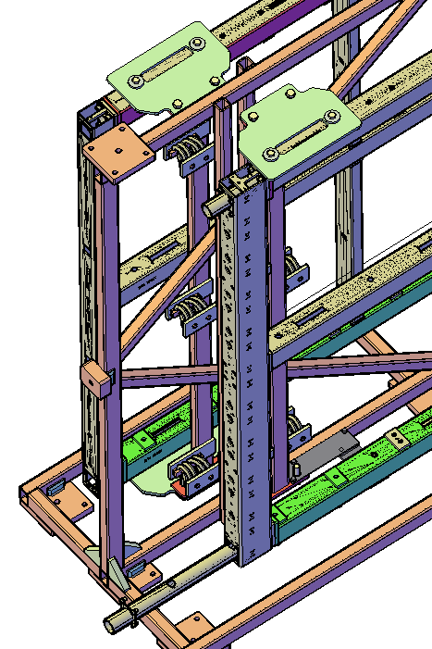
Conduit installation – Step 9-10
Remove the bottom plate and adaptor pins.
Insert the bottom conduit
Top Plate
Note: Protection is not shown for clarity
Stabilizing strap
Conduit

Slide 20
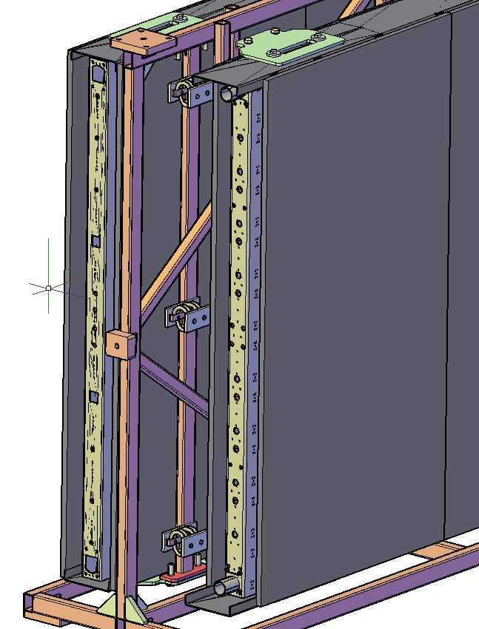
Conduit installation – Step 10-12
Protection with ends uncovered
Reinstall the adaptor pins and remount the bottom plates
Remove the bottom stabilizing straps.
Note: An alternative is to set up a special single APA station that simulates the Transport frame support brackets, but without the springs. The APA could then be moved to the transport frame with the edge lift kit. Additional holes would be required in the conduit for the edge lift kit.
Conduit
Conduit

Slide 21
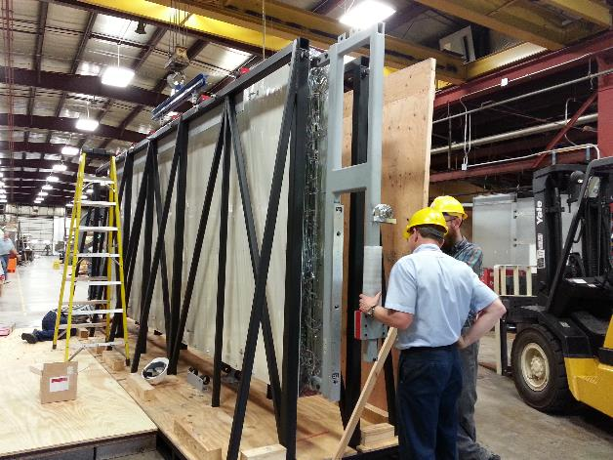
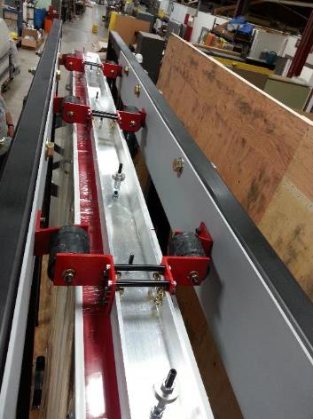
Lessons learned from protoDUNE transport box
The protoDUNE transport box was used for truck, air, and sea transport, but did not have nearly as many requirements imposed upon it.
For DUNE, the transport box must handle being lowered down the shaft and rotated to “ upside down” landscape. This drove significant design changes.
APA is suspended from above
ProtoDUNE APA being loaded into transport box
Suspension system

Slide 22
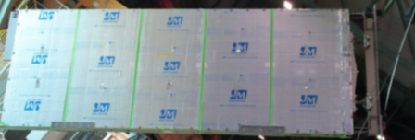
Lessons learned from protoDUNE transport box
Lessons learned still be applicable to the transport frame from “LessonsLearned by Systems.xlsx” (docDB 8255):
Took a long time to connect the lifting fixture, yoke and trolleys. > protoDUNE lifting fixture was mounted with the APA in landscape mode. It was difficult to install the connecting bars because they cantilevered into the side tubes and because they bound on the pins (Equivalent to the M16 to M20 adaptors). The new design will be connected with the Transport box vertical and connections will be more compliant. See APA removal talk.

Slide 23
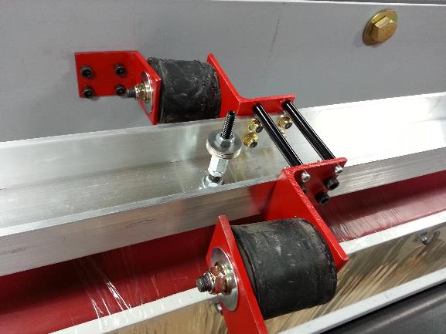
Lessons learned from protoDUNE transport box
Time consuming to remove suspension system. Many fasteners with Allen heads. > 48 bolts replaced with 8 M16 bolts and 8 M16 to M20 adapters.
Six suspensions assemblies with 8 bolts each
View of three suspension assemblies

Slide 24
Lessons learned from protoDUNE transport box
Working platforms were either to tall or too short. > Working with the installation team to ensure adequate access for operations.
Unpacking check list and tool list was useful > Goal is to do the same for DUNE.
Some fasteners came loose. (This may be a fastener retention issue or may have been a vibration isolation issue.) > Close attention is being paid to vibration isolation in the DUNE APA transport frame design. Also, methods of fastener retention will be implemented.
Rivnuts bolts (threaded rod) had Loctite and where difficult to remove on APA #6. > Will be considered when specifying retention methods.
M10 threaded rod.

