Slide 1
DUNE Vertical Cart Design Mark Langstaff - Manchester Peter Sutcliffe - Liverpool George Stavrakis - Liverpool
27th July 2020

Slide 2
Vertical and horizontal cart designs
The two carts are needed for the following reasons:
To move the transport frame and APAs horizontally around the wire winding factory.
To support the transport frame vertically underground and move frame and APAs into the clean room and allow the APAs to have the photon detectors added and move the APAs onto the cryostat rails.
The original idea was to lower the frame onto the respective cart and to bolt from underneath.
Following discussion with safety and handling colleagues, a different approach was needed as bolting underneath was seen to be tricky, and in the case of the vertical cart, may be a safety risk.
As you can see from the following talk, the idea of a ratchet strap system has been used for both the horizontal and vertical cart.

Slide 3
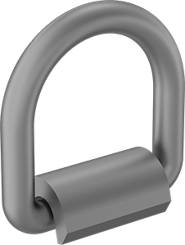
Overall vertical cart design
Note: Dimensions are approximate
3m
2.75m
4x Locating pins
0.54m
8” x 4” steel hollow section
8x Tie-down rings
4x Tow pads
Locating pins (internal threads)
Wixroyd part: 36240.W0231
20mm outer diameter
12mm shank (M6 internal thread)
Weld-on tie-down rings
McMaster-Carr part: 3028T25
Capacity: 6130 lbs (2780 kg)
Other sizes available

Slide 4
Casters
Manufacturer: Colson Casters (USA)
Series 8, 7.25” x 5.5” top plate, 10” Wheel, “Commander HD”, 3 inch tread, with brake and swivel lock
Capacity each: 5400 lbs (2450 kg)
Cost each: $180 (approx.)
Part no: 8.10689.5PNMTG61BRK1
Note
“Commander HD” wheels have a slightly crowned tread

Slide 5
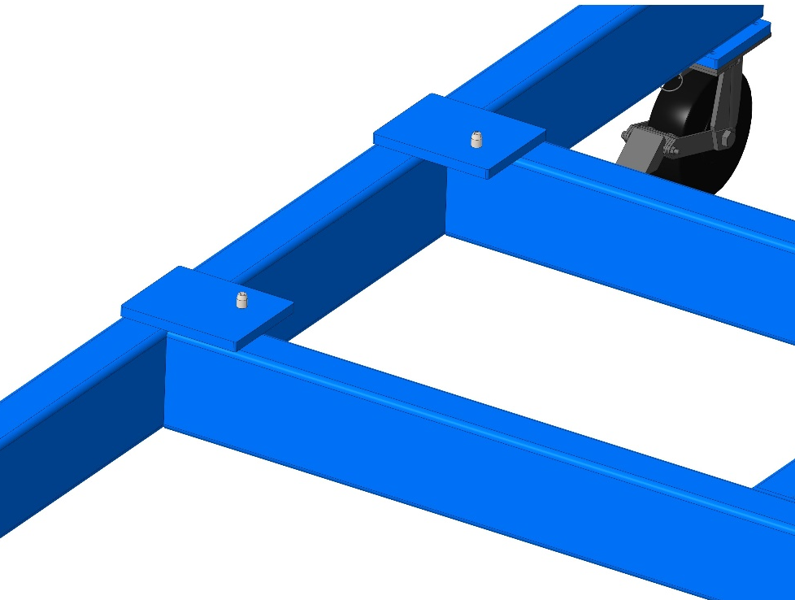
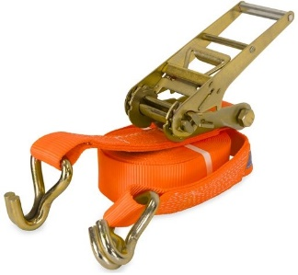
Transport Frame Location & Connection
Alternative to bolting from below
Locating pins
4x tie-down straps
1
2
3
4
Ratchet straps
Frame located on 4x pins

Slide 6
Attachment with Straps
Strap covering PD slot
Straps pass through swivel hoist rings (one continuous length)
Procedure
2 straps used per side (4 total).
All straps must be in place when moving the cart.
ONE strap can be removed (or loosened), but all other straps must be tensioned first.
Use continuous straps (passing through hoist ring) to ensure that tension is evenly applied/removed from both sides
Outer strap
Ratchet straps
Inner strap

Slide 7
Straps Covering Photon Detector Slots
Left View
Right View

Slide 8
Strap Clearance
Approx. 45mm between strap and panels

Slide 9
Beam Bending
7.5kN
7.5kN
8” x 4” x 0.25”
hollow section
1.8mm deflection

Slide 10
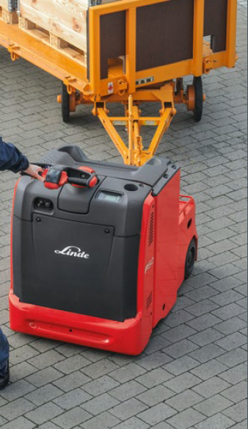
Transport underground
The transport frame will need to be moved in its vertical position from the SAS to the clean room area in a smooth and clean manner. This will be done using a motorised pallet truck, and an ‘A’ frame tow bar, similar to the ones shown

Slide 11
DUNE Horizontal Cart Design Mark Langstaff - Manchester Peter Sutcliffe - Liverpool George Stavrakis - Liverpool
27th July 2020

Slide 12
Overall horizontal cart design All dimensions are approximate
The horizontal cart uses standard readily available Bosch Aluminium profile and brackets.
The bolted on pads are either steel or aluminium, and machined.
This cart can easily be assembled in any APA winding factory or warehouse
Bespoke wheels can also be sourced for different surfaces.
1.75m
6.8m
0.5m
90 x 180 Aluminium profile (Bosch)
6 x Casters
(Rated to take the load)
6 x Seating pads
4x Locating pads
4 x Tie-down shackles

Slide 13
Lowering the cart
The APA transport frame is lowered onto the cart onto 4 Aluminium location pads as shown
Aluminium is used as to not cause damage to the frame
An alternative to Aluminium could be a robust plastic, such as Tufnol or Nylon
Each location pad has a 30° chamfer for alignment
All the pads are attached to the cart using M8 cap head screws and Bosch Tee nuts
Each Tee nut will take a minimum 8000N force

Slide 14
Connection to the transport frame
Connection to the frame is through two ratchet straps, as shown on the vertical cart.
The strap connects to two swivel rings on the transport frame, and to a shackle on the cart.
Each shackle is attached to a steel plate, which is in turn bolted to the aluminium frame using M8 cap head screws.

Slide 15
May need connections for towing?
Connections for towing could be added at the positions shown by adding bolted on steel bosses

Slide 16
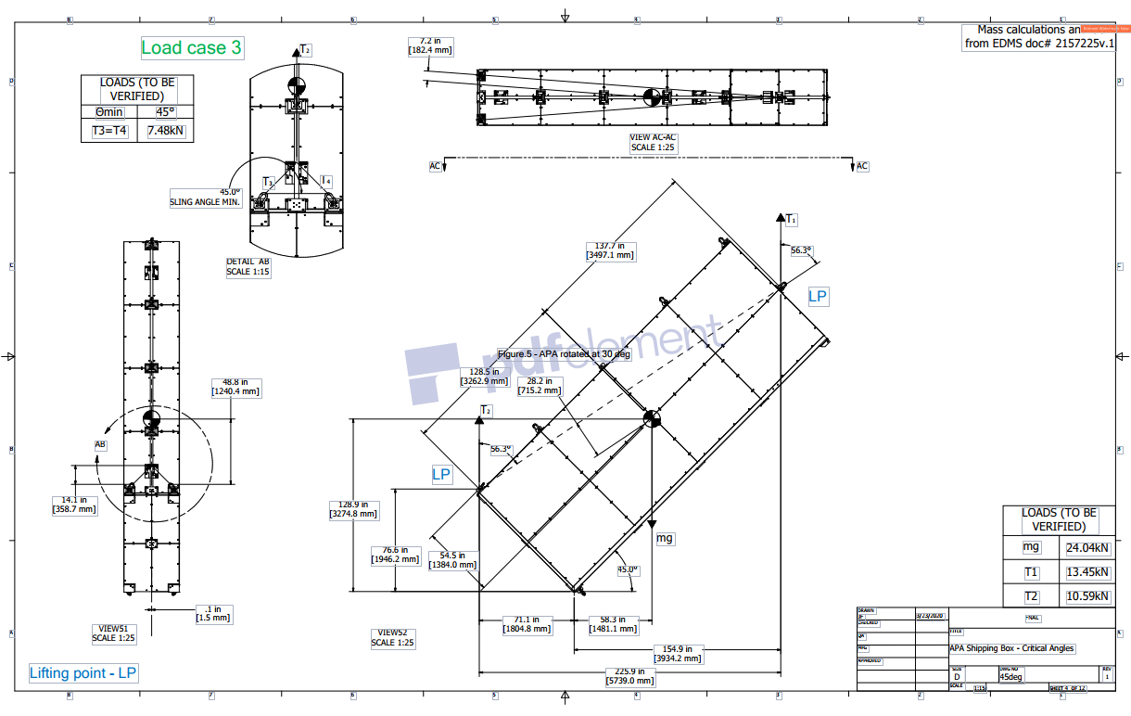
Stability analysis of the transport frame
A comprehensive stability analysis has been performed by Giuseppe Gallo and is covered in the Engineering analysis document “Engineering Design Report for the DUNE APA shipping frames” – Section F (EDMS https://edms.cern.ch/document/2370041/1
This summary shows the stability for the vertical cart, which is considered the worst case
The acceptance requirement is based on the OSHA Health and Safety requirements, where a tipping force ratio minimum of 4 is required.

Slide 17
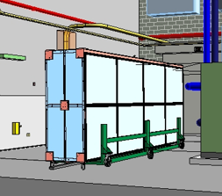
Horizontal Cart
APA shipping box and cart stationary assuming a floor inclination of 2 deg. Considering a minimum width of 1.06 m, the minimum resisting moment and the maximum tipping moment are:
$Minimum Resisting Moment=mass x gravity x (530−119)mm x\cos\left(2\right)=411mm x mg$
$Maximum Tipping Moment=mass x gravity x 1142 mm x sin⁡(2)=39.9mm x mg$
$\frac{Min Resisting Moment }{Max Tipping Moment}=\frac{411mm}{39.9mm}=10.3$
With a minimum cart width of 1.06 m , one APA frame and a max floor inclination of 2deg, the ratio of the resisting moment and the tipping moment is 10.3 well above the factor 4 recommended by OSHA
§1926.451- general requirements.

Slide 18
Horizontal Cart with 2 APAs – Horizontal movement
For the APA shipping box and cart moving at speed of 1ft/sec. If the cart were to hit a step during the transportation with an impact time of 1 second, the max deceleration is 1ft/sec^2 (3% gravity). With a minimum width of 1.06 m, the minimum resisting moment and the maximum tipping moment are:
$Minimum Resisting Moment=mass x gravity x \left(530−119\right)mm=411mm x mm$
$Maximum Tipping Moment=mass x 0.03gravity x 1142mm=34.3 mm x mg$
$\frac{Min Resisting Moment }{Max Tipping Moment}=\frac{411mm}{34.3mm}=12.0$
With a minimum cart width of 1.06 m and a moving speed of 1ft/sec, the ratio of the resisting moment and the tipping moment is 12.0 well above the factor 4 recommended by OSHA
§1926.451- general requirements.

Slide 19
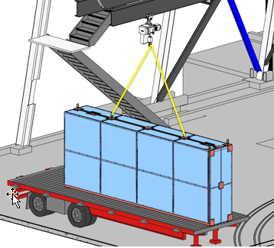
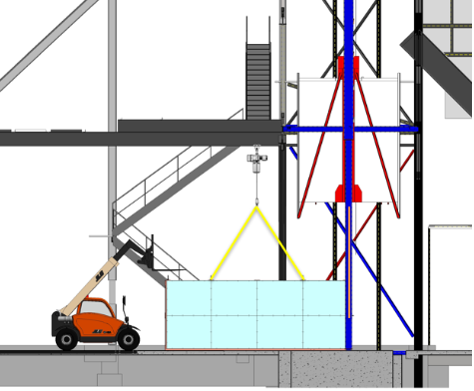
Lifting the shipping frame at the factory and in front of the Ross Shaft
This lifting is a standard rigging operation, utilizing the side rings to lift the APA shipping frames horizontally off the delivery truck as shown. Based on the lifting activities shown, all the lifting points are well above the center-of-gravity of the lifted object, so these lifting steps are stable.

Slide 20
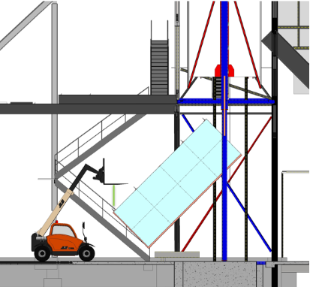
Lifting the frame into the Ross Shaft
The figure below shows the rotation of the APA shipping box from landscape to portrait orientation. According to these layout drawings the center-of-gravity on all the steps is below and within the plane defined by the three lifting points. In conclusion, the lifting and the handling of the APA shipping box is stable.

Slide 21
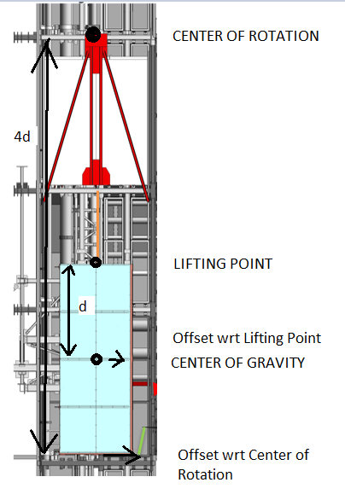
Lifting down the Ross Shaft
The transport frame will be lowered down the Ross shaft at a low speed. Based on the lifting activities shown, all the lifting points are well above the center-of-gravity of the lifted object, inline sideways with the top lifting point. During these lifting steps the side-to-side translation with respect to the lifting point is estimated to be up to 1 inch due to uncertainties so the maximum translation side-to-side might end up being up to 4 inches respect to the center of rotation of the lifting system.

Slide 22
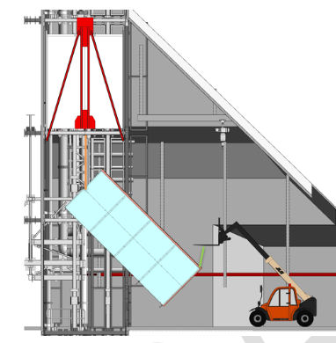
Lifting at the bottom of the Ross Shaft
The transport frame will need to be lifted off the underside of the cage and placed ‘upside down’ on an underground trolley. The frame will already be connected to the underside of the cage, and another lifting point will be required at the top edge furthest away from the shaft, using a local crane or fork. The figure shows the rotation of the APA shipping box with the APA detectors from portrait to landscape orientation. According to these layout drawings the center-of-gravity on all the steps is below and within the plane defined by the three lifting points. In conclusion the rotation of the APA shipping box is stable.

Slide 23
On the underground cart
The shipping frame sits on the frame in a landscape orientation as shown. APA shipping box and cart stationary assuming a floor inclination of 2 deg. Considering a minimum width of 1.06 m, the minimum resisting moment and the maximum tipping moment are:
$Minimum Resisting Moment=mass x gravity x 525mm x\cos\left(2\right)=524.7mm x mg$
$Maximum Tipping Moment=mass x gravity x 1268mm x sin⁡(2)=44.3mm x mg$
$\frac{Min Resisting Moment }{Max Tipping Moment}=\frac{524.7mm}{44.3mm}=11.8$
With a minimum cart width of 1.06 and a max floor inclination of 2deg, the ratio of the resisting moment and the tipping moment is 11.8 well above the factor 4 recommended by OSHA §1926.451- general requirements.

Slide 24
On the underground cart– Horizontal movement
For the APA shipping box and cart moving at speed of 1ft/sec. If the cart were to hit a step during the transportation with an impact time of 1 second, the max deceleration is 1ft/sec^2 (3% gravity). With a minimum width of 1.06 m, the minimum resisting moment and the maximum tipping moment are:
$Minimum Resisting Moment=mass x gravity x 525mm=525mm x mg$
$Maximum Tipping Moment=mass x 0.03gravity x 1268mm=38mm x mg$
$\frac{Min Resisting Moment }{Max Tipping Moment}=\frac{525mm}{38mm}=13.8$
With a minimum cart width of 1.06 and a moving speed of 1ft/sec, the ratio of the resisting moment and the tipping moment is 13.8 well above the factor 4 recommended by OSHA §1926.451- general requirements.

Slide 25
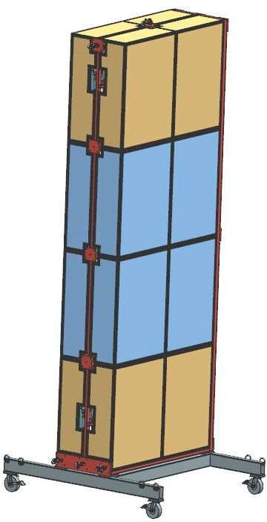
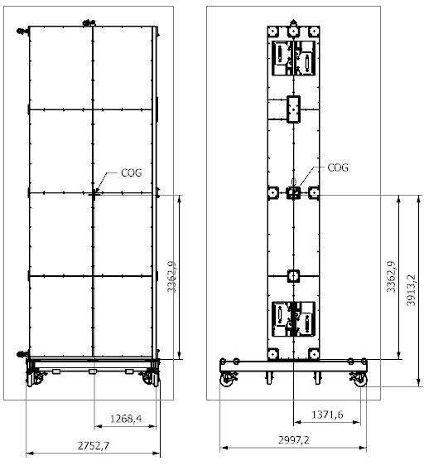
Vertical Cart with 2 APAs
APA shipping box with two APA and cart stationary assuming a floor inclination of 2 deg. Considering a minimum width of 2.75m, the minimum resisting moment and the maximum tipping moment are:
$Minimum Resisting Moment=mass x gravity x 1268mm x\cos\left(2\right)=1267mm x mg$
$Maximum Tipping Moment=mass x gravity x 3363mm x sin⁡(2)=117mm x mg$
$\frac{Min Resisting Moment }{Max Tipping Moment}=\frac{1267mm}{117mm}=10.8$
With a minimum cart width of 2.75 and a max floor inclination of 2deg, the ratio of the resisting moment and the tipping moment is 10.8 well above the factor 4 recommended by OSHA
§1926.451- general requirements

Slide 26
Vertical Cart with 2 APAs – Horizontal movement
For the APA shipping box and cart moving at speed of 1ft/sec. If the cart were to hit a step during the transportation with an impact time of 1 second, the max deceleration is 1ft/sec^2 (3% gravity). With a minimum width of 1.06 m, the minimum resisting moment and the maximum tipping moment are:
$Minimum Resisting Moment=mass x gravity x 1268mm=1268mm x mg$
$Maximum Tipping Moment=mass x 0.03gravity x 3363mm=101 mm x mg$
$\frac{Min Resisting Moment }{Max Tipping Moment}=\frac{1268mm}{101mm}=12.5$
With a minimum cart width of 2.75 and a moving speed of 1ft/sec, the ratio of the resisting moment and the tipping moment is 12.5 well above the factor 4 recommended by OSHA
§1926.451- general requirements.

Slide 27
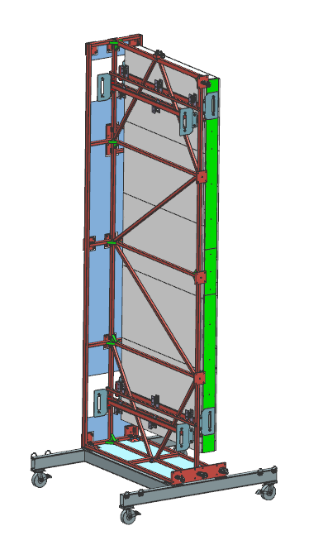
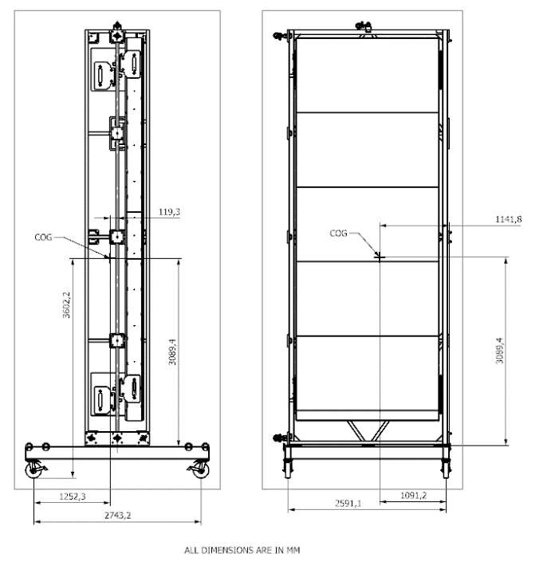
Vertical Cart with 1 APA
APA shipping box with one APA and cart stationary assuming a floor inclination of 2 deg. Considering a minimum width of 2.75m, the minimum resisting moment and the maximum tipping moment are:
$Minimum Resisting Moment=mass x gravity x 1091mm x\cos\left(2\right)=1090mm x mg$
$Maximum Tipping Moment=mass x gravity x 3602mm x sin⁡(2)=126mm x mg$
$\frac{Min Resisting Moment }{Max Tipping Moment}=\frac{1090mm}{126mm}=8.7$
With a minimum cart width of 2.75 and a max floor inclination of 2deg, the ratio of the resisting moment and the tipping moment is 8.7 well above the factor 4 recommended by OSHA
§1926.451- general requirements.

Slide 28
Vertical Cart with 1 APA – Horizontal movement
For the APA shipping box and cart moving at speed of 1ft/sec. If the cart were to hit a step during the transportation with an impact time of 1 second, the max deceleration is 1ft/sec^2 (3% gravity). With a minimum width of 2.75 m, the minimum resisting moment and the maximum tipping moment are:
$Minimum Resisting Moment=mass x gravity x 1091mm=1091mm x mg$
$Maximum Tipping Moment=mass x 0.03gravity x 3602mm=108 mm x mg$
$\frac{Min Resisting Moment }{Max Tipping Moment}=\frac{1091mm}{108mm}=10.1$
With a minimum cart width of 2.75 and a moving speed of 1ft/sec, the ratio of the resisting moment and the tipping moment is 10.1 well above the factor 4 recommended by OSHA
§1926.451- general requirements.

Slide 29
Summary
The Vertical cart is pretty much final, and drawings have been done and checked for the review.
A request was made on 20th July to have extra towing pads added, which will be implemented after the review.
The horizontal cart will need to be accepted by the relevant ‘users’, then the drawings can be issued, and a prototype manufactured.
The stability analysis of the vertical cart shows it is well within the OSHA requirements.

