Slide 1
Installation
Installing PDs
Removing the lower (inverted) APA from the shipping box
Transfer to the assembly fixture
Removing the upper APA from the shipping box
Transfer to the assembly fixture

Slide 2
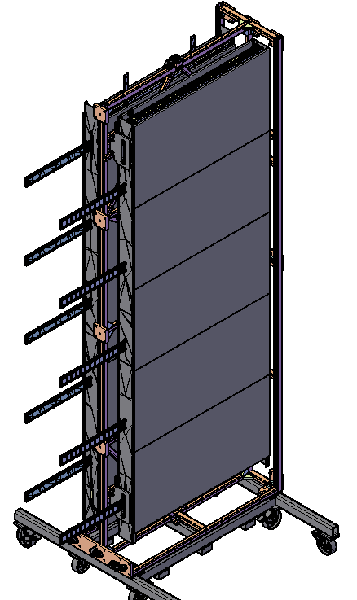
Installing PDs
PDS are installed while the APA is are in the transport frame on the vertical cart.
Transport box protection will be removed.
Clearances have been provided in the frame and in the support plates to allow for the installation
APA protection has cutouts to allow for PD installation
View of PDs partially installed.

Slide 3
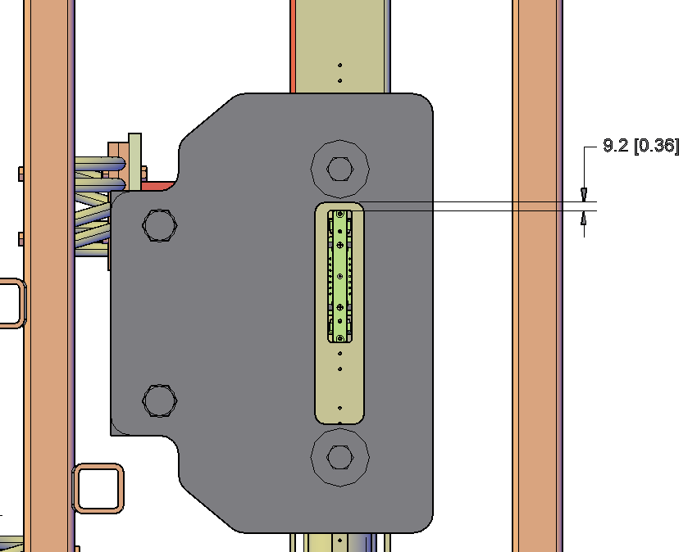
“Top edge”
Frame provides lots of clearance for PD installation
Support plates have cut outs to provide clearance.
Cut out for PD installation
View of “top” edge of the transport frame

Slide 4
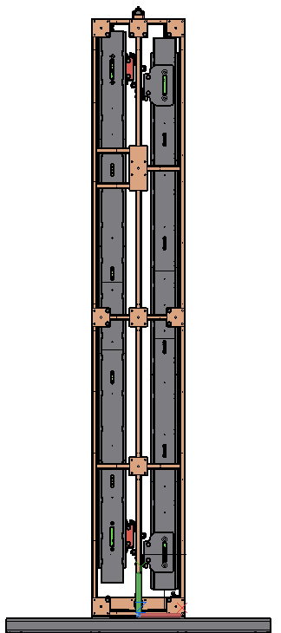
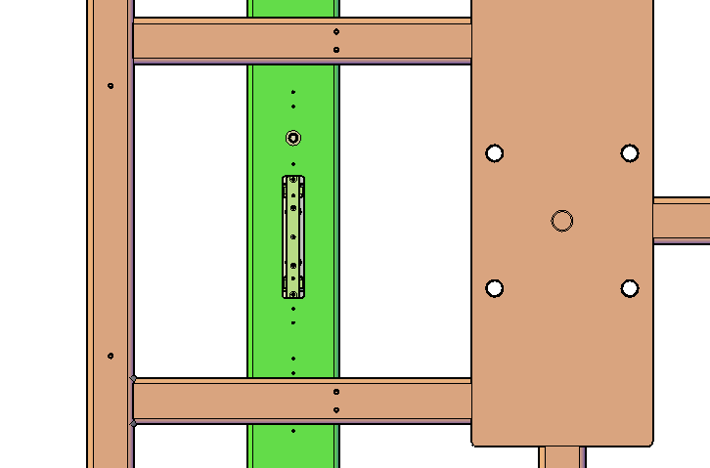
“Bottom edge”
Bottom edge has more framework, but adequate clearance has been provided.
Frame adjusted to provide clearance
Cut out for PD installation
View of “bottom” edge of the transport frame

Slide 5
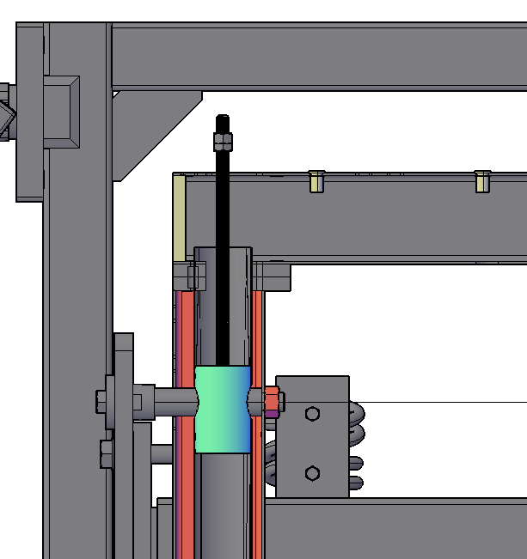
Conceptual plan for removing lower APA:
Pre-installation of clevis
Clevis is pre-installed in the APA/transport frame and secured with M20 adaptor.
Threaded rod allows for positioning the clevis when pin is inserted.
Requires clevises to be shipped with every APA
Does not require modification to APA support bracket plate.
Threaded rod
Clevis (conceptual)
M20 adaptor
APA support bracket plate
Cut away view of Lifting clevis preinstalled in APA.

Slide 6
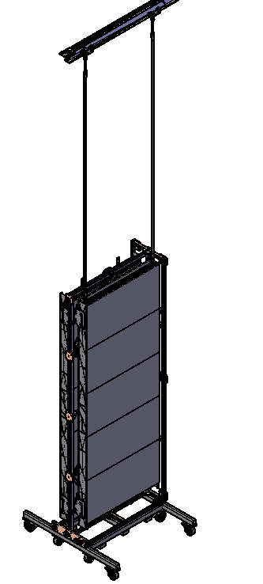
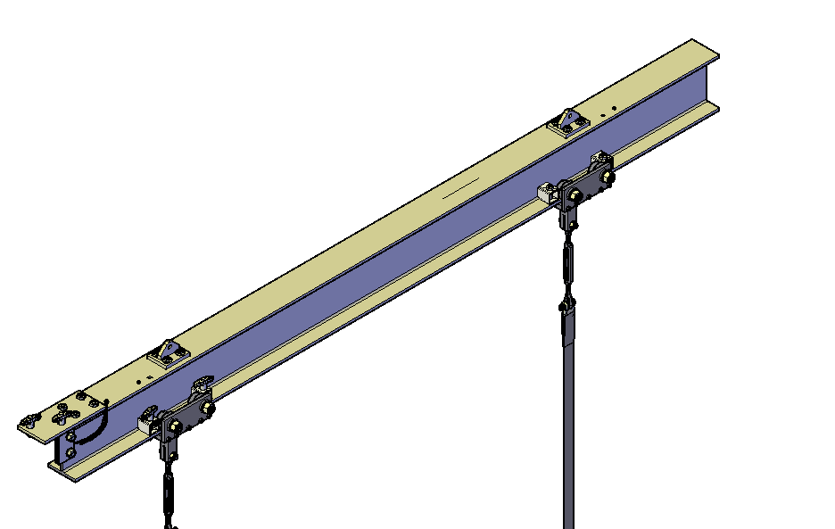
Preparation for lower APA
Transport box protective panels are removed
PD modules are installed
The lower APA is positioned under the hoist.
APA protection is removed on the top of the APA
The lifting beam is delivered to the APA
Note: Trolleys are blocked
Lifting beam
straps
Trolleys
Transport frame without covers

Slide 7
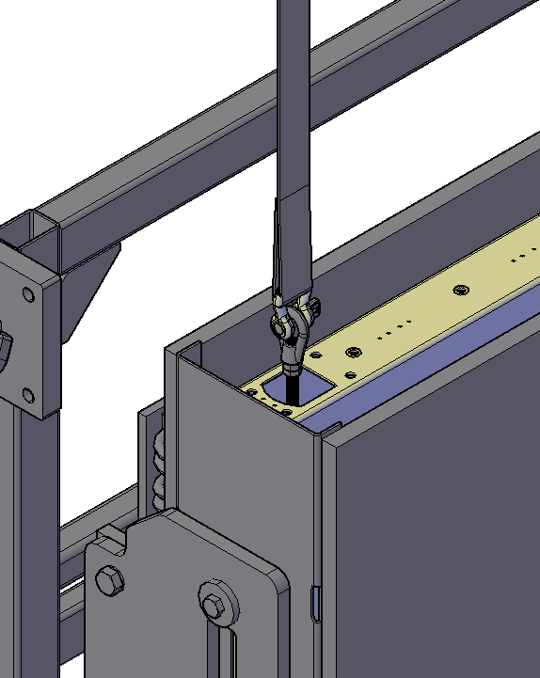
Connecting lifting gear
Lifting gear is connected to the threaded rod
Strap
Shackle
Threaded rod
Lifting eyelet
APA support bracket plate
Lifting gear connected to the APA

Slide 8
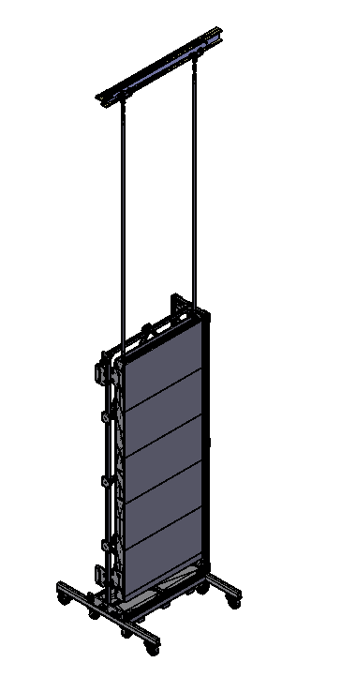
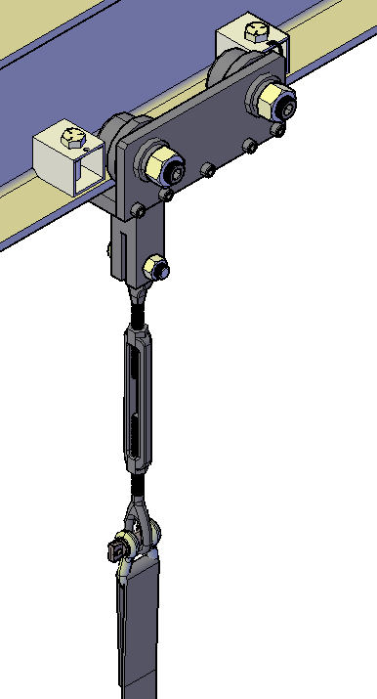
Transfer of load to hoist
Transfer beam with turnbuckles
The APA is lifted until the isolation springs are in a neutral position. This indicates that the load is transferred to the lifting gear and has been removed from the transport frame support brackets.
Note: Turnbuckles will be adjusted for first use to make sure APA frame hangs straight
View of lifting gear and APA in Transport frame

Slide 9
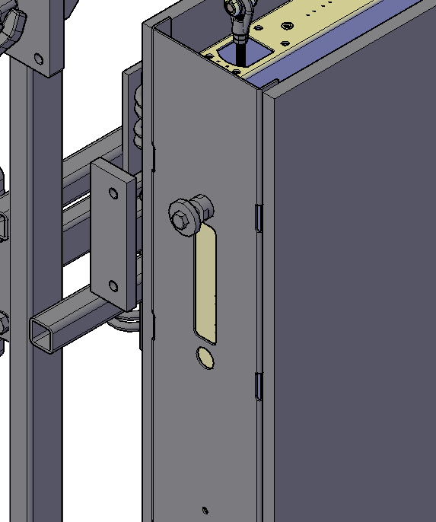
Removing transport frame hardware
Four support bracket plates and 6 of the 8 M20 adaptors are removed. The two adaptors supporting the load remain.
This adaptor is connected to the clevis and is left in place
View of edge of APA after support plate removal

Slide 10
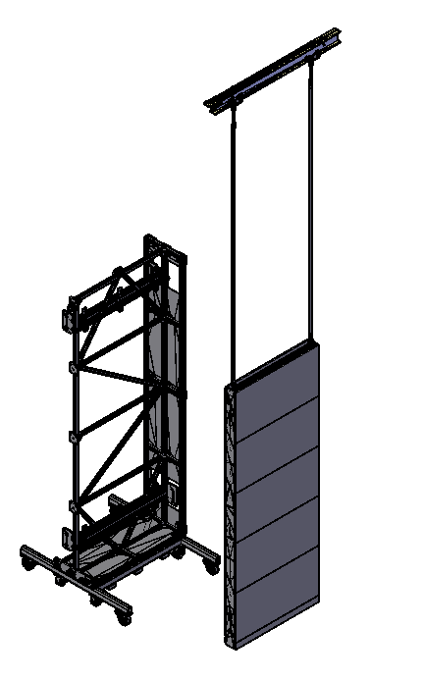
Clearing path for APA
The transport frame is pulled out of the way so the APA frame can be lifted by the hoist and translated towards the APA assembly fixture.
Transport Frame pushed back from the APA

Slide 11
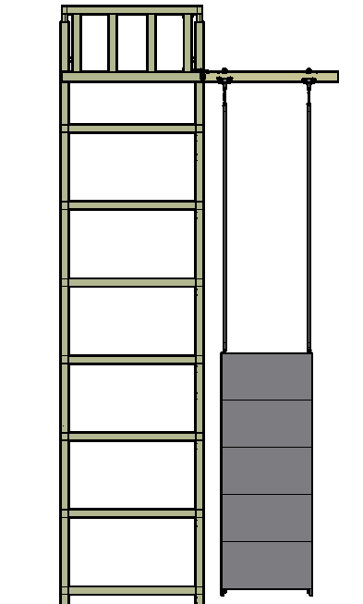
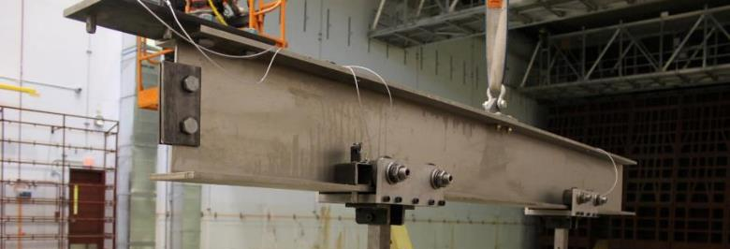
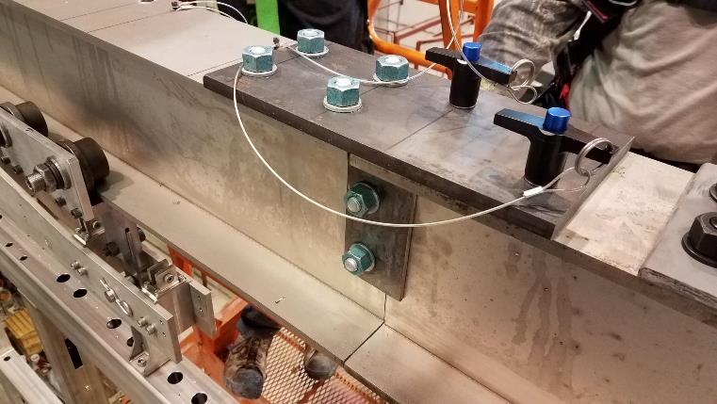
Transferring the APA to the tower
APA supported on lifting beam from trolleys
Lifting beam connected for transfer to assembly fixture
Lower APA and assembly tower

Slide 12
Initial position on Tower
Lower APA is secured to the assembly tower and is supported on stand
~300mm below final height
Actuator Stand
Electric Actuator for lifting after PD cables are connected. Max Travel speed ~15 inches per minute.
ISO view

Slide 13
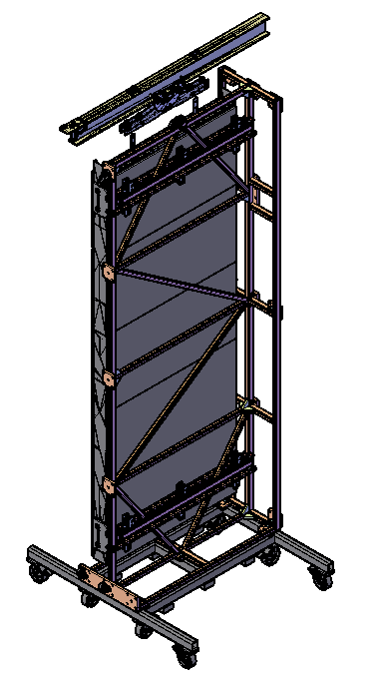
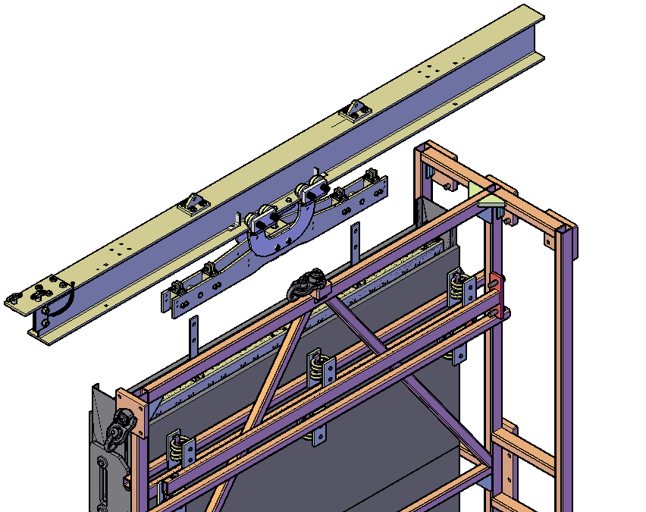
Preparation for upper APA
Lifting beam yoke assembly
The lifting beam is delivered to the APA
Views of lifting beam positioned above the APA

Slide 14
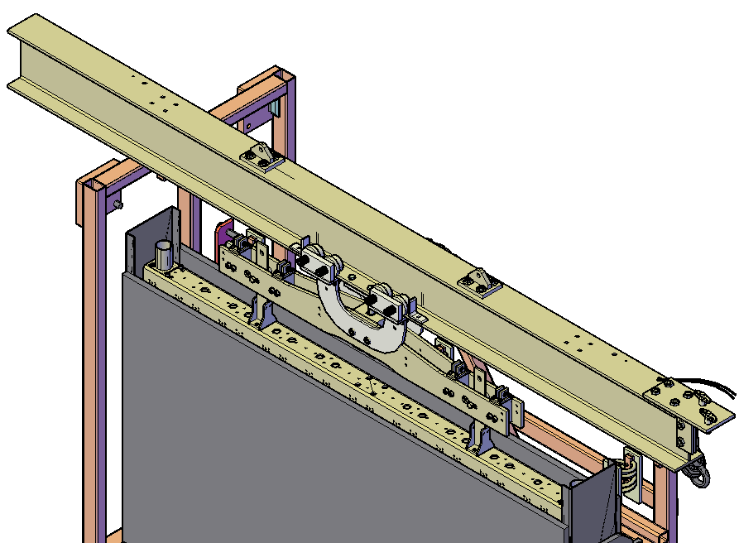
Connecting lifting gear
Yoke is pinned to the structural tees mounted to the top of the APA
Lifting Beam
Yoke
Pins
Trolley
Structural tees
Lifting gear connected to the APA

Slide 15
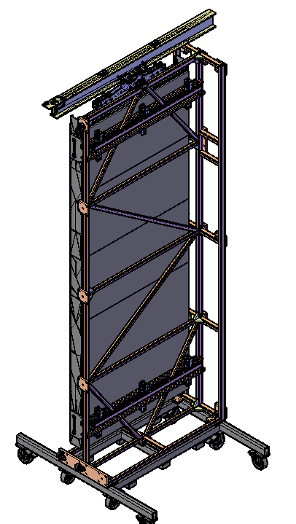
Transfer of load to hoist
The APA is lifted until the isolation springs are in a neutral position.
View of lifting gear and APA in Transport frame

Slide 16
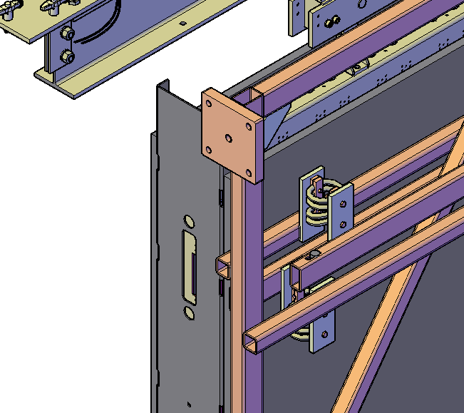
Removing transport frame hardware
Four support bracket plates and 8 M20 adaptors are removed.
View of edge of the APA after the support plates have been removed.

Slide 17
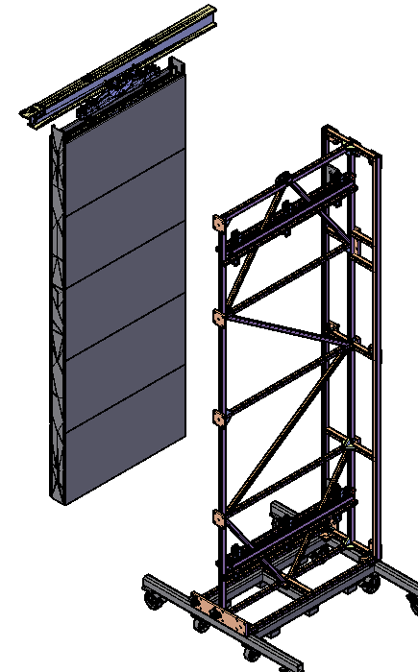
Clearing path for APA
The transport frame is pulled out of the way so the APA frame can be lifted by the hoist and translated towards the APA assembly fixture.
Transport Frame pushed back from the APA

Slide 18
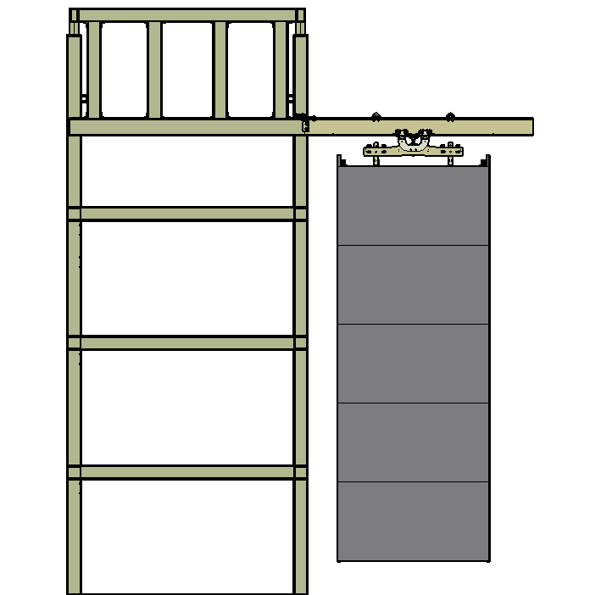
Transfer to the assembly tower beam
Lifting beam is connected and the APA is transferred in the same way as for the lower APA.

Slide 19
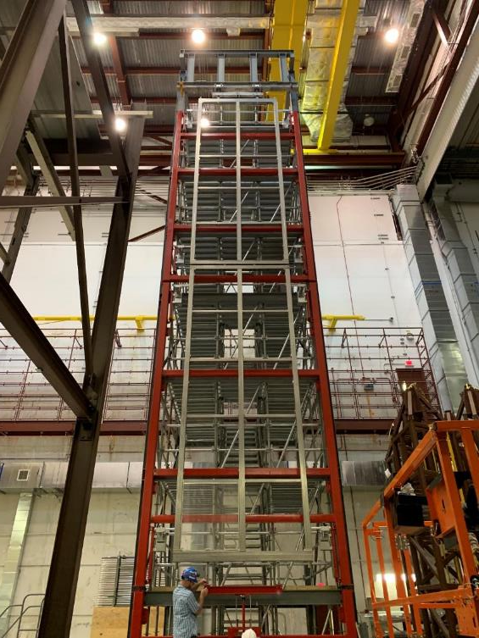
APA assembly fixture
Image of upper and lower APA frames assembled on the tower

Slide 20
Back Up Slides

Slide 21
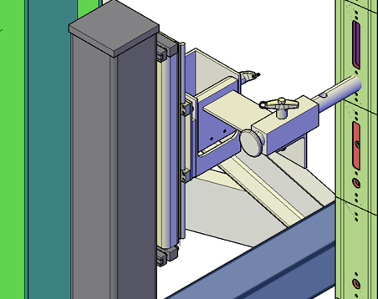
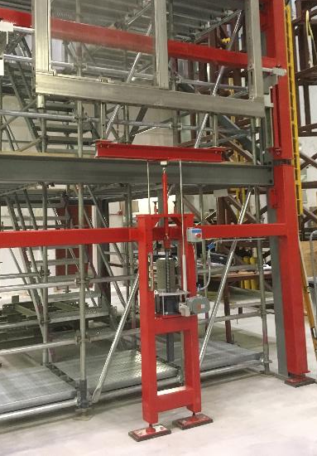
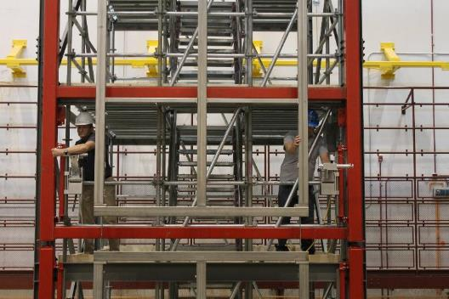
APA assembly fixture
Stabilizers do not support any load but position and guide the APAs
The actuator stand lifts the lower APA to make connections to the upper APA
Stabilizers pivot out of the way to allow the assembled pair to pass by
Successfully tested at Ash River
Stabilizer
Stabilizer being deployed
Actuator stand

Slide 22
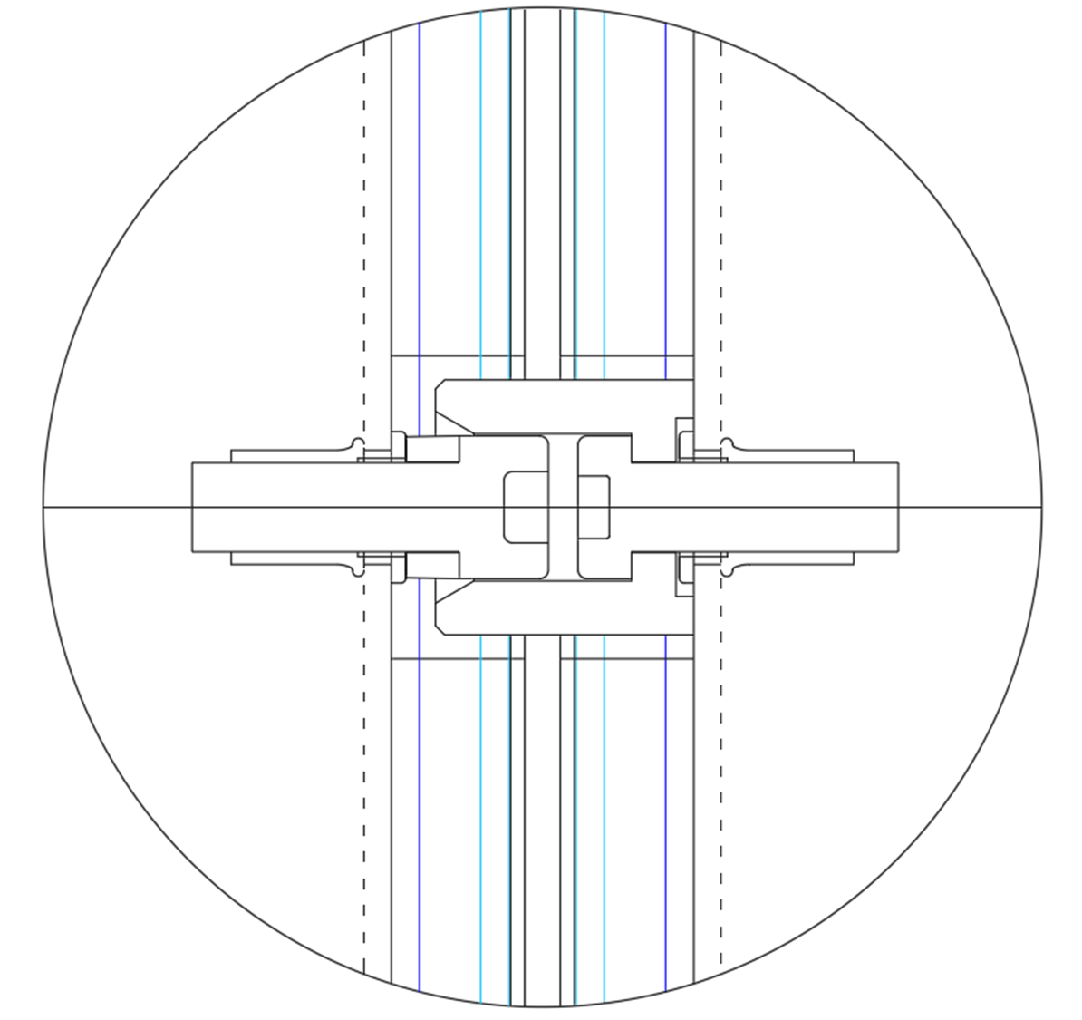
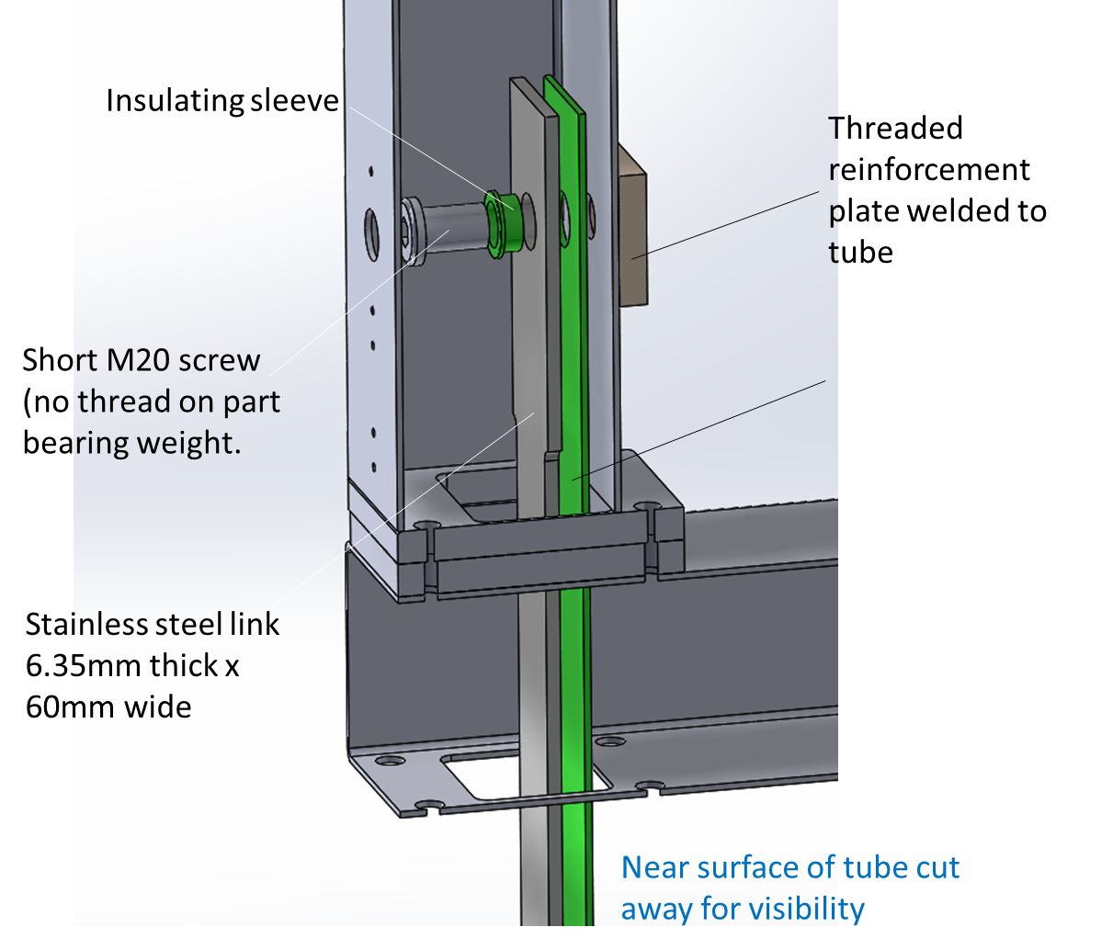
Connection between upper and lower APA
APA to APA links support the Lower APA.
Alignment pins control the alignment between the top and bottom APA
1 Pin-to-hole and 1 pin-to-slot engage and control alignment

