Slide 1
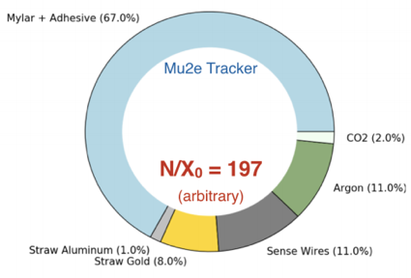
Thin straws
Brendan Casey

Slide 2
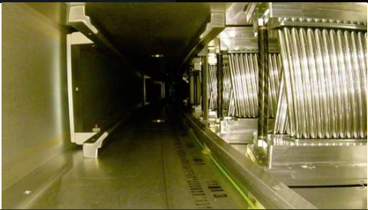
Current state
15 micron thick Mu2e straws have been demonstrated to work in g-2. They are about a factor of 2 less material than any other straws that have been deployed.
Now we are trying to get another factor of 2 (at least)

Slide 3
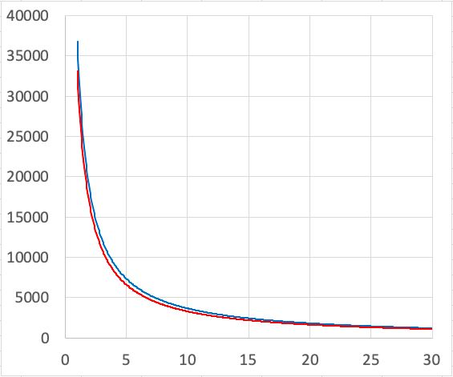
How low can you go?
Hoop stress for 1 ATM pressure differential
5 mm diameter cylinder
We are approaching physical limits of materials and winding techniques used in Mu2e straws
We will try to get as thin as we can with past techniques
We will also explore new techniques
PSI
Tensile strength of Mylar
shear strength of epoxy
4.5 mm cylinder
Wall thickness (microns)

Slide 4
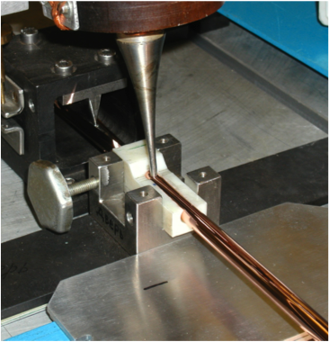
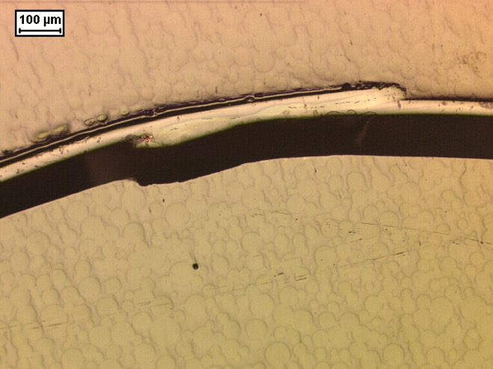
What is happening?
Spiral wound:
trying to demonstrate 8 micron wall thickness and also explore down to 3 micron
Fermilab LDRD and Mu2e-II baseline
Welded:
Trying to get down to 12 micron wall thickness.
Have made 1 straw proof of principle
NA62 upgrade + COMET
Extruded
Exploring 1 micron wall thickness for metal straws
Fermilab discussing options with the micro-forming community in mechanical engineering

Slide 5
Snowmass paper
It would be nice to have a joint paper with Mu2e-II, NA62, and COMET reviewing what we are trying to do
I am already talking to the groups but we have not yet talked about a paper. Minimum would be just a Mu2e-II paper.
We will probably also turn this into a US-Japan proposal. We considered this for the last round but didn’t start the process early enough to make the deadlines.

