Slide 1
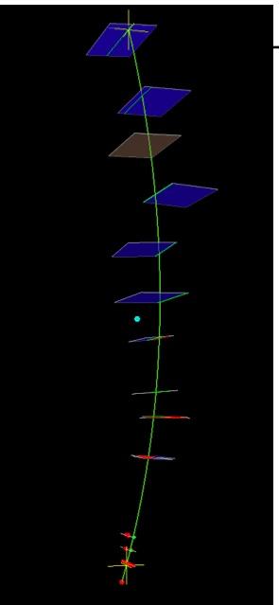
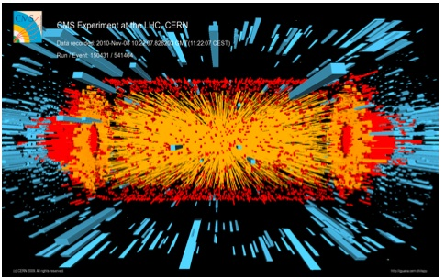
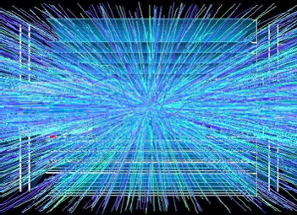
Some Thoughts on the future directions of
Precision Position and Timing Detector development
Ted Liu (Fermilab)

Slide 2
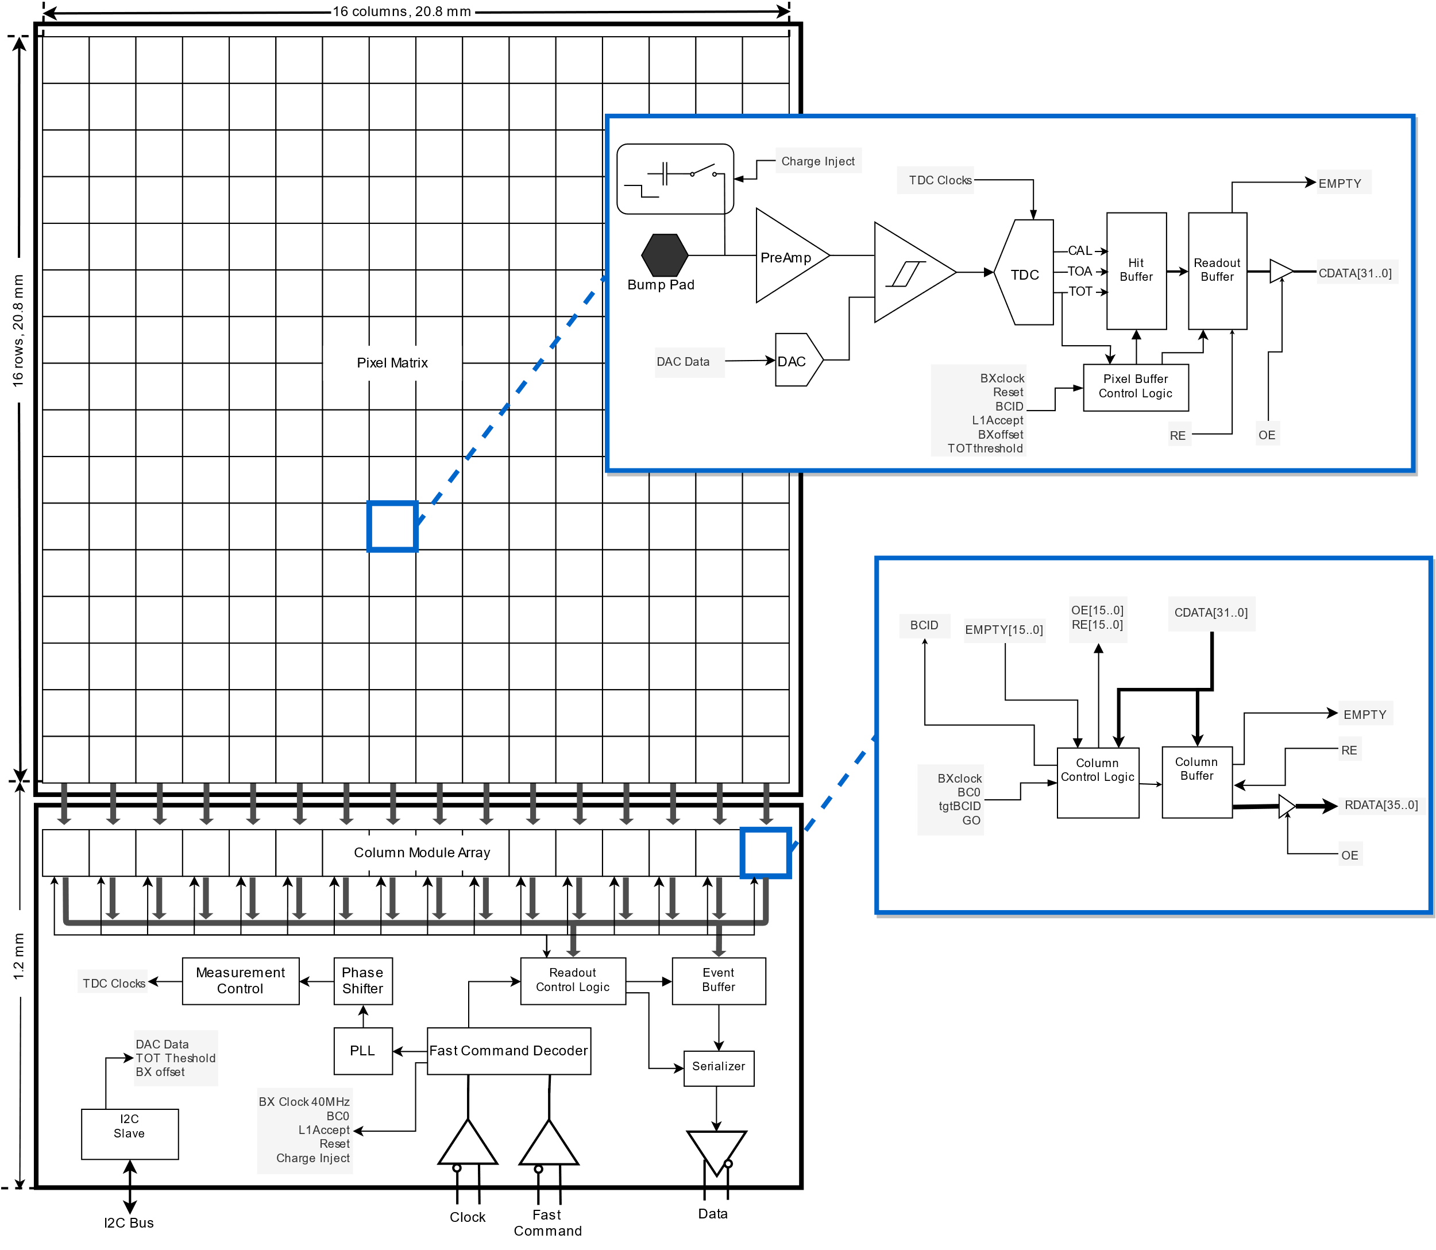
ETROC (CMS ETL ReadOut Chip) design
Preamp/Disc
low power
TDC
The 16x16 pixel array ETROC is bump-bonded
to 16x16 sensor pixel array of LGAD
The size of pixel: 1.3 mm x 1.3mm
(the same size for ATLAS HGTD)
This is the first generation precision timing
detector (~30-40 ps level)… but by no means
precision position detector.
To also have precision position information,
the pixel size needs to be scaled from
1.3mm x 1.3mm down to
~ 100 um x 100 um or below.
(a factor of > ~170)
This is challenging!
16x16 pixel cell array
Readout
Waveform sampler
locations: “spying”
two pixels
Precision clock
distribution to
all pixels

Slide 3
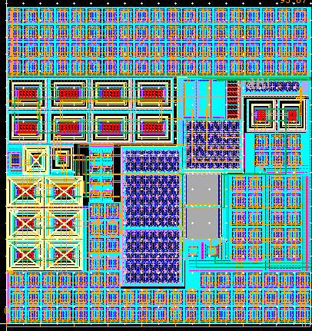
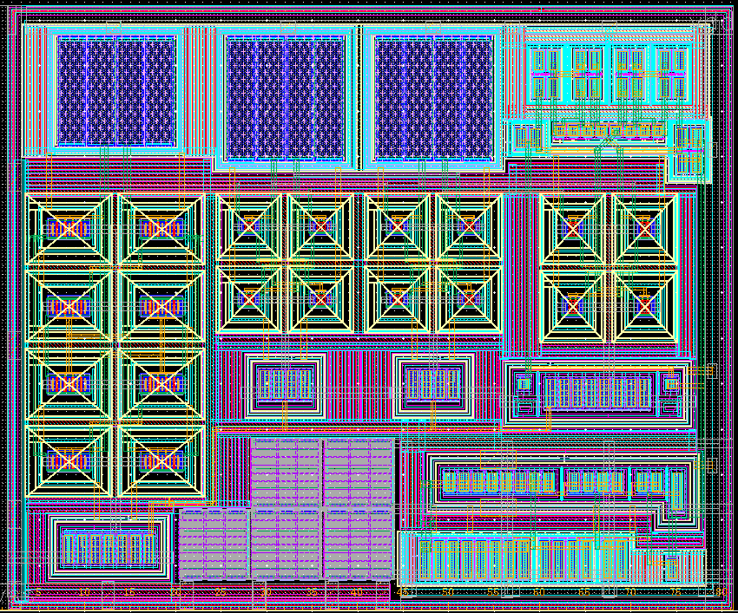
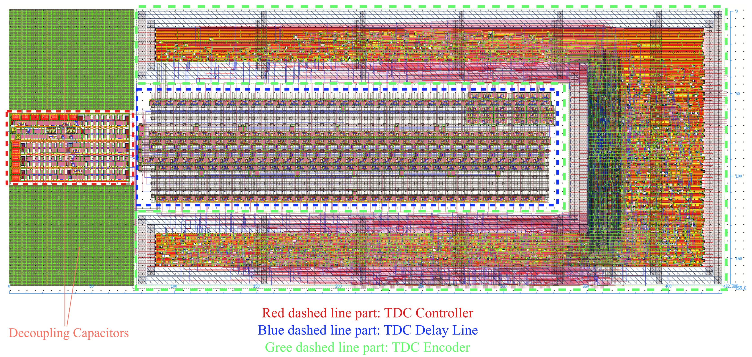
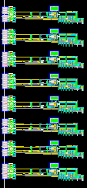
What we have learned from ETROC (CMS ETL ASIC)
65nm implementation
90 um X 94 um
16x16 pixel cell array (1.3mm x 1.3 mm)
Preamp/Disc
low power
TDC
Preamp
Hit buffer
81 um X 67 um
Discriminator
467 um X 166 um (can be subdivided)
TDC
300um x 800um
Hit
circular
buffer
3.2GS/s
waveform sampler
SRAM hit buffer
250 um x 150 um
(can be
subdivided)

Slide 4
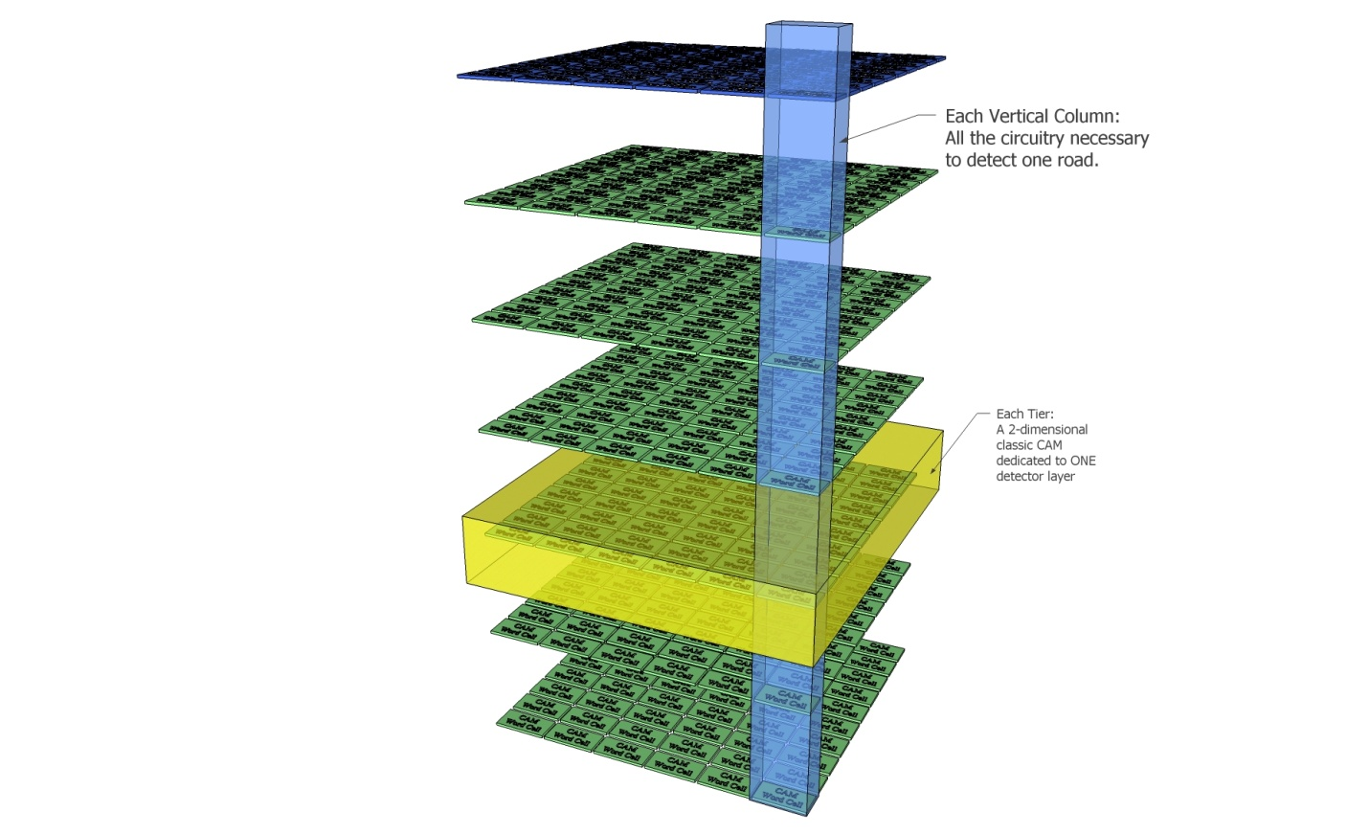
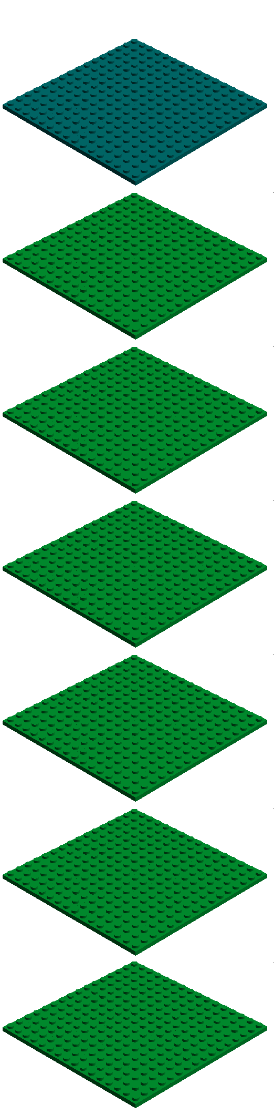
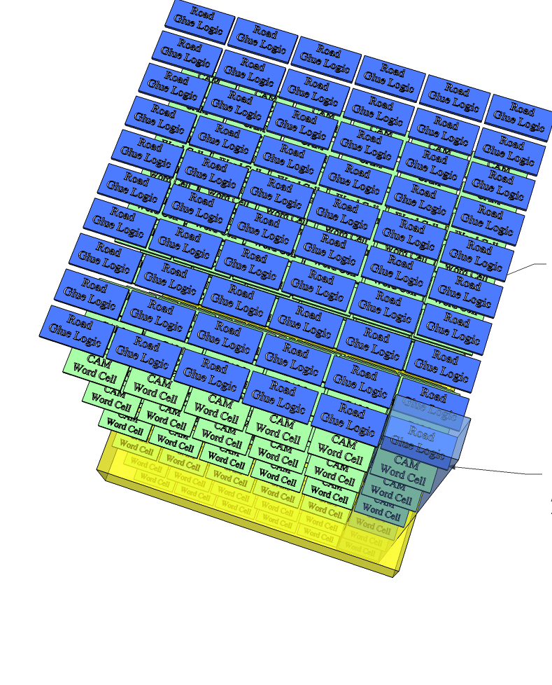
3DIC Technology
The 3D stack is very thin ( < ~ 10 um per tier)
Interconnection much better than bump-bonding
reduced power density or increased speed
“A New Concept of Vertically Integrated Pattern Recognition Associative Memory”
TIPP 2011 Proceedings http://www.sciencedirect.com/science/article/pii/S1875389212019165

Slide 5
How could 3DIC help to scale to smaller pixel size
for precision position & timing detectors
3DIC Technology
An open flexible architecture for
precision position and timing detector
(one example below)
Readout and interfaces
Hit buffer
Clock distribution
TDC
Discriminator
preamp stage
Sensor pixels (~100 um x ~ 100um each)
3DIC allows repartition of the design blocks
vertically for the whole processing chain
“A New Concept of Vertically Integrated Pattern Recognition Associative Memory”
TIPP 2011 Proceedings http://www.sciencedirect.com/science/article/pii/S1875389212019165

Slide 6
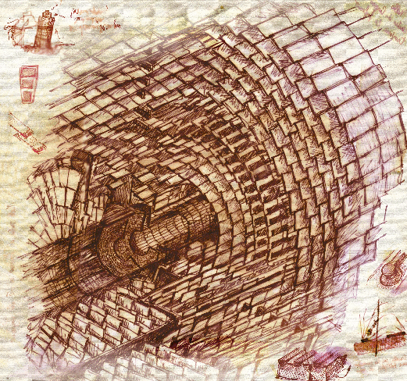
Detector design for triggering
Tracking @ future hadron collider
→ the view from HL-LHC (or a wild guess)
Emerging 3DIC
Technology promising
Data transfer (rad hard) high bandwidth low power data link
Data formatting
Telecommunication technology
There are new challenges:
(0) what kind of detector?
With precision position and timing info
(1) Data Reduction at detector/sensor stage
with much more intelligence integrated
(2) Data Transfer (rad hard, high bandwidth, low power link)
(3) Data Formatting
(4) Pattern Recognition
(5) Track Fitting …
Open question: Can fast timing be used for pattern recognition in tracking trigger?
(pattern recognition in 4D: both space and time)
what is the highest luminosity trigger can handle? (beyond 1E35?)
Pattern Recognition
Emerging 3DIC
Technology promising
Track
Fitting
Modern FPGAs
HLT

