Slide 1
NIR in LAR
Ideas for a White Paper
Carlos O. Escobar – Fermilab
In collaboration with Adam Para and Paul Rubinov
FERMILAB SAC strategic planning working group: Detectors 05/08/2020

Slide 2
Why looking into the NIR?
Mitigation of Rayleigh scattering effects
Mitigation of shadowing effects of wire mesh
No need for VUV -→ visible light shift
FERMILAB SAC strategic planning working group: Detectors 05/08/2020

Slide 3
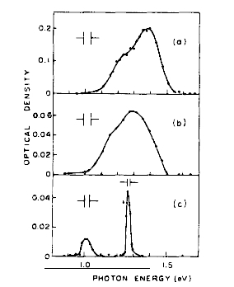
Historical review plus theoretical support for NIR scintillation
Important reminder: from the energetics point of view there is room for further emission other than VUV the mean energy necessary for an ionizing particle to produce an e-ion pair, W, is higher than the ionization energy I of the isolated atom. Extra energy W-I.
From Suemoto et al.
Observation of relaxed exciton states in condensed argon PL 61A, 131 (1977)
Broad structure observed for LAr, middle panel, centered a 1.3 eV = > 954 nm
FERMILAB SAC strategic planning working group: Detectors 05/08/2020
IR transitions in Rydberg states of Ar2 excited dimers

Slide 4
How to detect the NIR scintillation
New developments in SiPM technology enhancing PDE at λ ≈ 900 nm
Developments in InGaAs single photon detectors operating in the Geiger mode with active quenching
FERMILAB SAC strategic planning working group: Detectors 05/08/2020
Collecting the NIR light

Slide 5
Next: an experiment at PAB, using TallBo and new NIR MPPCs and VUV4 SiPMs aiming at a determination of the light yield and time structure of the NIR light

