Slide 1
Induced Current Detectors
Ron Lipton, Doug Berry
Snowmass white paper planning meeting
May 8, 2020

Slide 2
Induced Current detectors
There has been increasing interest in fast timing and “intelligent” detector systems. I would like to present some ideas for alternate designs of such systems looking at how technology for silicon-based detectors might evolve. This is a talk about the future - next generation of collider experiments.
The charge induced on an electrode depends on the coupling between the moving charge and the electrode
(Ramo’s theorem). We usually ignore the
fast transient signals on electrodes
where charge is not collected.
Technology has evolved to the point where
we can consider using these signals
for detailed information on the timing and
pattern of charge deposition
MIP pulse shapes – provide timing
and angle
Prompt induced
Current pulse
15 degree track in
300 micron detector

Slide 3
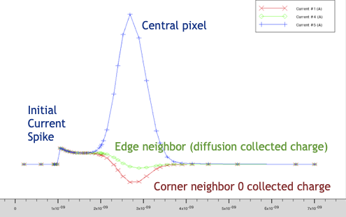
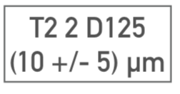
Pulse shapes
This Capability is enabled by new technologies that provide small pixels with low capacitance and sophisticated local processing
3D integration of sensors and electronics provide low capacitance, dense interconnects and processing
If the resulting signal/noise is high enough we can use fast induced currents rather than just collected charge to provide additional time, position, and angle information
Use the current pulse shape to characterize charge deposit, track angle
Fast timing, radiation hard, precise, position, angle resolution
Enables 5D tracking detectors (X,Y,Z,T,θ)
Example: x-ray at
185/200 micron
MC electrode simulation
with shaping and noise

Slide 4
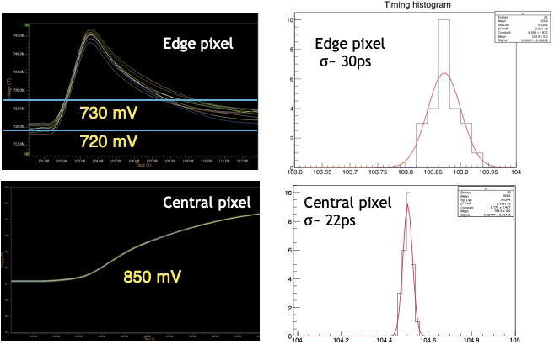
Simple example: Timing with charge sensitive preamp noise with x-ray at 185/200 micron depth
Apply a constant threshold of E1~10 mV, E4~130 mV
Tabulate time at threshold crossing including noise
Edge electrodes (0 charge) provide significant timing information
One MIP
Local deposit

Slide 5
Comments
All pixels with spacing small compared to depth will have similar fast signals ~ 16 pixels for a 25x200 micron sensor x 4 in (uncorrelated) time resolution
The central pixel will see a large signal within a few ns of the leading edge - initial thresholds can be set low and signals latched only if a central pixel fires at a higher threshold
The pattern of pixels will provide depth and/or angle information
Multiple thresholds or more sophisticated processing can give a time walk correction if needed
  3D enables multiple tiers of processing

Slide 6
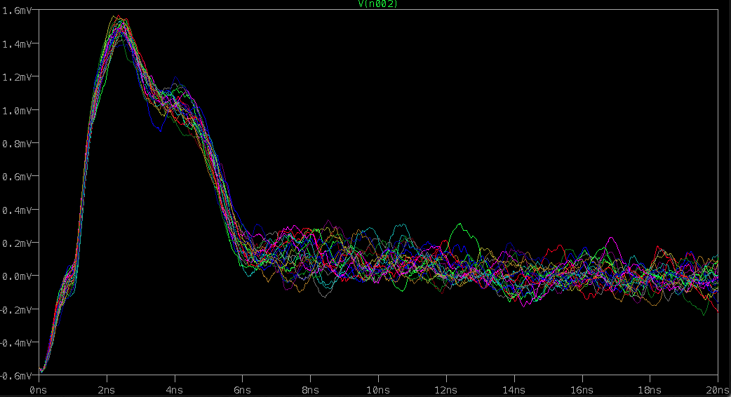
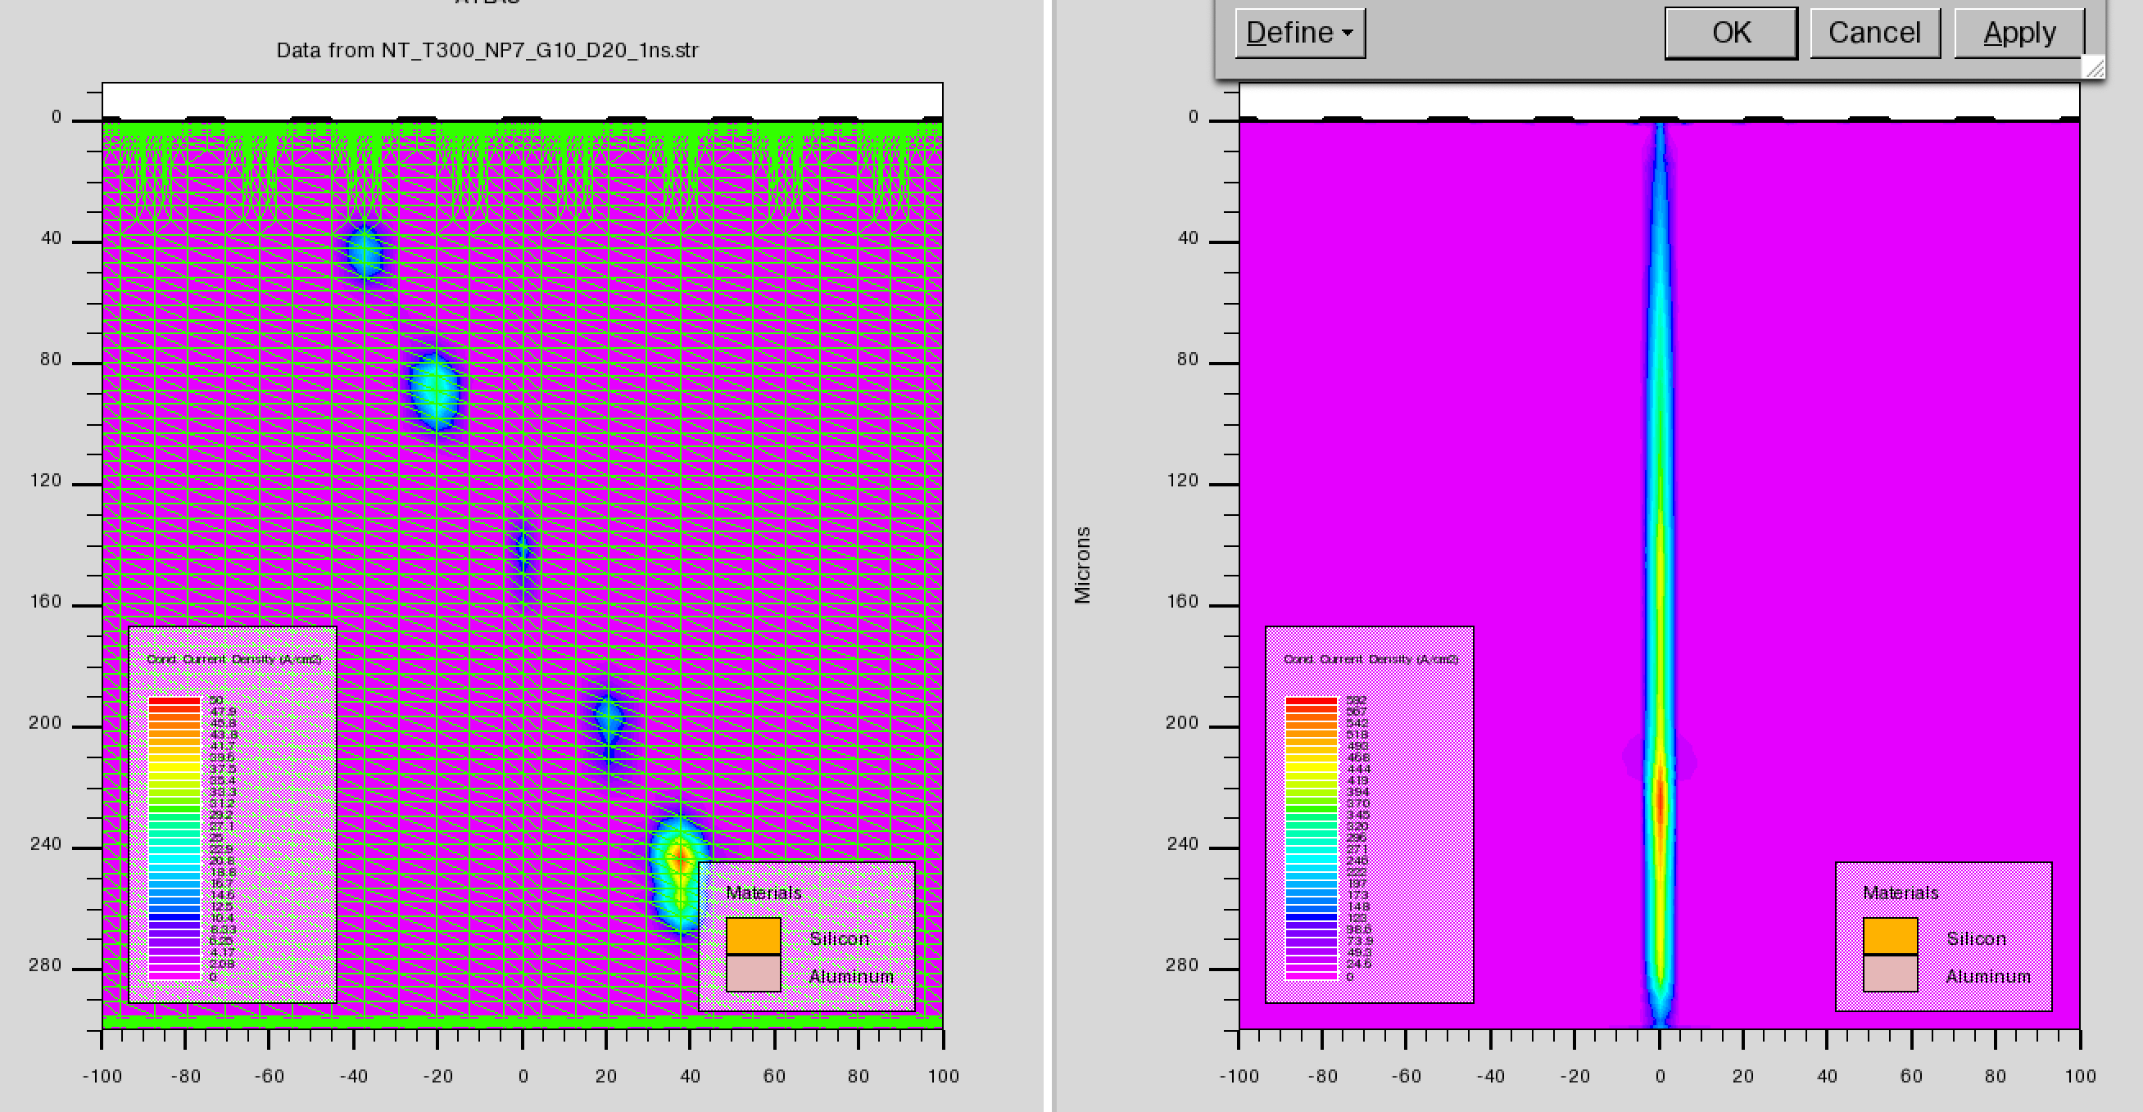
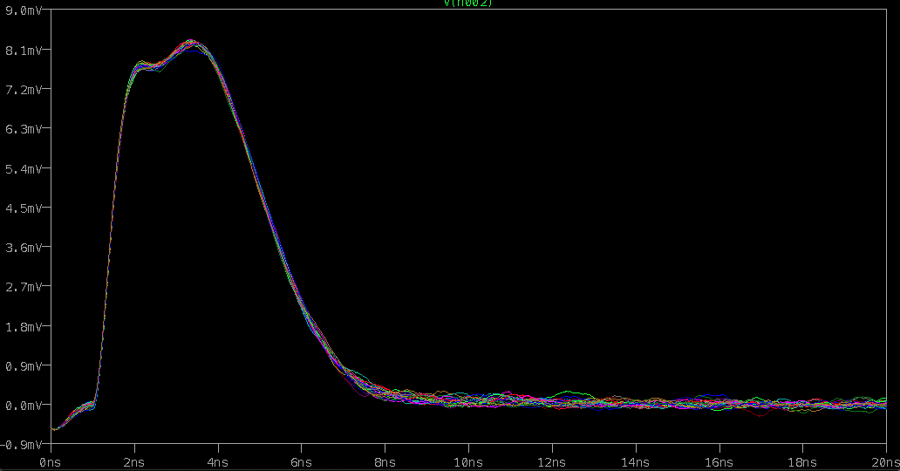
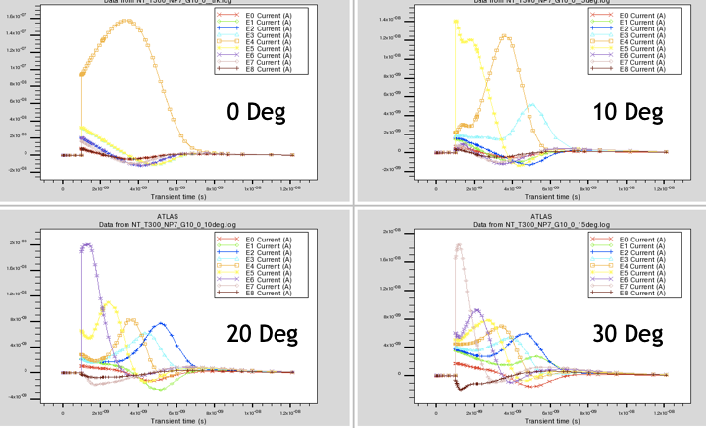
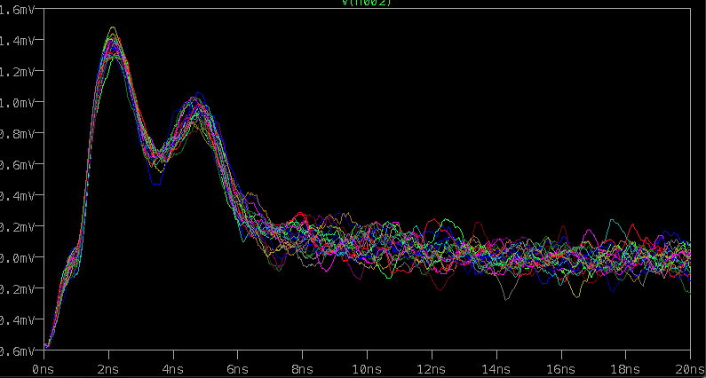
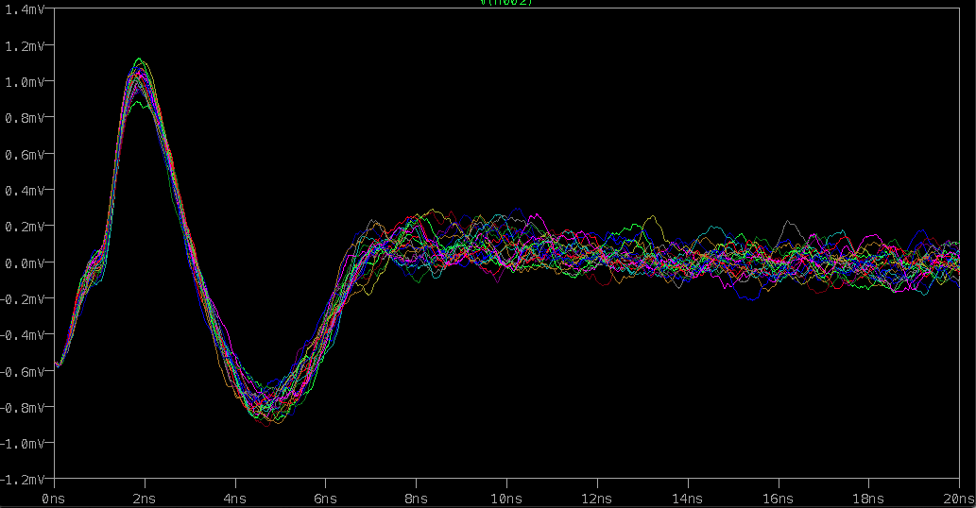
Angle resolution
2 degree MIP track
Angled tracks in thick (300 micron) detectors present a distinct pattern of signals.
Track angle can be estimated on-chip
Studies with TIA, landau fluct. realistic bandwidth and noise
E3
E0
E1
E2
E3
E4
E5
E6
E7
E8
25 μ pitch x
300 μ sensor
0 deg track
E4
20 ns
E5
E6

Slide 7
Summary
Induced current detectors with small pixels is an example of capabilities enabled by emerging technologies.
It is one way of addressing some of the extreme challenges of future experiments (FCC, Muon Collider, EIC …)
  Fast timing
  Precise position and angle resolution
  Radiation hard
  Complex event topologies
  X-ray imaging
R&D
  More sophisticated and accurate simulations
  Continue work on 3D integration with labs and industry, build small demonstration sensors

