Slide 1
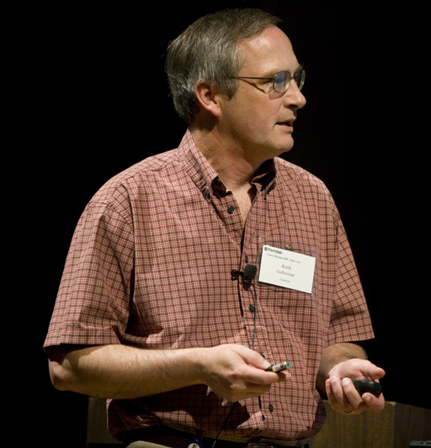

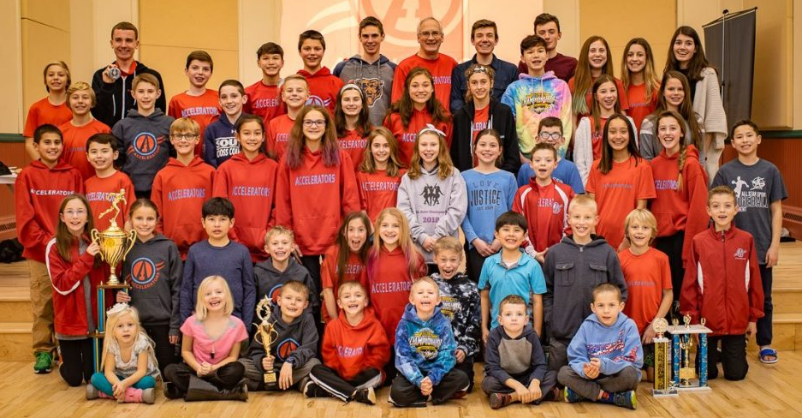
Keith Gollwitzer
Main Role – LBNF manager of the Target Complex
Other roles
  SARP
  Tritium Task Force
A number of years ago…pre-grey
Accelerators Running Club

Slide 2
Science Group (1 of 2)
Role
  To provide science connection between the target stations and the experiments
People
  Katsuya Yonehara
  Athula Wickremasinghe
  Jim Hylen
  Keith Gollwitzer
  Daniel Bowring
  Nilay Bostan

Slide 3
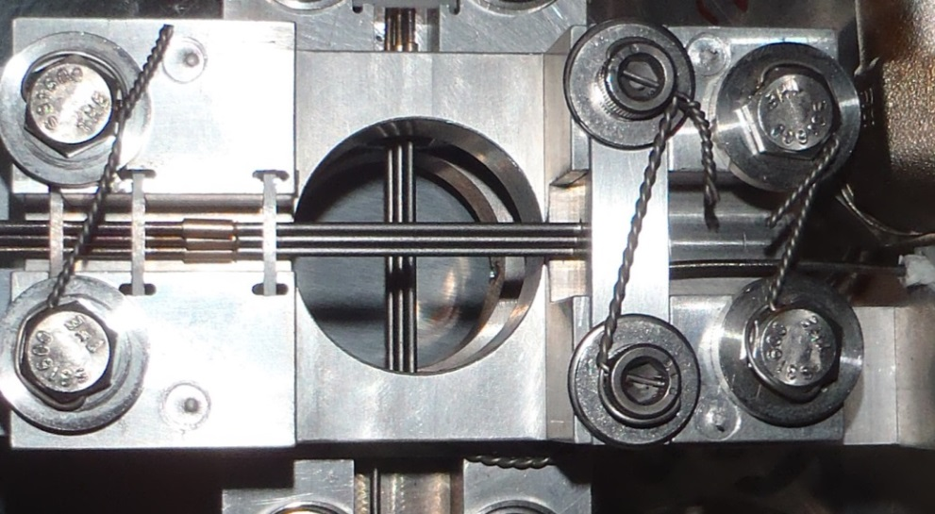
Science Group (2 of 2)
Activities in General
  Help design of target station components
  Experiment’s beam simulation efforts
  Monitoring of target station performance
Participation in Projects
  Mainly long baseline neutrino
    NuMI operations & upgrades
    LBNF

Slide 6
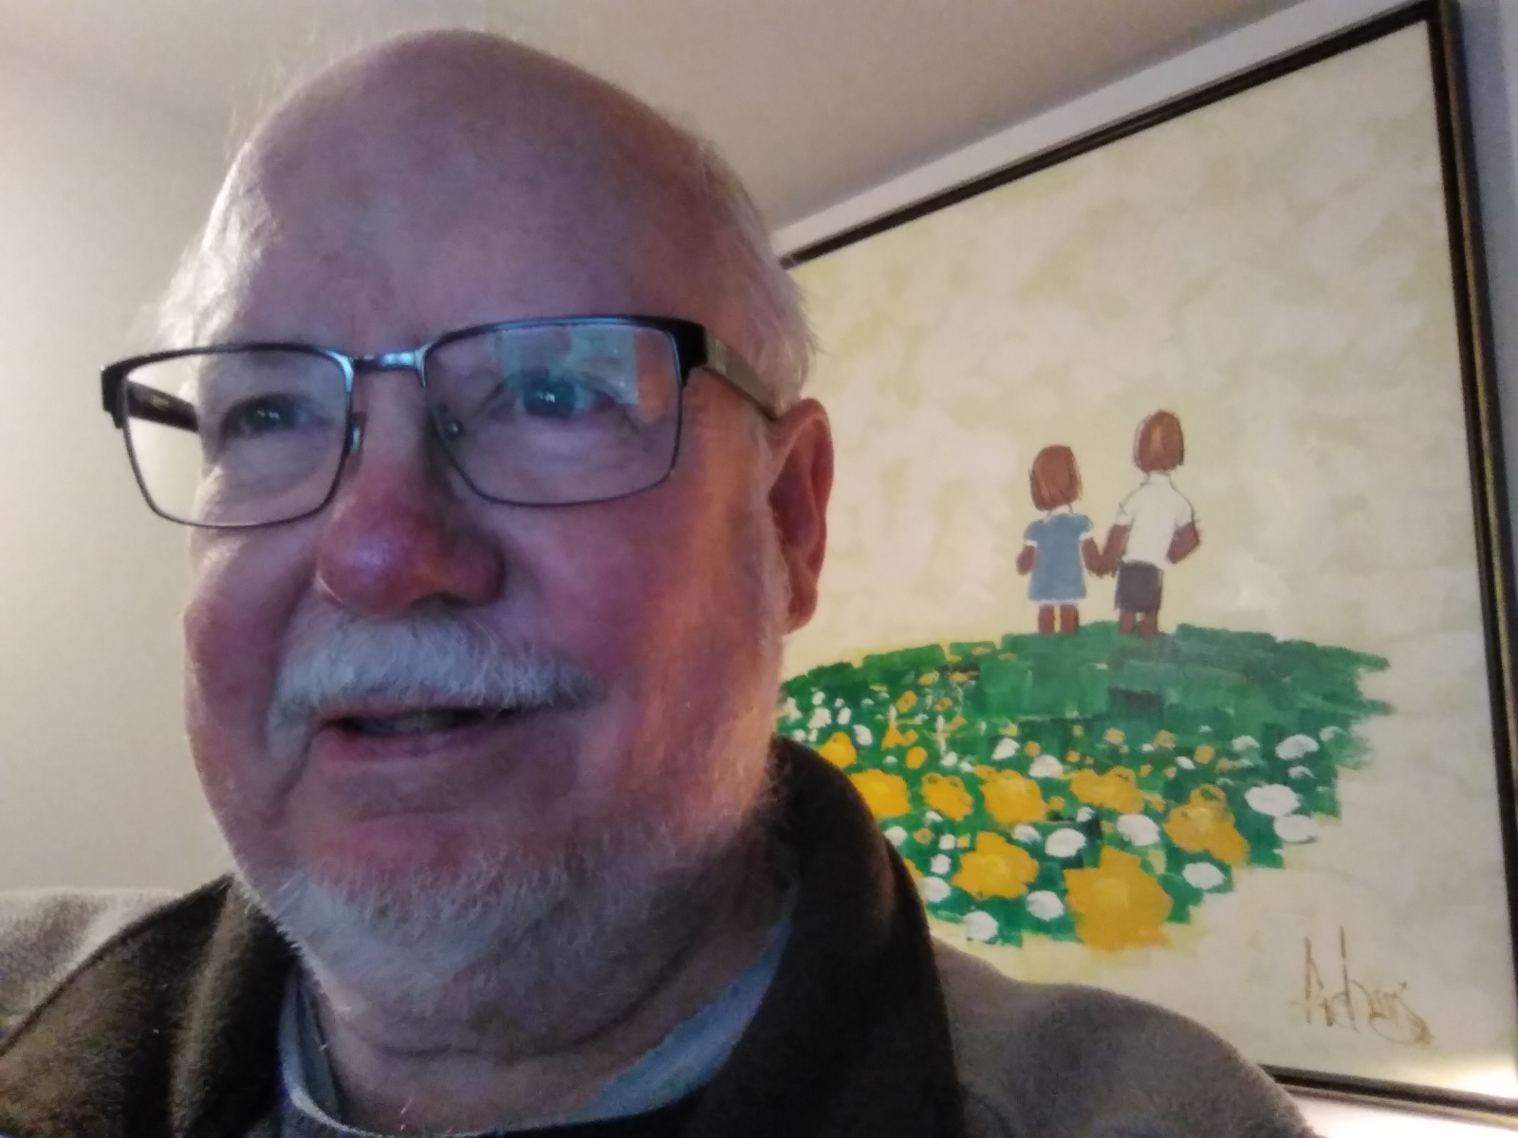
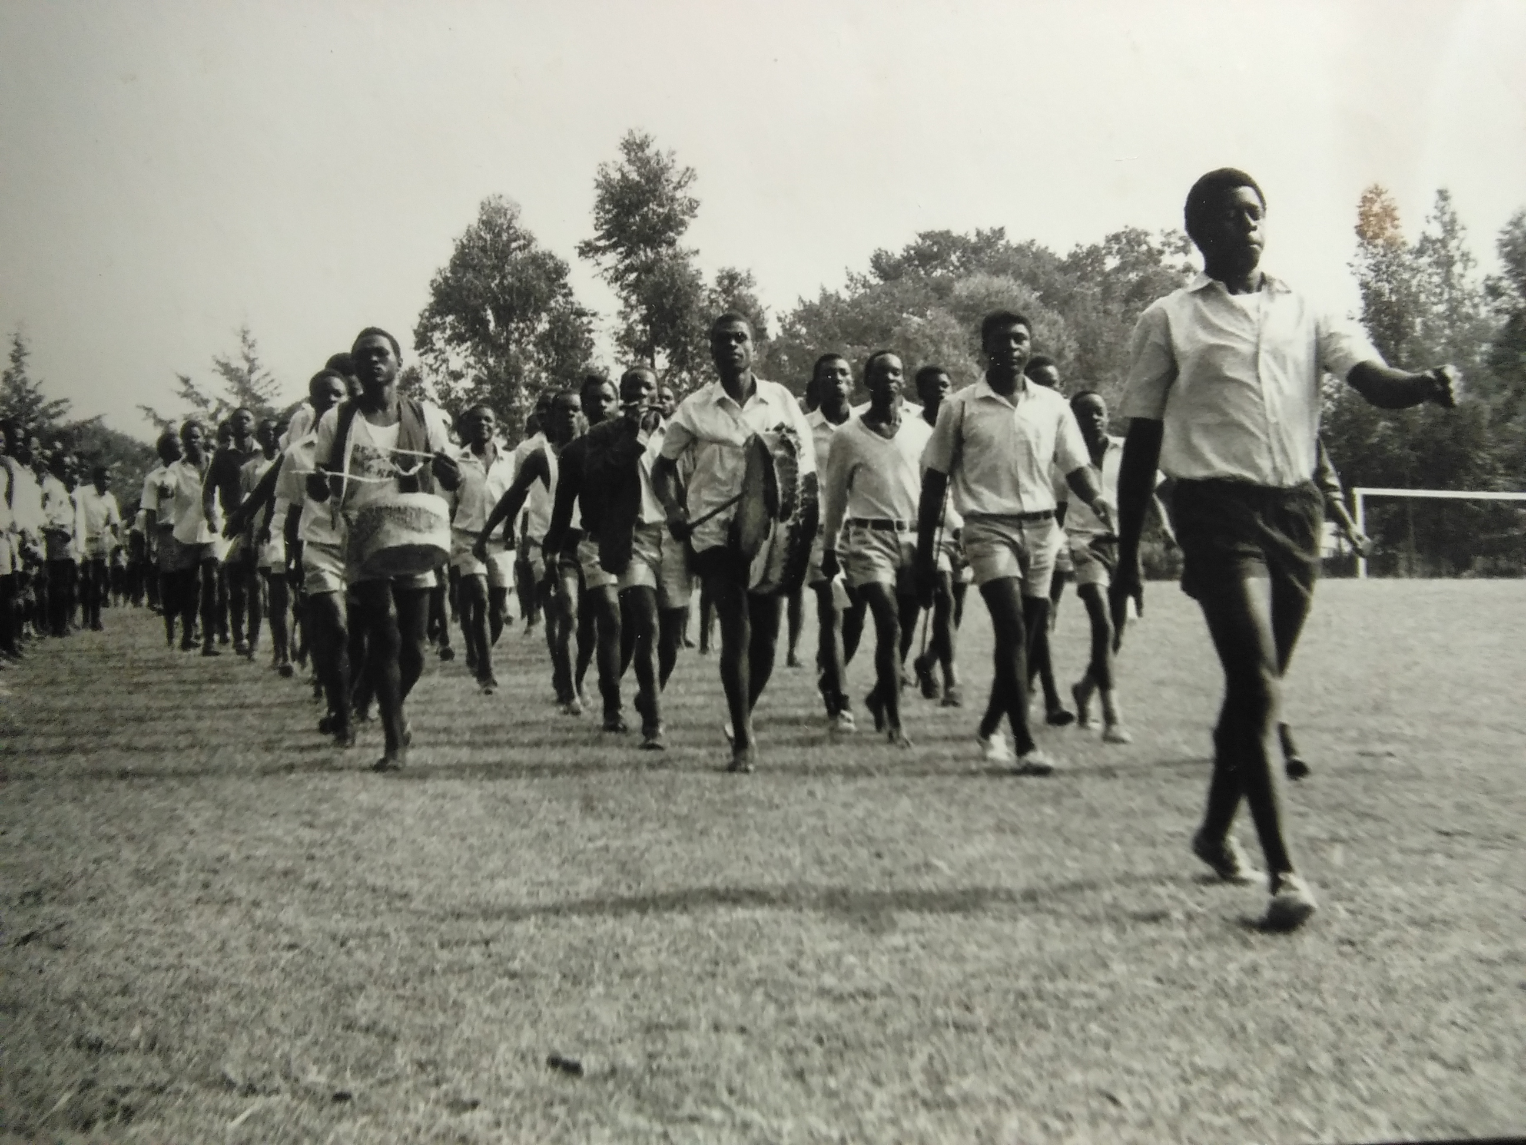
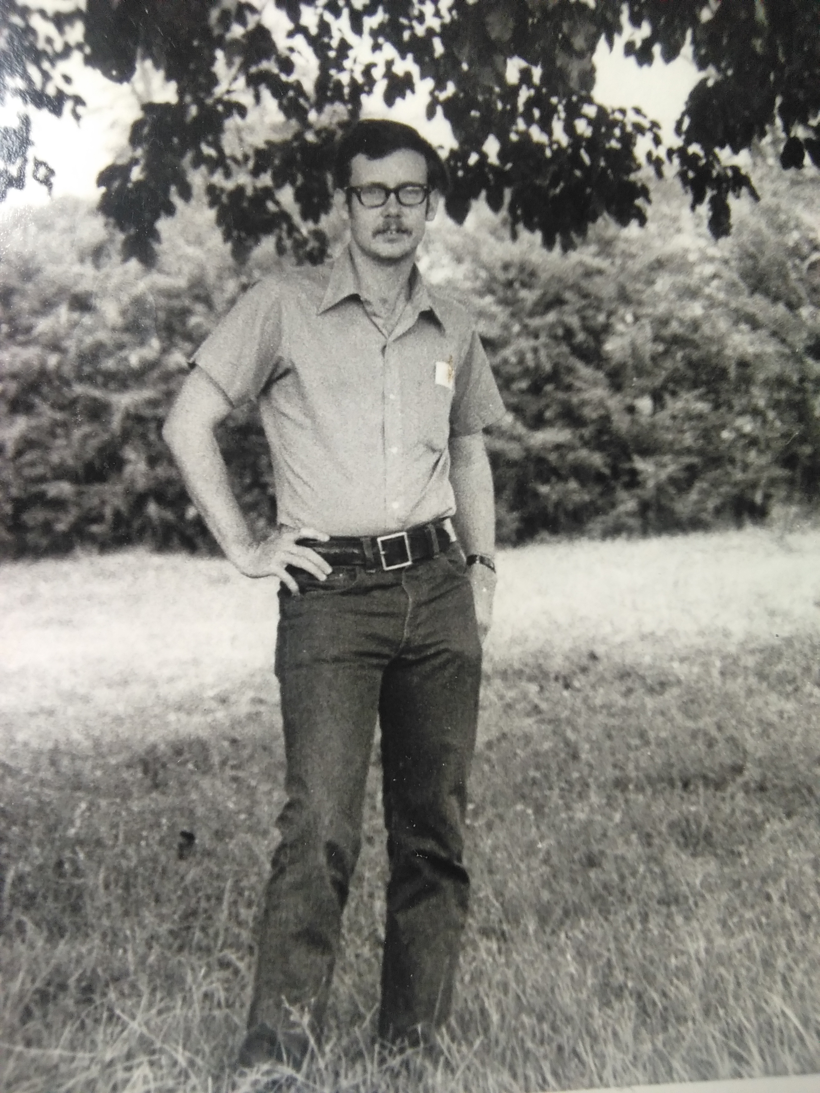
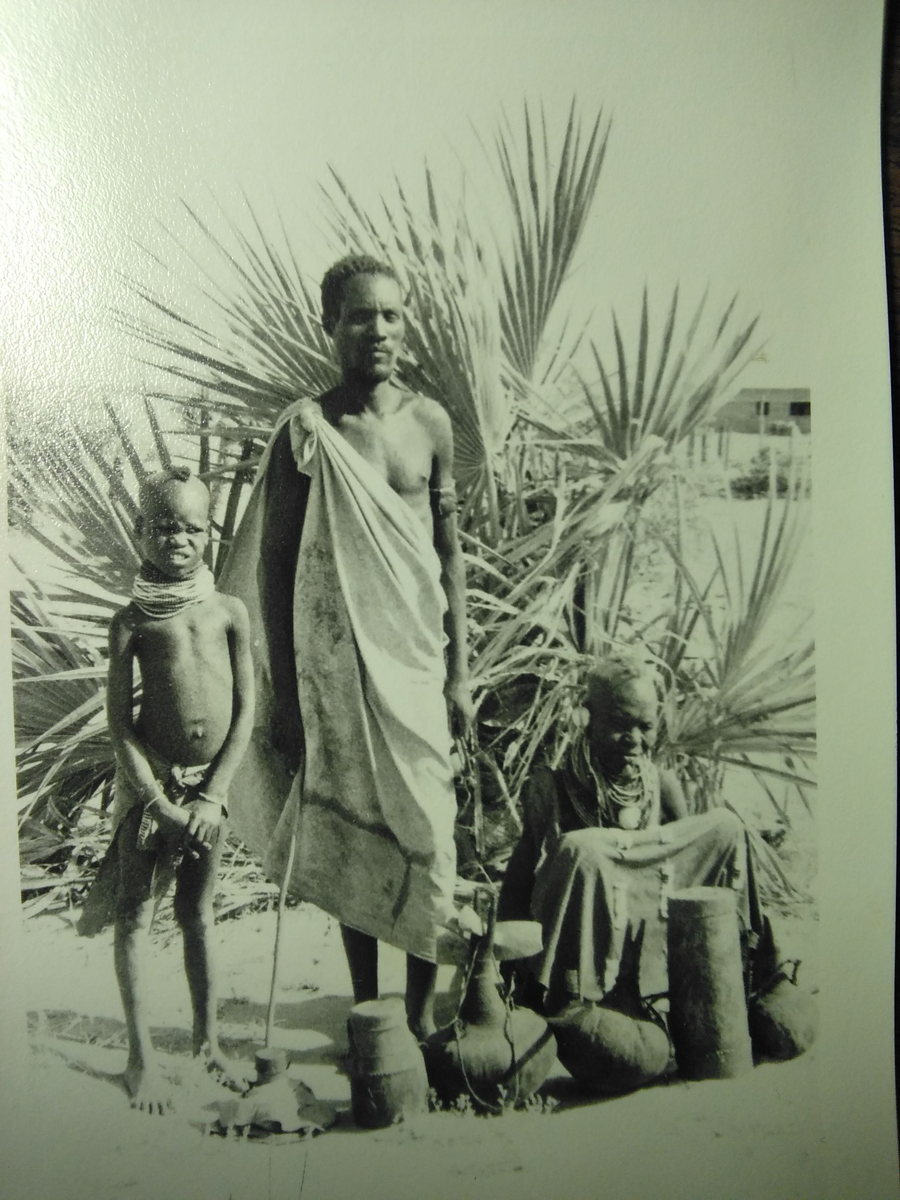
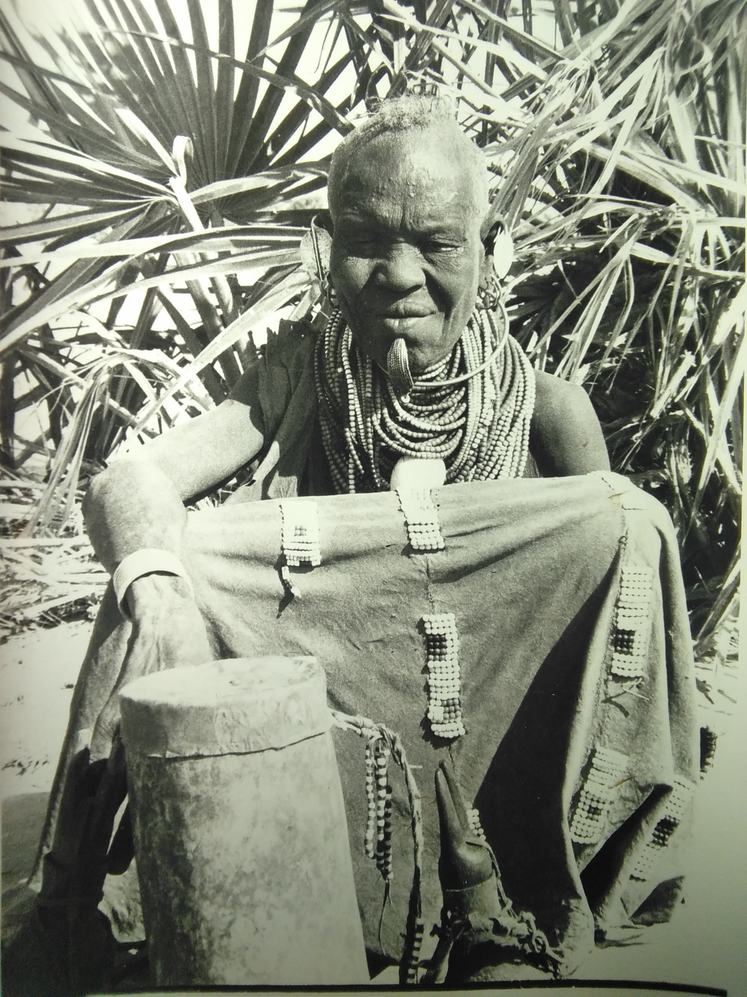
Jim Hylen
Advisor on LBNF design, based on 24 years experience with NuMI; Also Tritium mitigation
Three years Peace Corps in Kenya
  Once upon a time had hair

Slide 7
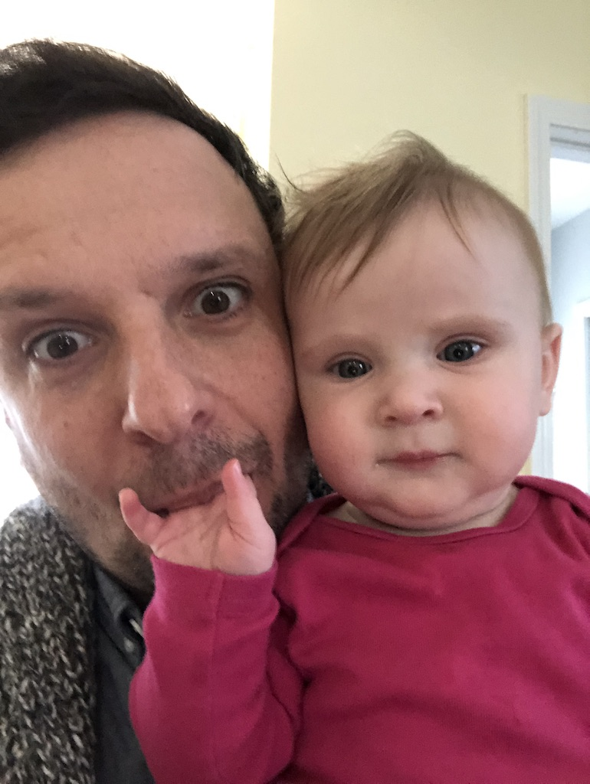
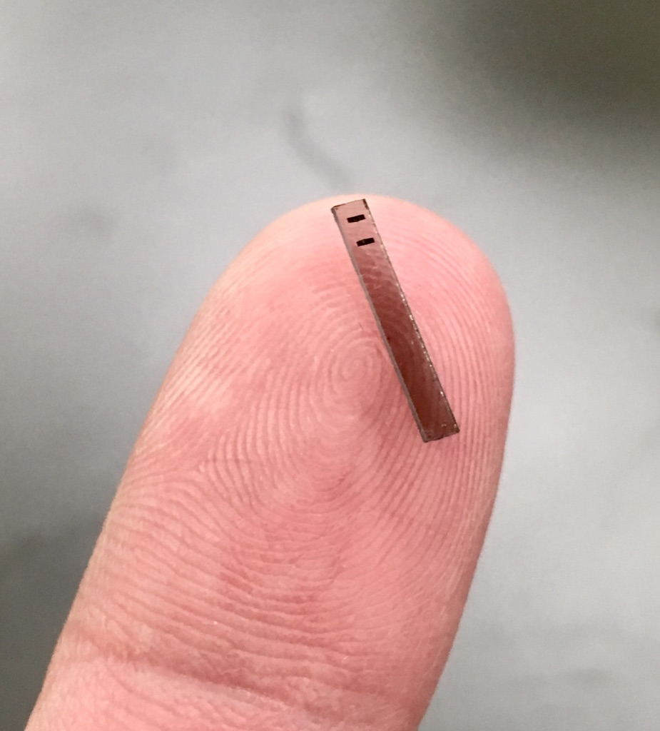
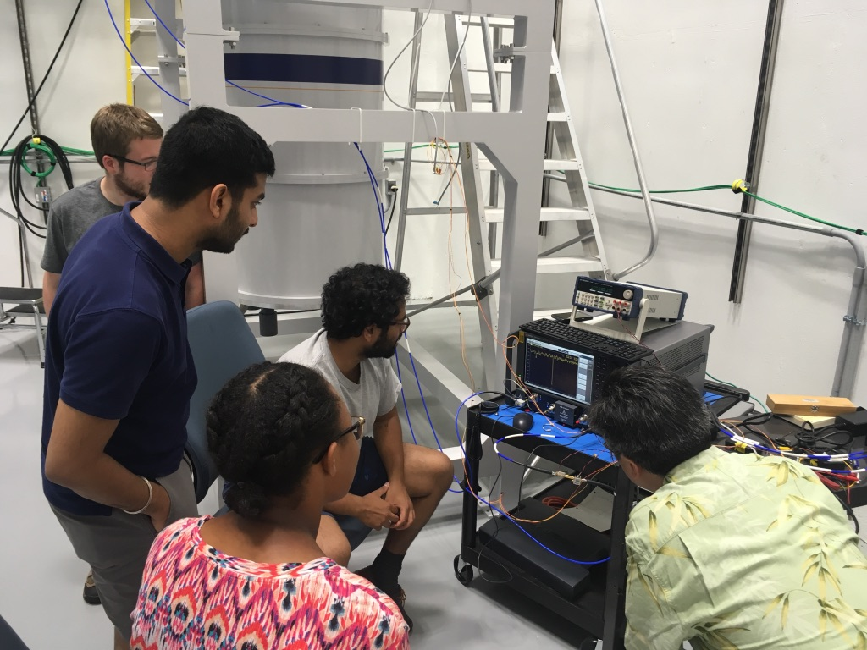
Hi, I’m Daniel Bowring
I’m in AD. I work on developing quantum sensors (superconducting qubits) for axion dark matter detection.
Under normal circumstances, I spend most of my time at SiDet.
Something nobody in TSD knows about me: I’m an avid rock climber when I live in places with rocks to climb.

