Slide 1
TSD All-Hands Meeting
TSD Engineering Group
30 April 2020

Slide 2
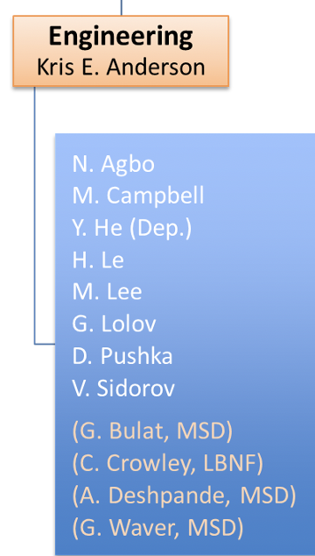
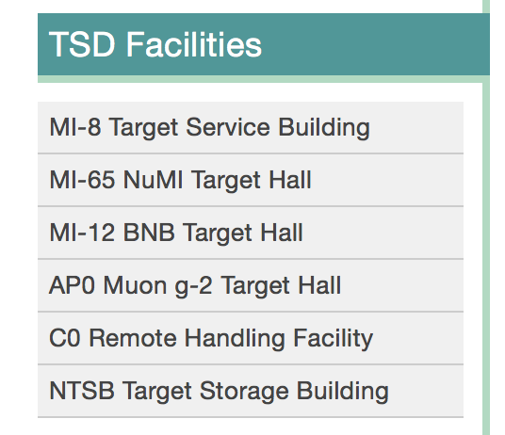
TSD Engineering Group
Group Mission: Provide Engineering support and expertise to target systems operations, projects, and high power targetry R&D and initiatives
Ongoing Target Halls Ops
NuMI since 2004
BNB since 2002
Muon g-2 (AP0)
Target beamline tests Replica Target, EMPHATIC)

Slide 3
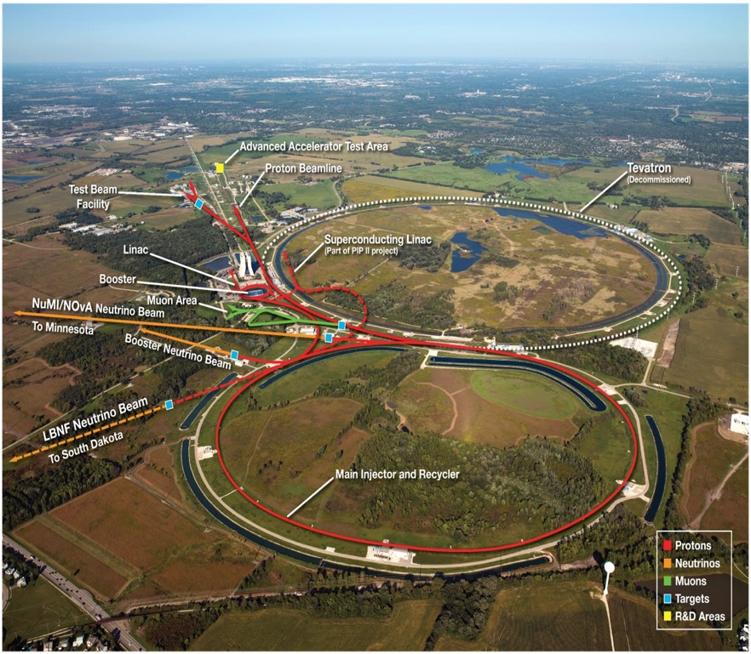
TSD Engineering Group
Projects
Mu2e
LBNF
1MW NuMI AIP
PIP-II
R&D
Mu2e target high emissivity coatings
Loaded targets
Support BLIP and RaDIATE
Currently supporting above efforts while teleworking from home

Slide 4
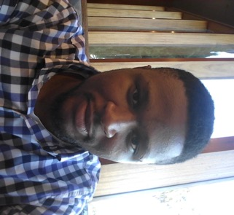
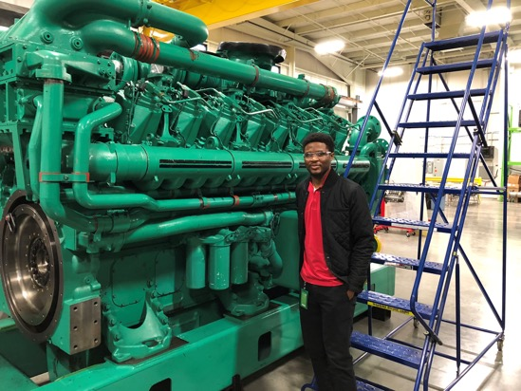
Nnamdi Agbo
Role – Mechanical Engineer, TSD
Joined on 3rd February,2020
Worked previously at Cummins and supported HHP engine design
Currently supporting
LBNF Horn design
LBNF Horn test stand design
NuMI 1MW Upgrade - Hadron Monitor design
PIP II Hadron dump
After this pandemic, you could find in any of the place at my leisure time:
A jazz bar with my IPA
At home playing video game
On the basketball court

Slide 5
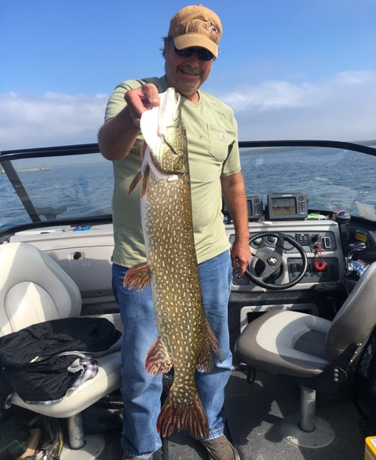
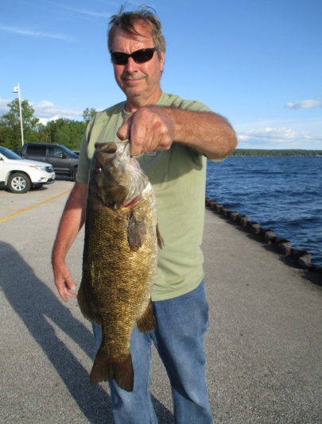
Kris E. Anderson
Engineering Group Leader
TSD Deputy Department Head
Started at Fermilab in 1989 working in MSD
Interesting Fact: Journeyman Bricklayer 1977-1986
Paid for out-of-state tuition at Purdue University one brick-at-a-time (all in all it’s just another brick in the wall)

Slide 6
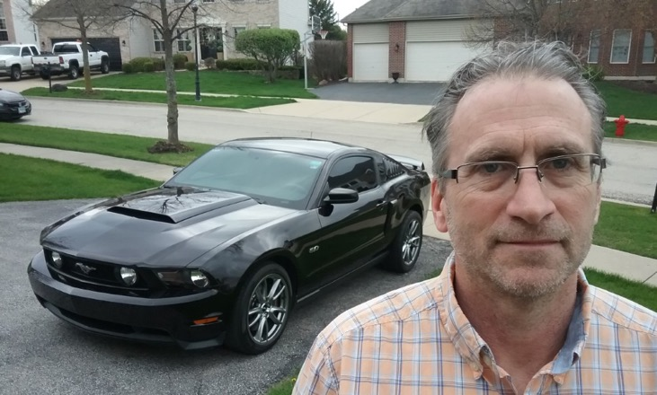
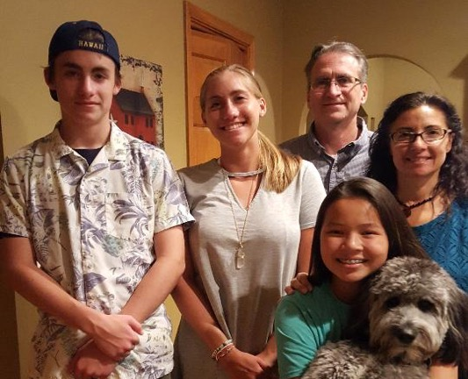
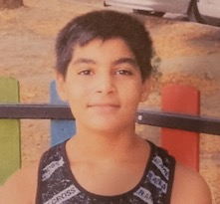
Michael Campbell
Principal Mechanical Engineer
Education: BSME Valparaiso University 1989
Experience: Designed machines for medical imaging and factory automation / robotics
Career at FNAL: 10+ years (not sure)
Role at FNAL: I design stuff
Projects: Mu2e Target Remote Handling Machine
Mu2e Window Remote Handling Machine
Mu2e RH Practice Frame / Target Mount
Czero Sliding Shield Door
NuMi AIP Laser Cut / Welding Robot
LBNF Horn Modules - A, B, C, & Baffle
Something few people know . . .
Diverse & growing family

Slide 7
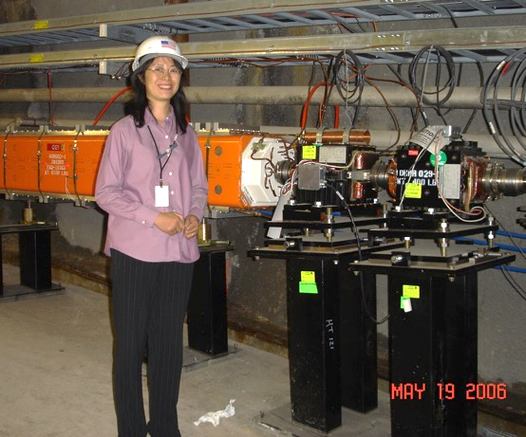
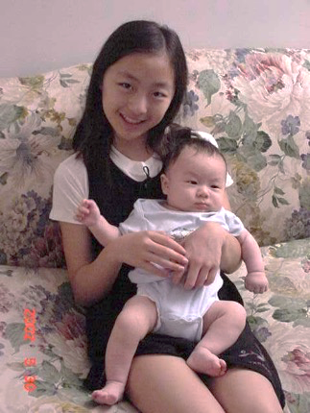
Yun He
NuMI-AIP project manager
TSD assistant head (SharePoint)
Muon g-2 target system lead mechanical engineer
-------------------------------------------
I have raised two single-child
Daughter Son
China Ithaca, NY
Boarding HS CA 18th Bday
Joined the lab in 2006
10 years apart
Long journey
May, 2002

Slide 8
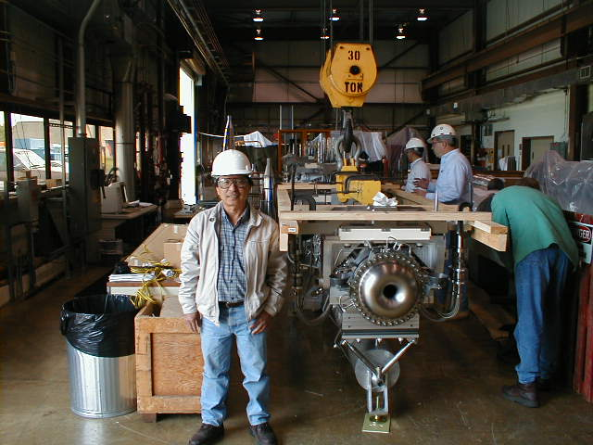
Hiep Le
Technical Expert
Supervised technician groups for AP0 Target Hall and MI-8 Techs for NuMI and BNB
Lithium lens expert
AP0 installation
BNB first horn fabrication
NuMI first horns fabrication and testing
NuMI construction
Started at Fermilab 1/24/1980 (40 years and counting)

Slide 9
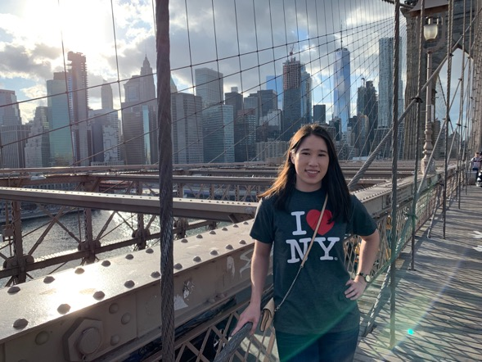
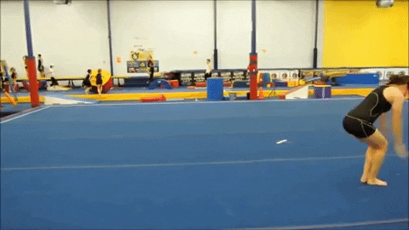
Meredith Lee
Meredith Lee
Mechanical Engineer
Horn fabrication
Target autopsy
NuMI and LBNF procedures
Competitive gymnast for 10 years
Not anymore!
Follow elite and NCAA gymnastics

Slide 10
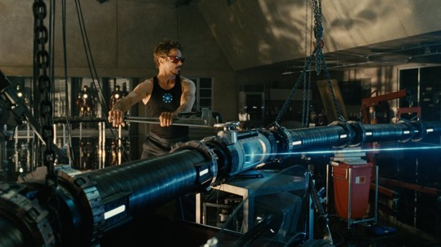
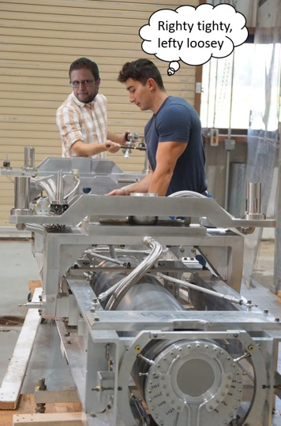
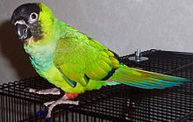
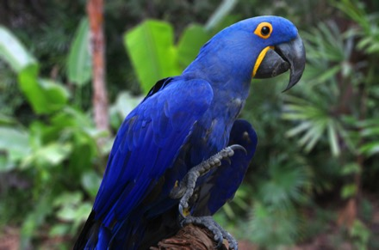
George Lolov
What my family and friends think I do
Lead NuMI Target/Operations Engineer with support for RADIATE and BNB Horns
A fun fact about is me is… l really like parrots!
What the technicians think I do
What I actually do
Conure
Hyacinth Macaw

Slide 11
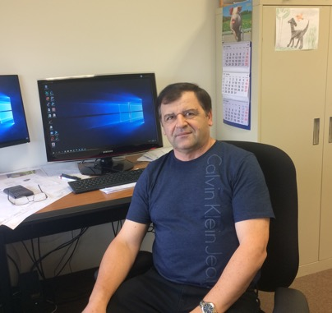
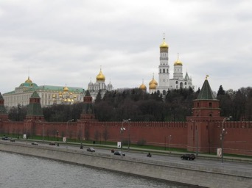
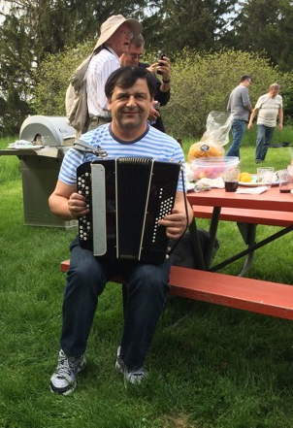
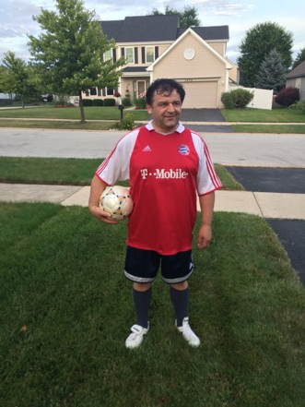
Vladimir Sidorov
Mechanical Engineer
Fermilab employee since March 1997
PPD CMS Department 1997-2002
AD MSD/TSD 2002- present
Design Fabrication and installation:
1. HEP Detectors
CMS Hadron and Forward Calorimeters
2. Accelerator complex beamline equipment
LINAC Collimator, MI, 8Gev Line, Recycler, Mu2e collimation systems, MiniBOONE Beamline equipment, BOOSTER notch absorber
3. Remote Handling facilities and equipment
C0 RH Facility, Transportation cask , NUMI TH Transportation system , Hadron Monitor Exchange fixture , NUMI Horn 1 and Horn2 repair
4. Targetry
NUMI Low Energy Target LE-2 and NOVA Medium Energy Target ME-1 Autopsy
Projects:
LBNF Target Hall Remote Handling
LBNF Absorber Design
PIP II New BOOSTER Collimation System
PIP II Transfer Line Collimation System
PIP II AIP Horn1 and Target Drive Mechanisms replacement

Slide 12
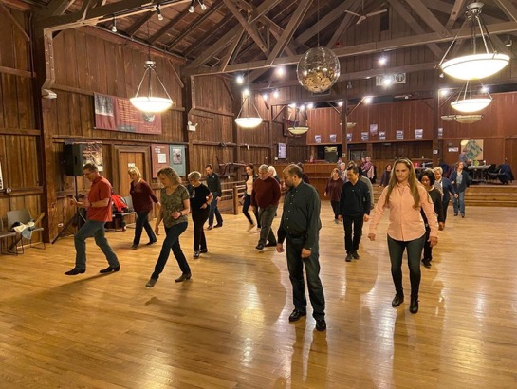
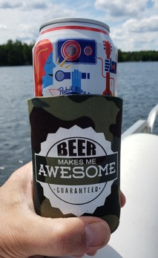
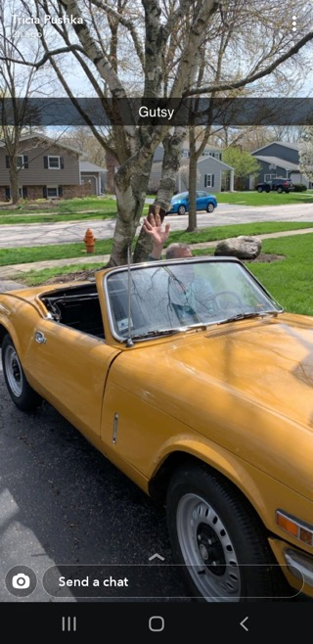
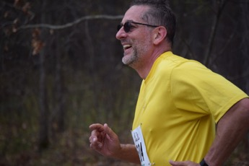
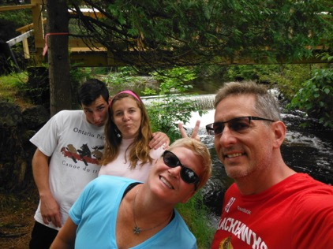
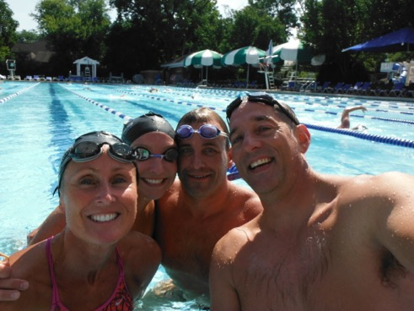
Dave Pushka
Role – Engineer. Fluent in:
Math
Materials
Mechanics
Calculations
CAD & FEA
Codes & Standards
Tools & Toys.
So Many Activities, So Little Time!

