Slide 1
Technical Group
Frankie “Chris” Kelly and Ruby on our skiing outing
Group Leader
Sr. Operations Specialist
I am one of 15 kids

Slide 2
Technical Group
Support the scientific mission
Maintain the operational integrity of the target halls
Build and test the components and the support systems for the target halls
Support new initiatives and the development of new technologies to improve operations
Remove and store radio-activated components that are no longer operational until they have decayed to the level they can be removed from the site
Assist in the documentation and development of assembly and operational procedures
Include best practices to insure safety and quality

Slide 3
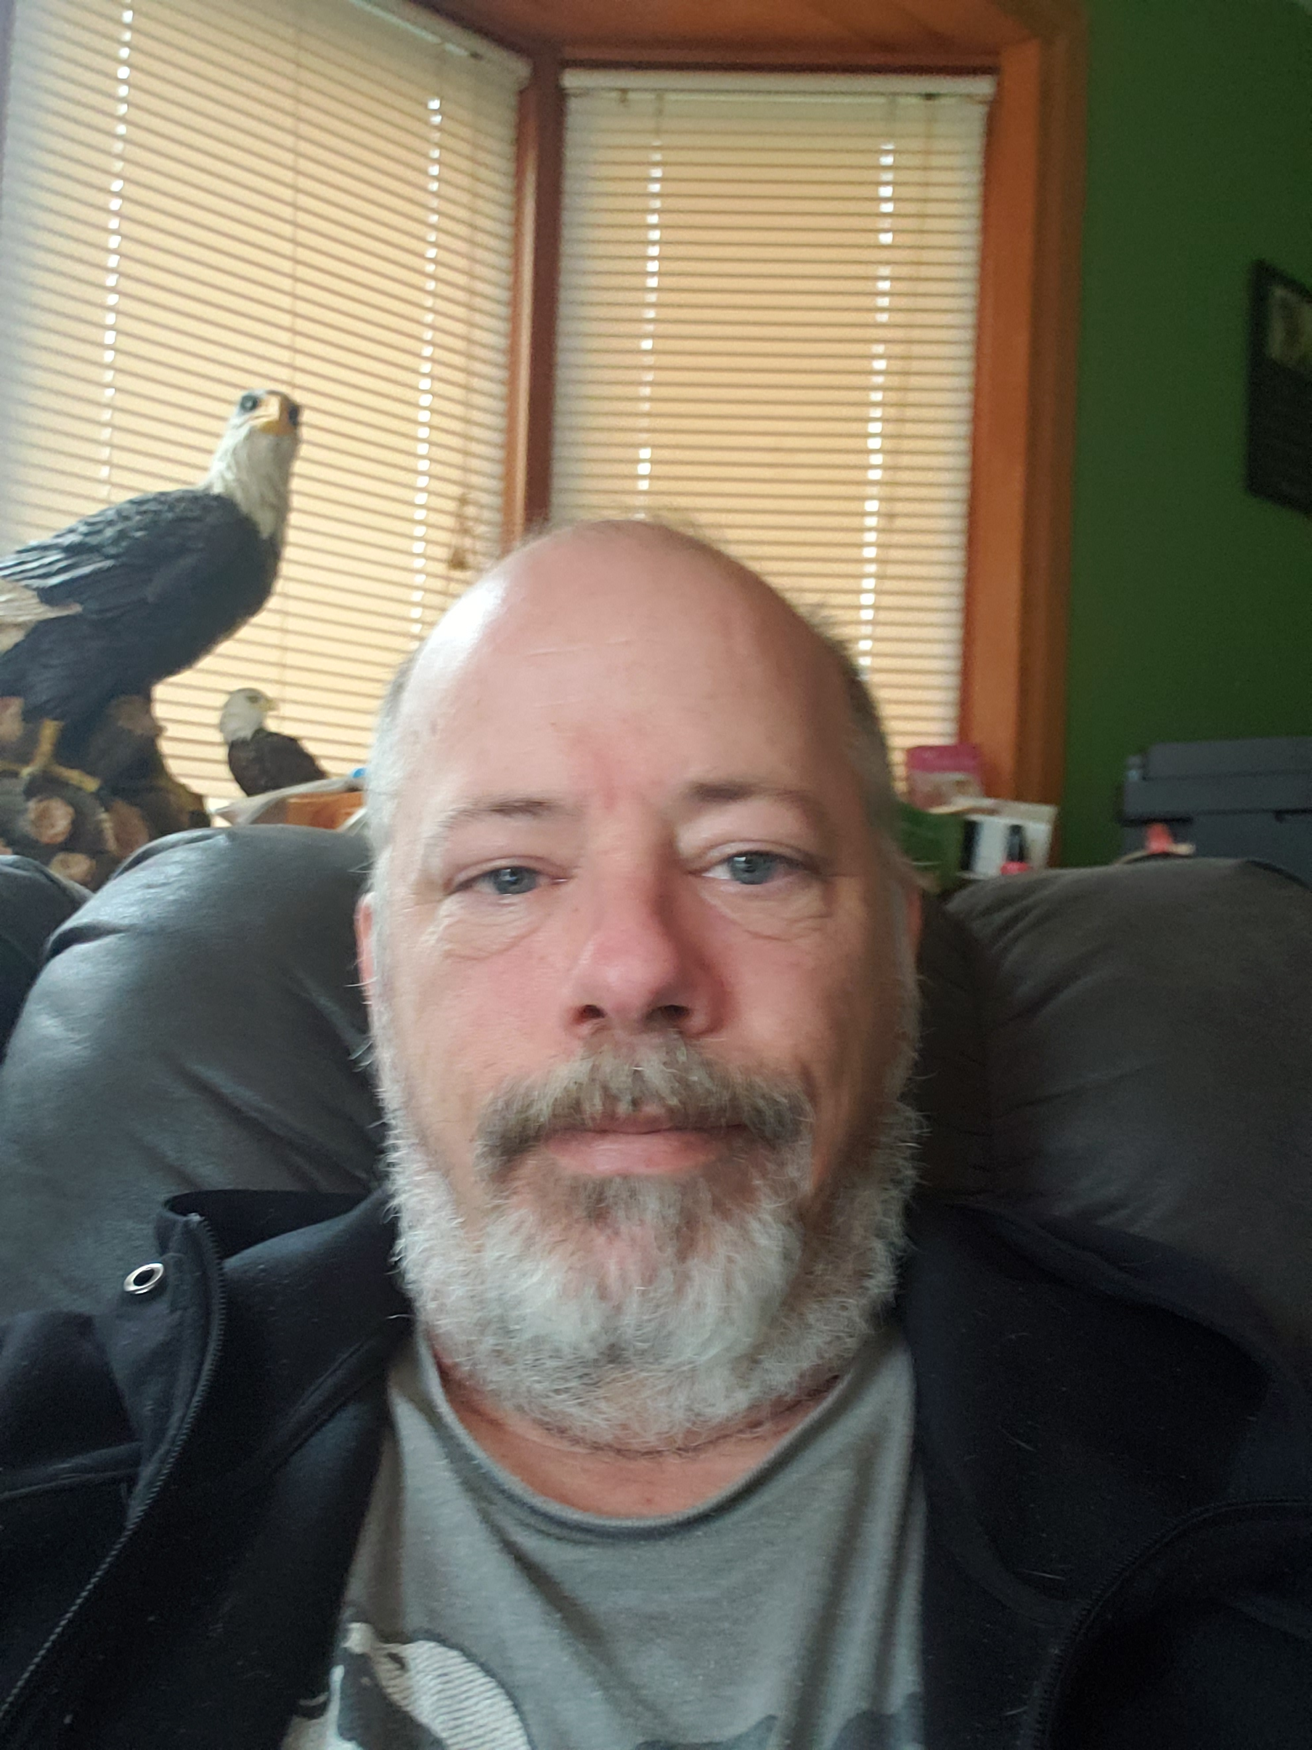
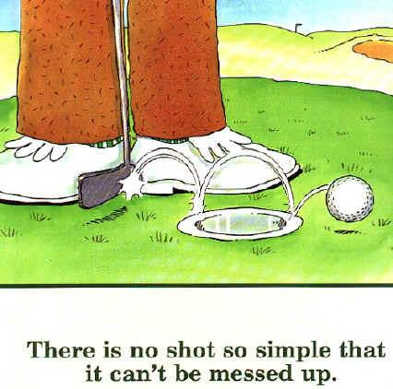
Keith Anderson
Technical Specialist
Component Assembly
3D Design
3D Printing Specialist
I have 3 daughters
I enjoy playing bad golf

Slide 4
James Zahurones
Technician – Build Numi Horns. Maintain Numi Target Hall components.
I love Sports.
Bears, Bulls, Cubs, Hawks. *Not the White Sox.
I enjoy the outdoors.
Hiking, hunting.

Slide 5
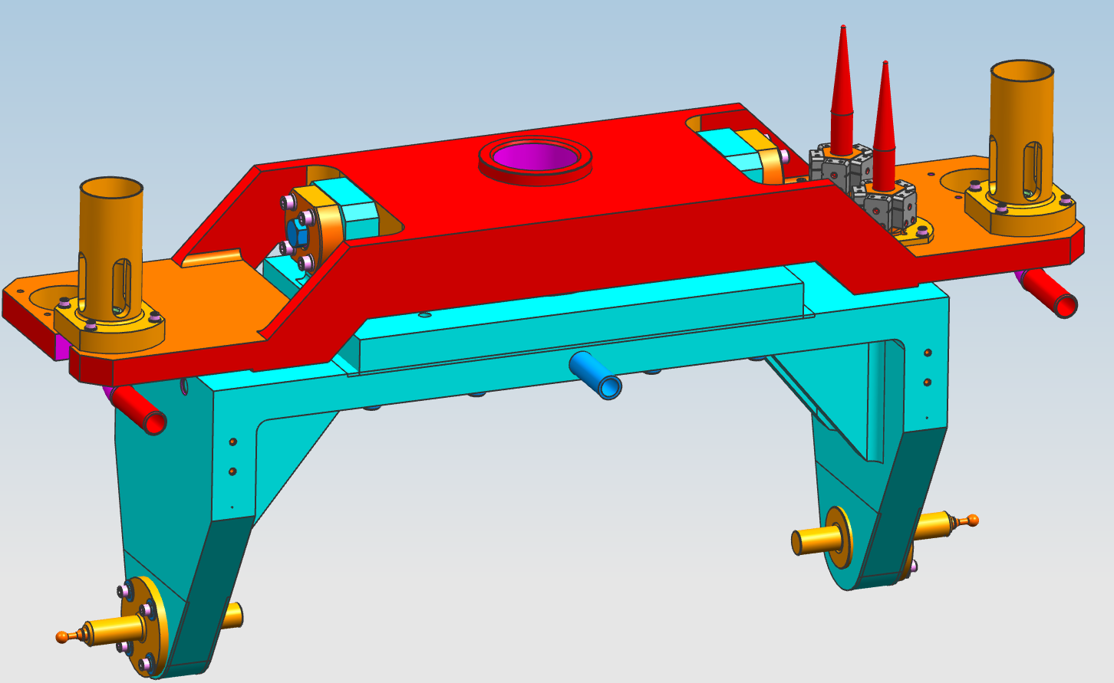
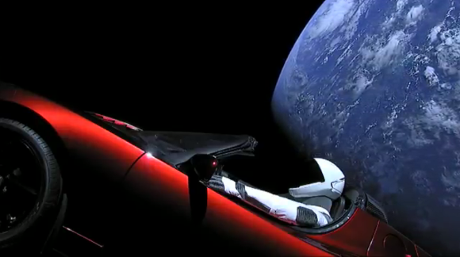
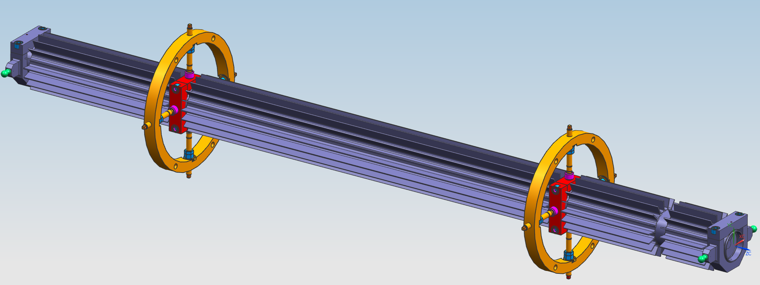
Mike Stiemann
Medium Energy Target Lead Technician.
I have never driven a Tesla Roadster in space.

Slide 6
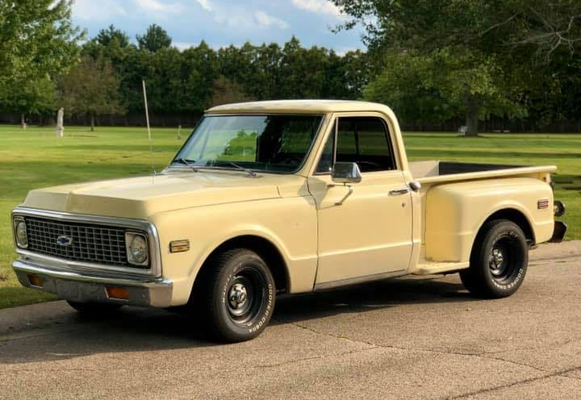
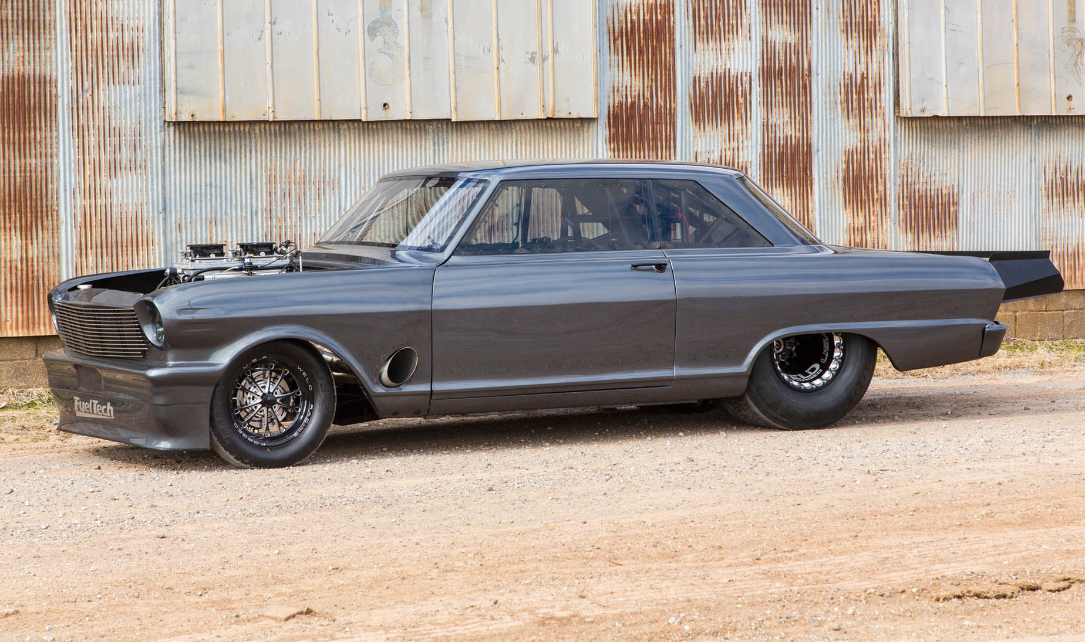
Clay Leonard
Tech II, currently working on assembly of PH1-06
When I am not working at Fermilab I enjoy working on vintage cars. I have owned a few over the years but my current project is a 1972 C-10. I don’t have much space right now but once I get a bigger garage I’d like to get into drag racing and restomods.

Slide 7
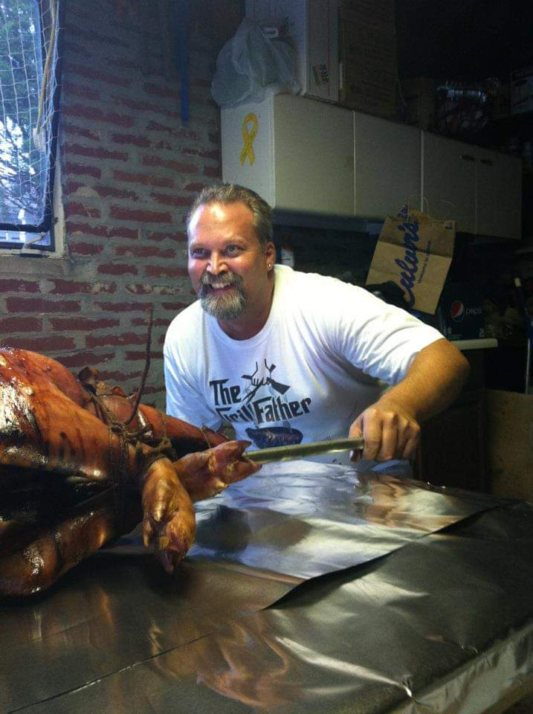
George Maniatis
Technician II
Lead Tech for AP-0 Target Hall
Machine Operator
“I cook whole hogs for fun it’s my passion”

Slide 8
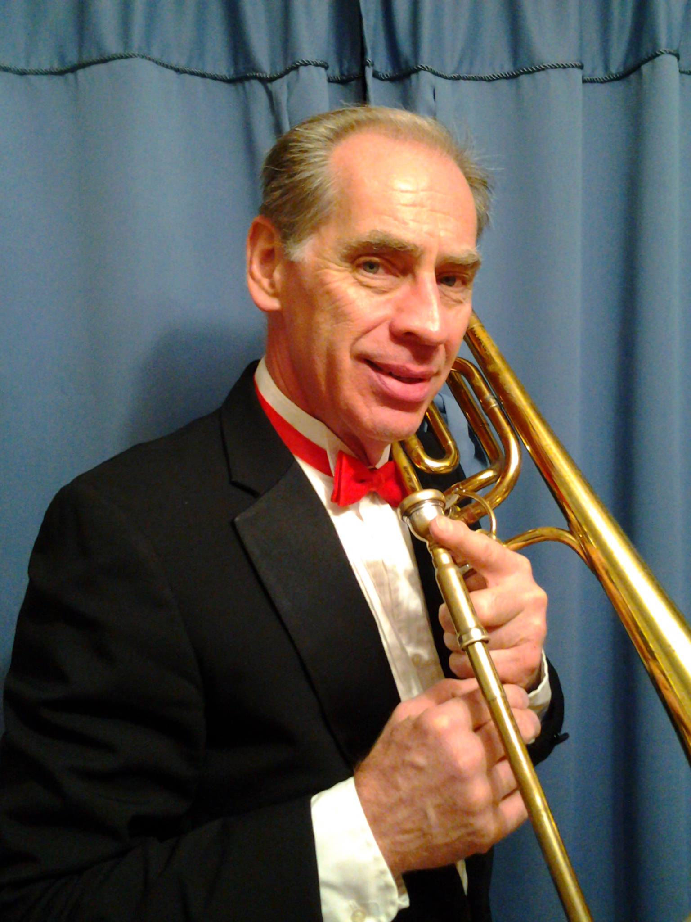
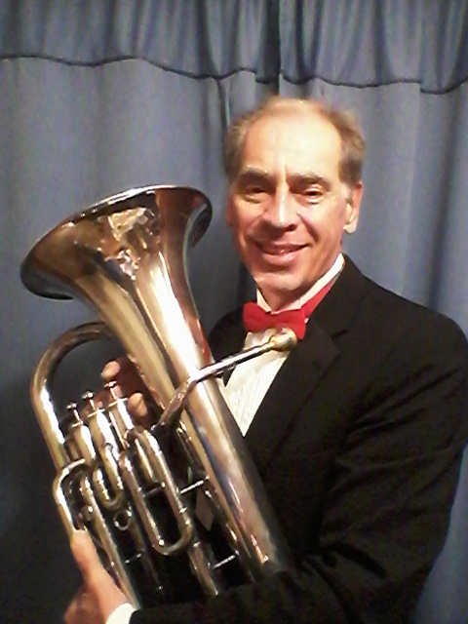
Henry Schram (aka E. Henry Schram)
MY PRIMARY FUNCTIONS
Maintain inventory and archival information on horns, targets and other apparatus
Perform quality assurance for above devices
Procure certain operating supplies using ProCard
Many misc. duties e.g.: Safety abatement, emergency warden, trash, scrap metal, vehicle mileage, etc.
SOMETHING YOU DON’T KNOW ABOUT ME
No one in this meeting knows I double on euphoniuim & bass trumpet
I’d rather be playing in an orchestra somewhere right now

Slide 9
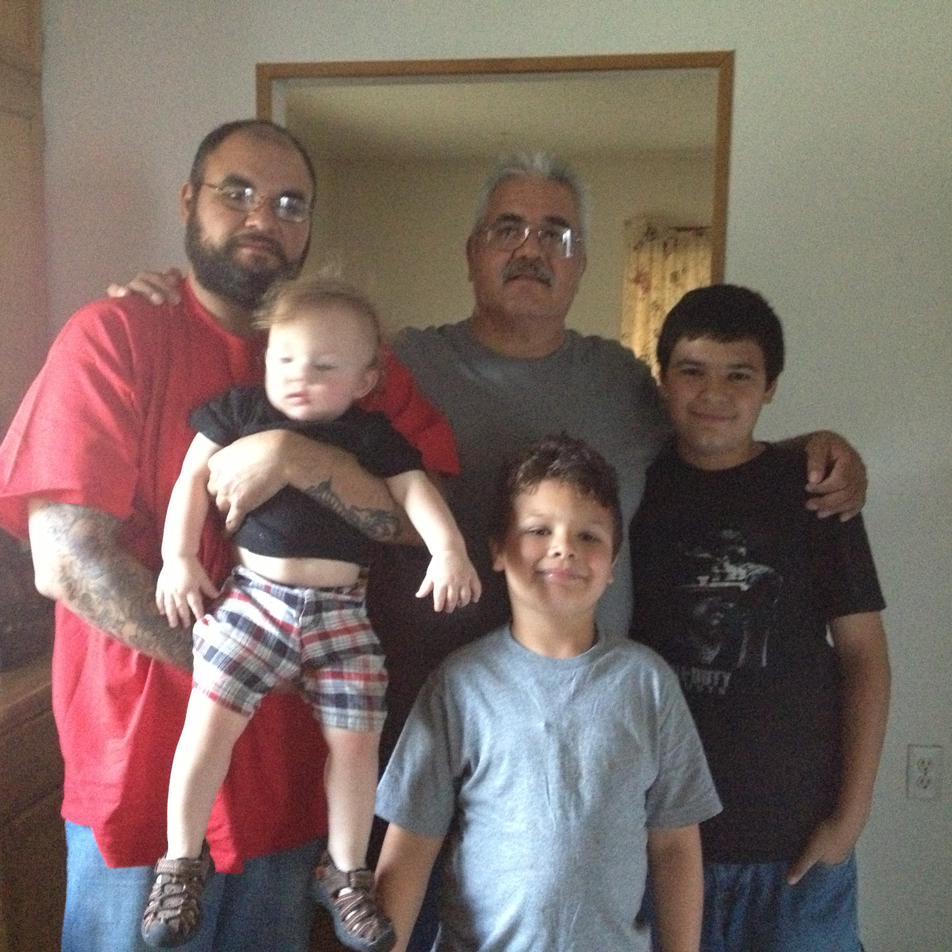
Cervando Castro Technician Specialist
BNB Horn/Target Assembly
Lead Technician for RAW Systems
My idea of self-isolating

Slide 10
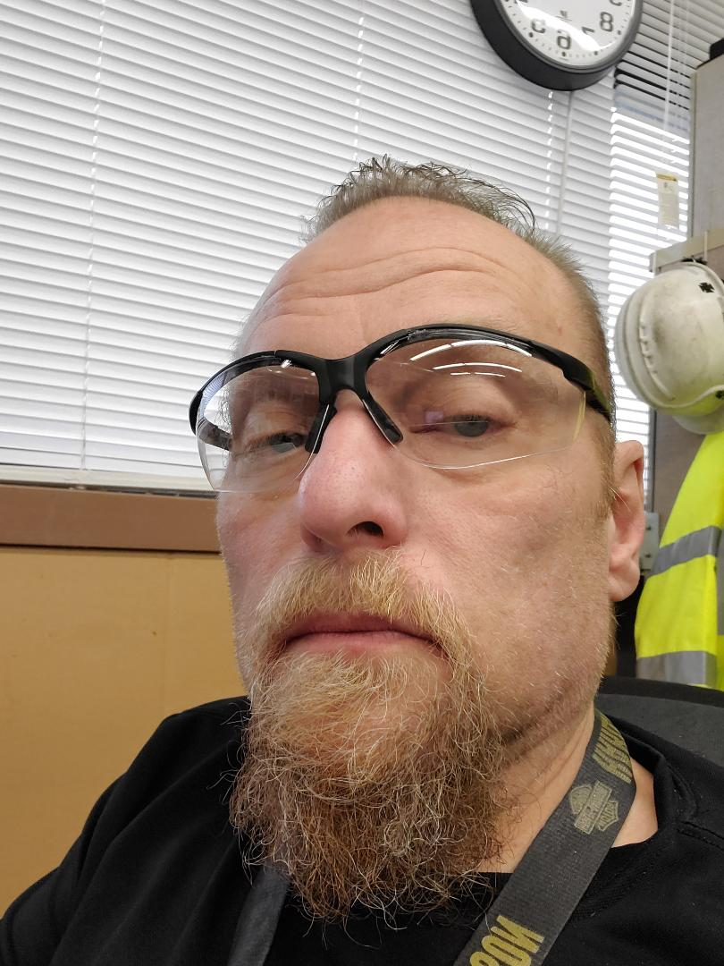
Paul Schild
Technician II
Tech Shop Lead
BNB Horn/Target Assembly
I’d rather be riding

