Slide 1
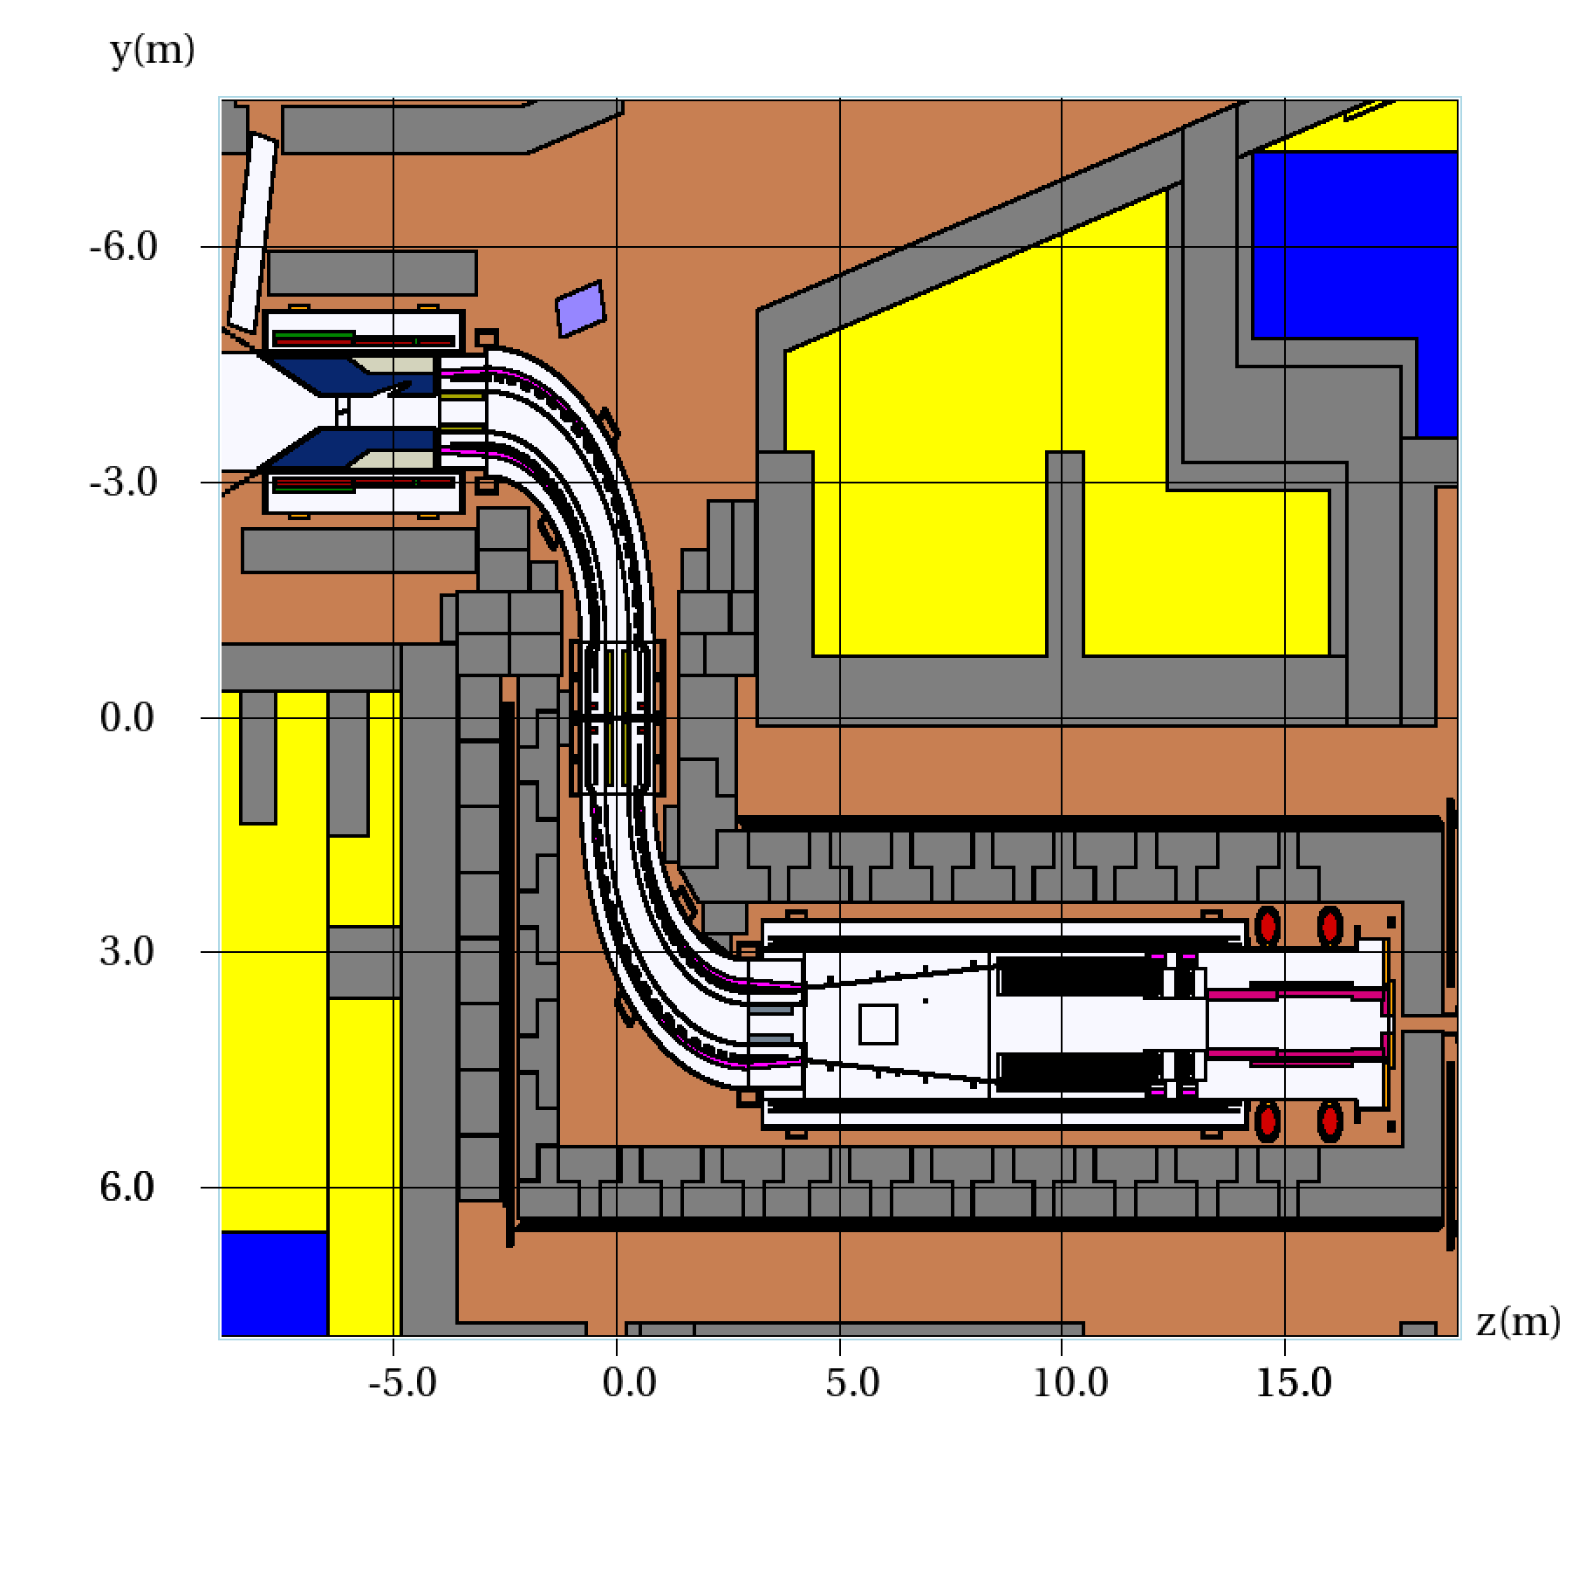
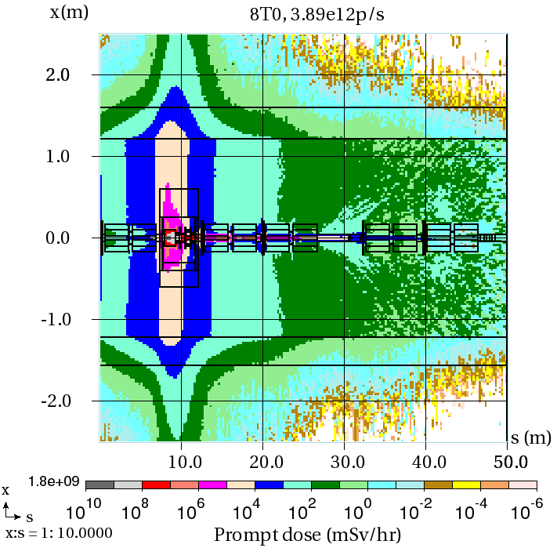
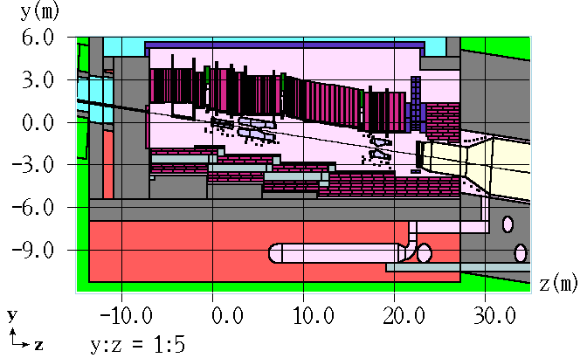
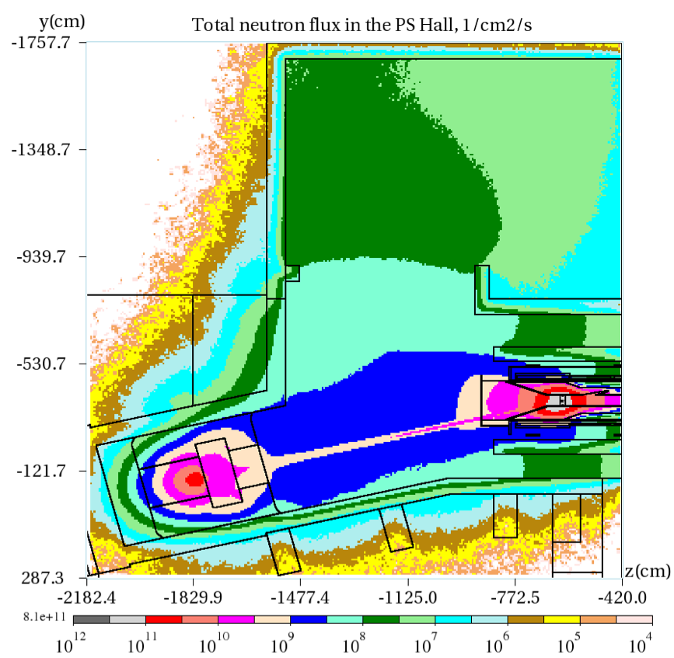
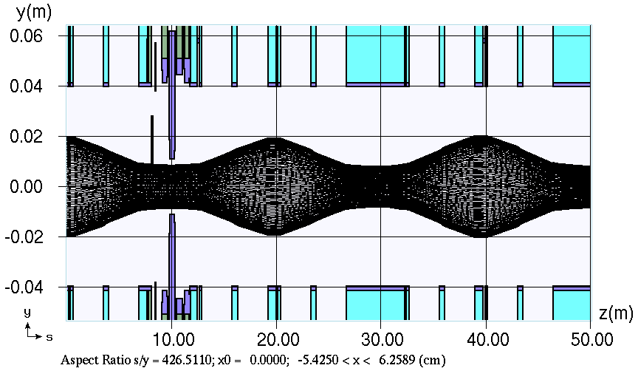
MARS Group
Nikolai Mokhov
TSD All-Hands Meeting
April 30, 2020

Slide 2
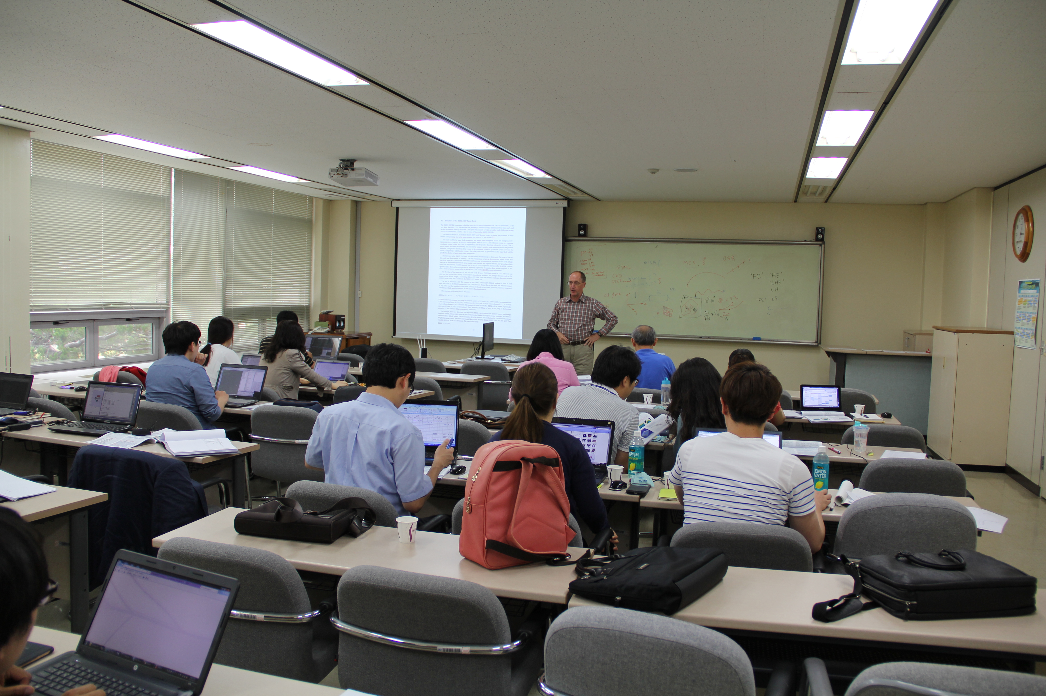
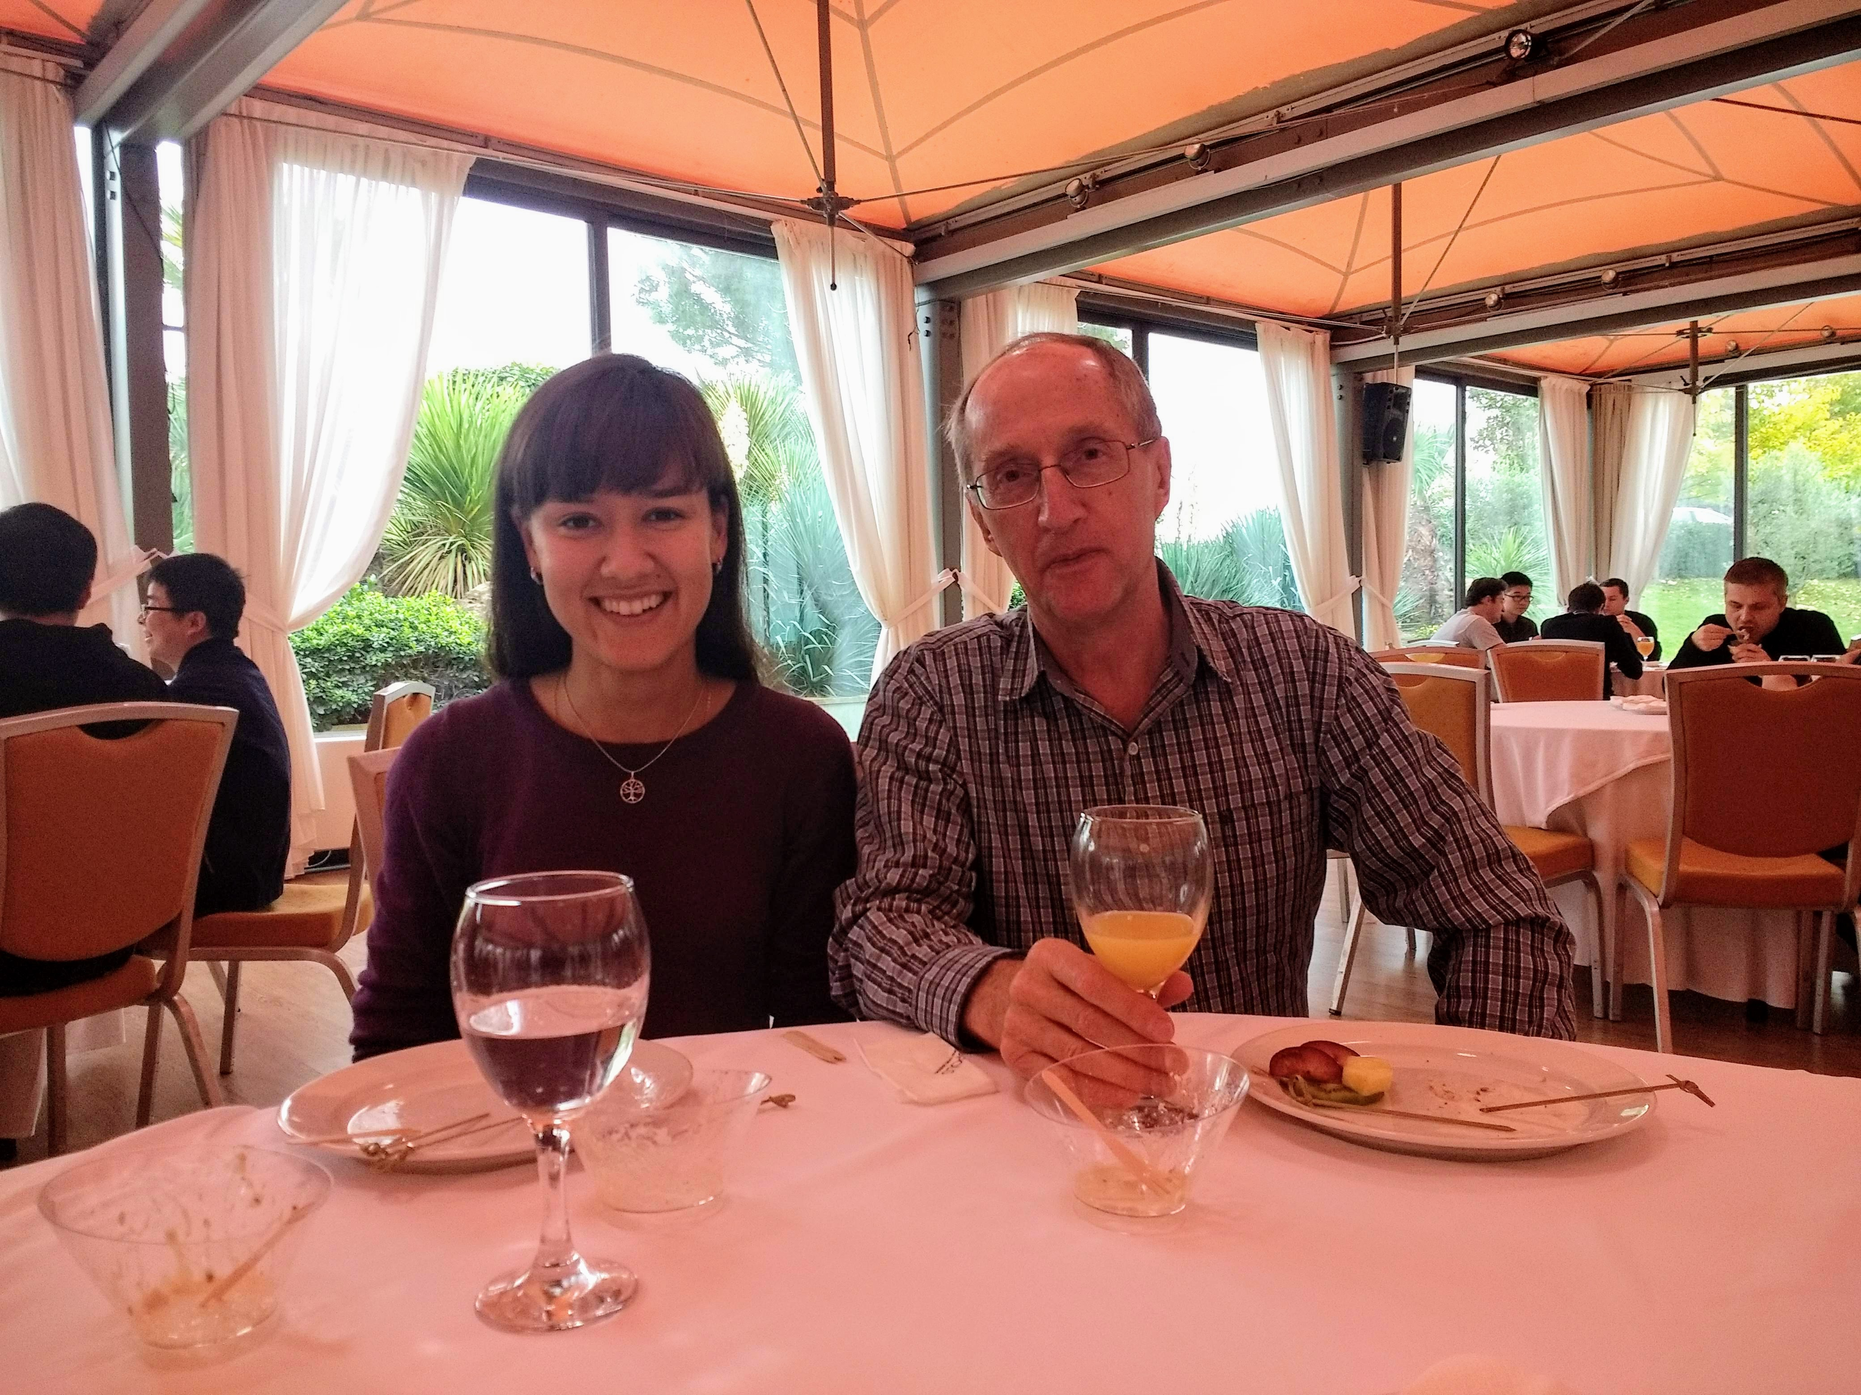
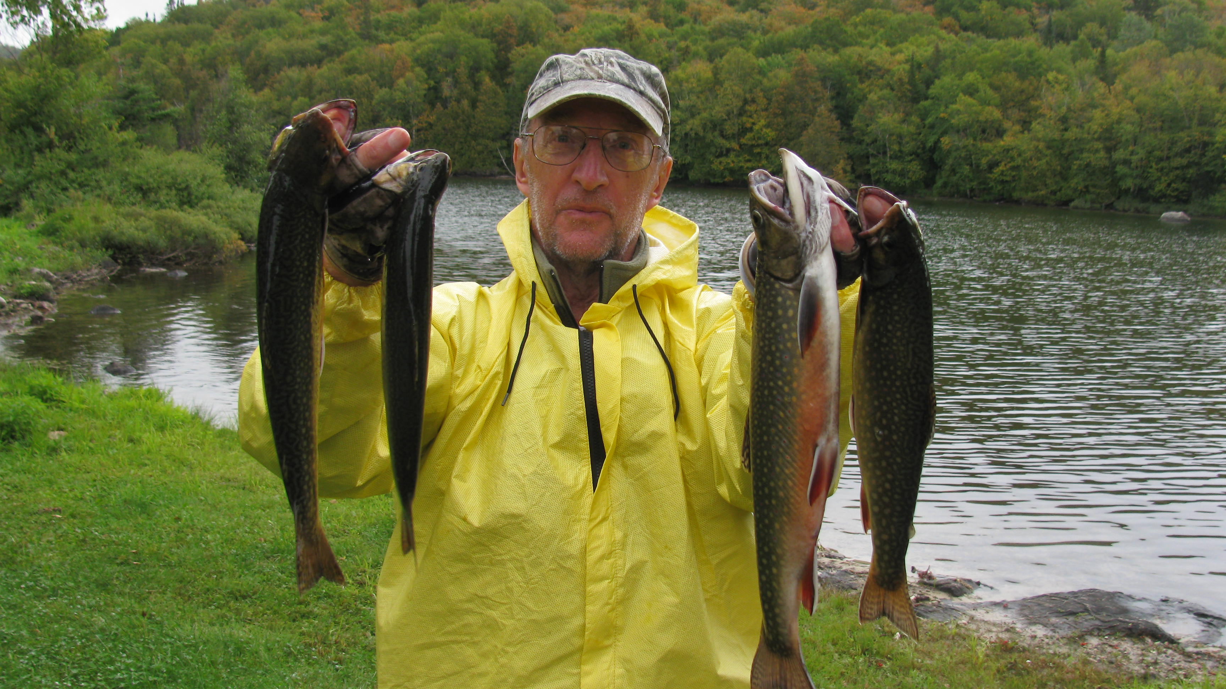
Nikolai Mokhov
MARS group leader, Distinguished Scientist, 45 years of experience in the field, creator of the original MARS code, its development and support since, co-author of dozens and dozens of accelerator and experiment systems around the globe. Almost 30 years at Fermilab permanently, after 3 long stays here in 80’s as a visiting scientist from IHEP, Russia.
Giving MARS tutorial at
Pohang, S.Korea, 2014
Teaching at CERN Accelerator
School, Thessaloniki, 2018
Fishing Brook Trout,
Ontario, 2019

Slide 3
MARS Group: Mission and People
MARS code development and project support
Building MARS models of predictive virtual particle accelerators and their systems (target stations, collimators etc.)
Using the models for Monte Carlo simulation of beam induced energy deposition and radiation effects, optimization and mitigation of deleterious beam impact on systems and environment
N. Mokhov
M. Kriss
V. Pronskikh
I. Rakhno
I. Tropin
S. Striganov

Slide 4
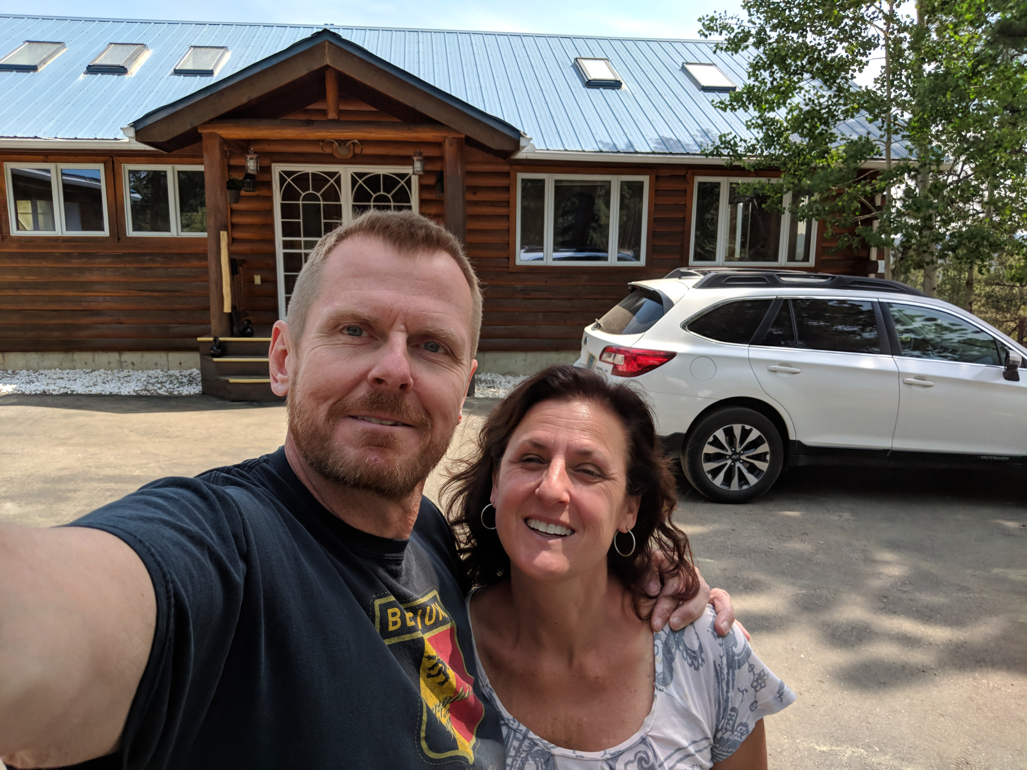
Michael Kriss
Systems Administrator III
Last 5 weeks online training on various AWS cloud options for MARS and TSD
Moved to Colorado 2 years ago
Bear broke into house 2 mos. after moving in
Grandfather of 3 boys
Seven-time Ironman Triathlon finisher

Slide 5
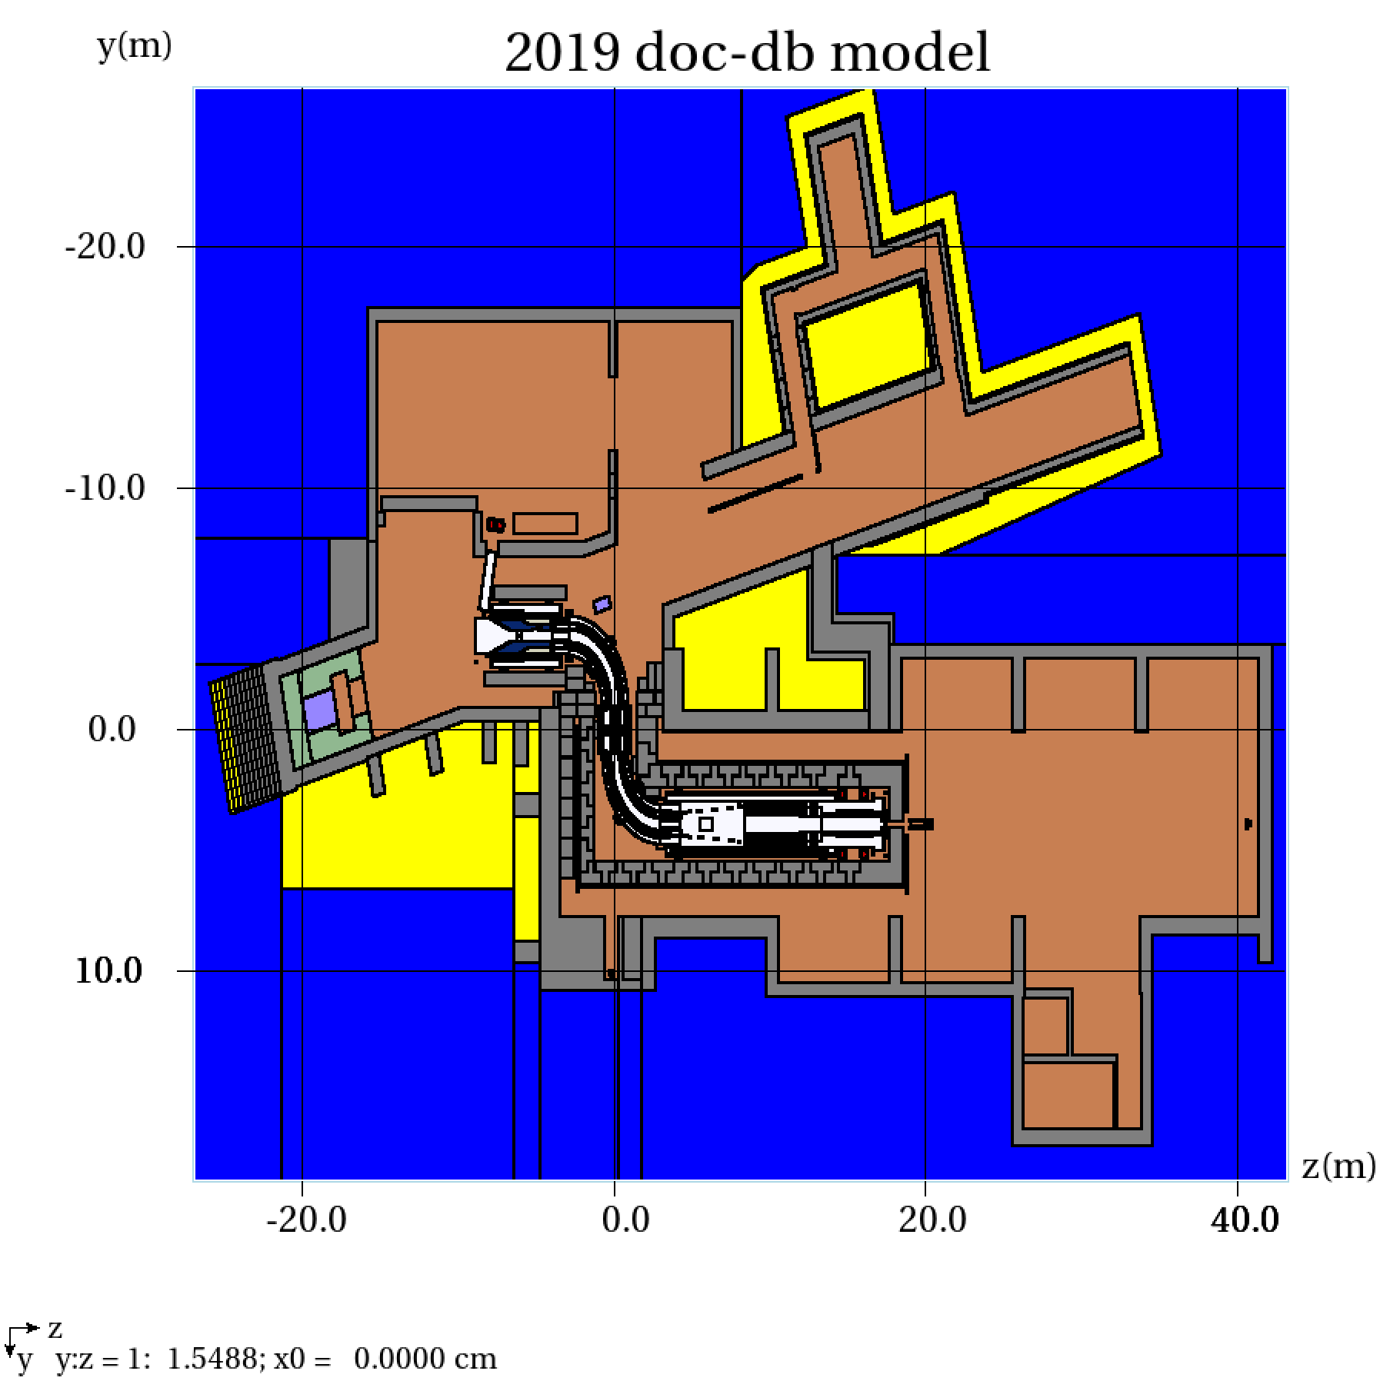
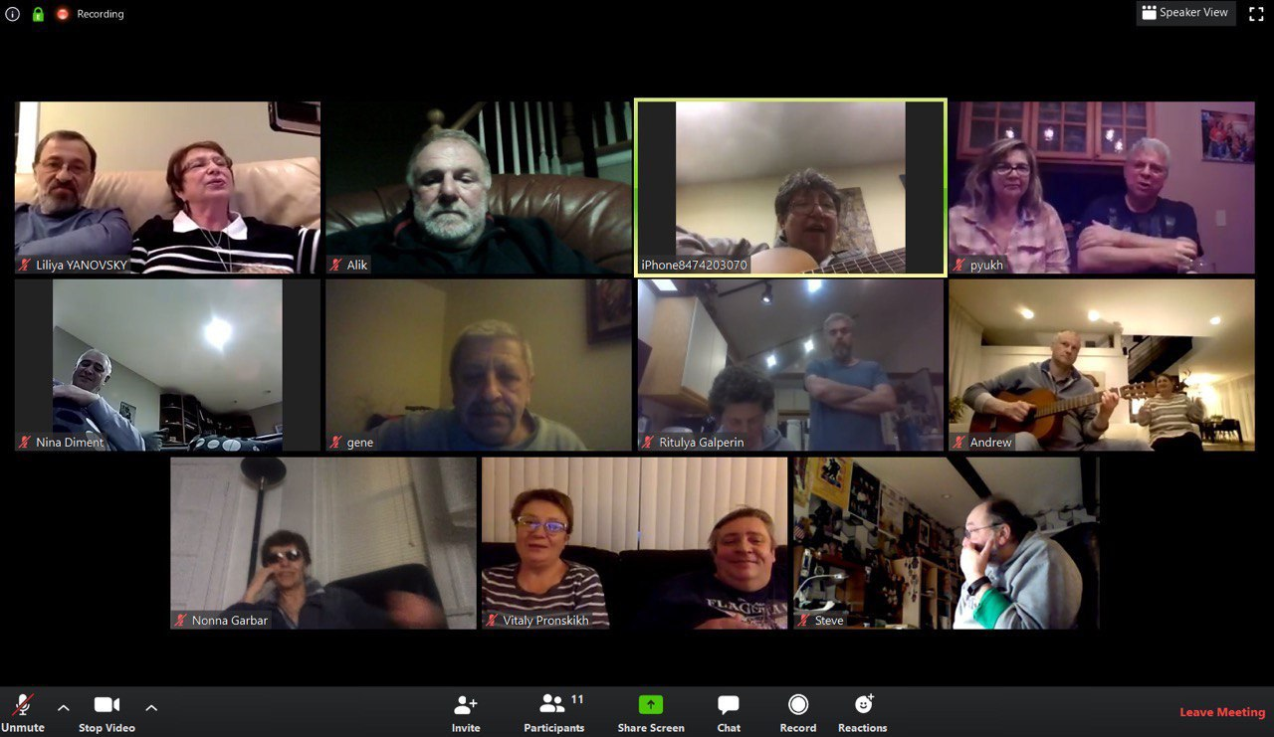
Vitaly Pronskikh
Role: Applications Physicist II
Functions:
  PI for Mu2e-II target LDRD
  Mu2e dose simulations, shielding assessment
  Booster Injection Absorber simulations
During quarantine enjoying Sunday evening virtual “Clubs of Amateur Song” meetings with friends

Slide 6
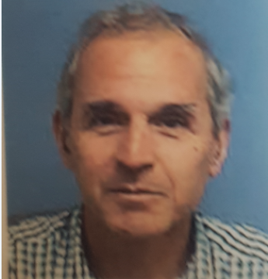
Igor Rakhno
Applications Physicist III
As a member of MARS group, I am involved in radiation shielding studies for various projects at Fermilab and at other labs (initially‒since 2000‒for LHC, then HiLumi LHC, and most recently – for European Spallation Source in Sweden).
Also, I work on MARS code developments. No one develops and maintains this code for our group, so that it is our job as well.
Something (almost) no one here knows about me – I am a happy grandfather. My little 4 year old granddaughter is pretty cute.

Slide 7
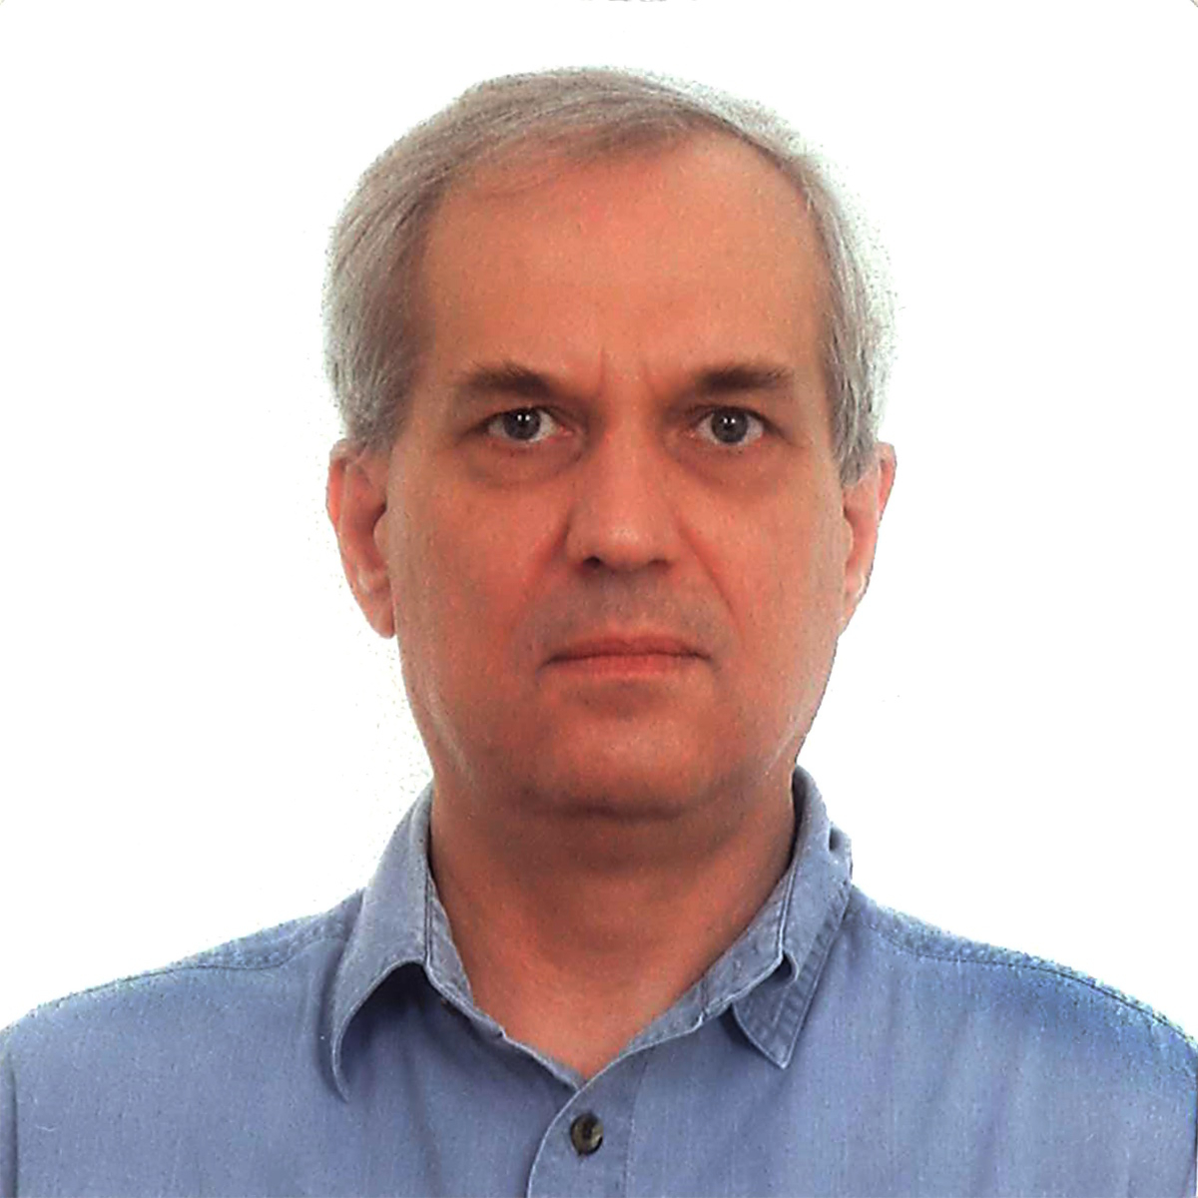
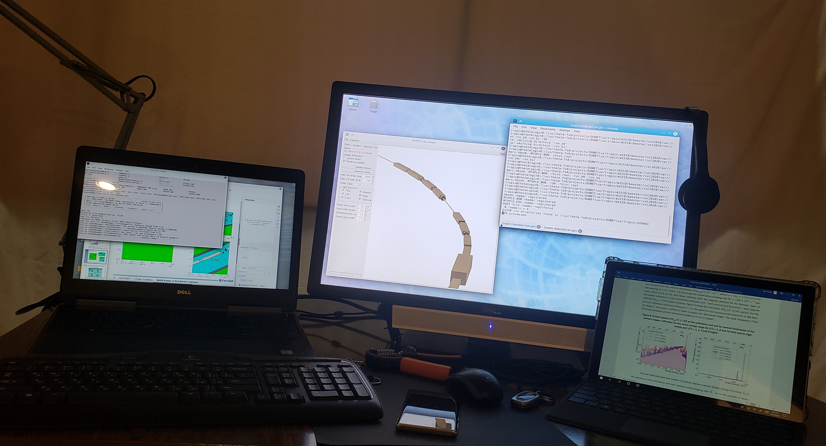
Igor Tropin
Application Physicist II
Work environment at home is almost the same as on site.
Interests:
  Monte Carlo method
  Parallel programming
  Linux, HPC clusters
  Interaction of radiation with matter
  7-String Russian Guitar. https://www.youtube.com/watch?v=1mK7naciqWw
Picture of yourself if you will not be available on video

