Slide 1
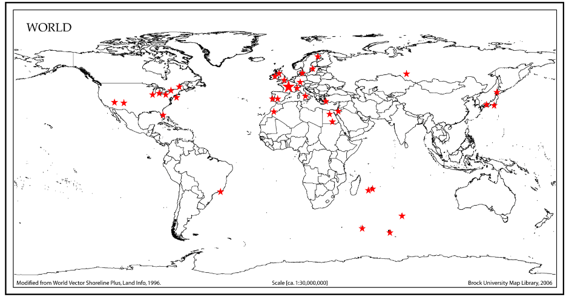
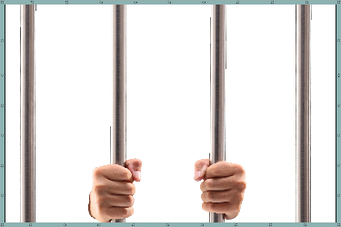
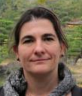
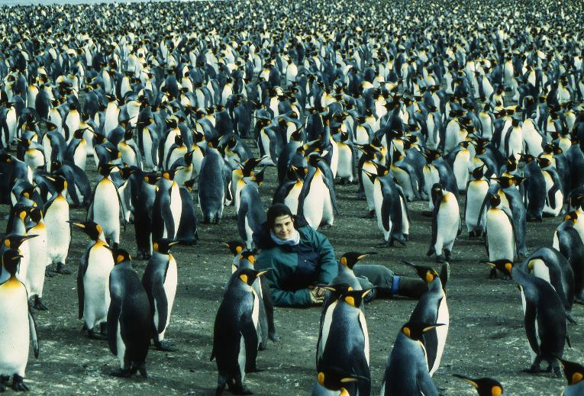
Frederique Pellemoine
Senior Scientist
No picture of me on site!
I am still confined in Michigan!!!
Target R&D program,
I have been in charge
for 2 weeks
A few words to remind you of “Something No One Here Knows About You”
  I love to travel around the world and learn about “exotic” society, cuisine, culture….

Slide 2
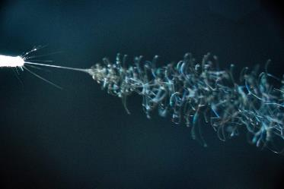
Targets R&D Program Group
NuMI target (NT-02)
Role/Mission
  Support target operation and future high power targetry
    Need to asses challenges of future target today
People
  Kavin Ammigan and Sujit Bidhar
  Raul Campos (MSD) and Tiziana Spina (APS-TD)
  Abraham C. Burleigh (IIT) and Gurkan Karaman (Iowa)
Facilities/Tools
  Current
    Electro-spinning new targets for accelerators
    Fatigue testing machine for low activated material
    Collaborations with PNNL, BNL (BLIP, NSLS-II), University of Michigan, STFC, CCFE, CERN (HiRadMat), University of Wisconsin-Madison, University of Bristol, US-JP program
  Future
    Electron beam irradiation at A2D2 facility (FNAL)
    TSIB with hot cell and advanced material testing lab
    Targetry application technologies: semi-autonomous robotic remote handling, novel target concepts, target health monitoring, etc.
NuMI Be windows
Electro spinner
Fatigue testing machine

Slide 3
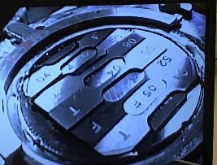

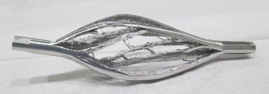
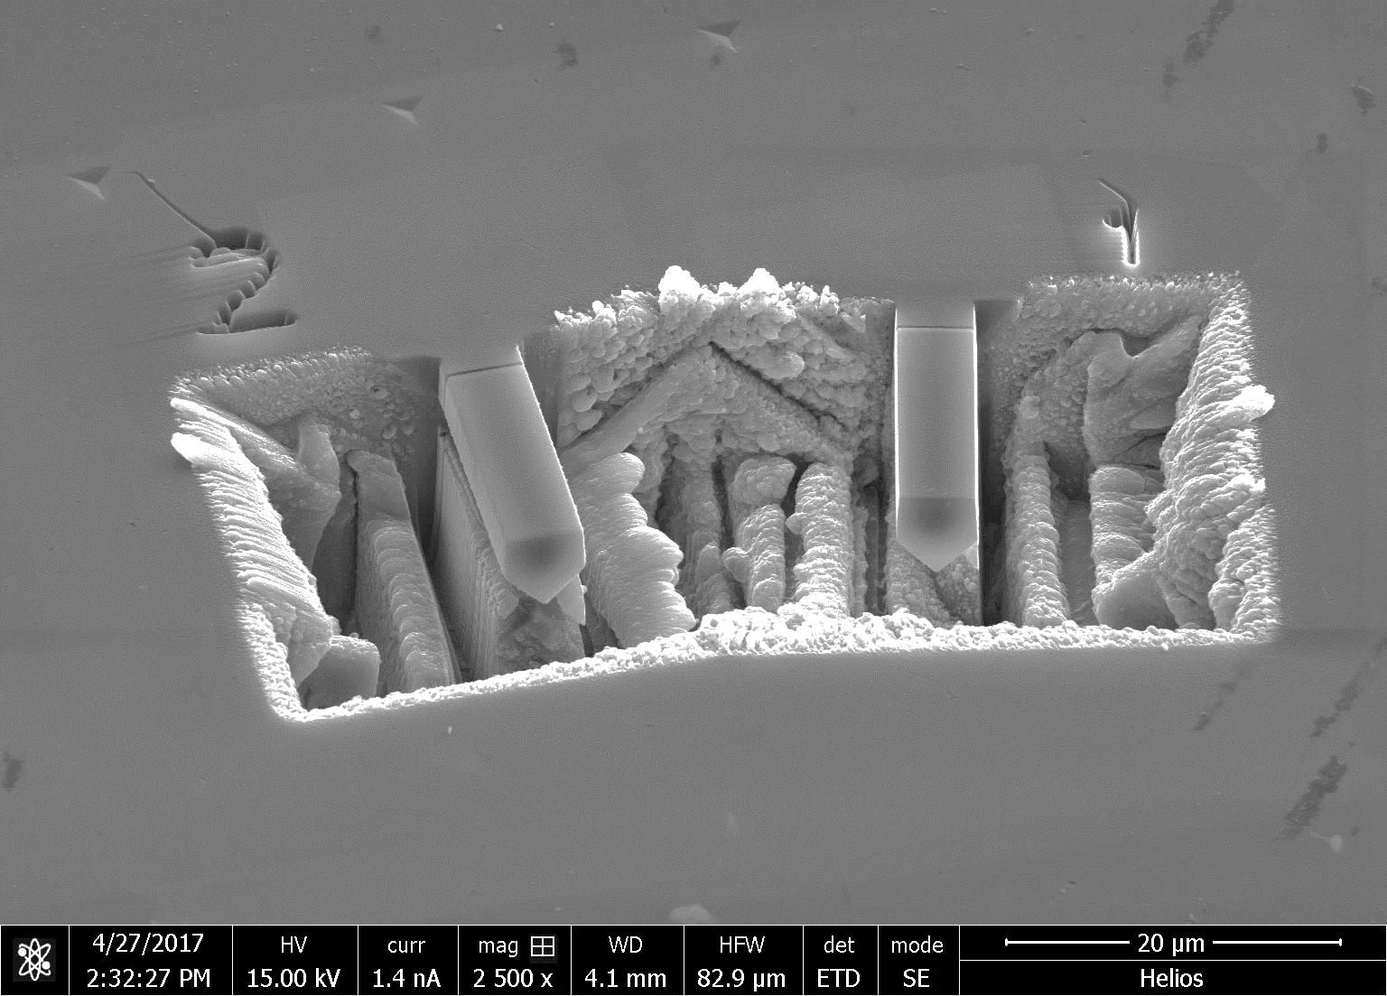
Targets R&D Program Group
Proton-irradiated Ti tensile specimens at BLIP
Activities in General
  RaDIATE Collaboration
    Answer targetry challenges: thermal shock, radiation damage
    Current R&D program: HE proton irradiations & Post-Irradiation Examinations (PIE), LE ion irradiations & PIE, PIE of spent targets / windows, in-beam thermal shock studies, fracture and fatigue studies
Participation in Projects
  NuMI AIP, LBNF
What we’re doing while staying at-home
  prepare next HE proton beam irradiations: BLIP, HiRadMat (activation simulations, thermo-mechanical / CFX simulations, safety study for experiments)
  Analyze irradiated samples and data acquired during previous experiments at BLIP and HiRadMat : fatigue test, thermal shock analysis
  Analyze and prepare heavy ion irradiation
  Prepare publications of results from previous tests (fatigue tests, tensile tests,…)
Thermal shock testing at HiRadMat
Microcantilevers testing at Oxford/CCFE
Mike Parkin
Rutherford Appleton Laboratory

Slide 4
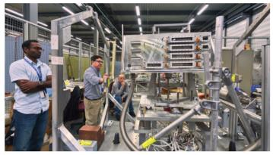
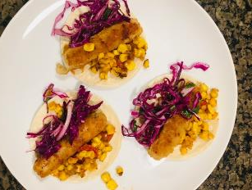
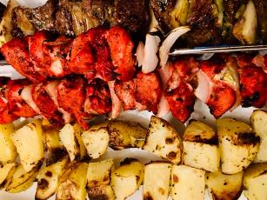

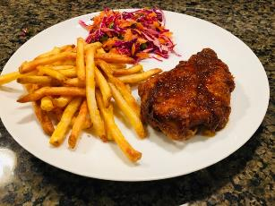
Kavin Ammigan
Senior Engineer in HPT R&D group
Design and execute in-beam material experiments in support of target R&D
Help manage RaDIATE collaboration activities
Provide engineering analysis support for the department
I enjoy cooking whenever I can…
Some recent meals since the stay-at-home order
Photos by Laura Ammigan

Slide 5
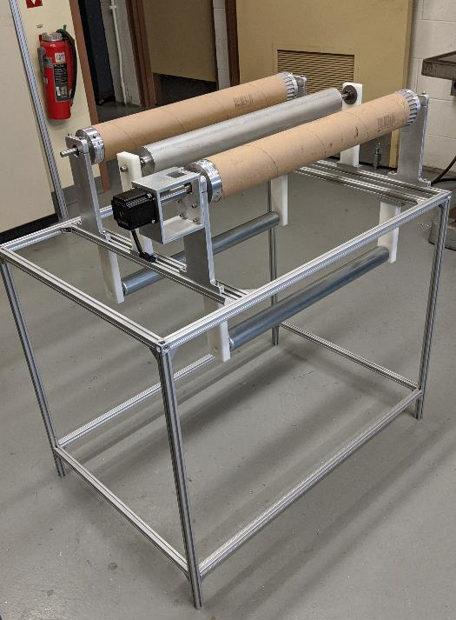
Sujit Bidhar, Post-doc research Associate
New target material research and development for future high power targets (nanofiber target)
To develop material models for material subjected to thermal shock and radiation damage.
Supporting other simulation and experimental activities of Target Systems (proton, ion, electron irradiation) and PIE works.
A few words to remind you of “Something No One Here Knows About You”
  Believer in natural healing. Successfully avoided ingestion of any medicine for last 15 years
  DIY projects

Slide 6
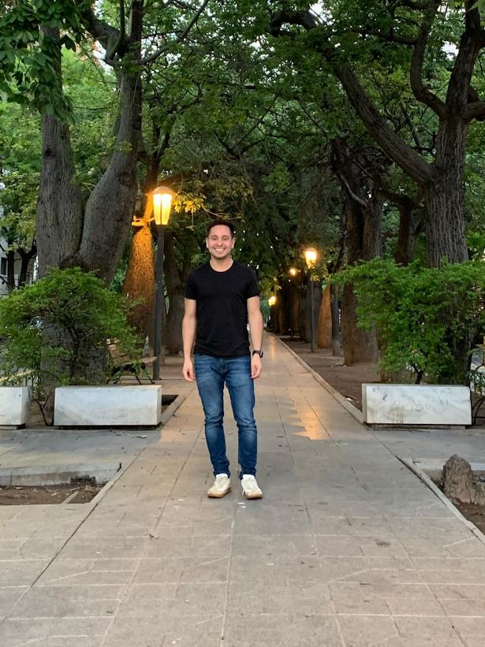
Raul Campos
Mechanical Engineer in AD Mechanical Support Department
  TSD work: Transient thermal and structural finite element analyses
    Vacuum windows, HiRadMat
    Prior to Fermilab: thermo-mechanical fatigue, vibration, large multi-body FEA
  MSD/Project work: PIP-II Instrumentation mechanical design, PIP-II Vacuum engineering/project management
Other info about me:
  Enjoy travelling, made it to 5 countries last year

Slide 7
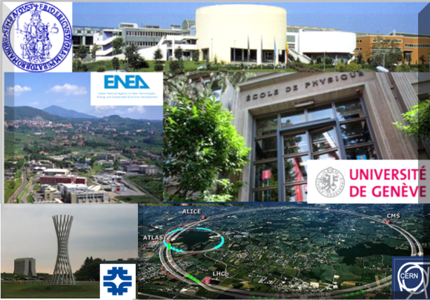
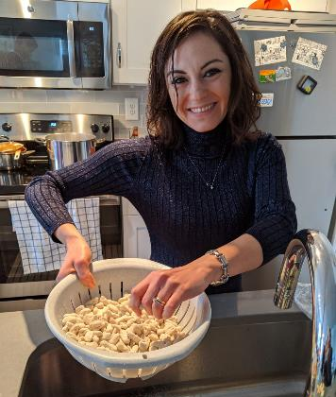
Tiziana Spina
Associate Scientist (Peoples Fellow) in the APS-TD since October 2018
A few words to remind you of “Something No One Here Knows About You”
  During this lock-down period, replacing the lab with kitchen, I can continue to do experiments and discoveries. For ex., I have just found how to get weight in 1 hour!!! ☺

Slide 8
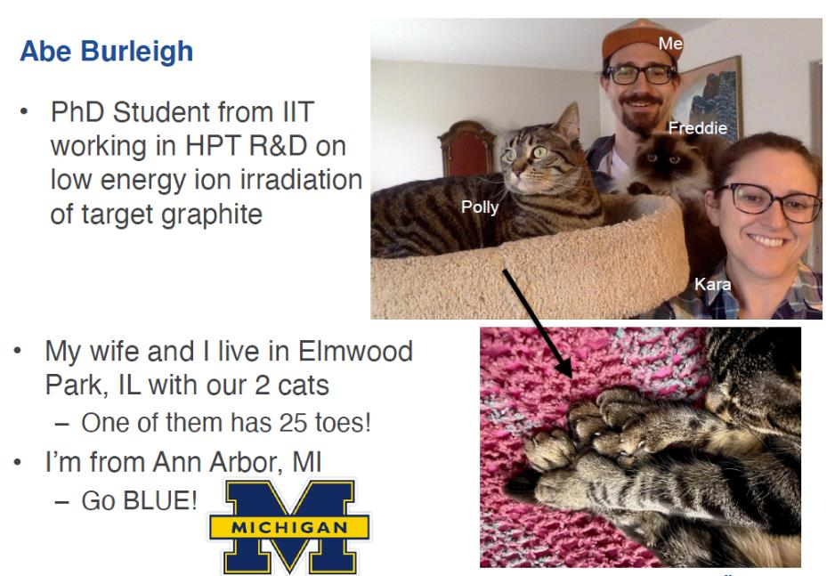
Abraham C. Burleigh

Slide 9
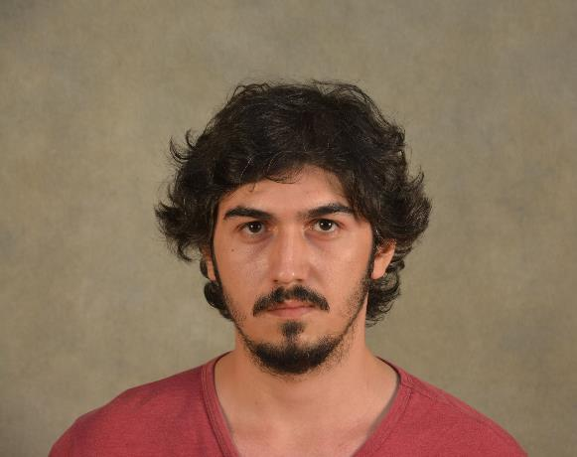
Gurkan Karaman
PhD student at UIowa in Physics
UIowa: working with Experimental
High Energy Physics group, working
on ProtoDUNE SP analysis
FermiLab: working with R&D Group
at TSD working on the electron beam
test station for thermal shock, fatigue
and radiation damage
Things to be remembered in these quarantine days:
  Can’t play pool anymore.
  I was gonna get my driver license but appointments have been cancelled due to Covid and I don’t wanna drive with instructors permit in which I need my girlfriend accompany me, which is so stressful.

