Slide 1
TSD All-Hands Meeting
Bob Zwaska
30 April 2020

Slide 2
Thank You
Everyone made the transition to working primarily at home
Plenty of hiccups, but here we all are
There is a lot of working going on
Thank you for your patience with the changed meeting and reporting requirements
Most of our in-person work has been stopped
We still have people on site every day:
Environmental protection
Personnel protection
Property protection
Studies of electrospun fibers as filters for PPE
Thanks to those who do this essential work on-site!

Slide 3
TSD Short-term Priorities in this period:
First Week:
Get people home who can be home
Keep people getting paid
Get work done
Prepare well all for all to work at home
Avoid panic
Encourage safe practices outside of work
Present:
Keep people home who can be home
Get work done
Make work from home effective, efficient, and connected
Don’t Panic
Start planning for limited return to work
Hard to say what the world will be when this is clear, but we can be confident science will continue to have a role in society.

Slide 4
Lab Status and Opening reporting
Lab is still closed to all but essential work
Anticipate a gradual return-to-work, possibly starting Mid-May
Ideas on this change on a daily basis
Start with regular on-site work by those already on the essential list
Expand gradually, week-by-week
PPE will be standard, and considered specifically for jobs
Gloves and face shields for work closer than 6 feet
Face coverings as much as possible in non-private areas
Enhanced hygiene and cleaning practices
People who are uncomfortable or unable to come on site at that time should discuss with their supervisor
Examples: lack of child care, health conditions
Access to site may involve one-time or recurring questionnaires, temperature/symptom checks, and possibly actual testing.
https://eshq.fnal.gov/covid19/

Slide 5
TSD People
We have a lot of unique tools, facilities, and activities; but our capability really comes from our people
This meeting is about us getting (re)acquainted with eachother
Recent Additions and Departures:
Ralph Ford Retired in December
Nnamdi Agdo and Meredith Lee started this year, not long before we started work-from-home
Pat Hurh moved on in February
Frederique Pellemoine started April 13 and has not yet visited Fermilab as an employee
Hiep Le has been sick (hope to see him back soon)
Bob Albrecht left the lab in March
Sergei Striganov…

Slide 6
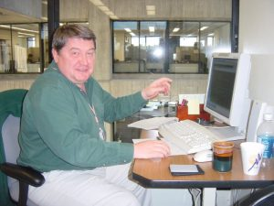
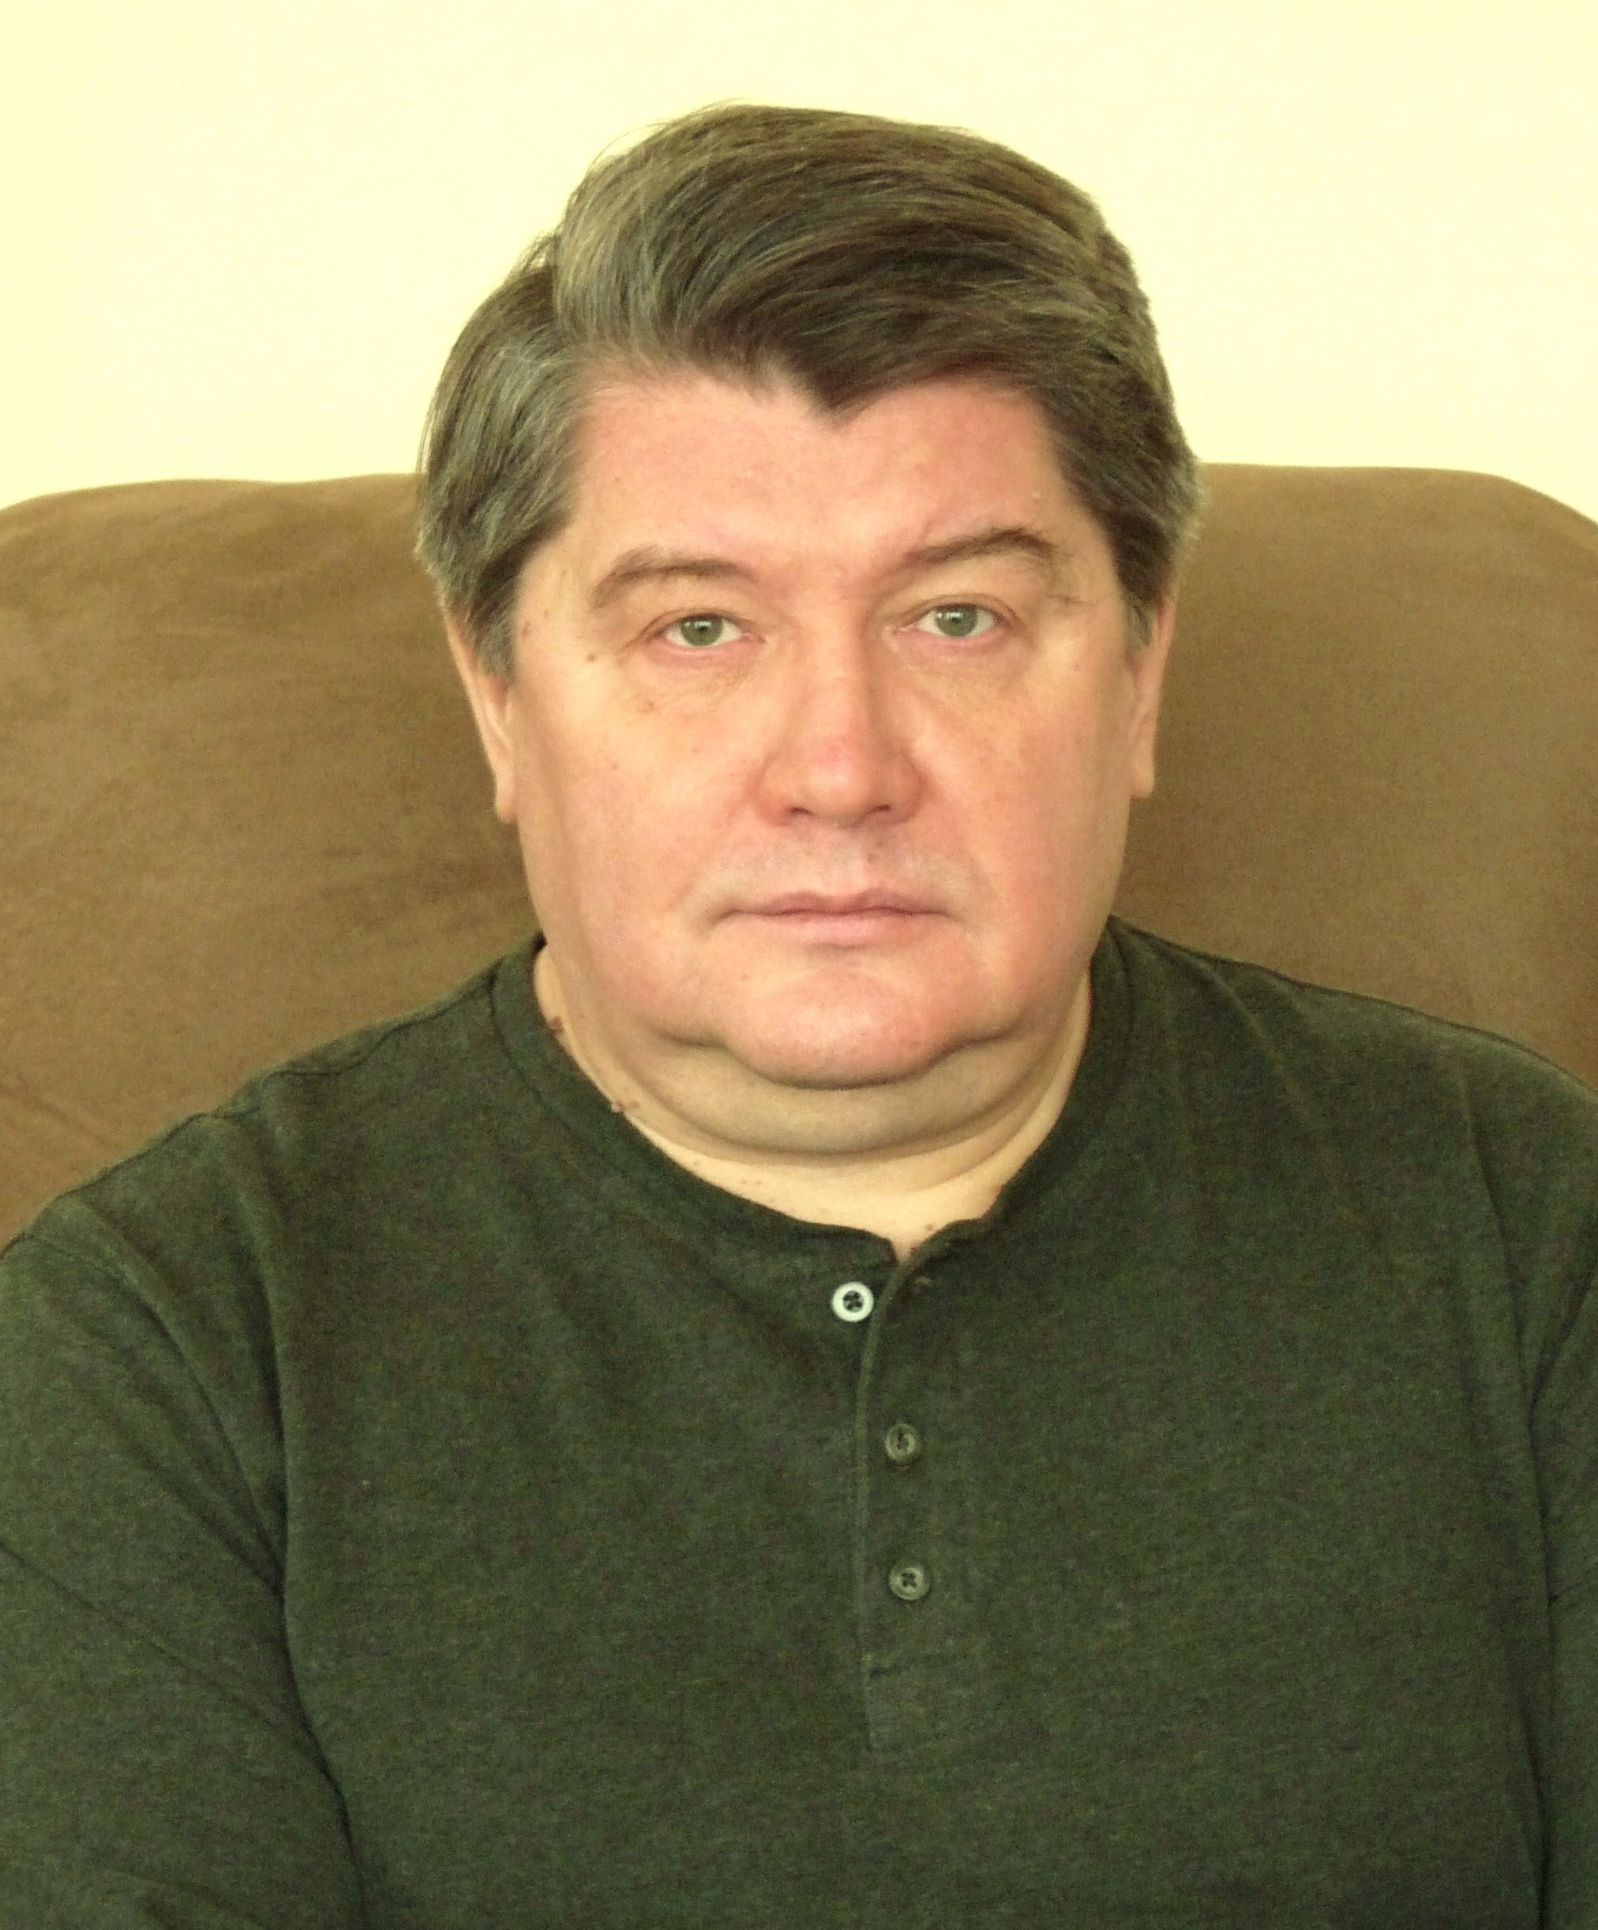
Sergei Striganov
Fermilab scientist Sergei Striganov died March 25 of a sudden heart attack. He was a lab employee for almost 20 years, personally mentored by Nikolai Mokhov since his formative years as a theoretical physicist. He grew up as a physicist at the Institute for High Energy Physics (with Ph.D. in high-energy physics in 1992) and the Superconducting Super Collider. Sergei has an extensive record of theoretical and experimental work in physics, as well as his radiological calculations as part of the MARS Group in the Target Systems Department of Accelerator Division. Sergei contributed to most of the recent Fermilab accelerator projects and was an important part of the team. He will be missed by his family and colleagues.
news.fnal.gov/2020/03/in-memoriam-sergei-striganov/

Slide 7
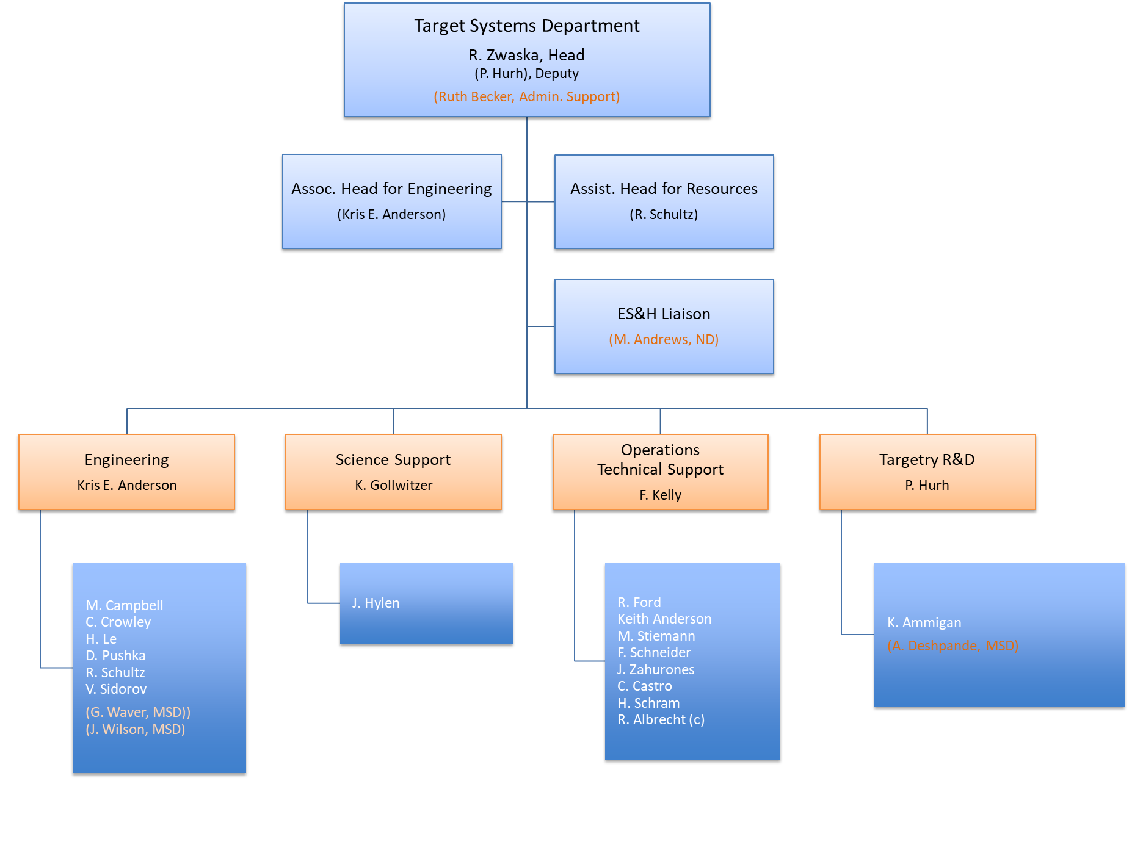
2015 Original

Slide 8
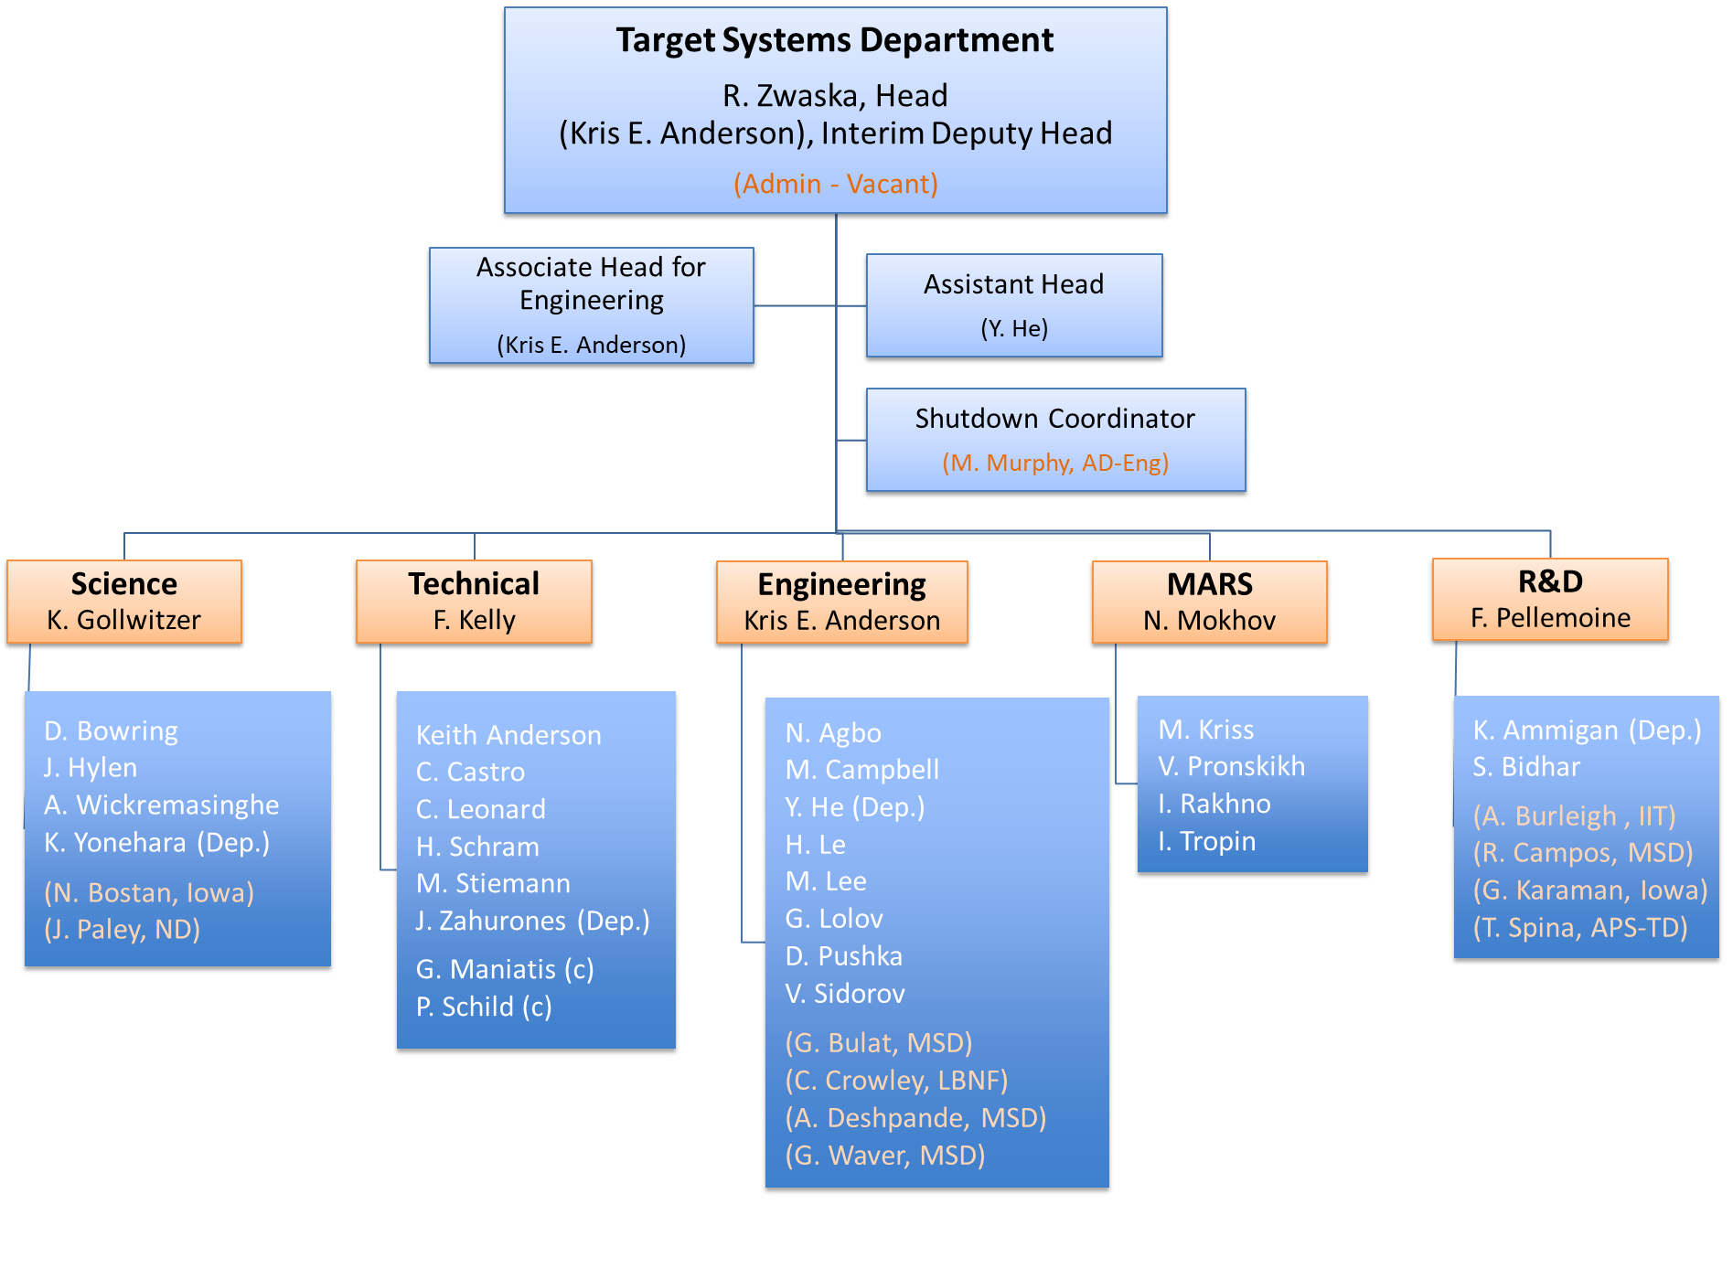

Slide 9
Summary
Thank you!
TSD is still working hard from home
We look forward to a great future load of work
We need to be safe as we come back to the lab
We want to keep TSD a capable organization now and as we return
Our capabilities are kept mostly in our people, so let’s hear from them

Slide 10
Introductions!
Yun is helping run the meeting, put questions in the chat
We want everyone to participate
Everyone made a slide to make in advance
If we missed you, please make a comment in the chat
Please use video and speak clearly
Less than 1 minute per person
Order
Group leader 1-slide into
Group 1-2 slide intro
Group members 1-slide intros
For each person:
Introduce yourself: “Hi my name is …”
We say “Hi …”
The one or few words at the end is to remind you of a very brief fact about yourself that nobody in the department knows (nothing too personal).
We will applaud – whether by zoom buttons or actually trying to clap into a microphone.

Slide 11
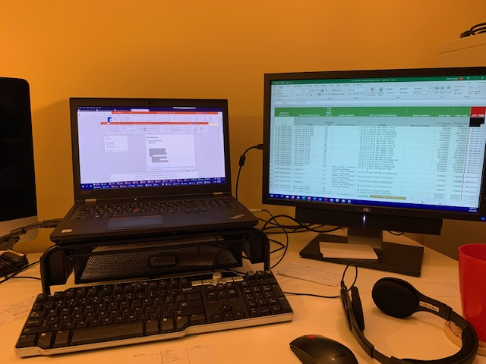
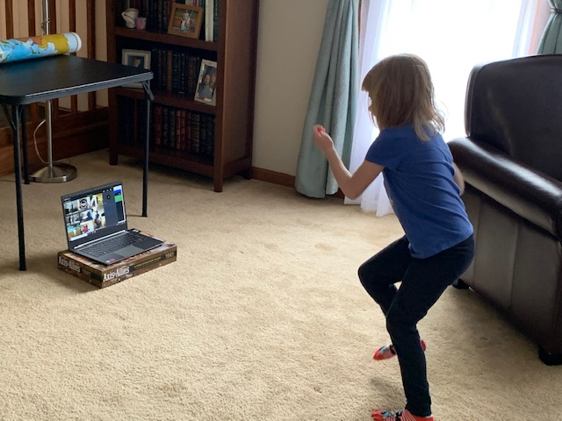
Bob Zwaska
Department Head / Physicist
Worked on Neutrino and Proton beams my whole career
15 years at Fermilab, and 5+ years a grad student
Working at home is different
We have a close family
I hope to see you soon
Telenetwork…

Slide 12
Groups
R&D
Engineer
Science
MARS
Technical

Slide 13
Wrap-up

