Slide 1
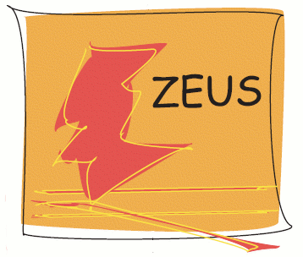
Inclusive measurements at HERA from low to high x
ISMD2013, Chicago, USA
17th September 2013
Olaf Behnke (DESY)
on behalf of
1
Notes:
Welcome to this DESY seminar
It is my pleasure to present you a sneak
preview of new H1 results for ICHEP06

Slide 2
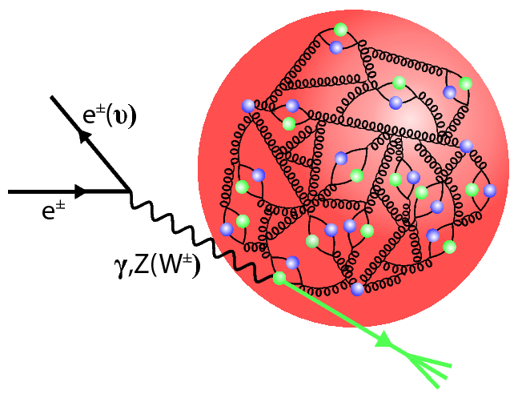
Content
HERA
Proton
Todays menu:
Neutral current (NC)
Charged current (CC)
Inclusive measurements:
Flavour inclusive
Charm production
2

Slide 3
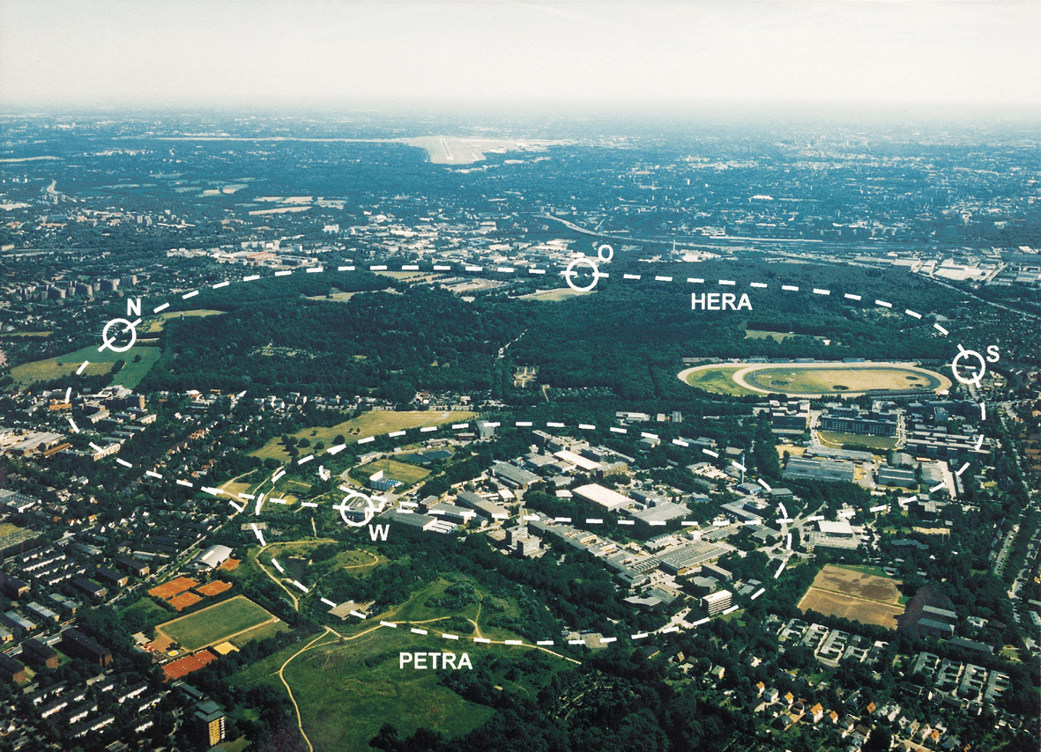
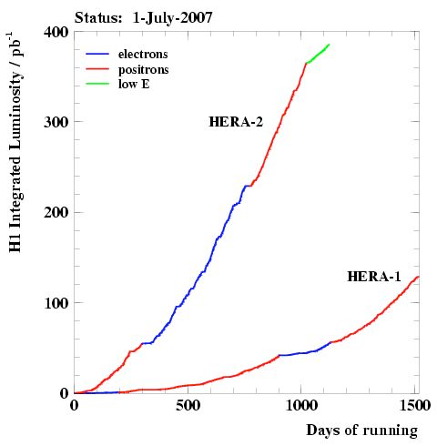
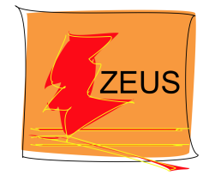
The HERA ep collider (1992-2007)
Longitudinally polarised e
~0.5 fb⁻¹ per experiment
±
3

Slide 4
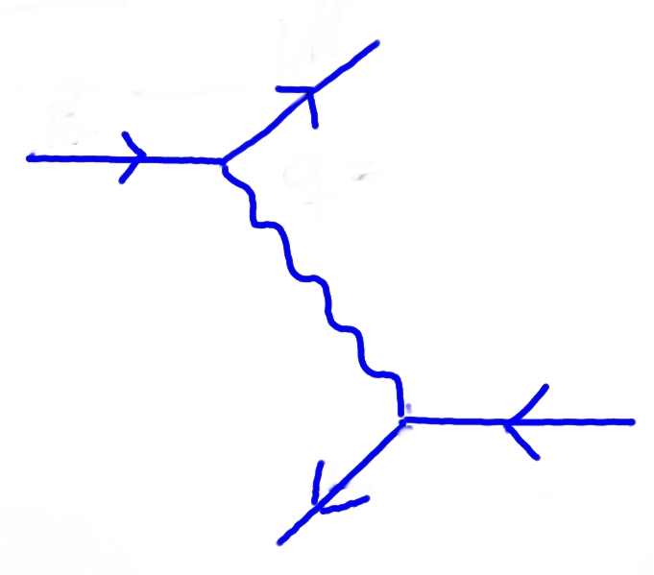
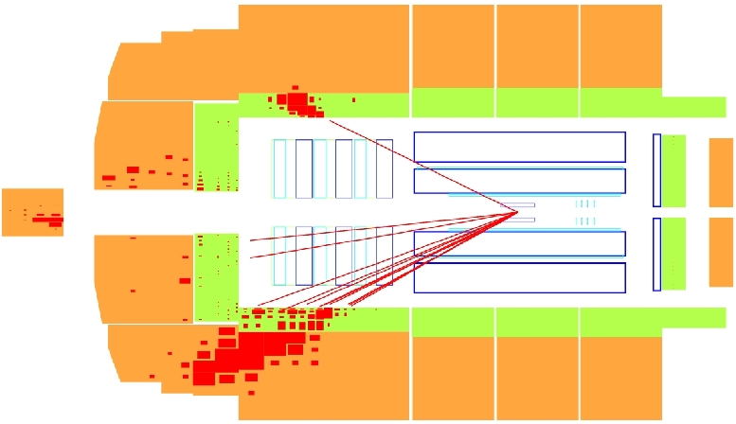
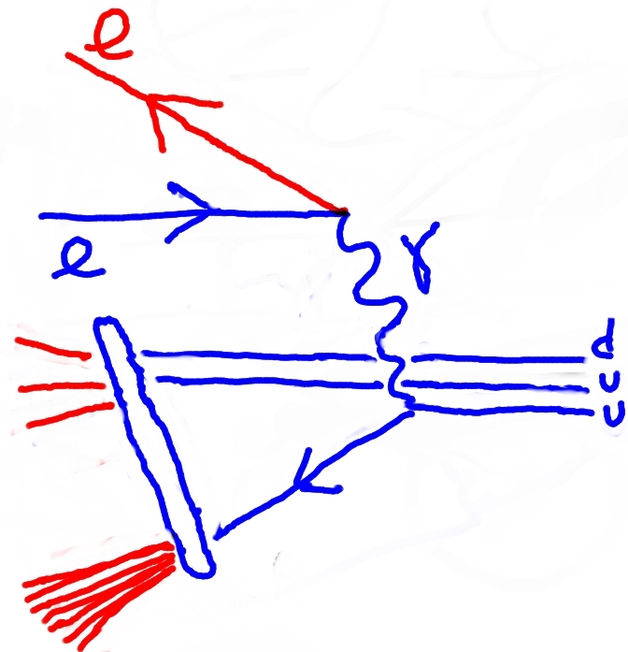
Deep inelastic scattering at HERA
NC event in H1 detector:
k'
Get Feynman diagram Event display?
27.6 GeV
k
q= k-k'
√S = 318 GeV
e±
γ-Resolution
Q² = -q²
Quark momentum
γ-Energy
x P
y = E_{γ}/E_{e|p-cms}
u
920 GeV
Relation:
Q² = Sxy
4
Notes:
- I start now the section on proton structure.
- Let me remind you of the basic kinematics of deep inelastic scattering at HERA
- 27.6 GeV electrons are scattered with 920 GeV protons so the centre of mass energy is 318 GeV.
- The scattering of the electron with a quark is
characterised by the photon resolution Q2 (which is the four momentum transfer squared) , the photon energy
which is represented by the inelasticity y and by
the proton momentum fraction x carried by the struck quark
- Only two of these quantities are independent the third is determined by this relation.
- On the right you see a nice deep inelastic scattering event in the H1 detector, the electron is backscattered here and the quark scatters downwards here.

Slide 5
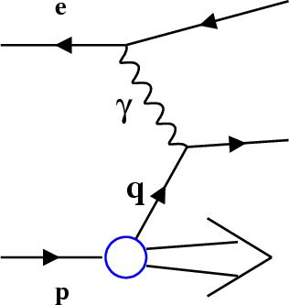
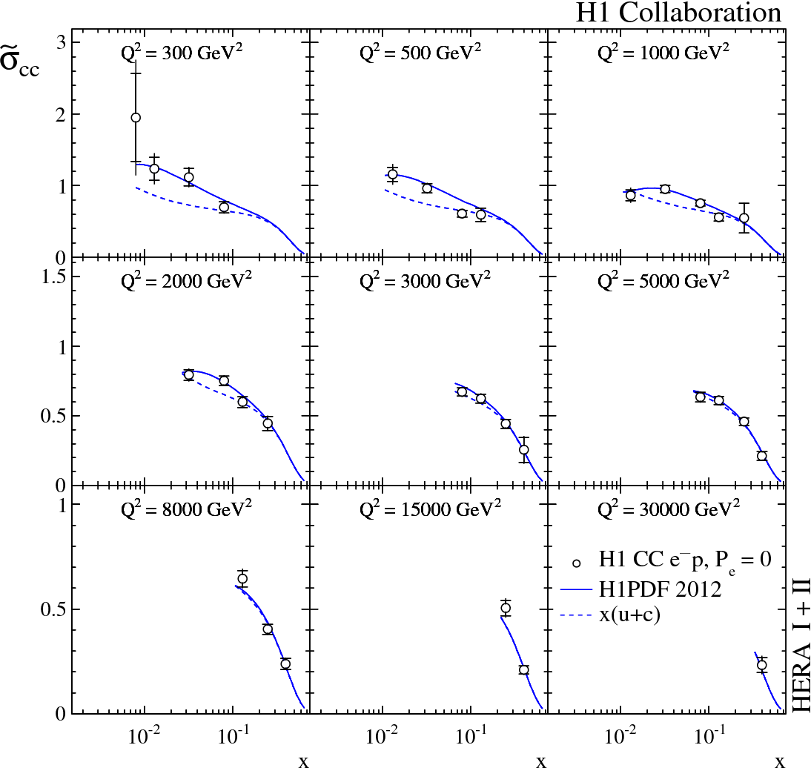
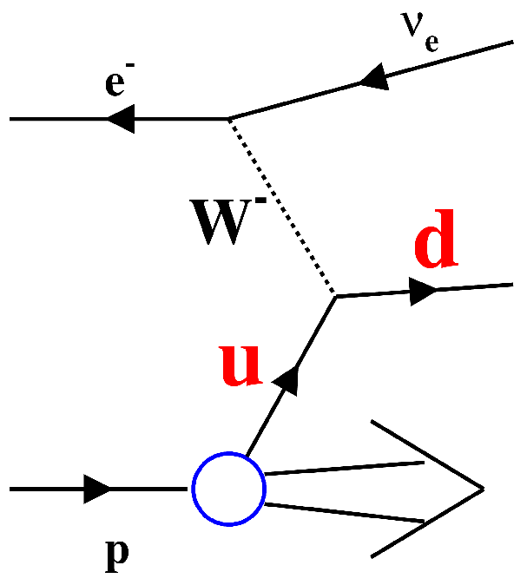
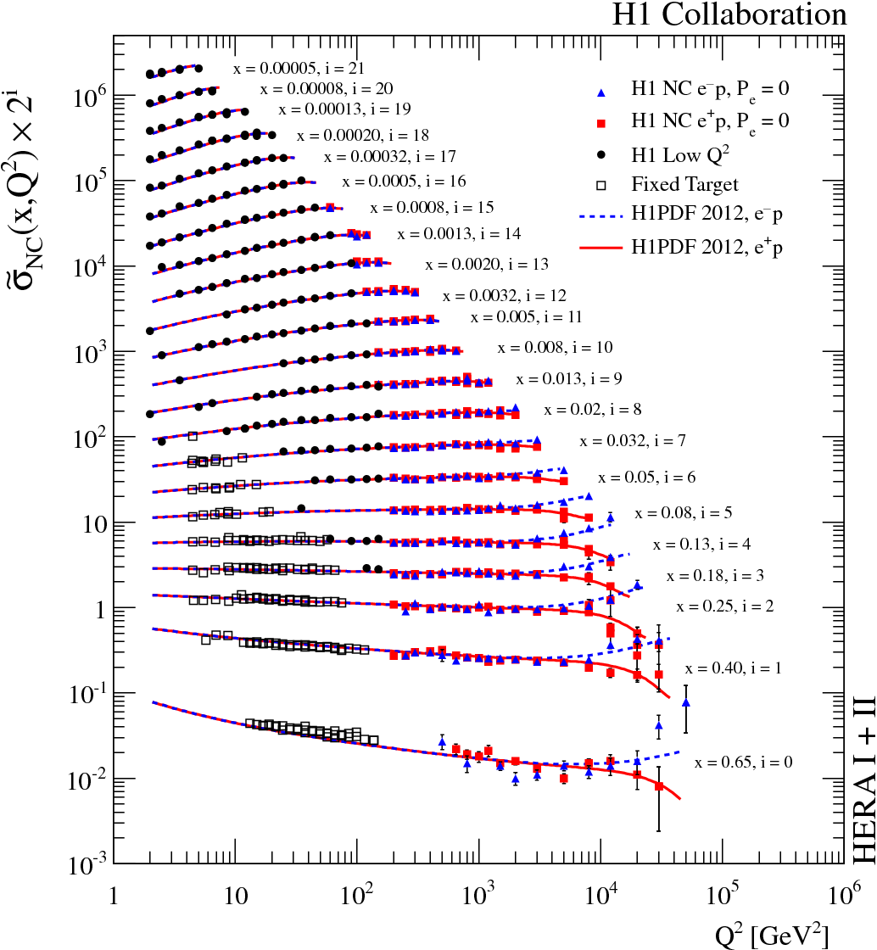
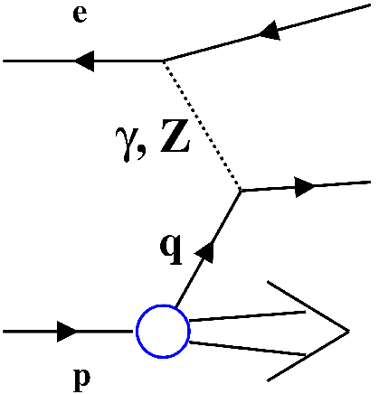
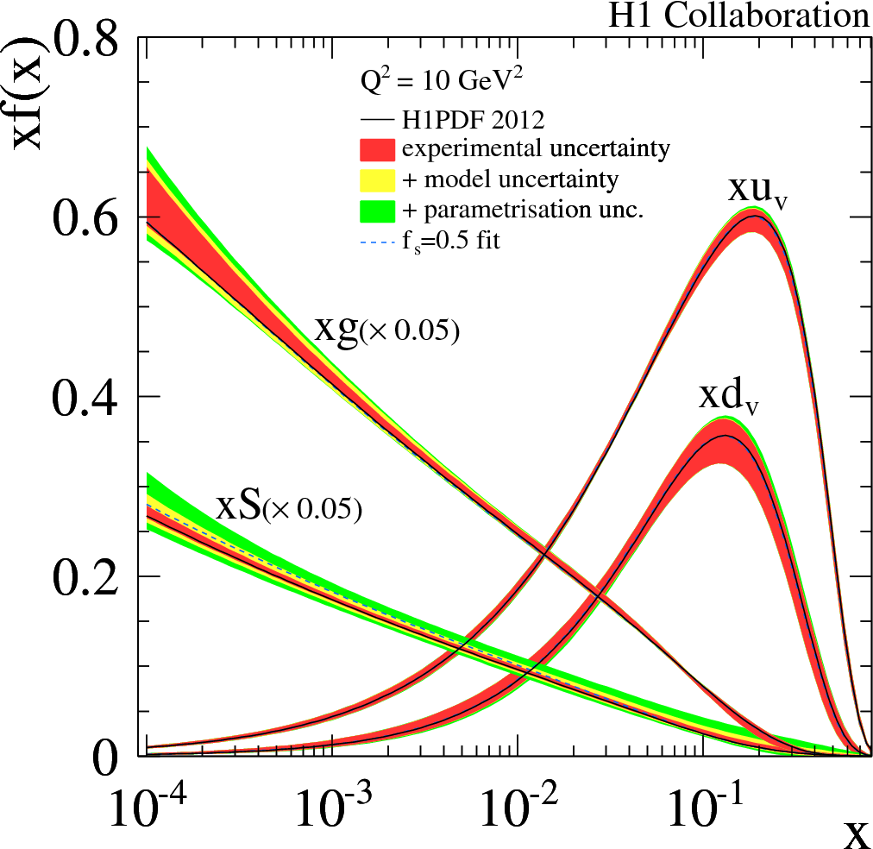
The HERA proton handbook
F₂, F_{L}
Using all info in an NLO QCD fit (DGLAP evolution) :
Scaling violations ~ g(x,Q²⁾
F₂, F_{L}, F₃
Bremsstrahlung of valence quarks
Charged Current
JHEP 09 (2012) 61
H1PDF 2012
Data well described by DGLAP NLO QCD
5
Notes:
- HERA has determined precise proton parton densities only using its own data
- The main ingredients are;
- the structure function F2 probed in photon exchange provide information on the quarks
- the scaling violations of F2 determine the gluon density, that means the higher the resolution scale Q2 the more sea quarks are produced from the gluons
- at large x you see negative scaling violations due to
Bremsstrahlung of valence quarks
- additional information on valence quark is provided at high Q2 from Z exchange and the corredsponding structure function xF3
- Charged current cross sections are sensitive to u and
d quark densities
- Using all info in an NLO QCD fit based on DGLAP evolution one arrives at these densities
- The densities are already precise at the 3to 10 % level, so why do we care for higher precision?

Slide 6
HERA inclusive data sets Low Q²<~150 GeV²,high Q²>~150 GeV²
HERA I
e⁺p
e⁻p
H1
Low Q²
NC 22 pb⁻¹
NC 100 pb⁻¹
NC 16 pb⁻¹
High Q²
CC 100 pb⁻¹
CC 16 pb⁻¹
ZEUS
Low Q²
NC 30 pb⁻¹
NC 108 pb⁻¹
NC 16 pb⁻¹
High Q²
CC 108 pb⁻¹
CC 16 pb⁻¹
HERA II
e⁺p
e⁻p
NC 182 pb⁻¹
NC 150 pb⁻¹
H1
High Q²
CC 182 pb⁻¹
CC 150 pb⁻¹
ZEUS
NC 136 pb⁻¹
NC 170 pb⁻¹
High Q²
CC 132 pb⁻¹
CC 175 pb⁻¹
+ further data sets from low E_{p} runs etc.
6

Slide 7
HERA inclusive data sets Low Q²<~150 GeV²,high Q²>~150 GeV²
HERA I
e⁺p
e⁻p
H1
Low Q²
NC 22 pb⁻¹
NC 100 pb⁻¹
NC 16 pb⁻¹
High Q²
CC 100 pb⁻¹
CC 16 pb⁻¹
ZEUS
Low Q²
NC 30 pb⁻¹
NC 108 pb⁻¹
NC 16 pb⁻¹
H1PDF 2012
High Q²
CC 108 pb⁻¹
CC 16 pb⁻¹
JHEP 09 (2012) 61
HERA II
e⁺p
e⁻p
NC 182 pb⁻¹
NC 150 pb⁻¹
H1
High Q²
CC 182 pb⁻¹
CC 150 pb⁻¹
ZEUS
NC 136 pb⁻¹
NC 170 pb⁻¹
High Q²
CC 132 pb⁻¹
CC 175 pb⁻¹
+ further data sets from low E_{p} runs etc.
7

Slide 8
HERA inclusive data sets Low Q²<~150 GeV²,high Q²>~150 GeV²
HERA I
e⁺p
e⁻p
H1
Low Q²
NC 22 pb⁻¹
NC 100 pb⁻¹
NC 16 pb⁻¹
High Q²
CC 100 pb⁻¹
CC 16 pb⁻¹
HERAPDF1.0
ZEUS
Low Q²
NC 30 pb⁻¹
JHEP 1 (2010) 1
NC 108 pb⁻¹
NC 16 pb⁻¹
High Q²
CC 108 pb⁻¹
CC 16 pb⁻¹
HERA II
e⁺p
e⁻p
NC 182 pb⁻¹
NC 150 pb⁻¹
H1
High Q²
CC 182 pb⁻¹
CC 150 pb⁻¹
ZEUS
NC 136 pb⁻¹
NC 170 pb⁻¹
High Q²
CC 132 pb⁻¹
CC 175 pb⁻¹
+ further data sets from low E_{p} runs etc.
8

Slide 9
HERA inclusive data sets Low Q²<~150 GeV²,high Q²>~150 GeV²
HERA I
e⁺p
e⁻p
H1
Low Q²
NC 22 pb⁻¹
NC 100 pb⁻¹
NC 16 pb⁻¹
High Q²
CC 100 pb⁻¹
CC 16 pb⁻¹
HERAs Best!
ZEUS
Low Q²
NC 30 pb⁻¹
NC 108 pb⁻¹
NC 16 pb⁻¹
High Q²
HERAPDF1.5
CC 108 pb⁻¹
CC 16 pb⁻¹
H1prelim-10-141(2)
ZEUS-prel-10-017(8)
HERA II
e⁺p
e⁻p
Preliminary data
NC 182 pb⁻¹
NC 150 pb⁻¹
Now published
H1
High Q²
CC 182 pb⁻¹
CC 150 pb⁻¹
JHEP 09 (2012) 61
Presented @last ISMD
Not yet available
ZEUS
NC 136 pb⁻¹
NC 170 pb⁻¹
High Q²
CC 132 pb⁻¹
CC 175 pb⁻¹
Now published
+ further data sets from low E_{p} runs etc.
DESY-12-145
9

Slide 10
HERA inclusive data sets Low Q²<~150 GeV²,high Q²>~150 GeV²
HERA I
e⁺p
e⁻p
H1
Low Q²
NC 22 pb⁻¹
NC 100 pb⁻¹
NC 16 pb⁻¹
High Q²
CC 100 pb⁻¹
CC 16 pb⁻¹
ZEUS
Low Q²
NC 30 pb⁻¹
NC 108 pb⁻¹
NC 16 pb⁻¹
High Q²
CC 108 pb⁻¹
CC 16 pb⁻¹
Future goal: combination of all the published measurements
and PDF fit
HERA II
e⁺p
e⁻p
NC 182 pb⁻¹
NC 150 pb⁻¹
H1
High Q²
CC 182 pb⁻¹
CC 150 pb⁻¹
ZEUS
NC 136 pb⁻¹
NC 170 pb⁻¹
High Q²
CC 132 pb⁻¹
CC 175 pb⁻¹
+ further data sets from low E_{p} runs etc.
10

Slide 11
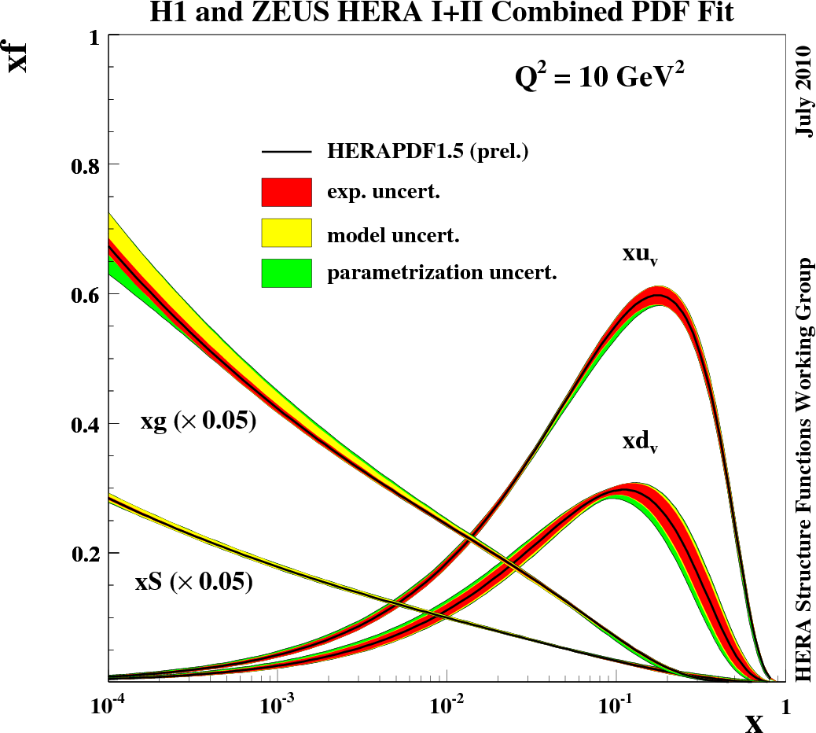
The HERAPDF1.5 family
NLO
Available at
NLO
NNLO
and now (sep. 2013) also at
LO
Obtained with the
open source QCD fit framework,
see poster by P. Starovoitov
11

Slide 12
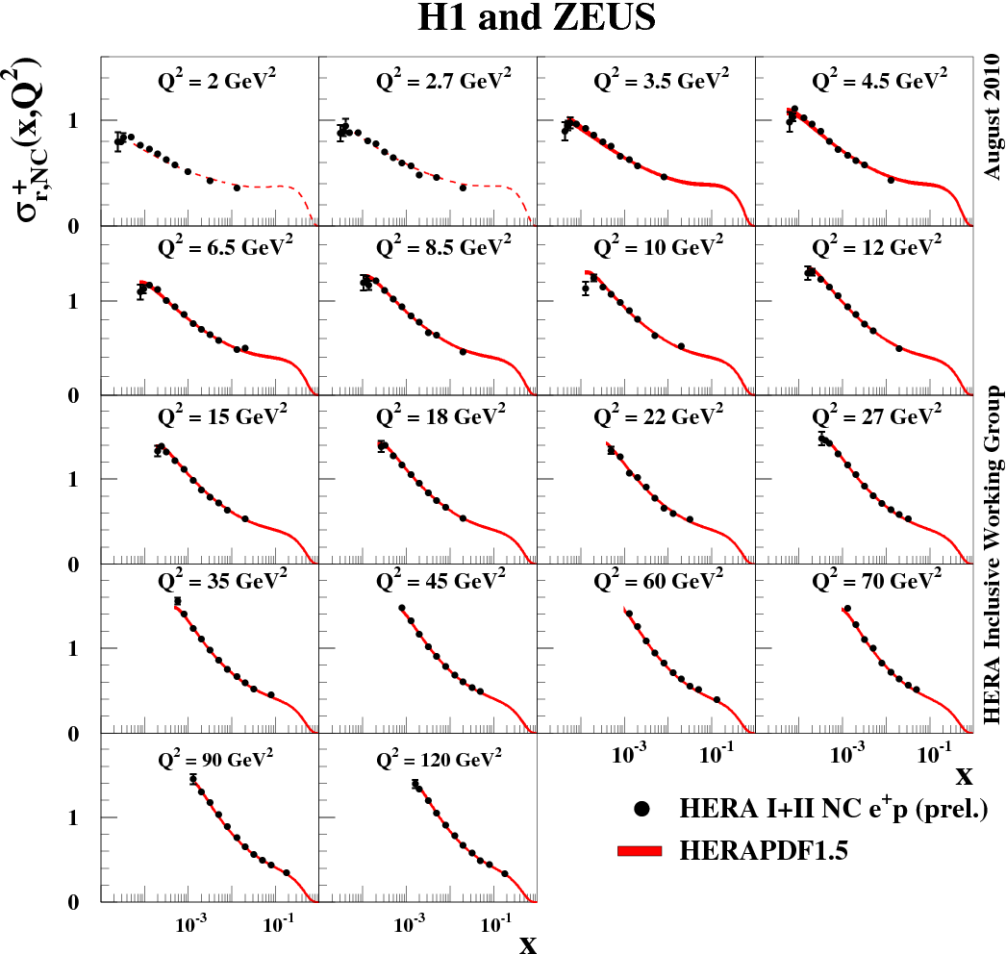
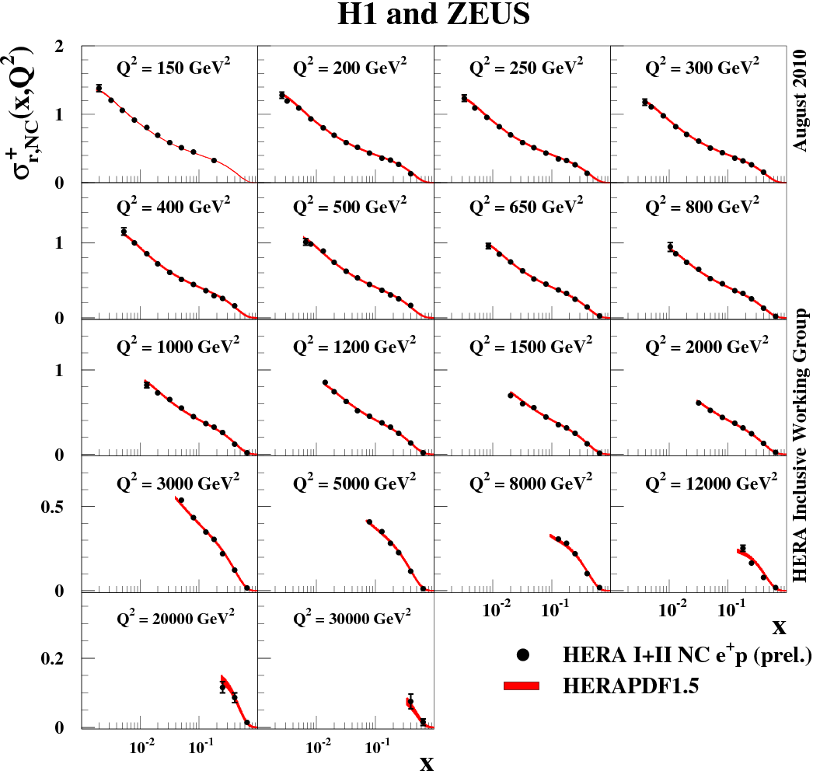
HERAPDF1.5 compared to HERA e⁺p NC data
Q²_{min}
Data well described over huge Q² and x range by DGLAP NLO QCD
12

Slide 13
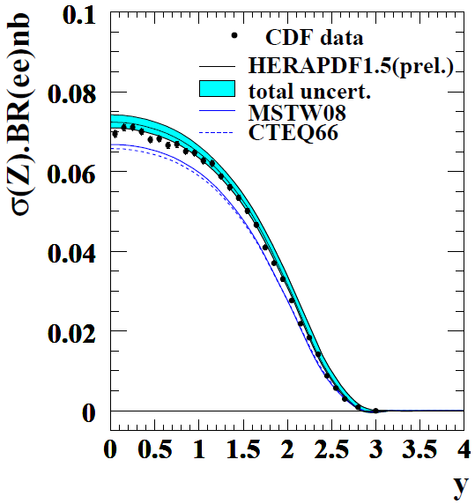
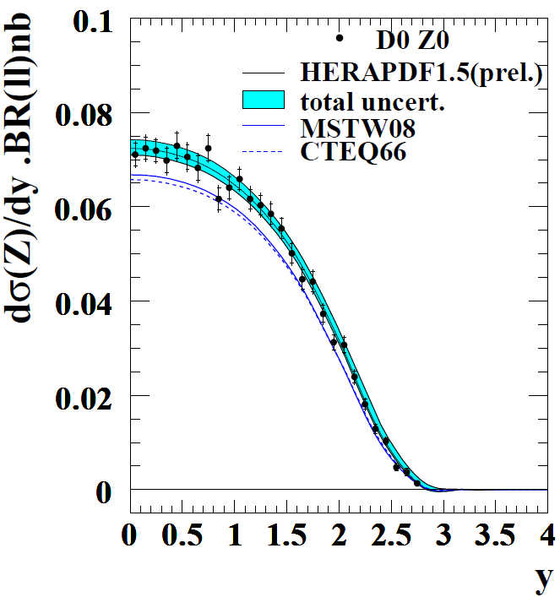
HERAPDF1.5 predictions for Tevatron
Data well described by HERAPDF1.5
13

Slide 14
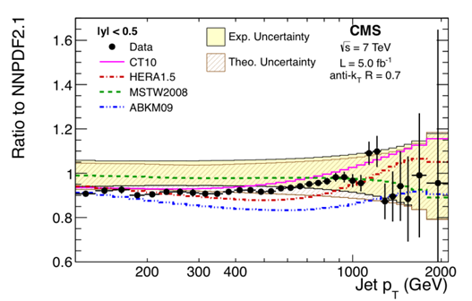
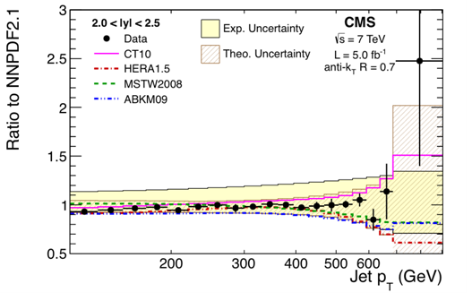
HERAPDF1.5 predictions for (exemplary) LHC jet data
Well described by HERAPDF1.5
These data yet to be used in PDF fit, carry information on high-x gluon
14

Slide 15
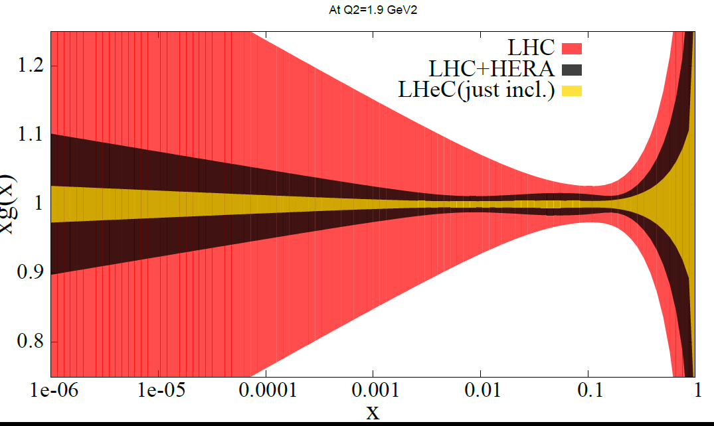
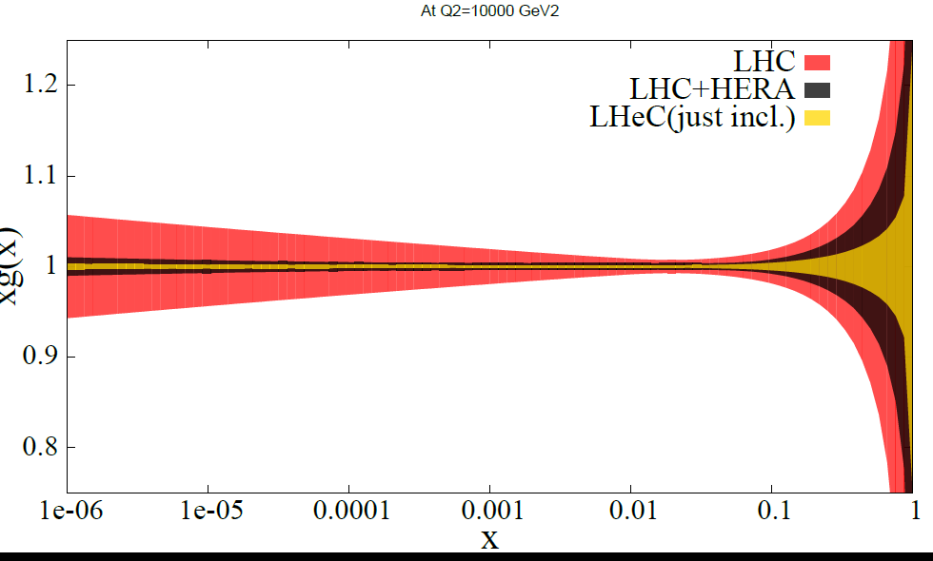
Can we get PDFs just from the LHC?
Using simulated LHC W, Z and jet data with ultimate precision estimated from current experience
Not with any precision
15

Slide 16
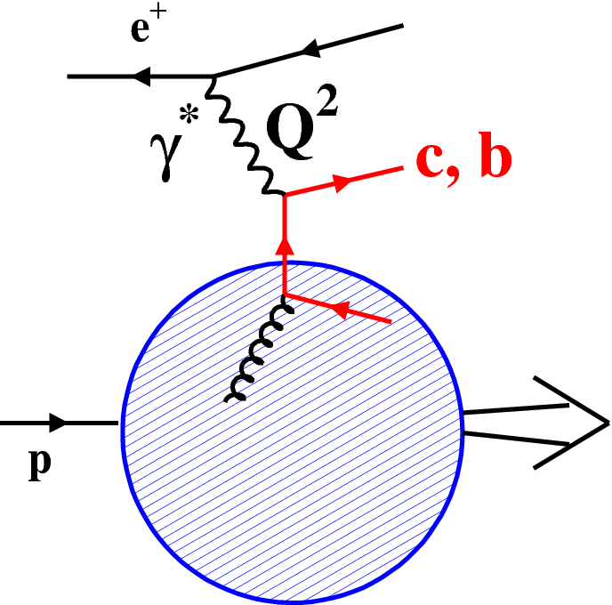
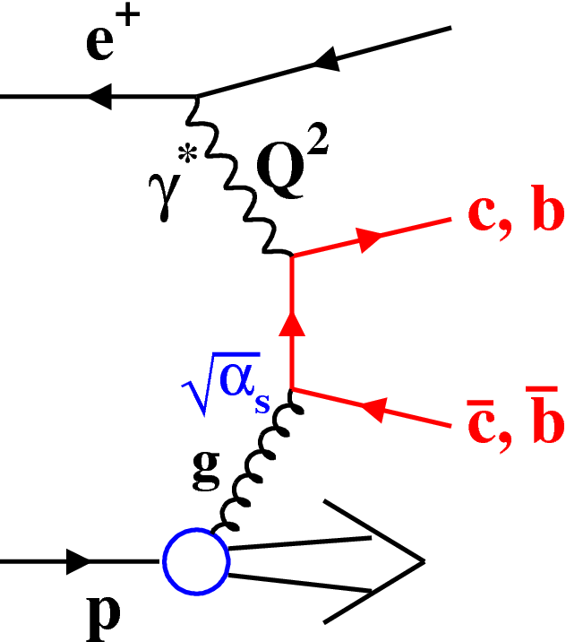
HERA Charm production and schemes
Massive scheme: Q²~m_{c}²
Massless scheme: Q²>>m_{c}²
ZM-VFNS
FFNS
Mixed schemes: interpolate, but how to do transition? → numerous variants
GM-VFNS
16

Slide 17
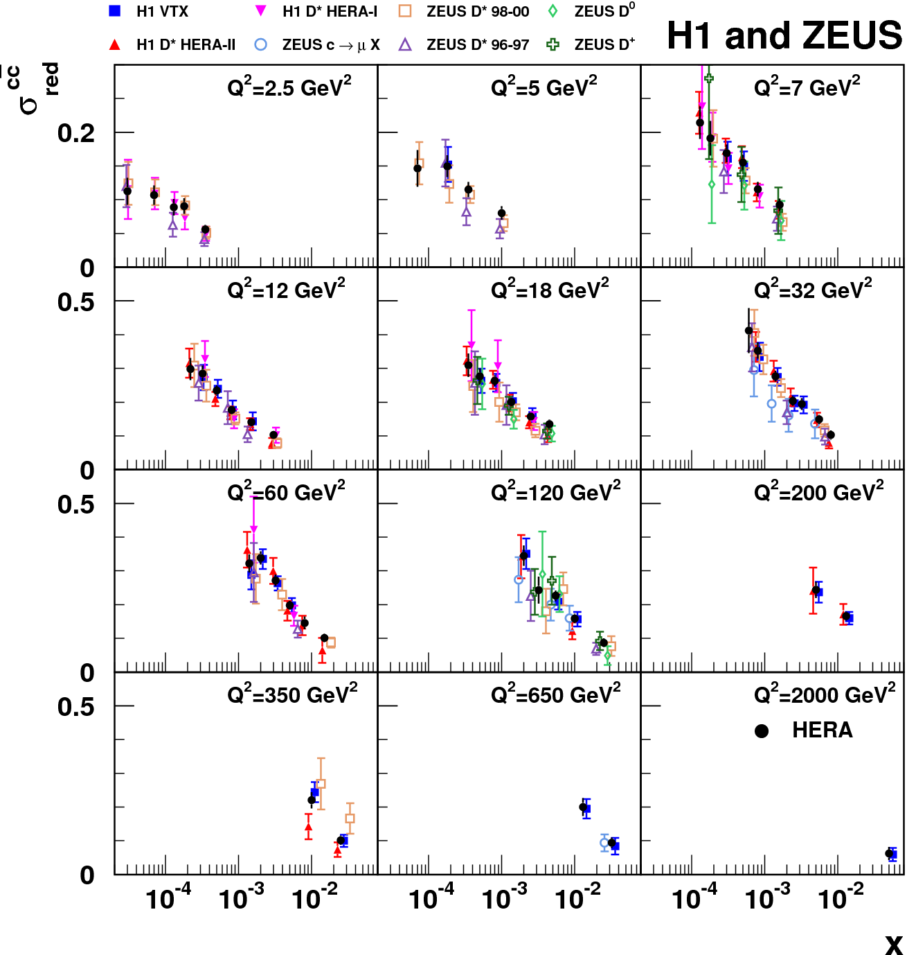
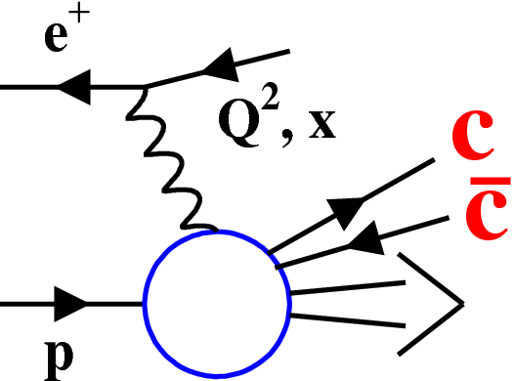
HERA Charm data combination
Combine D*,D⁺,D⁰, μ and lifetime tag data
take correlated systematics fully into account
EPJ C73 (2013) 2311
~σ^{cc}_{red}
17

Slide 18
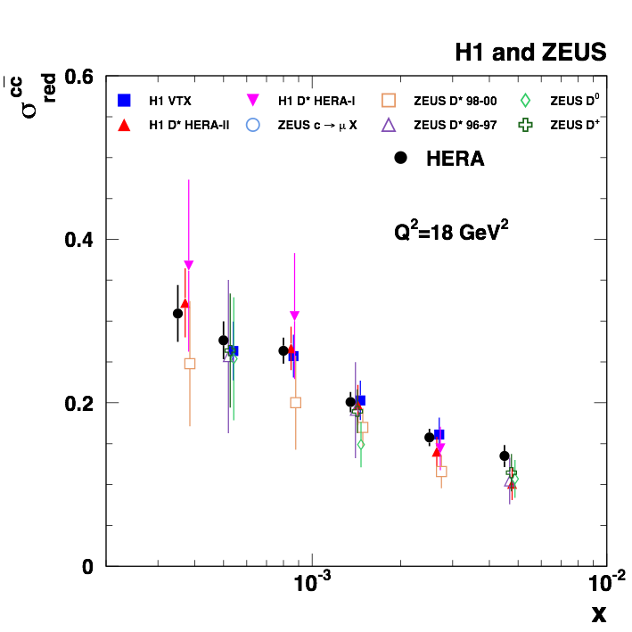
HERA Charm data combination
Combine D*,D⁺,D⁰, μ and lifetime tag data
take correlated systematics fully into account
EPJ C73 (2013) 2311
~σ^{cc}_{red}
Best precision:~5%
18

Slide 19
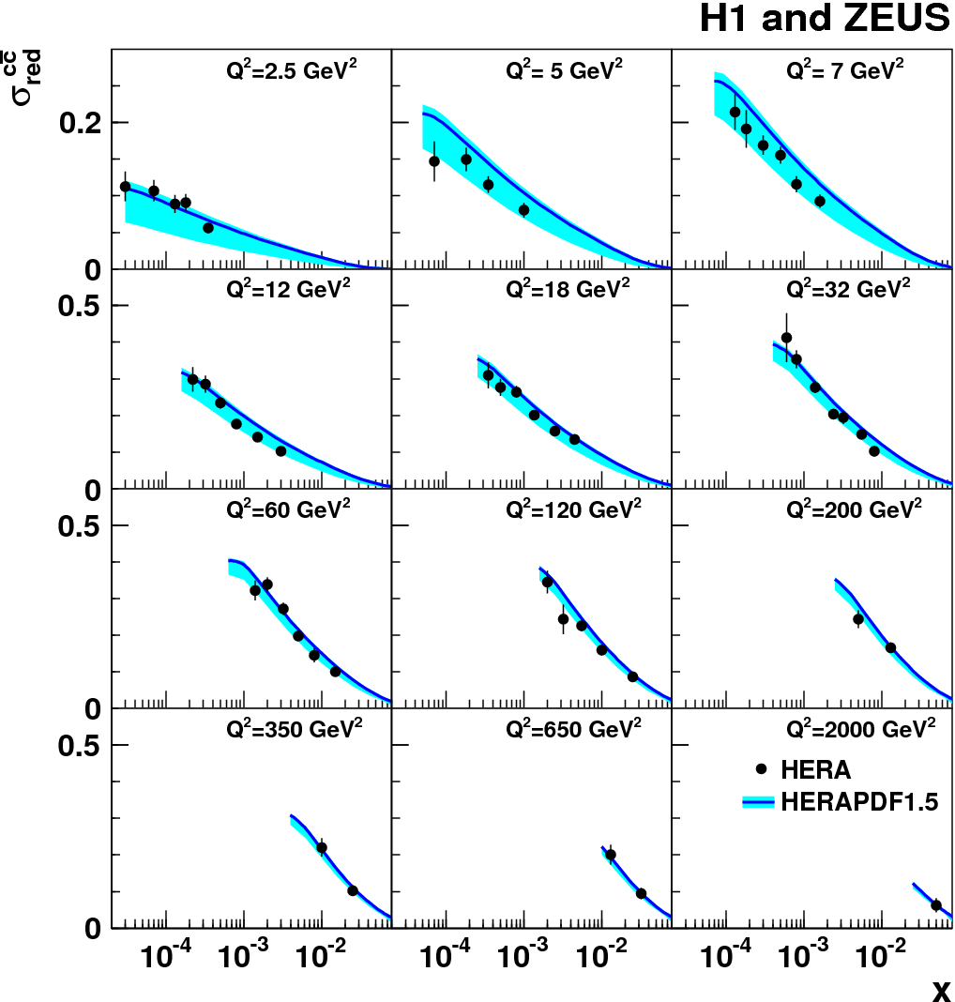
Combined charm data vs NLO GMVFNS
EPJ C73 (2013) 2311
HERAPDF1.5:
only inclusive DIS data
RT standard scheme
NLO GM-VFNS ok
large theory uncertainty dominated by m_{c} variation
19

Slide 20
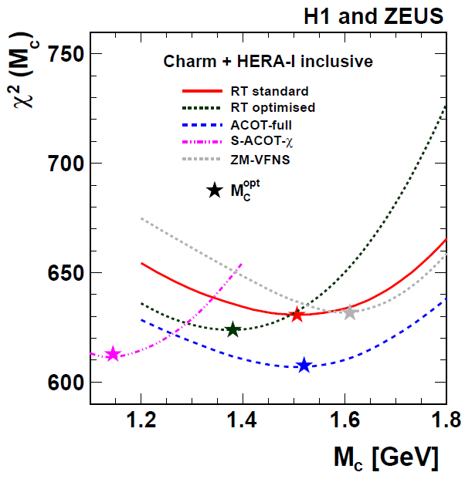
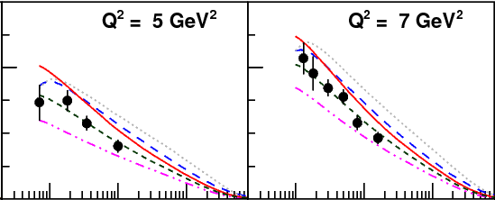
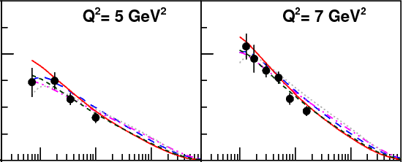
PDF plus charm mass parameter fit
EPJ C73 (2013) 2311
Fit combined charm and inclusive DIS data
GMVFN-schemes with charm pole mass M_{c}
M_{c} = 1.4 GeV
Using instead
M_{c} = M_{c}^{opt}
Various GM-VFNS: interpolate differently between massive and massless schemes
→ different quality of charm data description for fixed M_{c}→ compensate by M_{c}^{opt} values
→ stabilises flavour mixture in PDF → stabilises LHC predictions (W,Z) (see backup)
20

Slide 21
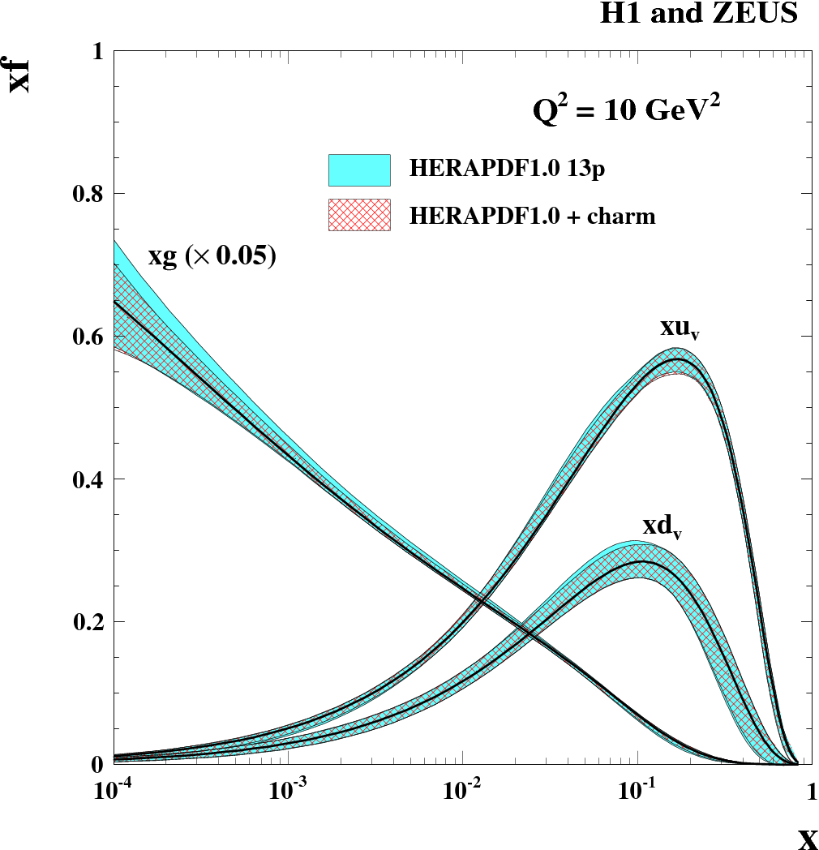
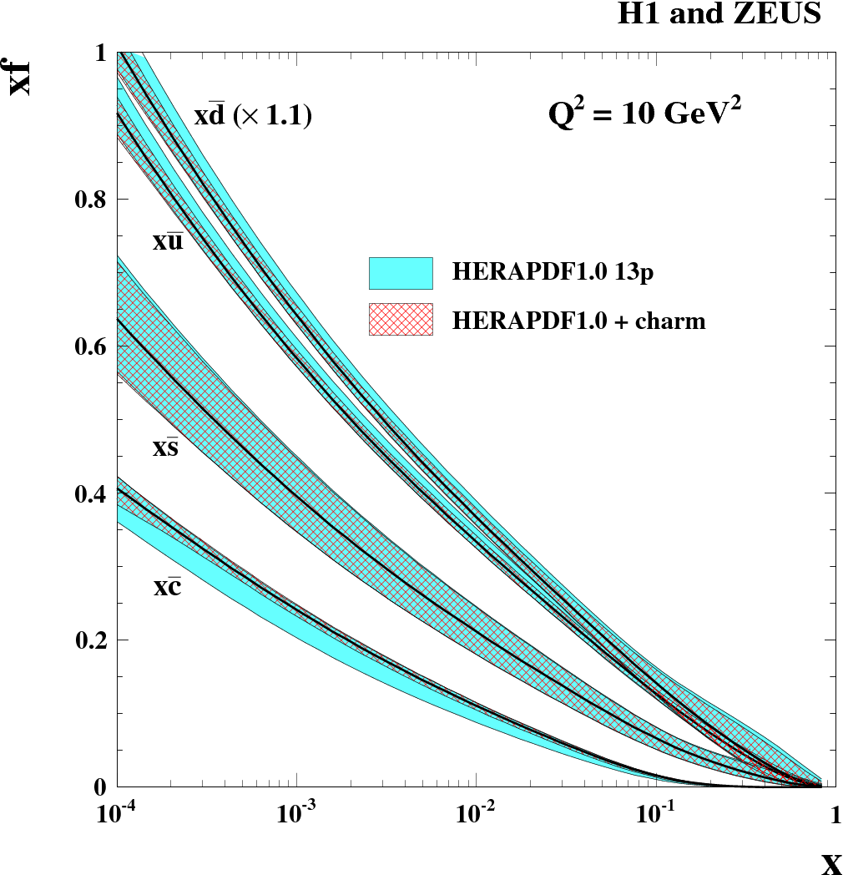
Impact of charm data on PDF
Example: RT optimal scheme
EPJ C73 (2013)
2311
improve sea flavour decomposition
21

Slide 22
Conclusions
Inclusive DIS
Final H1 and ZEUS Neutral and Charged Current bulk data sets available since 2012
Best precisions of ~1.5% for NC data with Q² from few to 500 GeV²
Data well described over large Q² and x range by NLO QCD
Ongoing work on final HERA combination
HERA Data based PDFs are essential for predictions at the LHC, we recommend HERAPDF1.5 (NNLO, NLO, now also @LO)
Charm production
Precise combined HERA charm DIS data → test heavy quark mass terms in pQCD:
variable flavour number schemes:
Data can separate between them, compensate by M_{c}^{opt}
improve sea flavour decomposition
Fixed flavour number scheme (not shown, see backup) :
Provides the best data description
Fit running m_{c}(m_{c})= 1.26±0.06 GeV
Further new precise ZEUS charm DIS data: D* and D+ (not shown, see backup) :
22

Slide 23
Backup slides

Slide 24
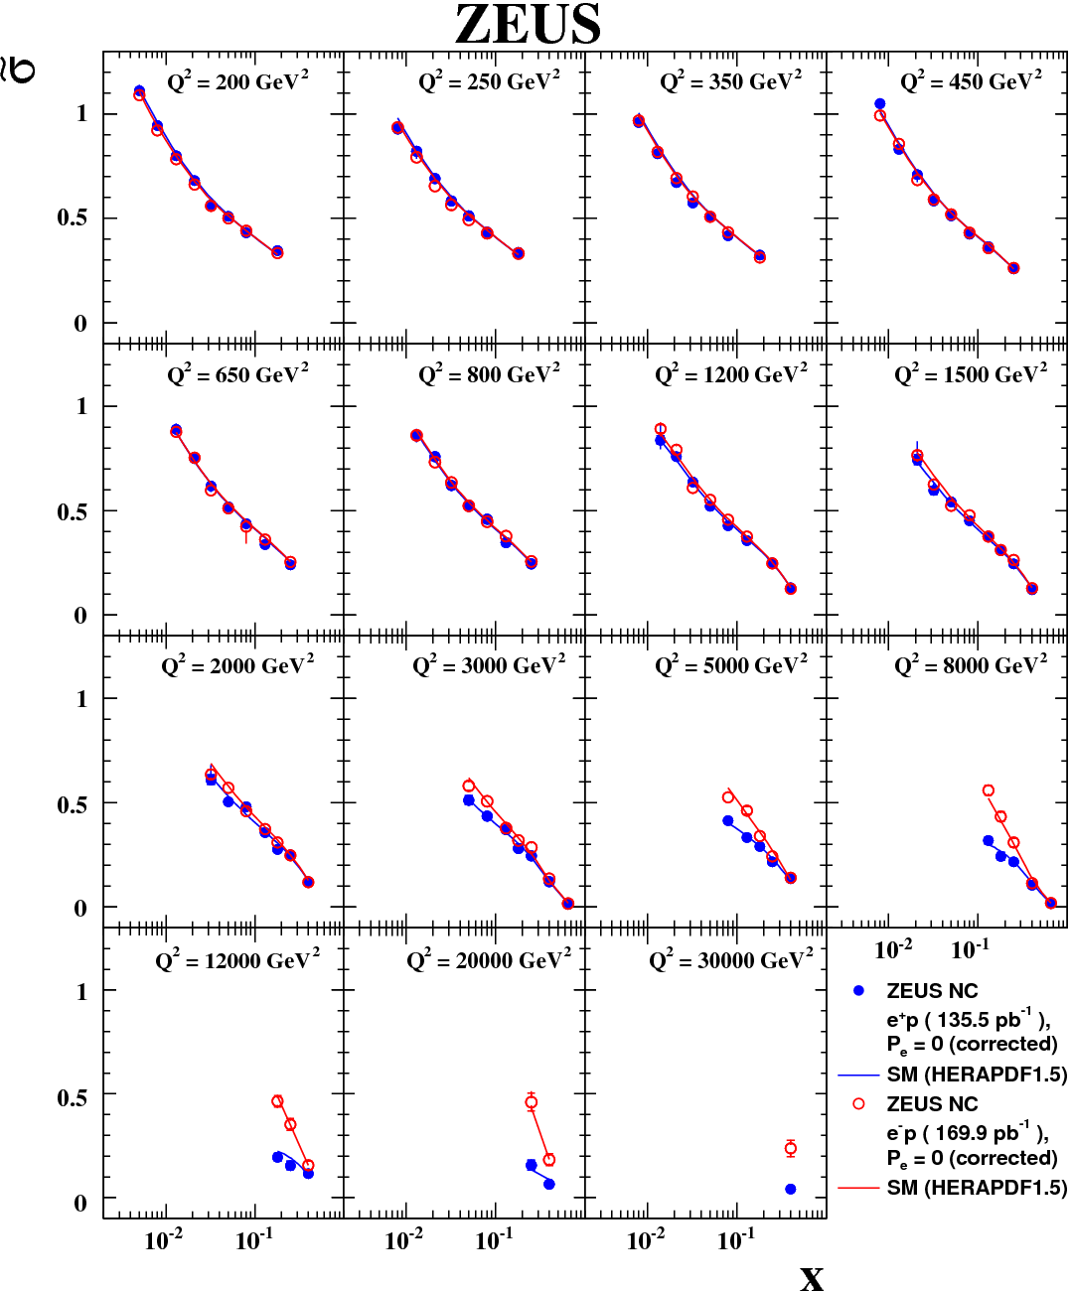
Reduced NC
cross sections
ZEUS final
high Q² HERA II results
completed by e+p NC data
PRD 87, 052014 (2013)
Best precisions of ~1.5%
Data well described by DGLAP NLO QCD
e-p
e+p
24

Slide 25
Charm production at HERA
Large contributions to incl. DIS
Sensitive to g(x)
25

Slide 26
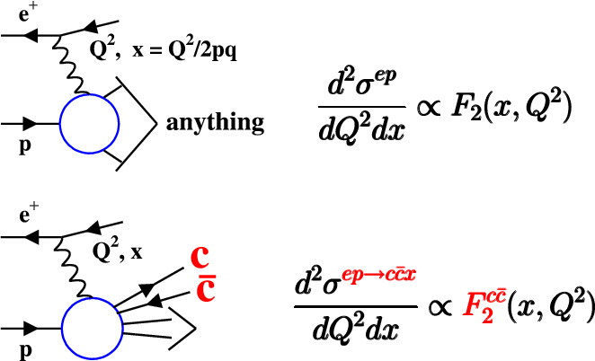
Charm contribution to DIS: F₂^{cc}
26

Slide 27
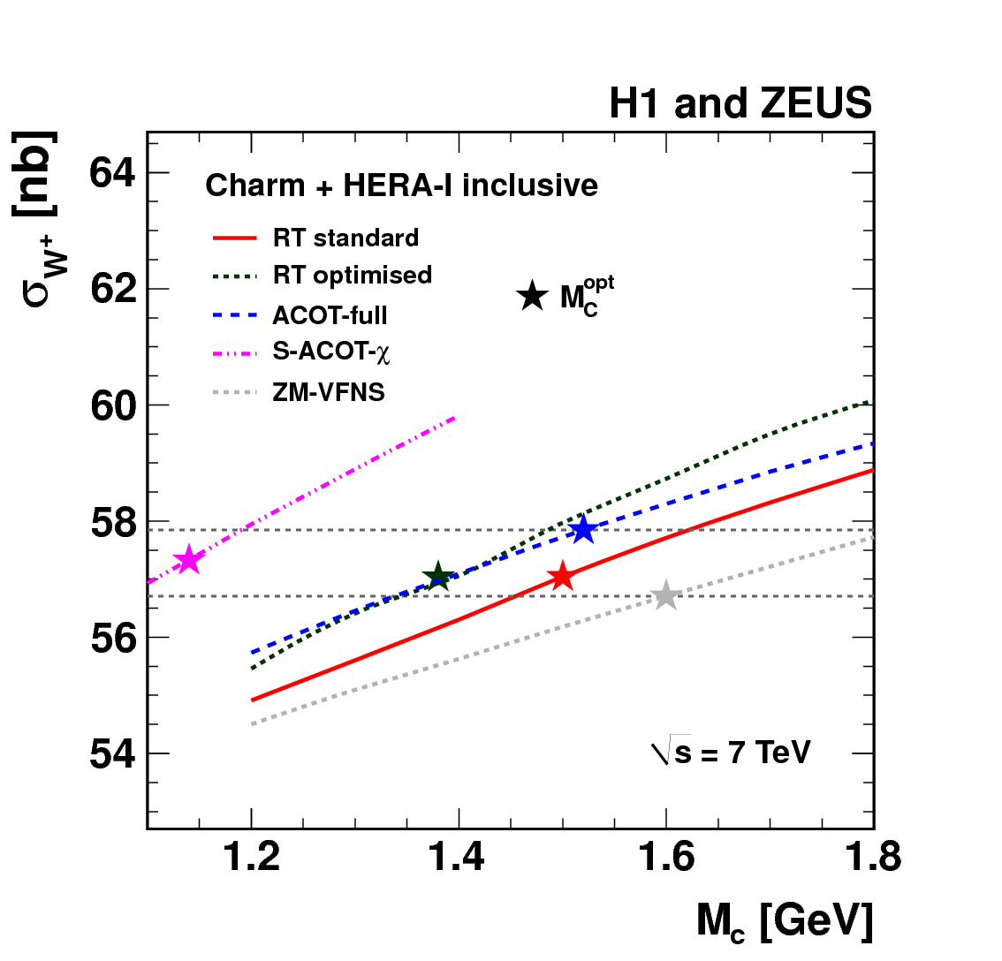
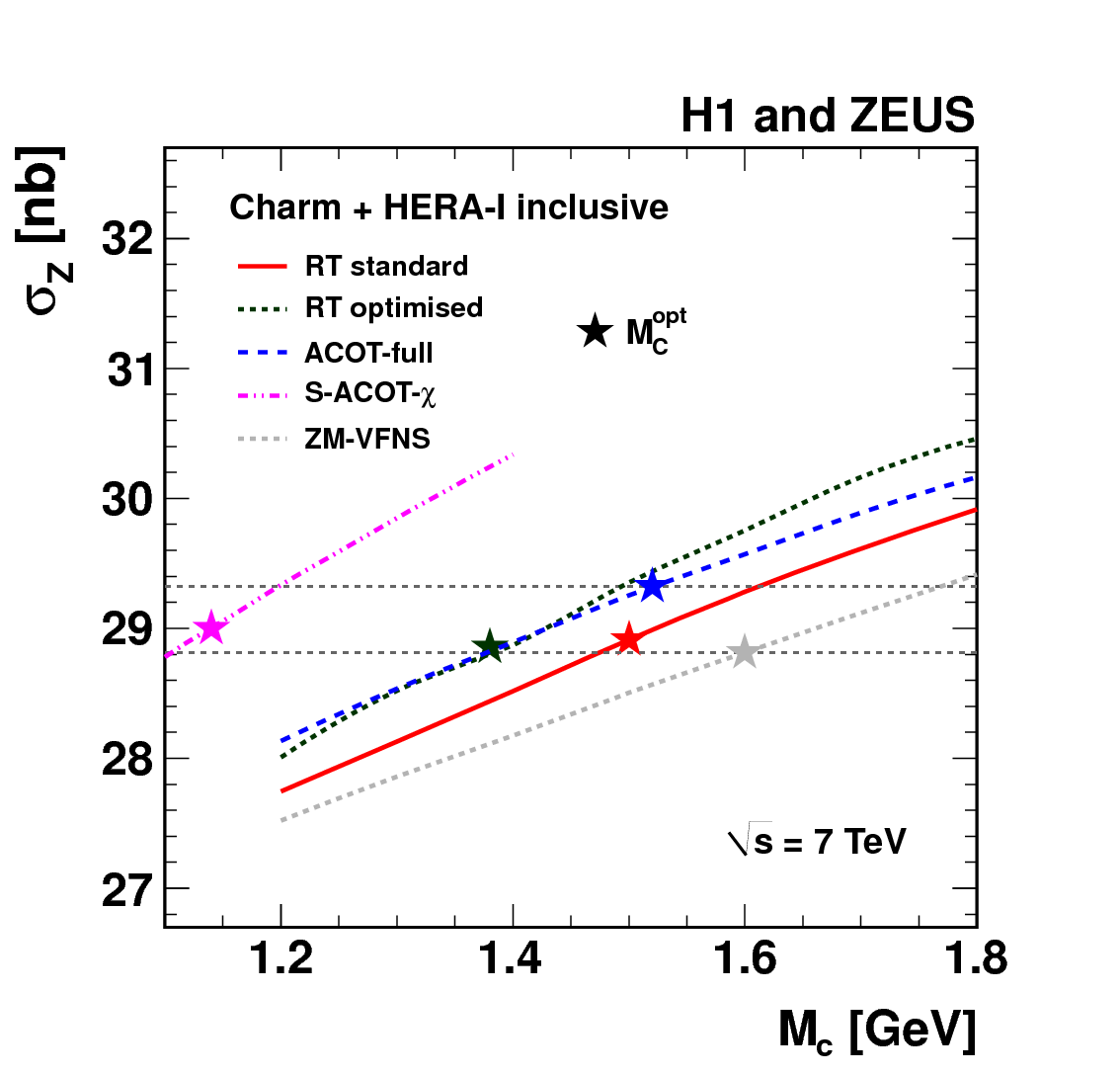
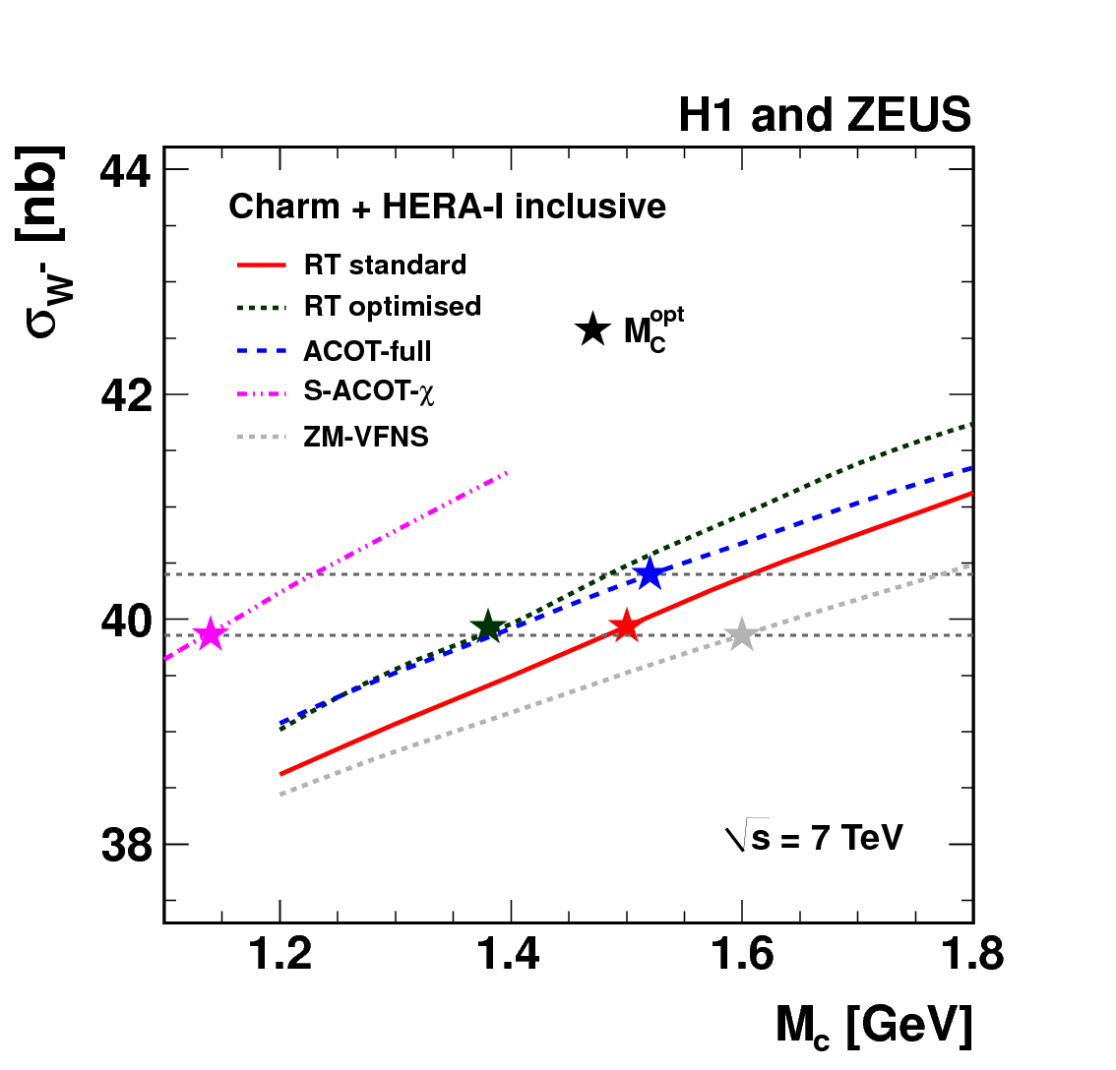
Z,W cross section predictions for LHC
EPJ C73 (2013) 2311
W⁺
Z⁰
W⁻
optimal M_{c} reduces significantly uncertainty
27

Slide 28
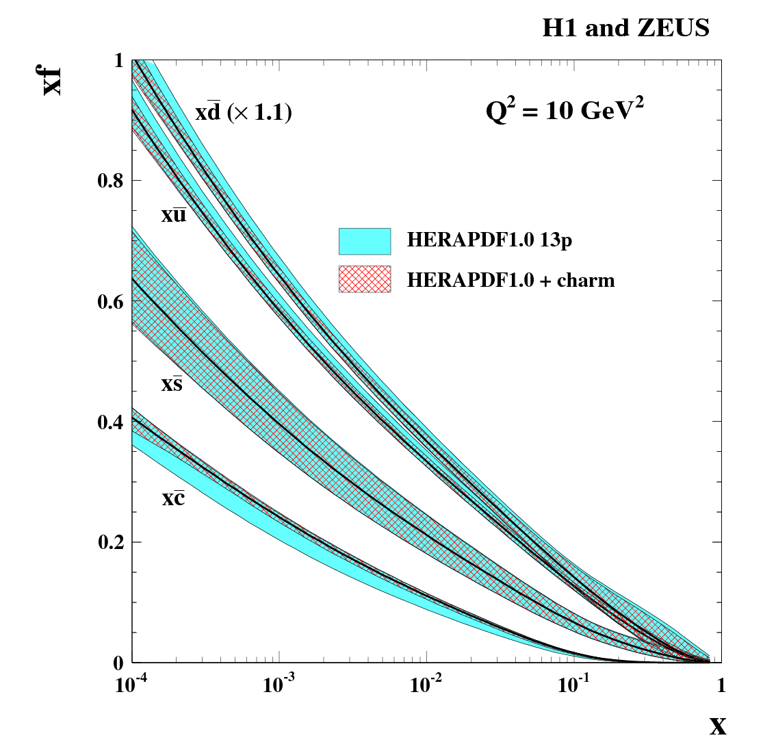
Impact of charm data on PDF
Example: RT optimal scheme
EPJ C73 (2013)
2311
stabilise sea flavour composition
28

Slide 29
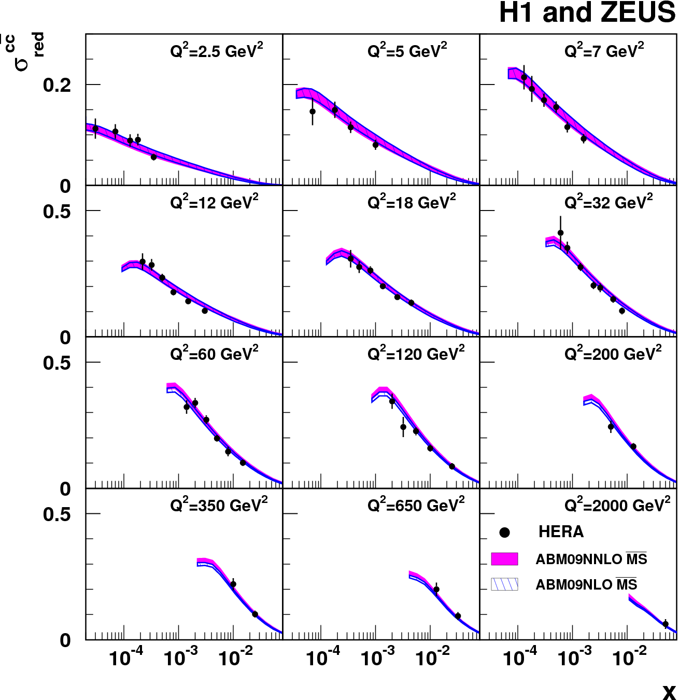
Combined charm data vs ABM FFNS prediction
EPJ C73 (2013)
2311
Use MS running mass NLO+ partial NNLO
Very good description everywhere
29

Slide 30
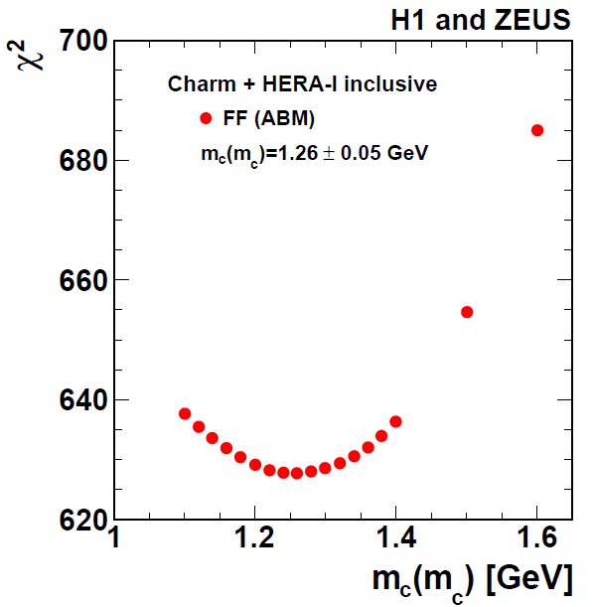
Fit: PDF plus MS running charm mass
EPJ C73 (2013) 2311
Fit combined charm
and inclusive DIS data
use ABM FFNS
nice and consistent result
m_{c}(m_{c}) = 1.26 ±0.05_{exp} ±0.03_{mod} ±0.02_{αs} GeV
PDG: 1.275 ±0.025 GeV (lattice QCD + time-like processes)
30

Slide 31
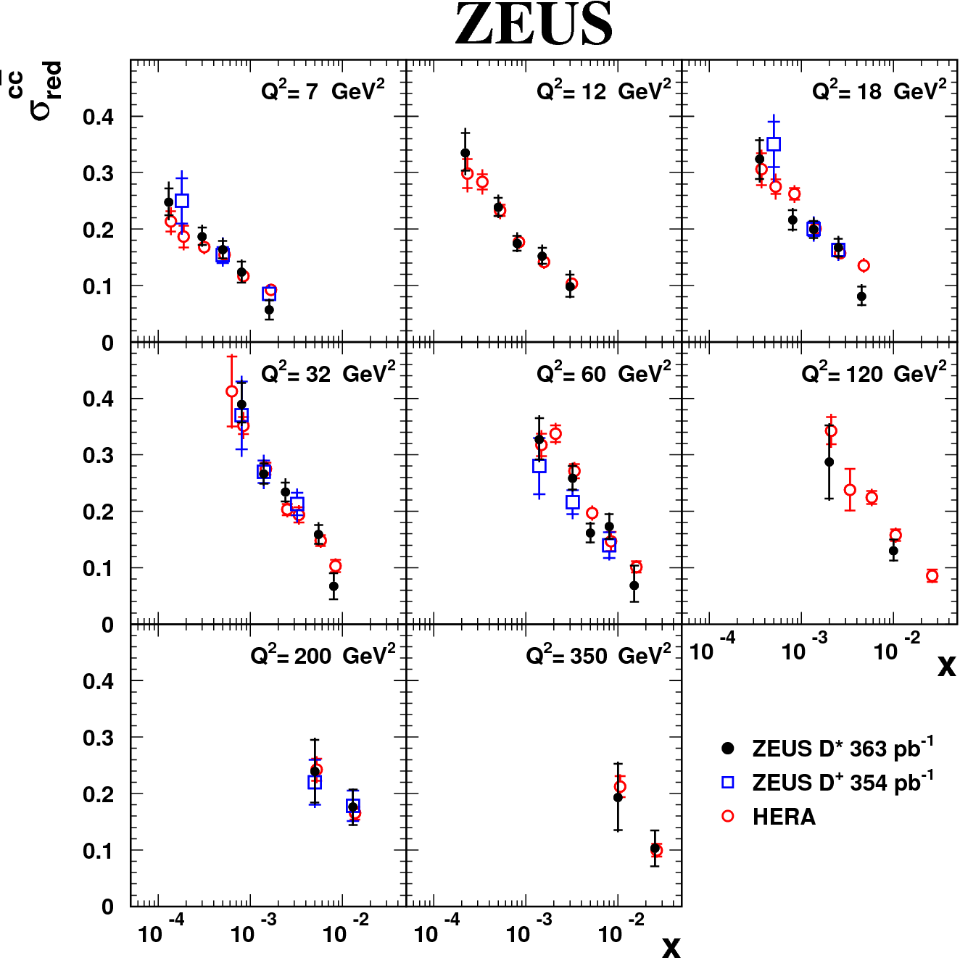
Brand new charm results in DIS: D* and D+
DESY-13-054
DESY-13-028
~σ^{cc}_{red}
Consistent findings
New ZEUS results will improve combination, PDF and m_{c} fits
31

