Slide 1
Exclusive central particle production in CDF
Mainly double pomeron exchange DPE
Mike Albrow (Fermilab) on behalf of the CDF Collaboration
“ISVFPD”
Central exclusive production, CEP.
Collider Detector at Fermilab (CDF) Detector
Triggers and data sets
Exclusivity cuts and luminosity normalization
Mass distributions before correcting for acceptance and efficiency
Corrections and cross sections: Mass M(ππ), p_{T}, s-dependence
J/ψ and χ_{c} limits.
Future studies, Summary

Slide 2
Central Exclusive Production in Hadron-Hadron
p + p → p + X + p : where + = rapidity gap Δy > 3 or 4 units, with no hadrons
p (or pbar) may emerge “quasi-elastically” or in a low mass excited state p* (e.g. → pππ)
and X is a fully measured (exclusive) “simple” state.
p
p
Δy >~ 4
Δy >~ 4
p
t₁
Exchange of 4-momentum in t-channel
for large Δy limited to photons γ or pomerons IP
t₂
p
In e+e- collisions, γ + γ only ... e.g. e+e-, μ+μ-, ...
In e-p collisions, γ + γ and γ + IP (photoproduction) e.g. ρ, ϕ, J/ψ, Υ, Z
In p+p collisions, γ + γ and γ + IP and IP + IP (double pomeron exchange), e.g. ππ, f0, χ _{c,b}, H

Slide 6
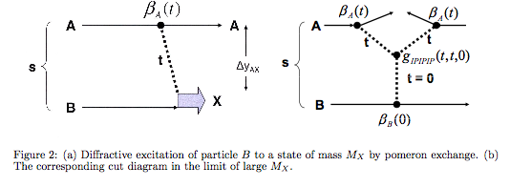
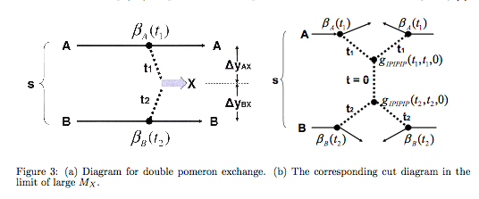
Regge phenomenology: If Single Diffraction then Central Diffraction or Double Pomeron Exchange
Optical theorem: total cross section = Im(forward scattering amplitude)
ACF

Slide 7
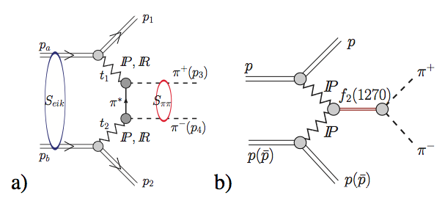
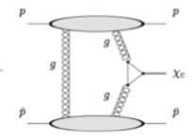
At low masses, Double Pomeron region, non-perturbative
and difficult to calculate. New efforts (Harland-Lang et al,
Antoni Szczurek et al.
Diagram from P.Lebiedowicz & A.Szurek
arXiv:12120166
Into perturbative regime:
“Durham” diagram
or f0(600)/σ or f0(980) etc.
e.g. χ_{c}, χ_{b}, γγ, Higgs !!
Central hadron state: Q = B = S (etc.) = 0 and I^{G} J^{PC} = 0⁺ (even)⁺⁺
Very good for hadron spectroscopy, especially gluon-rich (glueballs? η, η’ ?)

Slide 9
s-scan!

Slide 10
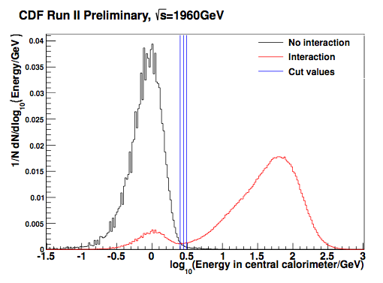
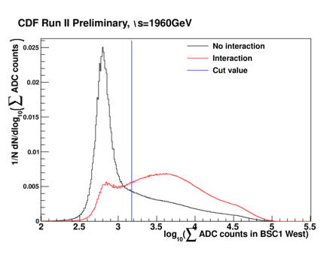
Noise levels → empty detector, exclusivity cuts and σ(vis) : examples
Energy in Central Calorimeter
Sum ADC counts in BSC (west)
Cuts well defined; noise well separated
from interactions.
0-bias data (critical)
2 classes:
No interaction = no tracks, no μ stubs, no CLC hits
>= 1 Interaction = all other bunch crossings.

Slide 11
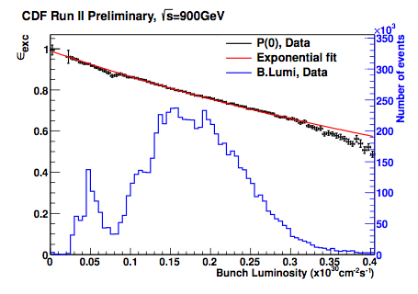
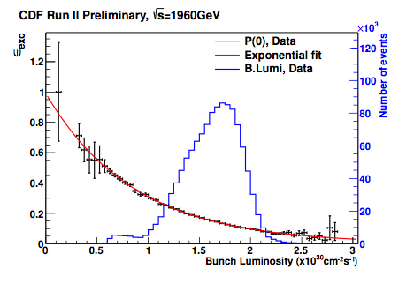
Take 0-bias events, measure P(0) = probability all CDF in noise |η| < 5.9 = ε(exclusive)
vs bunch luminosity (from CLC). Intercept = 1.0, slope = σ(vis) = σ(|η| < 5.9 )
We choose to use σ(vis) to calibrate the absolute luminosity at 900 GeV as CLC not calibrated.
At 1960 GeV methods agree. 10% syst unc. on L(900).
Note: above plots, divide BL by 47,747
to get BL per crossing (not /sec)

Slide 12
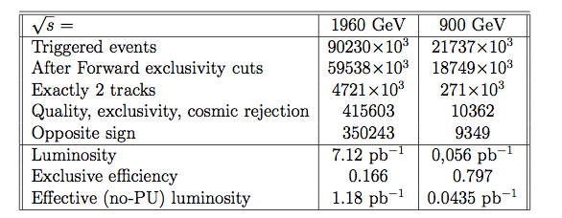
p + pbar → p(*) + [π+π-] + pbar(*)
Data at √s = 1960 GeV (standard) and 900 GeV (special, 38 hours at low luminosity)
Trigger:
2 Central |η| < 1.3 Calorimeter towers with ET (EM + HAD) > 0.5 GeV
Veto on signals in Beam Shower Counters, BSC, 5.4 < |η| < 5.9 (scint. + 1.7 X₀ rad.)
Veto on Cherenkov Luminosity Counters, CLC, 3.75 < |η| < 4.75 (48 gas tubes + PMTs)
Veto on Forward Plug Calorimeter (EM + HAD), 2.11 < |η| < 3.64 (Pb + Fe/scint.)
Off-line:
Require exactly two tracks, ΣQ = 0, |η| < 1.3, pT > 0.4 GeV/c, on vertex, good quality.
Require all CDF -5.9 < η < +5.9 detectors < noise level cuts except two track hits.
Assume pions, |y(ππ)| < 1.0, M(ππ) > 0.8 GeV/c (to accept all p_{T}(X))

Slide 13
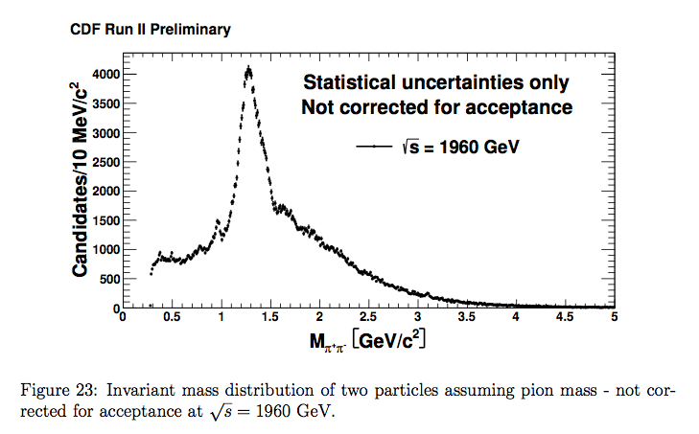
Raw data, uncorrected. At M < 0.8 GeV, small p_{T} not accepted.
Small Φ → K+K- (with π mass) at ~ 0.34 GeV
Tiny K⁰_{S} → π+π- (non-exclusive background)
f0(980) – f_{X}(1200-1500) --- 1.5 “mini-dip” --- J/ψ → e+e- (μμ?) at 3.1 GeV

Slide 14
Acceptance, given tracks η, p_{T}
and y(ππ) ... CDF simulation
Cross section in M, p_{T} plane
after all corrections

Slide 15
Gaps Δy > = 4.6 both sides

Slide 17
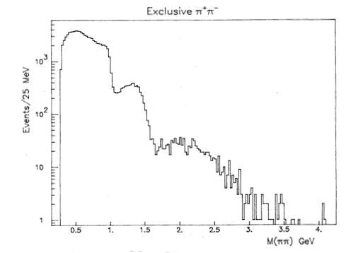
red
At ISR (R807) :
with p +(3) ππ +(+3) p low mass σ(0.8 – 0.95 GeV) >> σ(980, 1270,...)
(also at SPS, Tevatron FT energies)
Is this (a) √s (b) gaps 4.6 cf 3 (c) p not p*, including t = 0
(d) ppbar cf pp (ω or O?)
ISR 63 GeV
AFS R807

Slide 18
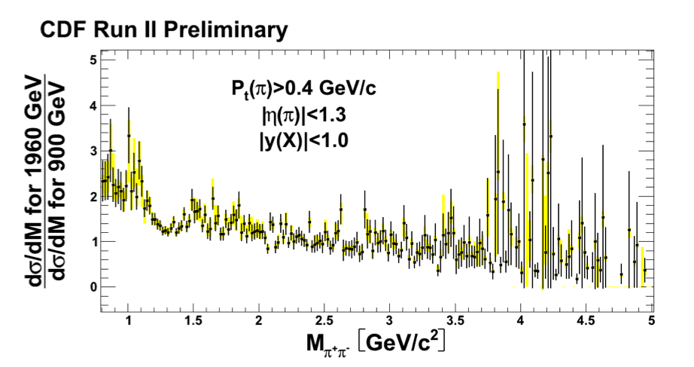
Ratio of cross sections at √s = 1960 GeV/900 GeV vs M(ππ).
Note: At 900 GeV, less rapidity space for proton dissociation:
Rap Gap to η = 5.9 at both √s
If no dissociation : p + X + p, 1960 GeV cross section lowers more than 900 GeV

Slide 19
Corrected for acceptance
Note different scales.
Abrupt rise at 1.5 GeV

Slide 21
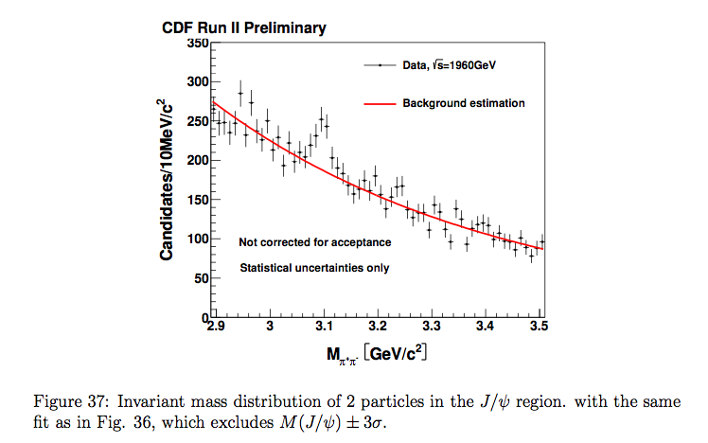
Size of signal “compatible” with photoproduced J/ψ → e+e- (measured in μ+μ- channel)
(Can include some μ+μ- if no muon stubs in outer detectors)

Slide 22
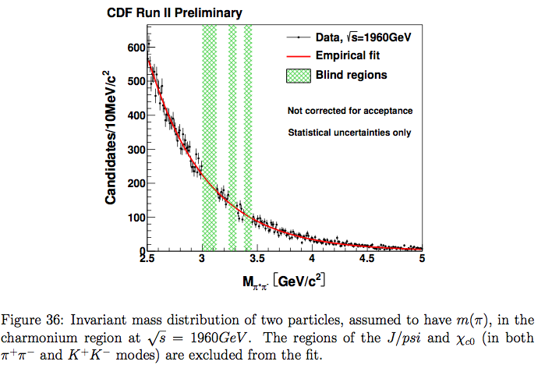
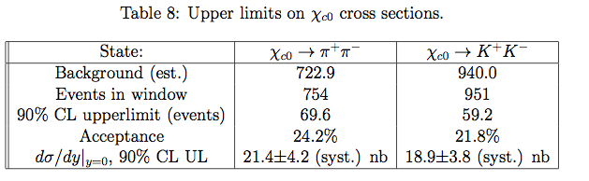
χ_{c0}(3415) ➔π+ π-, K⁺K⁻ ??
Previous observation
of χ_{c} ➔J/ψ+γ ~ 78+-14 nb
iff all χ_{c0}.
Now: <~ 25% are.

Slide 25
P₀ = 1.0
P₁
P₅
P_{odd} (should = 0.0)
P₃
P₇
Legendre coefficients vs Mass for 1960 GeV data and isotropic decay simulation.
Odd coefficients should all be zero as detector and physics left-right symmetric

Slide 26
P₆
P₂
P₄
P₈
P_{even} : Non-zero because sculpted by acceptance. Data agrees with S-wave MC
means isotropic: J = 0 or no polarization (when integrated over unseen)
Difference above M = 1.3 GeV → Higher waves (J = 2, 4, ...) present.

Slide 27
p-value of Smirnov test of S-wave-only hypothesis as a function of Mass
for 1960 GeV data. Above 1.5 GeV the S-wave-only hypothesis is excluded
at 99% C.L. (Data not isotropic in X-frame)
We are not sensitive enough (limited η) to distinguish J = 2 and 4 waves
To do: 2-dimensional PWA in cos θ and ϕ (Su-Urk Chung)

Slide 28
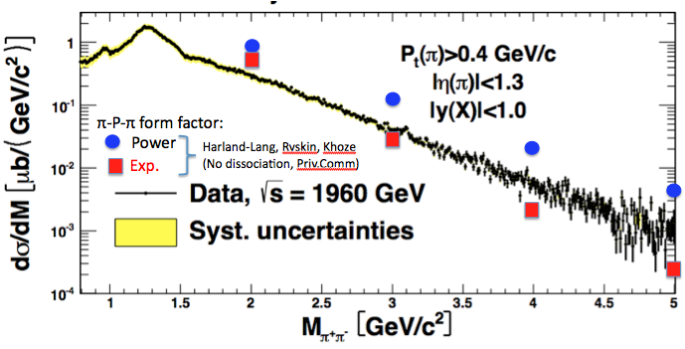
Data are test of central exclusive/double pomeron models in NP-QCD = PQCD transition.
We ask (challenge) theorists to predict our results.
Lucien Harland-Lang, Misha Ryskin and Valery Khoze are working on this.
Private Communication, “upper” and “lower” bounds, depending on π-pom-π form factor.
But not including proton dissociation (<20% effects)
Thanks Lucien Harland-Lang
for the points.
Wait for Antoni Szczurek and Piotr Lebiedowicz:
AIP Conf Proc. 1523 (2012) 132
arXiv:1212.0166 ... would like our cuts imposed.

Slide 30
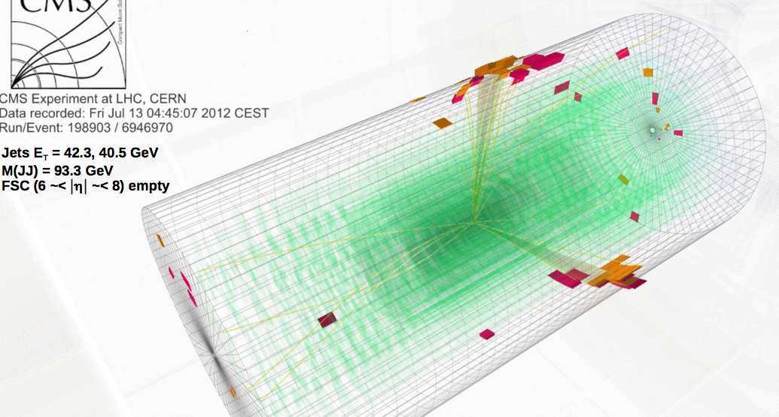
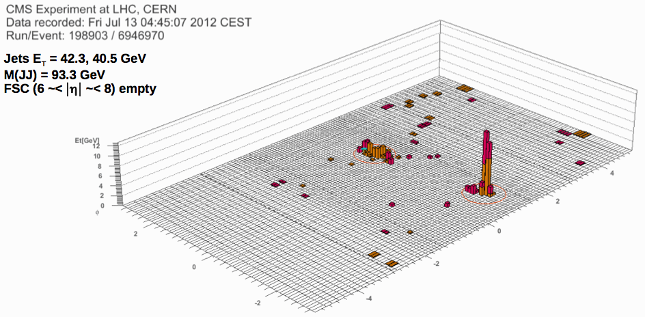
CMS & TOTEM : from 90 m β* Run with TOTEM: p + JJ + p
REAL CMS+TOTEM EVENTS!

Slide 31
Thank You
Back Ups

Slide 33
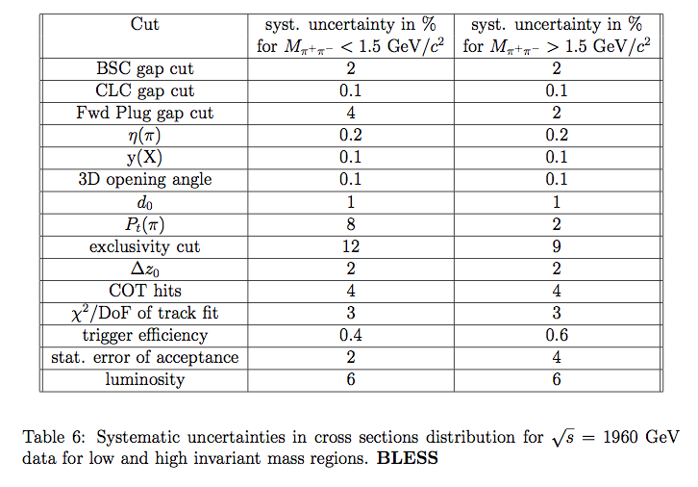

Slide 34
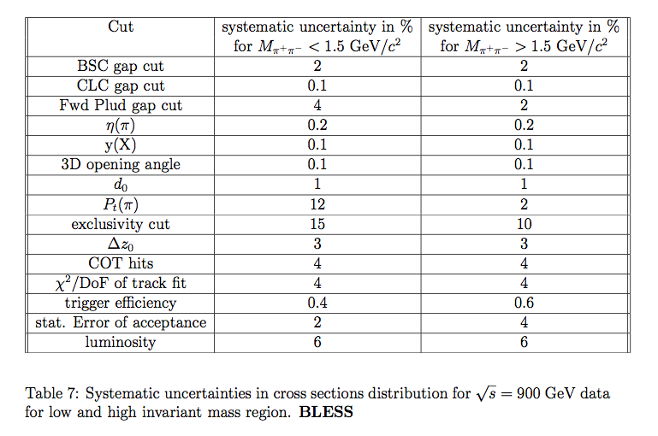
10
10

Slide 36
The probability of a track triggering
0, 1, or >2 trigger towers
as a function of track pT and η
Input for cross sections
From CDFSIMulation (GEANT)

