Slide 1
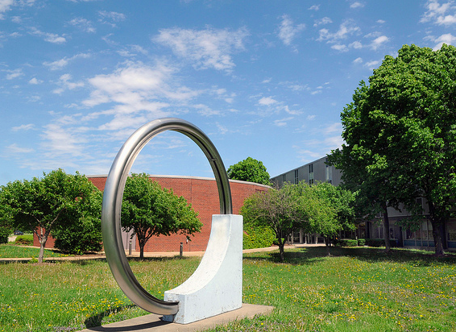
ANL vision for HEP future
Harry Weerts
Rik Yoshida
DOE Budget Briefing
3/1/2013

Slide 2
Challenges for HEP
Challenges facing HEP
Large expensive experiments that take decades to build and operate.
Difficult choices on which scientific goals to go after.
Students/Education
Education of most students locked into very specific aspect of HEP.
Difficult for students to get meaningful hardware experience.
The majority of students/postdocs cannot stay in HEP in the long term.
Weak connection to society, other science/engineering disciplines.
Declining budget.
All of these challenges are interconnected.
How do we begin to address these challenges?
“How do we revitalize HEP without large infusion of cash?”
No “silver bullet”. Improvement has to be incremental.

Slide 3
What can ANL do?
We believe the right place to begin to address these challenges is by building and strengthening connections.
Internal to HEP
Universities and Labs
Between various Frontiers
Other science and engineering disciplines
Nuclear Physics, Material Science, Nanoscience, Computer Science, Photon Source
To industry
Current ANL examples: Incom, Euclid, Luxtera
Visibility to industry: RD100 Award 2012
ANL has been pursuing this philosophy already for some years.
We believe we can build on what we have achieved already and make a difference in revitalizing HEP.

Slide 4
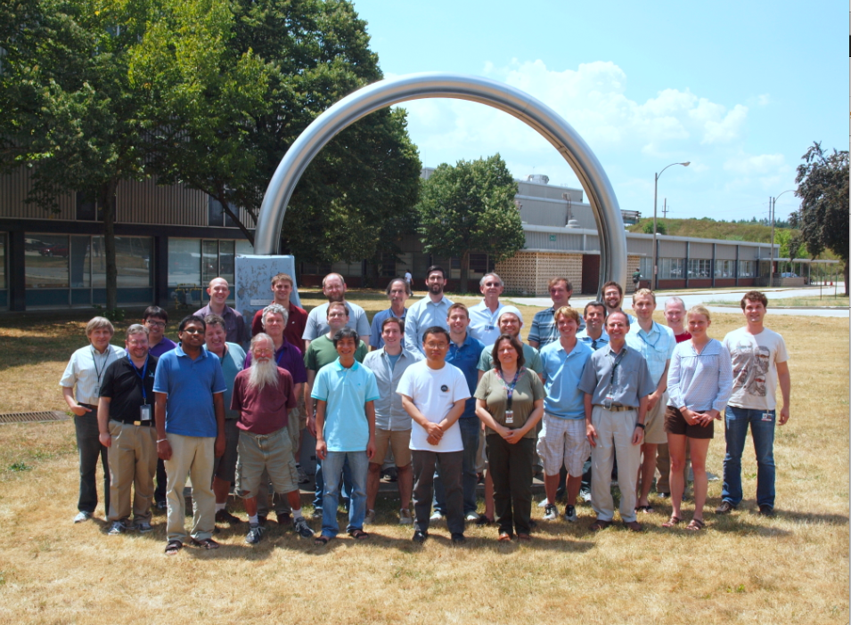
Example: ATLAS Analysis Support Center
What we have now: ATLAS ASC
Strong commitment by division and ATLAS group to the ASC for the last >5 years.
Have ~15 university visitors + many others the ATLAS group collaborate with as a result of their ASC experience.
Student Fellowship program. University students works with staff+their advisors to start analysis+technical work.
Near term Benefits
Builds analysis collaborations: more productivity for visitors and ANL staff
Builds technical collaboration: catalyst for wider collaboration with universities.
Saves money: gets students ready for their time at CERN.
(Possible) Next Steps
Projects for students from ATLAS upgrade.
Offer students projects from other division activities. Detector R&D to start with. Computational HEP, Accelerator, other Frontiers.
Future Benefits
Giving students a wide range of choice of hardware experience
Increase collaboration with universities in areas beyond ATLAS

Slide 5
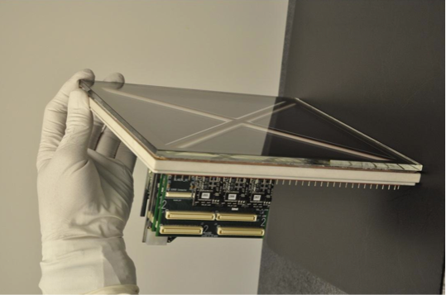
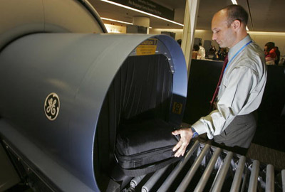
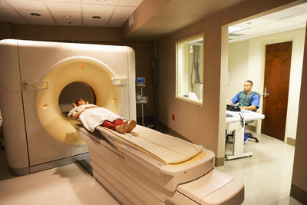
Example: R&D with Material Science
LAPPD and SCRF R&D
Could not have happened without close collaboration with Material Science Division (MSD)
Near term Benefits
LAPPD and SCRF developments. Both are game changers!
Long term connections with MSD.
(Possible) Next Steps
Universities are interested in collaboration with ANL in detector development.
Up to now: ANL HEP+other divisions. (Recent development: collab. with Nanoscience)
New: universities + non-HEP divisions at ANL (Already happening somewhat with LAPPD)
Technology transfer
ANL is reinvigorating technology transfer initiatives.
“Detector Center” at ANL with industry participation?
Offering university HEP students projects to work on.
Future Benefits
Increased and more efficient R&D activity
Giving university students industry experience and connections.

Slide 6
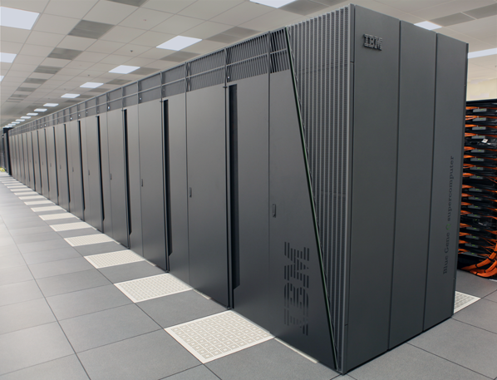
Example: High Performance computing
HEP computing
High Performance Computing for HEP
Close collaboration between
Leadership Computing at ANL + HEP ANL + University
Inside ANL HEP: ATLAS + Computational Cosmology
ANL theorists using NERSC (direct result of interactions inside division)
Near term Benefits
Relieve pressure on ATLAS Monte Carlo production
Increased theory computing at ANL (x10) without buying more computers!
(Possible) Next Steps
Optimizing HEP software for HPC.
HPC applications in other HEP areas (HPC for HEP!)
Theory (beyond lattice QCD)
Intensity Frontier
University student participation in this R&D
Future Benefits
Large cost savings for HEP experiments (use existing resources)
Close collaboration with HPC community
Ultimately, bulk of HEP computing done through ASCR?
University student education

Slide 7
Vision
We think investments in building strong connections both inside and outside HEP will have the strongest impact in revitalizing HEP.
More efficient research
Increase collaboration with and among universities
Universities take better advantage of the lab infrastructure (beyond HEP!)
Lab gains collaboration and broadens their portfolio of expertise
Better serve the young people in HEP
Give opportunities to students of gaining experience in
Hardware, computing
Other Frontier areas
Opportunities to connect with industry
HEP better integrates into scientific/technical community as well as industry.
Work across disciplines.
Lead to better understanding and support for HEP
Promoting more collaboration in diverse areas: this will lead, ultimately, to better communication and coherence in the HEP community.

Slide 8
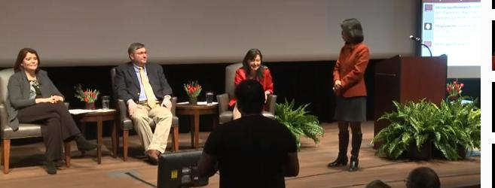
Outreach and communication efforts inside and outside ANL
December 11, 2012
July 11, 2012
December 1, 2011
September 27, 2012
Feb. 7, 2013

Slide 9
The support we need from you
Argonne ATLAS effort is in line with our vision. We are leveraging our current research efforts to increase and improve connections with those outside ANL HEP.
We will be making these types of efforts in all of our Frontier research areas.
Still, our “Core Technologies” is the lifeblood of our vision.
Detector R&D
Accelerator R&D
Computational HEP
These are the areas through which we primarily make our contacts for cooperation with those outside ANL HEP.
These are investments for the future, not only for ANL but for HEP in general.
We think these areas need to be safeguarded from “the 2% decrease for research funding for the next several years.”

Slide 10
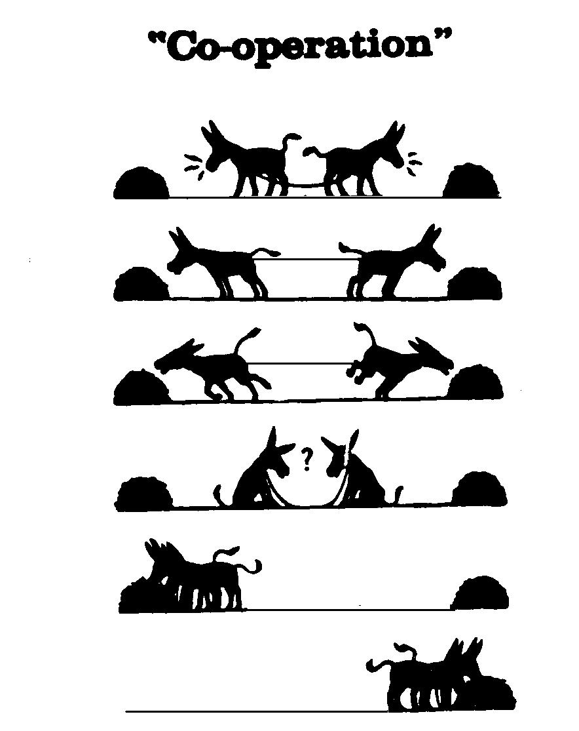

Slide 11
Communication

