Slide 1
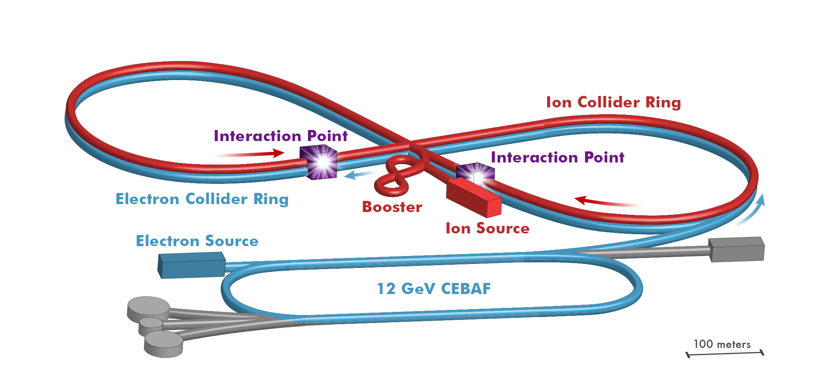

JLEIC IR and Detector Design Considerations
R. Yoshida for the JLEIC Detector & IR Study Group

Slide 2
General Design Considerations

Slide 3

DIS and Final State Particles
Aim of EIC is nucleon and nuclear structure beyond the longitudinal description.
This makes the requirements for the machine and detector different from all previous colliders including HERA.
Ion beamline
E_{ion}
E_{electron}
Electron beamline
Need more than this

Slide 4

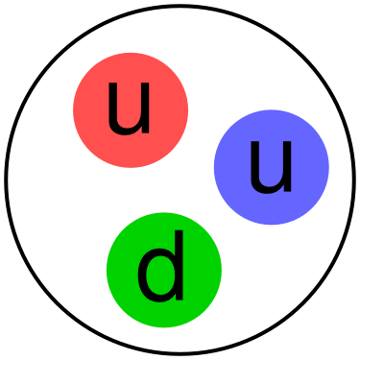
Final State Particles in the Central Rapidity
Products of the hard
electron-quark collision
Scattered electron
Ion beamline
Photons
E_{ion}
E_{electron}
Electron beamline
Particles associated with struck parton
Transverse and flavor structure measurement of the nucleon and nuclei:
The particles associated with struck parton must have its species identified and measured. Particle ID much more important than at HERA

Slide 5
Final State Particles in the Central Rapidity
Boosted towards ion beam
Ion beamline
E_{ion}
E_{electron}
Electron beamline
Boosted towards ion beam
Asymmetric collision energies will boost the final state particles in the ion beam direction: Detector requirements change as a function of rapidity

Slide 6
Particles Associated with the Initial Ion
For EIC, particles of the “target remnant” is
as important as the struck parton
Ion beamline
E_{ion}
E_{electron}
Electron beamline
Particles Associated with Initial Ion
Was not considered at HERA initially.
Close to the beamline
Not analyzed by central solenoid.
Aim for ~100% acceptance and good resolution at EIC.
Remember acceptance is equally
important as luminosity!

Slide 7
Particles Associated with the Initial Electron
Forward Electron area:
Tag photoproduction (Q²≈0)
Measure Luminosity
Measure electron polarization
Ion beamline
E_{ion}
E_{electron}
Electron beamline
Photons
beam electron (or low Q²)
Apply lessons from HERA, JLab and elsewhere

Slide 8
Final State Particles
The aim is to get ~100% acceptance
for all final state particles, and measure
them with good resolution.
Scattered electron
Ion beamline
Photons
Electron beamline
Photons
Particles Associated with Initial Ion
beam electron (or low Q²)
Particles associated with struck parton
Beam Elements
Central
Detector
Beam elements limit forward acceptance
Central Solenoid not effective for forward
Beam Elements

Slide 9
Interaction Region Concept
NOT TO SCALE!
Beam crossing angle creates
room for forward dipoles
Solenoid
Ion beamline
Electron beamline
Dipole (1 of 4)
50 mr
Dipole (1 of 3)
Dipoles analyze the forward particles
and create space for detectors in the forward direction

Slide 10

Interaction Region Concept
Possible to get ~100% acceptance for the whole event
Ion beamline
Electron beamline
Total acceptance detector (and IR)

Slide 11
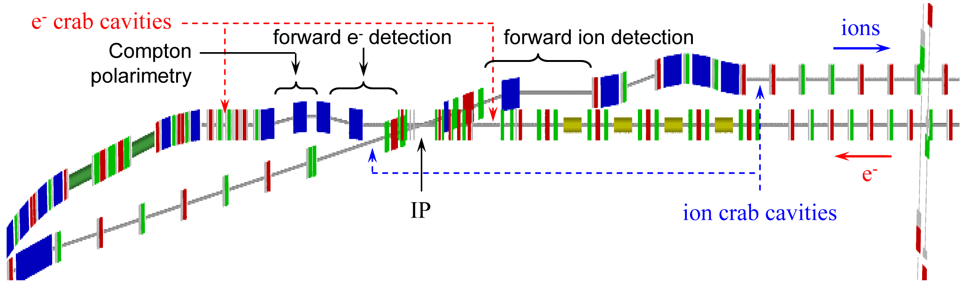
JLEIC IR Layout
Extended detector: 80+ m

Slide 12
Central Detector

Slide 13
Final State Particles in the Central Detector
Products of the hard
electron-quark collision
Scattered electron
Took away radiated photon
for simplicity
E_{electron}
E_{ion}
Took away the (exaggerated)
beam crossing for simplicity
Particles associated with struck parton

Slide 14
Basic Kinematic Reconstruction
Q² → Measure of resolution
y → Measure of inelasticity
x → Measure of momentum fraction
of the struck quark in a proton
Q² = s x y
E’_{e}
θ_{e}
θ_{jet}
E’_{e,}θ_{e ,}E_{jet ,}θ_{jet} : any two of these, in principle, sufficient to reconstruct x and Q².
What are the detector
requirements?
E_{jet}

Slide 15
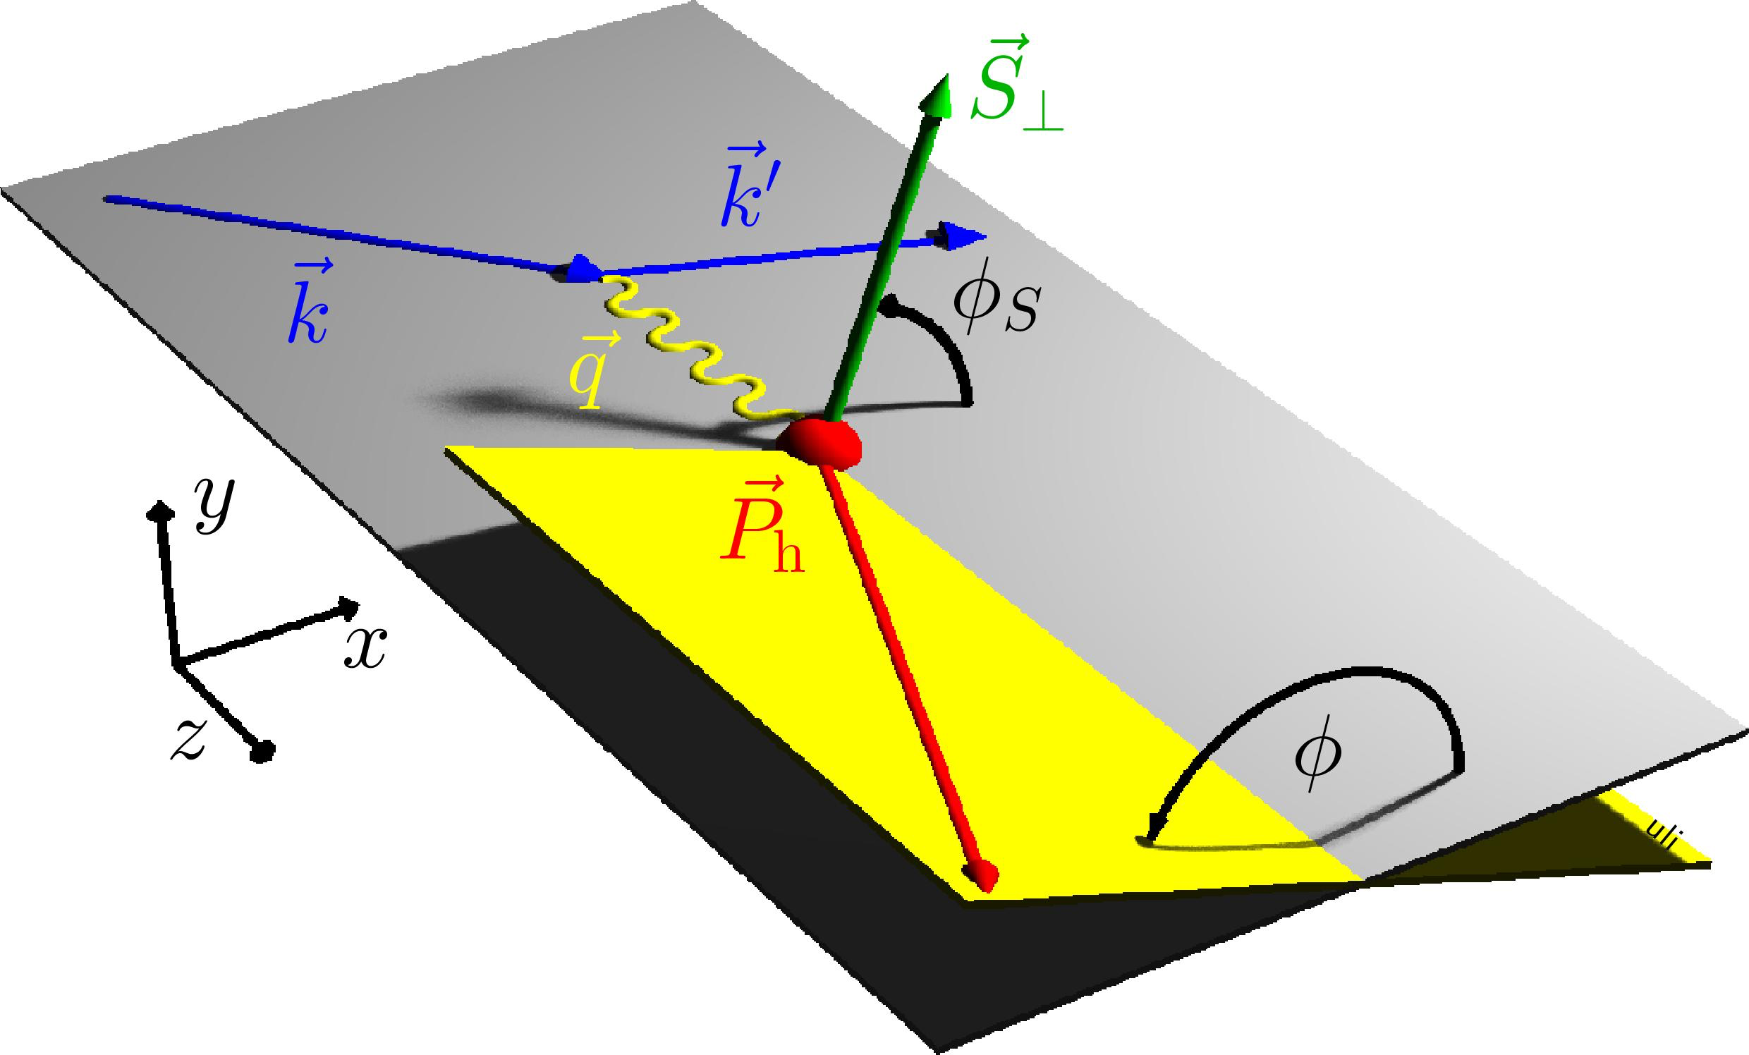
Reconstruction for Transvers Structure
Looking at out-of –plane component in the final state
Need to identify and measure
these particles
What are the detector
requirements?
Note: multiplicities are low (~20 for ep)
Cross-sec x Lumi < 0.01 x HLLHC
< 0.1 interaction/crossing

Slide 16
How Boosted is the Final State?
No Monte Carlo needed to Determine
Boosted towards ion beam
E_{electron}= 10 GeV
E_{ion}= 100 GeV
E’_{e,}θ_{e ,}E_{jet ,}θ_{jet} : any two of these, in principle, sufficient to reconstruct x and Q².
Given x and Q², E’_{e,}θ_{e ,}E_{jet ,}θ_{jet} are all
fixed

Slide 17
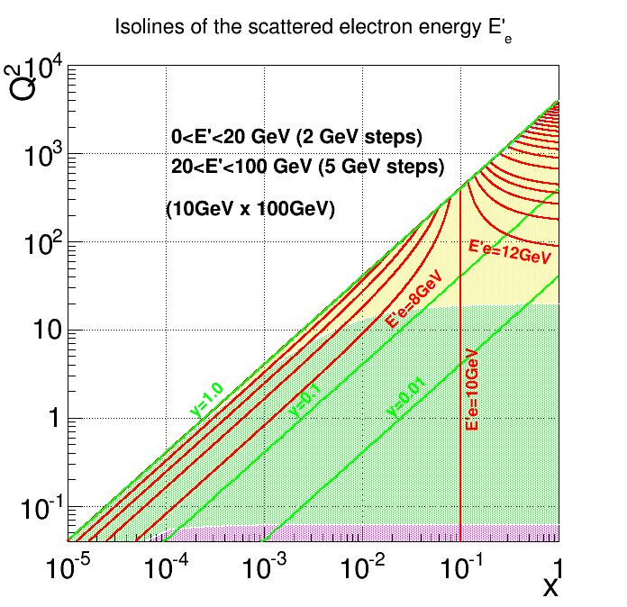
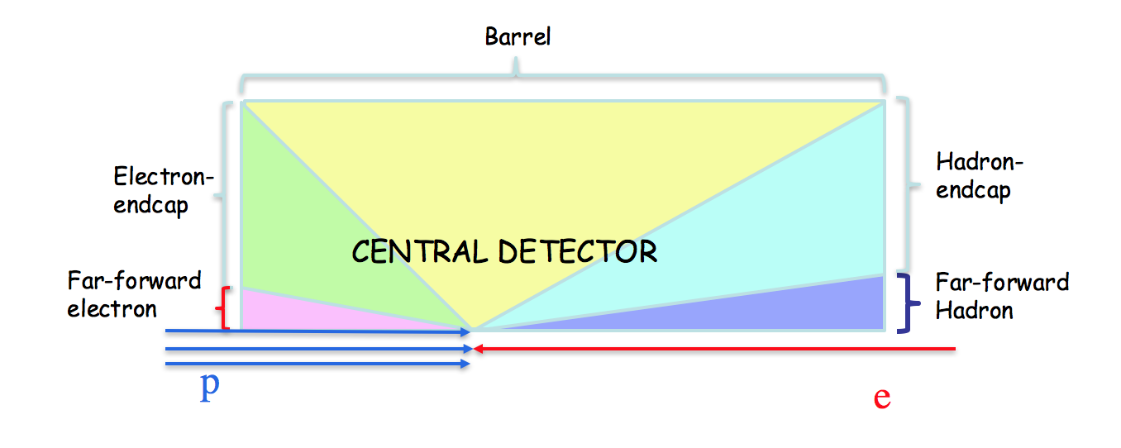
Electron Isoline Plot
Hadron Endcap
Barrel
Electron Endcap
Far-forward Electron
(out of central detector)

Slide 18
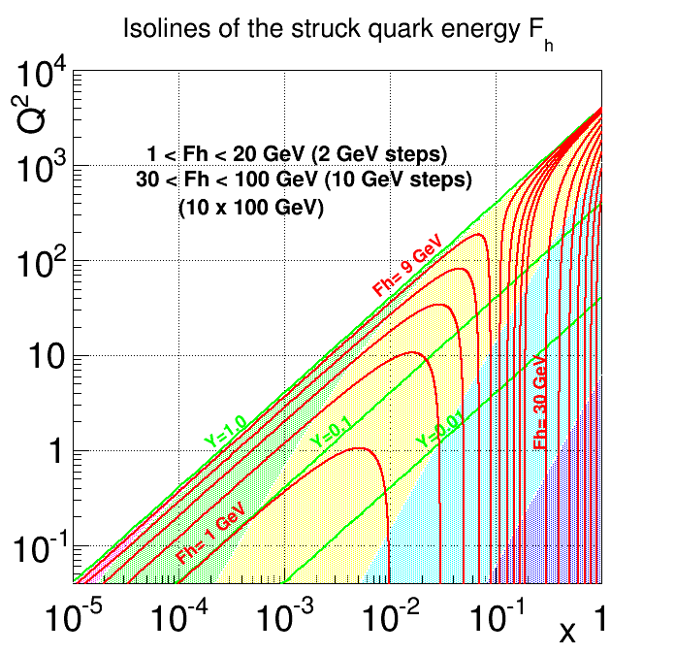
Quark(Jet) Isoline Plot
(E_{jet})
Barrel
Hadron Endcap
Far-forward Hadron
(Out of central detector)
Electron Endcap

Slide 19
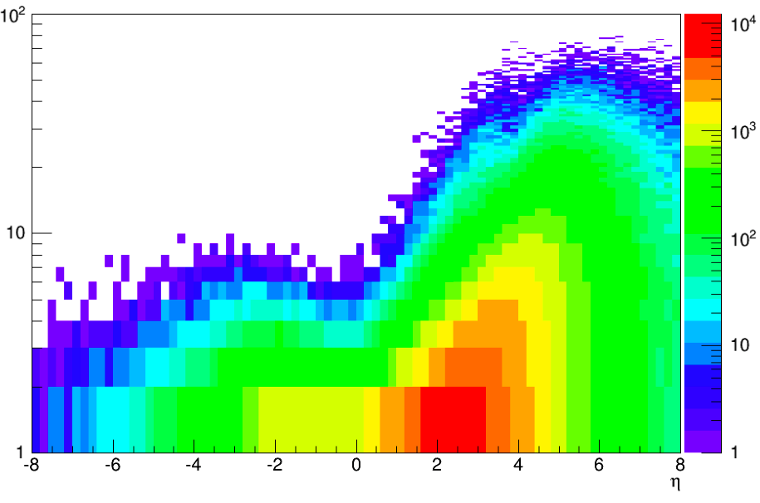
Particle Distribution
E-endcap
Barrel
H-endcap
E'e
<8 GeV
8-50 GeV
>50 GeV
Ejet
<10 GeV
~10-50 GeV
20-100 GeV
E,hadrons
<10 GeV
<15 GeV
~15-50 GeV
Pythia MC
occupancy
low
medium
high
π± Energy
100
10
GeV
η

Slide 20
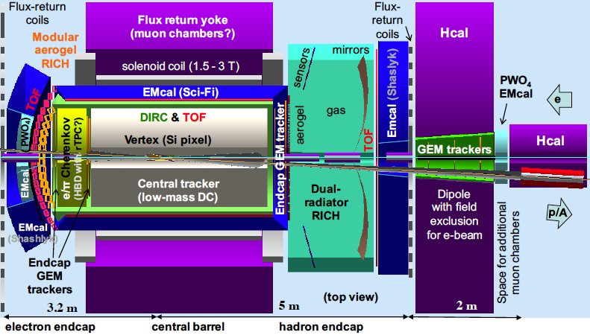
Current JLEIC Concept

Slide 21
Electron-Beam Direction

Slide 22
Chicane for Electron Forward Area
Extended detector: 80+ m

Slide 23
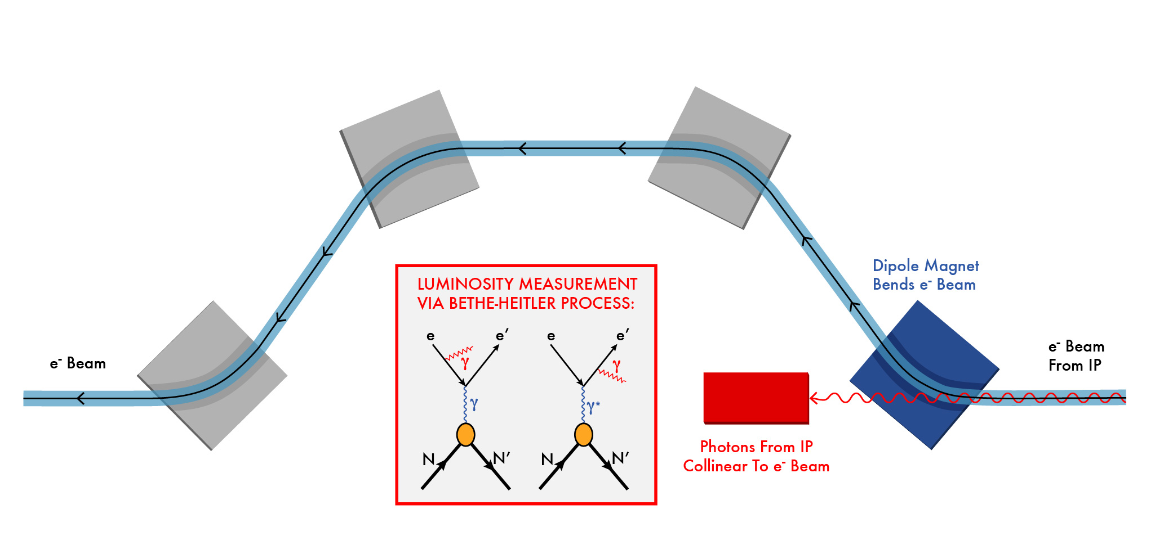
Luminosity Measurement
Use Bethe-Heitler process to monitor luminosity: same as HERA

Slide 24
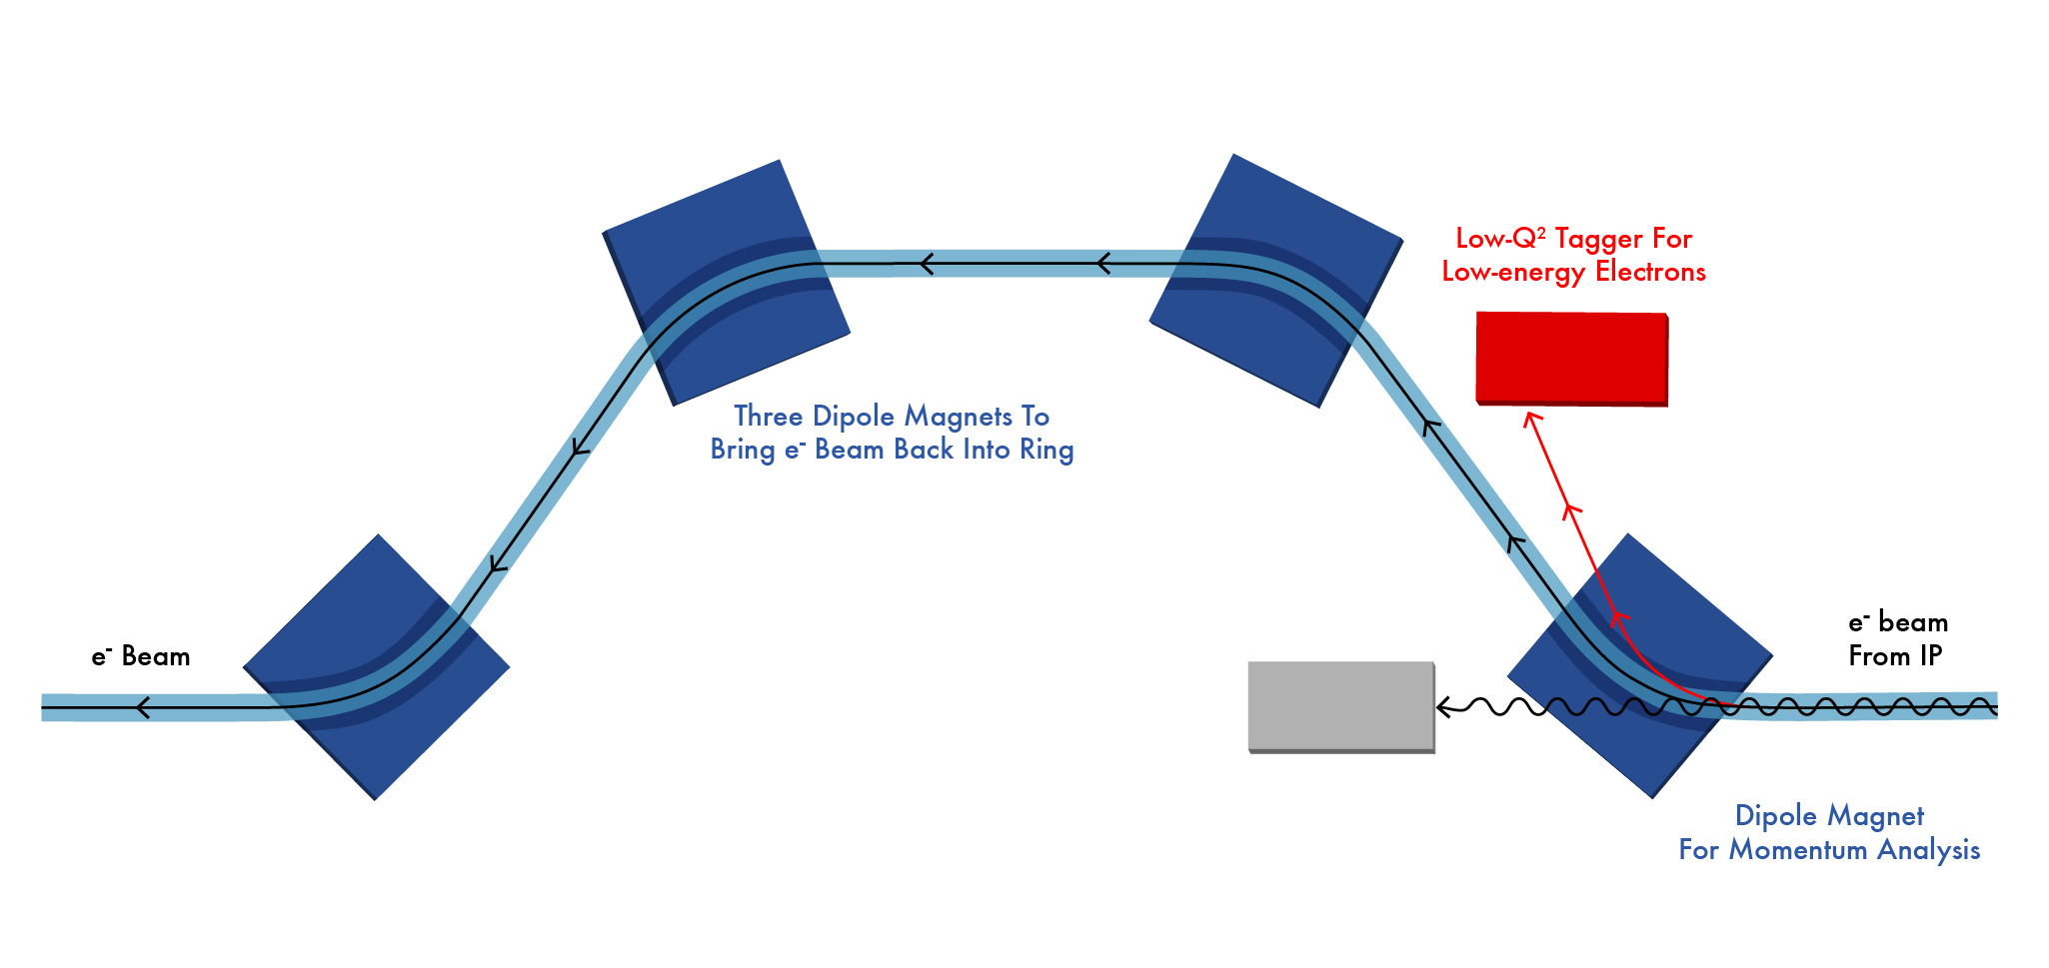
Low Q² Tagger

Slide 25
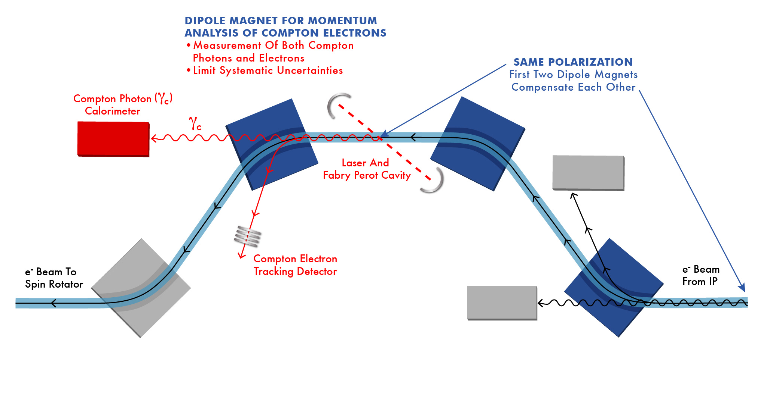
Polarization Measurement
Note the off-momentum electrons from IP does not enter the
Compton tracker for polarimetry.

Slide 26
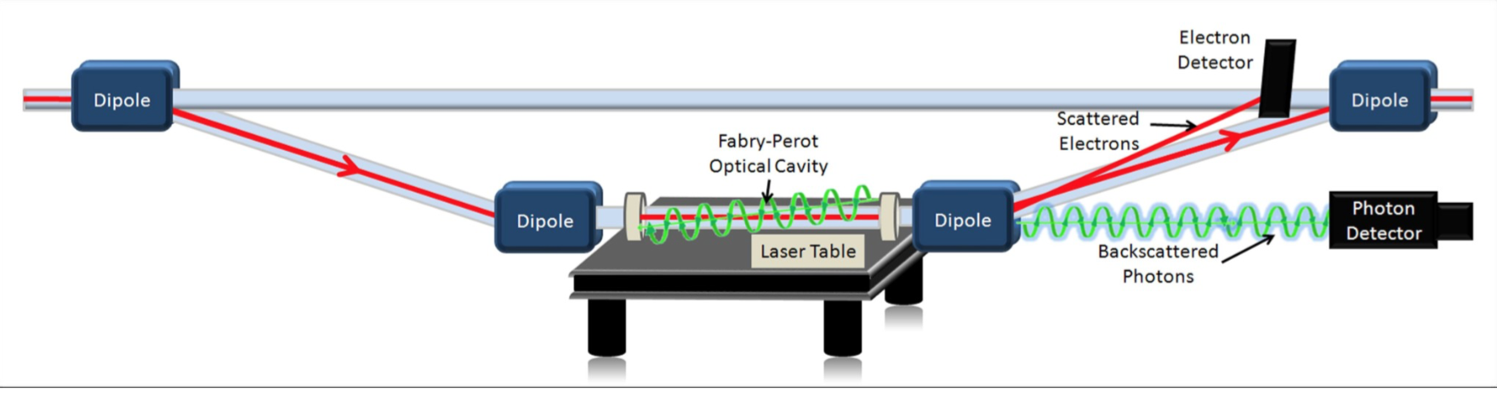
Compton Polarimetry
Existing Polarimeter in Hall C at JLab: Achieved 1% Precision

Slide 27
Ion-beam Direction

Slide 28
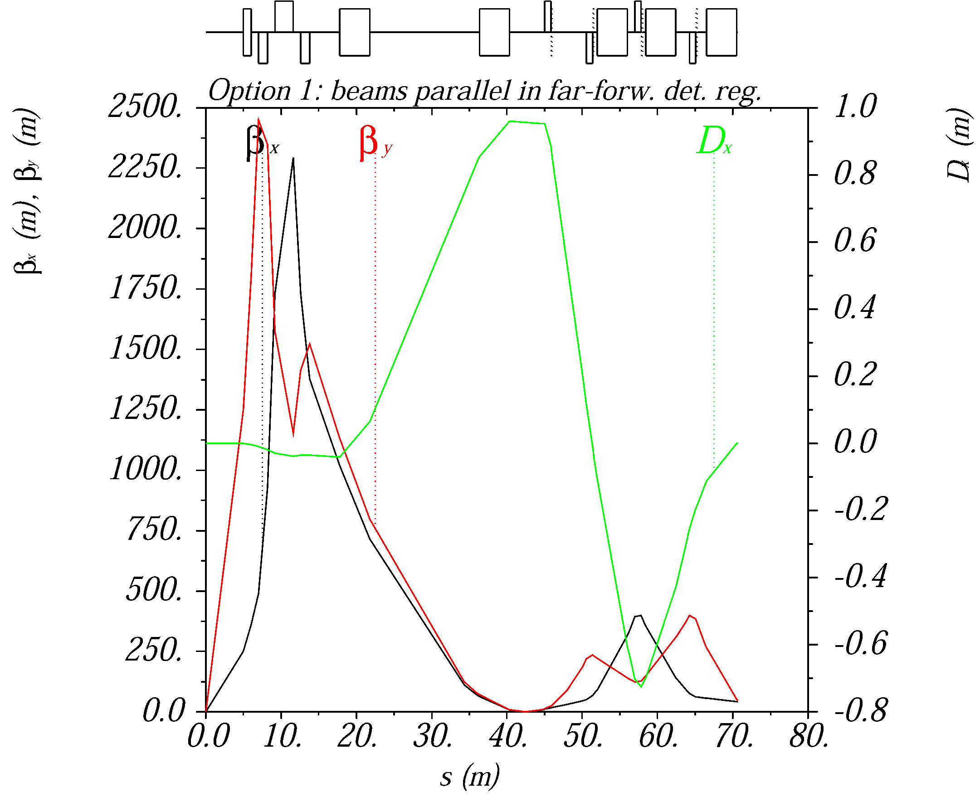
Ion optics for near-beam detection
Extended detector: 80+ m
A large dispersion at the detection point separates scattered (off-momentum) particles from the beam.
A second focus and small emittance (cooling) allows moving detectors closer to the beam
2nd focus on
Roman pots

Slide 29
EIC forward detection requirements
Good acceptance for recoil nucleons (rigidity close to beam)
  Diffractive processes on nucleon, coherent nuclear reactions
  Small beam size at detection point (to get close to the beam)
    Secondary focus on roman pots, small beam emmittance (cooling)
  Large dispersion (to separate scattered particles from the beam)
Good acceptance for fragments (rigidity different than beam)
  Tagging in light and heavy nuclei, nuclear diffraction
  Large magnet apertures (low gradients)
  Detection at several points along a long, aperture-free drift region
Good momentum- and angular resolution
  Free neutron structure through spectator tagging, imaging
  Both in roman pots and fixed detectors

Slide 30
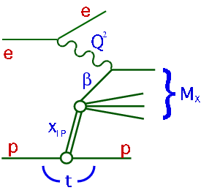
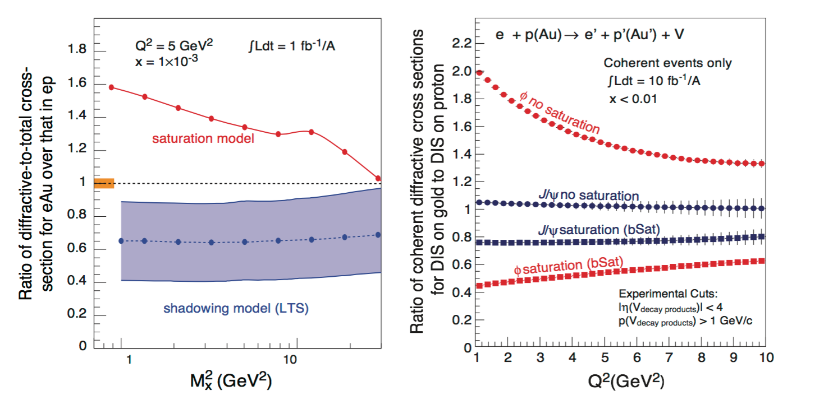
An Example: Diffractive DIS
Signature for Saturation (among other things)
Identify the scattered proton: distinguish from proton dissociation
Measure X_{L}= E_{p}’/E_{p}, and P_{t} (or t) (equiv. to measuring M_{x})

Slide 31
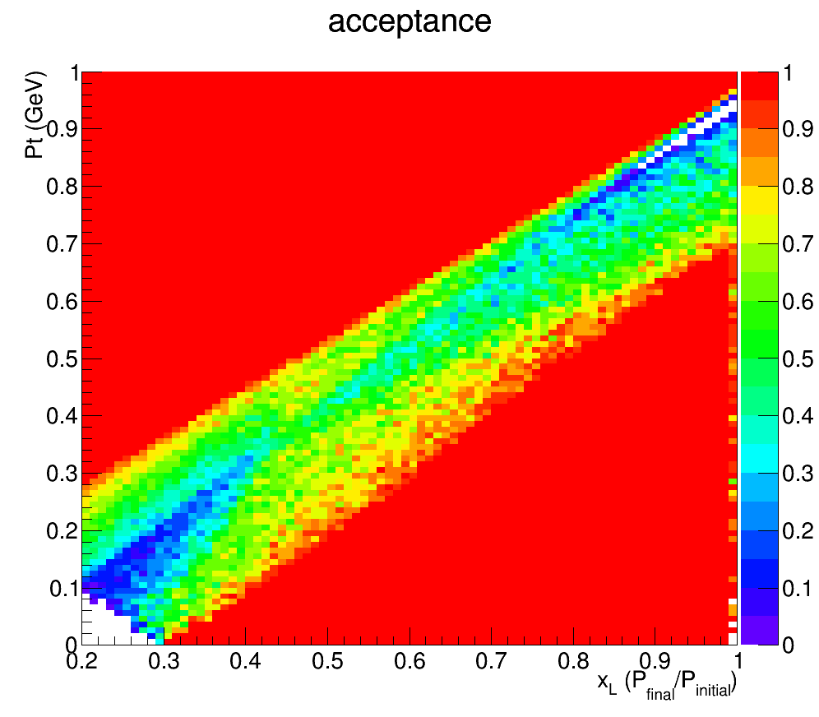
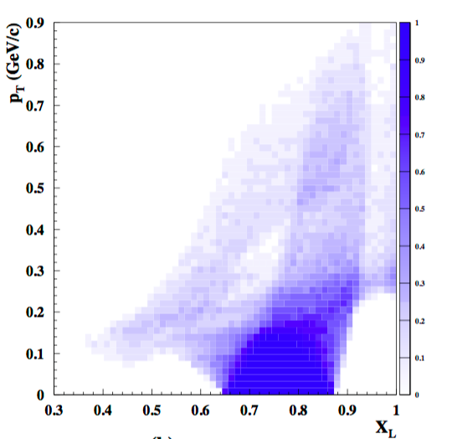
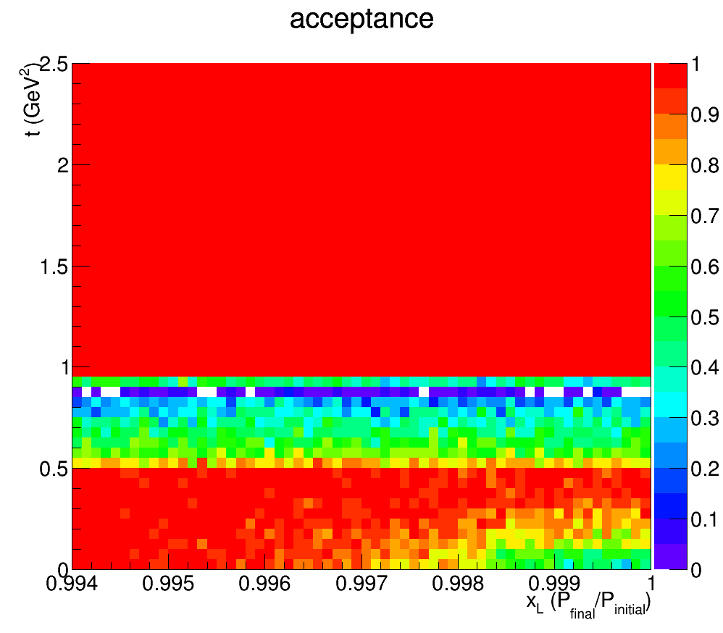
Acceptance for p’ in DDIS
JLEIC
ZEUS
Leading Proton Spectrometer
P_{t}
1
(GeV)
Region 1
Region 2 (Hi. Res)
0
0.2
1
X_{L}
t
2.5
(GeV²)
Acceptance in diffractive peak (X_{L}>~.98)
ZEUS: ~2%
JLEIC: ~100%
0.994
1
X_{L}

Slide 32
Summary
EIC project will revolutionize our understanding of nucleons and nuclei
The physics program of EIC demands a total acceptance detector. (This means excellent forward coverage in addition to the central coverage.)
Determining machine parameters, IR and detector design must go hand in hand, paying close attention to the emerging physics program of the EIC.
JLEIC is an integrated (accelerator, IR and detector) effort focused on the EIC physics goals.
Detector R&D proposals must make sense with respect to the physics program. Physics of nucleon and nuclear structure must drive the design.

Slide 33
Backup

Slide 34
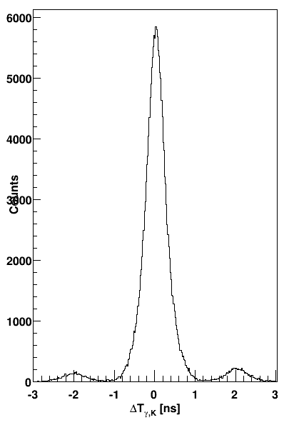
Bunch spacing and identification
Existing detectors (CLAS, BaBar, etc) at machines with high bunch crossing rates have not had problems in associating tracks with a specific bunch.
Example: CLAS detector at JLab 6 GeV
  2 ns bunch spacing (500 MHz rep. rate)
  0.2 ns TOF resolution (0.5 ns FWHM)
  The figure shows time matching of kaons in CLAS with electrons in the (low-Q²) tagger, in turn matched to the accelerator RF signal
    The 2 ns bunch structure is clearly resolved
  CLAS12 aims at a TOF resolution of 80 ps
K-e coincidence time in CLAS 6 GeV data
electron-kaon counts
The bunch spacing in the MEIC is similar to CLAS and most e⁺e⁻ colliders
  PEP-II/BaBar, KEKB/Belle: 8 ns
  Super KEKB/Belle II: 4 ns (2 ns with all RF buckets full)
  MEIC: 1.3 ns [750 MHz]
  CERN Linear Collider (CLIC): 0.5 ns [2 GHz]
Δt [ns]

Slide 35
Instantaneous rates
For a given luminosity, increasing the crossing rate reduces the number of collisions per crossing, making it easier to resolve individual events.
  Note that the average collision rate does not depend on the bunch structure
The number of collisions per crossing in the MEIC is comparable to HERA.
Events (e-p collisions) per bunch crossing | 1.33 ns spacing (MEIC) | 133 ns spacing (~HERA)
DIS @ L=10³⁴ | 10⁻³ | 10⁻¹
photo @ L=10³⁴ | 10⁻¹ | 10
DIS @ L=10³² | 10⁻⁵ | 10⁻³
photo @ L=10³² | 10⁻³ | 10⁻¹
Event spacing is particularly important for time matching of tracks in the central and far-forward detectors.
  Only the former pass the vertex tracker
  Photoproduction events also give rise to hadrons at small angles.
Matching is further improved by good resolution in the far-forward detectors.
  Angular for path-length corrections
  Momentum for β corrections
  Timing < 1 ns
Order-of-magnitude estimates of the instantaneous DIS and photoproduction rates based on a 7.5 mb total e-p cross section.

Slide 36
10 GeV (0.7 A) with tighter mask
Photons >10 keV/crossing
Numbers are Watts
Mike Sullivan, SLAC

Slide 37
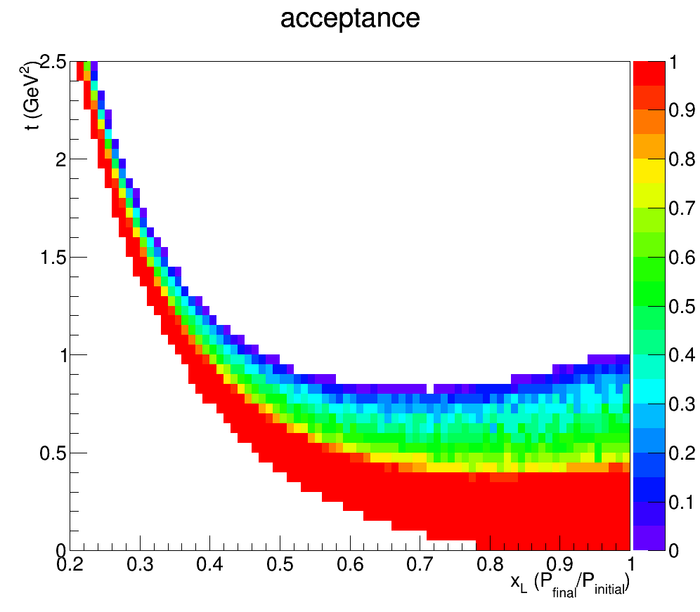
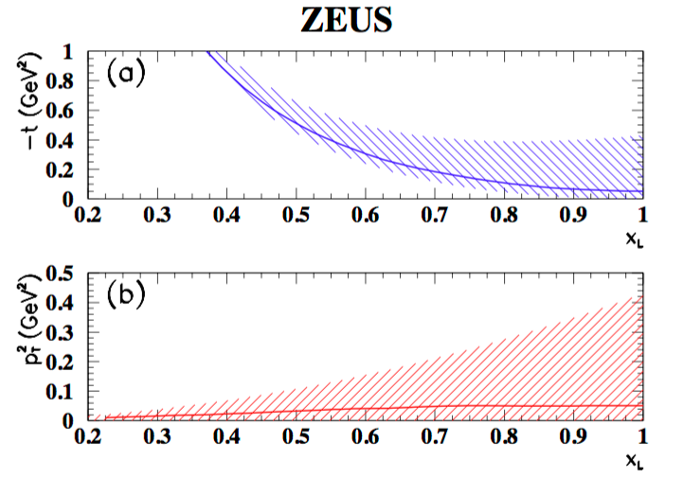
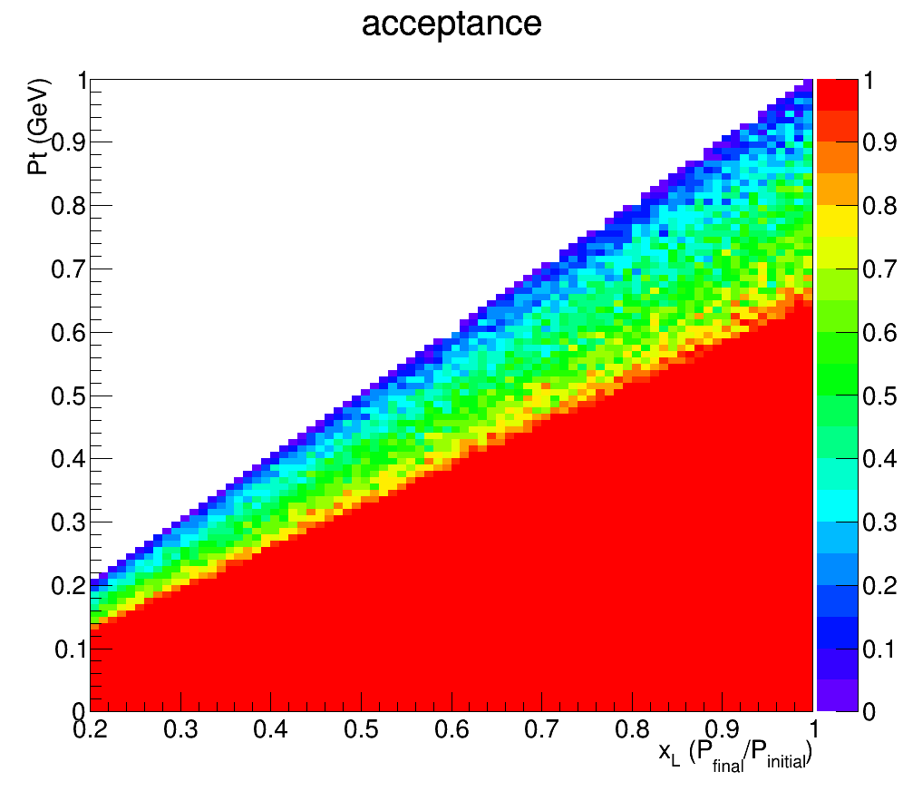
Neutron Acceptance for ep->e’Xn
JLEIC ZDC Acceptance
FNC Acceptance
~20% geometrical accep.
Doubles kinematic coverage
~5-10 times acceptance
compared to HERA
Zhiwen Zhao

Slide 38
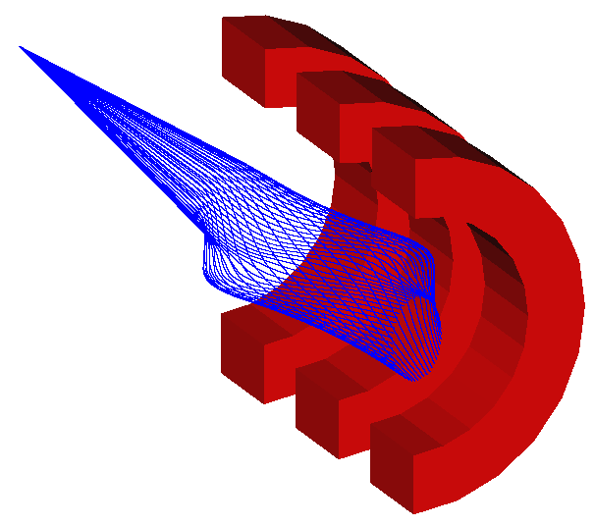
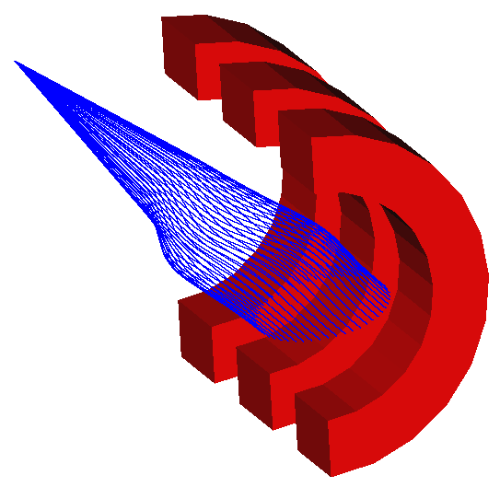
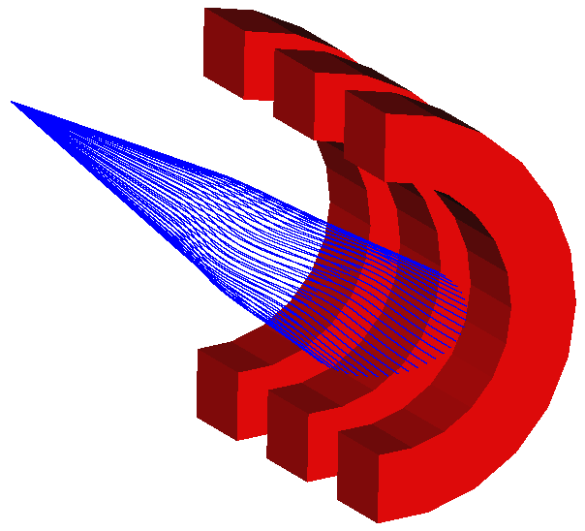
Far-Forward Acceptance for Ion Fragments
(protons rich fragments)
(neutron rich fragments)
Δp/p = -0.5
Δp/p = 0.0
Δp/p = 0.5
(spectator protons from deuterium)
(exclusive / diffractive recoil protons)
(tritons from N=Z nuclei)
FFQ’s
Forward geometry will provide ~100% acceptance for all cases
Notes:
38

Slide 39
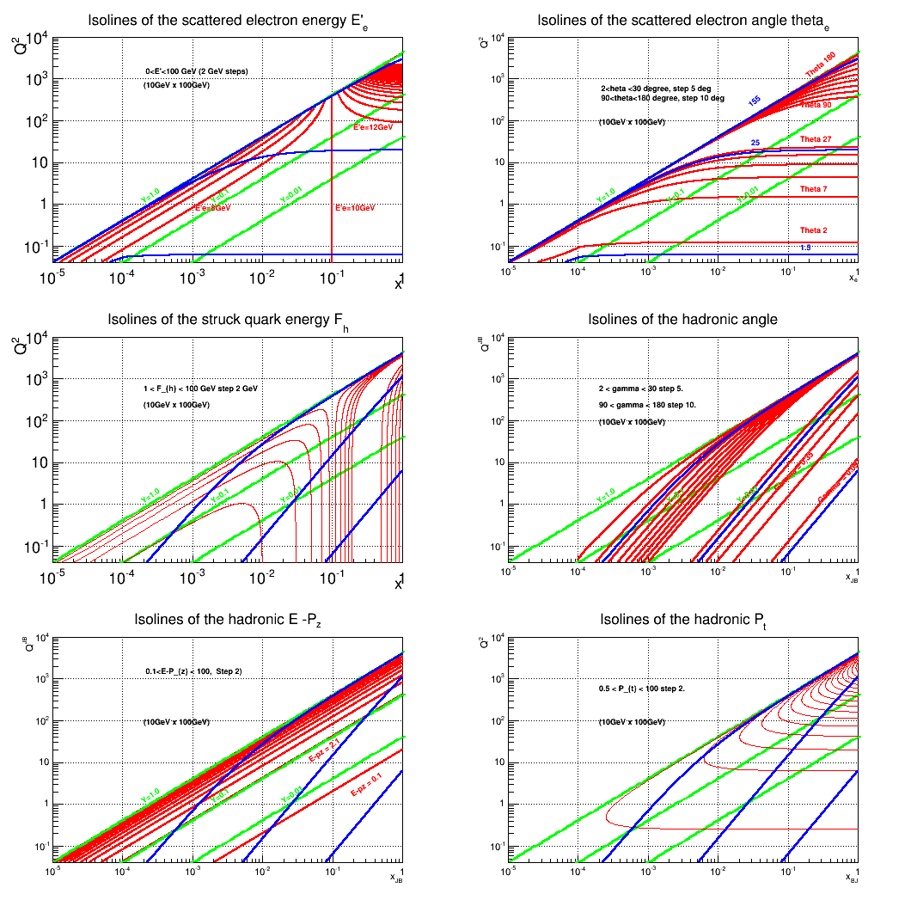
Yulia Furletova

Slide 40
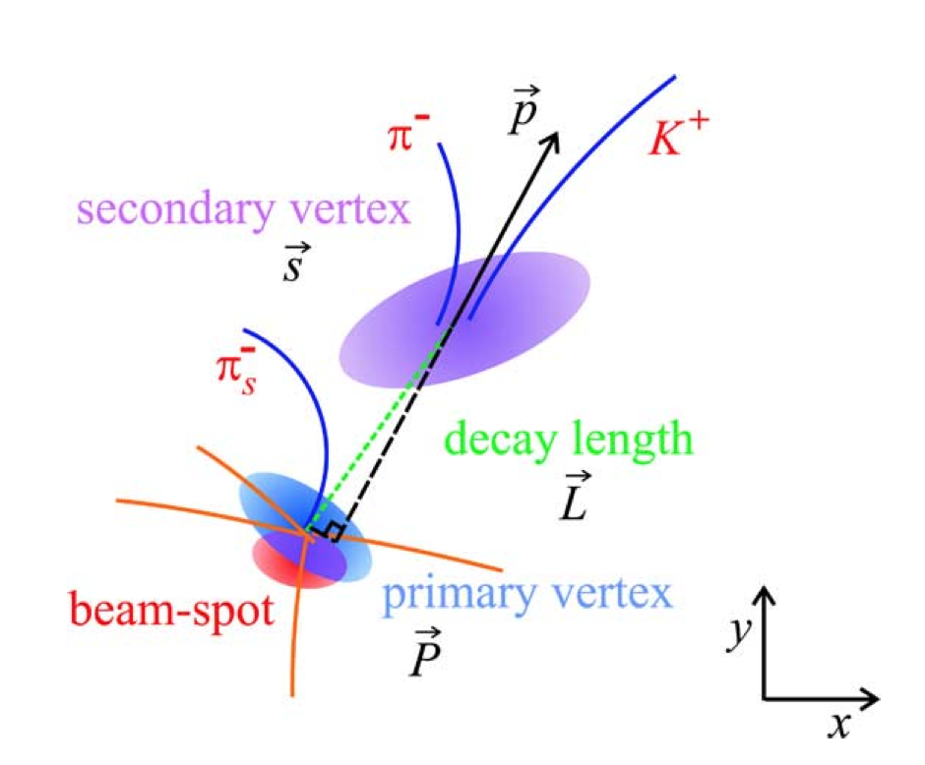
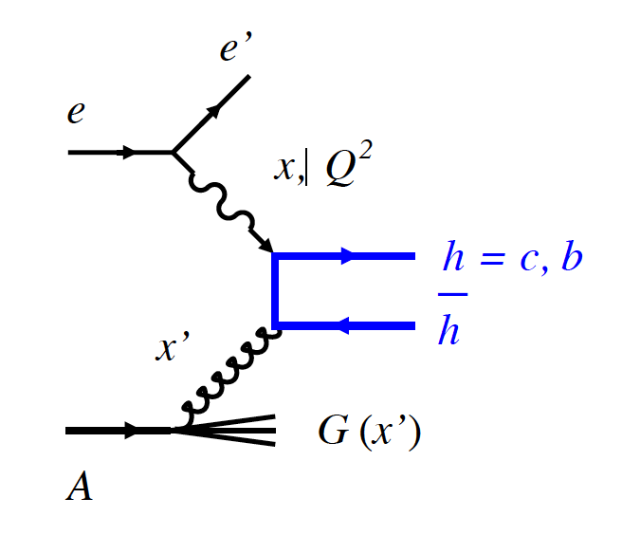
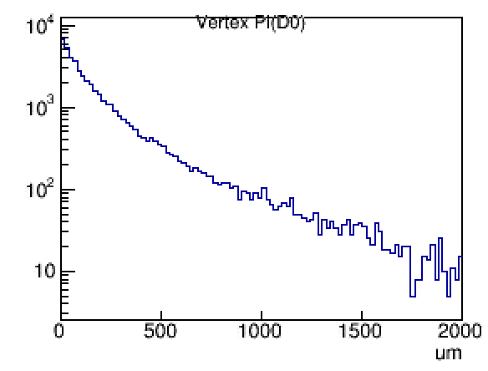

Vertex. Heavy quarks
Heavy quarks
(Boson Gluon Fusion)
D0
D*
-cτ (D (B) mesons) ~ 100 (400) μm
=> displaced vertex =>
Need Vertex detector with good resolution
- c (b) quark -> D,B mesons -> π,K
=> Particle identification ( prev. slides)
Vertex distribution
for D0 (pythia)
Notes:
Interior Page Design 2

Slide 41
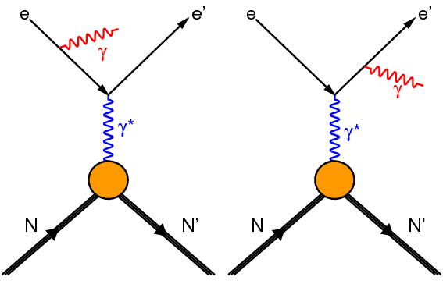
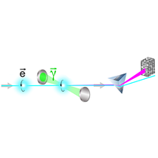
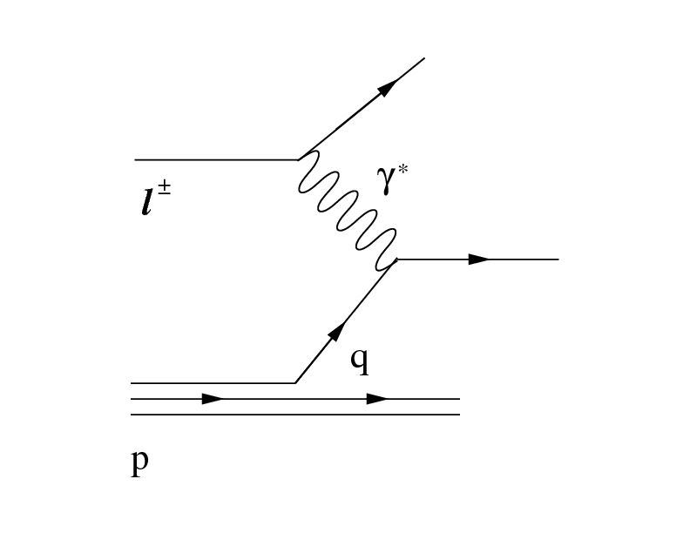
Particle associated with the e-beam
Bethe-Heitler process to monitor luminosity
(photons collinear to electron beam)
Electron-beam polarization measurement
Tagging electrons for photo-production
(scattered electron moving in the beam direction)
Almost real
All of these particles are moving in the e-beam direction

Slide 42
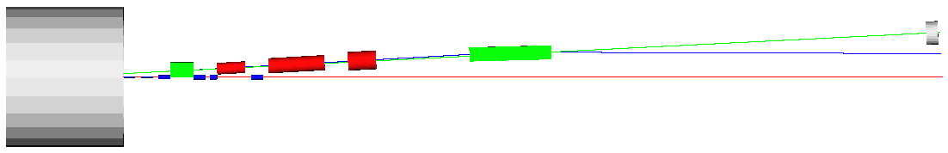
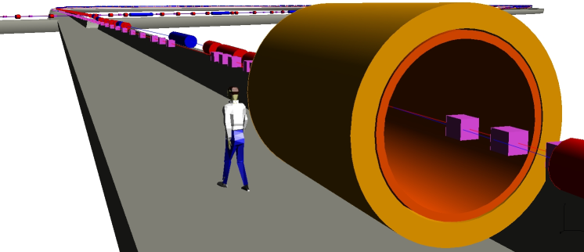
Forward hadron spectrometer
Compensating solenoid
Aperture-free drift space
high-res. ZDC
(n, γ)
2 Tm dipole
20 Tm dipole
p
solenoid
Forward hadron spectrometer
e
S-shaped dipole configuration optimizes neutron acceptance (20 mrad cone) and beam line separation (> 1 m)
Spectator protons (exit windows)
Recoil protons (roman pots at focal point 43 m from IP)
50 mrad crossing angle
(Belle II: 83 mrad)
Spectator proton angle after dipole is 75 mrad (from beam)
ion optics
ions
Large 20 Tm dipole provides excellent resolution
Large dispersion and small beam size at secondary focus ensure good acceptance for recoil protons
Large quadrupole apertures (1 / max beam energy) give good acceptance for hadronic and nuclear fragments, charged and neutral (high res. ZDC).
2nd focus on
Roman pots
IP (primary focus)

Slide 43
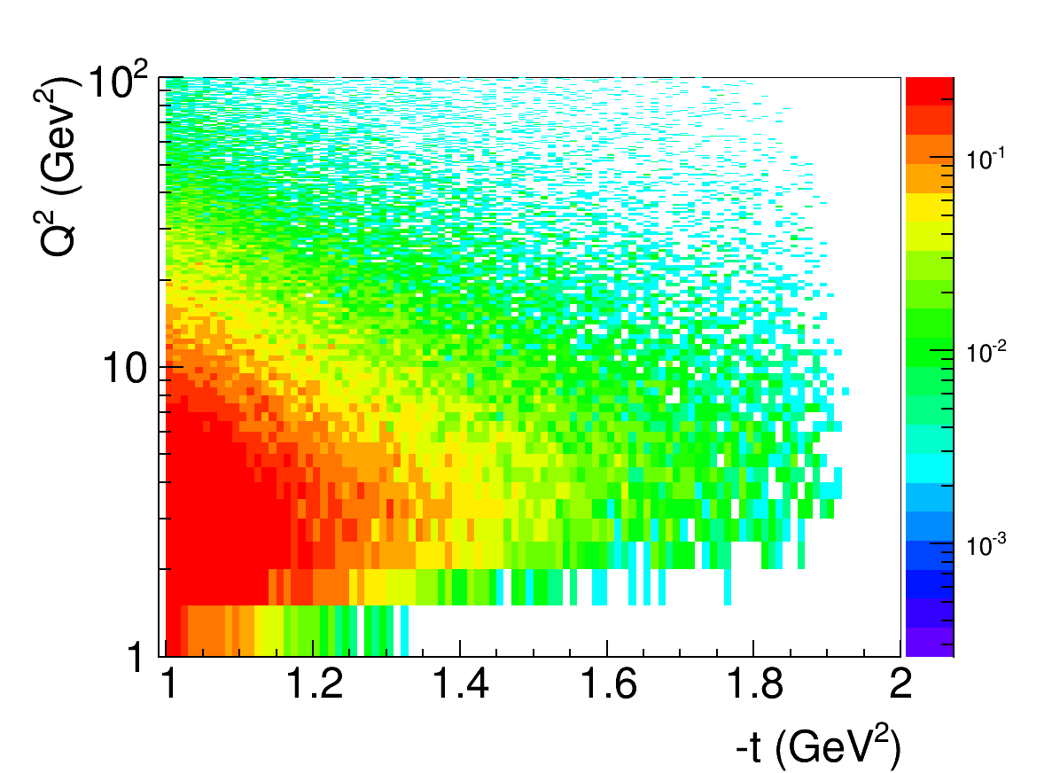
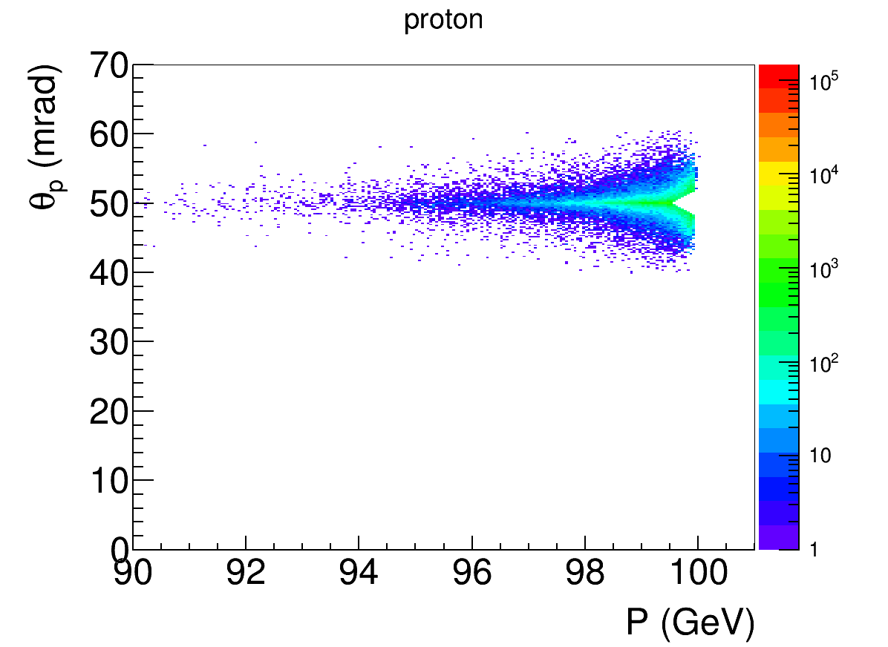
Forward acceptance and resolution
dp/p
proton-rich fragments
“spectator protons from ²H”
neutron-rich fragments
“tritons from N=Z nuclei”
Full acceptance for all partonic and nuclear fragments (different rigidities)
  Large coverage in p_{T} for recoils
Detector resolution designed to be limited by intrinsic spread of the beam (dp/p ~ few x 10⁻⁴, dθ < 0.3 mrad)
DVCS high-t (p_{T}) acceptance
DVCS low-t (p_{T}) acceptance
High-t acceptance limited by magnet apertures
p beam at 50 mrad
(beam separation not an issue with 50 mrad crossing angle)
Acceptance with 10σ beam size cut:
Proton angle at IP
p < 99.5% of beam for all angles
θ > 2 mrad for all momenta
e⁻ beam at 0 mrad

Slide 44
DIS and Final State Particles
Scattered electron
Ion beamline
Photons
Electron beamline
Photons
Particles Associated with Initial Ion
beam electron (or low Q²)
Particles associated with struck parton

Slide 45
Physics of EIC

Slide 46
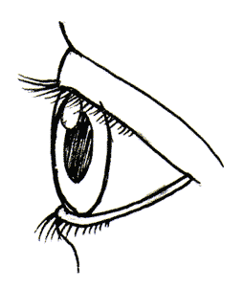

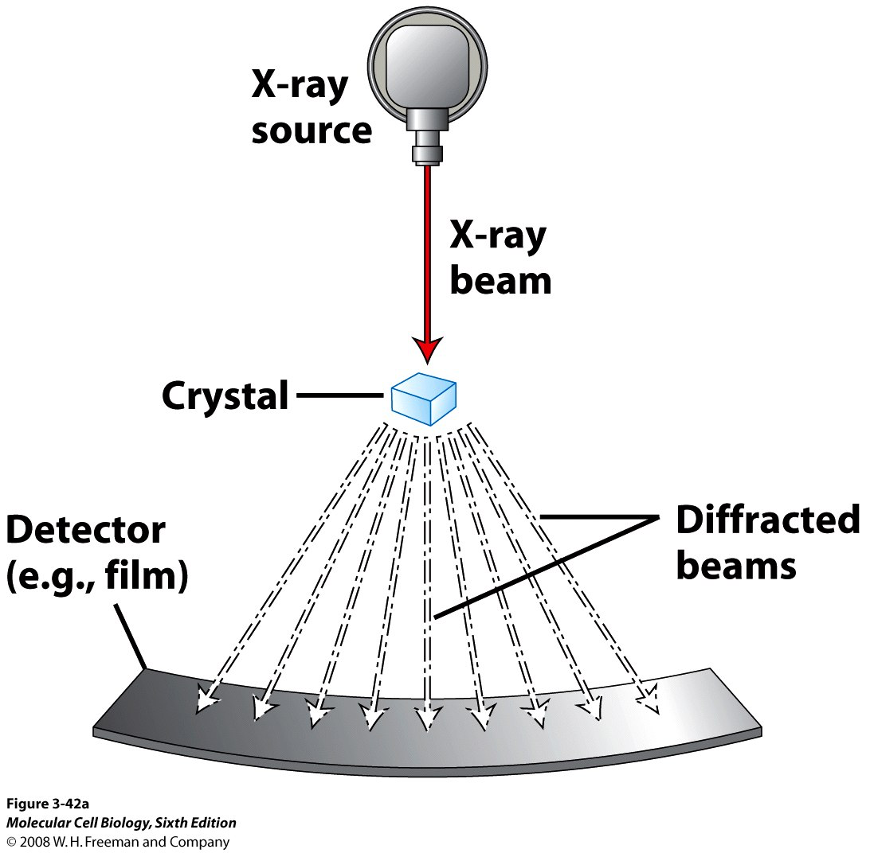
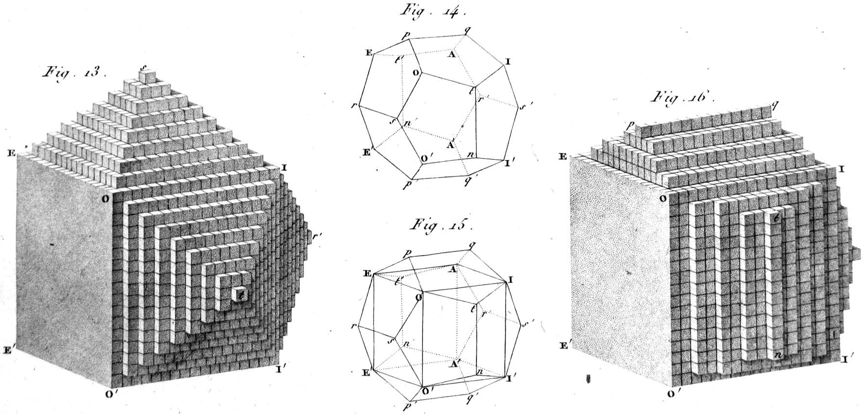
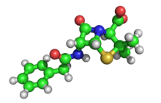
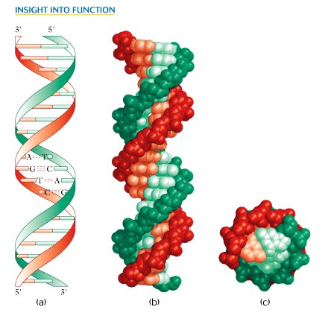
New Probes and New Science
Example: Structure of Atomic Matter
Advent of
X-ray Diff.
1912
Probe with the
right scale!
Crystal Structure: 1801
3D structure of penicillin: 1945
Precise understanding of structure leads to rich new sciences
Double Helix: 1953

Slide 47
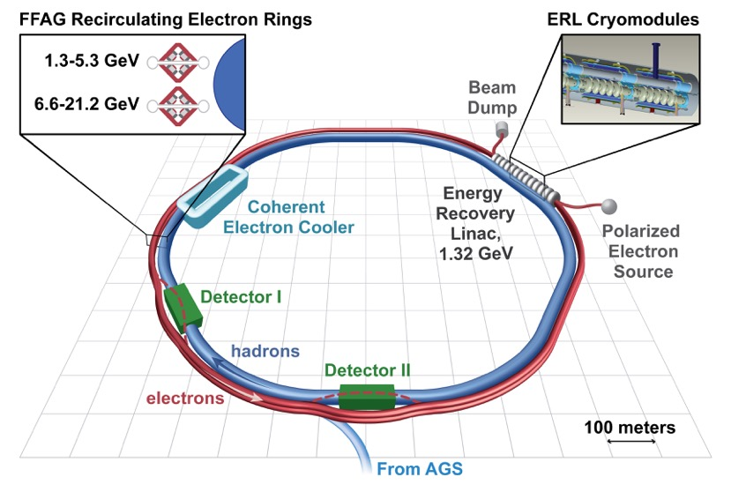
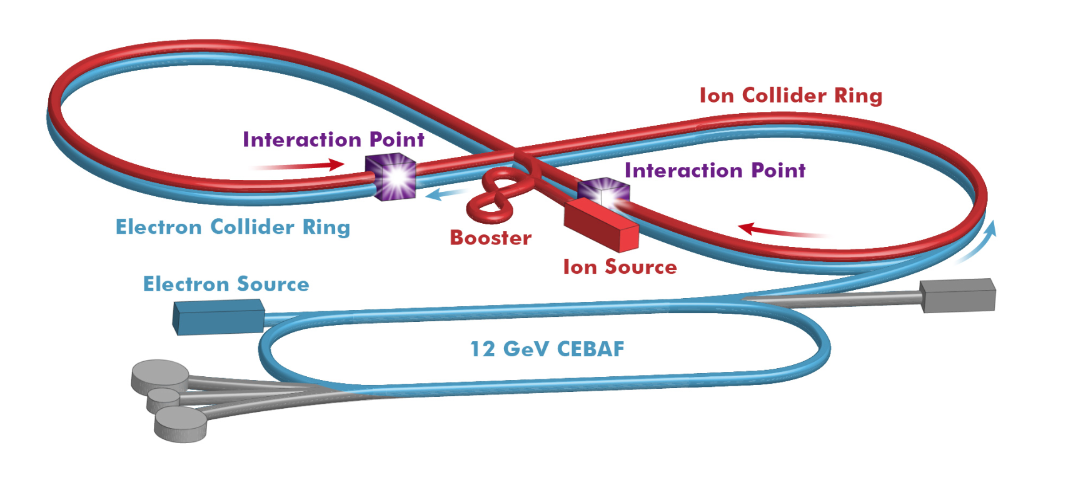
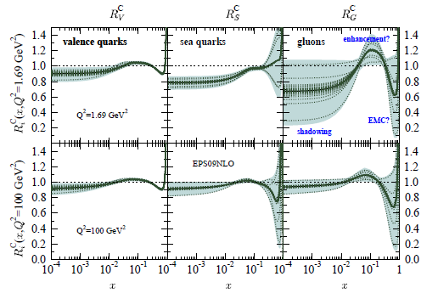

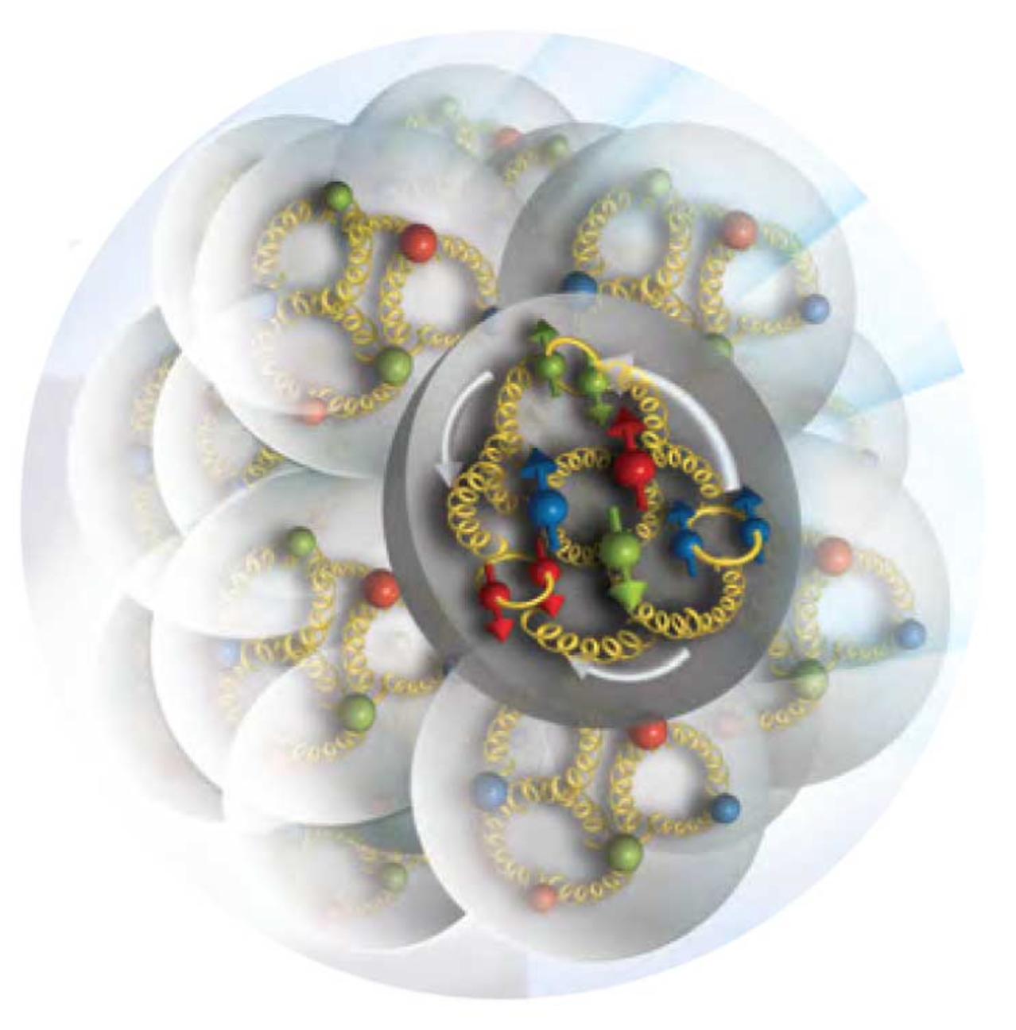
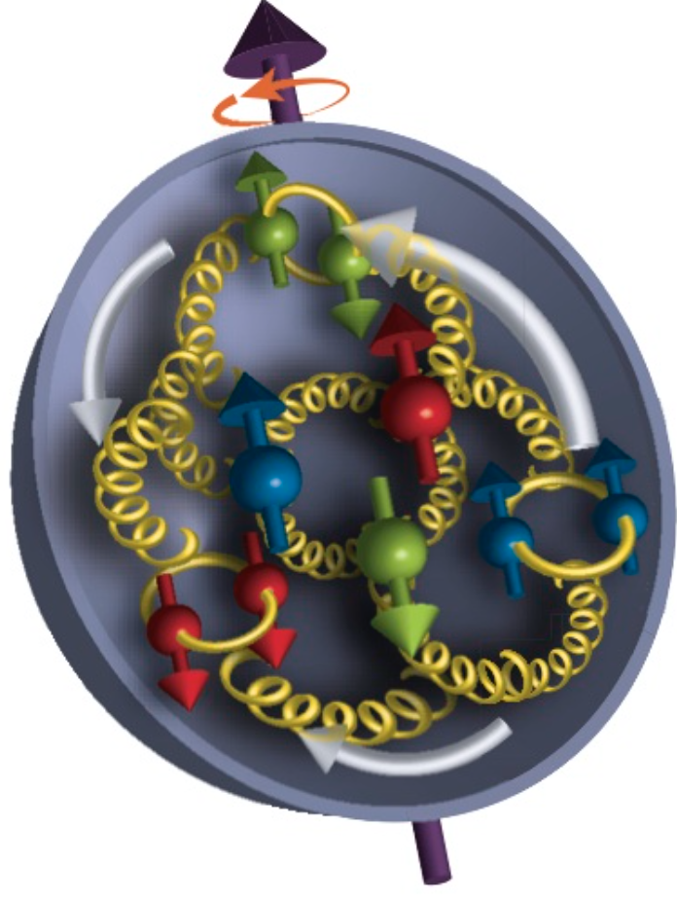
New Probe for Nuclear Science
2016
Probe with the
right scale!
Advent of EIC: ~2027
Precise understanding of structure and dynamics: dawn of new science

Slide 48
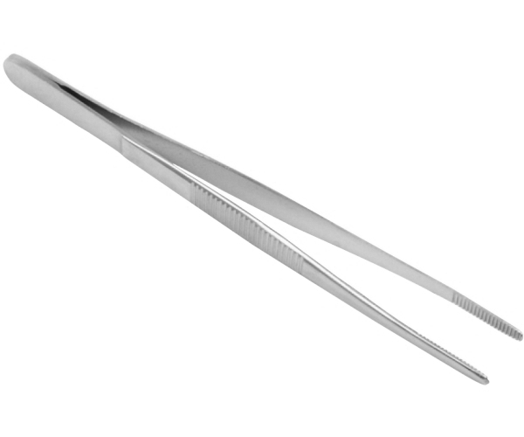
EIC Physics Program
Program aim: Revolutionize the understanding of nucleon and nuclear structure and associated dynamics. Explore new states of QCD.
small fraction of a fm
Program
Probe the nucleon in the many-body regime (down to x ≈ 0.005) at large Q²
Probe the nuclei in the N-N and multi-N interaction regime at large Q²
Extend our understanding of QCD (saturation, jets in cold nuclear matter)
Boring? Sounds like you’ve heard this for 30 years? No! Not Really!

Slide 49

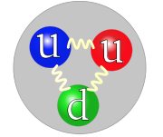
Understanding the Nucleon at the Next Level
Nucleon: A many-body system with challenging characteristics
Relativistic (M_{proton} >> M_{quark})
Strongly Coupled (QCD)
Quantum Mechanical (Superposition of configurations)
Measure in the Multi-Body regime:
- Region of quantum fluctuation + non-perturbative
effects → dynamical origin of mass, spin.
For the first time, get (almost?) all relevant
information about quark-gluon structure of the nucleon
and nuclei will be accessible.
Designing EIC, IR and Detector → Designing the right probe
Resolution appropriate for quarks and gluons
Ability to project out relevant Q.M. configurations of the
nucleon and the nuclei

