Slide 1
Jet Physics at an EIC
Brian Page
EIC User Meeting: ANL
July 2016

Slide 2
Outline
Particle Content of Jets
Is a Mid-Rapidity Hadron Calorimeter Necessary?
Quark Jet Vs Gluon Jet Discrimination
Accessing Gluon Polarization with Di-jets
Diffractive Di-jets
Summary

Slide 3
Do We Need a Hadron Calorimeter?
Group particles by how they interact with detector elements and look at average fraction of jet pT carried by each particle type and average number of each particle type in jets to determine if barrel hadronic calorimeter is necessary
Only look at jets in the mid-rapidity region, between -1 <= eta_lab <= 1, Q² = 10 – 100 GeV²
Particle groupings are:
Charged = muons, pions, kons, rhos, protons
Electromagnetic = photons, pi0, electrons
Hadrons = neutrons, K0_Long
Invisible = neutrinos

Slide 4
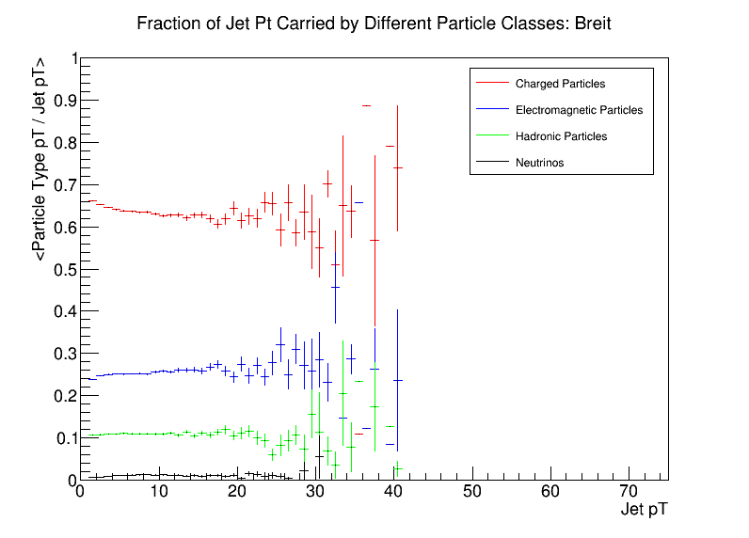
Particle p_{T} Fractions Vs Jet p_{T}
Take vector sum of particles of given type and find total transverse momentum
Plot average p_{T} of each particle class vs total jet p_{T}
See that charged particles dominate while neutral hadrons contribute roughly 10%

Slide 5
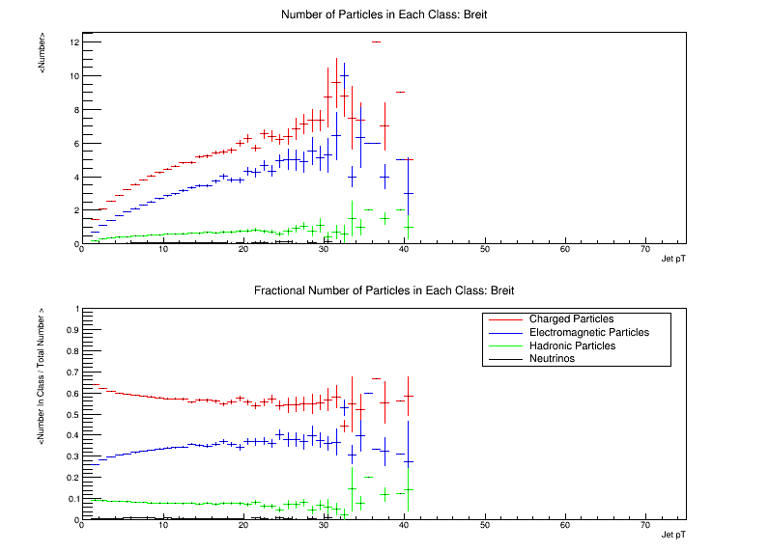
Particle Number Vs Jet p_{T}
Charged
Electromagnetic
Hadron
Invisible
Find average number of each particle type in a jet
Similar story as with p_{T} fractions: jets are dominated by charged hadrons and electromagnetically interacting particles

Slide 6
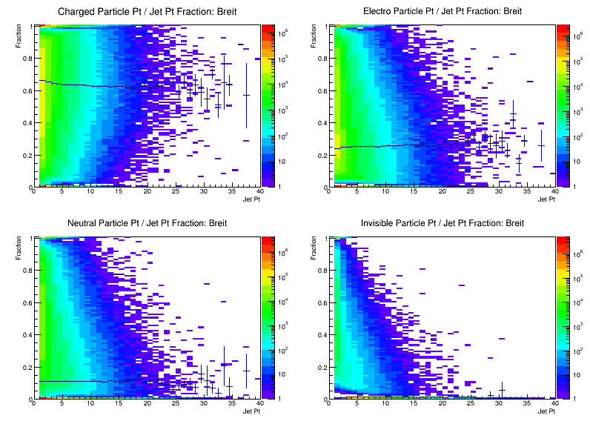
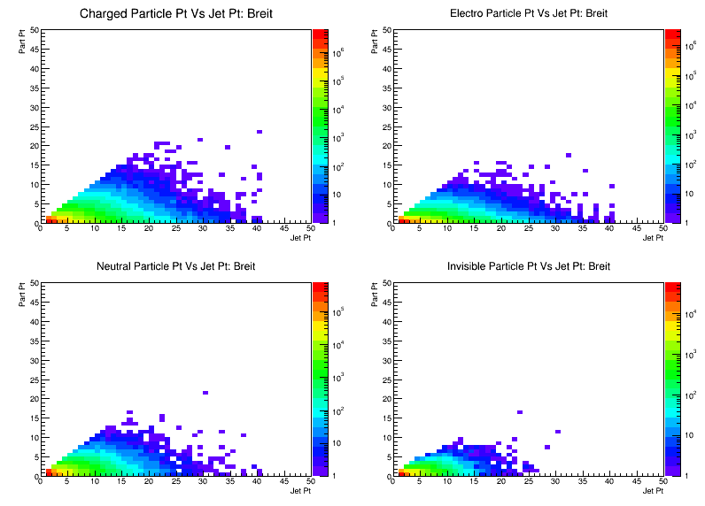
Particle – Jet 2D Correlations
Plots to the left show particle class p_{T} over total jet p_{T} vs jet p_{T} – scatter plot of second to previous slide
See that for charged particle, there is large locus at a fraction of 1 while for hadronic, the majority of events are at 0
Fraction of jets with majority hadronic content is small
Electro
Charged
Hadronic
Invisible
Charged
Electro
Plots to the right show individual particle p_{T} vs the p_{T} of the jet they are a part of
See that high p_{T} jets are not dominated by single high p_{T} particle, but are more often composed of multiple lower p_{T} particles
Jet measurements do not appear to drive the need for a hadron calorimeter
Hadronic
Invisible

Slide 7
Quark – Gluon Discrimination
Can we discriminate between jets arising from quarks and those arising from gluons?
For this study, only consider light quarks: u, d, and s. Assume that heavy quark tagging will employ different methods
Jets (part of a di-jet) are found in the Breit frame from events with Q² = 10 – 100 GeV² and resolved, QCDC, and PGF subprocess
Look only at jets with p_{T} ≥ 10 GeV as the separation between quark and gluon jets is more pronounced
Jet Mass: Low Jet p_{T}
Jet Mass: High Jet p_{T}
Quark Jet
Gluon Jet
3 ≤ Jet p_{T} < 5 GeV
Jet p_{T} ≥ 10 GeV

Slide 8
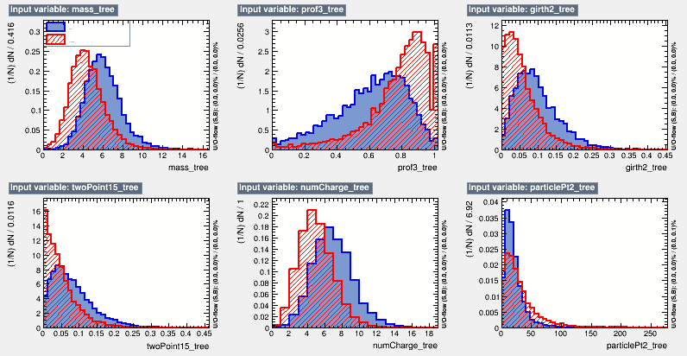
Input Variables
Mass
Profile
Girth²
Two Point
# Charged
Blue = Gluon
Red = Quark
Girth² = $\sum_{i}{\frac{pTi}{pTjet}} \left|ri\right|2$
2 Point = $\frac{1}{pTjet2}\sum_{i≠j}{pTi∗p_{Tj}∗\left|rij\right|β}$

Slide 9
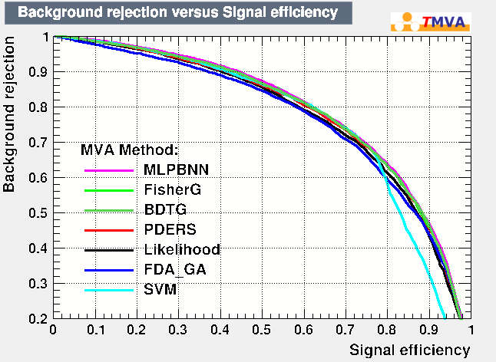
Method Comparison
Characterize a number of multivariate methods by percentage of background rejected vs signal retained
All methods performed roughly the same
For the following, use MLPBNN which is a neural network implementation

Slide 10
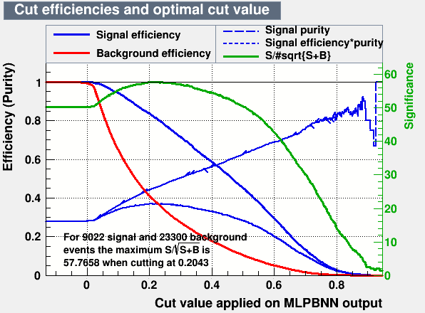
Cut Optimization
TMVA evaluates all input and maps them to a single variable with more signal-like events having a higher value
Plot signal & background efficiency, signal purity, significance, etc as a function of this cut value
This plot shows where to place cut in order to maximize purity, efficiency, or whatever an analysis requires
For current study, place cut where signal purity = signal efficiency

Slide 11
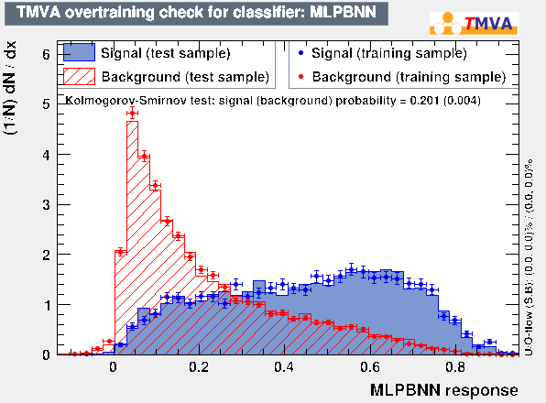
MLPBNN Response
Reject
Accept

Slide 12
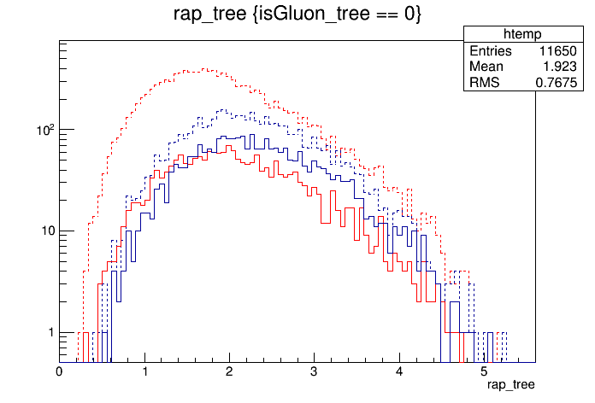
Jet Rapidity Spectra
After cut is applied, can plot quark and gluon jets vs any relevant variable
Here we see that gluons dominate at higher rapidity
Look at jets with rapidity > 1.8 to further enhance gluon fraction
Dotted Red = All Quarks (11650)
Dotted Blue = All Gluons (4511)
Solid Red = Quarks After Cut (1964)
Solid Blue = Gluons After Cut (2568)
G/Q Before Cut = 0.39
G/Q After Cut = 1.31
G/(G+Q) Before = 28%
G/(G+Q) After = 57%

Slide 13
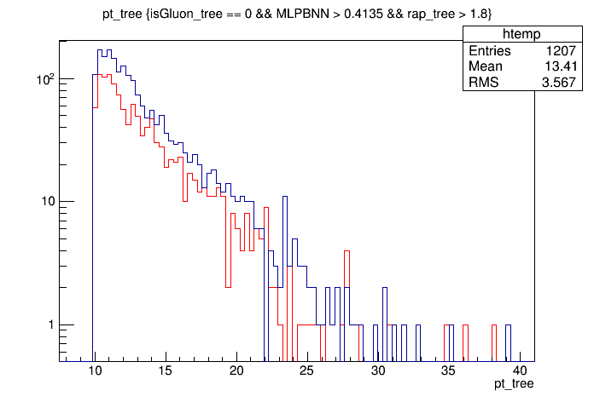
Jet p_{T} Spectra With Rapidity Cut
Red = Quark After MV & Rap Cut (1207)
Blue = Gluon After MV & Rap Cut (1941)
Plot jet p_{T} after all cuts
See reasonable enhancement of gluon jets over p_{T} range
Should be able to get relatively pure quark sample and enhanced gluon sample for applications which require identification
G/Q = 1.61
G/(G+Q) = 62%

Slide 14
Gluon Polarization with Di-jets
Measurements of scaling violations of the g₁ structure function will be the primary method of accessing gluon polarization at an EIC, however alternate measurements will be important for cross checks and differing systematic effects
Can access gluon polarization by measuring di-jet production arising from direct processes in which the virtual photon is point-like (see Xiaoxuan Chu’s talk on using resolved processes to measure polarized photon structure functions)
Hope is that di-jet mass provides perturbative scale to extend gluon polarization measurements to Q² < 1 GeV²
Resolved
Photon-Gluon Fusion & QCD-Compton

Slide 15
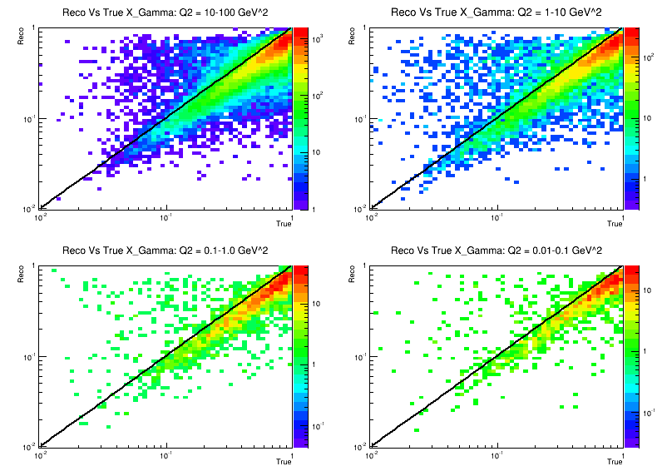
X_{γ}: Reconstructed Vs True
Will use virtual photon momentum fraction to discriminate between resolved and direct processes
See good agreement between reconstructed and true X_{γ} for all Q² ranges
Di-jets found in Breit frame and required one jet with p_{T} ≥ 5 GeV and the other with p_{T} ≥ 4 GeV
Q² = 10 - 100
Q² = 1 - 10
Q² = 0.1 – 1.0
Q² = 0.01 – 0.1
X_{γ} $= \frac{1}{2E_{e}y} \left(p_{T1}e^{−η_{1}}+p_{T2}e^{−η_{2}}\right)$

Slide 16
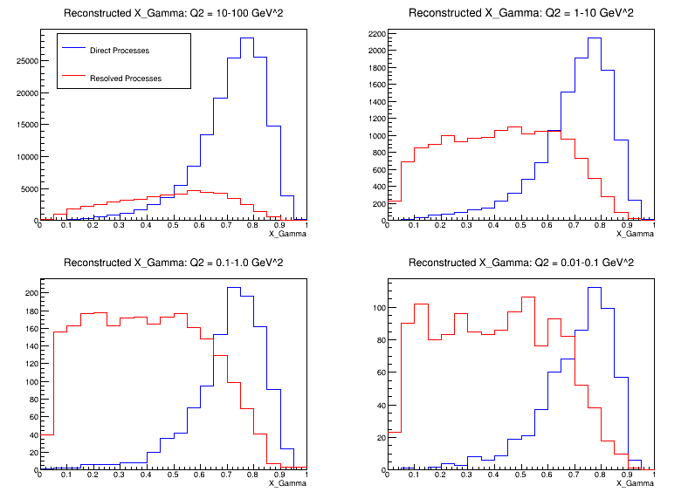
Direct Vs Resolved Processes
Plot reconstructed X_{γ} for direct and resolved processes
Direct processes should concentrate toward 1 while resolved processes are at lower values
Direct processes dominate at higher Q² while resolved are more prevalent at low Q²
Cut of X_{γ} > 0.7 enhances the direct fraction at all Q²
Q² = 1 - 10
Q² = 10 - 100
Q² = 0.1 – 1.0
Q² = 0.01 – 0.1
Accepted Region

Slide 17
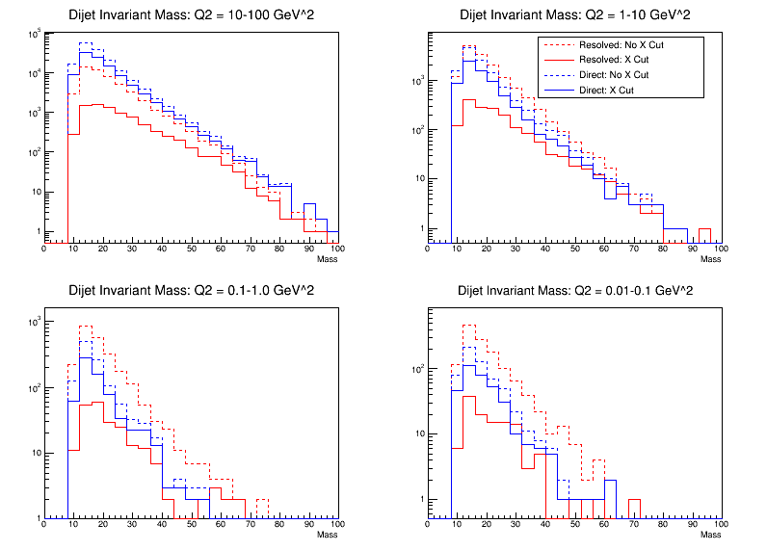
Di-jet Invariant Mass
See that the cut on X_{γ} significantly reduces the resolved contribution while maintaining the direct events
Separation between resolved and direct is most prominent at high Q² and low di-jet invariant mass
Further suppression of resolved events may be possible by looking at lab-frame rapidity correlations
Q² = 10 - 100
Q² = 1 - 10
Q² = 0.1 – 1.0
Q² = 0.01 – 1.0

Slide 18
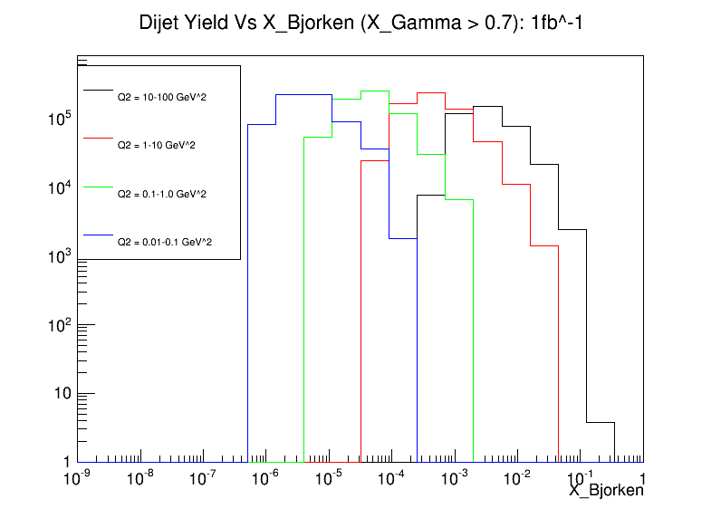
Di-jet Yield in X and Q²: 1fb⁻¹
Yield of di-jet events which pass X_{γ} cuts vs x_{B} for the four Q² bins simulated
Yield has been scaled to an integrated luminosity of 1fb⁻¹
See multiple decades of Q² coverage for several x_{B} bins
Different x_{B} ranges can be accessed at a given Q² by varying the collision energy
Study is in early stage but outlook is positive – can isolate direct contribution even at low Q²

Slide 19
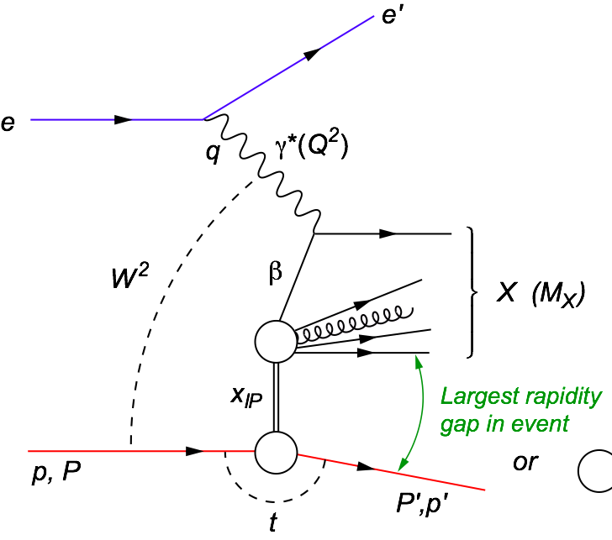
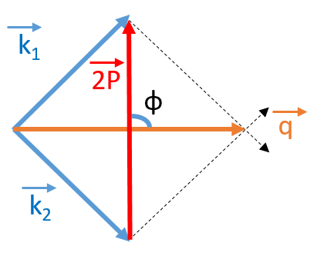
Diffractive Di-jet Studies
Diffractive
There have been several recent papers looking at angular correlations between jets in diffractive di-jet events: see for example Phys. Lett. B758 P373 and PRL 116, 202301
Would like to explore basics of diffractive di-jet production at an EIC – rates, t-dependence, masses, etc
Will simulate hard diffractive events using RAPGAP – beginning to integrate generator into existing eRHIC simulation framework
2P = k₁ – k₂
q = k₁ + k₂

Slide 20
Summary
Jet particle content and p_{T} budget dominated by charged particles with ~10% contribution from neutral hadrons – mid-rapidity hadron calorimeter likely not necessary
See reasonable ability to isolate quark or gluon initiated jets, especially at high jet p_{T}
Preliminary work has begun on investigating the use of di-jets as a probe of the gluon polarization
Work is beginning on investigating diffractive di-jets using the RAPGAP Monte Carlo

Slide 21
Backup

Slide 22
Subprocess Codes
11: f_{i} f_{j} -> f_{i} f_{j}
12: f_{i} f_{i}_bar -> f_{k} f_{k}_bar
13: f_{i} f_{i}_bar -> g g
28: f_{i} g -> f_{i} g
53: g g -> f_{k} f_{k}_bar
68: g g -> g g
91: Elastic
92: Single Diffraction (xB)
93: Single Diffraction (Ax)
94: Double Diffraction
95: Low-p_{T} Production
Resolved
Elastic / Soft
131: f_{i} γ_{T}* -> f_{i} g
132: f_{i} γ_{L}* -> f_{i} g
135: g γ_{T}* -> f_{i} f_{i}_bar
136: g γ_{L}* -> f_{i} f_{i}_bar
PGF / QCDC
99: γ*q -> q
DIS

Slide 23
Subprocess Codes
Resolved
Diffractive
Photon-Gluon Fusion & QCD-Compton
DIS

Slide 24
Jet Basics: Frames
Can define several useful frames:
Lab
Hadron-Boson: Beam hadron is at rest, z-direction chosen along virtual photon momentum vector
Breit: Virtual photon moves in -z direction and boost such that it has zero energy. Separation into target and remnant regions
Center of Mass: Virtual photon and struck parton have equal and opposite momenta. Can define Feynman-x

Slide 25
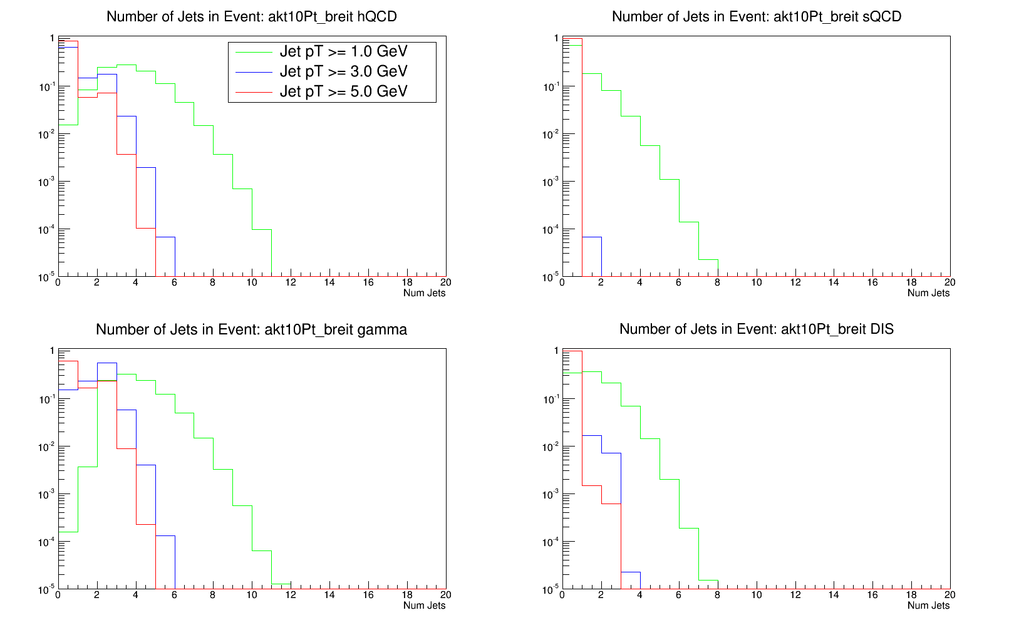
Jet Multiplicity: Q² = 10 – 100 GeV²
# Jets: Resolved Processes
Percentage of events with a certain number of found jets for different minimum allowed jet p_{T}s
See a decrease in number of jets with increasing minimum jet p_{T}
Jet p_{T} of 1 GeV may not be well described theoretically
Each curve normalized to unity
# Jets: PGF / QCDC
# Jets: L.O. DIS

Slide 26
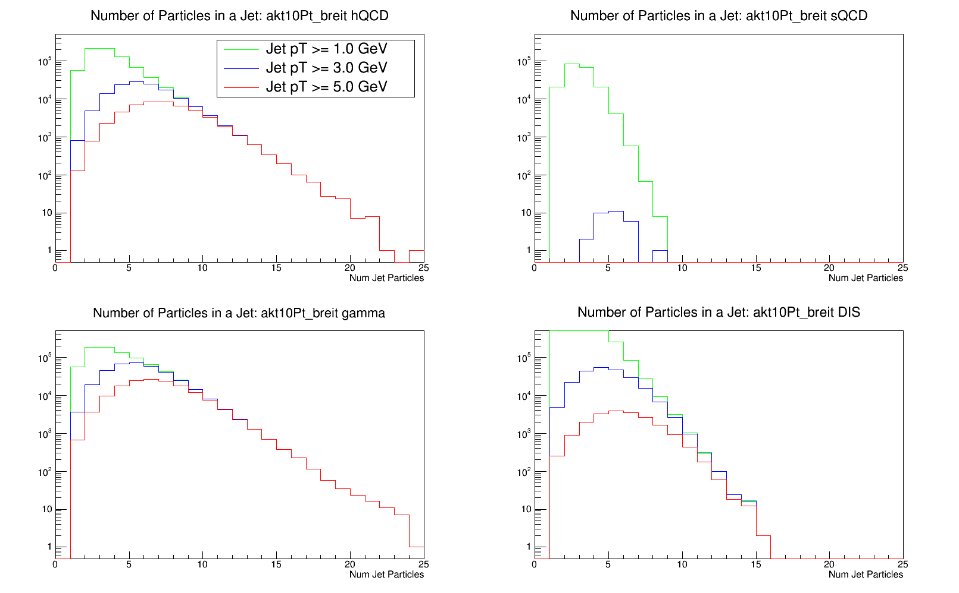
Jet Particle Mult: Q² = 10 – 100 GeV²
# Jet Particles: Resolved Processes
Number of particles in a jet for 3 minimum jet p_{T} values
Increase in minimum jet p_{T} leads to increase in average number of particles in jet
Higher p_{T} jets -> more “jet like” than “single particle like”
# Jet Particles: PGF / QCDC
# Jet Particles: L.O. DIS

Slide 27
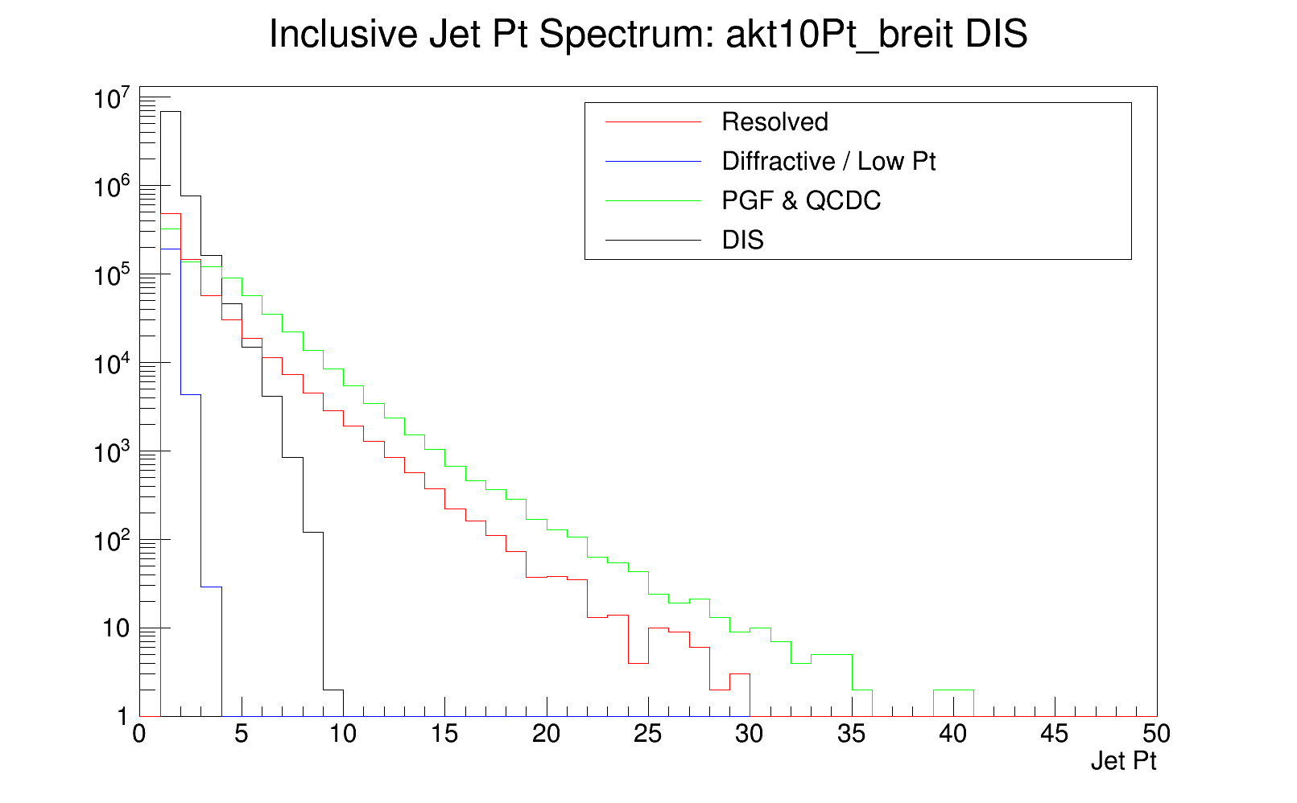
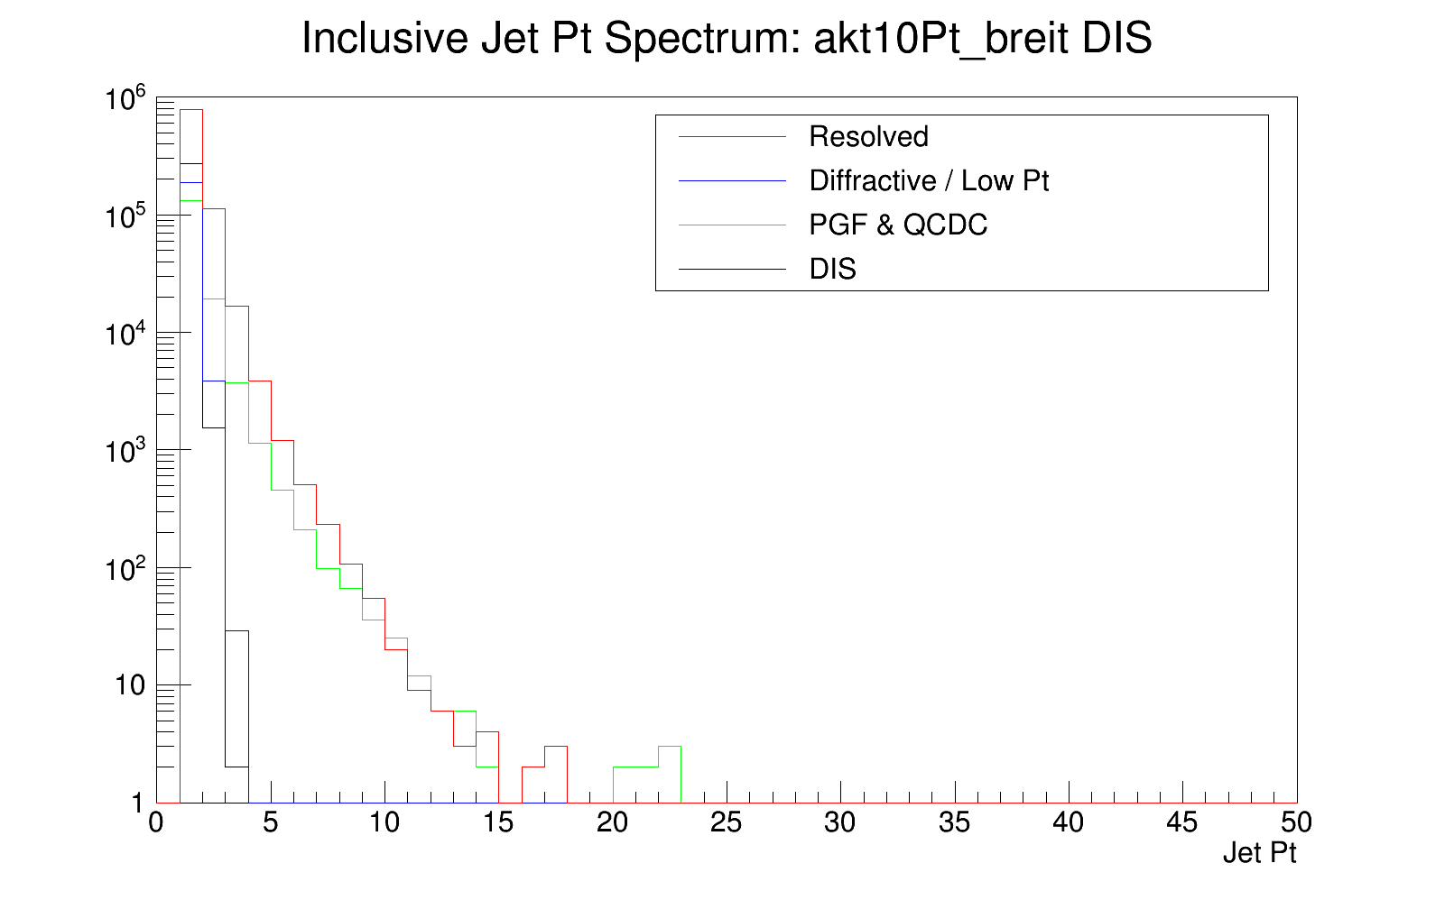
Jet p_{T}: Process and Q² Dependence
Inclusive Jet p_{T}: Q² = 10-100 GeV²
Jet p_{T} spectra for different sub-processes and Q² ranges
Jets found in Breit frame
Inclusive Jet p_{T}: Q² = 10⁻⁵-10⁻⁴ GeV²
Larger Q² leads to larger jet p_{T} for all sub-processes
Corresponds to behavior seen in particle multiplicities

Slide 28
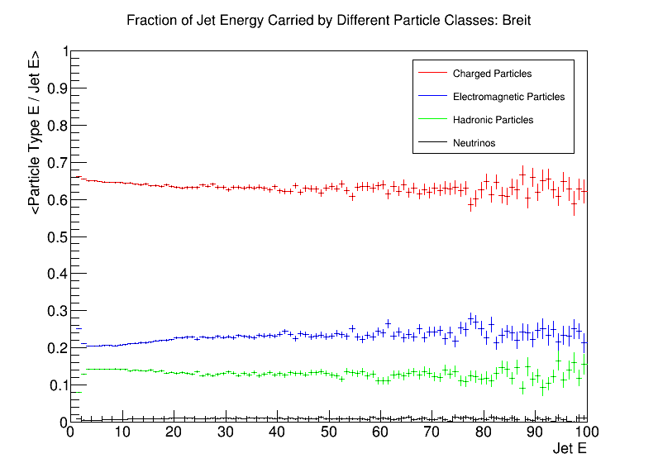
Particle Energy Fractions: Breit Frame

Slide 29
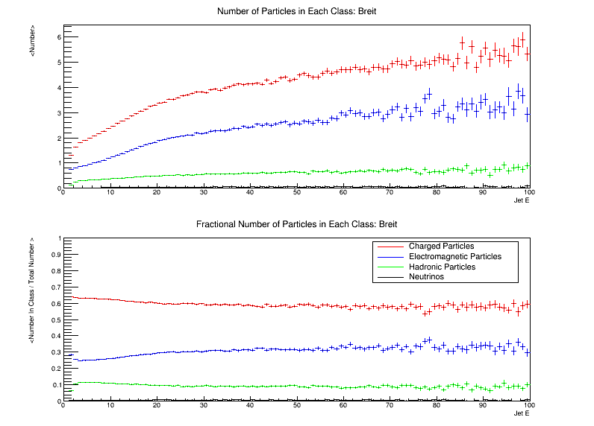
Particle Number Vs E: Breit Frame

Slide 30
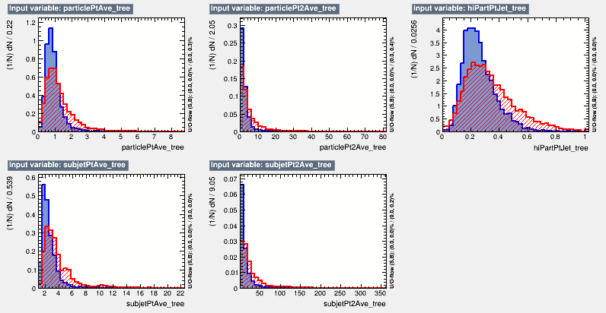
Remaining Input Variables

Slide 31
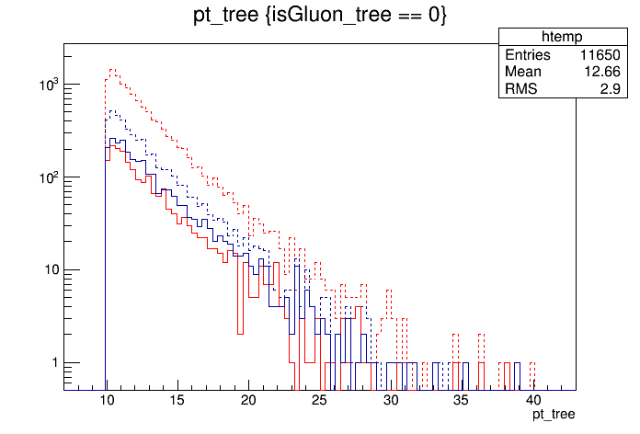
Jet p_{T} Spectra
Dotted Red = All Quarks (11650)
Dotted Blue = All Gluons (4511)
Solid Red = Quarks After Cut (1964)
Solid Blue = Gluons After Cut (2568)
G/Q Before Cut = 0.39
G/Q After Cut = 1.31
G/(G+Q) Before = 28%
G/(G+Q) After = 57%

