Slide 1


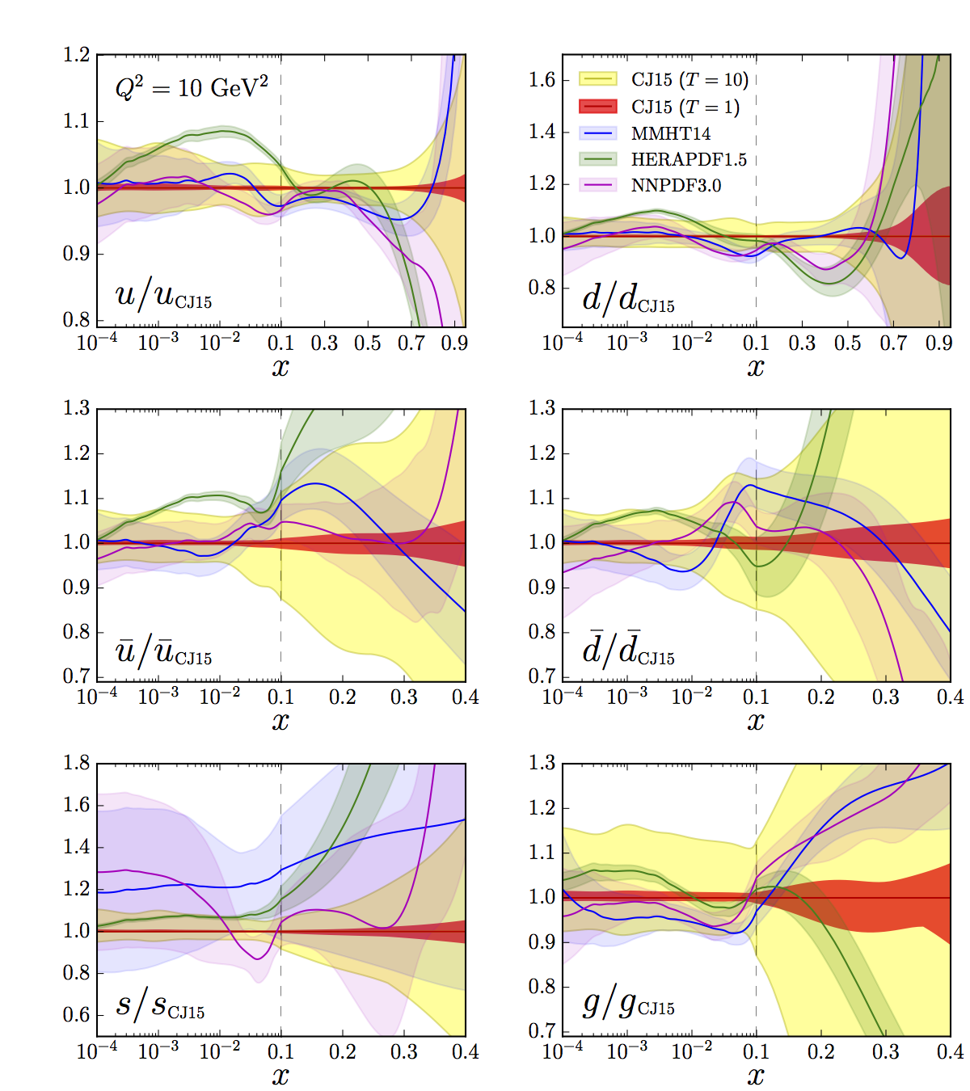
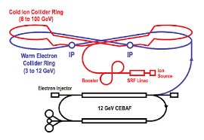
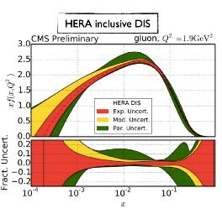
Determining Large x PDFs at JLEIC – a work in progress
Accardi (Hampton),
R. Ent, C. Keppel,
K. Park, R. Yoshida (JLab),
M. Wing (UC London)
EIC Users Group Meeting
Argonne National Lab, July 2016

Slide 2
Parton Distribution Functions (PDFs)
Provide fundamental information regarding nucleon and nuclear structure
Knowledge of the interaction initial state, and hence the PDFs, is critical to precision measurements at hadron colliders
  Sensitivity to new physics, new heavy particles, requires better knowledge of large x PDFs

Slide 3
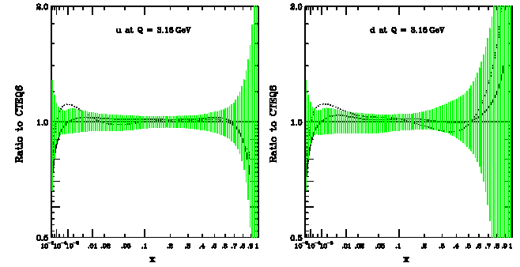
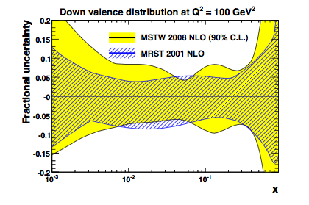
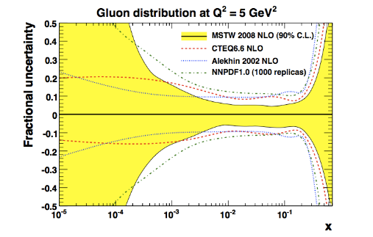
Large x (x > 0.05) -> Large PDF Uncertainties
u(x)
d(x)
This talk will focus largely on d(x), g(x)
d(x)
g(x)

Slide 4
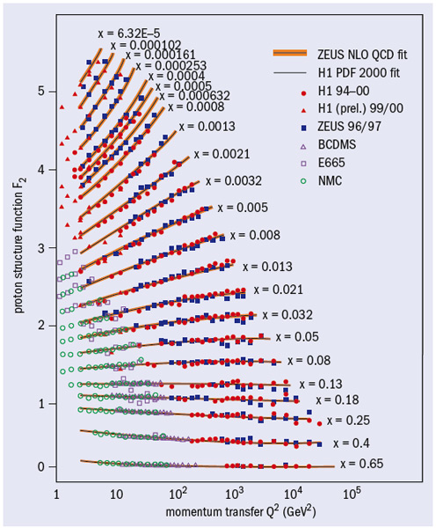
Nucleon Structure Function Measurements
F₂^{p}
Proton –
F₂^{p} measured over > 5 orders of magnitude in x, Q² by dozens of experiments at numerous laboratories and for decades
Well described by DGLAP, global PDF fits
Translates to small uncertainties on u(x)
Neutron –
No free neutron target
Historically difficult to extract neutron from deuteron - uncertainties from nuclear corrections
F₂^{d} not as well measured asF₂^{p}
Translates to large uncertainties on d(x)

Slide 5
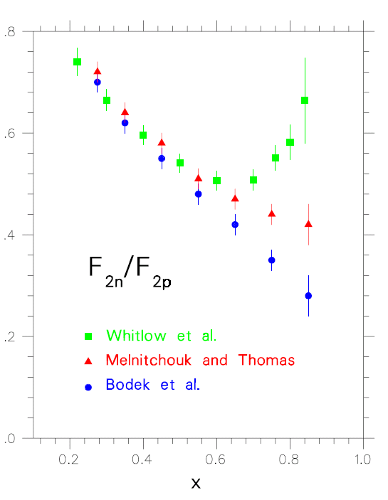
F₂^{n}/F₂^{p} (and, hence, d/u) is essentially unknown at large x:
- Conflicting fundamental theory pictures
- Data inconclusive due to uncertainties in deuterium nuclear corrections
- Translates directly to large uncertainties on d(x), g(x) PDFs
SU(6) symmetry
pQCD
DSE: 0⁺ & 1⁺ qq
0⁺ qq only
Review Articles:
N. Isgur, PRD 59 (1999),
S Brodsky et al NP B441 (1995),
W. Melnitchouk and A. Thomas PL B377 (1996) 11,
R.J. Holt and C. D. Roberts, Rev. Mod. Phys. 82 (2010)
I. Cloet et al, Few Body Syst. 46 (2009) 1.

Slide 6

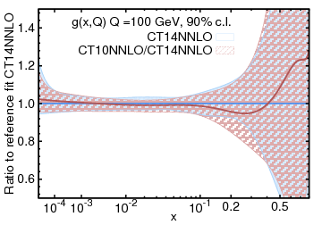
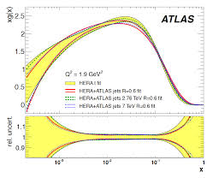
g(x) is poorly known at large (and small) x…
￼
Most knowledge comes from
- (small) scaling violations in the
evolution of the F₂ str. fn.
- Jets in p+p (and e+p)
Both are limited to x<~0.3

Slide 7
Can the EIC help?
Different data constrain different parton combinations at different x
Scaling violation studies require range in both x, Q² – not currently possible at large x without the EIC
Would like to have both F₂^{n} and F₂^{p} – possible with planned EIC spectator tagging capabiities
To begin investigating possibilities, we used projected data kinematics and uncertainties, and the “CJ” global PDF fit…

Slide 8

CTEQ-Jefferson Lab “CJ” PDF Fits
Phys. Rev. D81:034016 (2010) Phys. Rev. D84:014008 (2011)
Phys. Rev. D87:094012 (2013) Phys. Rev. D93 114017 (2016)
PDFs at http://lhapdf.hepforge.org/lhapdf5/pdfsets CJ collaboration: http://www.jlab.org/CJ
Goals:
  Extend CTEQ fit to larger values of x and lower values of Q²
  Incorporate data previously subject to kinematic cuts (SLAC and JLab largely)
To accomplish this:
  Need to relax conventional cuts defining “safe” region for issues such as higher twist, target mass - will now need to take these into account
  Allow d/u to go to a constant (not just (1-x)ª type form)
  Need accurate deuteron nuclear corrections

Slide 9
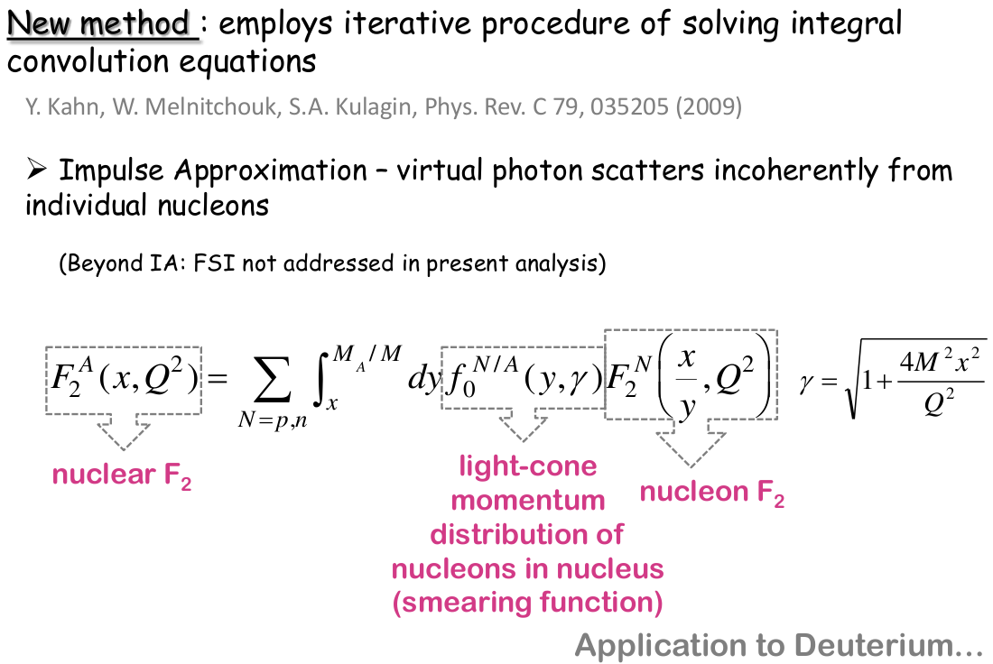


Improved Extraction of F₂^{n} from F₂^{d} and F₂^{p}
Convolution of light cone momentum distribution on nucleons in nucleus

Slide 10
CJ15 Global Fit
Phys. Rev. D93 114017 (2016)
State-of-the-art in large x PDFs
> 50% uncertainty on d(x) above x ~ 0.6
> 50% uncertainty on g(x) above x ~ 0.2

Slide 11
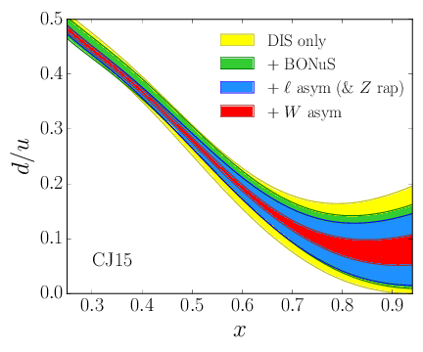
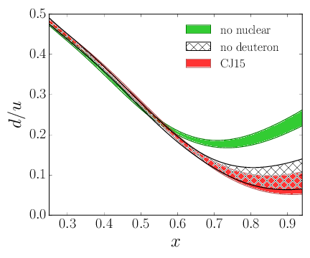
F₂^{n} better constrained
Effective neutron target via spectator tagging experiment at JLab
Resulting CJ uncertainty bands
Nuclear corrections still dominant
Constrained by p+p → W + X !

Slide 12
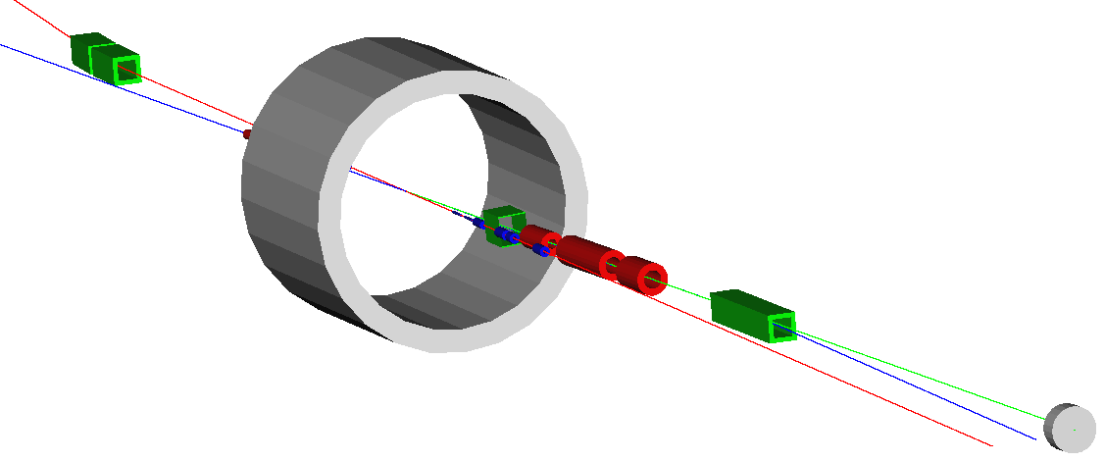
Tagged Structure Functions at the EIC
The technique is uniquely suited to colliders: no target material absorbing low-momentum nucleons
The JLEIC design provides electron–nucleon squared center–of–mass energies in the range 250 − 2500 GeV² at luminosities up to 10³⁴ cm⁻² s⁻¹
e–
Low Q²
e-tagger
2 Tm out
Central
Solenoid
See C. Hyde talk!
20 Tm in
Full acceptance for spectators from
longitudinally and transversely polarized
light ion beams
Neutron detection in a 25 mrad cone around 0°
n
e
p
Secondary high dispersive ion focus ~40 m downstream of IP

Slide 13
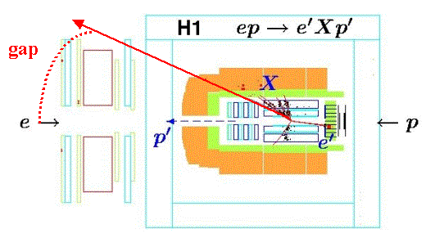
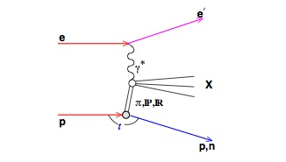
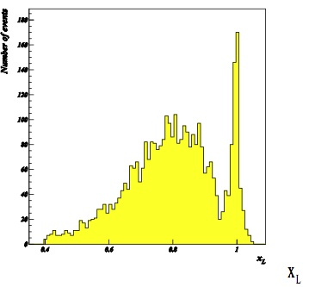

Tagged Structure Functions at HERA – Example: proton tag
Tag leading baryon production
ep → eXN via color singlet exchange
Diffractive
Scattering:
Large rapidity gap
x_{L} = E^{p}/E^{p}_{beam} ~ 1
Detect forward proton
Also tagged neutron
The Pomeron diverges as 1/(1-x_{L}), the f-Reggeon is flat.
DESY 10-095 Eur.Phys.J. C71 (2011) 1578

Slide 14
EIC: Full Acceptance for Forward Physics!
Example: acceptance for p’ in e + p → e’ + p’ + X
Huge gain in acceptance for forward tagging to measure F₂^{n} and diffractive physics!!!

Slide 15
(Tagged) Neutron Structure Extrapolation in t
t resolution better than 20 MeV, < fermi momentum
Resolution limited/given by ion momentum spread
Allow precision extraction of F₂^{n} neutron structure function

Slide 16
(Tagged) Neutron Structure Extrapolation in t
Preliminary examples (courtesy Kijun Park)
Uncertainties include on-shell neutron extrapolation systematics
1 year of EIC @ luminosity of 10³² gives about 1 fb⁻¹
1 year of EIC @ luminosity of 10³³ gives about 10 fb⁻¹
1 year of EIC @ luminosity of 10³⁴ gives about 100 fb⁻¹

Slide 17
Data so far being considered in CJ fit projection study….
So far, have used JLEIC 10x100 GeV² projections in bins 0.1 < x < 0.9 for:
F₂^{p}
F₂^{n} from deuterium with tagged proton spectator
F₂^{d}
Can check on-shell extrapolation by measuring F₂^{p} from deuterium with tagged neutron spectator, comparing to proton target data
Can check nuclear corrections to F₂^{d} against F₂^{n (tagged)}
  Finally will be able to distinguish between models!
Assume 1% systematic uncertainty
W² > 3.5 GeV² and Q² > 1.69 GeV² (standard CJ15 cuts)
A simple study so far (first results hot off the press)…

Slide 18
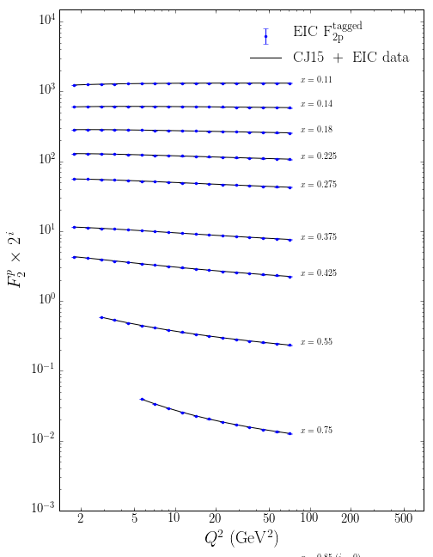
F₂^{p} (tagged) pseudodata vs x
Compressed scale makes it somewhat difficult to see the experimental and fit uncertainties
Currently no cut in y:
would loose a little bit in the high Q² range from y<ymax, unlikely a problem since ymax ~0.85.
would loose some low Q² leverage at large x from a y_min cut, might have impact on the gluon fits
requires more careful simulations

Slide 19
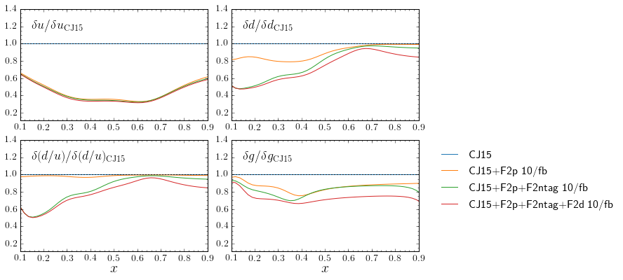
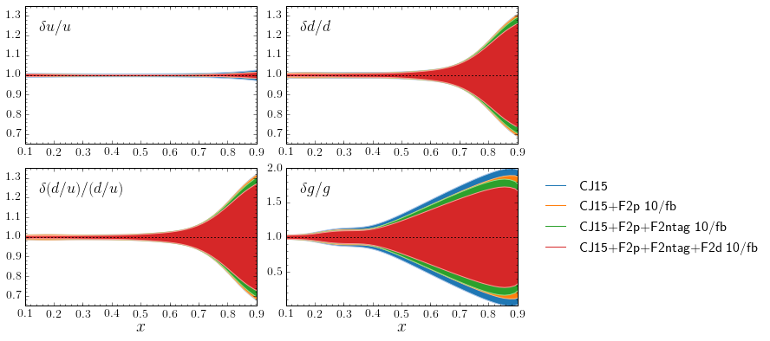
10/fb luminosity
Top: improvement in relative PDF uncertainties compared to CJ15
Bottom: relative uncertainties compared to CJ15
Improvement in u impressive, but already small uncertainty
Large improvement in d(x), ~50%
d/u tracks d
~20% improvement in g(x)

Slide 20
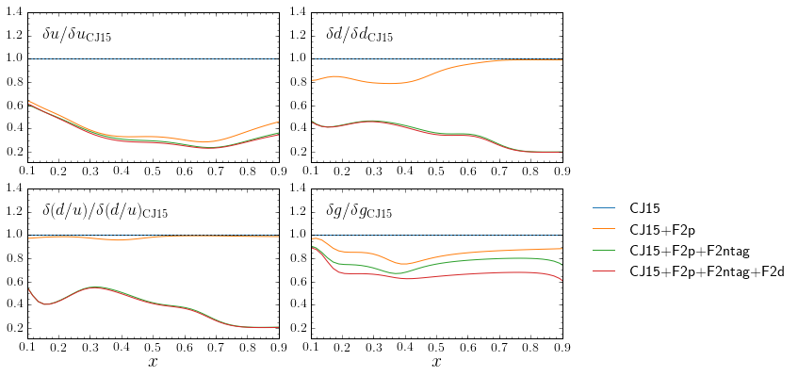
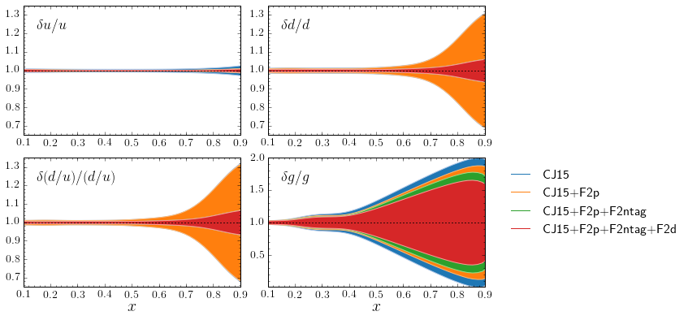
100/fb luminosity
d quark precision will become comparable to current u!!
similar improvement in g(x)
The u quark uncertainty becomes less than ~1%; may be important for large mass BSM new particles.
With d quark nailed by F₂^{n}, fitting F₂^{d} data will explore details of nuclear effects

Slide 21
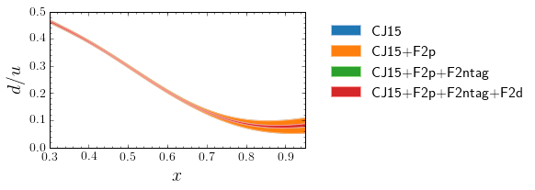
Improved d(x) precision is good news
The d-quark goes from a few 10% to ~1% percent level
Resolve long-standing mystery of d/u at large x, bell-weather for fundamental models of nucleon structure
D/(p+n) in one experiment for the first time – unprecedented handle on nuclear medium modifications
Facilitate accurate neutron excess/isoscalar corrections
  Important also for neutrino physics and nuclear PDFs

Slide 22
Improved g(x) precision also good news
The gluons improve by a bit less than 10% per data set included, with the improvement seemingly independent of luminosity
- Possibly gluons are accessed by the F₂ shape in Q², so that the precision of each data point is not very important, while the lever arm in Q² matters most
If true, expect that adding new measurements we will continue to improve the gluons: for example, adding energy scans at 3+100 and 6+100 may reach a global improvement in the large-x gluons closer to 80%.
Energy scans could also allow for direct access of gluons from F_{L}.
Need more work to confirm above

Slide 23
Summary
A 10/fb e-p run and an 100/fb e-d run (with e-n_{tag}!) reduces the u uncertainty to better than 1% and the d uncertainty down to 5% at x = 0.9.
The gluon will also be significantly improved, but…
Still a work in progress, need to:
Study more energy combinations
Study y cut
Evaluate also F_{L}
Expand x binning
Optimize grid

Slide 24
Thank you!

Slide 25
Backups

Slide 26
F₂^{p} – F₂^{n} yields non-singlet distribution
At moderate x (~0.3), singlet comparable to non-singlet
Large uncertainties on singlet distribution - - in structure function measurements, comes from (small) scaling violations in F₂
Q² evolution is simpler for the non-singlet (reduced number of splitting functions)
Assuming a charge-symmetric sea, p-n isolates the non-singlet
Such measurements provide a direct handle on the quark structure of the nucleon
Also, need to pin down non-singlet (p-n) to extract singlet (complementary to F_{L} )

Slide 27
