Slide 1
The continuum of nuclear physics… From small-x to heavy nuclei
David J. Dean
Director, Physics Division
ORNL
EIC meeting
Chicago, Illinois
July 8, 2016

Slide 2
NSAC LRP recommendations
From Tim Hallman, NSAC

Slide 3
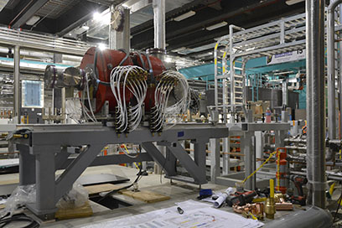
FRIB is becoming a reality
/
6
$730M TPC ($635.5M DOE)
Physics of Nuclei
Nuclear Astrophysics
Fundamental Symmetries
Isotope Harvesting

Slide 4
FRIB astrophysics example How did visible matter come into being and how did it evolve?
82
Input to r-process:
β decay properties
masses (Trap + TOF)
(d,p) to constrain (n,γ)
fission barriers, yields
Known half-life
FRIB reach for (d,p)
HST, 2011
N=126
50
126
Current reach
NSCL reach
RISAC Key Nuclei
First experiments
(70) Yb
(69) Tm
82
(68) Er
28
(67) Ho
Future
Reach
(66) Dy
FRIB reach for half-lives
50
H. Schatz

Slide 5
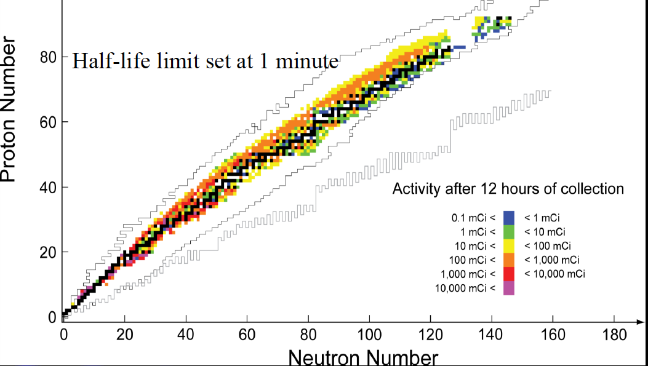
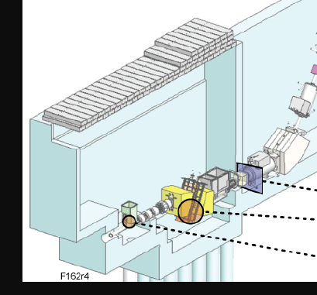
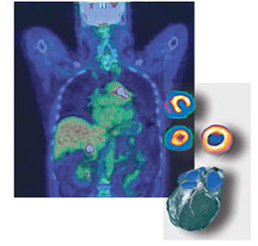
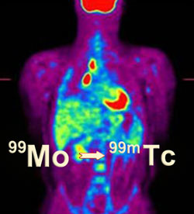
FRIB applications example What is the Nuclear Physics Value Proposition to society?
Isotope harvesting at the FRIB beam dump
Challenge: chemical separations (S. Lapi)
~1 page in RISAC and could be important
Water beam dump
Production target
Reactor based
80% of market
LANL/BNL ⁸²Sr

Slide 6
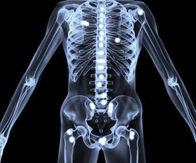
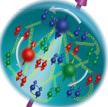
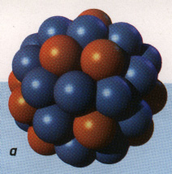
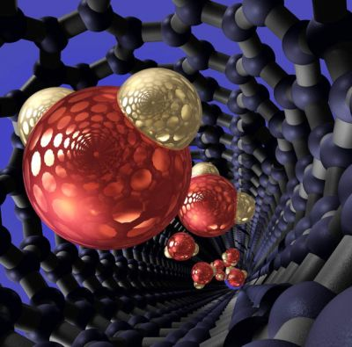
From small-x to heavy nuclei…
Scientific principles and laws do not lie on the surface of nature. They are hidden, and must be wrested from nature by an active and elaborate technique of inquiry. ~John Dewey, Reconstruction in Philosophy, 1920
Applications of Nuclei
Unity of Science
Time
Science is always wrong. It never solves a problem without creating ten more. ~George Bernard Shaw

Slide 7
Historic evolution
FRIB
EIC
Conceptual evolution of the machine from an ISOL to a fragmentation facility
Competition between two principal institutions (MSU and ANL)
DOE directed cost reduction at the time of the NAS review
Many affirming committees including NSAC and others
Conceptual design has been discussed for a long time with competing ideas (e.g., energy recovery linac vs conventional)
Competition between two principal institutions (TJ and BNL)
DOE has not yet put a limit on cost
Many affirming committees including NSAC and others

Slide 8
Charge to the EIC (2016)
The committee will assess the scientific justification for a U.S. domestic electron ion collider facility, taking into account current international plans and existing domestic facility infrastructure. In preparing its report, the committee will address the role that such a facility could play in the future of nuclear physics, considering the field broadly, but placing emphasis on its potential scientific impact on quantum chromodynamics.
In particular, the committee will address the following questions:
What is the merit and significance of the science that could be addressed by an electron ion collider facility and what is its importance in the overall context of research in nuclear physics and the physical sciences in general?
What are the capabilities of other facilities, existing and planned, domestic and abroad, to address the science opportunities afforded by an electron-ion collider? What unique scientific role could be played by a domestic electron ion collider facility that is complementary to existing and planned facilities at home and elsewhere?
What are the benefits to US leadership in nuclear physics if a domestic electron ion collider were constructed?
What are the benefits to other fields of science and to society of establishing such a facility in the United States?
Substantially the same as the RISAC charge

Slide 9
The RISAC charge (2005)
The committee will define a scientific agenda for a U.S. domestic rare-isotope facility, taking into account current government plans. In preparing its report, the committee will address the role that such a facility could play in the future of nuclear physics, considering the field broadly, but placing emphasis on its potential scientific impact on nuclear structure, nuclear astrophysics, fundamental symmetries, stockpile stewardship and other national security areas, and future availability of scientific and technical personnel. The need for such a facility will be addressed in the context of international efforts in this area.
In particular, the committee will address the following questions:
What science should be addressed by a rare-isotope facility and what is its importance in the overall context of research in nuclear physics and physics in general?
What are the capabilities of other facilities, existing and planned, domestic and abroad, to address the science agenda? What scientific role could be played by a domestic rare-isotope facility that is complementary to existing and planned facilities at home and elsewhere?
What are the benefits to other fields of science and to society of establishing such a facility in the United States?

Slide 10
The RESAC committee
JOHN F. AHEARNE, Sigma Xi and Duke University, Co-Chair
STUART J. FREEDMAN, University of California at Berkeley, Co-Chair
RICARDO ALARCON, Arizona State University
PETER BRAUN-MUNZINGER, GSI
ADAM S. BURROWS, University of Arizona
RICHARD F. CASTEN, Yale University
YANGLAI CHO, Argonne National Laboratory (retired)
GERALD T. GARVEY, Los Alamos National Laboratory
WICK C. HAXTON, University of Washington
ROBERT L. JAFFE, Massachusetts Institute of Technology
NOEMIE B. KOLLER, Rutgers
STEPHEN B. LIBBY, Lawrence Livermore National Laboratory
SHOJI NAGAMIYA, Japan Proton Accelerator Research Complex
WITOLD NAZAREWICZ, University of Tennessee, Knoxville
MICHAEL V. ROMALIS, Princeton University
PAUL SCHMOR, TRIUMF
MICHAEL C.F. WIESCHER, University of Notre Dame
STANFORD E. WOOSLEY, University of California at Santa Cruz
Nuclear Physicists
FRIB proponents
Non nuclear scientists
Heavily reviewed report

Slide 11
Personal Observations
Remain focused on the science because that’s what the charge is all about
Make the case that this is world-leading and good for the US
Recognize that $1.5B is a big number, but not as big as the SNS (at $1.7 in FY16 $$)
NAS is ‘friendly’ but tough and will help you strengthen your case
Anticipate curve balls (e.g., RIA becomes FRIB)

