Slide 1


Jefferson Lab
Electron-Ion Collider (JLEIC)
Rik Yoshida
For the JLEIC Detector and IR Study Group
EIC Users Group Meeting, Argonne
July 7, 2016

Slide 2
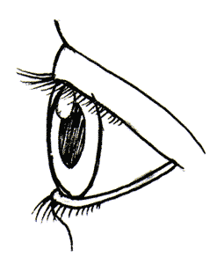

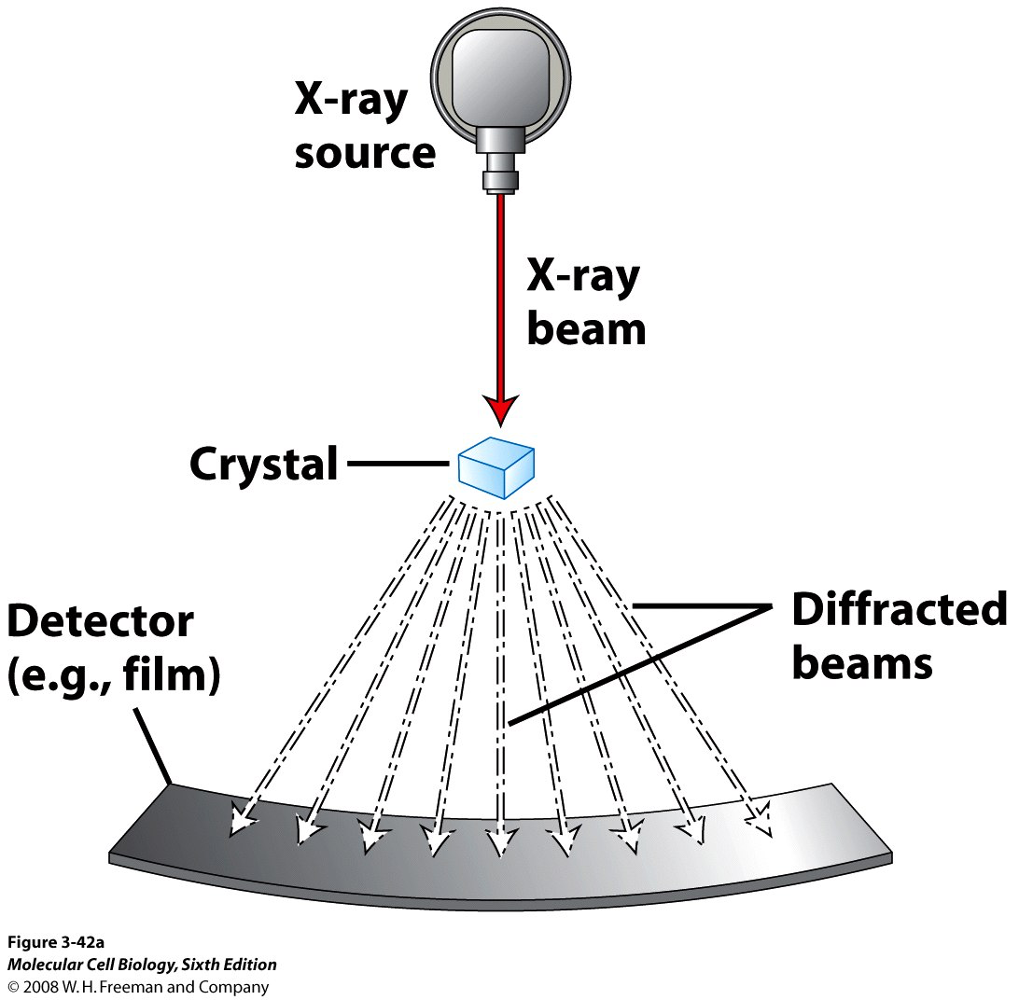
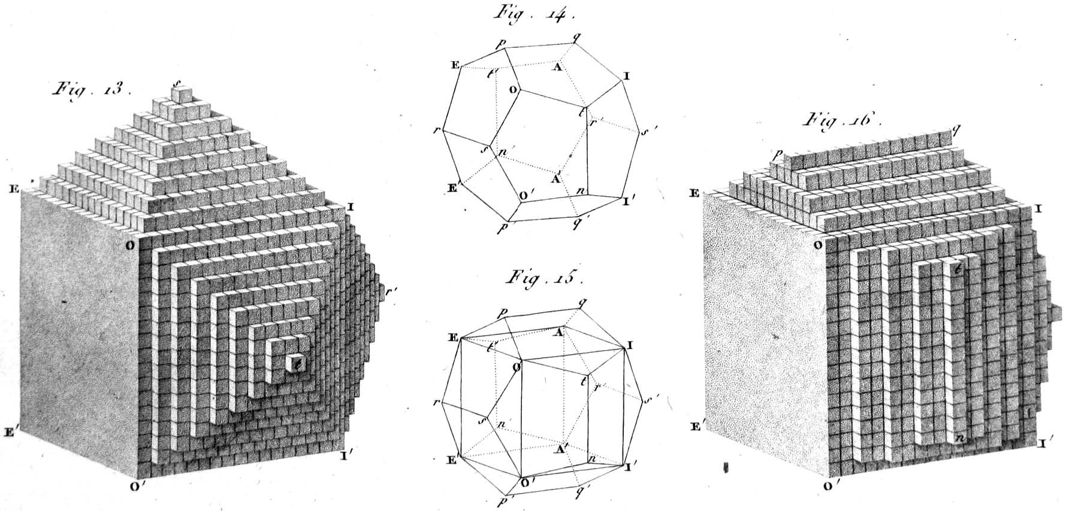
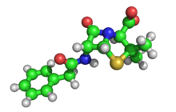
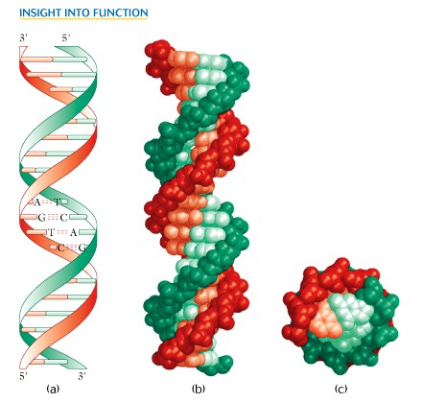
New Probes and New Science
Example: Structure of Atomic Matter
Advent of
X-ray Diff.
1912
Probe with the
right scale!
Crystal Structure: 1801
3D structure of penicillin: 1945
Precise understanding of structure leads to rich new sciences
Double Helix: 1953

Slide 3
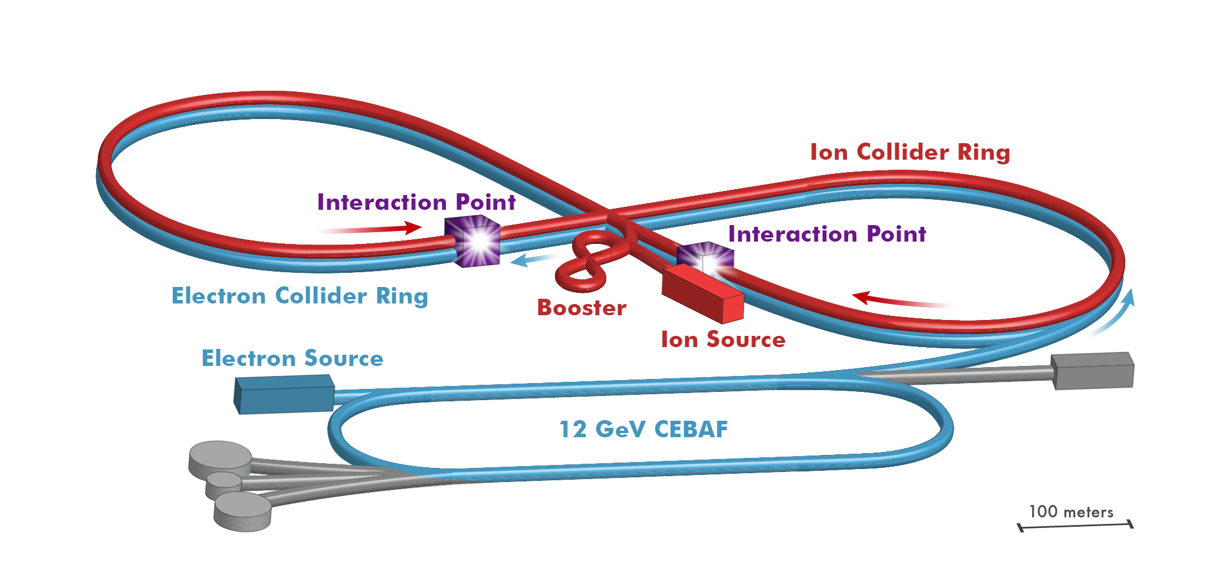
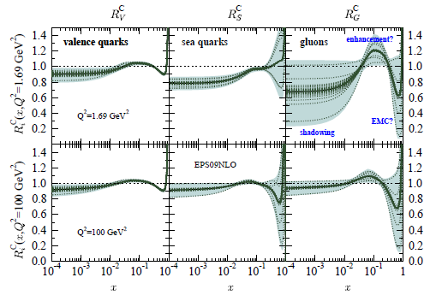

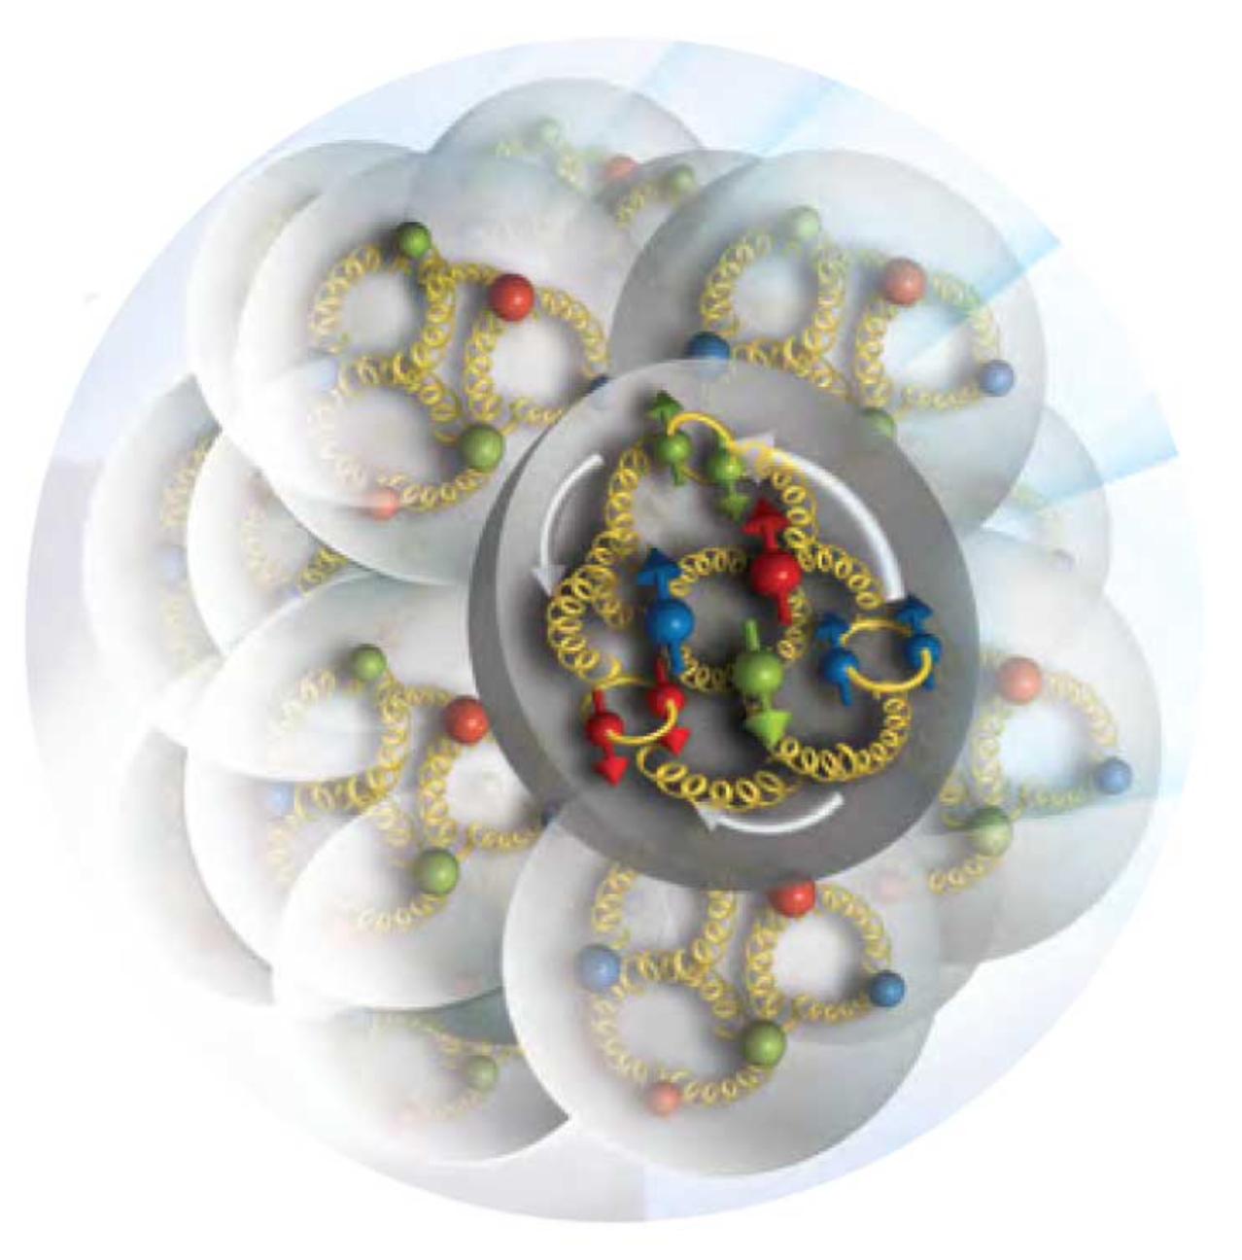
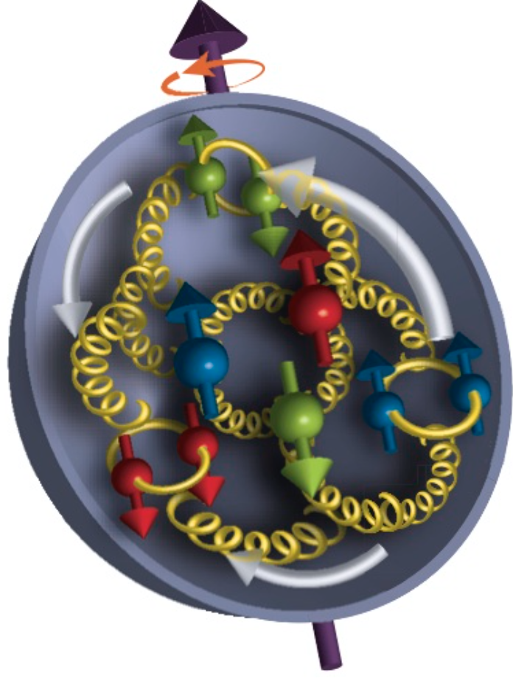
New Probe for Nuclear Science
2016
Advent of EIC: ~2027
Probe with the
right scale!
Precise understanding of structure and dynamics: dawn of new science

Slide 4
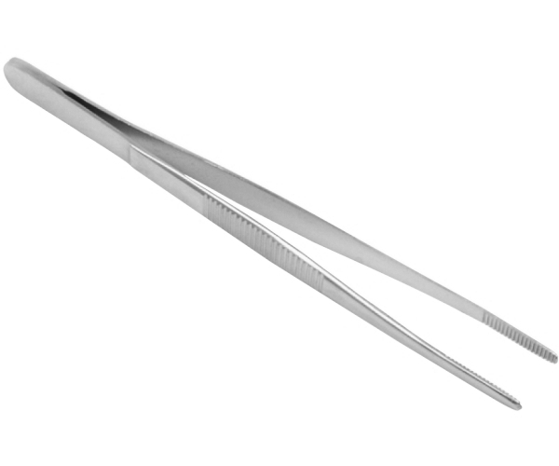
EIC Physics Program
Program aim: Revolutionize the understanding of nucleon and nuclear structure and associated dynamics. Explore new states of QCD.
small fraction of a fm
Program
Probe the nucleon in the many-body regime (down to x ≈ 0.005) at large Q²
Probe the nuclei in the N-N and multi-N interaction regime at large Q²
Extend our understanding of QCD (saturation, jets in cold nuclear matter)
Boring? Sounds like you’ve heard this for 30 years? No! Not Really!

Slide 5

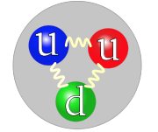
Understanding the Nucleon at the Next Level
Nucleon: A many-body system with challenging characteristics
Relativistic (M_{proton} >> M_{quark})
Strongly Coupled (QCD)
Quantum Mechanical (Superposition of configurations)
Measure in the Multi-Body regime:
- Region of quantum fluctuation + non-perturbative
effects → dynamical origin of mass, spin.
For the first time, get (almost?) all relevant
information about quark-gluon structure of the nucleon
Designing EIC → Designing the right probe
Resolution appropriate for quarks and gluons
Ability to project out relevant Q.M. configurations

Slide 6

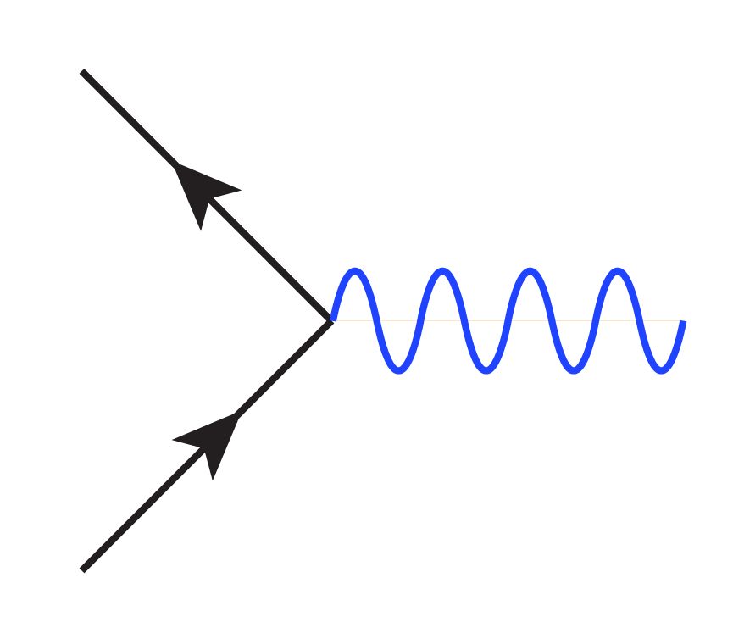
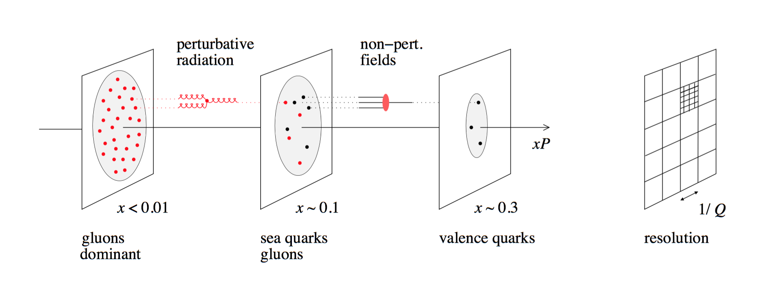
Parameters of the Probe
Q²
x
Ability to change x projects out
different configurations where
different dynamics dominate
Probe
Ability to change Q² changes the resolution scale
Q²= 400 GeV² => 1/Q = .01 fm

Slide 7

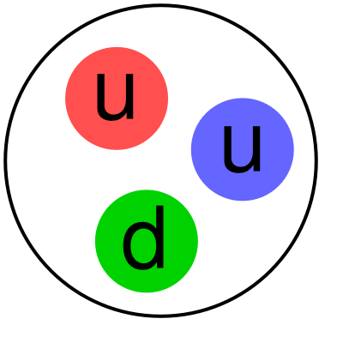
Where EIC Needs to be in x (nucleon)
Saturation
Regime:
Needs to be
Accessed via Ions
(see later)
Collective
Regime
Many-body
Regime
Few-body
Regime
10⁻⁴
10⁻³
10⁻²
10⁻¹
1
X (for proton)
QCD Radiation Dominated
(Studied at HERA)
Hadron Structure Dominated
Main interest for EIC Nucleon/Nuclear Program
Spin,TMD, GPD…

Slide 8
Where EIC needs to be in Q²
X > 10⁻³,10⁻² to 1
Non-perturbative
Regime
Perturbative
Regime
Transition
Region
HERMES, COMPASS, JLAB 6 and 12
EIC
HERA high-x
Q²
10⁻¹
1
10
10²
10³
[GeV²]
Include non-perturbative, perturbative and transition regimes
Provide long evolution length and up to Q² of ~1000 GeV² (~.005 fm)
Overlap with existing measurements
Disentangle Pert./Non-pert., Leading Twist/Higher Twist

Slide 9
Bjorken x and length scale
Correlation Length
in proton rest frame
100
10
1
fm
Corresponds to
Bjorken x
0.1
X
0.001
0.01
In the proton rest frame, QCD field (x < 0.1) extends far beyond the proton charge radius

Slide 10
Understanding the Nuclei at the Next Level
Q²
x
X > 0.1
Nuclear modification of nucleon. (“EMC effect”)
Probe
X ≈ 0.05
Nucleon-Nucleon Interaction
Probing the
nucleon interaction in the nuclei at the parton level!!
X ≈< 0.005
Multi-nucleon interaction
(“shadowing” eventually saturation)

Slide 11
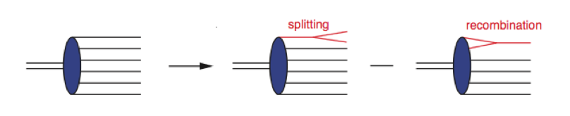
Beyond Nuclear Structure
Saturation
Eventually at low enough x
Cross-section will saturate
Equivalent to →
Can we see it at EIC?

Slide 12
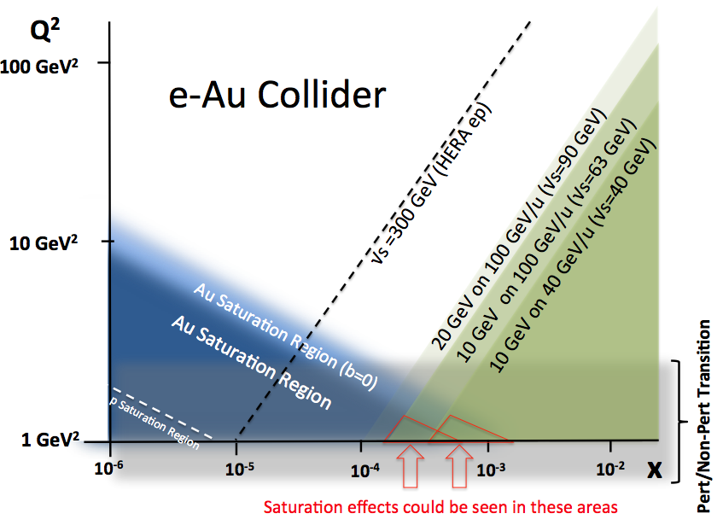
Saturation Regime and EIC
EIC kinematic reach for various scenarios
Two competing scales
Q_{s}(x) : Saturation Scale
Q₀ : Perturtative when Q > Q₀
Ideally, x such that Q_{s} >> Q₀
Difficult with EIC scenarios
A
Centrality
EIC has two knobs to turn
Investigate the on-set of saturation
multi-nucleon coherence → saturation

Slide 13
Jets, Hadronization
ν = E-E’ = 100-200 GeV to keep jet within nucleus
√s = 32-45 GeV for y=0.1 (keeping jet in the central region of the detector)

Slide 14
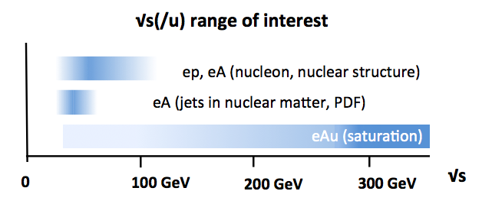
Designing The Right Probe: √s
What are the right parameters for the collider
for the EIC science program?
√s
EIC reach

Slide 15
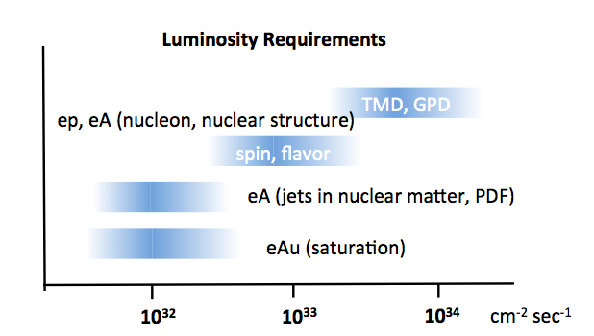
Luminosity Needed for Topics
HERA
Central mission of EIC (nuclear and nucleon structure) requires high
luminosity.
We need to design a EIC physics program: including how and when to upgrade the machine

Slide 16
JLEIC Energy Reach
E_{proton} > 100 GeV
Do nucleon, nuclear structure at 10⁻³ < x < 1 (see p.8,13)
jets, explore saturation
Baseline
12 GeV electron, 200 GeV proton (6T magnets)
Extend to x < 10⁻³, explore saturation further
if initial program indicates. (High proton energy
will compromise detector performance).
Being
looked at
16

Slide 17
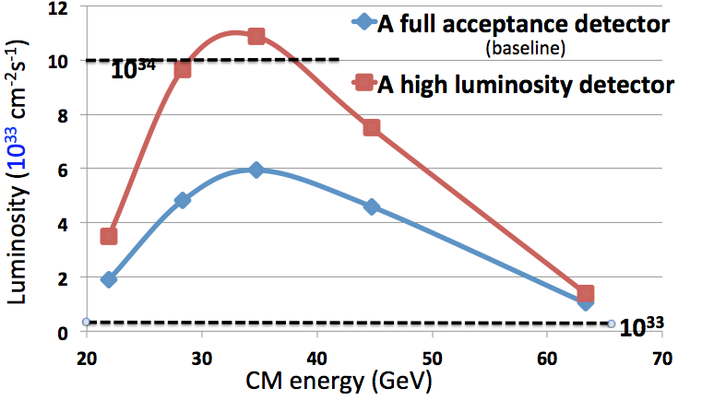
JLEIC Luminosity Reach
10³⁴
JLEIC baseline provides
high luminosity needed to
carry out the EIC physic program

Slide 18
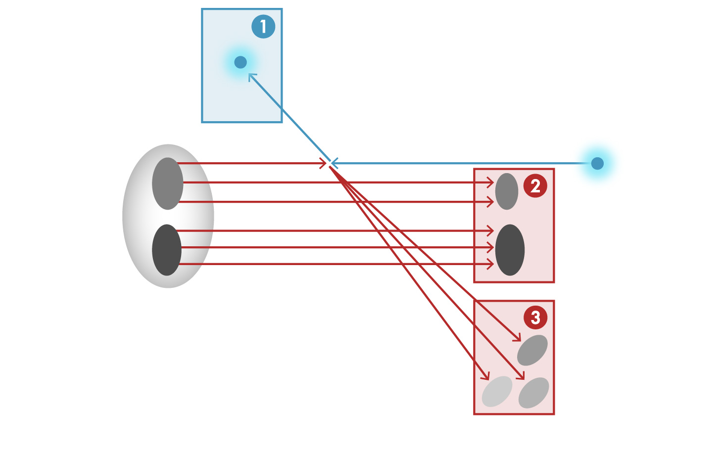

The Total Acceptance Detector
Scattered Electron
Beam Electron
Particles Associated with
Initial Ion
Beam Ion
Particles Associated with
struck parton
“Statistics”=Luminosity × Acceptance!!
EIC Physics demands ~100% acceptance for all final state particles (1,2, and 3)
is particularly challenging: 100% acceptance not usual concern at colliders.
Higher the Ion Beam energy, more difficult to achieve.

Slide 19




JLEIC IR & Detector Concept
Possible to get ~100% acceptance for the whole event
Central Detector/Solenoid
Ion beamline
Electron beamline
Dipole
Dipole
Forward (Ion) Detector
Total acceptance detector (and IR) is being designed. (also for variable beam energies).

Slide 20
Next steps for NP/EIC
NP/EIC community must further sharpen the message in support of EIC: (Up to now, we talked to the NP community. Now we talk to the community of scientists (National Academy of Sciences). Then to the public.
EIC physics program--i.e. how to execute the research at EIC to get the maximum science—still needs to be planned in detail. NP/EIC community must develop and reach consensus on what this plan is.
Laboratories (both BNL and JLab) need to take that science program and design an accelerator/detector plan to best serve that program.
Those laboratory plans will be the basis of the process of choosing where to ultimately build the EIC.

Slide 21
EIC and the future of NP
When the EIC is built, it will be the new NP machine for many decades.
EIC could revolutionize Nuclear Physics—but only if we build the right machine/detector.
It’s important that you get involved in thinking about and defining the EIC research program. If we do it right, this machine will enable fruitful and possibly revolutionary research for the 21st Century.

Slide 22
Jefferson Lab
Electron-Ion Collider (JLEIC)
Fulvia Pilat
For the JLEIC Accelerator Design Group
EIC Users Group Meeting
July 7, 2016

Slide 23
outline
Intro: energy, luminosity, polarization
JLEIC baseline design
Design and R&D highlights from last EICUG
JLEIC performance without bunched-beam electron cooling
Progress on project and site preparation
Plans for pre-CDR

Slide 24
Strategy for High Luminosity and Polarization
High Luminosity
Based on high bunch repetition rate CW colliding beams
KEK-B reached > 2x10³⁴ /cm²/s
However new for proton or ion beams
High Polarization
All rings are in a figure-8 shape
➔ critical advantages for both beams
  Spin precessions in the left & right parts of the ring are exactly cancelled
  Net spin precession (spin tune) is zero, thus energy independent
  Spin can be controlled & stabilized by small solenoids or other compact spin rotators
Beam Design
High repetition rate
Low bunch charge
Short bunch length
Small emittance
Excellent Detector integration
  Interaction region is designed to support
  Full acceptance detection (including forward tagging)
  Low detector background
IR Design
Small β*
Crab crossing
Damping
Synchrotron radiation
Electron cooling

Slide 25
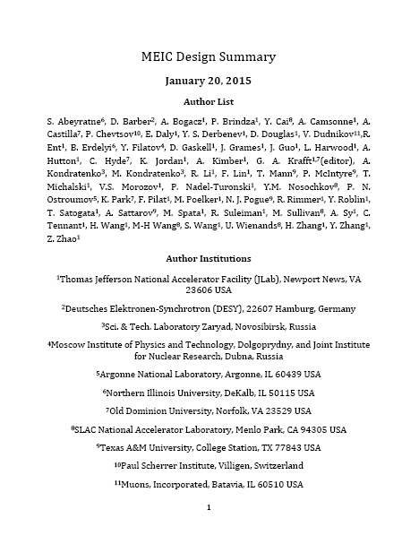
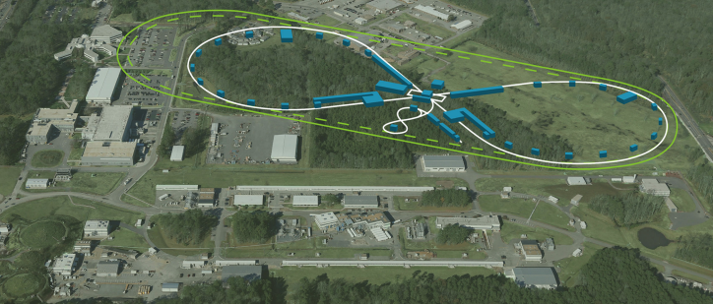
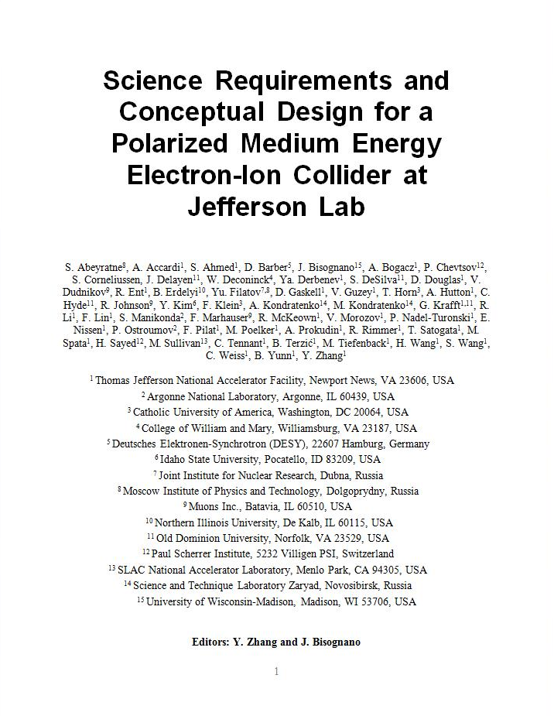

JLEIC Baseline
2012
2015
arXiv:1504.07961
arXiv:1209.0757
energy range:
e-: 3-10 GeV
p : 20-100 GeV
Cooling strategy:
DC cooler in booster
Bunched beam cooler in Ion collider ring

Slide 26
EIC design and R&D focus areas
Bunched beam electron cooling
ERL Cooler design (JLAB)
Magnetized source for e-cooler (JLAB LDRD, Cornell SBIR)
Bunched beam cooling experiment (JLAB, IMP)
Fast kicker for recirculator cooler (JLAB)
Magnets for the ion booster and collider
Super-ferric magnet R&D for 3T , prototype (Texas A&M, JLAB)
Super-conducting magnets design for 3T (LBL)
IR magnets design (Texas A&M, LBL)
SRF cavities and crab cavities
952 MHz crab cavity design, integration, prototype (ODU-JLAB)
952 MHz SRF cavities for cooler and ion collider: (JLAB)
Ion injector
SRF linac design, stripping, simulations (ANL, JLAB)
Evaluation warm vs. cold linac (MSU)
Interaction Regions and beam dynamics
IR design, detector interface, backgrounds, collimation (SLAC, JLAB)
Non-linear dynamics, corrections, DA (SLAC, JLAB)
Beam physics and modeling (JLAB, ODU, LBL, ANL, SLAC)

Slide 27
Single-pass ERL cooler
Ion Beam
1 Tesla Cooling Solenoid
De-chirper
Chirper
50 MeV Linac Cryomodule
Magnetized Gun
Booster
Beam dump
PARAMETERS
energy | 20–55 MeV
charge | 420 pC
linac frequency | 952.6 MHz
bunch length | 2 cm
gun voltage | 400 kV
solenoid field | 1 T
solenoid length | 2 x 30m
Close to reaching stable specification state
Space charge not a problem.
Spot sizes in the linac no longer a problems
Good progress on magnetized gun
Starting merger design

Slide 28
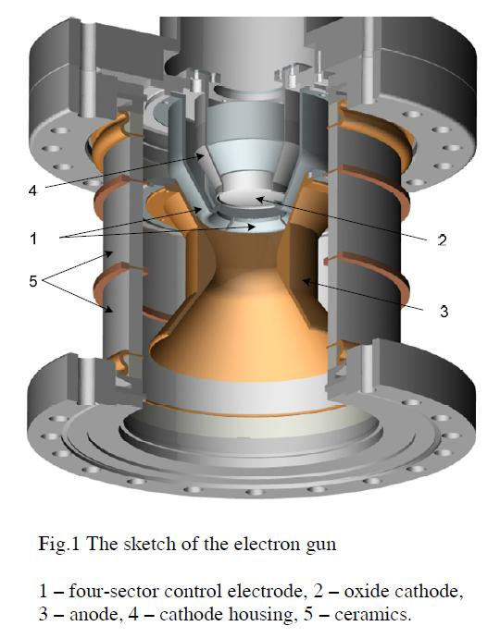
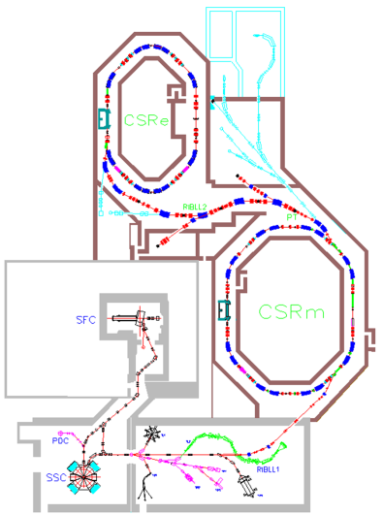
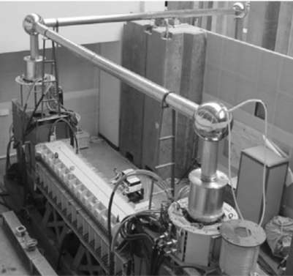
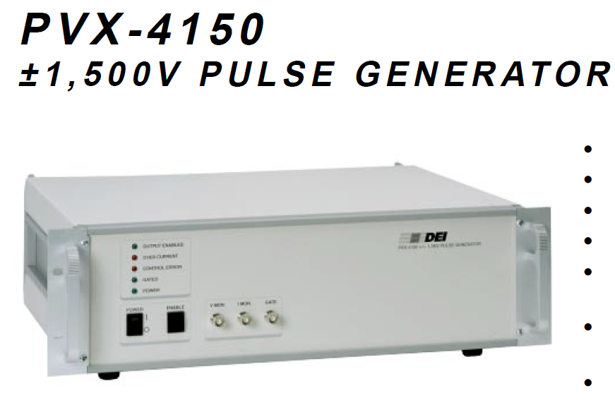
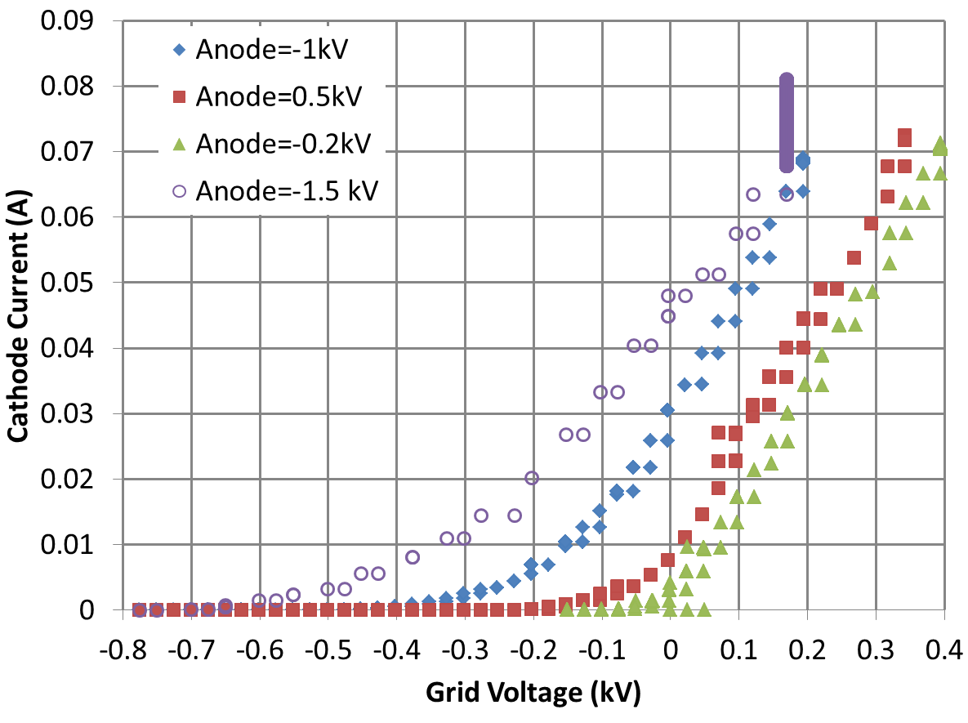
The bunched beam experiment at IMP
HIREL@IMP
Thermionic gun
A DC Cooler at IMP, China
The main power supply provides accelerating voltage of the thermionic gun
A grid electrode between the cathode and anode produces a negative electric field at the cathode edge for suppressing emission of electrons.
A pulser is connected to the grid electrode; changing the grid potential switches on/off the beam

Slide 29
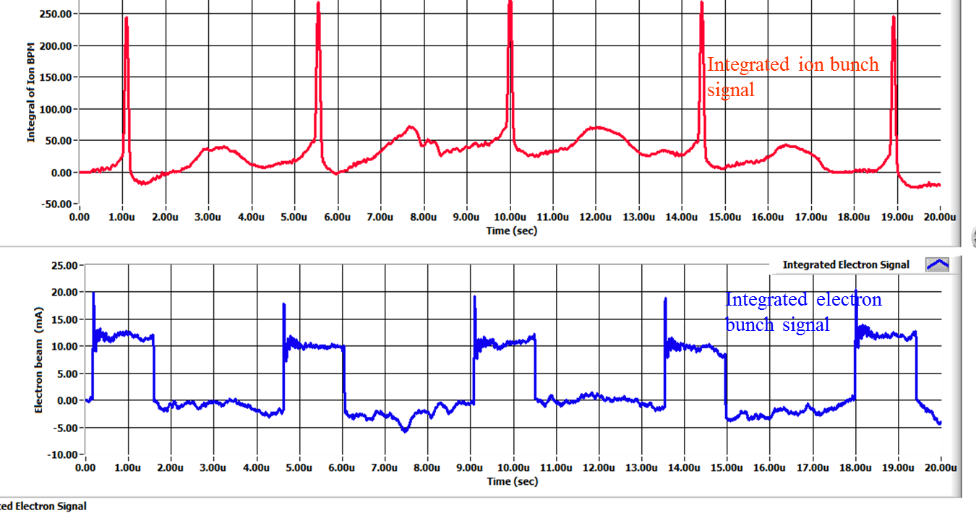
1st beam tests – preliminary results
A collaboration of JLAB and Institute of Modern Physics (IMP), China
The 1st experiment was carried out on May 17-22, 2016, at Lanzhou, China
A 7MeV/u ¹²C⁶⁺ ion beam stored in the IMP CSRm ring, either coasting or captured by 450kHz RF system (two long bunches)
Cooling of both coasting and bunched ion by a pulsed electron beam are observed: first successful step of experimental demonstration of bunched beam cooling
Data analysis both at IMP and JLAB is in progress
Initial 1D modeling with RF capture and bunching shows the ion cooling and synchrotron sideband effects, agree with experimental observations
Experiment data observation on BPMs
cooled ion bunches
uncooled ion bunches
Electron bunches 1.5μs

Slide 30
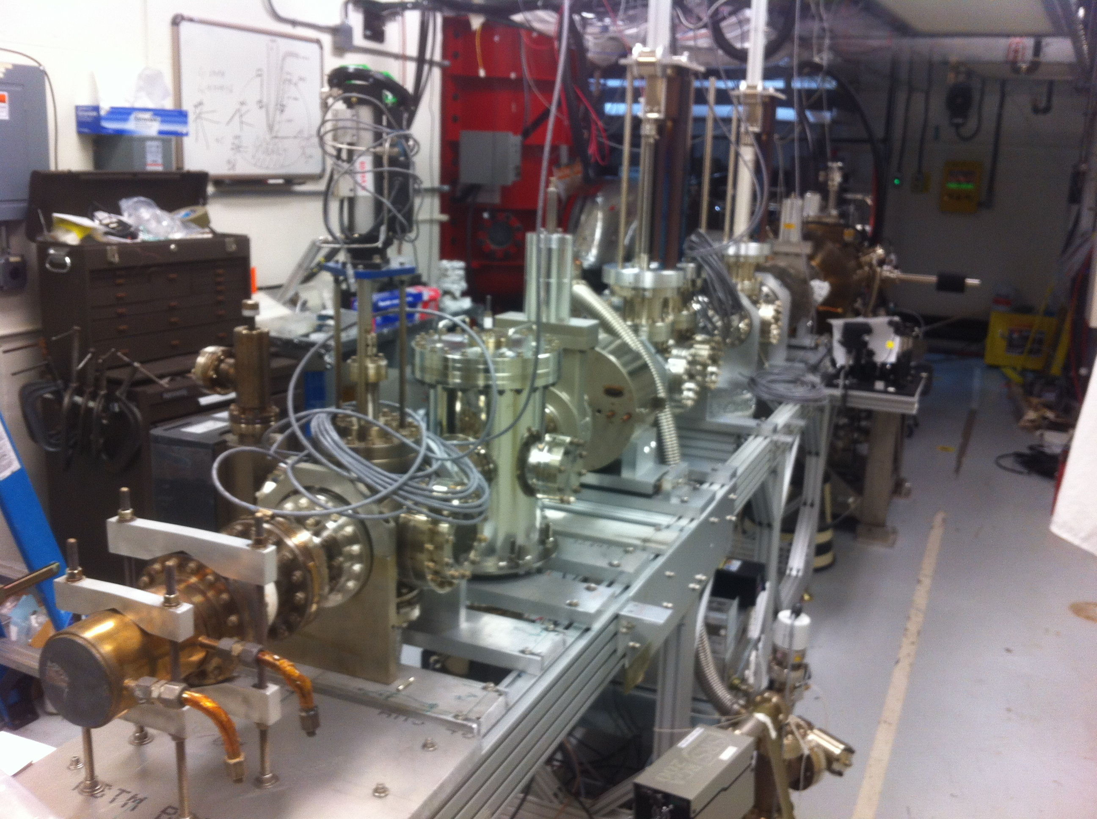
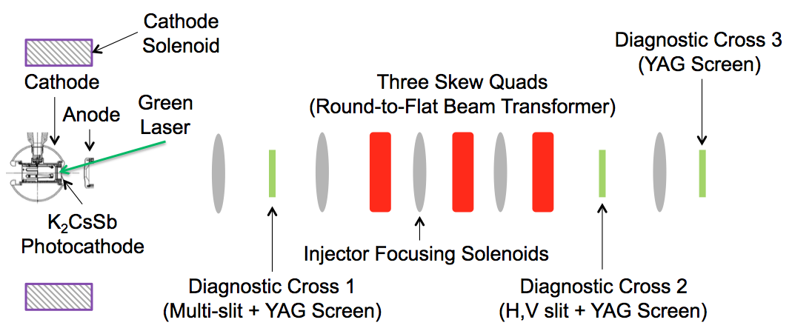
Source for Magnetized Cooling
Proposal awarded
JLAB 2016 LDRD
Bunch length | cm | 3
Repetition rate | MHz | 476
Bunch charge | pC | 420
Peak current | A | 4.2
Average current | mA | 200
Transverse norm. emitt. | μm | 10s
Emitting radius (a₀) | mm | 3
Solenoid field at cathode (B_{z}) | kG | 2
LERF
Test stand
Test: 32mA
Experimental set-up

Slide 31
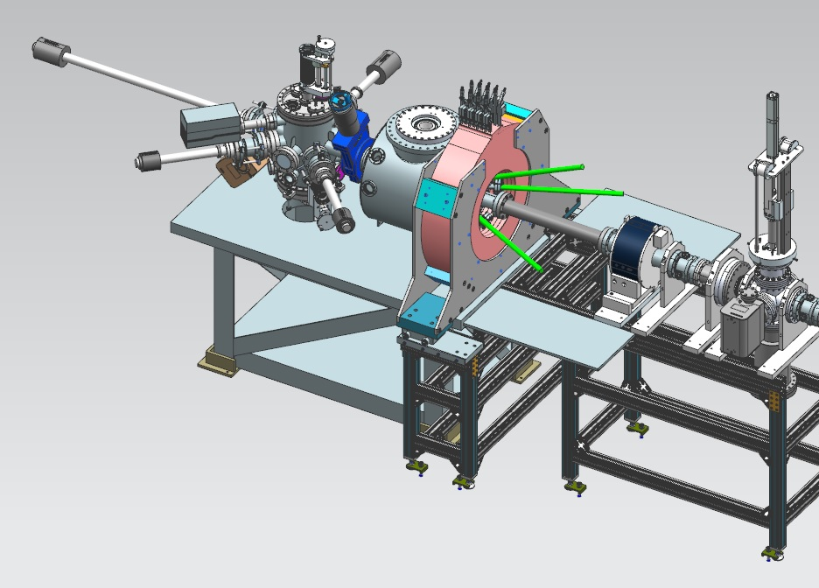
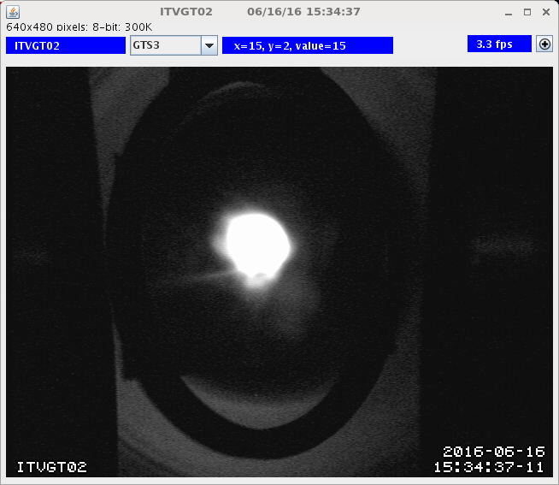
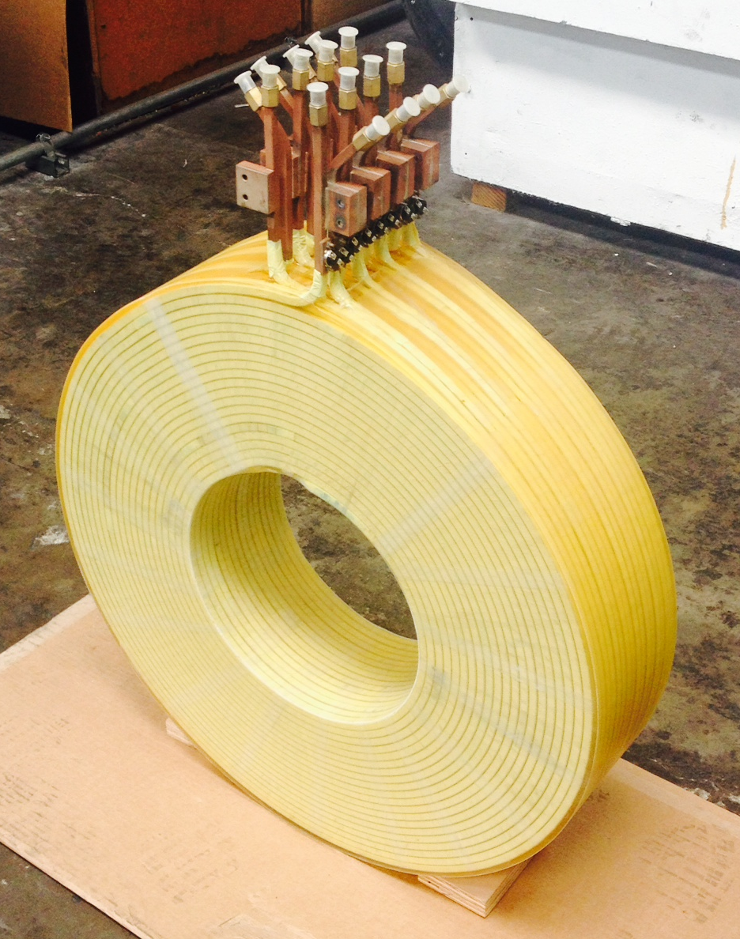
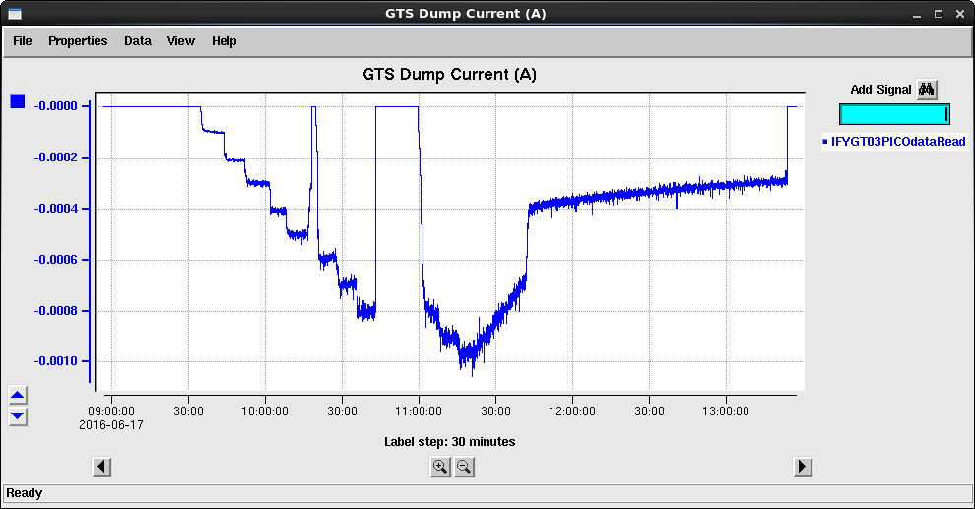
Source for magnetized cooling - progress
1 mA beam (non magnetized)
First magnetized beam:
first quarter FY17

Slide 32
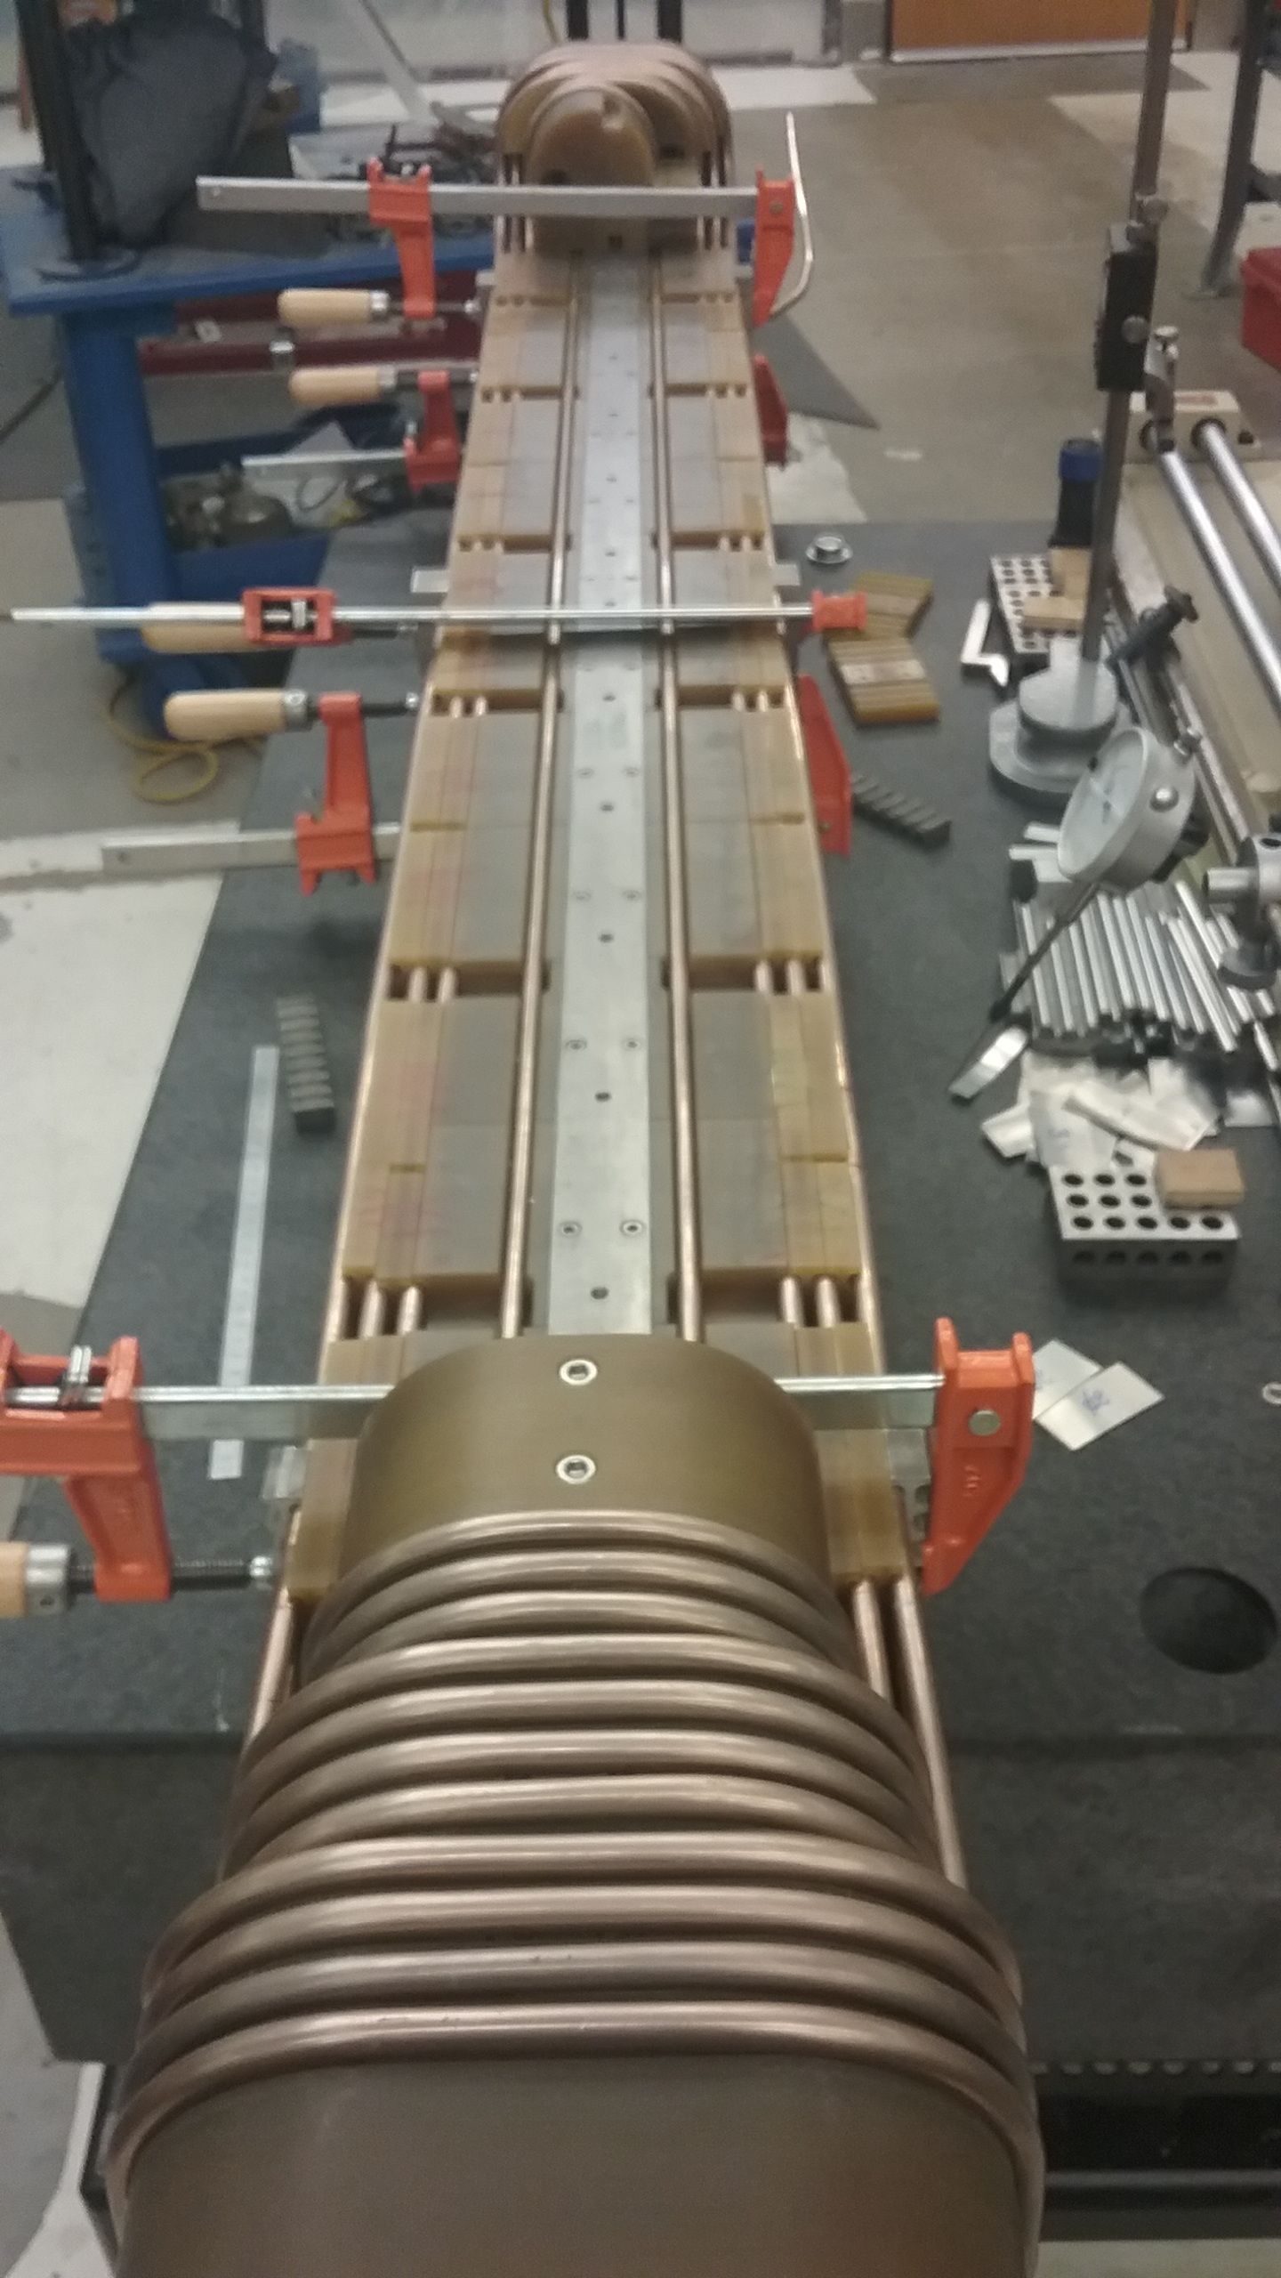
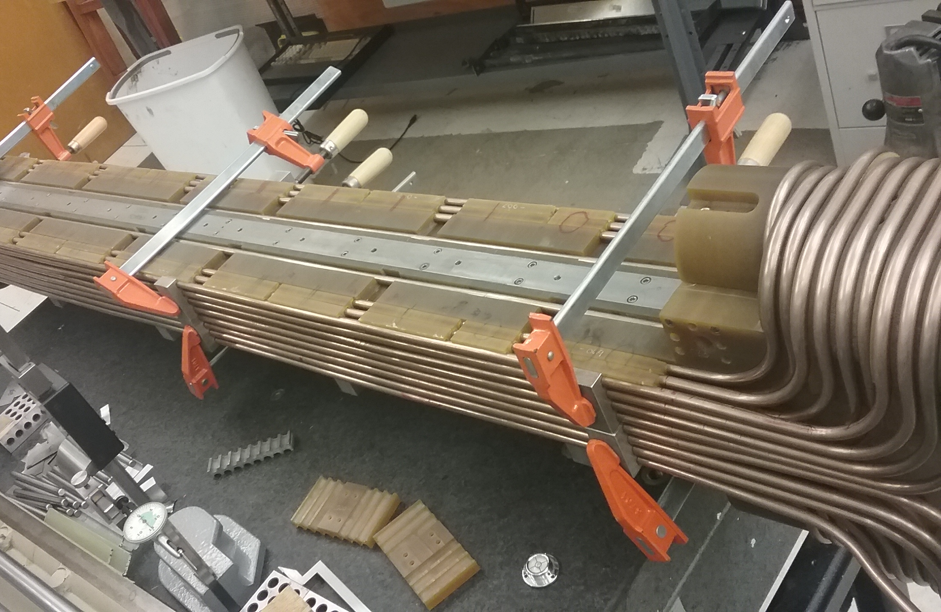
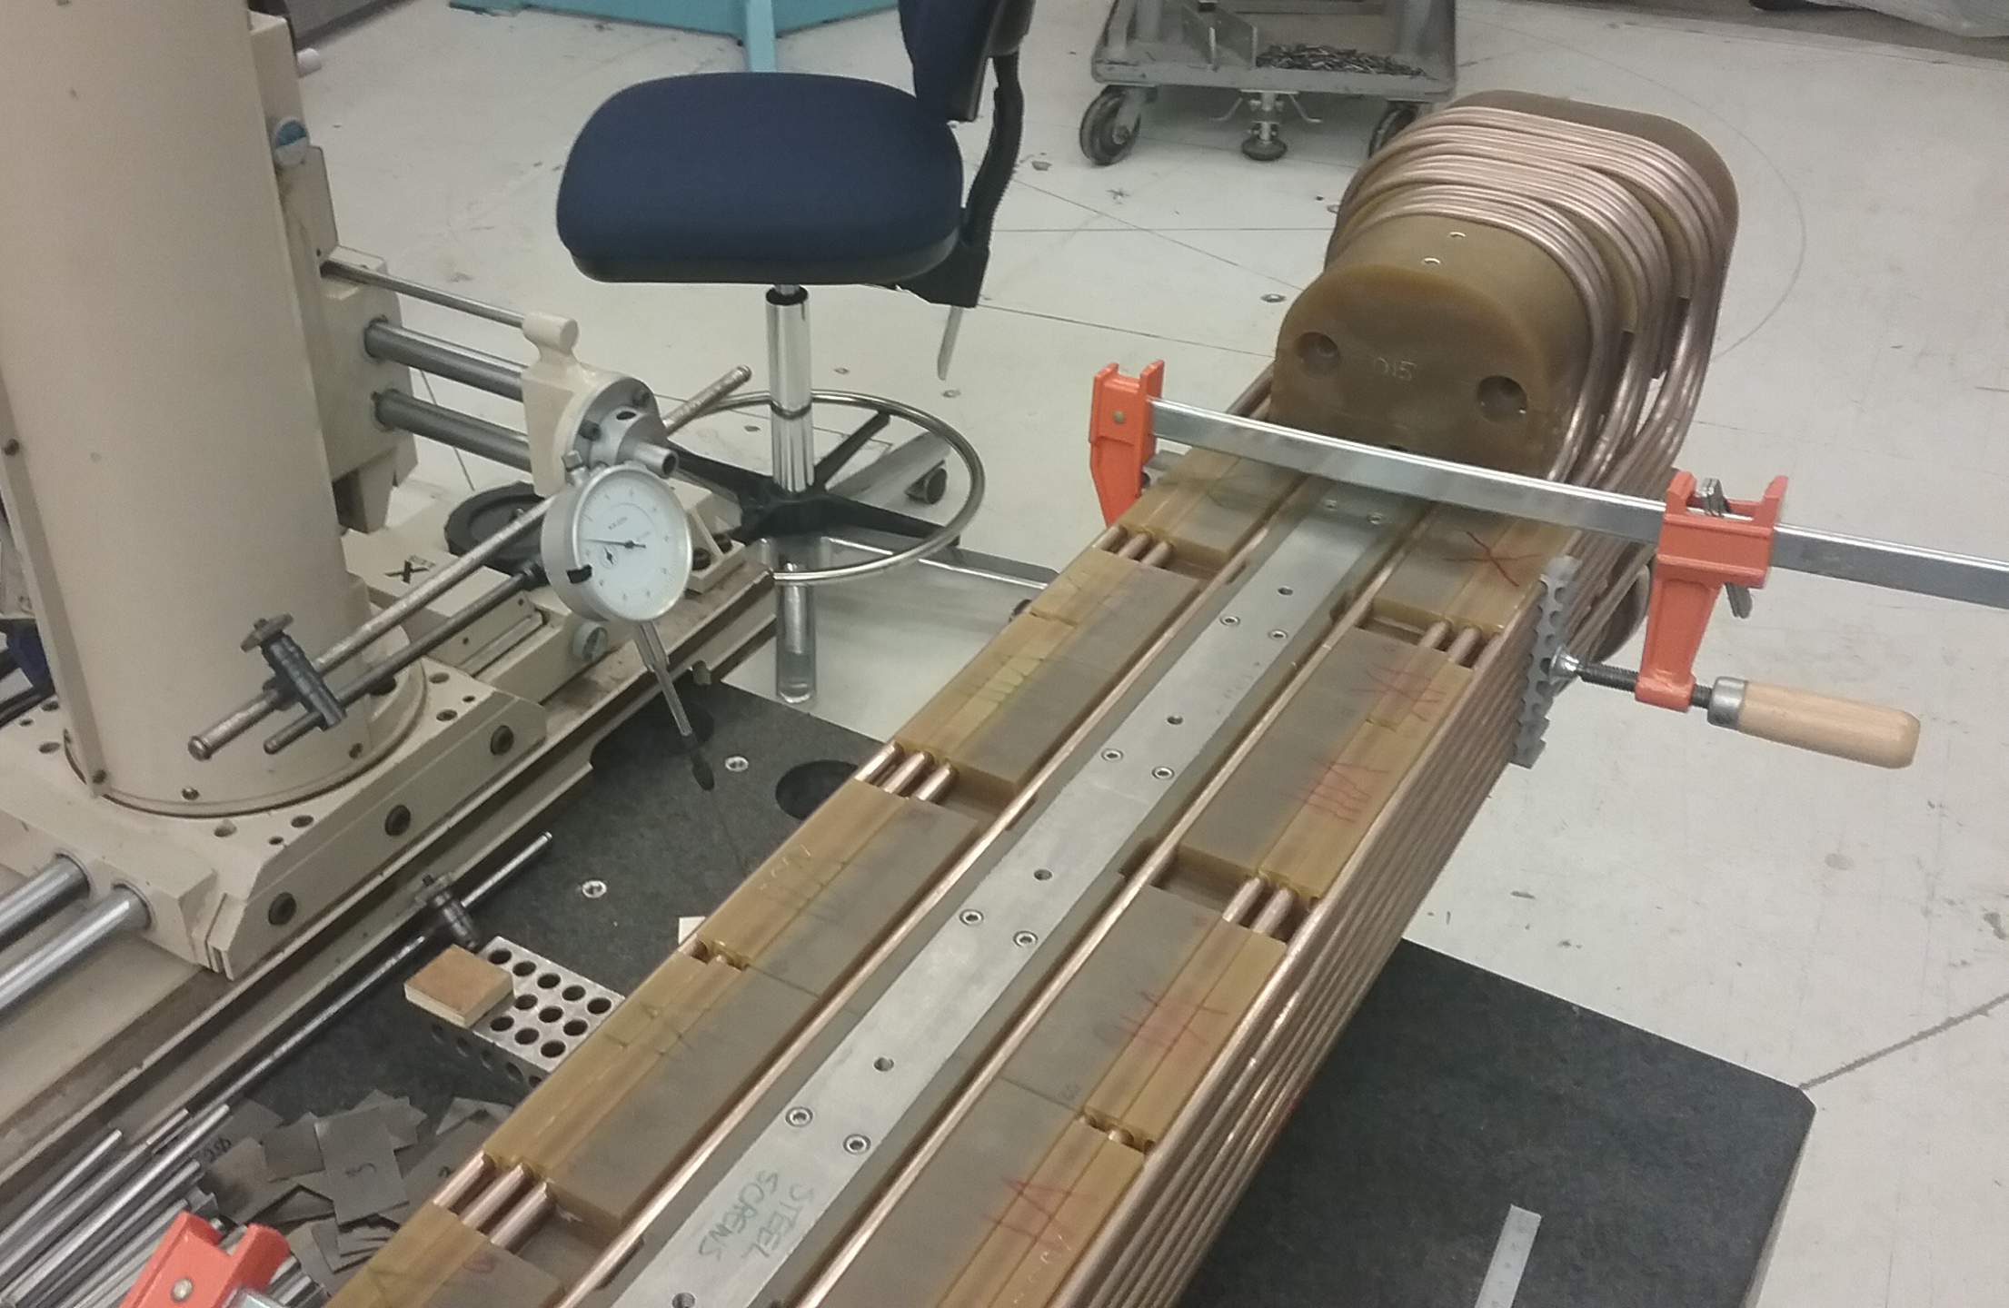
TAMU Super-ferric Dipole – Prototype Winding
Super-ferric magnets (3T):
Cost effective
Fast ramp rate
SF Magnet Core – SS Vacuum Chamber with G11 Coil Supports
24 Coils – Using representative copper tubing
Coil positions measured – resultant calculated multipoles are in spec
All bends made using motorized bending fixtures
Next Steps:
  Model Dipole with SC Cable-in-Conduit Conductor (CICC)

Slide 33
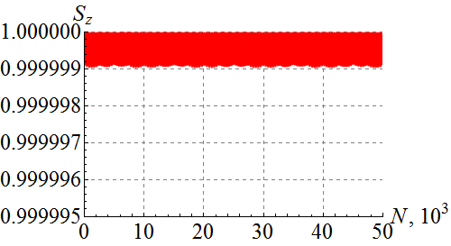
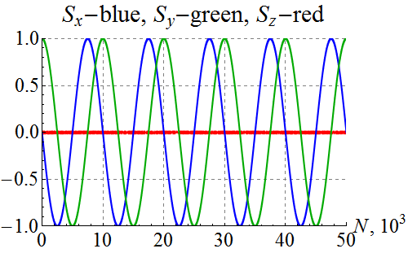
Spin tracking and polarization control in Figure 8
Verified ability of a 3D spin rotator to control the ion polarization in the JLEIC energy range
Calculated incoherent part of the resonance strength for protons and deuterons setting the limit on the 3D spin rotator strength
Calculated coherent part of the resonance strength for protons and deuterons using a statistical model
Compensated the coherent part of the resonance strength
Modeled a spin flipping system using a 3D rotator for protons and deuterons
All results obtained so far agree with earlier theoretical and analytical predictions
Deuteron in an ideal lattice with a 3D spin rotator launched with initially radial and vertical spins with 25/5 μm x/y offset at the IP

Slide 34
JLEIC performance without bunched beam cooling at collision
JLEIC strategy: DC cooler in Booster for emittance reduction
Bunched beam cooler at collision to cancel/reduce IBS
Evolution from “strong” to “weak” bb-cooling:
Cooling |  | Strong (with a circulator ring) |  | Weak (without a circulator ring)
 |  | p | e | p | e
Beam energy | GeV | 100 | 5 | 100 | 5
Collision frequency | MHz | 749.5 |  | 476
Particles per bunch | 10¹⁰ | 0.417 | 2.33 | 0.66 | 3.9
Beam current | A | 0.5 | 2.8 | 0.5 | 3
Polarization | % | > 70% | > 70% | >70% | >70%
Bunch length, RMS | cm | 1 | 1.2 | 1 | 1.2
Norm. emitt., vert./horz. | μm | 0.35 / 0.035 | 53.5 / 5.35 | 1 / 0.5 | 144 / 72
Horizontal and vertical β* | cm | 20 / 2 | 12 / 1.2 | 4/2 | 2.6/1.3
Vert. beam-beam param. |  | 0.015 | 0.031 | 0.006 | 0.014
Laslett tune-shift |  | 0.033 | Small | 0.01 | small
Detector space, up/down | m | 3.6 / 7 | 3.2 / 3 | 3.6 / 7 | 3.2 / 3
Hourglass(HG) reduction |  | 0.83 |  | 0.88
Lumi./IP, w/HG, 10³³ | cm⁻²s-¹ | 7.4 |  | 4.6
2012 MEIC Design Report
2015 MEIC Design Report

Slide 35
stores
Luminosity decay:
Emittance growth
Beam loss
Burn-out
Vacuum issues
etc

Slide 36
Luminosity Without Cooling During in Collision
2.8
Includes already ring filling time:
integrated = averaged x time

Slide 37
EIC Timeline
Activity Name | 2010 | 2011 | 2012 | 2013 | 2014 | 2015 | 2016 | 2017 | 2018 | 2019 | 2020 | 2021 | 2022 | 2023 | 2024 | 2025
12 GeV Operations
12 GeV Upgrade
FRIB
EIC Physics Case
NSAC LRP
NAS Study
CD0
EIC Design, R&D Pre-CDR, CDR
CD1(Down-select)
CD2/CD3
EIC Construction
pre-project
on-project
Pre-CDR
CDR
CD0 = DOE “Mission Need” statement; CD1 = design choice and site selection (VA/NY)
CD2/CD3 = establish project baseline cost and schedule

Slide 38
Project development
Integrated planning for design and simulation
Configuration management and control
parameter lists, lattices, element databases, nomenclature, documents
Pre-CDR
Site Development
Development of DoE 413.3 suite of documents
Refine cost estimate / TPC reduction
Funding profile
→ CDR

Slide 39
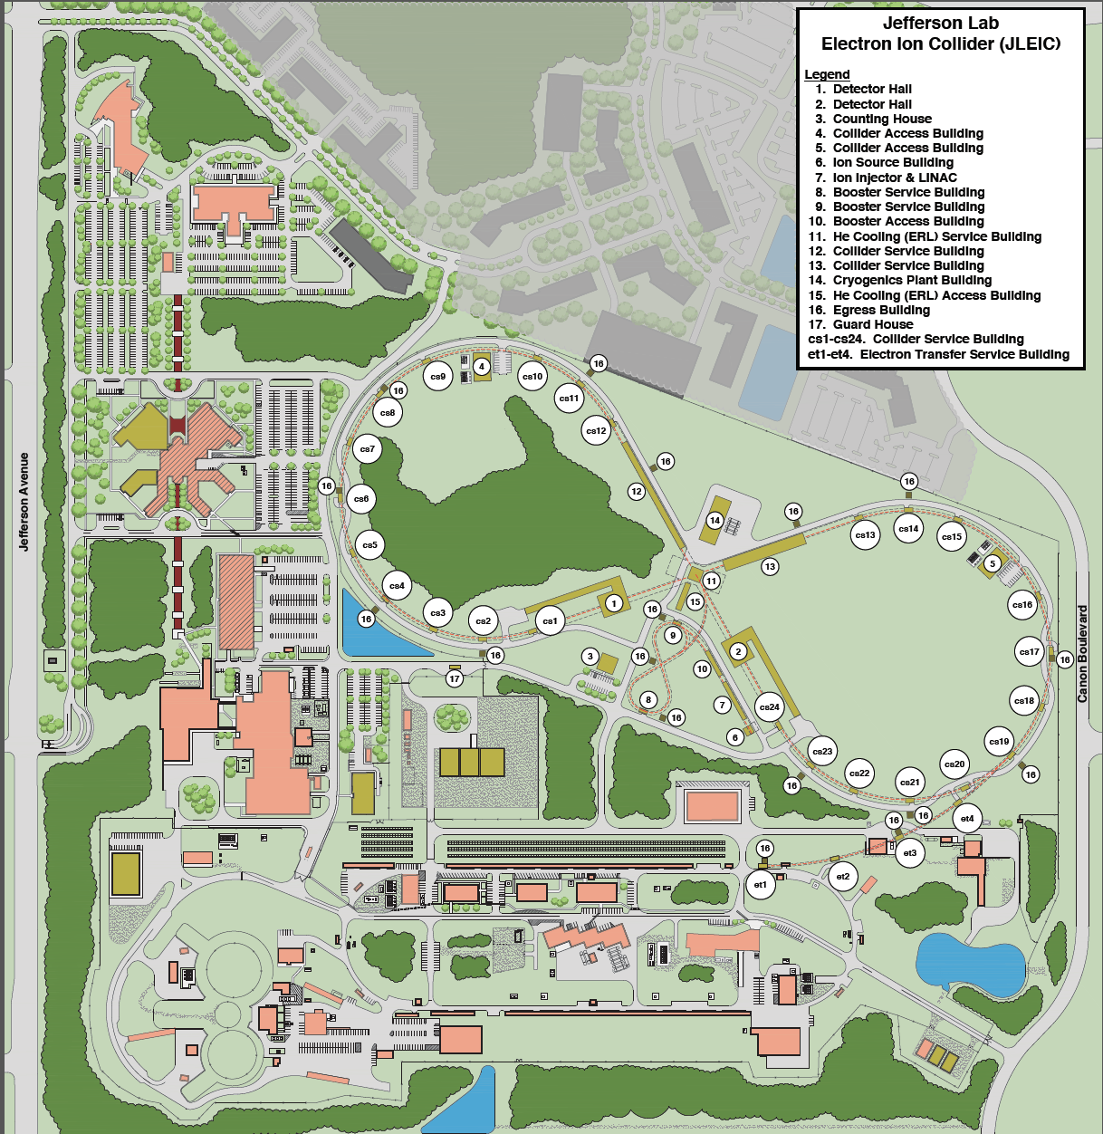
JLEIC site development
Cut-and cover and boring tunnel
options compared

Slide 40
Conclusion
The JLEIC design is driven by and optimized on physics requirements, is mature and low-risk
Design, R&D and project development are progressing well
Performance without the bunched beam cooler is good
Working towards project development and further cost reduction

