Slide 1
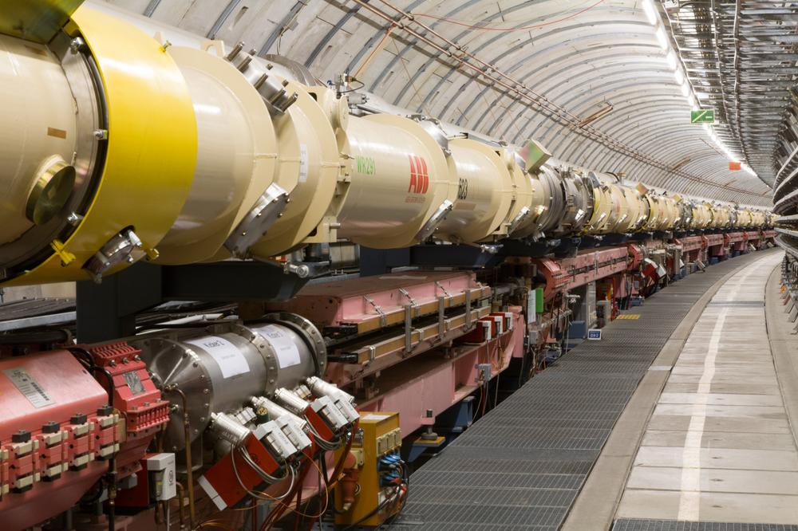
Lessons learned from HERA - the 1st ep Collider
José Repond
Argonne National Laboratory
EIC User’s Meeting
Argonne National Laboratory
July 7 – 9, 2016

Slide 2

Over the hill…

Slide 3
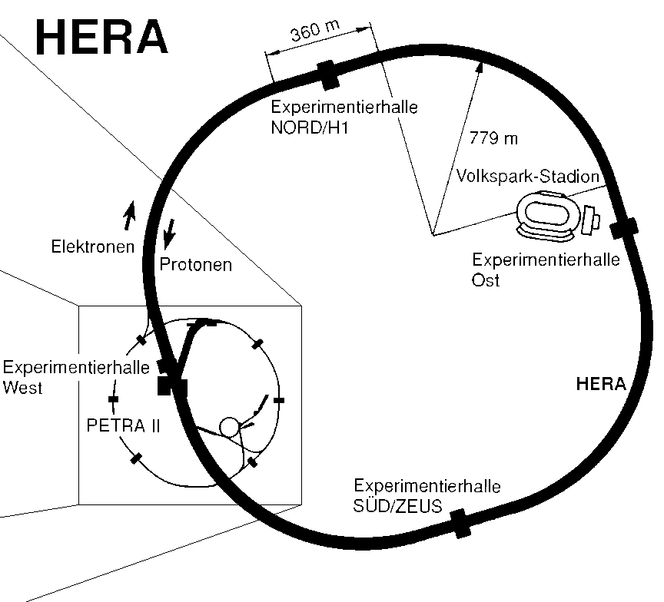

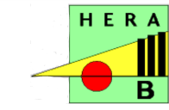

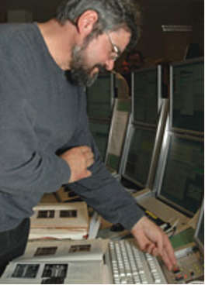

A quick reminder: What was HERA?
The one and only ep Collider (so far)
Electron/positron beam of 27.5 GeV
Proton beam of 820 → 920 GeV
Center of mass energy √s = 300 → 318 GeV
Location
Deutsches Elektronen Synchrotron DESY,
Hamburg, Germany
Operation
Started in 1992 (exactly on time!), ended in 2007
Experiments
Collisions: H1 and ZEUS
Electrons/positrons and gas jet target (polarized): HERMES
Protons and wire target: HERA-B

Slide 4
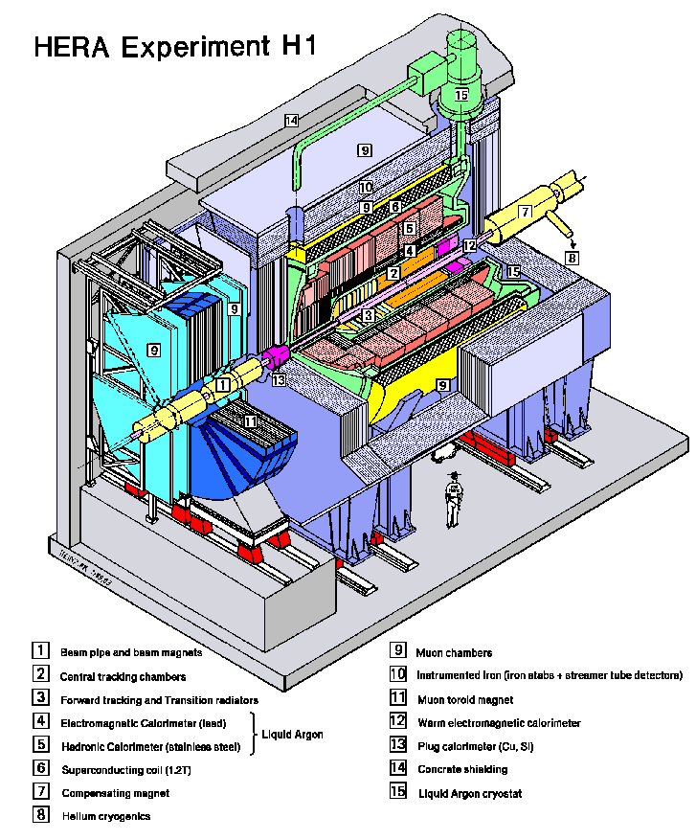
The Colliding Beam Experiments:
Multi-purpose 4π detector with
Charged particle tracking
Si - μVTX
Central drift chamber
Liquid Argon calorimeter
Rear Pb-scintillator plug
Muon chambers and more…

Slide 5

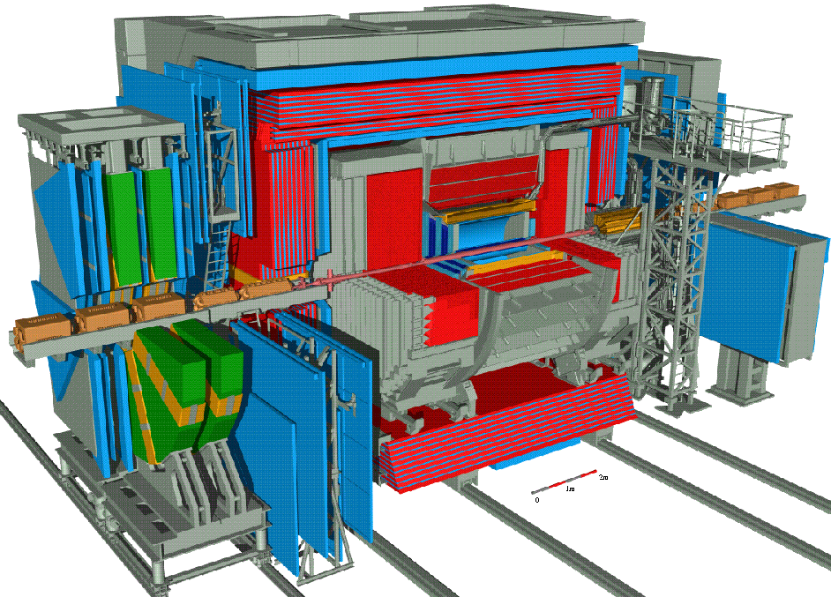
The Colliding Beam Experiments:
Multi-purpose 4π detector with
Charged particle tracking
Si - μVTX
Central drift chamber
Uranium-Scintillator calorimeter
Muon chambers and more…
Note: both detectors are asymmetric around the interaction point

Slide 6

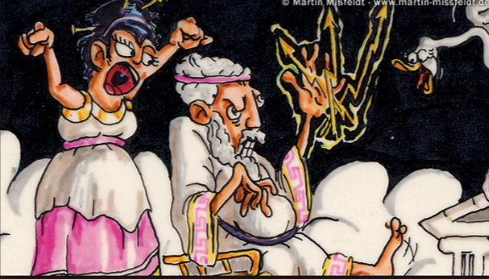
Acronyms
HERA
Hadron-Elektron Ring Anlage
H1
First experiment at HERA
H2 → ZEUS
Zero Experience with Uranium - Scintillator

Slide 7

Lessons learned from HERA…
Caveats
This is my personal view
I am/was more familiar with ZEUS, H1 was just as good
It’s been a long time – some details might not be accurate

Slide 8
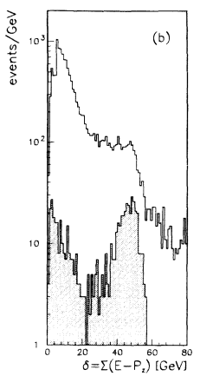
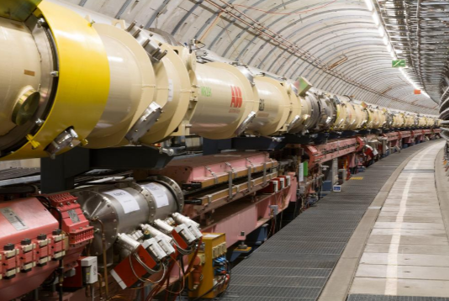
HERA was a complex/difficult collider
ZEUS
Phys Lett B 303(1993)183
HERA contained 2 machines
An electron machine
A proton machine
→ Need to collide the 2 beams
Backgrounds
Electrons radiate synchrotron radiation
Radiation deteriorates the vacuum
Protons interact with gas → beam-gas events
Useful variable
For DIS events …
(losses down the forward beam pine give a negligible loss)
Without
With timing cuts
Precise timing is important

Slide 9
Slow Start-up of HERA
H1, ZEUS detectors
Designed for High-Q² physics
The hope was to discover Lepto-quarks
DIS cross-section
High Q² requires high luminosity
Photoproduction
Real photons: Q² ~ 0
Study came as an afterthought, while waiting for the luminosity to improve
Design your detector to measure/do everything…

Slide 10
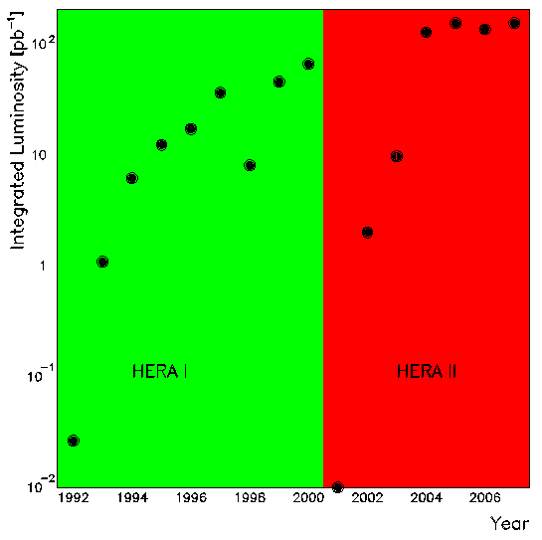
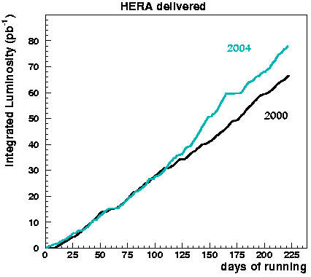
Luminosity upgrade
HERA I
CY 1992 – 2000
Integrated luminosity 193 pb⁻¹
Machine upgrade
CY 2000 – 2002
Decreasing proton beam size
Decrease electron beam size
(move quadrupoles closer and increase their strength)
HERA II
CY 2002 – 2007
Serious problems with synchrotron radiation/shields
Integrated luminosity 586 pb⁻¹
Not all upgrades are worthwhile

Slide 11
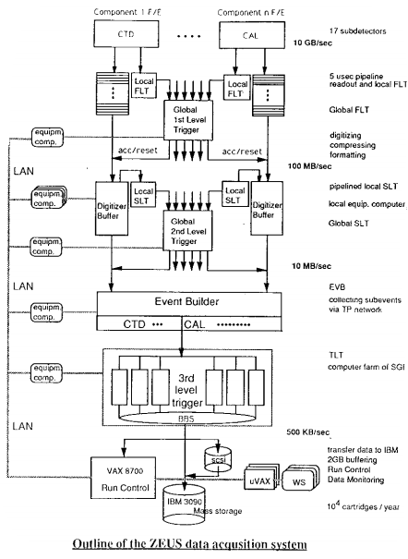
ZEUS Trigger System
Bunch crossings
Every 96 ns
The 3-level trigger system of ZEUS
- First level
Data stored in 5 microsecond pipeline,
clocked at 96 ns
Reduction from 100 kHz to 1 kHz
- Second level
Microprocessors analyze digitized data
Reduction from 1 kHz to 100 Hz
- Third level
Full event building
Analyzed by computer farm
Reduction from 100 Hz to 10 Hz
Invented by ZEUS and now being used at the LHC

Slide 12
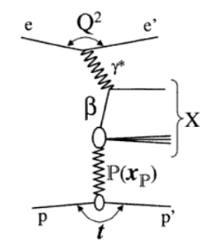
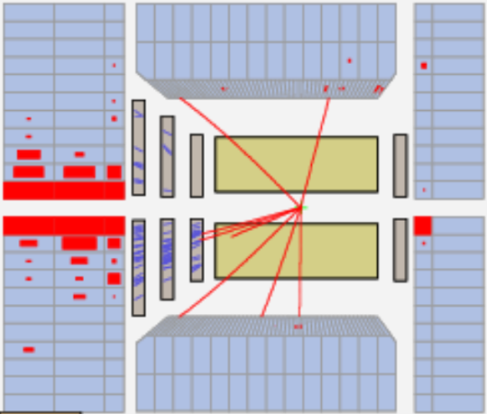
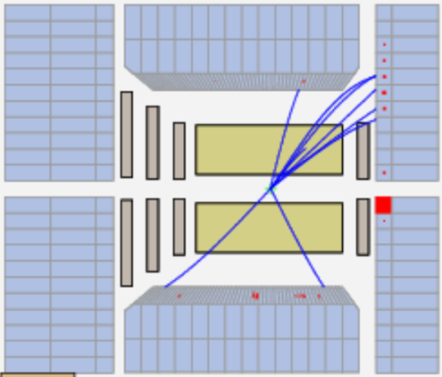
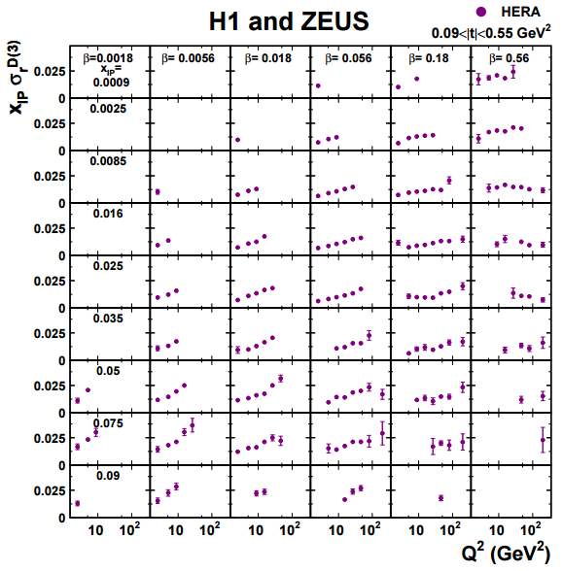
Expect the unexpected: Diffraction
Normal low-Q² DIS event
Low-Q² DIS event w/out p-remnant
Events without proton remnant
About 10% of all DIS events: totally unexpected!
Several methods to identify/measure
Rapidity gap, M_{X}, leading proton detection
Precision measurements
Diffractive structure functions

Slide 13
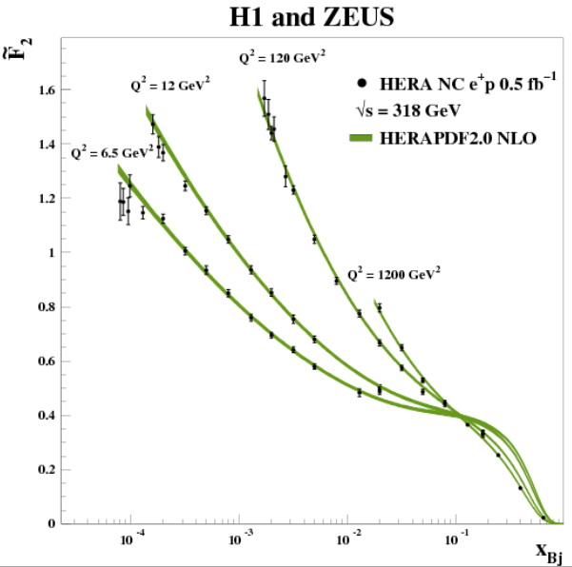
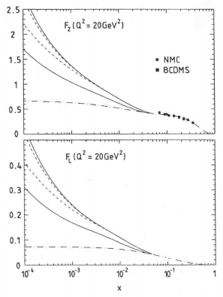
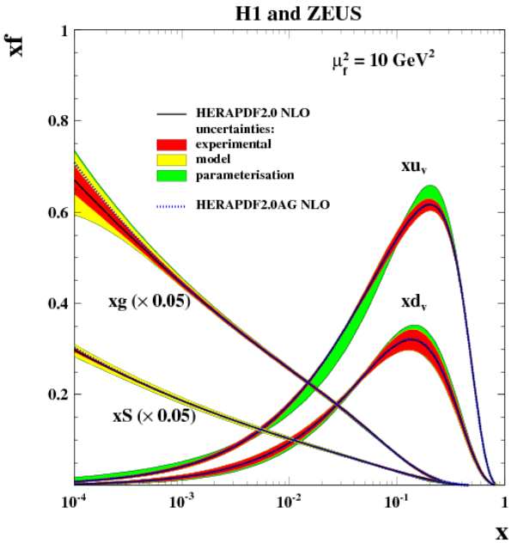
Expect the unexpected: Gluons at low-x
Pre-HERA knowledge of F₂
Limited to x > 5 × 10⁻²
Low x behavior totally unknown
Precise measurements at HERA
Pinned down low-x behavior
Spectacular increase of gluon density at low-x
Perhaps the most important result from HERA

Slide 14
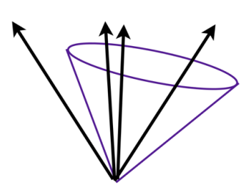
Jet Physics: Infrared safe jet algorithms
Hadronic jets
At collider energies, hadrons tend to cluster in ‘jets’
Jets reflect physics of underlying hard (parton) scattering
Various algorithms to define jets
Pre-HERA
Jet-physics at the colliders of the day (Tevatron,SppS, LEP, PEP, PETRA…)
Use of so-called ‘Cone Algorithm’
Group all particles together within a certain cone in η-φ space
Major disadvantage
Algorithm not infrared safe, i.e. soft and collinear divergencies do not cancel
Problem for theoretical calculations
Introduction of unphysical R_{sep} parameter
Precise comparison with theory → impossible

Slide 15
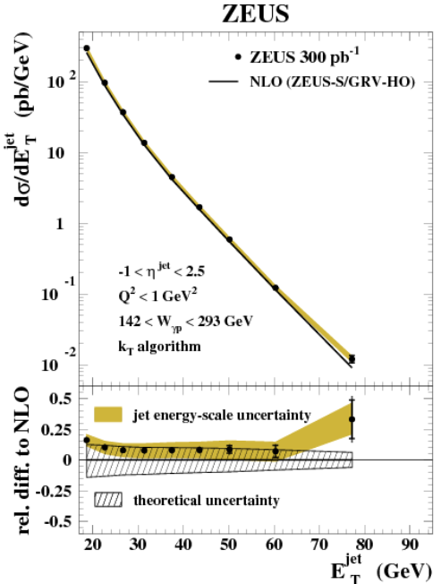
Jet Physics: Infrared safe jet algorithms
k_{t} Algorithms
Infrared safe (divergencies cancel)
Distance measures
Systematic studies by H1 and ZEUS
Comparison with fixed order NLO calculations
Precision jet physics is possible
→

Slide 16
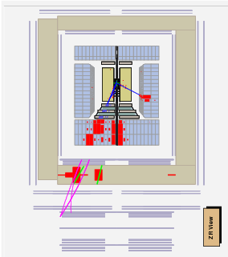
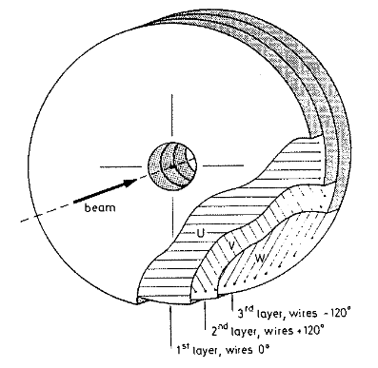
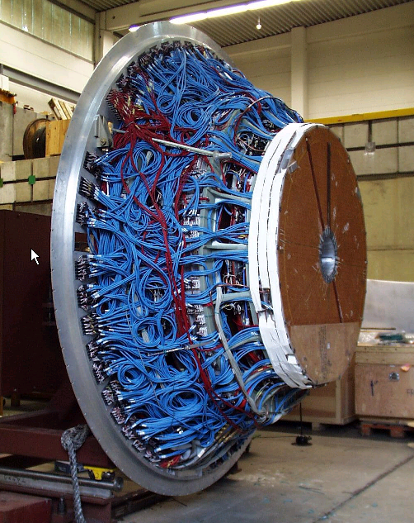
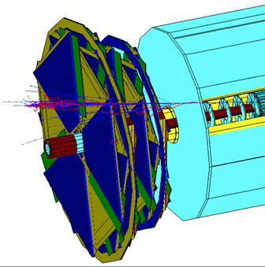
Forward detectors are challenging
Initial design
3 disk-like chambers
Drift cells with fixed wire orientations
→ Problems with occupancy!
Straw Tube Tracker
Implemented in 2001
Straws running tangentially to beam pipe
→ solved occupancy problem
Possibly first fully functional forward tracker
in a colliding beam experiment

Slide 17
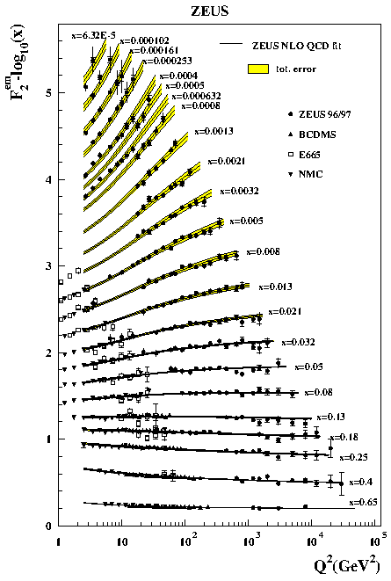
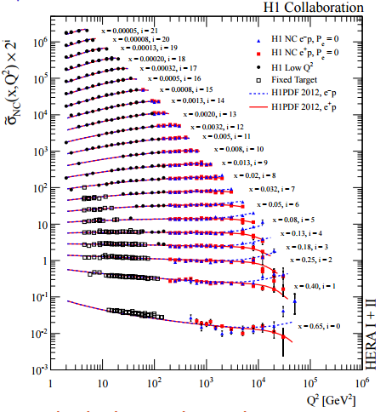
H1 versus ZEUS
Optimized for hadronic measurement: 35%/√E
Optimized for electron measurement: 12%/√E
Physics reach?
Despite different detector philosophy, comparable physics reach

Slide 18
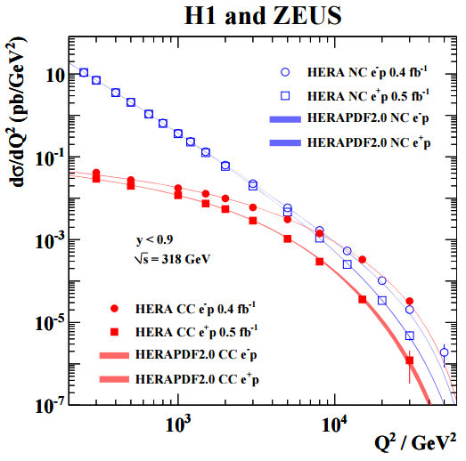
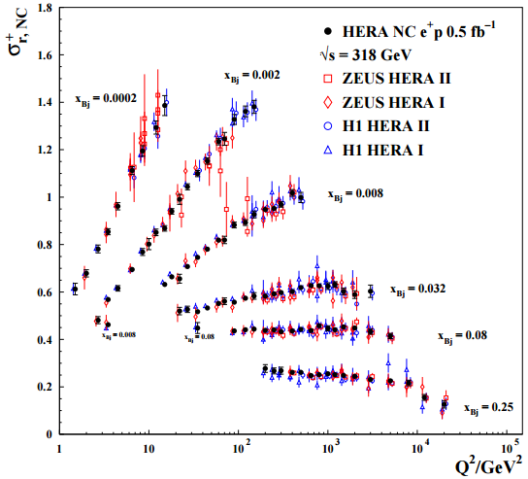
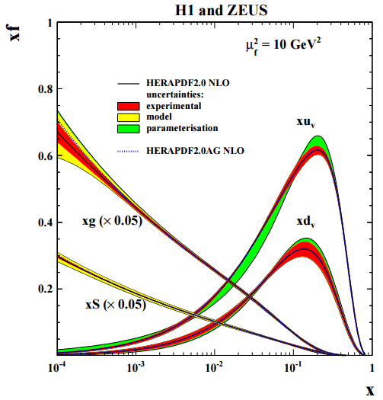
Combined H1 and ZEUS Results
7 combined papers since 2009
- Multi-Leptons with High Transverse Momentum
- Events with an Isolated Lepton and Missing Transverse Momentum…
- Combined Measurement and QCD Analysis of the Inclusive e⁺p …
- Combined Inclusive Diffractive Cross Sections…
- Combination and QCD Analysis of Charm Production Cross Section…
- Combination of Differential D^{*+} Cross-Section Measurements in…
- Combination of Measurements of Inclusive Deep Inelastic Scattering…
Useful to have 2 detectors with different systematic uncertainties: 1 + 1 > 2

Slide 19
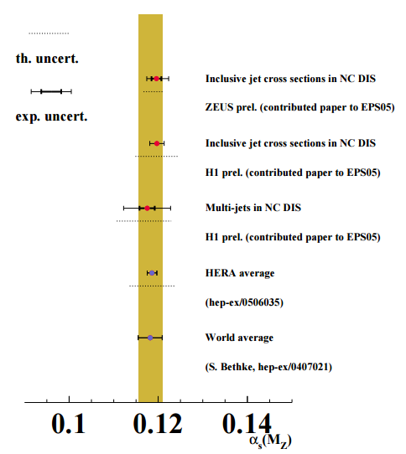
Commensurate Theory Effort Needed
Cost
HERA accelerator ~ $1B
HERA experiments ~ $0.5B
1 theorist <$0.0005B/year
Precision measurements
Diffraction
Jet production
….
Theoretical calculations
Lower precision
Often limiting factor

Slide 20

Conclusion

