Slide 1


BeAST Detector
(Brookhaven eA Solenoidal Tracker)
Alexander Kiselev for the BNL EIC taskforce
Argonne EIC User Group Meeting
Jul’2016

Slide 2
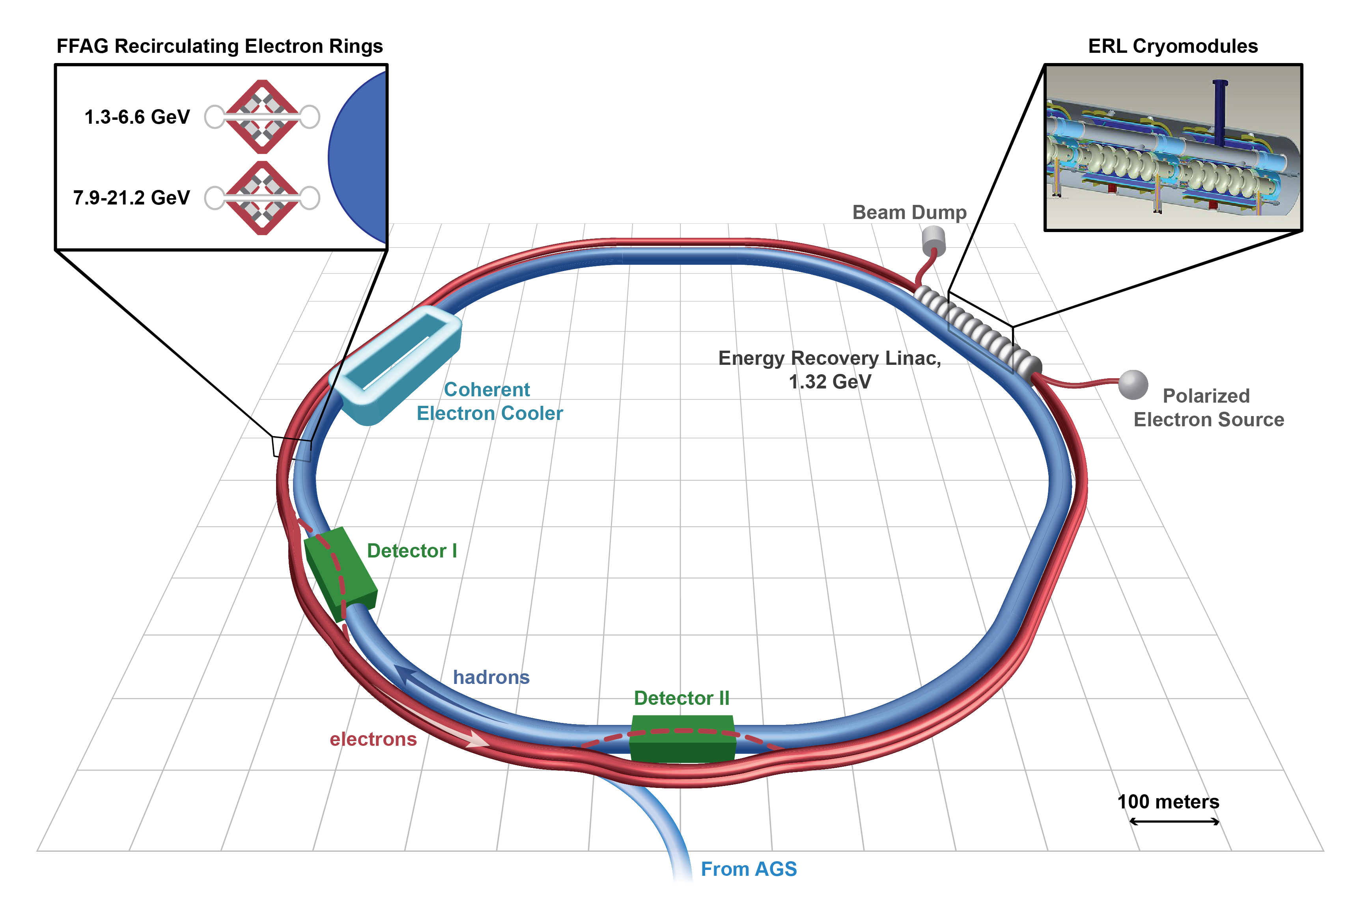
RHIC -> eRHIC upgrade proposal
Yesterday talk by
Vadim Ptitsyn
by 2025 convert RHIC to an electron-ion collider by adding ~21 GeV electrons to the existing hadron ring facility (arXiv 1409.1633)

Slide 3
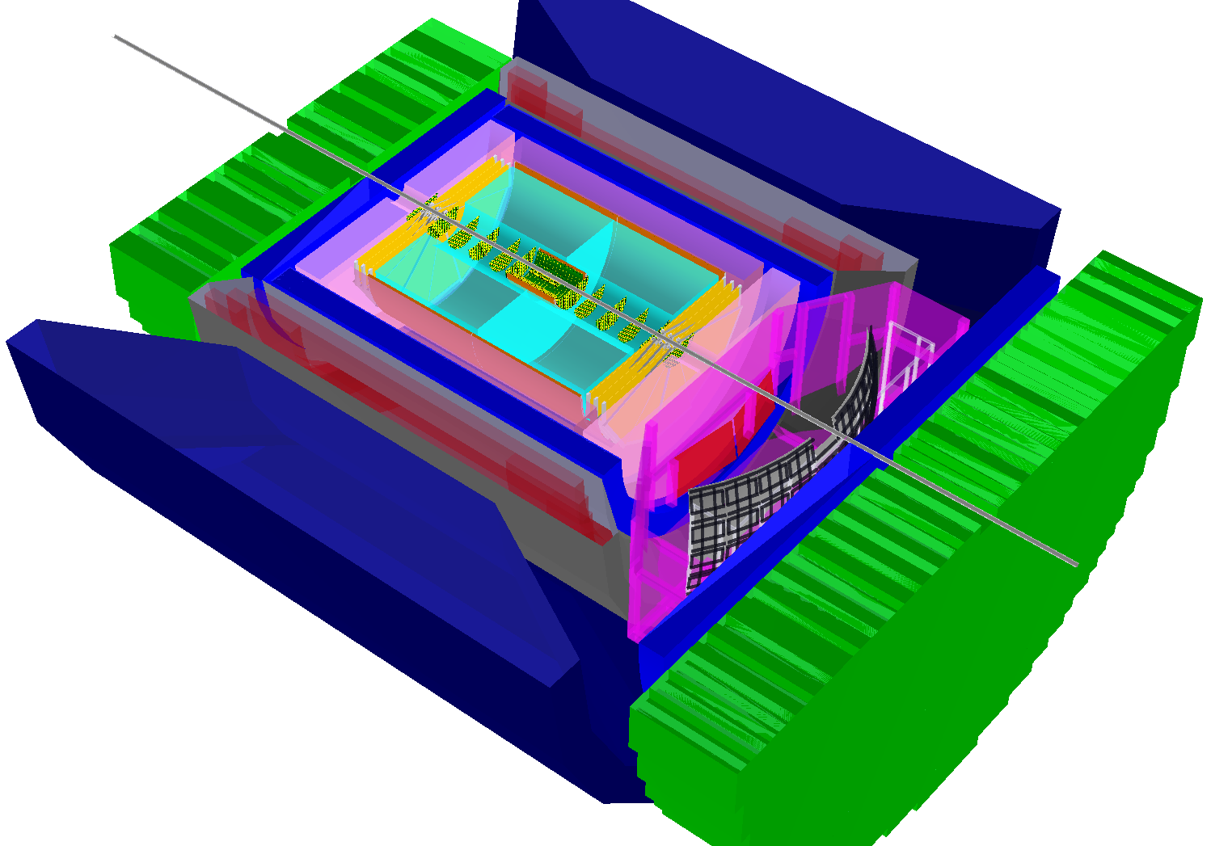
Two viable eRHIC detector options
Upgrade sPHENIX to ePHENIX
Build a new detector: BeAST (Brookhaven eA Solenoidal Tracker)

Slide 4


EIC physics program overview
Inclusive Reactions in ep/eA:
Physics: Structure Functions: g₁, F₂, F_{L}
→ Very good scattered electron ID
→ High energy and angular resolution of e’ (defines kinematics {x,Q²})
Semi-inclusive Reactions in ep/eA:
Physics: TMDs, Helicity PDFs, FFs (with flavor separation); di-hadron correlations; Kaon asymmetries, cross sections; etc
→ Excellent hadron ID: p±,K±,p± separation over a wide {p, η} range
→ Full Φ-coverage around γ*, wide p_{t} coverage (TMDs)
→ Excellent vertex resolution (Charm, Bottom separation)
Exclusive Reactions in ep/eA:
Physics: DVCS, exclusive VM production (GPDs; parton imaging in b_{T})
→ Exclusivity (large rapidity coverage; reconstruction of all particles in a given event)
→ High resolution, wide coverage in t → Roman pots
→ (eA): veto nucleus breakup, determine impact parameter of collision
→ Sufficient acceptance for neutrons in ZDC
e’
e
γ, π,J/Ψ
γ_{L}*
(Q²)
x+ξ
~
x-ξ
~
H, H, E, E (x,ξ,t)
p
p’
t

Slide 5
Detector and IR requirements “short list”
The more close to 4π acceptance the better
Low material budget
Reasonably high momentum resolution
Reliable electron ID
Good π/K/p separation
High spatial resolution of primary vertex
Ability to reconstruct jets
Close-to-beam-line acceptance detectors in order to register:
recoil protons
low Q² electrons
neutrons in hadron going direction
Luminosity and polarization measurement
acceptance
performance
IR interface
backgrounds

Slide 6
Lepton kinematics and (x,Q²) coverage
Q² > 1.0 GeV²: rapidity coverage -4 < η < 1 is sufficient
Q² < 0.1 GeV²: a dedicated low-Q² tagger is required
Increasing lepton beam
energy: scattered lepton
is boosted to negative η
low y-coverage limited by
E’_{e} resolution
-> use hadron or double angle
method to reconstruct event
kinematics

Slide 7
DVCS photon kinematics
Cuts: Q²>1 GeV, 0.01<y<0.85
EmCal pseudo-rapidity coverage -4 < η < 1 is sufficient
Also notice: increasing hadron beam energy influences max. photon energy at fixed η – photons are boosted to negative rapidities (lepton direction)

Slide 8
SIDIS: kinematic coverage for pions
Cuts: Q²>1 GeV², 0.01<y<0.95, p>1GeV
(no difference between π±, K±, p±)
-> -3.5 < η < 3.5 covers entire kinematic region in p_{t} & z important for physics

Slide 9
SIDIS: kinematic coverage for pions
Cuts: Q²>1 GeV², 0.01<y<0.95, z>0.1
(π±, K±, p± look similar )
Increasing lepton beam energy boosts hadrons
more to negative rapidity
Increasing hadron beam energy influences max. hadron energy at fixed η
-> except for the highest η values (1.5 < η < 3.5 range) hadron PID below ~5 GeV/c is sufficient

Slide 10
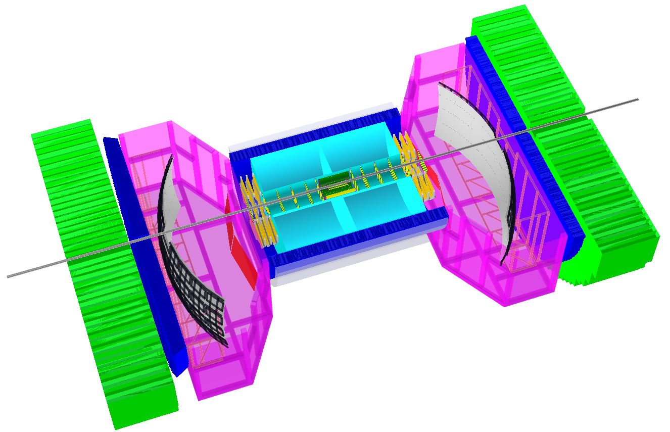
BeAST detector layout
hadronic calorimeters
e/m calorimeters
RICH detectors
9.0m
electrons
Obsolete as of DIS 2016
hadrons
silicon trackers
TPC
GEM trackers
3T solenoid coils

Slide 11
BeAST detector layout
-3.5 < η < 3.5: Tracking & e/m Calorimetry (hermetic coverage)
hadronic calorimeters
e/m calorimeters
RICH detectors
9.0m
hadrons
electrons
silicon trackers
TPC
GEM trackers
Micromegas barrels
3T solenoid cryostat
magnet yoke

Slide 12
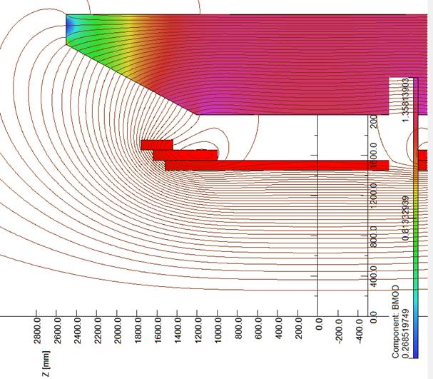
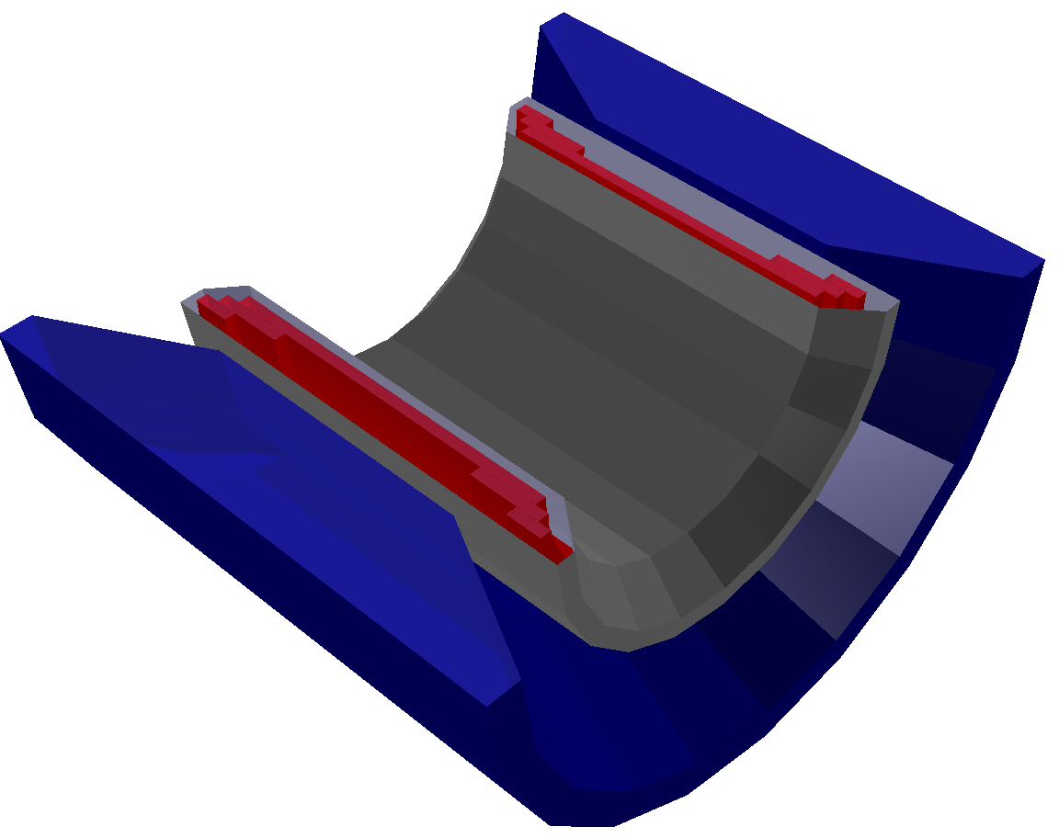
Superconducting solenoid
Goal:
Implement in the same compact design:
homogeneous ~3T field in the TPC
hadron-track-aligned field in the RICH
Keep it simple (no dual solenoid configuration; no reversed current coils; no flux return through HCal; no warm coils between EmCal and HCal)
η = 1.0
η = 1.5
RICH
location
TPC volume
η = 3.5
Field variation in TPC volume
Central field | 3T
Current density | 23 A/mm²
Full current | 4.6 kA
Main coil radius | 1500 mm
Coil pack length | 3520 mm
Cryostat inner radius | 1350 mm
+/- 4% or so

Slide 13
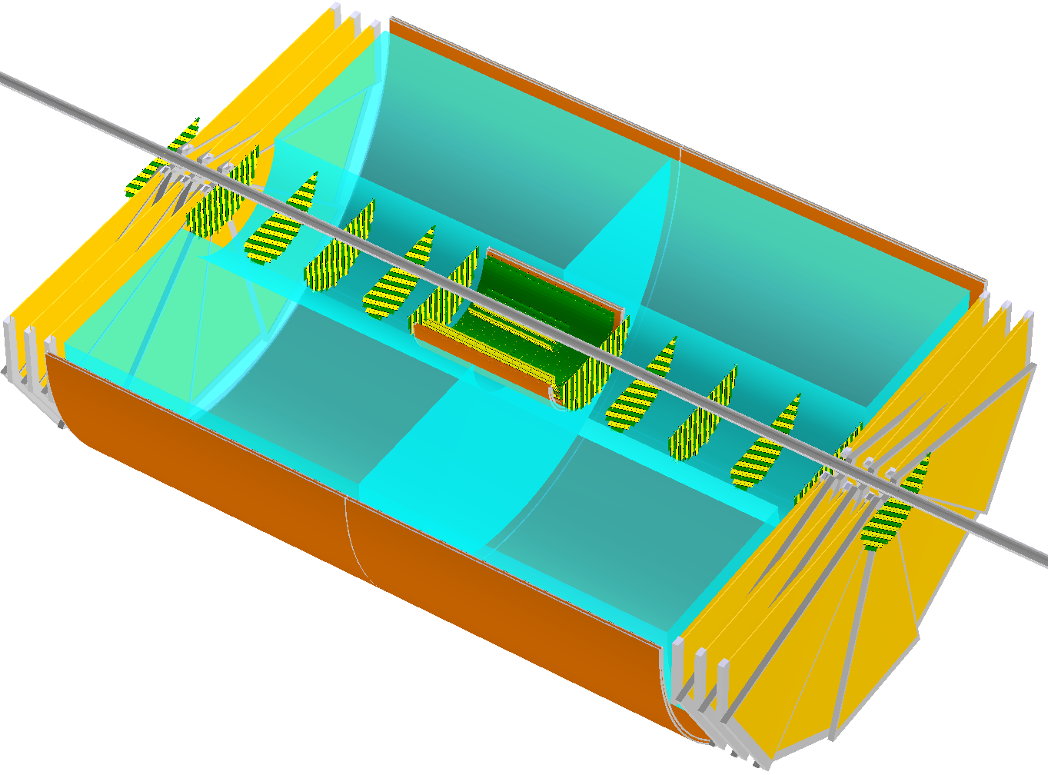
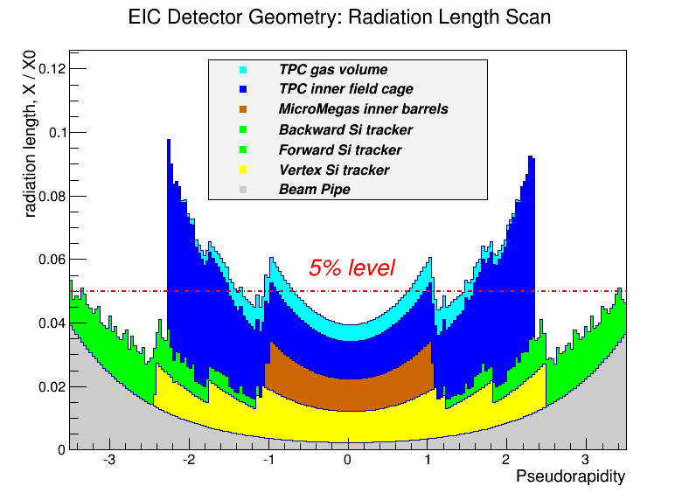
Tracker performance & properties
Radiation length scan (inner tracking elements only)
Momentum resolution
~2.0m
High redundancy
Material budget ~5% rad.length or so
Pretty much “basic” components
π⁺
H1 : 0.6%*P_{t} + 1.5%
ZEUS : 0.5%*P_{t} + 1.5%

Slide 14
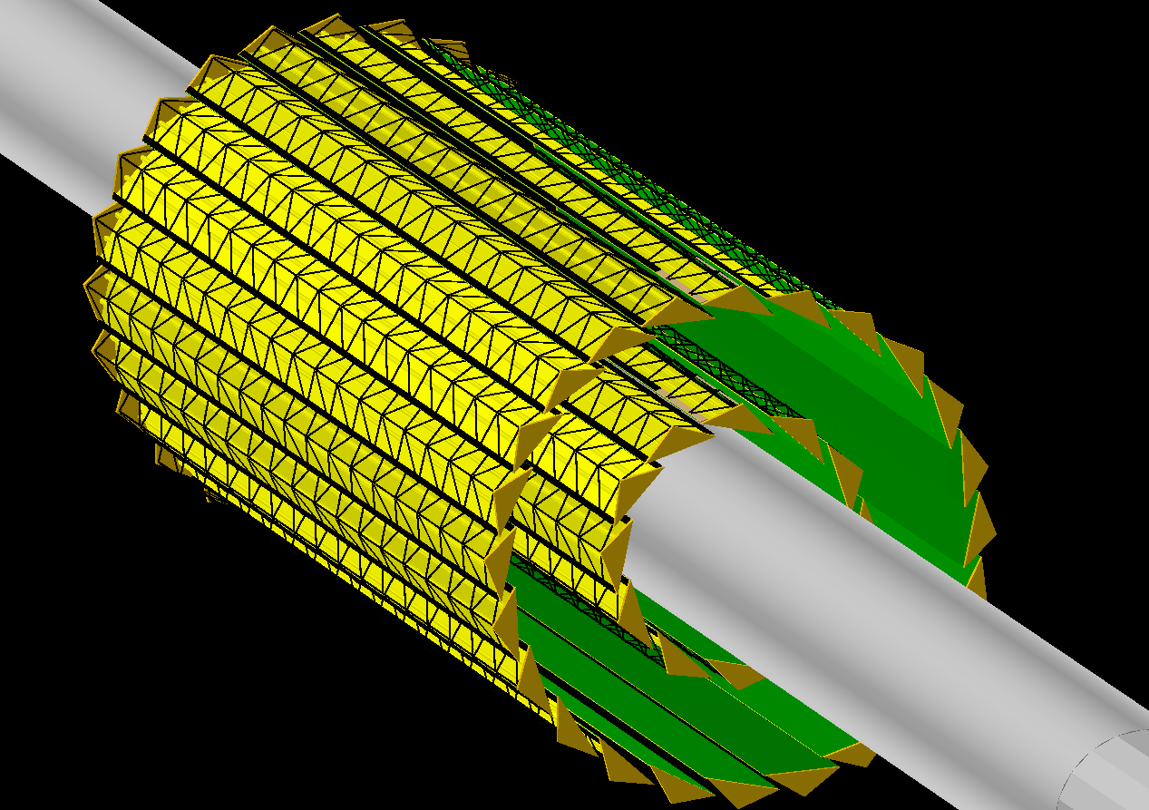
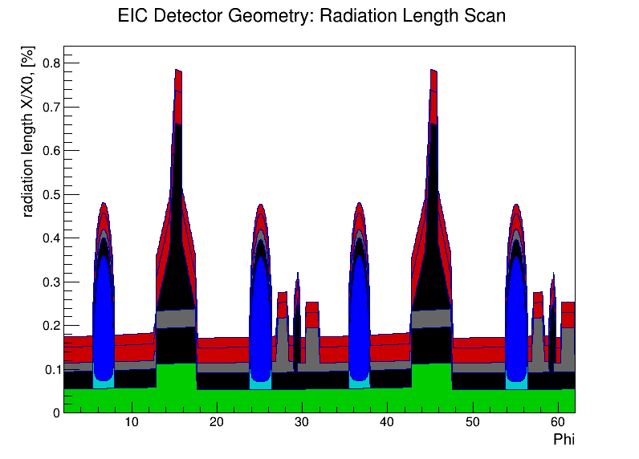
Silicon Vertex Tracker
ALICE ITS design
Two innermost layers
2x2 barrel layers with high resolution MAPS
assume discrete 20x20 μm² pixels and ~0.3% X₀ per layer
~180 mm
The prototype (ALICE ITS TDR page)
EicRoot radiation length scan (single layer)

Slide 15
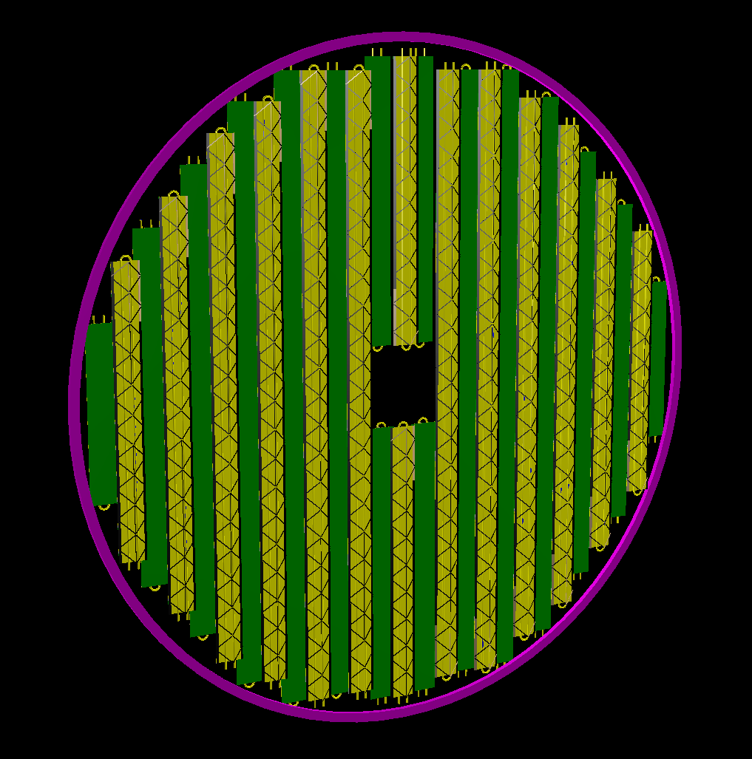
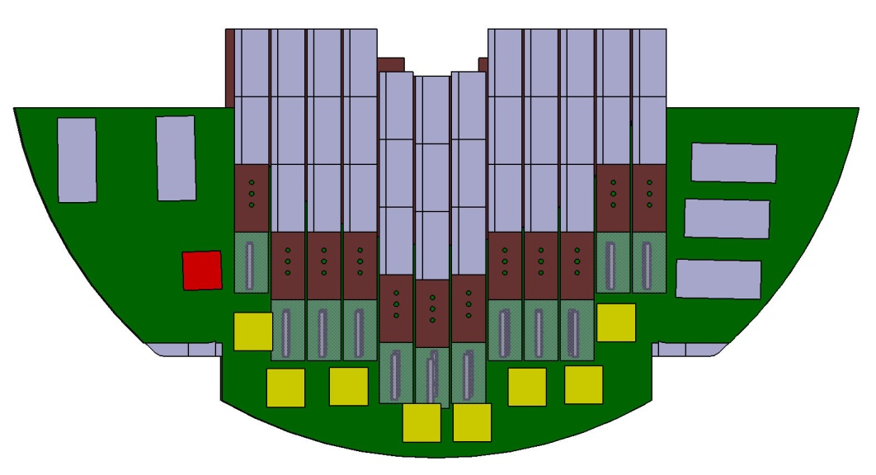
Forward & backward Silicon Trackers
for now assume the same a la ALICE ITS building blocks (complete staves) as in the vertex tracker; 2x7 “discs” with [30 .. 180] mm radius
~360 mm
Also notice: ALICE MFT design “as is” won’t work (no radial space!)
Design of this subsystem should clearly attract more attention (generic layout, material budget, cooling system type, support system, communications; also perhaps chip optimization, readout frequency increase, ...?)

Slide 16
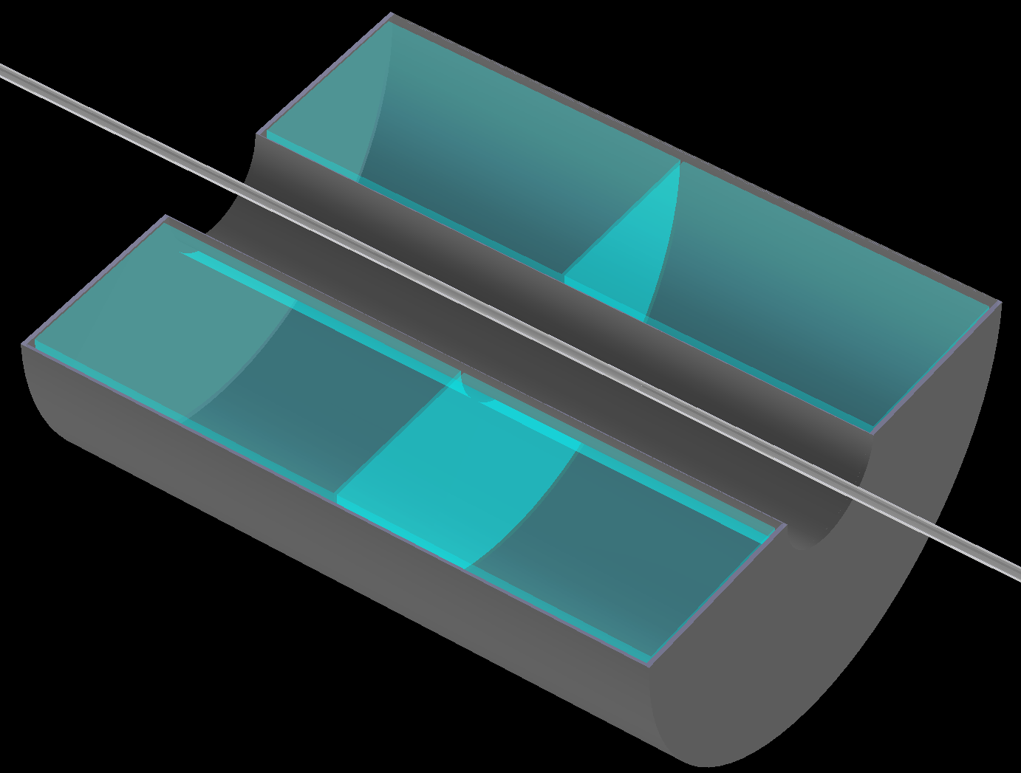
TPC
~2m long; gas volume radius [225..775] mm
1.2% X/X₀ IFC, 4.0% X/X₀ OFC; 15.0% X/X₀ end-caps
assume 5 mm long GEM pads and ~250 μm single point {rφ} resolution for the max. drift distance of ~1m
A gas mixture like T2K at ~250 V/cm (very small transverse dispersion in 3T field) will do the job
Pretty much in sync with sPHENIX prototype
~2.0 m
~1.6 m
These days this is seen as a medium size and medium resolution TPC

Slide 17
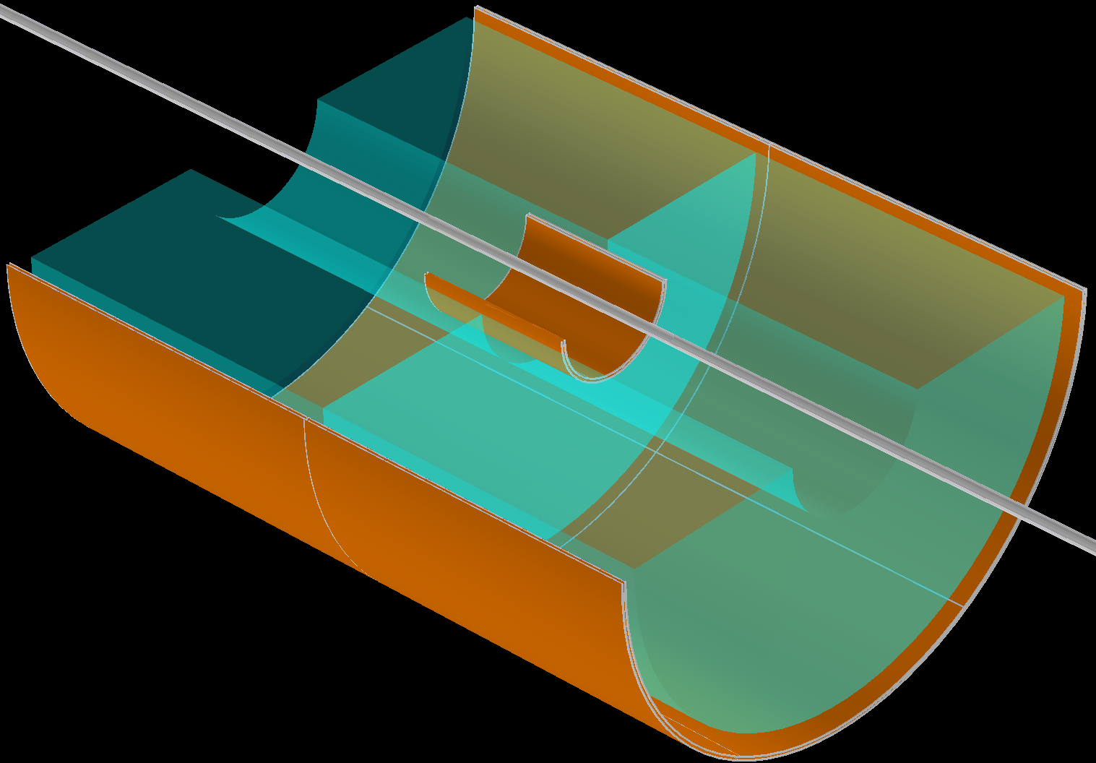
Micromegas barrel tracker
4 layers; technology-driven azimuthal and longitudinal segmentation
2D readout with ~100 μm spatial resolution
CLAS12 upgrade project
~2.0 m
Internal structure modeled according to the real-life prototypes
~0.5% X/X₀ per layer
Real life module (Saclay)

Slide 18
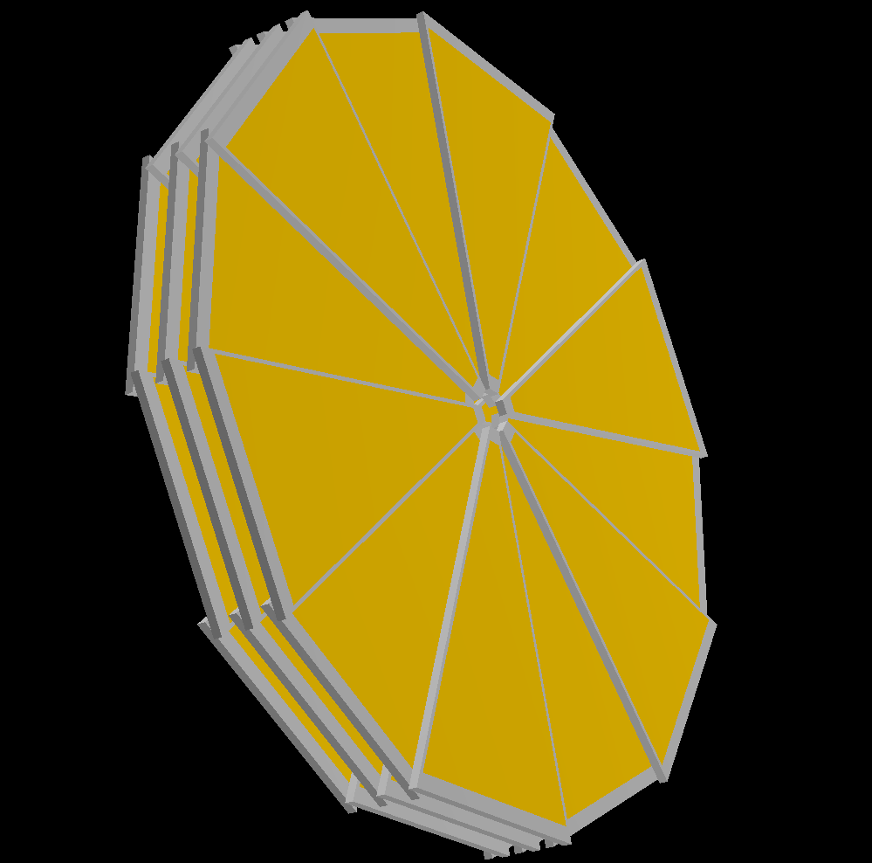
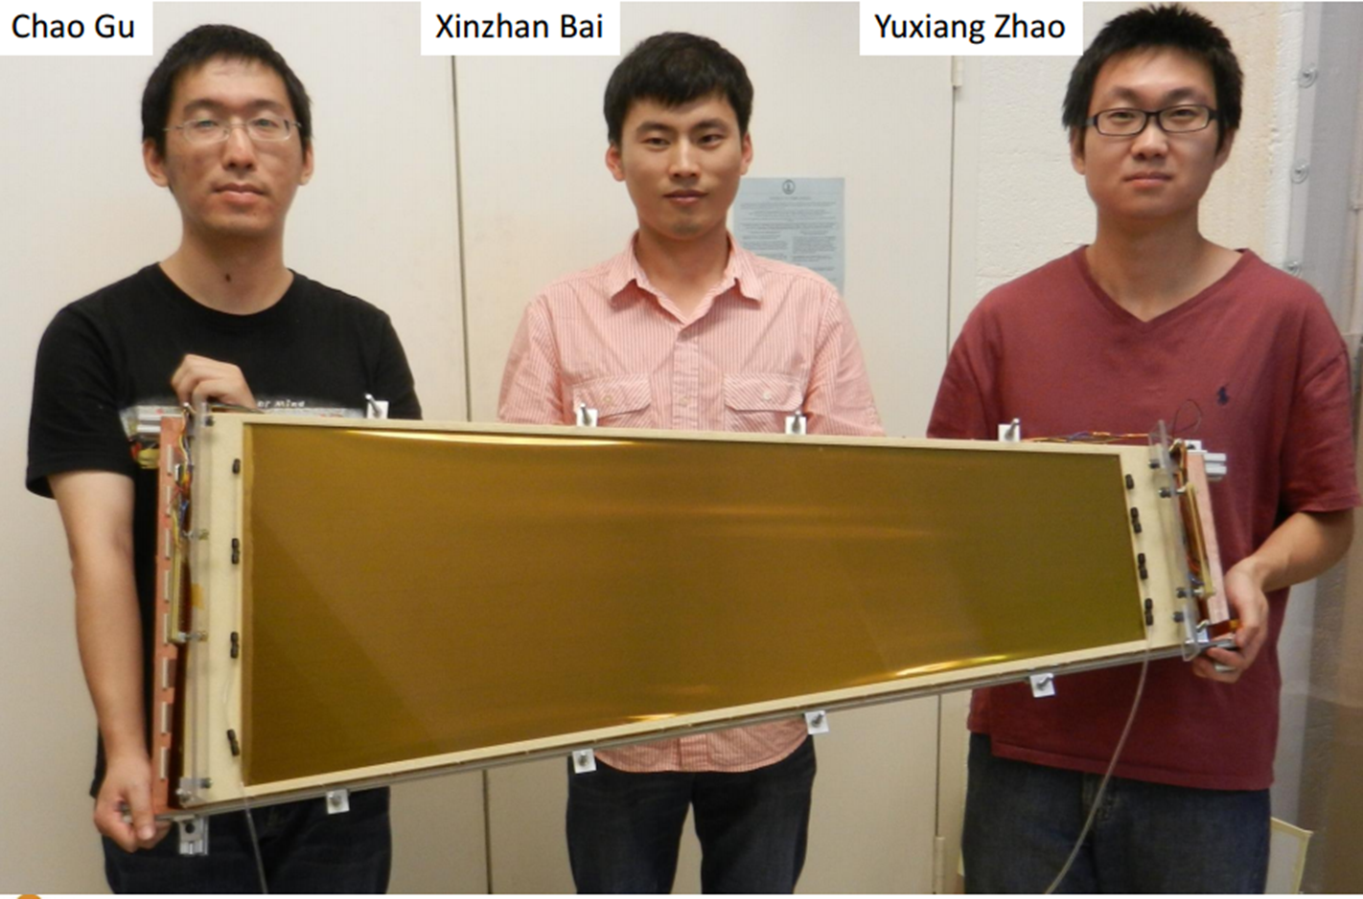
GEM endcap trackers
Ongoing EIC R&D project
3 disks behind the TPC end-caps; SBS internal design for now
assume 50 μm {rφ} spatial resolution can be achieved
~75 cm
Well advanced R&D program
A couple of groups have their own large area GEM designs

Slide 19
“Purity” in (x,Q²) kinematic bins
Describes migration between kinematic bins
Important to keep it close to 1.0 for successful unfolding
{PYTHIA 20x250 GeV} -> {GEANT} -> {Kalman filter track fit}
Bremsstrahlung turned on here (and it matters even for detector with ~5% X/X ₀!)
Lepton tracking only
Double-angle method
“Straightforward” lepton tracking can hardly help at Y<0.1
Hadronic final state accounting allows to recover part of the high Q² range
Performance has not changed much with the new magnetic field map

Slide 20
“Purity” in (x,Q²) kinematic bins
a trivial observation: tracker momentum resolution rapidly degrades at backward rapidities; this clearly affects {x,Q²} reconstruction quality
A possible solution: use e/m calorimeter in addition to tracking
~2%/√E energy resolution (and ~0 constant term) for η < -2 (PWO crystals)
~7%/√E energy resolution for -2 < η < 1 (tungsten powder scint. fiber sampling towers)
Consider “bremsstrahlung off ” case here for simplicity
Lepton tracking only
Lepton tracking + EmCal
High-resolution crystal calorimeter at very backward rapidities should
definitely help to increase available y range

Slide 21
Relative electron/photon/h⁻ yields
15x250 GeV configuration; particle yields versus momentum in the 4 < η < 4 range:
γ suppression:
the same η coverage for
tracking & Ecal
h⁻ suppression through E/p
-3.5<η<-1: 10:1 to 10³:1
−1<η <1: 10⁴:1
η range [-1.0 .. -3.5] is also covered by the hadronic calorimeter

Slide 22
BeAST detector layout
hadronic calorimeters
e/m calorimeters
RICH detectors
A detailed microscopic simulation of “e/p+HCal” electron identification is
in progress
9.0m
hadrons
If needed, the setup can be
appended at η < -1 by other
electron ID detectors
like preshower and/or TRD
electrons
silicon trackers
TPC
GEM trackers
Micromegas barrels
3T solenoid cryostat
magnet yoke

Slide 23
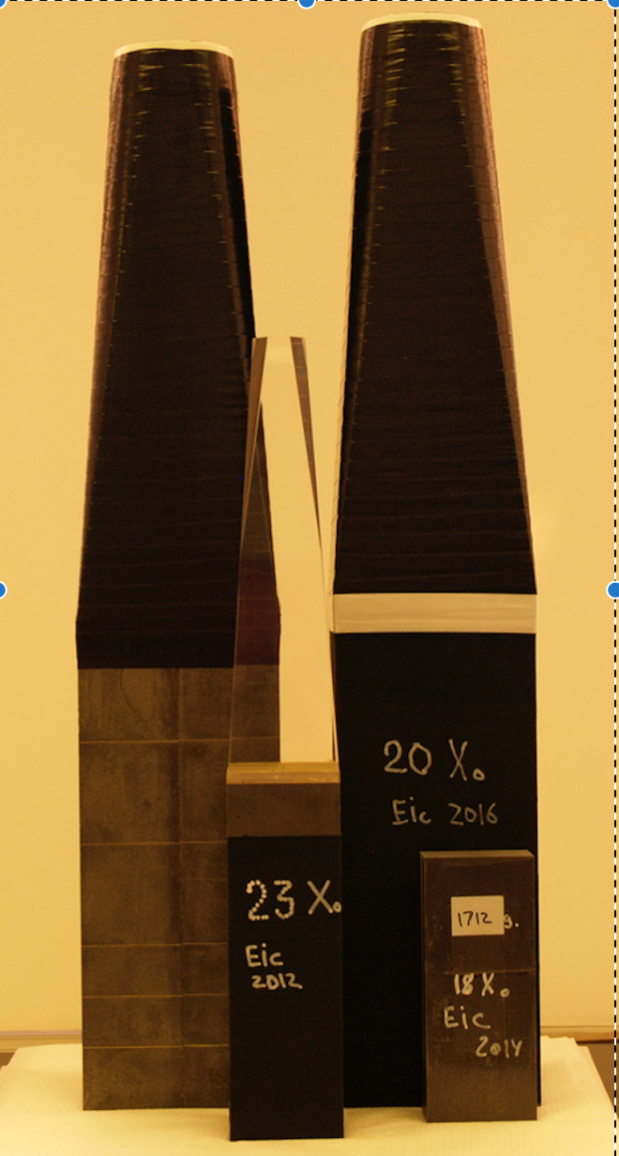
Electromagnetic calorimeters
Very backward pseudo-rapidities (η < -2):
PWO crystals with ~2%/√E (or better) energy resolution
Pseudo-rapidity range -2 < η < 3.5:
Tungsten powder scintillating fiber technology with ~7-10%/√E energy resolution
Ongoing EIC R&D projects
e⁻ and γ energy measurement;
e/p electron ID
H1 : (7..12)%/√E+1%
ZEUS : 18%/√E+1%
May’2016 test run in FNAL
Present status (May’2016 test run)
Several configurations tested since 2012
Reach energy resolution level of ~{7%/√E + 1%} with the PMTs
See clear path towards getting similar level of performance with a compact readout

Slide 24
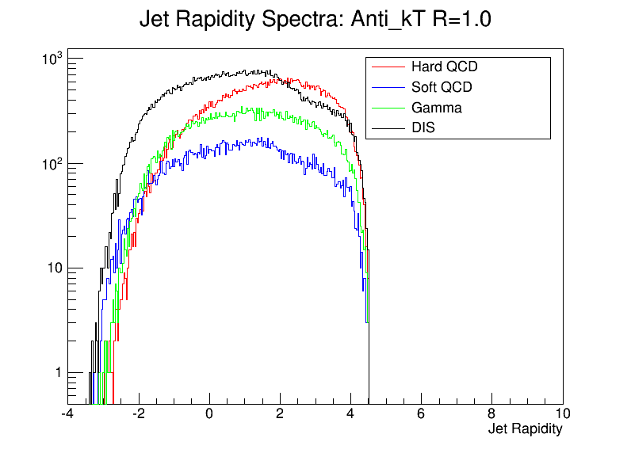
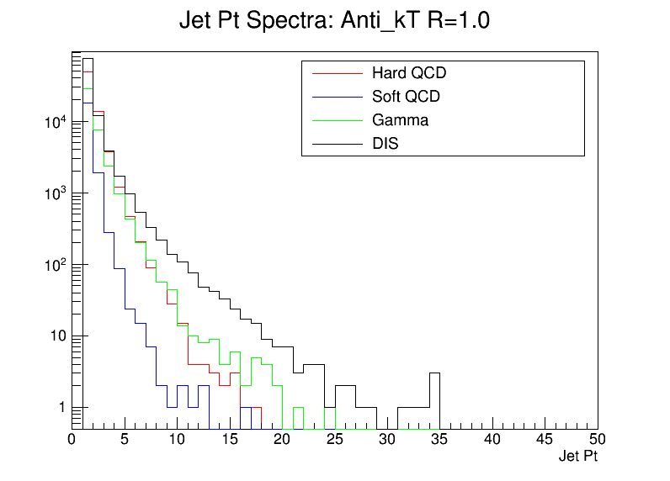
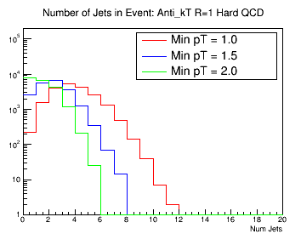
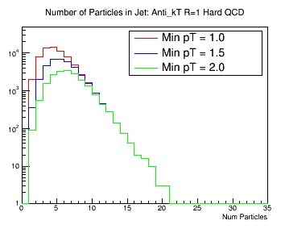
Jets at an EIC
by Brian Page
PYTHIA 20x250 GeV
-> see talk by Brian in the parallel session
EIC will see high energy jets in hadron-going direction

Slide 25
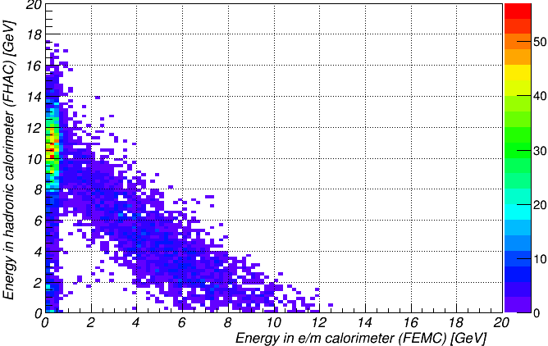
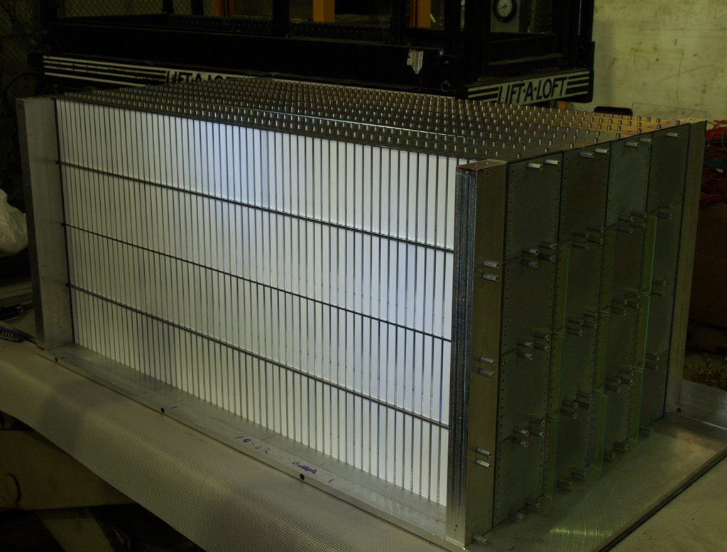

Hadronic calorimeter(s) in the end-cap(s)
Electron identification in electron-going direction;
jet physics in hadron-going direction
EIC R&D project
MC: 12 GeV pions: Hcal vs EmCal
Slope ~1.20 perfectly
matches measured data
Lead absorber scintillating plate sandwich technology
~50%/√E energy resolution looks fine
Adequate Monte-Carlo model exists in GEANT
Cost optimization and further R&D may be required (use steel plates instead of lead?)

Slide 26
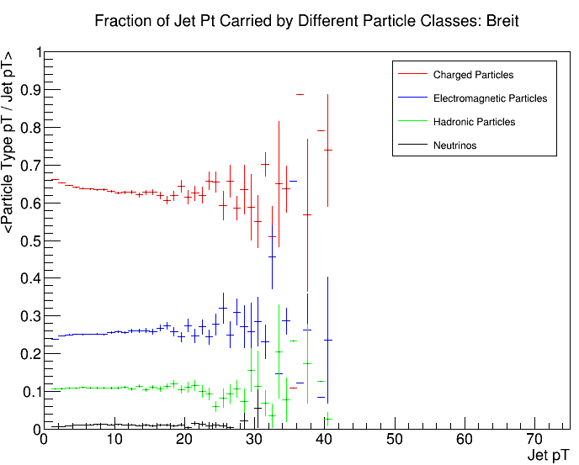
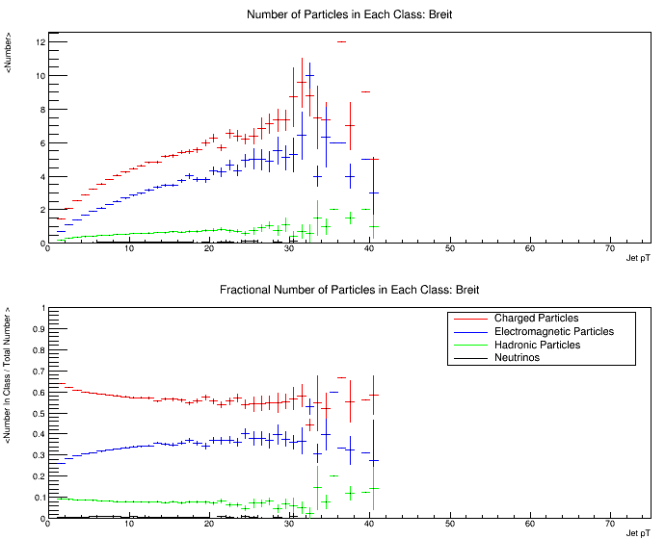
Jets at mid-rapidities
by Brian Page
20x250 GeV; Q² [10 .. 100] GeV² ; -1 < η < 1
Fraction of jet P_{t} carried by different particles classes
EIC jets at |η|<1 are “jetlets”
Absolute number of particles in each class
No apparent need to have HCal at |η|<1
Fractional number of particles in each class
Fraction of P_{t} carried by neutral hadrons is small
No way ~50%/√E hadronic calorimeter energy resolution at <40 GeV/c can beat tracker momentum resolution

Slide 27
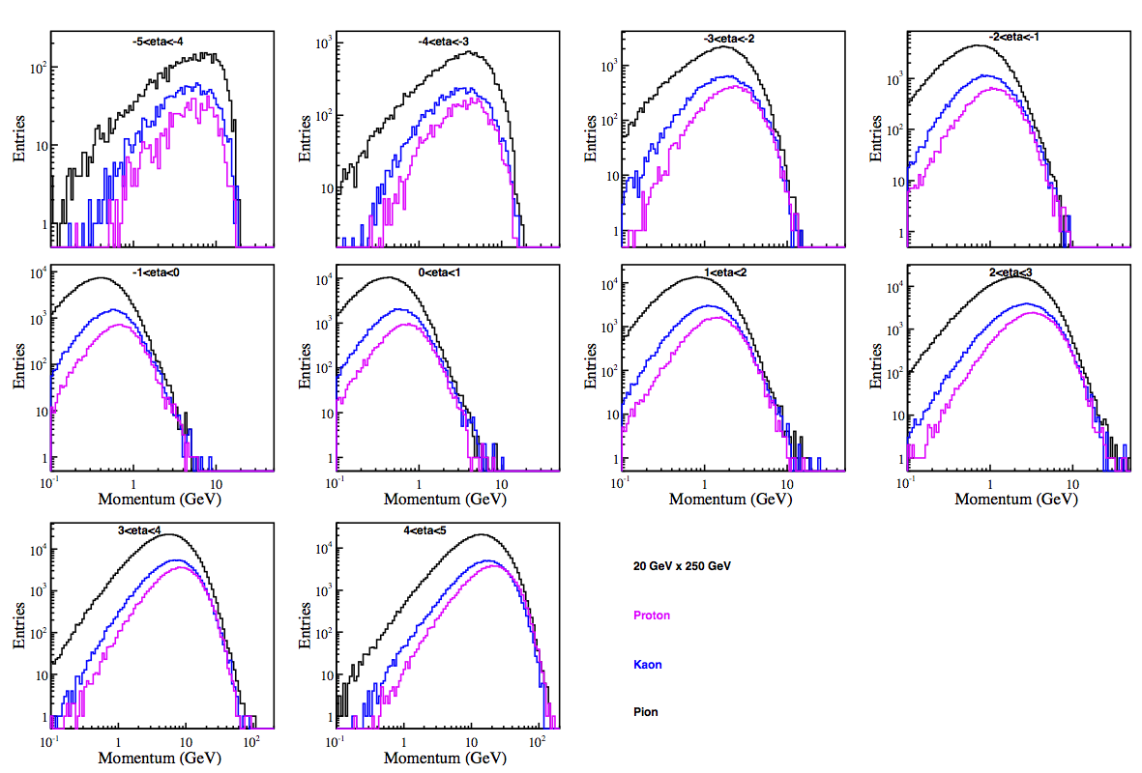
Relative pion/kaon/proton yields
20x250 GeV configuration; yields versus momentum in the 4 < η < 4 range:
π/K/p distributions at the same η look similar
π/K ratio is about 3:1 -> depending on the desired efficiency and contamination this defines the required suppression factors

Slide 28
Gas radiator RICH in solenoid fringe field
Consider configuration inspired by the eRD6 test run:
1m long CF₄ gas volume [1.5 .. 2.5]m from the IP
1m focal length; ~33mm ring radius at β ~ 1
GEM readout; effective 2.5mm hexagonal pads
Assume on average 12 photons per ring at β ~ 1
Additional 300 μrad instrumental resolution
EIC R&D project
“Back-of-the-envelope” Monte-Carlo study:
Realistic solenoid magnetic field
Realistic tracker momentum resolution
Cerenkov angle smearing in the field
CsI quantum efficiency ε(λ) dependence
Refractive index n(λ) variation
Finite readout board “pixel” size
ROOT TMVA-based output evaluation
Expected magnetic field effect
NB: this spread is in principle noticeable compared to the intrinsic single-photon angular resolution of ~1 mrad

Slide 29
Gas radiator RICH in solenoid fringe field
Require 95% kaon positive identification efficiency
worsening momentum resolution at η ~ 3.5 is what matters here
… and magnetic field plays a role only at very
high momenta and at pseudo-rapidity ~ 1
But we do not expect any SIDIS hadrons there:
So yes, RICH with a ~1m long gas radiator should work just fine in this solenoid stray field

Slide 30
Aerogel RICH in 3T field
NB: at 3T full track bending in aerogel volume is >5 mrad at 5 GeV/c!
Consider end-cap case in proximity-focusing configuration:
3cm thick aerogel; 20cm expansion volume
<n₀> = 1.05
~5cm attenuation length
SiPM array readout; 5mm² “pixel” size
Assume on average 15 photons per ring at β ~ 1
Aerogel RICH R&D for Belle II upgrade
“Back-of-the-envelope” Monte-Carlo study:
Constant B_{z} ~ 3T
Asymmetric (φ-dependent) attenuation
φ-dependent Cerenkov angle smearing in the field
SiPM quantum efficiency ε(λ) dependence
Refractive index n(λ) variation
Emission point uncertainty (thick radiator)
Finite readout board “pixel” size
TMVA-based output evaluation
So should work just fine; is compact
and readily available (with HAPDs)
… and magnetic field is again a minor effect
Require 95% kaon positive identification efficiency

Slide 31
π/K/p separation options
Lowest momentum in the whole η range: ALARA (but for sure <1 GeV/c)
Moderate resolution time-of-flight
dE/dx capability of GEM-based TPC (especially at central η)
Some of the low-momentum Cerenkov detector options reach to over there
Highest momentum:
Central η: up to ~3-4 GeV/c
DIRC (up to 5-6 GeV really possible?)
high resolution time-of-flight (but what about t₀?)
compact RICH a la eRD14?
either aerogel or C₆F₁₄ RICH in proximity focusing configuration?

Slide 32
π/K/p separation options
Highest momentum:
Forward η: up to ~50 GeV/c (at least for η range [1.5 .. 3.5])
Dual radiator RICH from eRD14 (n=1.02 aerogel and C₂F₆) + high resolution time-of-flight
Dual radiator RICH from eRD6 (C₆F₁₄ and C₂F₆) + a separate aerogel proximity focusing RICH?
Backward η: up to ~5-6 GeV/c would suffice
(pretty) high resolution time-of-flight (but: we are talking about >3σ separation; and again, t₀ issue)
compact RICH a la eRD14 runs out of stem?
then “regular” aerogel RICH in proximity focusing configuration?
At some point it would be very helpful to see a complete and coherent picture of
PID detector coverage in all η ranges (rejection factors, projected performance, side
by side comparison with existing solutions, price tags, …)
2) We should be able to put any modular stuff from any R&D effort (geometry files +
algorithms) into the simulation instead of the pink placeholders in BeAST configuration

Slide 33
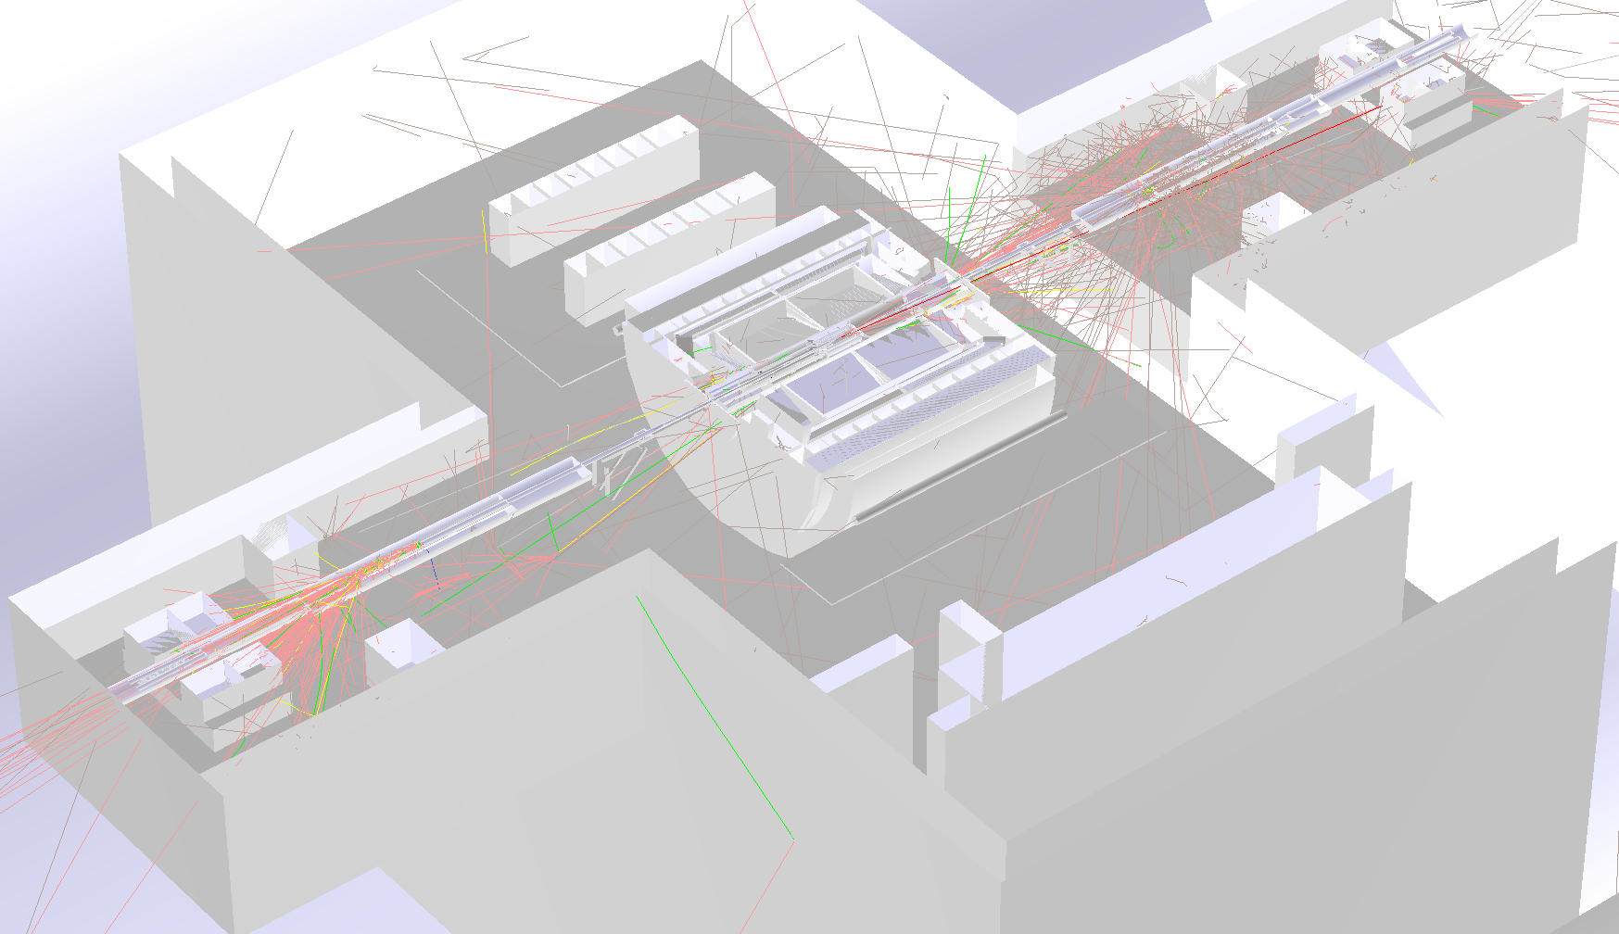
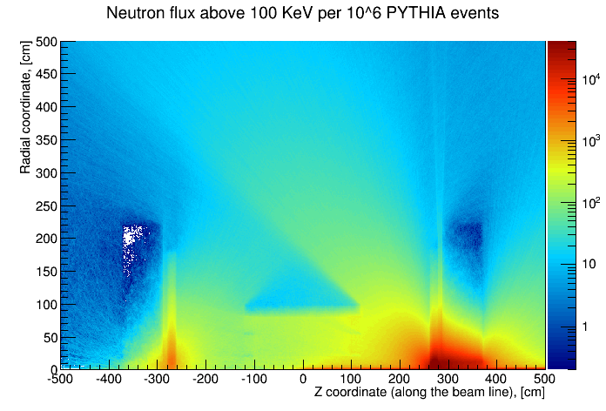
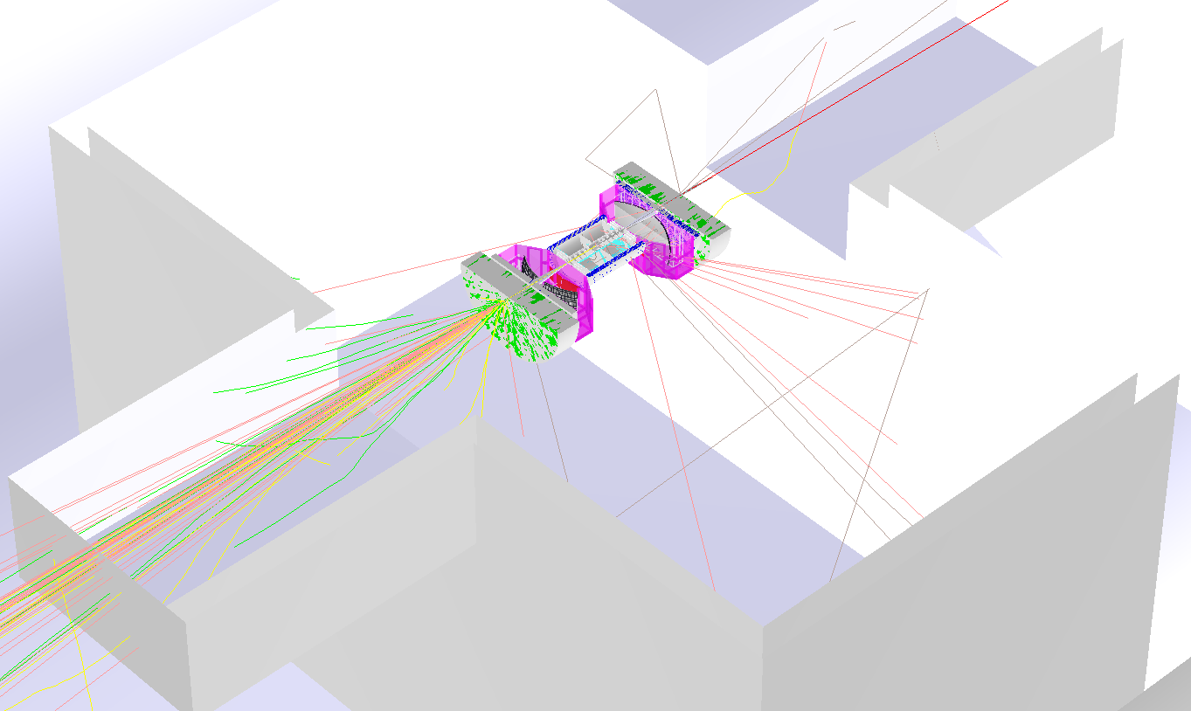
A comment on neutron flux estimation
STAR geometry imported in EicRoot
NB: very important topic since several detectors with SiPM type of readout are planned to be used
Strategy:
Import STAR experiment geometry (including experimental hall)
Run ep- and pp-PYTHIA simulations for STAR and BeAST setups
Use direct STAR neutron flux measurements from 2013 as a reference
These numbers are VERY preliminary
BeAST detector placed in STAR hall
n/cm² / 1MHz PYTHIA 20x250 GeV ep-events
At most ~10¹⁰ n/cm² per year of running at L=10³³ cm⁻²s⁻¹

Slide 34
Summary slide
A flexible eRHIC detector configuration is put together
It is based on either proven components or the ongoing R&D
Present and next items on the ToDo list:
Decide on the PID detector configuration
PID algorithm development: either write parts from scratch or import from elsewhere (and then they better belong to a shared EIC software “pool”)
Track finder algorithm for central rapidities (preferably within software consortium WPs, so portable between frameworks and generic enough)
Further optimization of various detector technologies to meet the detector requirements imposed by physics

