Slide 1


SUMMARY of the sessions
Novel Technical Advancements (Detector / Experiment)
Jets and Novel Probes (Experiment)
Salvatore Fazio
(Brookhaven National Lab)
EIC Users Meeting – Argonne National Lab
07-09 July, 2016

Slide 2
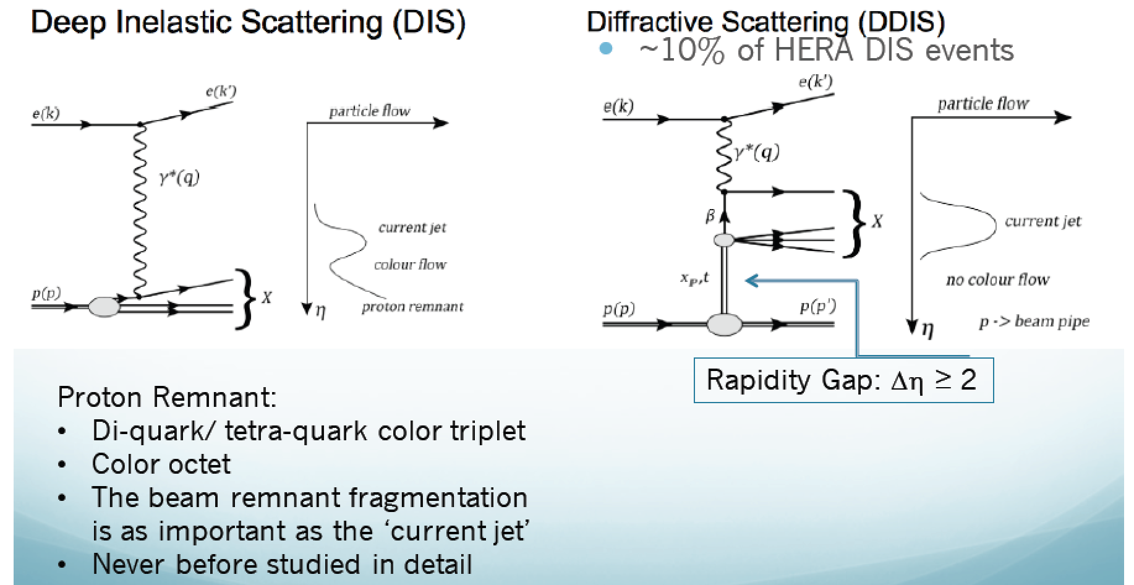
Forward Tagging as a Probe of Hadronic and Nuclear Dynamics
Charles Hyde

Slide 3
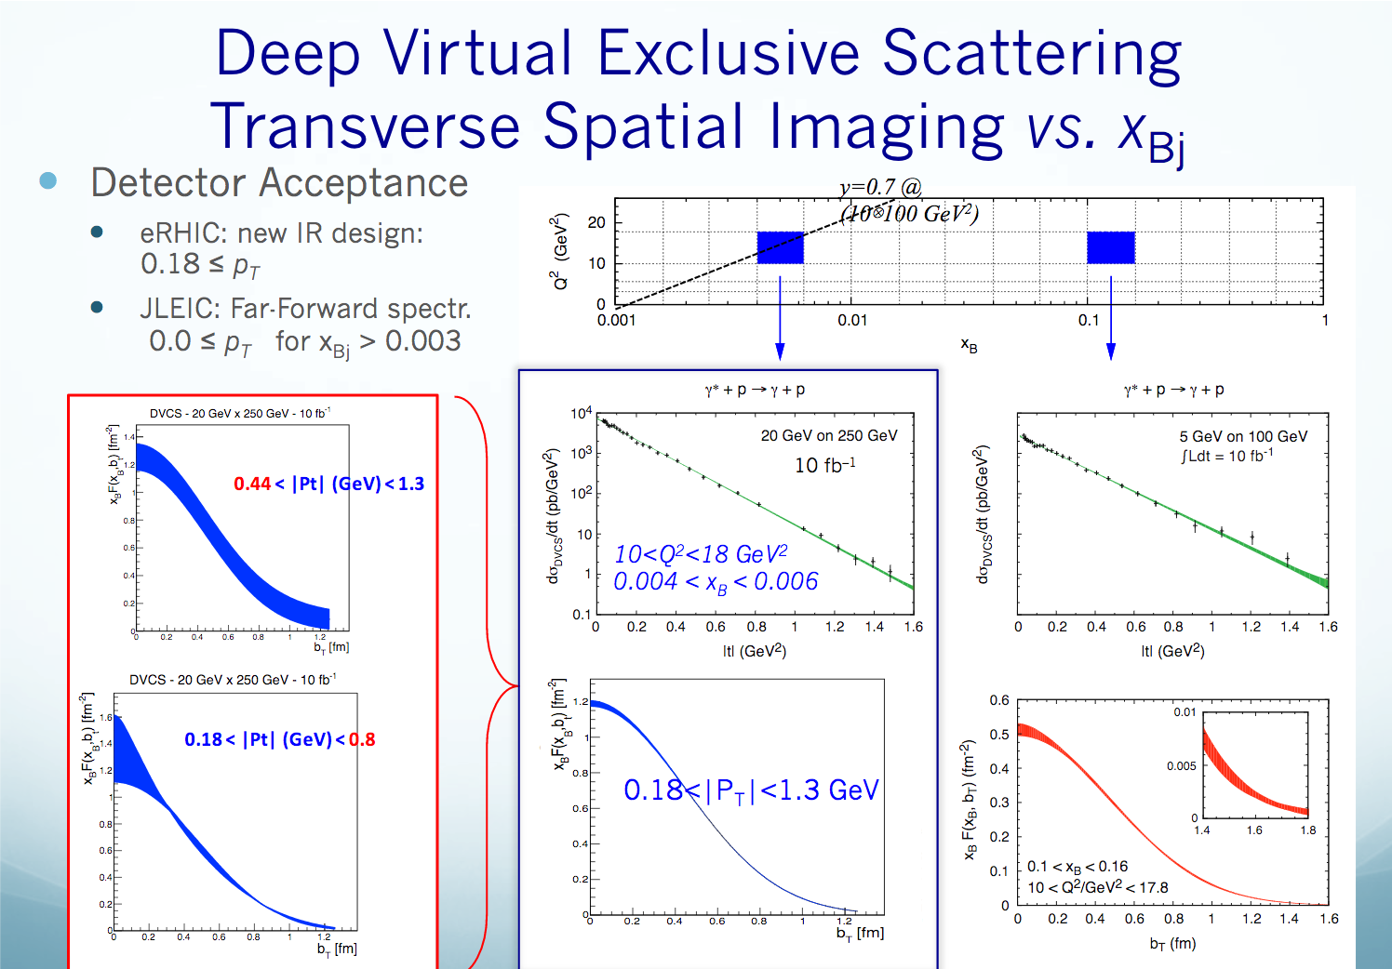
Charles Hyde
parton distribution

Slide 4
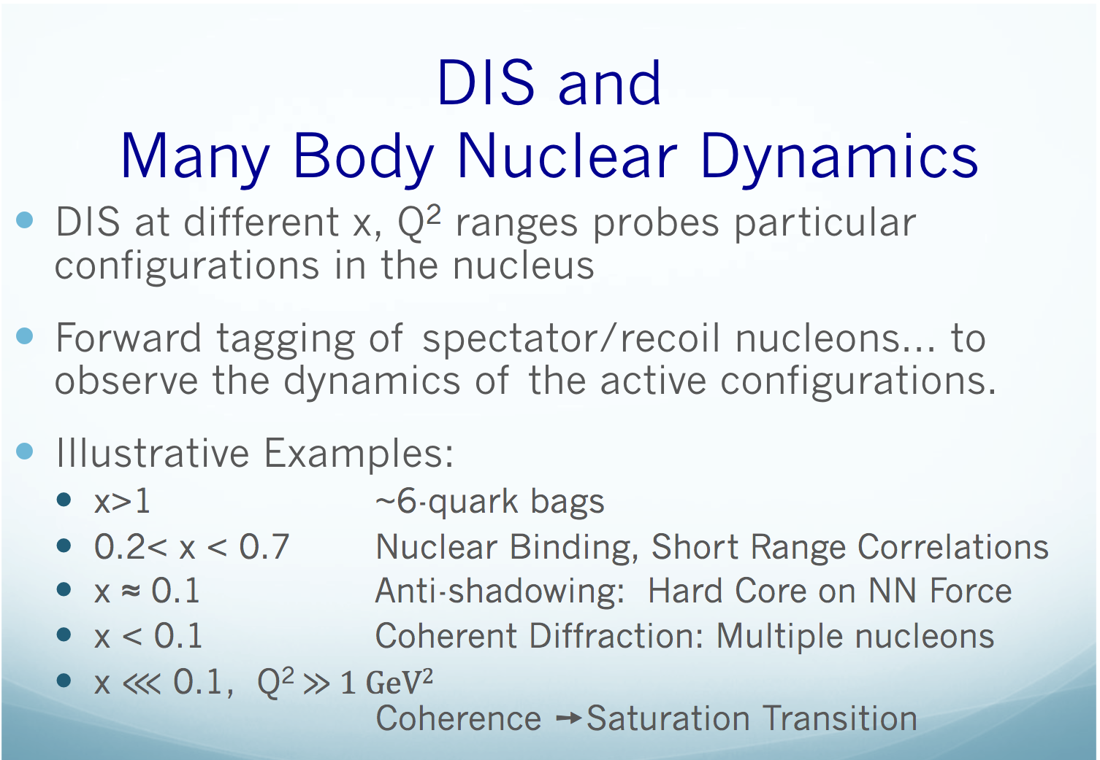
Charles Hyde

Slide 5


EIC physics program overview
Alexander Kiselev
Inclusive Reactions in ep/eA:
Physics: Structure Functions: g₁, F₂, F_{L}
→ Very good scattered electron ID
→ High energy and angular resolution of e’ (defines kinematics {x,Q²})
Semi-inclusive Reactions in ep/eA:
Physics: TMDs, Helicity PDFs, FFs (with flavor separation); di-hadron correlations; Kaon asymmetries, cross sections; etc
→ Excellent hadron ID: p±,K±,p± separation over a wide {p, η} range
→ Full Φ-coverage around γ*, wide p_{t} coverage (TMDs)
→ Excellent vertex resolution (Charm, Bottom separation)
Exclusive Reactions in ep/eA:
Physics: DVCS, exclusive VM production (GPDs; parton imaging in b_{T})
→ Exclusivity (large rapidity coverage; reconstruction of all particles in a given event)
→ High resolution, wide coverage in t → Roman pots
→ (eA): veto nucleus breakup, determine impact parameter of collision
→ Sufficient acceptance for neutrons in ZDC
e’
e
γ, π,J/Ψ
γ_{L}*
(Q²)
x+ξ
~
x-ξ
~
H, H, E, E (x,ξ,t)
p
p’
t

Slide 6
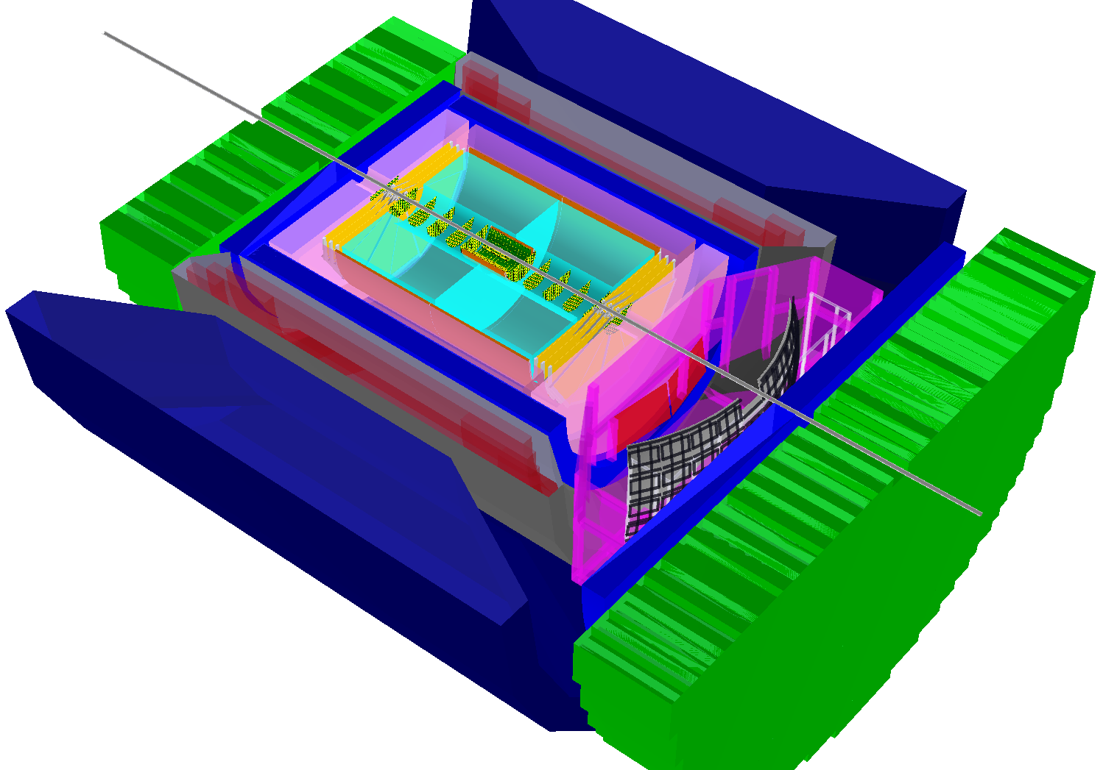
BeAST detector layout
Alexander Kiselev
-3.5 < η < 3.5: Tracking & e/m Calorimetry (hermetic coverage)
hadronic calorimeters
e/m calorimeters
RICH detectors
9.0m
hadrons
electrons
silicon trackers
TPC
GEM trackers
Micromegas barrels
3T solenoid cryostat
magnet yoke

Slide 7
BeAST Summary slide
Alexander Kiselev
A flexible eRHIC detector configuration is put together
It is based on either proven components or the ongoing R&D
Present and next items on the ToDo list:
Decide on the PID detector configuration
PID algorithm development: either write parts from scratch or import from elsewhere (and then they better belong to a shared EIC software “pool”)
Track finder algorithm for central rapidities (preferably within software consortium WPs, so portable between frameworks and generic enough)
Further optimization of various detector technologies to meet the detector requirements imposed by physics

Slide 8
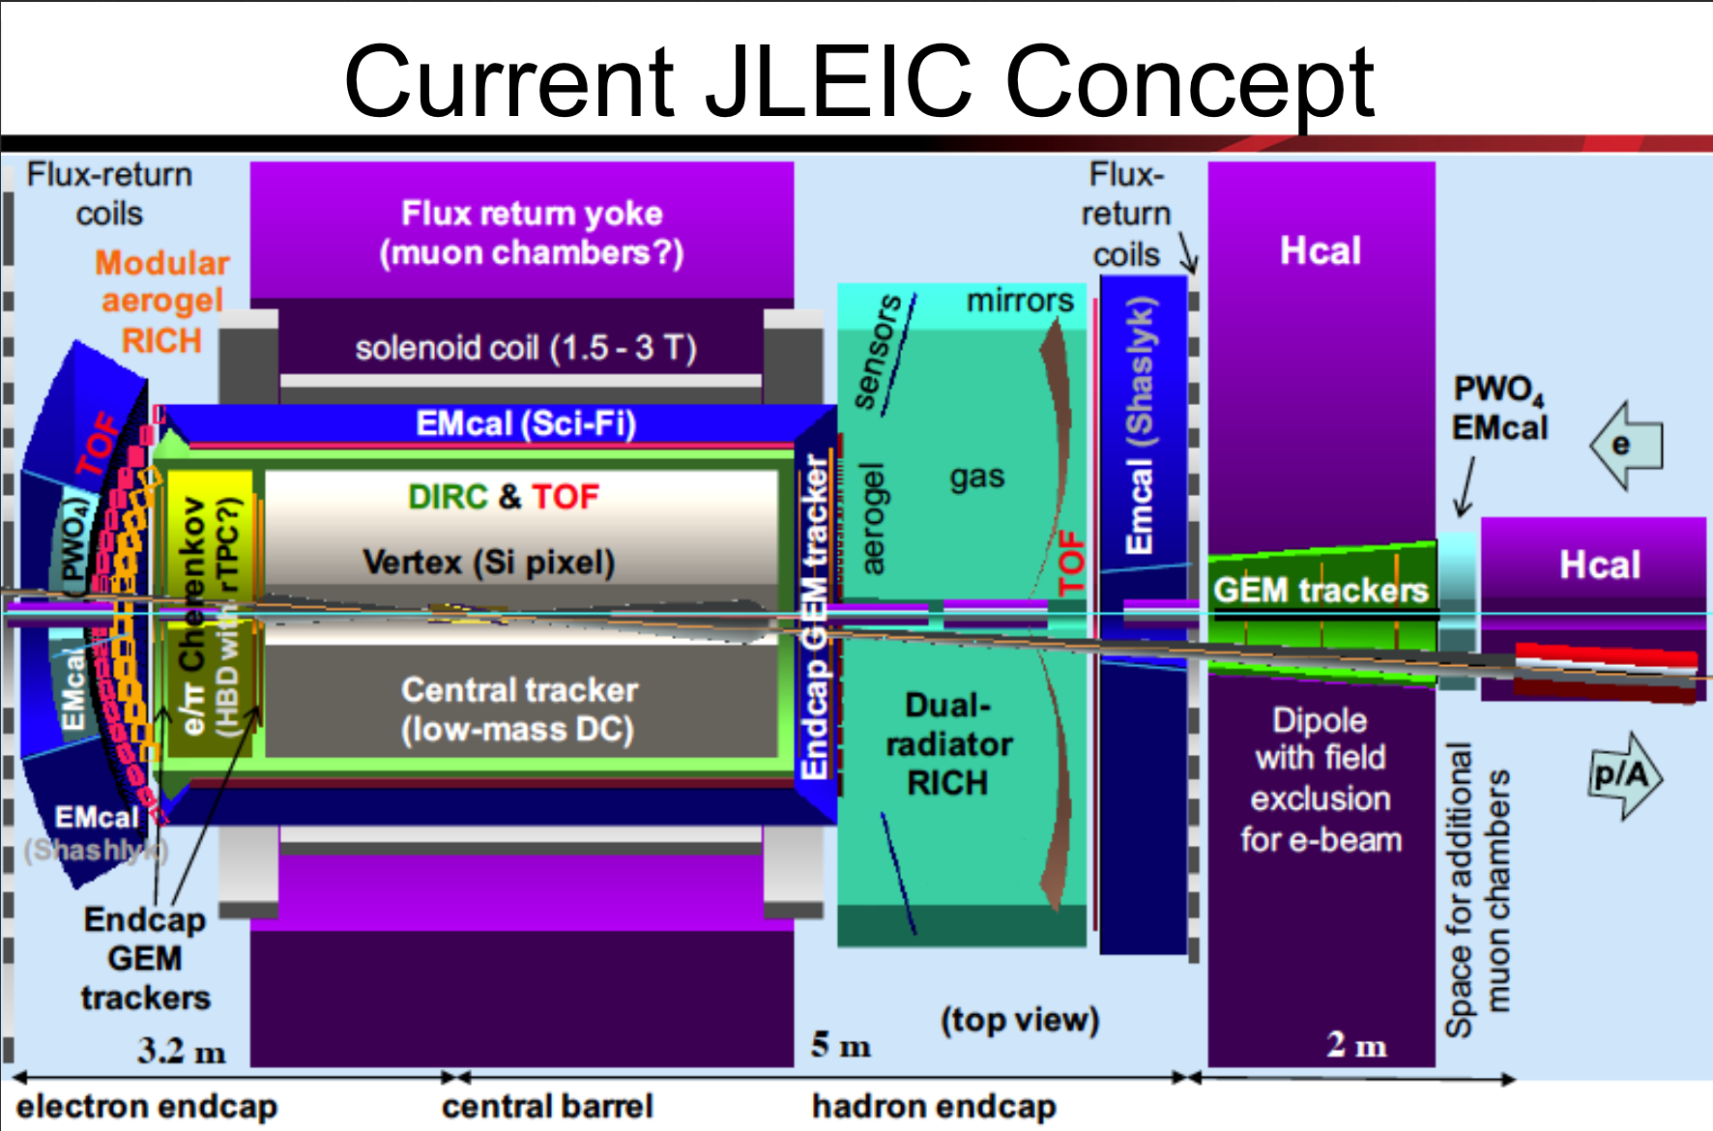
Rik Yoshida

Slide 9
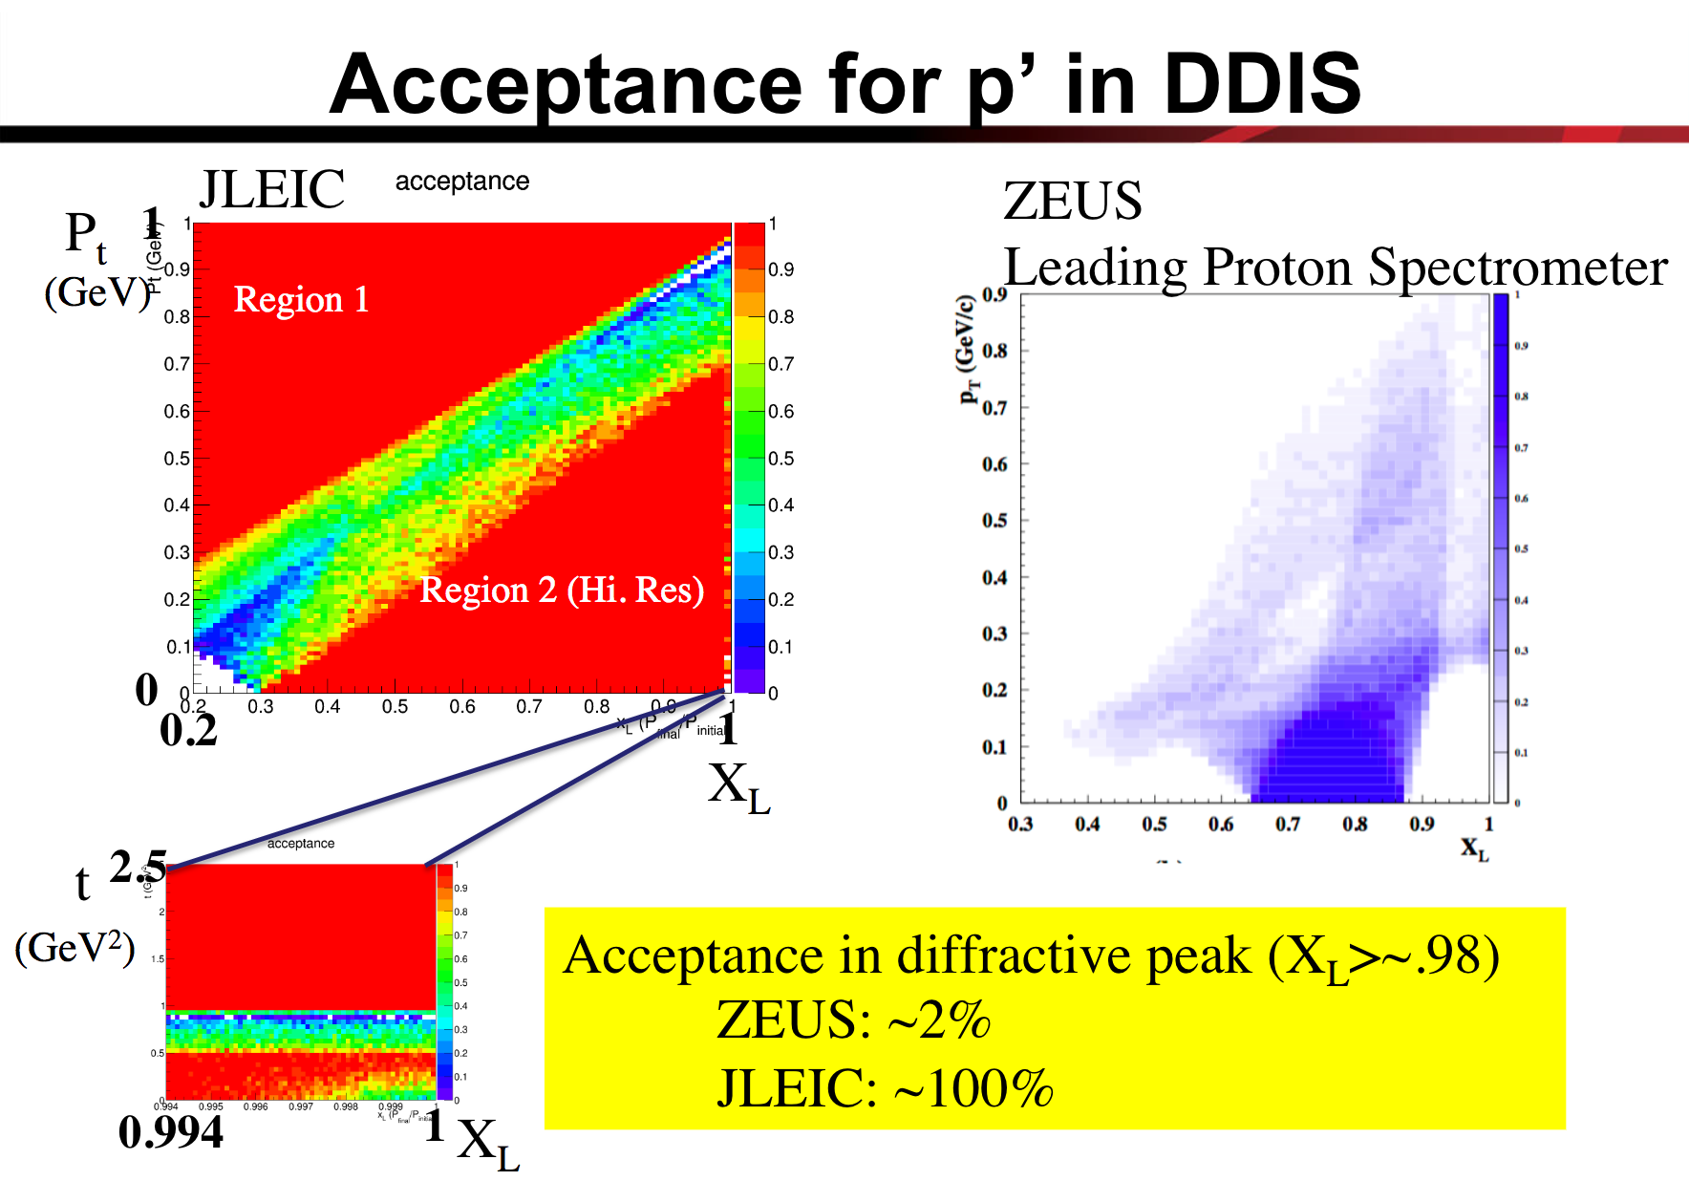
Rik Yoshida

Slide 10
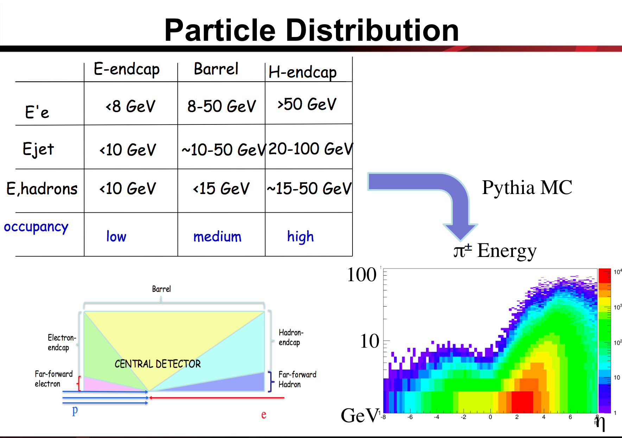
Rik Yoshida

Slide 11

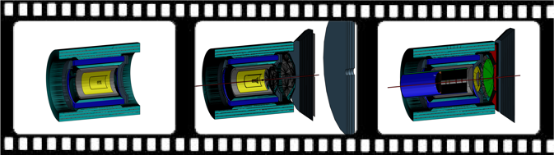
Evolution of sPHENIX into a Day-1 EIC Detector
Kenneth N. Barish
sPHENIX
fsPHENIX
EIC Day-1 Detector
sPHENIX: Centered around BaBar superconducting solenoid (1.5T). Motivation: study of Quark Gluon Plasma in heavy-ion collisions via jet structure, heavy-flavor tagged jets, and Upsilon spectroscopy.
fsPHENIX: addition of forward instrumentation (EMCal, Hcal, GEM trackers, Roman Pots?, to realize unique physics potential of polarized p+p, p+A, and A+A collisions.
EIC Day-1 Detector: further evolution into an EIC detector. Add Crystal EMCal, and tracking in electron going, further add PID in barrel and hadron going, and additional tracking in hadron direction
Takes advantages of significant investment in sPHENIX, and has coverage and resolutions to do essential Day-1 EIC physics.
Notes:
The sPHENIX experiment at RHIC is planned to run in 2020 and 2021 to explore and characterize hot phases of QCD. At the same time, sPHENIX is an excellent basis for an EIC detector in later years.
The sPHENIX experiment at RHIC is planned to run in 2020 and 2021 to explore and characterize hot phases of QCD. At the same time, sPHENIX is an excellent basis for an EIC detector in later years.
sPHENIX = Manget + barrel calorimeters (maybe keep tracking option?)
LOI: “In addition to fully utilizing the sPHENIX superconducting
solenoid and barrel calorimetry, ePHENIX adds new detectors in the barrel
and electron-going and hadron-going directions.”
There are ideas to augment this design with a forward hadron calorimeter in one direction for cold QCD and spin physics measurements already during the RHIC running time. When we move to the EIC era, this design could be further augmented with electromagnetic calorimeters in the forward direction and RICH detectors for PID.

Slide 12
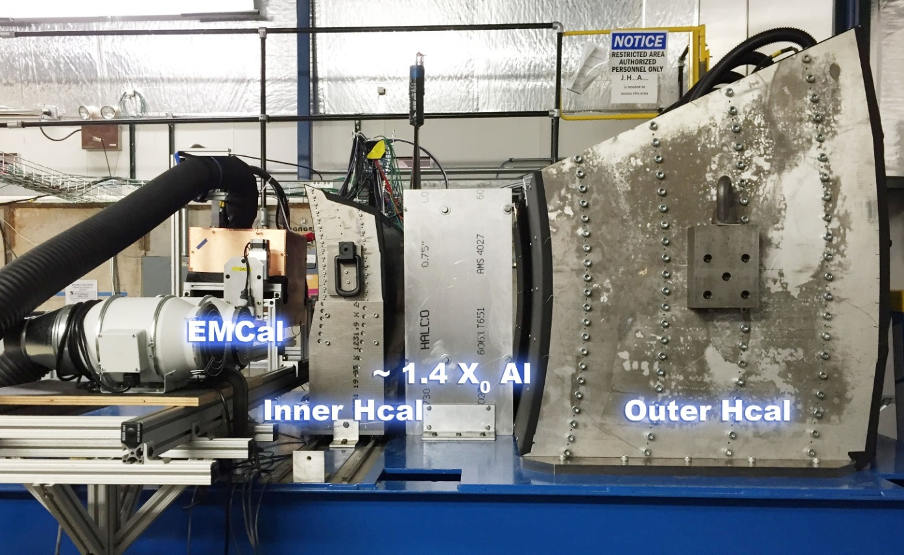
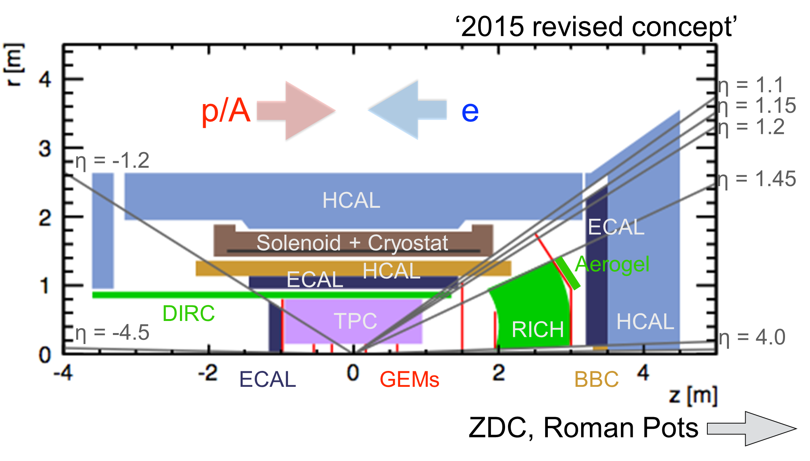
Day-1 EIC Detector
Beam Test Preliminary results
Kenneth N. Barish
Simulation shows good agreement with early data results
Expect to achieve required resolution of 12%/⎷E

Slide 13
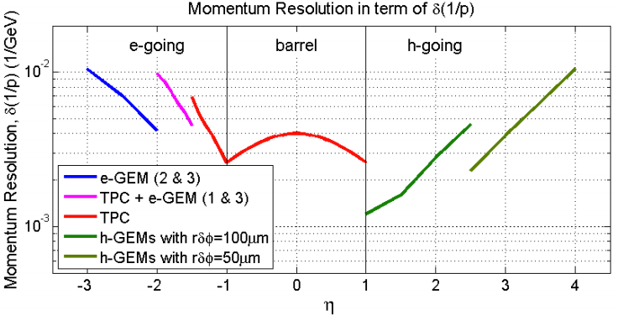
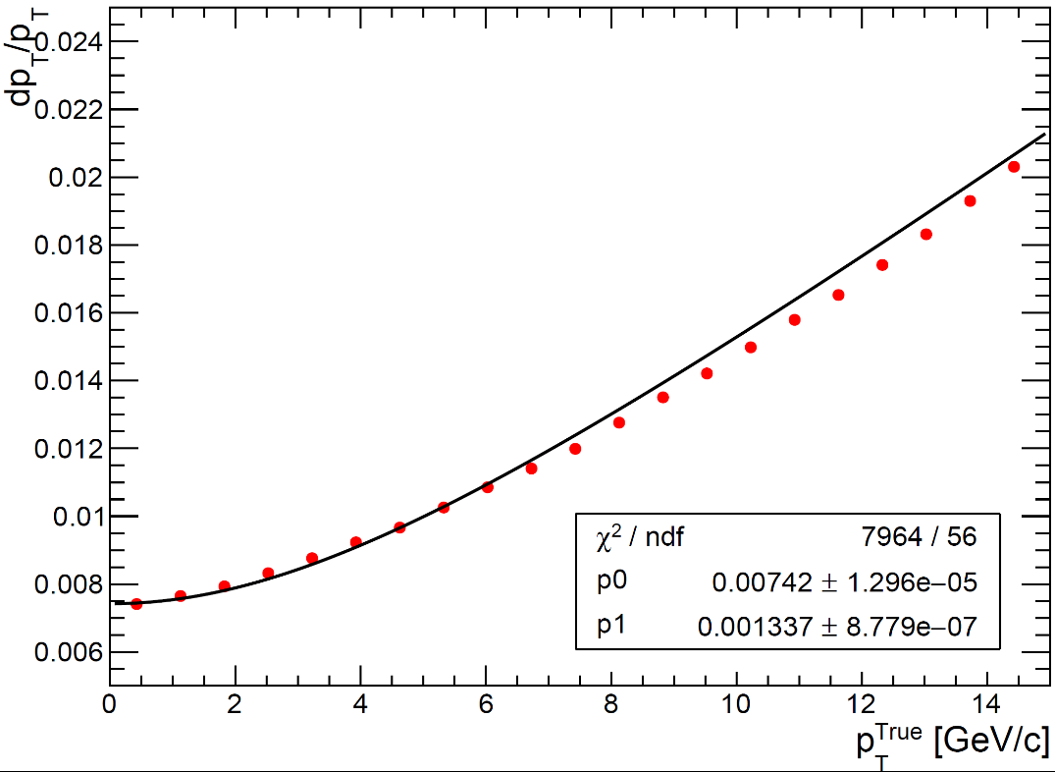
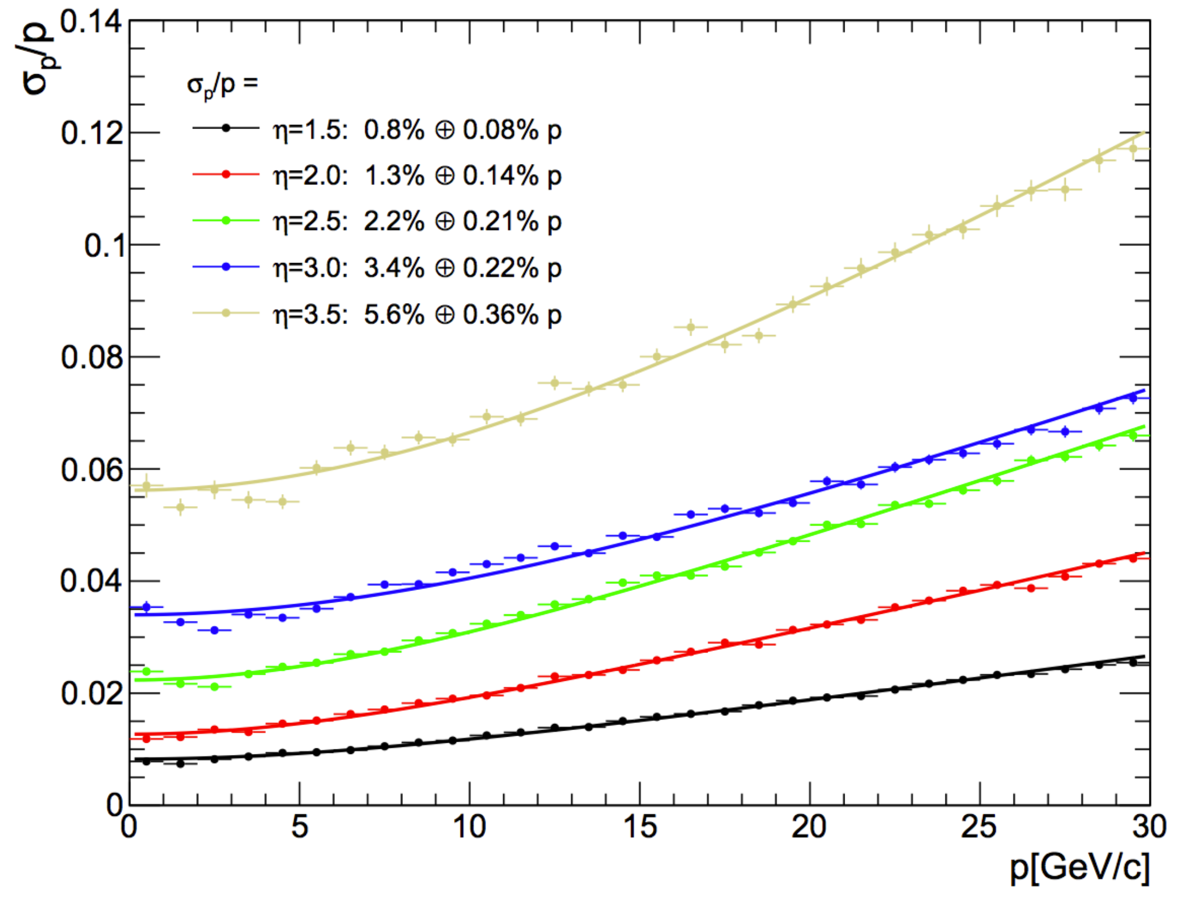
Tracking Updates
Kenneth N. Barish
Analytical estimation
of linear resolution term
In 2012-concept
[arXiv:1402.1209v1]
Central Update
Forward Update
MS: < 1% (low η) to 3% (η = 3)
One sPHENIX tracking option
EIC GEM forward tracker
MAPS inner tracker
+ TPC (better σ(r•φ) than in 2012-concept)
Geant4 + TPC digitization + Kalman filter
Geant4 + Kalman filter
Fit five GEMs + vertex
|eta|<1

Slide 14
Physics with jets at EIC
Yulia Furletova
Jets evolution and dynamics
    radiation/hadronization mechanism.
    formation of a jet
    reconstruction algorithms
Jets as a probe of partonic initial state
    gluons ( at high x) , quarks/anti-quarks
Jets in medium
    energy loss, quenching
    broadening
    multiple-scattering.
Notes:
Interior Page Design 2

Slide 15
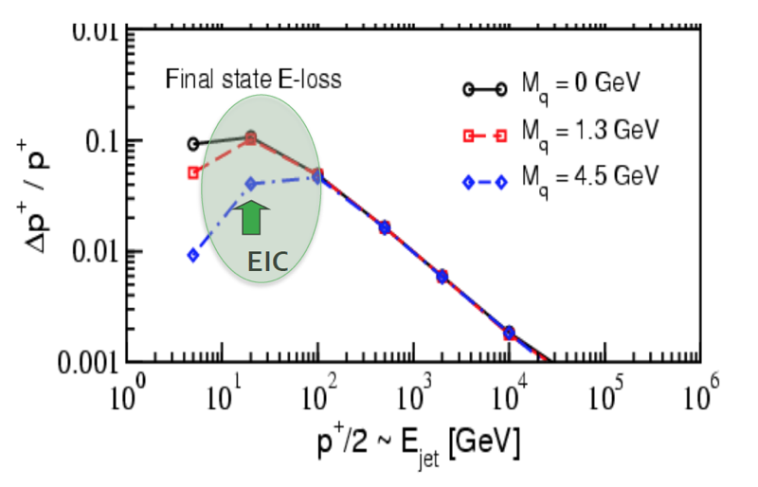
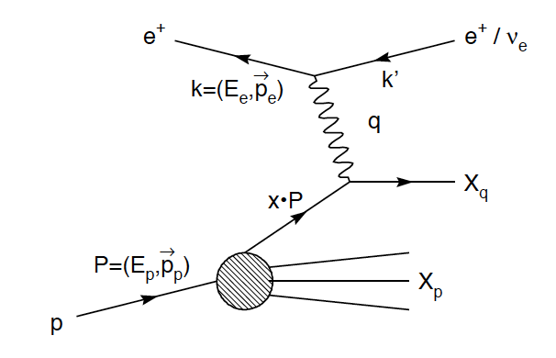

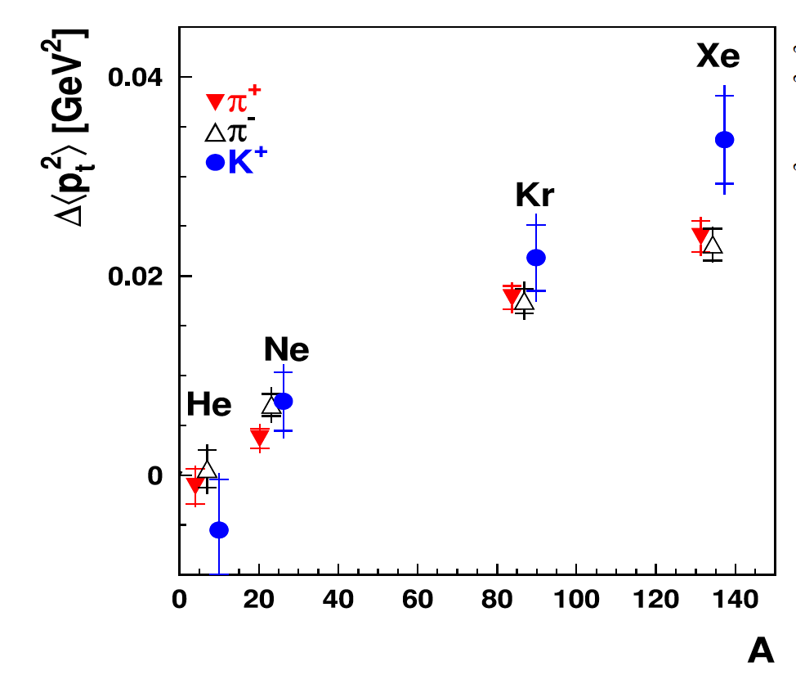
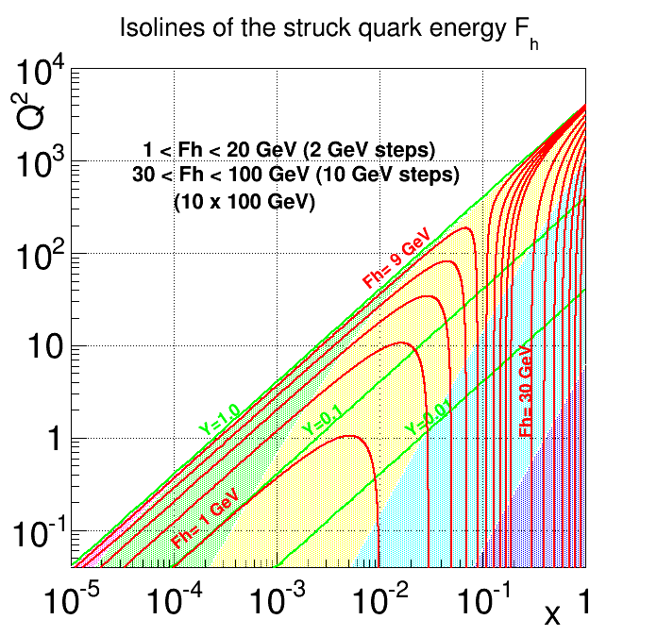
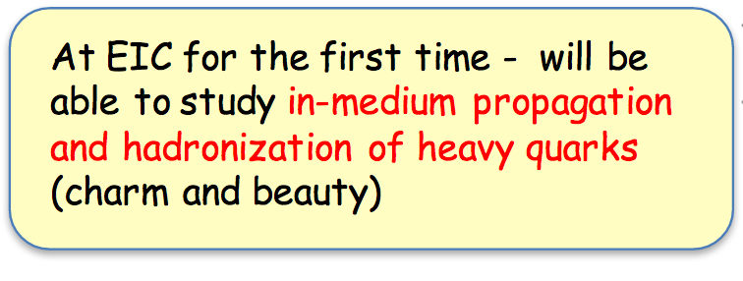
Jets at EIC
Yulia Furletova
Jet approximates a parton
Ivan Vitev
Jets Pt-broadening
HERMES,A.Accardi,etc.
E-loss mass dependence.
Heavy-quark in-medium propagation.
ep
Far-forward electron
Electron-endcap
Barrel
Forward-endcap
Far-forward
hadron
Struck quark energy Fh ~1-100 GeV
Notes:
Interior Page Design 2

Slide 16
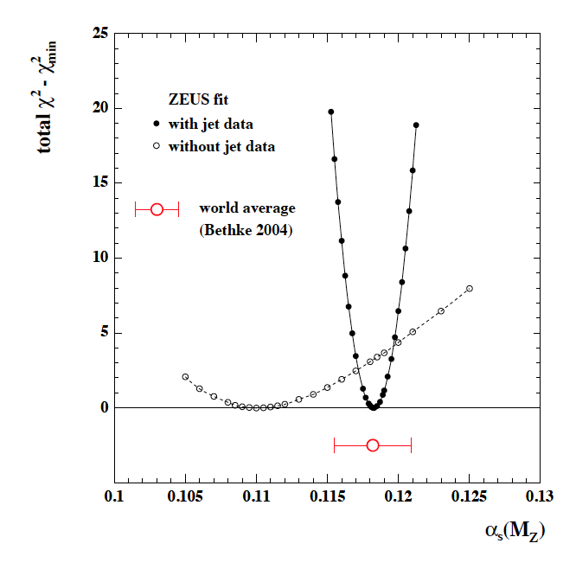
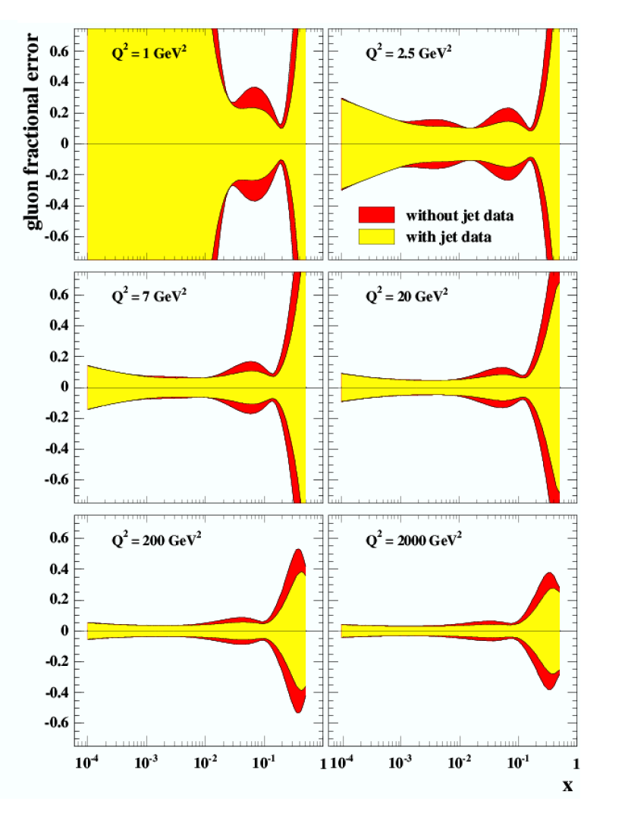
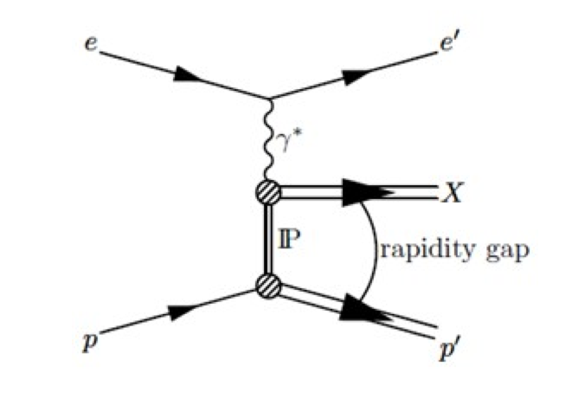
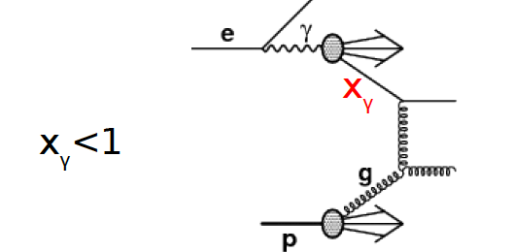
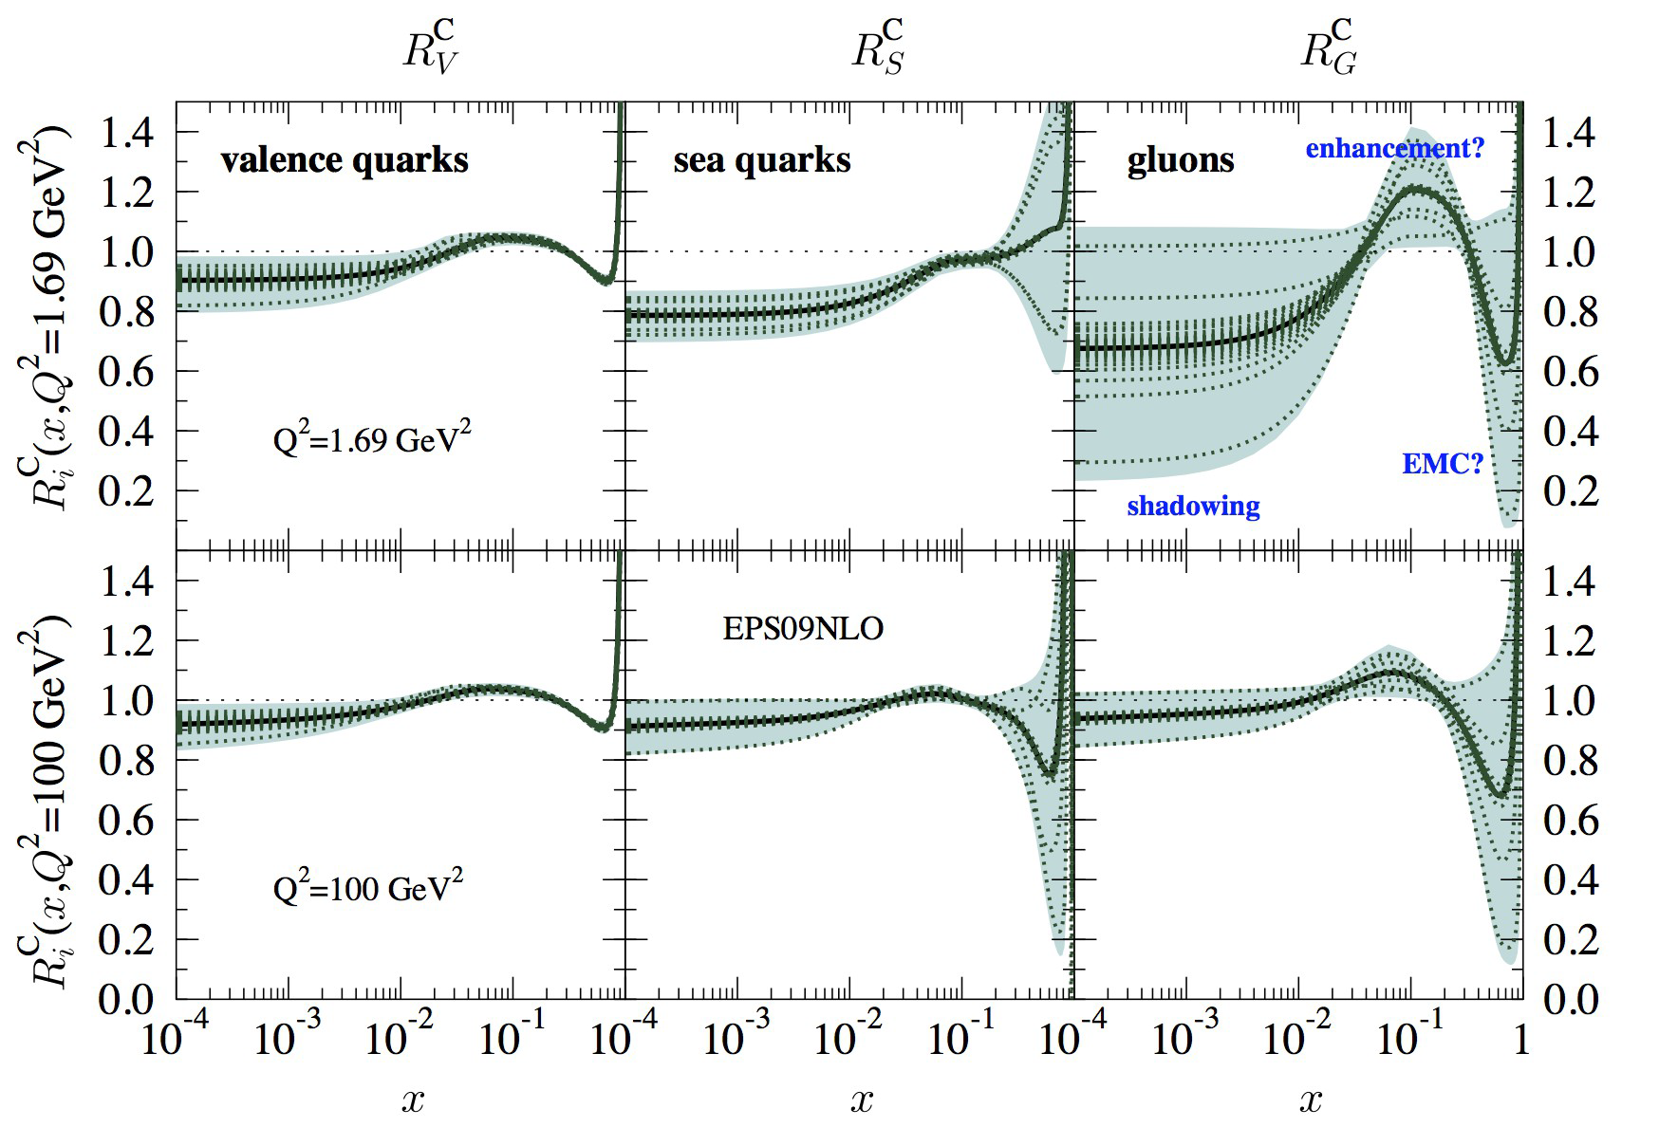
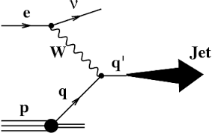
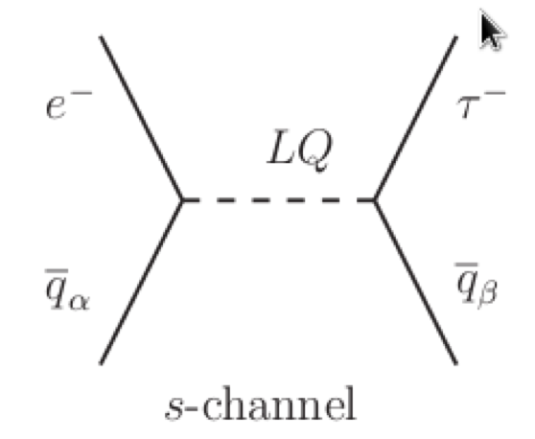
Other Jets at EIC
Yulia Furletova
Strong coupling (HERA)
Gluon pdf (HERA)
Remnant –jet
Diffractive –jet
Photon remnant
Charm jet
Charged current DIS
Tau -jet
Notes:
Interior Page Design 2

Slide 17
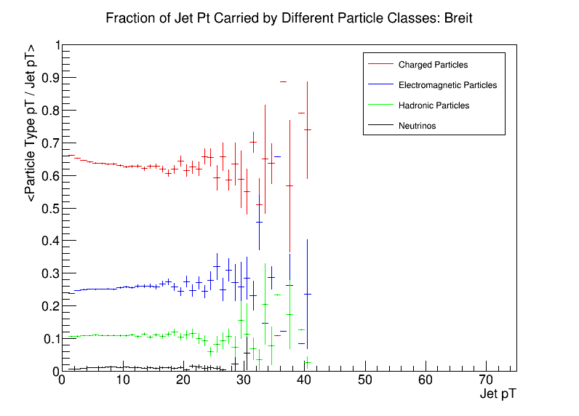
Particle p_{T} Fractions Vs Jet p_{T}
Brian Page
Take vector sum of particles of given type and find total transverse momentum
Plot average p_{T} of each particle class vs total jet p_{T}
See that charged particles dominate while neutral hadrons contribute roughly 10%
Notes:
Slide summarizes the section of my talk on particle fractions in jets and whether or not we need a hadron calo at mid rapidity. Shows that neutral hadrons comprise only ~10% of jet pT

Slide 18
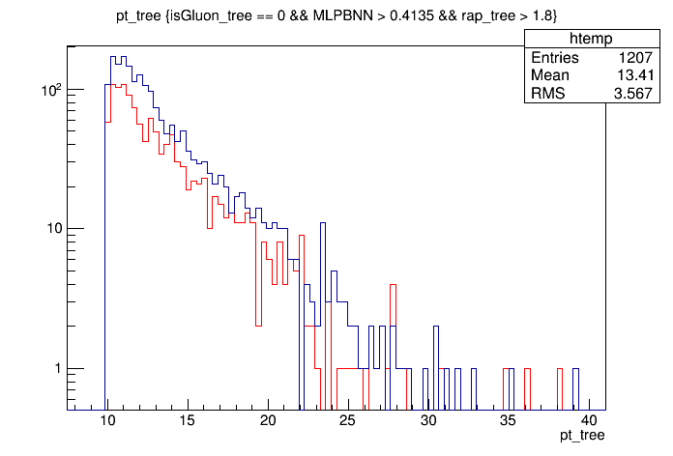
Jet p_{T} Spectra With Rapidity Cut
Brian Page
Red = Quark After MV & Rap Cut (1207)
Blue = Gluon After MV & Rap Cut (1941)
Plot jet p_{T} after all cuts
See reasonable enhancement of gluon jets over p_{T} range
Should be able to get relatively pure quark sample and enhanced gluon sample for applications which require identification
G/Q = 1.61
G/(G+Q) = 62%
Notes:
pT spectra for jets arising from quark and gluon initiated jets after application of cuts optimized in neural network and rapidity cut.

Slide 19
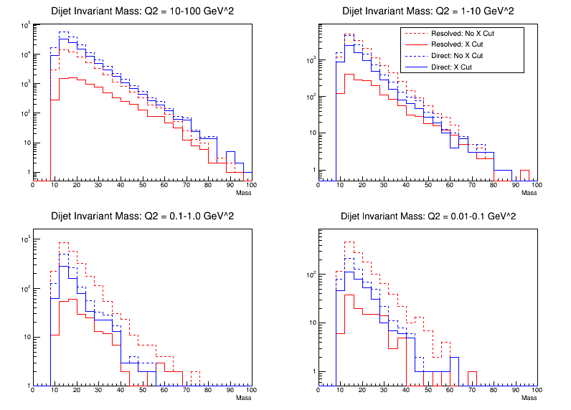
Di-jet Invariant Mass
Brian Page
See that the cut on X_{γ} significantly reduces the resolved contribution while maintaining the direct events
Separation between resolved and direct is most prominent at high Q² and low di-jet invariant mass
Further suppression of resolved events may be possible by looking at lab-frame rapidity correlations
Q² = 10 - 100
Q² = 1 - 10
Q² = 0.1 – 1.0
Q² = 0.01 – 1.0
Notes:
Dijet mass spectra for direct and resolved events before and after cuts on X_gamma meant to suppress resolved contribution

Slide 20
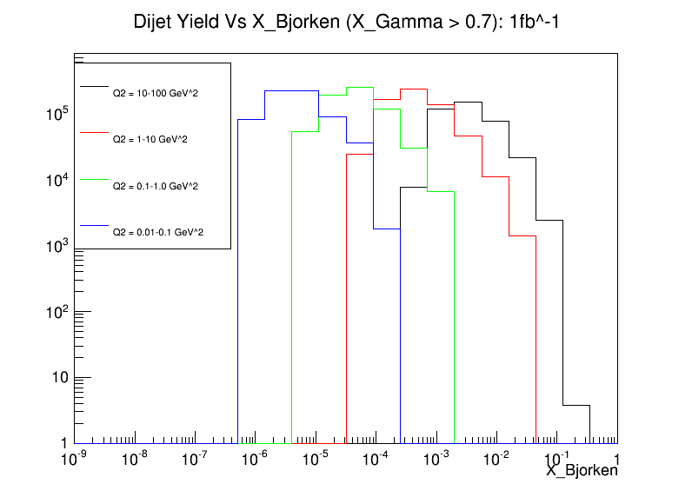
Di-jet Yield in X and Q²: 1fb⁻¹
Brian Page
Yield of di-jet events which pass X_{γ} cuts vs x_{B} for the four Q² bins simulated
Yield has been scaled to an integrated luminosity of 1fb⁻¹
See multiple decades of Q² coverage for several x_{B} bins
Different x_{B} ranges can be accessed at a given Q² by varying the collision energy
Study is in early stage but outlook is positive – can isolate direct contribution even at low Q²
Notes:
Yield of selected direct dijet events in 4 Q2 bins as a function of x_B scaled to an integrated luminosity of 1fb^-1

Slide 21
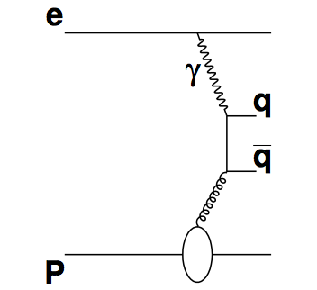
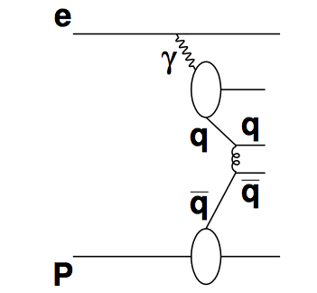
Xiaoxuan Chu
There are two types of processes which can produce di-jet through hard scattering: direct and resolved process.
direct
resolved
Only in resolved process, the photon has a structure. Then we can separate theses two types of processes at EIC by reconstructing
resolved
direct

Slide 22
Xiaoxuan Chu
Photon PDFs can be extracted by measuring di-jet cross section in photoproduction events.
We can reproduce the HERA data by using EIC simulation to measure di-jet cross section in photoproduction events (seen the figure on right), which indicates our EIC simulation is reliable.

Slide 23
Xiaoxuan Chu
Di-jet cross section measured at EIC
The simulation shows the capability to measure the cross section for di-jet production, with high accuracy in a wide kinematic range at EIC and extract the photon PDFs from a global fit.

Slide 24
Distinguish the mechanisms of rho broadening
Lijuan Ruan
Possible to distinguish between models (blue and red curves) after upgrade (red errors)
Knowing the mechanism that causes in-medium rho broadening and its
temperature and baryon-density dependence is fundamental to our understanding
and assessment of chiral symmetry restoration in hot QCD matter !
Turn off hot medium effect: electron-positron pair at the EIC? Understanding the
rho modifications in cold nuclear matter (e+A versus e+p) is fundamental!

Slide 25
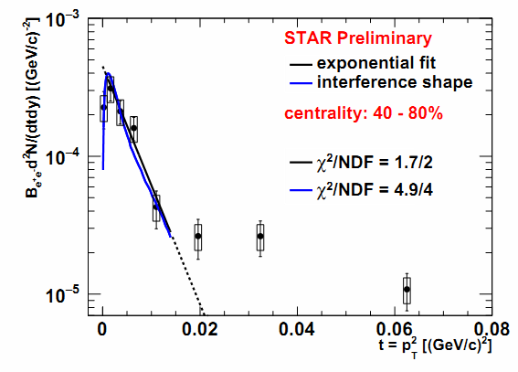
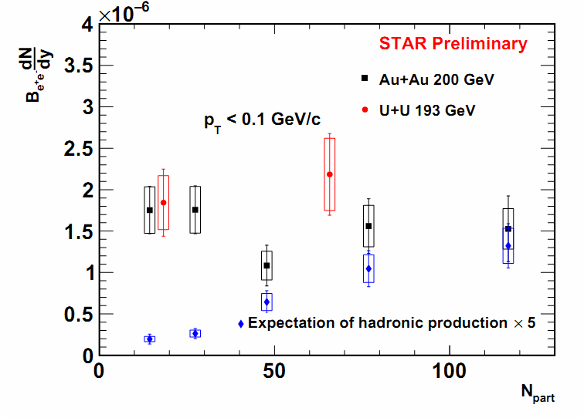
J/ψ yield :t=p_{T}² and centrality dependence
Lijuan Ruan
30 – 40%
Slope parameter consistent with the size of the Au nucleus. Interference structure observed. Coherent photon-nucleus interactions?
No significant centrality dependence of the excess yield! Interplay between photon flux cancellation in the overlapped area and the distance of the spectators of the two nuclei?
Simulations ongoing and need theoretical inputs!

Slide 26
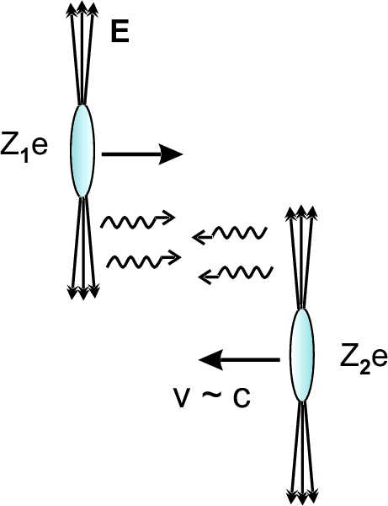
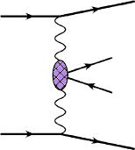
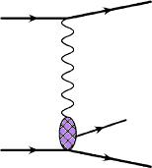
Coherent photonuclear and two-photon processes
Lijuan Ruan
=
+
Ann. Rev. Nucl. Part. Sci.55:271
(2005)
V=ρ , ω , φ , J/ψ
Two-photon
photonuclear
Studied extensively in ultra-peripheral collisions
How is the J/ψ from coherent photonuclear process affected by hot and cold QCD matter! Why do we still be able to observe these J/ψs?
A new tool to study enriched multi-body dynamics on the strong QCD force!
EIC serves as an ideal factory to study the cold QCD matter effect.
Study the very low p_{T} J/ψ production as a function of p_{T}2, multiplicity, and system size dependences (by varying nucleus type) in e+A collisions and also compare the measurements in e+A to those in e+p one (R_{eA}). Is it feasible?

Slide 27
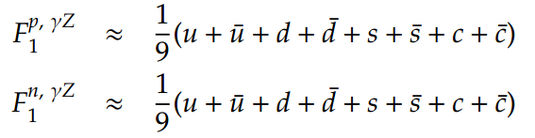
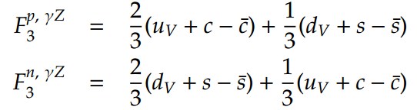
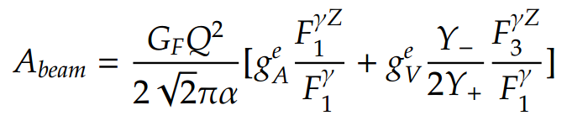
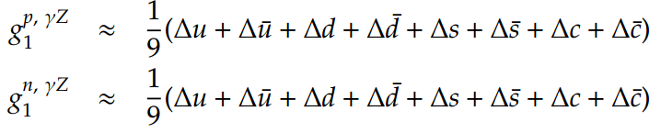
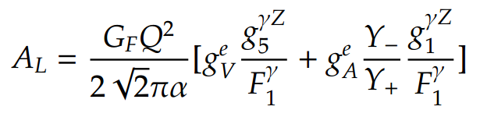
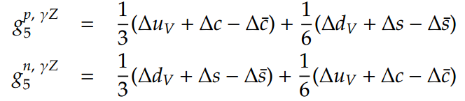
Electroweak physics at the EIC
Yuxiang Zhao
parity violating asymmetries are associated with a new series of structure functions
EIC offers new opportunities to access new structure functions and measure weak mixing angle at high Q²
With parity violation and Q² << Z²
pol. electron & unpol. nucleon:
unpol. electron & pol. nucleon:

Slide 28
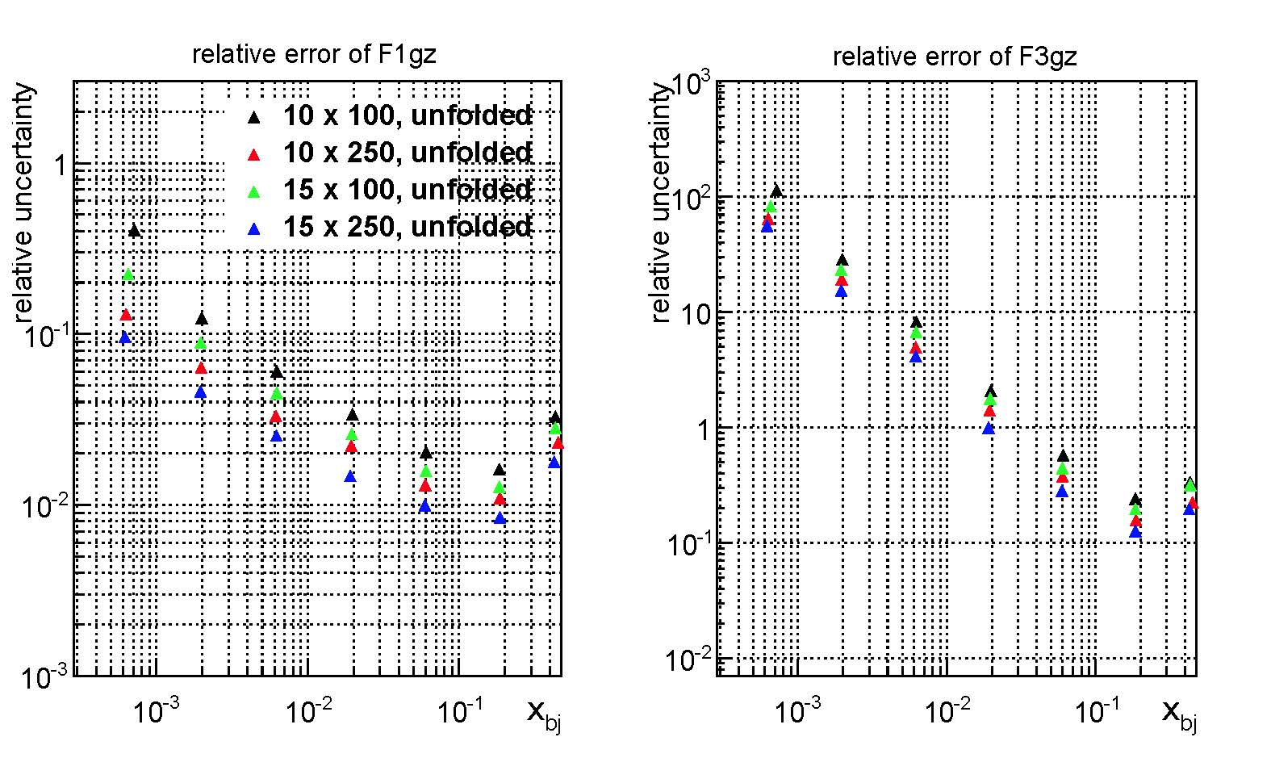
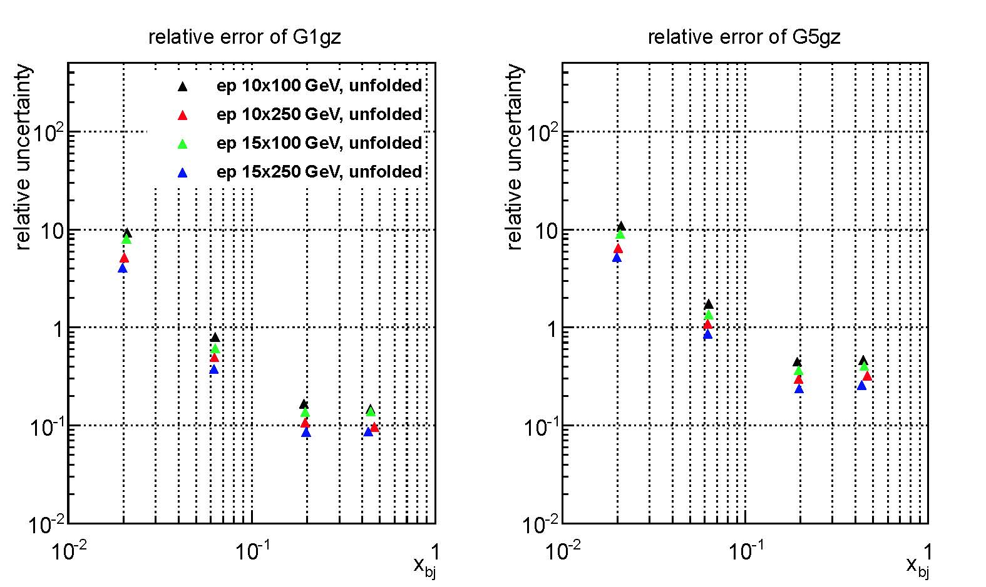
Structure functions study with e-p collisions
Yuxiang Zhao
500 fb⁻¹

Slide 29
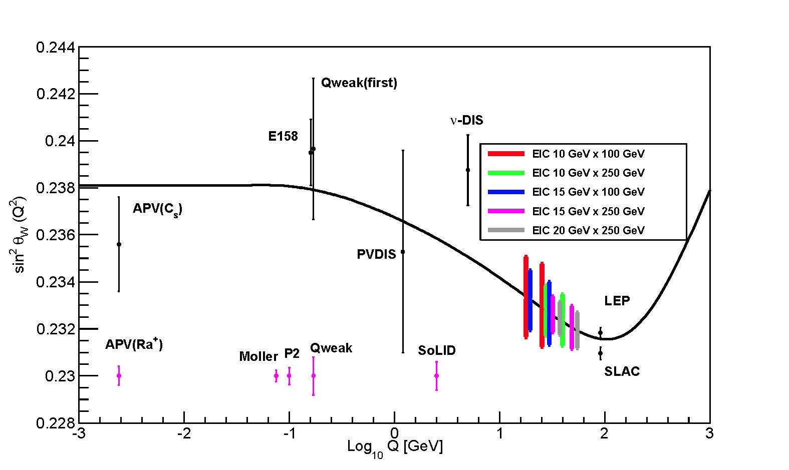
Weak mixing angle study with e-D collisions
Yuxiang Zhao
  APV ~ 20/3 sin²Ө_{w} -1
267 fb⁻¹ per nucleon

