Slide 1
Electroweak physics at an EIC
Yuxiang Zhao
July-8-2016
EIC user group meeting
A. Deshpande, K. Kumar, S. Riordan (SBU)
J. Huang(BNL)

Slide 2
Outline
Electroweak physics at an EIC
Nucleon spin structure
Measurements in e-p(n) DIS processes in the past decades
Weak neutral currents at an EIC offer a new opportunity
The weak mixing angle sin²Ө_{w}
Simulations and projections
Generator and detector smearing
Projections on unpolarized/polarized structure functions and sin²Ө_{w}
Summary

Slide 3
Structure functions and PDFs in e-p(n) DIS processes ---Before EIC
Experimental observables
PDFs
Unpolarized cross section
Unpolarized pdfs:
~50%
f(x)=q↑(x) + q↓(x)
Unpolarized structure functions
Quark-Parton Model
QPM
F₁^{ү} F₂^{ү}
A_{LL} A_{LT}
Polarized pdfs:
~30%
Spin crisis
Helicity distribution ∆q=q↑(x) - q↓(x)
Polarized structure functions
No g₂ interpretation in QPM
g₁^{ү} g₂^{ү}
SIDIS to access TMDs, DVCS to access GPDs … 3D era … ongoing efforts at JLab

Slide 4
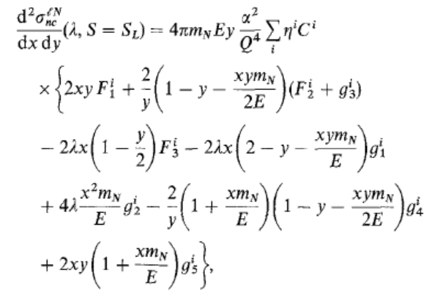
EIC offers new opportunities with weak neutral currents
Anselmino, Efremov, Leader, Ji …
Phys. Rep. 216 (1995)
With parity violation and Q² << Z²
Inclusive electron measurements
pol. electron & unpol. nucleon:
unpol. electron & pol. nucleon:

Slide 5
New structure functions ---ү-Z interference structure functions
pol. electron & unpol. nucleon:
unpol. electron & pol. nucleon:

Slide 6
New structure functions ---ү-Z interference structure functions
pol. electron & unpol. nucleon:
unpol. electron & pol. nucleon:

Slide 7
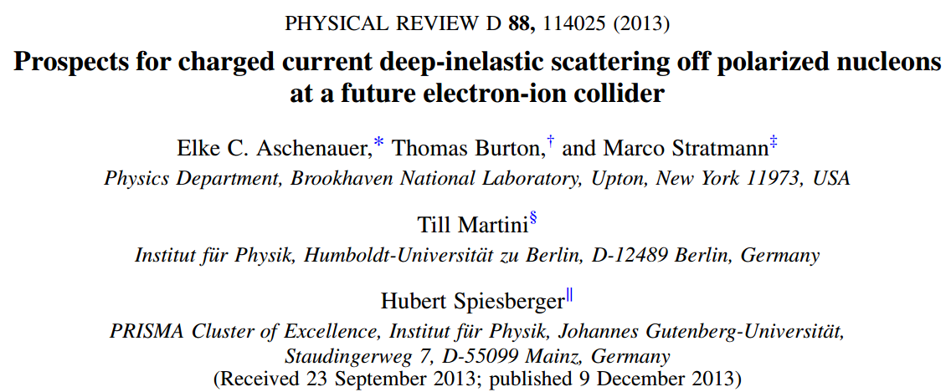
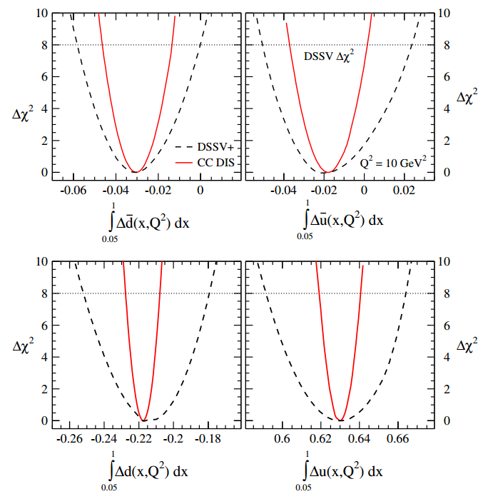
W exchange in DIS region

Slide 8
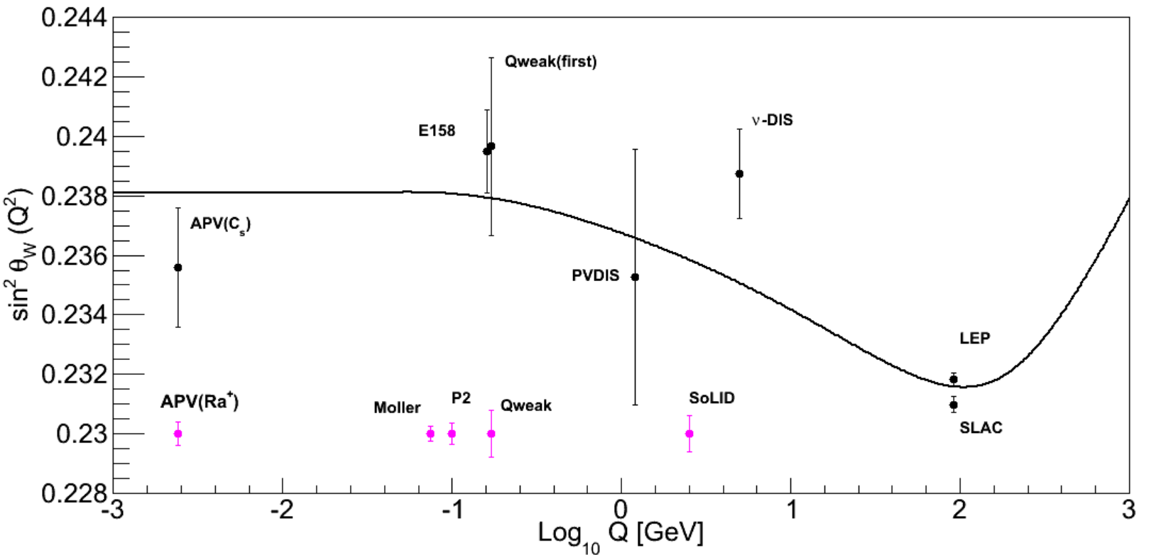
Parity-violating asymmetries in e-D collisions
Deuteron has same amount of u and d in x>0.2 region
APV ~ 20/3 sin²Ө_{w} -1
Fundamental quantity in SM, constraints on new physics, such as new Z boson etc.
1 loop calculation
Czarneckl and Marciano

Slide 9
Simulations
DJANGOH generator simulates DIS processes including QED and QCD effects at NLO
Developed by Hubert Spiesberger and used at BNL for the EIC Charged Current study
Electron-proton collisions to study new structure functions
The data is binned in (x, Q²) two dimensions
Doing Y dependent fit to extract projections on F₁^{үZ} , F₃^{үZ} , g₁^{үZ} , g₅^{үZ}
sin²Ө_{w} projections are from electron beam asymmetries in e-D collisions
Highlights of the projections:
Cuts:
Q²> 1 GeV², W_{h}>2 GeV, y>0.1, p cut for structure function studies
Q²<6400 GeV² and x>0.2 in addition for sin²Ө_{w} projections
Unfolding for kinematical migration due to radiation and finite detector resolution

Slide 10
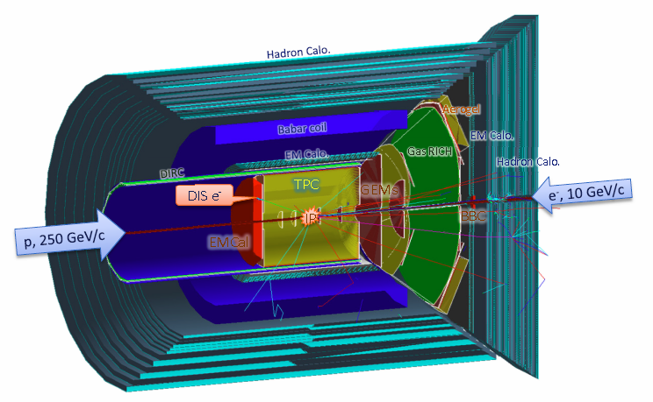
Day-1 EIC Detector
Please refer to Kenneth N. Barish’s talk for details

Slide 11
Detector smearing
Tracking
EMCal:
Reference [2]
Reference [1]
Thanks to the inputs from Jin Huang, Alexander Bazilevsky, Craig Woody

Slide 12
Luminosity and polarization table (e-p collisions)
e-p collisions | 10x100, 10x250, 15x100, 15x250
Run time luminosity | 10³⁴ /cm²/s
Detector efficiency | 70%
Beam efficiency | 70%
Beam time for running | 2.5 years 5 months per year = 12.5 months
luminosity after all efficiencies | 40 fb⁻¹ per month
Integrated luminosity | 500 fb⁻¹
Proton (electron) beam polarization | 70% (80%)
Uncertainty of proton (electron) beam polarization | 5% (2%)

Slide 13
Luminosity and polarization table (e-D collisions)
e-D collisions | 10x100,10x250,15x100,15x250,20x250
Run time luminosity (per nucleon) | 10³⁴ /cm²/s
Detector efficiency | 70%
Beam efficiency | 70%
Beam time for running | 200 days
luminosity after all efficiencies | 40 fb⁻¹ per month
Integrated luminosity | 267 fb⁻¹
Electron beam polarization | 80%
Uncertainty of electron beam polarization | 2%

Slide 14
Unpolarized structure functions
e-p collisions
electron: longitudinally polarized
proton: unpolarized
Integrated luminosity: 500 fb⁻¹

Slide 15
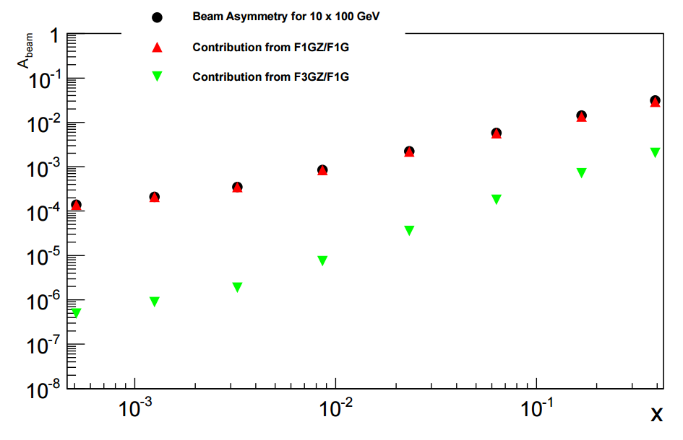
Predicted asymmetries
F₁^{үZ} dominates the asymmetry

Slide 16
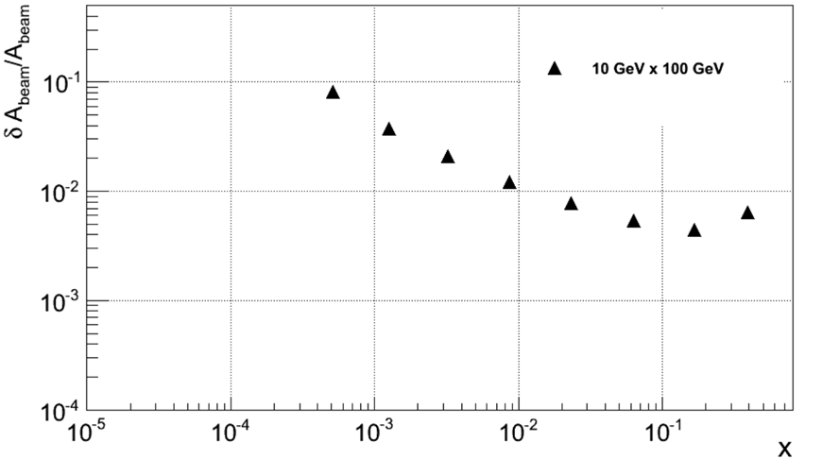
δA/A as a function of x
δA(sys)/A < 0.5%
Lumi. Sys. ~ 5x10⁻⁴

Slide 17
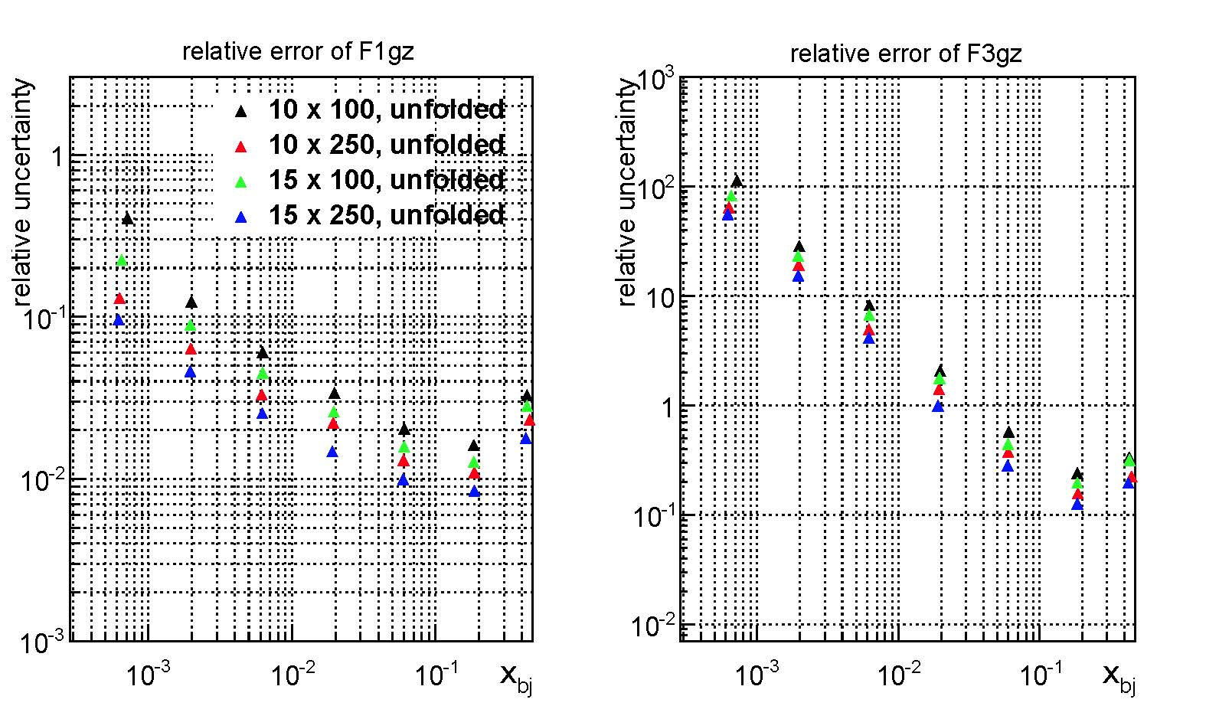
Unpol. SFs projections after unfolding

Slide 18
Polarized structure functions
e-p collisions
e: unpolarized
p: longitudinally polarized
Integrated luminosity: 500 fb⁻¹

Slide 19
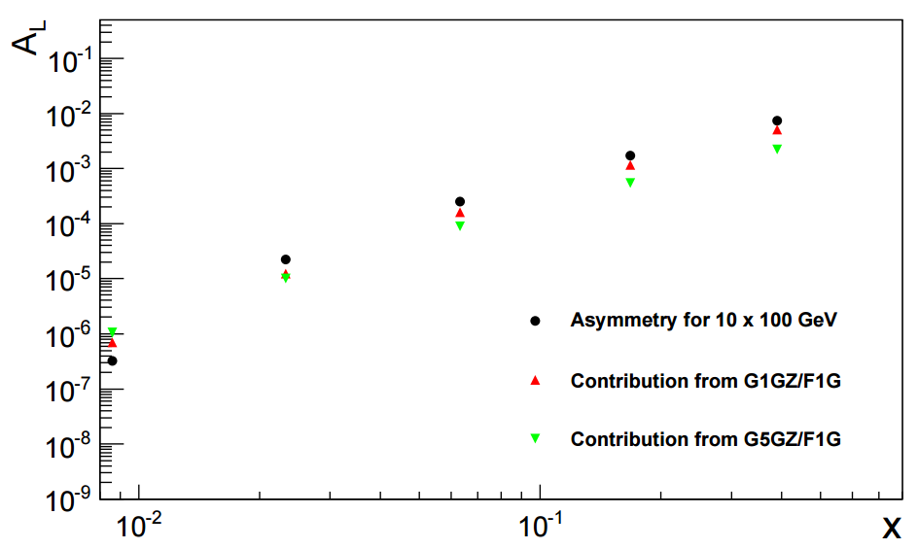
Predicted asymmetries

Slide 20
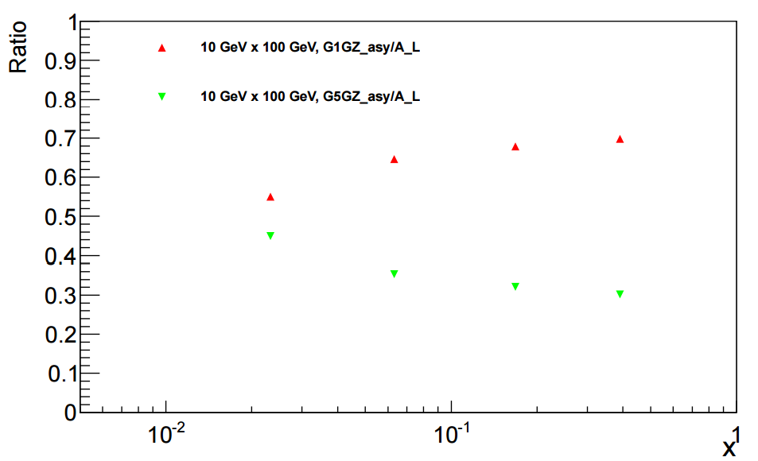
Predicted asymmetries

Slide 21
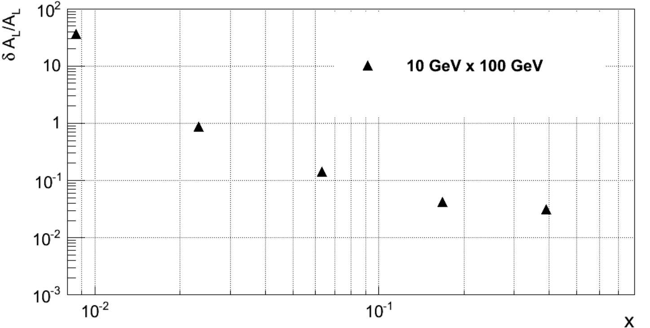
δA/A as a function of x
δA(sys)/A < 3%
Lumi. Sys. ~ 3x10⁻⁴

Slide 22
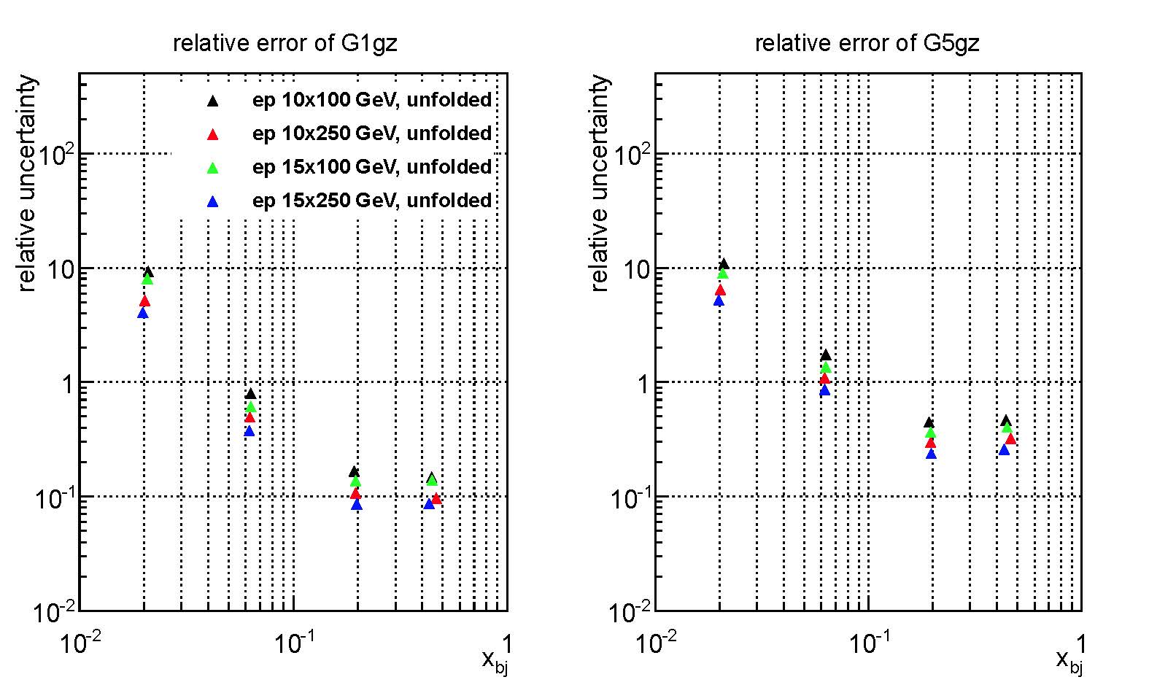
Pol. SFs projections after unfolding

Slide 23
Weak mixing angle
e-D collisions
e: longitudinally polarized
D: unpolarized
Integrated luminosity: 267 fb⁻¹ (200 days)

Slide 24
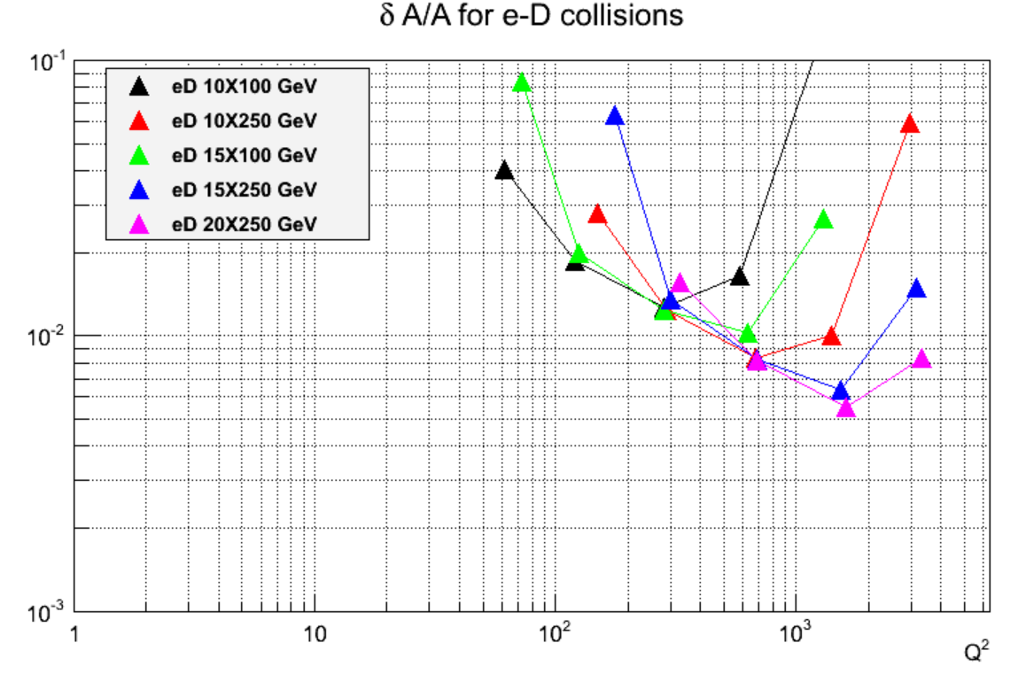
δA/A for e-D collisions
Polarimetry ~1% at the beginning and then 0.5% for higher energy and higher luminosity
Alex’s R&D proposal :
target at 1%
Experience:
Parity experiments drive the precision frontier of electron polarimetry: SLAC, PREX/CREX, MOLLER, SoLID
Lumi. Sys. ~ 5 x 10⁻⁴

Slide 25
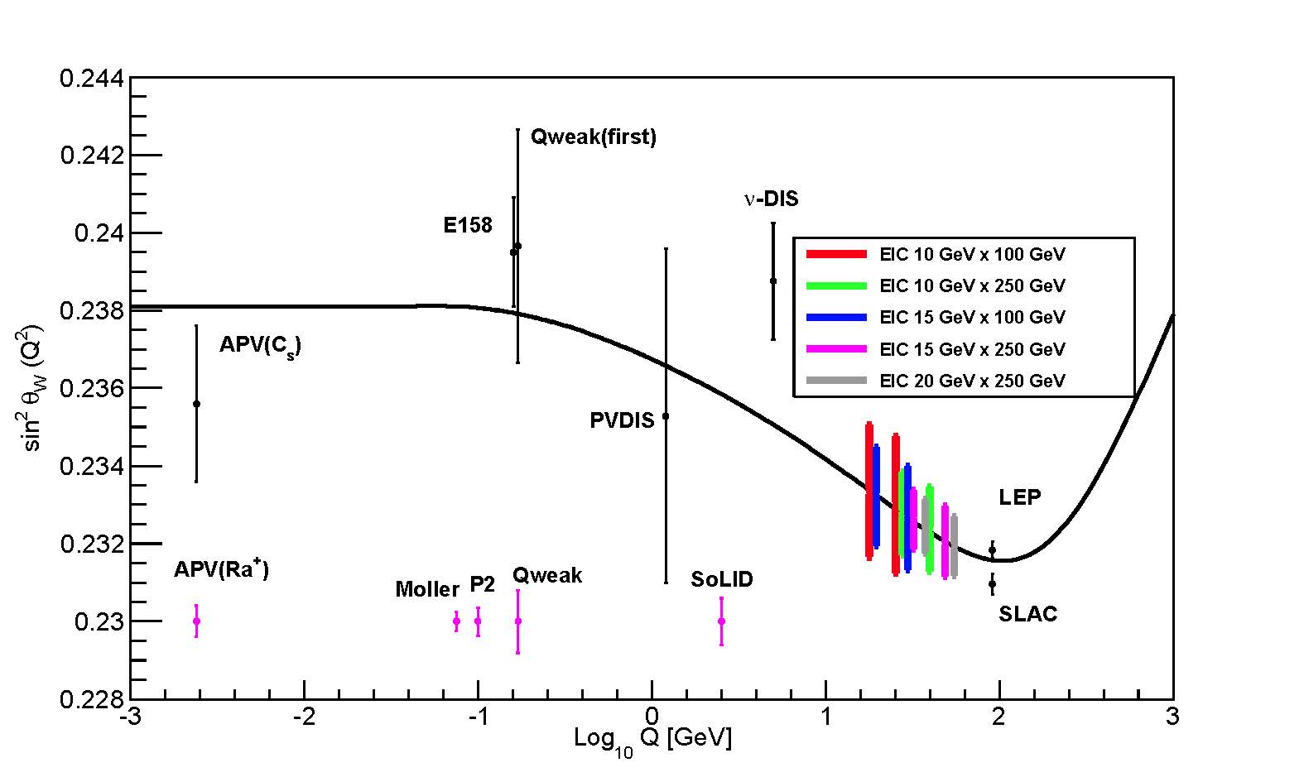
World data of sin²Ө_{w} including EIC projections
200 days of dedicated run
Can reach similar precision
to SoLID measurement
Interesting Q² region never
been measured or planned

Slide 26
Summary
Presented the projections of new unpol./pol. structure functions
Unique combinations of PDFs
Brand new, never been measured before
Independ inputs to the world data with high precision
Presented the projections of weak mixing angle
Dedicated 200 days of beam time
Reach relative high precision in an interesting Q² region
Next step …
Investigating the impact of the measurements of these structure functions on PDF fits
Systematic uncertainties, Z contributions…

Slide 27
Backups

Slide 28
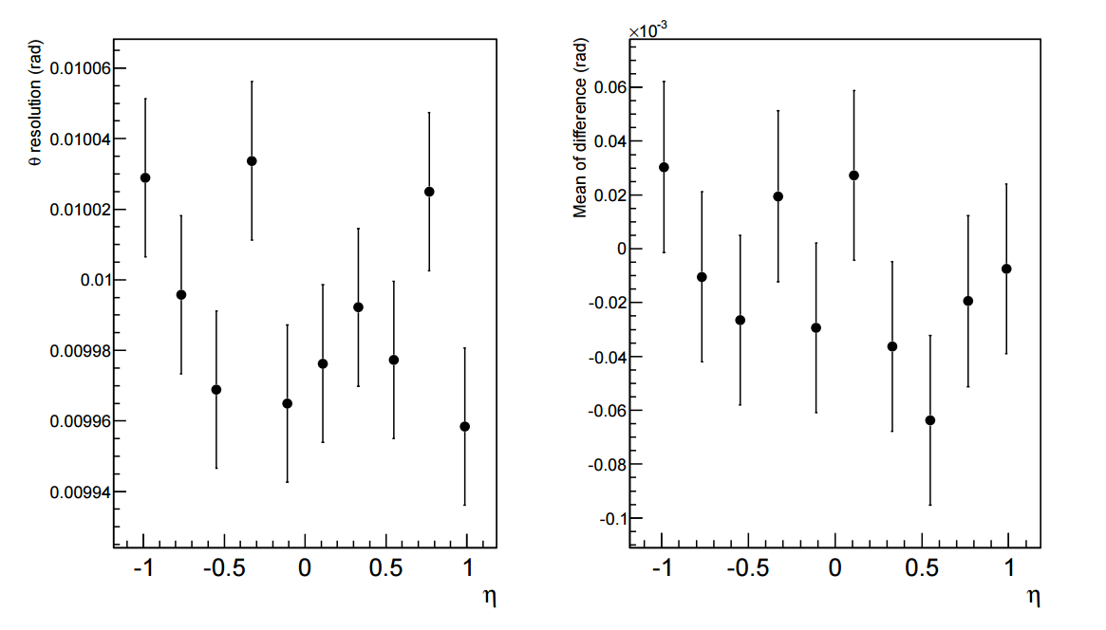
Check of detector smearing ---theta
Input resolution is 10 mrad

Slide 29
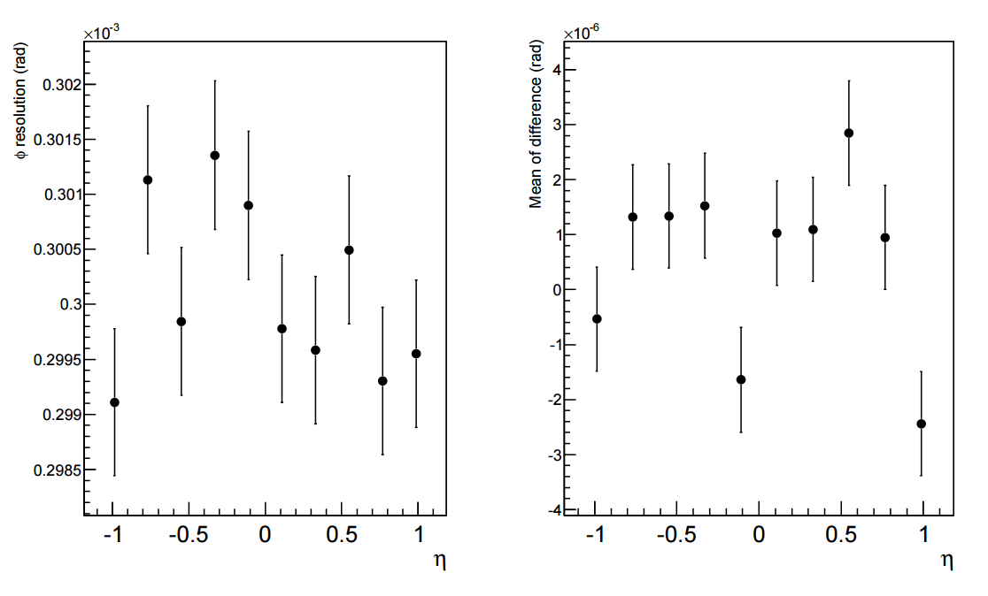
Check of detector smearing ---phi
Input resolution is 0.3 mrad

Slide 30
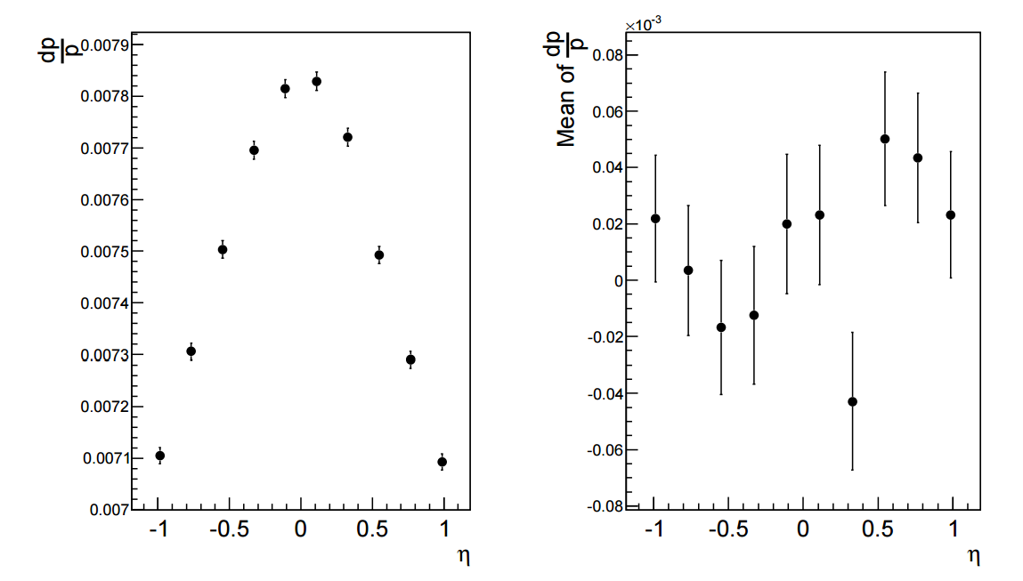
Check of detector smearing ---dp/p (for 5 +/- 0.1 GeV particles)

Slide 31
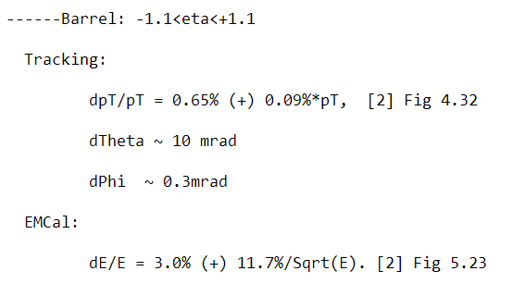
Parametrized detection resolutions for inclusive electrons

Slide 32
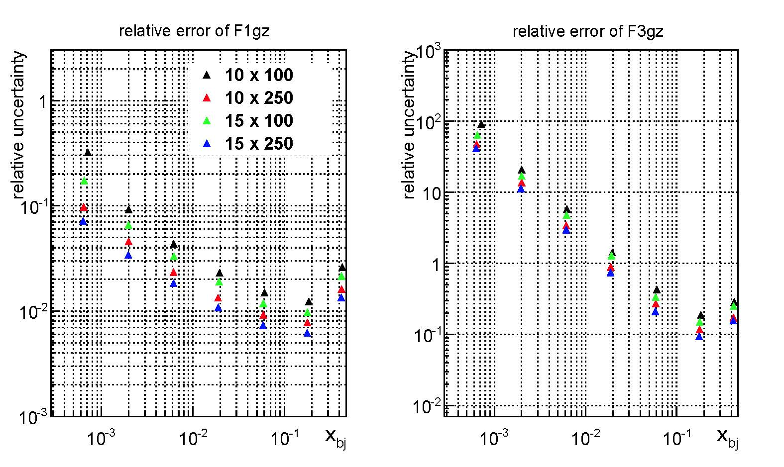
Projections on the measured yield (before unfolding)

Slide 33
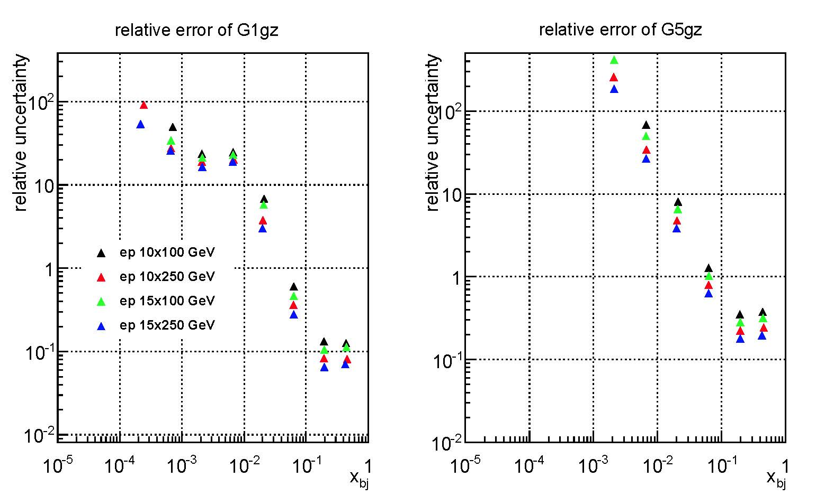
Projections on the measured yield (before unfolding)
Due to the sign change
of g1gz function

Slide 34
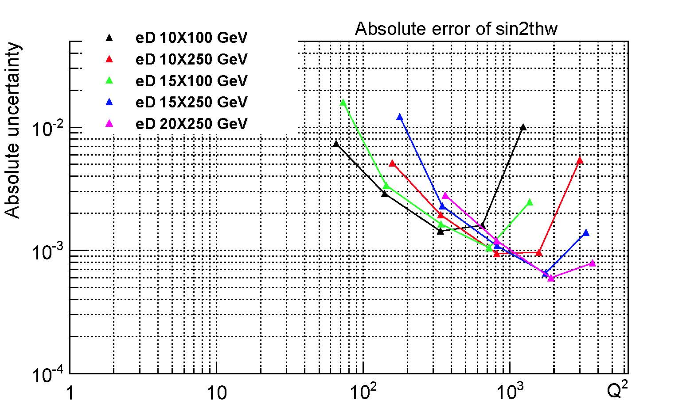
Projections on measured yield

Slide 35
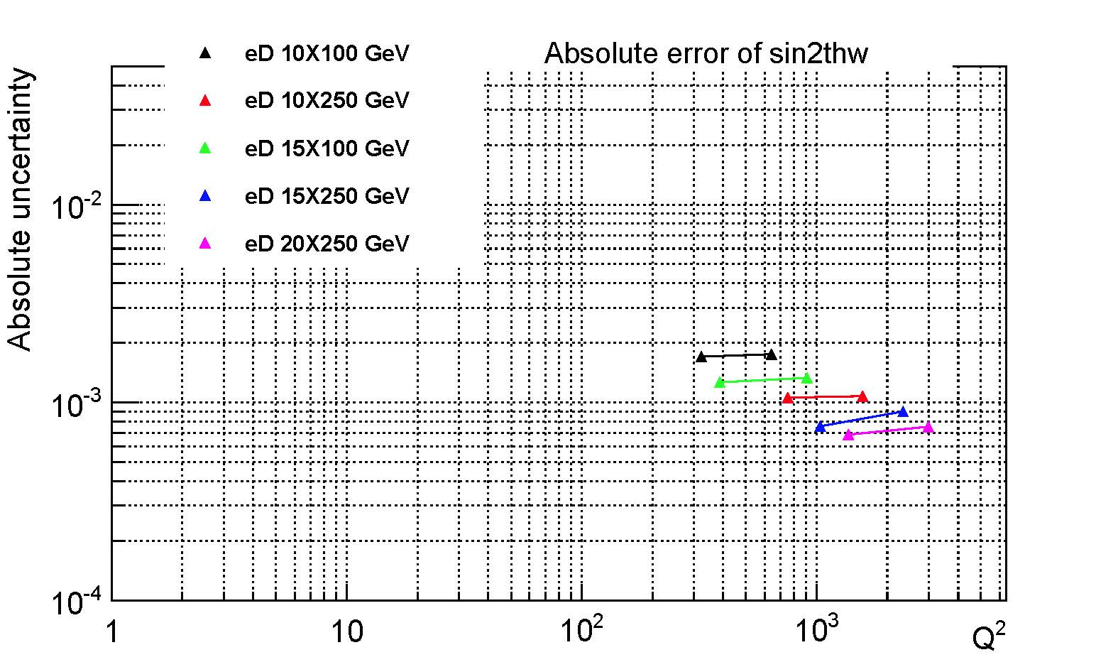
Projections considering bin migration

