Slide 1
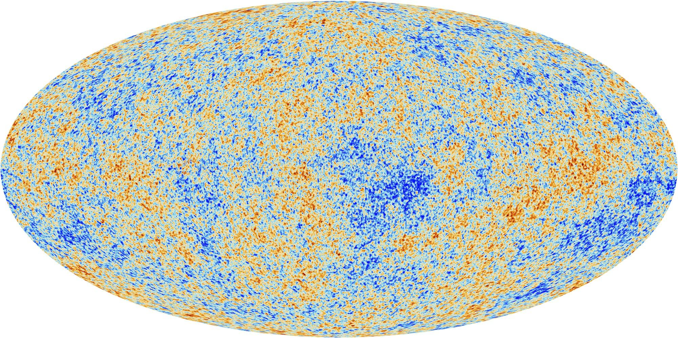
CMB Cosmology
& DOE/NSF/NASA Planning for the Coming Decade
Jamie Bock
California Institute of Technology
Jet Propulsion Laboratory
CPAD Instrumentation Frontier
Pasadena, 9 October 2016

Slide 2
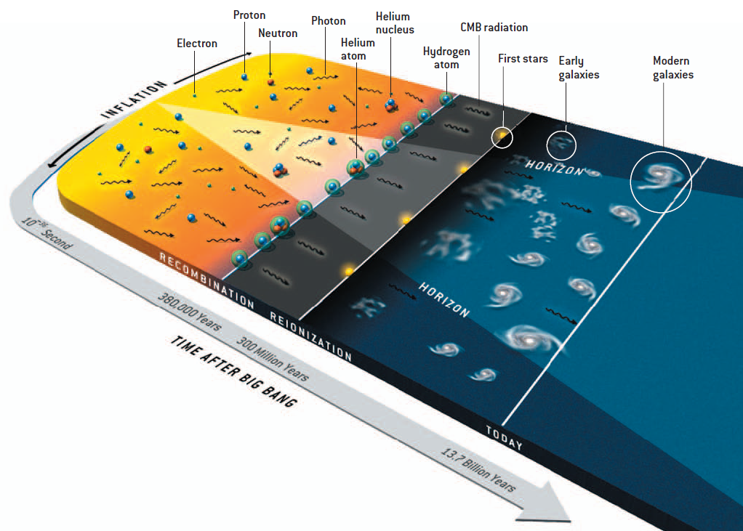
CMB Polarization Science
Test inflation physics
search for gravitational wave background
Neutrinos & light particles
size scales at recombination
evolution of large scale structure
History of Reionization
Notes:
CMB >> EBL
Two peaks from starlight and thermal dust emission
The background is the integral of luminosity density over cosmic history
- can measure with absolute photometry, galaxy counts
- a check that we aren’t missing populations
- if these agree then there is more information in the counts
The EBL is also a tool, a way to study objects that cannot be individually detected
- look at the spatial properties of a map to study sources below the detection threshold
- traces the population of galaxies producing photons on average
- galaxies trace dark matter
- can be done with a ‘small’ telescope
First peak to study then will be the FIR peak and we will come back to the optical/NIR peak later

Slide 3
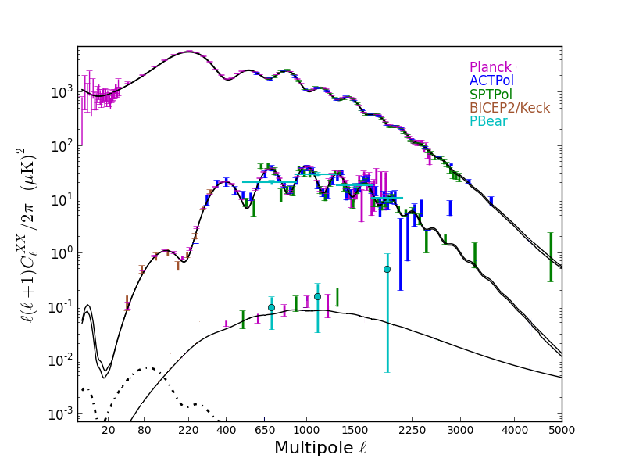
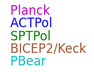
CMB Power Spectra
10º
1º
Angular Size [º]
0.1º
Temperature
c. 2015
Signal [μK²]
Gravitational
Lensing
E-Mode
Polarization
Recombination
bump
Reionization
bump
Gravitational
Waves at r=0.1
B-Mode
Polarization
Angular Frequency [ℓ]
Lyman Page 2015
Notes:
Finally here is the signal we are looking for, plotted at a fairly high amplitude. The signal peaks at an angular size of about 2 degrees, but it is very faint. The most interesting range is arguably 1 – 10 %, predicted by the first inflation models.

Slide 4
CMB Lensing Traces Large-Scale Structure
Planck 2015
Lensing derived from the gradient of the CMB temperature (and E-mode polarization)
However TT and EE have cosmological noise: best information will come from BB!
Notes:
A B-mode pattern flips in a mirror. It cannot be made by density waves.

Slide 5

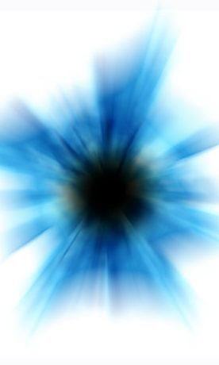
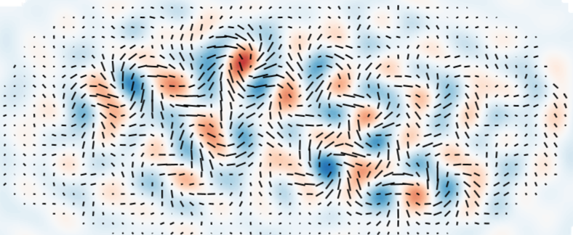
How Can We Test Inflation?
Inflationary gravitational waves: CMB “B-mode” polarization
Spectral index of fluctuations: CMB and large-scale structure
Non-Gaussianity: Large-scale structure (galaxies, HI)
Sub-atomic
vacuum fluctuations
of “inflaton”
Density perturbations studied
by Planck, WMAP, SPT, etc.
Inflation
Gravitational waves?
→ telltale polarization pattern
Sub-atomic
vacuum fluctuations
of graviton (quanta of gravity)

Slide 6
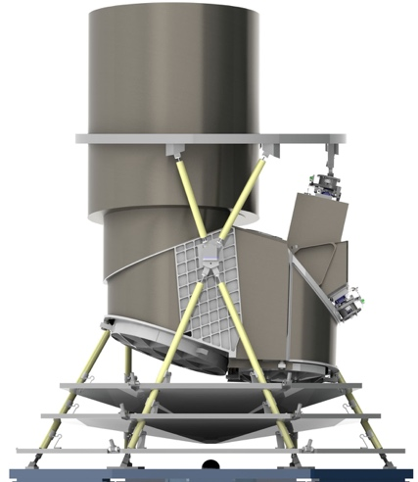
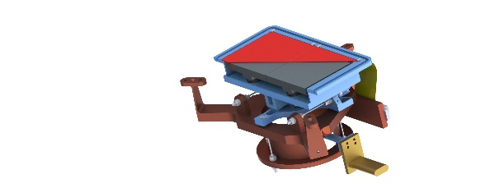
Non-Gaussianity as a New Probe of Inflation
The SPHEREx All-Sky Spectral Survey
SPHEREx Instrument
Linear variable filter spectrometer
Passive cooling
system
20 cm telescope effective diameter
3.5° x 7° field of view
6.2″ pixel size
0.75 – 5 μm wavelength range
λ/Δλ = 40-135 resolving power
spherex.caltech.edu

Slide 7
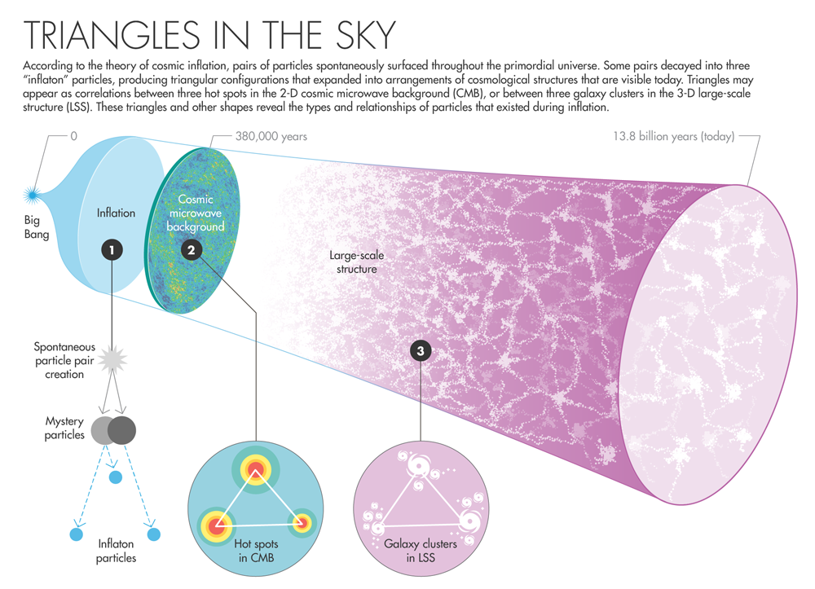
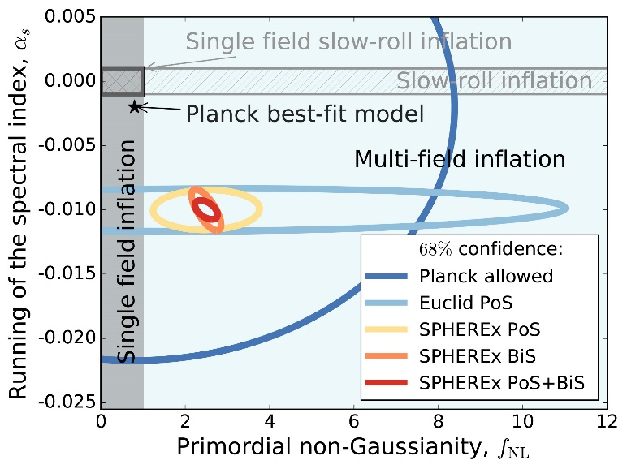
Use Large-Scale Structure to Measure NG
Image Credit: Natalie Wolchover / Quanta Magazine
Large Volume 3-D galaxy survey
Optimized for large scales to study inflation
Two independent tests of non-Gaussianity
  Power spectrum
  Bispectrum
Improve non-Gaussianity accuracy by >10
Δf_{NL} ~ 5 accuracy today to Δf_{NL} < 0.5
Discriminates between fields
  Single-field inflation f_{NL} << 1
  Multi-field inflation f_{NL} > 1
Inflation via CMB & LSS: Abazjian et al. 2015
SPHEREx white paper: Doré et al. 2014

Slide 8
Current State of B-Mode Polarization Data
Foreground
cleaned

Slide 9
Implications for Inflation
Foreground cleaned
The field will probe to the r = 0.01 level by 2020
r = 0.028
+0.026
-0.025
r < 0.09 (95 % CF)
Polarization data have overtaken CMB temperature info!
Combined with temperature: r < 0.07

Slide 10
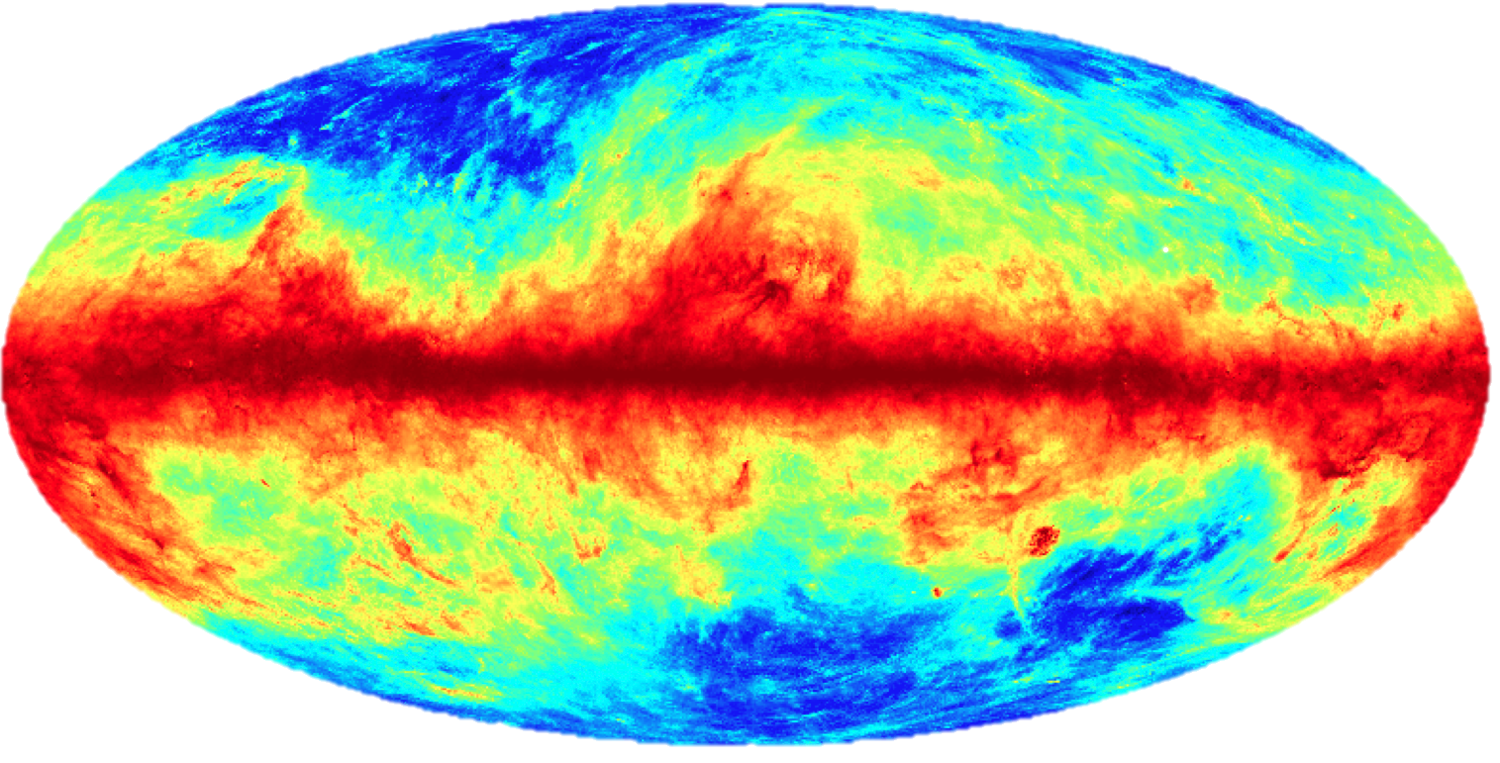
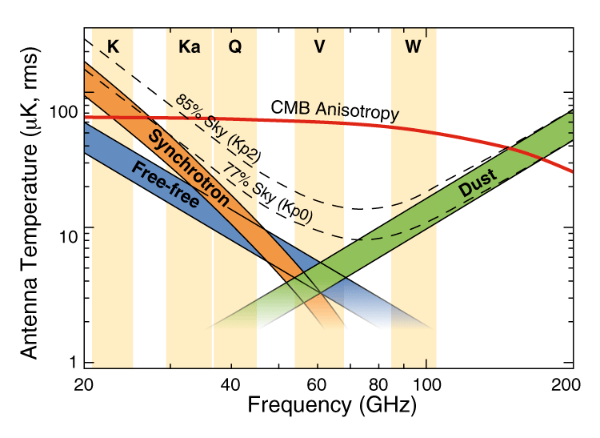
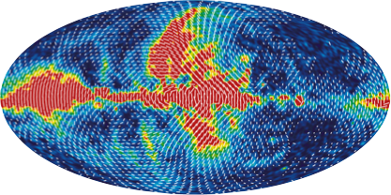
Foreground Challenges: the Galaxy
Model of Polarized Dust Emission
Map of Polarized Synchrotron Emission
  Synchrotron Spiraling electrons Emission α (Frequency)⁻³
  Dust Galactic dust grains Emission α (Frequency)^{1.75}
J. Filippini - Caltech - May 16, 2014

Slide 11
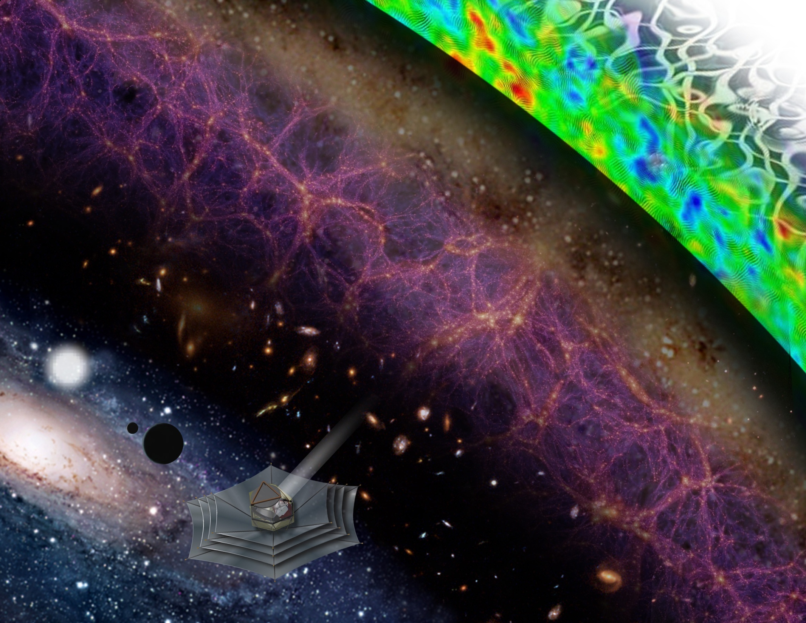
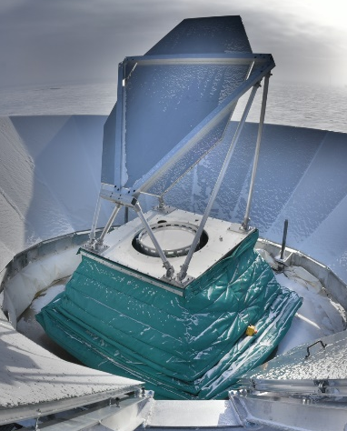
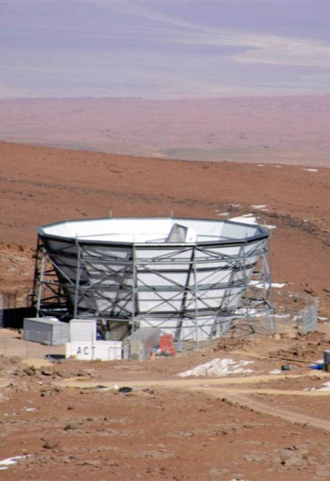
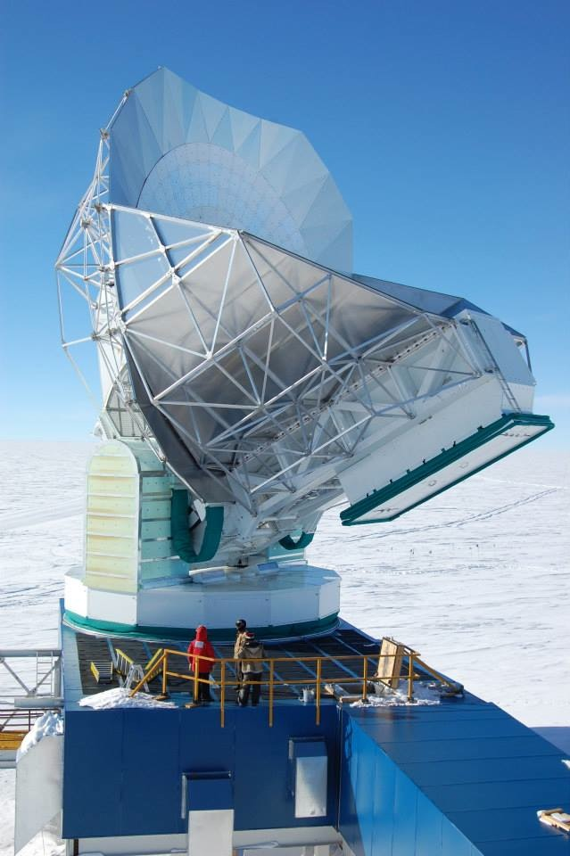
The Future of Polarization Measurements
Experiments 2016 – 2020
Measurements to r = 0.01 (3σ)
Focused on recombination bump
Deep foreground removal
Partial lensing removal
Spaceborne Measurements
All-sky, All-frequency
Determine exact value of r
Test statistical isotropy
Measure full spatial spectrum
Ground-Based Measurements
Large & Small Apertures
Small regions to great depth
Large-sky lensing
Neutrino masses, N_{eff}
Space: Inflation Probe
Ground: Stage-4 Program

Slide 13
BICEP Array: A “Stage 3½” Program

Slide 14
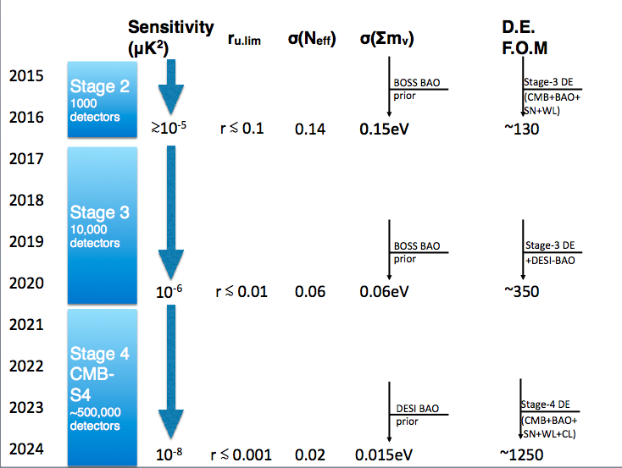
Stage IV CMB experiment: CMB-S4
The future enabled by CMB-S4:
Detect or rule out generic slow roll inflation, E~10¹⁶GeV
Measure the sum of the neutrino masses
Cosmological test of neutrino interactions and additional light species.
Greatly improve Dark Energy constraints and test General Relativity on large scales.
More fundamental discoveries?
“Natural Inflation Models” 10¹⁶ GeV: r~0.01
Path Forward is clear, Required technologies are in the pipeline
Next Step: Scaling to O(500,000) detectors
Slide: John Carlstrom
Notes:
Bottom line is that adding CMB doubles DE FoM at each stage. DID NOT SHOW THIS SLIDE AT DOE – KEPT CLUSTER AND DE OUT…
* Roughly 2016 - Stage-III - SN+BAO+WL+Clusters (DES+BOSS+SPT clusters) ~ 130
* Roughly 2020 - Add DESI to the above ~ 350 (depending on what you assume by redshift space distortions)
* Roughly 2024 - Stage-IV - SN+BAO+WL+Clusters (DESI BAO+LSST+S4 clusters) ~ 1250

Slide 15
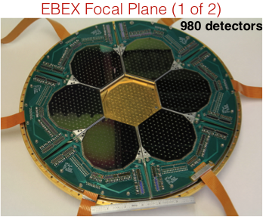
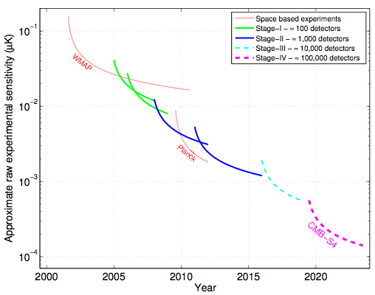
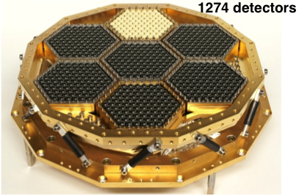

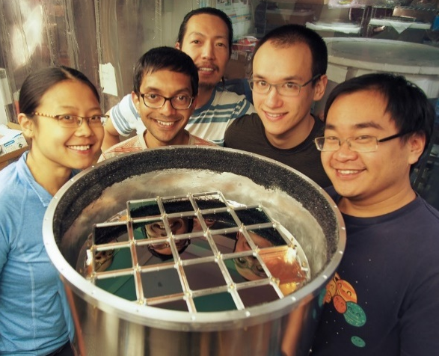
Detectors for S4: Betting on Moore’s Law
Sensitivity Projections
EBEX
Today
Increasing sensitivity
POLARBEAR
2560 detectors
BICEP3
Can we reach the goal of 500,000 detectors just by industrializing existing TES/SQUID technology?
Recent experience: BICEP3 x 200? Multiplexer hard to scale. Need to develop RF multiplexing with SQUIDs or KIDs.

Slide 16
TES Bolometers: They Work
E-mode Polarization Maps
Polarization Constraints on r
95 GHz
Experiment | Date | Bands | σ(r)
DASI | 2004 | 26… 36 | 7.5
BICEP1 2yr | 2009 | 100, 150 | 0.28
WMAP 7yr | 2010 | 30… 60 | 1.1
QUIET-Q | 2010 | 43 | 0.97
QUIET-W | 2012 | 95 | 0.85
BICEP1 3yr | 2013 | 100, 150 | 0.25
BICEP2 | 2014 | 150 | 0.10
BICEP2+Keck+Planck | 2015 | 150 + ext | 0.034
BICEP2+Keck+ext 2014 | 2015 | 95, 150 + ext | 0.024
BICEP2+Keck+ext 2015 | TBD | 95, 150, 220 + ext | ~0.018
150 GHz
Sensitivity
< 50 nK in 1 deg²

Slide 17
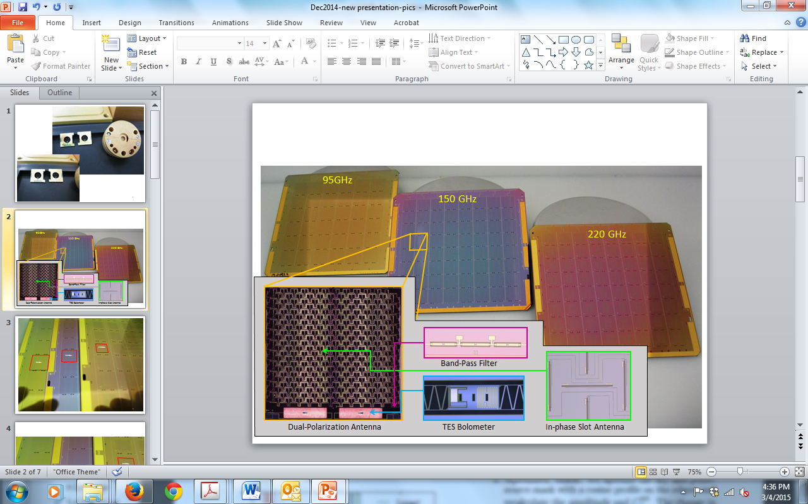
Detector Technology: Optical Coupling
Planar Antennas
JPL Deliveries 2005-2015
Frequencies: 95, 150, 220 GHz
Science wafers on sky: 88
Science detectors on sky: 10,144
Yield: ~30 %
So… how do you get to 500,000 detectors this way?

Slide 18
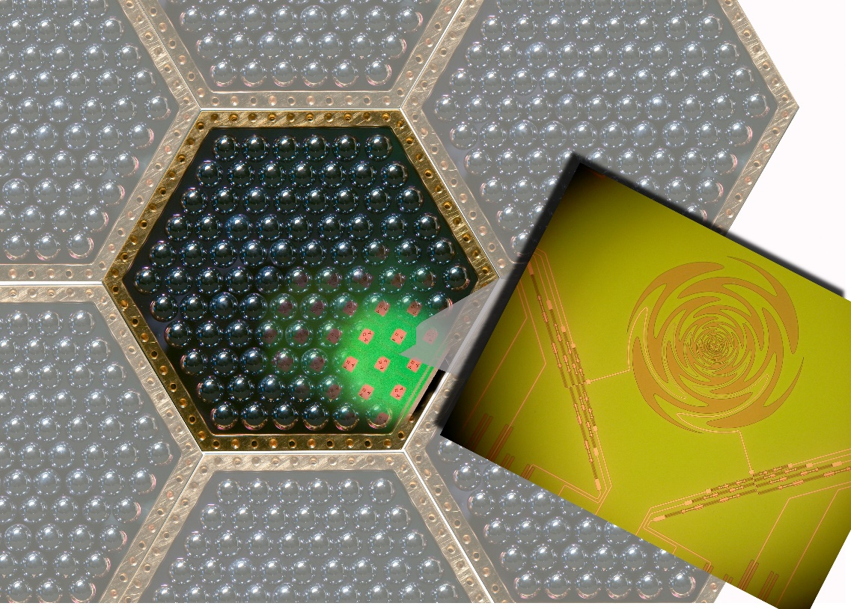
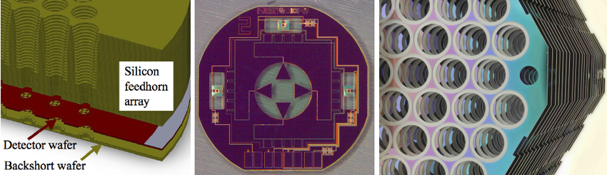
Detector Technology: Optical Coupling
Antenna + Lens
Antenna + Feedhorn

Slide 19
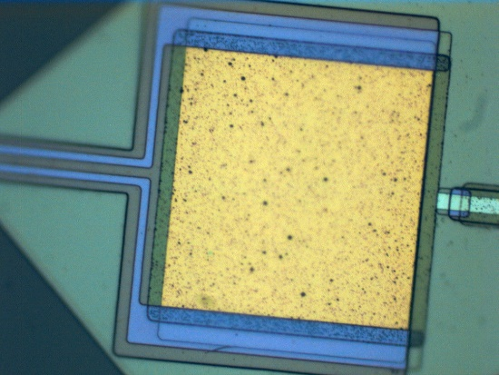
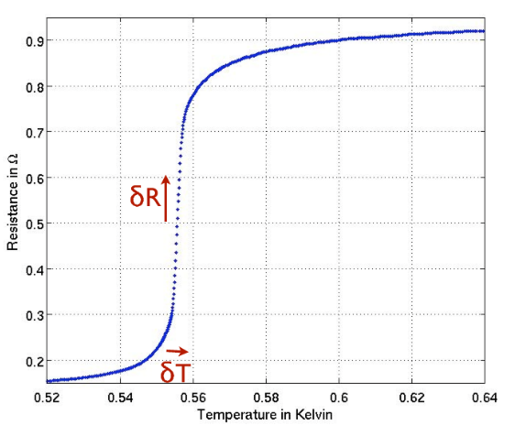
TES Detectors & SQUID Multiplexing
Transition-Edge Superconducting Bolometer
SQUID Time-Domain Multiplexing
SQUID Frequency-Domain Multiplexing
Pros / Cons
+ Proven NEPs
+ Proven noise stability
+ 2,500 detectors now routine
- SQUID muxing complex
- > 10⁴ detectors challenging

Slide 20
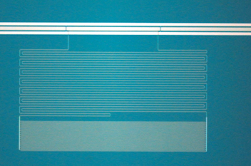
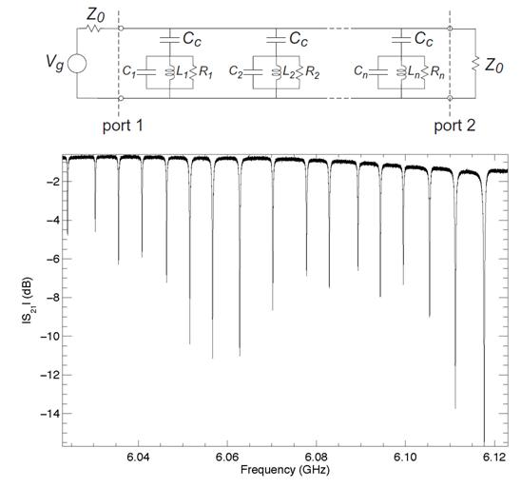
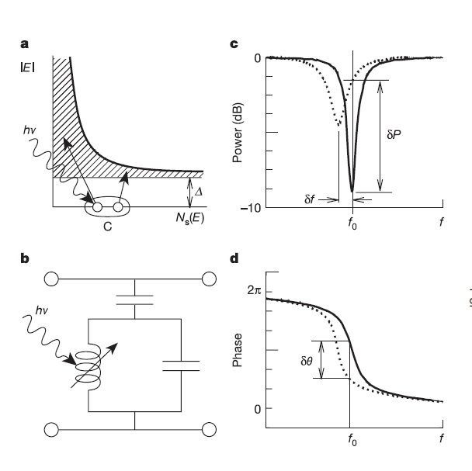
KID Detectors & RF Multiplexing
Radio-Frequency Multiplexing
L
C
Pros / Cons
+ Low NEPs demonstrated
+ RF muxing scales to large formats
+ RF SQUID/TES muxing also viable
- NEPs in CMB instrument?
- Noise stability?

Slide 21
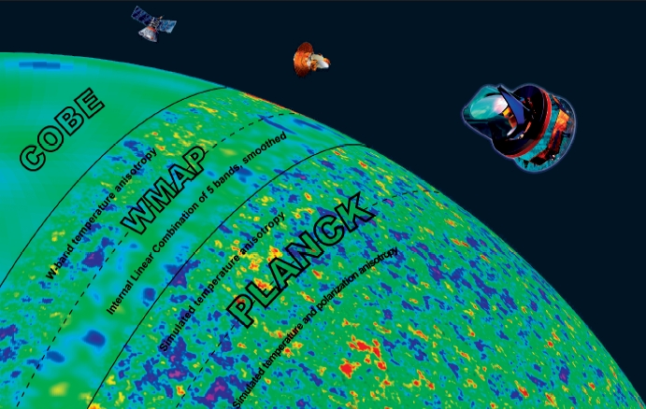
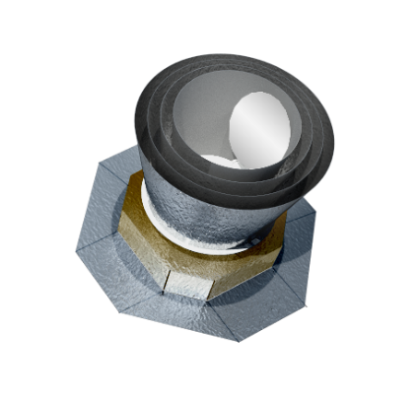
Planning for CMB Space Measurements
ESA M5 proposal submitted
~5′ resolution
2028 launch
JAXA phase-A concept
~20′ resolution
2025 launch
PIXIE
NASA MIDEX proposal concept
Polarimetry & absolute spectrum
~2° resolution
The NASA Inflation Probe:
Designed to extract all cosmological information from CMB in polarization: high-sensitivity measurements over entire sky
Space provides access to the largest spatial scales and entire EM spectrum – naturally complements CMB-S4 ground-based capabilities
The NASA Inflation Probe: late 2020’s

Slide 22
Conclusions
CMB offers great science from ground and space
- Ground-based experiments offer unrivaled resolution
- Space experiments offer unrivaled frequency and sky coverage
Should be investing in detector technology now
- S4 is going to need next-generation RF multiplexing
- NASA labs have been actively developing & fielding detectors
- Opportunity to maximize synergy between DOE/NASA labs
Notes:
Started 15 years ago; hunt very much in progress now
Most exciting phase, testing slow-roll models

Slide 23
Backup

Slide 24
Test of Light Particles
Two speeds: sound speed in the plasma and diffusion speed of photons
N_{eff} = 3.046 (neutrinos only)
Currently N_{eff} = 3.04 ± 0.33 Planck+ext 2015
More information available in the E-mode power spectrum: sharper peaks
Future projections for a 2020s Stage-4 CMB survey: ΔN_{eff} ~ 0.02
Notes:
A B-mode pattern flips in a mirror. It cannot be made by density waves.

Slide 25
Tests of Neutrino Mass
Σm_{ν} > 58 meV from solar oscillations
Relativistic neutrinos prevent small structures from clustering
Transition from relativistic to non-relativistic happens at late times, depends on m_{ν}
Future CMB and LSS measurements will go from today’s Σm_{ν} < 230 meV to ΔΣm_{ν} ~ 15 meV
Notes:
A B-mode pattern flips in a mirror. It cannot be made by density waves.

Slide 26
Galaxy-CMB Test of Gravity
Use CMB x galaxies and galaxies x galaxies to derive
the growth of structure D_{G}(z)
Giannantonio et al 2015
Notes:
A B-mode pattern flips in a mirror. It cannot be made by density waves.

Slide 27
Testing Models of Inflation
Slow-roll inflation models predict a relation between tensor-to-scalar ratio (r) and the tilt of the primordial power spectrum (1-n_{s})

