Slide 1
ARAPUCA a new device for LAr scintillation light detection
E. Segretoª, A.A. Machado^{a,b}, G.Cancelo^{c}, F.Cavanna^{c},
C.O. Escobar^{c,a}, E. Kempª, A.Para^{c}, G.A. Valdiviesso^{d}, D. Warner^{e}
ª Universidade Estadual de Campinas – UNICAMP (Brazil)
^{b} ABC Federal University (Brazil)
^{c} Fermi National Accelerator Laboratory (USA)
^{d} University Federal of Alfenas em Poços de Caldas (Brazil)
e Colorado State University (USA)
CPAD Instrumentation Frontier 2016 at Caltech – 8-10 Oct 2016

Slide 2
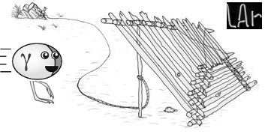
ARAPUCA a brief review
ARAPUCA in the language of native Brazilian means trap for birds
The idea at the basis of the ARAPUCA is to trap photons inside a box with highly reflective internal surfaces, so that the detection efficiency of trapped photons is high even with a limited active coverage of its internal surface
New concept for light detection in liquid argon (LAr)
High efficiency light collector + silicon devices (SiPM) ➔ good detection efficiency on large volumes of LAr

Slide 3
The dichroic filter I
The core of the device is a dichroic filter. It is a multilayer acrylic film - same technology used to produce reflective plastic foils like 3M VIKUITI or VM2000.
It has the property of being highly transparent for wavelength below a cutoff and highly reflective above it.
Transmittance
Reflectance
cutoff
cutoff

Slide 4
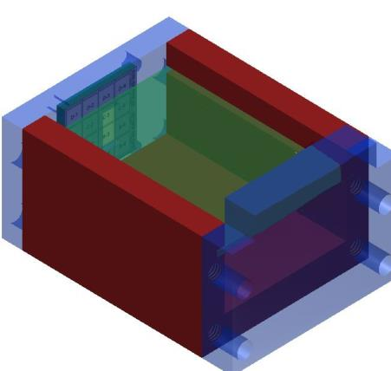
Operating principle I
The simplest geometry is a flattened box with highly reflective internal surfaces (Teflon, VIKUITI, VM2000) with an open side.
The open side hosts the dichroic filter that is the acceptance window of the device
The filter is deposited with TWO SHIFTERS – one on each side
The shifter on the external side, S1, converts LAr scintillation light to a wavelength L1, with L1 < cutoff
The shifter on the internal side, S2, converts S1 shifted photons to a wavelength L2, with L2 > cutoff
The internal surface of the ARAPUCA is observed by one or more SiPM
SIPM
Dichroic filter

Slide 5
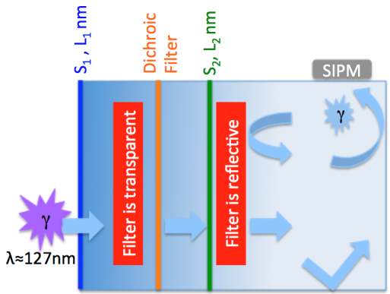
The Operating Principle II
After the first shift the light enters the ARAPUCA since the filter is transparent
After the second shift the photon gets trapped inside the box because the filter turns to be reflective
Photons are detected by the SiPM after some reflections

Slide 6
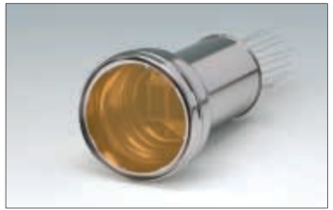
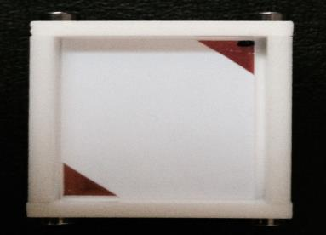
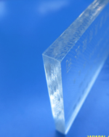
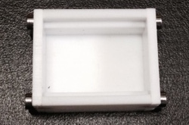
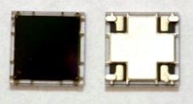
How to compare their photon detection capabilities ?
PMT
Light guide bar
ARAPUCA
SIPM

Slide 7
… calculating the equivalent surface
S_{eq} = ε × S_{w}
Surface area of acceptance Window
combined efficiency
Case of Guidinging Bars – TPB coated
S_{eq} = ε × S_{w}= 1.7 cm²
Bar surface = 1700 cm²,
Efficiency = 0.1 %.

Slide 8
Case of SIPM – TPB coated
SIPM
S_{eq} = ε × S_{w}= 5.4 x 10⁻² cm²
SIPM of 0.6 cm X 0.6 cm – SensL C60035
Efficiency = 0.3 (PDE) X 0.5 (TPB) = 0.15
An array of ~ 30 SiPM => S_{eq} = 1.7 cm²
Case of 3” PMT - TPB coated
S_{eq} = ε × S_{w}= 6.8 cm²
PMT area of 45.6 cm² (3”),
Efficiency = 0.3 (PDE) X 0.5 (TPB) = 0.15
PMT
Equivalent to ~ 4 times one bar

Slide 9
Case of ARAPUCA
Substantial saving of active devices
Amplification of the SiPM equivalent surface of a factor 10 can be realistically obtained (main constraint: reflectivity of internal surface => 95%)
An equivalent surface of 1.7 cm² can be reached with an array of 3/4 SiPM (coupled to an ARAPUCA) instead of 30. The ARAPUCA surface would be of the order of 40/45 cm² (a 6.5 cm x 6.5 cm square).

Slide 10
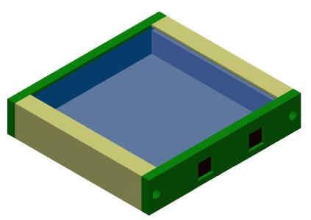
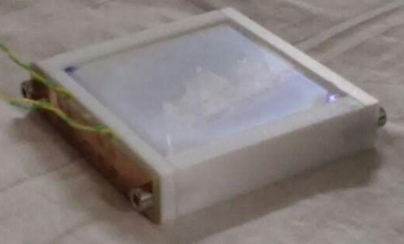
Test in LAr @ FERMILAB (I)
Arapuca with 5x5 cm² acceptance window;
Box with dimensions 5x5x0.6 cm³
Read-out by 2 SiPM 0.6cm X 0.6cm active area each
SensL MicroFC-60035-SMT (courtesy of Cormac Campbell - SensL Technologies Ltd.)
Dichroic filter (Quantum Design- cutoff @ 400 nm – substrate fused silica)

Slide 11
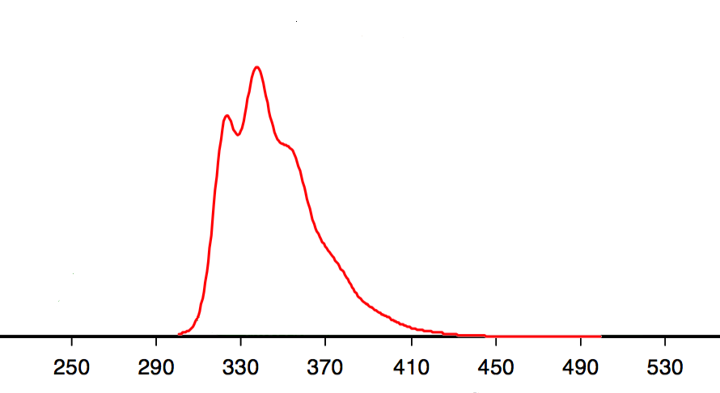
P-Terphenyl on the external side
Deposited by vacuum evaporation
p-Therphenyl
emission spectrum
Filter cut-off at 400 nm

Slide 12
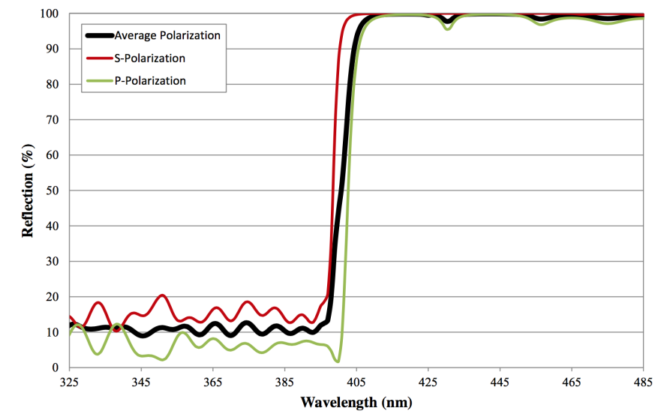
TPB on the internal side
Deposited by vacuum evaporation
TPB emission spectrum
Filter cut-off at 400 nm

Slide 13
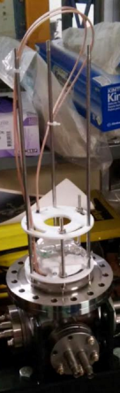
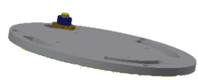
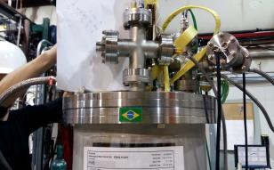

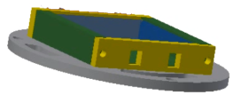
Test in LAr @ FERMILAB (II)
The device has been installed inside a liquid argon cryostat and exposed to an alpha source.
Alpha source is a 1μCi ²⁴¹Am that produces 5.4 MeV monochromatic particles
Two different runs have been performed and two different read-out electronics have been tested
α source

Slide 14
Test in LAr @ FERMILAB (III)
Encouraging results: we measured an efficiency of ~1% (S_{eq} ~ 0.25 cm²) in this first test
It can be significantly improved considering that:
  Low quality of the evaporations
  Thicknesses of the films non-optimized
  Internal reflectivity probably not at its maximum (cleanliness, quality of the material, thickness of the box walls)
Source spectrum
Single electron spectrum

Slide 15
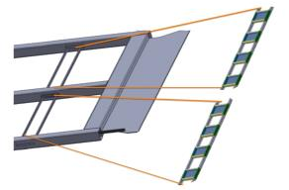
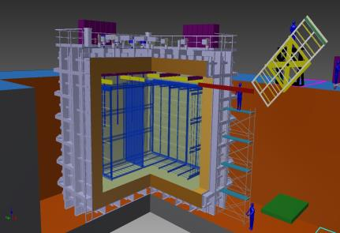
- Arapuca in protoDUNE -
Installing two arrays of ARAPUCAs in place of two scintillating bars.
The arrays will be produced in collaboration between Brazil and US (Fermilab, CSU)
No impact on the protoDUNE mechanical project
Read-out of the SiPM : same board foreseen for the protoDUNE reference design and with the same number of channels
Arrays will be plug and play systems, whose installation will be totally transparent to all the other sub-systems of the detector.

Slide 16
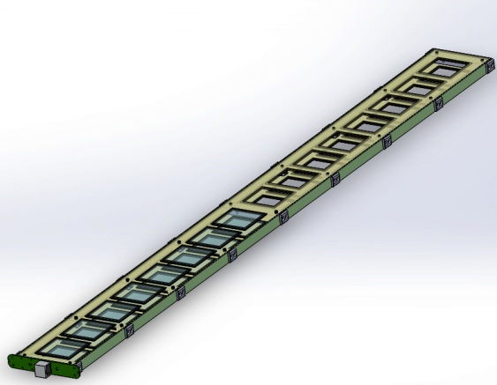
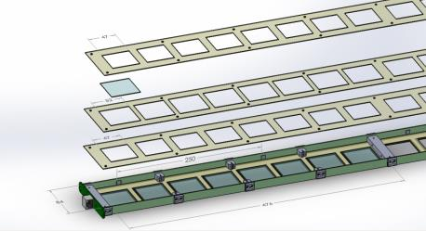
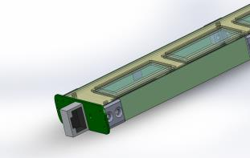
Preliminary design of a protoDUNE bar
Drawings by D. Warner
Exploded vision

Slide 17
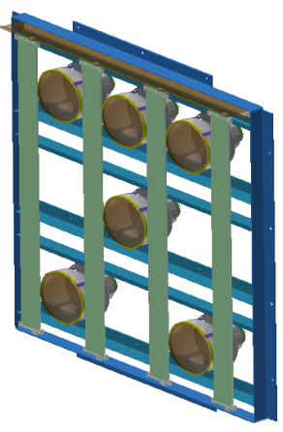


- Arapuca in SBND -
The SBND collaboration agreed to install this new device and we are preparing a formal proposal for the installation of an array of ARAPUCAs inside SBND.
Two options of installation are under study

Slide 18
Short term program
A test of an array of ARAPUCAs is being planned and will be realized in the second half of November at Fermilab.
The array will be installed inside the TallBo cryostat
Few different technical solutions will be tested:
  Filters from different vendors and with two different dimensions: 5x5 cm² and 5x7 cm²
  Two different reflectors: PTFE (totally diffusive) and VIKUITI (totally specular)
  Active and passive ganging of SiPM (still under discussion)
Objective of the test will be to define the solutions to be implemented for the protoDUNE bars

Slide 19
Longer term program
Continue test on reflectors, filters and SiPM at FNAL and UNICAMP
Refine and finalize the design of the ARAPUCA array for protoDUNE
Test inside TallBo with a guiding bar as a reference
Start production for the protoDUNE bars

Slide 20
Conclusions
A novel concept for liquid argon scintillation light detection has been developed
The performances of the first prototypes are promising
Two arrays of ARAPUCAs will be installed inside protoDUNE
Tests to optimize the device are ongoing
Final design of the array under development

Slide 21
Back-up

Slide 22
Test of trap effect of ARAPUCA
Was used a small prototype with a window of 3.5 cm x 2.3 cm
The box is made of teflon and has an internal height of 1 cm
The cutoff of dichroic = 400 nm
We used as shifters P-Terphenyl (λ ~ 350 nm) for the external side and TPB (λ ~ 430 nm) for the internal one.

Slide 23
Effect of the first shifter
p-Therphenyl
emission spectrum

Slide 24
Effect of the second shifter
TPB emission spectrum

Slide 25
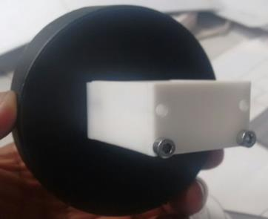
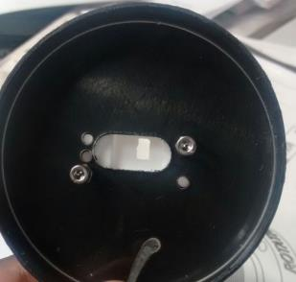
Verifying the trapping process
Experimental tests performed at room temperature in a black box @ UNICAMP
Using an alpha source to excite scintillation of the external shifter
Coupled the ARAPUCA to a PMT
The dimensions of the slit ~ fit one side of the PTFE box (~1.8 x 0.9 cm² )
slit

Slide 26
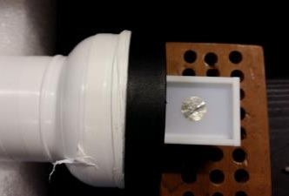

ARAPUCA with two different windows
Glass coated with TPB => NO TRAPPING EFFECT
Filter coated with pTP and TPB => TRAPPING EFFECT
Glass/Filter
α source
PMT
ARAPUCA

Slide 27
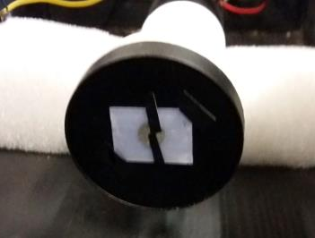
Normalize the input light
We measured the total amount of light produced by the alpha source gluing the glass or filter directly on the PMT.
The comparison of the measured spectra allows to determine the collection efficiency.
Glass/Filter
α source
PMT

Slide 28
No trapping effect - TPB on glass
Collection efficiency ~ 20%

Slide 29
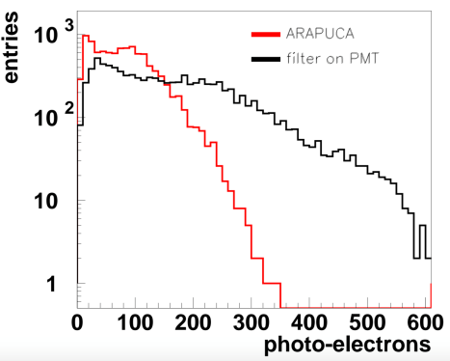
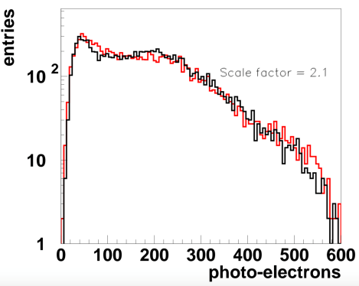

Trapping effect - ARAPUCA (filter)
Collection efficiency ~ 50%
The principle of ARAPUCA works!

Slide 30
New LAr laboratory at UNICAMP
A new laboratory for R&D studies on the detection of liquid argon scintillation light is being realized at UNICAMP, founded by FAPESP - São Paulo agency
It will be equipped with a brand new evaporator for organic materials, cryogenic facilities to test prototypes in a LAr environment, equipments to perform optical measurements (pulsed and continuous laser/led, integrating sphere, vacuum monochromator with deuterium lamp,...)
The laboratory will be operative starting by the end of this year.
The majority of the ARAPUCAs will be realized and tested in this lab (production could start even before the completion of the Lab => evporator will be installed in two/three months)
A fraction of the devices could be produced at Fermilab

