Slide 2
Photosensors at HZC
1. About HZC
2. PMTs for Experiment of High Energy Physics

Slide 3
About HZC
HZC has bought all production equipment, patents and technical information of PMT from PHOTONIS in 2011. The production started on December 12th, 2012.
Production capacity: 230,000 sets yearly.
Product line and the design and technology remains the same as PHOTONIS's.
HZC has been supplied to customers both in China and abroad.
HZC has set up a R&D Center for PMT in Xi'an China in cooperation with XIOPM (Xi'an Institute of Optics and Precision Mechanics of CAS. XIOPM has complete simulation software and measurement instrument for PMT, and has a scientific research team with rich experience in PMT design and mechanistic study.
PHOTONIS commits to continue supporting HZC technically in years.

Slide 4
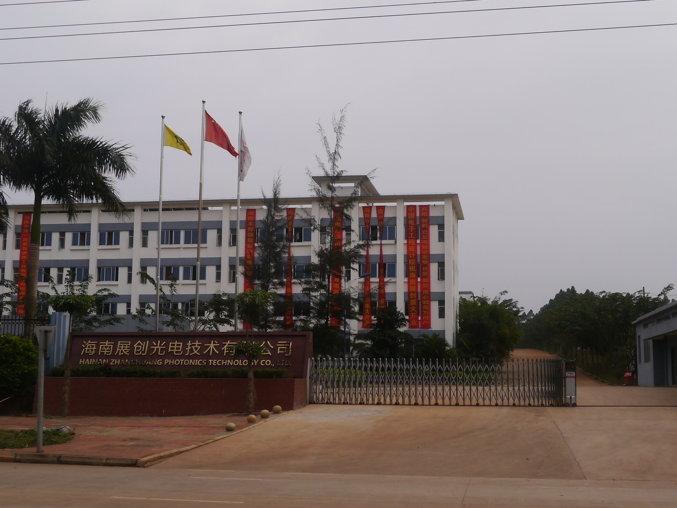

Slide 5
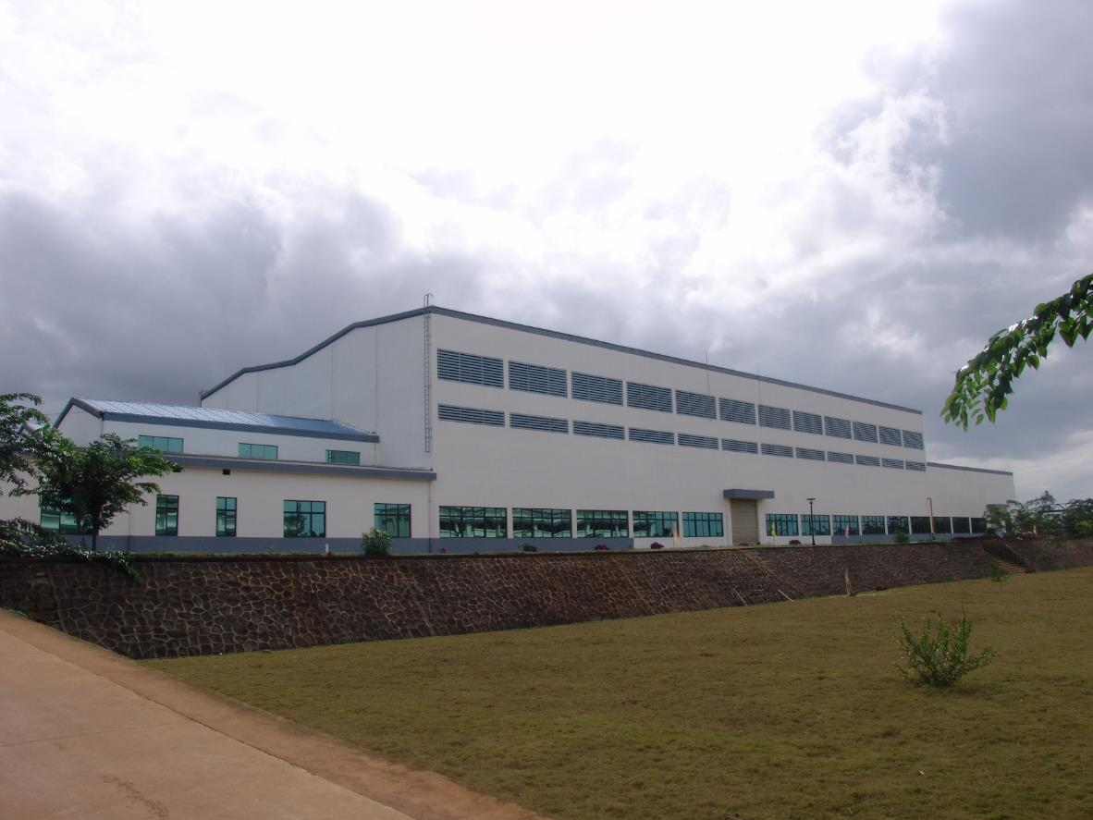

Slide 6
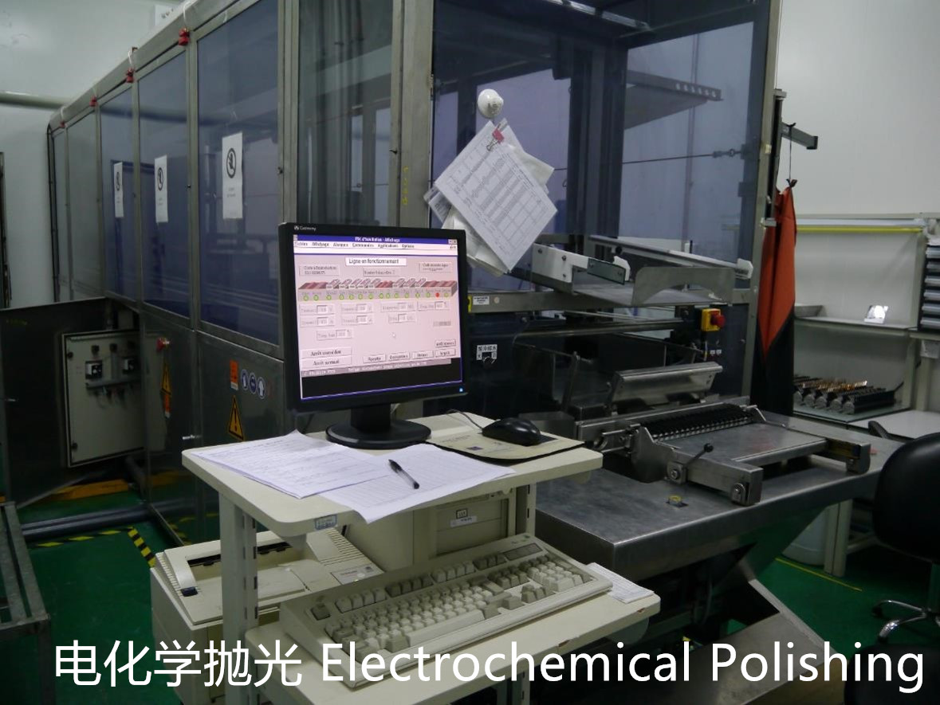
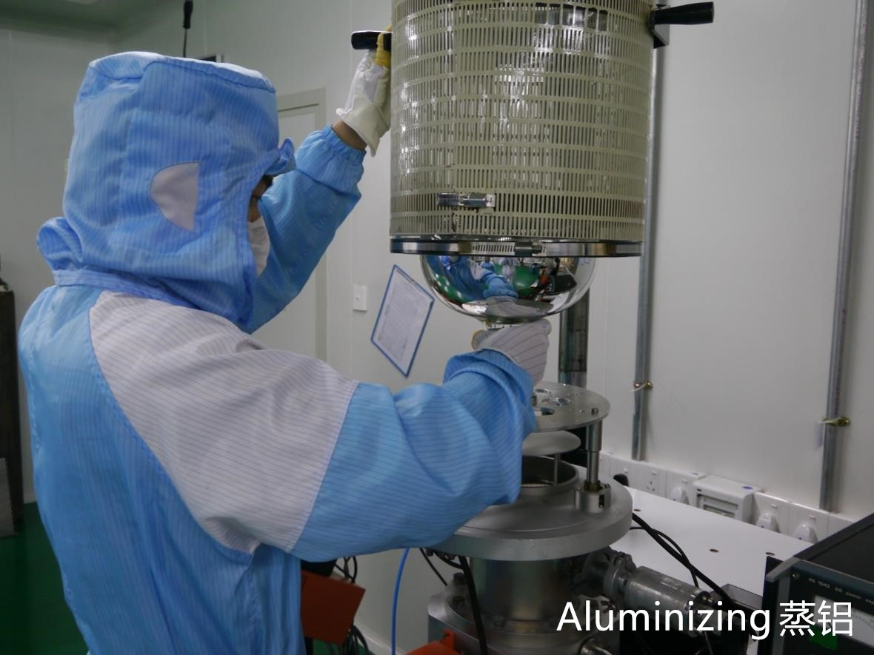
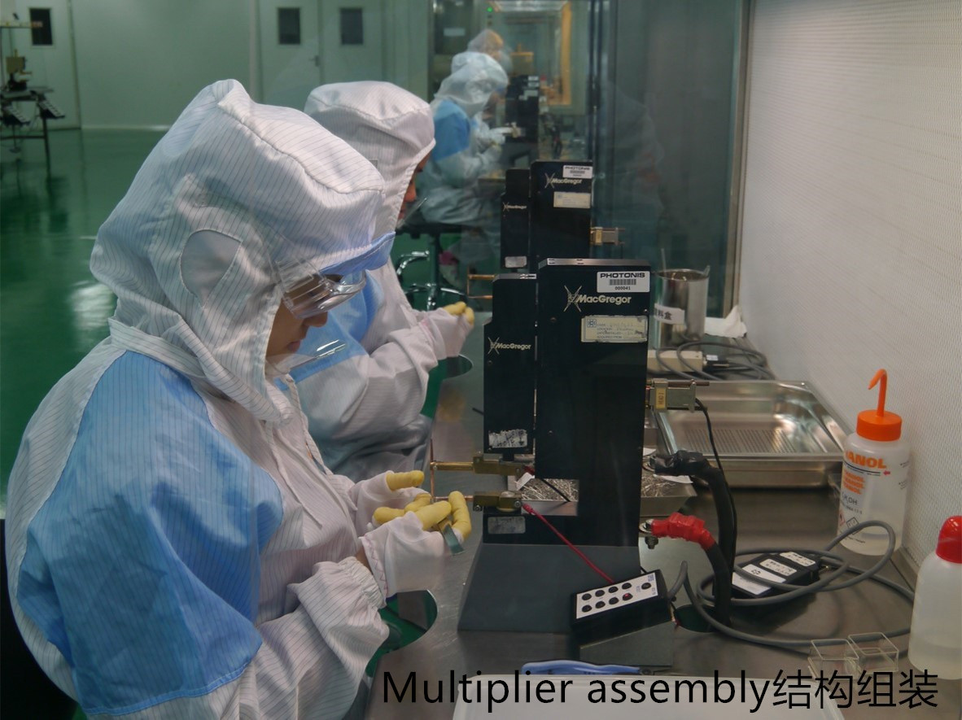
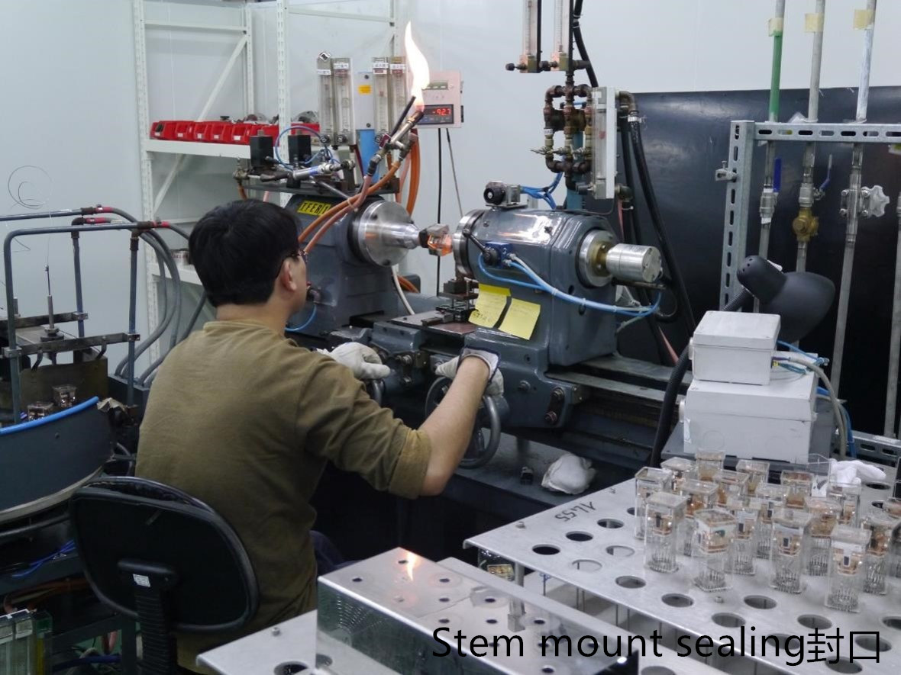
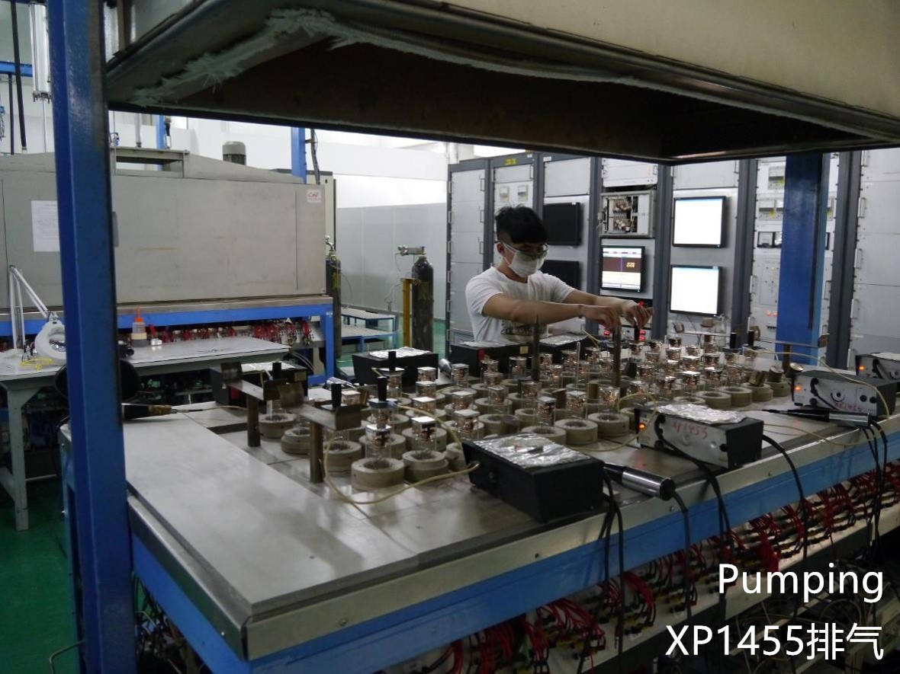
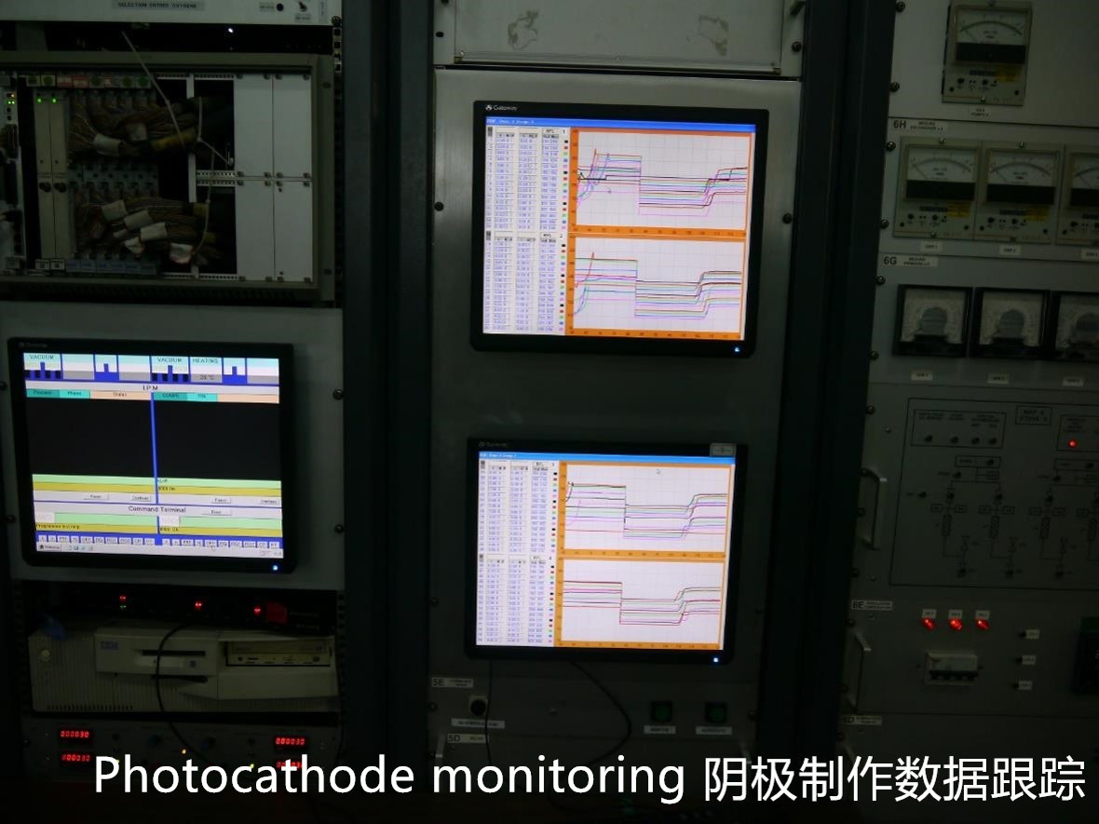
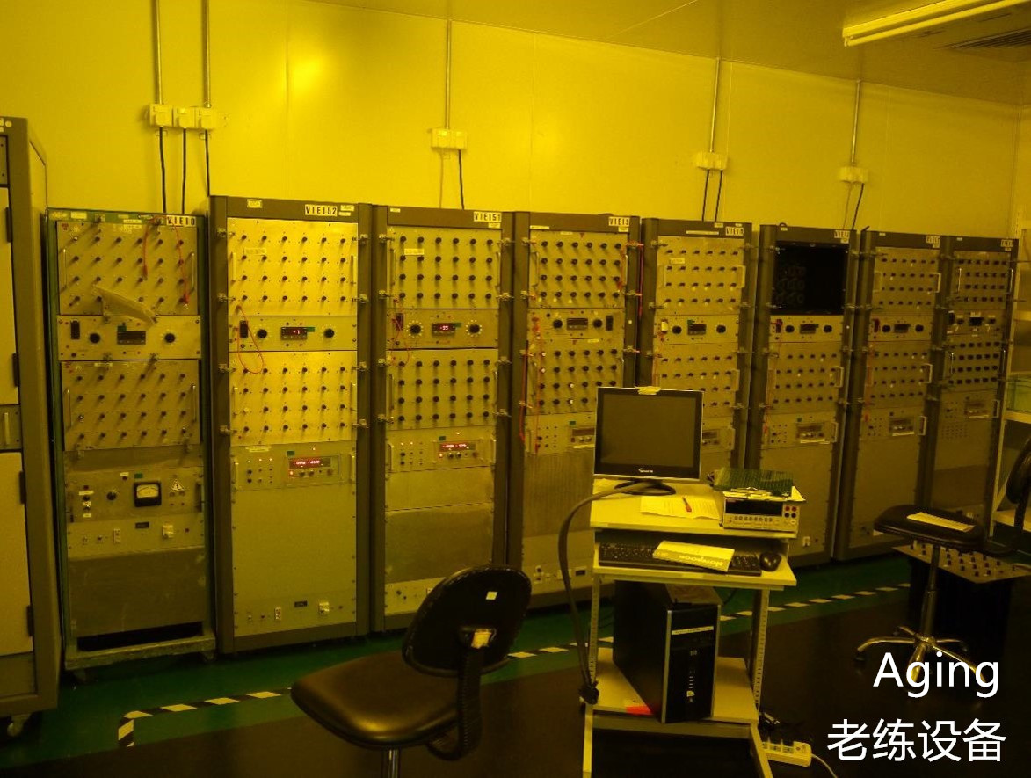
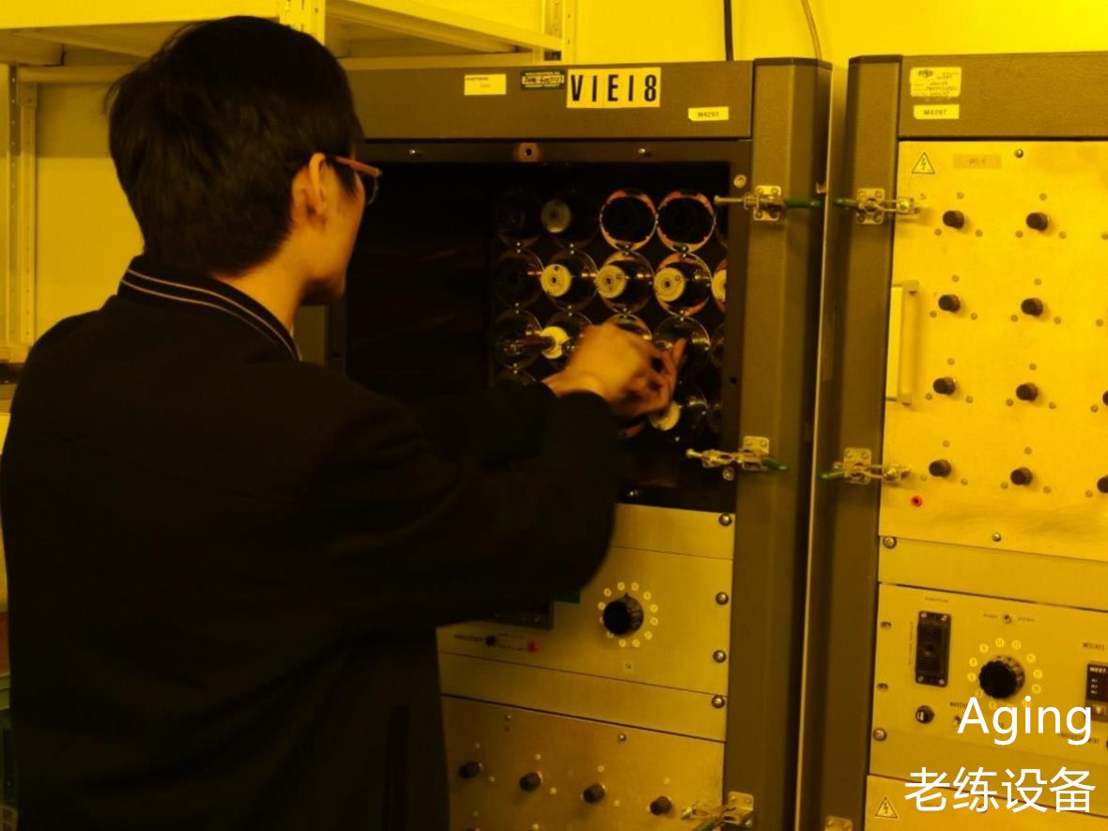
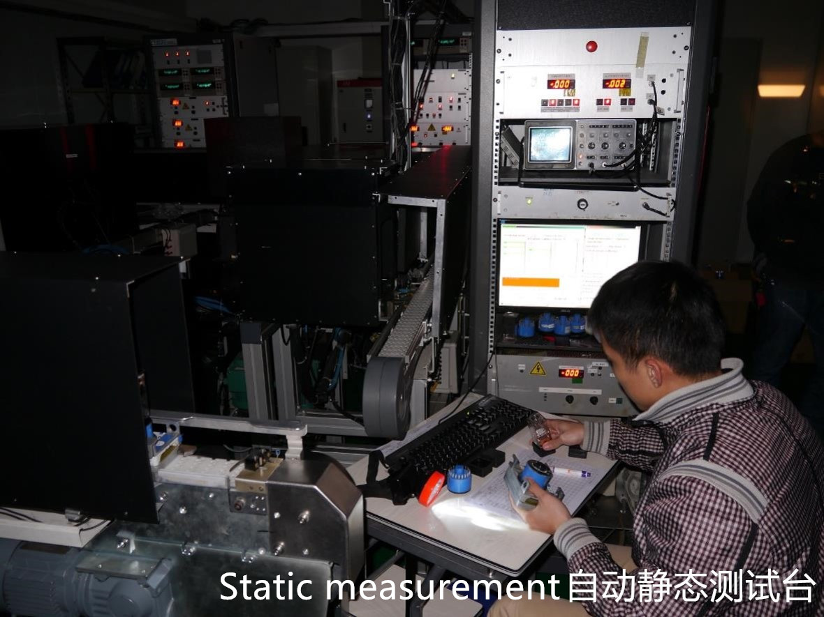
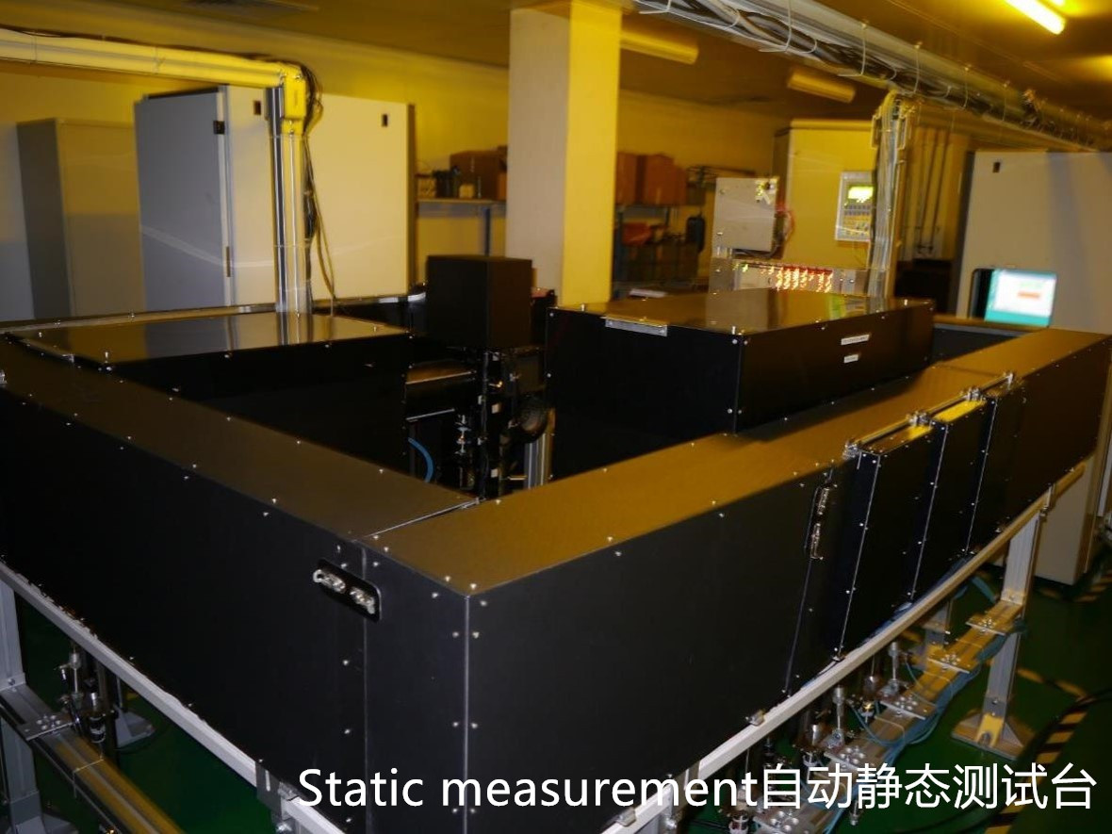
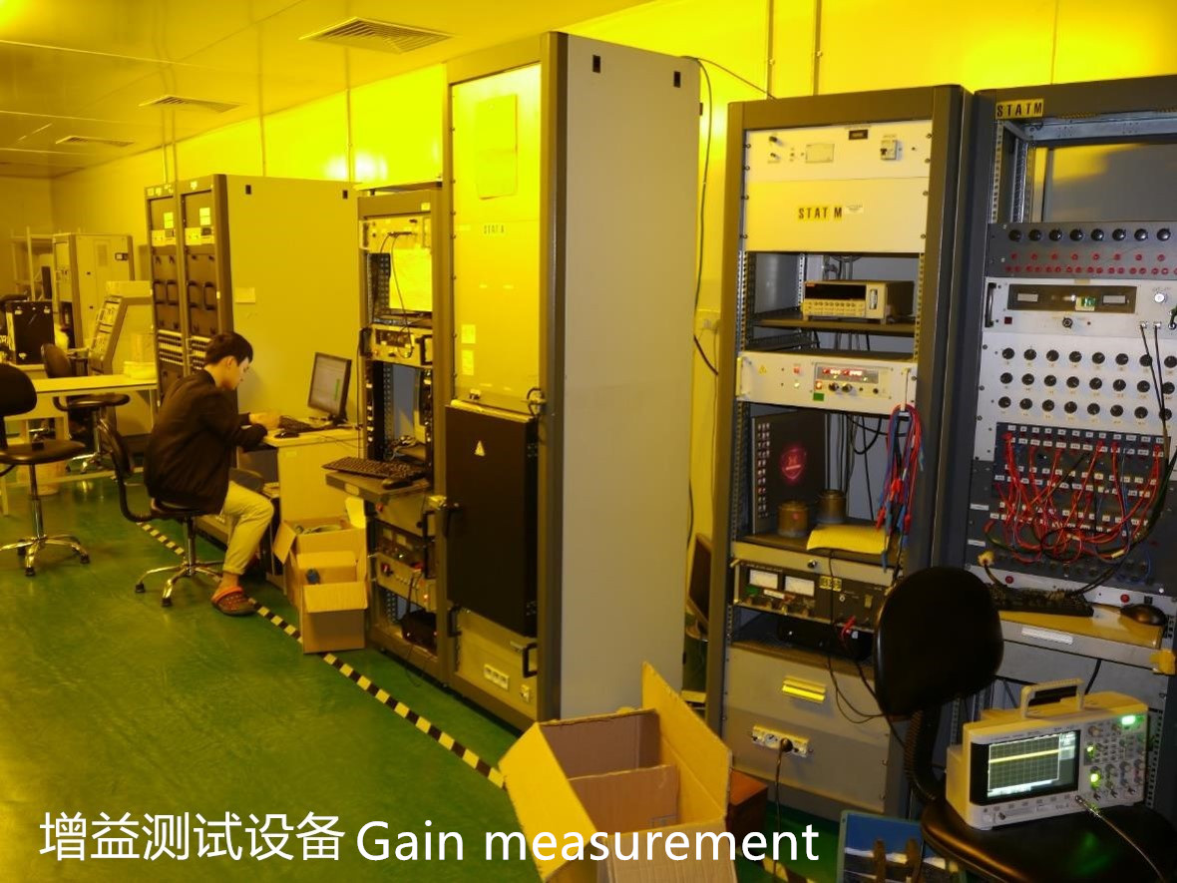
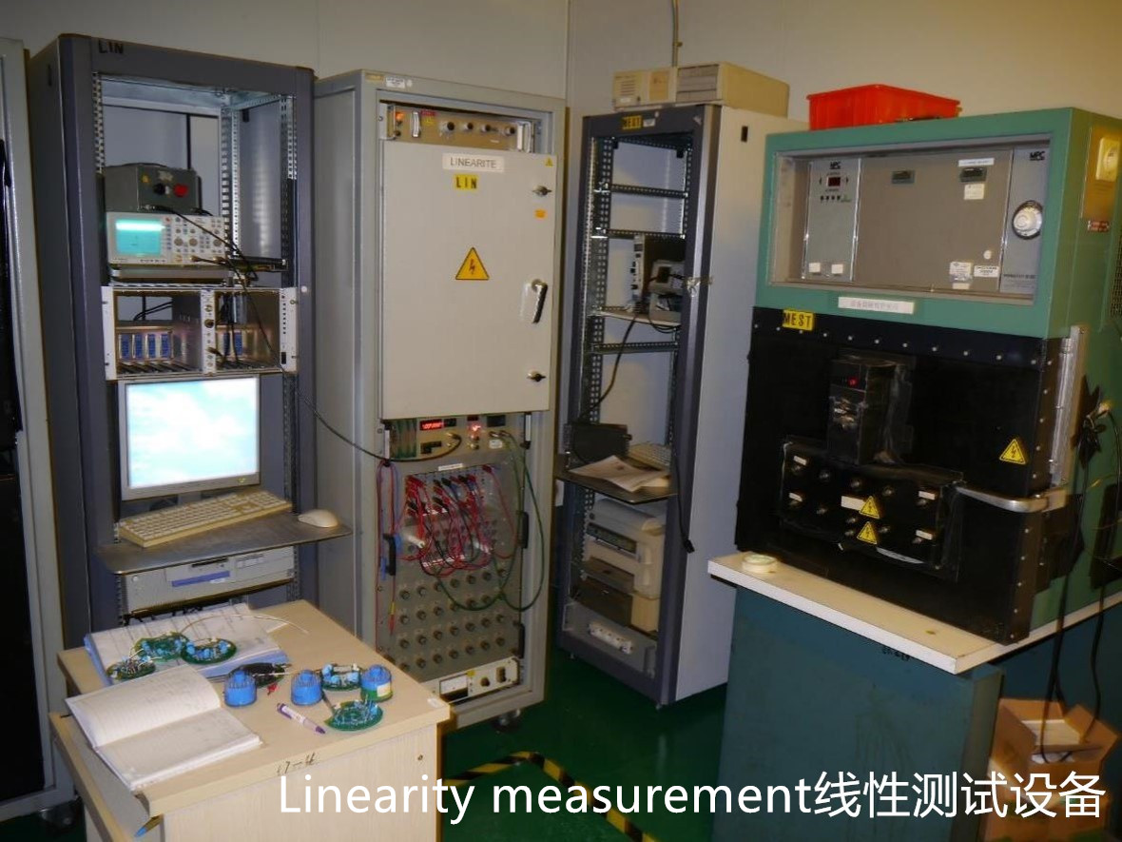
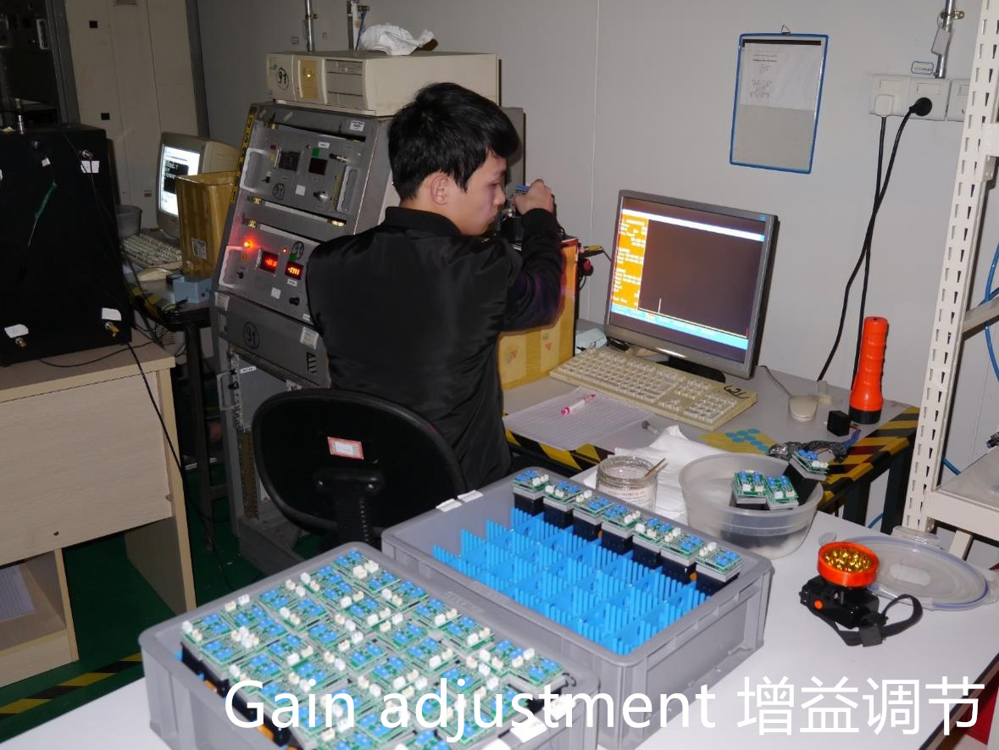
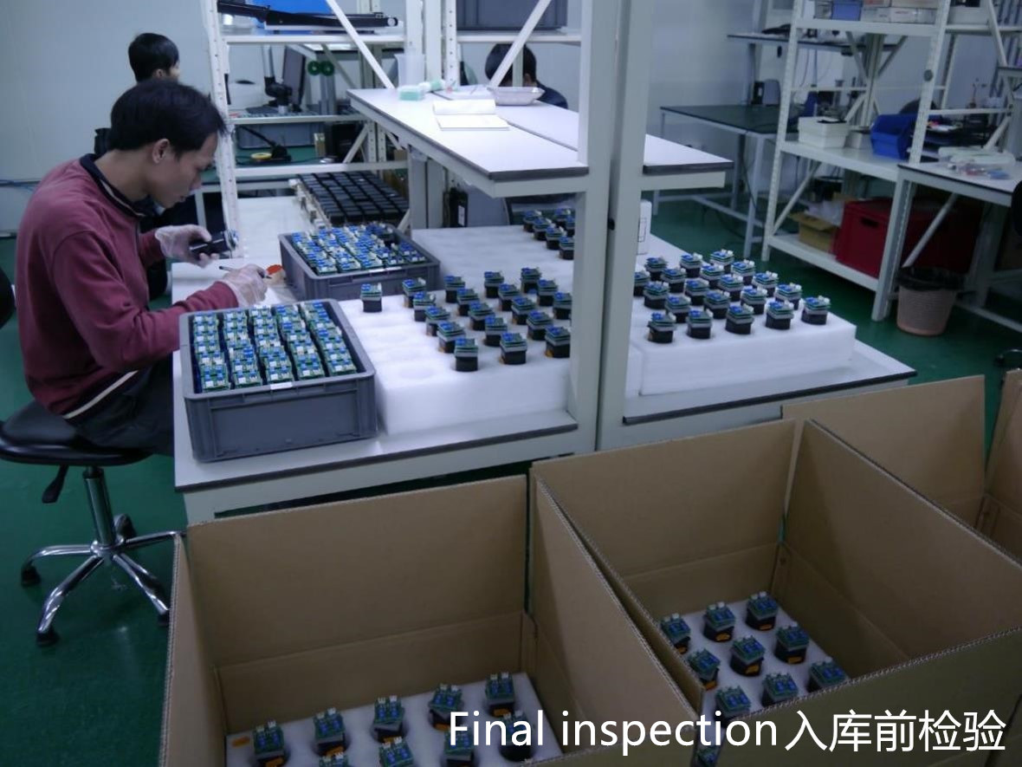
Production & Equipment
Zone 1: Raw Material
Preparation
Zone 2: Assembly
Zone 3: Glass
Zone 4: Pumping
Zone 5: Testing
Zone 6: Finishing
%
1
2
5
11
19
22
35
46
57
63
77
89
92
99
100

Slide 7
40%
Medical Equipment
40%
Physics Project
Spectrophotometry
Industrial
Biotechnology
Others
20%
HZC Business Revenue

Slide 8
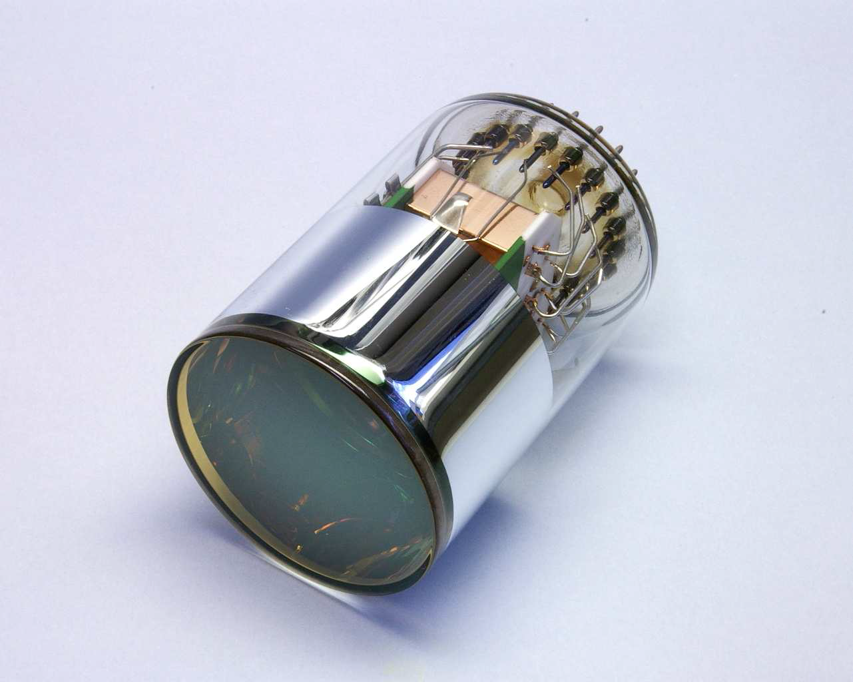
Products
For
Medical Equipment
XP5212
XP5381
XP5382
XP1912
XP1455
XP5312

Slide 9
Products
for
Physics Project
XP2262
XP53B20
XP72B20
XP1805
XP1807
XP1886

Slide 10
Products
for
Others
XP2920
XP2930
XP2950
XP3102
XP3110
XP3240

Slide 11
Customers
Denmark
UK
Germany
USA
Canada
France
Holland
Beijing
Korea
Italy
Israel
Tibet
Shanghai
Sichuan
Shenzhen
Argentina

Slide 12
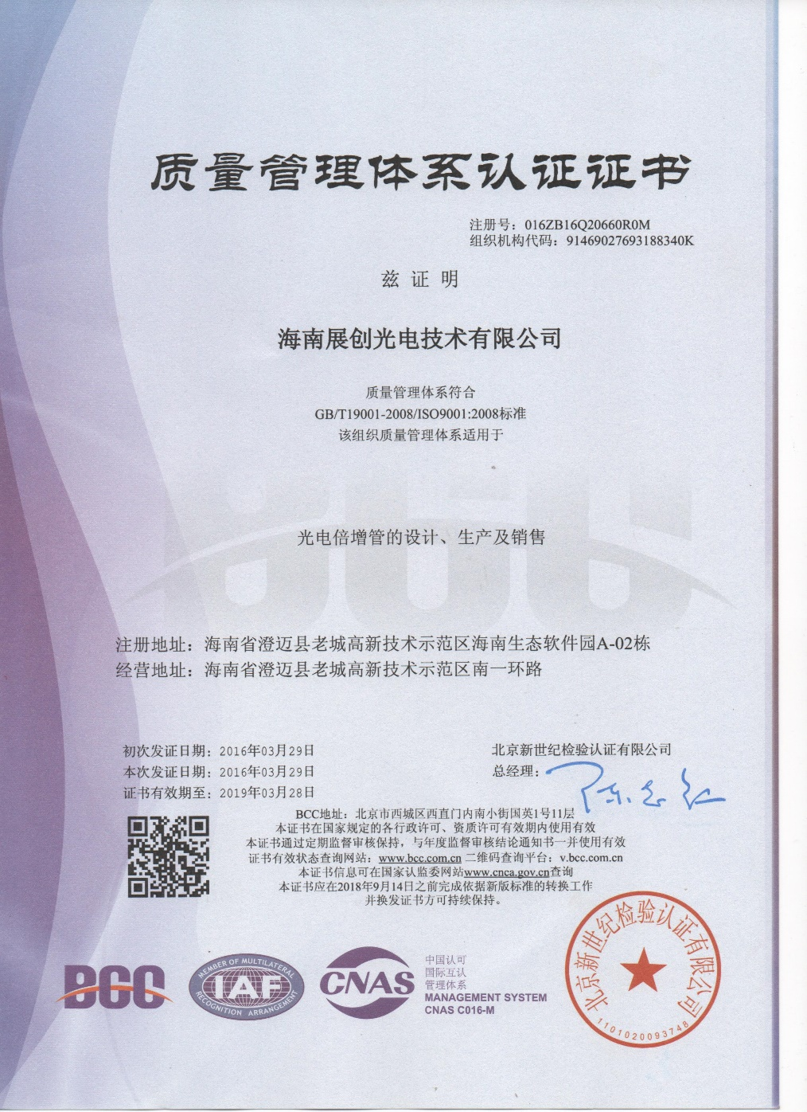
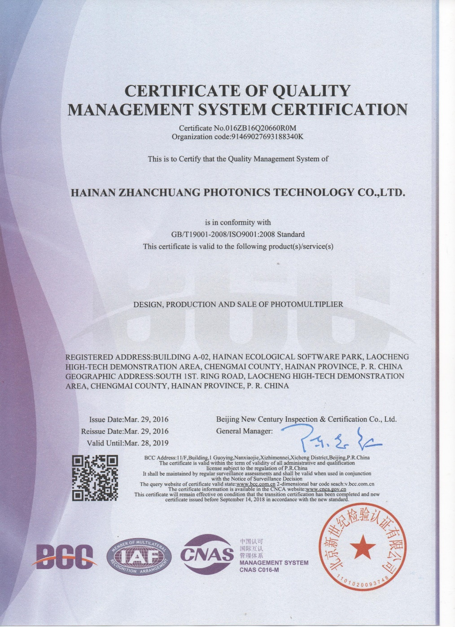
Quality Control

Slide 13
02
Experience
Reputation
Process
01
Quality first
Cost second
Parts Manufacturing
Raw Material
06
03
Mechanical Dimensions
Texture Inspection
Production Verification Test
Data Analysis
Step by Step Examination
Quality Feedback
Parts Certification& Inspection
Quality Control
System
05
04
Production Process Control
Store
Data Tracking
Self-inspection
Mutual Inspection
Special Inspection
Environment Control

Slide 14
Technical Exchange
and R&D

Slide 15
PHOTONIS provide technical assistance to HZC

Slide 16
PHOTONIS provide technical assistance to HZC

Slide 17
PHOTONIS provide technical assistance to HZC

Slide 18
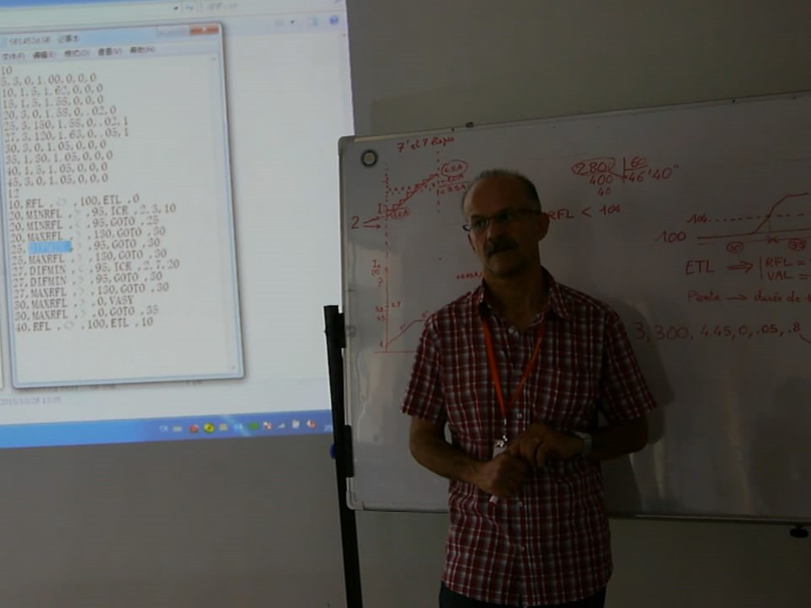
PHOTONIS provide technical assistance to HZC

Slide 19
Develop new product with PHOTONIS

Slide 20
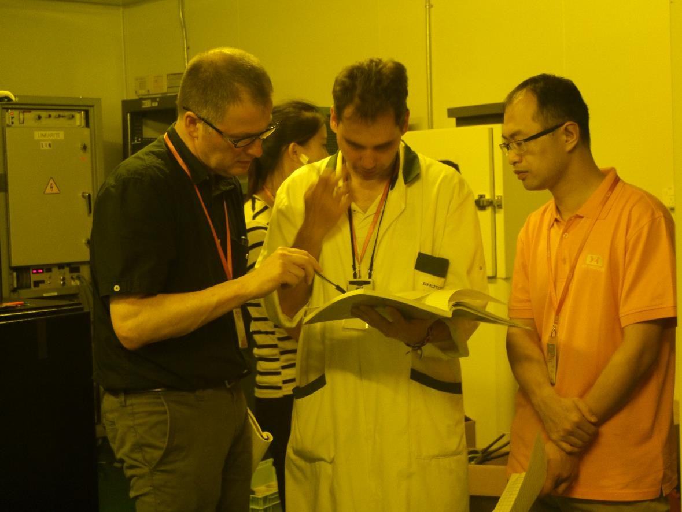
Develop new product with PHOTONIS

Slide 21
Develop new product with PHOTONIS

Slide 22
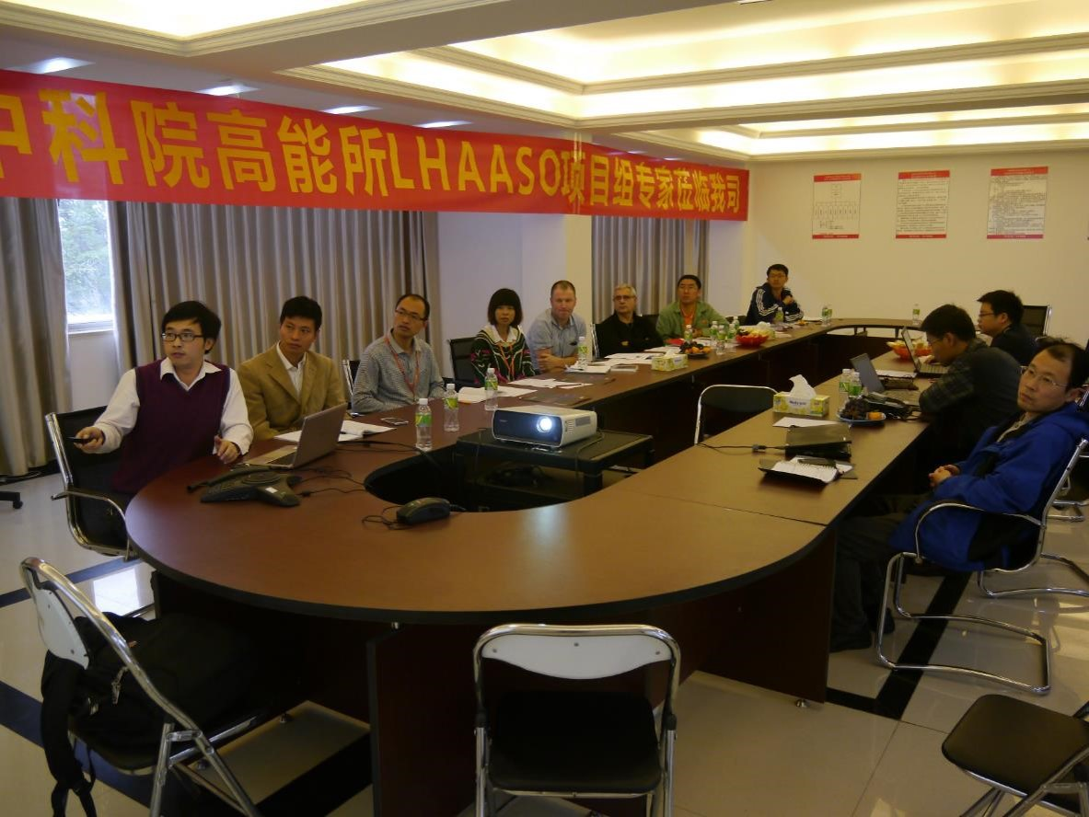
Cooperate with IHEP,CAS

Slide 23
Cooperate with XIOPM

Slide 24
Cooperate with institute of metal research，CAS, researcher Liu

Slide 25
Cooperate with Chinese PMT expert, professor Sun and professor Chen

Slide 26
Cooperate with Chinese PMT expert, professor Li

Slide 27
PMTs for Experiment of High Energy Physics

Slide 28
PMTS for High Energy Physics
 | XP72B20 | XP82B20 | XP1805
Size | 3 inch | 3.5 inch | 9 inch
QE@410nm | >25%,typ.28% | >25%,typ.28% | >20%,typ.24%
Homogeneity | ±20%,typ.±15% | ±20%,typ.±15% | ±15%,typ.±12%
Gain | 1.00E+07 | 1.00E+07 | 1.00E+07
Voltage | 1000-1500V,typ.1300V | 1000-1500V,typ.1300V | 1600V-2300V,typ.1900V
TTS | 3-5ns,typ.4ns | 3-5ns,typ.4ns | 2-3ns,typ.2.4ns
Noise@20℃ | <2000cps,typ.800cps | <2000cps,typ.1000cps | <5000cps,typ.3000cps
P/V | >2,typ.3 | >2,typ.3 | >1.4，typ.1.6
Linearity（2%） | —— | —— | 60mA

Slide 29
 | XP3960 | XP3182
Size | 1.5 inch | 1 inch
QE@410nm | >20%,typ.25% | >20%,typ.25%
Homogeneity | ±10%,typ.±5% | ±10%,typ.±5%
Gain | 4.00E+05 | 2.00E+05
Voltage | 1300-1700V,typ.1500V | 800-1200V,typ.1000V
TTS | 1.5ns,typ.1ns | ——
Temperature Coefficient | <0.1%/K | ——
Linearity（2%） | 50mA | 40mA

Slide 30
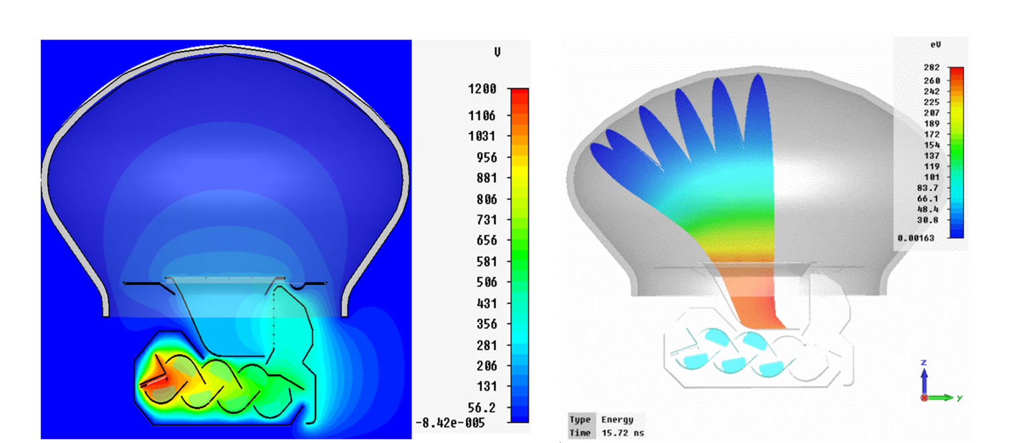
Simulation design by XIOPM

Slide 31
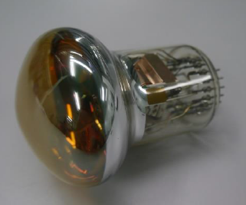
XP72B20

Slide 32
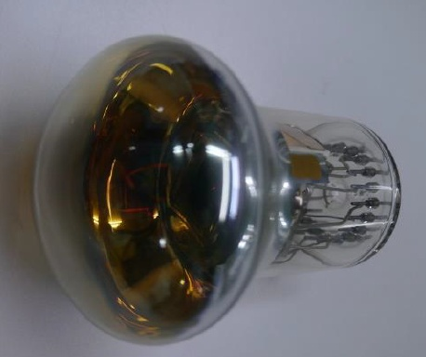
XP82B20
XP82B20 is as good as XP72B20, but have a larger cathode area，who‘s diameter of effective cathode area increase to 82mm.

Slide 33
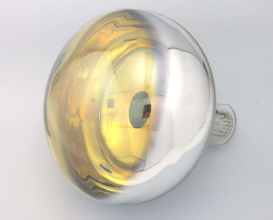
XP1805

Slide 34
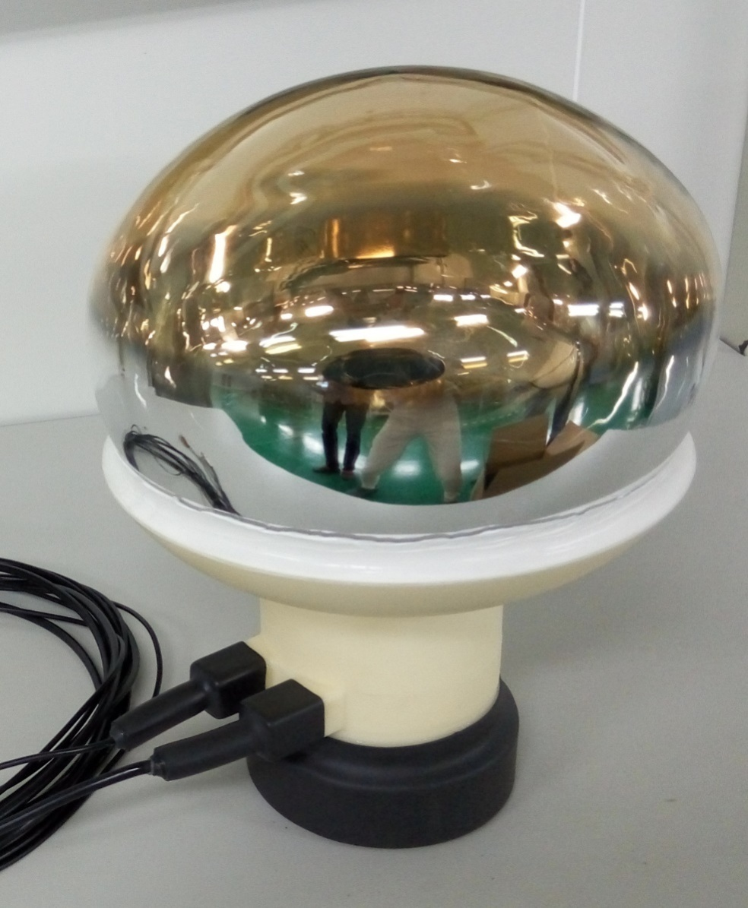
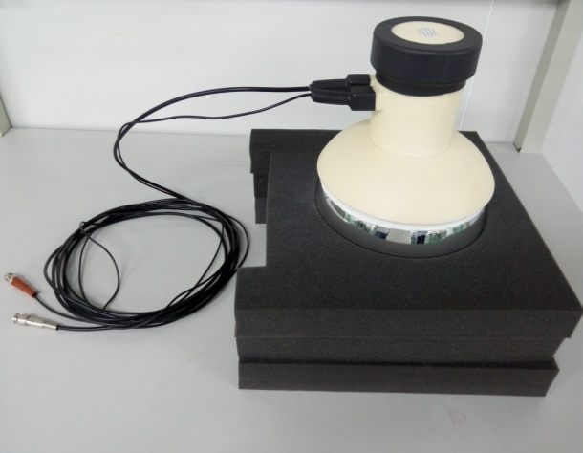
The waterproof technology of XP1805

Slide 35
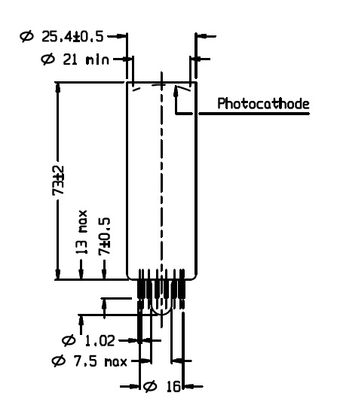
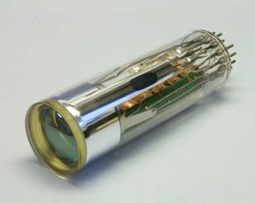
XP3182

Slide 36
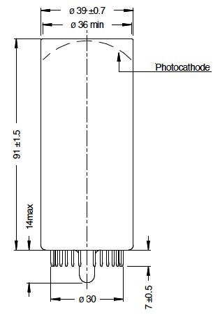
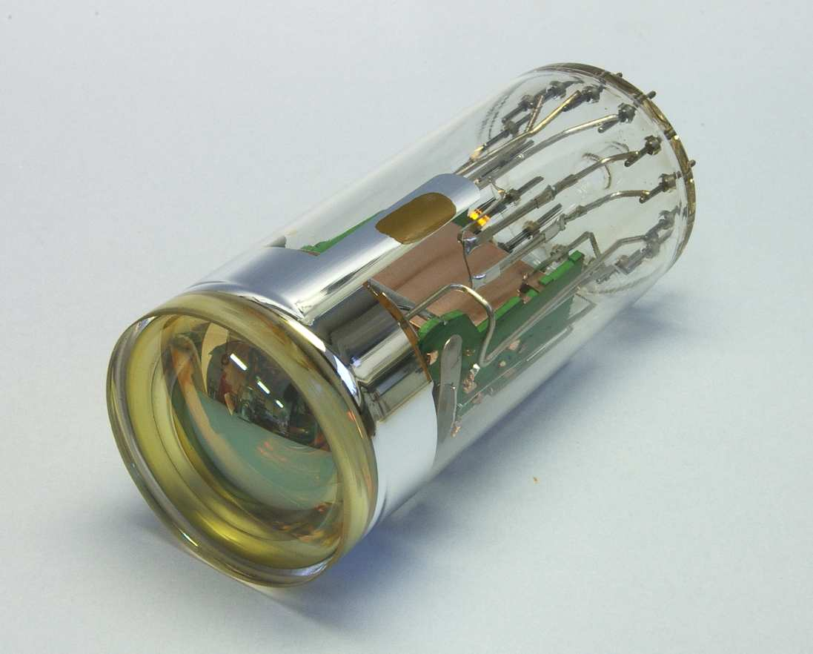
XP3960

Slide 37
Thanks

