Slide 1
ALD Technology Transfer – Progress Update
LAPPD2 Godparent Review
Aileen O’Mahony
5th April 2013

Slide 2
STTR Task #3
Incom ALD Coating Technology Transfer and Facility
Prepare specifications for facility and ALD coating hardware and thin film diagnostic instrumentation needed for electrode and ALD coating systems – ongoing
Receive quotations to purchase equipment and establish facility at Incom Inc. – ongoing
Documentation of the ANL ALD process technology – to be completed
Initiate purchase orders for equipment to ensure availability for Phase II – to be completed

Slide 3
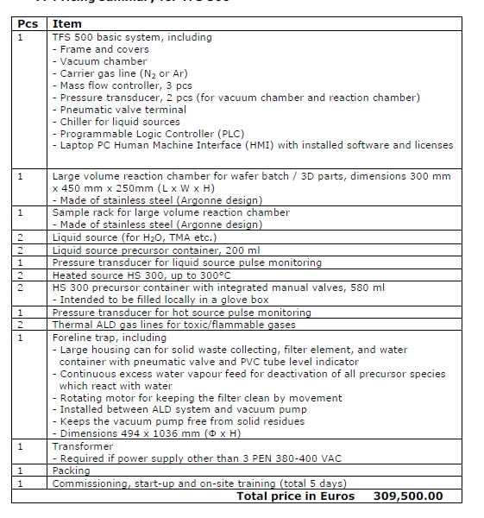
ALD System
Beneq ALD System
Updated quote received for Beneq TFS500 ALD system
Safety concerns expressed by Beneq with the gas precursors required for Chem1
Conference call with Beneq on 3rd March to review
Meeting at Incom on 11th April to discuss safety and facilities requirements to have these precursors on-site

Slide 4
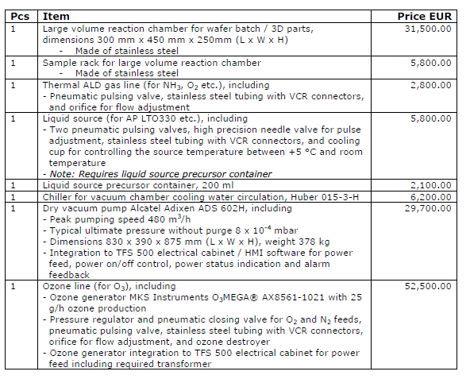
ALD System
Beneq ALD System
Option to order from Beneq in the US?
Possible to purchase other components (pump, chilller etc.) from US vendors?
Showerhead configuration required for processing of MCPs – cost for system customization ~$5,000
Preference for U. Chicago to fabricate showerhead for Incom Beneq system
Final showerhead configuration TBD for batch processing of MCPs

Slide 5
ALD System
Estimated cost of Beneq TFS500 system
Base price including: €309,500 = $397,000
Reaction chamber (ANL design) €31,500 = $40,000
Precursor lines
- 2 x liquid (TMA, H₂O) precursor lines & 200 ml containers
- 2 x hot precursor lines (300ºC) & 580 ml containers
- 2 x gas lines
Foreline trap, shipping and packing
Additional Components
Alcatel ADS 602H pump €29,700 = $38,000
Huber 015-3-H chiller €6,200 = $8,000
Showerhead configuration (TBD) ~$5,000
= $450,000
Additional modifications TBD – gas lines for Chem1 precursors and showerhead

Slide 6
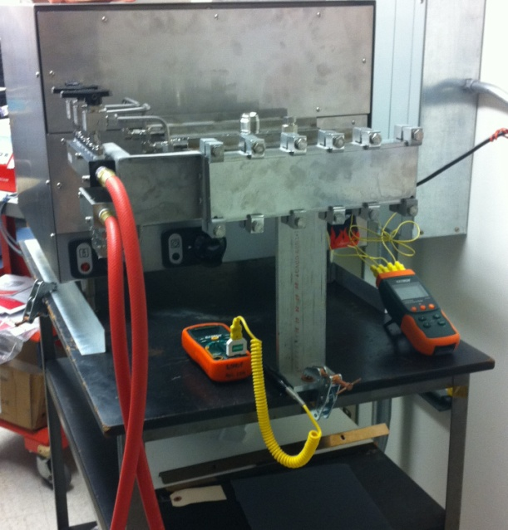
Additional Equipment
Evaporator
Veeco system from U. Chicago to ANL to be shipped to Incom
Being coordinated by Mike Lefebvre (Incom) with Jeff Williams (ANL)
To be assessed and refurbished by Yeagle Technology, Inc., CT
Ellipsometer
Final quote received from Woollam
Ordering fixed angle base, calibration wafers and software (~$10,000)
Evaluation/refurbishment may be required on-site at Incom
Annealing oven
Oven purchased and modified for ANL, to be installed
Incom plan to purchase same oven from U. Chicago with
approximate cost $10,000
Additional equipment: resistance and gain measurement,
scribing/dicing equipment, fumehood, glovebox, chemical
storage, MCP storage (desiccators), MCP racks etc.

Slide 7
R&D Lab Facilities Planning
Facilities layout at Incom R&D lab (Rte. 20 location)
Cleanroom planning in initial stages
To be determined:
Square footage of cleanroom and location
Class of cleanroom required
Equipment to be located in cleanroom or chase
Facilities requirements – house N₂, air, H₂O, chemical storage, gas lines, power supply, extraction/ventilation, fumehood, glovebox etc.
Funding and timeline for outfitting of cleanroom
Safety review meeting on 11th April at Incom regarding handling of hazardous precursors required for Beneq system
Proposal for $200,000 START Phase II funding from MassVentures earmarked for cleanroom layout planning unfortunately unsuccessful
Estimated cost of complete cleanroom for MCP processing ~$1,500,000

Slide 8
Personnel: Engineer Job Spec
Job spec for engineer to be hired by Incom for MCP coating and characterization
Vacuum deposition equipment – hands on experience with pumps, vacuum/pressure gauges, etc. – most important criteria
Deposition experience – process optimization, film characterization; ellipsometry, electrical characterization
Experience with LabVIEW and SolidWorks
Troubleshooting vacuum systems – leak checking etc.
Chemical handling – familiar with changing gas cylinders, precursor bottles
Resistance and gain measurements – experience with design, assembly and operation of equipment for resistance and gain measurement advantageous

Slide 9
Questions
What is the status of the STTR Phase I?
STTR Phase I is in the early stages of the technology transfer process.
Equipment vendors have provided quotes
Initial plans and safety reviews at Incom for the floor-plan and facilities required for the cleanroom
→ Dependent upon STTR Phase II funding?
Are there concerns about the interaction of the LAPPD MCP development and the STTR work?
Not from the perspective of the technology
ANL hired additional ALD personnel
Incom has plans to hire a graduate engineer
Thank you – Incom team, Argonne, U. Chicago

