Slide 1
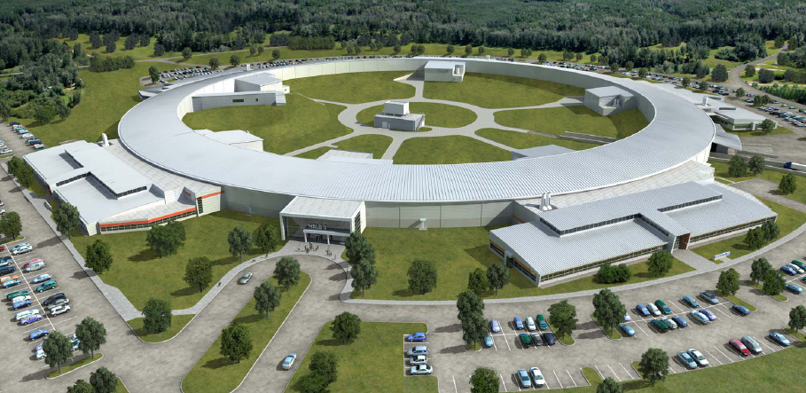
Better Multi-Alkali Materials
Klaus Attenkofer, John Smedley, Miguel Ruiz-Osés, Susanne Schubert, Ray Conley, Henry Frisch, Vivek Nagarkar
Photocathode Godparent Review
Apr. 6, 2013

Slide 2
Outline
The key to functionality:
  Materials quality enables device design
  Doping of multi-alkali materials
  Defects in glasses, crystals, and alloys
Transport in Multi-Alkalis
  Glasses, crystals, and alloys
  Diffusion driven by concentration gradient and mobility
What is required for a good cathode
    The “perfect cathode”
    Pros/cons of various coating processes
    Next steps
  Summary (Discussion): What coating process is best

Slide 3
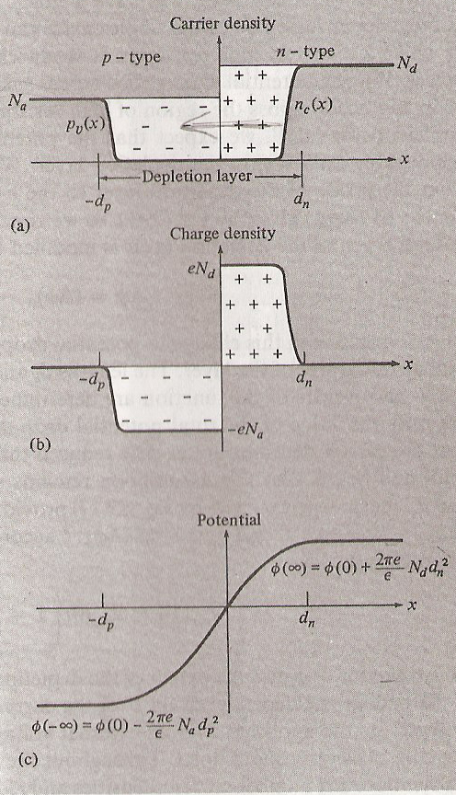
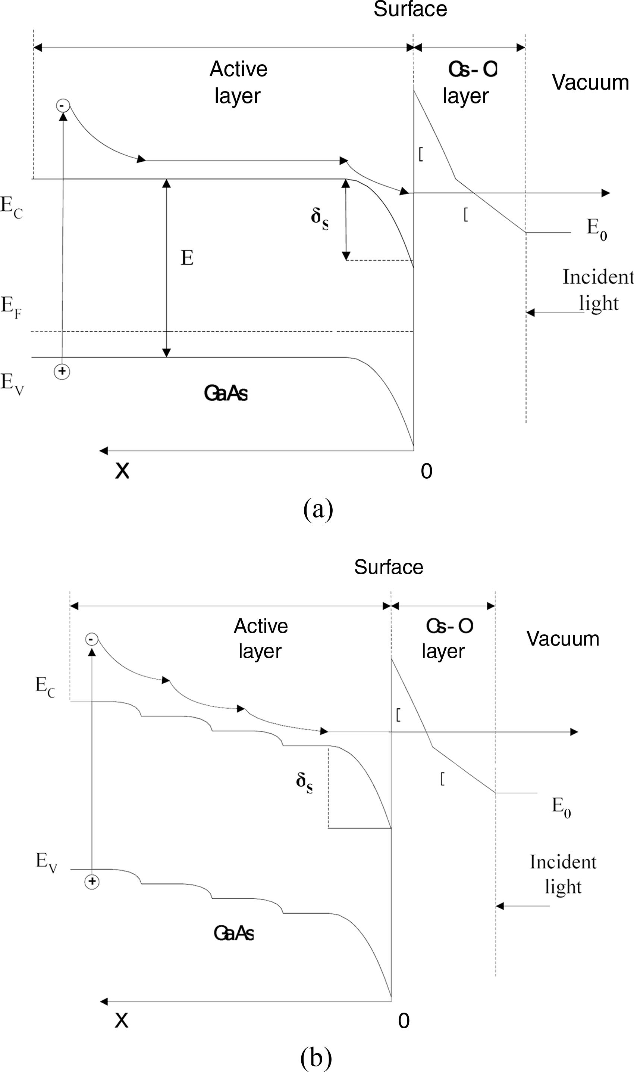
The Key to functionality:
  Materials Quality Enables Device Design.
Materials defect density determines:
  Fermi level
  Doping concentration
  Carrier mobility
  Traps and loss mechanisms
Device design requires:
  Growth with known doping concentration
  Process compatibility of growth methods and packaging
Device design allows:
  Rational design of complex hetero structures
  Full simulation capabilities with existing semiconductor tools

Slide 4
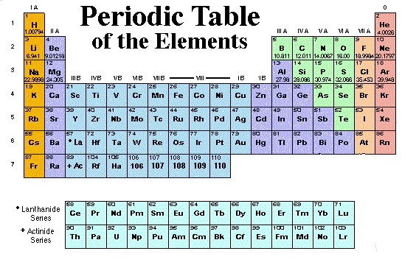
The Key to functionality:
  Simple Ionic Model
Ionic model: Total number of “binding electrons” should be 8, therefore:
  alkali₃Sb is most stable compound (also most likely the most ionic compound)
  A missing alkali will result in a lack of an electron (acceptor) therefore acts like p-doping
  An additional alkali will result in an electron too much (donor) therefore acts like a n-doping
  Too little Sb acts as an n-doping
  Too much Sb acts as p-doping
Alkali₃
Sb
3x Alkali¹⁺ + 3e⁻
1x Sb³⁻ - 3e⁻
However: Not all doping levels have to be activated

Slide 5
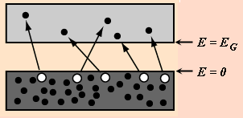
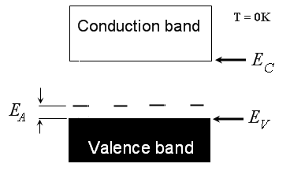
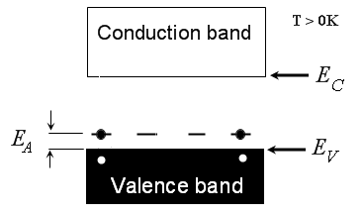
The Key to functionality:
  Not all defects are activated
Un-doped case
doped case
Activation energy is now E_{A}
There is an excellent talk on the web but I cannot find the reference (but I can provide the talk)

Slide 6
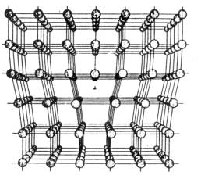
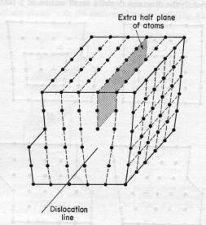
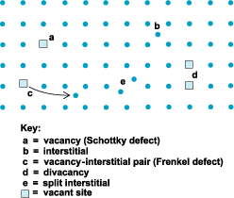
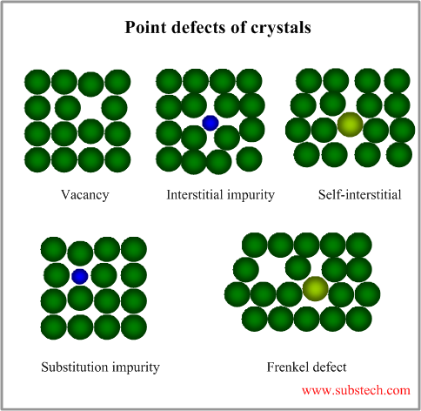
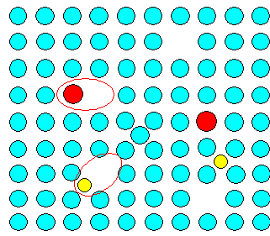
The Key to functionality:
  Defects in crystals

Slide 7
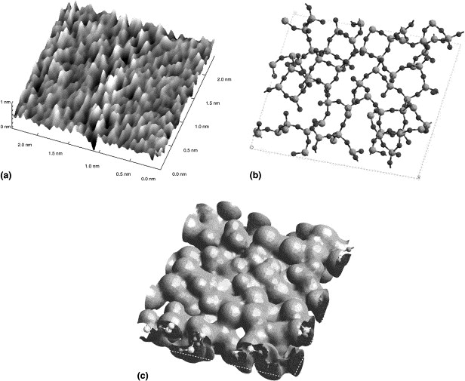
The Key to functionality:
  Defects in Glasses and Amorphous Materials
Journal of Non-Crystalline Solids
Volume 281, Issues 1–3, March 2001, Pages 221–226

Slide 8
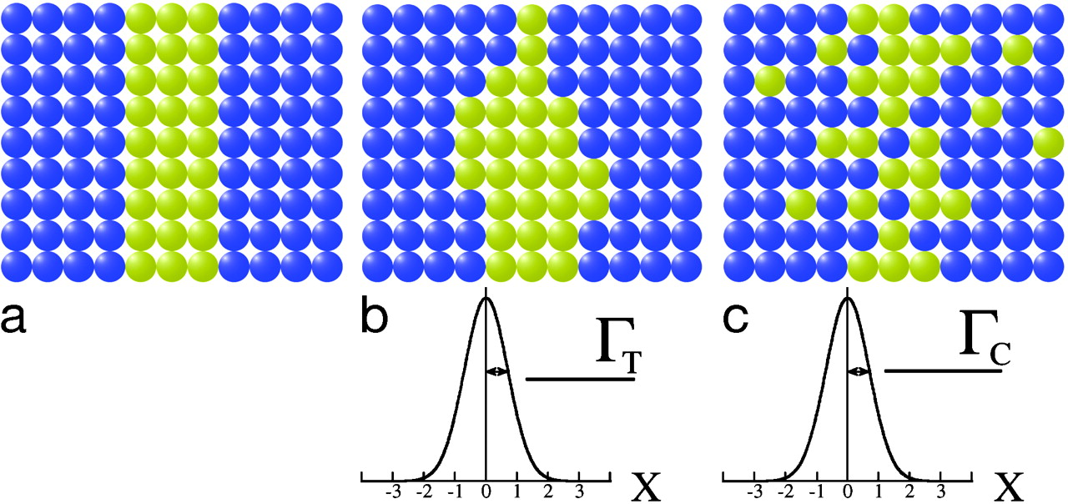
The Key to functionality:
  Defects in Alloys

Slide 9
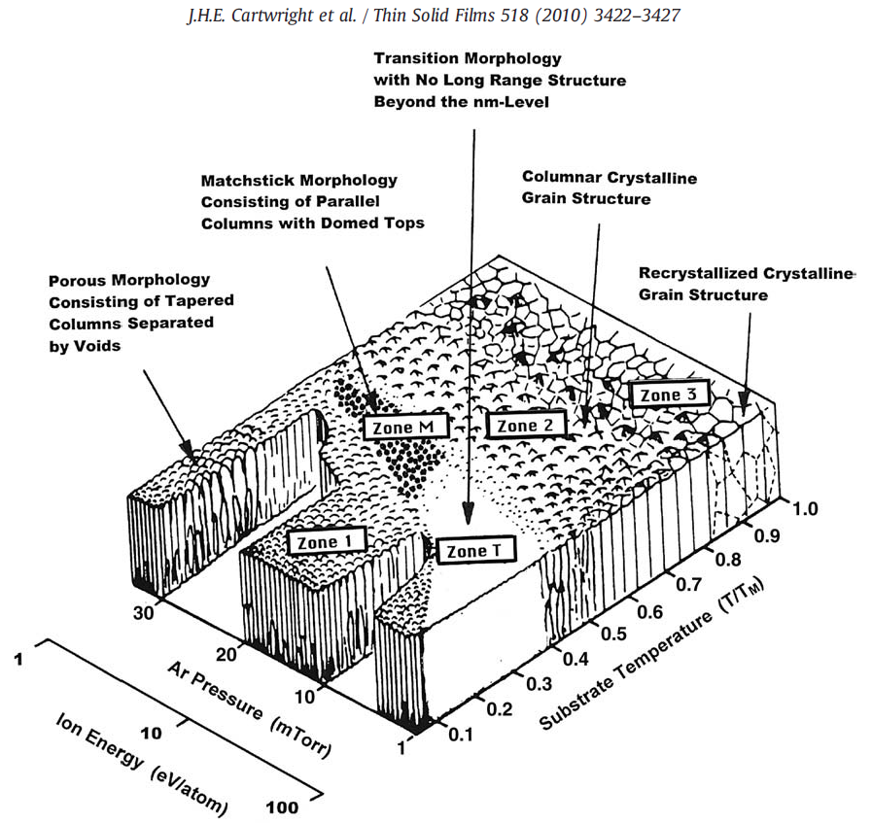
The Key to functionality:
  What drives materials properties during thin film growth?
Film morphology is responsible for
  Lateral and transversal diffusion rate
  Impurity scattering
  Speciation distribution trough out the film
Recipe parameters and film structure are strongly correlated
Examples for band-gap variations: K₃Sb
Eg: 1.1eV, 1.3eV, 1.4eV (dependent on crystalline phase)

Slide 10
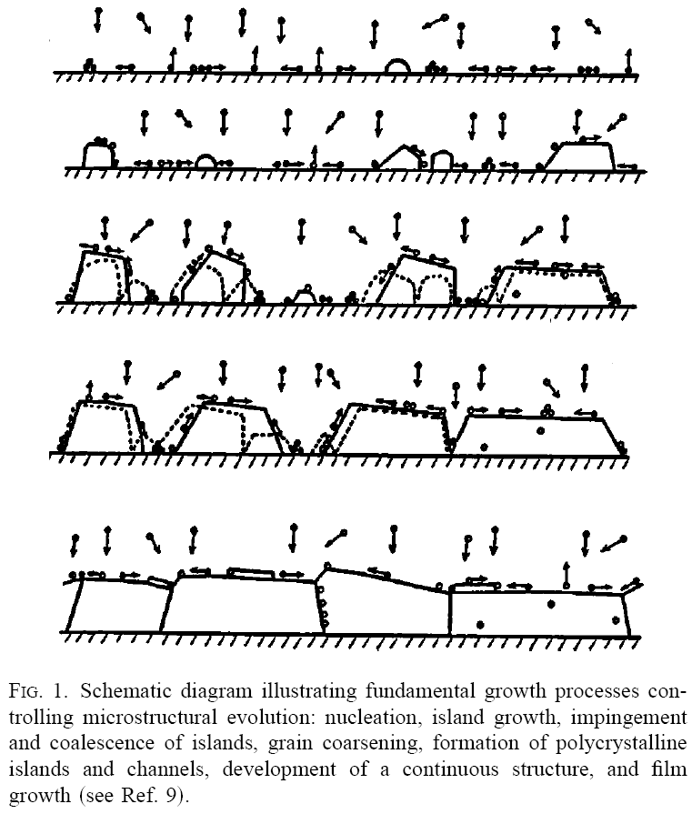
Transport in Multi-Alkalis:
  What drives materials properies during thin film growth?
Coating conditions
Substrate temperature
  Mobility of atoms on surface
  Diffusion rate through film
  Reaction rate (forming compounds)
  Sticking coefficient
  Segregation
Substrate properties
  Pseudo epitaxial growth
  “locking in specific crystalline phase”
  Texturing and grain size
Coating technique
  Sticking coefficient
  Stoichiometry
  Reaction activation
  Steric effects

Slide 11
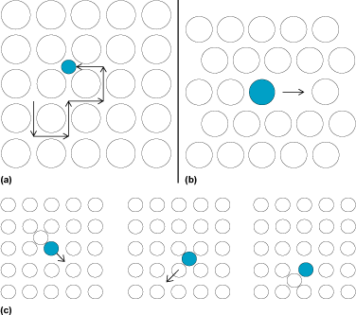
Transport in Multi-Alkalis:
  Glasses, crystals and alloys
Transport depends on
  Hopping energy
  Energy of the system (if thermalized)
  Gradient of dopant
Hopping energy depends strongly on the kind of defect
Energy my be provided by
  Thermal activation
  Reaction energy
  Specific non-equilibrium excitation (like photo absorption, electrical current (electron phonon coupling….)
Gradient drives the diffusion (entropy)

Slide 12
Transport in Multi-Alkalis:
  Diffusion driven by concentration, gradient, and mobility
Concentration on surface is determined by
  Sticking coefficient
    Surface temperature
    Surface chemistry
  Partial pressure of alkali in vacuum
  Concentration gradient in Sb-film

Slide 13
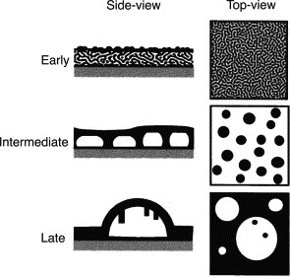
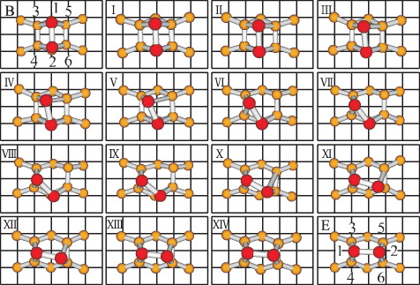
Transport in Multi-Alkalis:
  Influence of the surface
What can happen:
  First layer of alkali has specific chemical conditions, may be:
    Physi-sorbed (very low sticking coefficient)
    Chemi-sorbed (very high sticking coefficient)
  First layer:
    Introduces stress (may enable inter diffusion)
    Terminates dangling bonds (may reduce inter diffusion probability) -> crystal surface
  The issue of Physi- or Chemi-sorbed depends on the specific surface chemistry and temperature

Slide 14
Transport in Multi-Alkalis:
  What is a good cathode?
Best situation:
  Low p-doped on entrance window and high p-doped at the surface
  A n- delta-doped surface layer
  This correlates to:
    Nearly stoichometric concentration at the glass
    Low alkali concentration at the surface
    Surface n-dopeing can be done by:
      Excess of Cs (alkali)
      Sb-defects
Compare with typical growth recipes
This is very difficult to achieve with Sb-K-Cs recipes

Slide 15
Better Coating Technics:
  Co-evaporation/Jo-Jo method
Glass
p
p⁺⁺
n
Pro:
  Ratio between alkali and Sb can be varied during the film growth
  Self purification of materials due to evaporation
Con:
  High reaction temperature (to promote chemisorption is required increasing risk of depletion and diffusion
  Difficult to control processing (missing good process control parameter) -> electron emission depends on many parameters
  Most certainly cannot create a delta-profile (compare S20 literature)
  Hard to control phase segregation due to enhanced temperature (resulting in high mobility of non chemisorbed atoms). Defect play a large role! Compare x-ray measurements
Exact shape ?
Value?
3
Alkali/Sb-ratio
Value?
Thickness

Slide 16
Better Coating Technics:
  Sputtering
Glass
p
p⁺⁺
n
Pro:
  Sputter material can be provided in any compound composition; target determines cathode composition (nearly true)
  Compound is sputtered not atomic components; will allow to tune substrate temperature to achieve optimum mobility
Con:
  Variation of alkali has to be applied by additional Alkali-vapor
  Will also require improved control parameter (however, may be also possible by fixed recipe)
  Requires complex target preparation
Exact shape ?
Value?
3
Alkali/Sb-ratio
Value?
Thickness

Slide 17
Better Coating Technics:
  MOVPE/ALD
Glass
p
p⁺⁺
n
Pro:
  Relative ratio of alkalis and alkali-Sb can be determined exactly and can be easily tuned without new process parameters
  Can be used in complex geometries and production environments
Con:
  Requires enhanced substrate temperature to allow reaction (may be no issue if the right chemistry can be found)
  Issues with organic contamination (very aggressive C-Cs reactivity)
Exact shape ?
Value?
3
Alkali/Sb-ratio
Value?
Thickness

Slide 18
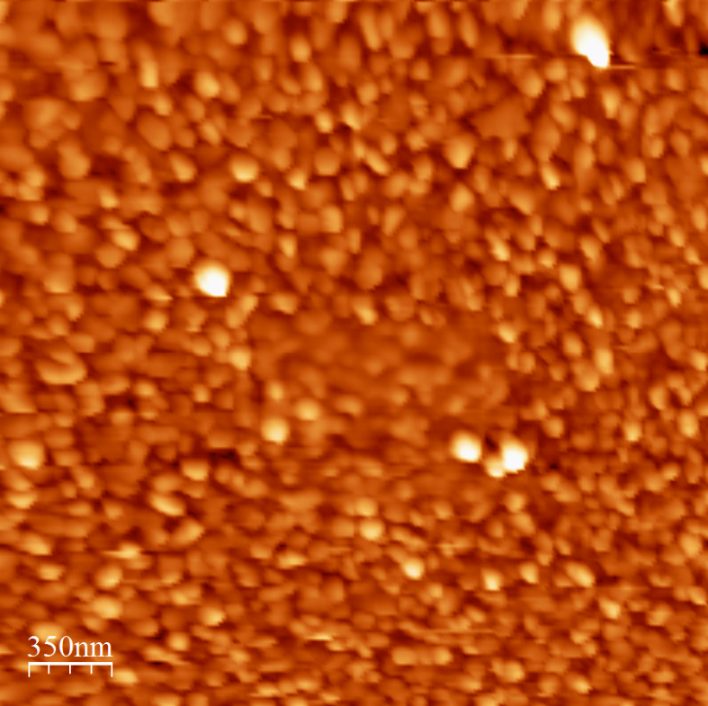
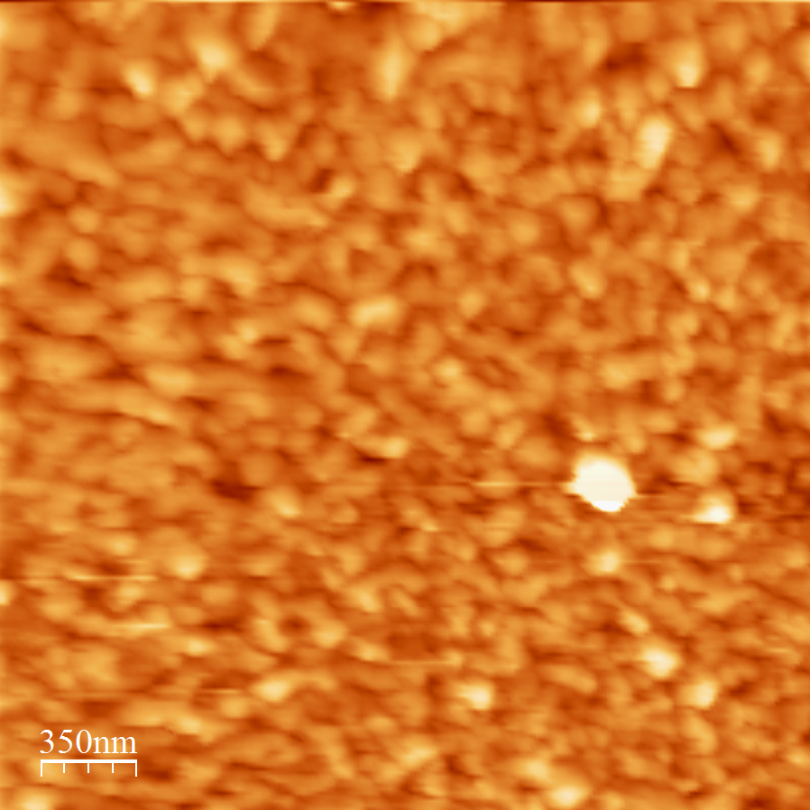
THE SURFACE
THE Topolocy (AFM)
First Deposition (full cathode)
Second Deposition (full cathode)
Cathode is very rough
Individual crystals are in the order of 50-60nm (more or less round)
Second deposition results in larger crystallites (in the order of 100-150nm)

Slide 19
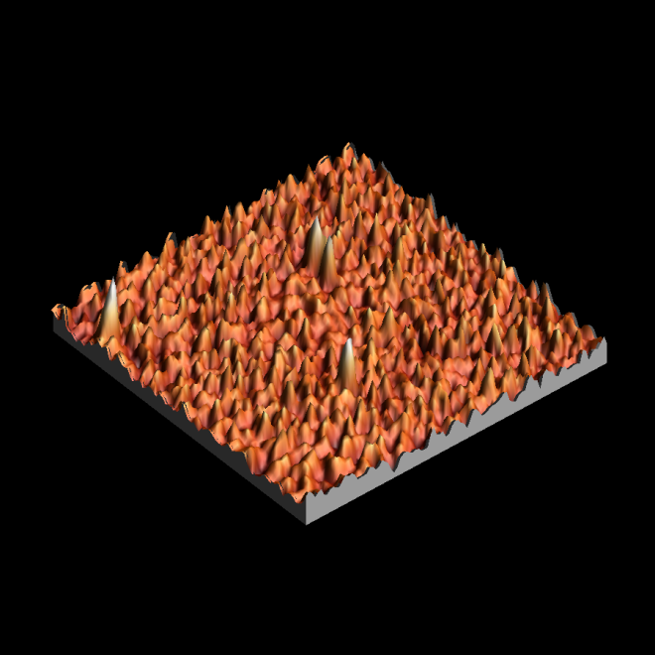
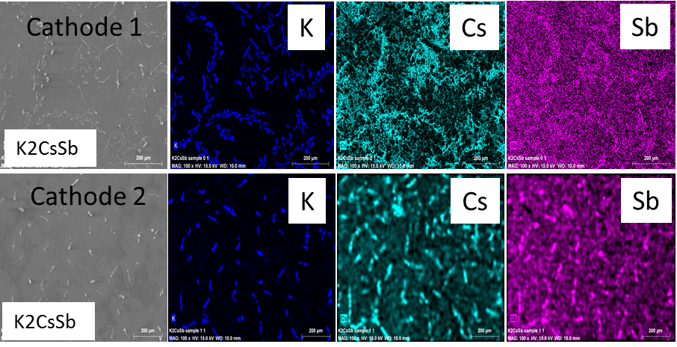
THE SURFACE
THE chemical composition (EDX)
UHV-AFM
First Deposition (full cathode)
QE(%)=1.1%
Second Deposition (full cathode)
First processing forms good compound (K,CS and Sb show similar structure)
Second processing results in more inhomogeneous cathode structure

Slide 20
Next steps (suggestions):
Selection of coating technology
  Co-evaporation: substrate temperature will determine if “doping profiles” can be made
  Sputtering: seems relative easy to be handled
  MOVPE/ALS: requires a large amount of fundamental research which is correlated with safety issues but potentially very rewarding for quality and process integration
Providing infrastructure and coating facilities
  Co-evaporation:
    Need for better process control parameter
    Any recipe can be tested with existing probes
    May need spectroscopy addition for amorphous growth parts
  Sputter:
    Needs appropriate target
    Probes exist (may need also spectroscopy)
  MOVPE/ALD
    Needs coating facility and gas handling
    May require a Sb/K MOVPE but Cs evaporation (don’t know if Cs chemistry exist
    Will require much fundamental work (large project)

Slide 21
Summary:
Complexity of recipes is caused by
  Missing process control parameters
  Interplay between mobility, re-evaporation, and reaction-activation
  Each of the three parameters depends on the history (full? See Johns talk) of the processing
Alternative coating processes are feasible
  Co-evaporation/Jo-Jo
  Sputter
  ALD/MOVPE
Potential improvements within reasonable development effort with sputter
MOVPE may be appropriate for better process compatibility but will be a very difficult development and needs fundamental prove.

