Slide 1
Non polarized true conventional positron target studies
O. S. Adeyemi¹, V. Kovalenko¹, G. Moortgat-Pick^{1;2}
S. Riemann², F. Staufenbiel², A. Ushakov¹
¹University of Hamburg
²DESY
Temperature evolution in the SLAC target
Velocity and stress evolution in the SLAC target
Temperature and pressure evolution in the true conventional target
(300 Hz scheme)
Conclusion

Slide 2
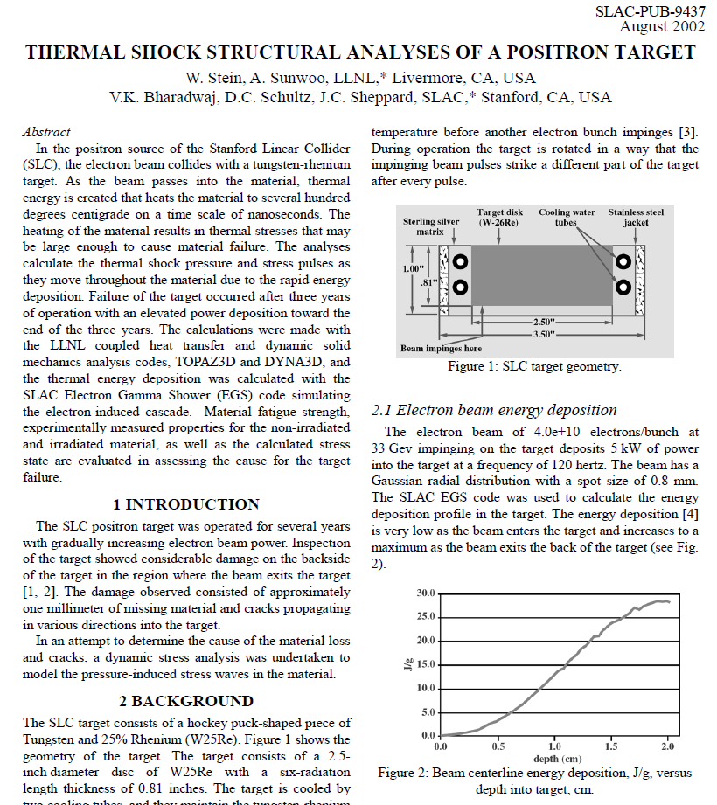
SLAC target
≈ 29 J/g

Slide 3
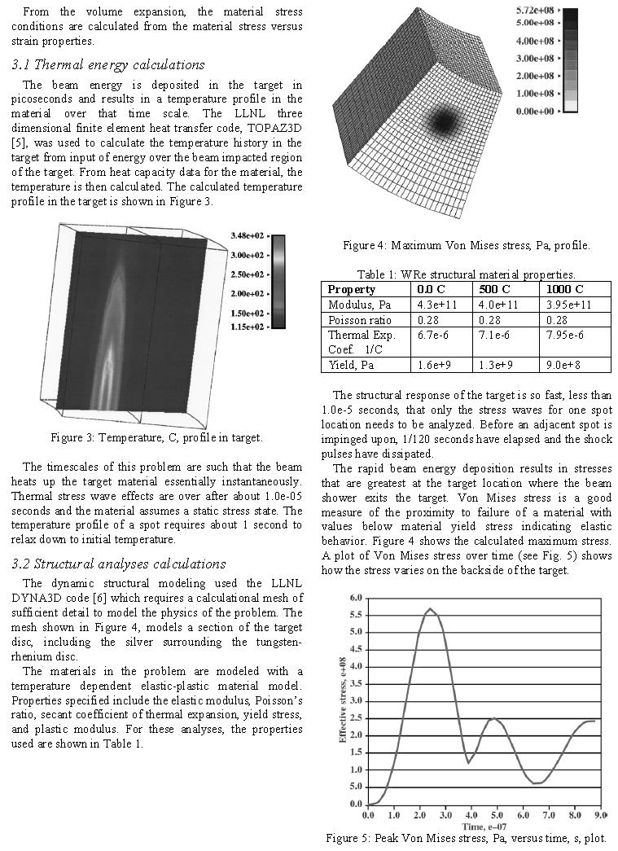
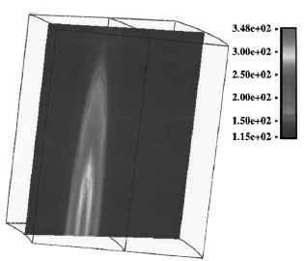
Temperature evolution in the SLAC target
fatigue | 640MPa | 520MPa | 360MPa
fatigue σ ≈ 40% ultimateYield σ

Slide 4
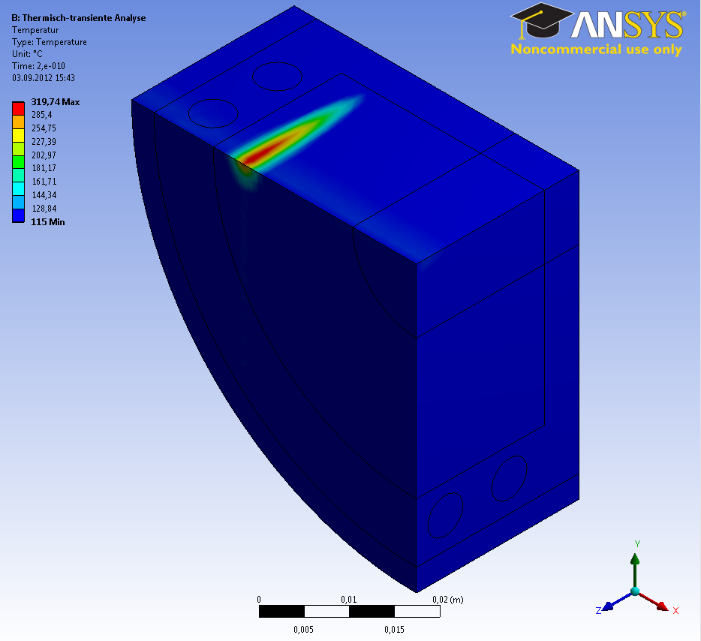
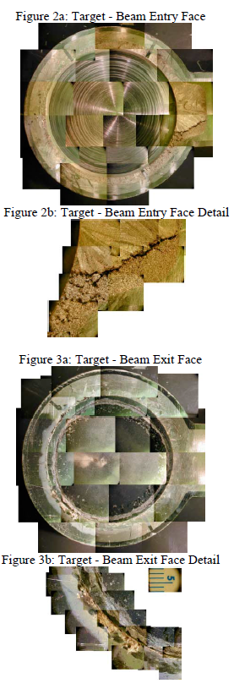
Temperature evolution in the SLAC target
SLAC
33 GeV e⁻
4*10¹⁰ e⁻/pulse
σ = 0.8mm
120 Hz ≈ 8 ms
Fe
Ag
W
Ag
W
backside
PEDD = ΔT_{max} * c_{W}
= 204.74 K * 0.140 J/g K
≈ 29 J/g

Slide 5
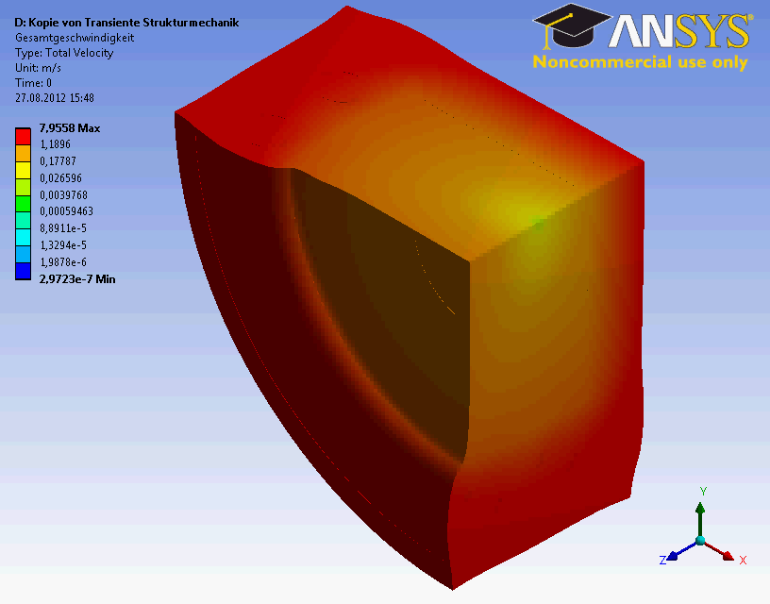
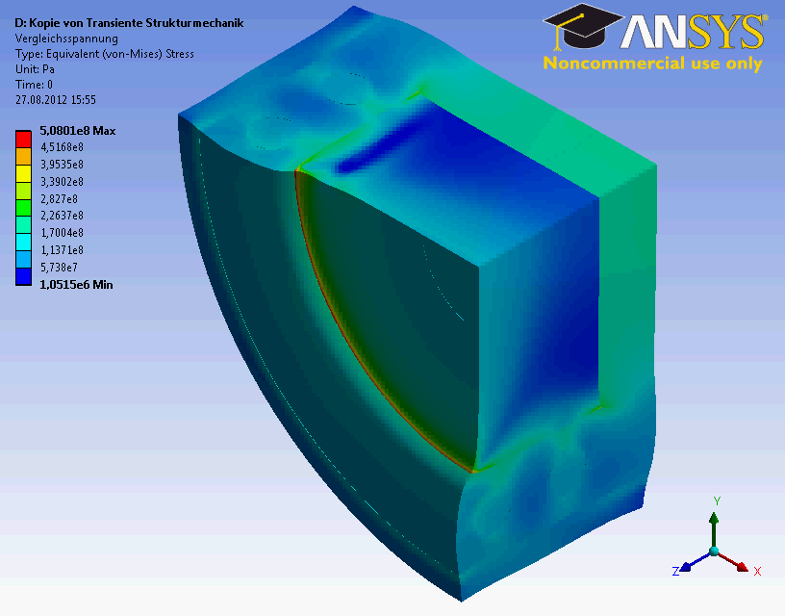
Velocity and stress evolution in the SLAC target
backside
SLAC
33 GeV e⁻
4*10¹⁰ e⁻/pulse (6.4nC)
σ = 0.8mm
120 Hz ≈ 8 ms

Slide 6
Temperature evolution in the true conventional target
SLAC
33 GeV e⁻
4*10¹⁰ e⁻/pulse
σ = 0.8mm
120 Hz ≈ 8 ms
beam ∅ (FWHM):
2,355 σ ≈ 1.9 mm
Fe
Ag
W
Ag
W
spot to spot spacing : 3 mm
backside
True conventional
6 GeV e⁻
2*10¹⁰ e⁻/pulse
σ = 4.0mm
300 Hz ≈ 3.3 ms
beam ∅ (FWHM):
2,355 σ ≈ 9.4 mm
≈ 10 mm

Slide 7
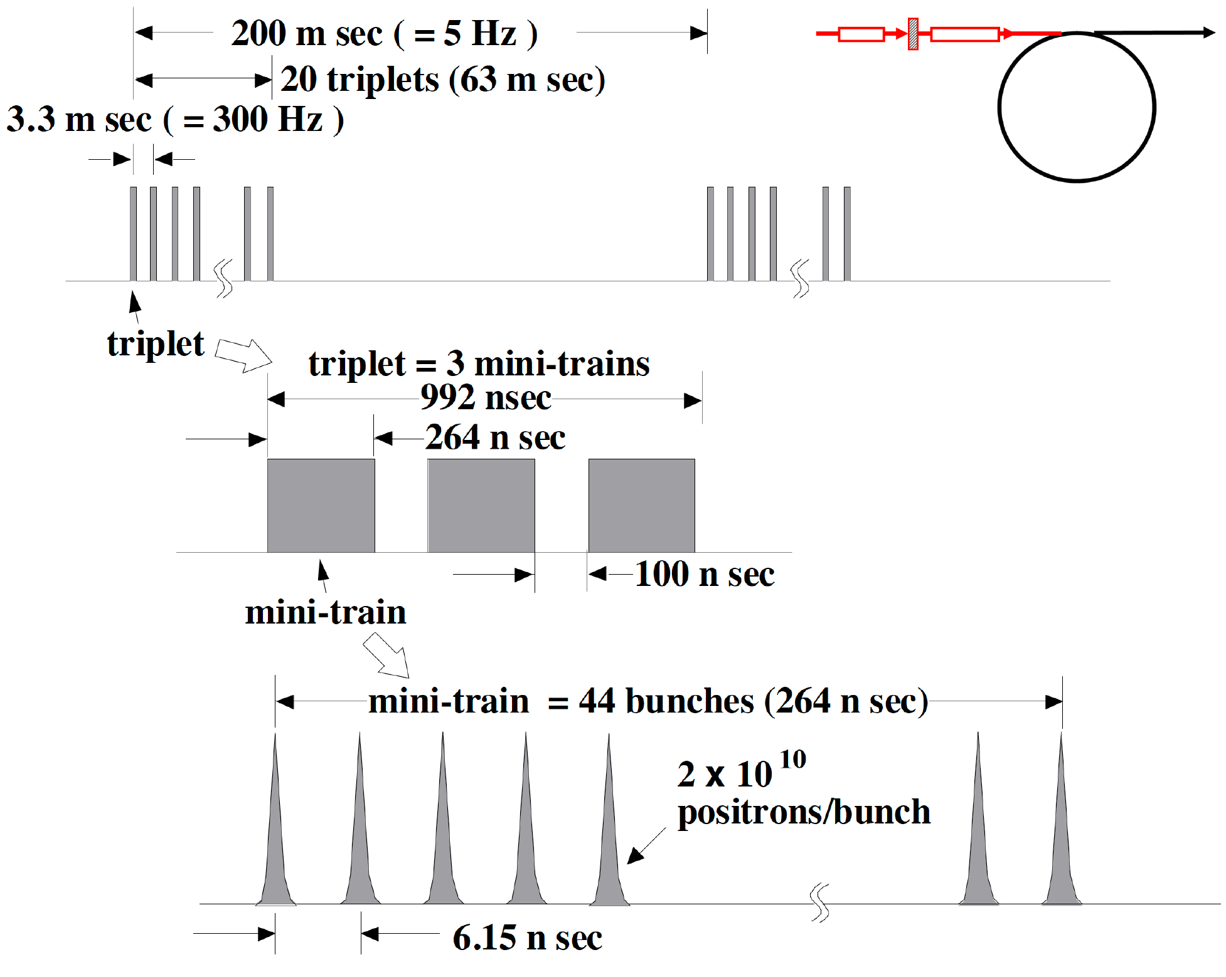
Temperature evolution in the true conventional target
T. Omori (KEK)
True conventional
6 GeV e⁻
2*10¹⁰ e⁻/pulse
σ = 4.0mm
300 Hz ≈ 3.3 ms
beam ∅ (FWHM):
2,355 σ ≈ 9.4 mm
≈ 10 mm
20 x 2.6·10¹³ e⁻/pulse train = 20 x 423 nC/pulse train (SLAC : 6.4 nC/pulse)
132 x 2·10¹⁰ e⁻/pulse train

Slide 8
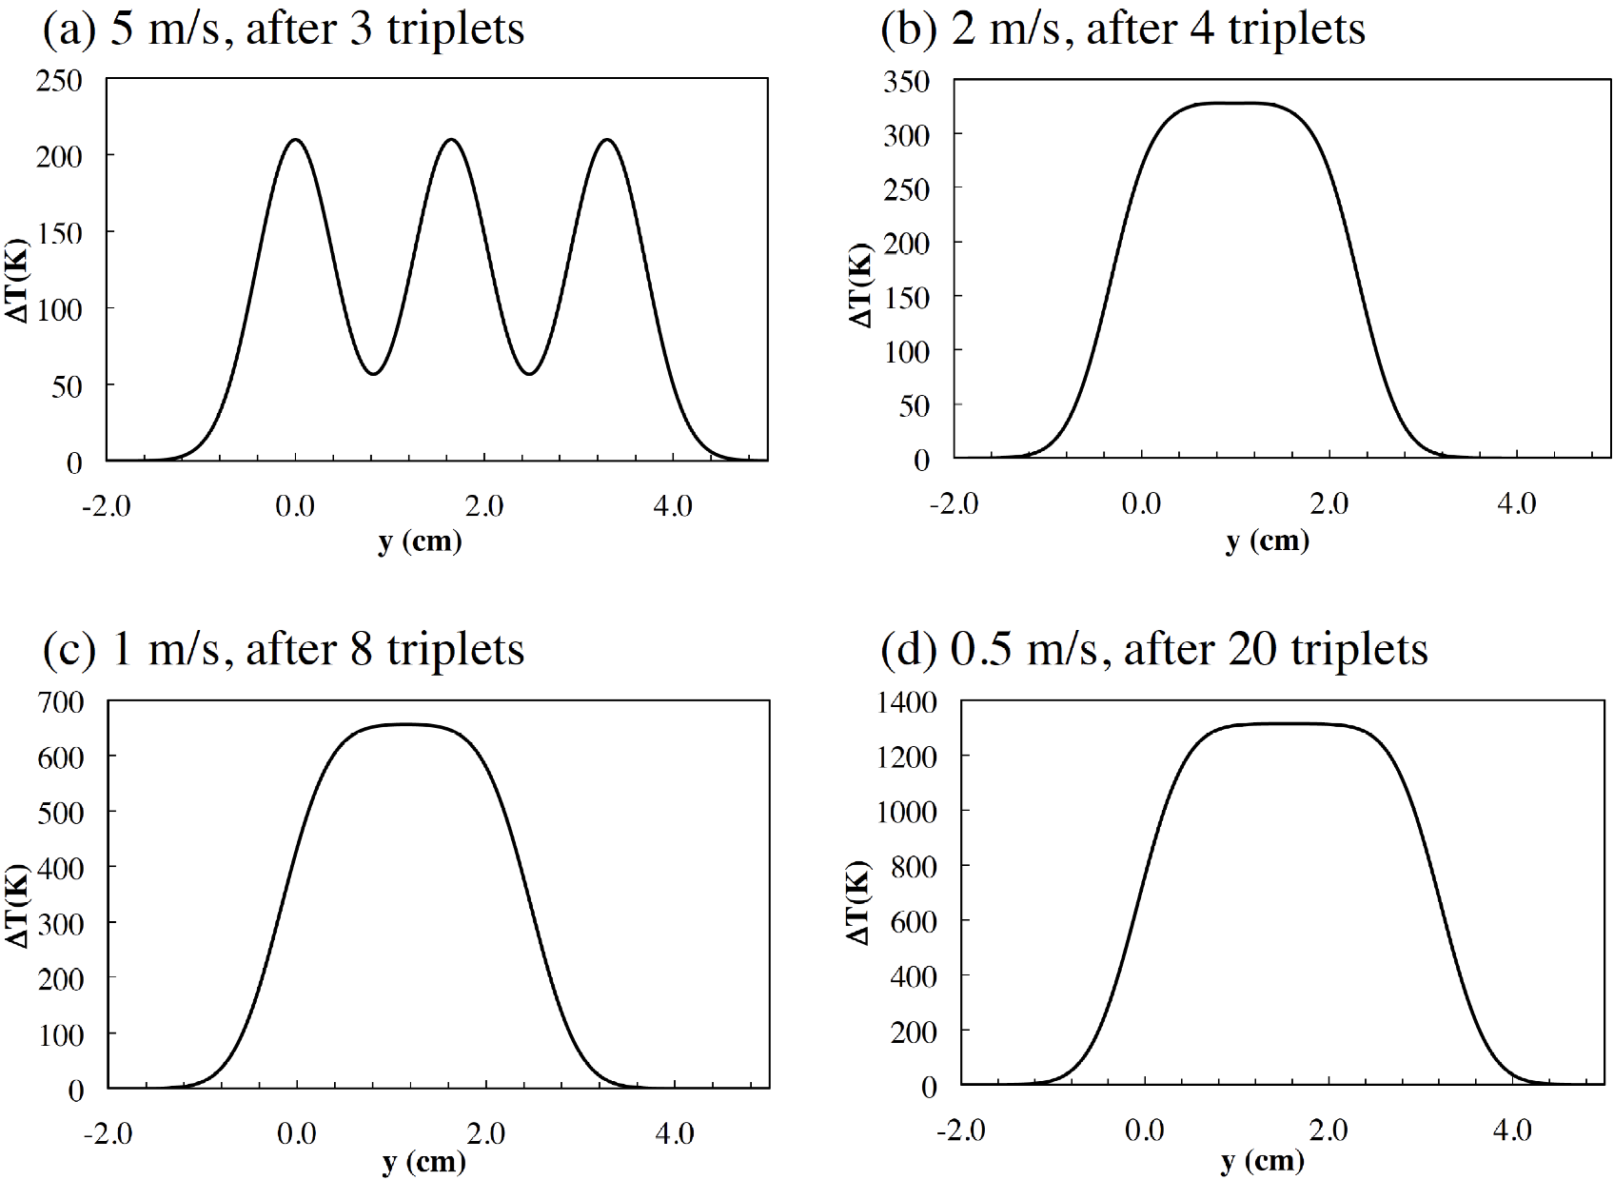
Temperature evolution in the true conventional target
T. Omori (KEK)
True conventional
6 GeV e⁻
2*10¹⁰ e⁻/pulse
σ = 4.0mm
300 Hz ≈ 3.3 ms
beam ∅ (FWHM):
2,355 σ ≈ 9.4 mm
≈ 10 mm
29 J/g
45 J/g
spot to spot spacing :16.5mm
spot to spot spacing : 6.6mm
132*2*10¹⁰ e⁻/pulse
91 J/g
182 J/g
spot to spot spacing : 3.3 mm
spot to spot spacing :1.2 mm
PEDD (EDD) = ΔT_{max} * c_{W} (0.140 J/g K) [J/g]
Mixture of dynamical and static energy density !

Slide 9
Temperature and pressure evolution in the true conventional target
T. Omori (KEK) pendulum target, v=1m/s
5 Hz pendulum
with bellows seal
Slow rotation target
with ferromagnetic
fluid seal
air
bellows seal
ferromagnetic
fluid seal
vacuum
air
vacuum
Today

Slide 10
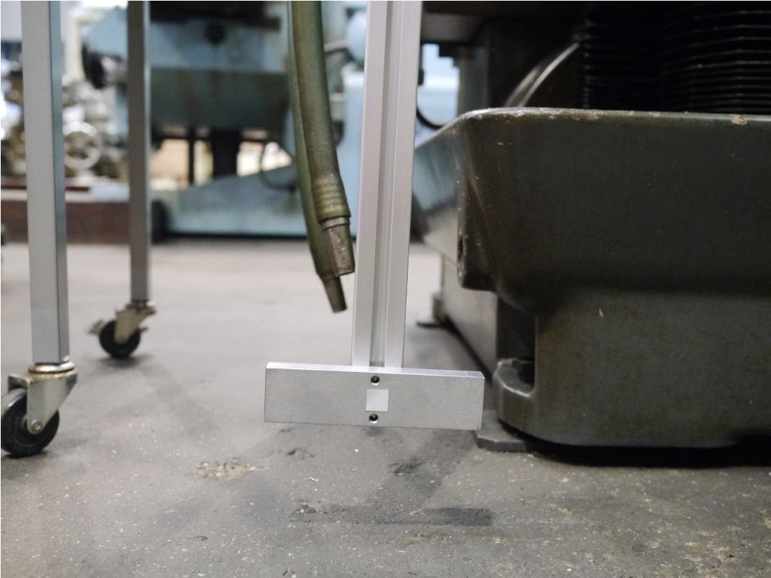
Temperature and pressure evolution in the true conventional target
T. Omori (KEK) pendulum target, v=1m/s
5 Hz pendulum
with bellows seal
Is this aluminum shown in the movie?
m_{Al} ≈ 80 g
m_{W} ≈ 580 g
air
bellows seal
ferromagnetic
fluid seal
vacuum
air
vacuum
Do you consider the inertial mass?
Today

Slide 11
Temperature and pressure evolution in the true conventional target
Pendulum target, v=1m/s
spot to spot spacing : 3.3 mm
30mm
73mm
beam ∅ (FWHM) ≈ 10 mm
100mm
ΔT_{triplet} ≈ 200 K , central region covers 3 triplets ⇒ ΔT ≈ 600 K

Slide 12
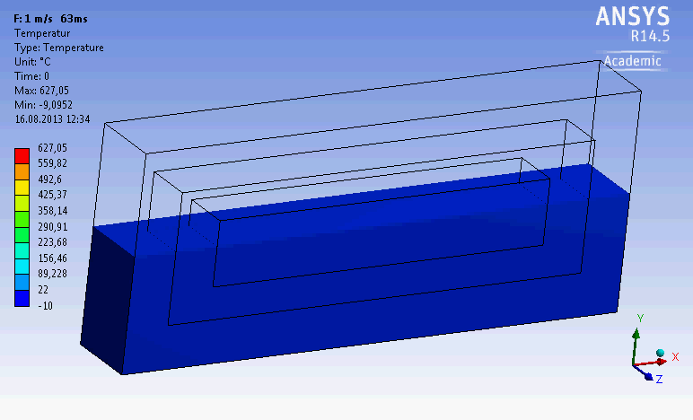
Temperature and pressure evolution in the true conventional target
v=1m/s
t=0.2s
Ag
W

Slide 13
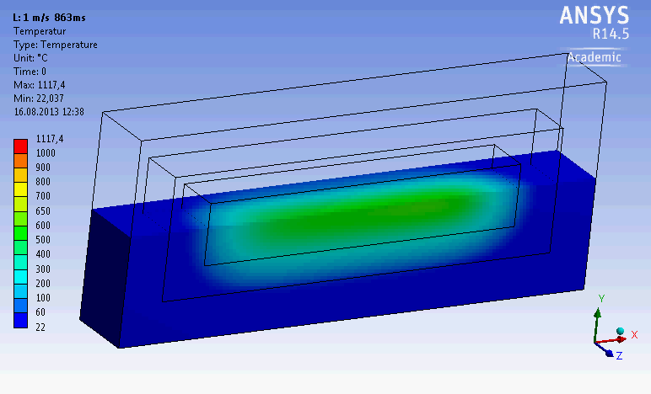
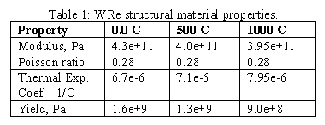
Temperature and pressure evolution in the true conventional target
v=1m/s
t=0.6s
Ag
W
ultimateYield
fatigueYield
fatigue | 640MPa | 520MPa | 360MPa
fatigue σ ≈ 40% ultimateYield σ

Slide 14
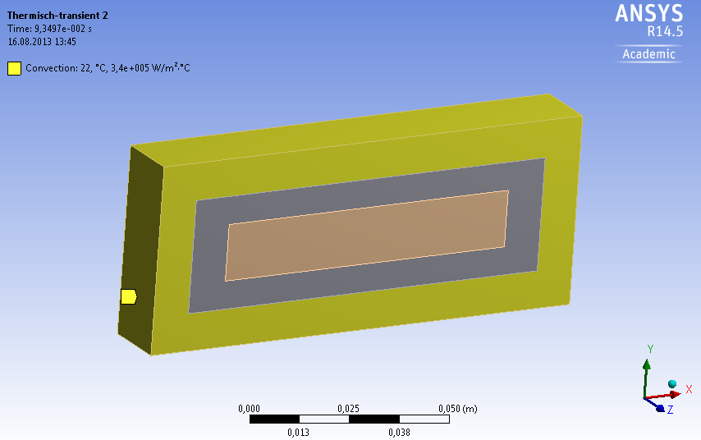
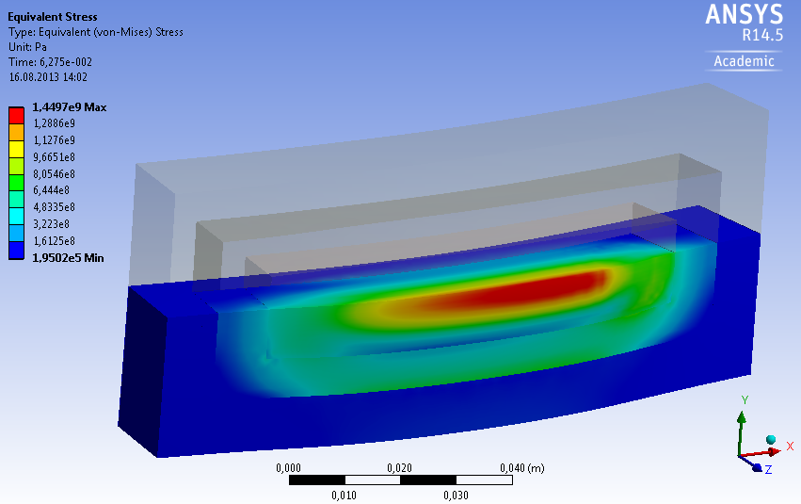
Temperature and pressure evolution in the true conventional target
Ag
Ag
W
W
cooling : 0.2 l/s
W
Pendulum with
v=1m/s does
not work!!

Slide 15
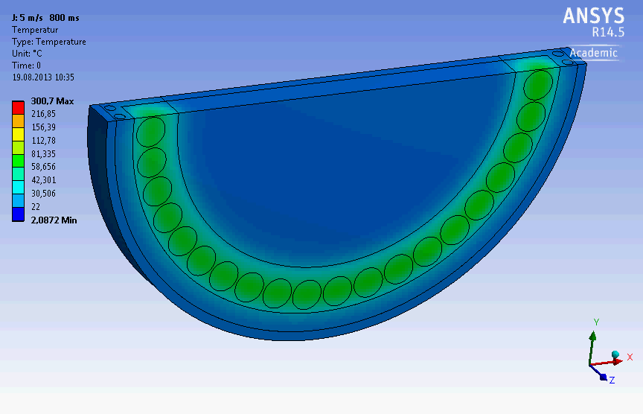
Temperature and pressure evolution in the true conventional target
v=5m/s
t=1.2s
wheel ∅ 200mm

Slide 16
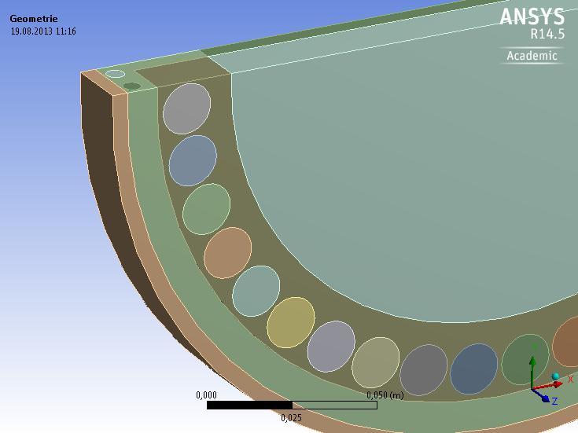
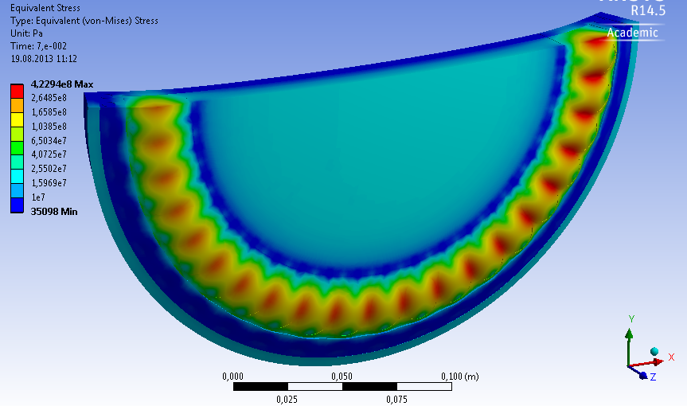
Temperature and pressure evolution in the true conventional target
Ag
Ag
W
v=5m/s
should be fine
Fe
W
cooling : 0.2 l/s
Wheel with v = 5 m/s
should work!!
Beam hits the same place 2.5 times in a sec. like the SLAC target
wheel ∅ 200mm

Slide 17
Conclusion
SLAC target gives a bench mark for the true conventional target
The pendulum target could be the best solution for beam line vacuum, but the
material’s mechanical properties failed completely!
A rotating wheel (∅ 200mm) with up to v = 5m/s rim velocity reach the SLAC conditions for
the proposed 300 Hz scheme
The opening of the Optical Matching Device (12mm) is close to the beam diameter
(10mm FWHM). Due to the close distance to the target (5mm) an overload of the
OMD could occur. Hence, positron capture is an open issue.

