Slide 1
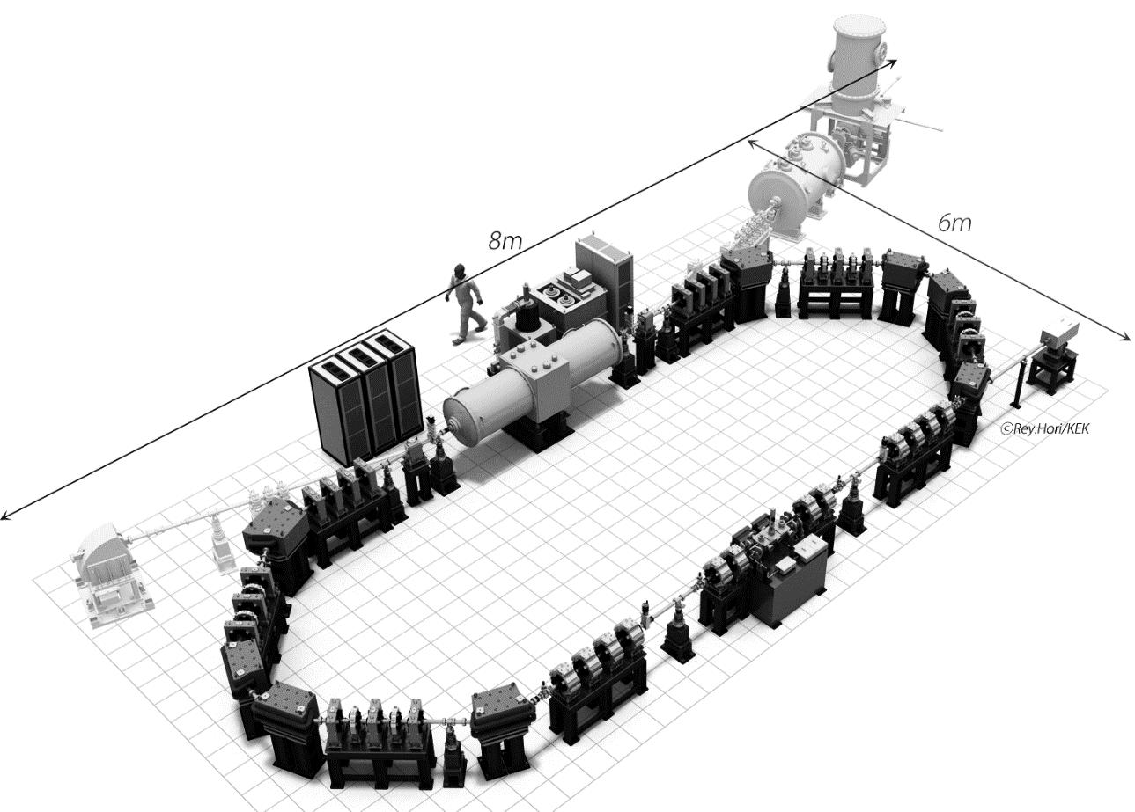
New QB Program (Fundamental Technology Development for High Brightness
X-ray Source and the Imaging by Compact Accelerator under Photon and Quantum Basic
Research Coordinated Development Program)
PosiPol2013 at ANL, 4-7 September 2013
KEK Junji Urakawa
Purpose of our project
Compact X-ray Source (Peak Brightness 10¹⁹)
~keV-100keV tunable X-ray generation
Development of Basic
Technologies
1. Multi-alkali photocathode
for high average current
2. Cryo-rf-gun
3. ERL
~1MW electron beam
4. ~1MW high-average
power laser
5. ~10μm precise collision
technique
6. X-ray imaging
7. 4K 325MHz spoke cavity
Super conducting cavity
Application of
X-ray:
Imaging etc.
cERL
~35MeV
ICS (Inverse Compton
Scattering)
Optical cavity for pulse
laser accumulation, collision point
Notes:
目的、基盤技術開発項目

Slide 2
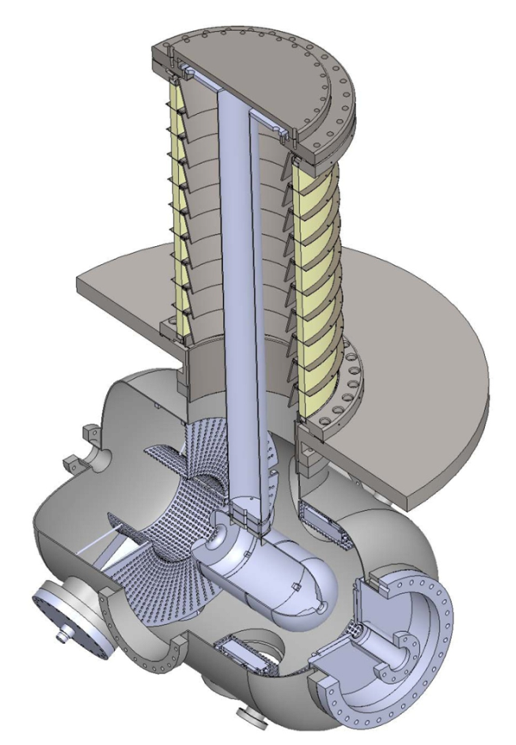
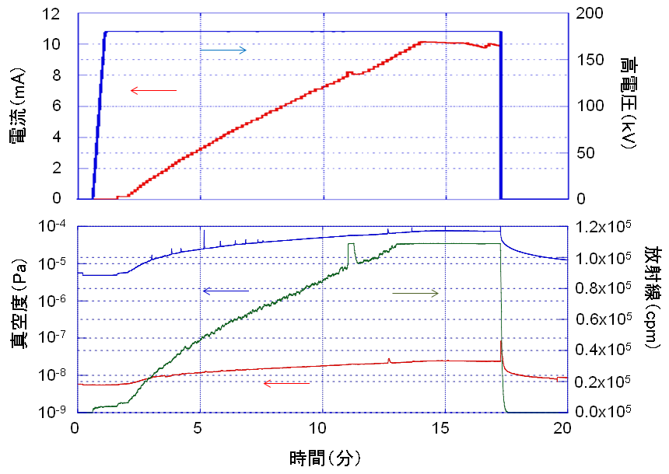
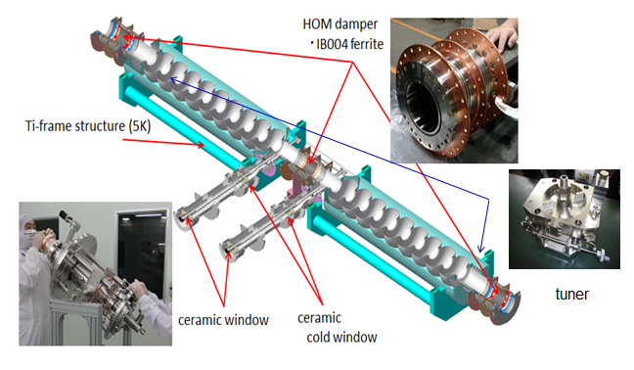
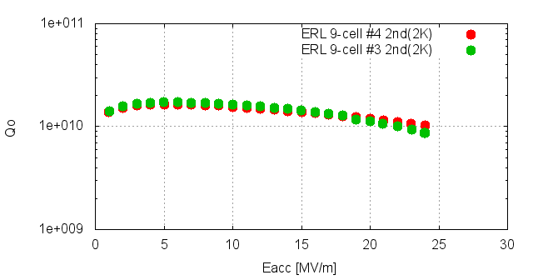
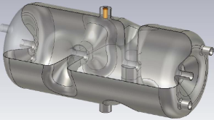

500keV-1.8mA Beam generation
500kV high voltage electron gun technology
Ceramic tube for
High voltage
isolation
From Negative Electron
Affinity (NEA)-GaAs
Photocathode to Multi-
Alkali photocathode
Development
From DC gun to
Cryo RF gun Development
Reason: to long lifetime
and Compact
We can proceed our
proof-of-principle
experiment using DC
gun and 2K-Super
conducting cavities
for high brightness X-ray
generation.
current (mA)
Time (min)
current (mA)
High Voltage (kV)
anode
Pressure (Pa)
Radiation (cps)
Time (min)
cathode
500kV-DC Gun
4K 325MHz super
Conducting Spoke cavity
Compact semi-conductor amplifier
is commercial available..
Notes:
高圧DC電子源技術達成、1.3GHz超伝導空洞技術達成
高輝度Ｘ線発生・利用実験の準備ができた。性能を向上する為の新技術開発。

Slide 3
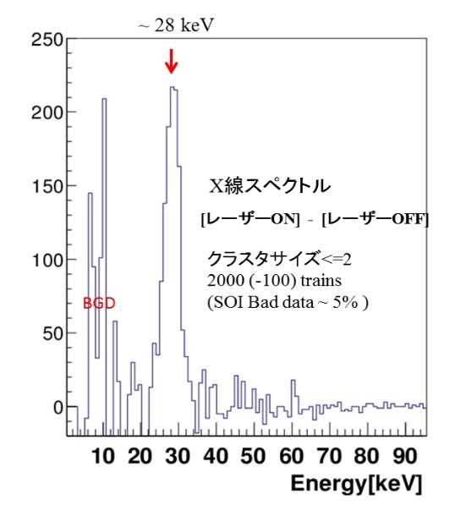
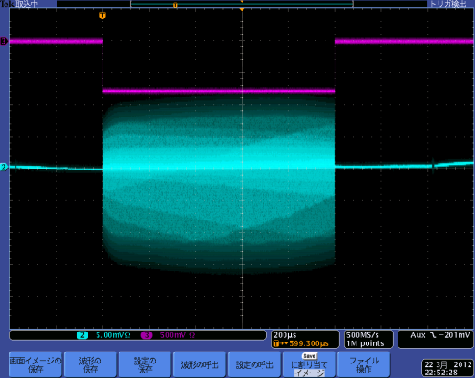
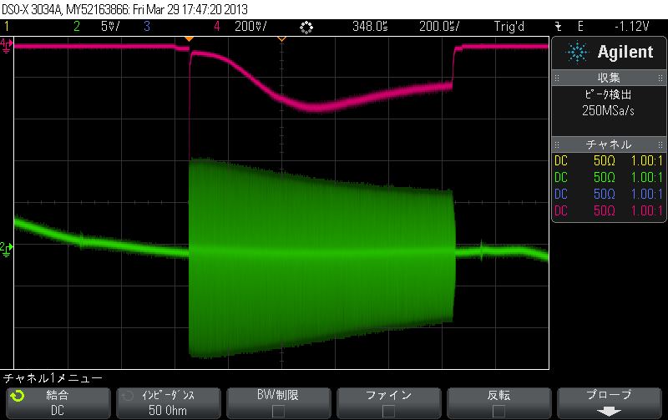
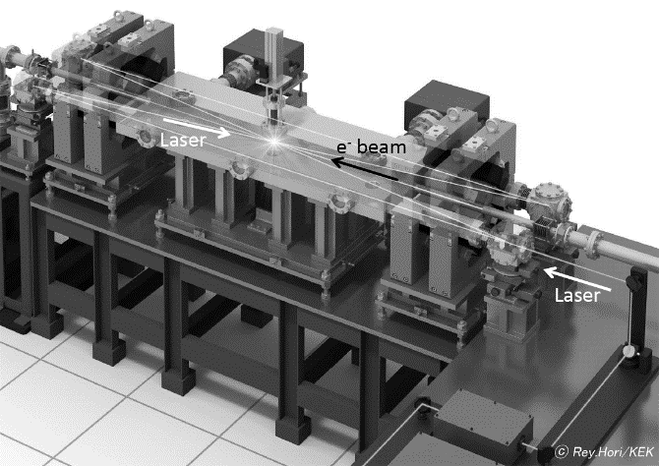
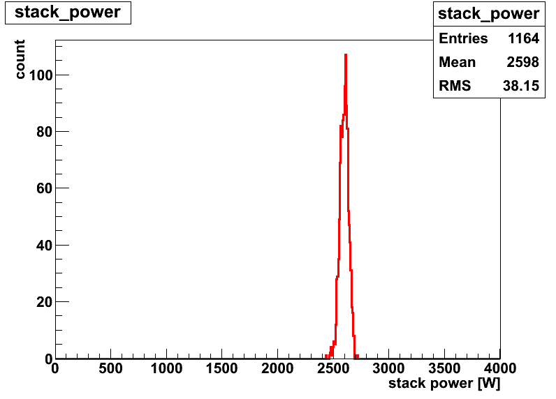
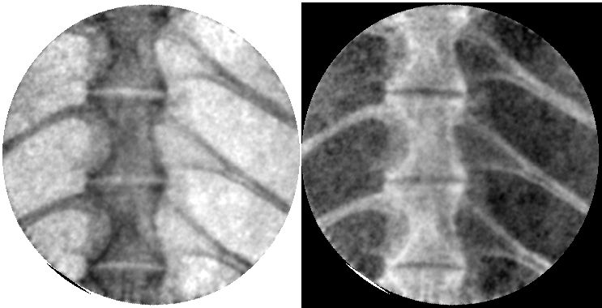
1ms flat beam extraction from RF gun
(RF feedback ON) 03.22.2012 50pC/bunch
1ms beam acceleration in STF accelerator
40MeV, 1ms, 7.5mA Beam Operation
Loss Monitor
X-ray spectrum
Data with laser
-without laser
1ms
BPM signal
(V1+V3)
Success of 28keV X-ray detection
Success of 162.5k electron bunches generation
and acceleration in 2K super conducting accelerator (STF)!
9mA(peak current)
6mA(peak current)
～15keV
1.4% fluctuation
-<8pm
From X-ray absorption imaging
To X-ray phase contrast
imaging. So, Measurement
Using Talbot interferometry
The measurement within 1 sec
is essential and we should
establish above technology
within 2~3 years.
In 2D-4 mirror optical cavity
Laser pulse was accumulated by
100kW. By the end of 2014
1MW will be achieved.
375MHz electron bunch and
Laser pulse collision is stably realized.
relative mirror position control of
8pm was achieved. Fast polarization
control (>10kHz) is possible.
Laser IP size 13μm was achieved.
Notes:
大電流ビーム生成・加速に成功。光共振器技術の見通しを得た。
吸収イメージング試験測定も行った。次は新位相コントラストイメージングで利用展開する。

Slide 4
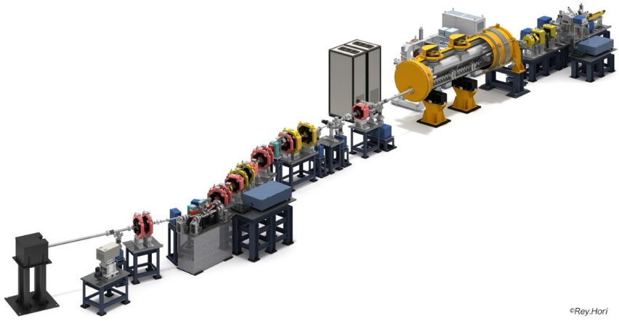
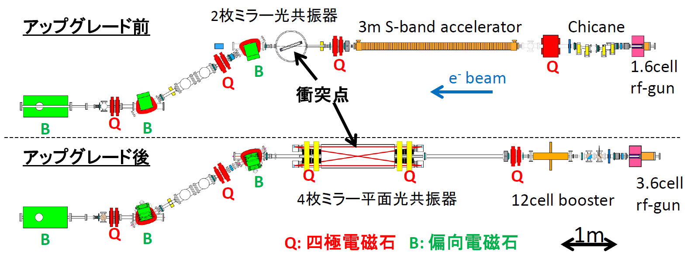
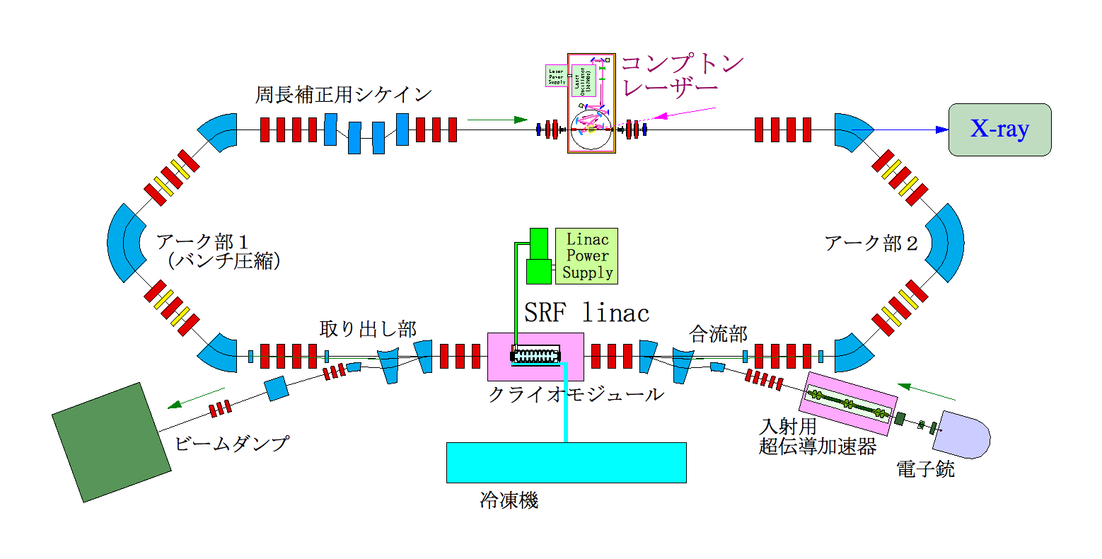
STF facility
Beam Dump
RF Gun Laser
X-ray Detector
Beam energy upgrade from 60MeV
to ~300MeV under going.
Re-operation from 2016 and high
energy X-ray generation and the
application are expected from 2016.
LUCX facility (40MeV)
cERL facility (35MeV)
After improvement, technology development for
~1MW laser pulse storage, 357MHz～10μm
collision technology and development for
imaging technology (2013-2019).
～10mA ERL operation by 2015, ICS X-ray
generation and application (2015-2019)
Notes:
最先端小型電子加速器施設が３つKEKにある。

Slide 5
Research organization and responsibility
Compact and stable multi-beam klystron
RF source development
Cooperative company
Toshiba
Compact RF source
JST advisors
PD and PO’s
AIST
X-ray application
Laser Development
Hitachi
Compact cooling
system
Cooperative institute
Osaka Univ.
Students education
Rigaku
X-ray imaging device
Main institute
KEK
Super conducting accelerator technology
Manufacture of new devices and
Measurement of the performance
Pos-doc and student education
facilities：LUCX, STF, cERL
Cathode development
Horoshima Univ.
Precise feedback technology
And cathode development
Student education
Cathode test chamber
Imaging device development
Tohoku Univ.
Method of X-ray imaging
Interference imaging
Green excited and high QE cathode
Mirror development
Waseda Univ.
Laser development
Student education
Laser development
NAOJ
Gravitational wave
Measurement Group
Strong high reflective mirror
JAEA
4k super conducting spoke
Cavity development
cERL electron source
500kV gun operation
Kyoto Univ.
4k super conducting spoke cavity
Student education
Improve both beam
Quality, X-ray
generation and
detection
Nihon Univ.
Cryo rf-gun
Student education
Cooperative institute
Tokyo Univ.
Strong high reflective mirror
Student education

Slide 6
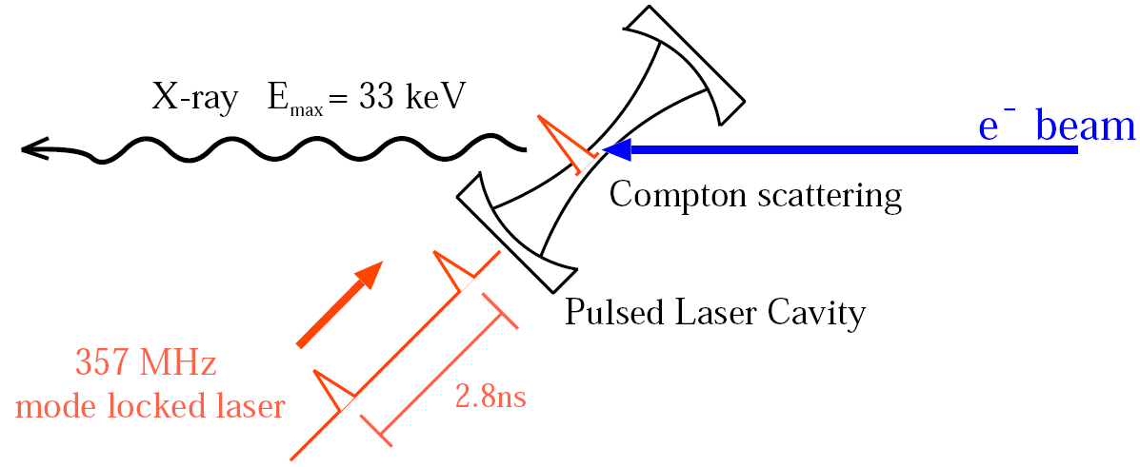
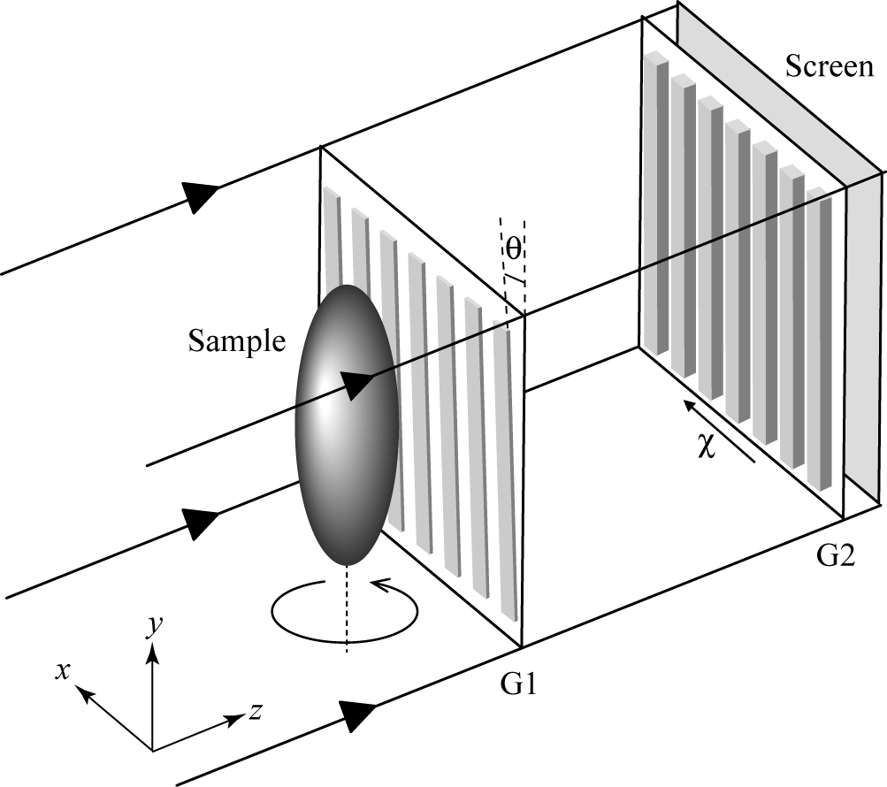

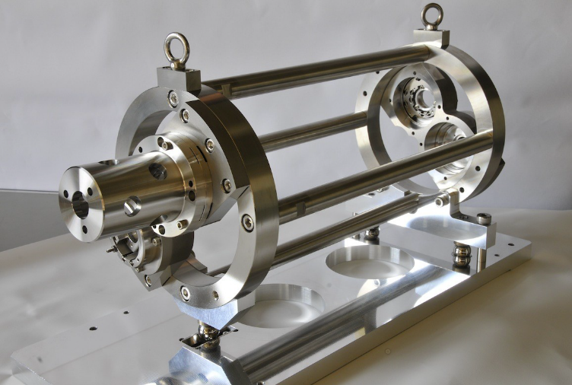
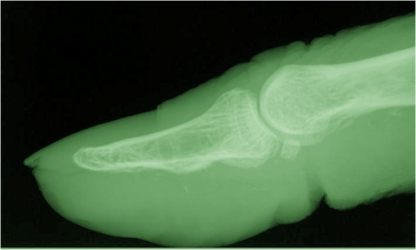
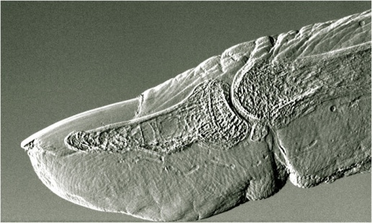
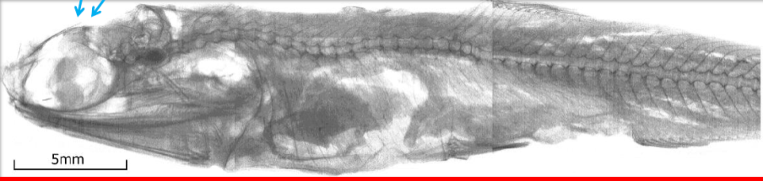
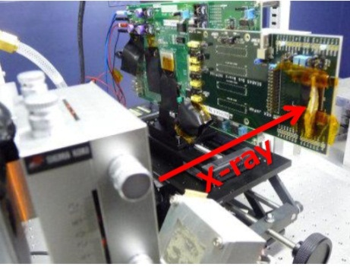
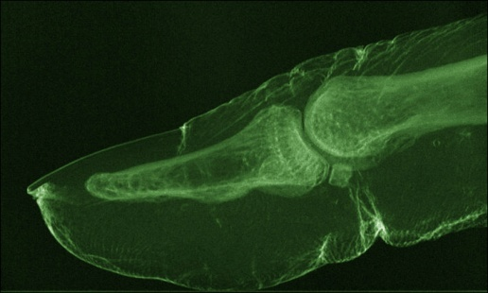
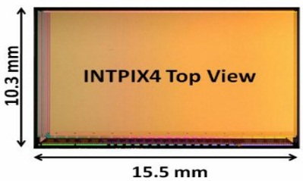
ICS photon beam comparing large
photo factory
・pulse to make a image in short
period.
・large angular divergence to
measure large area.
・polarized X-ray generation with
fast polarization switching .
X-ray Talbot
interferometry
2D 4-mirror optical cavity
3D 4-mirror optical cavity
absorption image
Control of circular polarization
phase differential image
円偏光共鳴状態制御
Intensity of transmitted light
X-ray Imaging by SOI Pixel Detector
left-handed
right-handed
scattering image
Round cavity length
Notes:
既に特許出願された新技術を高度化して利用展開へ。

Slide 7
Life science innovation
◎たんぱく質構造解析、創薬（（株）リガクの将来光源装置）
◎高速X線偏光スイッチングの利用
光学異性体識別：睡眠・鎮静剤サリドマイド等の副作用を与える鏡像異性体成分を選択的に
解離する技術開発が可能になる。
◎血管疾患の初期診断（糖尿病性慢性合併症）
微小血管病変 ⇒ 尿病性網膜症、糖尿病性腎症、大血管病変 ⇒ 心筋梗塞、脳梗塞
日本の糖尿病患者は 740万人おり、予備群も含めると2,200万人以上である。
既存の診断手法（血糖値検査）では予備群に対する診断が不十分、本研究にて開発する
小型高輝度ICS-X線源と吸収端撮像法によって、 これまで撮影が困難であった毛細血管の
収縮異常を 、リアルタイムで可視化することができる。
予備群を対象とした画期的な初期診断が期待できる。
ユーザー: 国立循環器病センター、東海大学医学部、岩手医科大学などの医療機関・病院
エンドユーザー： 国民（20%以上が対象）
◎骨疾患の初期診断
骨粗鬆症、関節リウマチ など、日本の骨粗しょう症患者は、1,300万人以上である。
既存の診断手法（DXA法、MD法、超音波法）、しかし、骨粗しょう症の骨鬆（す）は非常に
微細（数μｍ）なため、既存の手法では可視化できなかった。本研究にて開発する
小型高輝度ICS-X線源とタルボ干渉法を組み合わせることによって、 これまで撮影する
ことが困難であった骨粗鬆症の微細構造を、高解像度で短時間に可視化することができる。
画期的な初期診断・治療法の開発が期待できる。
ユーザー: 茨城県立医療大学、埼玉医科大学どの医療機関・病院
エンドユーザー： 国民（10%以上が対象）
◎準単色Ｘ線（50keV～150keV）によるがん治療
Notes:
「質問内容」 ユーザーニーズがどれだけあるか、魅力的な光源になりうるかなど、波及効果をせつめいすること。
イメージングまでの最終的な目標を実現させるための技術開発の課題と解決方法を説明すること。

Slide 8
Green innovation
◎ナノ構造解析（日立製作所、（株）リガクの将来光源装置）
◎高速ポンプ・プローブ実験（物質構造ダイナミックス解明）
◎高速X線偏光スイッチングの利用
光学異性体識別：磁気異方性の解明、界面におけるスピンダイナミクスの観察等。
◎ハイブリッドKエッジ濃度計
Kエッジ吸収法とX線蛍光散乱を組み合わせて、溶液中の物質濃度を高精度で測定する
装置。本研究にて開発する小型高輝度ICS-X線源によって、ウラン・プルトニウム硝酸溶液
の分析可能になる。
核燃料再処理工場の計量管理に応用可能。
◎アクチノイドなど重元素物質の化学結合および構造特性の解明
→ 究極の化学反応制御法の確立
「現状」大型放射光ビームラインの一部で核燃料取扱（KEK-PF, BL-27）
または、模擬物質（ランタノイド）を使った実験 (SPring-8, BL11XU)。
本研究にて開発する小型高輝度ICS-X線源を「将来」核燃料取扱施設に設置！
非密封RIの取り扱いに高い自由度（多様な核種の利用）
◎核セキュリティ（核不拡散・核セキュリティ技術開発（0.5MeV～10MeV） ）
入射ガンマ線
同位体に固有の原子核共鳴蛍光散乱
（Nuclear Resonance Fluorescence）
Pu-239
2143 keV
エネルギー可変、
単色ガンマ線ビーム
原子核反応を
選択的に実行
蛍光ガンマ線
2143 keV
R. Hajima, T. Hayakawa, N. Kikuzawa, E. Minehara, J. Nucl. Sci. Tech. 45, 441 (2008).

Slide 9

Application of advanced laser and accelerator
technology for our life.
http://kocbeam.kek.jp/ from 2008.9 to 2013.3
MEXT and JST are
administrating and asked me
to manage the research program
with PD and PO’s.
PD: Yasuhiro Ie,
PO’s: Makoto Inoue and
Sachii Morii
http://nkocbeam.kek.jp/ from 2013.8

Slide 10
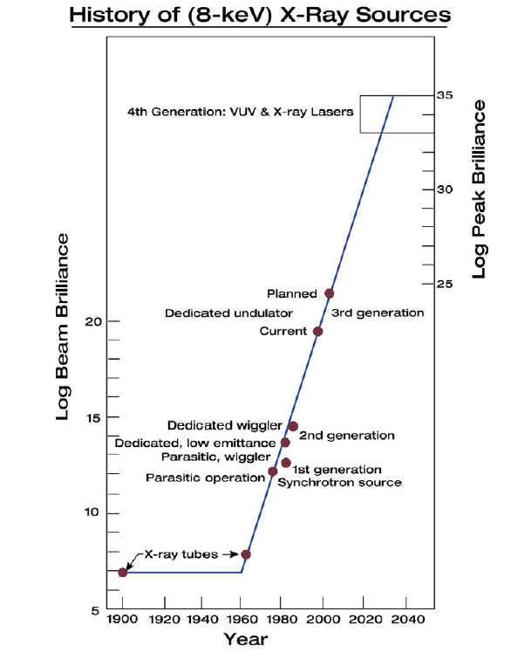
X-ray Lasers
Key-tech. for stimulated or super
radiation
Efficient pre-bunched FEL
and micro-bunch train generation
Energy or velocity modulation
to make intensity modulation by
laser field or intensity modulation
by other tech..
and coherent radiation
Coherent
Emission
Super-radiant ICS
Synchrotron
Radiation
ICS
10¹⁹
Relativity
X-ray Tubes

Slide 11
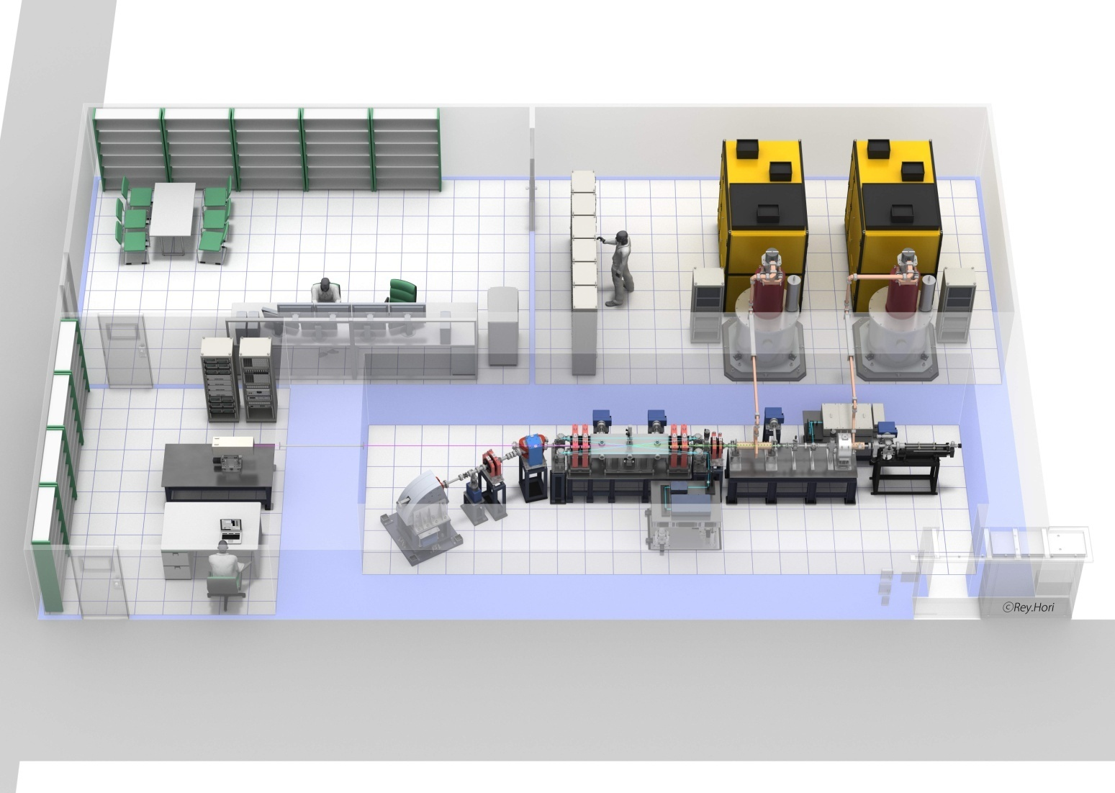
High brightness X-ray facility based on ICS
Down size
To 6 x 8m
～８ｍ
～１２ｍ
Add 4k refrigerator to use superconducting
cavity keeping compactness in future.
Normal conducting accelerator system for compact high
brightness X-ray

Slide 12
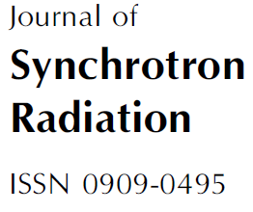
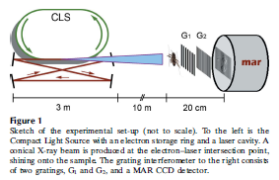

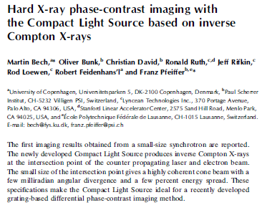
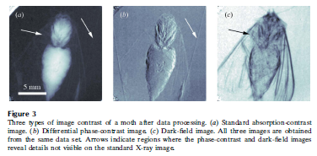
Brightness 10¹⁰～ 10¹¹
Photons/sec/mm²/mrad² in 0.1%b.w.
25MeV
電子リング
Photon Flux :
~10¹⁰ photons/sec1%bw
Reduce electron beam emittance by 100.
Reduce the energy spread of electron beam by 10.
Reduce electron bunch length at IP , we select high power electron Linac
and optical cavity to generate X-ray based on ICS.
Then, we have a possibility to get 10¹⁷and
one shot measurement for X-ray imaging.
X-ray exposing time more
than 100sec
12
12
January 2009

Slide 13
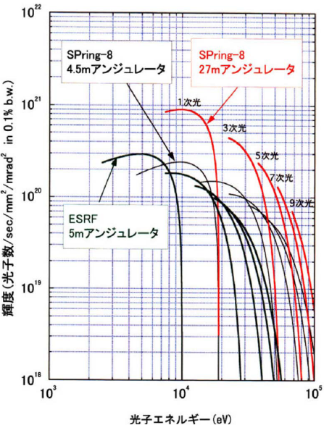
Schedule
High brightness X-ray generation at c-ERL
as a demonstration through beam experiment
2015 experiment
Pulse laser optical cavity
X-ray
-
E-bunch
Laser
SPring-8
World highest
Av. Brightness 10²¹
Photons/sec/mm²/mrad² in 0.1%b.w.
from 27m undulator at
SPring8
Beam dump
Energy recovery
Injector
Super-conducting linac
Realize the Brightness 10¹⁷Photons/sec/mm²/mrad² in 0.1%b.w.
10¹³ photons/(sec・1%b.w.)
35MeV electron beam x 1μm laser = 23keV X-ray

Slide 14
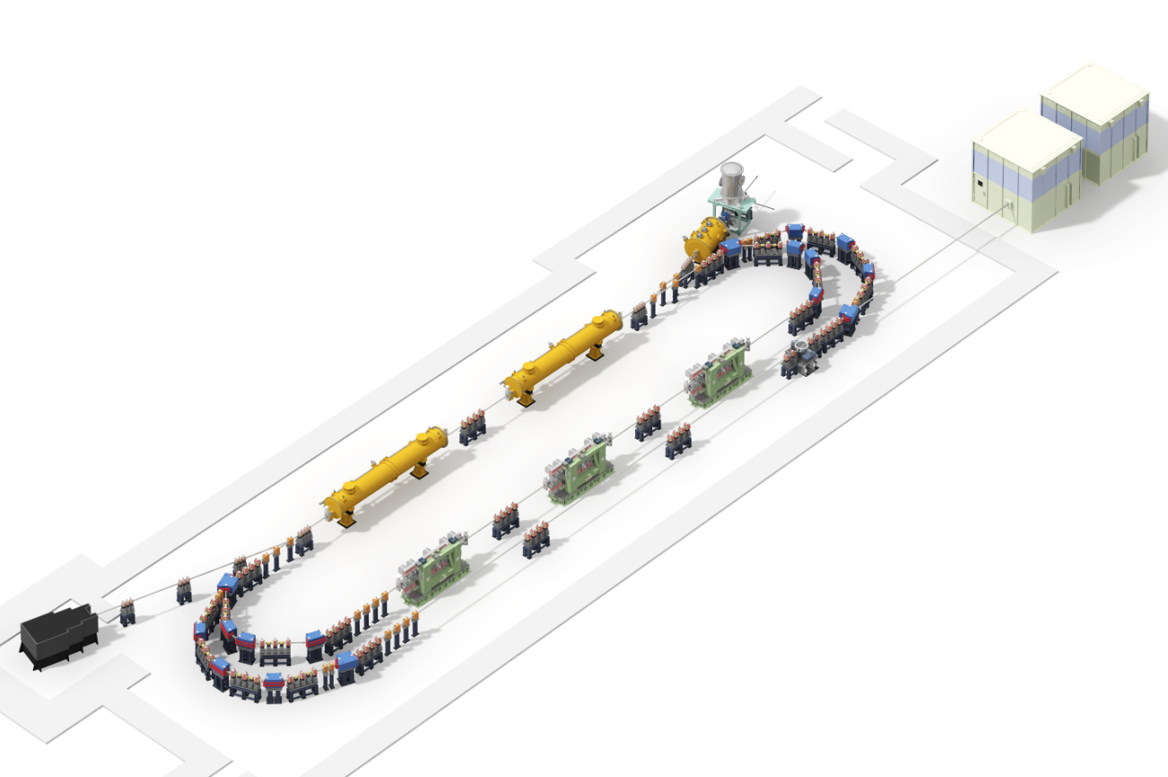
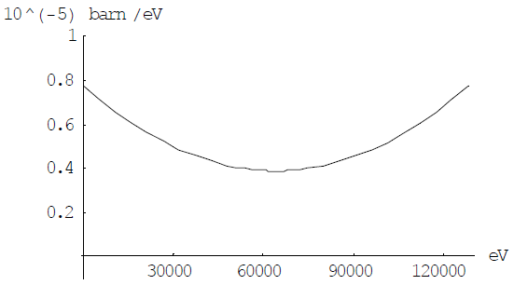
Proof-of principle experiment at compact ERL facility
After add super conduction cavities into
present compact ERL, we want to generate
Several MeV γ-ray and apply it for nuclear
physics.
Electron gun
500kV DC
LCS experimental facility
Super-conducting cavity
Under installation
Detector facility for
Gamma-ray detection
From 35MeV to 60MeV
Second phase of
cERL plan in ~2018.
LCS-gamma-ray source facility
is developing under this project
Four mirror optical
cavity for Gamma-ray
generation
60MeV Electron Beam, 532nm (green laser)
1.3GHz collision, X-ray 130keV
Number of photons per 1% width
5x10¹³
130keVx5x10¹³=1.04J/s
330 kGy (X-ray size 0.2mm diameter)
Illustration by Rey Hori
14
Notes:
This viewgraph shows the principle nuclear material detection by laser Compton gamma-rays.
Laser Compton scattering is a scheme to generate monochromatic gamma-rays by collision of a high-energy electron beam and a laser beam. The gamma-ray energy can be easily tunable by changing electron energy or laser wavelength.
If we irradiate a gamma-ray beam tuned at an energy specific to Pu 239, 2143 keV, nucleus of Pu-239 is excited by gamma-ray absorption and re-emitt another gamma-ray instantaneously. Observing this re-emitted gamma-ray, we can detect Pu-239.
This is nuclear resonance fluorescence.
The combination of laser Compton gamma-ray and nuclear resonance fluorescence has several advantages. First, nondestructive detection of radioactive and stable nuclides is possible. Second, We have excellent signal-to-noise ratio in the energy resolved gamma-ray detection. Third, detecting many kind of nuclides by scanning gamma-ray energy is also available. Fourth, we can detect materials through a thick shield. Finally, this is full utilization of high-power lasers and high-brightness electron beams, which show tremendous progress continuously.

Slide 15
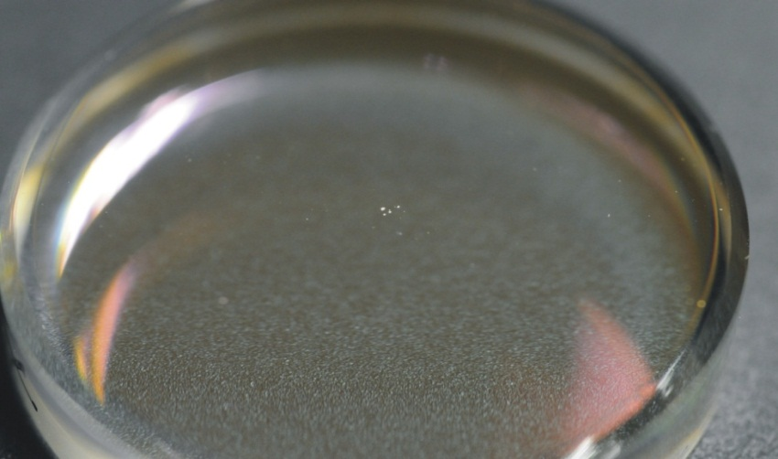
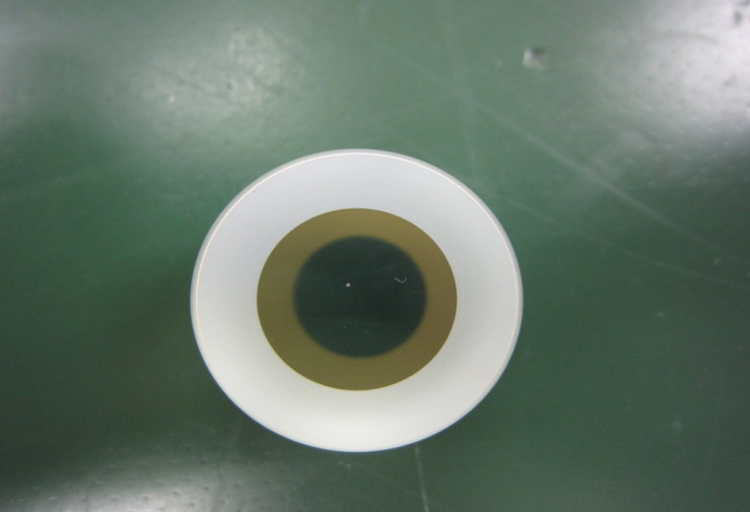
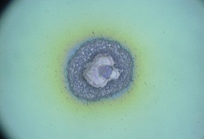
We destroyed the mirror coating two times. First occurred when the waist size was ~100μm with burst amplification and 42cm two mirror cavity. Second occurred when the waist size was 30μm with the burst amplification and the 42cm two mirror cavity. Now we are using 4 mirror cavity with smaller waist size at IP. From our experience, we have to reduce the waist size to increase the laser size on the mirror and need precise power control for the burst amplification. I guess about storage laser pulse energy from 2mJ to 4mJ destroyed the mirror coating with the waist size of 30μm. Also, we found the damaged position was not at the center.
2008
2011
From experimental results at LUCX X-ray generation based on ICS.

Slide 16
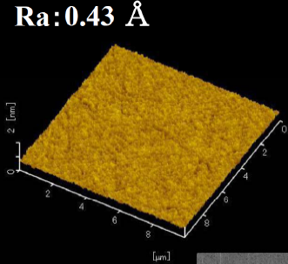
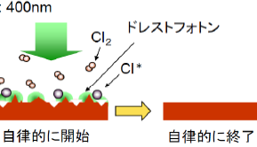
Development for stronger mirror : I want to start the collaboration with NAO (Gravitational
Wave Observatory group), Tokyo University (Ohtsu Lab.), Japanese private Co., LMA and LAL
hopefully.
Enlarge mirror size : we started the change from one inch to two inch mirror.
LMA prepared mirrors with reflectivity of 99.999% and loss (absorption and scattering)
less than 6ppm.
We ordered many substrates with micro-roughness less than 1 A to approach low loss mirror.
We understood the necessity of good clean room to handle the high reflective mirrors
in the case of the mirror which has high reflectivity more than 99.9%.
5. We have to develop how to make the stronger surface which has higher damage threshold.
Measurement of
surface roughness
for super-polish.
Reduce the loss
,which means low
absorption and
scattering.
Photo-chemical
etching occurred
by dressed photon.
We learnt a lot of things which humidity in Japan is high and makes OH contamination to
increase the mirror absorption. 50% humidity is suitable to handle the mirrors, especially high
quality mirrors. We confirmed this problem.

