Slide 1
Update of R&D Optical Cvities at KEK-ATF
Tohru Takahashi
Hiroshima University
for
KEK, Hiroshima University
LAL (Orsay) in Collaboration withCELIA (Laser lab., Bordeaux) and LMA ( coatings Lab., Lyon)
Introduction
Status of the cavity R&D
Recent activities
Out Look
September 6 2013
PosiPol 2013 ANL

Slide 2
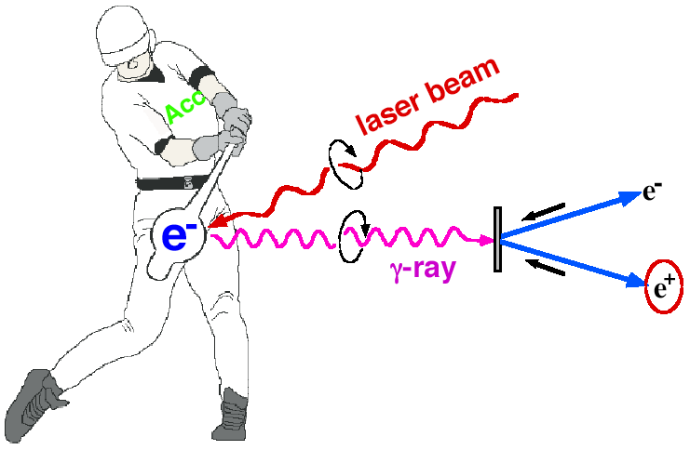
Compton at KEK ATF
Polarized e+ by laser Compton Scheme
Ee~1GeV for 10MeV gammas
controllability of polarization
Omori
Proof of principle
M.Fukuda et al., Phys. Rev. Letts. 91, 16480(2003)
T.Omori et al., Phys. Rev. Letts. 96, 114801(2006)
Toward the positron sources
ー> increase intensity of γ rays

Slide 3
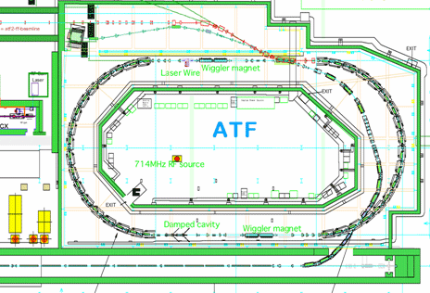
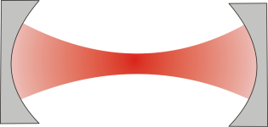
29th Mar 2013
Setup at the KEK-ATF
Laser cavity
γ
detector
ATF parameter
1.3GeV
1×10¹⁰ electron/bunch
Up to 10 bunch/train
2.16×10⁶ turn/s

Slide 4
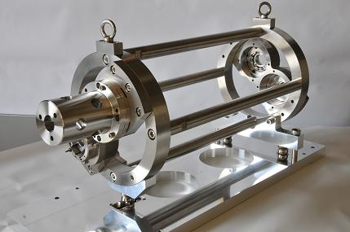
The Optical Cavity
Plane Mirror
Plane Mirror
Concave Mirror
IP
Concave Mirror
Main Parameters
Circumference:1.68m
Finesse:4040(Measured)
Power Enhansement:1230

Slide 5
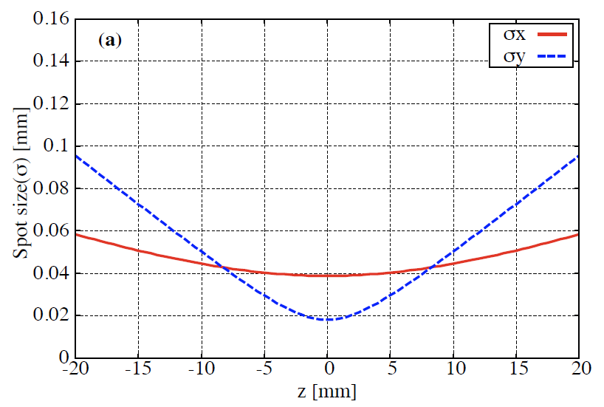
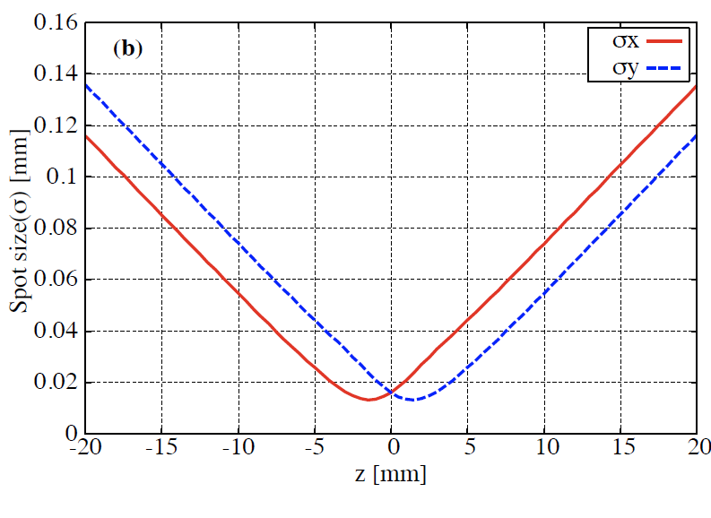
3D 4 Mirror Cavity
2D 4 M cavity has astigmatism
σx σy at the focal point of the cavity
2 D cavity
3 D cavity
See next speaker

Slide 6
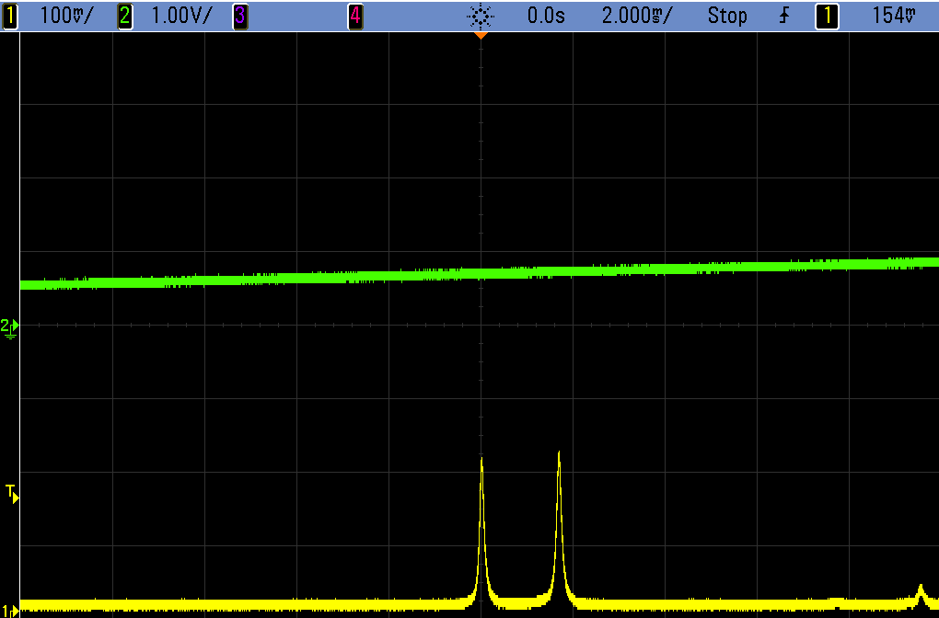
Polariaztion in the 3D4M cavity
Resonates only for circular polarization
geometric phase due to twisted pass
cavity only resonates with circular polarization
usable for pol. switching
left handed
right handed
transmitted light
circumference of the cavity

Slide 7
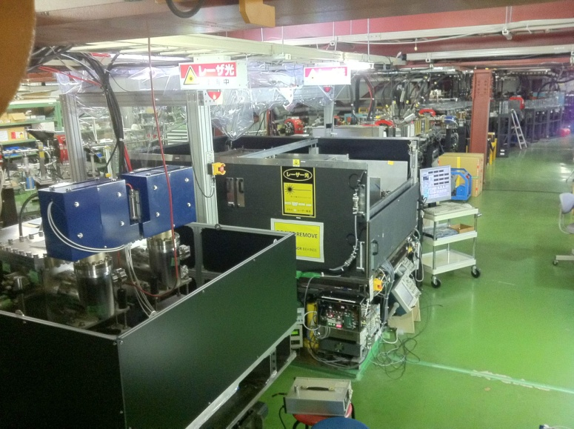
4 mirror cavities are at the ATF
KEK-Hiroshima
installed 2011
LAL-Orsay
installed summer 2010
relatively simple control system
employs new feed back scheme
sophisticated control
digital PDH feedback

Slide 8
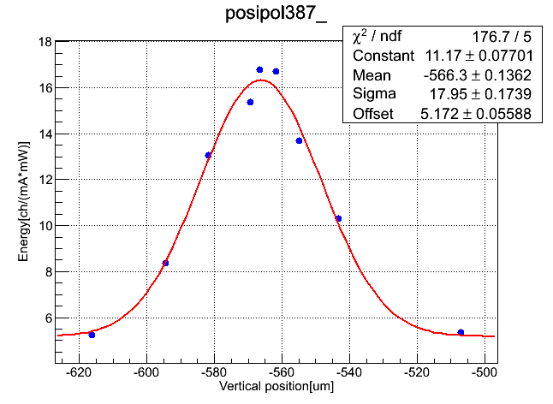
Laser spot size 13μm achieved
vertical deirection
σe=10μm
electrons
σL=13μm
γ ray yield [A.U]
σ=18μm
30μm w/ 2 M cavity
vertical position[μm]

Slide 9
Cavity feedback with 3D feature
cavity length must be kept L = nλ with very high precision
(for enhancement of 2000 dL<< 80pm while L = 1.64m)
+
=
L
L
R
New feedback scheme utilizing the polarization property of the cavity

Slide 10
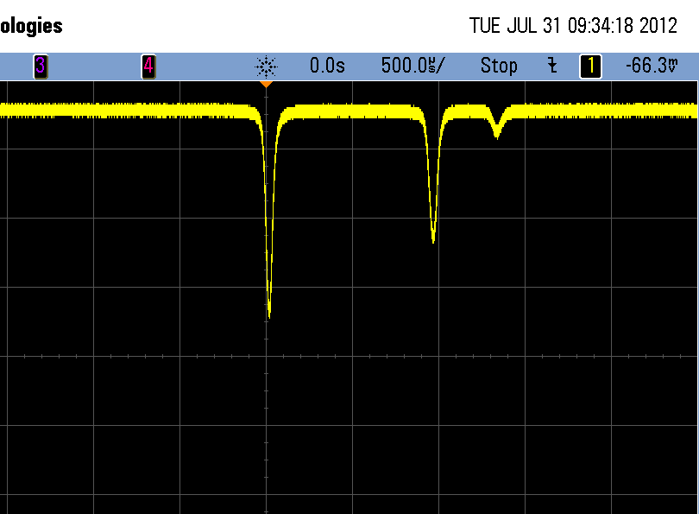
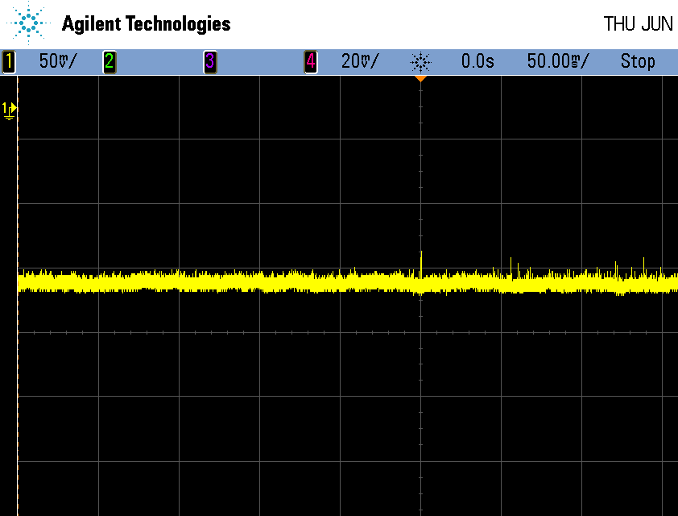
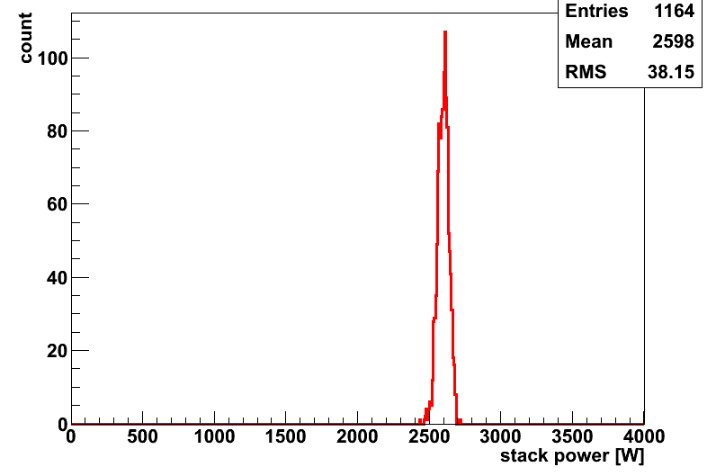
Stored Laser Power in the cavity
14th Sep 2012
Sotred power
Right pol
Left pol
must control
ΔL<<110pm
Laser Power: 2.6kW
w/ 38W fractuation
achieved
ΔL<<8pm
Stored Power [w]

Slide 11
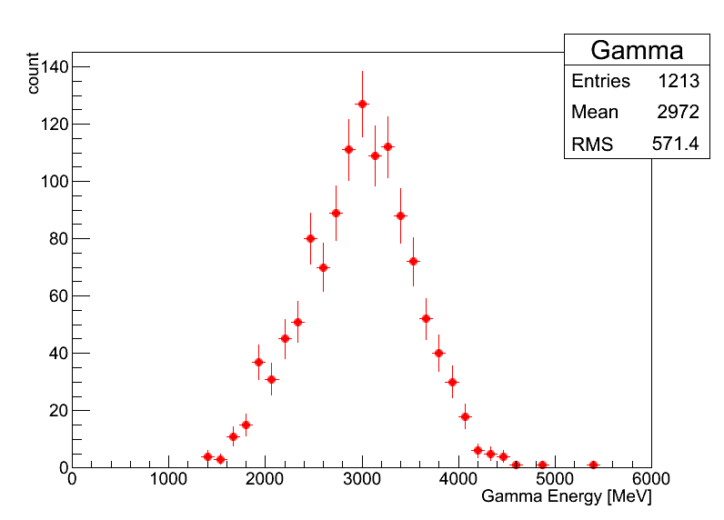
γray Generation
5bunches/train
laser
e-
γ
5.6ns
2970±20 MeV
⇒ ~120γs / trainのガンマ線に相当
ATF 2.16MHz
~2.6×10⁸/sec
Eγ[MeV]

Slide 12
Quantitative Understanding of the Cavity
Finesse
・Airy function
・Life time of the laser light in the cavity
Stored Power in the cavity
・From injection power
・From transmitted power
Profile at the interaction point
・Using Compton gamma (laser-wire)
・Estimate from a measured laser light profile

Slide 13
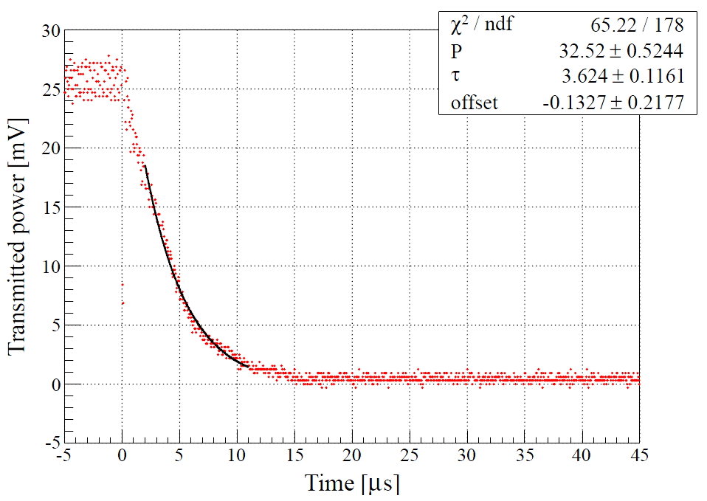
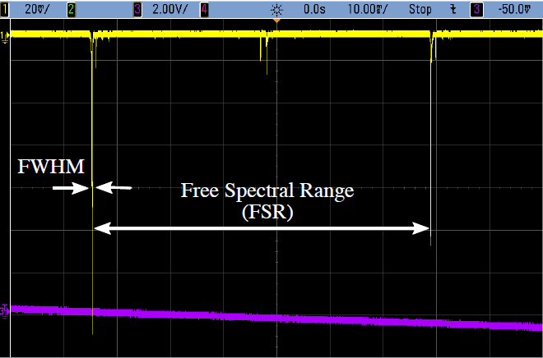
Finesse
PD
Airy Function
Life time of the laser light
Finesse: FWHM / FSR
=4040±420
2πcτ / L
=4040±110

Slide 14
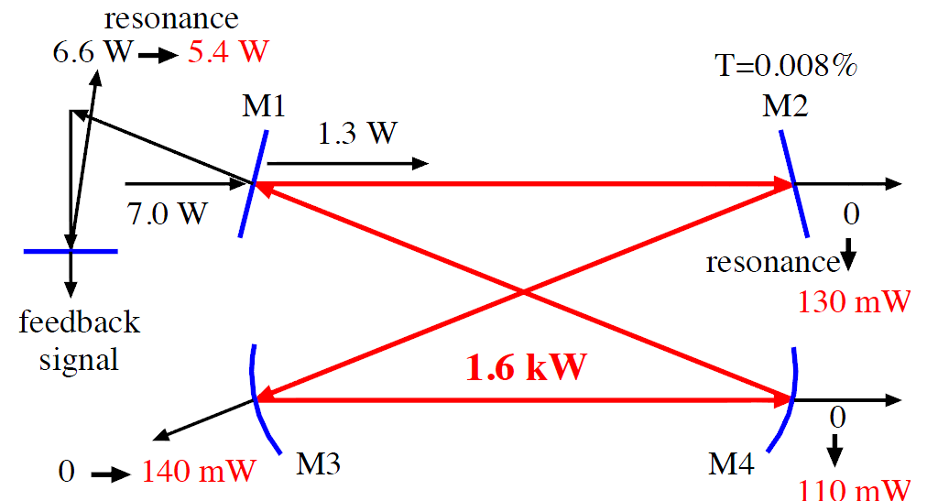
Stored Power
(Measured)
Two Estimates are consistent
Injection(1.3W) × Enhancement(1230) =1.6kW
Transmitted(130mW) / Transmittance(0.008%) =1.6kW

Slide 15
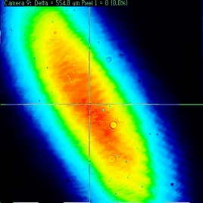
Profile of the laser light at the IP
y
レーザー光
10um
電子ビーム
x
27um
Calculated 16um
Measured 13um

Slide 16
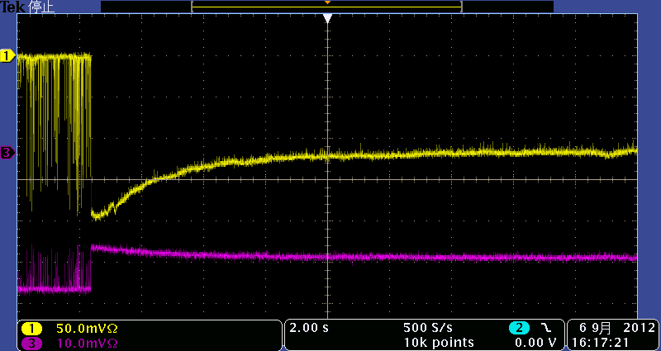
Issues
y
10um
Transmitted power
Reflected power
x
20s
27um
・Possibly a thermal effect
・Profile at the IP
due to (unexpected) power loss on mirrors
must revisit optical property in the cavity

Slide 17
What next ?
For positron sources, we need;
more than 100 times more power in the cavity
a few tens of more
power enhancement
injection laser power
Mirrors with
higher reflectivity
low loss

Slide 18
Future prospect
Try high reflectivity mirror
w/ careful handling
Trying 3000~5000 power enhancement this year -> more than 10,000 in next a few years
Low loss mirrors
collaboration with NAO (gravitational wave guys)
careful investigation of commercial mirrors
develop mirrors (substrates) by ourselves?

Slide 19
Summary
Current 3D4M cavity works well
we have basic technologies in our hand
but
optical properties yet to be understood
mirrors should be studied for high power storage
Issues are clear
step back once to basic study(PHYSICS) to go forward

Slide 20
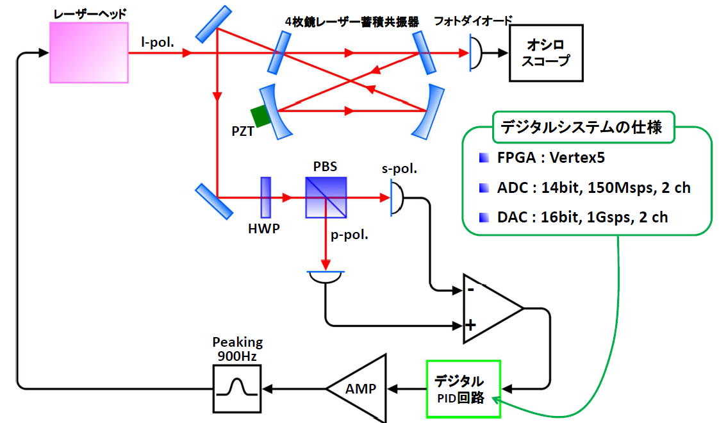
Digital Feecdback system
Digital
PID

Slide 21
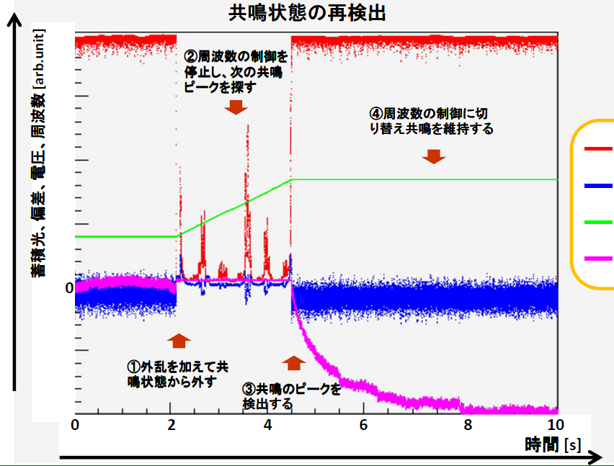
Automatic Restoration
Stored Power
cavity cont. signal

Slide 22
Summary and Prospect
So far
2.6kW stored w/ enhancement of 1230
Highly stable ΔL～4pm
vertical laser size at the IP 13μm
120g/5bunches -> ~2.6×10⁸/sec
Digital Feedback
Quantitative understanding
Finesse
Powers
Profile

Slide 23
Summary and Prospect
Issues
Laser profile at the IP
possible thermal effect
Near term plan
test Laser profile issue
low loss mirrors
Higher finesse

Slide 24
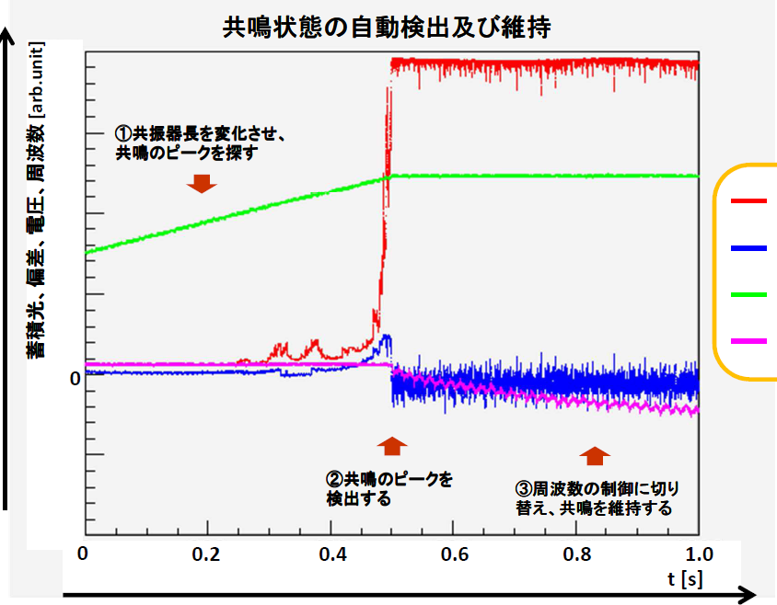
Resonance Finding
Stored Power
cavity cont. signal

