Slide 1
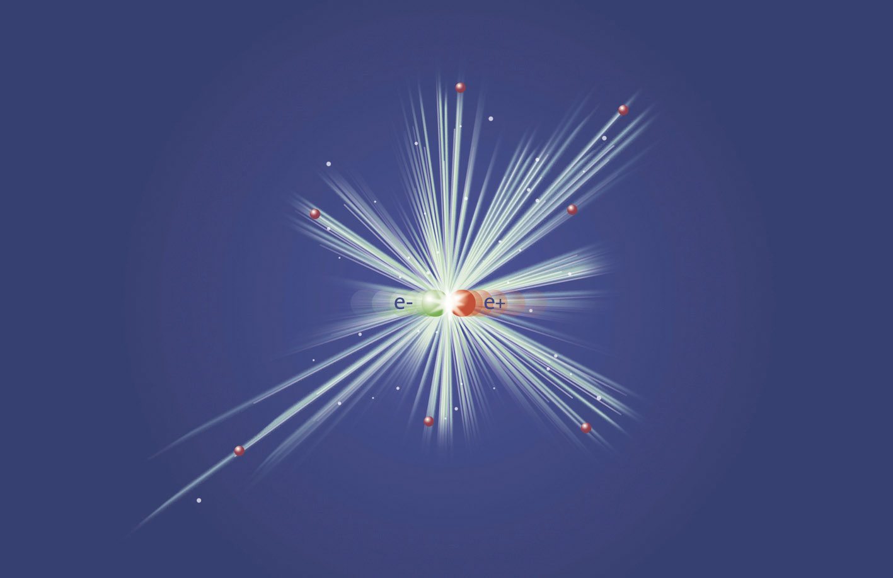



8th Workshop on Polarized Positrons
POSIPOL 2013
Sept. 4-6, 2013, Argonne National Lab,
9700 S. Cass Ave, Argonne, IL, 60439, USA
International Program Committee
  I. Bailey, Lancaster U
  E. Bulyak, KIPT
  S. Doebert, CERN
  W. Gai, ANL
  J. Gao, IHEP
  J. Gronberg, LLNL
  G. Moortgat-Pick, Hamburg U/DESY
  T. Omori, KEK
  S. Riemann, DESY
  L. Rinolfi, CERN
  J. Sheppard, SLAC
  F. Staufenbiel DESY
  V. Strakhovenko, BINP
  T. Takahashi, Hiroshima U
  J. Urakawa, KEK
  A. Ushakov, Hamburg U / DESY
  A. Variola, LAL
  F. Zimmermann, CERN
  F. Zomer, LAL
Conference topics:
▪ Generation of polarized positron beams
▪ High intensity positron sources
▪ Positron generation target issues
▪ Physics applications of polarized positrons
▪ Polarized gamma ray generation
▪ Channelling radiation and applications
▪ Physics applications of high quality X-rays
and gamma-rays
Local Organization Committee
  Wei Gai
  Wanming Liu
  Nancy Rezek

Slide 2
Welcome to ANL
Meeting is scheduled for 2 ½ days.
Boxed Lunch for the first day, sandwiches from Panera Bread.
Second and third day lunches will be at ANL cafeteria (on your self) from 12 – 2 pm.
Tour of the AWA on Thursday afternoon between 2:30 – 3:30.
Outing to Arboretum and dinner at Maggianos, 4 – 10 pm (will be chauffeured by my colleagues)

Slide 3
A special session on the ILC target design
Thursday 1:30 – 2:30 pm.
Issues on moving forward on the current LLNL test.
  Approaches are still viable?
  Funding
  Technical support
Alternative target design
  Differential pumping,
  Other type of targets?
Alternative scheme:
  300 Hz
  How to do a technical design?
  Resources on the technical design?

Slide 4
agenda

