Slide 1
Status of the CLIC study
CLIC status, general
Injector, positron production update
Drive Beam Injector Project
Conclusions and outlook

Slide 2
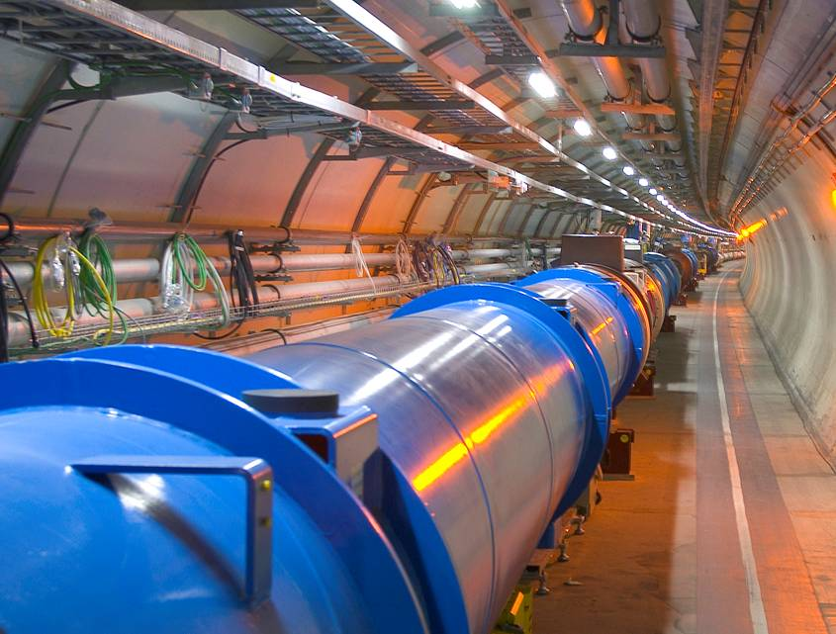
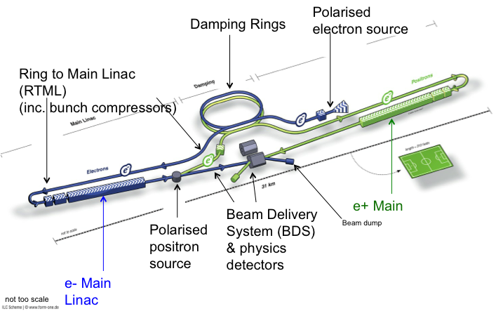
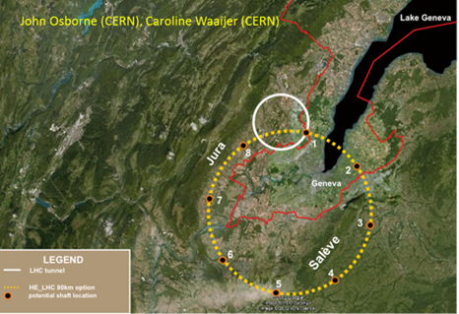
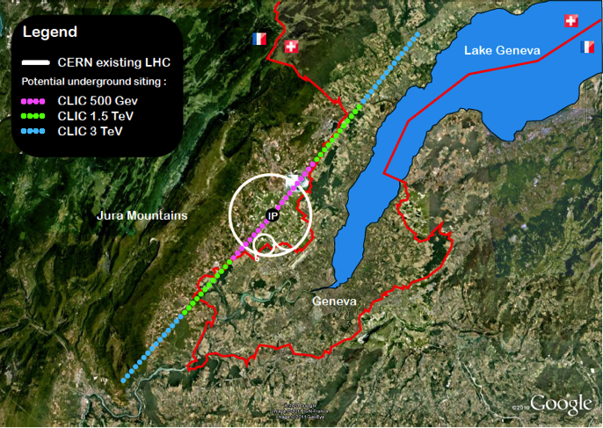
Context for the CLIC studies
LHC and LHC luminosity upgrades (until ~2030)
  Higgs and BSM physics
ILC in Japan, a possibility for exploring the Higgs in detail, starting at 250 GeV
  Requires significant integrated luminosities, and increased energies in steps (at least to 500 GeV), also long program
BSM – does it show up at LHC at 13-14 TeV (2015 onwards) ?
  What are the best machines to access such physics directly post LHC …. we don’t know but we can prepare main options
  Two alternatives considered, higher energy hadrons (HE LHC or VHE LHC), or highest possible energy e+e- (CLIC).

Slide 3
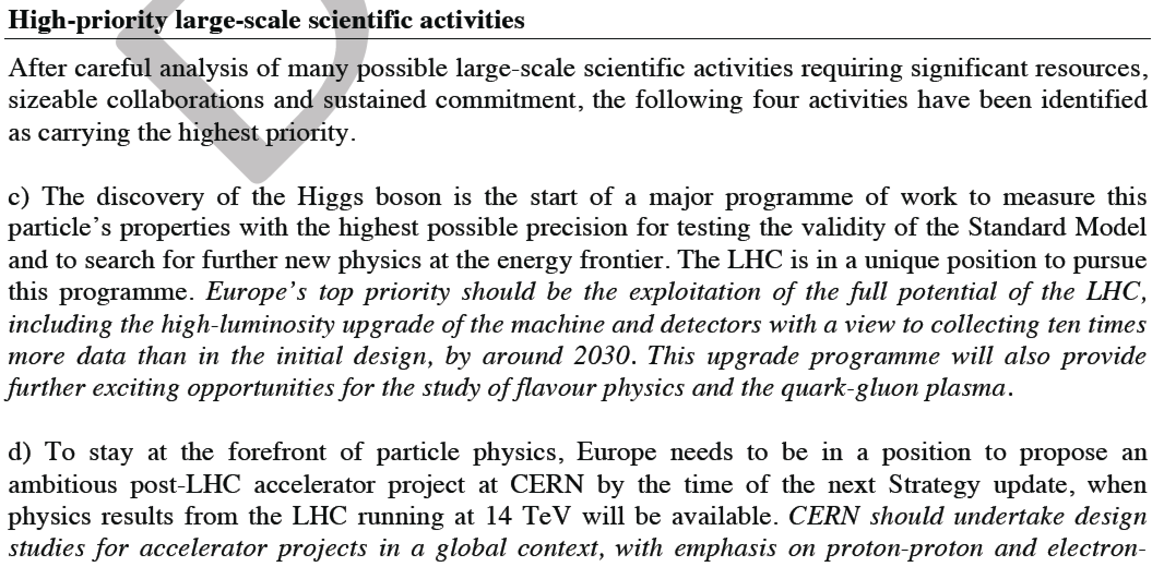
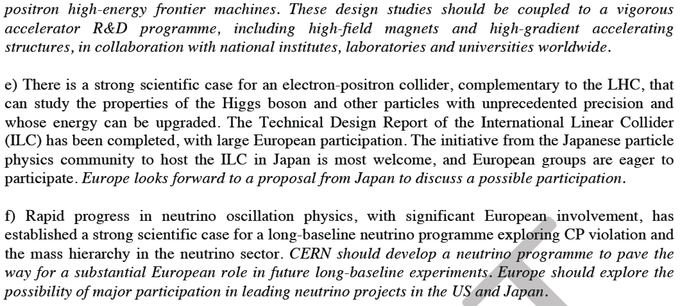
European strategy for high energy physics
ENERGY FRONTIER PROJECTS AT CERN AFTER LHC – THE CONTEXT OF THE CLIC ACTIVITIES
Open Session during the CLIC workshop end January:
Common session with main other alternatives for energy frontier projects at CERN after LHC (LHC energy upgrades), including presentations of what we can expect from LHC and a potential Higgs-factory
Status and very first focus on potential common or co-ordinated activities in the coming years (2013-2017)

Slide 4
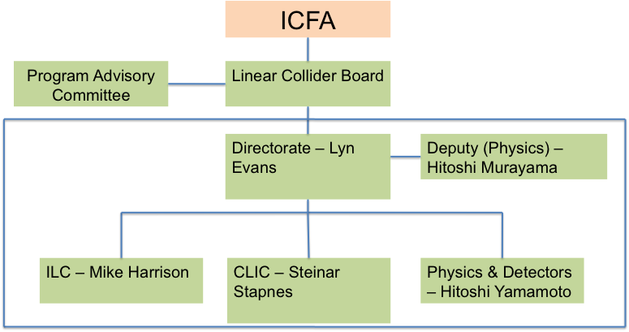
The LCC Organization and CLIC
Issues for CLIC:
Improve common work with ILC (optimize resources) – see below
Keep strong CLIC physics and detector activities as identifiable part of overall P&D box (we have common CLIC steering group and very direct weekly contacts)
Understand machine committee organization
Sources (common working group on positron generation)
Machine Detector Interfaces
Damping rings
Beam dynamics (covers along entire machine)
Beam delivery systems
Physics and detectors
How do we integrate POSIPOL activities ?,
How to we organise ourselves in the common Sources working group ?

Slide 5
CLIC guidelines and overall goals
Goal for next strategy update (2018):
Present a CLIC project that is a “credible” option for CERN beyond 2030:
Physics studies updated taking into account LHC-14 TeV (assume the physics case will be there for an energy frontier machine – i.e. not only the Higgs)
Physics no later than 2035
Initial costs at around LHC+50% for project construction
Upgradable in 2-3 stages over a 20-30y period, without major (max 3-4 years) operational breaks, and with upgrade costs contained to 3-5 B/10 years as “determined” by CERN budget when personnel and operation are accounted for
Promote ‘CLIC technology’ in other projects and field (XFEL, medical)

Slide 6
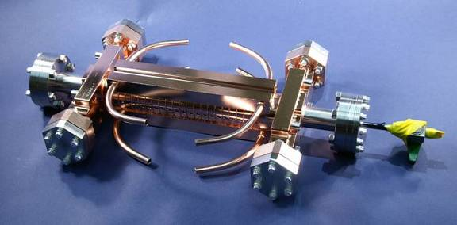
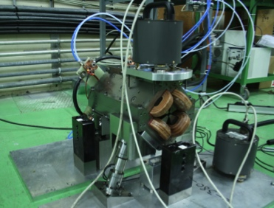
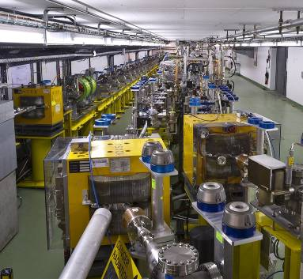
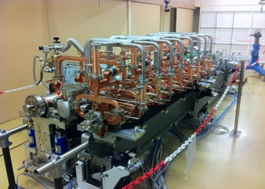
Main activities and goal for 2018
Design and Implementation studies:
Baseline design and staging strategy
Solid cost basis and more optimized power/energy (aim for 20% energy reduction)
Proof of industry basis for key components/units, in particular those specific for CLIC
Comprehensive reliability/robustness/uptime analysis
Pursue increased use of X-band for other machines/applications (hard to set concrete goal)
CDR status: not optimized except at 3 TeV and not adjusted for Higgs discovery, not optimized cost, first power/energy estimates without time for reductions, limited industrial costing, very limited reliability studies
System-tests:
Complete system-tests foreseen for next phase, and comprehensive documentation of the results at CERN (CTF3) and elsewhere
Strategy for further system verification before construction (XFEL, connected to light-sources, further drive-beam verifications) or as part of initial machine strategy.
CDR status: CTF3 results initial phase (as of early 2012), ATF and FACET very little, no convincing strategy for further system verification
Demonstrator of drive beam FE and RF power unit based on industrial capacity – will open for larger facilities beyond 2018 if necessary
CDR status: Nothing done beyond CTF3
X-band developments:
Statistics for gradient and structure choice (energy reach) and other X-band elements
CDR status: Single elements demonstrated – limited by test-capacity
Technology developments:
Demonstration of critical elements and methods for the machine performance:
  DR, main linac, BDS with associated instrumentation and correction methods (combination of design, simulation, system-tests and technologies)
  Stability/alignment (locally and over distances)
  Module including all parts
CDR status: alignment/stability partly covered, BBA assumed, wakefield mon. perf. assumed, no complete module

Slide 7
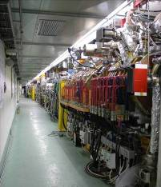
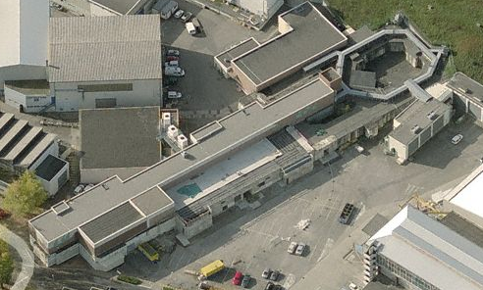
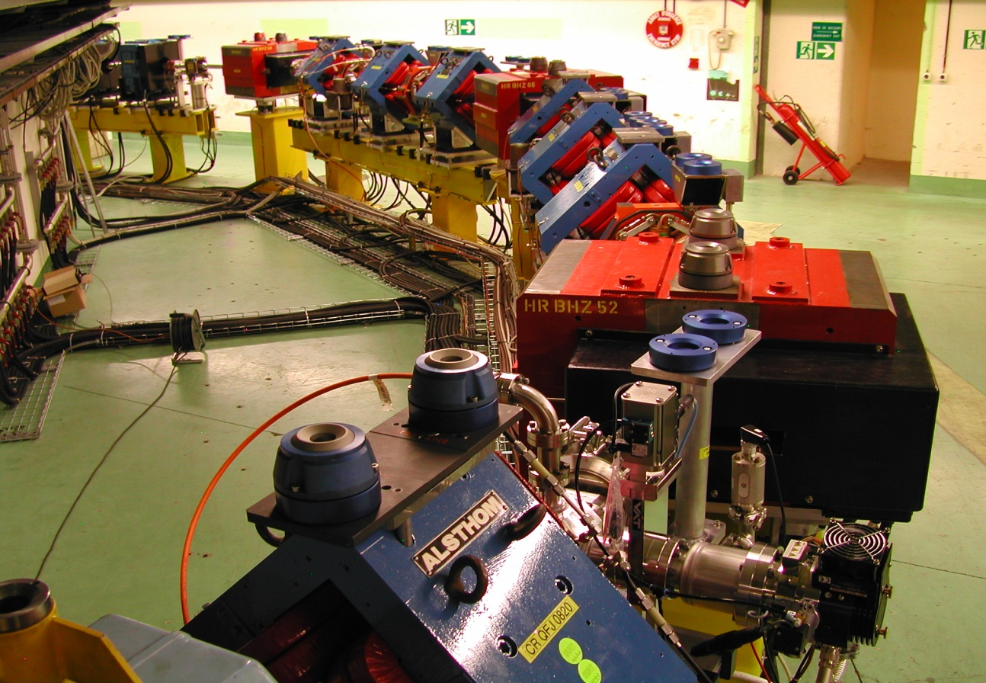
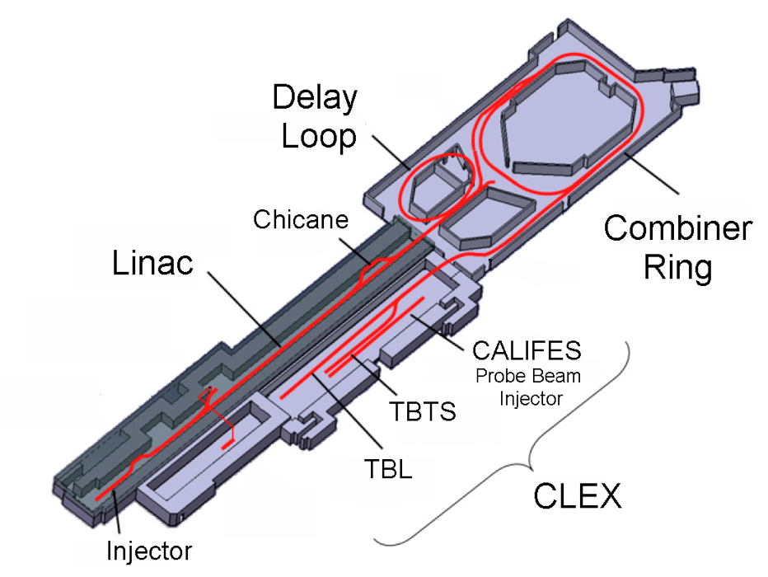
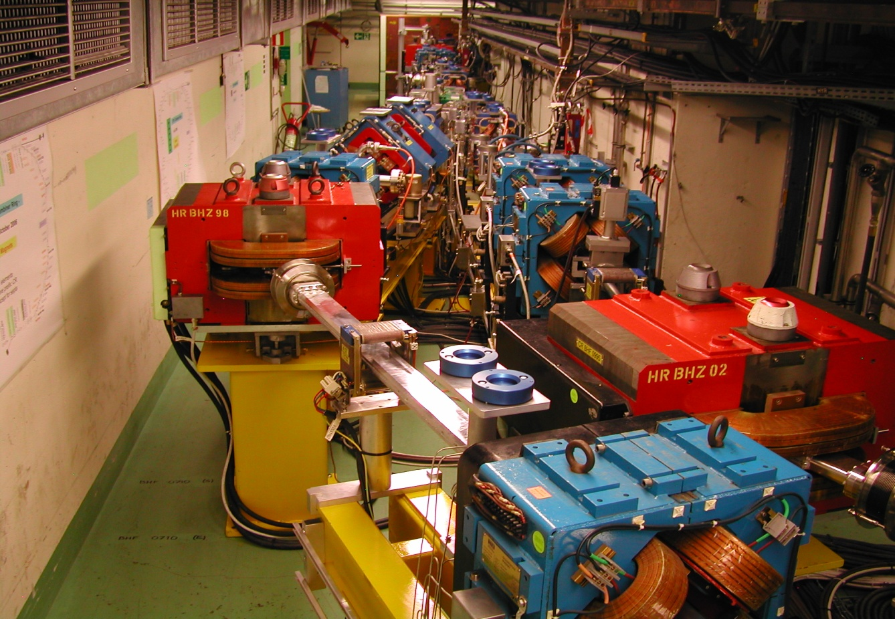
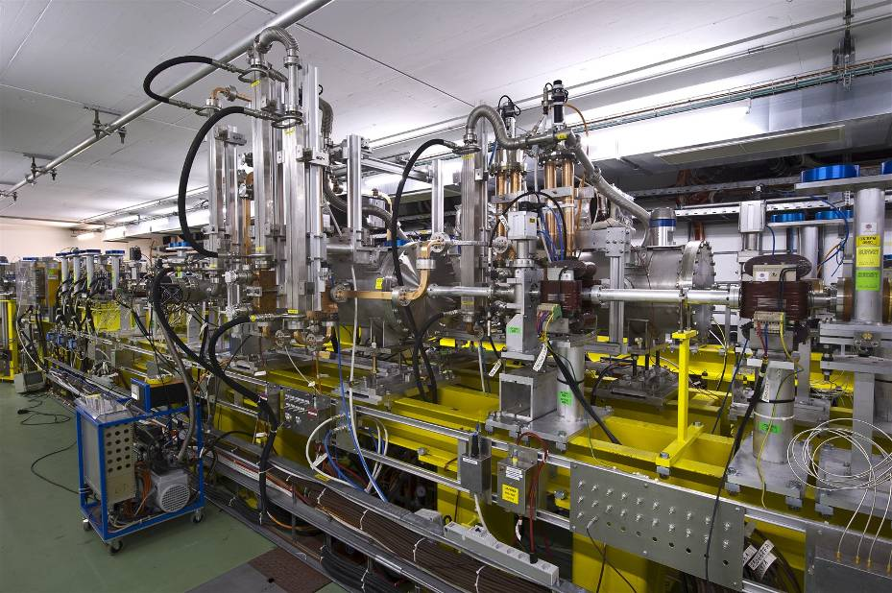
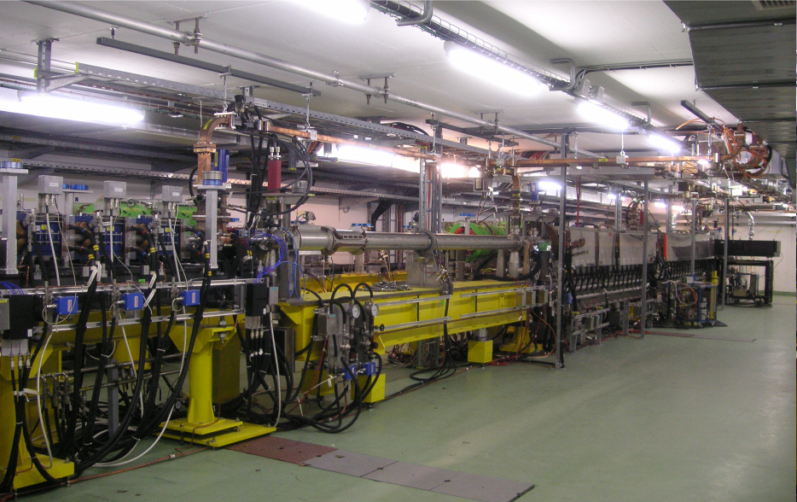
CLIC Test Facilities
Operation of isochronous lines and rings
4 A, 1.4us
120 MeV
Several other test-facilities are important:
ATF at KEK
FACET at SLAC
X-band test facilities at KEK and SLAC (more in progress)
CesrTA for electron cloud studies
…. and several more for specific technical developments
Do we need a positron production test facility ?
30 A, 140 ns
120 MeV
High current, full
beam-loading operation
Beam recombination and current multiplication by RF deflectors
12 GHz power generation by drive beam deceleration
High-gradient two-beam acceleration
30 A, 140 ns
60 MeV
Bunch phase coding

Slide 8
CLIC Main Beam Injectors
Layout
Pre-injector
e⁺ Linac
Primary 5 GeV e⁻ Linac
Injector Linac
gun
PDR
target
2.86 GeV
Booster Linac
2 GHz
e⁺ DR
BC1
0.2 GeV
Spin rotatator
DC gun
DL’s
Pre-injector
e⁻ Linac
e⁻ DR
9 GeV
PDR
Two hybrid positron sources (only one needed for 3 TeV)
Common injector linac
All linac’s at 2 GHz , bunch spacing 1 GHz before the damping rings

Slide 9
Positron source conventional ?
Hybrid target
Primary beam
Linac for e⁻
AMD
200 MeV
Primary beam
Linac for e⁻
Bunch compressor
Gun
5 GeV
RF-deflector
2 GHz
Hybrid target
Primary beam
Linac for e⁻
AMD
200 MeV
AMD: 200 mm long, 20 mm radius, 6T field
Target Parameters Crystal
Material | Tungsten | W
Thickness (radiation length) | 0.4 | χ₀
Thickness (length) | 1.40 | mm
Energy deposited | ~1 | kW
Target Parameters Amorphous
Material | Tungsten | W
Thickness (Radiation length) | 3 | χ₀
Thickness (length) | 10 | mm
PEDD | 30 | J/g
Distance to the crystal | 2 | m

Slide 10
Hybrid target
Target Parameters Crystal
Material | Tungsten | W
Thickness (radiation length) | 0.4 | χ₀
Thickness (length) | 1.40 | mm
Energy deposited | ~1 | kW
Target Parameters Amorphous
Material | Tungsten | W
Thickness (Radiation length) | 3 | χ₀
Thickness (length) | 10 | mm
PEDD | 30 | J/g
Distance to the crystal | 2 | m

Slide 11
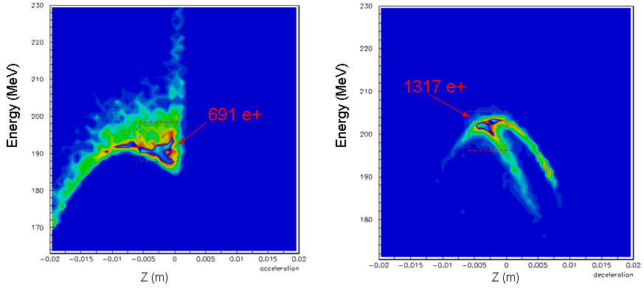
Yield simulations capture and pre-injector linac
Energy density at 200 MeV
Accelerating mode
decelerating mode
Positron yield: after target: ~8 e⁺/e⁻
at 200 MeV: 0.9 e⁺/e⁻
into PDR: 0.39 e⁺/e⁻
O. Dadoun

Slide 12
CLIC hybrid source-vs-
ILC 300Hz scheme
Parameter | ILC 300 Hz scheme | CLIC hybrid
No. of bunches | 2640, 20 *132 | 312
Rep. rate | 300 Hz / 5 Hz; 63 / 200 ms | 50 Hz, 20 ms
Bunch spacing | 6.15 ns | 0.5 ns / 1 ns
Bunch charge (driver) | 2 x 10¹⁰ e⁻ | 1.1 x 10¹⁰ e⁻
Drive beam energy | 6 GeV | 5 GeV
Charge per train Average charge | 264 x 10¹⁰ e⁻ in 992 ns 26320 x 10¹⁰ total | 343 x 10¹⁰ e⁻ in 156 ns 17150 x 10¹⁰ total
Beam radius | 4.0 mm | 2.5 mm
Capture frequency/ aperture | 1.3 GHz 45 mm | 1-2 GHz 20 mm
Yield at DR | 1.6; A_{x}+A_{y} < 0.09 mm | 0.39; ε = 7 mm, 17 MeV, 5.4 mm
Average power target, thickness | 35 kW 14 mm | 11 kW 10 mm
PEDD | 23 J/g | 30 J/g

Slide 13
CLIC hybrid source-vs-
ILC 300Hz scheme
Parameters not to different, can we find a ‘global’ optimum
Do we understand well the yield optimisation, what is the limiting factor, PEDD and capture efficiency ?
For CLIC: increase aperture, magnetic field, beam size to optimise ?
Heat load on target less serious for CLIC but
shock-wave sensitivity likely more important for CLIC
→ anyway ILC target should work as well for CLIC
(slowly rotating or fixed)
What about the hybrid scheme, benefits for CLIC or ILC ?
CLIC can’t stretch the train on the target due to 50 Hz rep. rate

Slide 14


Cost reduction for the main injectors
CDR design was focused on low risk, conventional, state of the art facility to guarantee excellent beam quality and not worry about cost or feasibility
It turned out that the injectors have a significant cost impact even on CLIC
→ In the frame work of the new base-line for CLIC, in particular optimizing a low energy first stage we decided to focus as well on cost and efficiency
Main proposals:
PDR for electrons not needed
Use 2 GHz bunch spacing through out the complex, shorter rf pulses in linac’s and no need for delay loop
Optimise timing of the beams to gain efficiency (PC optimisation)
Investigate to use booster linac as positron driver (saves positron driver)
Provide cost model for optimization
→350 MCHF savings potential identified !

Slide 15
Alternative layout
Without positron driver linac and e⁻ PDR, 2 GHz bunch spacing everywhere
156ns
156ns
e⁻
e⁻
e⁺
Positron production pulse
3300 ns
Pre-injector
e⁻ Linac
2.86 GeV
0.2 GeV
PDR
Injector Linac
DC gun
e⁺ DR
BC1
target
e⁻ DR
Booster Linac
2 GHz
gun
6 GeV
Save two rings, positron driver linac, and tunnel length (saving potential 200 MCHF)

Slide 16
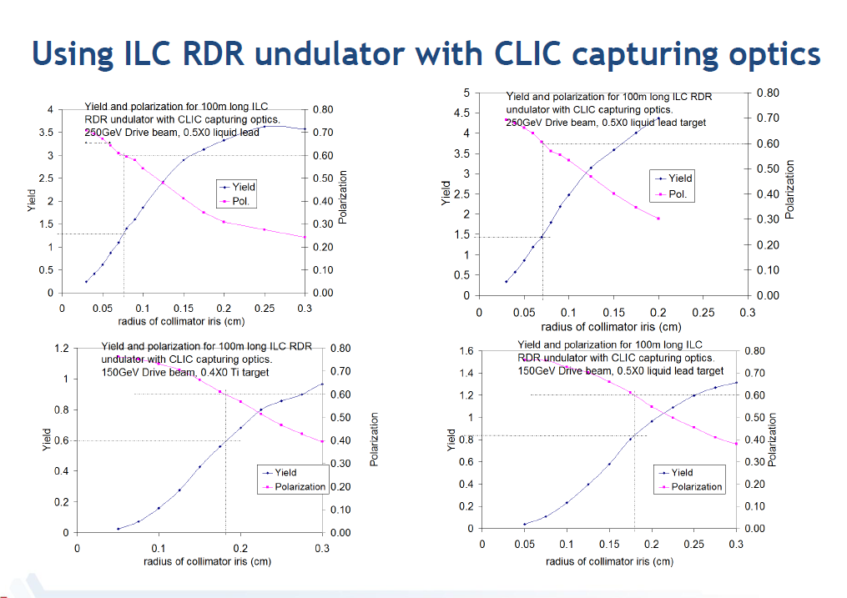
Undulator based positron source for CLIC
Together with the Argonne gang we decided to study in more detail this option which has a path to positron polarization and might have cost benefits as well
Wanming Liu

Slide 17

Layout with undulator based positron source
Main beam bypass line
Undulator
positron source
to transfer line, DR
Undulator 350 m
Photons 300 m
target
2.86 GeV linac ? 300m
~1000 m
Main Linac
BDS
IP
Main Linac
BDS
from injectors
Pre-injector
e⁻ Linac
2.86 GeV
0.2 GeV
PDR
Injector Linac
DC gun
from transfer line
e⁺ DR
BC1
target
to main linacs
e⁻ DR
Booster Linac
2 GHz
gun
6 GeV
Spin rotator
Minimum scenario for upgrade to positron polarization and fully compatible with conventional layout

Slide 18
Undulator based positron source
Consequences:
400 -1000 m more tunnel length (both sides ?)
Separate injector linac for positrons 2.86 GeV
transfer line from the tunnel to the injector complex
Spin rotator before and after damping ring (needed anyway for any polarized scheme)
Gap in damping ring due the delayed beams
Main beam bypass around positron production
Coupling of the two beams

Slide 19
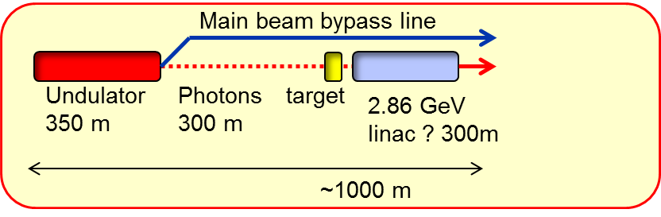
How about a dedicated scheme ?
Central Injectors and DR in deep tunnel
2.86 GeV
DC gun
e⁻ DR
Booster Linac
6 GeV
BC1
e⁺ DR
PDR
Main Linac
BDS
IP
BDS
Main Linac

Slide 20
How about a dedicated scheme ?
DR and injector at the end of each side
PDR
e⁺ DR
Main Linac
BDS
IP
BDS
Main Linac
e⁻ DR
2.86 GeV
Booster Linac
6 GeV
DC gun

Slide 21
Undulator based positron source
To be studied
Impact in cost, length and performance
Emittance preservation in undulator and bypass
Beam loading in PDR due to a likely gap of ~ 43 μs (500 GeV)
General timing consideration
Upgrade scenarios, energy scans
Undulator parameters, can we get 60% polarization
Wei Gai, Wanming Liu and CLIC team

Slide 22
CLIC DB front end,
Post CDR Project
Modulator-klystrons, 1 GHz, 15 MW
IOTs ?,
500 MHz
Diagnostics
Gun
SHB 1-2-3
PB
Buncher
Acc. Structures
~ 140 keV
~ 3 MeV
~ 12 MeV
For time being only major component development:
GUN, SHB, high bandwidth 500 MHz source, 1 GHZ MBK, modulator and fully loaded accelerating structure

Slide 23
CLIC DB injector specifications
Parameter | Nominal value | Unit
Beam Energy | 50 | MeV
Pulse Length | 140.3 / 243.7 | μs / ns
Beam current | 4.2 | A
Bunch charge | 8.4 | nC
Number of bunches | 70128
Total charge per pulse | 590 | μC
Bunch spacing | 1.992 | ns
Emittance at 50 MeV | 100 | mm mrad
Repetition rate | 100 | Hz
Energy spread at 50 MeV | 1 | % FWHM
Bunch length at 50 MeV | 3 | mm rms
Charge variation shot to shot | 0.1 | %
Charge flatness on flat top | 0.1 | %
Allowed satellite charge | < 7 | %
Allowed switching time | 5 | ns

Slide 24
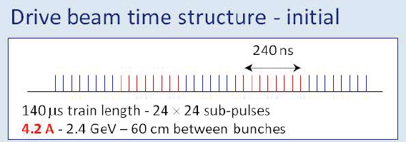
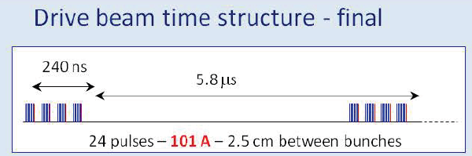
Sub Harmonic Bunchers (SHBs)
Modulator-klystrons, 1 GHz, 15 MW
IOTs,
500 MHz
Phase coding
Sub-harmonic bunching
ν₀ / 2
180° phase switch
Diagnostics
Acceleration ν₀
Main challenge of SHBs:
Fast 180° phase flipping capability, simulation indicate < 18 ns switching time needed
Gun
SHB 1-2-3
PB
Buncher
Acc. Structures
Deflection ν₀ / 2
~ 140 keV
~ 12 MeV
Gap creation and combination
even
buckets
odd buckets
  RF deflector ν₀ / 2

Slide 25
Tentative klystron
parameters
PARAMETER | VALUE | UNITS
RF Frequency Bandwidth at -1dB RF Power: Peak Power Average Power RF Pulse width (at -3dB) HV pulse width (at full width half height) Repetition Rate High Voltage applied to the cathode Tolerable peak reverse voltage Efficiency at peak power RF gain at peak power Perveance Stability of RF output signal at nominal working point RF phase ripple [*] RF amplitude ripple Pulse failures (arcs etc.) during 14 hour continuous test period Matching load, fundamental and 2nd harmonic Average radiation at 0.1m distance from klystron Output waveguide type, | 999.516 ≥ 1 ≥ 20 150 150 165 50 tbd, ≤ 180 tbd 67 ≤ 70 tbd, > 48 tbd ±1 (max) ±1 (max) < 1-2 tbd < 1 WR975 pressurised | MHz MHz MW kW μs μs Hz kV kV % dB μA/V^{1.5} RF deg % VSWR μSv/h 2-3 bar
Status: Call for tender

Slide 26
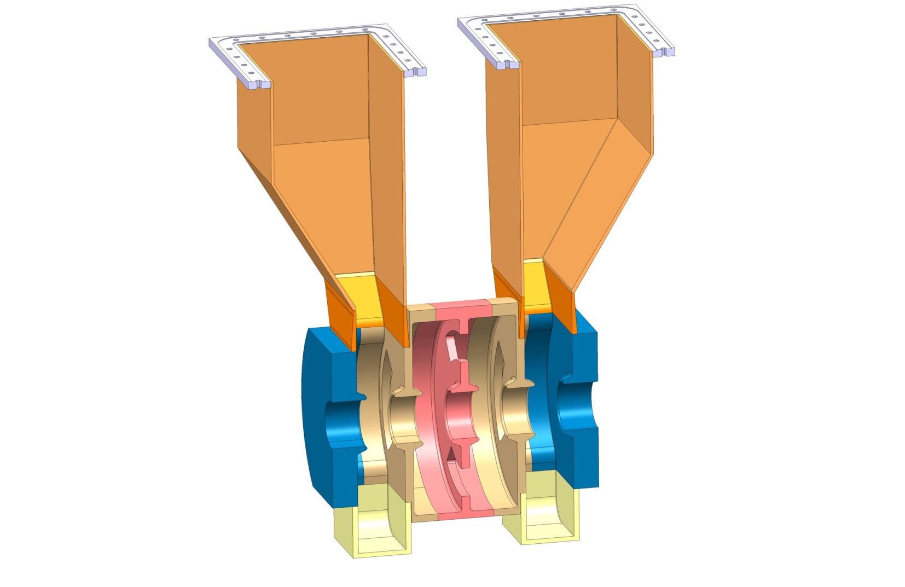
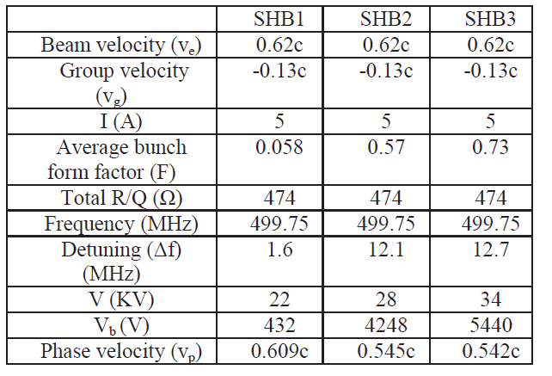
Sub-harmonic bunching system
Status:
RF design existing, mechanical design advanced,
Next: launch prototype (in aluminum ?)
Power source:
500 MHz, 34-82 kW, wide band (60 MHz) sources needed for fast phase switching. Started to discuss with industry.
Hamed Shaker, see IPAC paper

Slide 27
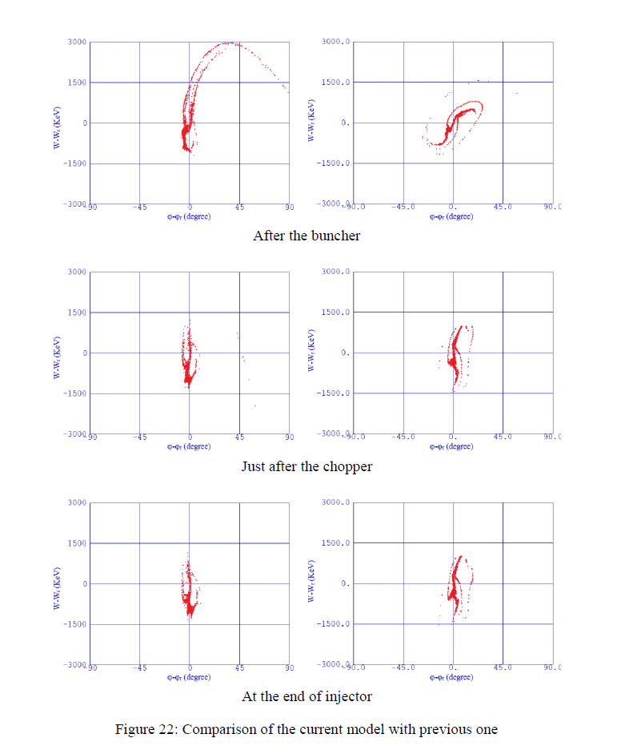
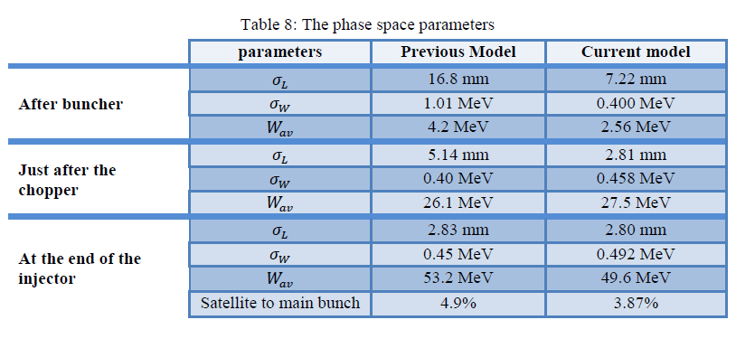
DB injector review and optimization
Shahin Sanaye Hajari, see as well IPAC paper
Total losses reduced from 30% to 11%

Slide 28
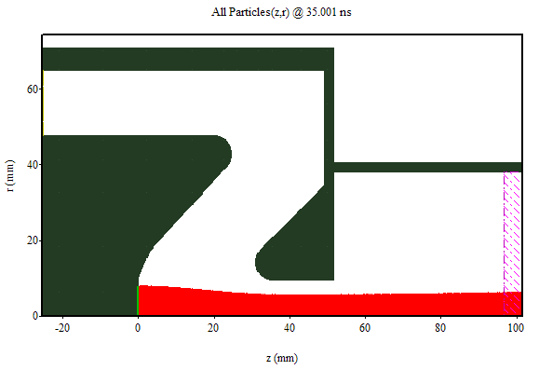
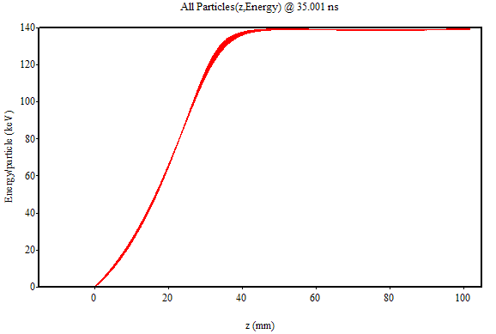
Jacques Gardelle, CEA-CESTA
Contour plots of field components at t=35ns
Typical MAGIC snapshot: particle positions in r-z
Typical MAGIC snapshot: kinetic energy of particles along z

Slide 29
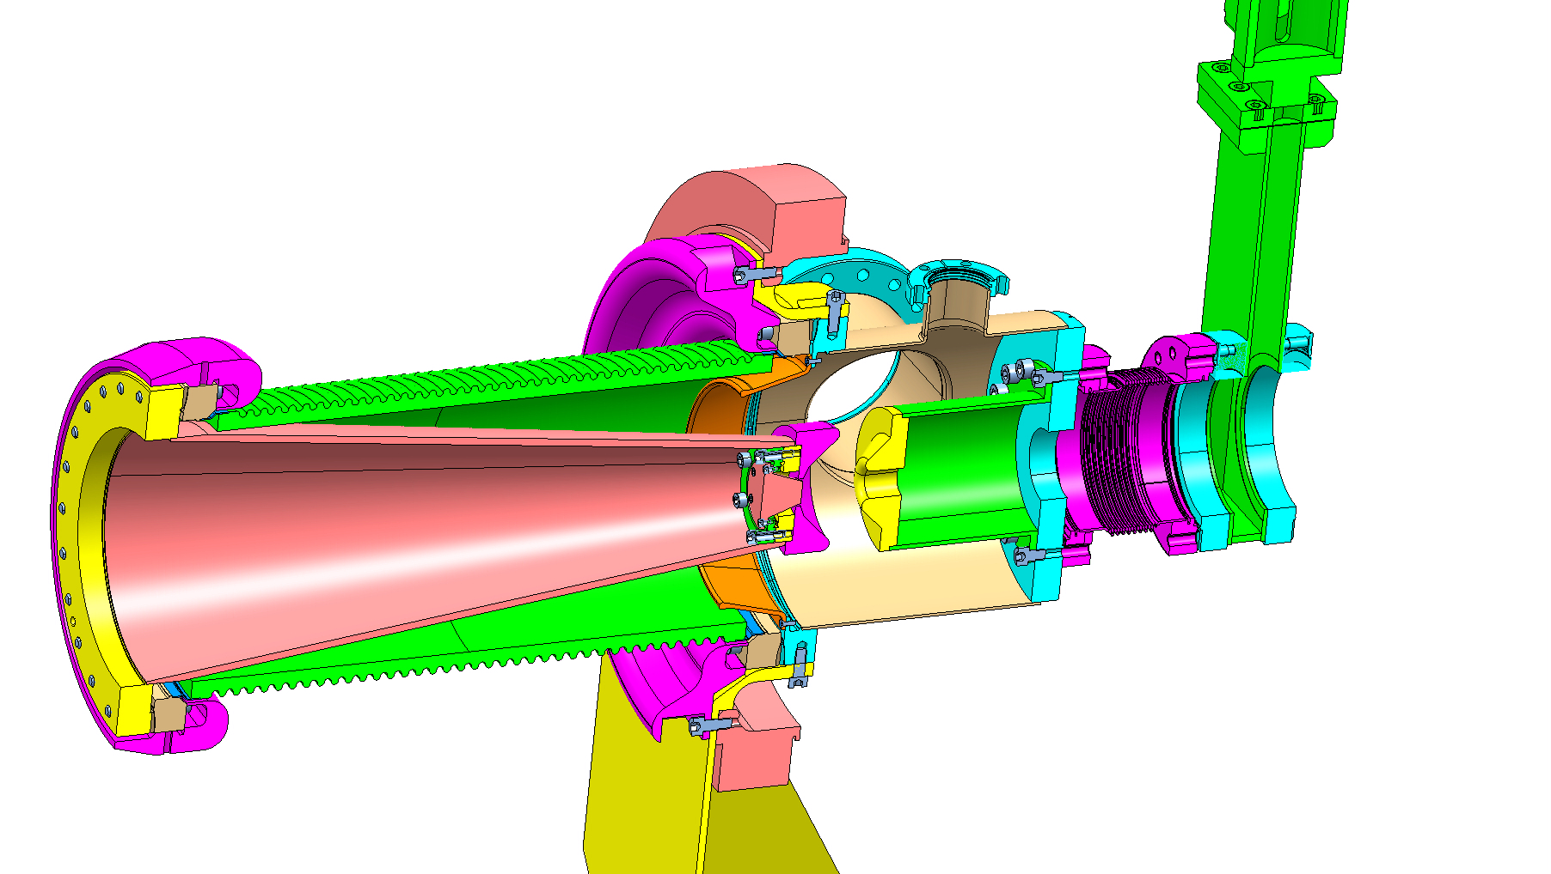
Gun design concept

Slide 30
Conclusion
Optimizing CLIC for lower energies, cost and power consumption
Seems there is still room for optimization of the conventional positron source for CLIC
Saving potential of 350 MCHF identified
Start to look into undulator based positron production
Challenging drive beam injector project
CLIC collaboration workshop, February 2014
POSIPOL 2013, ANL, September 4th, 2013

Slide 31
End

Slide 32
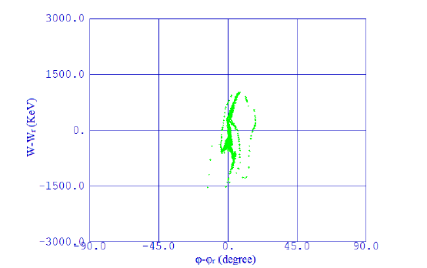
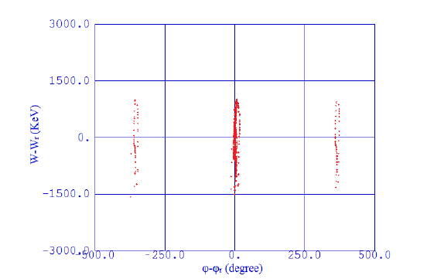
DB injector review and optimization
Final phase space at 50 MeV after re-optimization of the injector with realistic rf parameters, 4% satellites, good longitudinal phase space
Shahin Sanaye Hajari, see as well IPAC paper

Slide 33
Gun simulations
Emittance vs voltage

Slide 34

Cost per linac
Cost estimate per linac (1.5 TeV parameters)
LINAC | Energy Gain (MeV) | Bunch charge (10^9) | rf pulse length (ns) | Power per structure (MW) | Loaded gradient (MV/m) | Configuration (structure/2 klystrons) | No of rf modules | pulse compressor gain | No of structures | Length (m) | Energy gain per module (MeV) | Cost
e- pre-injector | 200 | 4.3 | 1300-1700 | 54 | 18 | 4 | 2 | 2.3-2.5 | 8.0 | 30 | 108 | 5830
e+ pre-injector | 200 | 11 | 1300-1700 | 56 | 15 | 4 | 3 | 2.3-2.5 | 9.0 | 40 | 90 | 8745
injector linac | 2660 | 6 | 3600-4000 | 44 | 15 | 2 | 60 | 1 | 119.0 | 300 | 45 | 127950
positron drive linac | 5000 | 11 | 1300-1700 | 56 | 15 | 4 | 56 | 2.3-2.5 | 223.0 | 400 | 90 | 163240
booster linac | 6140 | 4 | 1700-2000 | 53 | 16 | 4 | 64 | 2-2.3 | 256.0 | 473 | 96 | 186560
Efficiency (%) | Structure efficiency for 312 bunches (%)
2.68
4.58
6.64 | 31
6.13 | 32
4.79 | 27
Bunch charge and gradient determine power/structure, optimized for a 2x 50 MW klystron + pulse compressor configuration to feed a maximum of structures
Cost of structure 13%
Cost of high power system 75%, ~ factor 2 of this could hopefully be gained (150M)

Slide 35
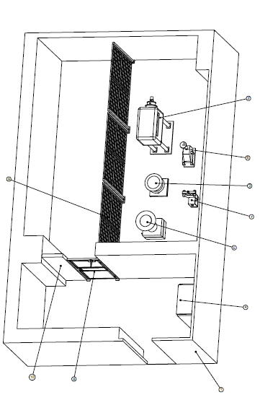
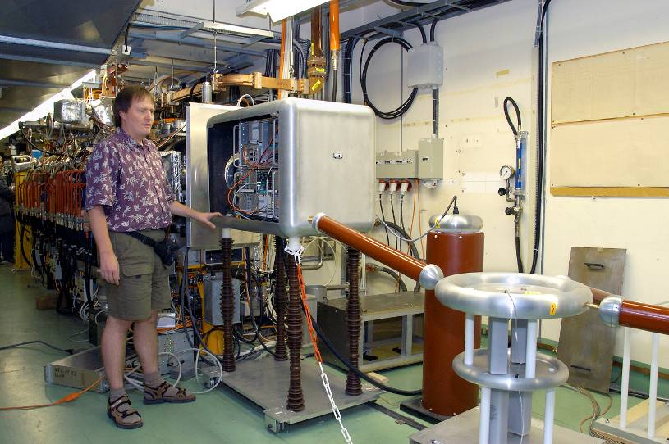
Gun Test Facility
Gun test area:
former GTF available, Bldg. 162-R-004/008, needs some refurbishment

Slide 36
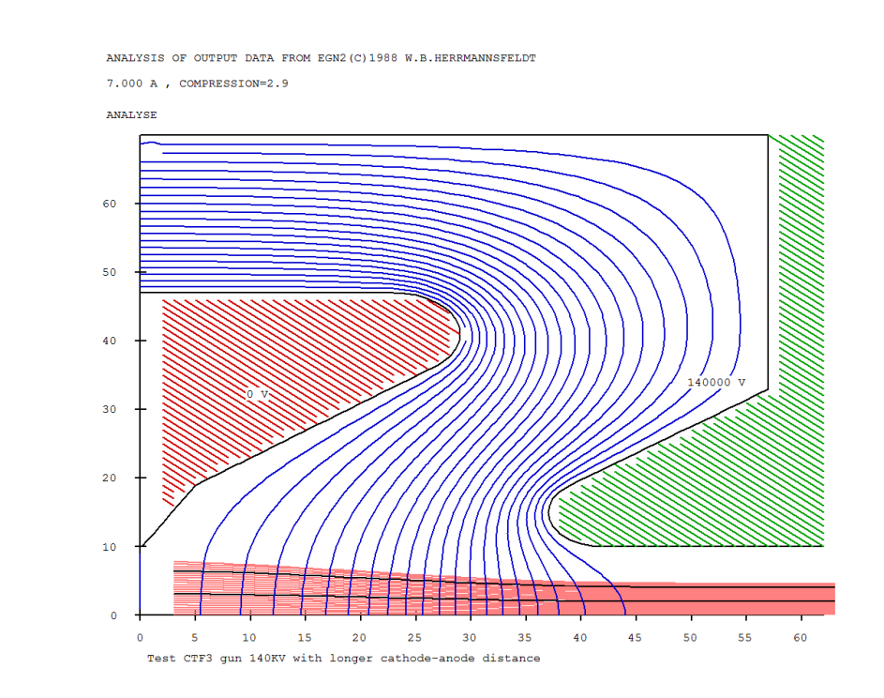
Gun simulations
Using EGUN
ε ~ 12 mm mrad

Slide 37
CLIC Layout at 3 TeV
Drive Beam Generation Complex
Main Beam Generation Complex

Slide 38
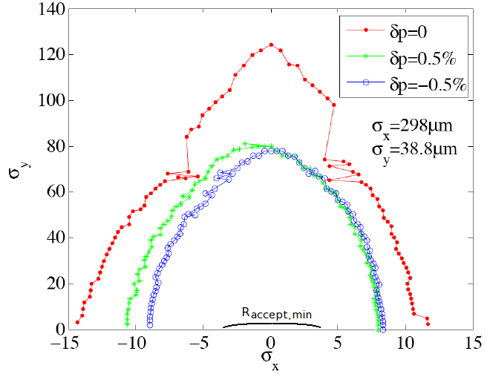

Electron linac requirements
For non-Gaussian beams the minimum required acceptance:
To avoid an e⁻ PDR:
  In horizontal R_{min} < 1 mm-rad
  In vertical R_{y}^{min} < 1.2 mm-rad
Required emittances from the electron injection linac in order to remove electron PDR
  ε_{x}^{rms}= 25 μm-rad
  ε_{y}^{rms}= 50 μm-rad
DA of the main DR
F. Antoniou

Slide 39
Linac Parameters
Pre-injector
e⁺ Linac
Primary 5 GeV e⁻ Linac
Injector Linac
gun
PDR
target
2.86 GeV
Booster Linac
2 GHz
e⁺ DR
BC1
0.2 GeV
Spin rotatator
DC gun
DL’s
Pre-injector
e⁻ Linac
e⁻ DR
9 GeV
PDR

Slide 40
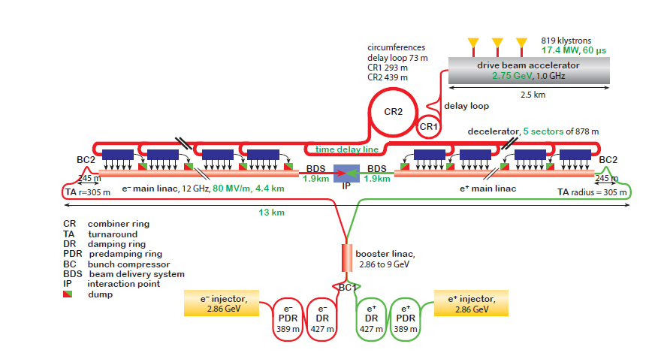
CLIC Layout at 500 GeV
Drive Beam Generation Complex
Main Beam Generation Complex

Slide 41
Injector linac rf system
Kly 1
Structure Parameter | Value
Frequency | 1998 MHz
Structure length (30 cells) | 1.5 m
Filling time | 389 ns
Cell length and iris thickness | 50 mm, 8 mm
Shunt impedance | 54.3 – 43.3 MΩ/m
Aperture a | 20 – 14 mm
Cell size b | 64.3 – 62.9
Group velocity vg/c | 2.54 -0.7 %
Phase advance per cell | 2π/3
50 MW, 8 μs
Mod
Pulse compressor
250 MW, 1.5 μs
Kly 2
BPM
Quad
Acc 1
Acc 2
Acc 3
Acc 4

Slide 42
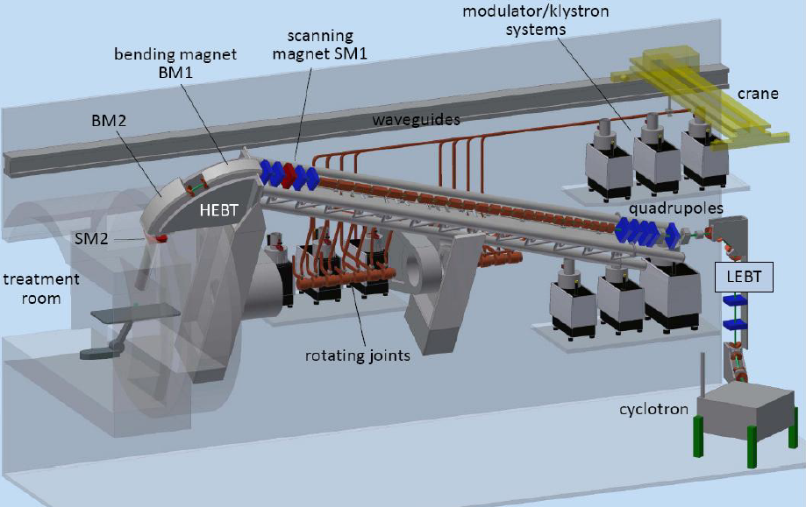
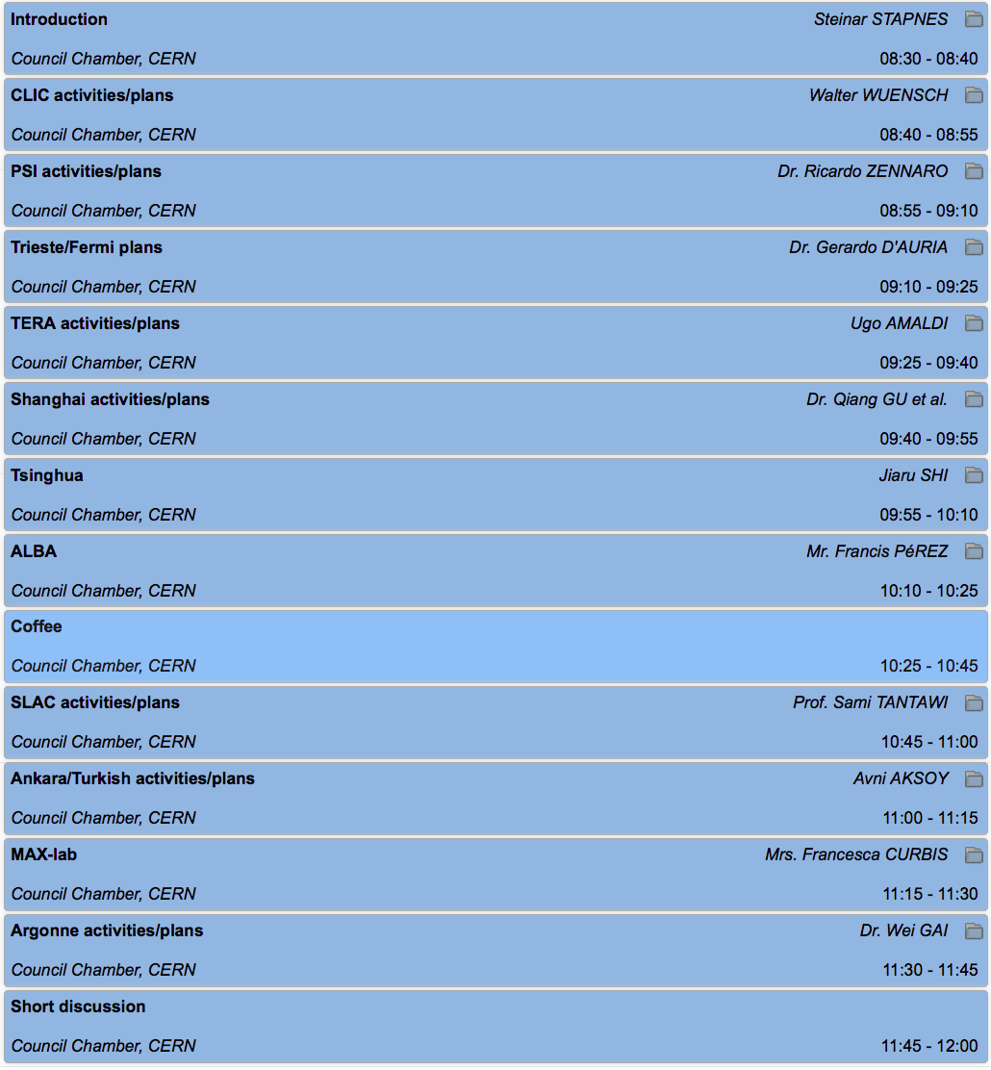
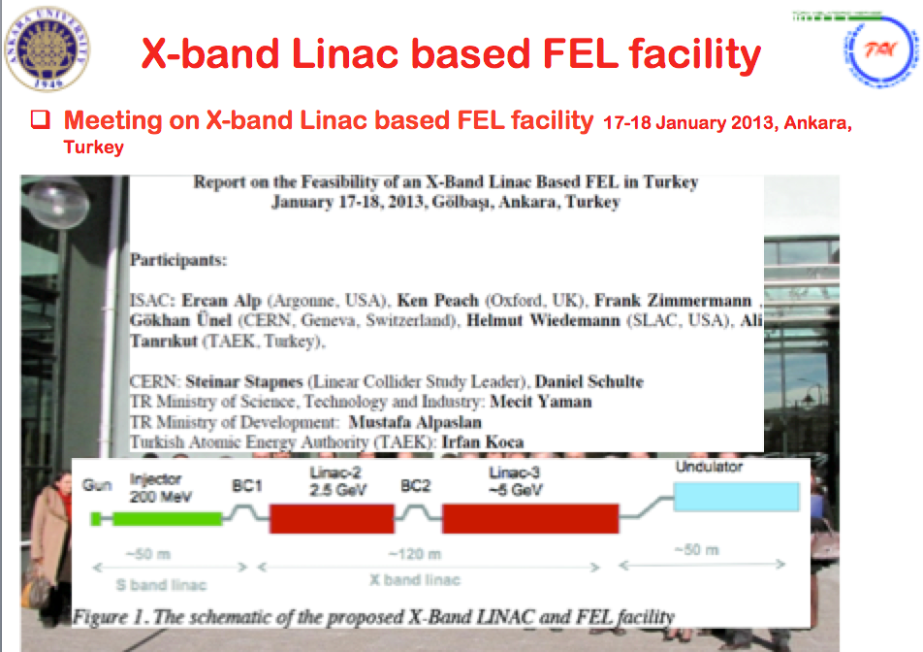
Links to other applications

Slide 43
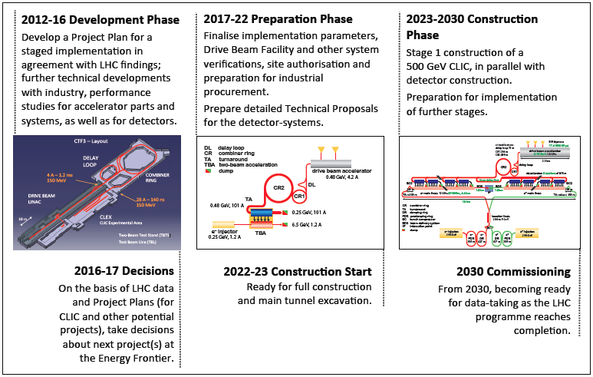
CLIC project time-line
(input to European Strategy)
The CLIC concept have been developed over many years. During the last 4-5 years there has been a concerted effort to prepare a Conceptual Design Report, to be ready when LHC data-taking was expected to be well underway (part of the European Strategy as formulated in 2006)
Focus has been on addressing all key critical issues for the concept, as well developing a coherent implementation model, and associated detector and physics studies to illustrate the physics performance

