Slide 1
Overview and Target R/D of 300 Hz Conventional e⁺ Source for ILC
T. Omori (KEK)
4-July-2013
Posipol 2013 at ANL
Truly Conventional Collaboration
ANL, IHEP, Hiroshima U, U of Tokyo, KEK, DESY, U of Hamburg
NIM A672 (2012) 52—56

Slide 2
300 Hz scheme
e+ generation in 63 m sec (cf. undulator : in 1 m sec)

Slide 3
How?
• Total Number of bunches: 2640
• Divide into 20 triplets
(1 Triplet = 3 Mini-Trains)
• Each triplet contains 132 bunches
• 2640 = 20 x 132
• 300 Hz creation of triplets
triplet to triplet time space = 3.3 m sec
• Create 20 triplets : 63 m sec
Stretching in time

Slide 4
Conventional e+ Source for ILC
Normal Conducting Drive and Booster Linacs in 300 Hz operation
e+ creation
go to main linac
20 triplets, rep. = 300 Hz
• triplet = 3 mini-trains with gaps
• 44 bunches/mini-train, T_{b_to_b} = 6.15 n sec
2640 bunches/train, rep. = 5 Hz
• T_{b_to_b} = 369 n sec
Drive Linac
Several GeV
NC
300 Hz
Booster Linac
5 GeV
NC
300 Hz
DR
Target
T_{b_to_b} = 6.15 n sec
Amorphous Tungsten
Pendulum or Slow Rotation
2640 bunches
60 mini-trains
Time remaining for damping = 137 m sec
We create 2640 bunches
in 63 m sec
Notes:
4

Slide 5
Conventional e+ Source for ILC
Normal Conducting Drive and Booster Linacs in 300 Hz operation
e+ creation
go to main linac
20 triplets, rep. = 300 Hz
• triplet = 3 mini-trains with gaps
• 44 bunches/mini-train, T_{b_to_b} = 6.15 n sec
2640 bunches/train, rep. = 5 Hz
• T_{b_to_b} = 369 n sec
Drive Linac
Several GeV
NC
300 Hz
Booster Linac
5 GeV
NC
300 Hz
DR
Target
T_{b_to_b} = 6.15 n sec
Amorphous Tungsten
Pendulum or Slow Rotation
2640 bunches
60 mini-trains
Time remaining for damping = 137 m sec
We create 2640 bunches
in 63 m sec
Stretching
Notes:
5

Slide 6
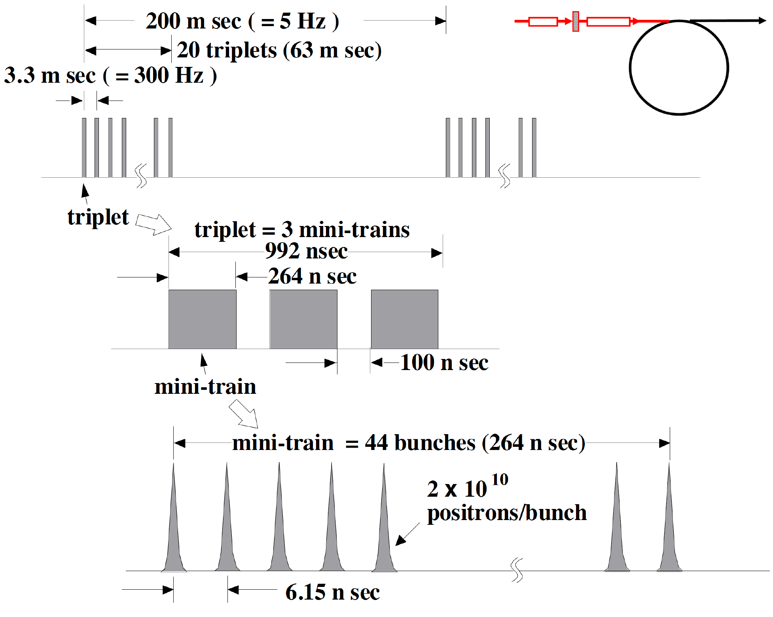
Beam before DR
=132 bunches
<-- the 100 ns gap is required to cure
an e- cloud problem in e+ DR.

Slide 7
Beam before DR
=132 bunches
Injection: usual kicker ( ~ 1 us)
no stacking is necessary
<-- the 100 ns gap is required to cure
an e- cloud problem in e+ DR.

Slide 8
Conventional e+ Source for ILC
Normal Conducting Drive and Booster Linacs in 300 Hz operation
e+ creation
go to main linac
20 triplets, rep. = 300 Hz
• triplet = 3 mini-trains with gaps
• 44 bunches/mini-train, T_{b_to_b} = 6.15 n sec
2640 bunches/train, rep. = 5 Hz
• T_{b_to_b} = 369 n sec
Drive Linac
Several GeV
NC
300 Hz
Booster Linac
5 GeV
NC
300 Hz
DR
Target
T_{b_to_b} = 6.15 n sec
Amorphous Tungsten
Pendulum or Slow Rotation
2640 bunches
60 mini-trains
Time remaining for damping = 137 m sec
We create 2640 bunches
in 63 m sec
Notes:
8

Slide 9
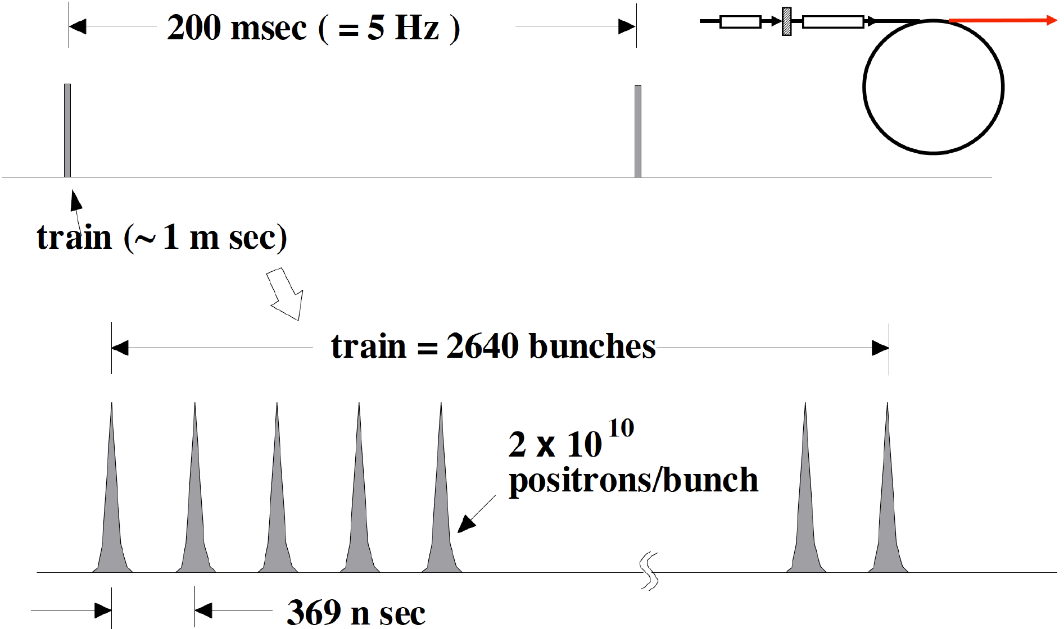
Beam after DR

Slide 10
Beam after DR
Extraction:
fast kicker ( 3 ns kicker: Naito kicker)
the same as the baseline

Slide 11
Target and Drive_Beam
Optimization

Slide 12
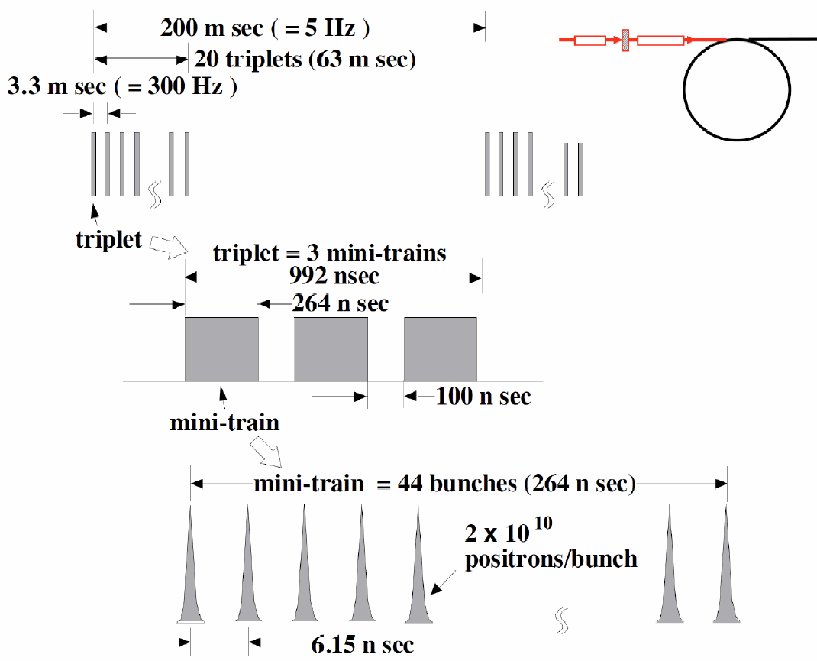
In the case of 300Hz scheme
spacing between triplets
=3.3ms
132bunches in 992ns
good for a FC
we can use existing FC technology

Slide 13
Assumptions
132 bunches
make a shock wave
heat same position on the target
drive electrons
2×10¹⁰/bunch
a triplet: 132 bunches 992ns
each triplet hits
different position on the target
3.3ms
a train: 20 triplet
= 2640 bunches 63ms
pendulum or slow rotation target

Slide 14
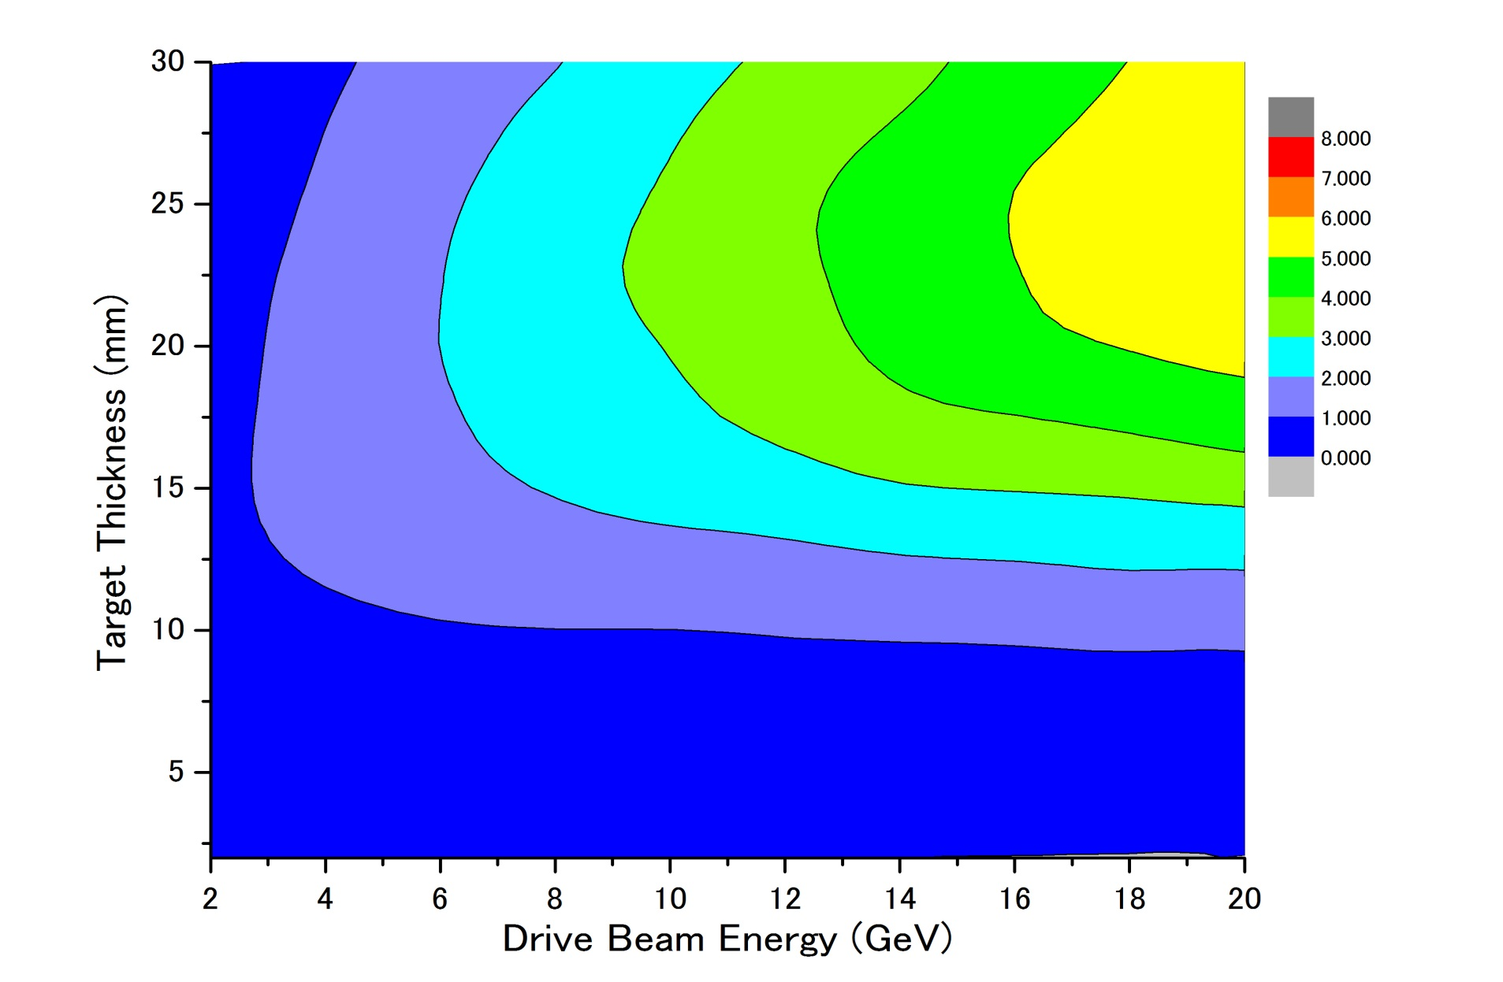
Parameter Plots for 300 Hz scheme
e- directly on to Tungsten
σ=4.0mm
colored band
accepted e+/e-
PEDD J/g
dT max by a triplet
Ne⁻(drive) = 2x10¹⁰ /bunch
１
２
３
４
5
35J/g
500k
100k

Slide 15
Parameter Plots for 300 Hz scheme
e- directly on to Tungsten
σ=4.0mm
colored band
accepted e+/e-
PEDD J/g
Ne⁻(drive) = 2x10¹⁰ /bunch
dT max by a triplet
１
２
３
４
５
35J/g
500k
there seems to be solutions
100k

Slide 16
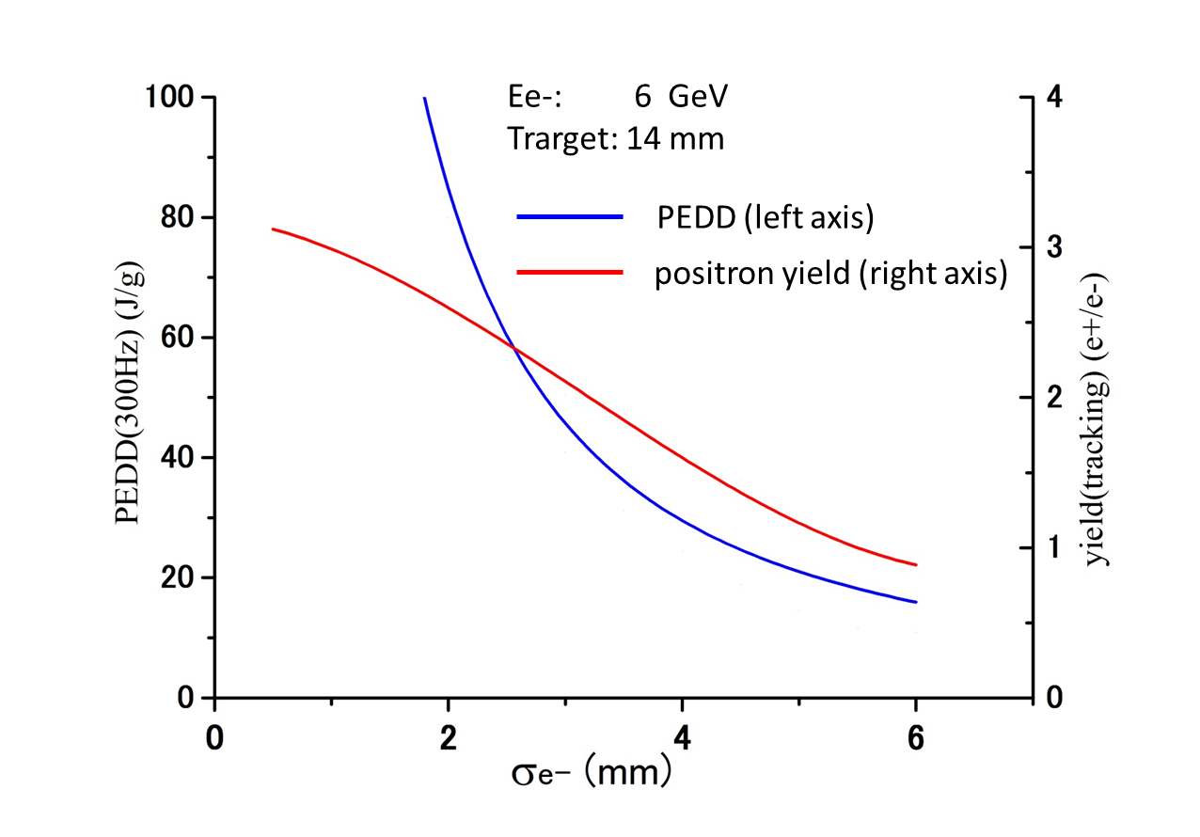
Dependence on Drive beam size
, Ne⁻/bunch = 2x10¹⁰
e+/e- =1.5
35J/g
σ of the Drive e- Beam (mm)

Slide 17
Target Heat Simulation (Wanming)

Slide 18
Target Heat Simulation (Wanming)
assumption:
1 m/s

Slide 19
Conventional e+ Source for ILC
Normal Conducting Drive and Booster Linacs in 300 Hz operation
e+ creation
go to main linac
20 triplets, rep. = 300 Hz
• triplet = 3 mini-trains with gaps
• 44 bunches/mini-train, T_{b_to_b} = 6.15 n sec
2640 bunches/train, rep. = 5 Hz
• T_{b_to_b} = 369 n sec
Drive Linac
Several GeV
NC
300 Hz
Booster Linac
5 GeV
NC
300 Hz
DR
Target
T_{b_to_b} = 6.15 n sec
Amorphous Tungsten
Pendulum or Slow Rotation
2640 bunches
60 mini-trains
Truly Conventional
* We assume single solid target.
* NO Liquid Target or
NO Hybrid Target are assumed
Time remaining for damping = 137 m sec
Notes:
19

Slide 20
R/D items

Slide 21
R&R Issues of the Conventional Source
“conventional” but still needs some more R&D
High current, high rep rate driver linac
Moving target
Flux concentrator
Booster linac
Overall simulation

Slide 22
Moving Target
~1m/sec required (1/100 of undulator scheme)
2 possible schemes being developed at KEK
5Hz pendulum with bellows seal
rotating target with ferromagnetic seal
ferromagnetic
fluid seal
air
bellows seal
vacuum
air
vacuum
main issue: life of bellows
main issue: vacuum
First step prototype fabricated

Slide 23
Flux Concentrator
Almost existing technology
  pulse length ~1μsec (cf. ~1msec in undulator scheme)
Beam aperture should be a bit larger
  ~7mm → ~12mm
Being developed for SuperKEKB
  It has 14mm aperture

Slide 24
Linacs
Driver linac (~6GeV)
  high current
  high rep rate (300Hz)
Booster linac (~5GeV)
  high rep rate
  accurate loading compensation (due to uneven bunch structure)
2×10¹⁰/bunch
a triplet: 132 bunches 992ns
3.3ms
a train: 20 triplet
= 2640 bunches 63ms

Slide 25
Loading Compensation Scheme
Urakawa
3x10¹⁰ positron/bunch
300Hz triplet beam
Less than +/- 0.7%
200MW, 3μs
300Hz Power
Supply
80MW Klystron
Low Level RF
Phase Shifter
and Amp.
3dB High Power
RF Combiner
precise control of
the phase shifters needed
50Ω High Power
Terminator
3m long constant gradient travelling wave structure
Test at ATF linac being planned

Slide 26
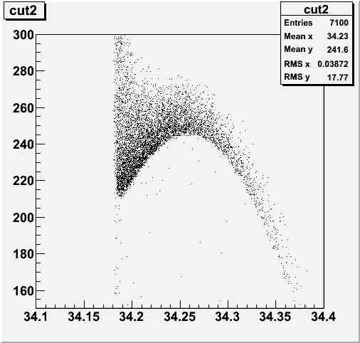
Overall Simulation
DR aperture
  ΔE < +-37.5MeV
  Δz < +-34mm
  A_{x}+A_{y} < 70μm
Must include
  target simulation
  loading compensation
Is S-band linac acceptable?
Longitudinal Phase Space
Pz(MeV)
+- 3.46 cm
Time (ns)

Slide 27
Target R/D
pendulum target hardware R/D
bellows lifetime test

Slide 28
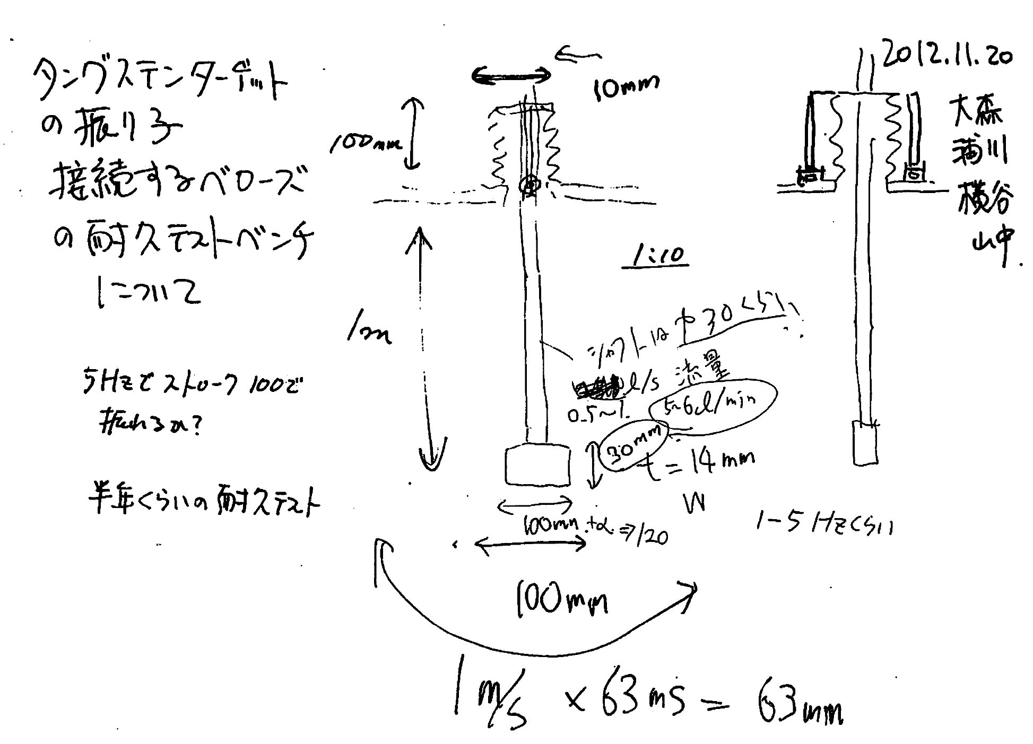
Plan of test: 5 Hz pendulum with bellows seal
22-Nov-2012

Slide 29
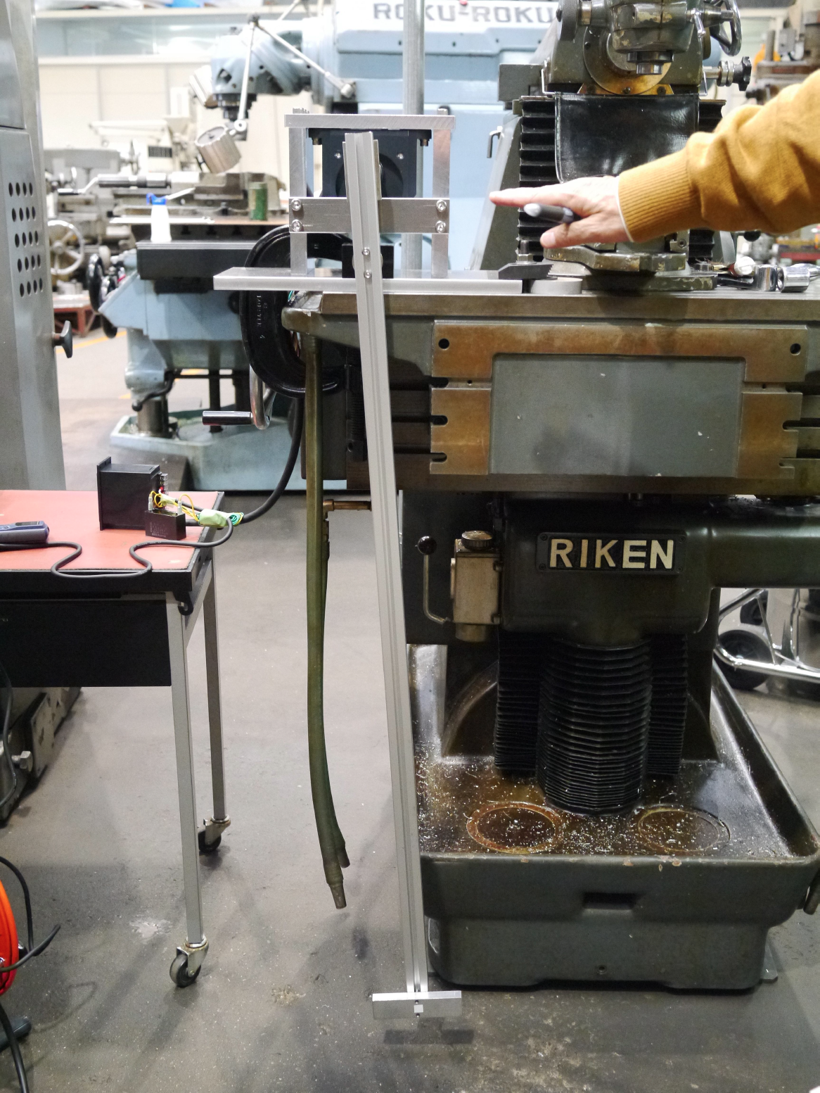
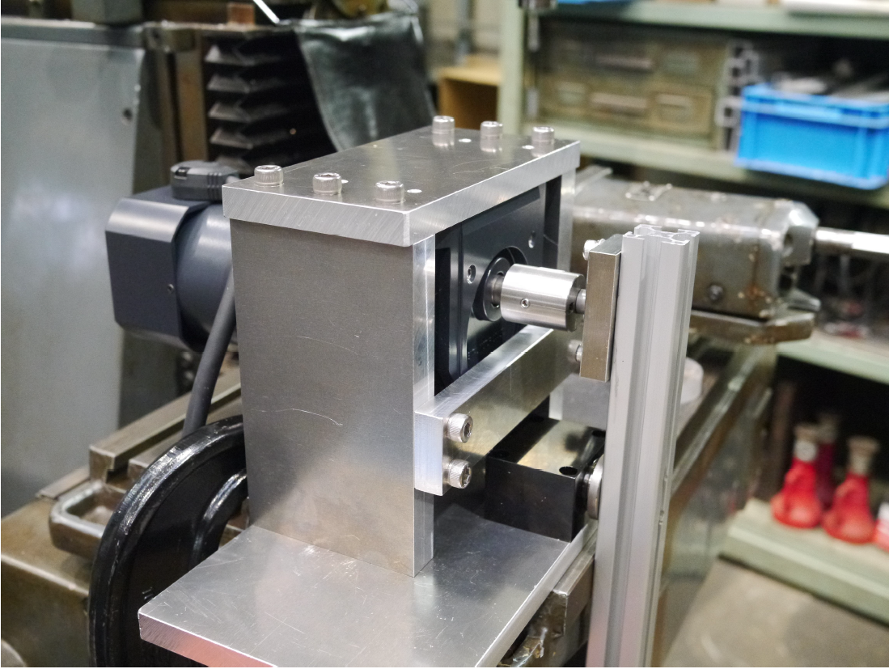
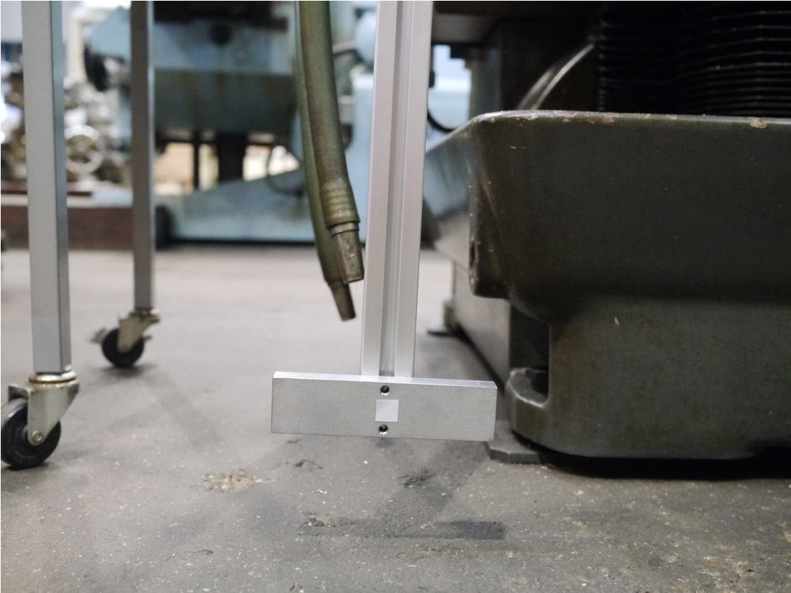
Toy model: 5 Hz pendulum (no bellows)
Apr-2013

Slide 30
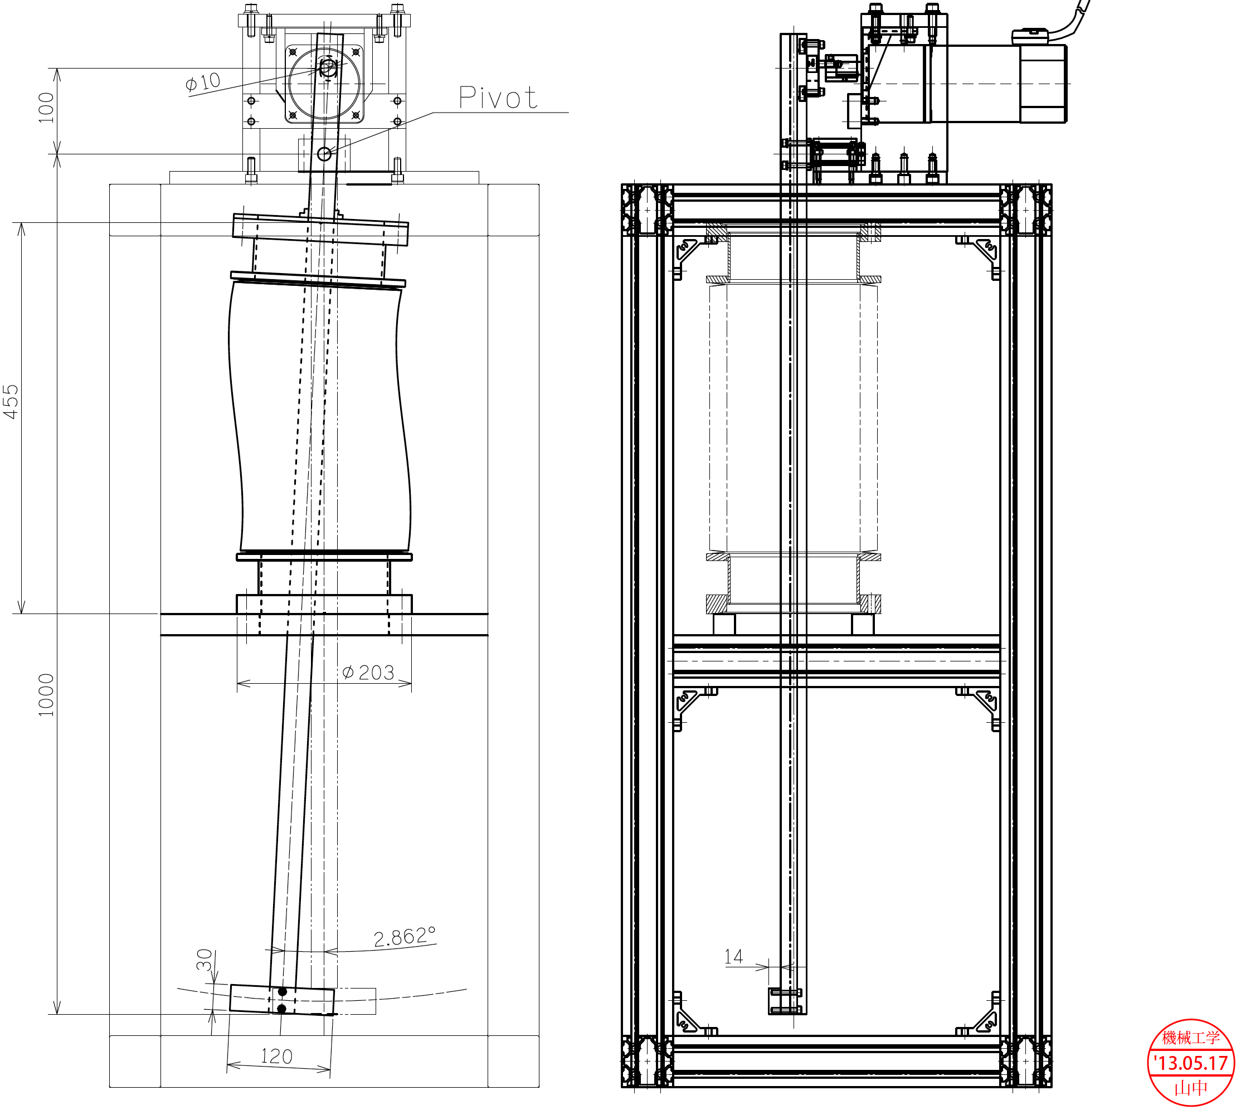
Drawing of the model with bellows (in air)
17-May-2013

Slide 31
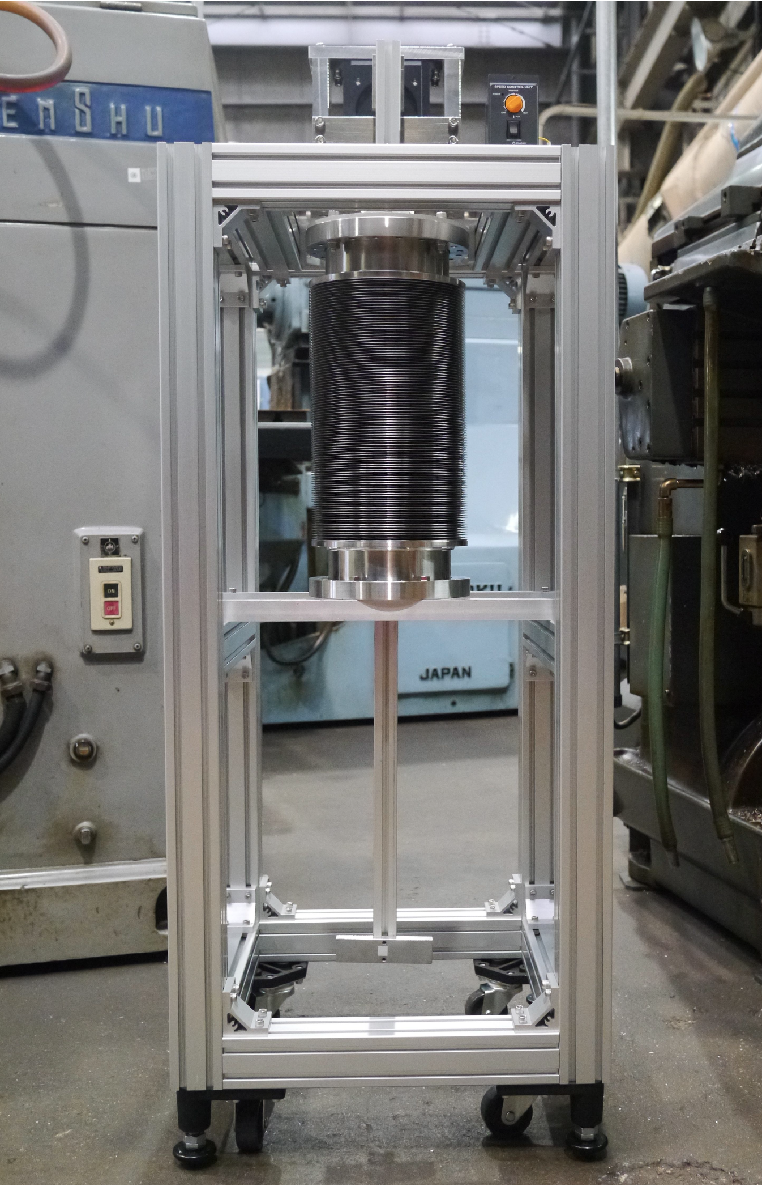
5 Hz pendulum (with bellows, in air)
17-July-2013

Slide 32
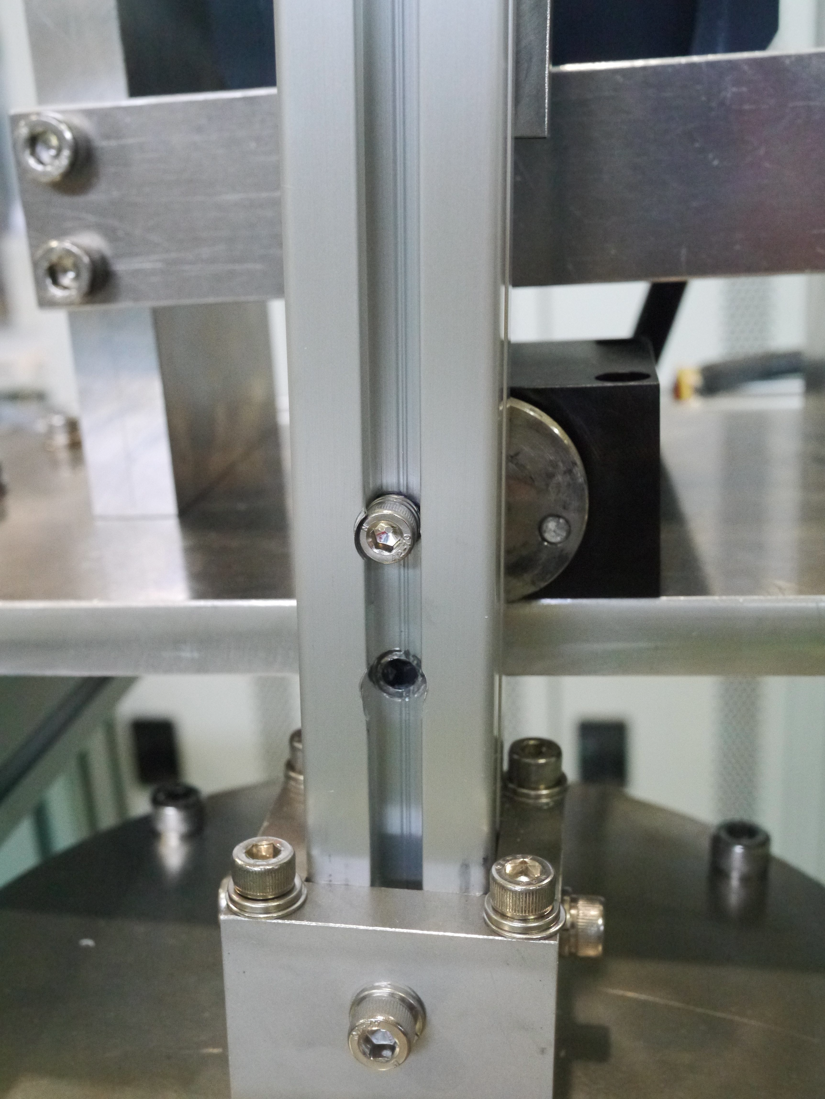
5 Hz pendulum (with bellows, in air)
26-July-2013
Moved to ATF building, fixed on the floor, made test.
A fixing bolt on the pivot broken in a very short time
broken here

Slide 33
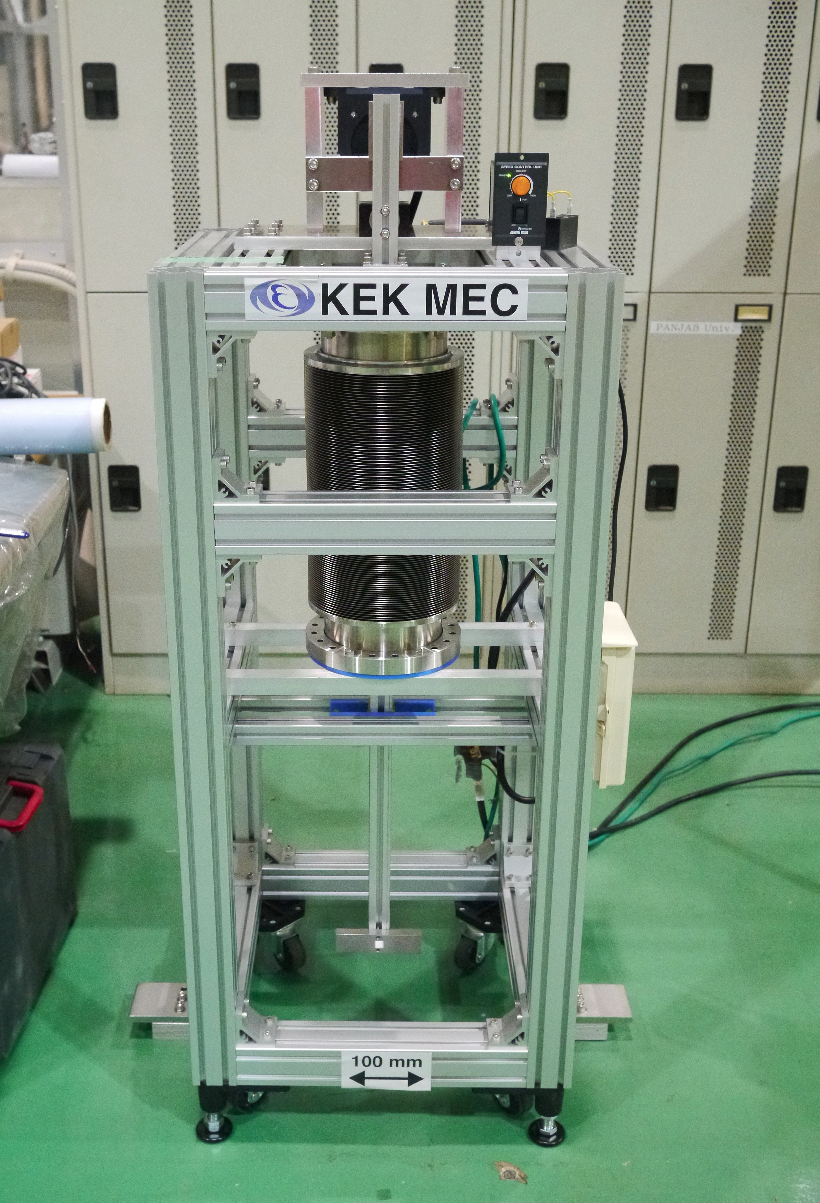
5 Hz pendulum (with bellows, in air)
End_of_Aug-2013
Made modification.

Slide 34
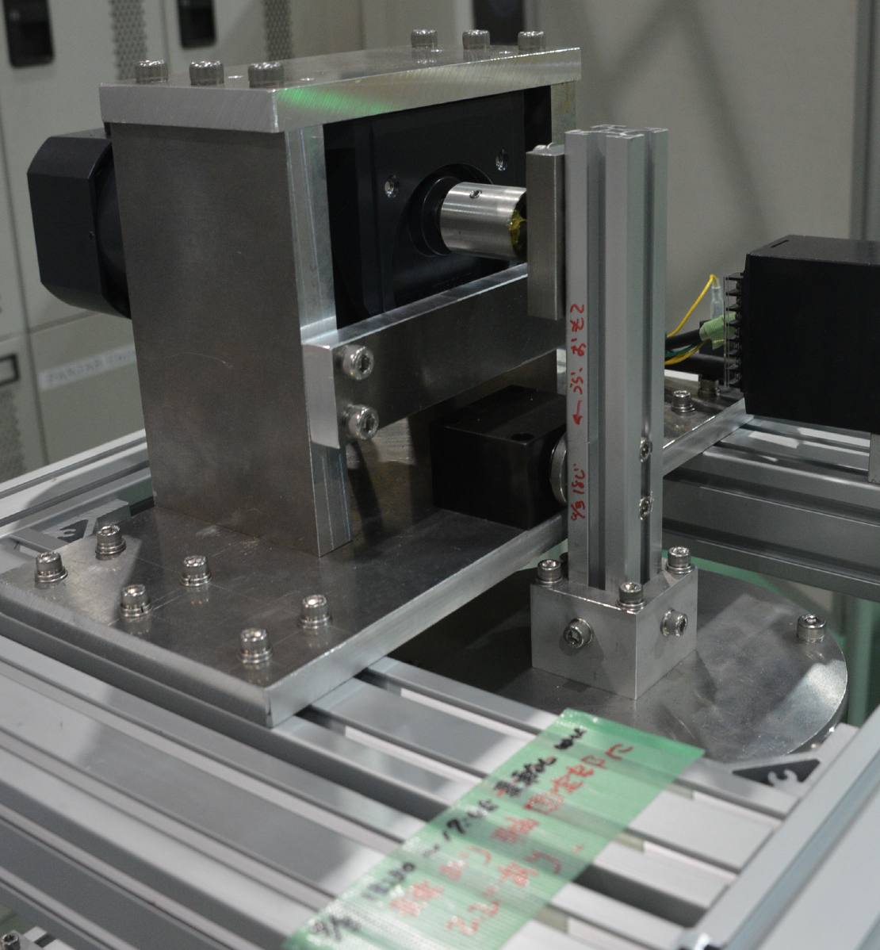
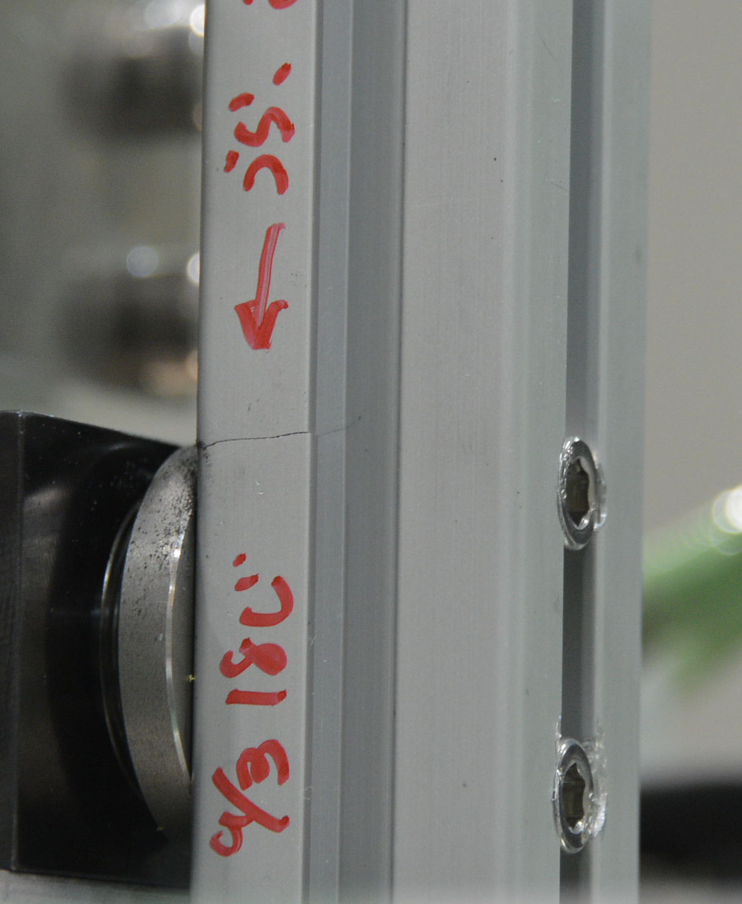
5 Hz pendulum (with bellows, in air)
2-Sep-2013
September 2nd was supposed to be the first day of the long term test.
But, after 4 hours of running, we found cracks on the arm.

Slide 35
5 Hz pendulum (with bellows, in air)
2-Sep-2013
September 2nd was supposed to be the first day of the long term test.
But, after 4 hours of running, we found cracks on the arm.
We are going to make improvement and go to the bellows lifetime test soon.

Slide 36
Summary

Slide 37
Summary
Conventional e+ source can be a solution for
ILC, with 300Hz scheme and optimized
beam&target parameters.
to go forward -> We need R/Ds
  High current, high rep rate driver linac
  Moving target
  Flux concentrator
  Booster linac
  Overall simulation

Slide 38
backups

Slide 39
Target and Drive_Beam
Optimization for
Truly Conventional
e+ Source

Slide 40
Method
EM shower simulation
e+ capture efficiency
e+ yields
Peak Energy Deposit Density (PEDD)
total energy deposit
# of e+ in the Damping Ring
+
Empirical formula by CLIC note 465
Geant 4
EM shower and particle tracking w/ Geant 4

Slide 41
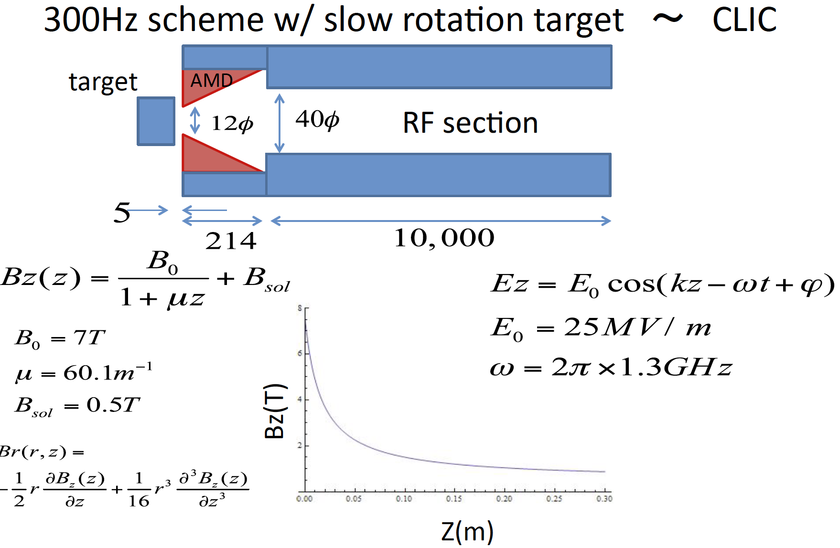
Parameters in capture section

Slide 42
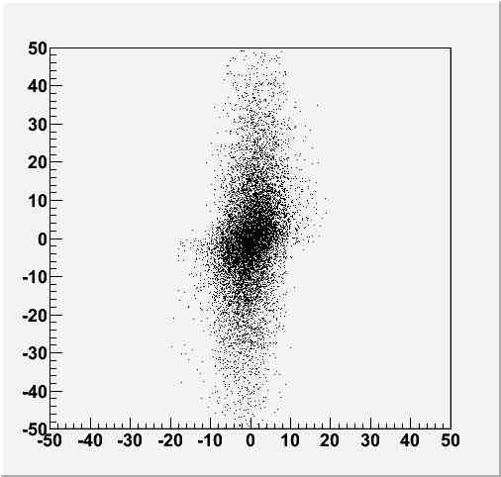
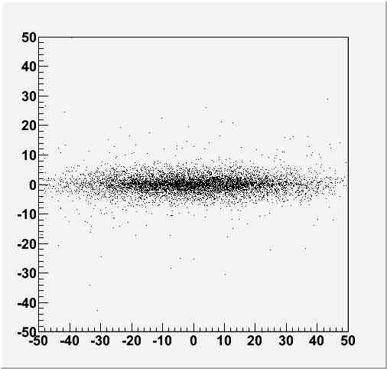
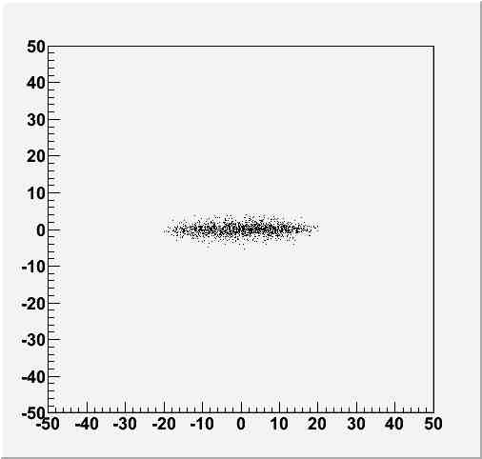
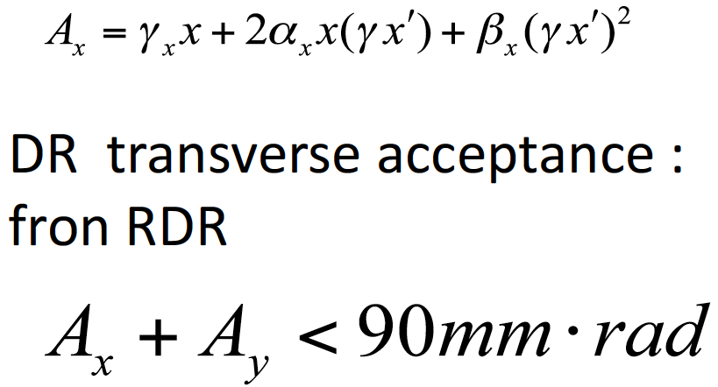
Simulation: Transeverse phase space
AMD Entrance
AMD exit
γx’
γx’
x(mm)
RF exit
γx’
x(mm)

Slide 43

Longitudinal phase space
Pz(MeV)
Time (ns)

Slide 44
Numbers for a Reference Point
Parameters for target and captures |  | Parameters for 300Hz scheme
Drive beam energy | 6 GeV | # drive e- /bunch | 2×10¹⁰
Beam size | 4.0 mm (RMS) | # bunches/triplet | 132 (in 996ns)
Target material | Tungsten | # bunches/train | 2640 (in 63 ms)
Target thickness | 14 mm | repetition | 5 Hz
Max AMD field | 7 T | Results numbers in () are for 300Hz operation
Taper parameter | 60.1/mm | e+ yield | 1.6 /e-
AMD length | 214 mm | PEDD in the target | 1.04 GeV/cm³/e- (22.7 J/g)
Const. field | 0.5 T | E. deposit in the target | 823 MeV/e- (35kW)
Max. RF field | 25 MV/m | E. deposit in the AMD | 780 MeV/e- (33kW)
RF frequency | 1.3 GHz | E. deposit in the RF section | 470 MeV/e- (20kW)

Slide 45
Target Tangential Speed
SLC (actual achievement)：
0.1 m/s (Swinging/Troll target: Not really rotating)
ILC baseline (design: test is ongoing):
100 m/s
Truly Conventional (assumption)：
1 m/s
large spatial overlap between triplets --> But OK in temperature.
Design study on going.
shockwave : OK because triplet to triplet separation 3.3 ms in time.
Probably 0.5 m/s is OK.
.
.
.

Slide 46
Higher Luminosity?
7.5 Hz main linac operation

Slide 47
Beam before DR
=132 bunches

Slide 48
Beam before DR
=132 bunches

Slide 49
5 Hz Operation
For 2640 bunches (High Power Option), which I showed so far.
200 ms
63 ms for
20 triplet
(2640 bunches)
137 ms for damping
For 1320 bunches (TDR baseline)
200 ms
30 ms for
10 triplet
(1320 bunches)
170 ms for damping

Slide 50
7.5 Hz Operation (x1.5 Lumi.)
For 2640 bunches (High Power Option)
133 ms
103 ms for damping
30 ms for
10 sextet
(2640 bunches = 10x6x44)
For 1320 bunches (TDR baseline)
133 ms
30 ms for
10 triplet
(1320 bunches)
103 ms for damping

Slide 51
7.5 Hz Operation (x1.5 Lumi.)
For 1320 bunch:
* We can adopt 7.5 Hz main-linac-rep.-rate for 300 Hz scheme.
* Average heat load on the target increase, but no major
difficulty.
For 2640 bunch:
* We can adopt 7.5 Hz main-linac-rep.-rate for 300 Hz scheme,
if we can employ sextet time structure in 300 Hz linec instead
of triplet.
* sextet : 44 bunches x 6 = 234 bunches , dulation ~ 2 usec.
* Need to increase pulse width of 300 Hz linac: 1 us -> 2us.
Need careful consideration.
* Instantaneous heat load on the target increase (x2).
Can be problem. Need careful consideration.

Slide 52
7.5 Hz Operation (x1.5 Lumi.)
For 1320 bunch: Possible
* We can adopt 7.5 Hz main-linac-operation for 300 Hz scheme.
* Average heat load on the target increase, but no major
difficulty.
For 2640 bunch: Need careful consideration.
* We can adopt 7.5 Hz main-linac-operation for 300 Hz scheme,
if we can employ sextet time structure in 300 Hz linec instead
of triplet.
* sextet : 44 bunches x 6 = 234 bunches , dulation ~ 2 usec.
* Need to increase pulse width of 300 Hz linac: 1 us -> 2us.
Need careful consideration.
* Instantaneous heat load on the target increase (x2).
Can be problem.
Need careful consideration on beam&target parameters.

Slide 53
Comparison with
NLC/GLC

Slide 54
300 Hz scheme
• Stretching in time

Slide 55
300 Hz scheme
• Stretching in time
• The Same as Warm colliders
NLC 120 Hz
GLC 150 Hz
CLIC 50 Hz

Slide 56
300 Hz scheme
• Stretching in time
• The Same as the Warm colliders
NLC 120 Hz
GLC 150 Hz
CLIC 50 Hz
Employs 3-4 targets
Thermal Shockwave
• We try to employ single target.
Truly Conventional
Amorphous Tungsten
We assume
NO Liquid Target or
NO Hybrid Target
Just solid tungsten target is OK
with
Pendulum Motion or Slow Rotation.

Slide 57
300 Hz scheme
• Stretching in time
• The Same as the Warm colliders
NLC 120 Hz
GLC 150 Hz
CLIC 50 Hz
Employs 3-4 targets
Thermal Shockwave
• We try to employ single target.
Truly Conventional
Amorphous Tungsten
We assume
NO Liquid Target or
NO Hybrid Target
Just solid tungsten target is OK
with
Pendulum Motion or Slow Rotation.
Why just single solid target is
OK in ILC ?

Slide 58
What is the difference wrt GLC/NLC design
Old GLC/NLC design employed 3 targets.
Why single target can survive in ILC 300 Hz.

Slide 59
What is the difference wrt GLC/NLC design
Old GLC/NLC design employed 3 targets.
Why single target can survive in ILC 300 Hz.
Because, improved optimization in ILC 300 Hz.

Slide 60
300 Hz scheme
• Stretching in time
• The Same as the Warm colliders
NLC 120 Hz
GLC 150 Hz
CLIC 50 Hz
Employs 3-4 targets
Thermal Shockwave

Slide 61
300 Hz scheme
• Stretching in time
• The Same as the Warm colliders
NLC 120 Hz
GLC 150 Hz
CLIC 50 Hz
Employs 3-4 targets
Thermal Shockwave
• We try to employ single target.
Amorphous Tungsten

Slide 62
300 Hz scheme
• Stretching in time
• The Same as the Warm colliders
NLC 120 Hz
GLC 150 Hz
CLIC 50 Hz
Employs 3-4 targets
Thermal Shockwave
• We try to employ single target.
Truly Conventional
Amorphous Tungsten
We assume
NO Liquid Target or
NO Hybrid Target
Just solid tungsten target is OK
with
Pendulum Motion or Slow Rotation.

Slide 63
What is the difference wrt GLC/NLC design
Old GLC/NLC design employed 3 targets.
Why single target can survive in ILC 300 Hz.
ILC 300 Hz GLC(JLC) 3 targets NLC 3/4 targets
(for each) (for each)
Eb 6 GeV 10 GeV 6.2 GeV
Ne-/bunch 2x10¹⁰ 1x10¹⁰ 1.5x10¹⁰
N of bunches 132 (triplet) 64 (192/3) 63 (190/3)
t_target 14 mm 21 mm 14 mm
spot (σ) on target 4 mm 2.5 mm 1.6 mm
DR/preDR accpt ΔE<25 MeV ΔE<19.8 MeV ΔΕ<10MeV
ΔT< 115ps ΔT<? ΔΤ<30 ps
γA_{x}+γA_{y}=0.09 m γA_{x}&γA_{x}<0.03 m γA_{x}&γA_{x}<0.03 m
PEDD 23 J/g 35 J/g 35 J/g
e+/e- 1.5 1 1.8
Because, improved optimization in ILC 300 Hz.

Slide 64
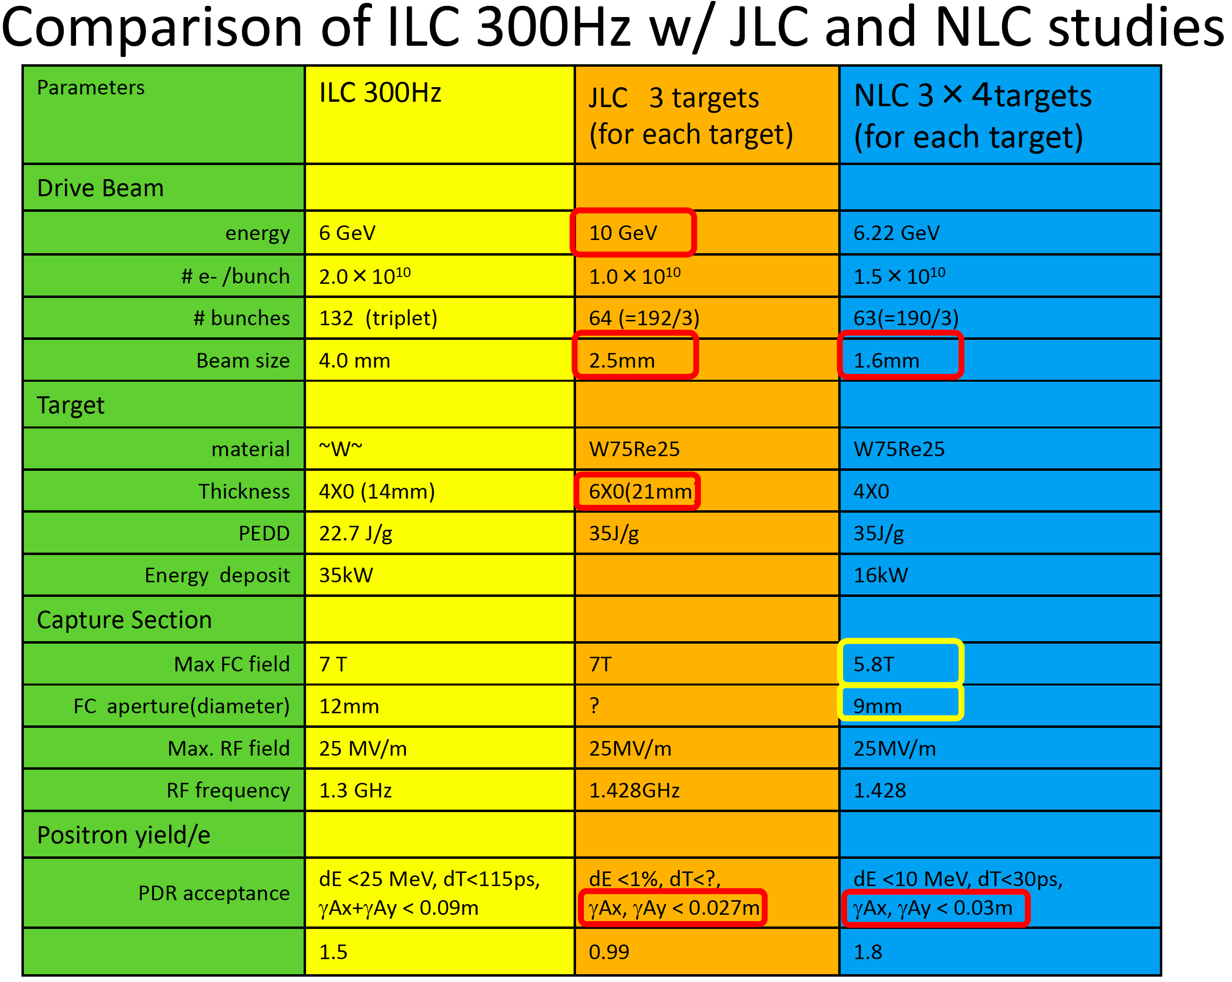
DR/
e+/e-

Slide 65
Target Issues
Two Issues
• Heat Load (by beam): Time Scale ~ 1 m sec.
• Thermal shock wave: Time scale ~ sub micro sec.
• Undulator Scheme (base line)
• In order to create e+s, it uses e- beam in the main linac.
• It creates 2600 bunches of e+s in 1 m sec.
• Heat load is a serious problem.
• It requires a challenging rotation target (100 m/s).
(spreads 2600 bunches in 100 mm length)
• 300 Hz Truly Conventional
• It creates 2600 bunches of e+s in 63 m sec. (stretching)
• Heat load is not a problem.
• Do we have a solution? Issue : shock wave

Slide 66
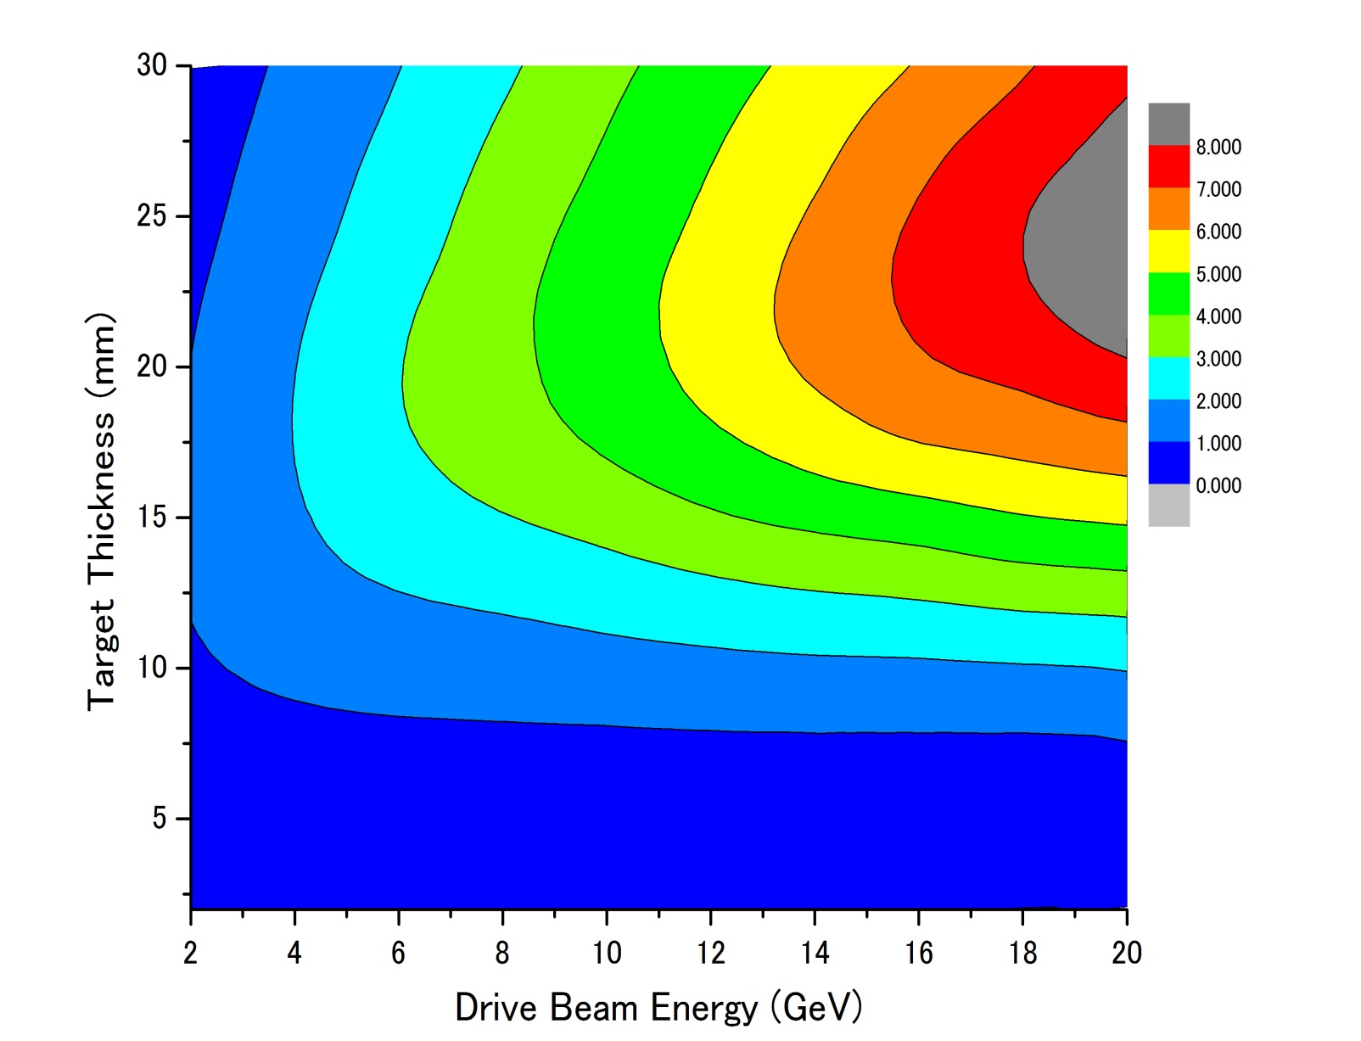
Parameter Plots for 300 Hz scheme
e- directly on to Tungsten
σ=2.5mm
colored band
accepted e+/e-
PEDD J/g
Ne⁻(drive) = 2x10¹⁰ /bunch
dT max by a triplet
１
２
３
４
５
６
７
８
1000k
35J/g
500k
100k

Slide 67
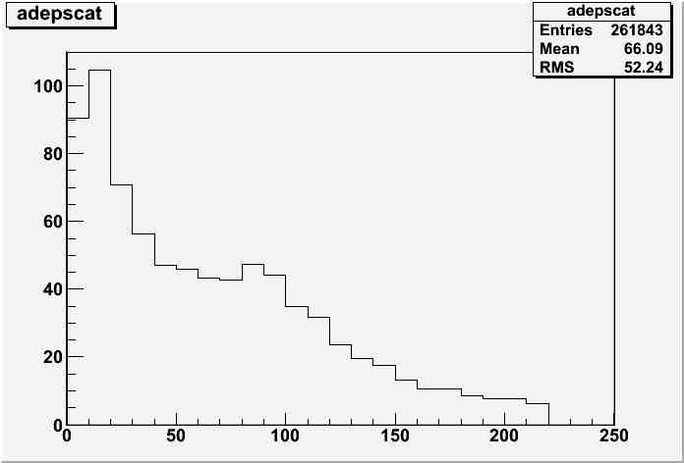
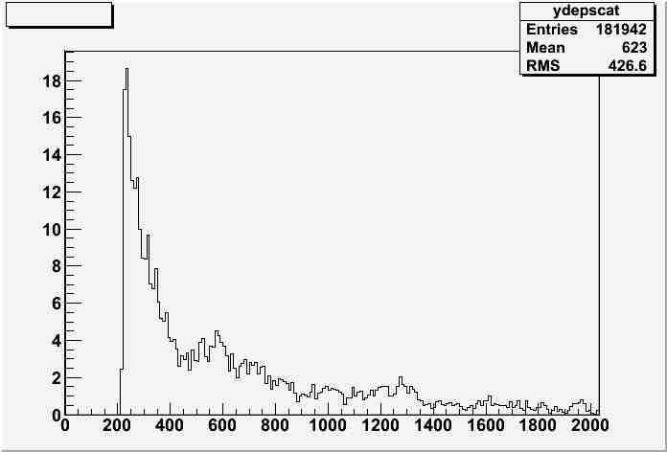
Energy deposit in capture section
MeV/10mm
MeV/10mm
Z(mm)
Z(mm)

Slide 68
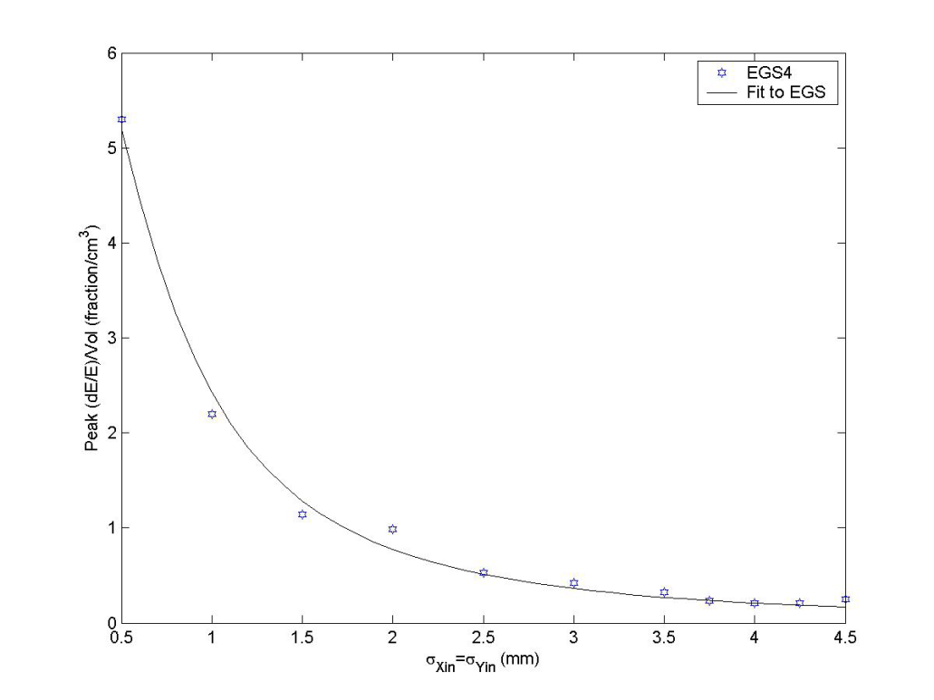
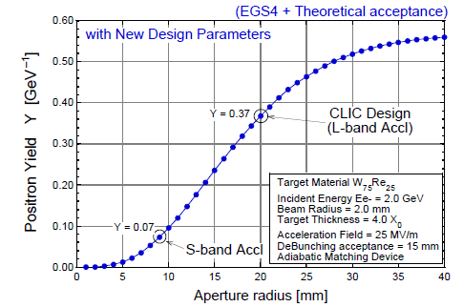
a few comments
numbers shown here are consistent w/
    independent calculation by a colleague in KEK and French colleague for Hybrid
comparison w/ SLC study
  both assumed AMD but acceptance for linac is;
    SLC S-band linac ←→ this study (CLIC) L –band
PEDD
John C. Sheppard
SLAC-TN-03-032
CLIC-note 465
consistent

Slide 69
Assumption
each triplet hits different position on the target
relatively low (1~2m/s)rotational target
duration of a triplet ~ dumping time of shock wave
shoter than time scale of thermal dissusion
132 bunches in a triplet contributes both shock wave and thermal damage

Slide 70
Target & Drive_Beam Optimization
Conventional e+ sources
thermal load,
shock wave
used to be
Well established
300Hz scheme
e+ gen. in 60ms rather than 1ms
targets
relax thermal
problem for
increase survivability w/
slow rotation targets
worth while
looking into
feasibility again
Capture section
larger aperture for RF section
larger acc. gradient

Slide 71
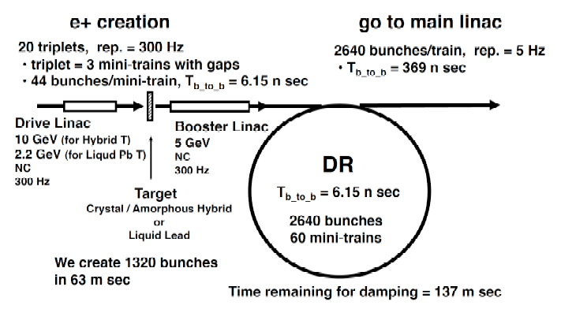
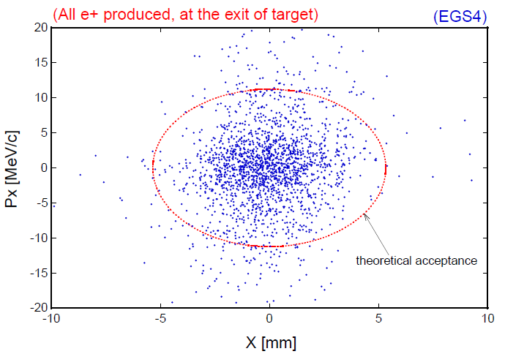
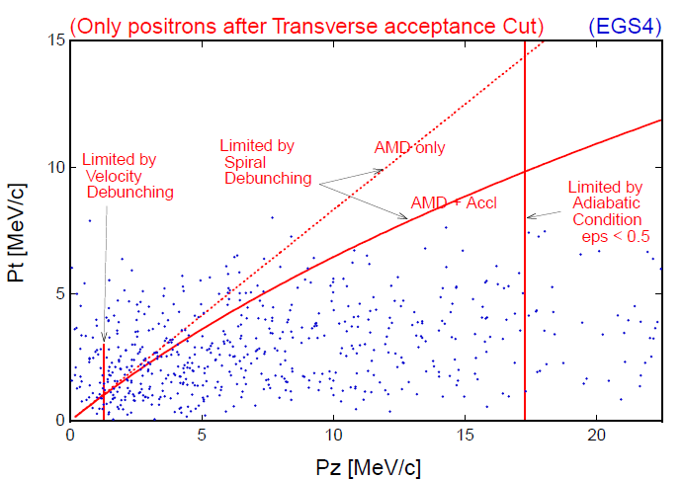
Acceptance estimate
CLIC note 465
[r/5.3[mm]]² + [pT[MeV]/11]² =＜1
pT < 0.1875 MeV/c + 0.625 pL
1.5 MeV/c < pL < 17.5 MeV/c
～# of e+ in DR (or booter linac)

Slide 72

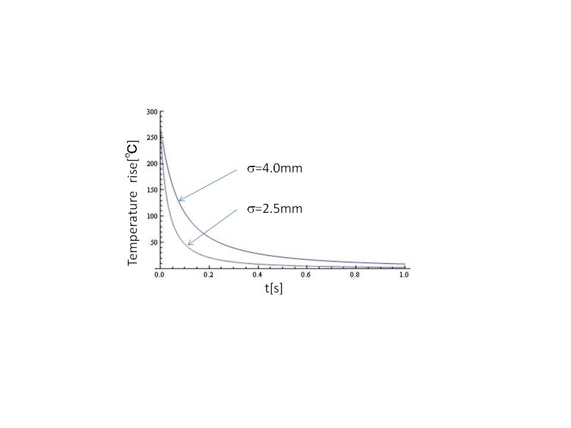
Thermal diffusion
time constant of the diffusion depends on beam spot size ~1/β
numerical calculation of
thermal diffusion shows
 |  | 1D | 2D | 3D
time constant | σ=2.5mm σ=4.0mm | 280ms 750ms | 80ms 200ms | 40ms 100ms
time constant is order of 100ms >> Ttriplet ~1μs

Slide 73
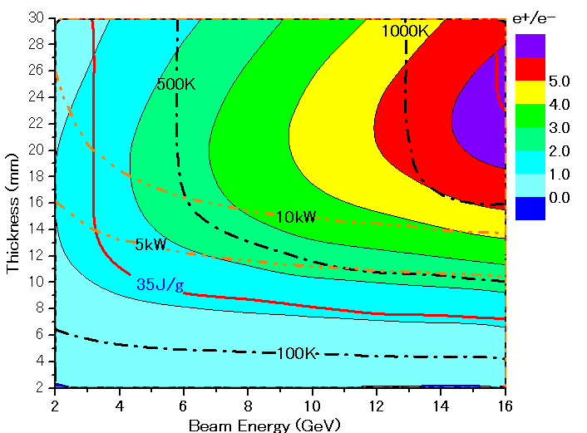
Parameter Plots for 300 Hz scheme w/ clic note formula
e- directly on to Tungsten
σ=2.5mm
colored band
accepted e+/e-
PEDD J/g
dT/triplet (132 bunc)
ToTal deposit kW

Slide 74
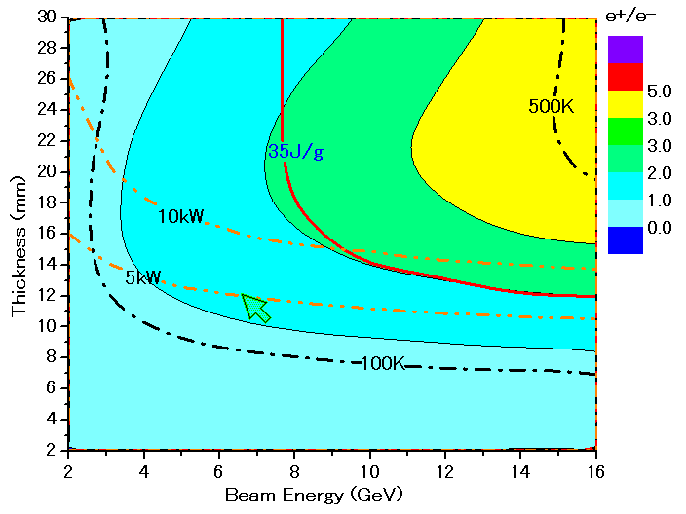
Parameter Plots for 300 Hz scheme w/ CLIC note formula
colored band
accepted e+/e-
e- directly on to Tungsten
σ=4.0mm
PEDD J/g
dT/triplet (132 bunc)
ToTal deposit kW

