Slide 1
ILC target wheel studies
O. S. Adeyemi¹, V. Kovalenko¹, G. Moortgat-Pick^{1;2}
S. Riemann², F. Staufenbiel², A. Ushakov¹
¹University of Hamburg
²DESY
ILC target unit (Ti wheel)
Average temperature of the ILC target wheel with cooling channels (high lumi)
Dynamical reaction force at the wheel bearings
Conclusion

Slide 2
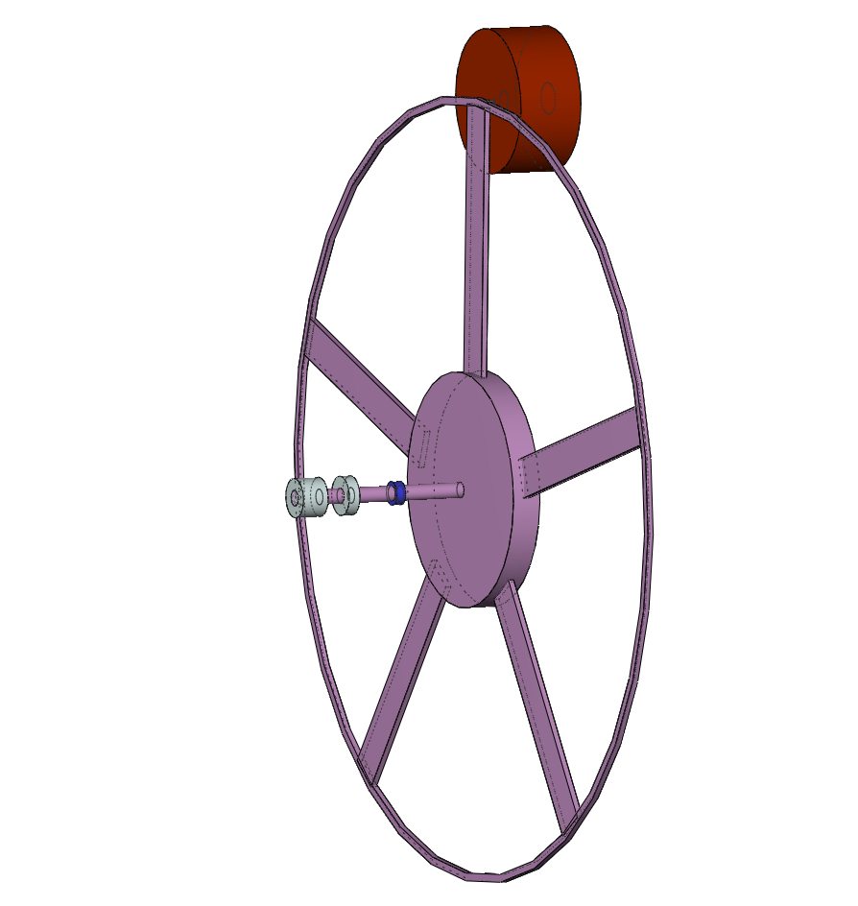
ILC target unit (Ti wheel and collimator stages)
Ti6Al4V target for polarised
positron production
e⁺
150-500 GeV e⁻
photon beam
helical undulator
distribution of
heat load !!
v_{rim} = 100 m/s
( 2000 rpm )
r
r = 0.5 m

Slide 3
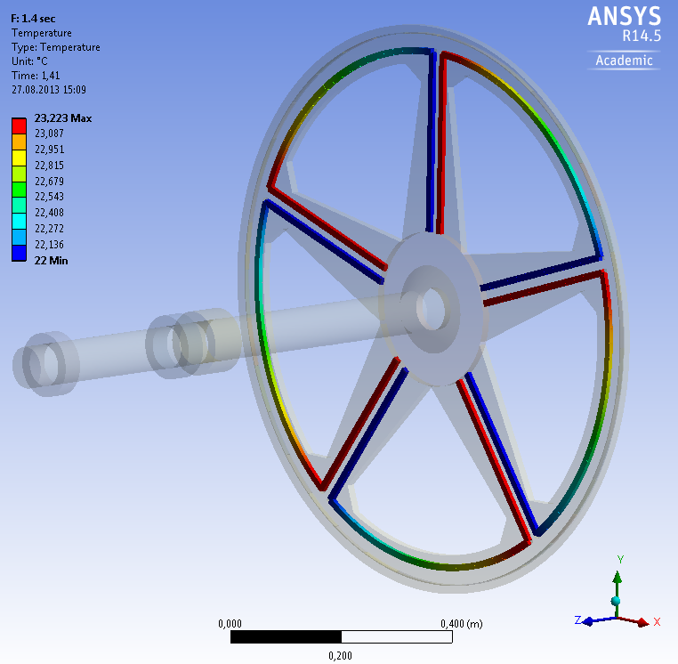
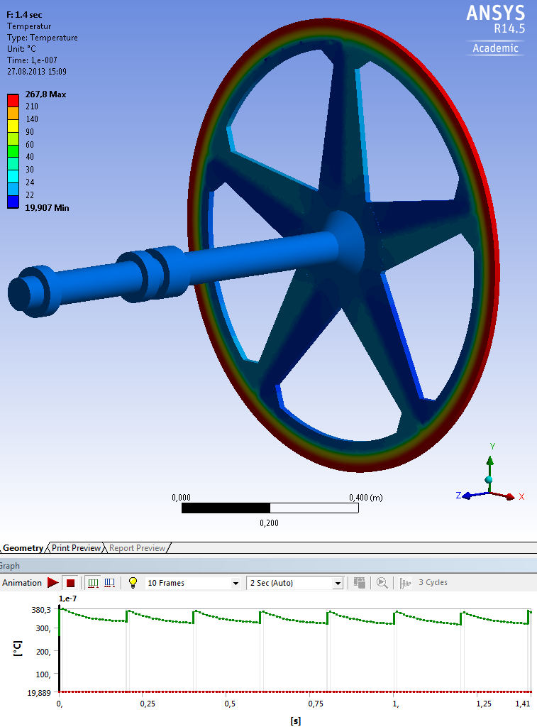
Average temperature in the ILC target wheel with cooling channels (high lumi)
Water temperature
Wheel temperature
Equilibrium temperature with cooling channels inside the wheel and a water flow of 0.1 l/s

Slide 4
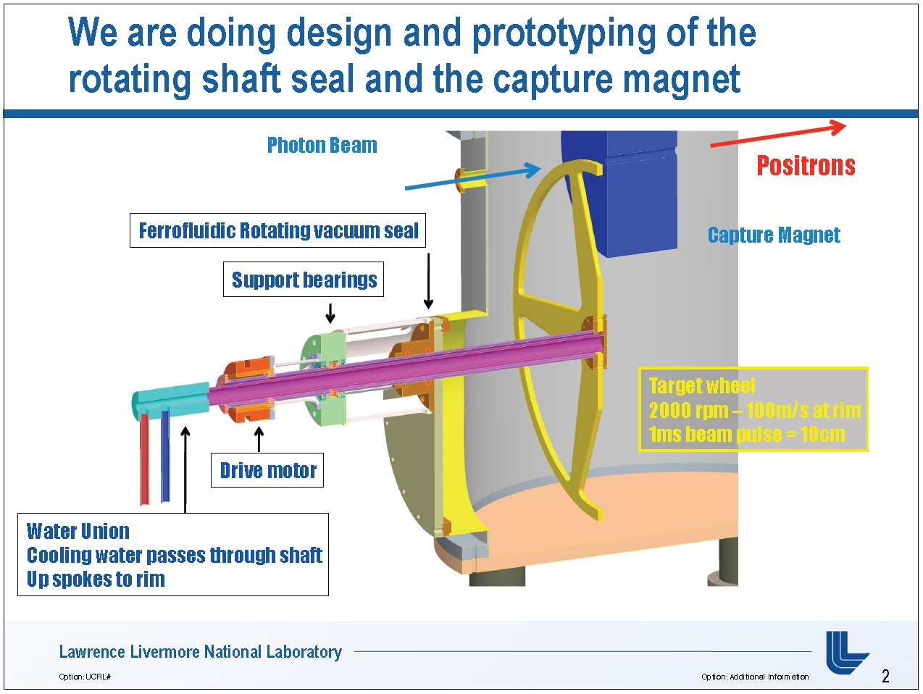
Dynamical reaction force at the wheel bearings
Beam induced deformation
reaction
Reaction force
Jeffrey Gronberg (LLNL)

Slide 5
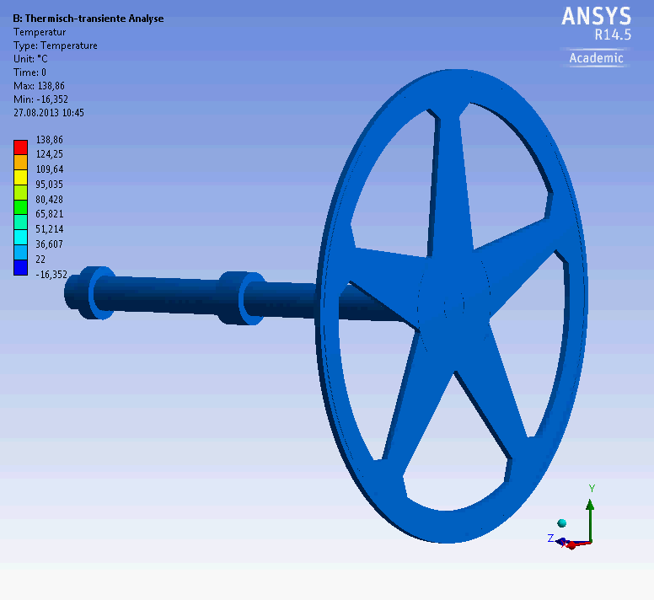
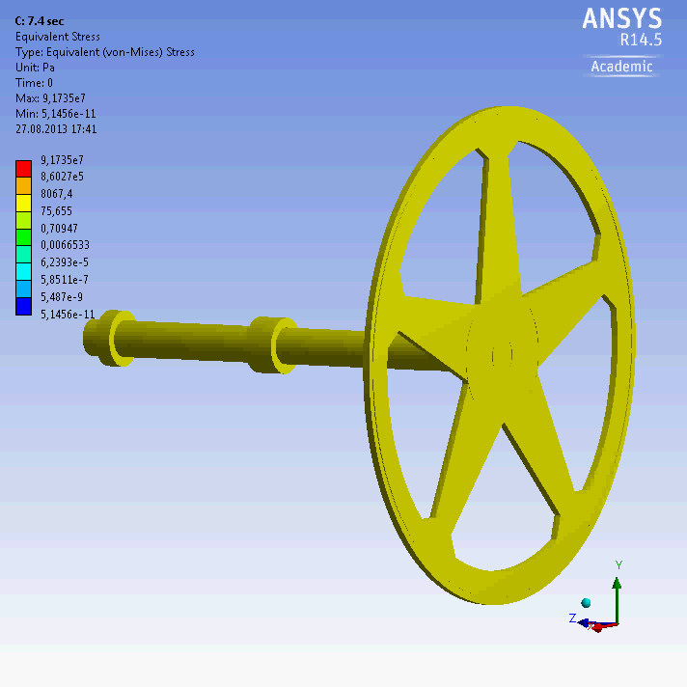
Dynamic stress and temperature evolution in the ILC target wheel (high lumi)
temperature
stress
2*10¹⁰ e⁻ / bunch
2625 bunch / train (0.97ms)
0.366μs bunch spacing
5 train / s

Slide 6
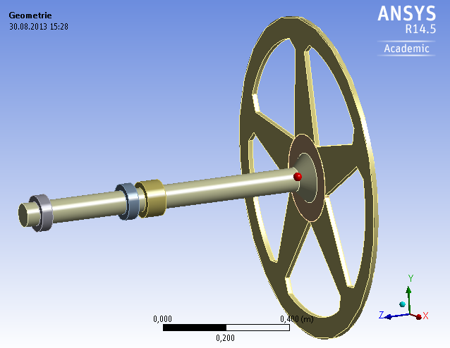
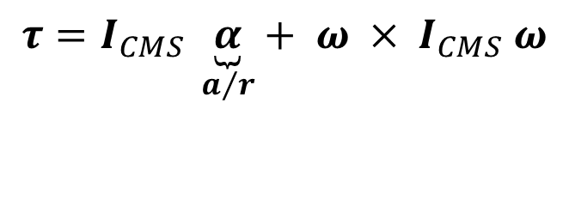
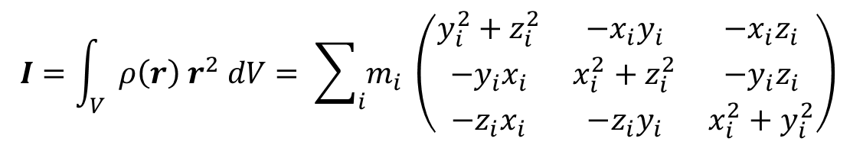


Dynamical reaction force at the wheel bearings
Inertia tensor I and resultant torque τ
$$I=\int_{V}^{ }{ ρ\left(r\right){ r}^{2} dV= \sum_{i}{m_{i} }\left(\begin{matrix}y_{i}^{2}+z_{i}^{2} & −x_{i}y_{i} & −x_{i}z_{i} \\ −y_{i}x_{i} & x_{i}^{2}+z_{i}^{2} & −y_{i}z_{i} \\ −z_{i}x_{i} & −z_{i}y_{i} & x_{i}^{2}+y_{i}^{2}\end{matrix}\right)}$$
Beam induced deformation
$$τ=I_{CMS} \underset{a/r}{\underbrace{α}}+ ω ×{ I}_{CMS} ω$$
reaction
$$CMS$$
$$\underset{⇒}{ } \left\|τ\right\|∝ m r^{2} ω^{2}$$
Reaction force

Slide 7
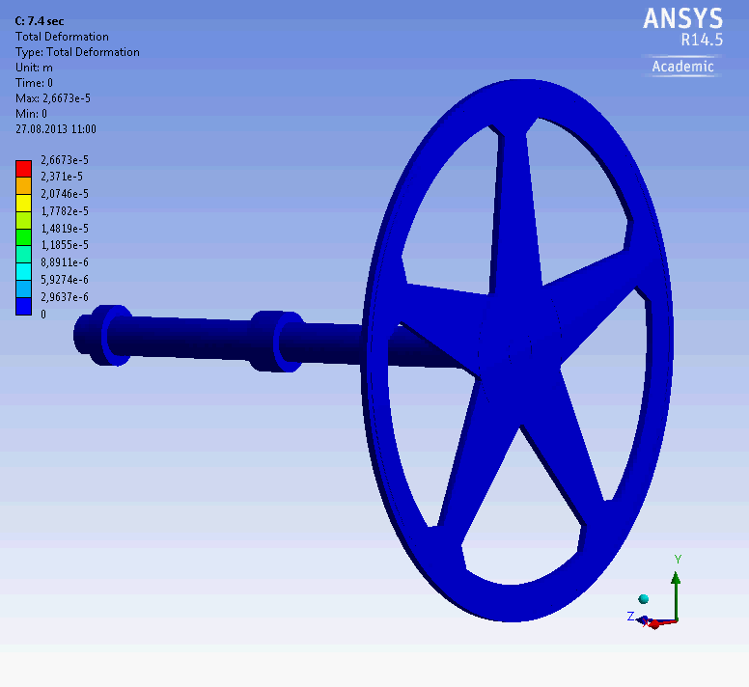
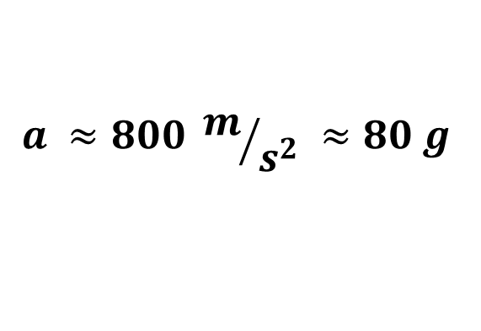
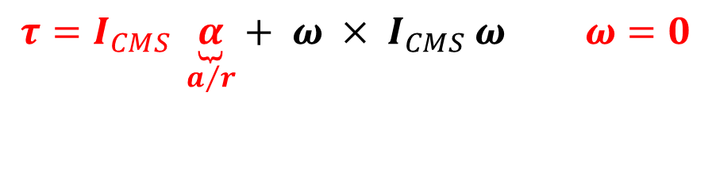
Dynamical reaction force at the wheel bearings
$$τ=I_{CMS} \underset{a/r}{\underbrace{α}}+ ω ×{ I}_{CMS} ω ω=0$$
2*10¹⁰ e⁻ / bunch
2625 bunch / train (0.97ms)
0.366μs bunch spacing
5 train / s
deformation
$$a ≈800 m/{s^{2}} ≈80 g$$
Acceleration of matter induce torque and reaction forces

Slide 8
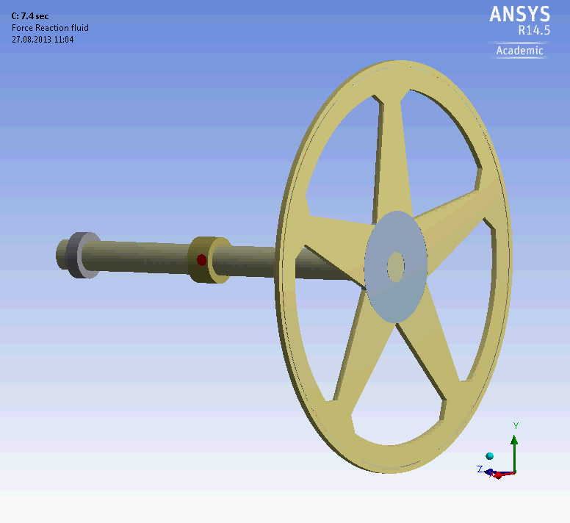

Dynamical reaction force at the wheel bearings
$$τ=I_{CMS} \underset{a/r}{\underbrace{α}}+ ω ×{ I}_{CMS} ω ω=0$$
reaction force
fluid bearing
reaction force
conventional bearing

Slide 9
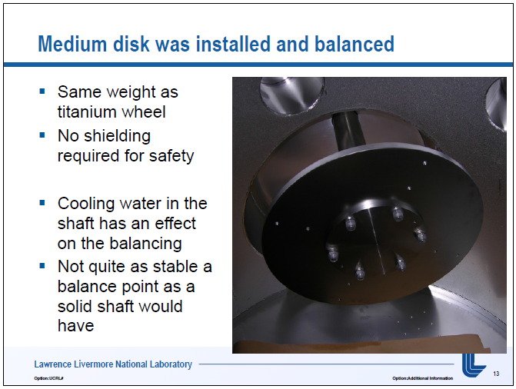
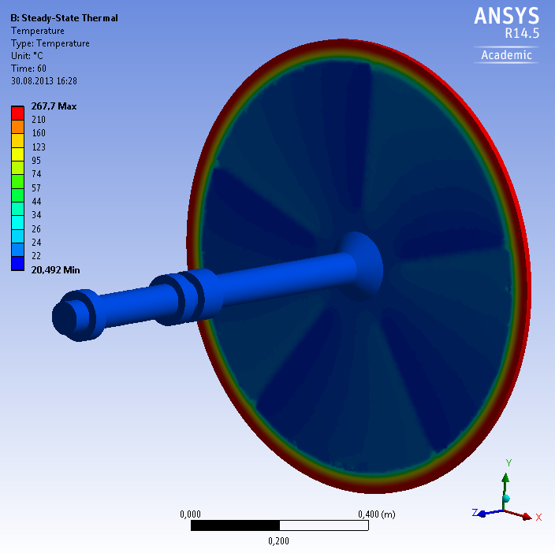
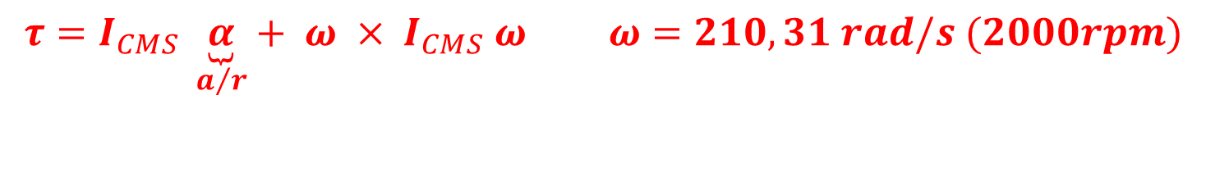
Dynamical reaction force at the wheel bearings
$$τ=I_{CMS} \underset{a/r}{\underbrace{α}}+ ω ×{ I}_{CMS} ω ω=210,31 rad/s (2000rpm)$$
Elastic supports with
defined force (e.g.30kg)
Jeffrey Gronberg (LLNL)
Disk to avoid geometry balance problems
from this ANSYS model (balance of spokes)

Slide 10
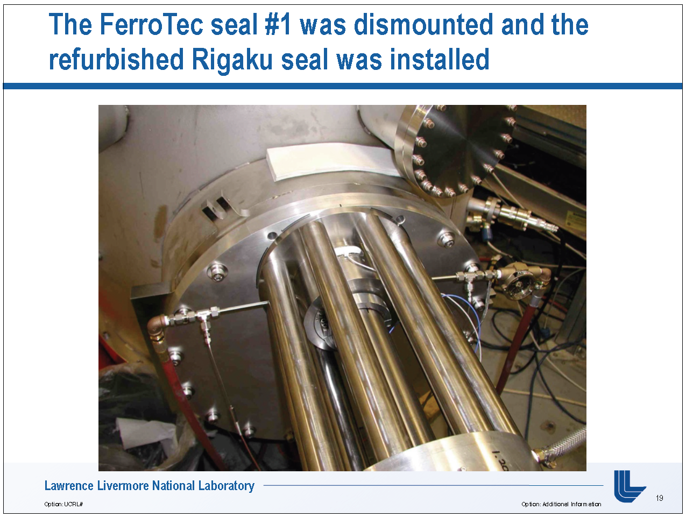
Dynamical reaction force at the wheel bearings
$$τ=I_{CMS} \underset{a/r}{\underbrace{α}}+ ω ×{ I}_{CMS} ω ω=210,31 rad/s (2000rpm)$$
Elastic supports with
defined force (e.g.30kg)
Jeffrey Gronberg (LLNL)
Disk to avoid geometry balance problems
from this ANSYS model (balance of spokes)

Slide 11
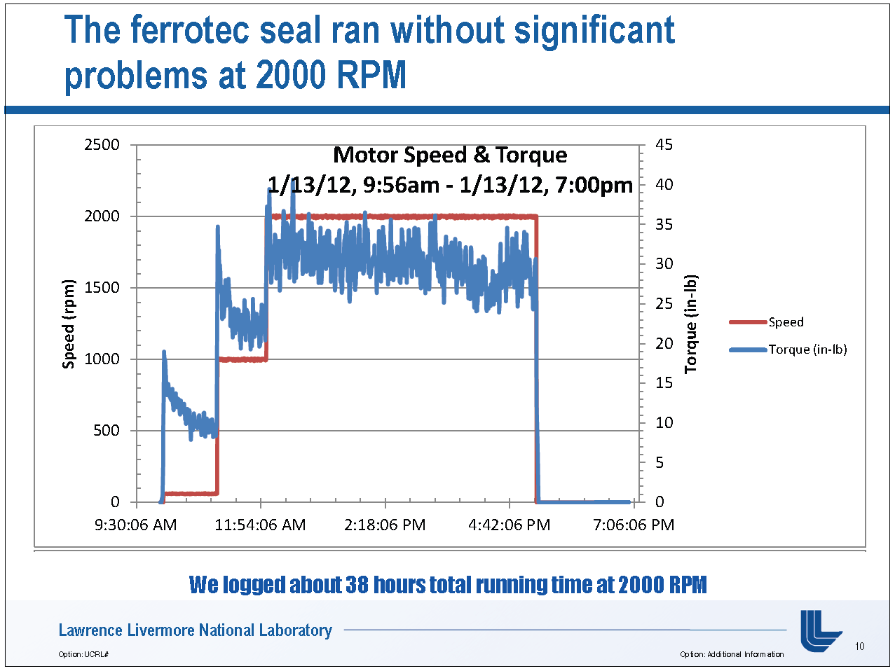
Dynamical reaction force at the wheel bearings
$$τ=I_{CMS} \underset{a/r}{\underbrace{α}}+ ω ×{ I}_{CMS} ω ω=210,31 rad/s (2000rpm)$$
Elastic supports with
defined force (e.g.30kg)
Jeffrey Gronberg (LLNL)

Slide 12
Dynamical reaction force at the wheel bearings
$$τ=I_{CMS} \underset{a/r}{\underbrace{α}}+ ω ×{ I}_{CMS} ω ω=210,31 rad/s (2000rpm)$$
Elastic supports with
defined force (e.g.30kg)

Slide 13
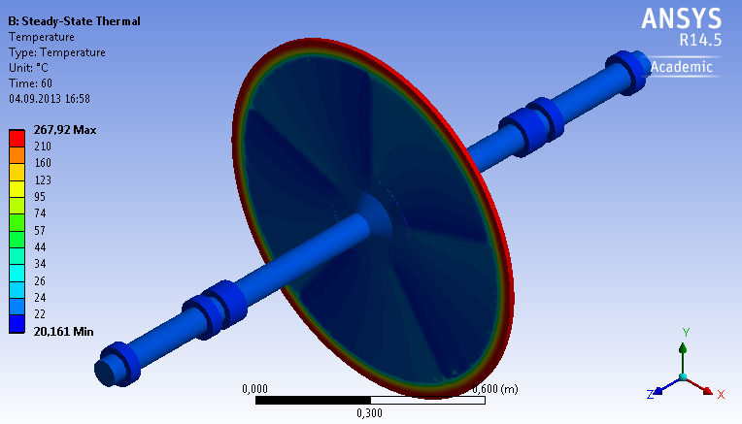
Dynamical reaction force at the wheel bearings
$$τ=I_{CMS} \underset{a/r}{\underbrace{α}}+ ω ×{ I}_{CMS} ω ω=210,31 rad/s (2000rpm)$$
Elastic supports with
defined force (e.g.30kg)

Slide 14
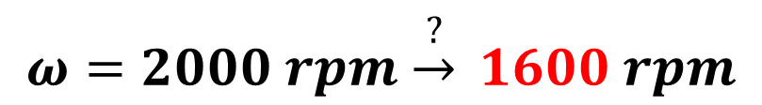
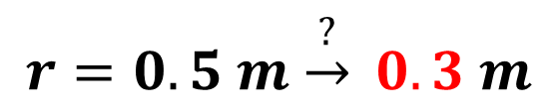

Dynamical reaction force at the wheel bearings
Inertia tensor I and resultant torque τ
$$I=\int_{V}^{ }{ ρ\left(r\right){ r}^{2} dV= \sum_{i}{m_{i} }\left(\begin{matrix}y_{i}^{2}+z_{i}^{2} & −x_{i}y_{i} & −x_{i}z_{i} \\ −y_{i}x_{i} & x_{i}^{2}+z_{i}^{2} & −y_{i}z_{i} \\ −z_{i}x_{i} & −z_{i}y_{i} & x_{i}^{2}+y_{i}^{2}\end{matrix}\right)}$$
Beam induced deformation
$$τ=I_{CMS} \underset{a/r}{\underbrace{α}}+ ω ×{ I}_{CMS} ω$$
$$\underset{⇒}{ } \left\|τ\right\|∝ m r^{2} ω^{2}$$
reaction
$$CMS$$
$$r=0.5 m \underset{→}{?} 0.3 m$$
Reaction force
$$ω=2000 rpm \underset{→}{?} 1600 rpm$$

Slide 15
Conclusion
Beam induced vibrations at the rim leads to a reaction force at the bearings
Cooling channels have add to the target wheel design and can deliver the necessary
cooling power (water dynamics not now included)
The wheel support is may be an open question and have to be discussed
Elastic supports could may be leads to a better damping of the wheel vibrations
Wheel radius and rotation speed could may be reduced to increase the reaction force
at the bearings for a longer life time

