Slide 1
300Hz Linac Hardware Upgrade
(Hardware Upgrade ??? Due to present
Budget problem)
PosiPol2013 at ANL, 4-7 September 2013
KEK, Junji Urakawa
Contents :
0. Short review of 300Hz conventional positron source
1. 300Hz Linac Scheme for Beam Loading Compensation
2. Cost
3. Consideration from the design of NLC positron source
4. Plan for beam loading compensation experiment at ATF
5. Summary

Slide 2
0. Short review of 300Hz conventional positron source
From T. Omori et al. / NIMA 672 (2012) 52–56
The baseline choice of the ILC positron source is the helical undulator scheme. After accelerating the electron beam in the main linac, it passes a 150 m long helical undulator to create a circularly polarized photon beam, and goes to the interaction point. The photon beam hits the production target and generates electron–positron pairs. The positrons are captured, accelerated to 5 GeV, damped, and then accelerated to the collision energy in the main linac. Thus the undulator based positron generation gives interconnection to nearly all sub-systems of the ILC.
Following design is the backup for proposed ILC positron source.

Slide 4
Time structure of beam
0<t<264.45ns, i=0.532A
264.45<t<362.85ns, 0A
362.85ns<t<627.3ns, 0.532A
627.3ns<t<725.7ns, 0A
725.7ns<t<990.15ns, 0.532A
0.532A is beam loading current.

Slide 5
Bunch by bunch
extraction from
Damping Ring
to make ILC beam
train.
This is the model for
positron target system
to confirm the generation
of ILC positron beam.

Slide 6
Abstract of the paper.
A possible solution to realize a conventional positron source driven by a several-GeV electron beam for the International Linear Collider is proposed. A 300 Hz electron linac is employed to create positrons with stretching pulse length in order to cure target thermal load. ILC requires about 2600 bunches in a train which pulse length is 1 ms. Each pulse of the 300 Hz linac creates about 130 bunches, then 2600 bunches are created in 63 ms. Optimized parameters such as drive beam energy, beam size, and target thickness, are discussed assuming a L-band capture system to maximize the capture efficiency and to mitigate the target thermal load. A slow rotating tungsten disk is employed as positron generation target.

Slide 7
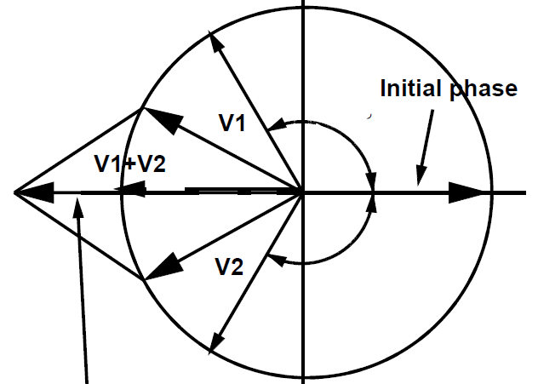
1. 300Hz Linac Scheme for Beam Loading Compensation
Phase to Amplitude Modulation Method
for Beam Loading Compensation
200MW, 3μs
300Hz Power
Supply
Low Level RF
Phase Shifter
and Amp.
80MW Klystron
3dB High Power
RF Combiner
50Ω High Power
Terminator
Speed of phase control
is about 100 degrees/10ns.

Slide 8
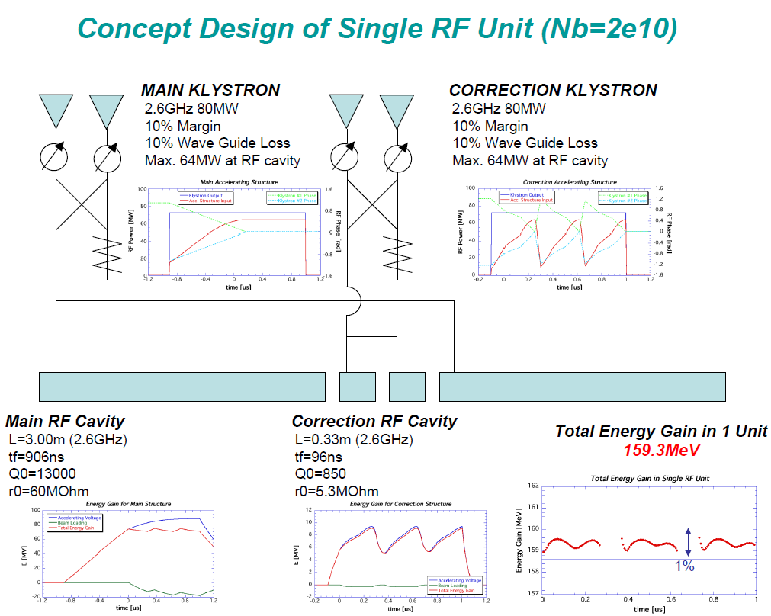
One accelerator unit for 6GeV Electron Drive Linac
Q0=13000
R0=60MOhm

Slide 9
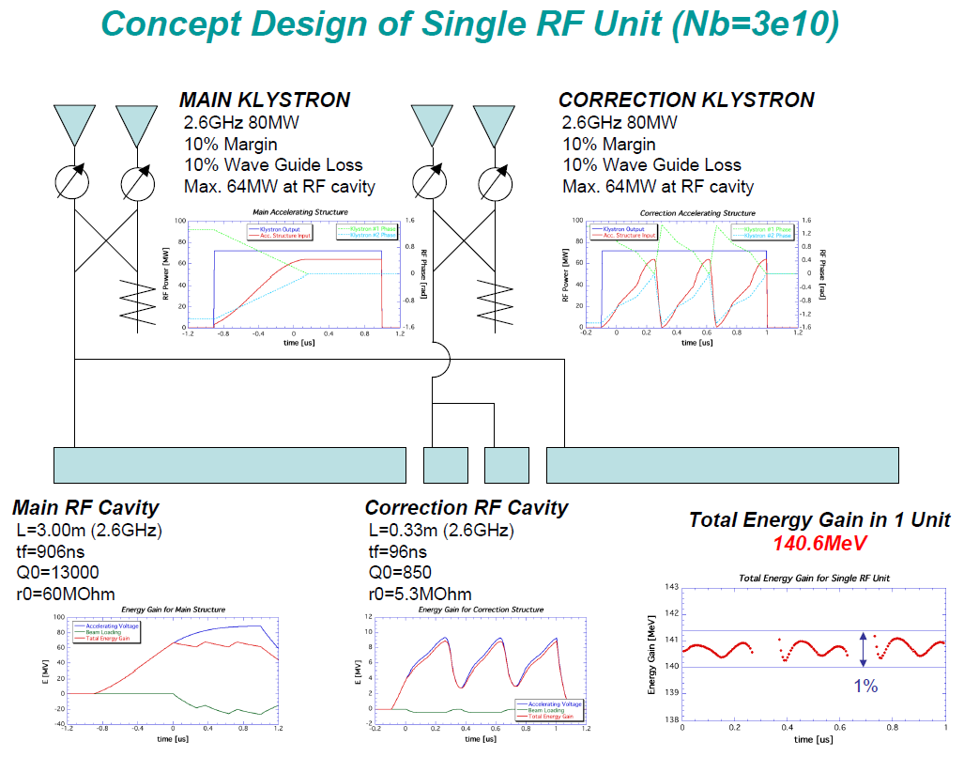
One accelerator unit for 5GeV Positron Linac

Slide 10
3x10¹⁰ positron/bunch
300Hz triplet beam
Less than +/- 0.7%
Beam loading current
0.78A.
200MW, 3μs
300Hz Power
Supply
80MW Klystron
Low Level RF
Phase Shifter
and Amp.
We do not need the system of
correction structure for beam
loading compensation.
We need the precise control of
the phase shifters.
3dB High Power
RF Combiner
50Ω High Power
Terminator
3m long constant gradient travelling wave structure
Also, I assume 10% margin as wave guide loss and so on because of
the experience at ATF Linac. So, klystron output power 80MW and
3μs pulse width are necessary.

Slide 11
Control of input RF power by phase shifters
Detail of beam loading
compensation:
Less than ±0.7% is possible
For ILC 300Hz multi-bunch
beam.

Slide 12
200MW, 3μs
12.5Hz Power
Supply
80MW Klystron
Essential Beam Loading
Compensation Scheme
Low Level RF
Phase Shifter
and Amp.
3dB High Power
RF Combiner
50Ω High Power
Terminator
3m long constant gradient travelling wave structure
3m long constant gradient travelling wave structure

Slide 13
2. Cost
6GeV Drive Linac with 2x10¹⁰ electrons/bunch
38 RF units
2 main klystrons (x 38) with 10% margin and 10% loss
2.6GHz 64MW at RF cavity (total 76 klystrons) 1748
number of 3m-long cavities (total 76 structures) 1157
2 phase shifters (x 38, total 76 phase shifters) 38
HP combinor (x 38) 130
3dB divider (x 38) 70
waveguide (x 38) 20
2 modulators (x 38, total 76 modulators) 3952
Computor Control Unit (x 38) 30
35 quads 35
27 horizontal steerings 10
27 vertical steerings 10
power supplies for magnets 50
beam monitor devices 50
total 13756
2 correction klystrons x 38 with 10% margin and 10% loss
2.6GHz 64MW at RF cavity (total 76 Klystrons) 1748
number of 0.33m long cavities (total 76 structures) 468
2 phase shifters (x 38, total 76 phase shifters) 38
HP combinor (x 38) 130
3dB divider (x 38) 70
waveguide (x 38) 20
2 modulators (x 38, total 76 modulators) 3952
Computor Control Unit (x 38) 30
26793M\-12571M\=
14222M\, which is 142
Oku-Yen for 300Hz
6GeV Drive Linac and
5GeV positron Linac.
6456 saved

Slide 14
5GeV Positron Linac with 3x10¹⁰ positrons/bunch
36 RF units
2 main klystrons x 36 with 10% margin and 10% loss
2.6GHz 64MW at RF cavity (total 72 Klystrons) 1656
number of 3m long cavities (total 72 structures) 1096
2 phase shifters (x 36, total 72 phase shifters) 36
HP combinor (x 36) 120
3dB divider (x 36) 66
waveguide (x 36) 20
2 modulators (x 36, total 72 modulators) 3744
Computor Control Unit (x 36) 30
2 correction klystrons x 36 with 10% margin and 10% loss
2.6GHz 64MW at RF cavity (total 72 Klystrons) 1656
number of 0.33m long cavities (total 72 structures) 443
2 phase shifters (x 36, total 72 phase shifters) 36
HP combinor (x 36) 120
3dB divider (x 36) 66
waveguide (x 36) 20
2 modulators (x 36, total 72 modulators) 3744
Computor Control Unit (x 36) 30
Total 26793MYen for 6GeV and 5GeV S-band 300Hz Linac, Total 26993 Myen
34 quads 34
26 horizontal steerings 10
26 vertical steerings 10
power supplies for magnets 50
beam monitor devices 50
total 13037
26793M\-12571M\=
14222M\, which is 142
Oku-Yen for 300Hz
6GeV Drive Linac and
5GeV positron Linac.
6115 saved

Slide 15
3. Consideration from the design of NLC positron source
NLC positron source design based on SLC positron source experience is
more reliable but more challenging comparing our beam loading
compensation scheme. Following shows the beam parameters for NLC
and beam loading scheme.
Drive electron linac energy: 3.11GeV or 6.22GeV (NLC-I or –II, S-band).
Bunch intensity: 1.5X10¹⁰ e⁻ ,Bunch spacing: 1.4ns
Positron production target and collection system are conventional and
not issues for me now.
Positron capture accelerator is L-band and the booster linac to DR is
also L-band (1.428GHz).
Beam loading compensation scheme: Δf + Δt which is usual technique.
Total beam loading current due to both electrons and positrons amounts
to about 14A for NLC-II in the capture accelerator. ~50% beam loading
Beam loading current in the booster linac is 2.75A for NLC-II. ~12% beam
loading, Bunch intensity: 2.1 for NLC-I and 3.1 for NLC-II at source (after
capture), End of 2GeV linac: 1.7 for NLC-I and 2.5 for NLC-II with unit of
10¹⁰ e⁺. We have a beam loading margin of 6.15/1.4 x 2.5/3.0 =3.66.

Slide 16
My suggestion is following for the 300Hz Linac in ILC conventional
positron source system.
1. Positron capture section upto ~250MeV maybe L-band (1.3GHz)
normal conducting accelerator.
2. Bunch compressor should install before S-band (2.6GHz)accelerator.
3. We need tight collimator to make the transverse matching to S-band
in the positron capture section.
4. Japanese companies (Toshiba and Mitsubishi heavy industries)
guarantee the manufactures of the 2.6GHz RF power sources and
accelerator tubes with 300Hz operation, 4μsec pulse duration and
80MW peak power.
5. We need the simulation R&D and beam loading test at ATF.
6. SLAC can contribute the manufacture of the normal conducting
L-band accelerating system.
7. Beam dynamics design is necessary from target to DR.
I think the beam loading system for ILC positron source is almost
no risk except for the target design and the test of beam loading
control at ATF. (need the dedicated budget for ILC source.)

Slide 17
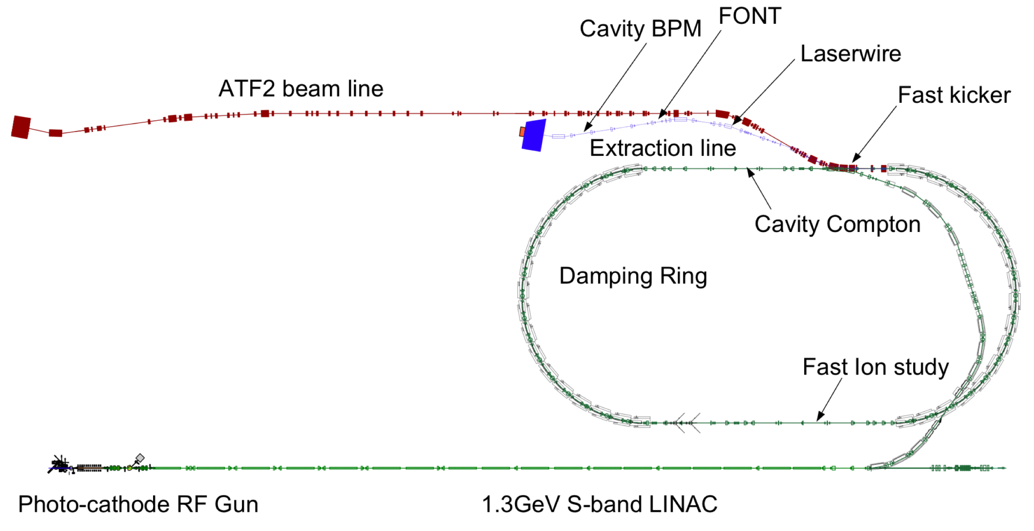
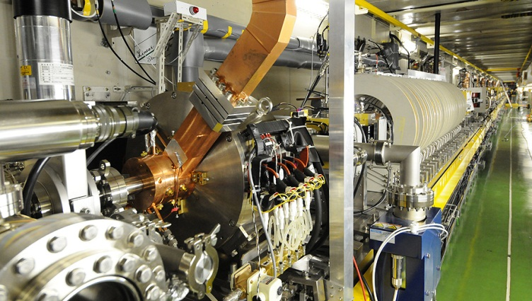
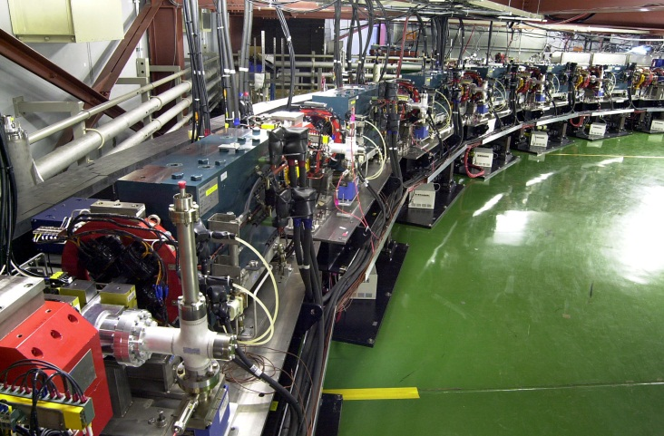
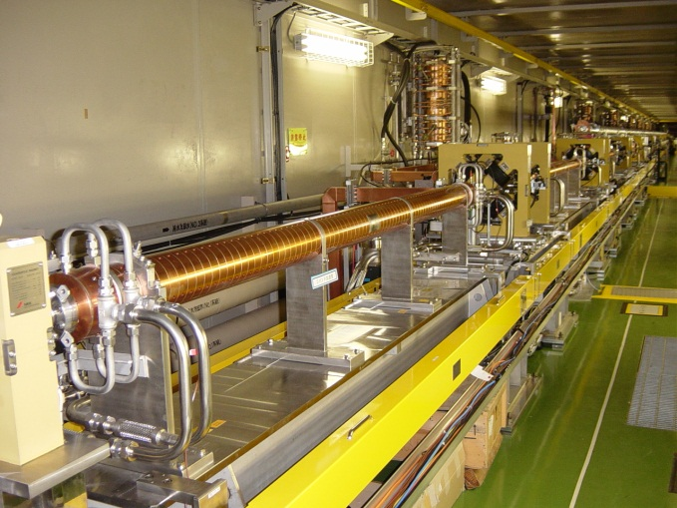
4. Plan for beam loading compensation experiment at ATF
Extraction line
Damping Ring
Photo-cathode RF gun
(electron source)
S-band Linac

Slide 18
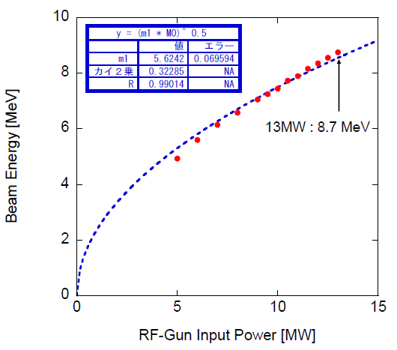
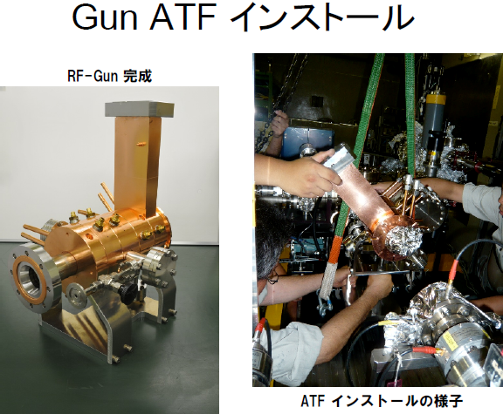
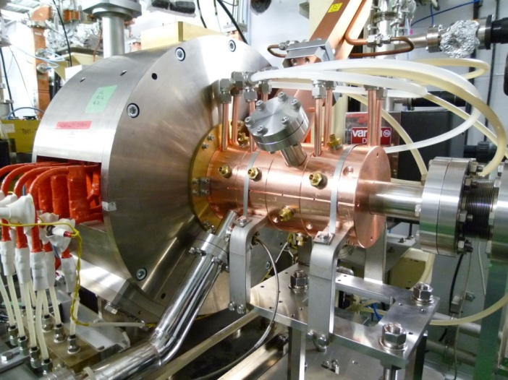
3.6 cell RF Gun Installation
In 2012
In 2010
Now, 10MeV multi -
bunch trains are generated
and accelerated.
9.6MeV beam in
one week RF aging
with ~20.3MW RF
input power
With RF amplitude modulation
And without beam
3.6 cell RF-Gun
started beam acceleration test from 1/11,2012.
Energy of multi-bunch
beam
11MeV beam at 120MV/m, from
100bunches/pulse to 500bunches/pulse beam generation

Slide 19
Phase to Amplitude Modulation Method
for Beam Loading Compensation
200MW, 3μs
300Hz Power
Supply
Low Level RF
Phase Shifter
and Amp.
80MW Klystron
3dB High Power
RF Combiner
50Ω High Power
Terminator
Speed of phase control
is about 100 degrees/10ns.

Slide 20
1.4x10¹⁰ electrons/bunch
With 2.8nsec bunch spacing
And 2856MHz Linac
Beam loading current: 0.78A
200MW, 3μs
300Hz Power
Supply
80MW Klystron
Low Level RF
Phase Shifter
and Amp.
We do not need the system of
correction structure for beam
loading compensation.
We need the precise control of
the low level phase shifters.
3dB High Power
RF Combiner
50Ω High Power
Terminator
3m long constant gradient travelling wave structure
Also, I assume 10% margin as wave guide loss and so on because of
the experience at ATF Linac. So, klystron output power 80MW and
3μs pulse width are necessary.

Slide 21
ATF Injector for 1.5GeV ATF Linac will be modified for beam
loading compensation experiment in next year. However,
due to the lack of 2013 budget, we delayed this experiment.
3m long TW
3m long TW
Beam Transport
3.6 cell RF Gun
90 degrees bending magnet
to measure the energy of multi-bunch
3x10¹⁰ with 6.15nsec bunch spacing corresponds to 1.4x10¹⁰
in the case of 2.8nsec bunch spacing as same beam loading
in multi-bunch trains.
ATF Triplet Beam : 10 bunches/train with 30nsec train gap
and 2.8nsec bunch spacing. This operation is possible in the
safety of the radiation for ATF accelerator.

Slide 22
200MW, 2μs
12.5Hz Power
Supply
200MW, 2μs
12.5Hz Power
Supply
Low Level RF
Phase Shifter
and Amp.
60MW Klystron
3dB High Power
RF Combiner
50Ω High Power
Terminator
Speed of phase control
is about 100 degrees/10ns.
Generation of three
mini-train per pulse
90 degrees bending magnet
to measure the energy of multi-bunch
3.6 cell RF Gun SW
3m long TW
3m long TW
Chicane
150 bunches/pulse with 2.8ns bunch spacing
Energy spread 0.1% in rms
1nC/bunch

Slide 23
1.4x10¹⁰ electrons/bunch
With 2.8nsec bunch spacing
And 2856MHz Linac
Beam loading current: 0.78A
200MW, 3μs
300Hz Power
Supply
80MW Klystron
Low Level RF
Phase Shifter
and Amp.
We do not need the system of
correction structure for beam
loading compensation.
We need the precise control of
the phase shifters.
3dB High Power
RF Combiner
50Ω High Power
Terminator
High power att.
3.6 cell RF Gun
A0 3m long constant gradient travelling wave structure
Considering the cost reduction for this experiment now.
Single bunch beam loading compensation can be done using off crest
Acceleration on which we have a lot of experience.

Slide 24
5. Summary
Beam dynamics simulation from the target to DR is
necessary.
Target R&D is necessary at KEK.
Simple beam loading compensation experiment is
necessary at ATF.
We have a budget problem for these urgent R&D.
I hope Japanese Gov., US DOE and European friends
help us quickly.

