Slide 1
Capture and Booster Linac Issues for 300Hz Scheme
K. Yokoya
2013.9.5 POSIPOL2013
@ANL

Slide 2
R&D Issues of the Conventional Source
“conventional” but still needs some more R&D
High current, high rep rate driver linac
Moving target
Flux concentrator
Booster linac
Overall simulation

Slide 3
Loading Compensation in Booster Linac
Accurate loading compensation needed because of the limited DR energy aperture
Much easier if continuous 132 bunches instead of triplet (DR e-cloud issue: Is triplet absolutely needed?)
Junji gave a linac design using phase shifter at S-band
2×10¹⁰/bunch
a triplet: 132 bunches 992ns
3.3ms
a train: 20 triplet
= 2640 bunches 63ms

Slide 4
Loading Compensation Scheme
Urakawa
3x10¹⁰ positron/bunch
300Hz triplet beam
Less than +/- 0.7%
200MW, 3μs
300Hz Power
Supply
80MW Klystron
Low Level RF
Phase Shifter
and Amp.
3dB High Power
RF Combiner
50Ω High Power
Terminator
precise control of
the phase shifters needed
3m long constant gradient travelling wave structure
+/- 0.7% corresponds to +/- 35MeV at end of 5GeV booster
Big fraction of the DR energy aperture +/- 37.5MeV
Factor ~2 energy compression at linac end helps but not enough

Slide 5
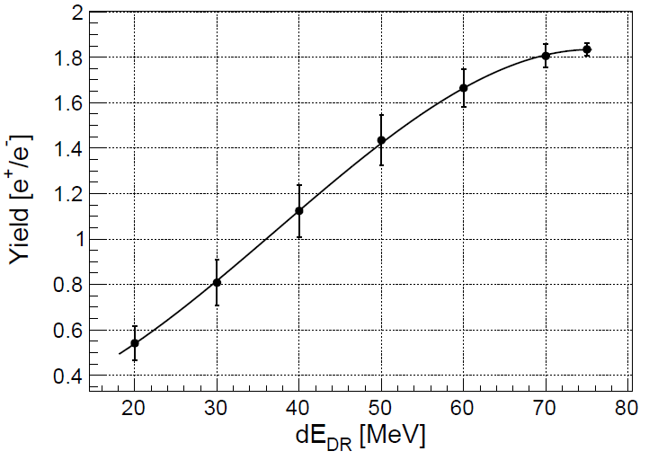
Yield as a function of DR energy aperture
35MeV
Ushakov

Slide 6
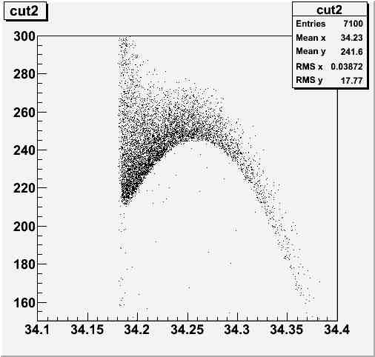
Bunch Length
DR aperture
ΔE < +-37.5MeV
Δz < +-34mm
A_{x}+A_{y} < 70mm.rad
Is S-band linac acceptable?
Clearly No according to this figure
Need bunch compression
But not at this energy because the (relative) energy spread is too large
Some more acceleration with L-band is needed
But L-band is too expensive (NC linac!!)
Longitudinal Phase Space
S-band 90deg
Pz(MeV)
Time (ns)
An example of t-E phase space at end of first L-band section by T.Takahashi

Slide 7
A Possible Solution
Use L-band up to ~1GeV (relative energy spread around ~5%?)
Bunch compressor with L-band plus chicane by factor ~2
The S-band to up 5GeV
Followed by energy compression by factor ~4
Larger factor than in ILC standard (undulator) design
This will make the effect of miss-loading-compensation +/- 35MeV to +/- 9MeV
Optimization of the red numbers needed

