Slide 1
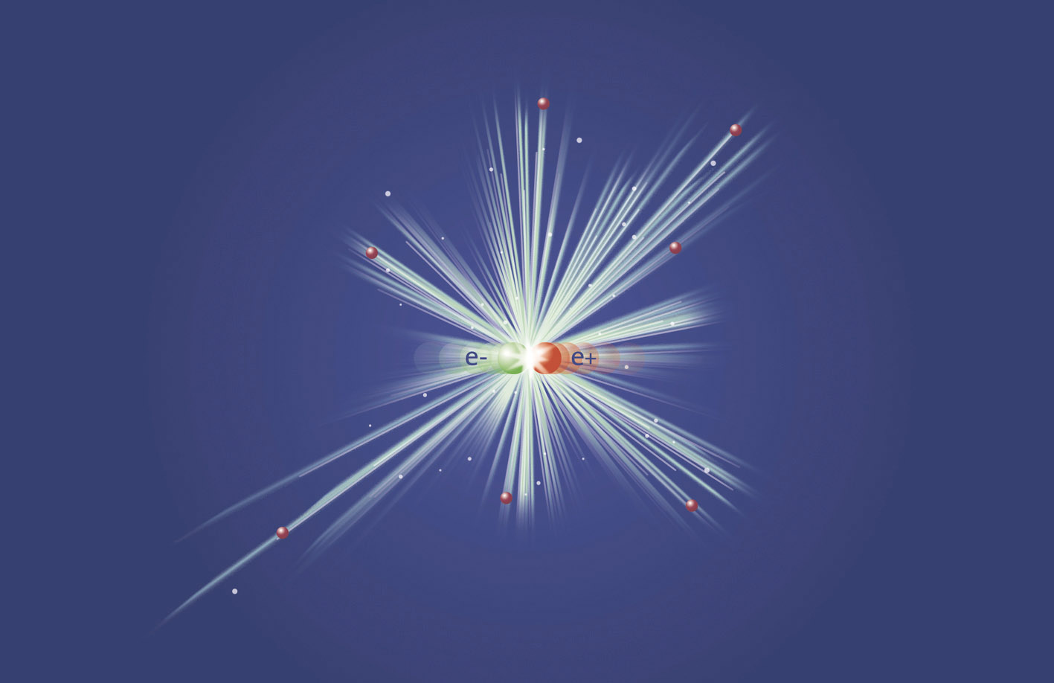
8th Workshop on Polarized Positrons
POSIPOL 2013
Sept. 4-6, 2013, Argonne National Lab,
9700 S. Cass Ave, Argonne, IL, 60439, USA
International Program Committee
I. Bailey, Lancaster U
E. Bulyak, KIPT
S. Doebert, CERN
W. Gai, ANL
J. Gao, IHEP
J. Gronberg, LLNL
G. Moortgat-Pick, Hamburg U/DESY
T. Omori, KEK
S. Riemann, DESY
L. Rinolfi, CERN
J. Sheppard, SLAC
F. Staufenbiel DESY
V. Strakhovenko, BINP
T. Takahashi, Hiroshima U
J. Urakawa, KEK
A. Ushakov, Hamburg U / DESY
A. Variola, LAL
F. Zimmermann, CERN
F. Zomer, LAL
Conference topics:
▪ Generation of polarized positron beams
▪ High intensity positron sources
▪ Positron generation target issues
▪ Physics applications of polarized positrons
▪ Polarized gamma ray generation
▪ Channelling radiation and applications
▪ Physics applications of high quality X-rays
and gamma-rays
Local Organization Committee
Wei Gai
Wanming Liu
Nancy Rezek

Slide 2
Welcome to ANL
Meeting is scheduled for 2 ½ days.
Boxed Lunch for the first day, sandwiches from Panera Bread.
Second and third day lunches will be at ANL cafeteria (on your self) from 12 – 2 pm.
Tour of the AWA on Thursday afternoon between 2:30 – 3:30.
Outing to Arboretum and dinner at Maggianos, 4 – 10 pm (will be chauffeured by my colleagues)

Slide 3
A special session on the ILC target design Thursday 1:30 – 2:30 pm.
Issues on moving forward on the current LLNL test.
Approaches are still viable?
Funding
Technical support
Alternative target design
Differential pumping,
Other type of targets?
Alternative scheme:
300 Hz
How to do a technical design?
Resources on the technical design?

Slide 4
Existing (unsolved) Issues for Undulator based source
Beam dynamics, (OK)
Undulator (OK? Or @95%)
Target (heating and shocks)
Good? No issues? No critical problems (97%), there is rooms for further improvements.
Target support vacuum chamber (Jeff?)
Life time of the vacuum seal (short time survival, but long term > a few weeks with vacuum spikes, no clear path forward at this point), no radiation damaging testing yet. , and
Cooling water impact on wheel dynamics (simulation should be done).
Rotating Seal leak tests at KEK planned.
New ideas: Non-contact labryntarithen (differenetial pumping), support, radiation cooling.
OMD, (OK)
Accelerator (NC)
SLAC test showed 14 MV/m.
Interfacing with damping ring (OK)

Slide 5
Conventional Source (300 Hz)
6 GeV drive beam generation (OK? We have a design that will work Sband)
Target: Shocks, stresses, cooling (use SLC solution), slow rotating target wheel in vacuum, or pendulum, easier to seal). Need some engineering studies, require 5 m/s.
AMD, easy, existing (higher field next year, no issues at this point).
Beam capturing Linac
300 Hz linac (hybrid L and S?)
Un-even beam loading, and energy compensation, RF gymnastics (solution exists, although may not be optimized).
Interface between L-band and S-band (bunch compressor?) A detailed beam dynamics simulation is required.
Costing according to ILC methodology.
Interface with damping ring simulation.
to be done.

