Slide 1
Recent Developments in
(N=4 SYM) Scattering Amplitudes
Anastasia Volovich
Brown University
LoopFest, June 2017
with Tristan Dennen, Igor Prlina,
Marcus Spradlin, James Stankowicz, Stefan Stanojevic

Slide 2
Plan
N=4 SYM Scattering Amplitudes:
integrals and integrands
S-matrix program old and new: determining physical singularities from integrands
My recent work: geometric algorithm for one, two and three-loop MHV amplitudes in N=4 Yang-Mills
Conclusions

Slide 3
Why N=4 Yang-Mills?
It is a nice toy model. Some techniques developed for N=4 Yang-Mills have been applied to QCD and Standard Model.
N=4 Yang-Mills is a string theory (AdS/CFT), learning about it teaches us about quantum gravity.
N=4 Yang-Mills is “integrable” or “solvable”. Some pieces of the theory, such as planar anomalous dimension, can reasonably be said to have been already “solved”.
But for more complicated quantities, such as general correlation functions or scattering amplitudes, it is not yet completely clear what form a “solution” will even take.

Slide 4
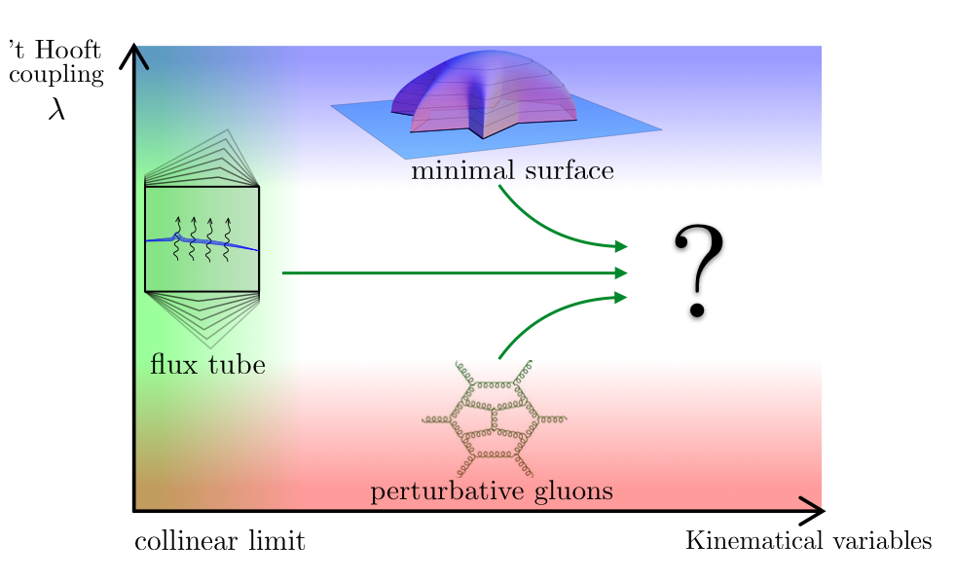
This question is being explored “experimentally”
from a variety of complementary approaches.

Slide 5
N=4 Yang-Mills amplitudeology
The goal is to explore the hidden structures of amplitudes and to exploit these structures as much as possible to make previously impossible computations possible.
Twistor string description
Dual conformal and Yangian symmetries
WL/amplitudes/correlation funcs triality
Grassmannian
Color/kinematic duality
Amplituhedron
Bern, Dixon, Kosower; Witten; Drummond, Henn, Korchemsky, Sokachev, Brandhuber, Heslop, Spence, Travaglini, Arkani-Hamed, Cheung, Cachazo, Kaplan, Trnka, Bourjaily, Bern, Carrasco, Johansson, Caron-Huot, He, Beisert, Eden, Staudacher, Mason, Skinner, Alday, Madalcena, Basso, Sever, Viera, Roiban, Spradlin, many others

Slide 6
Loop Level Amplitudes
Standard Lore
Integrand =
“solved” for all loops and all legs in N=4
Bern, Dixon, Kosower;
Arkani-Hamed, Bourjaily, Cachazo, Caron-Huot, Trnka

Slide 7

Amplitudes and Integrand
Standard Lore
Integrand = solved for all loops and all legs in N=4
Integral = still very hard to evaluate! This step requires a lot of blood and tears begging for some new technology!
Bern, Dixon, Kosower; Arkani-Hamed, Cachazo, et al
e.g. Smirnov’s book

Slide 8
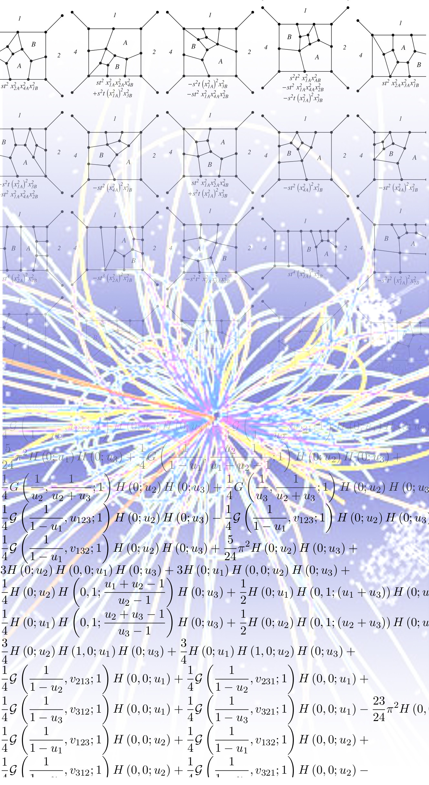
Integrand
Scattering
Amplitude

Slide 9
N=4 Yang-Mills Amplitudes
Despite recent advances, relatively few scattering amplitudes in N=4 Yang-Mills are available in the literature.
6-point MHV and NMHV up to 5-loops [Caron-Huot, Dixon, McLeon, Von Hippel 2016]
All 2-loop MHV [Caron-Huot 2011]
7-point 2-loop NMHV [Caron-Huot, He 2011]
7-point 3-loop MHV symbol [Drummond, Papathanasiou, Spradlin 2014]
7-point 4-loop MHV and 7-point 3-loop NMHV symbol [Dixon, Drummond, Harrington, McLeod, Papathanasiou, Spradlin 2016]

Slide 10
Multi-loop Amplitudes in N=4 YM
We are looking for new tools — like those which exist at tree level — to make loop calculations easier.
Having more “data” in hand is crucial for identifying hidden structures of these amplitudes.
There remains a gap between our understanding of integrands and corresponding integrals.
Modern approaches to computing multi-loop amplitudes (such as amplitudes bootstrap) avoid knowledge of integrands completely. [Dixon et all]

Slide 11
S-Matrix Program: Old and New
It has long been a goal of the S-matrix program to be able to construct scattering amplitudes based on a few physical principles and a thorough understanding of their analytic structure.
We have been exploring some well known technology
(Landau singularities) from ELOP
to determine branch points of amplitudes in N=4 SYM.

Slide 12
S-Matrix program: New Ingredients
Why couldn’t this talk been given 40 years ago?
Three relatively recent developments are
crucial ingredients:
1. Kinematic Variables: momentum twistors [Penrose, Hodges]
2. Integrals: Symbol of an amplitude [Goncharov, Spradlin, Vergu, AV]
3. Integrands: Amplituhedron
[Arkani-Hamed, Hodges, Trnka]

Slide 13
1. Momentum Twistors
Penrose, Hodges
Arkani-Hamed, Bourjaily,
Cachazo, Trnka
Spinor helicity
Dual coordinates
Momentum twistors

Slide 14
1. Momentum Twistors (examples)

Slide 15
N=4 Yang-Mills Integrand

Slide 16
S-Matrix program: New Ingredients
Three relatively recent developments are crucial ingredients:
1. Kinematic Variables: momentum twistors [Penrose, Hodges]
2. Integrals: Symbol of an amplitude [Goncharov, Spradlin, Vergu, AV]
3. Integrands: Amplituhedron
[Arkani-Hamed, Hodges, Trnka]

Slide 17
2. Symbol of an Amplitude
Many of the simplest (and hence best understood) amplitudes can be expressed in terms of a class of generalized polylogs defined by iterated integrals
Much of the information about the analytic structure of such function is captured in symbol.
Goncharov, Spradlin, Vergu, AV

Slide 18
2. Symbol of Transcendental Function
Goncharov, Spradlin, Vergu, AV
Symbol is an element of the k-fold tensor product of the multiplicative group of rational functions.

Slide 19
S-Matrix program: New Ingredients
Three relatively recent developments are crucial ingredients:
1. Kinematic Variables: momentum twistors [Penrose, Hodges]
2. Integrals: Symbol of an amplitude [Goncharov, Spradlin, Vergu, AV]
3. Integrands: Amplituhedron
[Arkani-Hamed, Hodges, Trnka ]

Slide 20
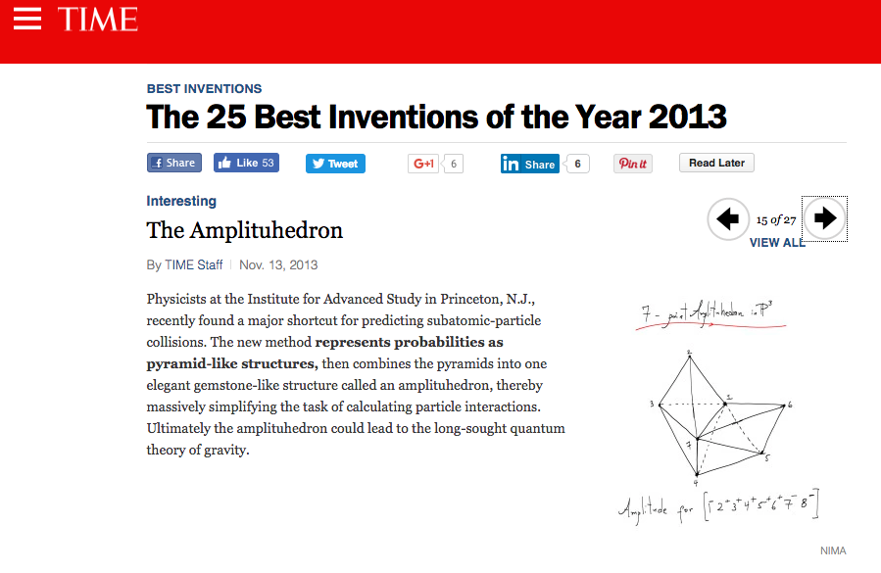
The integrand of MHV amplitude is a canonical form
defined by having logarithmic singularities only on the
boundary of the amplituhedron.

Slide 21
My Recent Work
We proposed a simple geometric algorithm to determine physical singularities of amplitudes in N=4 Yang-Mills from the Amplituhedron.
We applied the algorithm to one, two and three-loop MHV amplitudes.
This is a step towards translating integrands directly to amplitudes. Once you have a list of singularities, you use amplitudes bootstrap to determine the amplitude.
Dennen, Prlina, Spradlin, Stankowicz, Stanojevic, AV

Slide 22
Landau Singularities
Landau equations for a given Feynman integral are a set of kinematic
constraints that are necessary for the appearance of a pole or
branch point in the integrated function
In this talk: only focus
on singularities described
by Landau equation
Landau
Equations
Landau 1959
Eden, Landshoff, Olive, Polkinghorne
“The Analytic S-Matrix”
Landau Singularities
locus in external kinematic data
where Landau equations admit solutions
etc

Slide 23
One-Loop Box
Landau 1959
Eden, Landshoff, Olive, Polkinghorne
“The Analytic S-Matrix”
The Landau equations are easily solved for one-loop box integrals in four dimensions.
(and bubbles and triangles)
The second Landau equation puts propagators on-shell (no constraints on external kinematics).
The solvability of the first equation gives a determinant constraint.
Leading
Landau
Singularities

Slide 24
Landau Singularities and Symbol
Much of the information about the analytic structure of such function is captured in symbol.
For amplitudes of generalized polylogarithm form there should be a close connection between Landau singularities and symbol alphabet of the amplitude.
We expect that the symbol entries appearing in any amplitude should be such that their zeros specify values of the external momenta where solutions of the Landau equations exist.
Maldacena, Simons-Duffin, Zhiboedov 2015
Abreu, Britto, Duhr, Gardi, Gronqvist 2014

Slide 25
Landau Singularities:
One-loop n-point MHV in N=4 SYM
Bern, Dixon, Dunbar, Kosower
Arkani-Hamed, Bourjaily,
Cachazo, Trnka
chiral pentagon
Dennen, Spradlin, AV
Reduces to boxes
Reduces to triangles

Slide 26
Symbol:
One-loop n-point MHV in N=4 SYM
Bern, Dixon, Dunbar, Kosower
Arkani-Hamed, Bourjaily, Cachazo, Trnka
Compute the Symbol
First Entry
Second Entry
Summary:

Slide 27
Comparison: One-loop n-point MHV
Dennen, Spradlin, AV
Prefactor
Second entries of the symbol
First/Second
entries of the symbol

Slide 28
Landau Singularities and Symbol
Dennen, Prlina, Spradlin, Stanojevic, AV
First, consider a representation of an amplitude as a sum over particular integrals. Find Landau singularities of a generic term in the sum. These tell us potential singularities.
Second, for each potential singularity check whether the corresponding on-shell conditions have a non-zero intersection with the (closure of) the amplituhedron. If the answer is no, then the singularity must be spurious.
We analyzed 2 and 3-loop integrands in N=4 SYM.
This approach is straightforward but inefficient. The most significant drawback of the approach is that it relies on having an explicit representation of an integrand in terms on local Feynman integrals.

Slide 29
An Amplituhedrony Approach
Dennen, Prlina, Spradlin, Stankowicz Stanojevic, AV
Instead of using Feynman diagrams to generate sets of cut conditions that we need to check one by one, we can ask amplituhedron itself directly to identify all potentially “valid” sets of cut conditions that are possibly relevant to the singularities of an amplitude.
For each valid set of cut conditions, solve Landau equations and find the corresponding singularity.
This works for one, two and three-loops.

Slide 30
Conclusion
Reviewed some of the recent developments in N=4 scattering amplitudes.
Presented a geometric algorithm to determine singularities of amplitudes in N=4 SYM.
This is a step towards translating integrands directly to amplitudes.
Many questions remain…

