Slide 1

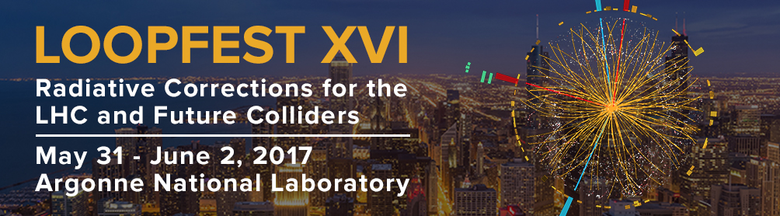
Outlook
LoopFest 2017
May 12, 2012
Zvi Bern
TexPoint fonts used in EMF.
Read the TexPoint manual before you delete this box.: AAAAAAAA
Notes:
Will say things that should be obvious to people but it is something that I think is important and needs repeating.

Slide 2
Outline
An impressive display of technical firepower
to achieve remarkable precision with experiment!
Here I want to talk about the need to keep on pushing
technical firepower, not just for phenomenology, but also
for theoretical issues.
I will draw examples that fit my theme from my own work
as well as from talks at this conference.

Slide 3
Links to other fields
A healthy field should have links to other fields.
Loops, Legs
and Phenomenology
preaching
to the choir
Experimental
Physics
Formal Theory
Important to exchange ideas with other subfields.
Important impact on formal theory!
TexPoint fonts used in EMF.
Read the TexPoint manual before you delete this box.: AAAAAAAA

Slide 4
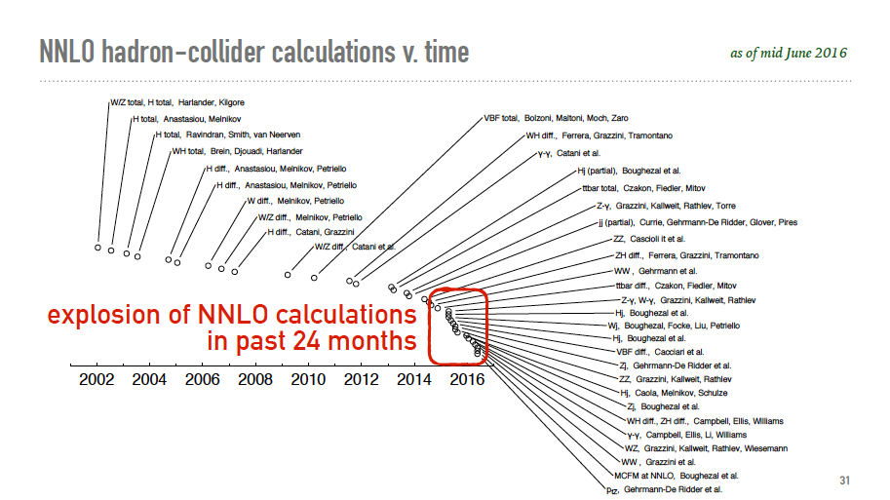
From G. Salam
See XXX talks
Notes:
Soft gluon resummation

Slide 5
Many New Results
50 Talks!
We heard about many new advances including:
Continued advances in NNLO
NLO including high multiplicity
N³LO calculations
N^{k}LL resummation.
Effective field theory appoaches.
New ideas for multi-loop amplitudes and integrals.
Parton showers
PDFs
4-loop β-function
Etc.
Talks: Dulat, Dreyer, Gauld, Grazzinni, Lui,
Moult, Mitov, Neumann, Page, Schubert
Talks: Buccioni, Deutchmann, Figy,
Frixione. Wiegand, Reuchele, Ringer, Vitev
Talks: Dulat, Moch
Talks: Banfi, Monni, Museli, Theeuwes
Talks: Deutschmann
Talks: Bowrowka, Ita, Li, Mishima, Schabinger, Zhang, Zeng
Talks: Hoeche,Presetel, Soper, Re
Talks: Moch, Nadolsky
Talks: Zoller
Impressive advances
Notes:
Power corrections

Slide 6
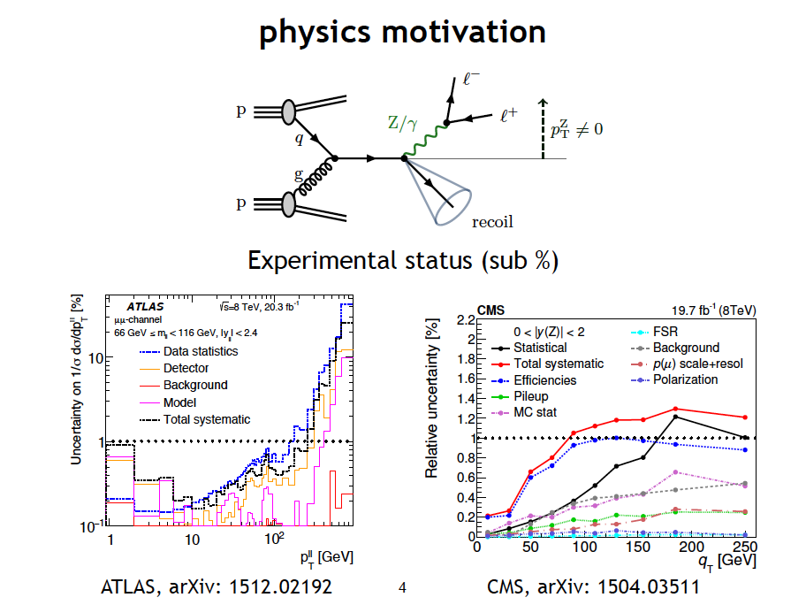
Talk from Guald
Need NNLO+
Notes:
Q_T of the Z

Slide 7
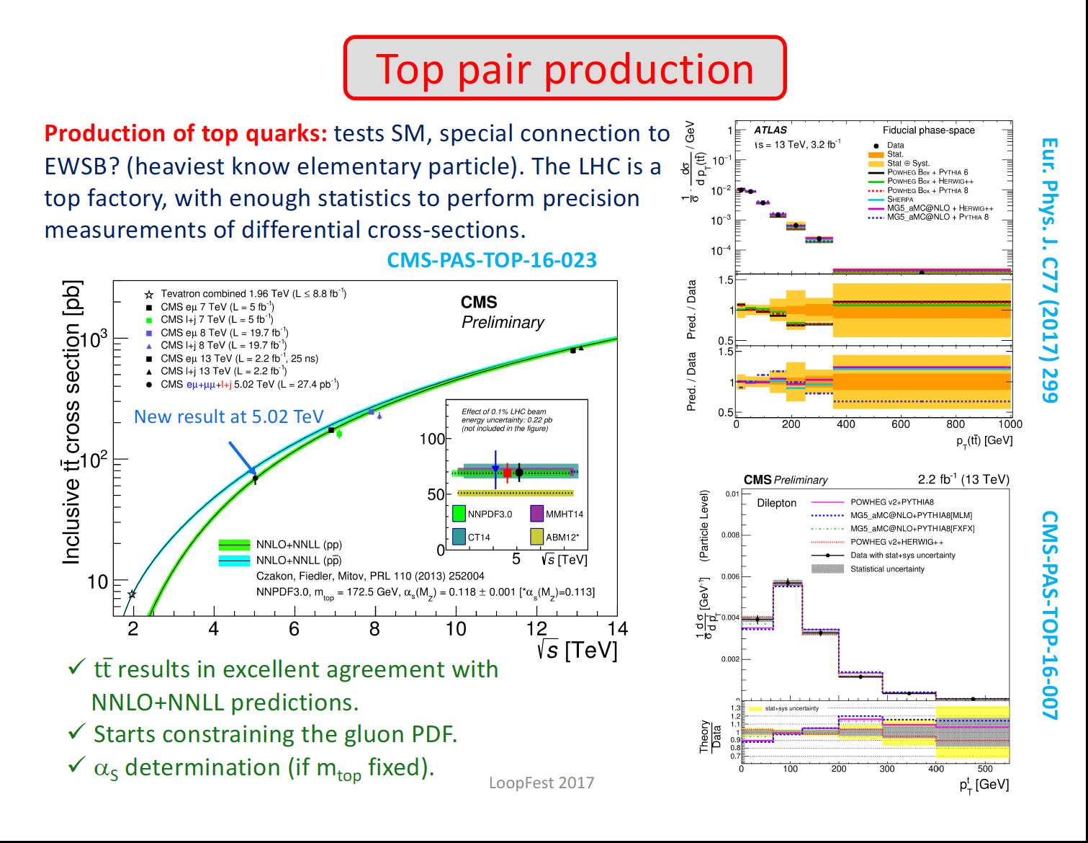
From Barberis’ talk
Great example of utility of NNLO
Notes:
Soft gluon resummation

Slide 8
From Mitov’s talk
Fitting PDF from top-pair data
Czakon, Hartland, Mitov, Nocera, Rojo 2016
Improvement in the gluon PDF after top data is included.
Very significant reduction of PDF error.
Notes:
Soft gluon resummation

Slide 9
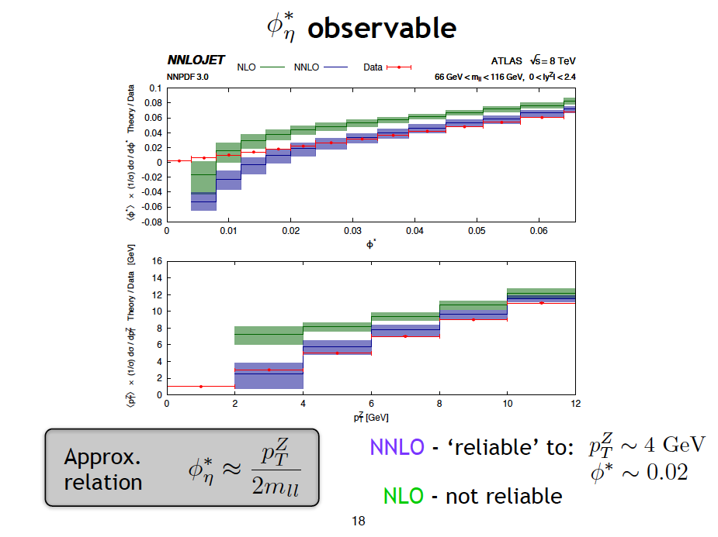

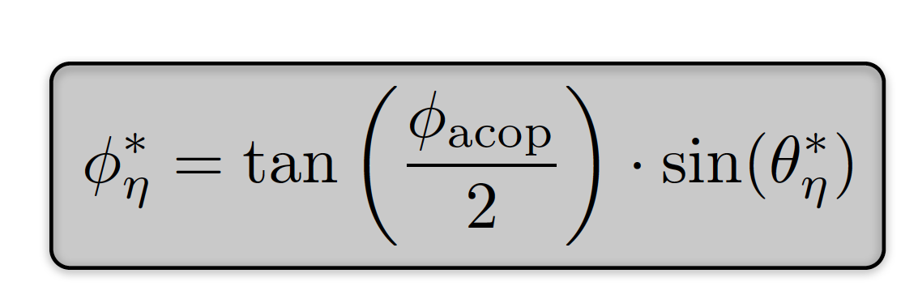
Talk from Gauld
NNLO
Notes:
Inclusive Z production

Slide 10
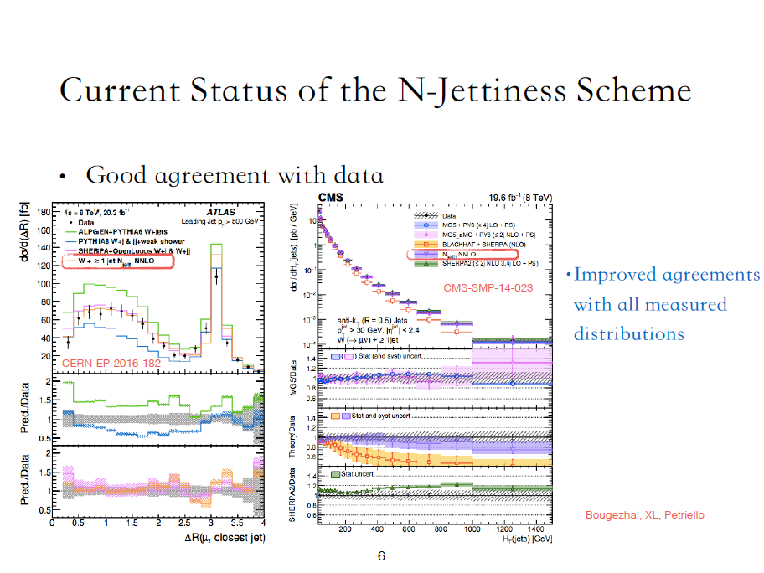
Talk from Lui
W+ ≥1 jet
Notes:
W+>=1 jet

Slide 11
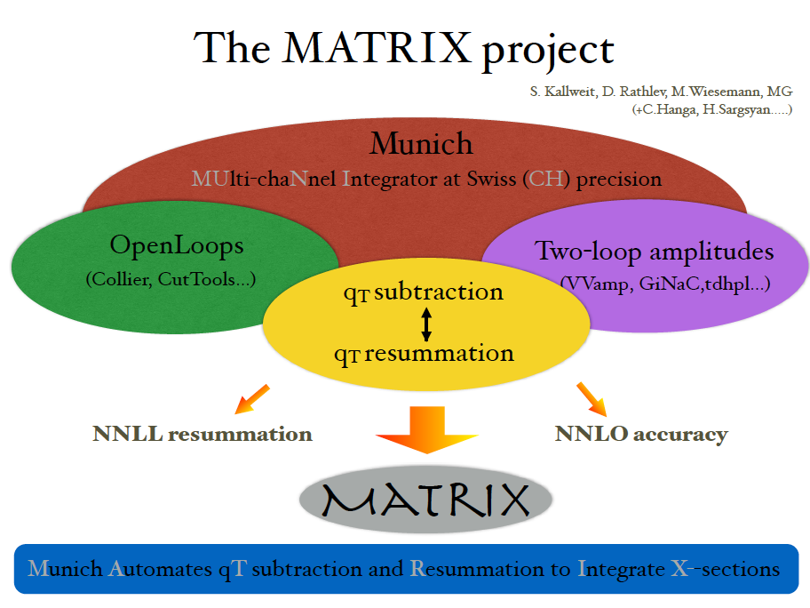
Talk from Grazzini
Notes:
Automating everything except for two-loop amplitudess

Slide 12
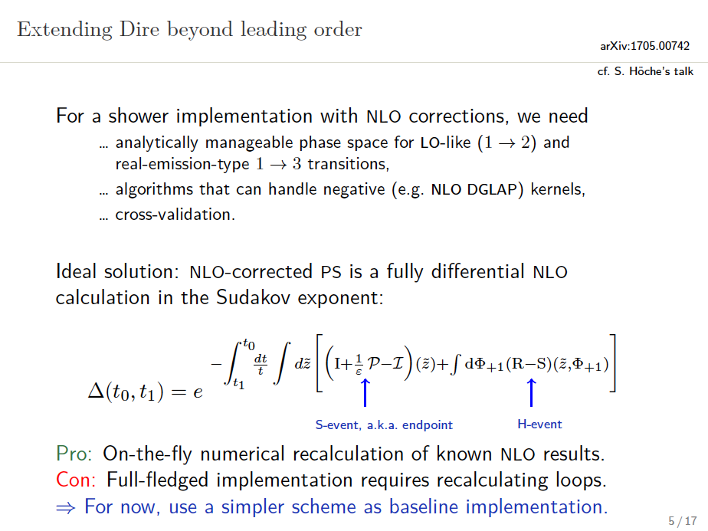
From talks of Prestel and Hoche: NLO Parton Showers
Notes:
Soft gluon resummation

Slide 13
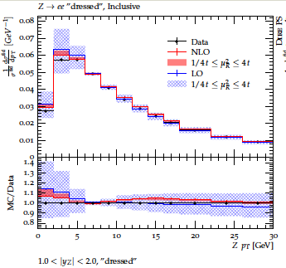
From talks of Prestel and Hoche: NLO Parton Showers
Dire
NLO parton showering can be done!
Notes:
Soft gluon resummation

Slide 14
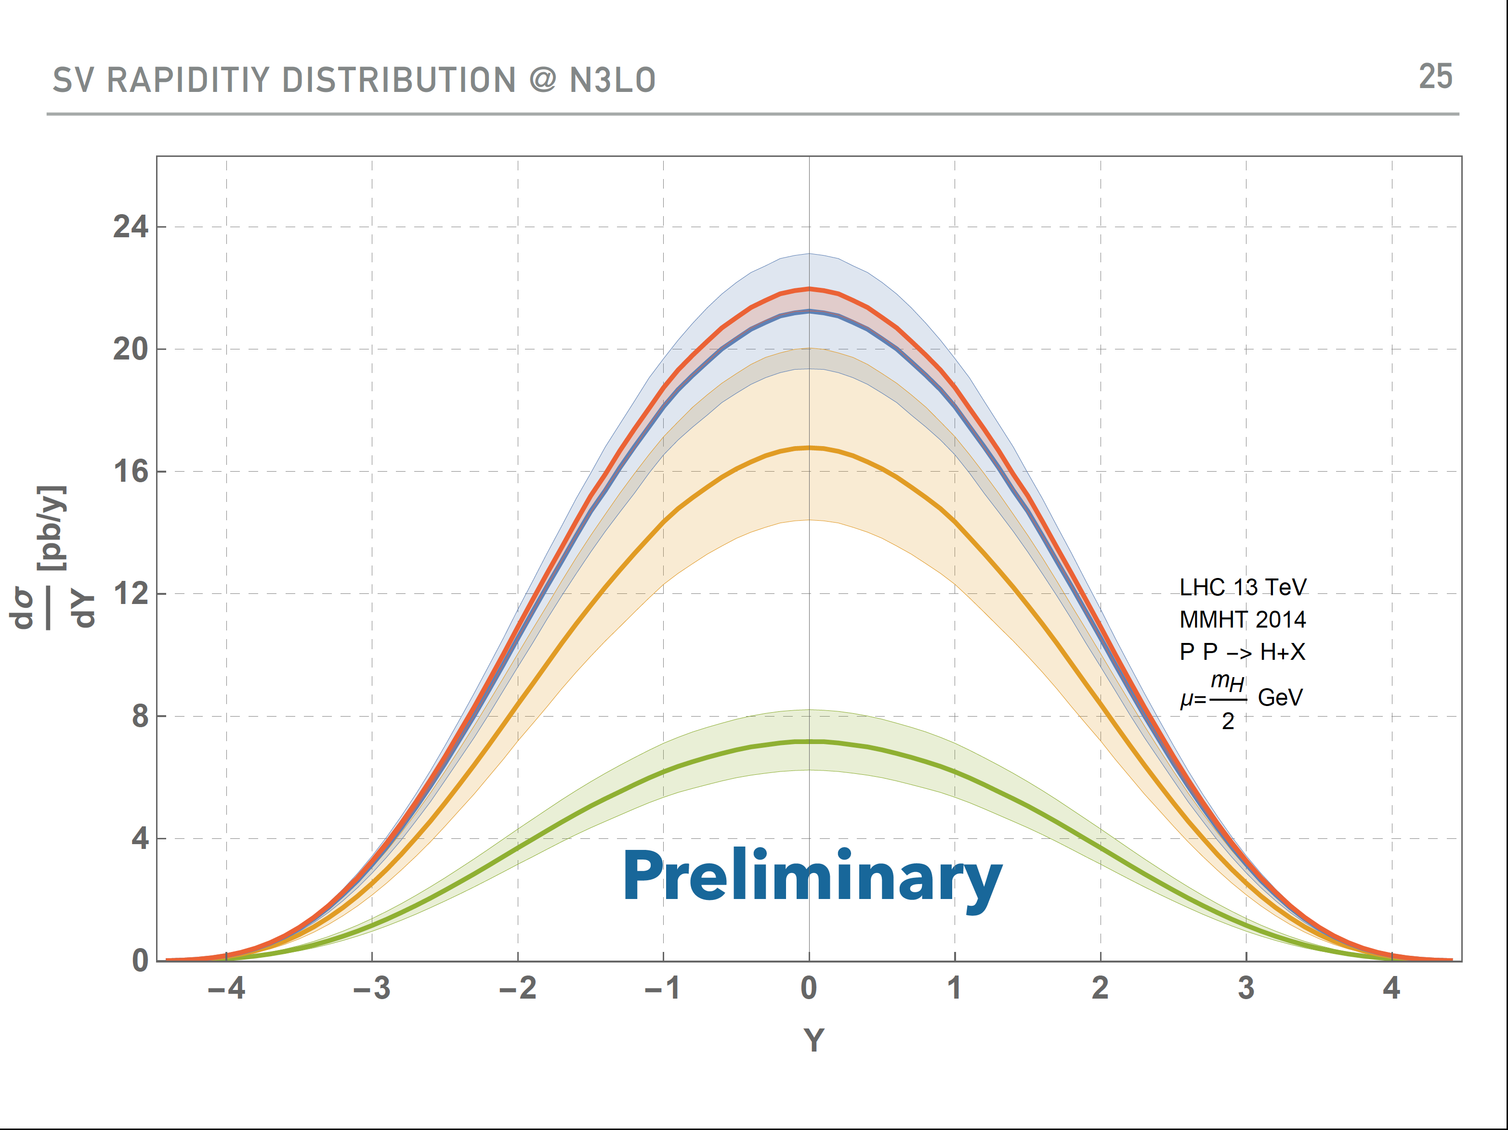
N³LO Teaser From Dulat
Notes:
Threshold expansion. Not ready for phenomenology.

Slide 15
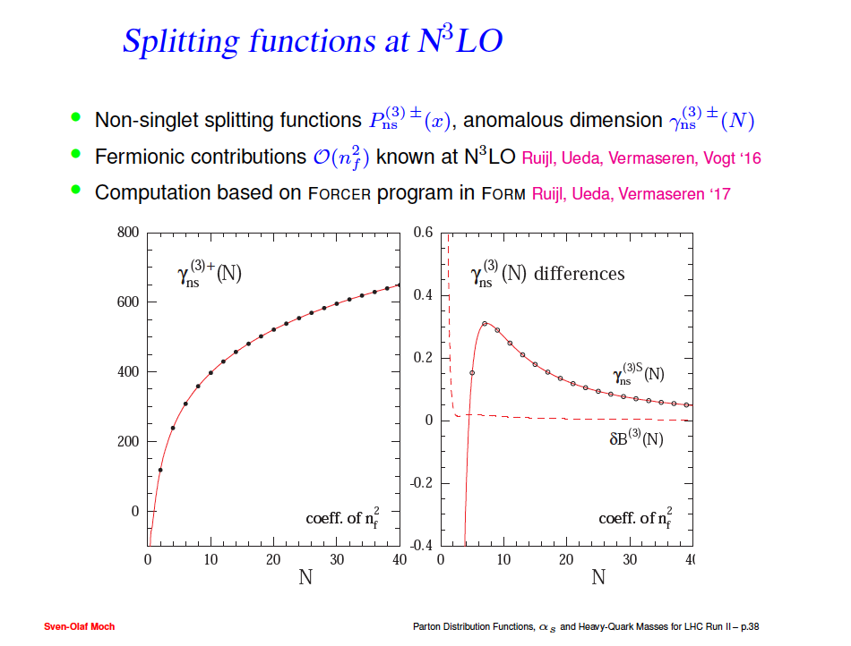
Talk from Moch
See XXX talks
Also many other advances in top physics background and signal:
Talks from
Notes:
Soft gluon resummation

Slide 16
Relation to Formal Issues
No shortage of technical firepower!
I want to show you how the advances are playing
a crucial role not only in phenomenology, but in
formal questions.
Notes:
Soft gluon resummation

Slide 17

IBP Multiloop Technology
Basic technology for multiloop integrals: integration by parts
Chetyrkin and Tkachov
Laporta alogithm: make the system big enough and you can solve,
in terms of master integrals.
Basic tools: AIR, FIRE5, REDUZE2, LiteRed…
Awesome tools,
even at 4 loops!
Anastasiou; A. Smirnov; von Manteuffel; Lee
But systems get out of control. Always have harder problems to solve!
Is there a better way? Yes! Syzygy, alegbraic geometry, unitarity
compatibility…
Talks from Ita, Zeng, Schabinger, Zhang
Notes:
Soft gluon resummation

Slide 18
New or Improved Loop Integration Technologies
Many talk on new ideas and advances:
IBPs and differential equations without doubled propagators.
Asymptotic expansion of Feynman integrals.
Numerical unitarity method in QCD
First two-loop amplitudes with numerical unitarity method
Azurite: a package to determine master integrals via
computational algebraic geometry.
Numerical approach to multi-scale multi-loop integrals
Baikov-Lee representations of cut Feynman integrals
Finite fields for linear equations.
Mao Zeng
Go Mishima
Harald Ita
Ben Page
Yang Zhang
Zhao Li
Robert Schabinger
Andreas von Mantuefel and Robert Schabinger

Slide 19
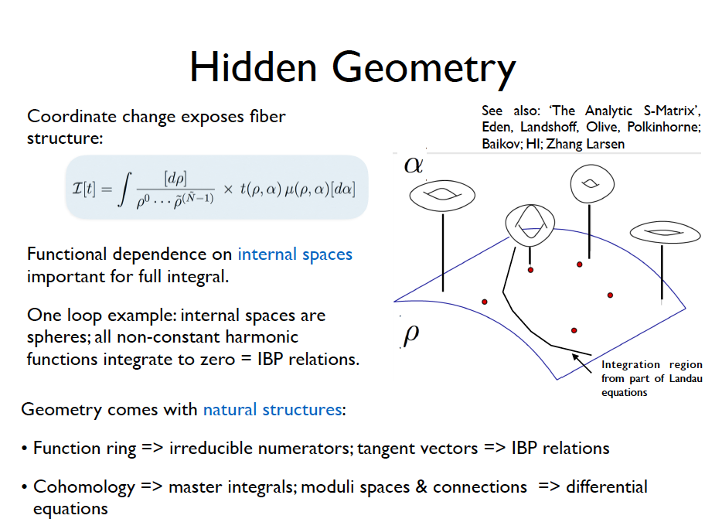
From Ita’s talk
Algebraic geometry
Notes:
Soft gluon resummation

Slide 20
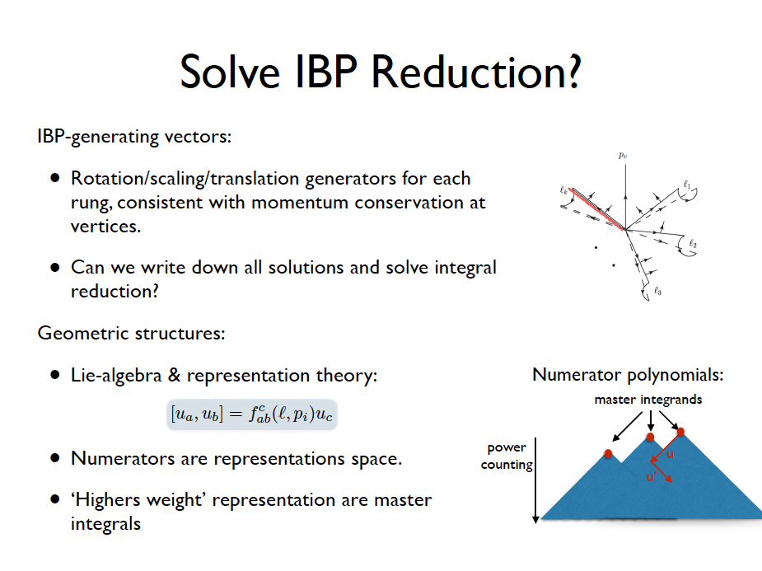
From Ita’s talk
There is structure to be exploited
Notes:
Soft gluon resummation

Slide 21
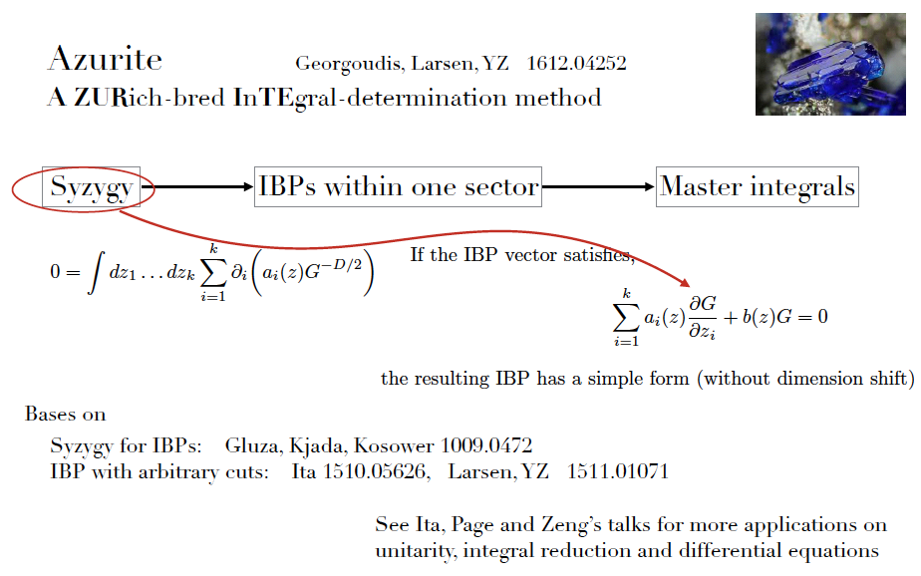
FROM YANG ZHANG’S TALK
Algebraic geometry to find master integrals.

Slide 22
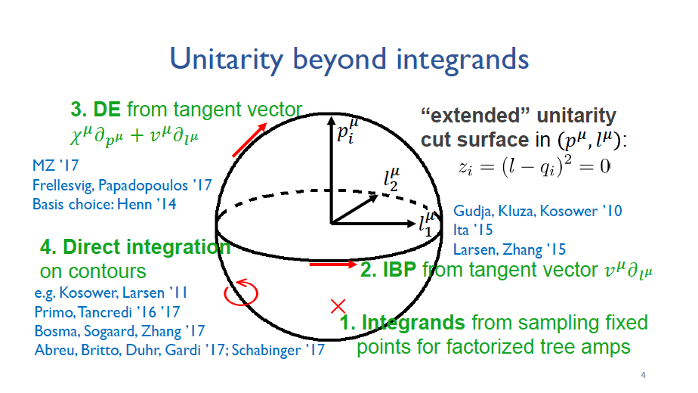
From Mao’s Zeng’s talk
Analytic understanding.

Slide 23
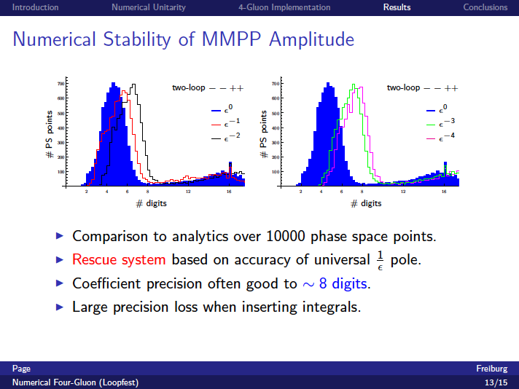
Talk from B. Page
Proves new technology works in real situations
Notes:
Soft gluon resummation

Slide 24
Formal Topic: Solve N = 4 sYM Theory
See talk from Volovich
The key goal is to “solve” planar N = 4 sYM theory.
Connection to AdS/CFT and Maldacena conjecture.
Connection to integrability.
Bootstrap program.
Notes:
Maybe include Mao’s talk

Slide 25
How is QCD Connected to N = 4 sYM?
N = 4 sYM plays central role in AdS/CFT and string theory
Connection to QCD is simple.
At any loop order to get N = 4 sYM from QCD:
Replace quarks with 1 adjoint fermion.
Place all states in D = 10.
Put all loop momenta in D = 4-2ε.
Dimensional reduction of D = 10, N = 1 susy is N=4 sYM
If you have a QCD computation, N = 4 sYM is
essentially free! N = 4 sYM is lot simpler.
Notes:
Works because N=4

Slide 26
N=4 Yang-Mills Amplitudes
From Volovich talk
Despite recent advances, relatively few scattering amplitudes in N=4 Yang-Mills are available in the literature.
6-point MHV and NMHV up to 5-loops [Caron-Huot, Dixon, McLeon, Von Hippel 2016]
All 2-loop MHV [Caron-Huot 2011]
7-point 2-loop NMHV [Caron-Huot, He 2011]
7-point 3-loop MHV symbol [Drummond, Papathanasiou, Spradlin 2014]
7-point 4-loop MHV and 7-point 3-loop NMHV symbol [Dixon, Drummond, Harrington, McLeod, Papathanasiou, Spradlin 2016]

Slide 27
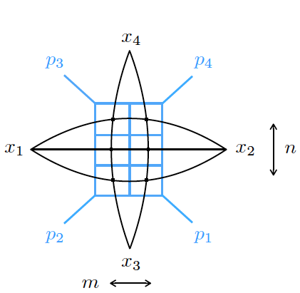
Some Work Related to N = 4 sYM
See talk from Volovich
Symbols and polylogs.
Landau singularities.
Bootstrap: Abolish integrands.
Simpler differential equations for multiloop integrals.
Fishnet integrals at any loop order.
Goncharov, Spradlin, Vergu, Volovich
Dennen, Prlina, Spradlin, Stanojevic, Volovich
Caron-Huot, Dixon, McLeod, Matt von Hippel; Dixon, Drummond, Harrington,
McLeod, Papathanasio, Spradlin; Li, Neill, Zhu
Henn; Henn, Smirnov and Smirnov
Basso and Dixon
Dual conformal integrals have uniform
transcendental weight. Use such integrals
as basis in QCD calculations.
Obvious cross-talk between QCD and N = 4 amplitudes
Notes:
Maybe include Mao’s talk

Slide 28
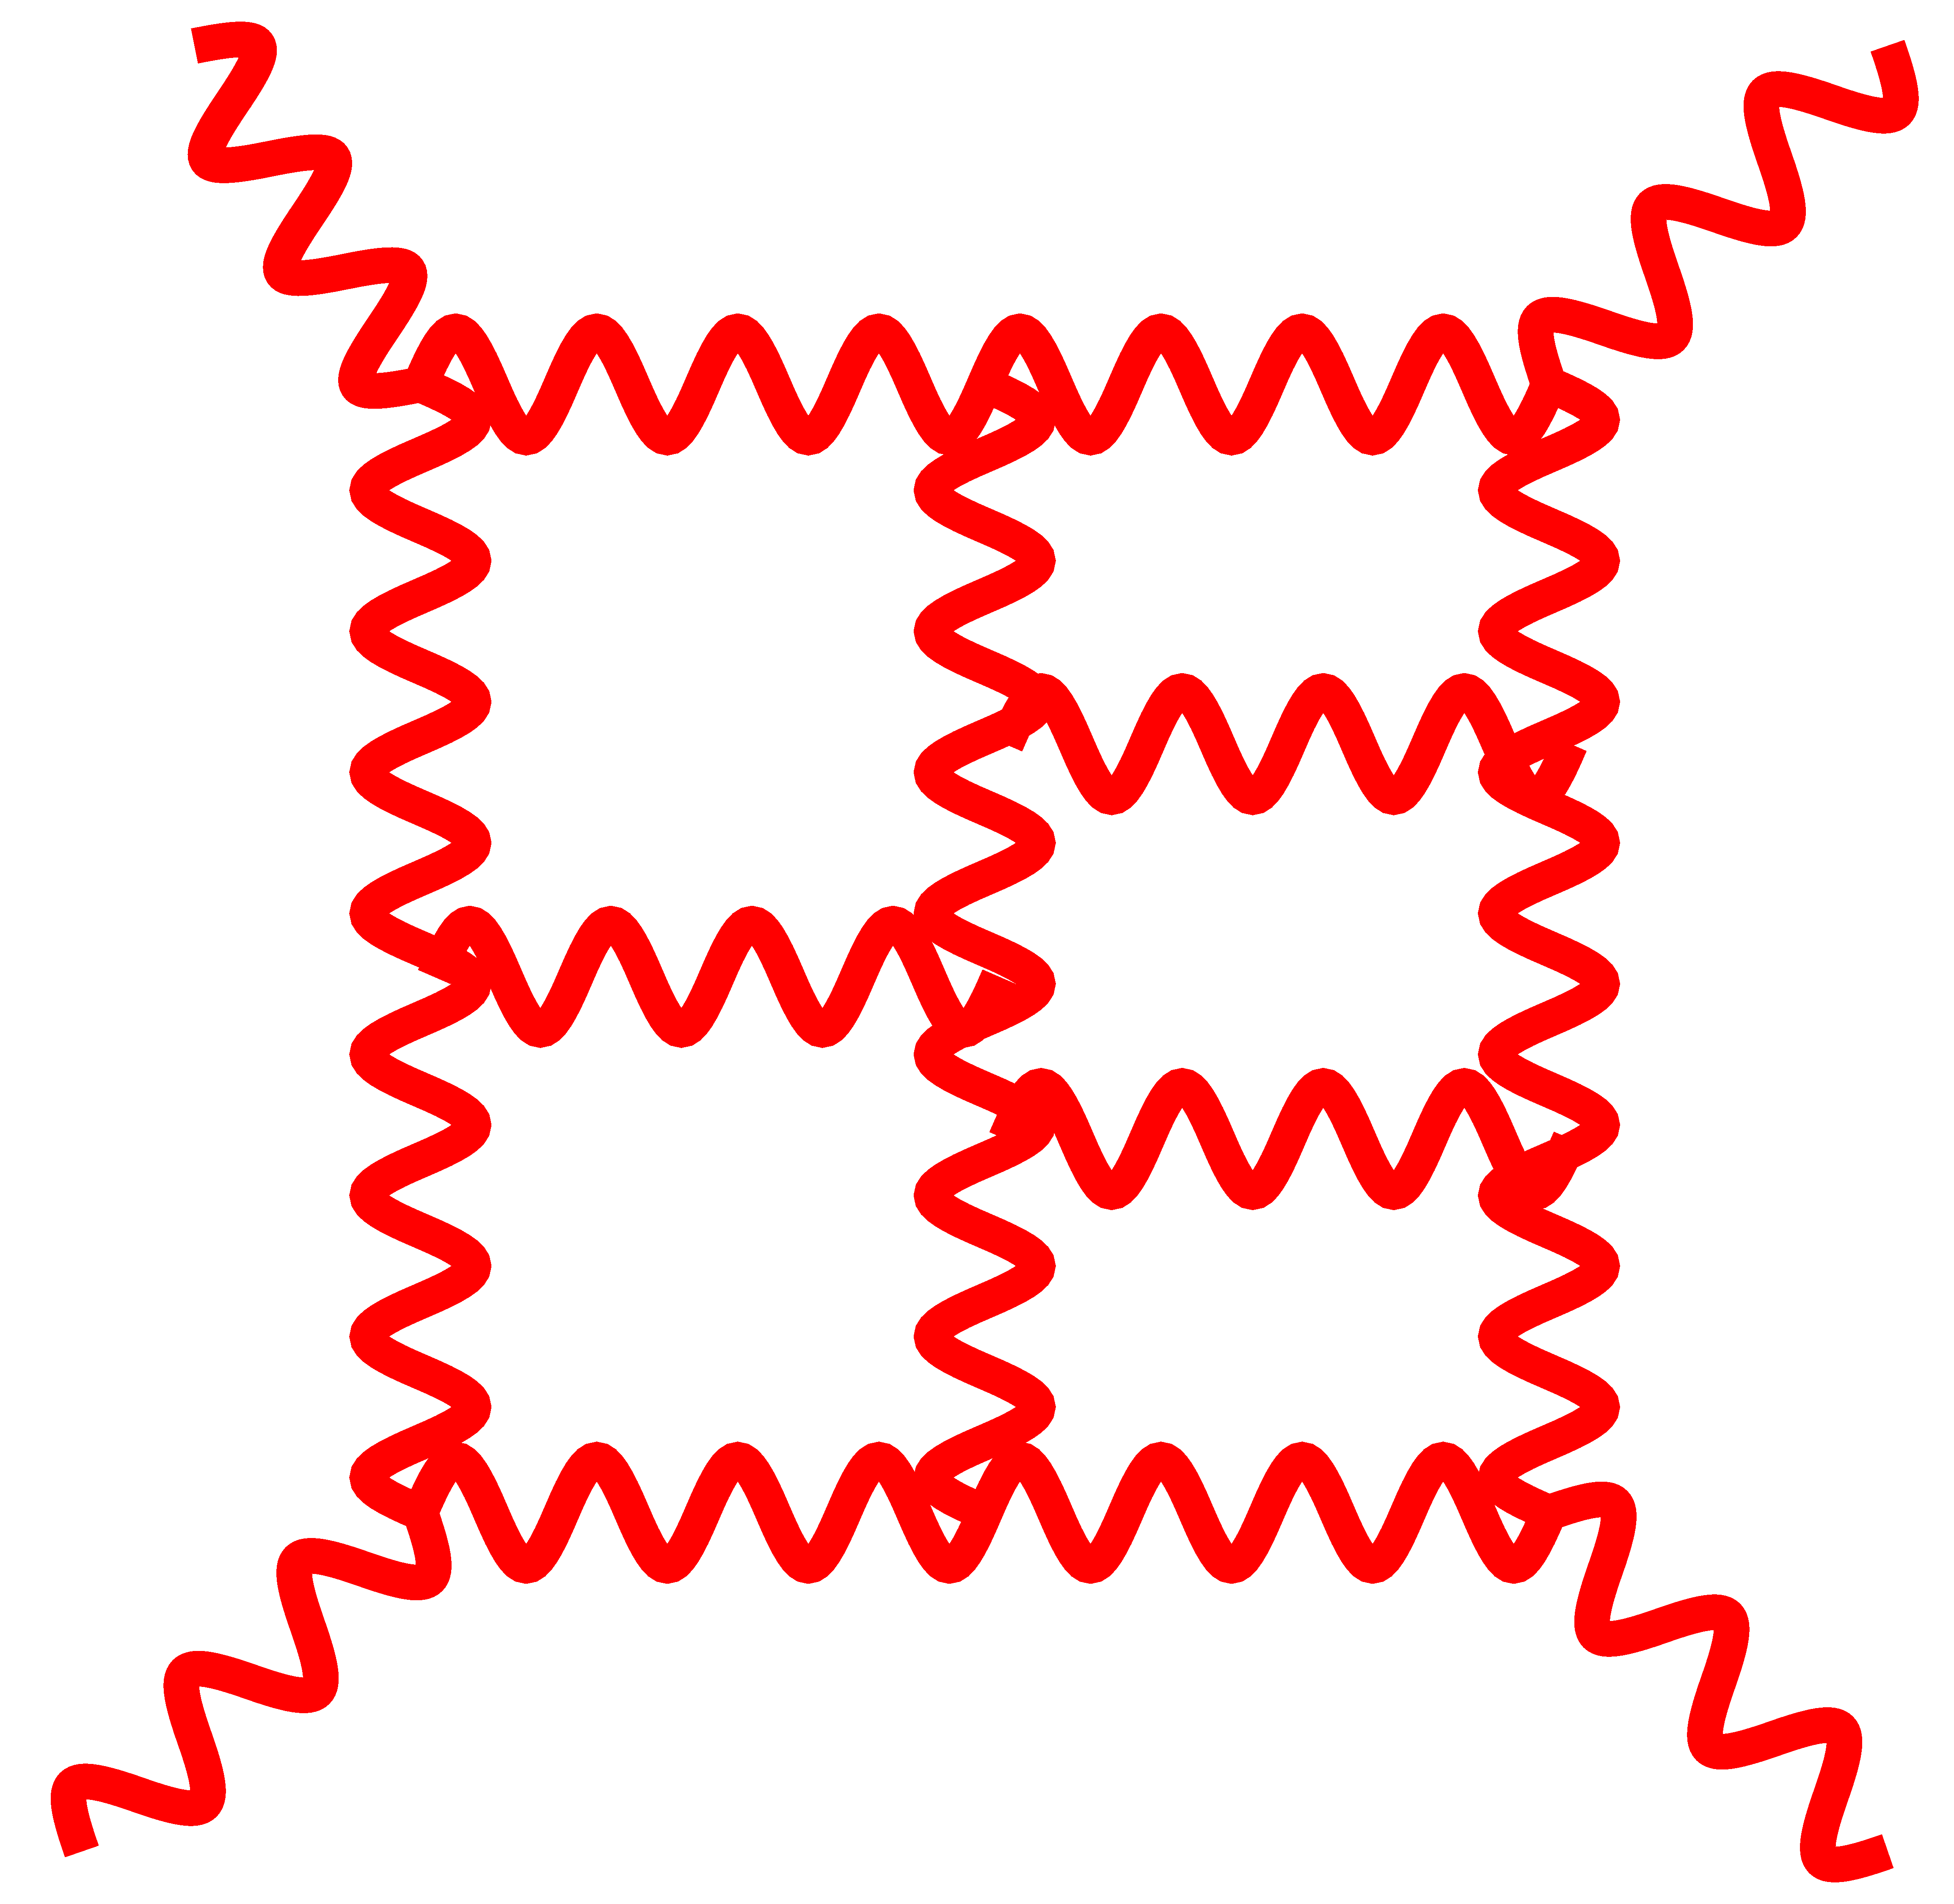
Example: Formal Theory Problem Where We Need
Improved Loop Integration
What is the UV behavior of gravity theories?
For major progress we need multi-loop advances
of the type discussed at LoopFest!

Slide 29
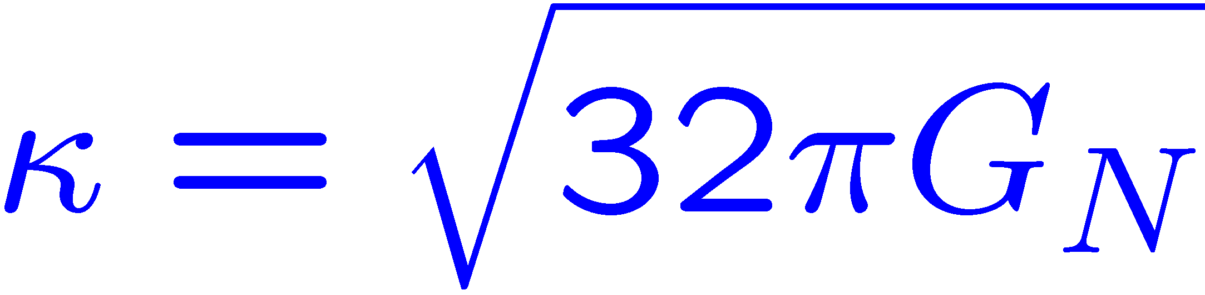
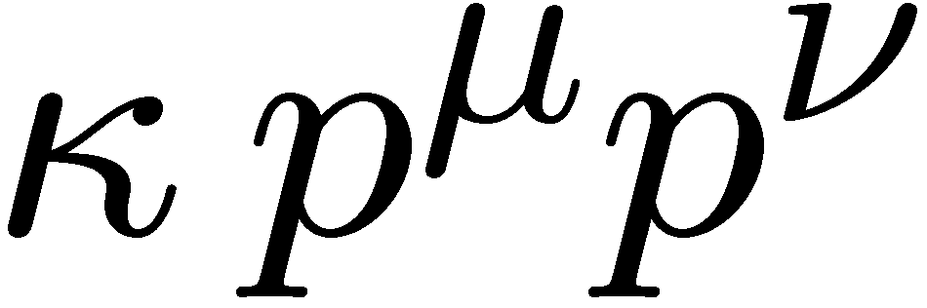
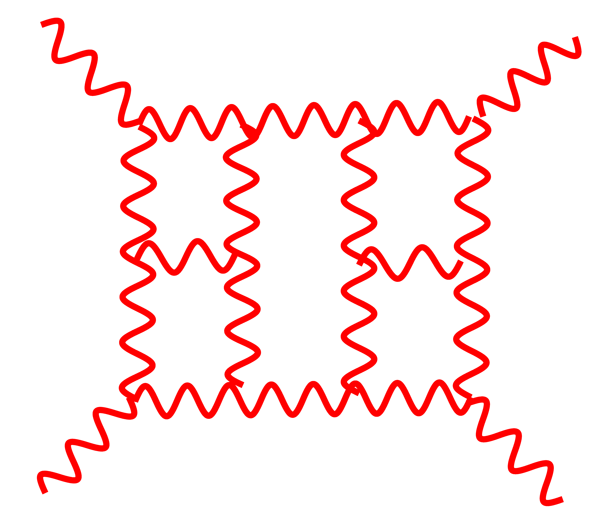
UV Behavior of Gravity?
Dimensionful coupling
Gravity:
Gauge theory:
Extra powers of loop momenta in numerator means integrals are
badly behaved in the UV and must diverge at some loop order.
Much more sophisticated power counting in supersymmetric theories
but this is basic idea.
With more supersymmetry expect better UV properties.
Need to worry about “hidden cancellations”.
N = 8 supergravity best theory to study.

Slide 30
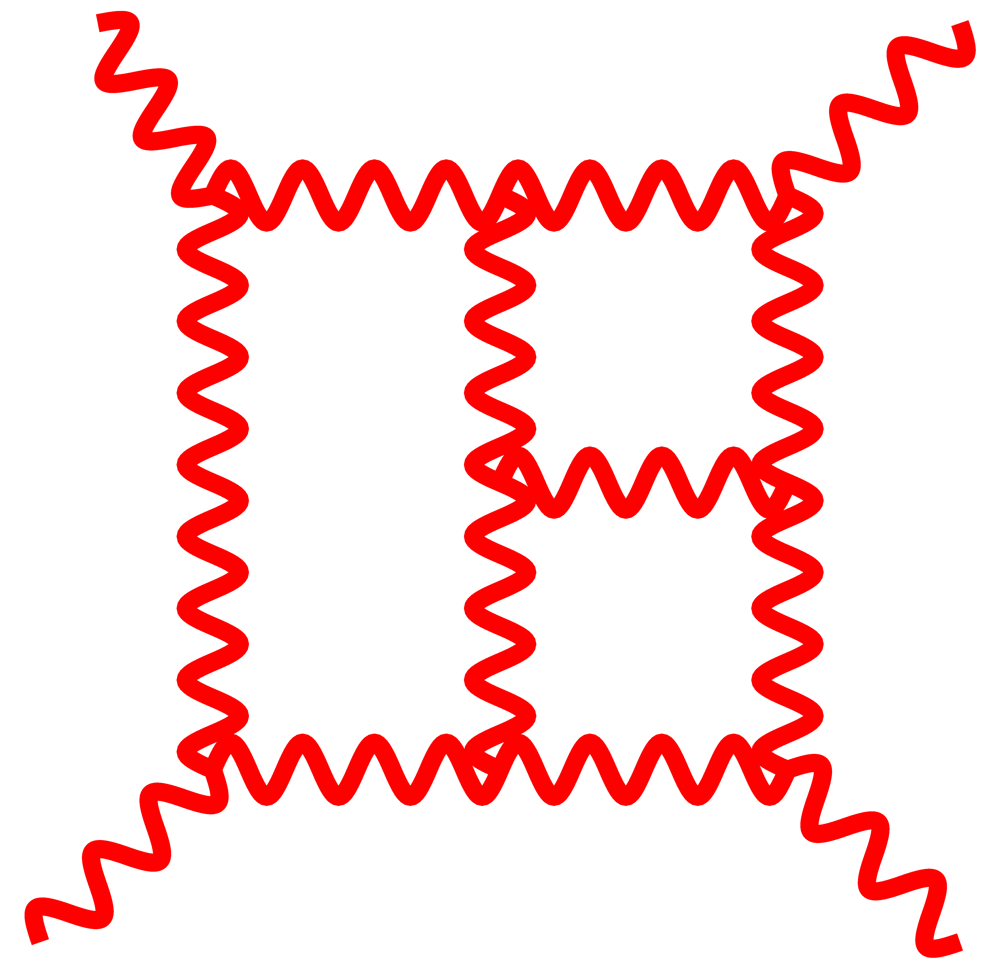
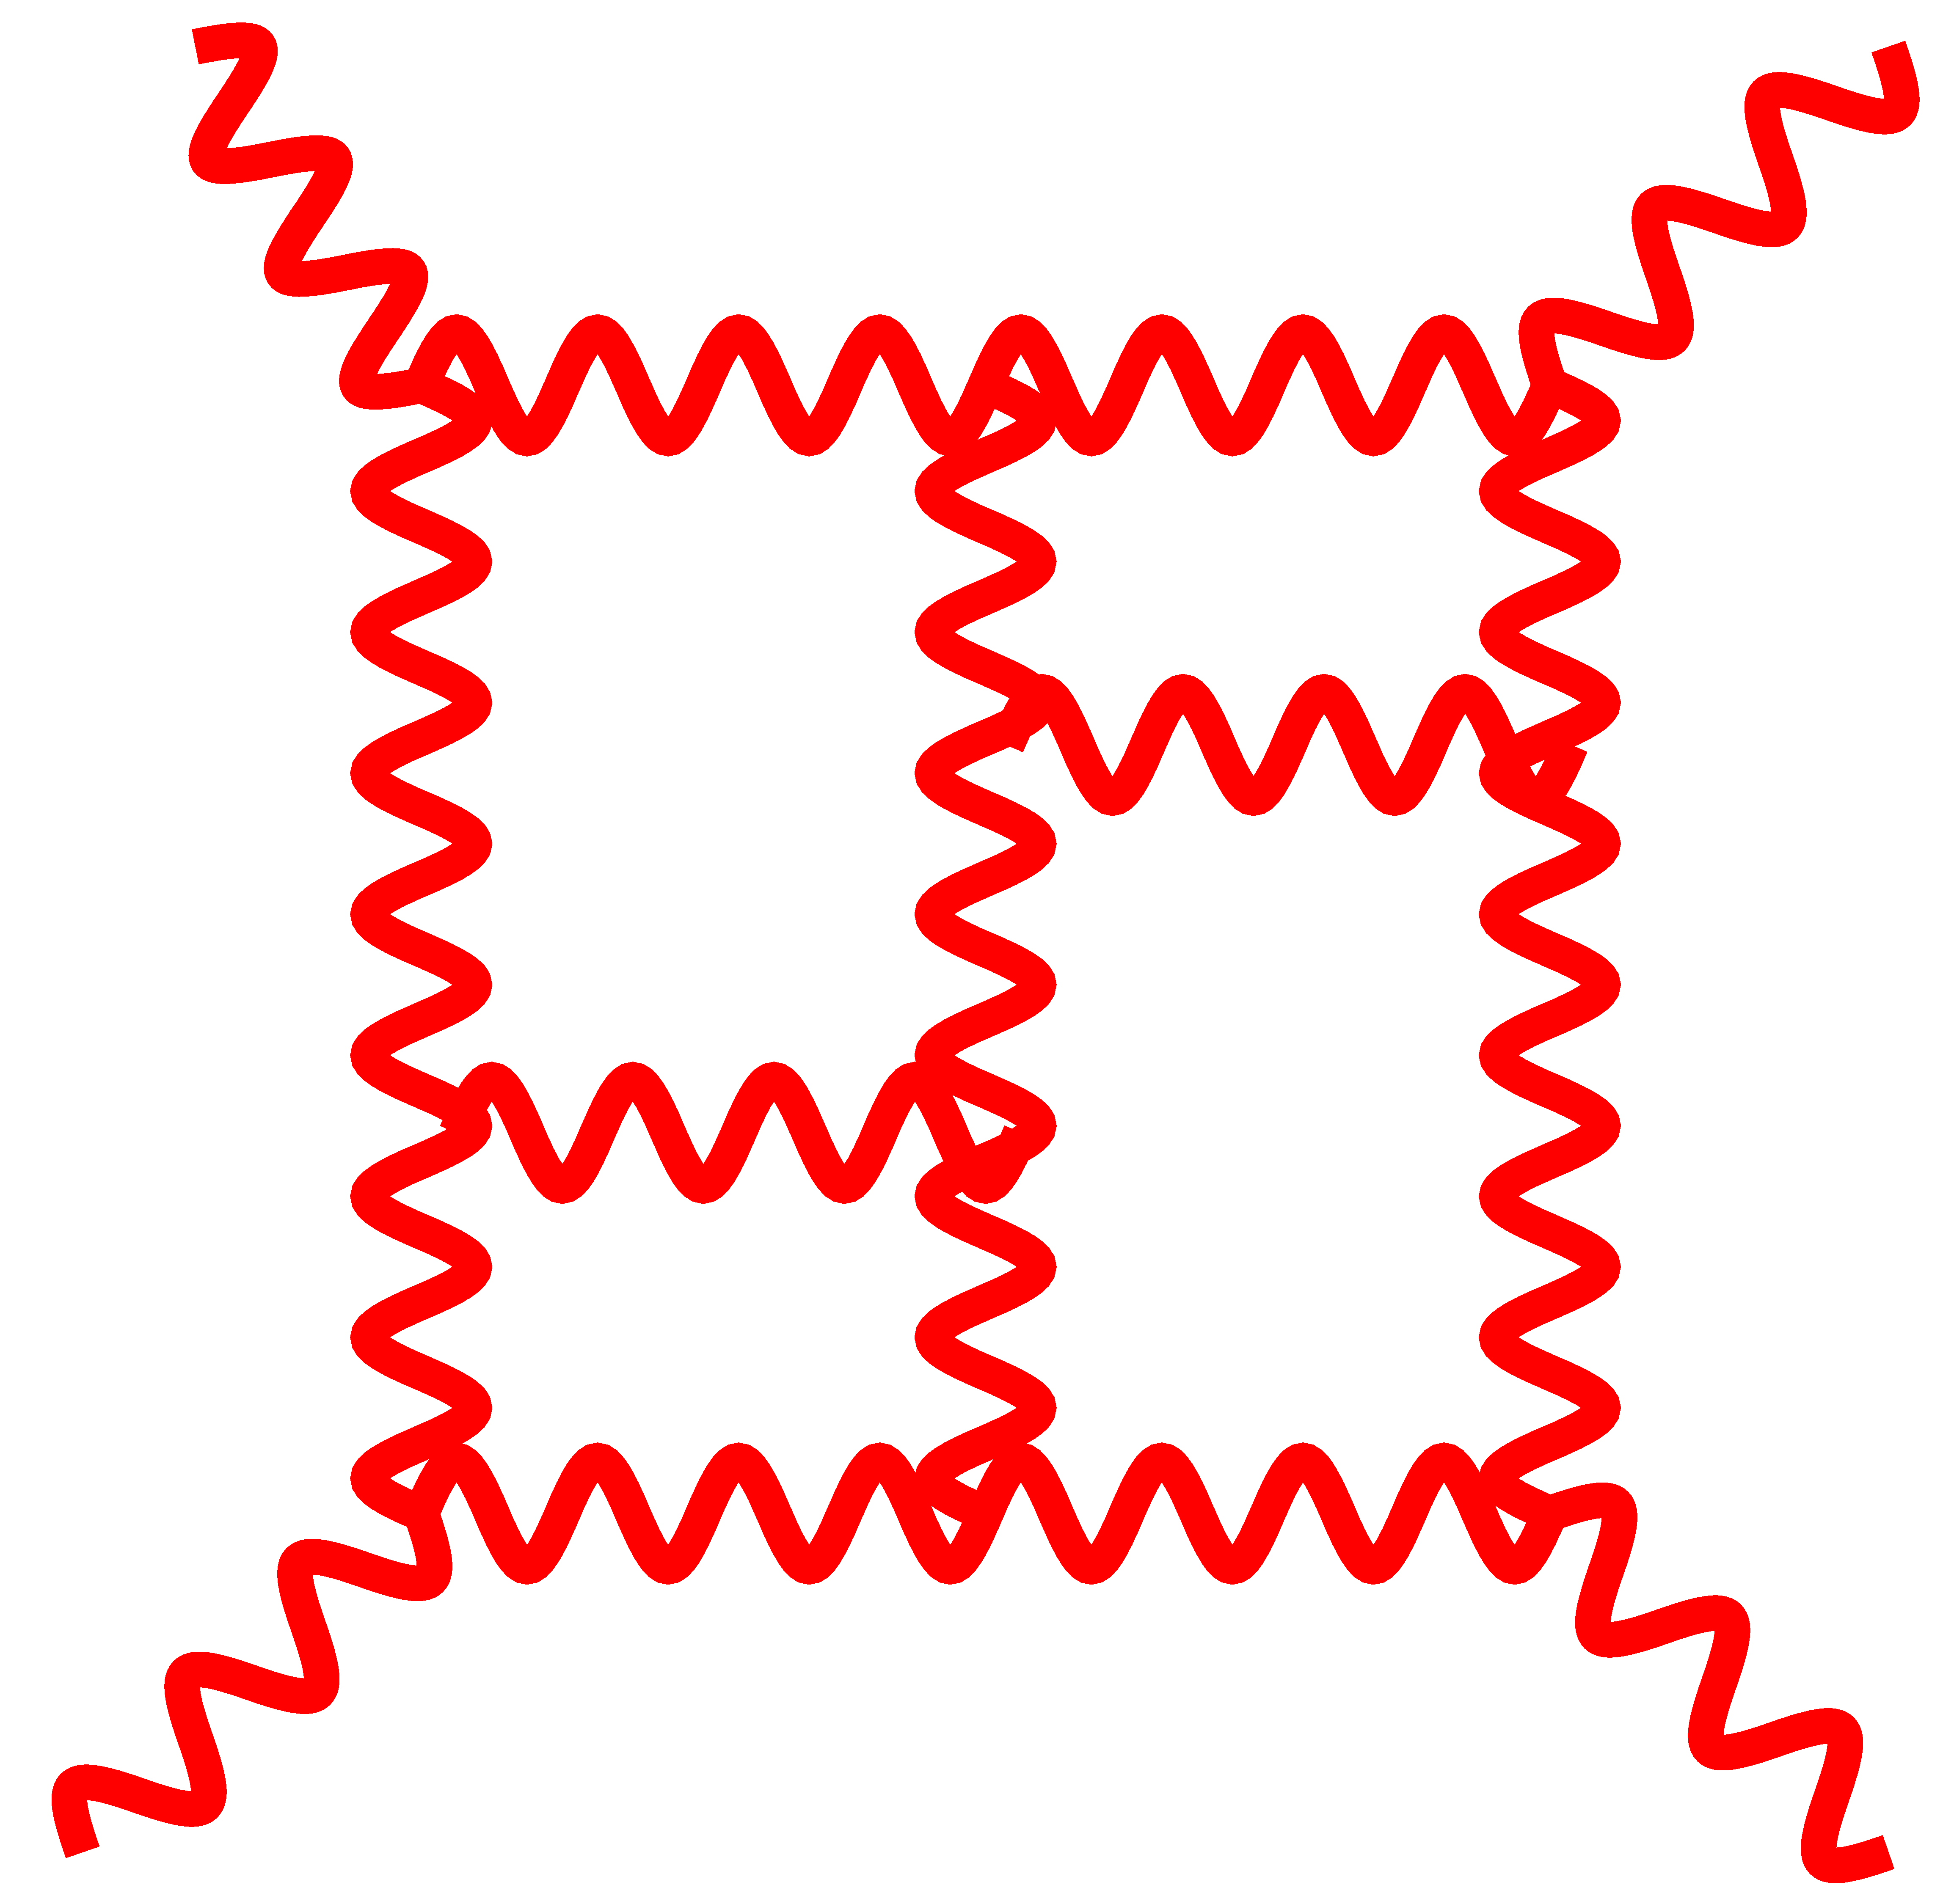
Feynman Diagrams for Gravity
Suppose we want to check UV properties of gravity theories
Using Feynman diagrams:
~10²⁰
TERMS
No surprise it has never been calculated via Feynman diagrams.
3 loops
Calculations to settle this seemed utterly hopeless!
Seemed destined for dustbin of undecidable questions.
4 loops
~10²⁶
TERMS
5 loops
~10³¹
TERMS
More terms than atoms in your brain!
Need a better approach.

Slide 31
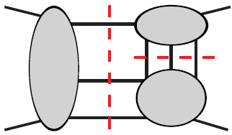
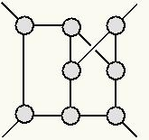
Basic Tools for Attacking the Problem
We use following tools for computing scattering amplitudes and
studying their UV properties:
Generalized unitarity method.
Duality between color and kinematics. Gravity scattering
amplitudes directly from gauge-theory ones. Double copy.
Advanced loop-integration technology.
ZB, Dixon, Dunbar, Kosower
ZB, Carrasco, Johansson, Kosower
ZB, Carrasco and Johansson (BCJ)
Chetyrkin, Kataev and Tkachov; Laporta; A.V. Smirnov; V. A. Smirnov; Vladimirov; Marcus, Sagnotti; Czakon; Laporta; Kosower; Ita; Larsen and Zhang; Zeng, etc
Last item is directly connected to LoopFest.

Slide 32
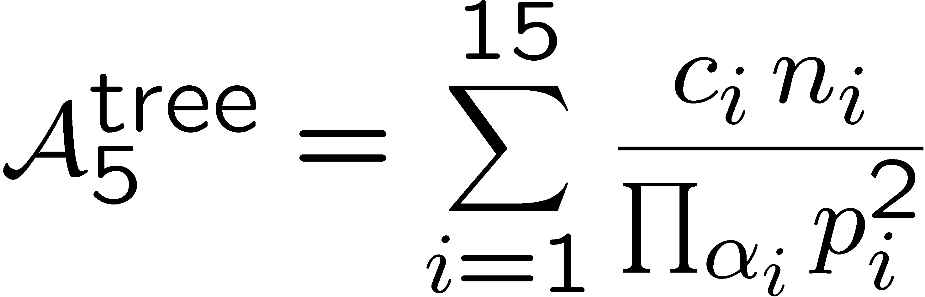
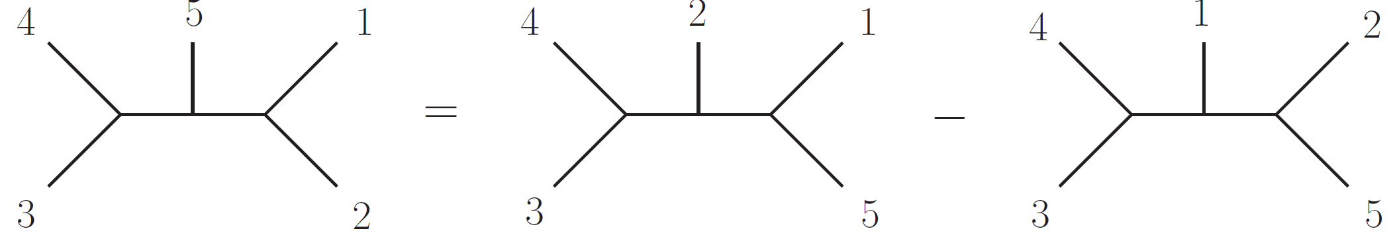

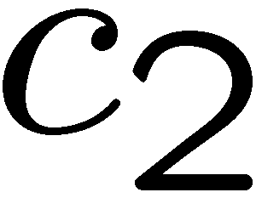
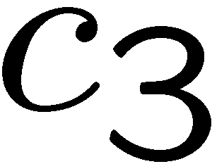
How is Gravity Connected to Gauge Theory
Consider QCD five-gluon tree amplitude:
ZB, Carrasco, Johansson (BCJ)
color factor
kinematic numerator factor
Feynman propagators
Duality between color and kinematics:
⇔
At tree level we can always find a rearrangement so color and
kinematics satisfy the same algebraic constraint equations.
Progress on unraveling relations.
BCJ, Bjerrum-Bohr, Feng, Damgaard, Vanhove, ; Mafra, Stieberger, Schlotterer;
Tye and Zhang; Feng, Huang, Jia; Chen, Du, Feng; Du, Feng, Fu; Naculich, Nastase, Schnitzer
O’Connell and Montiero; Bjerrum-Bohr, Damgaard, O’Connell and Montiero; O’Connell, Montiero, White, etc.
Notes:
Very nontrivial. Add refs.

Slide 33

How is Gravity Connected to Gauge Theory
Duality between color and kinematics:
ZB, Carrasco, Johansson (BCJ)
⇔
gauge theory
gravity
N = 8 sugra: (N = 4 sYM) (N = 4 sYM)
There is now a whole zoology of theories that can be obtained
via “double copy” procedure.
Anastasiou, Bornsten, Duff; Duff, Hughs, Nagy; Johansson and Ochirov;
Carrasco, Chiodaroli, Günaydin and Roiban; ZB, Davies, Dennen, Huang and Nohle;
Nohle; Chiodaroli, Günaydin, Johansson, Roiban. A. Anastasiou, L. Borsten, M.J. Duff, M.J. Hughes,
Marrani, Nagy, Zoccali; Cachazo, He, Yuan; Chen Du, Broedel, Schlotterer and Stieberger; Carrasco,
Mafra, Schlotterer;
Notes:
Add references for twins, etc

Slide 34
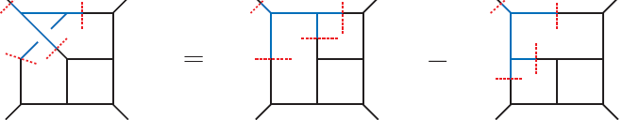
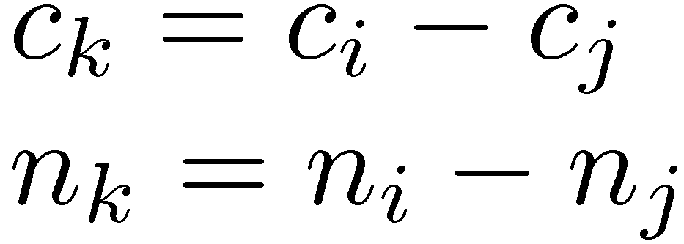
How is Gravity Connected to Gauge Theory?
ZB, Carrasco, Johansson (BCJ)
color factor
(i)
kinematic
numerator
(k)
(j)
If you have a set of duality satisfying numerators.
Conjecture:
gauge theory gravity theory
simply take
color factor kinematic numerator
c_{k} n_{k}
Gravity loop integrands follow from gauge theory!
The nontrivial part is to find kinematic numerators
where duality holds. Double copy is easy to prove.
Notes:
Entire problem of perturbative quantum gravity is reduced to gauge theory.

Slide 35
Supergravity: Ultraviolet Divergence Status
Bossard, Howe, Stelle; Elvang, Freedman, Kiermaier; Green, Russo, Vanhove ; Green and Björnsson ;
Bossard , Hillmann and Nicolai; Ramond and Kallosh; Broedel and Dixon; Elvang and Kiermaier;
Beisert, Elvang, Freedman, Kiermaier, Morales, Stieberger; Bossard, Howe, Stelle, Vanhove, etc
In recent years renewed effort to understand UV of supergravity
Key point: all supersymmetry cancellations are exposed.
Poor UV behavior, unless new types of cancellations between
diagrams exist that are “not consequences of supersymmetry
in any conventional sense”.
Bjornsson and Green
Consensus agreement from all methods
Want to
check this.
N = 8 sugra should diverge at 5 loops in D = 24/5.
N = 8 sugra should diverge at 7 loops in D = 4.
N = 4 sugra should diverge at 3 loops in D = 4.
N = 5 sugra should diverge at 4 loops in D = 4.
?
?
✗
✗
New types of cancellations do exist: “enhanced cancellations”.
ZB, Davies, Dennen

Slide 36
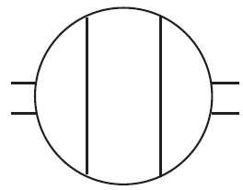
Enhanced UV Cancellations
ZB, Davies, Dennen
Suppose diagrams in all possible Lorentz covariant representations are UV divergent, but amplitude is well behaved.
By definition this is an enhanced cancellation.
Not the way nonabelian gauge theory works.
already log divergent
N = 4 sugra: pure YM x N = 4 sYM
N = 4
sugra
2
3
1
4
This diagram is log divergent
Amplitude is UV finite.
3 loop UV finiteness of N = 4 supergravity proves existence of “enhanced cancellation” in supergravity theories.
No known standard symmetry explanation.
Notes:
May want to remove!!!!

Slide 37
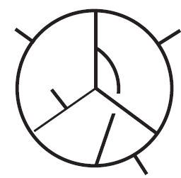
N = 5 Supergravity at Four Loops
ZB, Davies and Dennen
We calculated four-loop divergence in N = 5 supergravity.
Industrial strength software needed: FIRE5 and special purpose C++
N = 5 sugra: (N = 4 sYM) x (N = 1 sYM)
Crucial help
from (Smirnov)²
N = 4 sYM
N = 1 sYM
Diagrams necessarily
UV divergent.
N = 5 supergravity has no divergence at four loops.
Nontrivial example of an “enhanced cancellation”.
Notes:
Define number of vector multiplets, add arxiv number

Slide 38
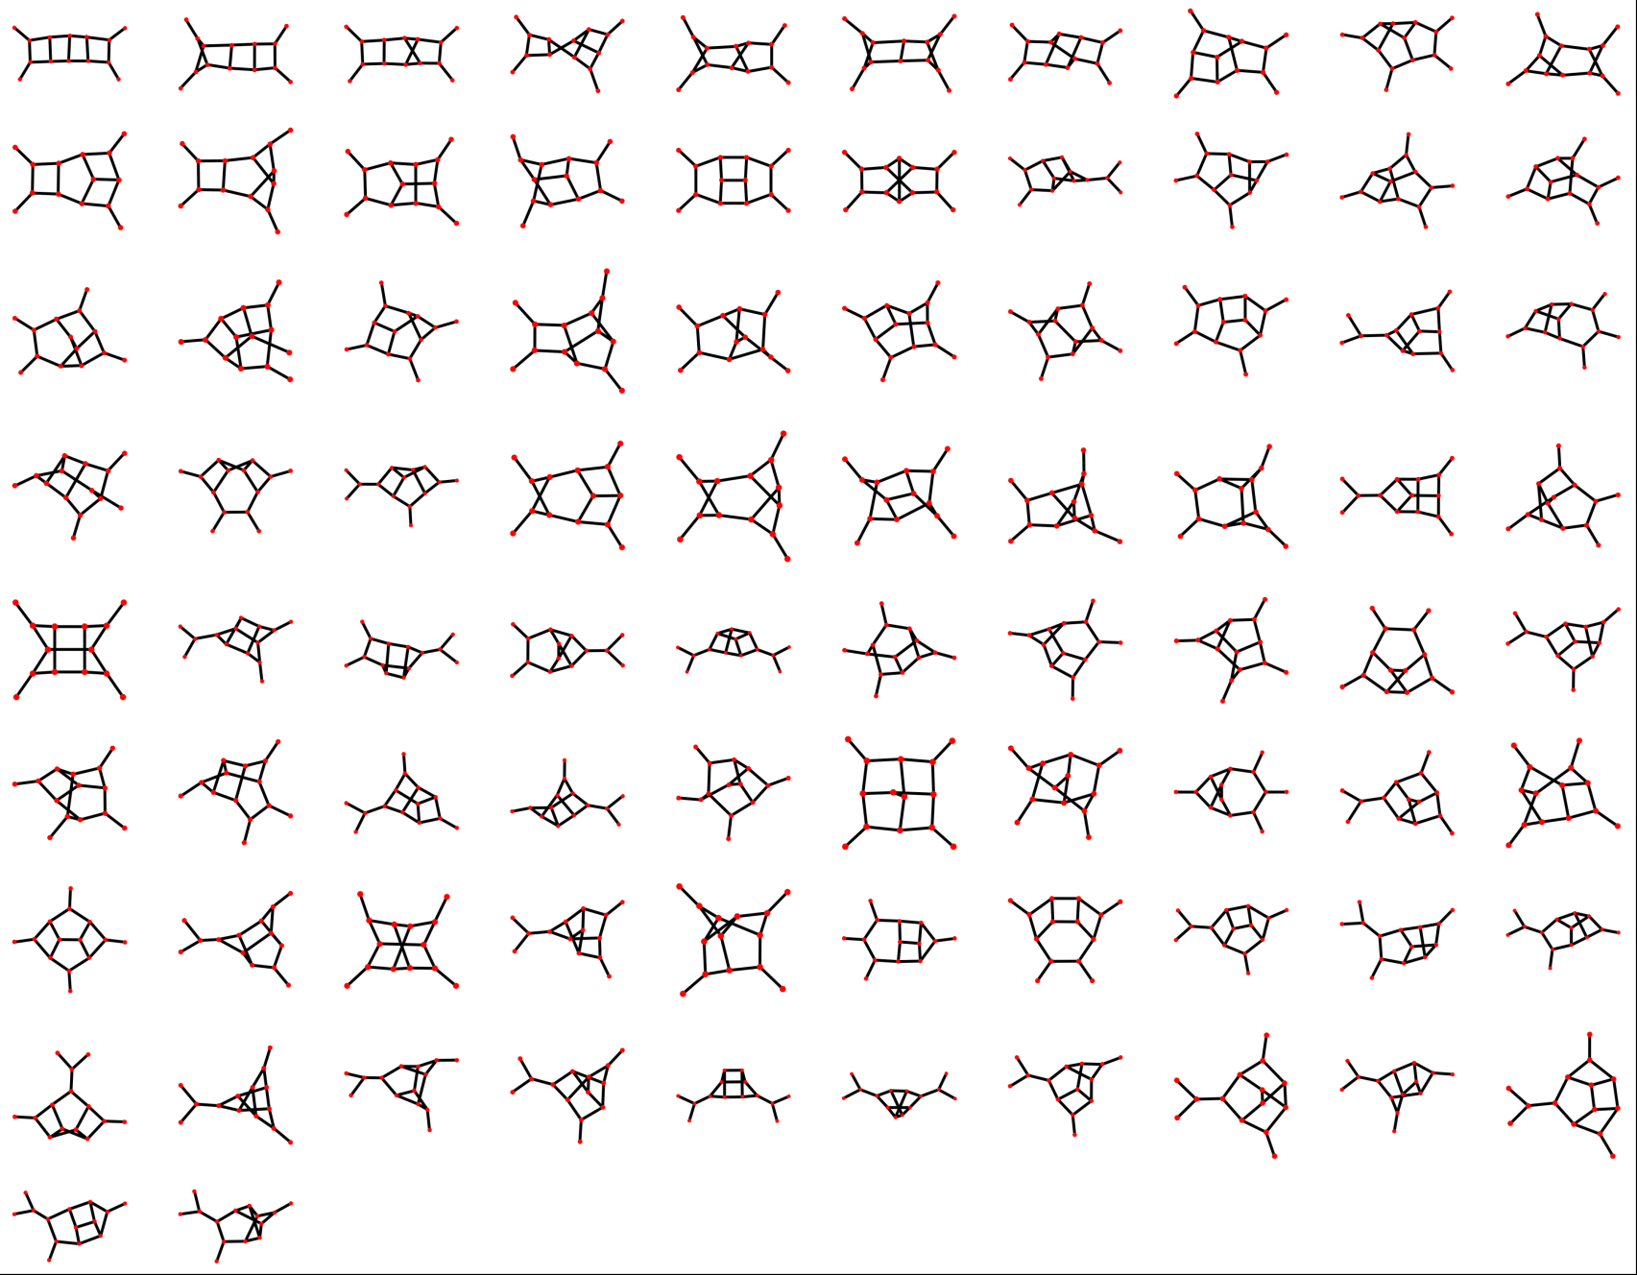
82 nonvanishing numerators in BCJ representation
ZB, Carrasco, Dixon, Johansson, Roiban (N = 4 sYM)

Slide 39
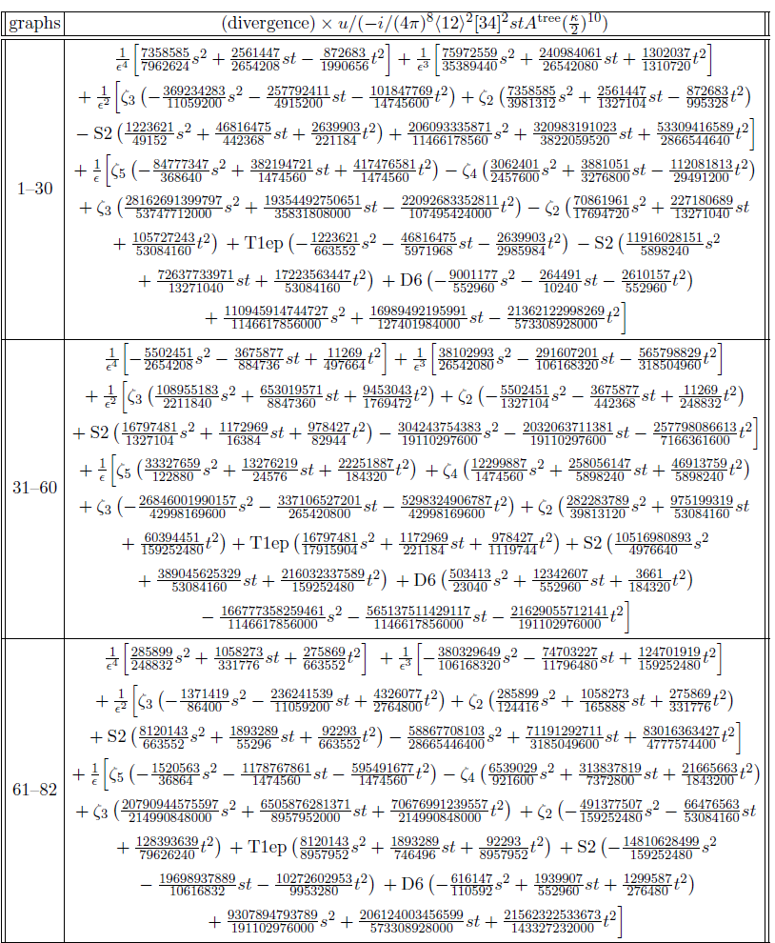
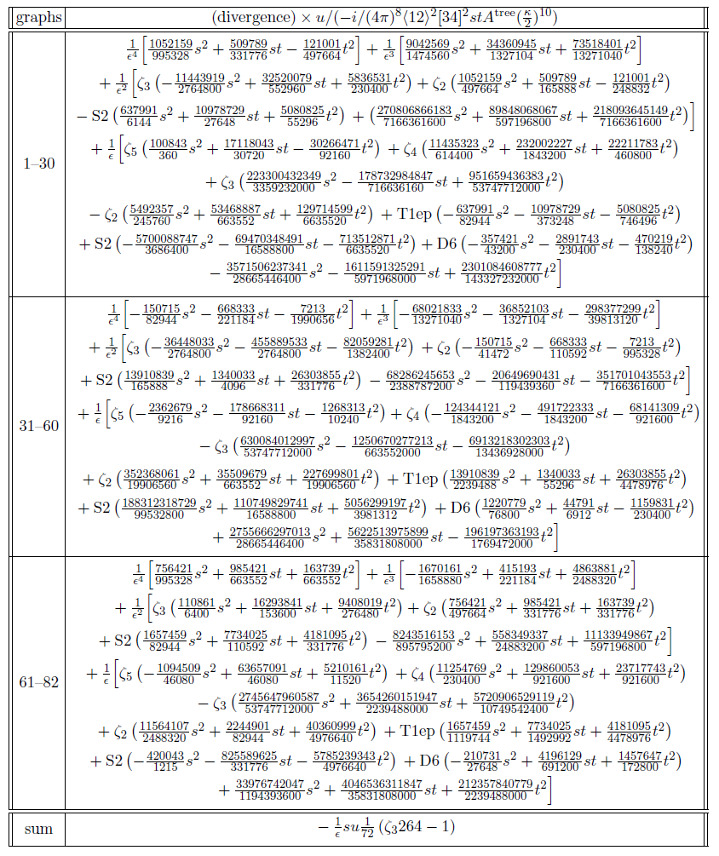
N = 5 supergravity at Four Loops
Special purpose C++ and FIRE5
ZB, Davies and Dennen
Adds up to zero: no divergence. Enhanced cancellations!
No standard (super)symmetry explanation exists.
Notes:
Define number of vector multiplets, add arxiv number

Slide 40
Need Better Loop Integration Methods
Enhanced cancellations:
Standard supersymmety powercounting arguments fail.
Cancellations visible only after integration. Not in integrand.
Supergravity friends want to help, but no supersymmetry
angle available. Kind of frustrating.
At present there is only one technique available:
Do full calculation including integration to extract UV.
Notes:
Works because N=4

Slide 41
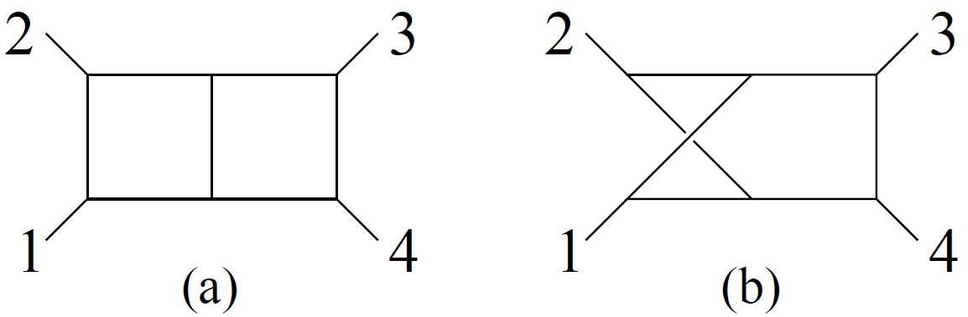
Multiloop Enhanced Cancellations
ZB, Enciso, Parra-Martinez, Zeng (2017)
Conjecture: At large loop momentum enhanced cancellations
follow from Lorentz symmetry and SL(L) relabeling symmetry.
Lorentz
symmetry
SL(L) relabeling
symmetry
L loops
Symmetries generate a generic set of identities between integrals.
Understanding structures of IBPs is crucial
Notes:
Replace based on our paper

Slide 42
5 Loop N = 8 Supergravity
Finally, after considerable effort we have constructed five-loop integrand. Modified double copy.
ZB, Carrasco, Chen, Johansson, Roiban (2017)
We have the N = 8 five-loop four point integrand!
16K nonvanishing diagrams.
We need to extract UV divergence (or lack thereof) from this:
Similar five-loop QCD beta function, except:
Nastier tensor integrals—rank 16.
D = 24/5 instead of D = 4.
See Zoller’s talk
We are currently setting up an ibp program.
ZB, Carrasco, Chen, Johansson, Roiban, Zeng
Need high tech ibp: See talks from Ita, Page, Zhang and Zeng.
Numerical approaches for checking. See talks from Borowka, Li
Notes:
QCD rank 10

Slide 43
Take Home Message
The formal and collider phenomenology communities can
learn from each other. Feeds into supergravity.
QCD
N = 4
sYM
Supergravity
Our ability to understand UV of supergravity
relies crucially on loop advances.
Keep up the great work! Pheno not only reason.

Slide 44
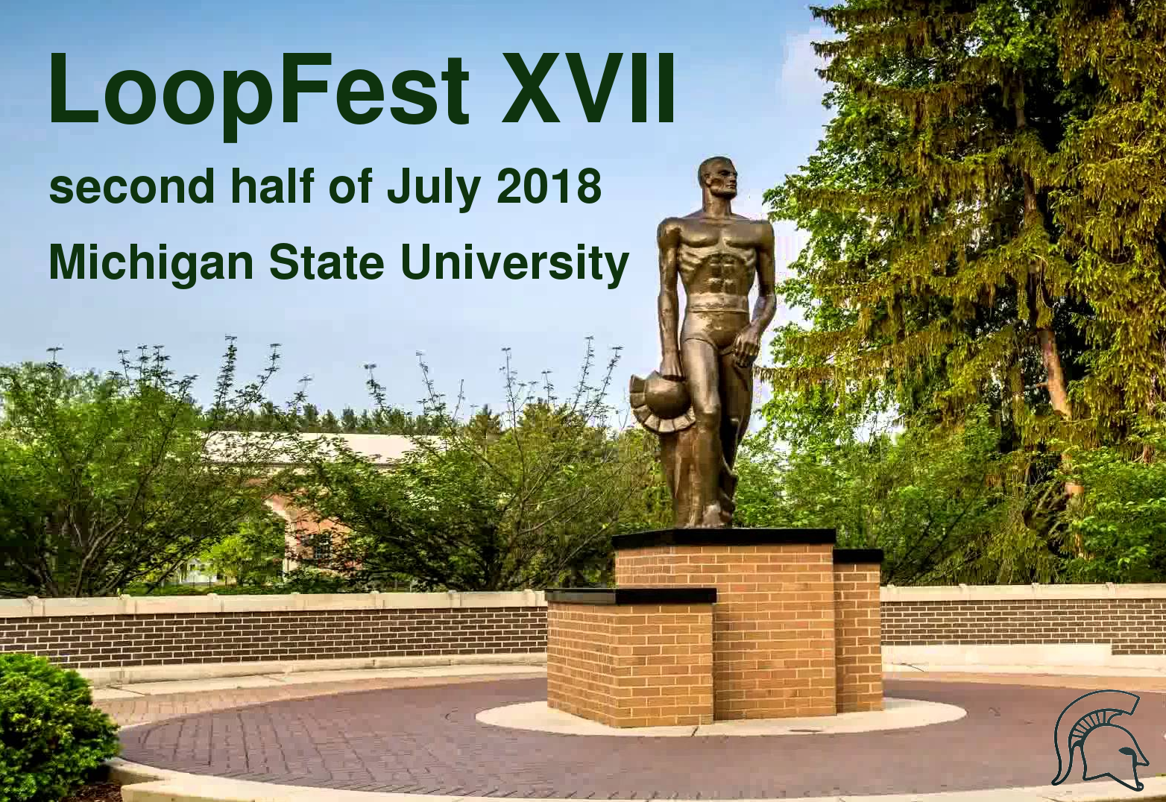

Slide 45
Let’s thank the organizers for this great conference:
Local Committee: Radja Boughezal, Andrea Isgro,
Ulrich Schubert and Hongxi Xing
Advisors: Sally Dawson, Lance Dixon, Frank Petriello,
Laura Reina and Doreen Wackeroth

