Slide 1
Evolution of Computing Facilities
Dr. Burt Holzman, Fermi National Accelerator Laboratory
Coordinating Panel for Advanced Detectors (DPF/APS)
October 11, 2017

Slide 2
Disclaimer
Reference herein to any specific commercial product, process, or service by trade name, trademark, manufacturer, or otherwise, does not necessarily constitute or imply its endorsement, recommendation, or favoring by the Fermilab, the United States Government, or any agency thereof.

Slide 3
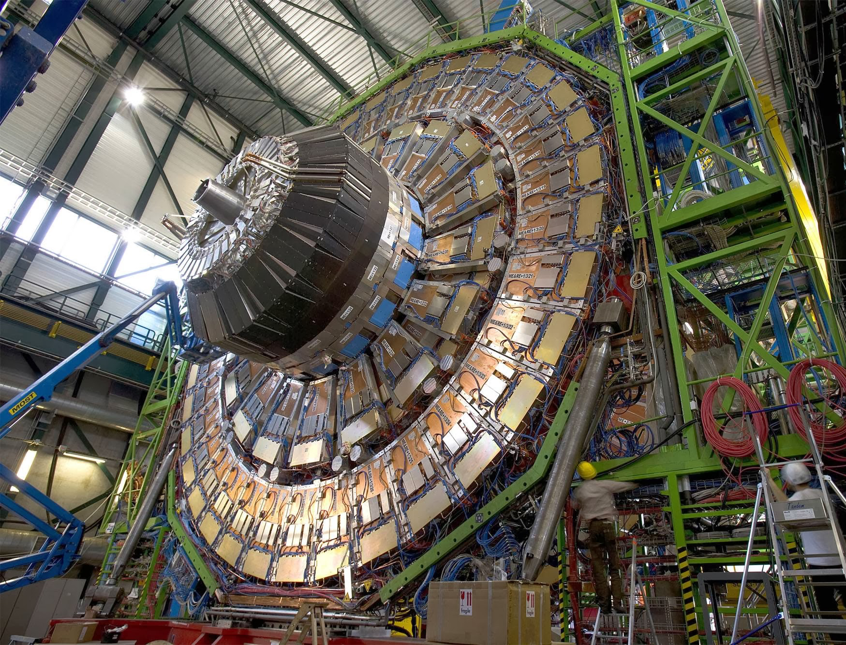
CMS Experiment at the Large Hadron Collider
Protons collide at the Large Hadron Collider
14 million times per second
100 Megapixel “camera” captures energy, position
  1000 times per second
All measurements of a collision are called an “event”

Slide 4
What is HEP Computing? Mostly “Production”
Coordinated production of reduced-sized datasets for use by the collaboration in analysis
Event Simulation
Detector Simulation
Detector Signal Simulation
Detector Data
Event Reconstruction
Event Reconstruction
Simulation
Data
Notes:
Not equal balance – Oli can pull together some Ecom Slides.

Slide 5
Production is “Production Line”
Event
Generation
Simulation
Digitization &
Reconstruction
Embarrassingly “Pleasingly” parallel
Notes:
Exploit the pleasingly parallel nature of the problem

Slide 6
Production is essentially online
Reconstruction
Notes:
Also add a note/slide that we are not tackling “user analysis” – the last mile. Because the scaling behavior is less dramatic than production.

Slide 7
User analysis
The term analysis is overloaded
  At a recent workshop, we spent more time arguing about
  the definition of “analysis” than on technical matters
Chaotic and difficult to predict
  After production, data is in the hands of analysis groups and users
Common tools – but specific to HEP
  Cross-experiment frameworks (art ), Gaudi/Athena, CMSSW
  ROOT (http://root.cern.ch)
  Some movement towards broader tools: HDF5, R
I’ll touch briefly on analysis at the end of the talk

Slide 8
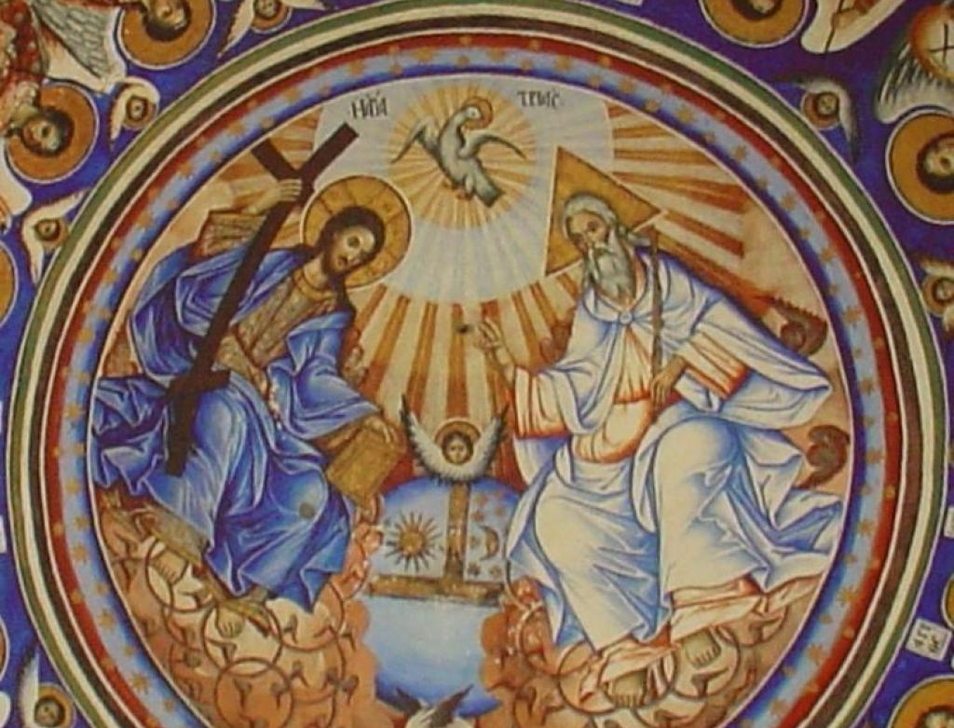
Networking
Compute
Storage
Storage
Compute

Slide 9
Bird’s-eye View
Compute
Network
Storage
On-Prem
Cache
On-Prem
Cloud
Cloud
HPC
Cache
Cache
Notes:
Silos of compute. Silos of storage. Network to tie them all together. Elasticity of compute.

Slide 10
Driver: Scale

Slide 11
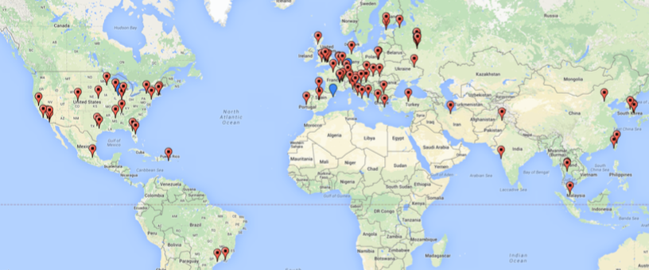
Scale of CMS computing
70+ compute clusters (Open Science Grid and Worldwide LHC Computing Grid)
  150,000 cores
  ~75 Petabyte Disk
  ~100 PB used tape space
Strong networks connecting the individual sites
  Weekly transfer volume between all sites: 4-6 Petabyte
  Total LHC Trans-Atlantic network capacity: 340 Gigabits per second
High-throughput computing – data-intensive science
Open Science Grid provides tools, packaging, common ops

Slide 12
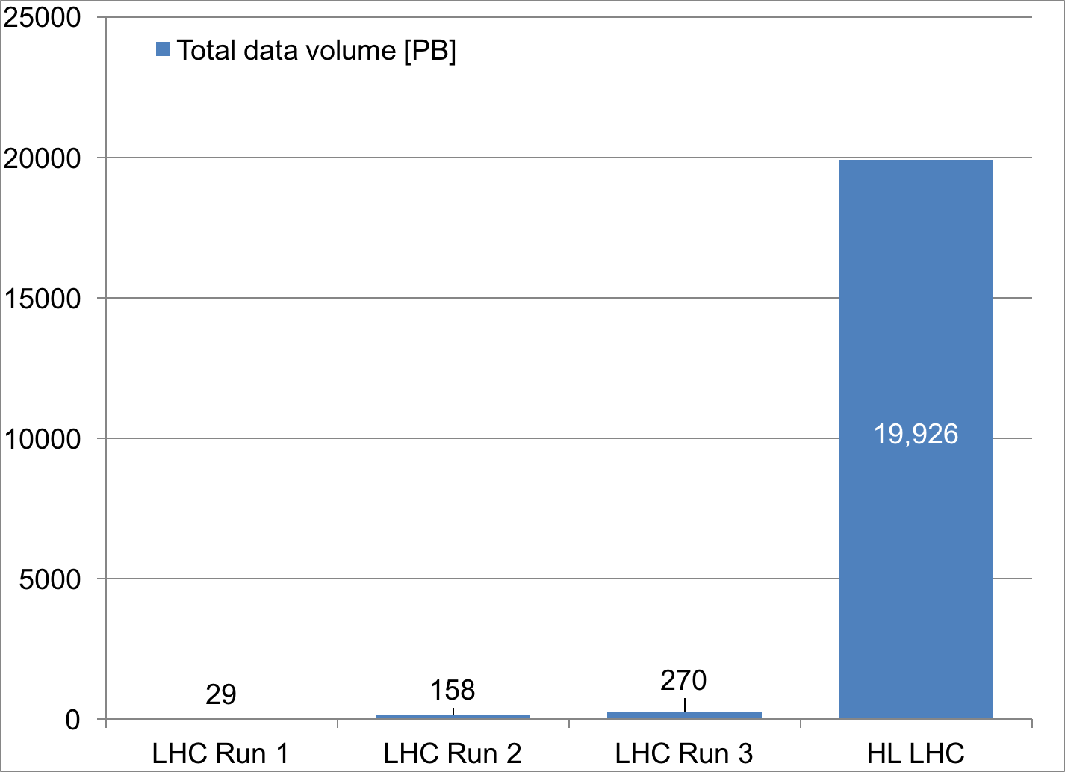
But that will not be enough …
Number of Particle Collisions
Total Data Volume in Petabytes
YOU ARE HERE
High Energy Physics computing will need 10-100x current capacity

Slide 13
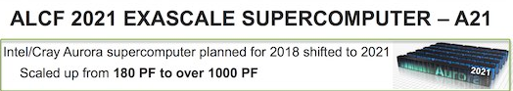
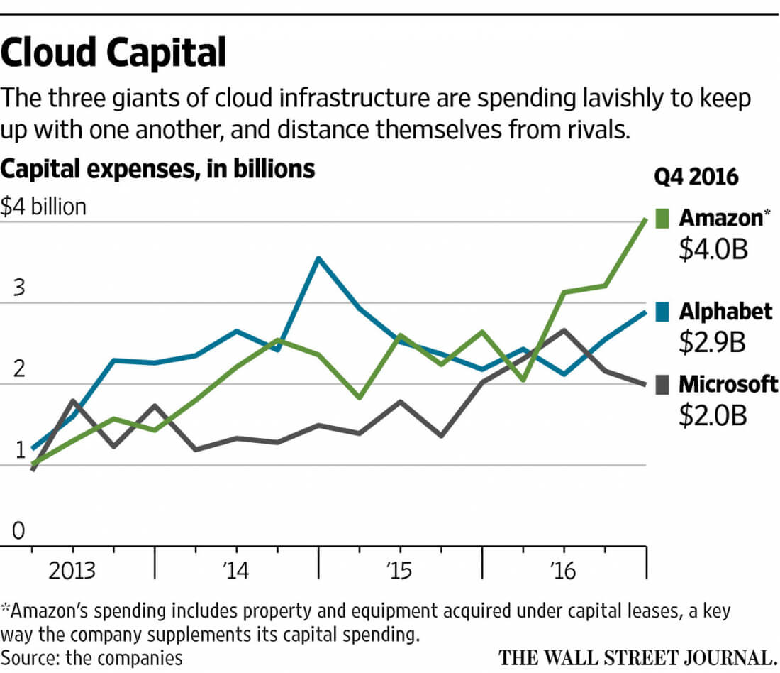
DOE and Industry heavily investing in Cloud, HPC
Barb Helland @ ASCAC, 9/26/17
Facility evolution must incorporate distributed resources of
HPC, Cloud

Slide 14
Driver: Flexibility
Uncertainty in computing hardware trends
  See the next slide
Rapid evolution in hardware
  The next GPU generation happens much faster than machine lifetime on my facility floor
  Can rent the latest and greatest …
Uncertainty in budgets
  At least it feels that way
The answer is to be flexible and agile – the Open Science Grid model
  Add capability to provision whatever resources (Grid, HPC, Cloud, ?) as we can

Slide 15
Driver: Flexibility
Crystal-ball gazing is a dangerous hobby
Jack Dongarra, IHPCF17

Slide 16
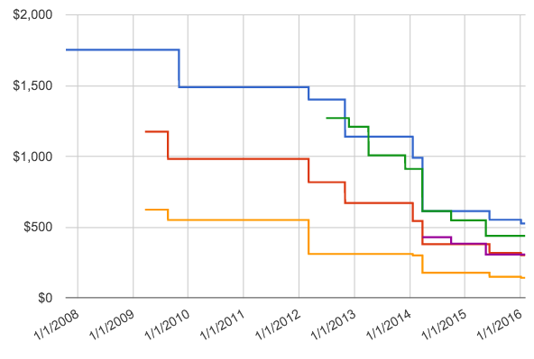
Moore’s Law (Dennard Scaling) is Dead; but
The number of compute cores seems to grow to be essentially infinite with little cost
  Industry: commercial cloud, IoT
  Research: NSCI,
  Exascale program,
  Leadership Computing Facilities
Experimental software
frameworks (with some foresight
and some luck) have already been refactored for many-core
architectures

Slide 17
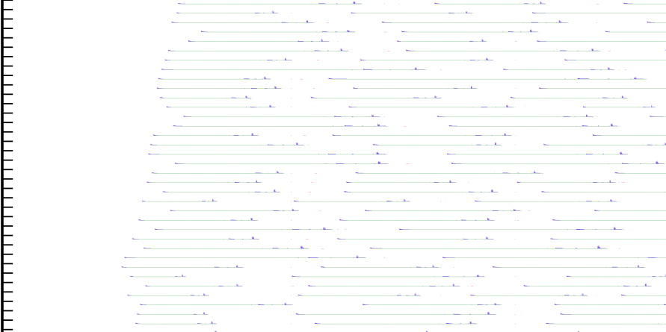
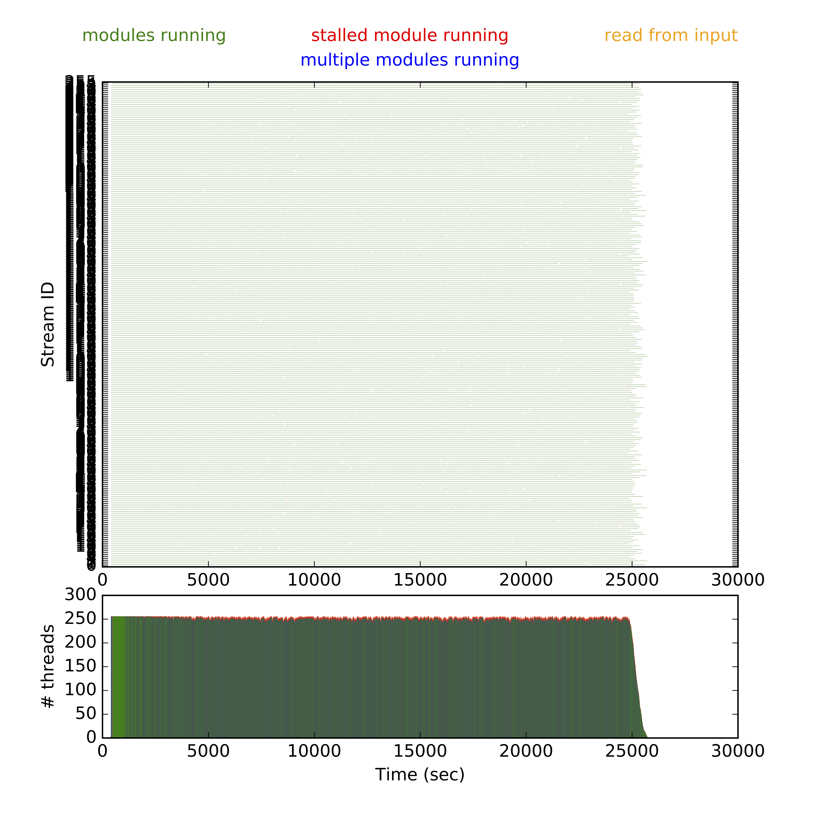
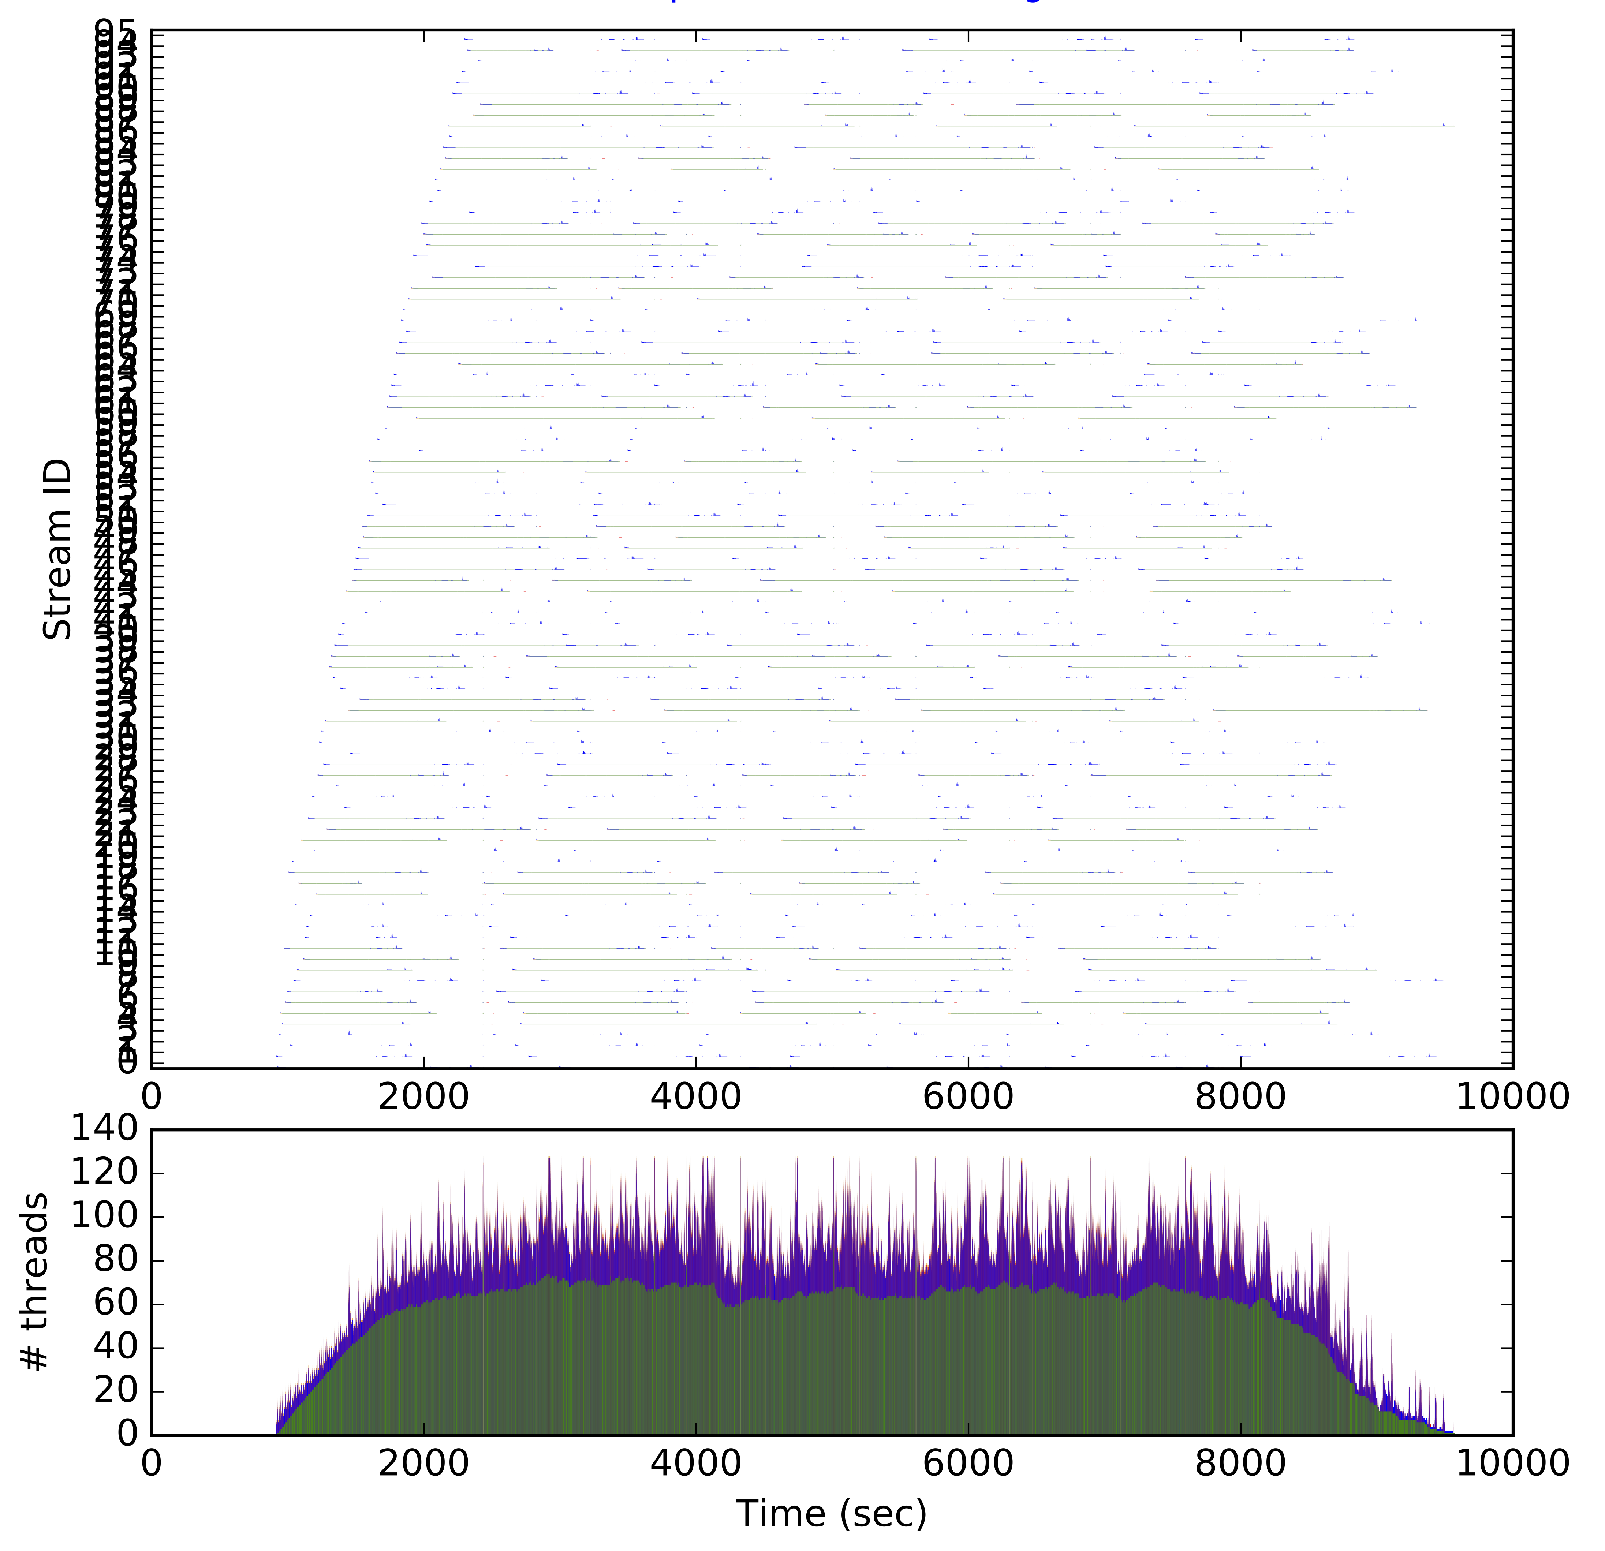
Example: CMS on Knights’ Landing
Generation + Simulation
Reconstruction
Notes:
Left plot: 256 streams, GEN-SIM. Power of multithreading. Right plot: RECO -- can only get to 96 threads due to memory limitations. (Otherwise we hitOOM). “Amdahl Gaps” that are I/O related -> importance of data

Slide 18
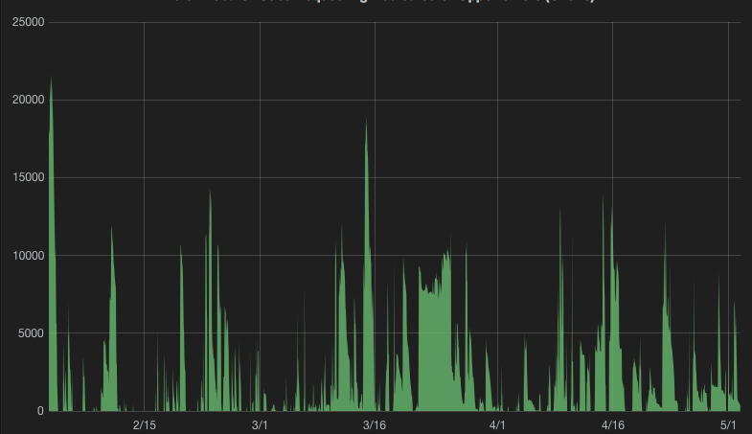
Driver: Elasticity
Usage is not steady-state
Computing schedules driven by real-world considerations (detector, accelerator, …) but also ingenuity – this is research and development of cutting-edge science
NOvA jobs in the queue at FNAL
Facility size

Slide 19
Inside an elastic facility: “HEPCloud”
Vision Statement
  HEPCloud is envisioned as a portal to an ecosystem of diverse computing resources, commercial or academic
  Provides “complete solutions” to users, with agreed upon levels of service
  The Facility routes to local or remote resources based on workflow requirements, cost, and efficiency of accessing various resources
  Manages allocations of users to target compute engines
Pilot project to explore feasibility, capability of HEPCloud
  Goal of moving into production during CY18
  Seed money provided by industry
Don’t blame for the name, I didn’t name it – not just commercial cloud

Slide 20
HEPCloud Architecture
Workflow
(resource provisioning trigger)
Facility Interface
Authentication and Authorization
Monitoring takes input from all components
Monitoring
Decision Engine
Facility Pool
Provisioner
Cloud Resources
Cloud Resources
Cloud Resources
Local
Resources
HPC
Resources
Grid Resources

Slide 21
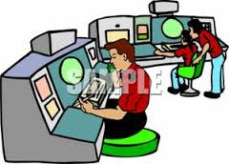

HEPCloud – one pilot-based implementation
HTCondor Schedulers
HTCondor
Central Manager
condor submit
HTCondor Schedulers
VO Frontend
Frontend
Pull Job
Cloud Provider
GlideinWMS Factory
Virtual Machine
HTCondor-G
VM
Glidein
HTCondor
Startd
Job
Grid Site
Local Resources
High Performance Computers
Virtual Machine
Virtual Machine
Virtual Machine
Job
Job
Job

Slide 22
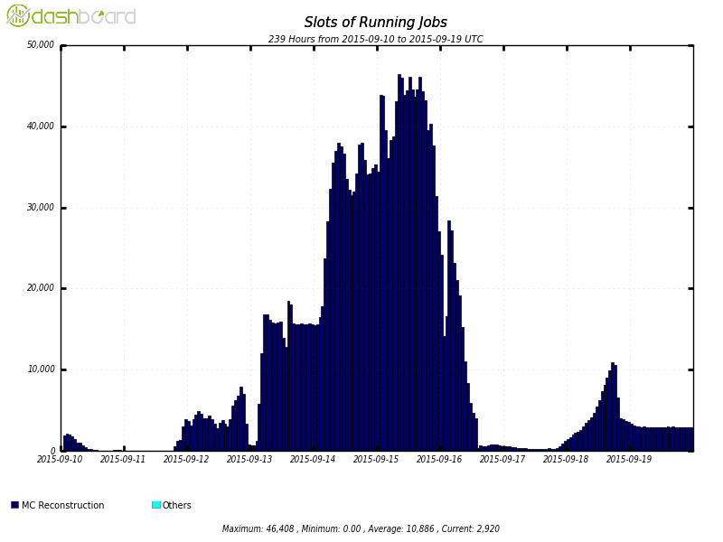
Reaching 45k slots on Amazon AWS via Panda
From John Hover,
ATLAS and BNL

Slide 23
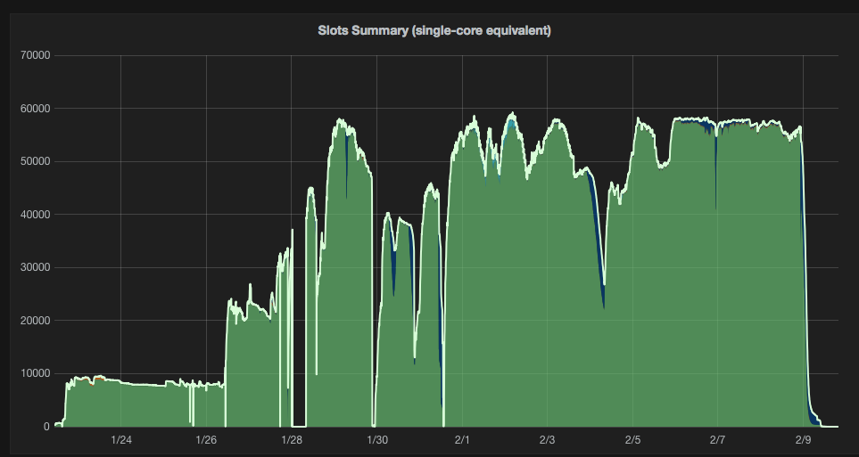
Reaching 60k slots on AWS with FNAL HEPCloud
Holzman, B., Bauerdick, L.A.T., Bockelman, B. et al. Comput Softw Big Sci (2017) 1: 1. https://doi.org/10.1007/s41781-017-0001-9
60000 slots
25%
BH, Bauerdick, L.A.T., Bockelman, B. et al.
Comput Softw Big Sci (2017) 1: 1.
10% Test

Slide 24
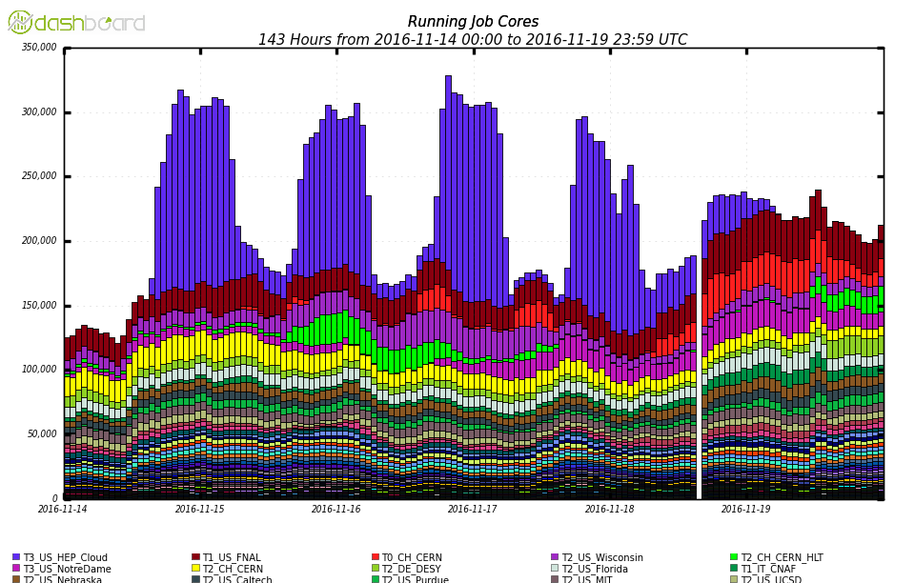
Doubling CMS’s compute reach @ Google via FNAL HEPCloud
Cores from Google

Slide 25
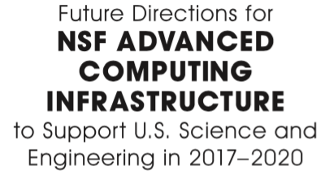
To support data-driven science, advanced computing hardware and software systems will need adequate data capabilities, in most cases more than is currently provided. Some research will need large-scale data-centric systems with data-handling capabilities that are quite different from traditional high-performance computing systems. For example, data analytics often requires that data reside on disk for extended periods. Several factors suggest that meeting these needs will require one or more large investments, rather than just multiple small projects, including the following: (1) the scale of the largest problems, (2) the opportunities for new science when disparate data sets are colocated, and (3) the cost efficiencies that come from consolidating facilities. Indeed, the growth in data-driven science suggests that investments will ultimately be needed on a scale comparable to those that support modeling and simulation. At the very least, the systems should be better balanced for data (input/ output and perhaps memory size), thereby allowing the same systems to be used for different problems without needing to double the size of the resources. As data play a growing role in scientific discovery, long-term data management will become an important aspect of all planning for advanced computing. A partnership with a commercial cloud provider could provide access to larger systems than NSF could afford to deploy on its own. Of course, even as it moves to provide better support for data- driven research, NSF cannot neglect simulation and modeling research.
Recommendation 2.2. NSF should (a) provide one or more systems for applications that require a single, large, tightly coupled parallel computer and (b) broaden the accessibility and utility of these large-scale platforms by allocating high-throughput as well as high-performance workflows to them.
Notes:
Move later in the talk

Slide 26
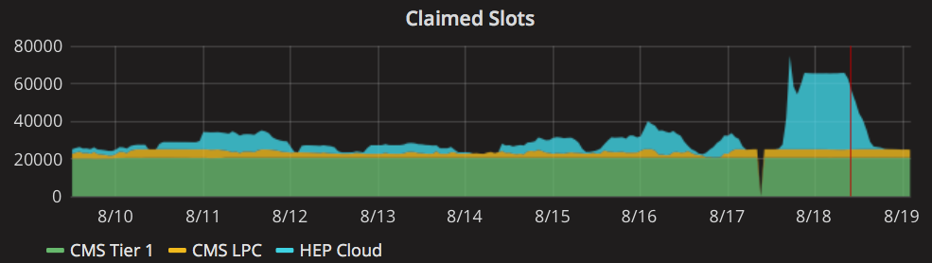
HEP use of DOE HPC facilities – two examples
Month
CMS Slots @ NERSC via HEPCloud
CMS concurrent cores on Cori

Slide 27
Bird’s-eye View
Compute
Network
Storage
On-Prem
Cache
On-Prem
Cloud
Cloud
HPC
Cache
Cache

Slide 28
Workflow and Data Management
The community has built experiment-agnostic workflow/provisioning tools based on pilot paradigms
  Single-experiment (PanDa)
  General purpose (glideinWMS, Dirac)
Vaandering’s Law: Any discussion of workflow management evolves into a discussion on data management
Data management solutions
  Do bookkeeping but also data placement/transfers
  Often tightly integrated with experiment (DQ2, PhEDEx, …)
  General-purpose solutions are advancing (FIFE, Rucio, …)

Slide 29
Networking
We (HEP scientists) treat networking not as a first-class resource
but as a utility
We try to ensure we
have enough capacity
(with added safety
factors)
We only care about the
size of the pipe when
it gets clogged
And then we
desperately call
the experts (1-800-ESNet?)

Slide 30
Challenge: distributed storage management
Domain scientists should only manage data silos
General solutions for data placement and transfer are a step forward, but
A storage management system should handle
  Managing data caches close to compute silos
  Triggering data transfers and placement
  Apportioning network bandwidth (with latency guarantees) – treating network as a first class resource
This imposes requirements on the application side
  Need to request network the same way we request cores, memory, local disk
Could be rolled into “smart” networks?

Slide 31
Storage and Networking at the Facility
HPC
Cache
Distributed, reliable, performant storage cache that
scales to the size of the computational resource
Good networking between the cache and compute workers
Wide networks between the cache and ESNet

Slide 32
FNAL experience - archival storage
Offline long-term archival storage
  Demands of high reliability for archival storage (every collision is sacred!)
  Tape continues to be the best bang for the buck
    Roughly 2.5x less in TCO
  But we constantly re-evaluate these assumptions
  Recall rates for HL-LHC may be problematic

Slide 33
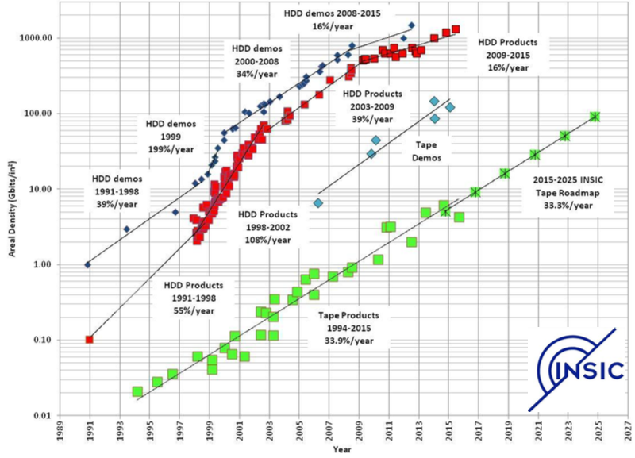
Areal Density for Tape still has room to grow

Slide 34
FNAL experience - near-line storage
At Fermilab
  dCache provides 34 PiB, EOS 5 PB
  Storage servers currently entirely hardware RAID (but we are evaluating moving to JBODs under ZFS) - Longer-term (>5 years) evaluation in
Evolution of near-line
  One component in a multi-level hierarchial storage model
  Programmable (object) storage
    Many solutions in industry – complete or just layers (Ceph, HDFS, GPFS, etc.) that

Slide 35
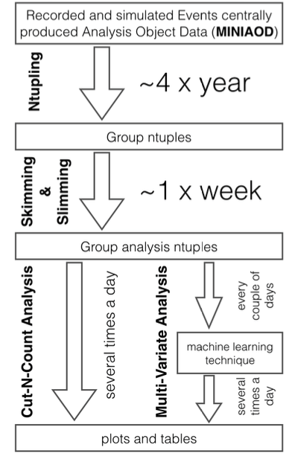
Analysis – also a conveyor belt
New toolkits and systems collectively called “Big Data” technologies have emerged to support the analysis of petabyte and exabyte datasets in industry.
Three-fold goal in HEP using
Big Data
  Reduce time to physics
  Educate grad students/postdocs in data science skills
  Leverage advances in toolkits outside of HEP

Slide 36
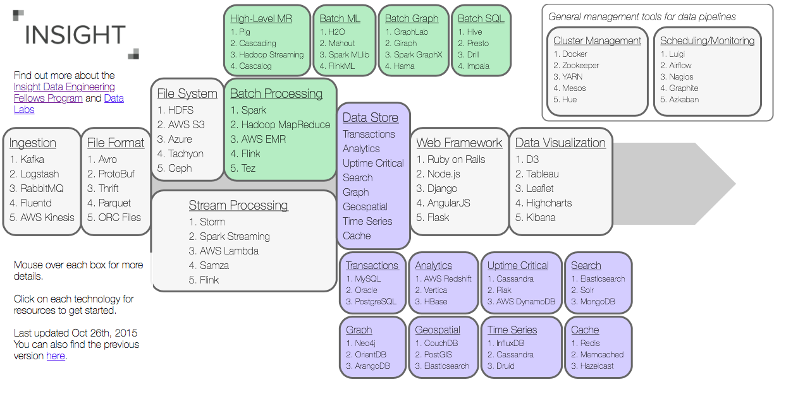
Rich landscape of Big Data tools

Slide 37

”New” analysis methodologies
Machine Learning
  ”Cybernetics” (1940s), ”Artificial Neural Networks” (1990s)
    Marginal recognition in HEP
    “Ten years ago there was a great deal of excitation about NN in HEP. Many people felt that a revolution in HEP computing was in the works. It is perhaps a bit disappointing today to see that although NN have gained some measure of acceptance, the networks making their way into physics papers are still simple
    [ … ] and often quite small ones at that.”
      Neural networks in high energy physics: a ten year perspective.” Denby, B. CPC 199 (1999)
Industry has caught up and surpassed us
  More data, more compute, more model complexity

Slide 38
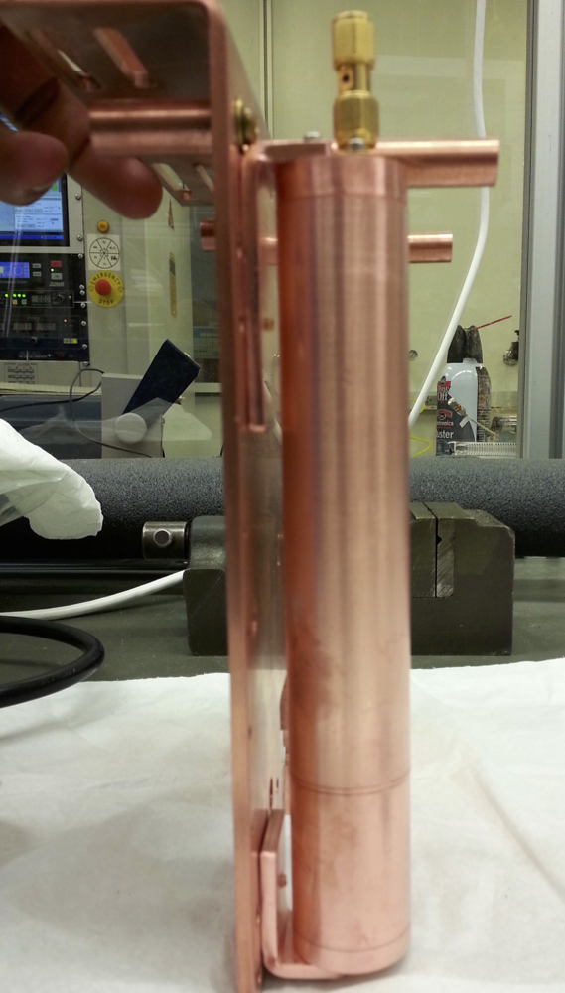
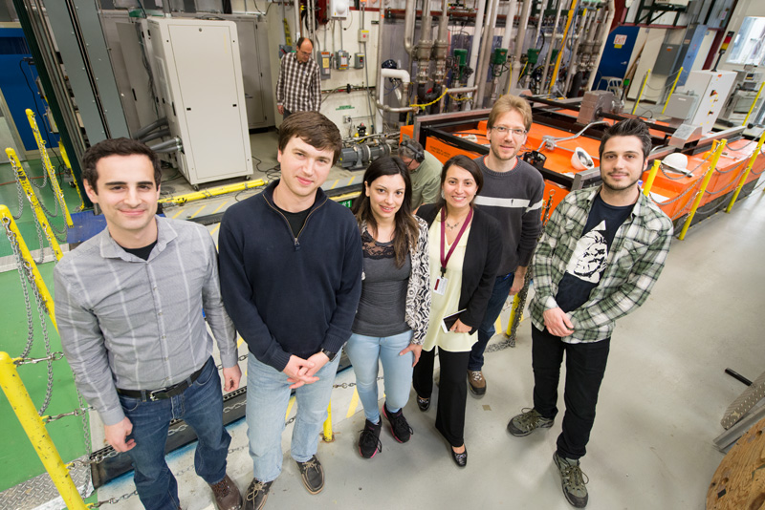
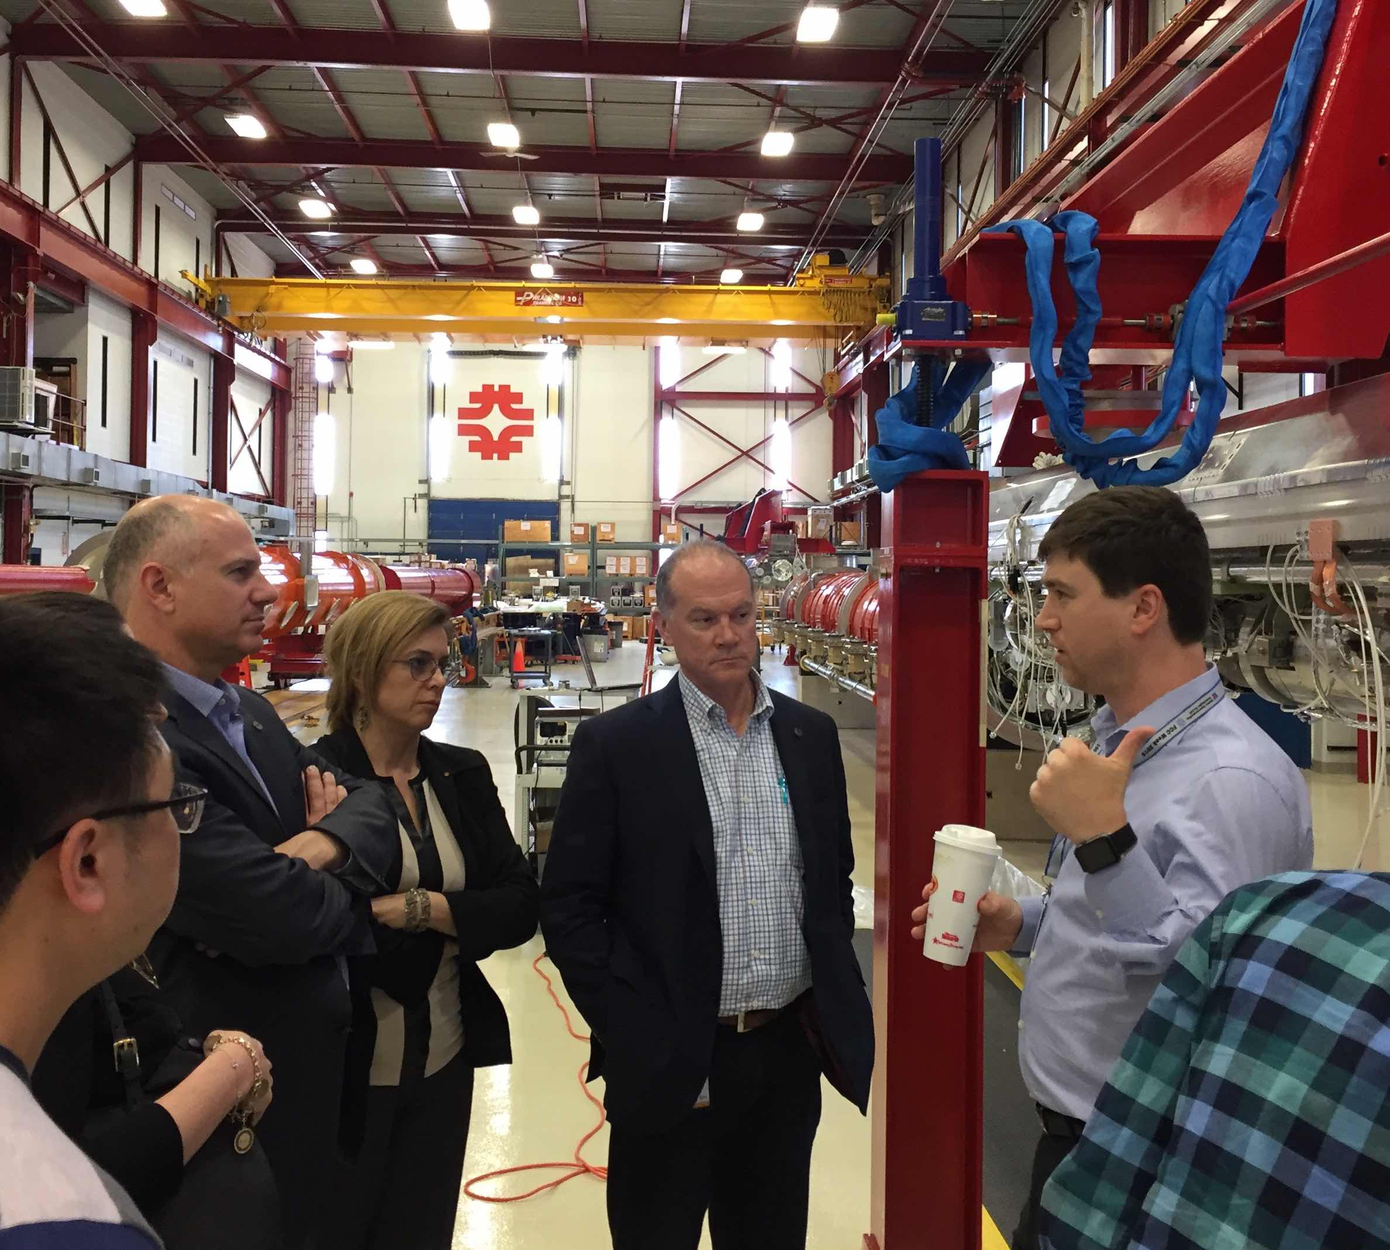
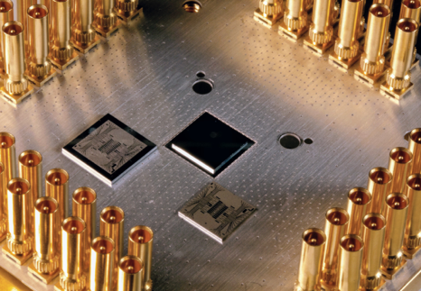
Quantum Computing
Quantum sensors
  Adapting quantum devices for use as quantum sensors for particle physics experiments such as direct dark matter detection
Superconducting technologies
  Some quantum computers use superconducting cavities similar to those we develop for accelerators.
Quantum networks
  We have agreed to host a quantum network on site in collaboration with Caltech and AT&T
Quantum Algorithm development
  Preliminary efforts using quantum optimization, quantum approaches to machine learning and partial differential equations
Quantum Testbed Project with Google
  Use new Google quantum computing hardware
  Provide interface between quantum computing hardware designers and quantum information scientists
  Working toward a true quantum computing user facility
Quantum sensors for axion search LDRD by Aaron Chou, Andrew Sonnenschein, and Dan Bowring
Fermilab SRF group is in a R&D collaboration with U. Chicago, ANL
Quantum networks visit with John Donovan of AT&T
Google’s 22 qubit Xmon quantum processing unit (QPU) in its wiring mount, currently in test

Slide 39
Summary
Data, Data, Data!
  Facilities must evolve to support high throughput computing as a key science stakeholder
  We need general-purpose robust storage and cache management solutions across distributed networks
  We need smart networks to interconnect the two as we treat the ”network as a resource”
Partnerships in industry will help: “data science” is a field
  ”New” analysis methodologies
  Co-design: continue optimizing hardware and software for each other

Slide 40
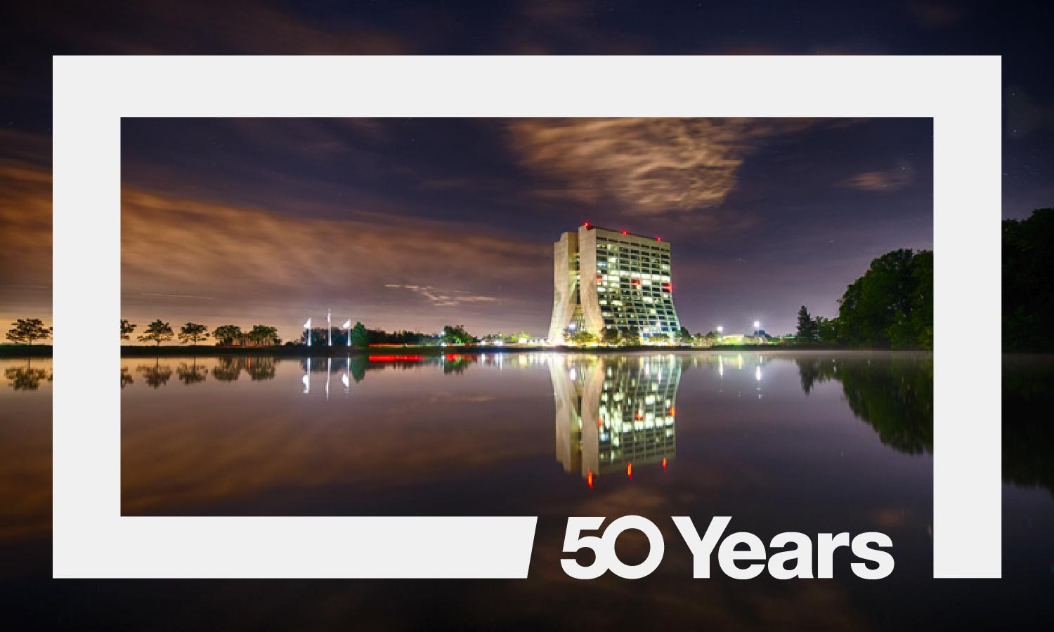
2017 is Fermilab’s 50th Anniversary!
Visit http://50.fnal.gov/ for anniversary-related events and content

Slide 41
Backup

Slide 42
Analysis - A multi-step process
Interactivity is the key to successful analysis: “Search for the needle in the haystack”
  Select events, calculate new properties, train neutral nets, etc.
Current Analysis Workflow
  Touches only a subset of the total data volume, but subset varies from analysis to analysis
  Complicated multi-step workflow because dataset is too large for interactive analysis
    Slimming & Skimming, analysis dependent
    Calculation of new quantities
    Rerun framework code (b-tagging with non-default parameters, etc.)
    Recipes on top of centrally produced samples to correct problems/mistakes
  Can take weeks using GRID resources and local batch
  Not all time spent is actual CPU, a lot of time is bookkeeping, resubmission of failed jobs, etc.
Input:
  Centrally produced output of reconstruction software, reduced content optimized for analysis
Ntupling:
  Convert into format suited for interactive analysis (still too big for interactive analysis)
Skimming & Slimming:
  Reduce number of events and information content

Slide 43
Memory and Storage

Slide 44
Open Science Grid and HEP
HTCondor
HTCondor-CE
SSH-based Compute Elements (BOSCO)
HDFS
Load-balanced GridFTP
Squid fallback proxies
CVMFS server stratum 1
Singularity
Worker node client
ATLAS, CMS connect
T3-in-a-box
Parrot
Network services
End-to-end testing
Accounting (GRACC) data and dashboards
Authoritative naming, network meshes
WLCG accounting reports
glideinWMS factories
OSG Certificate Authority
Globus GSI infrastructure, VOMS, LCMAPS, fetch-fcrl, IGTF CA bundle
Security advisories & alerts, 24/7 CSIRT-like response, 24/7 ticketing and ticket exchange with EGI, XSEDE
Aggregated network performance data (incuding archival)
Ticketing capabilities for software/support
Global compatibility of software (WLCG, GDB)
Representation in NSF, DOE, other cybersecurity communities
Network analysis and coordination

Slide 45
Drivers for Evolving the Facility: Capacity and Cost
High Energy Physics computing needs will be 10-100x current capacity
  Two new programs coming online (DUNE, High-Luminosity LHC), while new physics search programs (Mu2e) will be operating
Scale of industry at or above R&D
  Commercial clouds offering increased value for decreased cost compared to the past
Price of one core-year on
Commercial Cloud

Slide 46
Drivers for Evolving the Facility: Elasticity
Usage is not steady-state
Computing schedules driven by real-world considerations (detector, accelerator, …) but also ingenuity – this is research and development of cutting-edge science
NOvA jobs in the queue at FNAL
Facility size

Slide 47
HEPCloud: the Evolved Facility
Vision Statement
  HEPCloud is envisioned as a portal to an ecosystem of diverse computing resources commercial or academic
  Provides “complete solutions” to users, with agreed upon levels of service
  The Facility routes to local or remote resources based on workflow requirements, cost, and efficiency of accessing various resources
  Manages allocations of users to target compute engines
Pilot project to explore feasibility, capability of HEPCloud
  Goal of moving into production during FY18
  Seed money provided by industry

Slide 48
HEPCloud Collaborations
Participate in collaboration to leverage tools and experience whenever possible
Grid technologies – Worldwide LHC Computing Grid
  Preparing communities for distributed computing
BNL and ATLAS, ANL – engaged in next HEPCloud phase
HTCondor – common provisioning interface
CMS, IF experiments – collaborative knowledge and tools, cloud-capable workflows
CERN faces similar challenges and we are having productive conversations with different facets
  For example - CERN openlab CTO is engaged in HEPCloud

Slide 49
HEPCloud Architecture

Slide 50
HEPCloud – glideinWMS and HTCondor
HTCondor Schedulers
HTCondor
Central Manager
condor submit
HTCondor Schedulers
VO Frontend
Frontend
Pull Job
Cloud Provider
GlideinWMS Factory
Virtual Machine
HTCondor-G
VM
Glidein
HTCondor
Startd
Job
Grid Site
Local Resources
High Performance Computers
Virtual Machine
Virtual Machine
Virtual Machine
Job
Job
Job

Slide 51
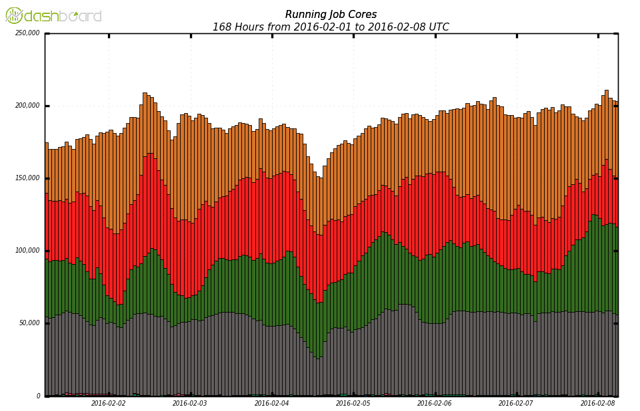
HEPCloud AWS: 25% of CMS global capacity
Production
Analysis
Reprocessing
Production on AWS
via FNAL HEPCloud

Slide 52
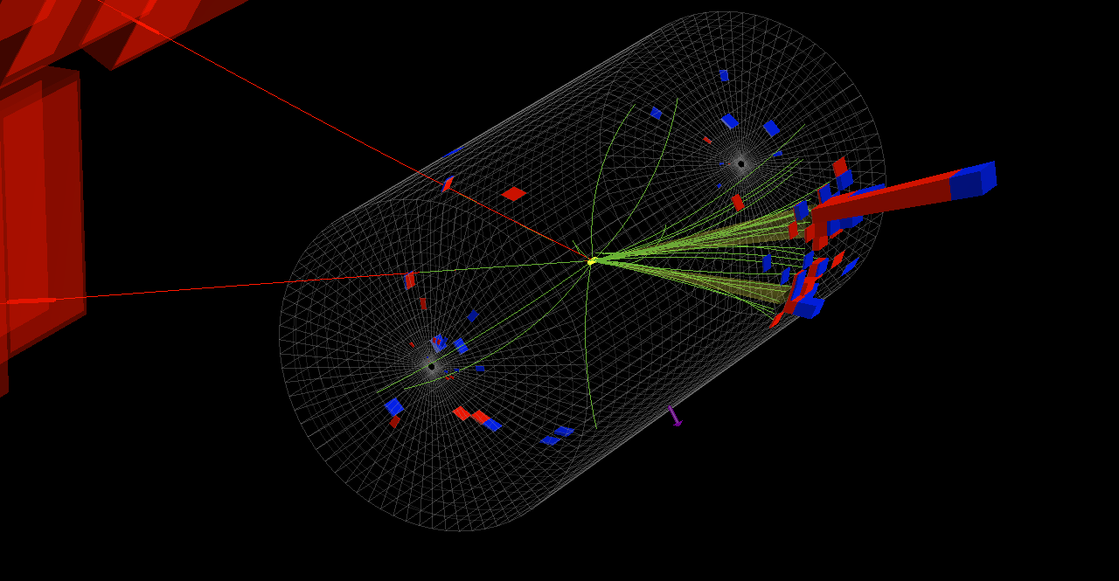
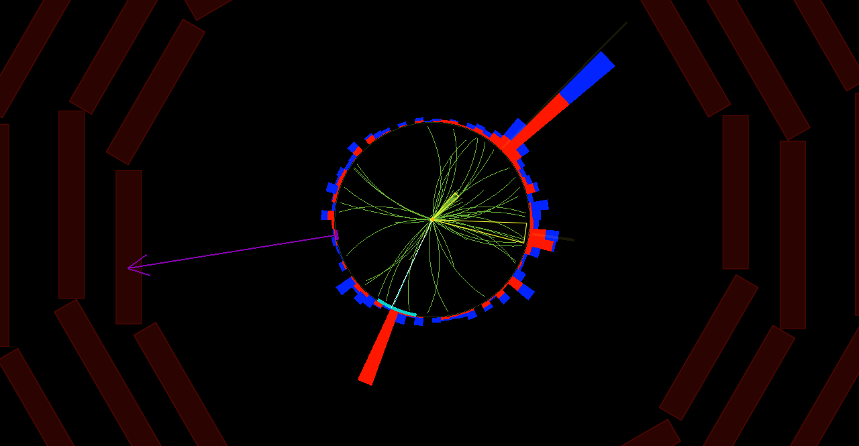
Results from the Jan 2016 CMS Use Case
All CMS simulation requests fulfilled for conference
  2.9 million jobs, 15.1 million wall hours
    9.5% badput – including preemption
    87% CPU efficiency
  518 million events generated

Slide 53
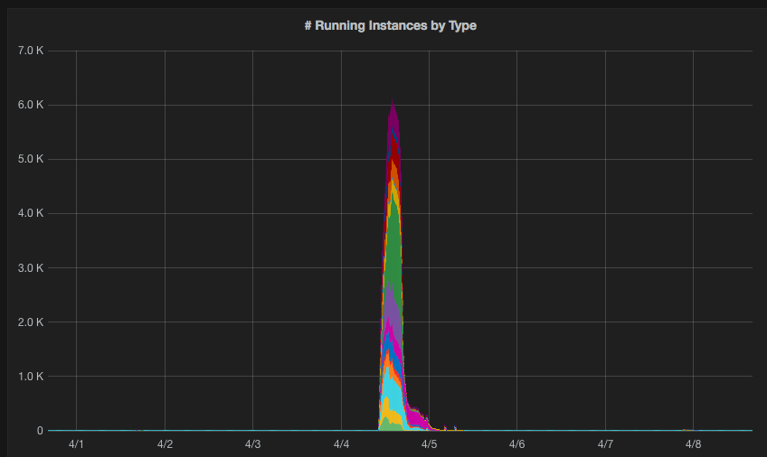
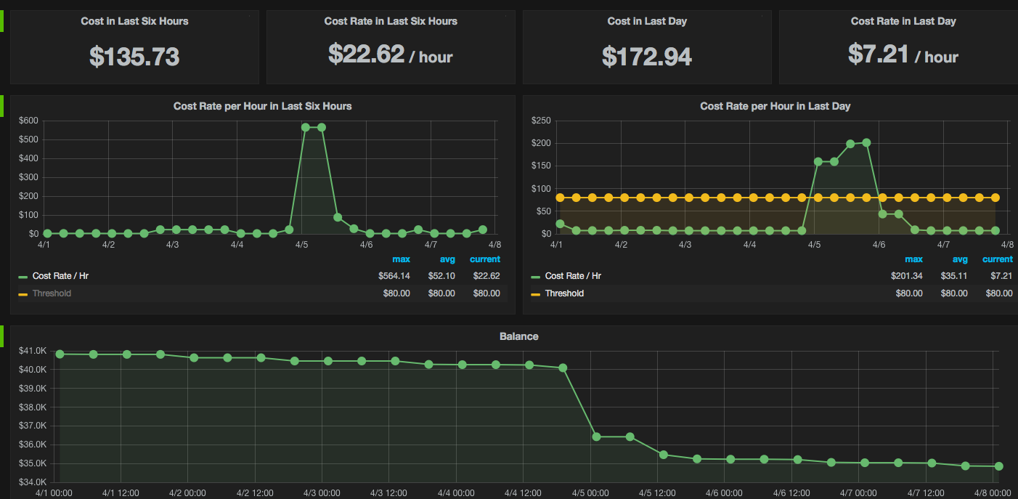
HEPCloud: Orchestration
7000
Monitoring and Accounting
  Synergies with FIFE monitoring projects
    But also monitoring real-time expense
  Feedback loop into Decision Engine
Cloud
Instances by type
600
$/Hr

Slide 54
Results from the Jan 2016 CMS Use Case
All CMS simulation requests fulfilled for conference
  2.9 million jobs, 15.1 million wall hours
    9.5% badput – including preemption
    87% CPU efficiency
  518 million events generated
Supercomputing 2016
  Aiming to generate* 1 Billion events in 48 hours during Supercomputing 2016
  Double the size of global CMS computing resources
* 35% filter efficiency – 380 million events staged out

Slide 55
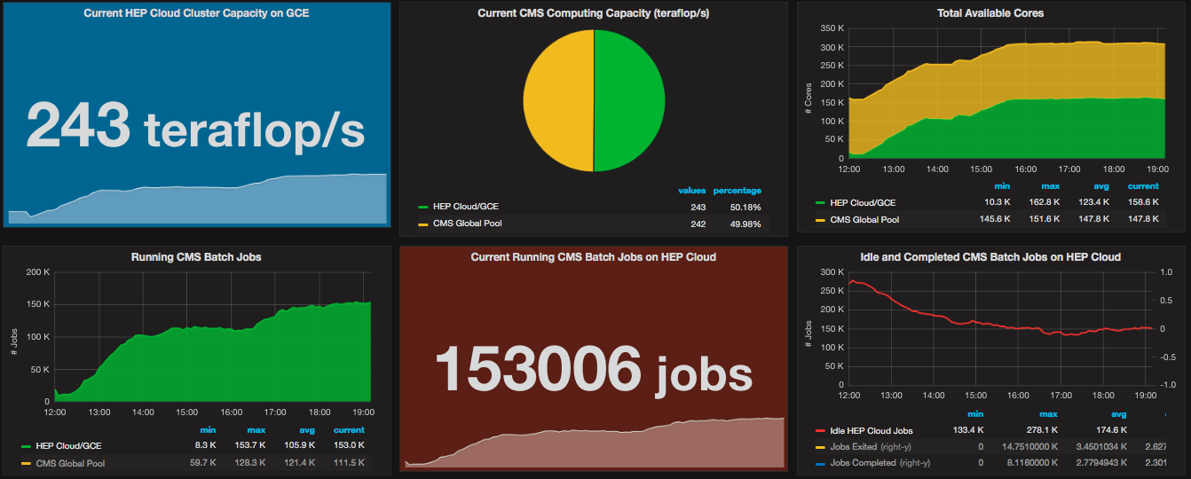
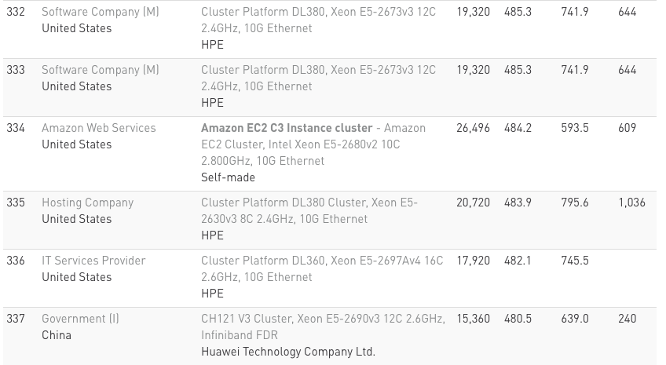
https://fifemon.fnal.gov/hcf/dashboard/db/hep-cloud-demo?from=now-12h&to=1479172229000
485
334 on the Top500 list?

Slide 56
Doubling CMS compute capacity
Cores from Google

Slide 57
CMS @ Google – preliminary numbers
6.35 M wallhours used; 5.42 M wallhours for completed jobs.
  730172 simulation jobs submitted; only 47 did not complete through the CMS and HEPCloud fault-tolerant infrastructures
  Most wasted hours during ramp-up as we found and eliminated issues; goodput was at 94% during the last 3 days.
Used ~$100k worth of credits on Google Cloud during Supercomputing 2016
  $71k virtual machine costs
  $8.6k network egress
  $8.5k disk attached to VMs
  $3.5k cloud storage for input data
205 M physics events generated, yielding 81.8 TB of data

Slide 58
On-premises vs. cloud cost comparison - AWS
Average cost per core-hour
  On-premises resource: .9 cents per core-hour
    Includes power, cooling, staff
  Off-premises at AWS: 1.4 cents per core-hour
    Ranged up to 3 cents per core-hour at smaller scale
Benchmarks
  Specialized (“ttbar”) benchmark focused on HEP workflows
    On-premises: 0.0163 (higher = better)
    Off-premises: 0.0158
Raw compute performance roughly equivalent
Cloud costs larger – but approaching equivalence
  Still analyzing Google data; back-of-envelope ~ 1.6 cents per core-hour

Slide 59
HEPCloud Compute and HPC
A very appealing possibility, as we are approaching the exascale era, is to consider HPC facilities as a potential compute resource for HEPCloud
  and, in the other direction, consider HEPCloud facility services (e.g. storage) as a potential resource for HPC facilities
Investigate use cases with workflows that will allow such utilization within the constraints of allocation, security and access policy of HPC facilities.
Initiate work with HPC facilities to fully understand constraints and requirements that will enable us to develop the HEPCloud process, policies and tools necessary for access of HPC resources

Slide 60
HEPCloud Compute and HPC
Early steps: adapt HTC workflows to HPC facilities
  MicroBooNE production on Cori @ NERSC
    Successfully downloaded the entire MicroBooNE release, including LArSoft and the art framework onto Cori, using Shifter from dockerhub.
    Executed single node tests of MicroBooNE Monte Carlo production, reading from and writing to the global scratch file system through the container
  Pythia on Mira @ ALCF: multi-parameter tuning of event generators using collider data
    MPI + multi-threading to execute 32k instances of Pythia and the Rivet analysis suite
    Spirit of code-sharing – leveraged CMS contributions to multi-thread Pythia
  CMS production on Edison, Cori @ NERSC: Provisioned resources and executed a variety of different GEN-SIM-DIGI-RECO workflows

Slide 61
HEPCloud Compute and HPC
Early steps: adapt HTC workflows to HPC facilities
  MicroBooNE production on Cori @ NERSC
  Pythia on Mira @ ALCF
  CMS production on Edison, Cori @ NERSC
Plans for 2017: HEPCloud provisioning @ NERSC
  HEPCloud allocation granted for 28 million MPP-hours
    16 million MPP-hours for intensity frontier (mu2e, MicroBooNE, NOvA, …)
    12 million MPP-hours for CMS
      CMS production will run Knight’s Landing; experiment is working to optimize and maximize efficiency
  Leverage experience with eye on leadership computing facilities

Slide 62
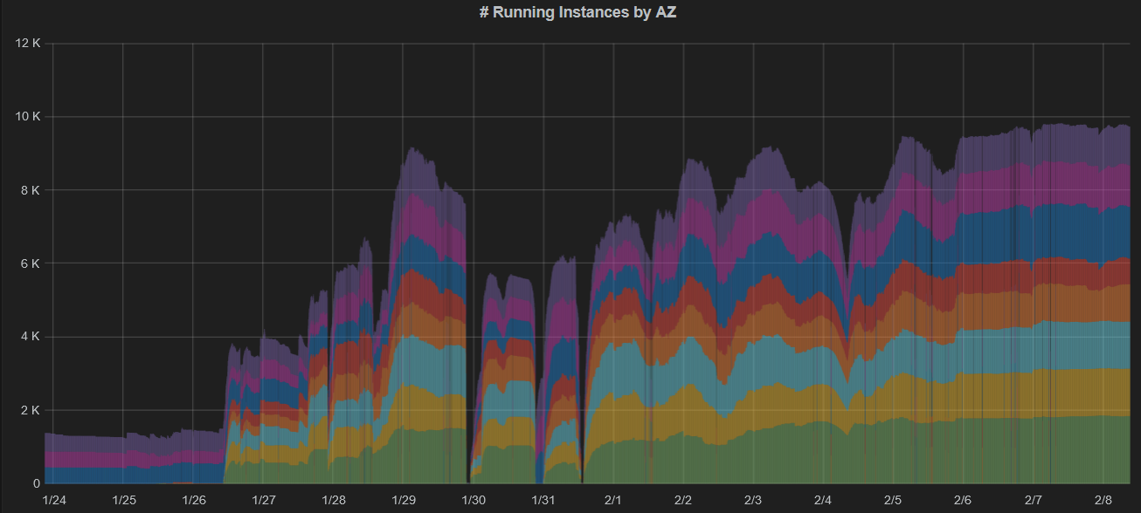
HEPCloud AWS slots by Region/Zone
Each color corresponds to a different region+zone

Slide 63
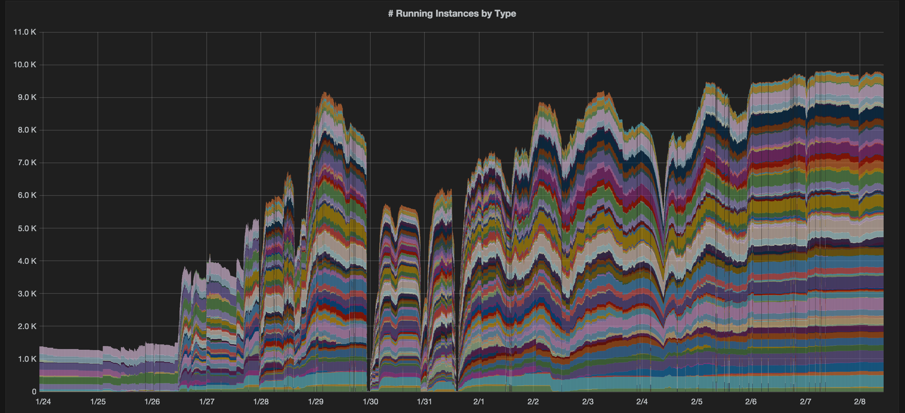
HEPCloud AWS slots by Region/Zone/Type
Each color corresponds to a different region+zone+machine type

Slide 64
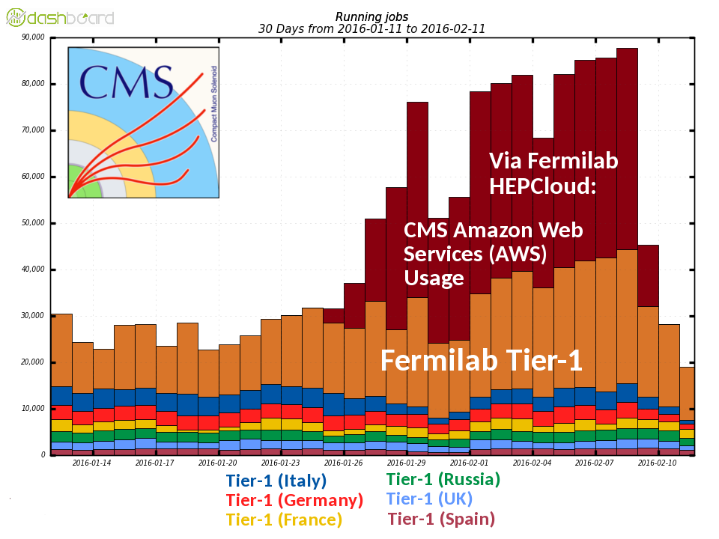
Fermilab HEPCloud compared to global CMS Tier-1

Slide 65
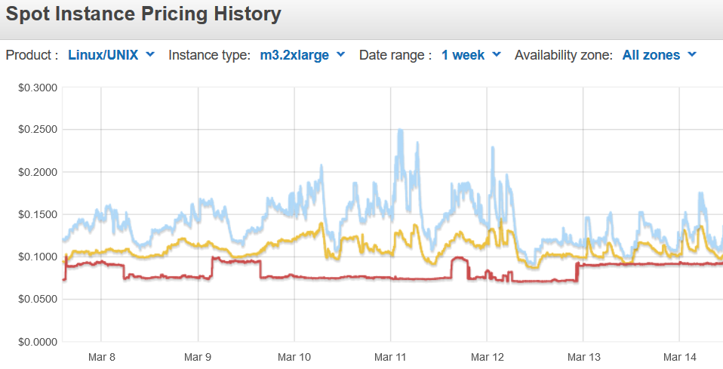
VM Pricing: using the AWS “Spot Market”
AWS has a fixed price per hour (rates vary by machine type)
Excess capacity is released to the free (“spot”) market at a fraction of the on-demand price
  End user chooses a bid price
  If (market price < bid), you pay only market price for the provisioned resource
    If (market price > bid), you don’t get the resource
  If the price fluctuates while you are running and the market price exceeds your original bid price, you may get kicked off the node (with a 2 minute warning!)

Slide 66
VM Pricing: using Google preemptible VMs
Google VMs have a fixed cost (varies by machine types)
Preemptible Google VMs are available at a significantly smaller fixed cost – 1 cent per core hour for a “standard candle”
  We saved a few percent on cost by using custom VMs (2 GB per core instead of the standard 3.75 GB per core)

Slide 67
Running on Google Cloud - Google Services
Distributing experiment code (many versions and codes)
  CVMFS: caching layer using squid web caches
  Scalable, easy-to-manage software distribution
  Good fit for Google Load Balancing
Reading input data
  Staged 500 TB of input data to Google Cloud Storage
    Standard HEP and CMS data management tools now speak http!
    Thanks to ESNet and Google for upgraded (100 Gbit+) peering!
  Mounted data using gcsfuse
    Good for big serial reads
Monitoring
  Stackdriver logging
    Splunk-like functionality – a big help for troubleshooting

Slide 68
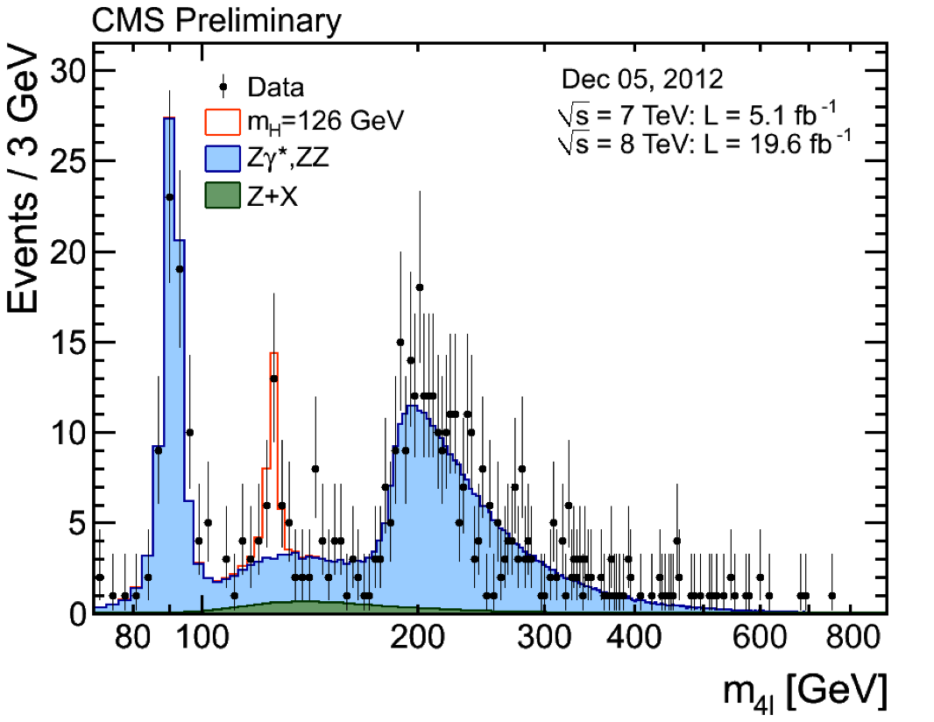
How is the science done?
Particle Physics: Statistical Science
Comparison with what we know (Standard Model)
Analyze all data and look for deviations ➜ Needle in the Haystack

Slide 69
Decision Engine – design & architecture
Decision Engine chooses what to provision next
  v1.5 implementation: Strict matching based on processing type
  v2.0 implementation: Zeroth-order prioritization based on cost
Input Agents
Cloud API
Cloud
Price, Usage,
Resource Specification
Broker/Controller
Cloud
On-premises resources
On-premises resources
Provisioner
Provisioner
State
HPC
HPC
Job manifest
Match algorithm(s)
Batch API
Job
Job

Slide 70
Pythia on Mira – Details
We incorporated MPI into the main routines, using scatter and broadcast to send out unique parameters. The plan is to start one process on each node, running 64 threads, each with an instance of the pythia-based analysis. We will do this in chunk of 128 nodes, where each chunk is a gather collection point for writing to disk.
Things were running on our x86 cluster - the porting to power PC of the build tools was the challenging part.
~150 core test

Slide 71
Description of CMS workflow
Four chained steps (output of step N is input of step N+1)
  Step 1 requires few GB input (“Gridpack”) – same files per job
  Step 2 requires additional input: “pile-up” data (simulating multiple events per bunch crossing), 5-10 GB
Pile-up data is constructed on-the-fly by random seek and sequential reads into a 500 TB dataset
    Staged pile-up datasets to Google Cloud Storage (storage service) ahead-of-time using FTS3 and PhEDEx – standard HEP grid tools and CMS data placement service

Slide 72
Reading pile-up from Google Cloud Storage
Mounted regional bucket via gcsfuse on glide-in startup to
/gcsfuse
Used HTCondor “additional_json_file” functionality to specify role tied to image

Slide 73
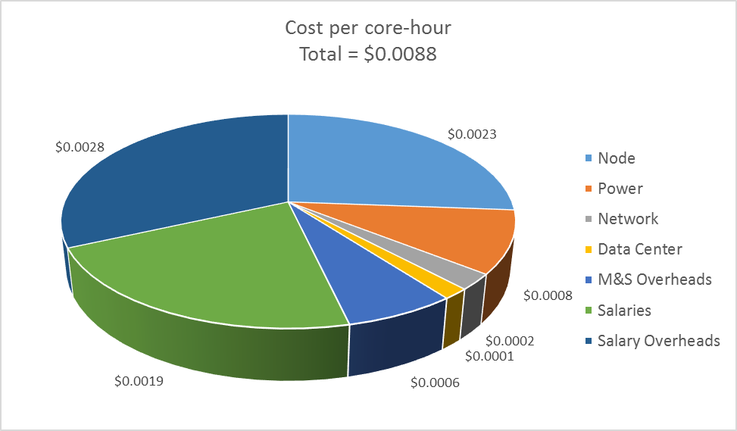
Elements of the cost per core-hour
Based on Fermilab CMS Tier-1

Slide 74

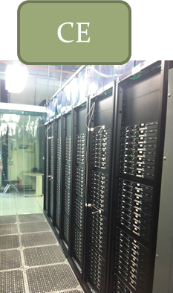


glideinWMS – Building dynamic HTCondor pools
VO Frontend (CommandControl)
CMS
Pull
VO Frontend (Command/Control)
μBooNE
Pull

Slide 75
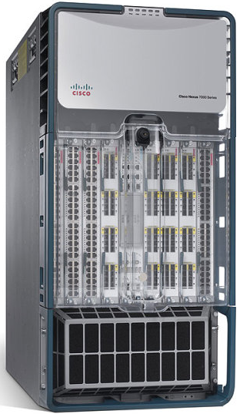
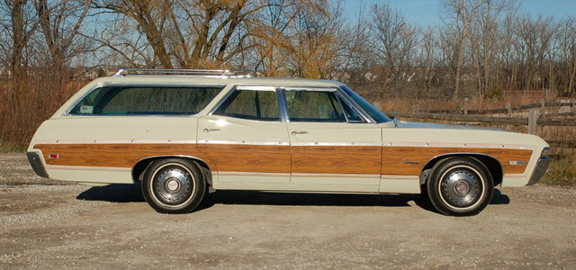
HEPCloud: Networking
All models of distributing computing rely on the performance of the underlying (local and wide-area) network
Fermilab is approaching 1 Terabit data center – connect to Energy Sciences Network (ESNet) at 4*100 Gigabit
  ESNet enables distributed computing
  beyond ESNet sites: 100 Gigabit peering points with other networks
Zone-based security protection of
network resources
On-demand (Software Defined
Network-based) traffic controls
Virtualization of network resources

Slide 76
HEPCloud: Storage
Data is the lifeblood of science
  HEP experiments generate it by the station-wagon-load
  Fermilab is a leader in the field in storing and serving petabytes of data to the world
We are working with industry and other collaborators to modernize our services
  Data storage and retrieval
  Data cataloging
  Support multiple-layer storage infrastructure approach
One part of HEPCloud is to understand how to integrate all of these components – always driven by the experiment needs, both present and future

Slide 77
User’s View of HEPCloud

Slide 78
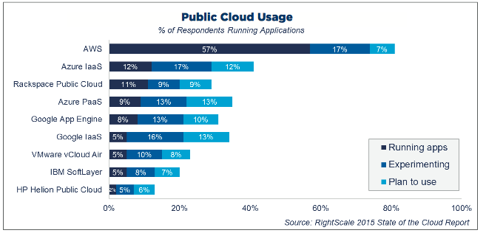
Fermilab HEPCloud: expanding to the Cloud
Reference herein to any specific commercial product, process, or service by trade name, trademark, manufacturer, or otherwise, does not necessarily constitute or imply its endorsement, recommendation, or favoring by the United States Government or any agency thereof.

Slide 79
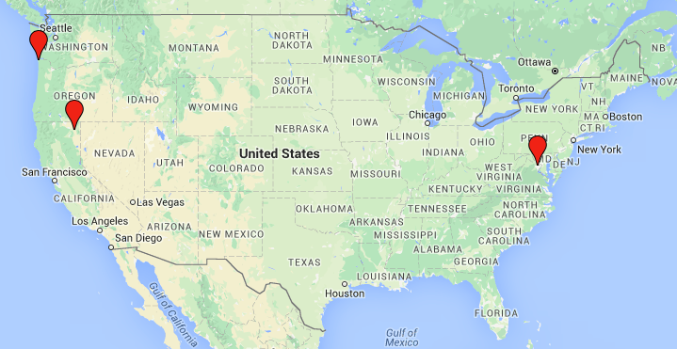
AWS topology – three US data centers (“regions”)
US-West-2
US-West-1
US-East-1
Each Data Center has 3+ different “zones”
Each zone has different “instance types”
(analogous to different types of physical machines)

Slide 80
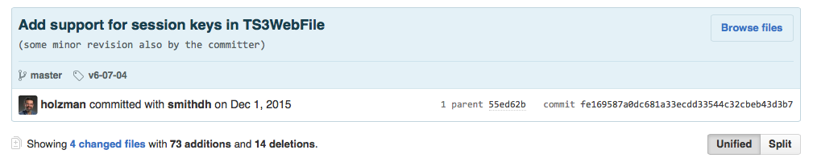
Reading pile-up from AWS S3 (storage)
AWS worker nodes granted permission to read from AWS S3 folder (“bucket”) via AWS Security-Token-Service (STS)
ROOT has a TS3WebFile class!
  But session key support was missing (needed for STS!)
This worked great, except…
This worked great!
  Except…

Slide 81
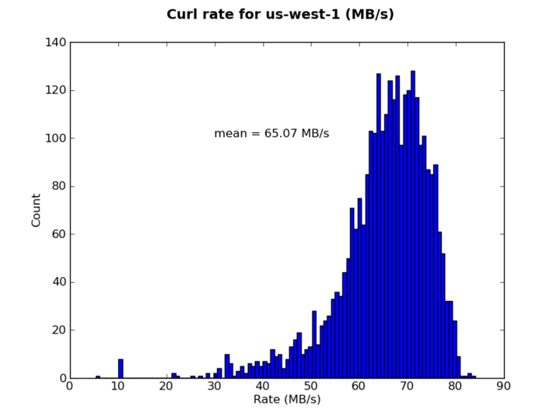
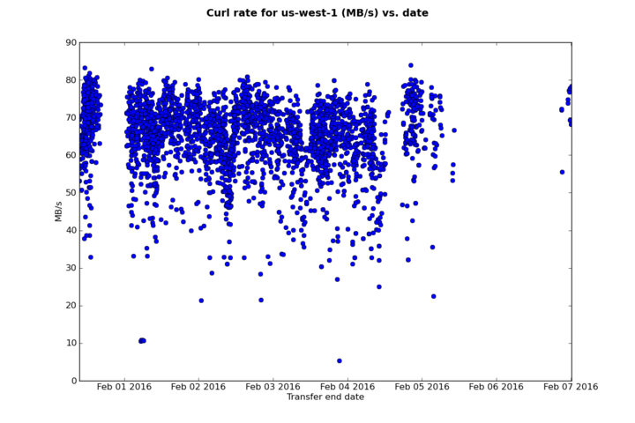
Reading pile-up from AWS S3 (storage)
Cost of data access was 30% of compute costs
  150 million HTTP GETs per hour is a lot!
Wrote a curl wrapper to provide the custom AWS authentication headers
  (Not often I can say I reduced costs by 5 orders of magnitude!)
Mean:
65 MB/s

Slide 82
Late 2016 HEPCloud Use Cases - Google
NoVA Processing
Processing the 2014/2015 dataset
16 4-day “campaigns” over one year
Demonstrates stability, availability, cost-effectiveness
Received AWS academic grant
CMS Monte Carlo Simulation
Generation (and detector simulation, digitization, reconstruction) of simulated events in time for Moriond16 conference
56000 compute cores, steady-state
Demonstrates scalability
Received AWS academic grant
CMS Monte Carlo Simulation
Generation (and detector simulation, digitization, reconstruction) of simulated events in time for Moriond17 conference
160000 compute cores during Supercomputing 2016 conference (~48 h)
Demonstrates scalability, capability
Received Google Cloud Platform grant
mu2e Processing
Simulating cosmic ray veto detector and beam particle backgrounds
3M integrated core-hours
Demonstrates rapid on-boarding
Received Google Cloud Platform grant

Slide 83
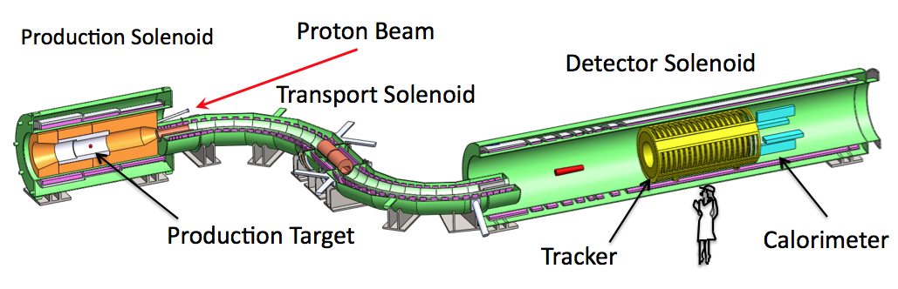
Mu2e experiment
Charged Lepton Flavor Violation is a near-universal feature of extensions to the Standard Model of particle physics
Rare muon processes offer the best combination of new physics reach and experimental sensitivity
Search for muon (in bound state) converting to an electron (“mu” to “e”)

Slide 84
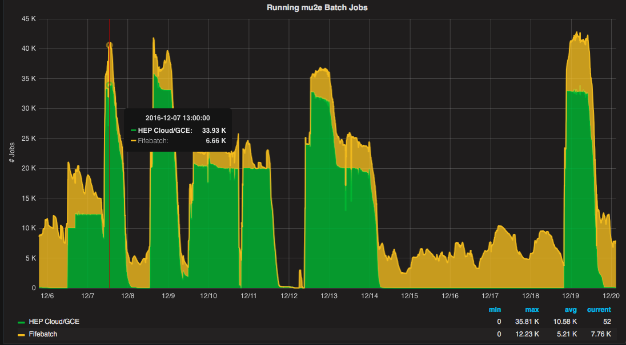
Mu2e – executing on Google Cloud

