Slide 1
SMuRF: SLAC Microresonator RF Readout
Josef Frisch for the SMuRF group,
CPAD Instrumentation Frontier Workshop 2017
Technical Innovation Directorate
Advanced Instrumentation for Research

Slide 2
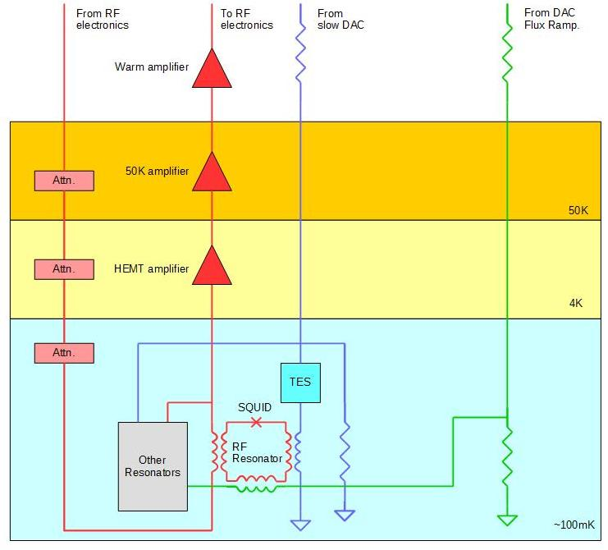
Cold System
Resonators tune with TES current
Flux Ramp eliminates 1/f noise in resonators, SQUIDS and warm electronics
MKID readout systems are similar, but no flux ramp so 1/f noise is important

Slide 3
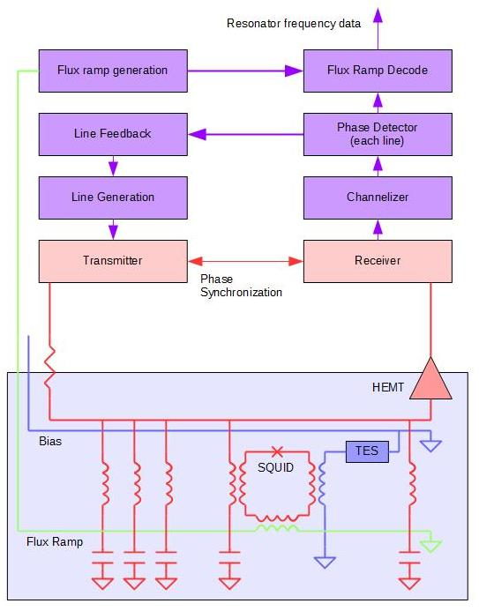
SMuRF system for TES / SQUID resonators
Generate a set of tones to excite cryogenic micro-resonators
Detect phase shifts due to resonator frequency changes
Feedback to track resonator frequencies
Drive flux ramp and detect resonator frequency vs flux ramp
Technical challenges
Noise
Linearity
Wide bandwidth
Computation power

Slide 4
Noise and Linearity
The requirement for low noise in the readout electronics is clear, but for a multi-line system linearity is also critical.
$$A=\sin\left(w_{1}t+φ\right), B=sin⁡(w_{2}t+φ)$$
$$Y=C_{1}A+C_{2}B+C_{3}A^{2}+C_{4}B^{2}+C_{5}AB+C_{6}A^{2}B+C_{7}AB^{2}+…$$
$$w_{1}, w_{2}$$
Original tones
$$2w_{1}, 2w_{2}$$
Out of band
$$w_{1}+w_{2},$$
$$w_{1}−w_{2}$$
Out of band
$$2w_{1}−w_{2}, 2w_{2}−w_{1}, other f$$
In band!
Signal band
~N³ 3rd order terms!

Slide 5
Linearity:
If the system bandwidth includes an octave or more bandwidth, 2nd order non-linear products are important (f₁-f₂) is in-band.
This can still work but requires careful design
Otherwise the first important nonlinear terms are 3rd order (f₁+f₂-f₃) which are typically smaller.
Signal levels need to trade off noise vs nonlinearity throughout the design
SMuRF uses a low gain HEMT and 50K amplifier
SMuRF design avoids octave bandwidths.
With evenly spaced lines the intermodulation products are “hidden” underneath the main lines, invisible but still there
With randomly spaced lines, the intermodulation products look like broadband noise
Linearity needs to be tested with random line spacing

Slide 6
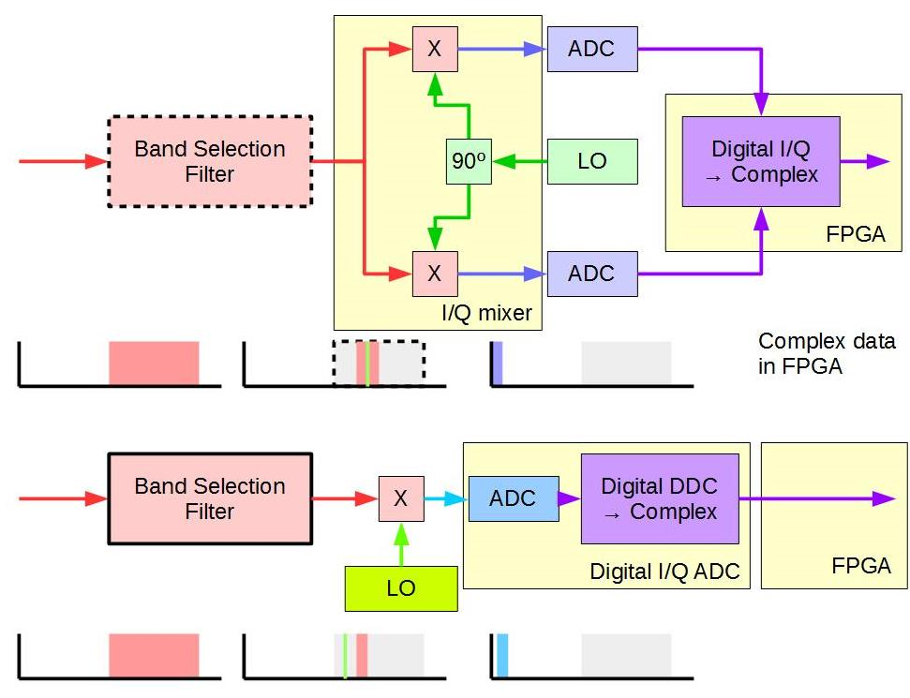
Receiver Design
Analog I/Q scheme used for many systems
Digital I/Q scheme used in SMuRF
Variety of trade-offs between analog and digital I/Q receivers
Transmitter design concepts very similar to receiver design

Slide 7
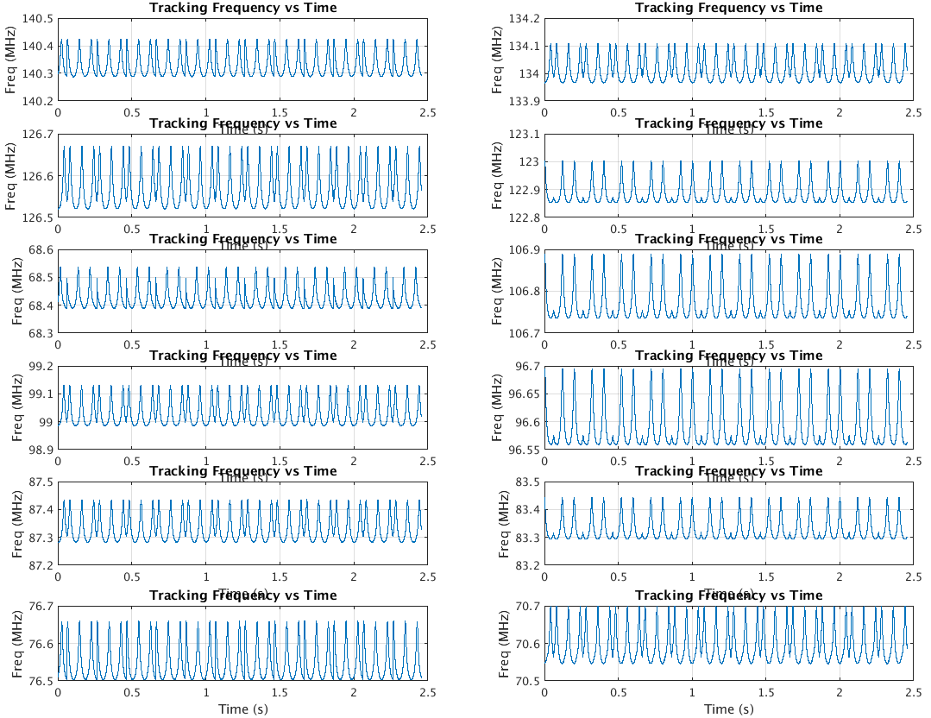
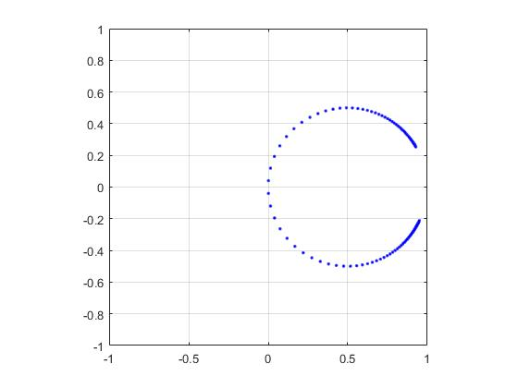
Line Tracking
Drive RF tones track resonances
Resonance dips typically 20dB which reduces the power in the receiver system for the same S/N
Same ADC/DAC hardware and bandwidths
Complex amplitude vs resonator frequency (calculation)
Low sensitivity to amplitude variation: works near a signal null
Always operates were $\frac{d\vec{V}}{df}$is maximum.
Allows use of resonators where the frequency shift > linewidth.
By including reference tones away from the resonances, also insensitive to phase shifts in cables / electronics
Tracking 12 cryogenic resonators with flux ramp using earlier generation hardware

Slide 8
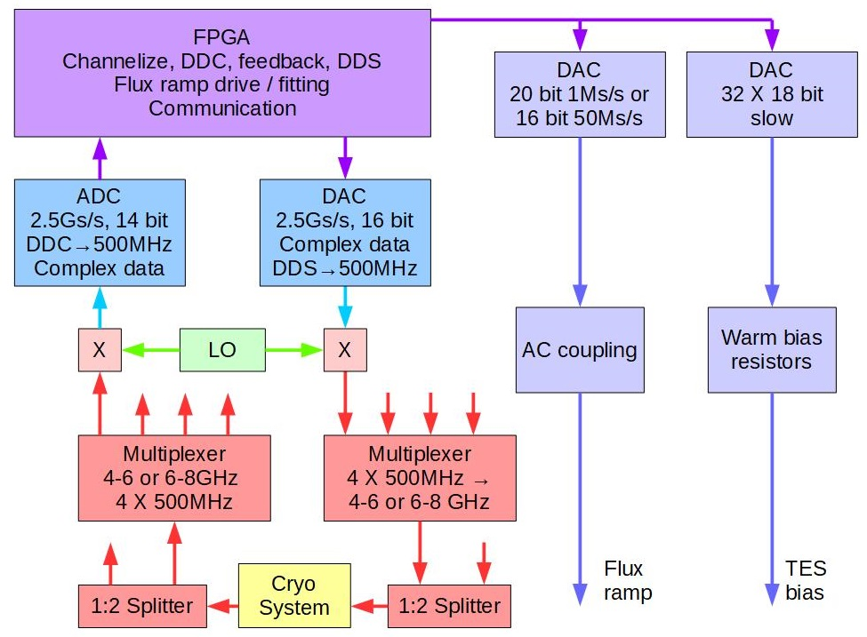
SMuRF Block Diagram

Slide 9
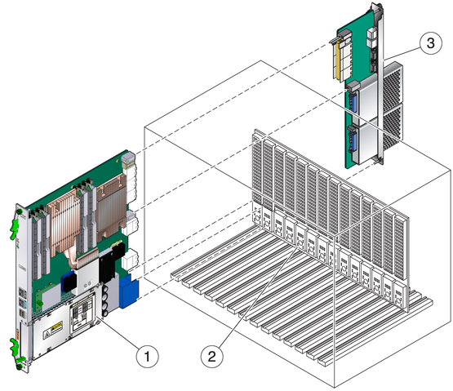
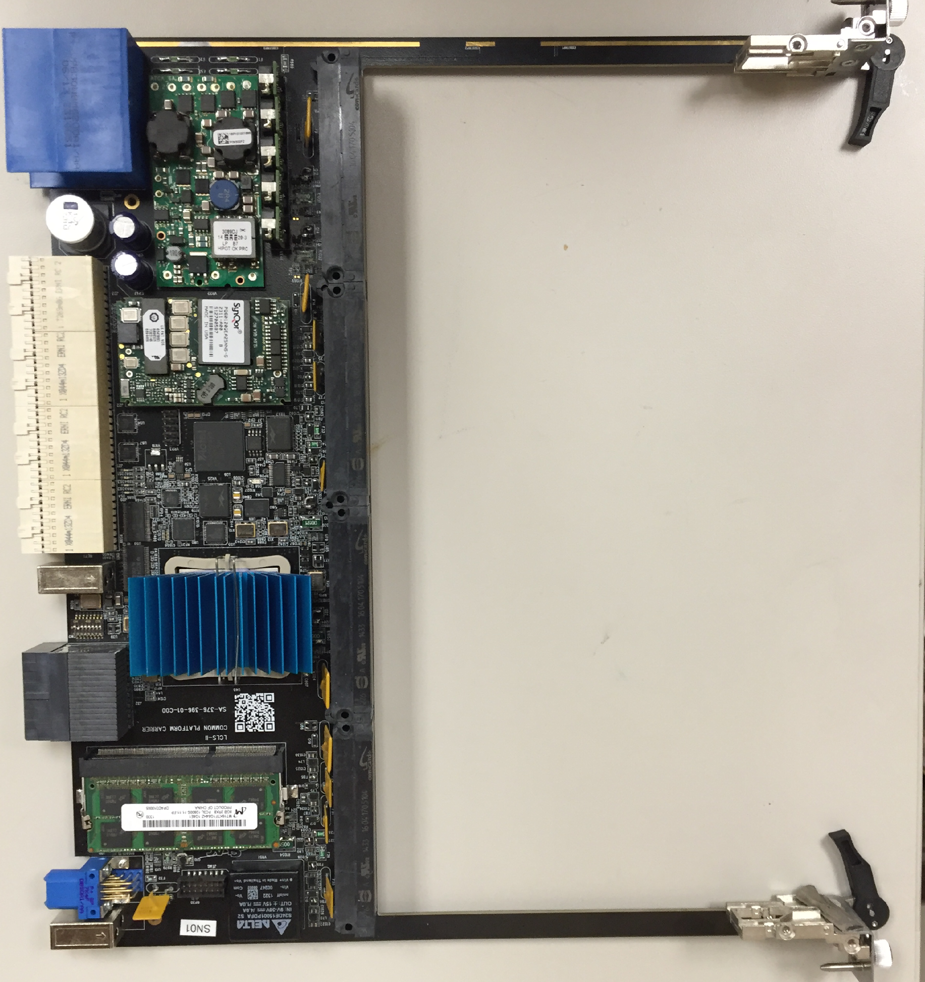
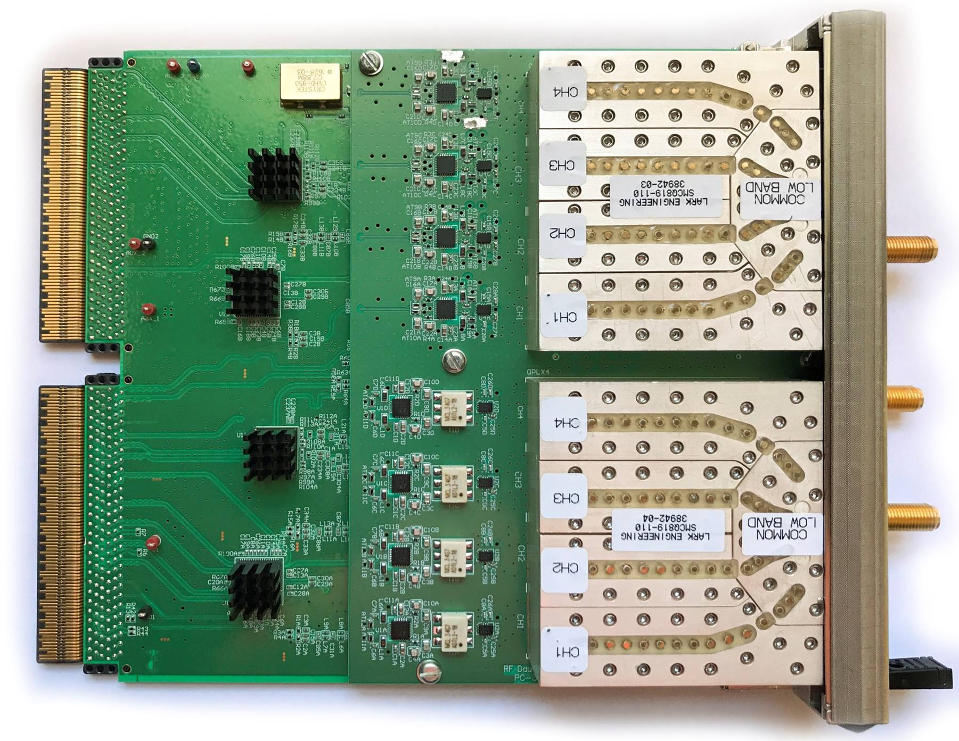
SLAC Hardware Configuration (ATCA common platform)
1: Carrier Card (Xilinx KU060, 2.7K slices)
2: Crate (ATCA, 1-14 slot available)
3: RTM
Each carrier supports 2 AMC application cards
Carrier card: FPGA, memory, backplane connections
AMC cards: ADCs, DACs, high performance front end electronics
RTM: General purpose IO, extra networks, miscellaneous

Slide 10
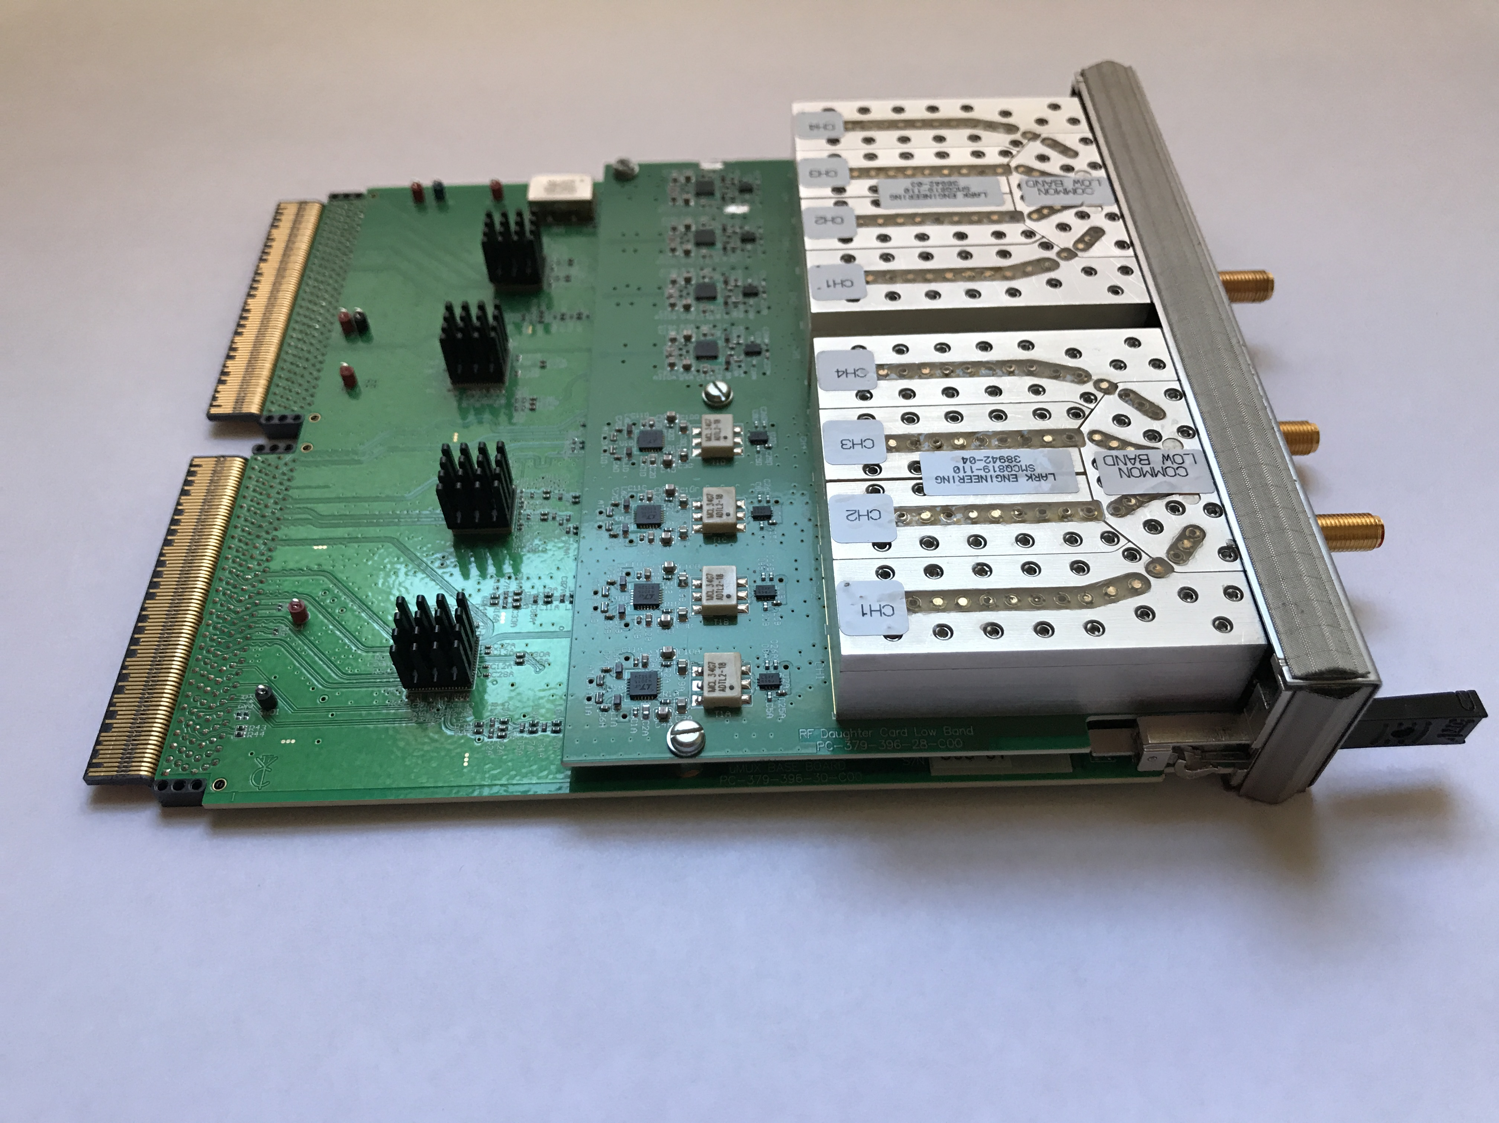
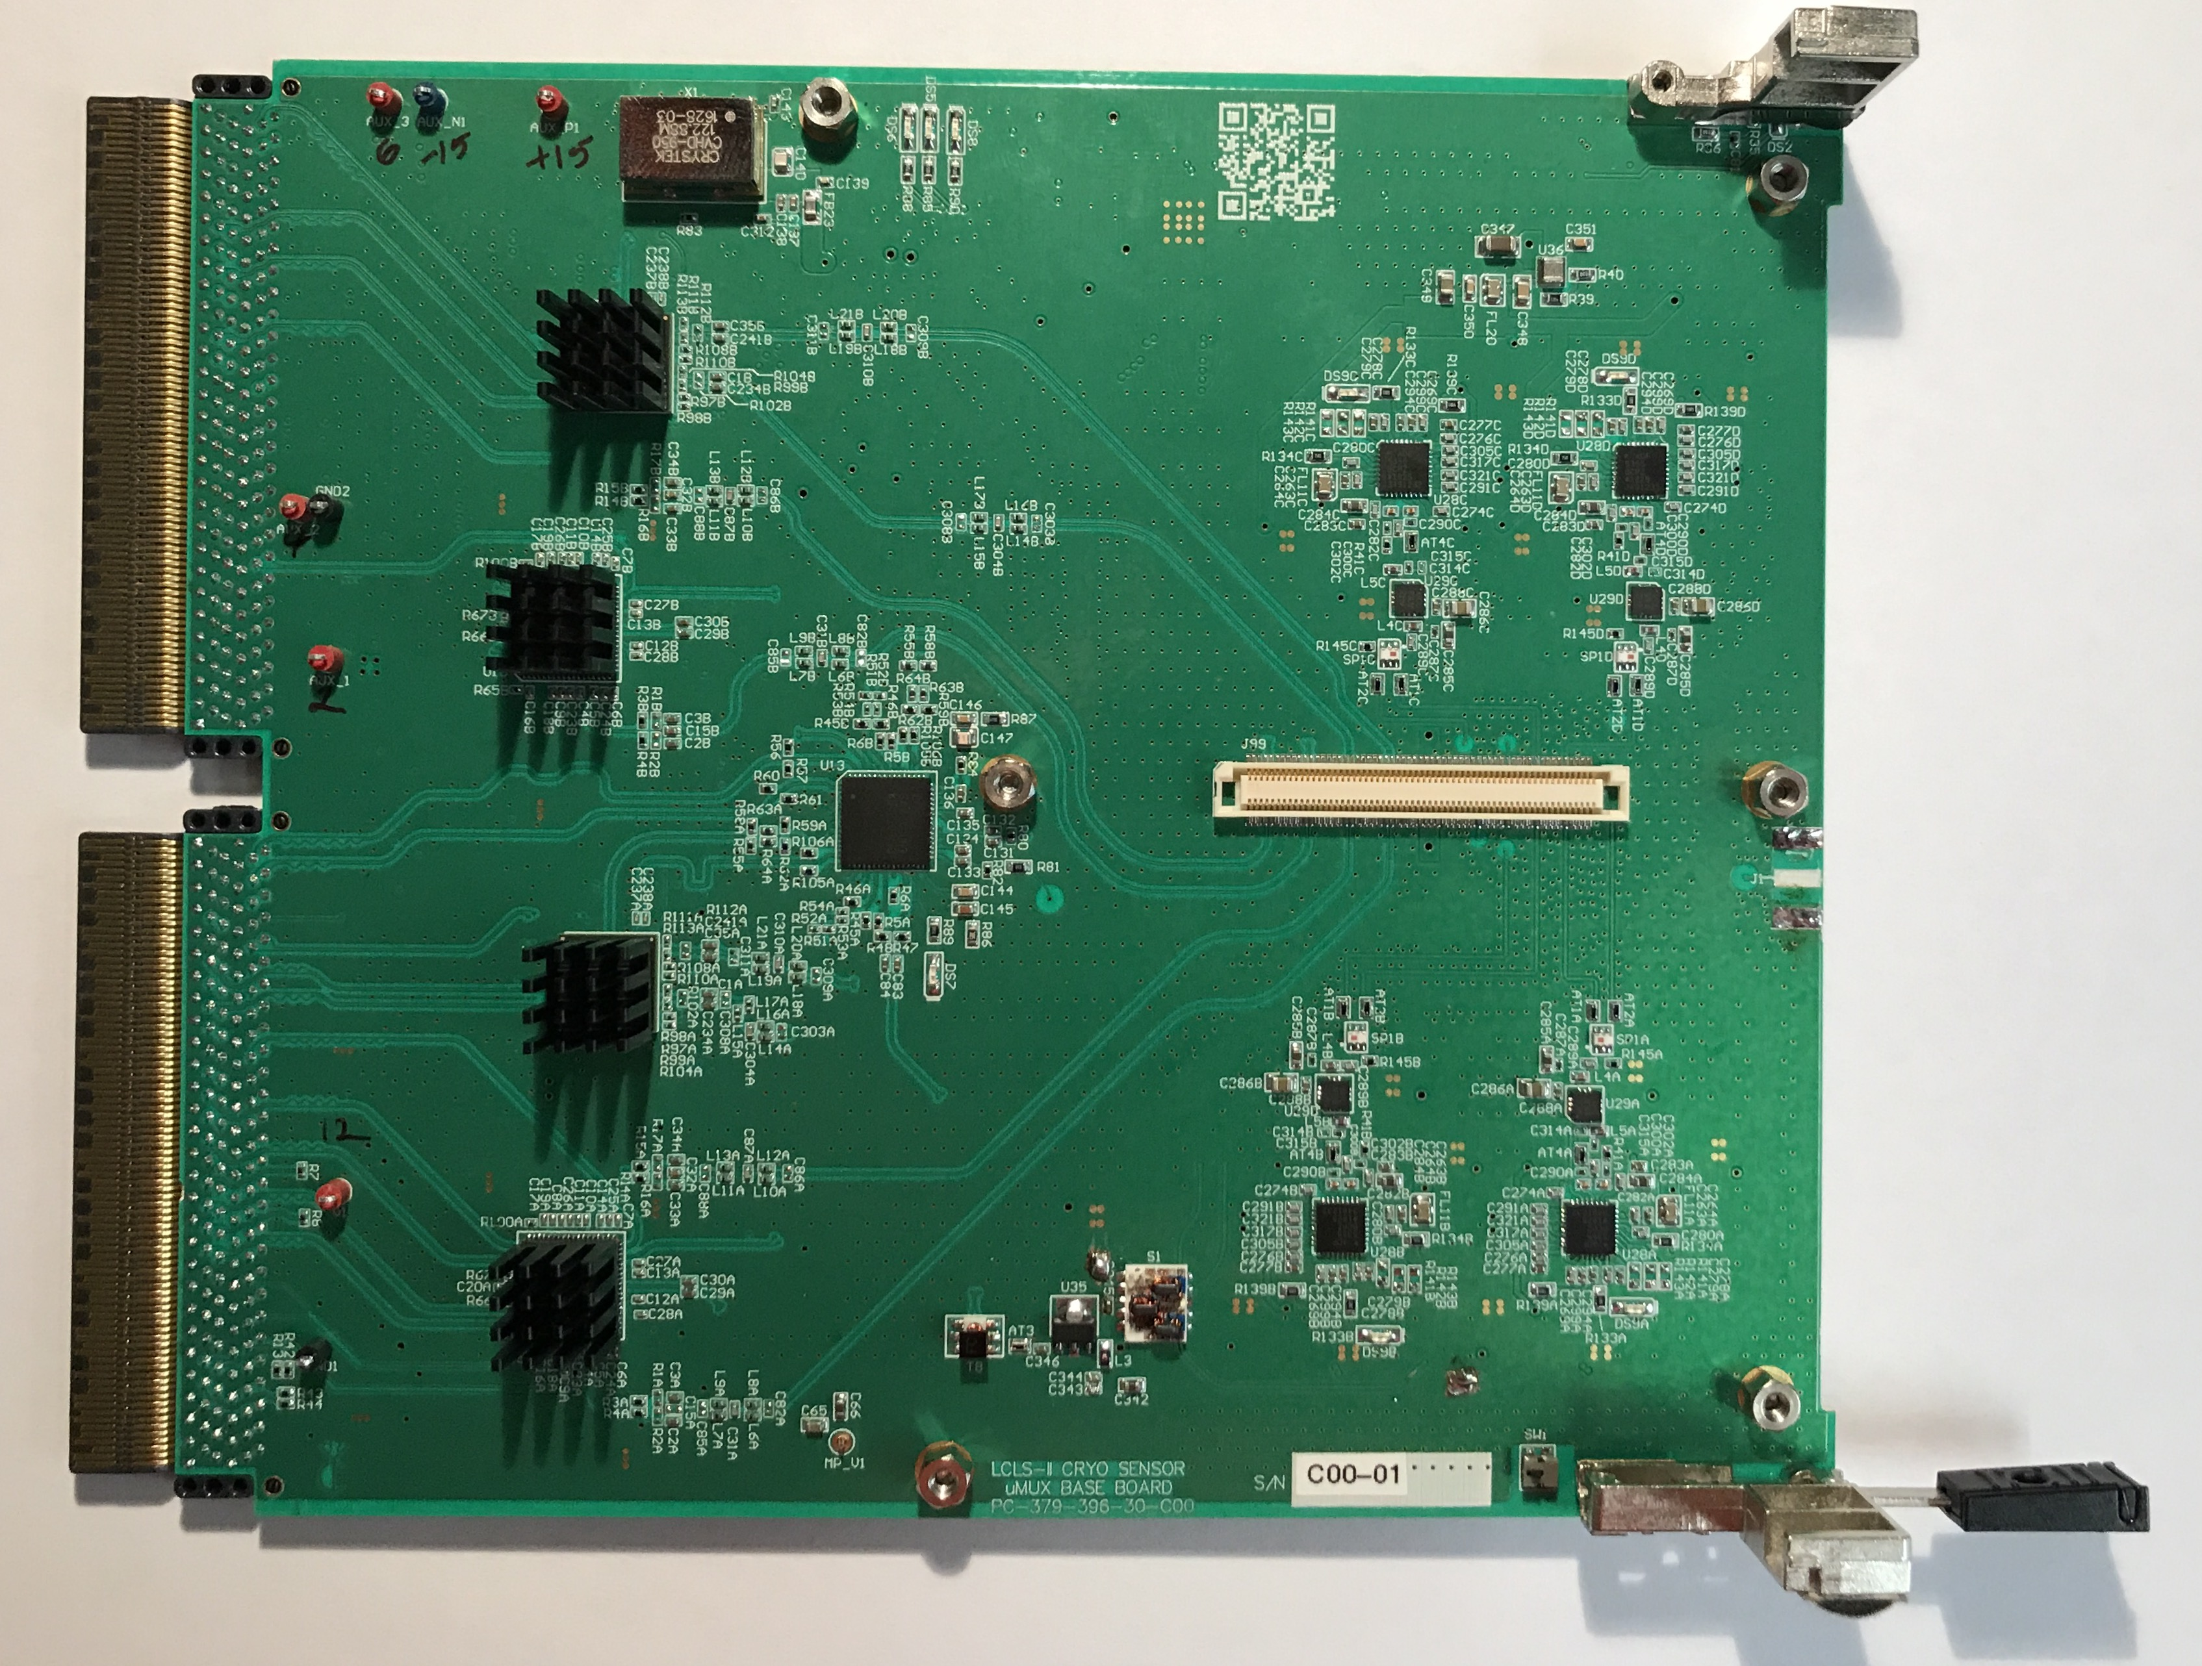
RF Cards
Mixers
Daughter Card
1:4 multiplexing filters
ADCs each 2X 2.5Gs/s 14 bit
Multiplexer filter
DACs each 2X
2.5Gs/s 16 bit
LO generators 4X
2X (AMC + daughter card) in each carrier
AMC Card

Slide 11
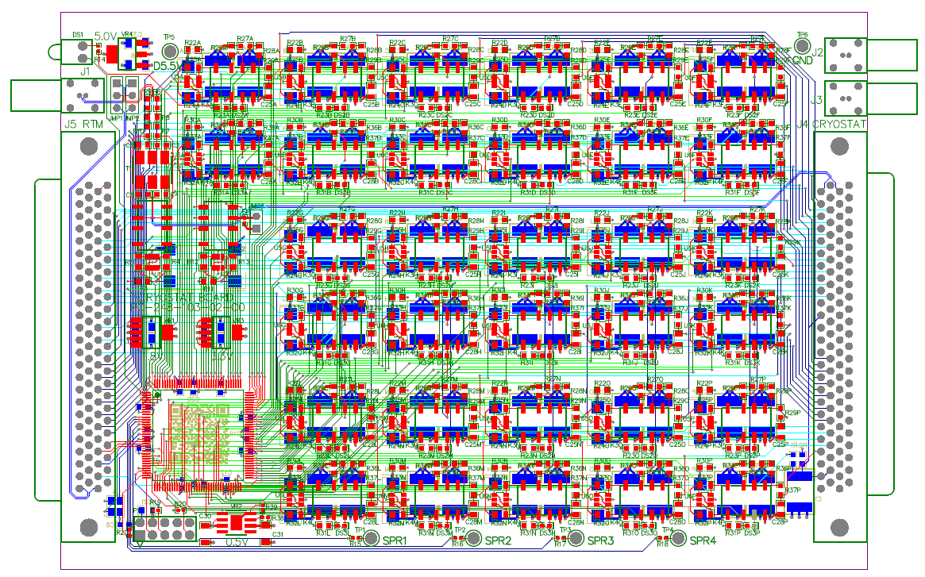
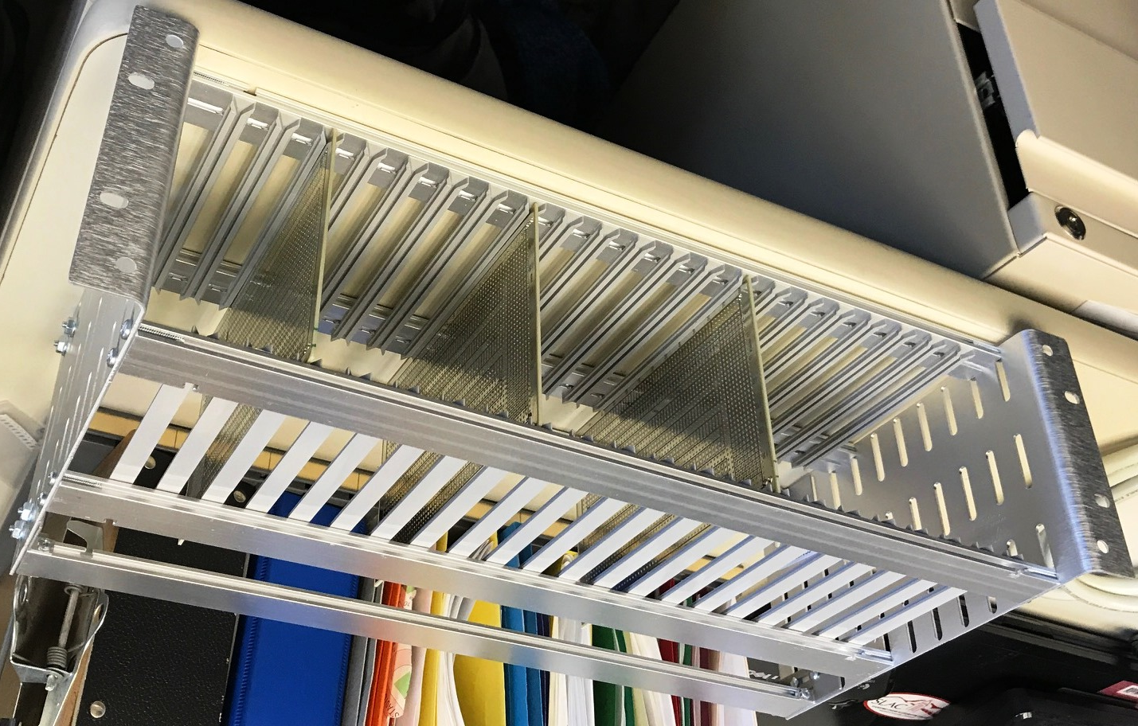
Low Frequency Systems
Cryostat board
TES Bias resistors
De-latch relays
Mounted to cryostat
RTM board (ATCA crate)
Flux ramp DAC
18 bit DACs (X3) TES bias
Communication to FPGA

Slide 12
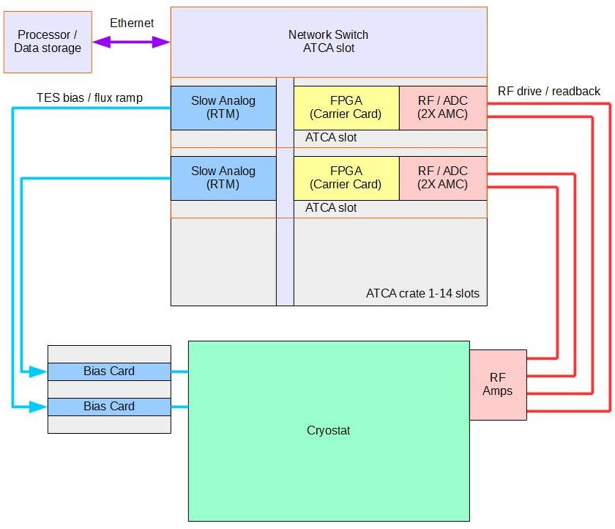
System Configuration

Slide 13
Configuration
Single ATCA includes RF, TES bias, flux ramp and amplifiers for a 4GHz block of signals
Baseline is 4-8GHz
Modification for 2X 2GHz blocks to 8X 500MHz blocks is straightforward
Frequency changes (below 10GHz) are straightforward
Synchronization data stream provided on ATCA backplane. Multiple formats supported. (includes frequency reference)
System density
Space is approximately 4GHz / rack “U”.
Power <250W / 4GHz system (doesn’t depend on number of resonators)
Environment:
ATCA rated for telecom use, up to ~50C (sea level)
Investigating high altitude operation, expect operation to ~17000’ is OK.
Temperature stability requirements under investigation but flux-ramp algorithm is insensitive to drifts.
Resistor bias cards may have high temperature sensitivity – but low power dissipation makes temperature control straightforward.

Slide 14
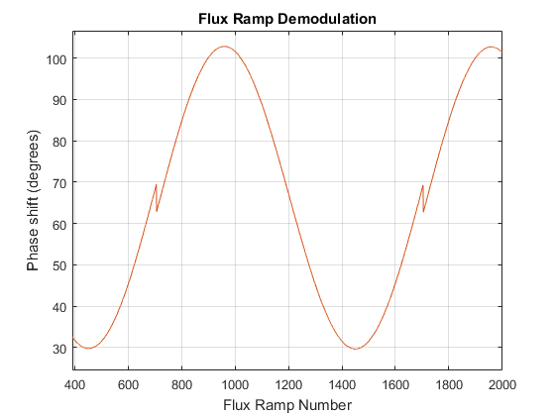
Algorithms / Firmware (Should be its own talk!)
Firmware functions
Process ADC data into individual channels
Calculate line resonance frequencies
Digitally synthesize tones to track the frequencies
Drive flux ramp and measure line frequency vs. flux ramp phase
Decode into per-pixel, per-flux ramp data.
Operation to ~10KHz flux ramp
High bandwidth modification for fast sensors with low occupancy
Feed-forward to predict line motion
Allow flux ramp to >1MHz
Energy resolving X-ray detectors
Cryogenic particle detectors
Works in simulation, testing soon.
Line tracking and flux ramp decoding of uMUX resonator
Glitch in data was determined to be a real glitch in the flux ramp drive signal generator!

Slide 15
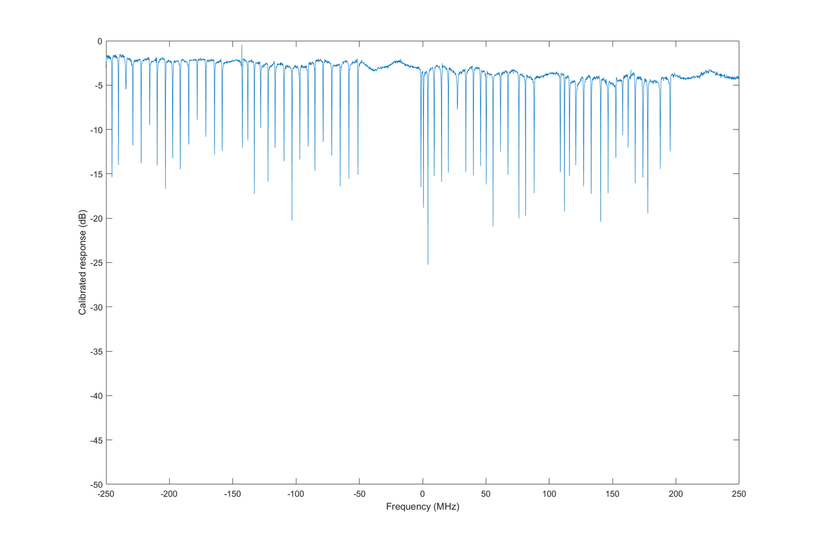
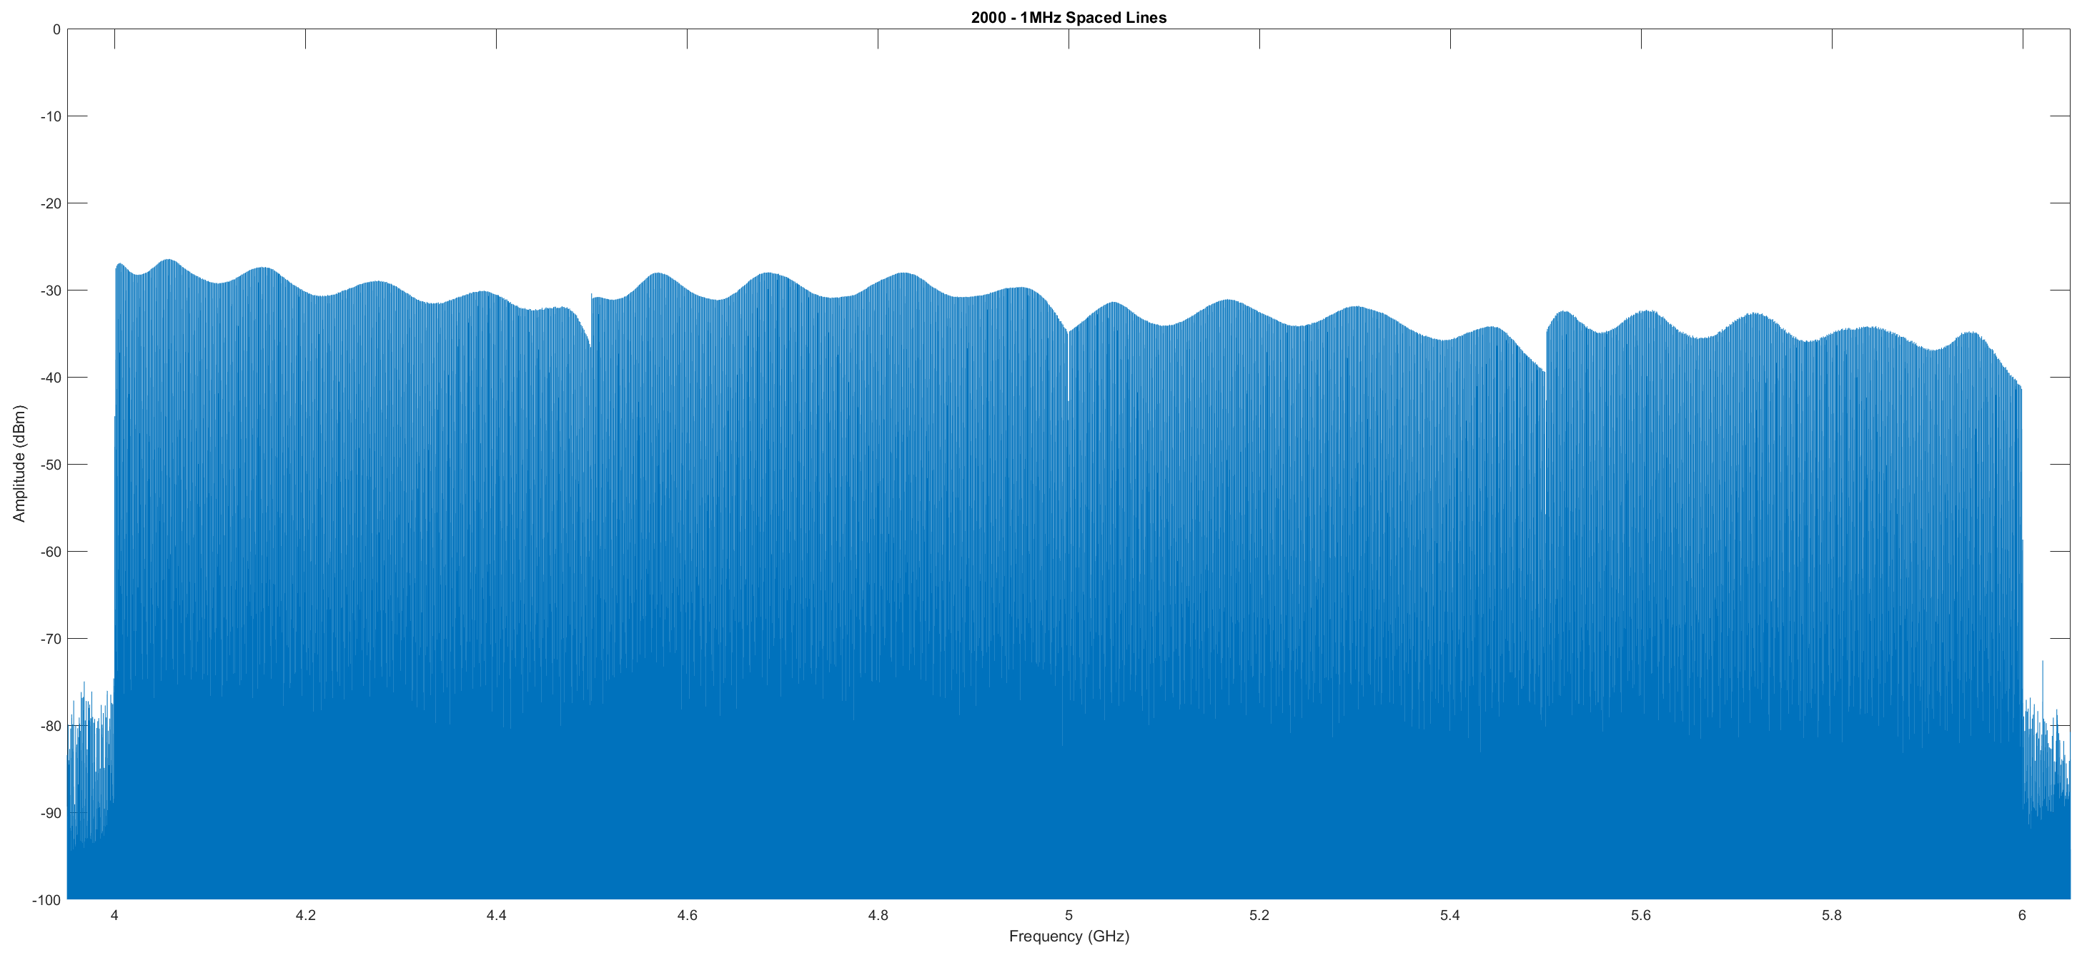
Status
Prototype hardware tested for single 500MHz block
Designed for 107dBc/Hz spec for 4000 detectors in 4GHz
ADC, DAC, upmix, downmix, LO generation tested.
Most lines >110dBc/Hz, Worst case 101 dBc/Hz, expect to fix with tuning.
TES bias and flux ramp circuits tested. Boards in fab
Line tracking firmware working using simple DDC/DDS algorithm
Computationally efficient algorithm works in simulation and fits comfortably in FPGA
Expect full hardware / firmware in prototype stage by end of 2017
60 cryogenic resonators in 500MHz read out with prototype electronics
Generating 2000 randomly space lines in 4-6GHz
One full AMC card operating
Not that block gain adjustment will level output power

Slide 16
Future
ADCs, DACs, high dynamic range electronics are all advancing
6.4Gs/s, 12 bit ADC with 10GHz input bandwidth available
9Gs/s 14 bit DAC available
In not too long it should be possible to directly digitize and synthesize the 4-8GHz RF with a single DAC / ADC pair. (not yet!)
Xilinx has announced RFSoC chips with integrated FPGA and RF A-D and D-A. (not ready for our application yet)
Expect technology to improve performance, decrease size and cost.
We are fortunate to be using the same sort of technology that industry is driving
When to update designs? Its inevitable that by the time a project is ready for production there will be better cheaper parts available.
The best advice on upgrades comes from the late Arthur C. Clarke’s short story “Superiority”

