Slide 1
Toward detection of coherent scattering of reactor antineutrinos on nuclei with dual-phase Xe or Ar detectors.
Rare Events Detection group, LLNL
Sergey Pereverzev, Jingke Xu, Brian Lenardo, Adam Bernstein.
CPAD 2017 October 12-14

Slide 2
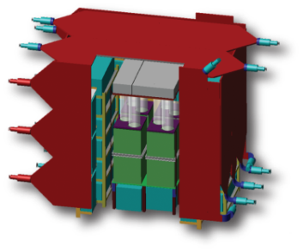
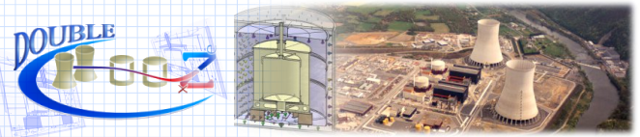
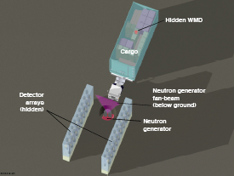
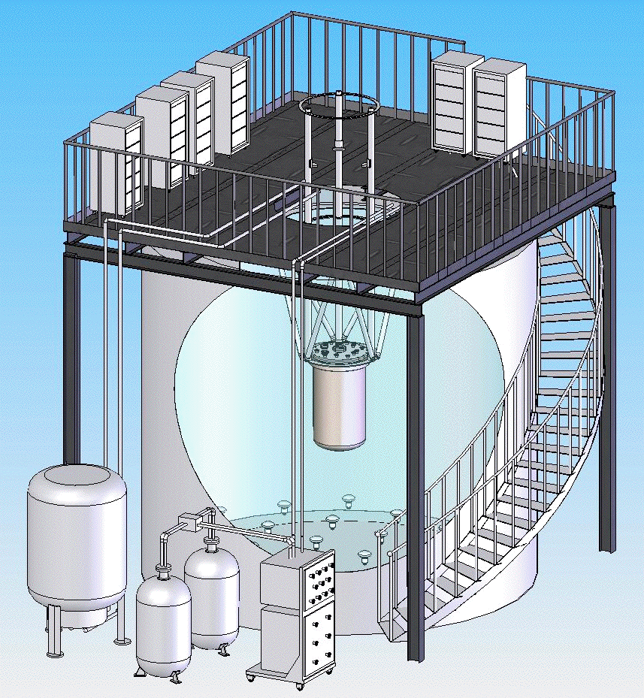
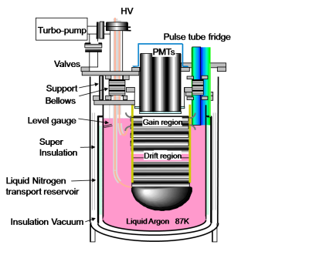
Detection of rare neutral particles is a common goal of nuclear nonproliferation and nuclear physics
LLNL/SNL inverse beta
antineutrino detector
Double Chooz
Inverse Beta
Antineutrino detection
Reactor power, operational state, Pu content measured with LLNL/SNL antineutrino detector
Oscillation signal = Monitoring signal
LLNL carwash detectors
Precision measurement of the final neutrino oscillation angle theta 1–3
Neutron/Gamma detection
XENON/LUX/LZ
DM/neutrino background = SNM signal
Detection of SNM in cargo and
for nuclear monitoring regimes
LLNL coherent scatter
antineutrino detector
Nuclear recoil detection
Direct detection of WIMP dark matter
DM signal ≈ Monitoring signal
After COHERENT results, reactor antineutrino detection
is “mostly engineering” problem
Reactor power, operational state, measured in 10x smaller detector

Slide 3
Ionization yield of low energy nuclear recoils in Xe, LUX measurements
https://arxiv.org/abs/1608.05381

Slide 4
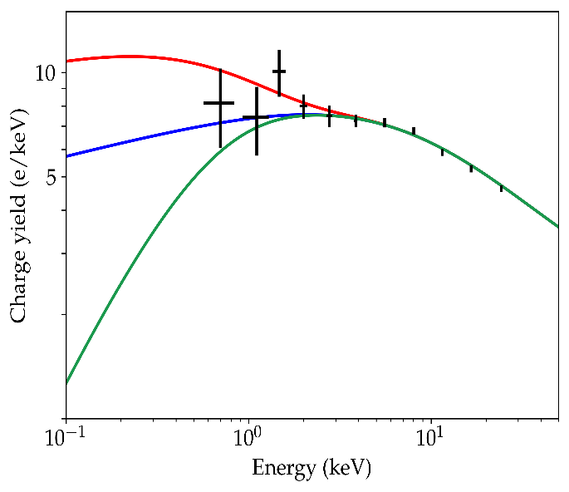
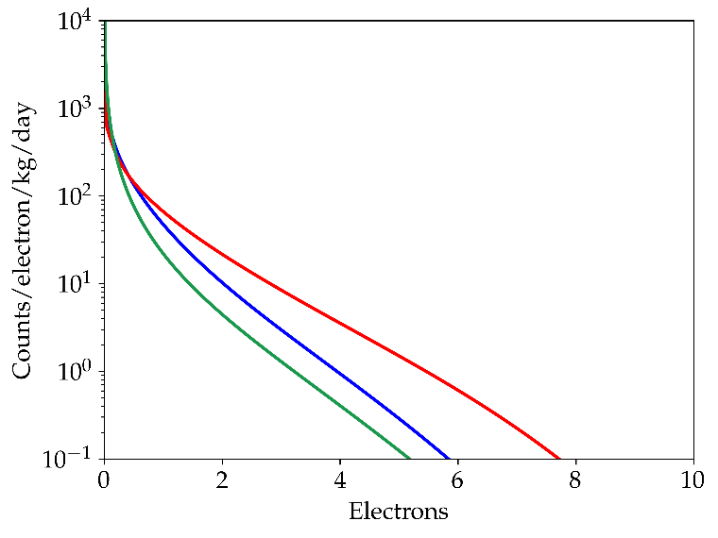
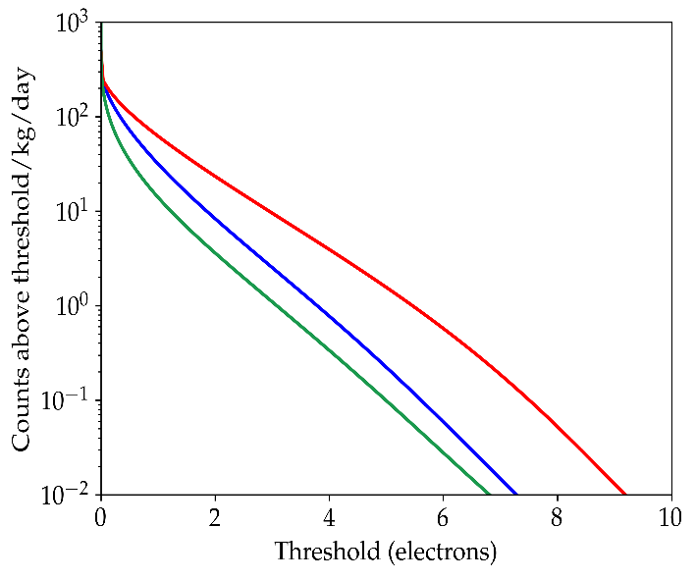
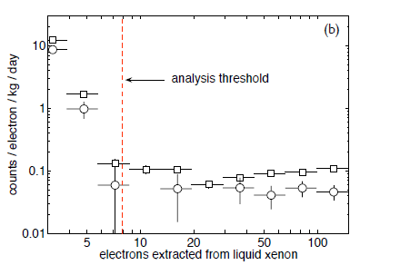
Estimated response to reactor antineutrinos and background problem
Model charge yield, expected spectrum of event (in elections) and counts above threshold
Colors show range of extrapolated yield curves, all consistent with world yield data
Xenon 10 S2 only analysis; underground data
“few electrons” background is much stronger on surface, and rises with ionization load ( private communication, D. Akimov, Moscow RED group )
“Synchronous” emission of parasitic electrons is puzzling
P. Sorensen et al., arXiv:1011.6439

Slide 5
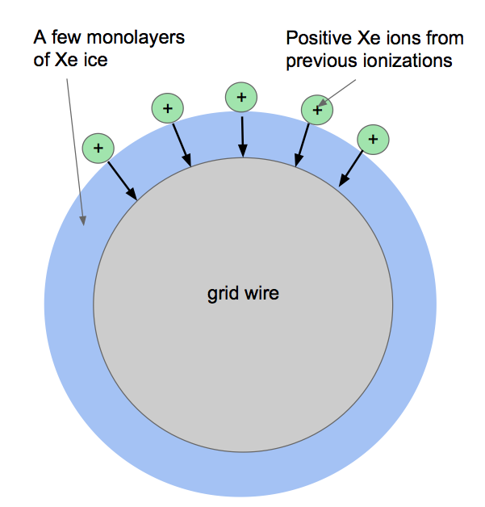
Possible charge trapping (excitons) in solid layers of Nobles on metal surfaces
Louis Malter observations (1936)
charge buildup on/ in thin dielectric Al₂O₃ layers on metal surfaces greatly enhances electron emission; surface micro-breakdowns for large charge density.
Observations since Malter:
Up to 10 mono-layers of solid xenon (also He, Ne, Ar, Xe, Rn) form on metal surfaces in liquid rare gases at low temperatures (L.W. Brush et al., Rev. Mod. Phys. 79, 2007)
Thermally induced luminiscence (TIL) and photo-induced exoelectron emission (PIEE) are present in bulk Al₂O₃ and in bulk in other dielectric, including solid noble elements (Radiation effects in atomic cryogenics solids, E.V. Savchenko et al, NIM B268, 2010)
TIL and exoelectron emission is observable in thin Al₂O₃ films on metal surface, as well as for many other thin dielectric films (like SiO₂) on metal surface or metal oxide films on metal surface
Open question:
Can similar surface effects (resembling Malter effect) be present for solid noble films ? Probably yes !
Consequences for dark matter and other detectors:
positive ions accumulate at the noble-liquid-metal boundary enhancing grid electron emission;
may be responsible for correlated emission of few electrons or photons (surface micro-breakdown?);
may lead to High Voltage instabilities and electrical breakdowns in detectors.
Notes:
----- Meeting Notes (8/18/14 13:43) -----
Several monolayers of solid are known to form on metal surfaces immersed in noble liquids
Positive ions drift to the surface and are prevented from immediate recombination with mettalic electrons by these layers
The positive ion monolayer lowers the work function on metal surface (similar to the Malter effect , 1936)
Mobility increase of solids is not enough to alone explain the long lifetimes of trapped ions

Slide 6
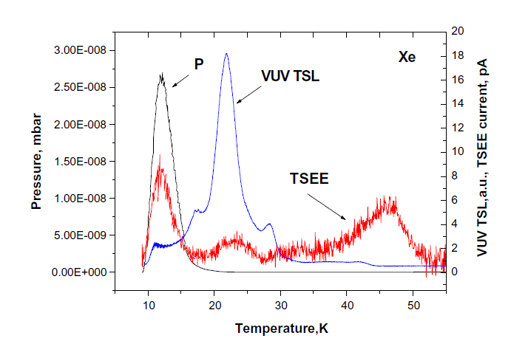
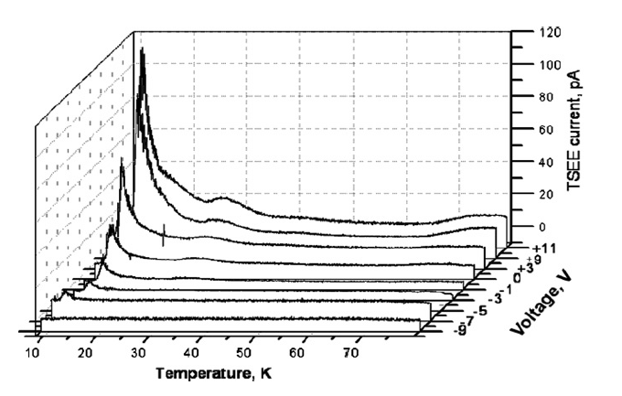
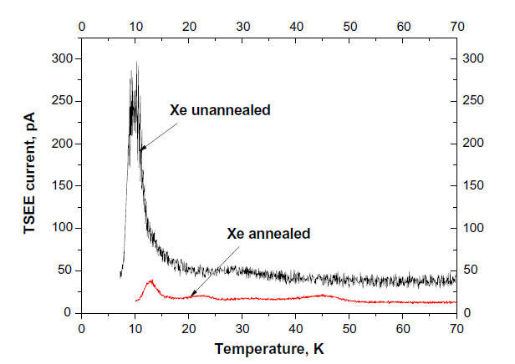
Solid Rare Gases trap ions in a manner analogous to personal dosimeters
Radiation effects in atomic cryogenics solids, E.V. Savchenko et al, NIM B268, 2010
Personal dosimeter based on Al₂O₃:C can be “erased” due to ion de-trapping by microwaves, by visible light; possibly by strong AC field or ultrasound.
Charge trapping effects in detector should be sensitive to average ionization rate/ ion current density on electrode surface, UV photon flux to the surface, electric field on the surface; application of AC electric field between grid wires can de-trap ions

Slide 7
Xenon Recoil Yield Measurement
Funded Project Summary:
Construct portable xenon TPC testbed with high electron detection efficiency
Measure xenon recoil yield at the lowest energy possible using low energy, pulsed neutron beam
Proposal Review
Start Fabrication
Vacuum Test
Beam Neutron PSD/DAQ test
Scintillation in liquid test
Beam Neutron Measurement
Publish First Result
D-D neutron Test
FY18: repeat with lower background and lower threshold
Funding begins
Gas System Assembly
Data Acquisition Development
Condensation Circulation, HV leads
Dual Phase TPC Tests –started
Beam Neutron Analysis
LDRD support

Slide 8
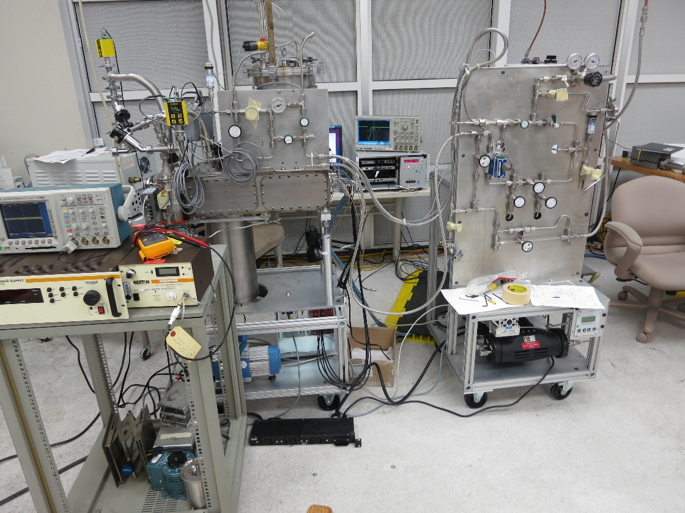
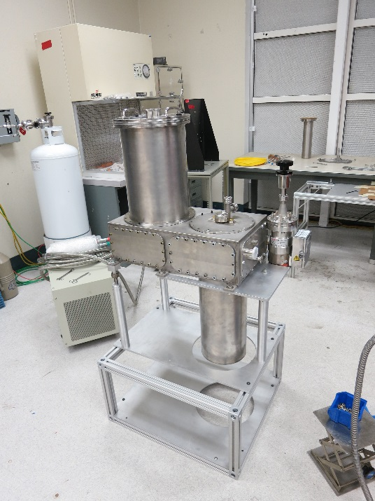
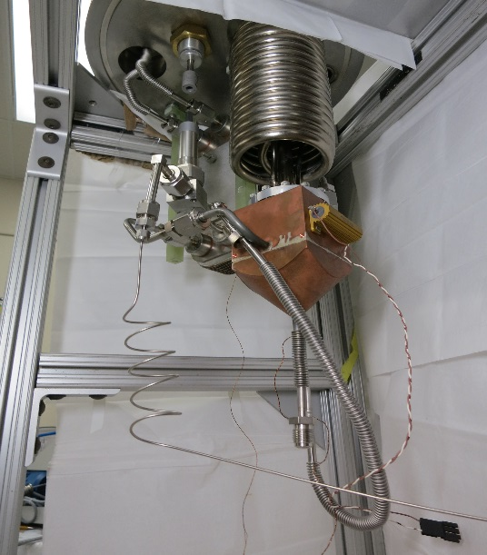
LLNL Xe set-up
Design features:
Mobile
Easy to align (two flexible hoses to gas circulation cart)
J-T cryocooler (low vibrations), passive emergency gas recovery (no liquid Nitrogen required).

Slide 9
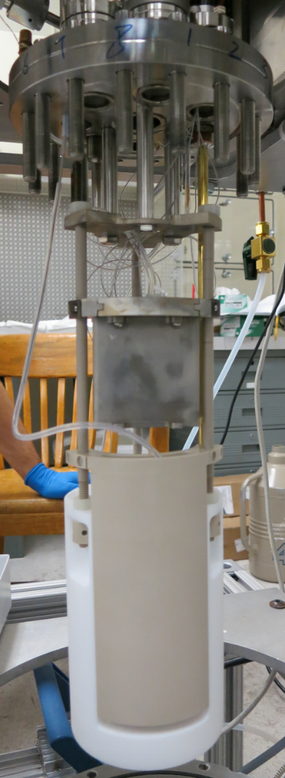
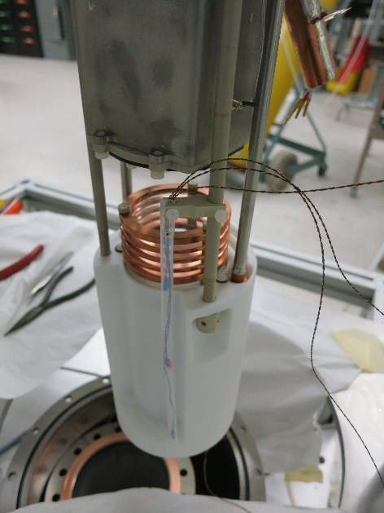
Detector physics studies capabilities
Low-capacitance multi-wire high-voltage leads (tested up to 30 kV; can apply modulations to grids wires)
Easy access to detector internal parts
Modular design
Easy to change grids, electrode configuration, gas amplification length, PMT block, etc.
Large range of operation voltages and fields
Gas PMT in Faraday cage (operational even when glow discharge ignited inside detector)
Large circulation rate (~2.5 h for total Xe load)
Two separate Xe cylinders – can have one load with Ar37 for low energy calibration
Provision for optical access (two windows on the top)

Slide 10
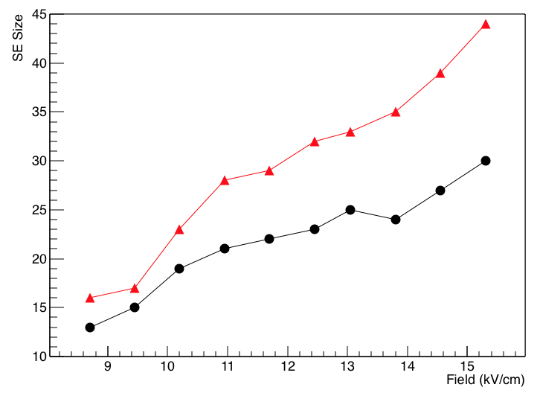
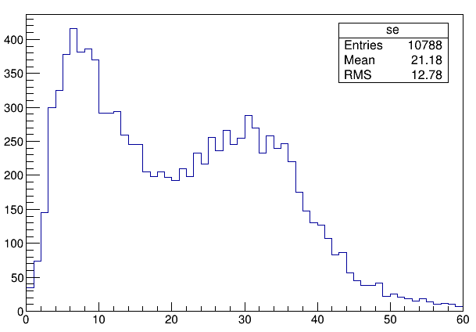
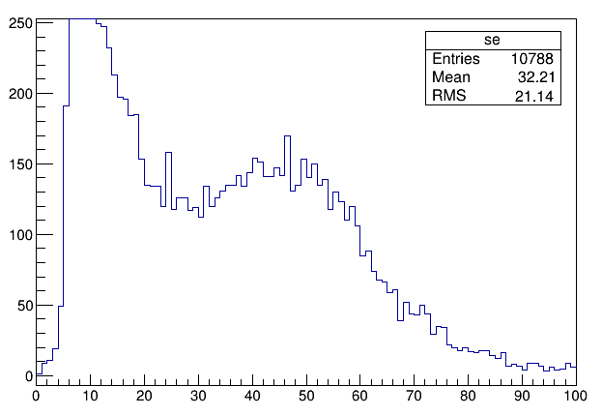
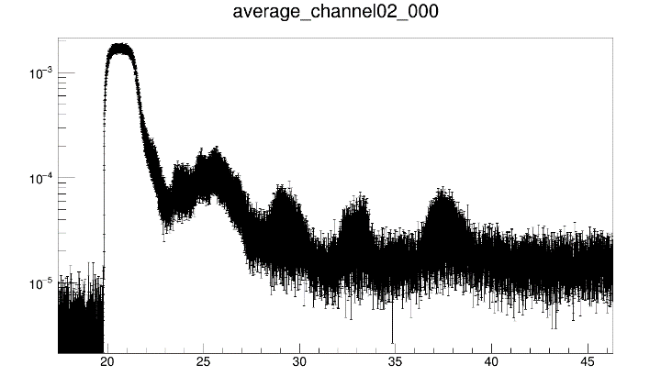
First run to test purity, drift, HV performance
Gas amplification (Single electron extracted from liquid)
Spike counting and pulse integral give ~30-40% different SE sizes, but both are high; no fiducialization
Large signals (muons)
S3 signals- echos of S2 because of photoeffect
On field shaping rings and grids (grids frames).
Detector is currently operating in normal configuration . PLANS:
characterize few electron background for different drift and amplification fields, possibly for different field on grid surface (by using different transparency grids) .
optimize detector performance for neutron scattering experiments (January).

Slide 11
Conclusions
We have designed and build a portable xenon TPC testbed with high electron detection efficiency to measure xenon recoil yield at the lowest energy possible using low energy, pulsed neutron beam
Future rigorous investigation of detector- induced low energy (few electron events) background by indirect and direct means should provide understanding of microscopic noise mechanisms and allow predictive models of backgrounds, and possibly background suppression
Small-scale: In the near term, low threshold ~10 kg detectors would offer significant new reach into the phase space for dark sector photons and other dark matter channels (UA’1 proposal, Sorensen, Bernstein, Essig , Lang, Ni)
mid-scale: next, 100 kg detectors with single electron sensitivity will enable reactor antineutrino detection, benefiting reactor monitoring regimes for nonproliferation
large-scale: Future multi-ton low threshold Xe and Ar TPCs will be able to monitor flux of low energy solar with high statistics, and look for neutrino signatures of supernova.

Slide 12
Slides in addition

Slide 13
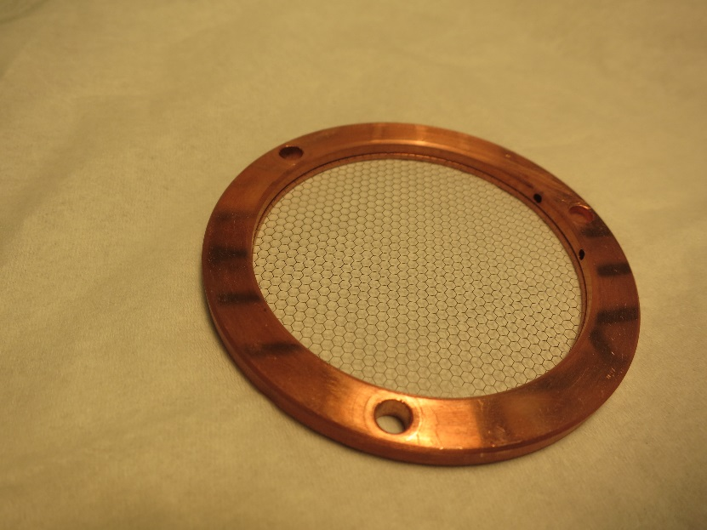
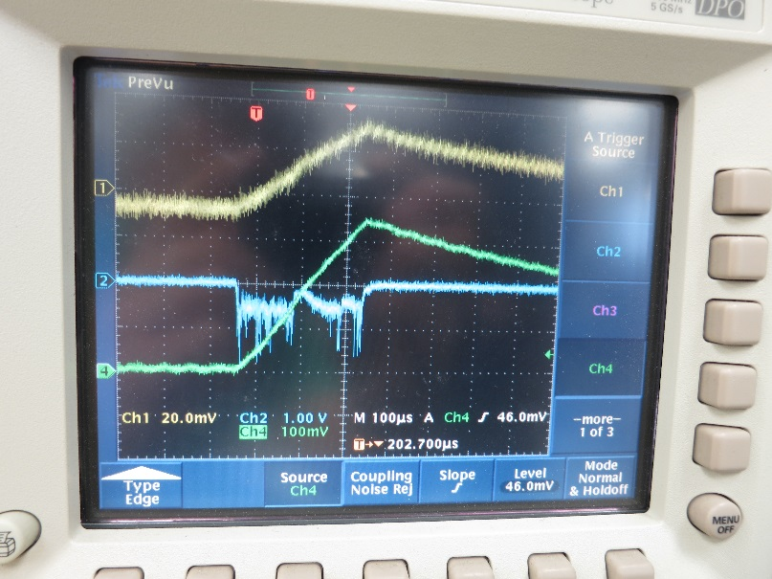
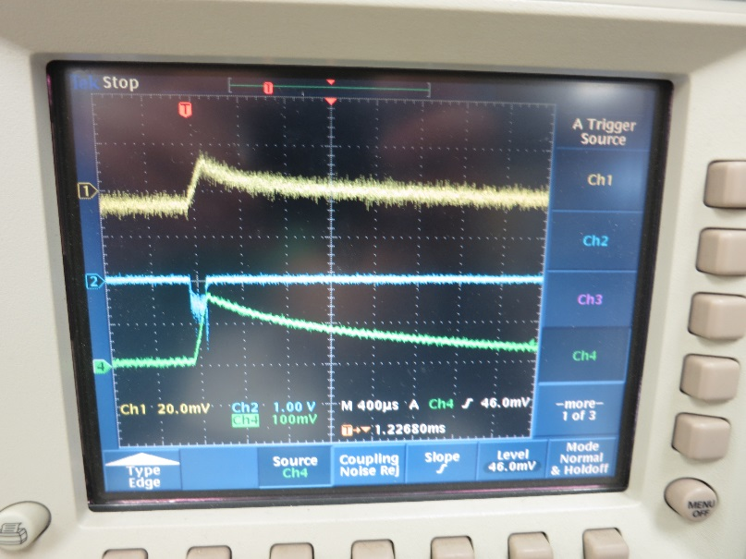
Discharge traces, discharge suppression

Slide 15
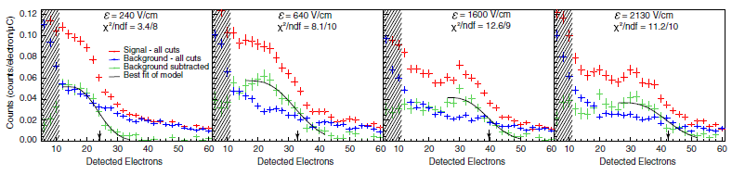
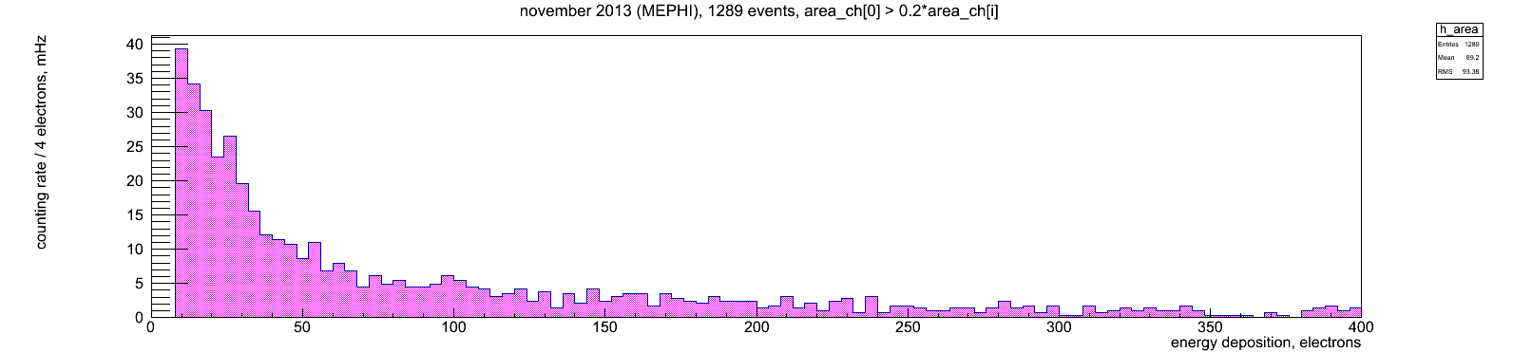
More Examples of low-energy background
LLNL Ar detector; T.Joshi and all, PRL 112(2014)
Xe detector (R.E.D.) in Moscow
Courtesy of D. Akimov
• S3 signals (“anomalous” photo-effect) and High Voltage instabilities can be connected
• Anomalous electron emission can be caused by positive ions (Malter effect)
• Unexplained rise in low-energy backgrounds – is this due to positive ions ?

Slide 16
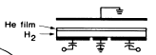
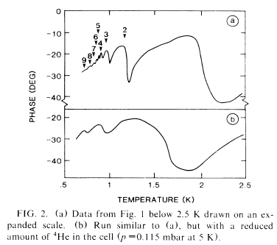
Physisorbed solid films of rare gases
• Ar, Kr and Xe do form several solid monolayers on metal surface at low temperatures
L.W. Brush et al., Rev. Mod. Phys. 79 (2007)
Structure of growing solid films was revealed by X rays diffraction and cold atoms diffraction.
Thickness of physisorbed film is rising monotonically with gas pressure.
As film thickness is increasing, re-entance behavior observed: top monolayer grow as disordered (liquid) film, but became ordered as more then half of the next monolayer is added. Eventually, layers start to add as liquid.
Solid He films on H₂ surfaces
Surface electron motion
Number of He
monolayers
• Measured electron surface mobility
peaks at filled He monolayer(s)
Cieslikowski, Leiderer, PRL 58 (1987)
• Solid He monolayers form on solid H₂ surfaces
• They will also form on metal surfaces at low T
Noble gases will always from solid dielectric film on metal surfaces at low temperatures.

Slide 17
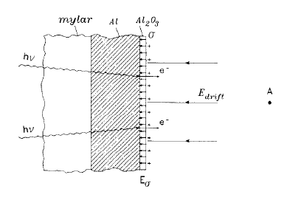
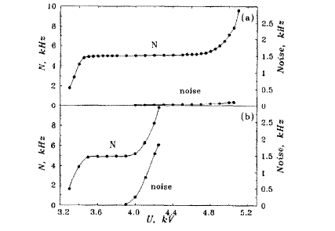
Ar ions trapped on Al₂O₃ layer enhance photo-emission in Ar gas counter
Ar Ions Trap on Oxidized Al Cathode
Cathode Becomes Sensitive to Visible (!) Light
Light off
Light on
• Al-Kapton “straw-tube” with Ar + ¹⁰⁶Ru source
• Ions on surface reduce work function
Chirikov-Zorin et al., NIM A 371, 375 (1996)
• Sensitivity to visible light in presence of positive ions
Our claim: Even one ion produce locally lowered tunneling barrier. To check one need to look on photo-effect spectra for different ion surface densities.

Slide 18
Physisorbed Helium Films and Ions
Measure photocurrent before and after gas discharge in helium at 4K.
Monochromator
Initial (in vacuum at 4K)
Picoammeter
V
hν
After gas discharge
Photocurrent [a.u.]
Wire ring anode
hν
Final (warm-up)
Ag film on glass
cathode
hν
Photon energy
S. Pereverzev, P. Leiderer (1993), unpublished

Slide 19

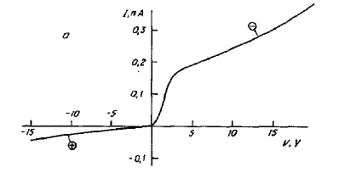
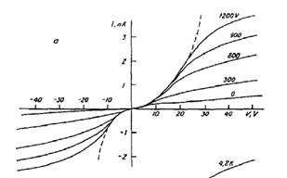
Electrode polarization/ charging
Observed in liqid Helium:
Ti³H
⁴He at 4K
V
I
Stainless
Wait…
S. Pereverzev, A. Parshin
Physica B 197, 347 (1994)
• hysteresis (red) due to electrode surfaces charging (shifts up to 20-30 V)
• Strong (~kV) AC Voltage (at 1 mm gap) remove hysteresis by de-trapping ions
• AC field across 10-20 nm solid layer much less than dielectric strength (layer hold 20-30 V )

