Slide 1
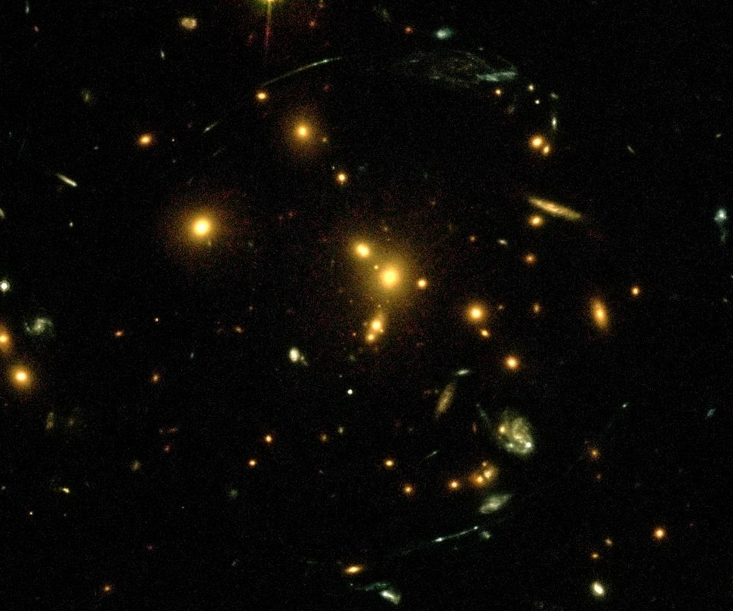
The DAFT/FADA Project: a Study of Clusters of Galaxies and a Forerunner to Much Larger WLT Projects
Mel Ulmer at ANL 23 May 2013
http:faculty.wcas.northwestern.edu/ulmer

Slide 3

DAFT/FADA Started with 1 yr DOE grant to study the nature on DE with [collaboration of] a DOE lab [FNAL]
Goal to demonstrate that, with Weak Lensing Tomography in the direction of Rich Clusters of Galaxies, we can set limit to w in the equation of state of DE p = wρc, where w = −1 for a cosmological constant.
For thes first time this would be done purely by geometrical means
This is a hard problem, because the devil is in the details:

Slide 4
First a min-tutorial (with apologies to those that remember everything from Doug Clowe’s visit in the Fall):
What is a cluster of galaxies
Clusters in Broader Context
What is weak lensing
What is weak lensing tomography (WLT)
What is DAFT/FADA?
Why Clusters and Why HST

Slide 5
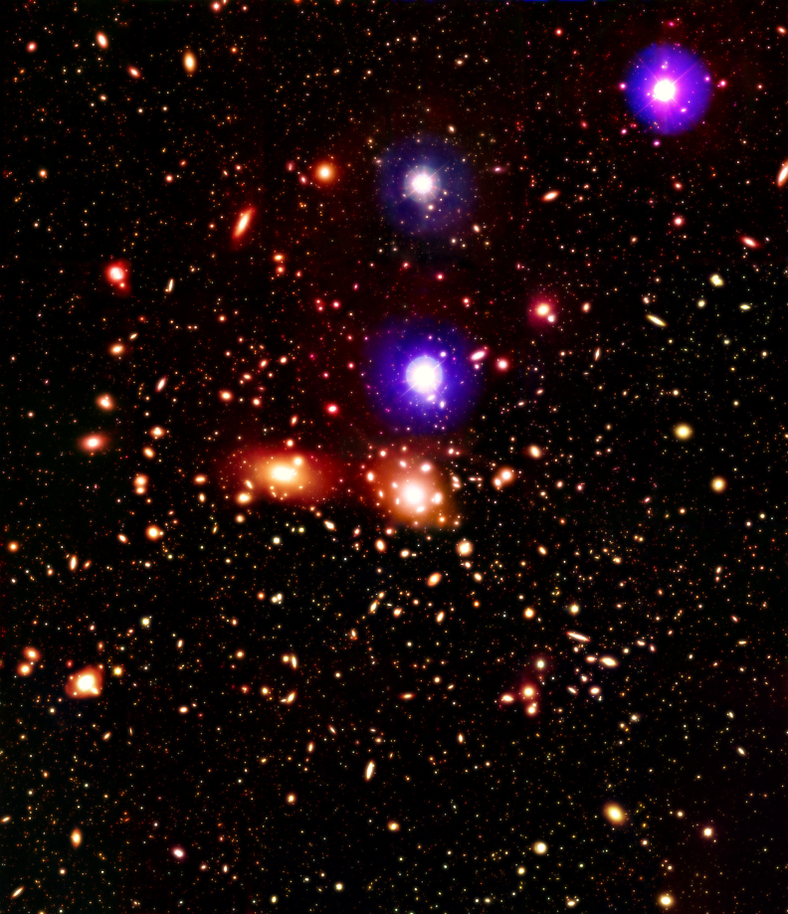
The Coma Cluster, A Poster Child Cluster
1,000 galaxies within a radius of about 1 Mpc = 3 million light years

Slide 6
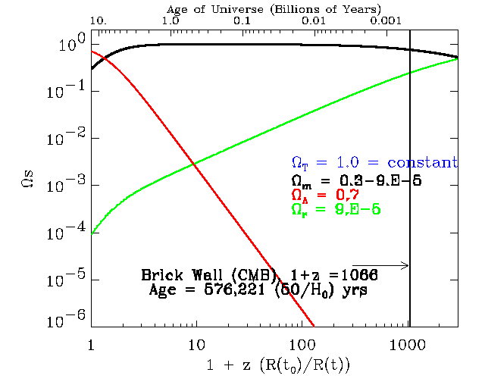
Where clusters are in the “scheme of things”
Clusters formed here

Slide 7
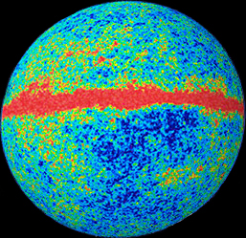
Cluster formation and evolution in a larger context, large scale structure growth

Slide 8
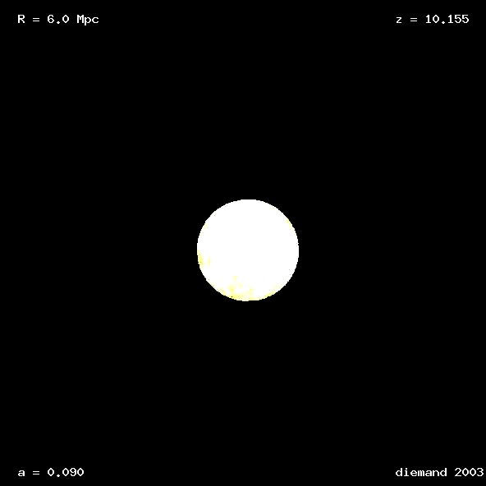
Simulation of how cluster form

Slide 9
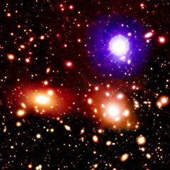
We think we may know how to make the Coma cluster! Rotated 90 deg. to compare with simulation

Slide 10
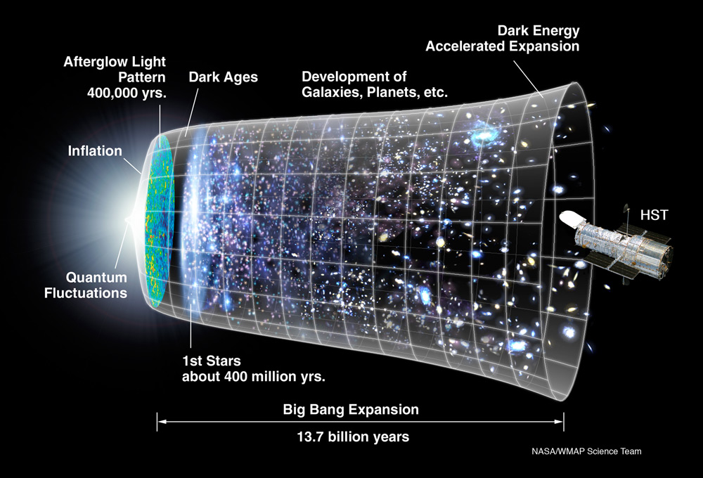
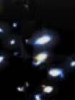
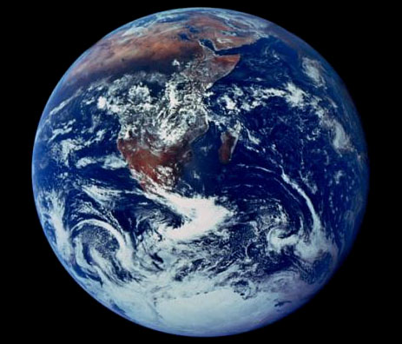
An artist’s concept depicting the idea behind this quote: “21st Century astronomers should be uniquely positioned to study “the evolution of the universe in order to relate causally the physical conditions during the Big Bang to the development of RNA and DNA” –Riccardo Giacconi 1997

Slide 11
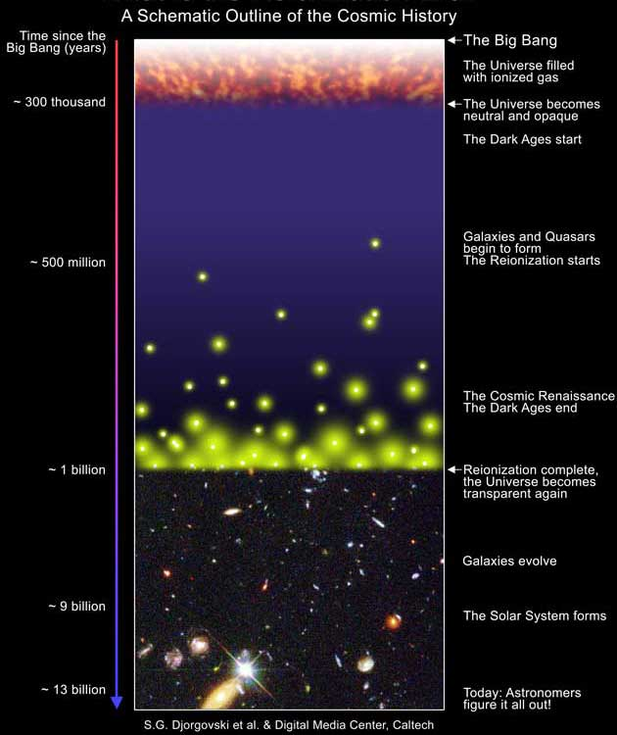
Using clusters lenses to explore the era or re-ionization => what is this era?
Redshift = about 7

Slide 12
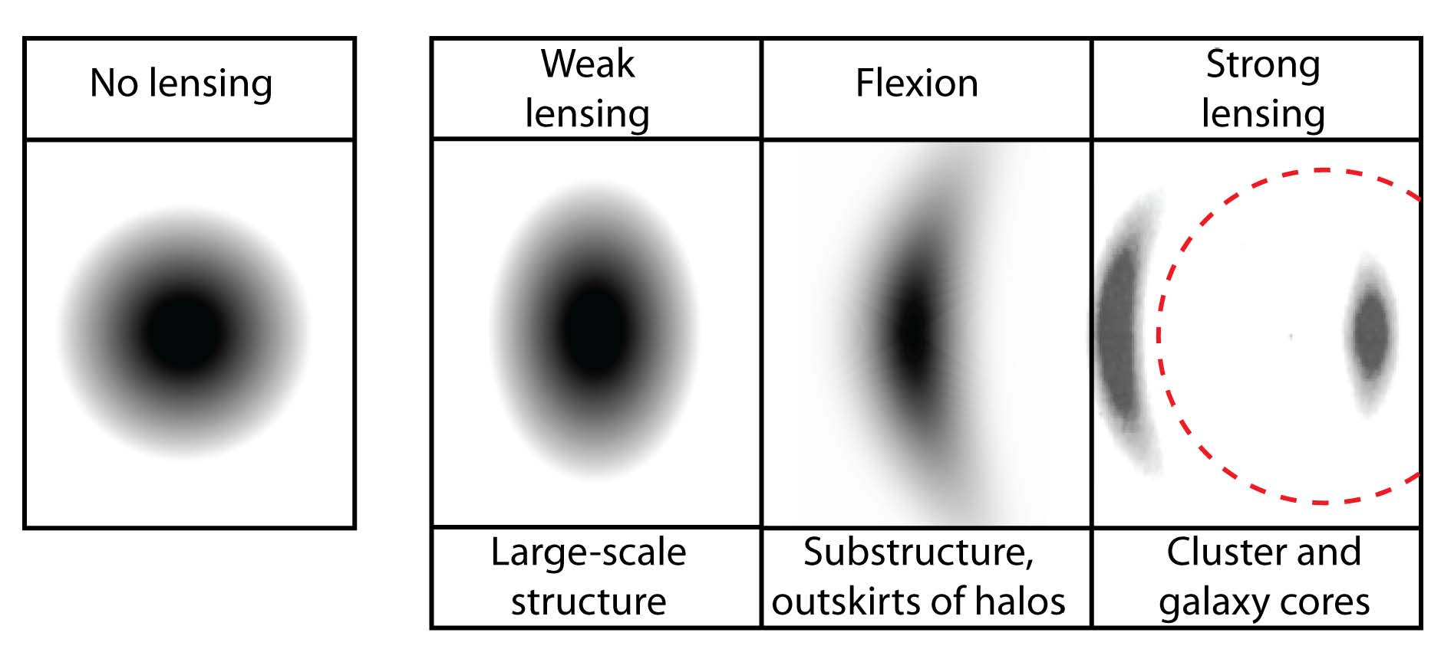
Tutorial on lensing

Slide 13
Weak Lensing Tomography
Shear signal depends on mass in front of the galaxy, and the angular distances between us the the mass, and the mass and the galaxy and us and the galaxy
The angular distance D_{a} depends on Ω_{Λ} (and w), Ω_{m}, H_{0,} and redshift (z) and the mass surface density causing the shear.
Assuming we know H₀ and z, then we can derive Ω_{Λ} (and w), Ω_{m}
D_{a} = f(Ω_{Λ,}w, Ω_{m}, H₀) => f(Ω_{Λ,} Ω_{m}, H₀) for w = −1, and f is still pretty simple if we confine ourselves to a constant value… Otherwise all bets are off as we have no [good?] theory to guide us on how w should vary with z.
I will return to z later

Slide 14
In the simplest case: take the shears of two galaxies at different redshifts but at the same radius from a symmetrical cluster. Take the ratio of the shear signal, and the mass model cancels out , left with something that depends on H₀, Ω_{m}, and Ω_{Λ}, and z.
=> Know z and H₀ can derive Ω_{m} and Ω_{Λ}! With enough pairs given the result is statistical, can do a great job.

Slide 15
Why clusters: They give well defined masses at well defined locations
And, they magnify the shear over the field

Slide 16
To summarize:
General Recipe is shear signal and redshifts, but what are the ingredients and preparation
Accurate as possible shear measurement = HST very carefully, i.e. ever changing PSF corrections, image processing (multi-drizzle)
Galaxies are in general too faint for spectroscopic redshifts
need photo-zs
=> need multi-wavelength ground based coverage of all your HST fields
Need to then measure shear field
Need to carry out the tomography

Slide 17
What is DAFT/FADA?
Use HST archive to carry measure shear signal (WL)
Original target 91 clusters (about 60 with ACS and 30 with WFPC2) in z-range 0.4-0.9
Then determine redshifts of the background sheared galaxies
(all cluster redshifts are known)
Then carry out WLT!
Determine if w = −1 is OK (or not)

Slide 18
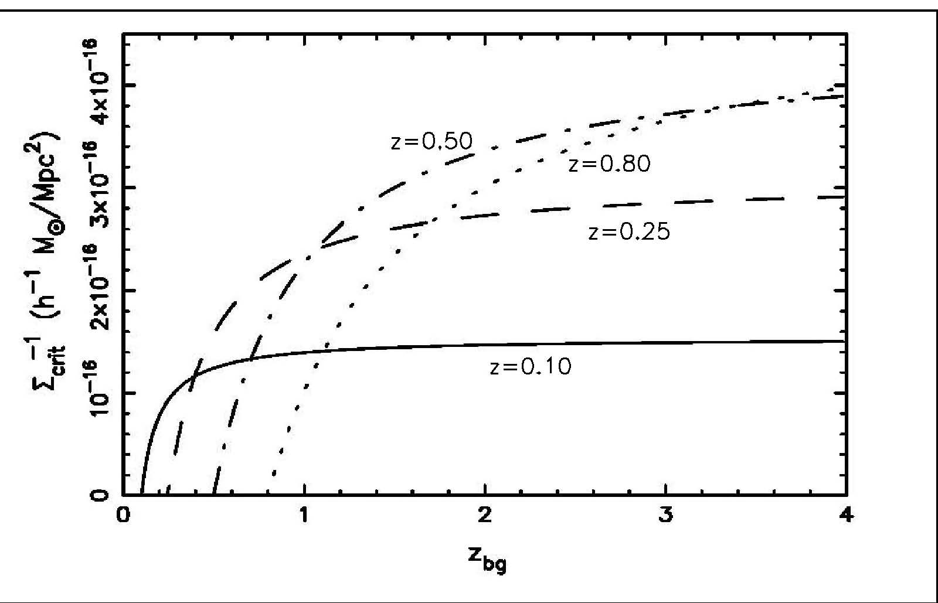
Why we chose our redshift range 0.4-0.9 High end observational, low end we need a steep (enough) dependence

Slide 19
Now z determination is the “rub”
If we wanted to derive redshifts from spectra, this would take forever on a 10 m class telescope. ☹
What to do? => Broad band and derive what are called photo-zs

Slide 20
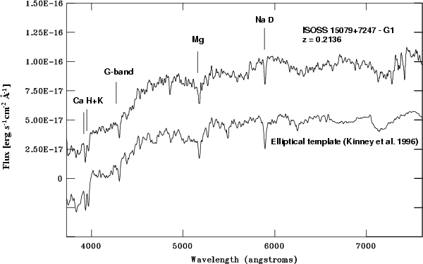
Can see that you need high signal to noise to get good CA H&K! Use Photo-zs (broad band fits with library)
4000 A break

Slide 21
But sometimes get more than on answer (or other screw ups)

Slide 22
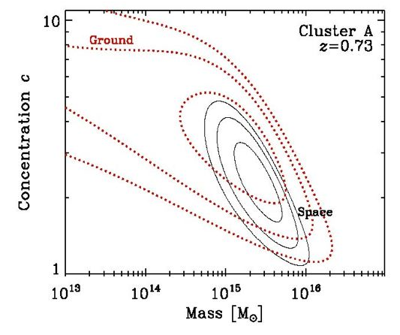
One example [from literature = unbiased] of why “space is the place” (or HST beats ground)
Figure 3: A comparison of the cluster mass
profile fitting errors from weak lensing data
derived based on typical Subaru versus
HST/ACS images for a high redshift cluster
(Kasliwal et al. 2008). Despite the larger field,
the ground-based images have worse mass and
concentration errors as one cannot obtain lensing
data near the cluster core due to blending issues.

Slide 23
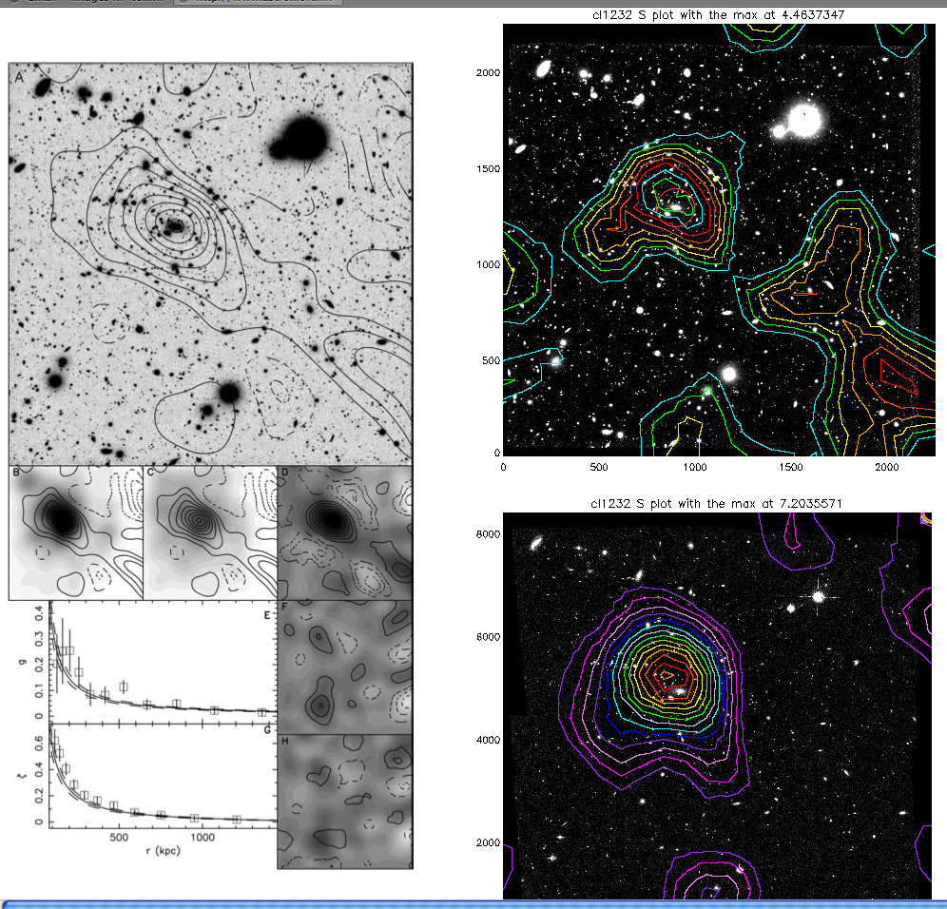
Doug’s ground
Our ground,
improved
with photo-zs
Our space, including
photo-zs

Slide 24
What we have found so far? First, in general, then one strong lensed detailed study [for fun]

Slide 25
We need J-band! (Spitzer looks OK but the large pixel size leads to source confusion)
BTW, our conclusion has been verified in the sense the EUCLID will have J-band and the LSST is counting on that coverage
Because of the way w “plays” against Ω_{Λ}, without % of errors less than 5% and going out to z =1.5 (to get enough galaxies) we find an unbelievable value of w = −2 => Work in progress with about 50 clusters done! We need to carry out the photo-zs and then WLT

Slide 26
And Great Expectations based on simulations from our group if we can ever convert to a dedicated HST project with a dedicated survey vs a grab bag for the HST archive =>

Slide 27
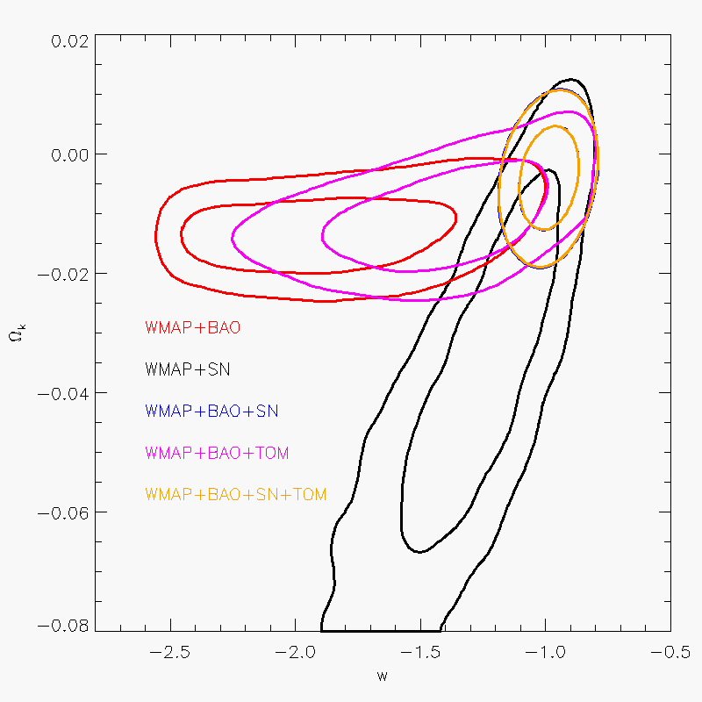
With just 100 clusters

Slide 28
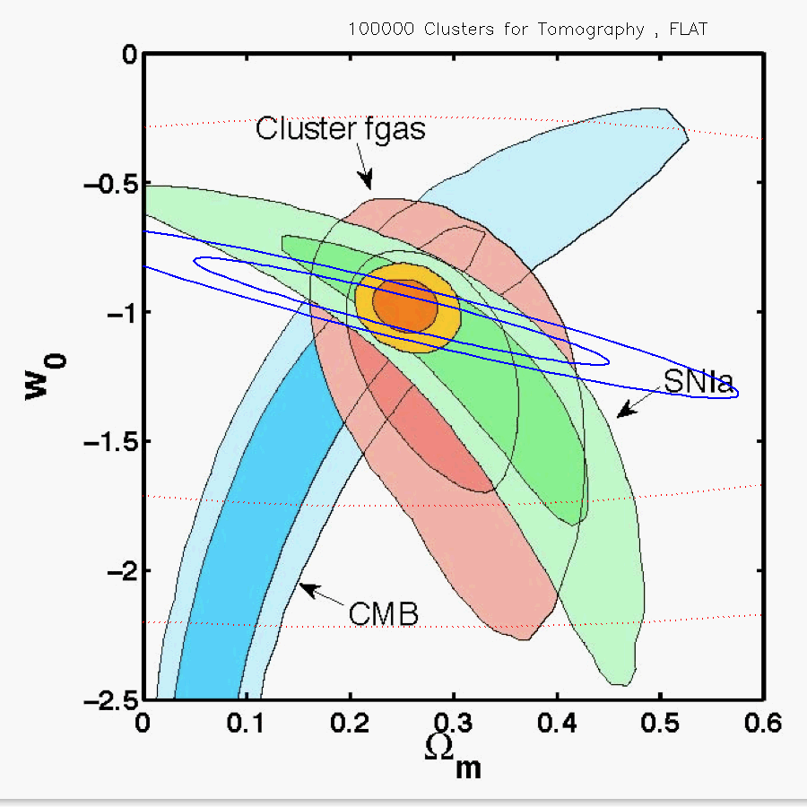
100,000 [very tough] WLT clusters alone, Flat (Blue)

Slide 29
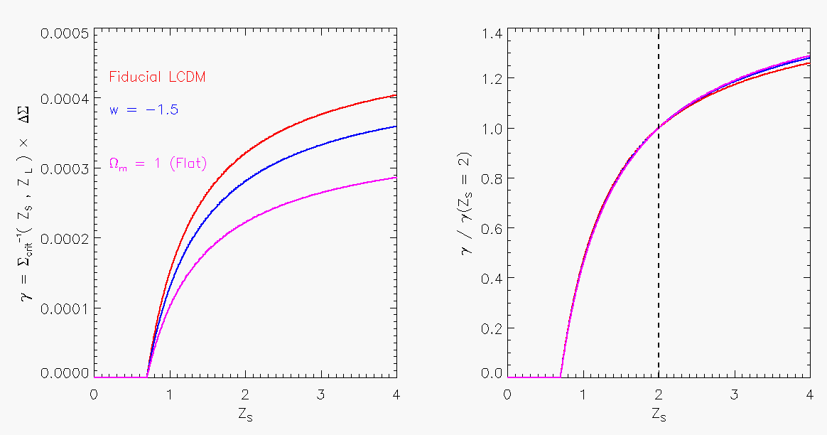
Weak Lensing Tomography
What’s next/and how to improve our results if we can find an independent to normalize… We think. We’re working on it!

Slide 30
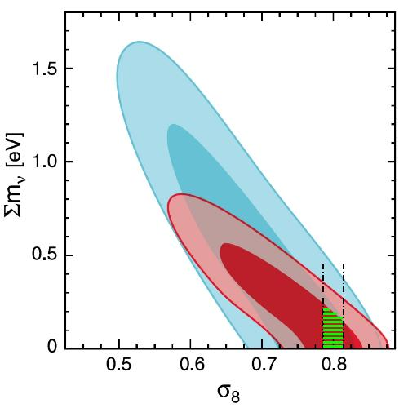
With about 100-300 clusters, neutrino mass when combined with other approaches

Slide 31
Once you have team of experts (in different things) you can have some fun
One example: a strongly lensed cluster CL1216… It only took us about 3 years to submitting a request to get time to get a redshift of the arcs, but we did it. => Mass models CMD/baryon ratio and central concentration.

Slide 32
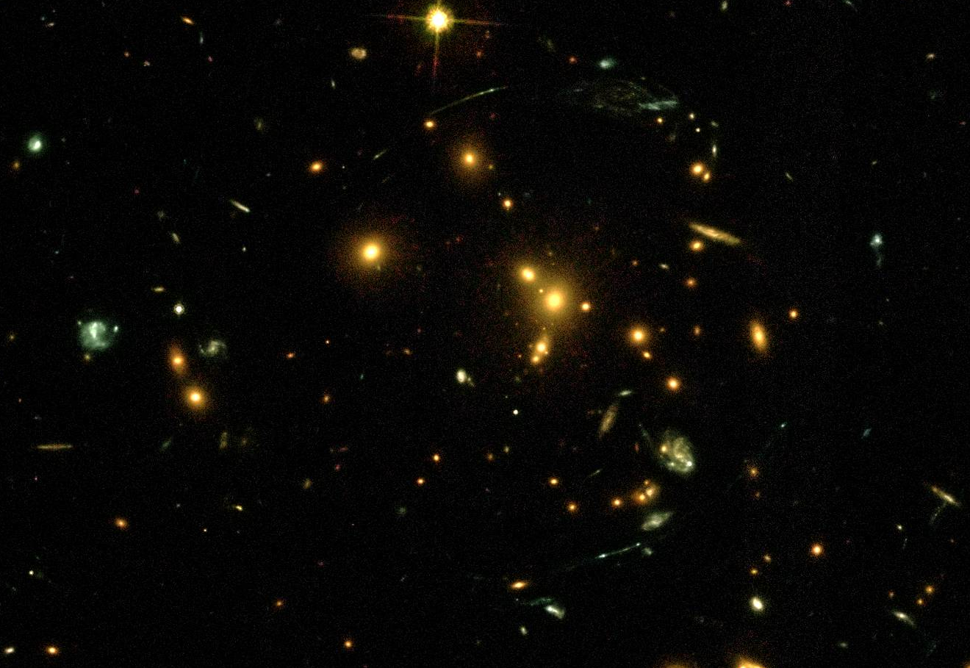
The cluster Cl1216-12 (Cl1216 hereafter) redshift 0.8 ! See the arcs? Case study on mass from strong lens, and redshifts More the “debris” on next slide

Slide 33
Debris? But photo-z is z = 2 and debris photo-z is different enough from galaxy photo-z, cluster is z = 0.8 we want follow up with HST and Chandra

Slide 34
Mass models of Cl1216 based on velocity dispersion and strong lensing, lots of models, lots of choices. But, the all converge at r of about 1 Mpc

Slide 35
Weak lensing of z <0.3 versus Cl1216 (square) Higher z less time for gas to flow back in [r₅₀₀ = about 1 Mpc] ?, but sample of 1
NB besides perhaps being low compared to z < 0.3, also low relative to CMB/Planck (Cl1216 the square)

Slide 36
XMM image showing no evidence of current AGN (active galactic nucleus energy output in X-rays ⬄ strong enough galactic wind)
X-ray Image of Cl1216 aka LCDCS0504, no AGN there now??

Slide 37
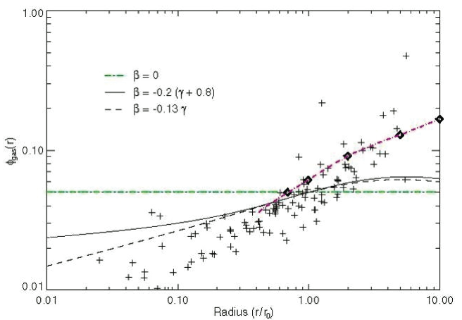
Fraction of X-ray gas to total mass (via X-rays) apples to apples, now seems pretty normal??
Our data

Slide 38
Planck prefers b = 0.45 (1-b = 0.55) but blue is 1-b = 0.8,
Can our sample of 1 can help see next slide)? ⬄ Also, we have about 10 more, stay tuned!

Slide 39
Ratio for cl1216 is in the right direction
1/(1-b) approximate preferred value for Planck
Notes:
Considering several ingredients of the gas physics
of clusters, numerical simulations predict scaling relations with
30% scatter in amplitude (at a fiducial mass of 61014Msol ). All
this points toward a mass bias between the true mass and the estimated mass of (1 - b) = 0:8+0:2-0:1 , and adopting the central value we found constraints on m and 8 that are in good agreement
with previous measurements using clusters of galaxies.
Comparing our results with Planck primary CMB constraints
within the CDM cosmology indicates some tension. This can be alleviated by permitting a large mass bias (1-b
b ~= 0:55 ), which is however significantly larger than expected. Alternatively, the tension may motivate an extension of the CDM model that modifies its power spectrum shape. For example the inclusion of non-zero neutrino masses helps in reconciling the primary CMB and cluster constraints, a fit to Planck
CMB + SZ + BAO yielding sum(m) = (0:22 0:09) eV.

Slide 40
Planck is all Sky, but beam dilution is an issue plus, redshifts etc => aside the don’t forget X-rays and using lensing to find clusters
Or maybe “tension” is a selection effect problem?
Notes:
Left panel: distribution in the M– z plane of the Planck clusters (filled circles) compared with the SPT clusters (open light red
circles) from Reichardt et al. (2013) and ACT catalogue (open red squares) from Hasselfield et al. (2013).

Slide 41
Can improve result by using clusters to strengthen the signal => One more reason to carry out photo-zs and broad band coverage: find high z ( > 6) candidates!

Slide 42
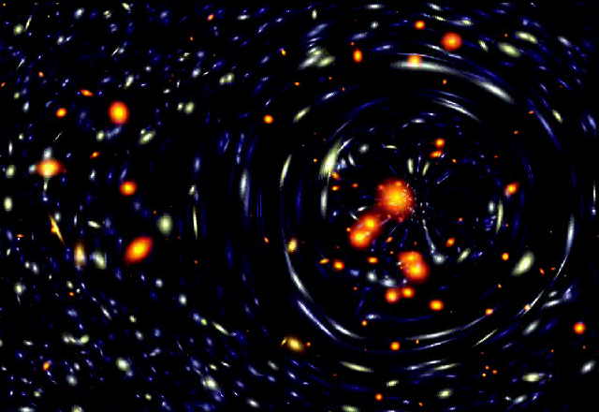
A cool demo of a cosmic magnifier a work
From Tyson on the web

Slide 43
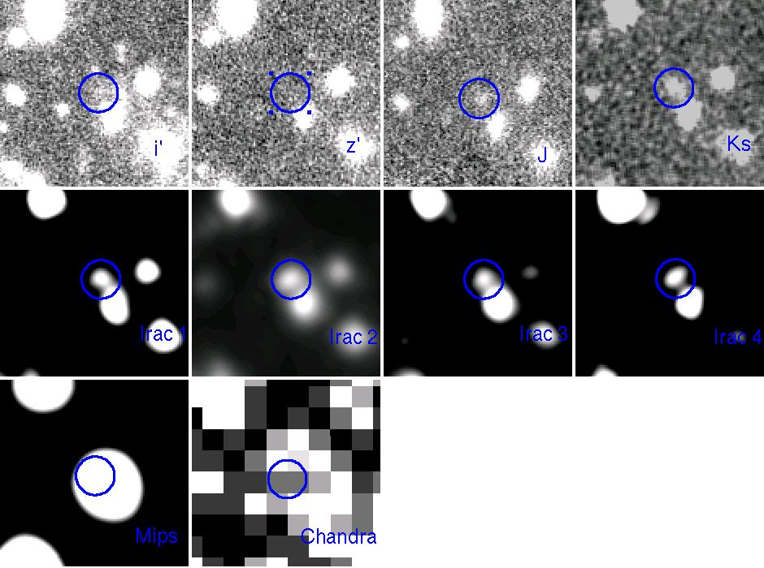
Example 1, z = about 7 best guess if Lyman break (not dusty)

Slide 44
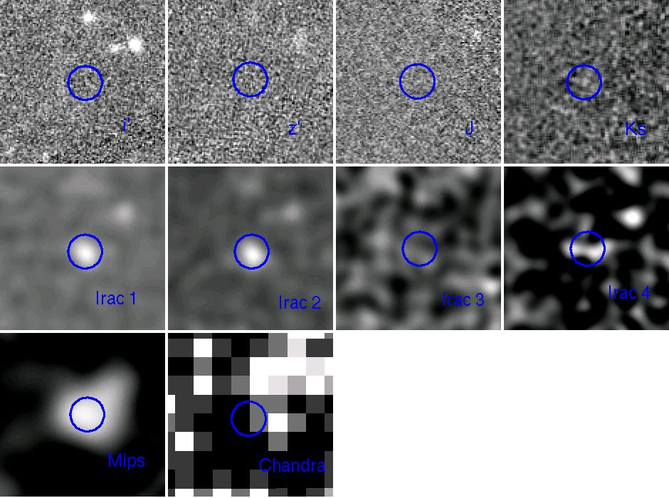
Example 2, z = about 10! best guess if Lyman break (not dusty)

Slide 45
Summary and conclusions
Getting a limit to w even in the ± 0.1-0.3 range will be hard work but will be geometrical and hence put the nail in the coffin re those ideas would prefer anything but DE, OR, hope springs eternal, that we’ll find something new
We have confirmed experimentally what EUCLID has supposed… you need J-band to go with BVRIZ to get the photo-zs right out to z of 1.5
Space is clearly the place, but we’ll in the US have to make do with the ground (BTW, EULCID has about 1,000 total CO-Is yet the US is limited to 40 total, period [no fair adding on postdocs afterwards ☹]
By calculating a truly rigorous mass we find hint that the X-ray masses are under-estimated and that this could help Planck. Also, BTW, note Planck has a beam dilution problem.
By assembling team of experts, we can carry out many interesting projects related to clusters and lensing, and in particular high z candidates and perhaps even a background high z ( >2) cluster that has been magnified enough to detect.
My personal bet: w will turn out to be −1 to whatever limit we can get, but the role
DAFT/FADA (or CLASH ☹), DES, LSST and EULCID (and WFIRST??) will be significant in regards to neutrino mass, CMD ⬄ large scale structure growth and finding the highest redshift objects to lift the veil from the so called “Dark Ages”

Slide 46
The End
Thanks

Slide 47


Slide 48
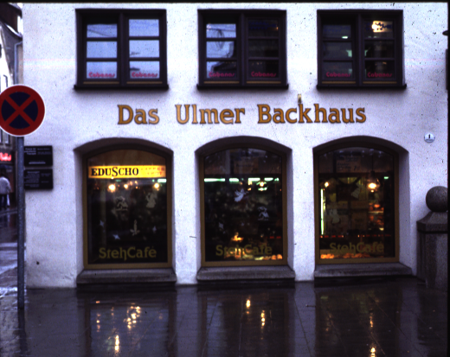
Where Mel Ulmer cooks up his ideas for new projects
Ulm is where Einstein was born and Kepler published his famous works, BTW

