Slide 1
Generative Adversarial Networks
Prasanna Balaprakash
Mathematics and Computer Science Division &
Leadership Computing Facility
Argonne National Laboratory
Argonne National Laboratory
July 28, 2017

Slide 2
Acknowledgements
I. Goodfellow, et al. “Generative adversarial nets.” Advances in neural information processing systems. 2014.
T. Salimans et al. “Improved techniques for training GANS.” Advances in Neural Information Processing Systems. 2016.
I. Goodfellow. "NIPS 2016 Tutorial: Generative Adversarial Networks." arXiv preprint arXiv:1701.00160 (2016)
http://www.iangoodfellow.com/presentations.html
https://ishmaelbelghazi.github.io/ALI/
https://github.com/soumith/ganhacks
http://www.rricard.me/machine/learning/generative/adversarial/networks/2017/04/05/gans-part1.html
https://blog.openai.com/generative-models/

Slide 3
Outline
Generative Modeling
Generative Adversarial Networks
Applications and Extensions

Slide 4
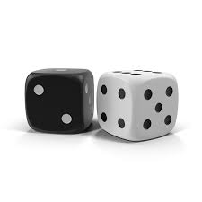
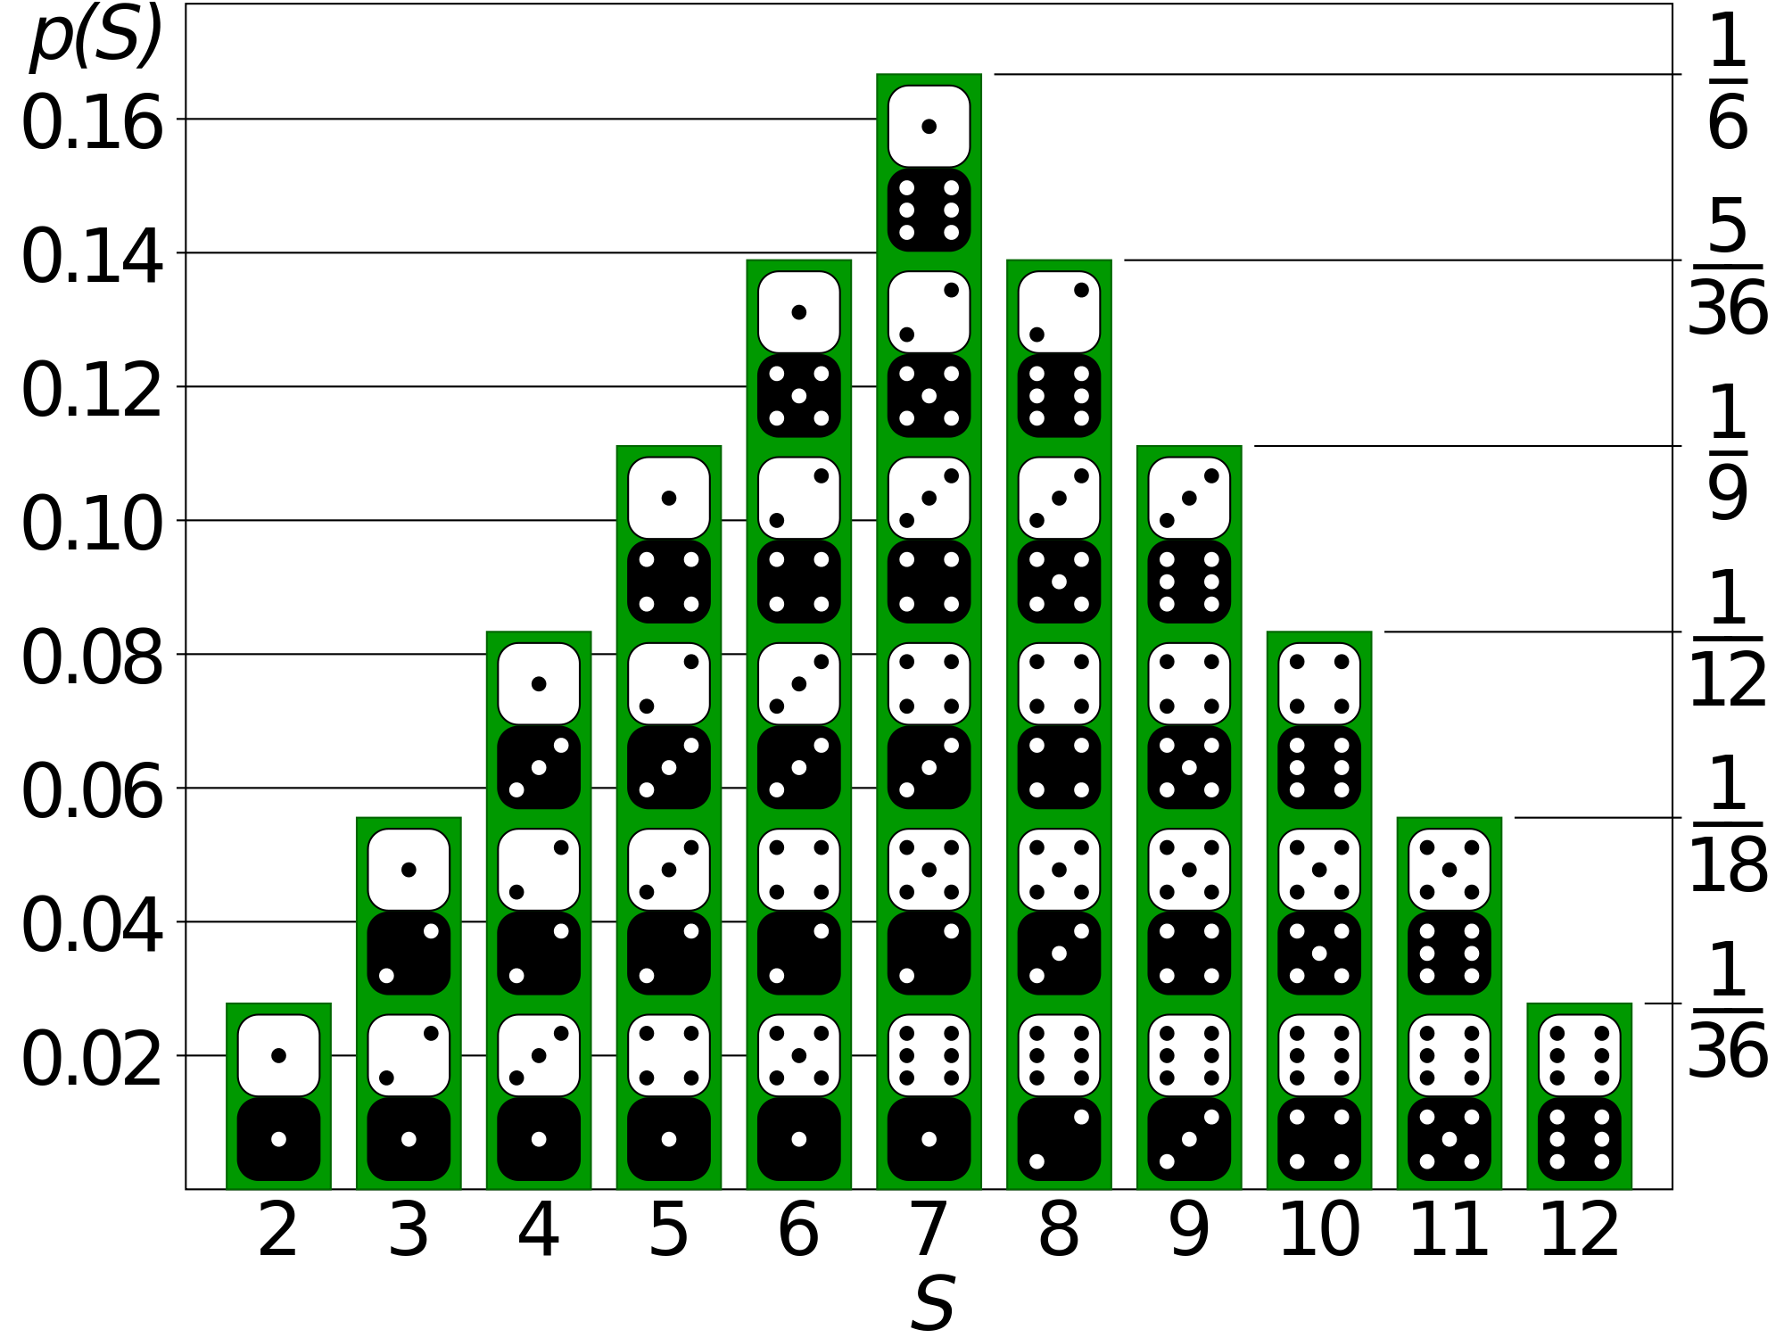
Generative Models
Sample data
Distribution
Model how the data was generated

Slide 5
Generative Models
Sample data
Distribution
Model how the data was generated

Slide 6
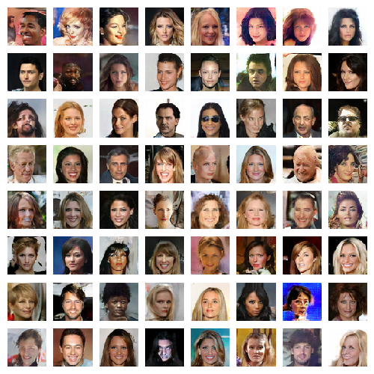
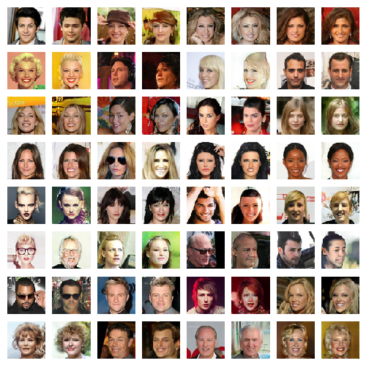
Generative Models
Sample data
Distribution data
Generate data from the distribution
Notes:
Take a lot of training examples
learn the probability distribution
Estimate of the function of that defines the distribution
New samples from the distributon

Slide 7
Why Generative Models?
Ability to use high-dimensional, complicated probability distributions
Simulate possible futures or simulated reinforcement learning
Missing data
semi-supervised learning
Multi-modal outputs (many outputs for a single input)
Realistic generation of samples

Slide 8
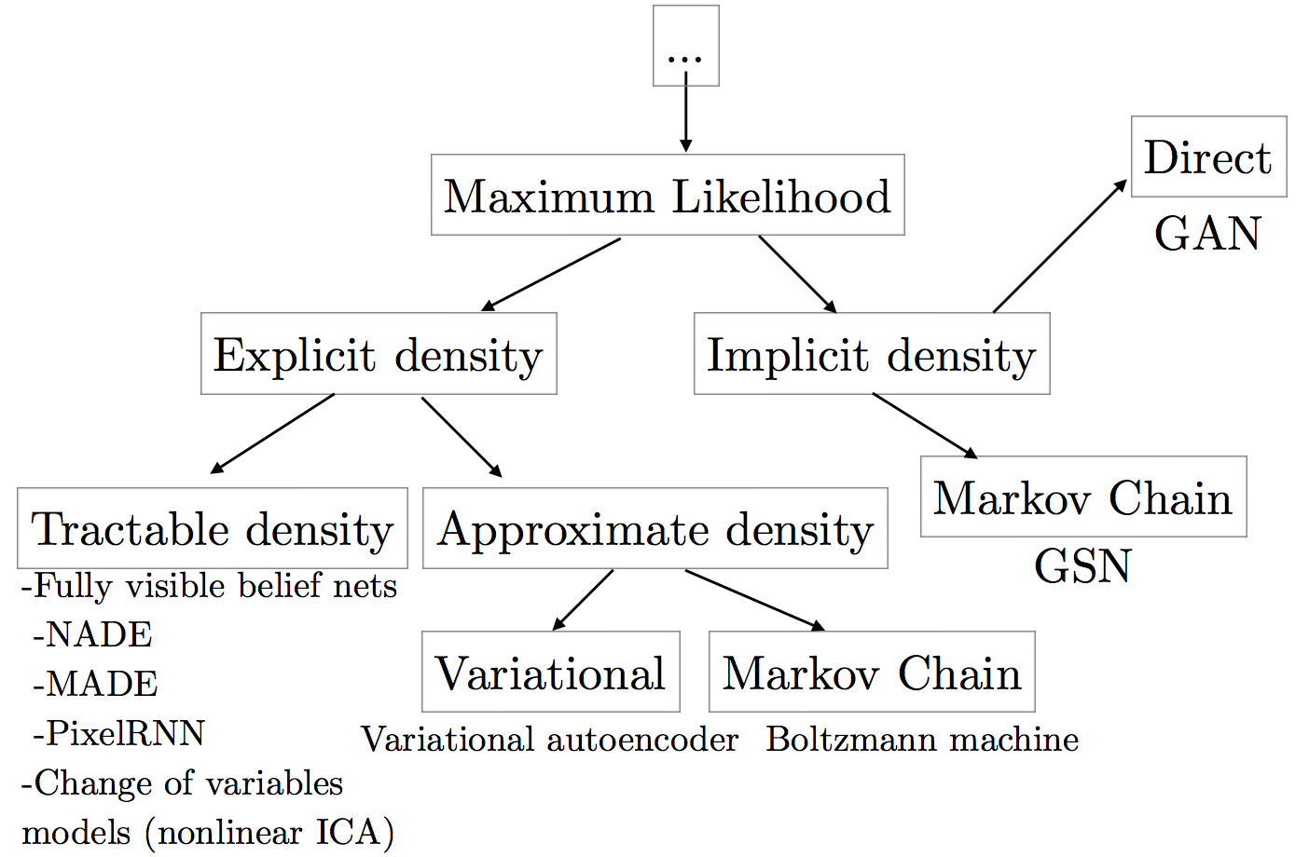
Taxonomy of Generative Models

Slide 9
Outline
Generative Modeling
Generative Adversarial Networks
Applications and Extensions

Slide 10
Generative Adversarial Networks
Notes:
Source: https://ishmaelbelghazi.github.io/ALI/

Slide 11
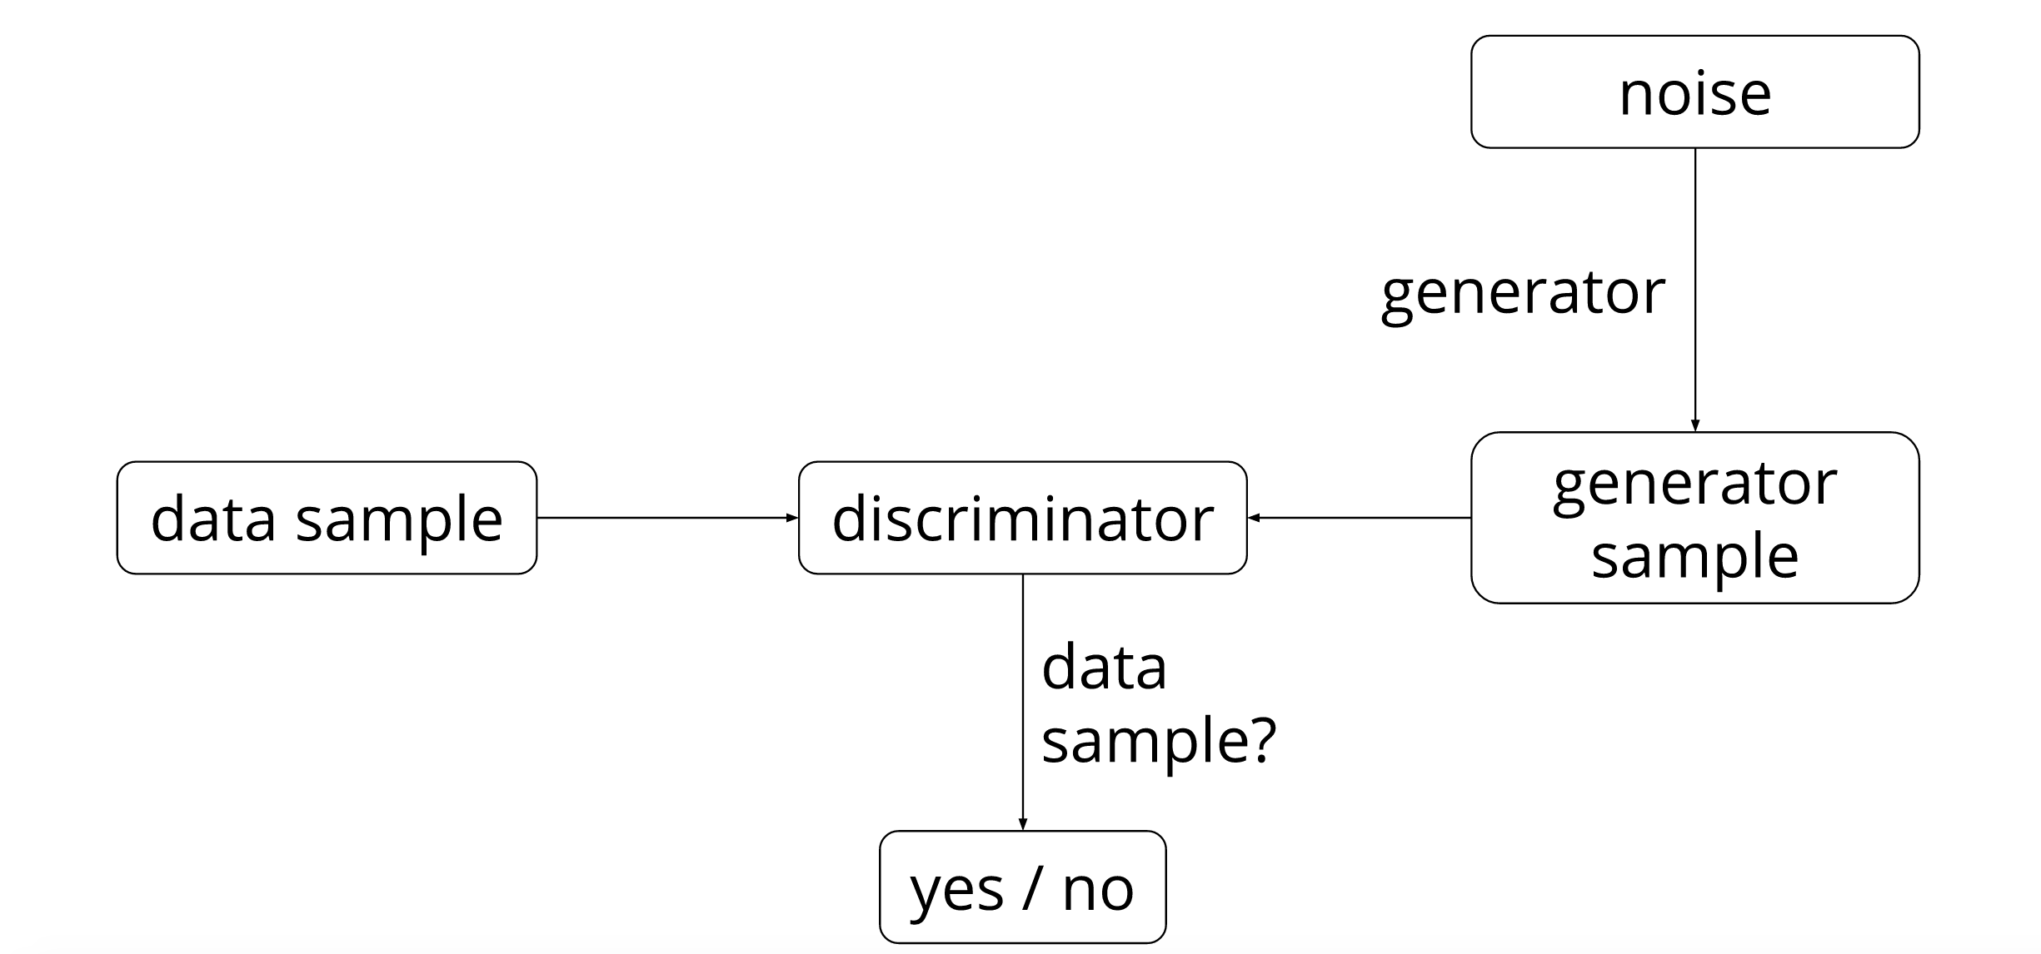
Generative Adversarial Networks
Notes:
Source: https://ishmaelbelghazi.github.io/ALI/

Slide 12
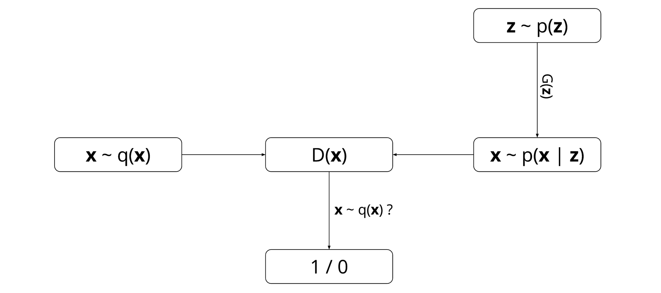
Generative Adversarial Networks
GAN pits two neural networks against each other:
a discriminator network D(x)
a generator network G(z)
Notes:
https://ishmaelbelghazi.github.io/ALI/

Slide 13
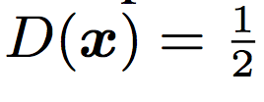
Generative Adversarial Networks
Maximize discrimination
Minimize
getting caught

Slide 14
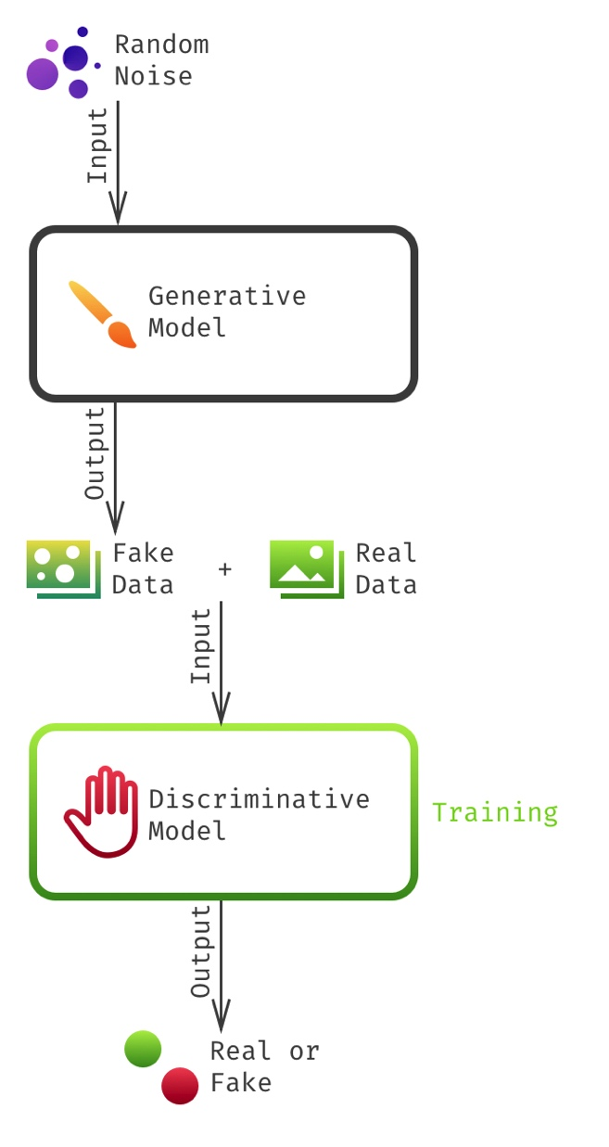
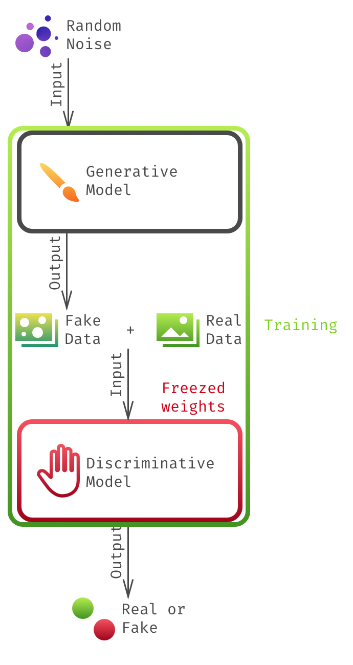
Generative Adversarial Networks
Step1:
Train the discriminator
Step2:
Train the generator via
chained models
Notes:
http://www.rricard.me/machine/learning/generative/adversarial/networks/2017/04/05/gans-part1.html

Slide 15
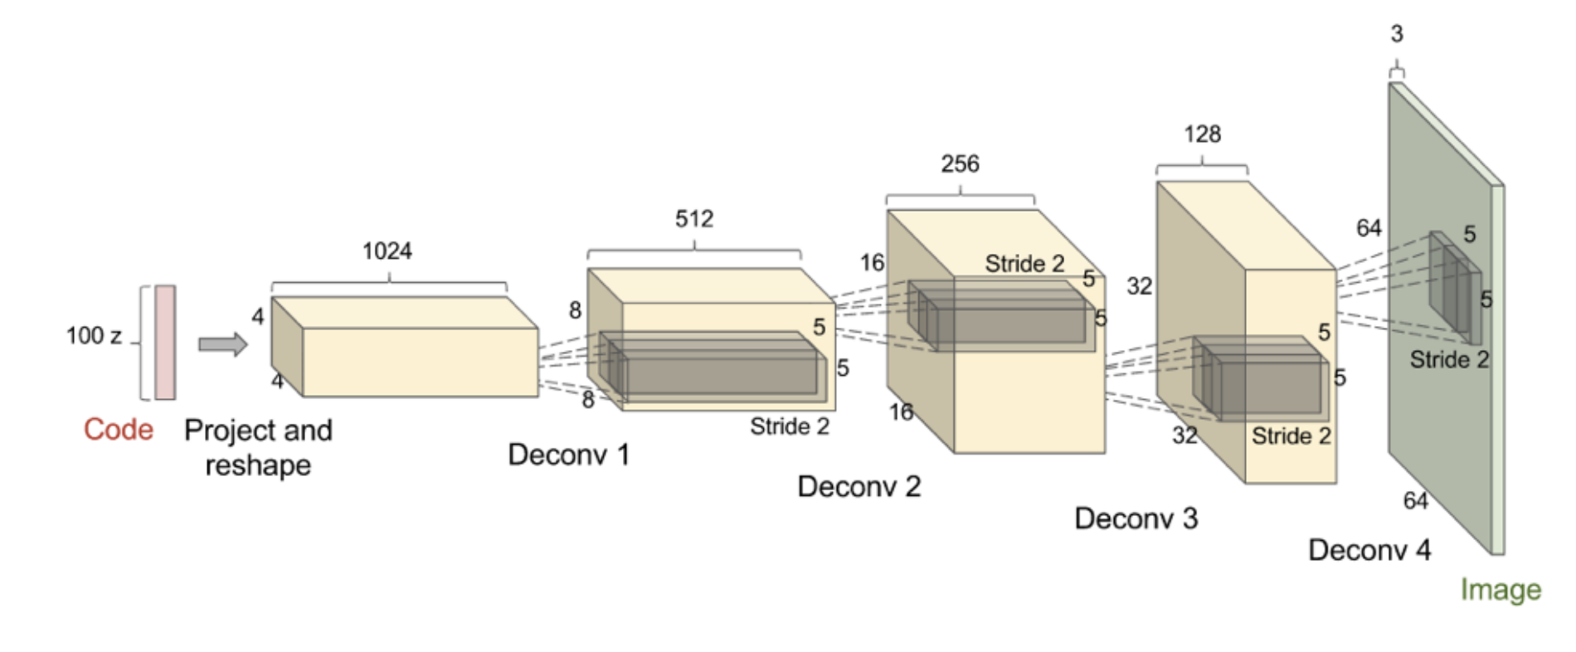
DCGAN Architecture
De-convolution: convolution run backwards (with stride > 1)
Batch normalization: faster and stable learning
No pooling layers: because pooling operation is not invertible

Slide 16
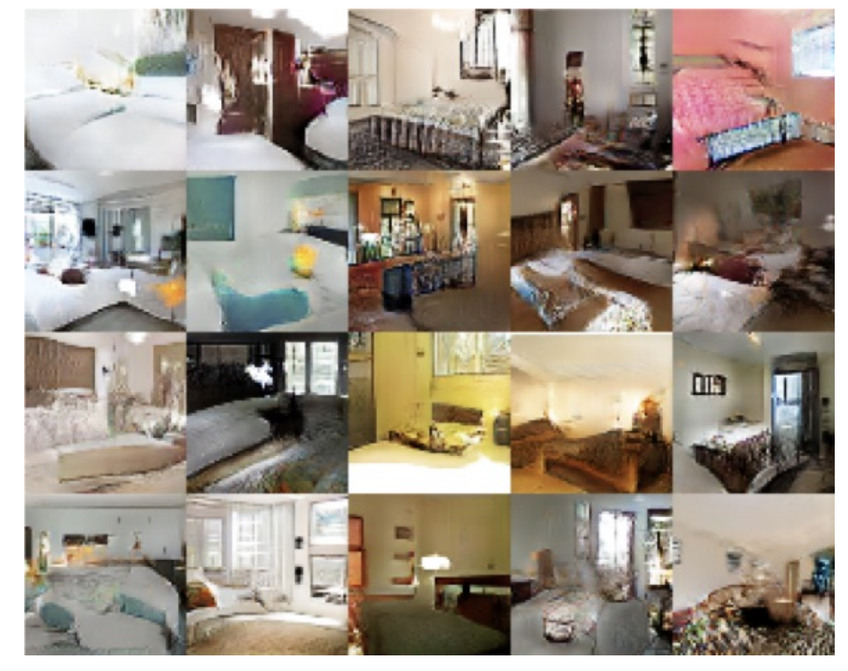
DCGAN Architecture
Sample images of bedrooms generated by a DCGAN trained on the LSUN dataset

Slide 17
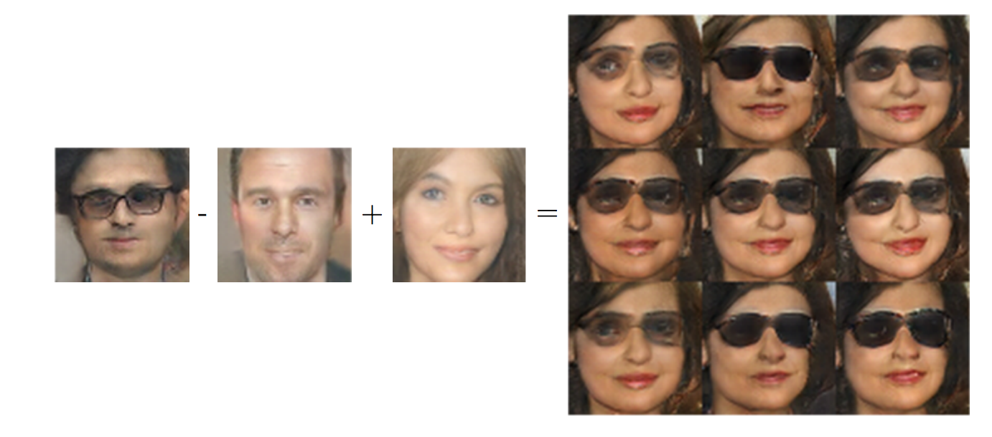
Vector Space Arithmetic

Slide 18
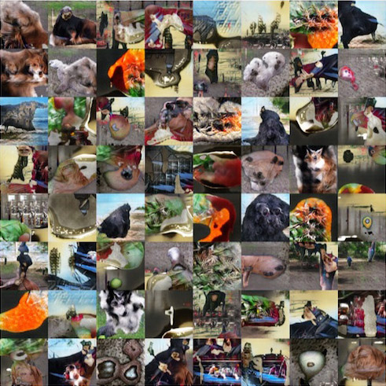
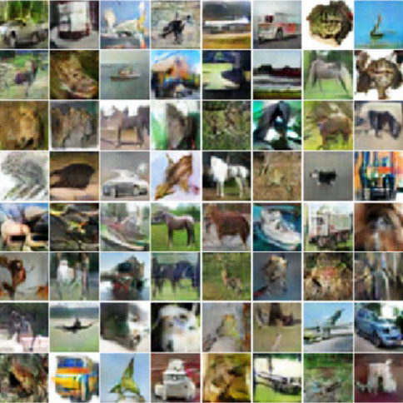
Imagenet and CIFAR10
Notes:
https://arxiv.org/pdf/1606.03498.pdf

Slide 19
Outline
Generative Modeling
Generative Adversarial Networks
Applications and Extensions
Notes:
Data
Complexity
Humans
Optimization
Real-time

Slide 20
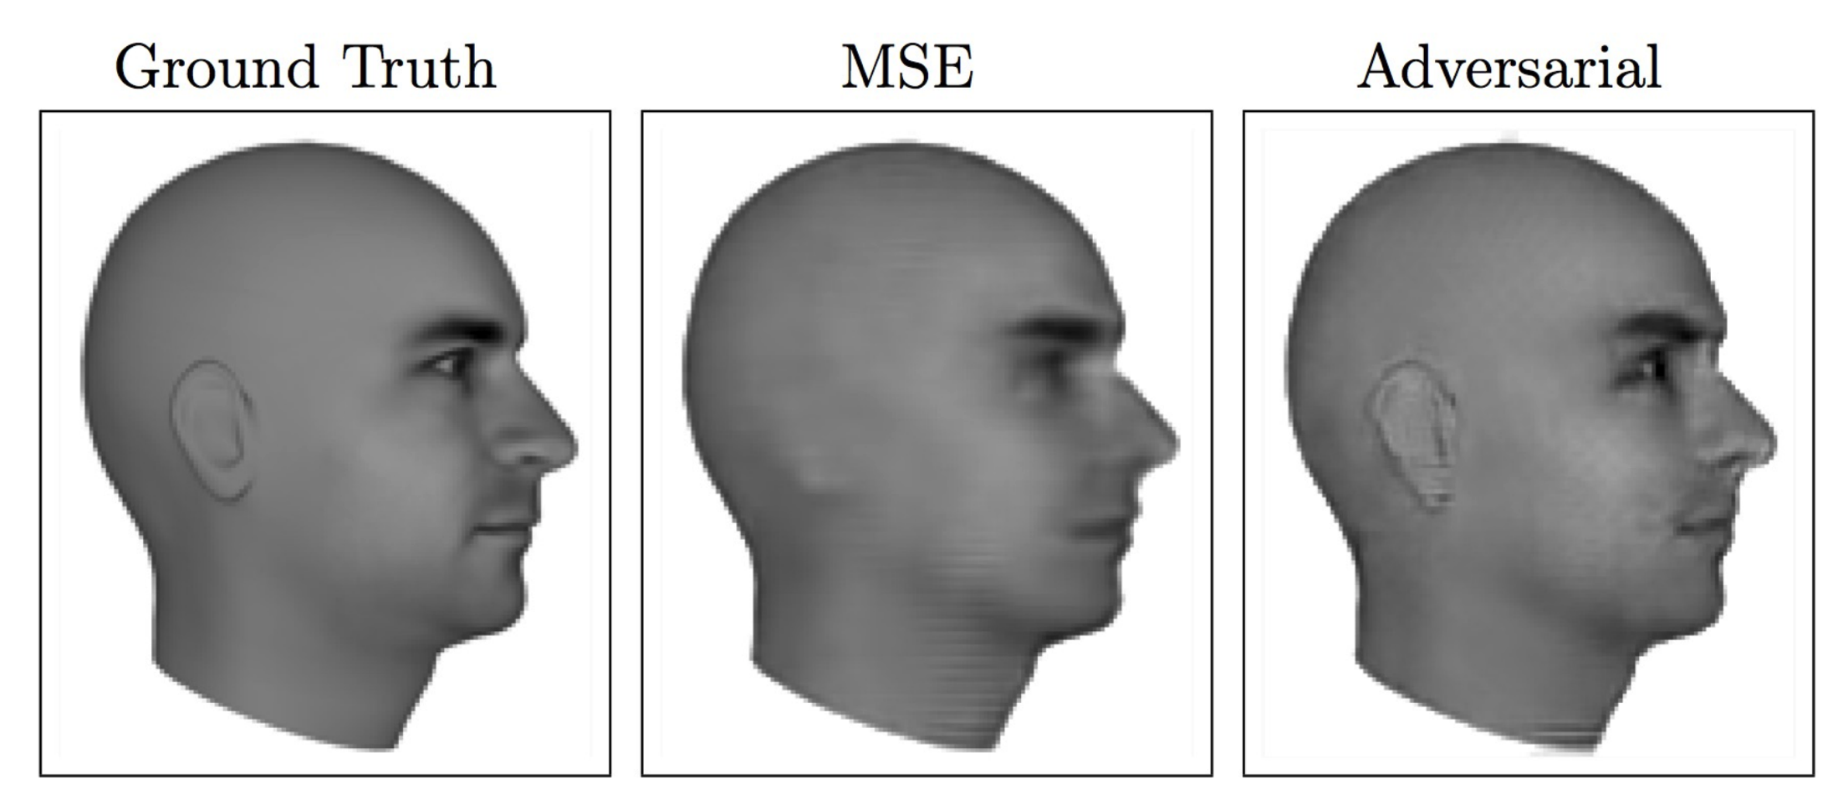
Next video frame prediction
(Lotter et al 2016)

Slide 21
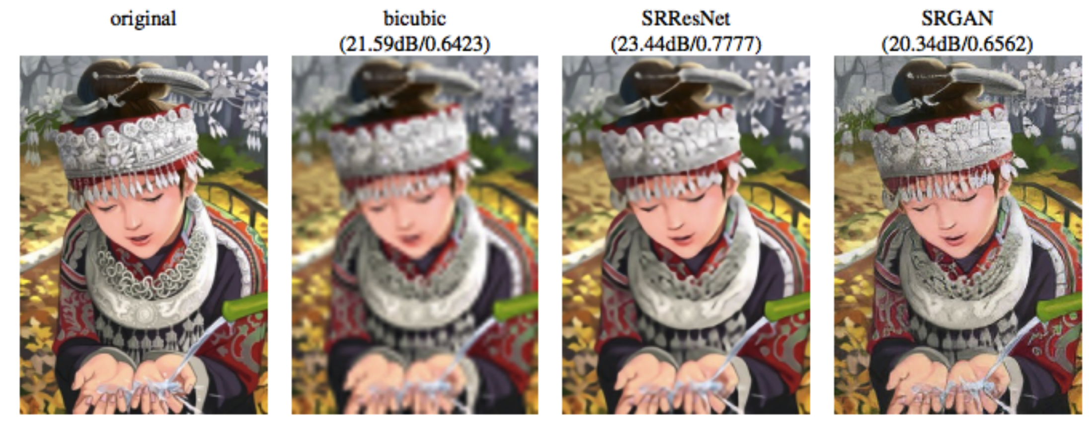
Image super resolution
(Ledig et al 2016)

Slide 22
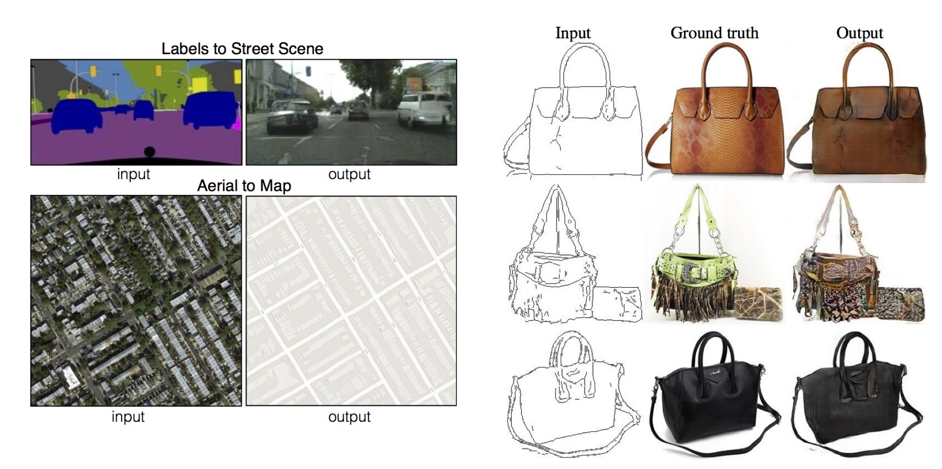
Image to image translation
(Isola et al 2016)

Slide 23
GANS for Jets
(Oliveira et al 2017)

Slide 24
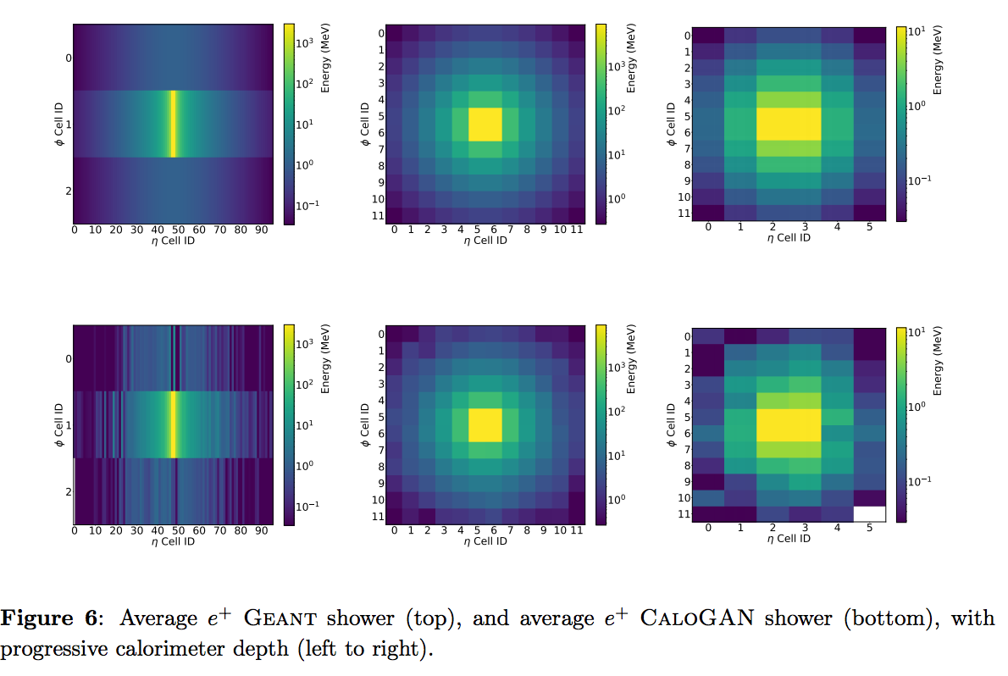
GANS for Calorimeter Simulation
(Paganini et al 2017)

Slide 25
Extensions
Adversarial auto encoders
Semi-supervised learning
Transfer learning
Reinforcement learning
Inverse problems
…

Slide 26
Outline
Generative Modeling
Generative Adversarial Networks
Applications and Extensions
Notes:
Data
Complexity
Humans
Optimization
Real-time

Slide 27
Conclusion and summary
GANS
approximate probability density
use supervised learning to approximate an intractable cost function
simulate many cost functions, including the one used for maximum likelihood
generate high resolution samples from diverse image classes
Successful in several (image-based) applications
Training is still an art than science
Many interesting research directions and extensions

Slide 28
“Adversarial training is the coolest thing since sliced bread.”
Yann LeCun, Director of AI Research at Facebook and Professor at NYU

Slide 29
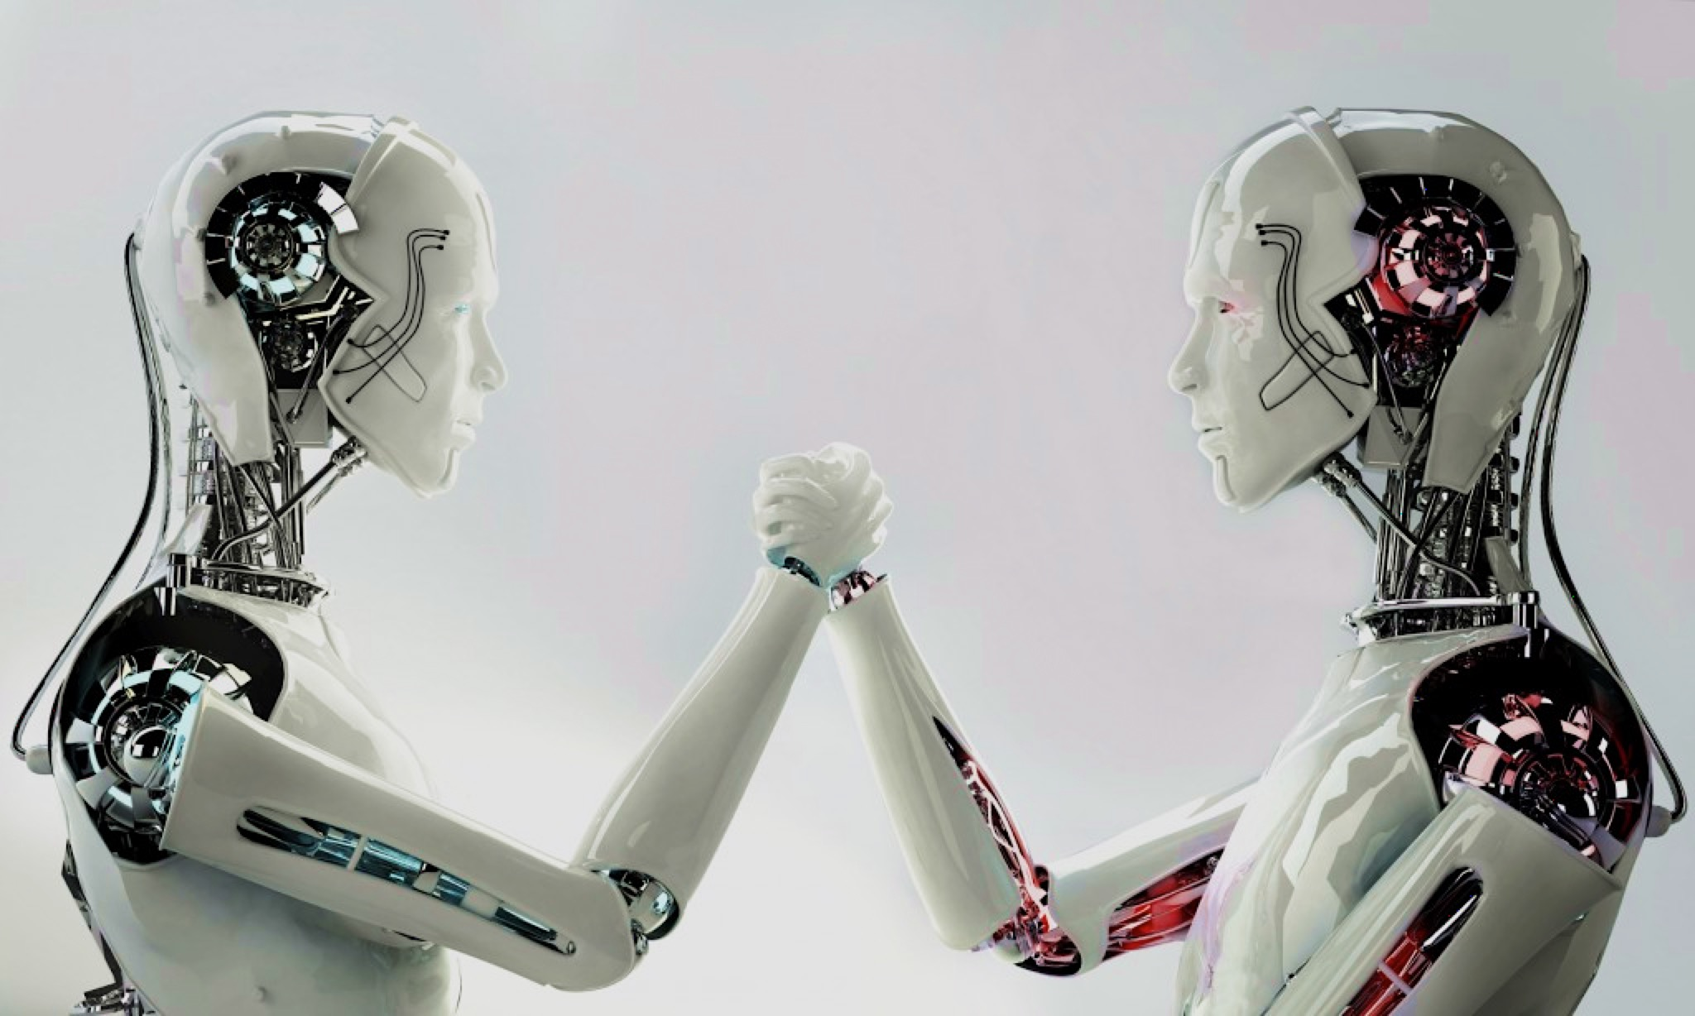
Thank You
Discriminator
Generator

