Slide 1
Rad-Hard Methodology and CAD Tools
Sandeep Miryala
ASIC Group, Fermilab

Slide 2
Outline
Introduction
  Radiation Effects on Semi-Conductor Devices
TID effects
  Device models
  Library characterization
SEE mitigation using TMR
  TMR insertion by RTL engineers
  TMR Macro
  SEE tolerant Digital Logic Synthesis Flow (Genus & Innovus)
Summary

Slide 3
Radiation Effects on Semi-Conductor Devices
Radiation Effects
Cumulative Effects
Single Event Effects
Ionization (TID)
Displacement (Fluence)
Permanent
Transient
Static
Single Event Transient
Single Event Upset
Single Event Burnout
Single Event Latchup
Single Event Gate Rupture

Slide 4
Total Ionizing Dose (TID)

Slide 5
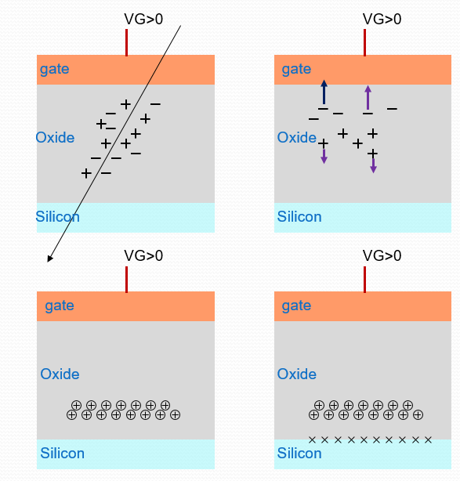
Total Ionizing Dose (TID)
Ionizing radiation builds up interface trap states
TID-induced charge in the oxide decreases with the thickness
Thick oxide used for device isolation introduces leakage
Parameters:
  Temperature
  Bias
  Annealing
  Dose Rate

Slide 6
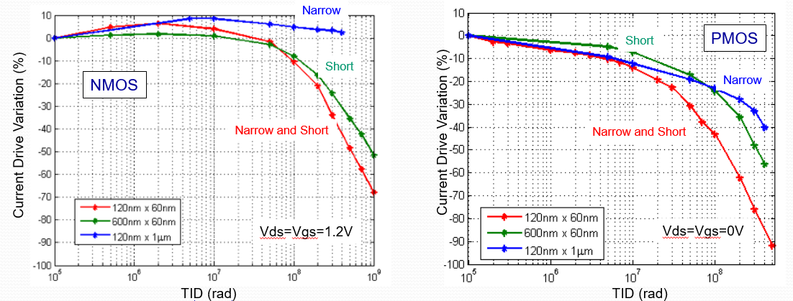
Device Irradiation (65nm)
Narrow Transistors
  NMOS less affected by TID
Short Transistors
  PMOS and NMOS devices are degraded
Narrow and Short devices
  PMOS completely off for 1 Grad
F.Faccio et al., TWEPP 2015, TID effects in 65nm transistors: summary of long irradiation study at the CERN X-rays facility

Slide 7
Irradiation Effects Modeling
Spectre model corners were developed based on irradiation tests
  200Mrad and 500Mrad and the dependence on W and L is included
  Threshold voltage increase is included for PMOS and NMOS
  Leakage current variations are included for NMOS
Assumptions
  Room temperature irradiations and worst case biasing (VDS = VGS = 1.2)
  Does not include annealing
HVT and LVT models were extrapolated from NVT device measurements
Mohsine Menouni et.al, Main results of radiation of CMOS 65nm technology and the impact on the design of RD53A, a large scale pixel chip prototype for HL-LHC

Slide 8
TID effects on Circuits
Analog Designs
  Avoid excessively narrow and short transistors
  NMOS: L >= 120nm, any W, PMOS: L >= 120nm, W >= 300nm
Digital Designs (Semi-Custom Design Flow)
  Small size transistors in standard cells → Speed degradation
  Generate timing Libraries at 200Mrad and 500Mrad
    Liberate tool (Cadence)
    Used by several cad tools
.libs (P, V, T)
Synthesis
Floorplanning
Timing, Power, Signal Integrity
Place & Route
Timing, Power and Signoffs

Slide 9
Library Contents (.lib)
Timing
  Combinational
    Delay & Transition Time
  Sequential
    Delay & Transition Time
    Hold and Setup
    Recovery and Removal
Power
  Leakage
  Internal Power
Noise
  Signal Integrity analysis
Data is arranged in Look Up Table (LUT) format
  Sample 4 x 4 LUT
Index | cl1 | cl2 | cl3 | cl4
Trin1 | D11 | D12 | D13 | D14
Trin2 | D21 | D22 | D23 | D24
Trin3 | D31 | D32 | D33 | D34
Trin4 | D41 | D42 | D43 | D44

Slide 10
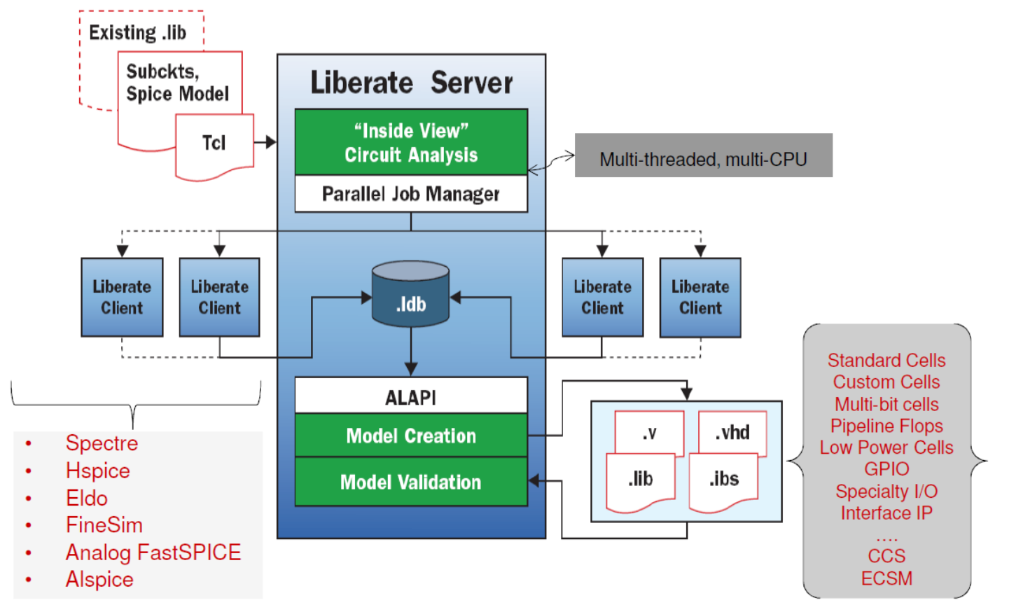
Liberate Tool Flow
1
2
Extracting arcs & indexes
3

Slide 11
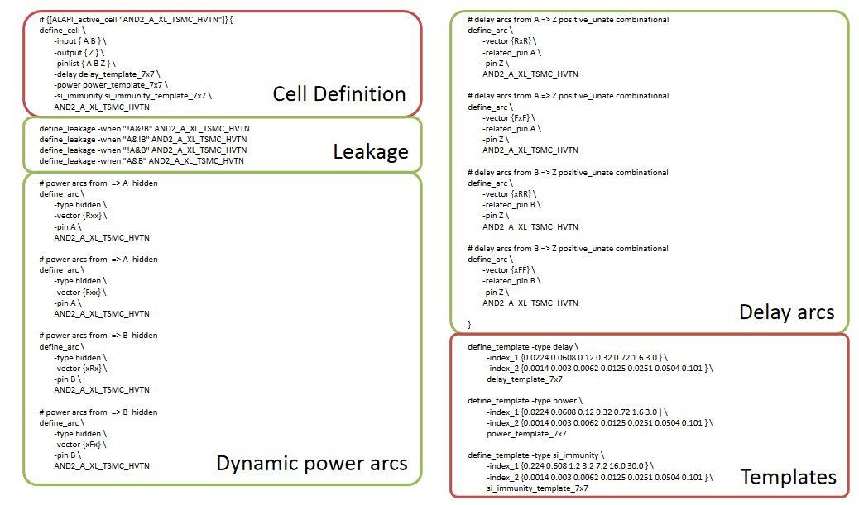
Define_Cell and Define_Arc
Generate arcs from existing .lib

Slide 12
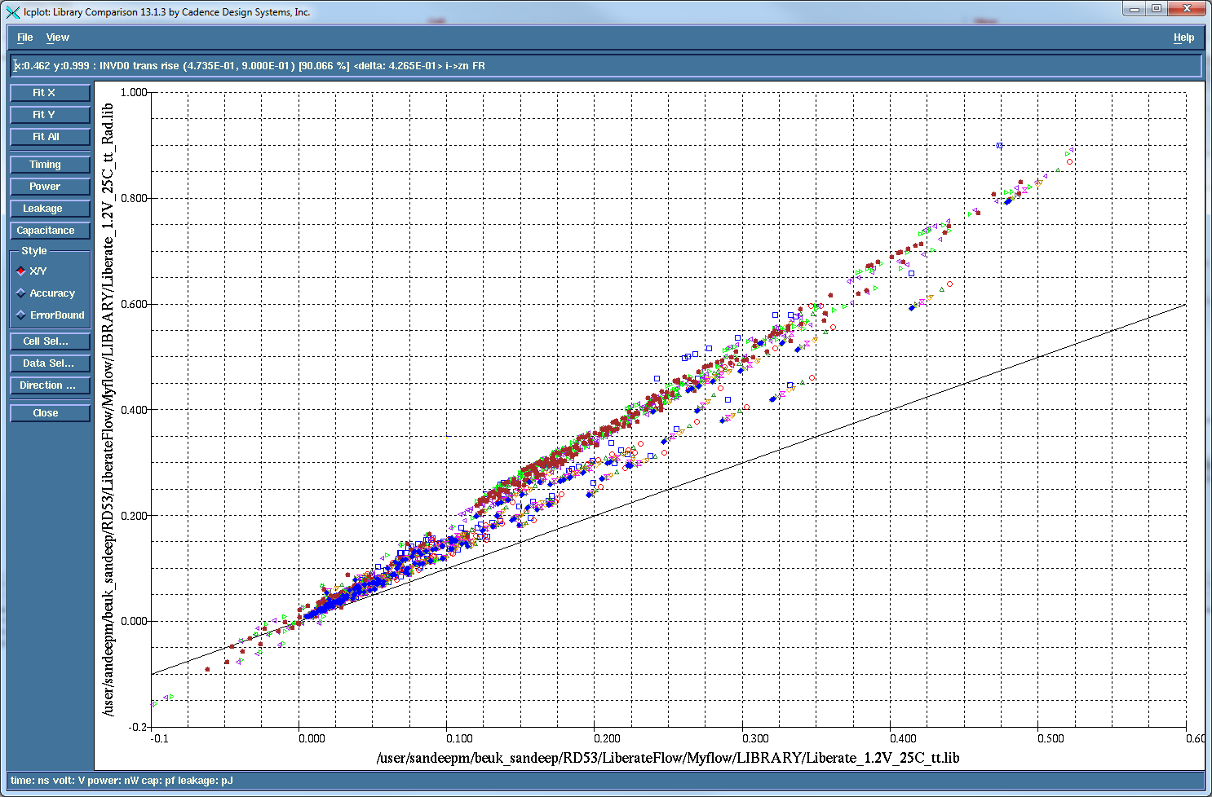
Library Comparison (LC Plot)
Cells (INV and DFD)
200MRad radiation models
Timing includes (Delay, Slew, setup, hold)
X axis: pre-rad Library
Y axis: 200Mrad Library

Slide 13
Liberate Applications for HEP
Re-characterize cells
  New PVT corners
  New Models (Radiation & Cold models)
  Modify input slew and output load templates
Characterize new cells
  Multi-bit latches
  Dynamic Flip-Flops, SEU DFF
Characterize new standard cell libraries

Slide 14
Single Event Effects

Slide 15
Radiation Effects on Semiconductor Devices
Image taken from Introduction to SEU, Altera, white paper, Sep 2013

Slide 16
SEUs on SRAM
VDD
A
B
GND
Initial state : A = VDD, B= GND
Current spike/charge at drain of M1
Transient current changes the state of node A
  VDD -> GND
The second inverter (M3-M4) switches node B
  GND -> VDD

Slide 17
Single Event Effects (SEE) Classification
Soft Errors
  Transient
    Single Event Transient (SET)
  Static
    Single Event Upset (SEU)
Soft Error mitigation
  Technology level
    Bulk CMOS Vs SOI
  Cell level
    Dice latch
  System level redundancy : Triple Modular Redundancy (TMR)
Mitigate Soft Errors using TMR
SEE tolerance is needed in:
Global configuration registers
Pixel configuration registers
Data path registers

Slide 18
Triple Modular Redundancy (TMR)
Q = (Q1&Q2)| (Q2&Q3)| (Q3&Q1)
Data is replicated on multiple nodes
Additional area and power consumption
reset
reset
DFF
Q1
Q1 | Q2 | Q3 | Q
0 | 0 | 0 | 0
0 | 0 | 1 | 0
0 | 1 | 0 | 0
0 | 1 | 1 | 1
1 | 0 | 0 | 0
1 | 0 | 1 | 1
1 | 1 | 0 | 1
1 | 1 | 1 | 1
Din
DFF
Clk
set
set
reset
Din
DFF
Voter
Q
Q2
Clk
set
reset
DFF
Q3
Clk
set

Slide 19
TMR insertion by RTL designers
module TMR (Din, Q, clk);
Input Din;
output Q;
reg Q1, Q2, Q3;
always @(posedge clk)
begin
Q <= Din;
Q1 <= Din;
Q2 <= Din;
Q3 <= Din;
end
assign Q = (Q1 & Q2) | (Q2 & Q3) | (Q3 & Q1)
endmodule
Q
DFF
Q1
Din
DFF
Clk
Clk
Din
DFF
Voter
Q
Synthesis
Q2
Clk
DFF
Q3
Clk
Disadvantages:
1. Redundant logic is removed by synthesis tools
2. Additional don’t touch commands
3. Complex for chips with huge # of registers

Slide 20
TMR Macro
Realize TMR as a macro
  Single row implementation
  like a standard cell
After synthesis, replace the registers with TMR Macro
Din
DFF
Q1
DFF
Q2
DFF
Q3
Voter
Q
Clk
Disadvantages:
Non-optimal placement
Routing issues

Slide 21
SEE Tolerant Semi-Custom Flow
Specification
RTL (Verilog)
TMR Insertion
Memory Elements Spatial Separation
Synthesis (Genus/RC)
Clock Delay/Skew Insertion
Placement
Physical Design (Encounter/Innovus)
TMR Insertion methodology with timing /placement aware in semi-custom design flow
Clock Tree Distribution
Routing
Physical Verification

Slide 22
Logic Synthesis Flow
Load Libs and RTL
1
FF1
FF2
Combinational Data Path
Apply SDC
Set Avoid on undesirable Flipflops
2
Synthesize Design
3
FF3
FF4
4
Write Final Netlist

Slide 23
TMR Synthesis
Read_netlist TMR.v
foreach I [filter –regexp libcell DFQD* [find /designs/$DESIGN –instance instances_seq/*tmr*]] {
Change_link –inst $i –design_name /designs/tmr_flop
}
1
Load Libs and RTL
4
read TMR Netlist
Use Change Link to convert desired flops to TMR
2
Apply SDC
Set Avoid on undesirable Flipflops
rm /designs/LTMR
Uniquify $DESIGN
Set_attr preserve size_ok [find / -subdesign TMR*]
Synth –to_map incr
5
Remove TMR flop design
Uniquify
Synthesize Design
3
6
Write Final Netlist

Slide 24
TMR Insertion Automation
TMR_Hinst
FF1A
FF1 C
FF1 B
FF2 A
FF2 B
FF2 C
voter
DATA PATH
voter
Additional steps in synthesis flow does TMR insertion
FF3 A
FF3 B
FF3 C
FF4 A
FF4 B
FF4 C
voter
voter

Slide 25
4
read_netlist TMR_DFQD.v
foreach I [filter –regexp libcell DFQD* [find /designs/$DESIGN –instance instances_seq/*reg*]] {
Change_link –inst $i –design_name /designs/TMR_DFQD
}
TMR_DFQD.v
module TMR_DFQD (CP, D, Q);
input CP, D;
output Q;
wire CP, D1, D2, D3, Q, Q1, Q2, Q3, n_0;
DFQD1 DFFQ2_reg(.CP (CP), .D (D), .Q (Q2));
DFQD1 DFFQ1_reg(.CP (CP), .D (D), .Q (Q1));
DFQD1 DFFQ3_reg(.CP (CP), .D (D), .Q (Q3));
MAOI222D0 p4324D(.A (Q1), .B (Q2), .C (Q3), .ZN (n_0));
CKND0 Fp4461A(.I (n_0), .ZN (Q));
endmodule
Each flipflop type must have its corresponding TMR netlist

Slide 26
4
read_netlist TMR_DFQD.v
foreach i [filter –regexp libcell DFQD* [find /designs/$DESIGN/* –instance instances_seq/*reg*]] {
change_link –inst $i –design_name /designs/TMR_DFQD
}
Change_link, built-in command in RC compilers which
Replaces the cell with LTMR cell
Search for all the sequential instances with instance name consisting of *reg*
Filter all the *reg* instances mapped to DFQD cell in the technology library
Delete independent designs
5
rm /designs/TMR_DFQD
Uniquify $DESIGN
Set_attr preserve size_ok [find / -subdesign TMR*]
Synth –to_map incr
Incremental Synthesis

Slide 27
TMR Insertion Scenarios
Triplicating only the registers having *tmr* in RTL
Triplicating all the registers in the RTL
Triplicating in one of the hierarchical module in RTL
module TOPModule ();
…
reg in_tmr;
…
endmodule
read_netlist TMR_DFQD.v
foreach I [filter –regexp libcell DFQD* [find /designs/$DESIGN/* –instance instances_seq/*tmr*]] {
Change_link –inst $i –design_name /designs/TMR_DFQD
}
module TOPModule ();
…
reg in;
…
endmodule
read_netlist TMR_DFQD.v
foreach I [filter –regexp libcell DFQD* [find /designs/$DESIGN/* –instance instances_seq/*reg*]] {
Change_link –inst $i –design_name /designs/TMR_DFQD
}
module submodule();
reg test;
….
endmodule
module TOPModule ();
…
submodule hierInst ();
endmodule
read_netlist TMR_DFQD.v
foreach I [filter –regexp libcell DFQD* [find /designs/$DESIGN/instances_hier/hierInst –instance instances_seq/*reg*]] {
Change_link –inst $i –design_name /designs/TMR_DFQD
}

Slide 28
Physical Design
Requirement
  Flops within the same TMR module must be at least X um apart
  Voter logic can be placed anywhere without any spacing restrictions
FF2 B
FF1A
>=X um
>=X um
FF1 C
FF2 A
voter
voter
>=X um
Data Path
>=X um
>=X um
FF1 B
>=X um
FF2 C
FF3 A
FF3 B
FF3 C
FF4 A
FF4 B
FF4 C
voter
voter

Slide 29
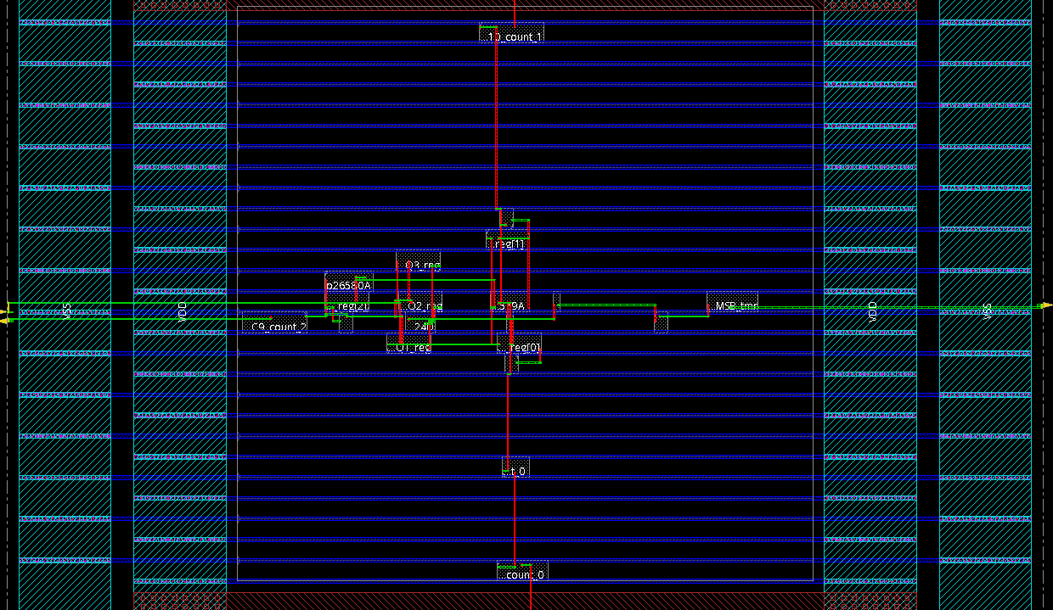
Encounter Implementation
Default placement
Separated by 1 row (1.8 um)
Innovus 16.X has native space group constraints
  Create space group constraint
  Enable space group constraint during placement
  Place design

Slide 30
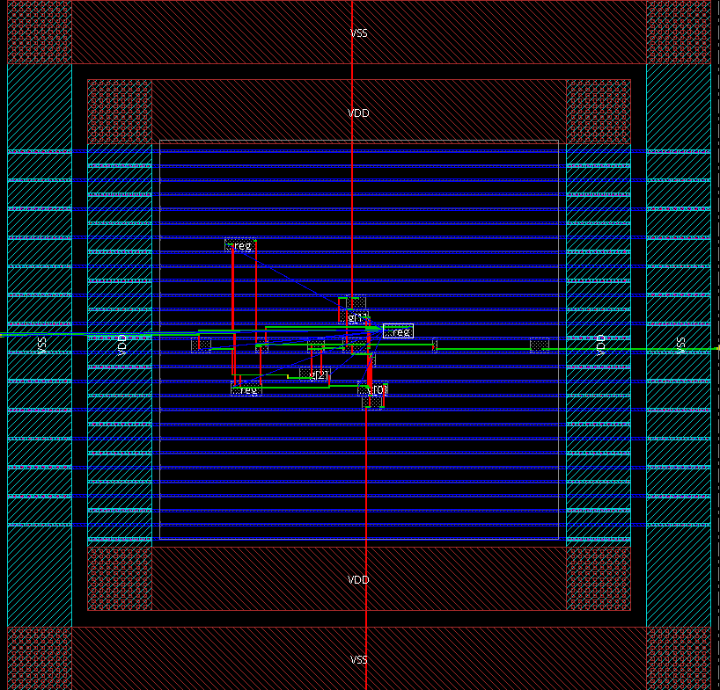
INNOVUS 16.2
Takes horizontal and vertical spacing during place & route
create_inst_space_group tmrSpaceGrp${n} -inst [ dbget [dbget$thPtr.allInsts.cell.isSequential 1 -p2].name ] –spacing_x $reg_spacing –spacing_y $reg_spacing
Triangular placement
9 rows = 16.2uM
15.3 um

Slide 31
SET Mitigation
Din
DFFQ1
Din
delay1
DFF
DFF
D
Q
D
Q
DFFQ2
Voter
Clk
delay2
Clk
DFFQ3
delay3
Data
Simplest solution, Different delay values
SET Latching

Slide 32
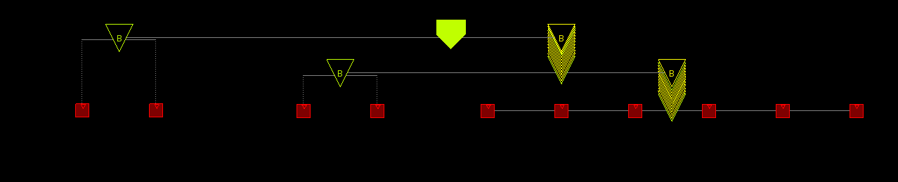
SET Mitigation : Clock Delay Insertion
Din
DFFQ1
Clk
DFFQ2
Voter
set CkDel1 0.50
set CkDel2 1
# Clock Insertion Delays on the TMR flops for SET Mitigation
set_ccopt_property insertion_delay -delay_corner {av_typ_dc} $CkDel1 -pin DFFQ2/CP
set_ccopt_property insertion_delay -delay_corner {av_typ_dc} $CkDel2 -pin DFFQ3/CP
DFFQ3
1st
2nd
3rd
insertion delay of 0.5ns
insertion delay of 1ns

Slide 33
Summary
TID Effects
  Device modeling
  Library Characterization using Liberate
Single Event Effects
  TMR insertion during synthesis
  Specific distance between memory elements during physical design
  SET mitigation with clock delay insertion
  Timing/Placement aware TMR insertion methodology

Slide 34
Acknowledgements
RD53 Collaboration
ASIC group, Fermilab
Cadence Support
!!! THANK YOU FOR YOUR ATTENTION !!!

Slide 35
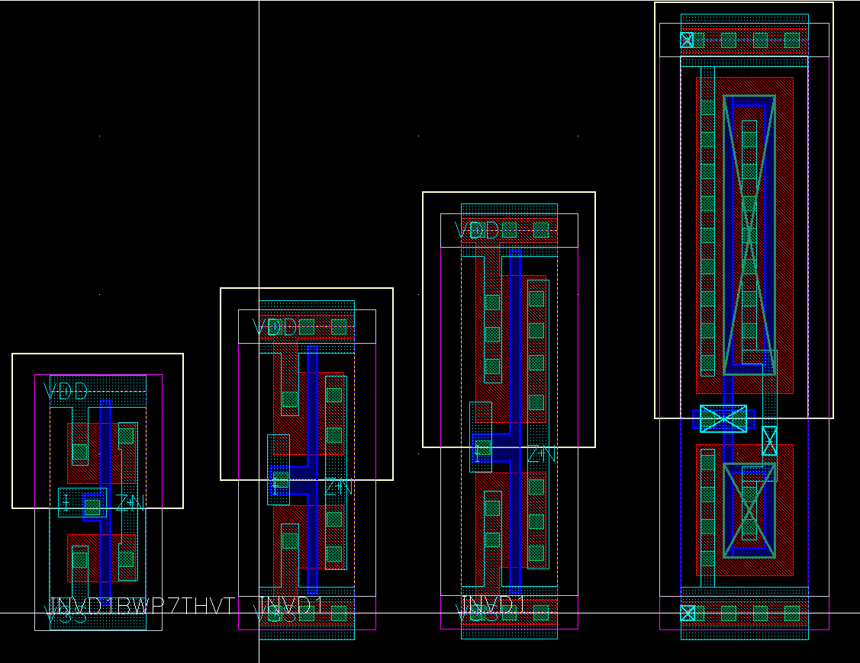
DRAD Test Chip
Objective
  To study the radiation
  effects on digital standard cells
7 Track (7T)
  High Vt (HVT)
9 Track (9T)
  Nominal Vt, High Vt
  Nominal Vt with increased width
12 Track (12T) (Modified)
  Nominal Vt, Low Vt, High Vt
  Nominal Vt with L=130n
18 Track (18T) (Custom)
  Enclosed layout transistors, for LPGBT grp.
FOUNDRY
7T
9T
12T
18T

Slide 36
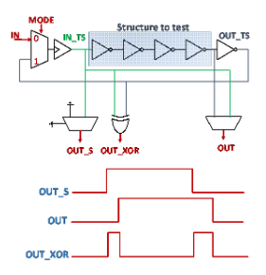
DRAD Test Structures
Standard Cells
  INV, NAND, NOR, XOR, Clock buffers, DFF and latches
Modes of Operation
  Delayed Mode
  Ring Oscillation Mode

Slide 37
DRAD Measurements
Simulation results goes in the same direction as irradiation tests
  Model overestimates the TID damage level
  Models were done for worst case of biasing

Slide 38
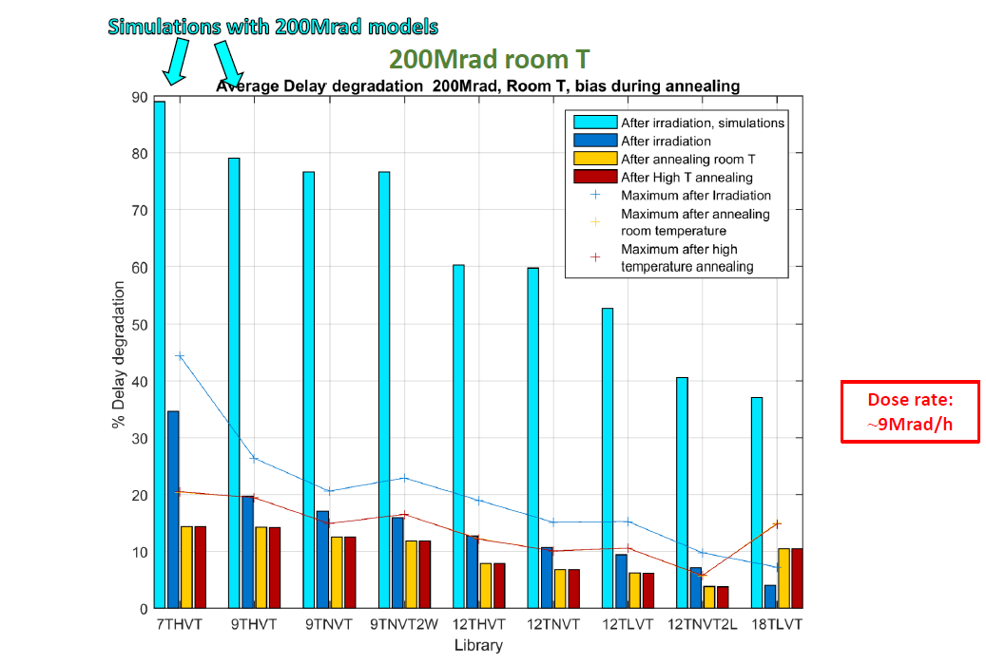
Library Comparison
Luis Miguel Jara Cases et.al, Characterization of Radiation Effects in 65nm Digital Circuits with DRAD Digital Radiation Test Chip, Twepp, 2016

Slide 39
### Spacing distance
set LEN 15
### TMR Module Name Prefix
selectInstByCellName TMR*
### Foreach TMR Module Create Spacing Group & Assign the Corresponding Flops To The Spacing Group
foreach thPtr [dbGet selected] {
create_inst_space_group tmrSpaceGrp${n} -inst [ dbget [dbget $thPtr.allInsts.cell.name DFQD* -p2].name ] -spacing_x $LEN -spacing_y $LEN
}
### Enable Spacing Constraint During Placement
setPlaceMode –place_detail_check_inst_space_group true
### Place Design
place_opt_design
built-in command in Innovus

Slide 40
Back Up: TMR with Correction
reset
Din
DFF
resetMux
Voter = Q1&Q2 + Q2.Q3 + Q3.Q1
DFF
Q1
set
Clk
setMux
DFF
reset, set
Din
Voter
Q
resetMux, setMux
Q2
Q
Clk
SEU
Error
E
DFF
Q3
E
Clk
Error = Q1Q2Q3+ Q1Q2Q3

Slide 41
Back Up: TMR with Correction
TMR Cell
DFF
Q
Q1
Din
DFF
Voter
CLK
Load
DFF
Q2
Q
CLK
Din
DFF
Q3
CLK
Load

