Slide 1
Digital Analog Design:
A Digital Centric Approach to Mixed Signal Design
Byong Chan Lim and Mark Horowitz
bclim@stanford.edu; horowitz@ee.stanford.edu

Slide 2
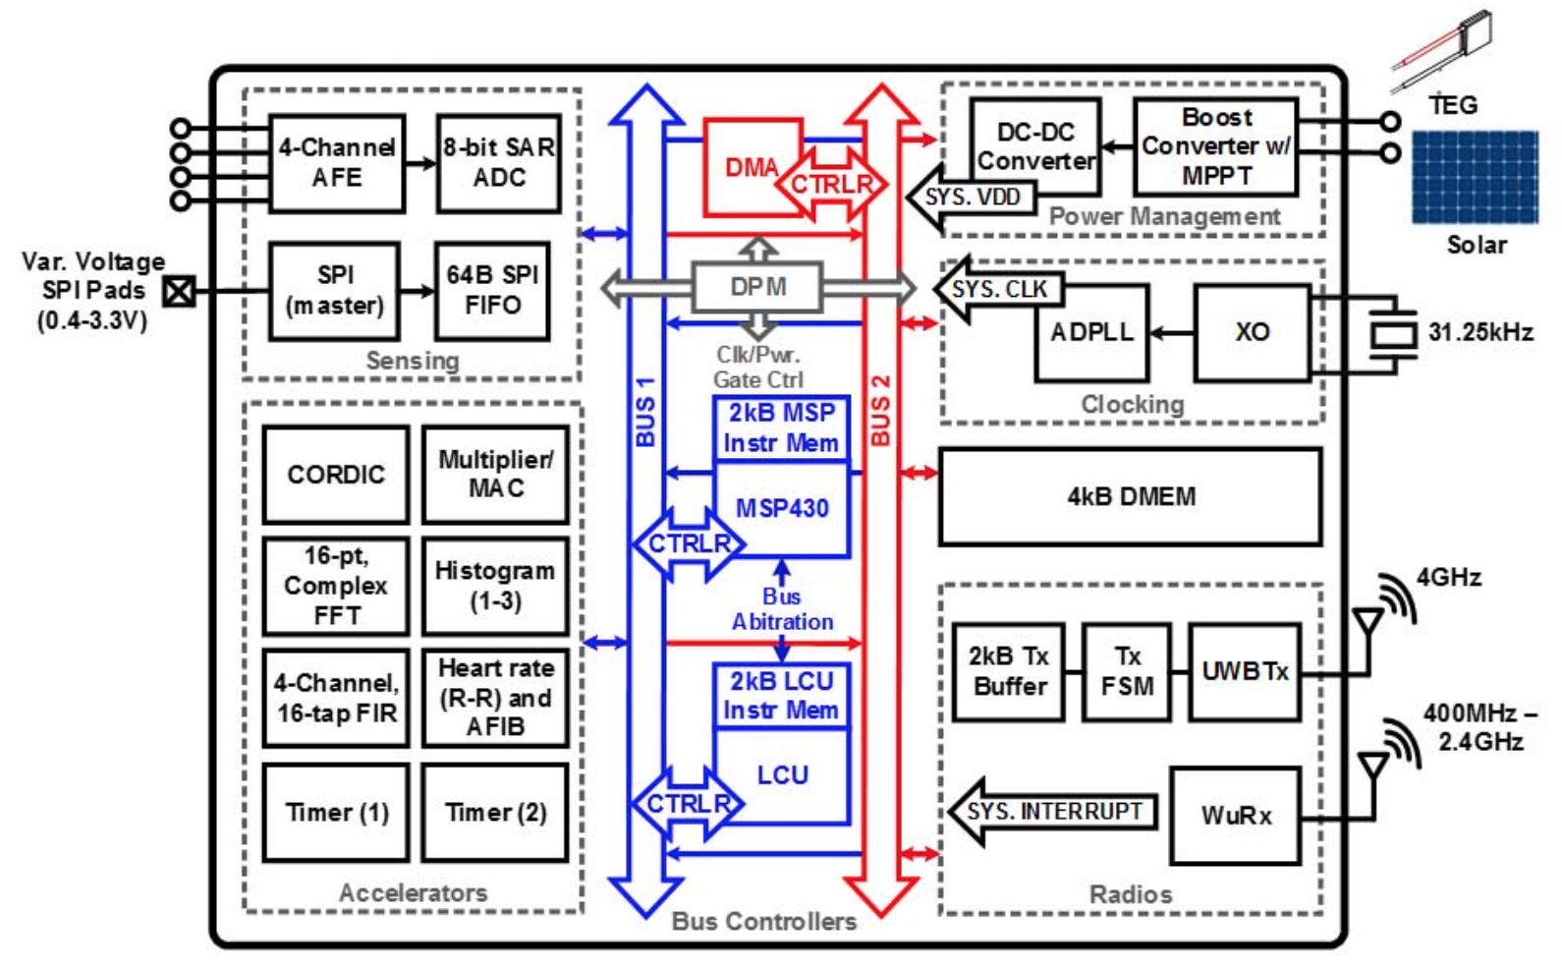
MS-SoC Verification
Regression test at chip level is essential
  It needs faster AMS verification environment
Self-powered IoT SoC
A. Klinefelter, et al., ISSCC 2015, pp. 384

Slide 3
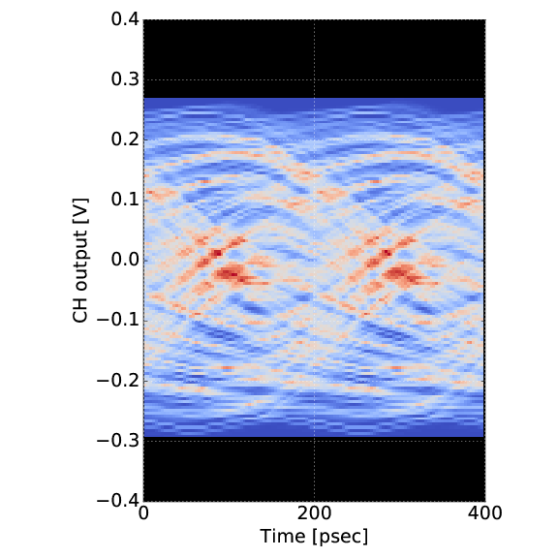
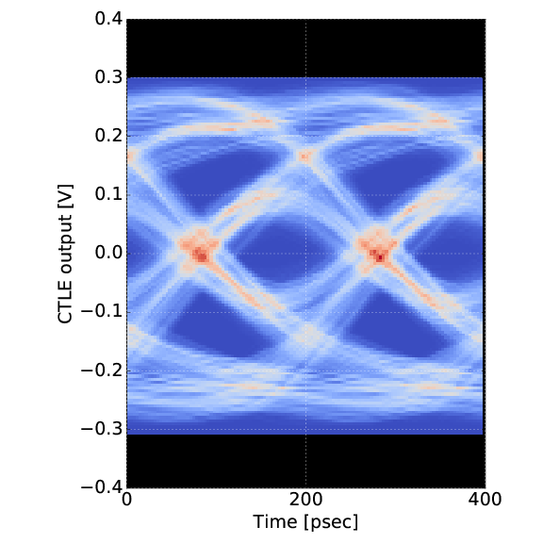
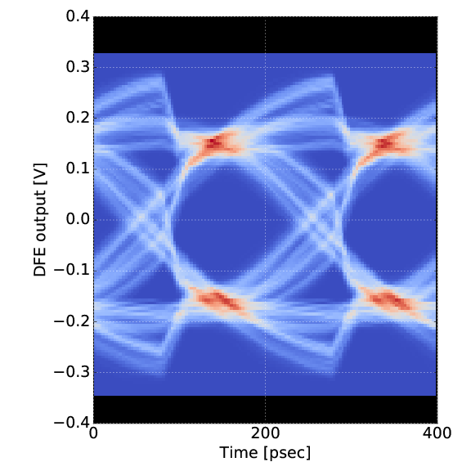
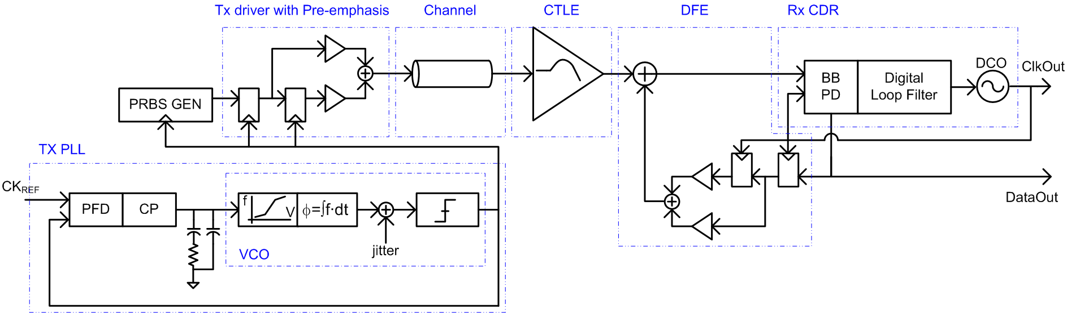
Fast, Accurate Analog Models
We demonstrated on several mixed-signal IPs and chips
<Complete wireline link running at 5 Gbps. CPU time is ~ 10 sec for collecting 50k symbols).>

Slide 4
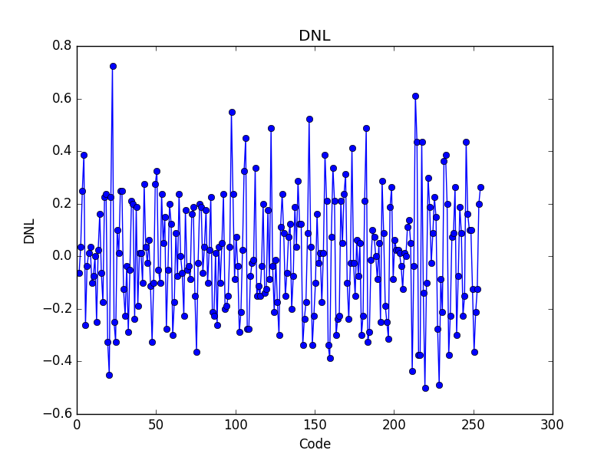
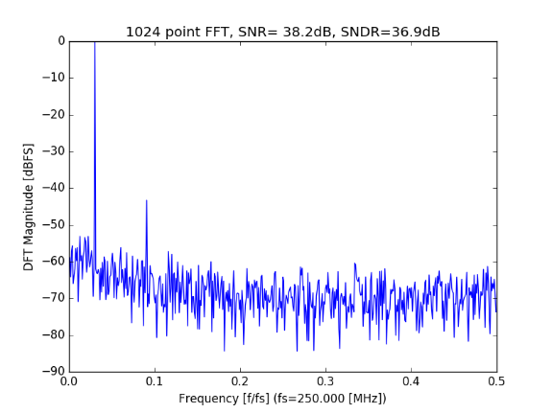
Fast, Accurate Analog Models
Circuit impairments can be easily handled
  Nonlinearity, noise, jitter, mismatches, etc.
Finite BW, nonlinear switch resistance,
thermal noise, pedestal error,
clock jitter effect, sampling aperture
Finite GBW, input offset,
gain compression, thermal noise
Finite regeneration time, input offset, sampling aperture, thermal noise
Vin
Sample-Hold
C-DAC
Pre-amplifier
Regenerative
Latch
Capacitance mismatch,
finite switching time
Data capture & timing logic
Dout
Finite delay
<8-bit SAR-ADC: 8100x speed-up compared with Spectre APS).>

Slide 5
Model Validation
Have developed a way to formally check equivalence
  Between functional model and implementation
Prevents many bugs slipping in mostly because of trivial errors
  Mislabeled pins, inverted polarity, missing connections, etc.
module PI (input CLKa, CLKb,
input [3:0] wgt, output reg CLKo);
...
always @(CLKa or CLKb)
if (CLKa ^ CLKb) t1 = $realtime;
else begin
t2 = $realtime;
t_diff = t2-t1;
tdly = Tdelay + (1-weight)*t_diff;
CLKo = #(tdly) CLKa;
t1=t2;
end
endmodule

Slide 6
Digital Analog Design
(how we accomplished this)
Don’t just use more digital gates
Make analog design more like digital
  Better encapsulation of function
  Methods for system validation
  Automatic electrical rules checking
  Better reuse of components
Reduce time to port design
  Fewer “stupid” mistakes
Never allow the same error to occur twice

Slide 7
Provide Analog Equivalents For:
Std.Cells
Abstraction
Functional Model
Equivalence Checking

Slide 8
Analog Standard Cell ?
Building analog standard cell library is too costly
  Many circuit topologies/technologies
  Different specification requirements for different applications
Building analog circuit constructors is risky
  Circuit designers do come up with clever solutions
  These systems are basically optimizers
    Require explicit circuit constraints and opt. objective
Turns out we are thinking about the problem backwards
  We don’t really need the implementation
Notes:
We had is a question whether it’s possible to build analog standard cell libraries like digital standard cells. It might be possible, but it doesn’t make sense economically because building the cells is too expensive. There are too many circuit topologies and the specification requirements are different for different applications. And, it is also true that analog circuit synthesis is too risky because there is no generic electrical rule checks.
But, we still need at least analog functional models for system-level validation.

Slide 9
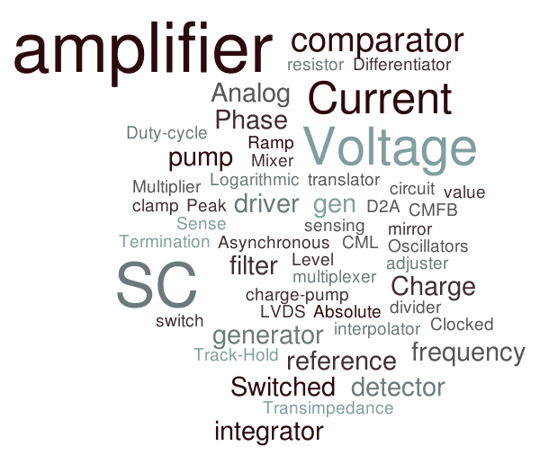
Types of Analog Circuits
There are not many circuit classes in terms of functionality
Notes:
There are tons of analog circuits in the world, but in terms of functionality there are not many circuit classes. For example, there are audio amplifier, low noise amplifier, folded cascade amplifier, one or two stage amplifier. But, the core function of such amplifiers is the same; amplification of a signal. So, if we classify analog circuits in terms of functionality, # of circuits will be less than one or two hundreds which is kind of manageable number.

Slide 10
Analog Standard Models
Think of it as a template (constructor) lib for analog cells
  Flexible in both level of detail, and specific pins
Designers use this library to generate
  Models for initial high-level system exploration
  Test collateral for validation of their circuit implementations
  Accurate function models of their implementation
    The model parameters are extracted from circuit validation
Layout is done manually or through another tool
  See B. Murmann’s talk (or BAG)
Notes:
So, our goal is to provide a library of analog standard models instead of writing models for different circuits. So, the models are available at the very beginning design stage such that it can be used from architecture exploration to chip-level validation. Each of the standard models will have the following characteristics.
First, it is generic for reusability. So, a single model can generate multiple models for different circuit topologies and applications.
Second, the complexity of the model can be configured by users, such that a simple model can be used for functional checks and a more complicated model can be used for performance evaluation.
Lastly, model parameters can be extracted and annotated from circuit netlist to the generated model automatically.

Slide 11
Types of Checks
Test bench:
  Contains stimuli generation and results analysis
  Create for each major piece of the design
  Gets run when you are “checking out” that module
Assertions
  Assumptions made in circuit design (and test bench)
    Common-mode voltage, input range, etc.
  Must be monitored each time the cell is used
    Prevent the circuit from operating outside the constraints

Slide 12
Turns What We Archive Inside Out
Currently we archive
  Circuit
  Layout
In this system we archive:
  Functional model template for a class of circuits
  Test templates for a class of circuits
The validation information is both more valuable and stable!
Notes:
To achieve the goals, we have built a framework to generate analog functional models from model and test templates.
Using the framework, we’d like to provide a library of the standard models which can be configured by users so that models with different pin configuration and different properties can be generated from a single model.

Slide 13
Provide Analog Equivalents For:
Std.Cells
Abstraction
Functional Model
Equivalence Checking

Slide 14
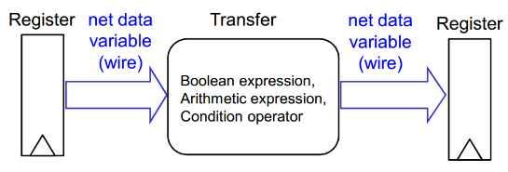
Circuit Abstraction
(the magic behind the template lib)
Abstraction is key in creating/checking functional models
Boolean and synchronous nature of digital systems enable
  RTL description, static timing analysis
  Formal verification

Slide 15
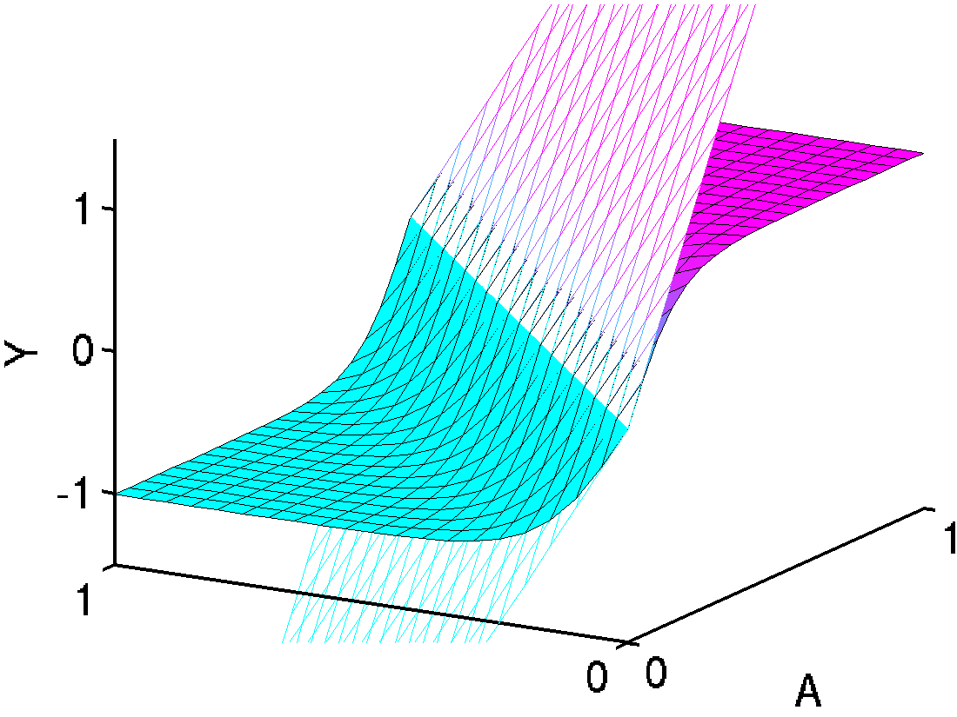
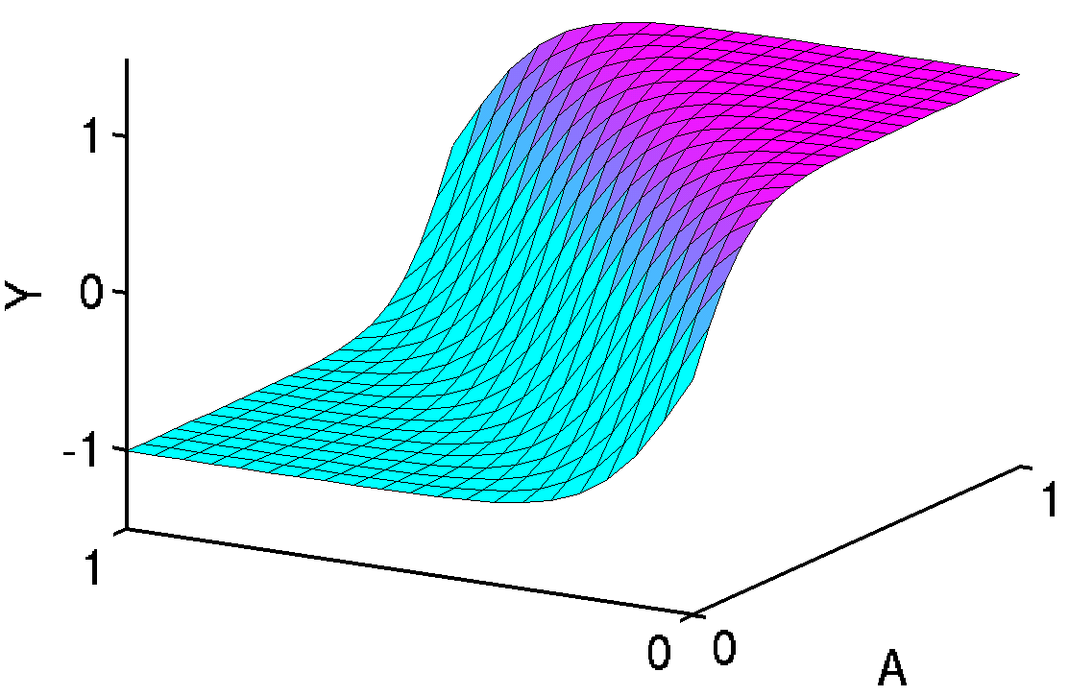
The Analog Abstraction
Key Observation: Analog response surface is smooth
Operating Point (OP)
Y
B
A

Slide 16
The Analog Abstraction
Analog circuit analysis
  Model linear or weakly nonlinear (dynamic) systems
  Analyze circuit’s deviations from the linear model
We use a “(Piecewise) Linear System Model”
  As the formal analog model
    (Check all your specs)

Slide 17
Real Circuits are not Linear
But digital circuits are not Boolean neither
Model validation is to capture designer’s intent
  The intent of analog circuits is to operate linearly
Subtle analog issues are verified through circuit simulation
Analog circuits that appear strongly nonlinear
  Linearization through domain translation
  Model as coupled linear systems

Slide 18
Domain Translation
Analog abstraction is revealed in different variable domains
  Phase, delay, duty cycle, and etc.
Linear
Non-linear
<Domain translation example [Kim07]>

Slide 19
Tunable Circuit
Some parameters of the system are tuned by control inputs
  e.g., gain controlled by bias current input
V_{OUT} = f(I_{BIAS}) × V_{IN}
V_{IN}
V_{OUT}
α=f(I_{BIAS})
I_{BIAS}
<Variable Gain Amplifier>

Slide 20
Coupled Linear System
Tuned parameters are static or slowly time varying
Decouple the tunable system into multiple linear systems
V_{IN}
V_{OUT}
I_{BIAS}
α
α_{IBIAS=C}
β
<between Input/Output>
<between Control input/Tuned parameter>

Slide 21
Provide Analog Equivalents For:
Std.Cells
Abstraction
Functional Model
Equivalence Checking

Slide 22
Two Questions in Analog Modeling
How do you express a continuous-time signal?
How do you model system’s dynamic behavior?

Slide 23
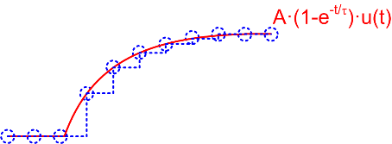

Previous Works – Oversampling
Represents an analog signal as piecewise constant waveform
  a.k.a. “real number modeling”
A circuit is modeled as a linear dynamic system
  It is implemented with IIR/FIR filters with high-speed ticks
Simulation speed vs. accuracy trade-off issue
  e.g. modeling sampling clock jitter effect
<Sampled data representation>

Slide 24
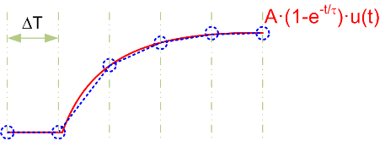
Previous Works – PWL Approximation (1/2)
Represents an analog signal with offset and slope at uniform intervals
  Interpolate values between samples
Dynamic behavior is represented as a sum of complex exponentials to a ramp input for linear dynamic systems [Park11][Liao14]
typedef struct {
real a; // signal offset
real b; // signal slope
real t0; // time offset
} pwl;
<PWL signal representation>
<PWL waveform datatype in SystemVerilog>

Slide 25
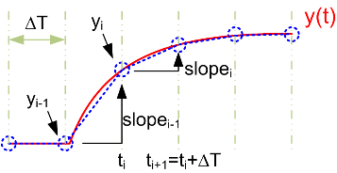
Previous Works – PWL Approximation (2/2)
Updating a PWL segment does not involve time integration
But, choosing proper ΔT for given e_{tol} is time consuming
  Depends on systems being modeled, input slope, etc
Also, this regular evaluation could be redundant
  e.g. a signal is not steep

Slide 26
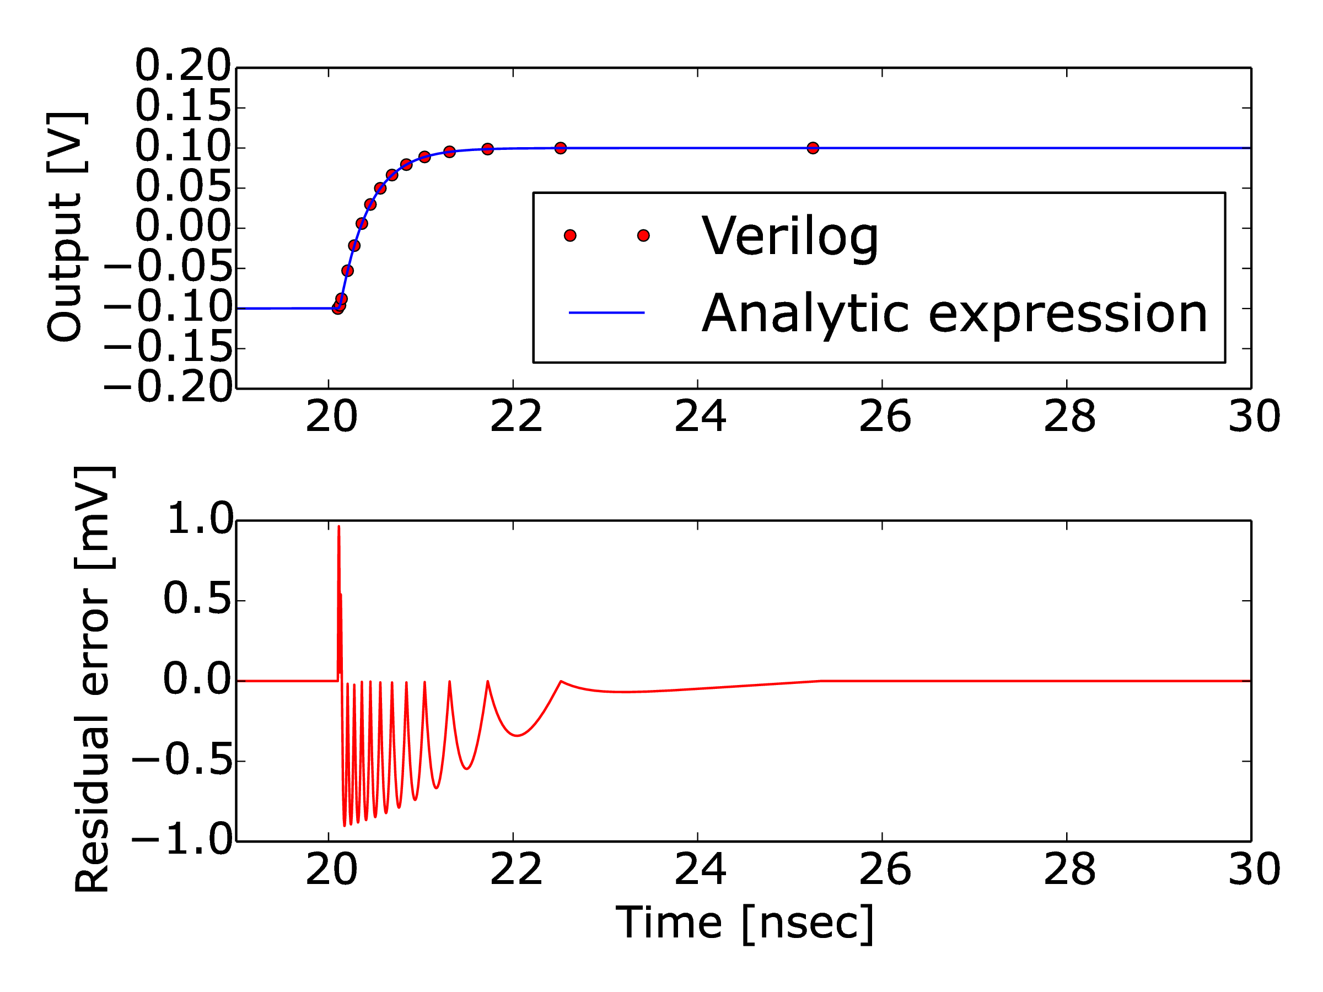
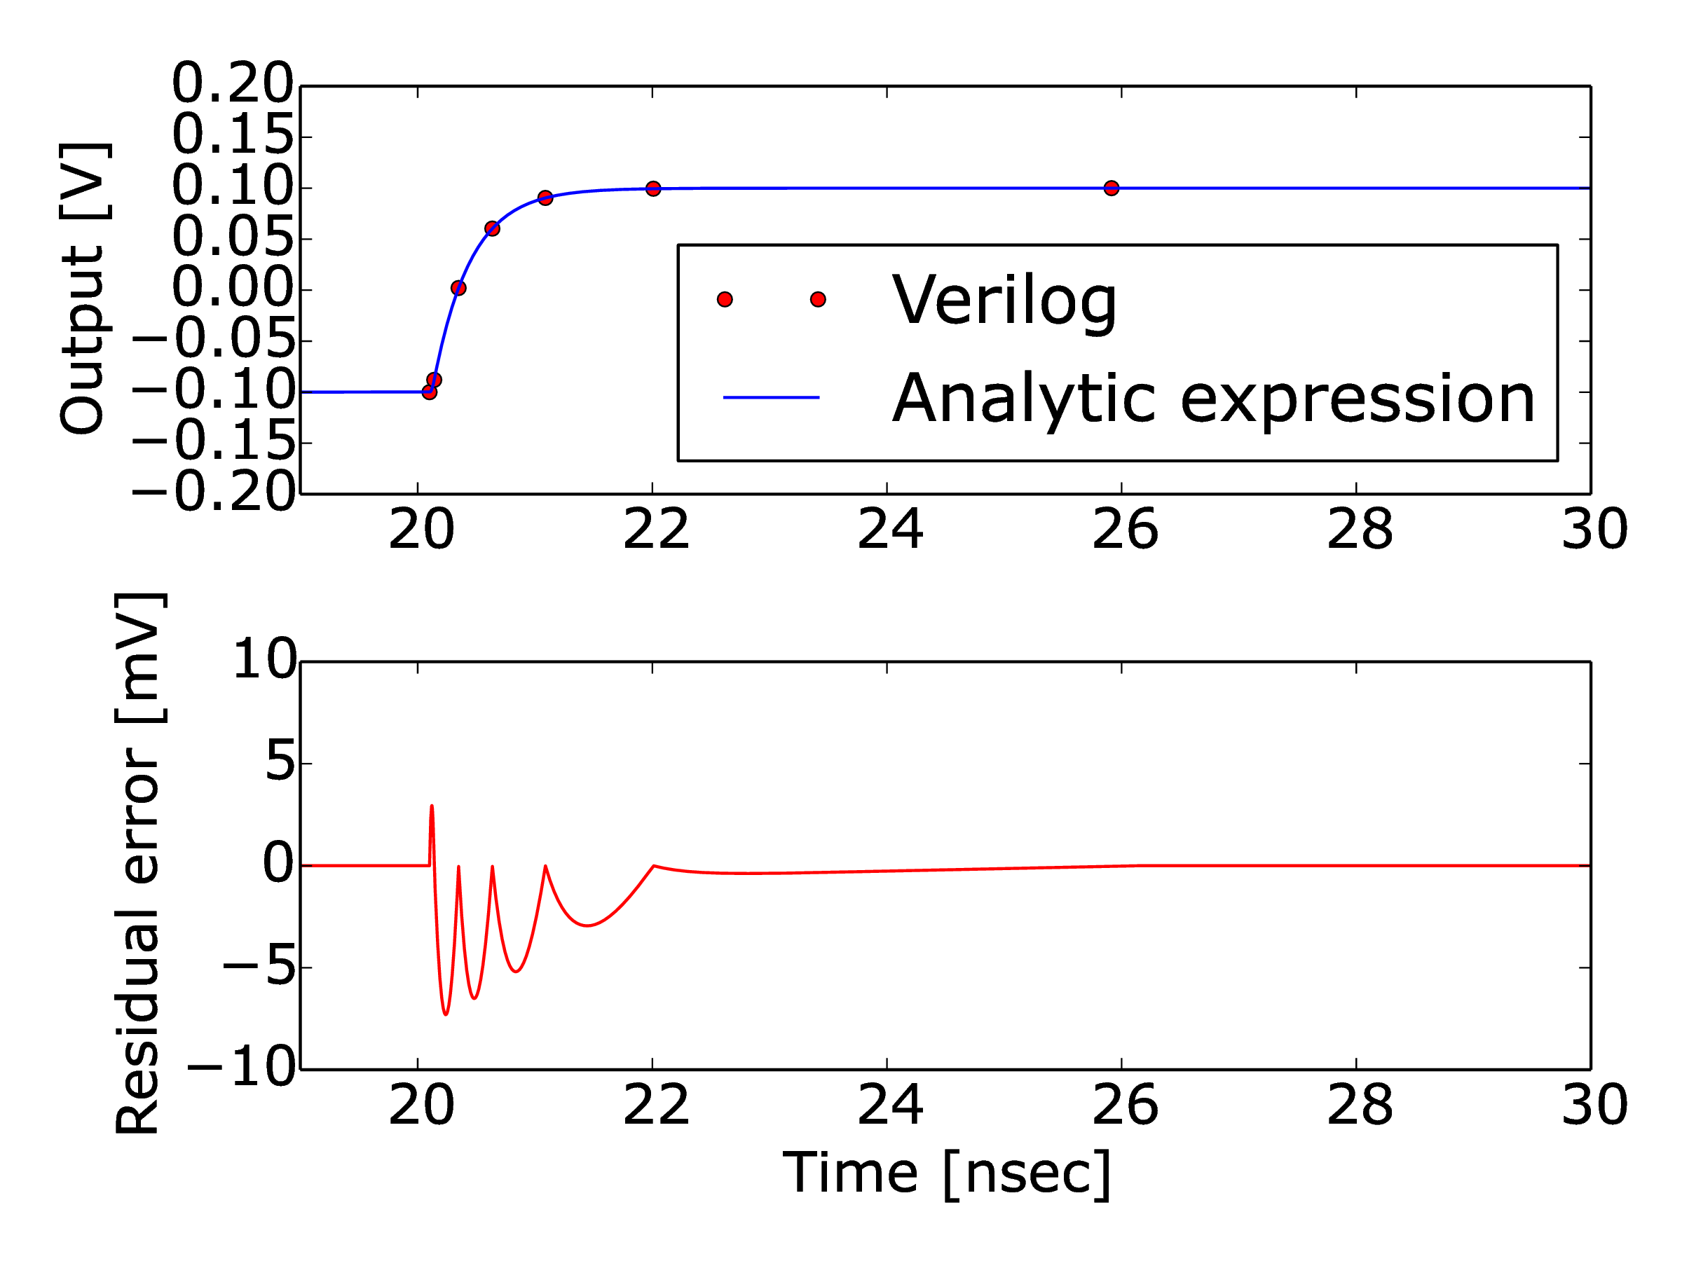
Filter Model – Single-Pole Filter
One can trade accuracy for speed with no additional cost
  e.g.) events marked with filled circles below
<Ramp response of a single-pole filter model with e_{tol} = 1 mV (left) and 10 mV (right)>

Slide 27
Provide Analog Equivalents For:
Std.Cells
Abstraction
Functional Model
Equivalence Checking

Slide 28
Analog Equivalence Checking
Map circuit/Verilog responses to abstract models (transfer matrix)
  e.g., linear model*
Compare two extracted matrices for equivalence checking
Y: Outputs/Properties
x: Inputs
G: Gain matrix
Y=Gx
* It can be generalized to ”linear regression model” to include higher-order terms

Slide 29
Functional Coverage
Check coupled systems
  Linear system from analog inputs to analog outputs
  Linear system from (control) inputs to controlled parameters
Dynamics are checked by observing TF parameters
  Poles, zeros
But, no universal checks for analog circuits
  Need archived test (benches) for each analog cell type

Slide 30
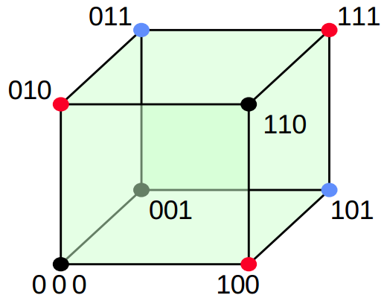
Analog State Exploration
Analog surface is smooth
Smaller # of samples are needed for analog models
  e.g., Superposition holds for a completely linear system
<Digital response>
<Analog response>

Slide 31
Port Classification
Ports are I/O of a linear system model
  c.f., pins of a DUT
Data type & intent classify port type
 | Port Intent | Analog | Digital
Port Data type
Real |  | Analog
Logic |  | Quantized Analog | True Digital

Slide 32
Analog Port – Example
 | Intent | Analog | Digital
Datatype
Real |  | Analog
Logic |  | Quantized Analog | True Digital
Analog Inputs
Analog Outputs
Pseudo Output
Analog Control Input

Slide 33
Quantized Analog Port – Example
 | Intent | Analog | Digital
Datatype
Real |  | Analog
Logic |  | Quantized Analog | True Digital
Quantized Analog Inputs
Delay(CLKo-CLKa) = [1-a_{k}·wgt_{k})]·Delay(CLKb-CLKa) + c

Slide 34
True Digital Port – Example
 | Intent | Analog | Digital
Datatype
Real |  | Analog
Logic |  | Quantized Analog | True Digital
{calib_en, /pwrdn} creates 4(2²) linear systems
: Linear system’s analog ports

Slide 35
Test Vector Generation
Generate test vectors of (quantized) analog ports
  Ideally, N+1 test vectors for N inputs
Oversample analog vectors for checking linearity assumption
  Wrong signal domain, port labeling, invalid input range, etc.
Enumerate 2^{k} linear circuits by true digital ports
Apply test vectors
Generate analog vectors
Linear circuit I
Test vectors of
analog + quantized
analog ports
Linear circuit 2^{N}

Slide 36
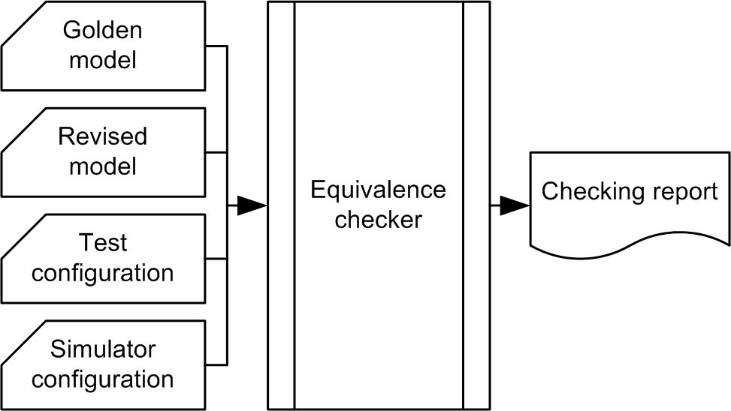
mProbo: AMS Equivalence Checker
We have developed an AMS equivalence checker, mPobo
Supported models
  Circuit netlist, (System)Verilog, Verilog-AMS
Test configuration file
  Checker control option
  Port specification
  Test bench
Simulator configuration file
  Simulator option
<Checker data preparation>

Slide 37
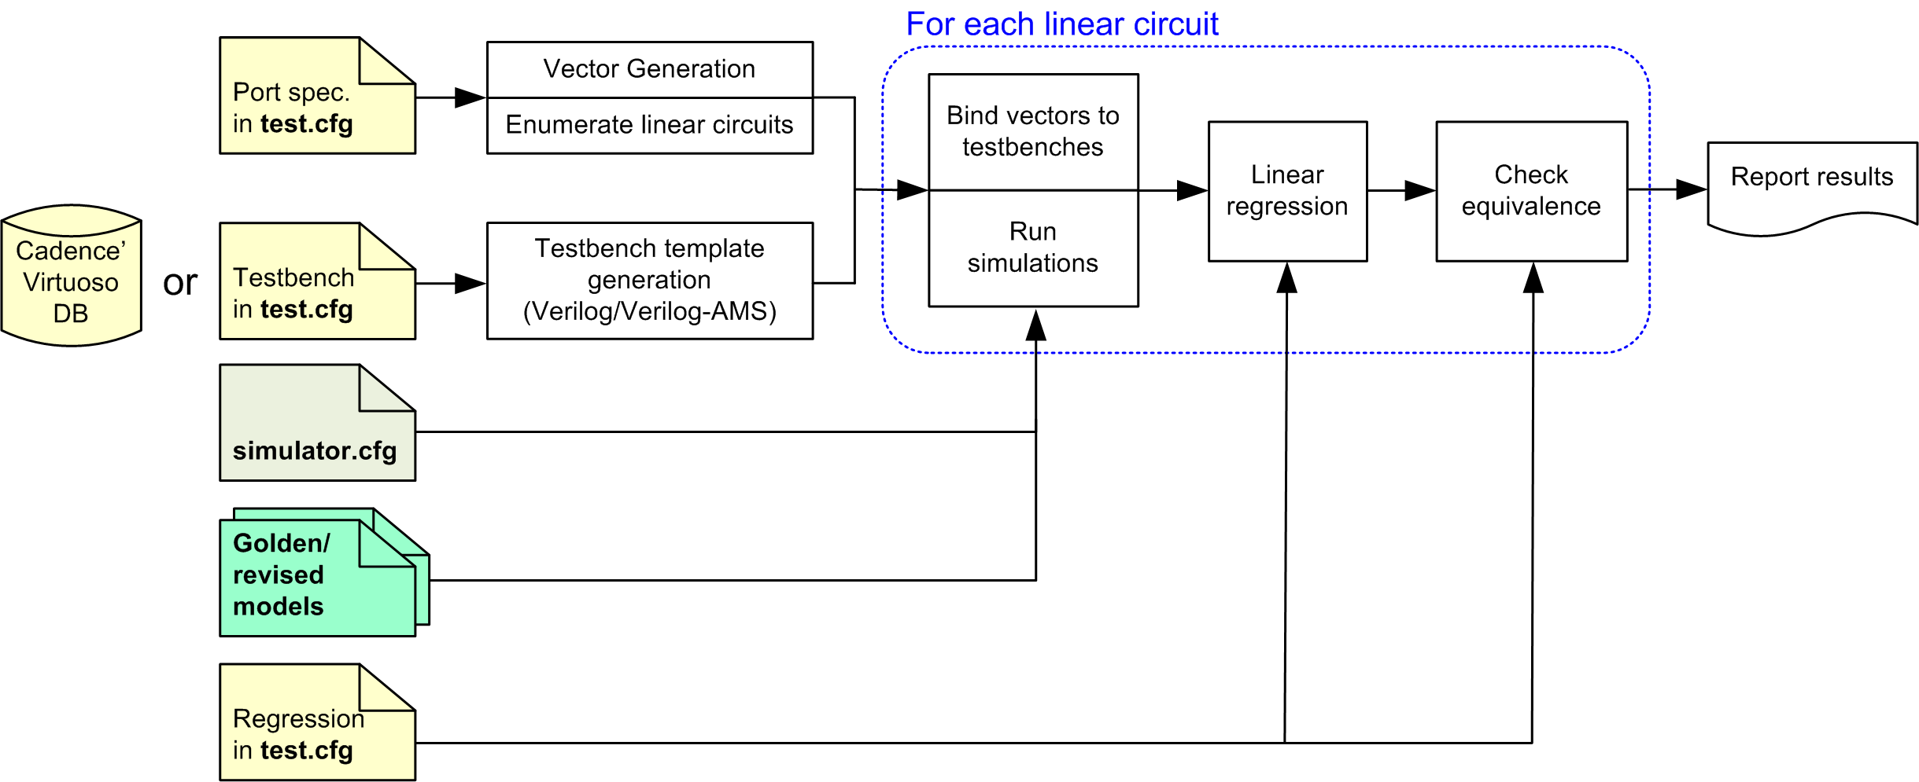
Checker Data Flow

Slide 38
Conclusion
Full-chip validation of mixed-signal systems:
  Needs fast, high-fidelity analog functional models
Piecewise linear model
  Can serve as a formal model of analog circuits
The linear abstraction guides writing a concise analog models
  Captures both linear and nonlinear behaviors
The linear model also helps in checking models
  Validate model parameters are the same

Slide 39
References
[Cottrell90] Event-driven behavioral simulation of analogue transfer functions, EDAC, Mar. 1990.
[Kim07] Variable Domain Transformation for Linear PAC analysis of Mixed-Signal Systems, ICCAD, Nov., 2007.
[Horowitz10] Fortifying Analog Models with Equivalence Checking and Coverage Analysis, DAC, June, 2010.
[Lim10] An efficient test vector generation for checking analog/mixed-signal functional models, DAC, June, 2010.
[Park11] Fast and accurate event-driven simulation of mixed-signal systems with data supplementation, CICC, Sept. 2011.
[Jang12] True Event-Driven Simulation of Analog/Mixed-Signal Behaviors in SystemVerilog: A Decision-Feedback Equalizing (DFE) Receiver Example, CICC, Sept. 2012.
[Lim12] Model Validation of Mixed-Signal Systems, PhD thesis, Stanford university, 2012.
[Liao14] Verilog Piecewise Linear Behavioral Modeling for Mixed-Signal Validation, PhD thesis, Stanford university, 2014.
[Nothaft14] Pragma-based floating-to-fixed point conversion for the emulation of analog behavioral models, ICCAD, Nov., 2014.
[Lim 15] Digital Analog Design: Enabling Mixed-Signal System Validation,” IEEE design and test magazine, Feb. 2015.

Slide 40
Backup

Slide 41
What Else ?
Process variation analysis with analog functional models
  Process corner analysis
  Device mismatch analysis
  Assertion checks
ATPG for analog fault modeling

Slide 42
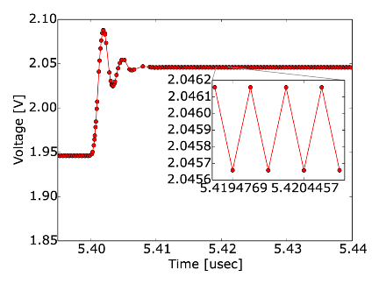
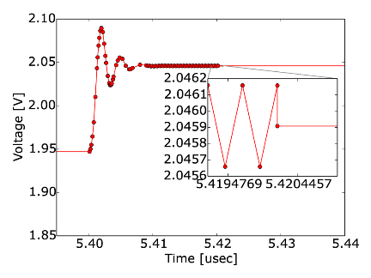
Limit Cycle in Analog Feedback Loop
A gatekeeper on feedback path prevents the possible limit cycle oscillations
  Otherwise, it slows down simulation
<Transient response of a unity-gain amplifier: with/without limit cycle oscillations>

Slide 43
Model Generators
We implement a few of model generators in SystemVerilog
Analog filter generator
  Take a s-domain transfer function and generate the corresponding time-domain model
Look-up table model generator from circuit simulation results
  This is useful for modeling nonlinearity
In addition, many primitive models are also available

Slide 44
Simulation-Based Checker
Responses are sampled through simulations
Testbench in “test configuration” is translated in Verilog
  Verilog-AMS for either circuit netlist, Verilog-AMS model
  SystemVerilog for (System)Verilog
  Otherwise, the testbench is prone to errors
This means that a testbench should be structural
  So, stimulus drivers, measurements, domain translation needs Verilog/-AMS module libraries
  We support primitive libraries for PWC & PWL models

Slide 45
Is Writing Testbenches Bothersome ?
Building test libraries/infrastructure needs some efforts
Fortunately, the number of primitive analog functions is not many
They are reusable

Slide 46
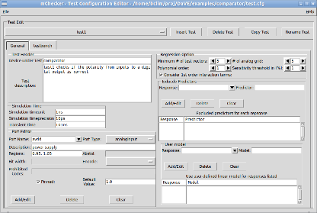
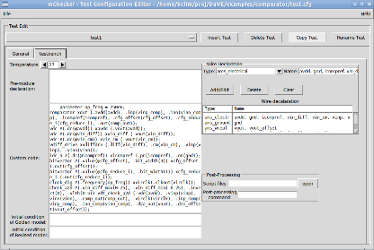
Equivalence Checker – GUI Environment
Test/simulator configuration editor,
Testbench editor in Cadence’ virtuoso
<Test configuration GUI editor>

Slide 47
Future Plan
Automatic testbench generation
  Extracts transfer functions (gain, poles, zeros) from port specification with variable domain information
Calibration of piecewise segmentation of linear models
  For given analog input ranges, creating sub-regions where each region forms a linear model
  Use the information for checking equivalence for each region

Slide 48
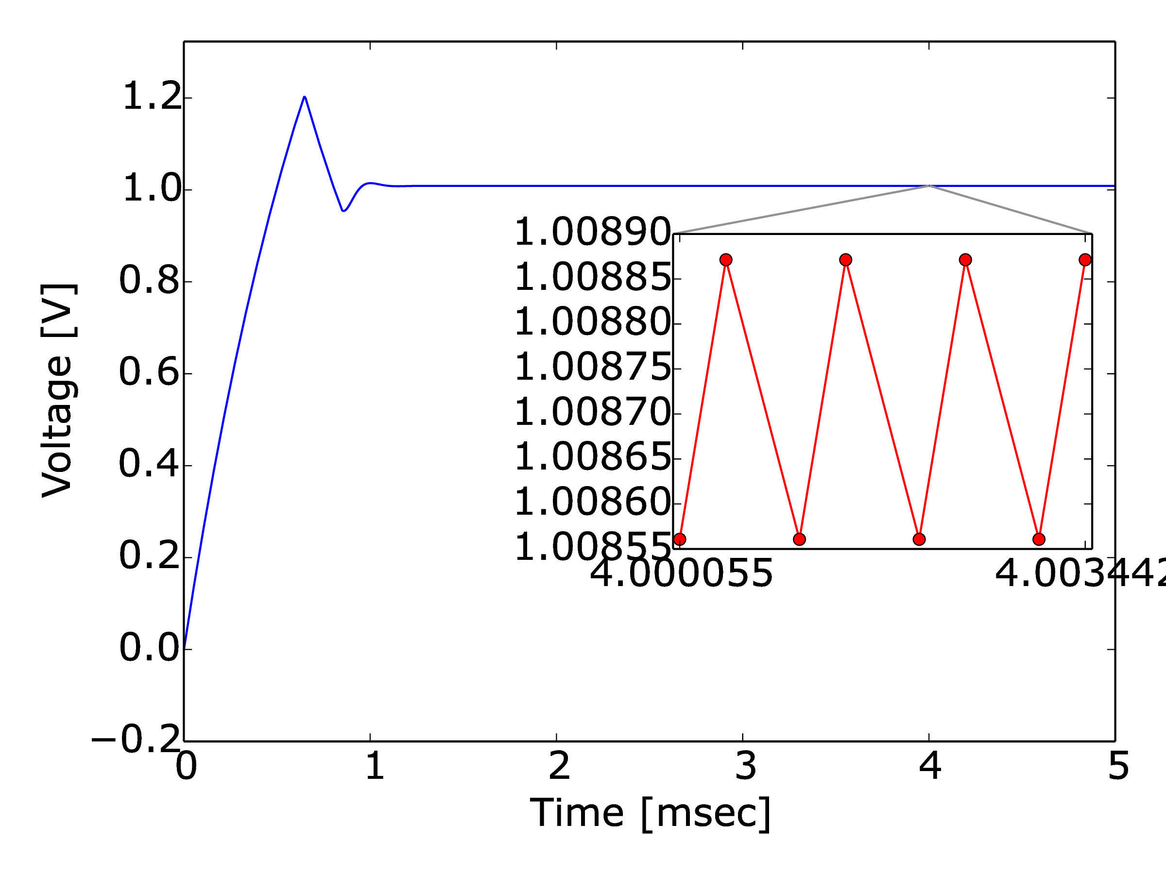
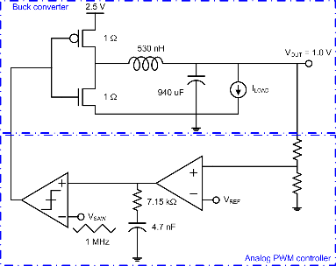
Example – Buck Converter
Buck converter with analog PWM feedback control
  4.2 sec runtime for 100 msec transient simulation
Switches configure two linear systems in the converter core
<Transient simulation with I_{LOAD} = 100 mA>

Slide 49
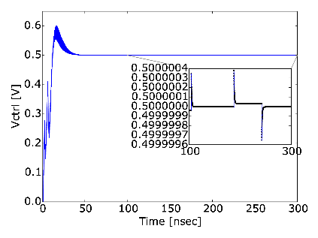
Example – Phase-Locked Loop
A charge-pump PLL with 2nd order passive loop filter
  Reference clock frequency: 2.1 GHz
  Feedback divider ratio: 1
Filter models in this PLL
  Phase-domain VCO model
  Passive loop filter
Runtime is 1.3 sec for
10 usec transient simulation
<Loop filter voltage>

Slide 50
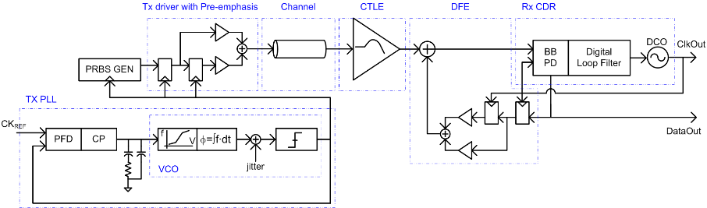
Example – High-Speed Link
SERDES running at 5 Gbps
  Random jitter (1 psec rms) is added to VCO output
<SERDES example>

Slide 51
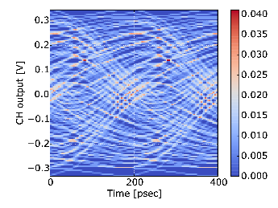
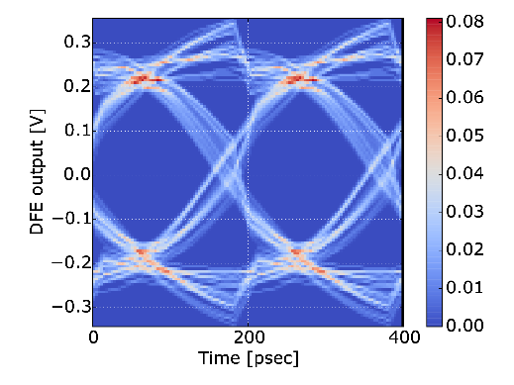
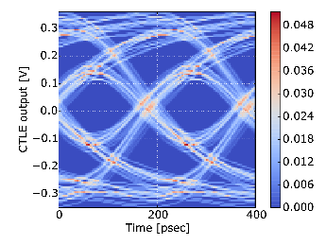
Example – High-Speed Link
Exercise 50k symbols running at 5 Gbps: runtime is ~12.4 sec
<Eye diagram: Channel output, CTLE output, and DFE output>

Slide 52
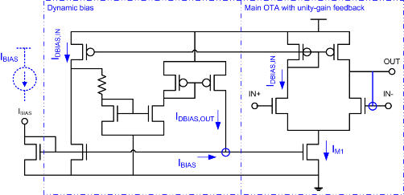
Example – Pseudo Class-AB OTA
It exhibits strongly nonlinear behavior
  Bias current dynamically changes when the input rises
Two piecewise linear systems are modeled
  Main OTA and dynamic bias
The circuit is formed w/
two external feedback loops
<Pseudo class-AB OTA>

Slide 53
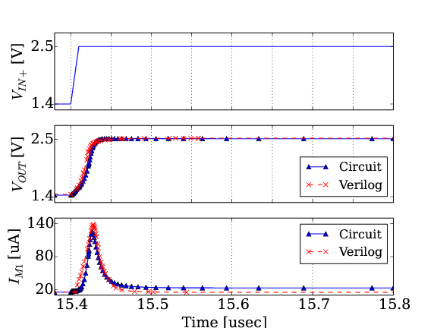
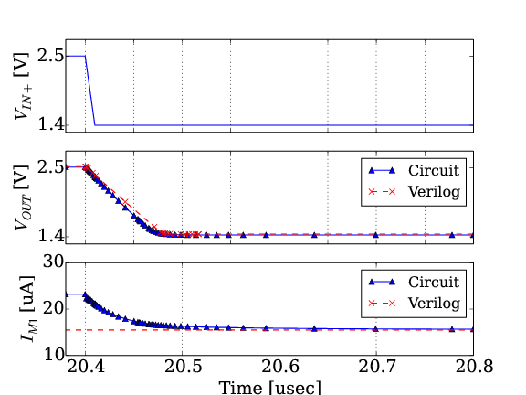
Example – Pseudo Class-AB OTA
System’s parameters vary with inputs’ operating points
  It still shows 14x speed improvement
<Transient waveforms of the pseudo class-AB OTA: circuit vs. Verilog>

Slide 54
Extracting Models From Schematics
All models are approximations
  Need to include the critical factors for accuracy
  But need to leave out many details that are not critical
Is very hard
  Unless you know a lot about the circuit function
    Which domain is the circuit smooth?
  And the prior errors with this circuit
Most extracted models are not good
  Essentially fast simulators

Slide 55
Template Based Models
If you know the function of the circuit
  It is easy to extract its parameters
If you know the previous errors
  Can ensure that you model those effects
Create templates for circuit classes
  Part of the circuitbook framework
  These can automatically extract models from schematics
    Actually just extracting the model parameters

